Slide 2
Update on subclinical thyroid dysfunction
Department of Diabetes, Endocrinology, and Hematology, Dokkyo Medical University Saitama Medical Center, Saitama 343-8555, Japan JUN 2022
dr Koshi Hashimoto

Slide 3
With progress in laboratory medicine, thyroid function tests (TFTs) have become part of routine clinical work.
Physicians may often encounter subtle abnormalities in TFTs for serum thyroid-stimulating hormone (TSH) levels.
A significantly more common finding, however, is serum TSH levels outside of the reference range, despite normal thyroid hormone levels.

Slide 4
This is referred to as subclinical thyroid dysfunction, and includes subclinical hypothyroidism (SCH) and subclinical hyperthyroidism (SCHyper).
Despite several guidelines published for these diseases, there are still controversies regarding their clinical significance and appropriate management.

Slide 5
Subclinical Hypothyroidism (SCH):
SCH is defined as a disease that, despite normal serum free T4 (FT4) levels, has serum TSH levels that are higher than the reference range thus it is a biochemically-defined disease.
It is categorized into two groups based on serum TSH levels:
mild (Grade 1) : Serum TSH levels in the mild (Grade 1) type are higher than the upper limit (4.5 mIU/L in most cases) and below 10 mIU/L.
severe (Grade 2): Serum TSH levels are higher than 10 mIU/L .

Slide 6
Approximately 75% of all SCH patients belong to the mild (Grade 1) type .
SCH is found in 4–10% of the general population and is as high as 7–26% of the elder population .
According to the Colorado study of approximately 26,000 subjects in the US, the prevalence of SCH was 9.5% in the general population and was increased to 21% and 16% in females and male subjects, respectively, who were 74 years old or older.
In Japan, a Clinical Guidelines Committee of the Japan Thyroid Association reported that SCH is found in 3.3–10.2% of the general population.

Slide 7
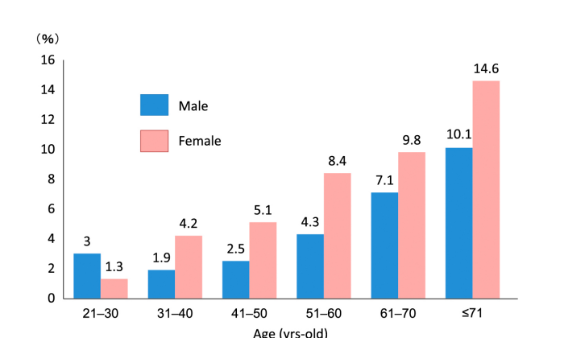

Slide 8
Sixty to eighty percent of the SCH patients are found in patients with Hashimoto’s thyroiditis and those who have thyroid autoantibodies such as anti-thyroid peroxidase (TPO) and anti-thyroglobulin (Tg) antibodies positive.
Spontaneous remission and persistent unchanged status of SCH are frequently found in mild type SCH patients.

Slide 9
Serum TSH levels can be restored to normal within 2 years in patients whose levels are below 7 mIU/L, who are anti-TPO antibody negative, and whose thyroid ultrasonic findings are normal.
On the other hand, female patients with severe type SCH, whose serum TSH levels are above 10 mIU/L, and who are anti-TPO anti‐ body positive are likely to progress to overt hypothyroidism .

Slide 10
Diagnosis of SCH and TSH harmonization :
most guidelines recommended employing the upper limit of serum TSH levels in each facility for diagnosis of SCH.
Since the upper limits of serum TSH levels were generally 4.0–5.0 mIU/L in most facilities, the guidelines from the Endocrine Society, the American Thyroid Association (ATA), and the American Association of Clinical Endocrinologists (AACE) defined the upper limit of serum TSH levels as 4.5 mIU/L for the clinical practice of SCH diagnosis .
Thus, the marker of 4.5 mIU/L has also been employed in Japan as the upper limit of serum TSH levels for diagnosis of SCH.

Slide 11
Pitfalls when evaluating serum TSH levels :
Prior to confirming a diagnosis of SCH, serum FT4 and TSH levels should be reassessed 1–3 months later in order to rule out a transient increase of serum TSH levels due to excess intake of iodine, etc.
Moreover, some factors and pathological conditions may affect serum TSH levels:
1. Obesity: Leptin secretion is increased in adipose tissue from obese patients, thereby promoting TRH (thyrotropin-releasing hormone) secretion from the hypothalamus, which may result in increased serum TSH levels .

Slide 12
2. Drugs: Anti-thyroid agents, rifampicin, and amiodarone may increase serum TSH levels. Amiodarone is especially known to increase serum TSH levels as high as or higher than 10 mIU/L, therefore, the upper limit of serum TSH levels in such patients may be as high as 20 mIU/L.
3. Adrenal insufficiency: In cases of primary adrenal insufficiency and isolated ACTH deficiency, mild increase of serum TSH levels may be observed, which can be a pitfall in the diagnosis of SCH. In these cases, hydrocortisone should be supplemented prior to levothyroxine (LT4) administration.

Slide 13
4. Hypothalamic hypothyroidism: In hypothalamic hypothyroidism, mild increase and decrease in serum TSH and FT4 levels, respectively, may often be observed, while the serum FT4 levels are sometimes normal, which is similar to SCH .
5. Therapeutic process of overt hypothyroidism: At an early stage of overt hypothyroidism or due to poor compliance to LT4 administration for it, serum TSH levels may be mildly increased despite normal FT4 levels .

Slide 14
6. Non-thyroidal illness (NTI): In the case of debilitating diseases such as cancer cachexia due to malignancy, it is possible to obtain results in thyroid function tests that are similar to SCH .
7. Heterophilic antibodies:
Heterophilic antibody against TSH may lead to false high levels of serum TSH, depending on the type of measurement kit.

Slide 15
8. Genetic disorders:
Heterogenous genetic mutations of TSH receptor gene (inactive form) are found in 11.4– 29.0% of children with SCH.
Mild increase in serum TSH levels can be found in patients with genetic disorders of dual oxidase 2 (DUOX2), which is important for the organification of iodine in the thyroid gland.
SCH can be found in 25.3–60.0% of patients with Down’s syndrome.
Moreover, mild increase in serum TSH levels can be found in patients with pseudohypoparathyroidism type 1a, thereby yielding TSH resistance.

Slide 16
Clinical Significance of SCH:
Cardiovascular disease:
It has been reported that SCH is associated with various risk factors for cardiovascular disease (CVD), such as hypertension and dyslipidemia .
A population-based cross-sectional study in Rotterdam, The Netherlands (1,149 women (mean age ± SD, 69.0 ± 7.5 years) reported that SCH was associated with the prevalence of aortic atherosclerosis (odds ratio (OR): 1.7, 95% confidence interval (CI): 1.1–2.6) and myocardial infarction (OR: 2.3, CI: 1.3–4.0) when age adjusted, in elderly women .

Slide 17
Another cross sectional study of a general population demonstrated that SCH in males below 50 years was associated with CVD compared to euthyroid males (OR: 3.4, CI: 1.6–6.8) .
Several meta-analyses , including the most recent analysis , indicate that SCH is associated with an increased CVD risk and all cause mortality, particularly in participants younger than 65 years with high CVD risk.

Slide 18
There are several pro and con studies regarding the use of LT4 for improving CVD outcomes in individuals with SCH.
Even though no large-scale, randomized, placebo-controlled trial to support evidence for the benefit of LT4 administration to SCH on CVD risk has been performed to date, taken together, these studies suggest that LT4 administration may not improve CVD outcomes in SCH, especially in elderly patients.

Slide 19
Dyslipidemia:
It is well-known that overt hypothyroidism is associated with hyperlipidemia.
To date, severe SCH with serum TSH levels above 10 mIU/L (Grade 2) is associated with hyperlipidemia .

Slide 20
For mild SCH patients with serum TSH levels below 10 mIU/L (Grade 1), a systematic review of the studies and a meta-analysis for 35 case control and cohort studies was recently performed and reported that total cholesterol, low density lipoprotein, and triglycerides were significantly higher and that high density lipoprotein was significantly lower in Grade 1 SCH patients compared to euthyroid individuals .
A recently updated meta-analysis revealed that LT4 supplementation in SCH leads to improvement in lipid profile, but with a smaller degree of improvement than in overt hypothyroidism.

Slide 21
cognitive decline and dementia :
Some meta-analyses have been conducted regarding the association of SCH with cognitive impairment, but no association was found in elderly patients who were older than 65 or 75 years.
A recently updated meta-analysis of 21 cohorts comprising 74,565 total participants revealed that neither SCH nor SCHyper are associated with cognitive function, cognitive decline, or incident dementia.

Slide 22
Type 2 diabetes mellitus (T2DM) and renal function:
Evidence has accumulated which suggests an association between SCH and T2DM .
Meta-analysis of 12 prospective studies revealed that those patients with high serum TSH levels (above 2.21 mIU/L) had 17% icresed risk of T2DM (relative risk (RR): 1.17, CI: 1.01– 1.36) compared to those with normal serum TSH levels.

Slide 23
Meta-analysis of 36 articles, which contained a total of 61 studies, revealed that SCH might increase diabetic complications such as nephropathy (OR: 1.74, CI: 1.34–2.28), retinopathy (OR: 1.42, CI: 1.21–1.67), and neuropathy (OR: 1.87, CI: 1.06–3.28) .
SCH is also reported to be associated with lowering glomerular filtration rate (GFR) through accelerating endothelial dysfunction.

Slide 24
It is well-known that LT4 supplementation may significantly improve insulin sensitivity in patients with overt hypothyroidism and T2DM, by normalizing fasting hyperinsulinemia. Thus, LT4 supplementation may be beneficial to improve the insulin resistance and dyslipidemia that is associated with SCH.
It is also of interest that metformin, which is popular for the first-choice oral hypoglycemic agent against T2DM, may ameliorate SCH in T2DM patients by reducing serum TSH levels without altering thyroid hormone levels.

Slide 25
Therapeutic Strategy against SCH:
An algorithm of medical management of SCH patients is shown in Fig. 2 based on the guidelines published by the ATA and AACE in 2012 and the guidelines published by the European Thyroid Association (ETA).
In cases where serum TSH levels are lower than 10 mIU/L, unless the symptoms of hypothyroidism such as general fatigue, constipation, dry skin, edema, weight gain, and hoarseness are demonstrated, generally speaking, LT4 supplementation is not recommended.

Slide 26
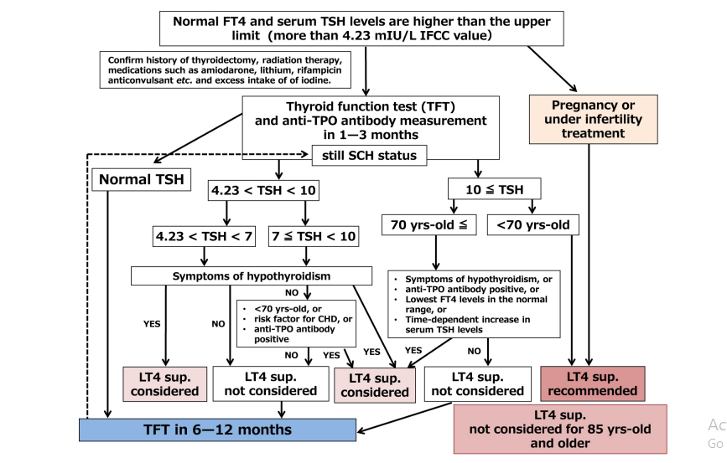
Risk factor for CHD=presence of risk factors for cardiovascular events, such as hyper cholesterolemia, atherosclerosis, angina, and a medical history of ischemic heart disease.

Slide 27
Recently, and controversially, the British clinical practice guidelines published in 2019 recommended against LT4 supplementation for almost all patients with SCH except women who are pregnant or trying to conceive or those with serum TSH levels greater than 20 mIU/L and those with severe symptoms or those younger than 30 years old.

Slide 28
SCH in Pregnancy:
When patients with SCH become pregnant, serum TSH levels and anti-TPO antibody should be evaluated.
Recently significant geographic and ethnic diversity in TSH concentrations during pregnancy have been found. Thus, the latest guidelines from the ATA stated that population-based trimester-specific reference ranges for serum TSH should be defined through assessment of local population data representative of a health care provider’s practice.

Slide 29
According to the ATA guidelines, LT4 should be administered in the situations as listed below:
1) In cases where the anti-TPO antibody is positive and serum TSH levels are the upper limit of each trimester or higher.
2) In cases where the serum TSH levels are 10 mIU/L or higher even though anti-TPO antibody is negative.

Slide 30
In addition, LT4 supplementation should be considered in the following situations:
3) In cases where the anti-TPO antibody is positive and serum TSH levels are 2.5 mIU/L or higher but lower than the upper limit of each trimester.
4) In cases where the anti-TPO antibody is negative and serum TSH levels are the upper limit of each trimester or higher but lower than 10 mIU/L

Slide 31
serum TSH levels should be lower than 2.5 mIU/L by LT4 supplementation for patients with SCH undergoing infertility treatment such as in vitro fertilization.
LT4 Supplementation:
LT4 supplementation usually starts with 25 μg/day. It is important to take it with water on an empty stomach. It should not be taken with other liquids such as coffee, green tea, or milk, which may interfere with LT4 absorption.

Slide 32
For patients who have suffered from SCH for more than 6 months, have a history of ischemic heart disease, or are suspected with heart failure, LT4 supplementation should start with a low dose (12.5–25 μg/day) with gradual increases based on symptoms and serum TSH levels .
On the other hand, for the patients with SCH who are pregnant, higher doses of LT4 should be supplemented depending on the trimester.

Slide 33
However, based on the current evidence it is reasonable to raise the target serum TSH levels to 4–6 mIU/L in patients greater than age 70–80 years .
Moreover, it is of note that serum TSH levels <0.1 mIU/L, suggesting excess levels of LT4 supplementation , may be associated with adverse outcomes, such as cardiovascular diseases and osteoporosis in older persons or postmenopausal women .
In the near future, a target TSH in the age-specific reference range should be determined by randomized controlled trials of LT4 supplementation in patients with SCH.

Slide 34
Subclinical Hyperthyroidism (SCHyper):
SCHyper is categorized into two groups based on serum TSH levels: mild and severe.
Serum TSH levels in mild type are from 0.1–0.4 mIU/L
severe type are lower than 0.1 mIU/L.
Since the mild type can be resolved, it is recommended to repeat measurements of serum TSH and FT4 levels in 3 to 6 months before confirming a diagnosis of SCHyper.
the severe type is likely to progress to overt hyperthyroidism.

Slide 35
Epidemiology :
prevalence of SCHyper depends on age, gender, ethnicity, genetic predisposition, and iodine status .
In the United States, the prevalence of SCHyper is 0.7% of the general population .
the majority remained as SCHyper (63%), while (36% )spontaneously returned to normal serum thyroid function, especially those with serum TSH levels between 0.1 and 0.4 mIU/L, during the 7-year follow-up period .

Slide 37
Transient SCHyper may prolong for 3 to 6 months, depending on its origin.
Transient SCHyper may be observed under the administration of medications such as lithium, immune checkpoint inhibitors(Nivolumab,Pembrolizumab), amiodarone, interferon, tyrosine kinase inhibitors, dopamine, somatostatin analogs, and glucocorticoids .
NTI, which is called low T3 syndrome, is also one of differential diagnoses of SCHyper, but generally no treatment is needed.
Recently, it has been reported that coronavirus disease-2019 (COVID-19) may develop into SCHyper, which is diagnosed as destructive thyroiditis .

Slide 38
Diagnosis:
When SCHyper is indicated by TFT, it is important to repeat that TFT in 3 to 6 months .
Upon confirmation of SCHyper, anti-TSH receptor antibody (TRAb) or anti-TSH stimulating antibody (TSAb) is the next subject to be measured.
In cases that have a family history of autoimmune thyroid diseases, anti-Tg and anti-TPO antibodies should also be measured.
Increased serum Tg levels are highly indicative of destructive thyroiditis .

Slide 39
Other laboratory test results such as erythrocyte sedimentation rate, CRP, and complete blood count may complement the diagnosis of SCHyper since hemoglobin levels are often decreased in SCHyper.
Evaluation of blood flow by thyroid ultra‐ sound is helpful to diagnose Graves’ disease. 123I and 99mTc scintigraphy are another powerful tool.
If a patient demonstrates symptoms related to hyperthyroidism such as atrial fibrillation (Af), the TFT should be repeated in 2 to 6 weeks .

Slide 40
Clinical Significance of SCHyper :
Cardiovascular disease :
A meta-analysis to assess the risks of total and CHD mortality, CHD events, and Af in SCHyper employing 10 large prospective cohorts was performed and revealed that SCHyper was associated with increased total mortality (hazard ratio [HR]: 1.24, CI: 1.06–1.46), CHD mortality (HR: 1.29, CI: 1.02– 1.62), CHD events (HR: 1.21, CI: 0.99–1.46), and Af (HR: 1.68, CI: 1.16–2.43) after adjusting for age and sex.
It also revealed that risks for CHD mortality and Af were higher for serum TSH levels lower than 0.10 mIU/L compared with those between 0.10 and 0.44 mIU/L .

Slide 41
At the same time the association between SCHyper and stroke remains inconclusive and needs to be further evaluated by large-scale prospective studies .
Osteoporosis and fractures:
Thyrotoxicosis induces osteoclastic activity, thereby resulting in net bone loss.
Even though it is well known that overt hyperthyroidism leads to secondary osteoporosis, which increases the risk of fractures , the association between SCHyper and bone metabolism remains unclear.

Slide 42
In a recent meta-analysis of 17 prospective cohort studies with a total of 313,557 individuals, SCHyper was found to be associated with an increased risk of any fracture (RR: 1.17, CI: 1.08–1.26), hip fracture (RR: 1.27, CI: 1.09–1.48), spine fracture (RR: 1.97, CI: 1.31–2.97), and non-spine fracture (RR: 1.19, CI: 1.04–1.37).
SCHyper was associated with lower distal forearm bone mineral density (BMD) in women.

Slide 43
Dementia and cognitive dysfunction:
The findings on the association between SCHyper and dementia and cognitive dysfunction are inconsistent .
In individual participant data meta-analysis on source data from community-dwelling participants aged 80 years and older from The Netherlands, New Zealand, United Kingdom, and Japan, cognitive function was evaluated by Mini-Mental State Examination (MMSE). Of the total 2,116 participants at baseline (mean age 87 years, range 80–109 years), 60 (2.8%) participants who were SCHyper had similar MMSE scores compared with 1,811 (85.6%) euthyroid participants.

Slide 44
SCHyper induced by excessed LT4 supplementation and its clinical outcome:
Some patients, who underwent thyroid surgery for thyroid cancer followed by TSH suppression therapy with LT4 supplementation, demonstrate SCHyper.
Moreover, SChyper may occur in the cases, to which LT4 inadequately and excessively administered for weight reduction.
Sinus tachycardia and atrial flutter are also commonly associated with LT4-induced SChyper and Af is the most common cardiac complication with significant mortality and morbidity resulting from embolic events.

Slide 45
Treatment of SCHyper:
According to guidelines from the ATA and AACE, patients with SCHyper should be treated when serum TSH levels are lower than 0.1 mIU/L in those aged 65 years or older with cardiac risk factors, heart disease, or osteoporosis; postmenopausal women without estrogen or bisphosphonate administration; and in those who develop hyperthyroid symptoms .

Slide 46
These recommendations state that treatment is not warranted in asymptomatic patients aged younger than 65 years old who can be monitored with several rounds of thyroid function tests, because the risk of transition into overt hyperthyroidism is low and spontaneous remission of the SCHyper can be expected.
The treatment strategies for SCHyper are the same as those for overt hyperthyroidism and include thionamides (i.e., methimazole or propylthiouracil), inorganic iodines, 131I-radioisotope therapy, and thyroid surgery.

Slide 47
