Slide 2
Nonalcoholic Fatty Liver Disease: Review of Management for Primary Care Providers
September 2022

Slide 3
Ffffffffkkk

Slide 4
Introduction:
Nonalcoholic fatty liver disease (NAFLD) is one of the most common causes of chronic liver disease globally and in the United States.
It is characterized by the development of hepatic steatosis (triglyceride accumulation in hepatocytes) in the absence of secondary causes, including significant alcohol consumption (US standard drink, 14 g of alcohol: >2 drinks/day for men, >1 drink/ day for women).

Slide 5
Nonalcoholic fatty liver disease encompasses the full spectrum of histopathologic changes (simple steatosis to extensive fibrosis to cirrhosis), whereas nonalcoholic steatohepatitis (NASH) is characterized by inflammation and hepatocyte injury (ballooning) with or without fibrosis.
Disease progression from steatosis to cirrhosis may not be linear, and periods of stability or regression can occur.

Slide 6
Fibrosis progression occurs in approximately 40% of individuals with NASH.
The severity of liver fibrosis is a key predictor of the long-term outcomes in people with NASH, including overall mortality.
Nonalcoholic fatty liver disease is strongly associated with metabolic syndrome (MetS), obesity, type 2 diabetes (T2D), and dyslipidemia.
cardiovascular disease (CVD) is the most common cause of death in people with NAFLD .

Slide 7
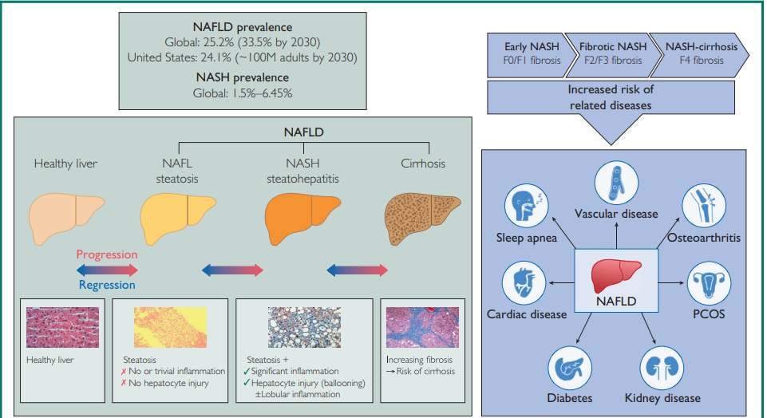

Slide 8
NAFLD is associated with disease progression in cardiovascular disease (CVD) and chronic kidney disease (CKD) and with increased cancer-related mortality.
Approximately 20% of people with NAFLD are classified as having NASH, and 20% of those with NASH have advanced liver disease (category F3/F4 fibrosis).

Slide 9
An estimated 18.2 million american adults have T2D and NAFLD, of whom 6.4 million have NASH.
20-year costs for NAFLD in these patients are almost $56 billion and are projected to increase significantly during the coming 20 years.

Slide 10
PRAGMATIC APPROACH TO MANAGEMENT :
In the United States, the American Association for the Study of Liver Diseases (AASLD) published practice guidance in 2018.
combined guidance from 3 European societies was published in 2016 (European Association for the Study of the Liver [EASL], European Association for the Study of Diabetes [EASD], and European Association for the Study of Obesity [EASO]).
the United Kingdom’s National Institute for Health and Care Excellence(NICE) (2016).

Slide 11
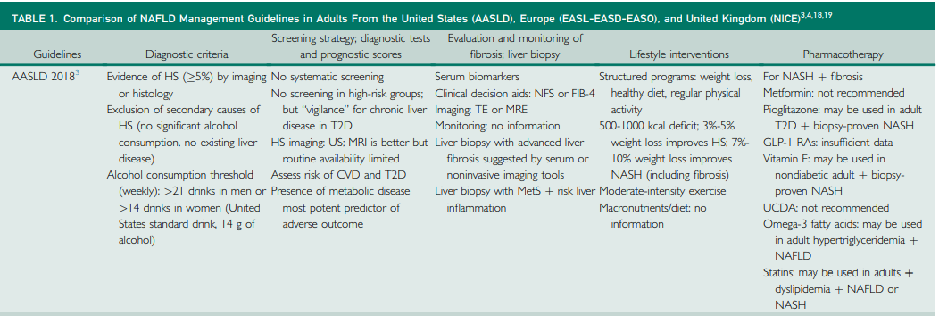

Slide 14
Risk Factors, Comorbidities, and Complications :
The pathogenesis of NAFLD is multifactorial and not yet fully understood .
the presence of excess lipid is the primary insult and is followed by , insulin resistance, lipotoxicity, and immune system activation; these are combined with adverse nutritional intake (eg, foods rich in fructose or saturated fats) and proinflammatory changes to the gut microbiome.
There are also known genetic predispositions to hepatic fat accumulation (eg, polymorphisms in the PNPLA3 gene and variants of the TM6SF2 gene).

Slide 15
Obesity(excessive body mass index [BMI] and visceral obesity) is the most common risk factor for NAFLD and NASH (prevalence of 51% and 82%, respectively) and includes the range from overweight to severely obese.
Some normal-weight individuals (BMI <25 kg/m2) can exhibit NAFLD with or without exhibiting abnormal levels of liver enzymes; this is so-called lean NAFLD.

Slide 16
lean NAFLD patients can develop the full spectrum of liver damage associated with “non-lean” NAFLD.
This may be due to such individuals’ having dysfunctional adipose tissue or expressing genes associated with obese NAFLD patients (eg, PNPLA3).
insulin resistance may play an intrinsic role in the pathogenesis of NAFLD independent of BMI.

Slide 17
A bidirectional association between MetS and DM2 and NAFLD .
The severity of NAFLD was shown to correlate with the number of MetS criteria present in an individual.
A 60% prevalence of NAFLD in individuals with T2D was reported .

Slide 18
Dyslipidemia (high serum triglyceride and low high density lipoprotein levels) is also frequently observed in people with NAFLD (prevalence >50%) , and often occurs secondry to insulin resistance.

Slide 19
Evidence indicates that NAFLD increases the risk of hypertension, coronary heart disease, cardiomyopathy, and arrhythmias, resulting in increased cardiovascular morbidity and mortality in patients with NAFLD.
Therefore, cardiovascular risk assessment should be undertaken in individuals with NAFLD.

Slide 20
The link between NAFLD and CKD has also been examined, and there is increasing epidemiologic evidence that NAFLD is an independent risk factor for CKD, although causality is not yet proven.
Nonalcoholic steatohepatitis is now among the top causes of hepatocellular carcinoma (HCC) and the second most common indication for liver transplant in the United States.
The risk for HCC is highest among those with NAFLD cirrhosis.

Slide 21
Clinical Pathway for Primary Care Providers :
the key questions to be answered are the following:
Does the patient have NAFLD or something else?
If NAFLD is diagnosed, does the patient have NASH?
If NASH is diagnosed, what is the patient’s risk for development of liver fibrosis?
Is a liver biopsy necessary?

Slide 22
There is no individual diagnostic test for NAFLD, and it is largely a diagnosis of exclusion.
Patients with NAFLD may be identified incidentally during investigation for other conditions (eg, abdominal imaging, liver function tests).
People with uncomplicated NAFLD are typically asymptomatic, or their symptoms are vague (eg, fatigue, abdominal discomfort).

Slide 23
Clinicians should consider the following individuals to be “at risk” or “high risk”:
those with obesity, T2D, or MetS
those with hepatic steatosis on any imaging study
and those with persistently elevated plasma aminotransferases (at least 2 abnormal values within 6 months)

Slide 24
Secondary causes of hepatic steatosis and causes of concurrent liver diseases must be excluded to make a diagnosis of NAFLD, including alcohol and drug use, hepatitis C virus (genotype 3), autoimmune liver disease, Wilson disease, and hemochromatosis.
Liver biochemistry is inadequate in assessing NAFLD (eg, transaminases were within the normal range in 43% of patients with NAFLD ) and is not predictive of liver fat content or fibrosis stage.

Slide 25
First-line identification of hepatic steatosis is done by abdominal ultrasound scan, on which increased echogenicity is indicative of steatosis.
Ultrasound is an inexpensive and accessible tool.
Although it has limitations, an ultrasound scan offers the convenience of enabling complete liver imaging and liver fibrosis assessment to be carried out in the same session.

Slide 26
Other imaging techniques are available, including vibration-controlled transient elastography (VCTE), shear wave elastography,and magnetic resonance imaging (MRI).
For example, FibroScan (Echosens North America) is a transient elastography device that measures liver fat and fibrosis, and Liver MultiScan software (Perspectum Ltd) analyzes MRI data, including the generation of MRI proton density fat fraction maps.

Slide 27
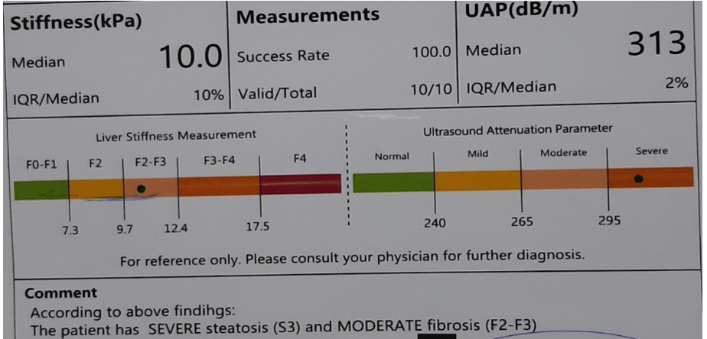

Slide 28
Importantly, if the stage of fibrosis is F3 (severe [bridging] fibrosis) or higher, the clinical action plan must shift from routine monitoring and lifestyle modification to aggressive management.
Liver biopsy remains the “gold standard” for the diagnosis of NASH, but it is impractical to perform routinely on every patient with NAFLD.

Slide 29
Furthermore, the procedure has well-documented limitations; it is invasive, there is a risk of procedural complications and sampling errors, and it has cost implications.
liver biopsy should be considered in any individual with NAFLD in whom there is a high suspicion of NASH or if other causes of hepatic steatosis or chronic liver disease need to be excluded.

Slide 30
Anthropometric assessments (eg, BMI) and noninvasive biomarkers (eg, liver fibrosis scores) can be used to make an initial assessment of the patient’s risk of NAFLD with liver fibrosis.
The preferred noninvasive test is the FIB-4 index; it is validated and free of charge.

Slide 31
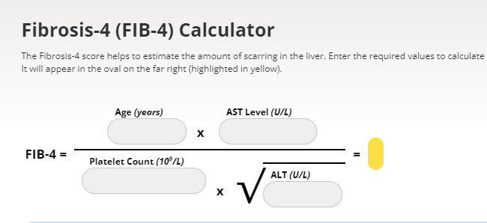
F0=no fibrosis F1=portal fibrosis F2=periportasl fibrosis F3=bridging fibrosis F4=cirrhosis

Slide 32
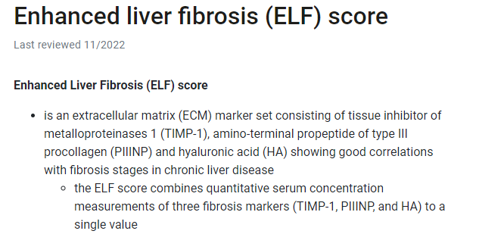
Other patented scoring systems are available, such as the enhanced liver fibrosis (ELF) score (available in the United States in 2022).

Slide 33
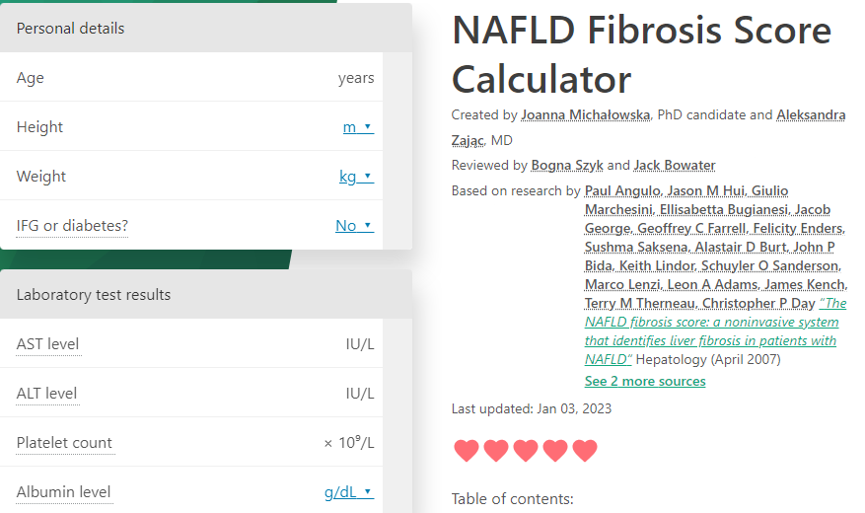

Slide 34
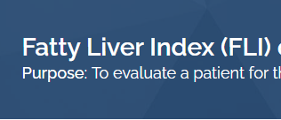

Slide 35
Clinicians should consider doing further work-up if an individual has obesity or T2D and intermediate or high noninvasive liver fibrosis scores.
FIB4 below 1.30 is low risk and 1.3-2.67 is intermediate risk and over 2.67 is high risk.
Patients with T2D and a FIB-4 score above 1.3 should be screened by VCTE (if available).

Slide 36
In the absence of VCTE, shear wave elastography, or magnetic resonance elastography, clinicians should use risk indices such as the ELF score or other proprietary biomarkers that establish or exclude advanced fibrosis.
Similarly, patients with type 1 diabetes should be screened if they have additional risk factors for NAFLD, such as obesity, MetS, elevated alanine aminotransferase or aspartate aminotransferase (˃30 U/L) or FIB-4 score (>1.3), or hepatic steatosis on imaging.

Slide 37
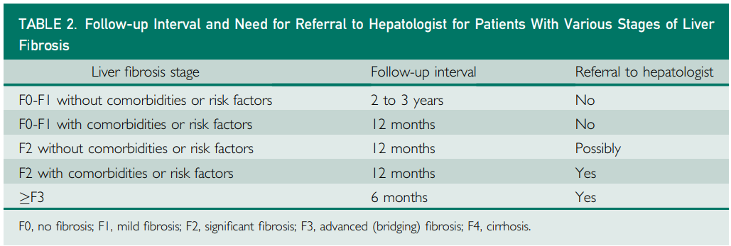

Slide 38
In all cases, monitoring should include routine biochemistry, assessment of metabolic and CVD risk factors (including blood pressure, lipids, and T2D), and noninvasive assessment of fibrosis.
For patients with cirrhosis, surveillance for HCC with imaging should be carried out every 6 months.

Slide 39
Management of Patients With NAFLD :
Standard treatment for NAFLD centers on lifestyle modification leading to weight loss, including calorie reduction, exercise, and healthy food intake.
The EASL-EASD EASO guidelines recommend using macronutrients per the Mediterranean diet, in which a large fraction of dietary lipid is provided as monounsaturated fatty acids.
A diet high in monounsaturated fatty acids was shown to lower liver fat and to improve hepatic and total insulin sensitivity.

Slide 40
Data from clinical trials (randomized and non randomized) have shown an association between weight loss interventions and improved biomarkers of liver disease in NAFLD and NASH.
Loss of at least 5% of body weight improved steatosis, and weight loss of 7% to 9% improved most histopathologic changes, but improvement in fibrosis was observed only with weight loss of more than 10%.
However, these levels of weight loss are extremely difficult to achieve, let alone to sustain.

Slide 41
The involvement of primary care practitioners plus other specialists (such as psychologists, dietitians, fitness coaches) is central in supporting an individual through long-term weight loss management.
In individuals in whom these measures are not sufficient, pharmacotherapy is recommended as an adjunct to lifestyle modifications in patients with a BMI above 30 kg/m2 or in patients with a BMI above 27 kg/m2 in the presence of weight-related comorbidities, such as diabetes, hypertension, and dyslipidem.

Slide 42
Five medications are currently approved by the US Food and Drug Administration (FDA) for chronic weight management:
orlistat (lipase inhibitor), phentermine/topiramate extended release (sympathomimetic plus anticonvulsant), naltrexone extended release/bupropion extended release (opioid antagonist plus aminoketone antidepressant), and liraglutide and semaglutide (glucagon-like peptide 1 receptor agonists [GLP-1 RAs]).
In addition to significant weight loss, semaglutide has been shown to improve NASH, although not fibrosis, and it is also associated with significant cardioprotective and nephroprotective effects.

Slide 43
Bariatric surgery could also be considered in the treatment of persons with NAFLD or NASH and a BMI of 35 kg/m2 or higher (32.5 kg/m2 in Asian populations), particularly if T2D is present, when medical therapy has failed.
The aim is to interrupt the pathophysiologic processes of NASH, and it is likely that combination drug therapies with different mechanisms of action will be required.

Slide 44
Pharmacotherapy may also be used in patients with less severe liver disease but at high risk of disease progression (MetS, diabetes, persistently elevated alanine aminotransferase, high necroinflammatory activity).
At the time of writing, no pharmacologic agents have completed phase 3 clinical trials or gained regulatory approval for use in the management of NASH in the United States or Europe.

Slide 45
Treatment recommendations from the NAFLD guidelines are mainly confined to the use of vitamin E (in confirmed NASH; nondiabetes, non-cirrhosis) or pioglitazone (in biopsy-confirmed NASH; off-label use in non-T2D).

Slide 46
Long-term vitamin E treatment is associated with an increase in all-cause mortality, hemorrhagic stroke risk, and increased risk of prostate cancer in men.
Limited clinical trials data indicate that GLP-1 RAs and sodium-glucose cotransporter 2 (SGLT2) inhibitors may contribute to improvements in NAFLD and NASH.

Slide 47
Tirzepatide, a dual glucose-dependent insulinotropic polypeptide and GLP-1 RA,is under FDA consideration for use in T2D, but no recommendation can be given for its use in NAFLD or NASH at this time.
The main agents being evaluated are obeticholic acid (Ocaliva), a farnesoid X receptor agonist; arachidyl amido cholanoic acid (Aramchol), a stearoylecoenzyme A desaturase modulator; and resmetirom, a thyroid hormone receptor b agonist.

Slide 48
For patients with hypercholesterolemia, statins should be continued where possible as the leading non liver cause of mortality in patients with NAFLD is cardiovascular death.
For patients with T2D, preference should be given to treatments that address insulin resistance (eg, metformin) or to newer agents such as the GLP1RAs that have shown promising data for NASH.

Slide 49
Data from randomized controlled trials are needed, but observational study data indicate that bariatric surgery may reverse the pathologic liver changes associated with NAFLD in addition to inducing weight loss and improving the features of MetS and T2D.

Slide 50
A prospective study by Lassailly et al demonstrated a durable and sustained resolution of NASH in 84% of patients at 1 year after bariatric surgery, with progressive reduction in fibrosis observed during 5 years.
Recent data on the use of endoscopic bariatric procedures, including the intragastric balloon and endoscopic sleeve gastrectomy, also suggest that other treatment options will be available in the near future.

Slide 57
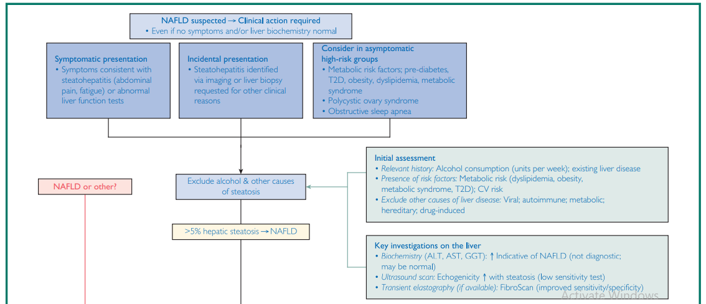

Slide 58
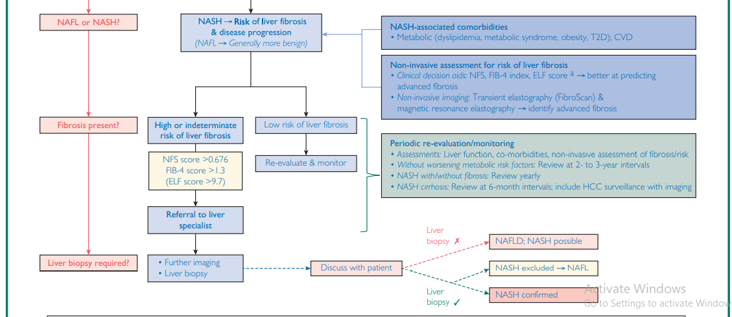

Slide 60
