Slide 2
Treatment of Symptoms of the Menopause: An Endocrine Society Clinical Practice Guideline

Slide 3
Method of Development of Evidencebased Clinical Practice Guidelines
In terms of the strength of .the recommendation,
strong recommendations use the phrase “ recommend” or “we recommend against” and the number 1, and weak recommendations use the phrase “we suggest” or “we suggest against” and the number 2.
Crossfilled circles indicate the quality of the evidence, such that
QEEE denotes very low quality evidence;
QQEE, low quality;
QQQE, moderate quality;
and QQQQ, high quality.

Slide 4
Abbreviations:
BZA, bazedoxifene; CEE, conjugated equine estrogens; CHD, coronary heart disease; CI, confidence interval; CVD, cardiovascular disease; DVT, deep vein thrombosis; EPT, estrogen plus progestogen therapy; ET, estrogen therapy; GSM, genitourinary syndrome of menopause; HR, hazard ratio; MetS, metabolic syndrome; MHT, menopausal hormone therapy; MI, myocardial infarction;MPA,medroxyprogesterone acetate;OTC,over the counter; PE, pulmonary embolism; POI, primary ovarian insufficiency; QOL, quality of life; RCT, randomized controlled trial; SERM, selective estrogen receptor modulator; SSRI, selective serotonin reuptake inhibitor; SNRI, serotonin-norepinephrine reuptake inhibitor; VMS, vasomotor symptoms; VTE, venous thromboembolism; VVA, vulvovaginal atrophy.

Slide 5
Diagnosis
Table 1 lists definitions of the clinical spectrum o menopause.
In a woman with an intact uterus, menopause is a clinical diagnosis based upon cessation of menses for at least 12 months.
Sex steroids, gonadotropins inhibin B, or anti-Mullerian hormone measurements do not further inform the diagnosis, do not indicate when the final menstrual period will occur, and will not influence management unless a womanis seeking fertility.
In women having undergone a hysterectomy but not bilateral oophorectomy elevated FSH levels and estradiol concentrations< 20 pg/mL on several occasions support but do not confirm the diagnosis

Slide 6
. Definitions of Spectrum of Menopause
Menopause
Clinical status after the final menstrual period, diagnosed retrospectively after cessation of menses for 12 mo in a previously cycling woman and reflecting complete or nearly complete permanent cessation of ovarian function and fertility.
Spontaneous menopause
Cessation of menses that occurs at an average age of 51 y in the absence of surgery or medication.

Slide 7
.The age at menopause is probably determined in part by genetic factors, because mothers and daughters tend to experience menopause at about the same age.Environmental factors may modify the age at menopause.
For example, current smoking is associated with an earlier menopause,
whereas alcohol consumption delays menopause.
Oral contraceptive use does not affect the age at which menopause begins.

Slide 8
Menopausal transition (or perimenopause)
An interval preceding the menopause characterized by variations menstrual cycle length and bleeding pattern, mood shifts, vasomotor, and vaginal symptoms
and with rising FSH levels and falling anti-Mullerian hormone and inhibin B levels, which starts during the late reproductive stage and progresses during the menopause transition .

Slide 9
Climacteric
The phase in the aging of women marking the transition from the reproductive phase to the non reproductive state.
This phase incorporates the perimenopause by extending for a longer variable period before and after the perimenopause.

Slide 10
Climacteric syndrome
When the climacteric is associated with symptomatology.
Menopause after hysterectomy without oophorectomy Spontaneous cessation of ovarian function without the clinical signal of cessation of menses.
Induced menopause
Cessation of ovarian function induced by chemotherapy, radiotherapy, or bilateral oophorectomy.
Early menopause
Cessation of ovarian function occurring between ages 40 and 45 in the absence of other etiologies for secondary amenorrhea (pregnancy, hyperprolactinemia, and thyroid disorders).

Slide 11
. With radiotherapy- or chemotherapy- induced menopause, it is important to recognize that ovarian function may resume after 12 months of amenorrhea , depending on the age of the woman and the dose and duration of treatment .
For POI, persistent FSH elevation in women<age 40 provides a tentative diagnosis .

Slide 12
POI
Loss of ovarian function before the age of 40 y with waxing and waning course and potential resumption of menses, conception, and pregnancy .
The prevalence of POI is approximately 1% and differentiated into idiopathic, autoimmune (associated with polyglandular autoimmune syndromes), metabolic disorders, and genetic abnormalities (including fragile X premutation).

Slide 13
Introduction and background
VMS, hot flashes, and night sweats, are the hallmarks of menopause, although not all women experience these symptoms.
Other climacteric symptoms include sleep disturbance , arthralgia , and vaginal dryness and dyspareunia . It is less clear whether anxiety, irritability, depression, palpitations, skin dryness, loss of libido, and fatigue can be attributed to menopause .
Symptoms frequently start in the years before the final menstrual period and can last, with unpredictable duration, from a few years to more than 13 years.

Slide 14
Prevalence. Hot flashes (also called hot flushes) occur in approximately 75% of postmenopausal women in the United States .
. In a cross-sectional study of premenopausal women( mean age, 48 y), one-third reported “ever” experiencing hot flashes .

Slide 15
Persistence of hot flashes may also vary depending upon when in the menopausal transition VMS were first noted.
In SWAN, earlier onset of VMS was associated with longer postmenopausal duration .

Slide 16
Clinical manifestations.
Hot flashes typically begin as the sudden sensation of heat centered on the upper chest and face.
When moderate or severe, the hot flash rapidly becomes generalized, lasts from 2 to 4 minutes, and can be associated with profuse perspiration, palpitations, or anxiety. Triggers include spicy food or alcohol.
At night, vasomotor instability manifests as hot flashes or night sweats, which may represent different physiological mechanisms. The differential diagnosis includes several entities distinguishable by clinical features (Table 2).
New-onset VMS in older (age, 65 y) postmenopausal women may be associated with, but not necessarily causally related to, increased risk of major CHD and all-cause mortality .

Slide 17
, more than three fourths have hot flashes for more than 1 year, and approximately one half have them for up to 5 years.
Hot flashes lessen in frequency and intensity with advancing age, unlike other sequelae of menopause, which progress with time.
A hot flash is a subjective sensation of intense warmth of the upper body, which typically lasts for approximately 4 minutes but may range in duration from 30 seconds to 5 minutes.

Slide 18
Table 2. Conditions That May Cause or Mimic Vasomotor Events and That Can Be Distinguished From Menopausal Symptoms by History, Examination, and Investigations, as Indicated
Hormone excess
Thyroid hormone excess
Carcinoid syndrome (flushing without sweating)
Pheochromocytoma (hypertension, flushing, and profuse sweating)
Dietary factors
Alcohol
Spicy food
Food additives (eg, monosodium glutamate, sulfites)
Pharmaceuticals
Chronic opioid use
Opiate withdrawal
SSRIs (may cause sweats)
Nicotinic acid (intense warmth, itching lasting up to 30 min)
Calcium channel blockers
Medications that block estrogen action or biosynthesis

Slide 19
Table 2. Conditions That May Cause or Mimic Vasomotor Events and That Can Be Distinguished From Menopausal Symptoms by History, Examination, and Investigations, as Indicated
Chronic infection (increased body temperature)
Other medical conditions
Post gastric surgery dumping syndrome
Mastocytosis and mast cell disorders (usually with gastrointestinal symptoms)
Some cancers: medullary carcinoma of the thyroid, pancreatic islet-cell tumors, renal cell carcinoma, lymphoma
Anxiety disorders

Slide 20
Association with sleep
In polysomnography studies, nocturnal hot flashes are more common during the first 4 hours of sleep, whereas subsequent rapid eye movement sleep suppresses hot flashes, arousals, and awakenings.
A recent study that induced estrogen deficiency in health premenopausal women with a GnRH agonist directly demonstrated that hot flashes are associated with three factors:
1) an increase in episodes of waking after sleep-onset;
2) a decrease in perceived sleep efficiency;
3) a statistically significant correlation between nocturnal VMS and sleep disruption ..

Slide 21
Mechanisms.
VMS appear to involve the central nervous system because:
1) hot flashes occur simultaneously with, but are not caused by, LH pulses ;
2) research has shown an association with the neuroregulators kisspeptin, neurokinin B, and dynorphin .
3)Alterations of thermoregulatory systems.

Slide 22
Genitourinary syndrome of menopause
This new term “genitourinary syndrome of menopause” (GSM) combines the conditions of VVA and urinary tract dysfunction (Table 3)
VVA most often presents in the late postmenopausal stage, when VMS may have abated. When VVA is severe, women may have discomfort wearing tight-fitting clothing or while sitting or . Sexual activity is not required for patients to experience vaginal or genital discomfort.
Urinary symptoms— dysuria, urinary frequency, and recurrent urinary tract infections—increase in severity with time since menopause.

Slide 23
Table 3. Genitourinary Syndrome of Menopause
Symptoms
Vulvar pain, burning, or itching
Vaginal dryness
Vaginal discharge
Dyspareunia
Spotting or bleeding after intercourse
Dysuria, urinary frequency, urgency
Recurrent urinary tract infections
Signs, external genitalia
Decreased labial size
Loss of vulvar fat pads
Vulvar fissures
Receded or phimotic clitoris
Prominent urethra with mucosal eversion or prolapse
Signs, vagina
Introital narrowing
Loss of elasticity with constriction
Thin vaginal epithelial lining
Loss of mature squamous epithelium
Pale or erythematous appearance
Petechiae, ulcerations, or tears
Alkaline pH (5.5)
Infection (yellow or greenish discharge)

Slide 24
Other signs and symptoms
The menopausal decline of estradiol increases bone resorption and contributes to fractures .
Possible related signs and symptoms
Research has suggested (but not proven) a direct relationship between menopause and mood changes, mild depressive symptoms, anxiety, irritability, arthralgias, loss of libido, palpitations, skin dryness, fatigue, and reduction in QOL .

Slide 25
Recommendations
1.0 Diagnosis and symptoms of menopause
1.1 We suggest diagnosing menopause based on the clinical criteria of the menstrual cycle. (2 QQEE )
1.2 If establishing a diagnosis of menopause is necessary for patient management in women having undergone a hysterectomy without bilateral oophorectomy or presenting with a menstrual history that is inadequate to ascertain menopausal status,
we suggest making a presumptive diagnosis of menopause based on the presence of vasomotor symptoms (VMS) and, when indicated, laboratory testing that includes replicate measures of FSH and serum estradiol. (2 QQEE )

Slide 26
2.0 Health considerations for all menopausal women
2.1 When women present during the menopausal transition, we suggest using this opportunity to address bone health, smoking cessation, alcohol use, cardiovascular risk assessment and management, and cancer screening and prevention. (Ungraded best practice statement)

Slide 27
Adequate intake of calcium and vitamin D, along with limiting alcohol consumption will minimize bone loss and reduce the risk of falls and fractures .
For postmenopausal women < 65 years of age and at high risk of osteoporosis, dual-energy x-ray absorptiometry assessment of bone mineral density contributes to risk assessment. ET for the relief of menopausal symptoms prevents bone loss and reduces fracture risk .
Women without VMS and at significant risk of osteoporosis can discuss the merits of ET for bone preservation.
.

Slide 28
3.0 Hormone therapy for menopausal symptom relief
3.1 Estrogen and progestogen therapy
3.1a For menopausal women < 60 years of age or < 10 years past menopause with bothersome VMS (with or without additional climacteric symptoms) who do not have contraindications or excess cardiovascular or breast cancer risks and are willing to take menopausal hormone therapy (MHT), we suggest initiating estrogen therapy (ET) for those without a uterus and estrogen plus progestogen therapy (EPT) for those with a uterus. (2 QQEE )

Slide 29
Evidence
In postmenopausal women, ET improves menopause associated (climacteric) symptoms (eg, VMS, genitourinary symptoms, sleep disturbance, menopause-associated anxiety and depressive symptoms, and arthralgias.
ET also reduces menopause-related bone loss, lowers the risk of fragility fractures in older women, and reduces the incidence of self-reported diabetes.
In addition, combined EPT reduced the risk of colorectal cancer.

Slide 30
Cardiovascular risk
3.1b For women < age 60 or < 10 years past menopause onset considering MHT for menopausal symptom relief, we suggest evaluating the baseline risk of cardiovascular disease (CVD) and taking this risk into consideration when advising for or against MHT and when selecting type, dose, and route of administration. (2 QQEE )
3.1c For women at high risk of CVD, we suggest initiating non hormonal therapies to alleviate bothersome VMS (with or without climacteric symptoms) over MHT. (2 QQEE )

Slide 31
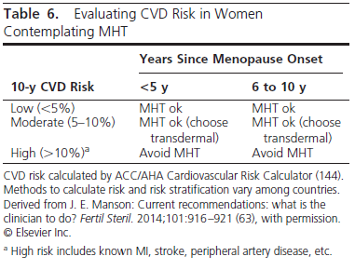

Slide 32
Technical remarks
High risk includes known MI, cerebrovascular disease, and peripheral arterial disease, abdominal aortic aneurysm, diabetes mellitus, chronic kidney disease, and 10- year CVD risk> 10% .
3.1d For women with moderate risk of CVD, we suggest transdermal estradiol as first-line treatment, alone for women without a uterus or combined with micronized progesterone (or another progestogen that does not adversely modify metabolic parameters) for women with a uterus because these preparations have less untoward effect on blood pressure, triglycerides, and carbohydrate metabolism. (2QQEE)

Slide 34
Venous thromboembolic events
3.1e For women at increased risk of VTE who request MHT, we recommend a non oral route of ET at the lowest effective dose, if not contraindicated (1QQEE);
for women with a uterus, we recommend a progestogen (for example, progesterone and dydrogestone) that is neutral on coagulation parameters. (1QQQE)

Slide 35
Breast cancer
3.1f For women considering MHT for menopausal symptom relief, we suggest evaluating the baseline risk of breast cancer and taking this risk into consideration when advising for or against MHT and when selecting type, dose, and route of administration. (2 QQEE )
3.1g For women at high or intermediate risk of breast cancer considering MHT for menopausal symptom relief, we suggest non hormonal therapies over MHT to alleviate bothersome VMS. (2 QQEE )

Slide 36
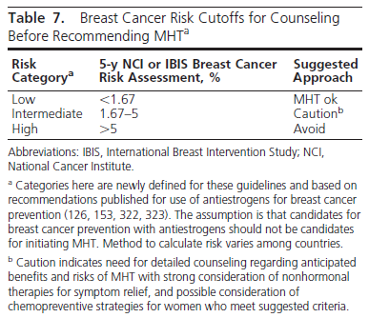

Slide 37
Tailoring MHT
3.1h We suggest a shared decision-making approach to decide about the choice of formulation, starting dose, the route of administration of MHT, and how to tailor MHT to each woman’s individual situation, risks, and treatment goals. (Ungraded best practice statement)

Slide 38
Custom-compounded hormones
3.1i We recommend using MHT preparations approved by the US Food and Drug Administration (FDA and comparable regulating bodies outside the United States and recommend against the use of custom-compounded hormones. (Ungraded best practice statement)

Slide 39
3.2 Conjugated equine estrogens with bazedoxifene
For symptomatic postmenopausal women with a uterus and without contraindications,
we suggest the combination of CEE/BZA (where available) as an option for relief of VMS and prevention of bone loss. (2QQQE)

Slide 40
Evidence
The combination of CEE with the SERM/BZA (available in the United States and licensed in the European Union) relieves VMS and vaginal atrophy and reduces bone resorption in women with a uterus;
it provides an alternative to progestogen therapy for women averse to vaginal bleeding, breast tenderness, or altered mood.

Slide 41
Benefits
Vasomotor symptoms. The number and severity of moderate- to-severe VMS were significantly decreased at 12 weeks; hot flash frequency was reduced by74%compared with 51% for placebo, and hot flash severity was reduced up to 54%. Hot flash reduction was sustained at 12 months (P .05) .
Bone loss.
Bone loss at the lumbar spine and hip was prevented in postmenopausal women at risk for osteoporosis , as reflected by reduction of serum bone turnover markers and enhancement of bone mineral density vs placebo .

Slide 42
Vaginal effects.
Treating postmenopausal women ages 40 to 65 with VVA at baseline improved vaginal maturation at 12 weeks . Women reported a lower incidence of dyspareunia.
Quality of life.
Secondary endpoints included improvements in sleep, health-related QOL, and improved treatment satisfaction . In RCTs, bothCEE/BZAand CEE/MPA improved sleep disturbance and time to fall asleep .

Slide 43
Safety considerations
Breast.
The incidence of breast pain and tenderness was similar for CEE/BZA and placebo and was less than with CEE/MPA. After 1 year of therapy with CEE/ BZA, mammographic breast density was not appreciably different than with placebo, whereas it increased with CEE/MPA .

Slide 44
Endometrium
Cumulative amenorrhea rates for CEE/ BZA were comparable with placebo and greater than for CEE/MPA .
At 2 years, the incidence of neither endometrial hyperplasia nor endometrial cancer was increased.

Slide 45
Potential risks
Adverse events. Although an osteoporosis trial found a 2-fold risk of VTE with BZA 20-mg therapy alone , there was no additive effect on VTE when BZA was combined with CEE, although adequately powered studies are necessary.
,In trials of up to 2 years in women ages 40 to 65, rates of cardiovascular events, cancers (breast, endometrial, ovarian), and mortality were similar to placebo .

Slide 46
3.3 Tibolone
Tibolone, a synthetic steroid with estrogenic, androgenic, and progestagenic properties, is approved in many countries for treatment of menopausal symptoms and prevention of osteoporosis. Tibolone preserves BMD, reduces hot flashes, and may increase libido and vaginal lubrication in postmenopausal women.
3.3a For women with bothersome VMS and climacteric symptoms and without contraindications, we suggest tibolone (in countries where available) as an alternative to MHT. (2QQEE)
3.3b We recommend against adding tibolone to other forms of MHT. (1QQEE)
3.3c We recommend against using tibolone in women with a history of breast cancer. (1QQEE)

Slide 47
Evidence
Tibolone. This agent is available in many countries outside of the United States at doses of 1.25–2.5 mg/d.
Benefits
Menopausal symptoms.
Tibolone alleviates VMS with equivalent or lesser potency than conventional MHT. Tibolone also improves sleep, mood, and urogenital atrophy and may improve libido .

Slide 48
Possible risks
Endometrium. There is no endometrial thickening or increase in myoma with tibolone. A Cochrane analysis concluded that there was no clear evidence of endometrial cancer with tibolone therapy
Thrombosis and CVD.
In an observational study , tibolone did not increase the risk of thrombosis. In an RCT of older women with osteoporosis, tibolone increased stroke .
Breast and colon cancers.
The incidence of breast tenderness is low (around 3%), and neither mammographic density nor invasive breast cancer was increased; however, the risk of colon cancer was decreased .

Slide 49
3.4 Clinical management of patients taking hormone therapies
Monitoring during therapy
3.4a For women with persistent unscheduled bleeding while taking MHT, we recommend evaluation to rule out pelvic pathology, most importantly, endometrial hyperplasia and cancer. (1QQQE)
3.4b We recommend informing women about the possible increased risk of breast cancer during and after discontinuing EPT and emphasizing the importance of adhering to age-appropriate breast cancer screening. (1QQQE)

Slide 50
3.4c We suggest that the decision to continue MHT be revisited at least annually, targeting the shortest total duration of MHT consistent with the treatment goals and evolving risk assessment of the individual woman. (Ungraded best practice statement)

Slide 51
3.4d For young women with POI, premature, or early menopause, without contraindications, we suggest taking MHT until the time of anticipated natural menopause, when the advisability of continuing MHT can be reassessed. (2QQEE)
Stopping considerations
3.4e For women preparing to discontinue MHT, we suggest a shared decision-making approach to elicit individual preference about adopting a gradual taper vs abrupt discontinuation. (2QQEE)

Slide 52
4.0 Nonhormonal therapies for VMS
4.0 For postmenopausal women with mild or less bothersome hot flashes, we suggest a series of steps that do not involve medication, such as turning down the thermostat, dressing in layers, avoiding alcohol and spicy foods, and reducing obesity and stress. (2QQEE)

Slide 53
4.1 Nonhormonal prescription therapies for VMS
4.1a For women pharmacological management for moderate to severe VMS for whom MHT is contraindicated, or who choose not to take MHT, we recommend selective serotonin reuptake inhibitors (SSRIs)/serotonin norepinephrine reuptake inhibitors (SNRIs) or gabapentin or pregabalin (if there are no contraindications). (1QQQE)
4.1b For those women seeking relief of moderate to severe VMS who are not responding to or tolerating the non hormonal prescription therapies, SSRIs/SNRIs or gabapentin or pregabalin, we suggest a trial of clonidine (if there are no contraindications). (2QQEE

Slide 54
Relative efficacy of non hormonal prescription therapies vs estrogens
None of the RCTs established statistically significant superiority of one treatment regimen over another.
However, when these and other published data are taken into account , the limited evidence available suggests that standard-dose MHT is more effective than non hormonal agents.

Slide 55
Evidence
Clinical trials of paroxetine, venlafaxine, desvenlafaxine, citalopram, and escitalopram demonstrate statistically significant efficacy with a reduction of frequency of hot flashes ranging from 25 to 69% . The composite score of hot flash frequency and severity is reduced by 27–61%.
Other agents such as sertraline and fluoxetine are associated with non-statistically significant trends toward the reduction of hot flashes and inconsistent results .

Slide 56
Pregabalin
In one 6-week RCT, pregabalin (75–150 mg twice daily) decreased mean hot flash scores by 65 and 71%, compared with 50% by placebo , and was reasonably well tolerated.
Choice of SSRI/SNRI vs gabapentin/pregabalin
A randomized, crossover, multicenter trial that compared recommended doses of venlafaxine vs gabapentin, 300 mg three times a day , reported that both agents reduced hot flash scores by 66%, but two-thirds of patients preferred venlafaxine over gabapentin. The quality of this comparative evidence is low due to imprecision.

Slide 57
Hypersensitivity or prior adverse drug reactions to each of these agents represent contraindications.
For the SSRI/SNRIs, prior neuroleptic syndrome, serotonin syndrome, and concurrent use of monoamine oxidase inhibitors are also contraindications.
SSRI/SNRIs should be used with caution in patients with bipolar disease, uncontrolled seizures, hepatic or renal insufficiency, uncontrolled hyponatremia, concurrent use of other SSRI/SNRIs, or poorly controlled hypertension.
These agents uncommonly induce suicidal thoughts within the first few months of treatment. Preliminary evidence suggests a possible increase in risk of bone fracture.

Slide 58
Meta-analyses and a Cochrane review concluded that SSRIs and SNRIs exert mild-to-moderate effects to reduce hot flashes in women with a history of breast cancer. Each of these agents appears to have similar efficacy in breast cancer survivors as in healthy menopausal women, although studies are small .
Caution is advised in the use of paroxetine in patients taking tamoxifen because paroxetine markedly interferes with the metabolism of tamoxifen to its metabolite, endoxifen .
.

Slide 59
Gabapentin
On the basis of clinical experience, women whose hot flashes occur primarily at night respond well to a single bedtime dose.
Individual dose requirements vary widely, as determined by empiric dose escalation, and range from 300 to 1200 mg. Gabapentin effects as a sedative and a reducer of vasomotor instability work well together when used at bedtime because sedating side effects dissipate by morning.
However, when used during the day, gabapentin may result in a level of lethargy that is not tolerable.

Slide 60
Gabapentin and pregabalin may increase suicidal thoughts and behaviors, cause drowsiness or dizziness, and impair balance and coordination. Pregabalin may impair memory and concentration.

Slide 61
Clonidine
Several RCTs demonstrated that this -2-alfa adrenergic receptor agonist reduced hot flashes, but less effectively than the SSRI/SNRIs, gabapentin, and pregabalin, and with more side effects .
Clonidine transdermal patches are preferred over tablets because of more stable blood levels.
Clonidine is contraindicated in patients with low blood pressure and may cause lightheadedness, hypotension, headache, and constipation; sudden cessation of treatment can be associated with significant increments in blood pressure

Slide 62
4.2 Over-the-counter and alternative non hormonal therapies for VMS
4.2 For women seeking relief of VMS with Over-the-counter (OTC) or complementary medicine therapies, we suggest counseling regarding the lack of consistent evidence for benefit for botanicals, black cohosh, omega-3-fatty acids, red clover, vitamin E, and mind/ body alternatives including anxiety control, acupuncture, paced breathing, and hypnosis. (2QQEE)

Slide 63
5.0 Treatment of genitourinary syndrome of
menopause
5.1 Vaginal moisturizers and lubricants
5.1a For postmenopausal women with symptoms of vulvovaginal atrophy (VVA), we suggest a trial of vaginal moisturizers to be used at least twice weekly. (2QQEE)
5.1b For women who do not produce sufficient vaginal secretions for comfortable sexual activity, we suggest vaginal lubricants. (2QQEE)

Slide 64
5.2 Vaginal estrogen therapies
5.2a For women without a history of hormone- (estrogen dependent cancers who are seeking relief from symptoms of genitourinary syndrome of menopause (GSM) (including VVA) that persist despite using vaginal lubricants and moisturizers, we recommend low-dose vaginal ET. (1QQQE)

Slide 65
Evidence
As a guiding principle, we recommend using the lowest effective dose.
RCTs of low-dose vaginal estrogen products report rapid improvement of vaginal symptoms (vaginal dryness or dyspareunia) and urinary symptoms (dysuria and urge incontinence) within 2 to 3 weeks. Objective improvements continue at 12 weeks and are maintained to 1 year.

Slide 66
Practice statement
5.2b In women with a history of breast or endometrial cancer, who present with symptomatic GSM (including VVA), that does not respond to non hormonal therapies, we suggest a shared decision-making approach that includes the treating oncologist to discuss using low-dose vaginal ET. (Ungraded best practice statement)
5.2c For women taking raloxifene, without a history of hormone- (estrogen) dependent cancers, who develop symptoms of GSM (including VVA) that do not respond to non hormonal therapies, we suggest adding low-dose vaginal ET. (2QQEE)

Slide 67
5.2d For women using low-dose vaginal ET, we suggest against adding a progestogen (ie, no need for adding progestogen to prevent endometrial hyperplasia). (2QEEE)
5.2e For women using vaginal ET who report postmenopausal bleeding or spotting, postmenopausal bleeding or spotting, we recommend prompt evaluation for endometrial pathology. (1QQEE)

Slide 68
5.3 Ospemifene
5.3a For treatment of moderate to severe dyspareunia associated with vaginal atrophy in postmenopausal women without contraindications, we suggest a trial of ospemifene. (2QQQE)
5.3b For women with a history of breast cancer presenting with dyspareunia, we recommend against ospemifene. (1QEEE)

Slide 69
Figure 1. Approach to menopause guideline. Numbers correspond to section of text addressing selected clinical issue.

Slide 70
Technical remarks
Regular clinical follow-up, initially, within 1 to 3 months after starting MHT, and then every 6 to 12 months, depending upon the individual (and health care system), allows for monitoring efficacy and side effects (abdominal/pelvic pain, mastalgia, metrorrhagia, weight gain, mood changes, blood pressure), and if necessary, making treatment adjustments .

Slide 71
.
Urinary incontinence persisted after oral MHT was discontinued; however, the percentage of affected women was approximately one-third less than during active treatment .
when oral therapy is discontinued, glucose, cholesterol, triglycerides, calcium, and TSH levels may change.

Slide 72
Table 4. Specific Cautions to Use of Systemic MHT or SERMsa,b for Treatment of Menopausal Symptoms
In general, ET should not be used in women with any of the following conditions:
Undiagnosed abnormal genital bleeding
Known, suspected, or history of cancer of the breast
Known or suspected estrogen-dependent neoplasia including endometrial cancer
Active DVT, pulmonary embolism, or history of these conditions Active arterial thromboembolic disease (for example, stroke, MI) or a history of these conditions

Slide 73
Table 4. Specific Cautions to Use of Systemic MHT or SERMsa,b for Treatment of Menopausal Symptoms
Known anaphylactic reaction or angioedema in response to any ingredient in the medicationc
Known liver impairment or disease
Known protein C, protein S, or antithrombin deficiency, or other known thrombophilic disorderscc Specific to CEE combination with BZA.
Known or suspected pregnancy
Caution should also be exercised in women with:
Gallbladder disease (oral ET)
Hypertriglyceridemia (>400 mg/d) (oral ET)
Diabetes
Hypoparathyroidism (risk of hypocalcemia)
Benign meningioma
Intermediate or high risk of breast cancer
High risk of heart disease
Migraine with aura (oral ET)
Other conditionsd

Slide 74
d Estrogen therapy may cause an exacerbation of asthma, diabetes mellitus, epilepsy, migraine, porphyria, systemic lupus erythematosus, and hepatic hemangiomas and should be used with caution in women with these conditions.

Slide 75
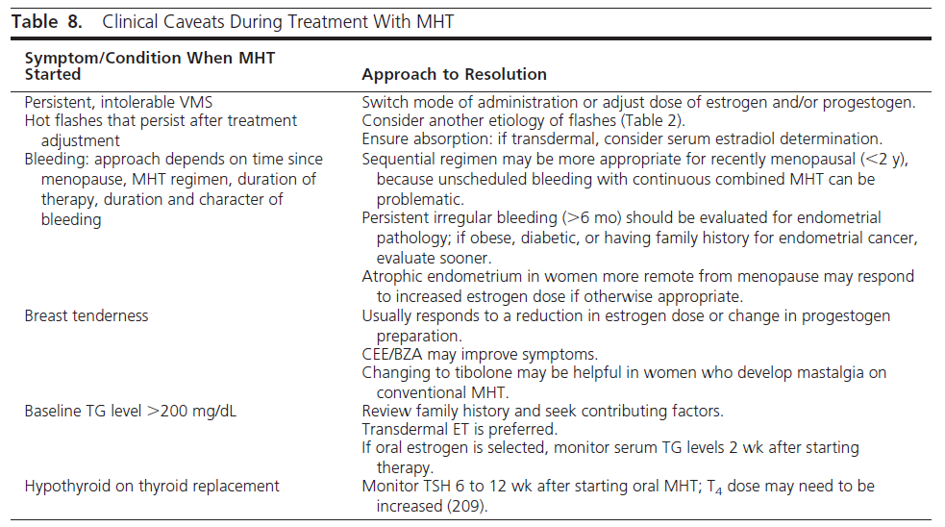

Slide 76
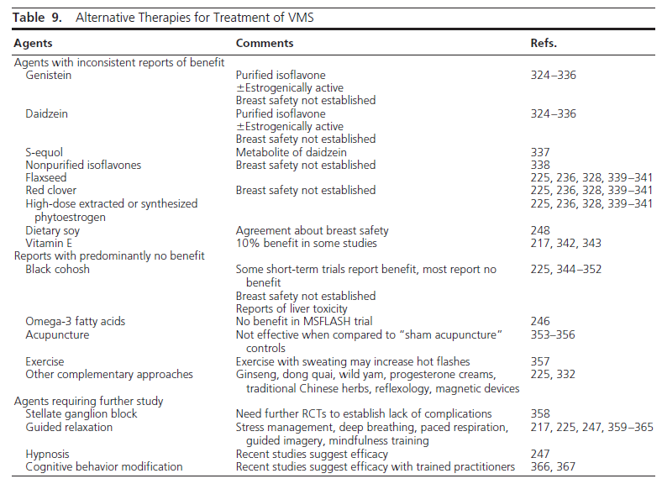

Slide 77
.
Benefits of MHT
Vasomotor symptoms
ET is the most effective treatment for VMS and improving QOL in symptomatic women . In a dose-dependent manner, MHT reduces hot flash frequency by approximately 75% and severity by 87%, compared with 50% with placebo.

Slide 78
Genitourinary syndrome of menopause
Systemic estrogen administration effectively treats VVA and improves symptoms of overactive bladder and recurrent urinary tract infections .
With lower doses of systemic MHT, vaginal symptoms may persist and local therapy may be needed.

Slide 79
Sleep disruption
Large placebo-controlled trials reported significantly fewer sleep disturbances with MHT use , but additional data are required for definitive conclusions.
Anxiety and depressive symptoms
Anxiety symptoms increase during the menopause transition and are associated with an increased likelihood of a major depressive disorder .
ET may improve mild to moderate depressive symptoms during or shortly after the menopause transition, whereas antidepressant therapy remains appropriate treatment for major depression

Slide 80
Arthralgia
Joint pain or stiffness and general aches or pains were improved in women receiving EPT .Joint pain increased slightly after discontinuation of treatment.

Slide 81
Potential preventive benefits of menopausal hormone therapy
Bone loss and fracture
. RCTs, observational studies, and meta-analyses consistently report reduction in bone loss with ET.
The updated WHI analysis reports a significant reduction in vertebral fractures and a borderline significant reduction for all fractures with EPT in women ages 50 to 59 years ; this effect was greater than with ET .
Benefit may also be dose-related.

Slide 82
Type 2 diabetes.
RCTs and large observational studies. reported that MHT reduced the prevalence of self-reported diabetes by 14 to19%.an effect that did not persist after therapy was discontinued.
Colorectal cancer.
In clinical trials, EPT was associated with a non significant lower incidence of colorectal cancer in women ages 50 to 59 .Cancers that did occur in women receiving EPT, however, were diagnosed at a more advanced stage when all age groups were considered .The reduction in cancer during active therapy did not persist after discontinuation.

Slide 83
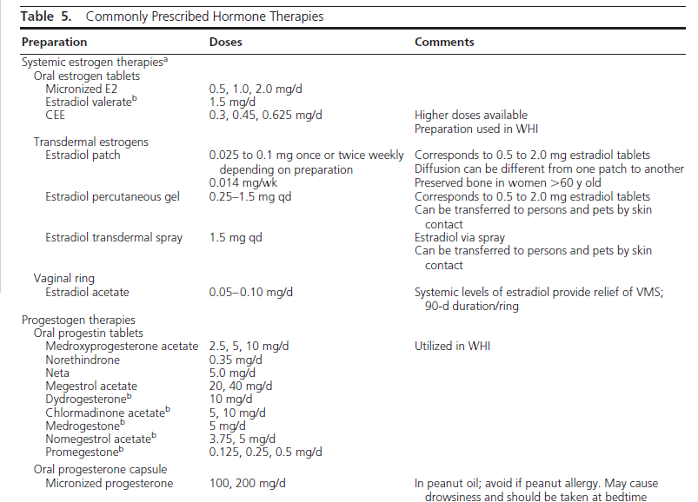

Slide 84
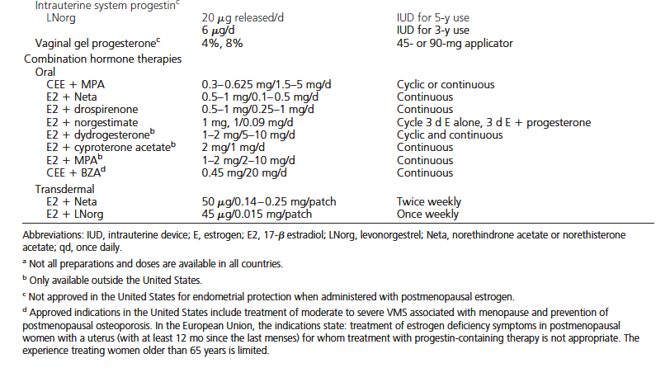

Slide 85
Risks of MHT
Endometrial cancer
Unopposed ET increases the risk of endometrial hyperplasia and cancer , whereas concurrent progestogen therapy for at least 12 days per month reduces this risk and is recommended for all women with a uterus.
.

Slide 86
Breast cancer
Estrogen therapy. Most, but not all, observational studies report an increased breast cancer risk with oral or transdermal estradiol when initiated in recently menopausal women .
This increase occurs as a function of duration of ET with a linear trend in the largest study .

Slide 87
Lung cancer
In the 50- to 59-year age group in the WHI study, the incidence of lung cancer was not significantly increased or decreased in either treatment arm.

Slide 88
Ovarian cancer
. A controversial meta-analysis of 52 observational studies showed an increase of 0.52 cases/1000 in women starting MHT(no difference in risk between ET and EPT) at age 50 and continuing therapy for 5 years.

Slide 89
Coronary heart disease
Estrogen therapy. The age at initiation of ET influences risk. In the WHI, there was a trend toward a reduction in CHD and total MI in women aged 50 to 59 years at trial enrollment .
In summary, ET does not increase CHD risk in women starting therapy at ages 60 years and may possibly reduce this risk
A meta-analysis reported
no significant difference in CHD outcomes between oral and transdermal MHT . No associations with estrogen dose were reported.

Slide 90
Combined EPT.
an increased risk of CHD among women close to the onset of menopause, and if any risk elevation is present in women younger than 60 years, its magnitude is small. A definitive conclusion regarding CHD risk requires an appropriately powered RCT.

Slide 91
Stroke
Researchers reported a non significant trend toward an increase in stroke risk with EPT in women ages 50 to 59 in the WHI.. When examined by years since menopause, ET increased stroke risk in women 10 years since menopause.
In summary, MHT may confer a small risk of stroke.

Slide 92
Venous thromboembolic events
Estrogen therapy. RCTs demonstrate that oral ET increases VTE risk in women ages 50 to 59 . These data are supported by observational studies .Risk declined after discontinuing therapy .
Observational studies and meta-analyses suggest that transdermal ET does not increase VTE risk, even in women with thrombophilia or obesity .

Slide 93
Combined EPT.
The WHI trial found an association between EPT and both DVT and pulmonary embolism (PE) in women ages 50 to 59 . Risks resolved when therapy was discontinued.
Observational studies suggest that formulations containing MPA and normethytestosterone derivatives appear to be associated with greater risk than other progestogens.
A recent meta-analysis comparing ET and EPT did not report any statistically significant differences in risk .

Slide 94
Gallbladder disease
Observational studies report increased risk with oral, but not transdermal, estradiol and increased dose and duration .

Slide 95
Incontinence
Stress urinary incontinence, urge urinary incontinence, and mixed urinary incontinence increase in women taking oral ET and EPT .
An increased risk may persist after discontinuation .

Slide 96
Uncertain benefits of hormone therapy
Mortality
A meta-analysis of RCTs demonstrated no significant effect on all-cause mortality with MHTuse, but these data included women< and > 60 years of age.
summary, further data are required for definitive conclusions about mortality in younger women.

Slide 97
Dementia
Observational studies suggest a possible benefit of MHT if started in younger women closer to menopause
Some studies of postmenopausal women treated with estradiol reported an improvement in verbal memory and executive function, whereas other studies did not associate CEE therapy with cognitive improvement.

Slide 98
Metabolic syndrome. The metabolic syndrome (MetS) is associated with higher risk of cardiovascular events and breast and colon cancers ..
Transdermal estradiol with micronized progesterone might have less deleterious metabolic effects than oral therapies,
but there are no RCTs that have evaluated the safety of these preparations in women with MetS.

Slide 99
Diabetes.
Diabetes is considered by the AHA to be aCHD risk equivalent,
which would suggest that women with diabetes should not take MHT.

Slide 100
. However, some diabetic women, after careful evaluation of cardiovascular risk, may be candidates for MHT,
preferably transdermal estrogen and micronized progesterone or another less metabolically active progestogen.

Slide 101
Cutaneous and transdermal estradiol.
Cutaneous and transdermal estradiol, administered via percutaneous gels, sprays, emulsions, or transdermal patches, have a similar efficacy as oral ET in reducing climacteric symptoms and are easily tailored to the individual .
Transdermal therapies, at low doses, are preferable for women with a VTE risk, as evidenced by a recent metaanalysis commissioned for these guidelines , and they may also be preferable in patients with hypertension, hypertriglyceridemia, obesity, MetS, diabetes, or a history of gallbladder disease.

Slide 102
Vaginal delivery of systemic estrogens.
Estradiol acetate vaginal rings, delivering 50 or 100 g of estradiol daily (Table 5), provide consistent systemic estradiol levels for 3 months per ring insertion.
They are indicated for treatment of moderate to severe VMS and VVA due to menopause .
High-dose vaginal creams containing estradiol or CEE (ie, 1–2 g) also result in systemic estrogen levels. Concomitant progestogen is needed with these preparations to abrogate endometrial stimulation.

Slide 103
Progestogen administration
In women with a uterus, a progestogen must be added to prevent endometrial hyperplasia and cancer. The various formulations (Table 5) are administered in two regimens. The combined sequential regimen includes estrogen for 20 to 25 days and a progestogen for 12 to 15 days each month.
This approach is preferred for recently menopausal woman who are prone to breakthrough bleeding during the first year or two of therapy. The combined continuous regimen utilizes both an estrogen and prodoi gestogen daily on a continuous basis.
Clinicians can administer progestogen orally, transdermally by patch, vaginally, or by intrauterine administration .

Slide 104
Progestogen alone.
For those who do not tolerate ET, progestogens can relieve VMS. In RCTs, oral synthetic progestogens (Table 5) and micronized progesterone were effective.
Clinical outcome trials are lacking in women with breast cancer; thus, progestogen therapy is best avoided, except under limited circumstances in these patients, because the effect on recurrence is unclear .

Slide 105
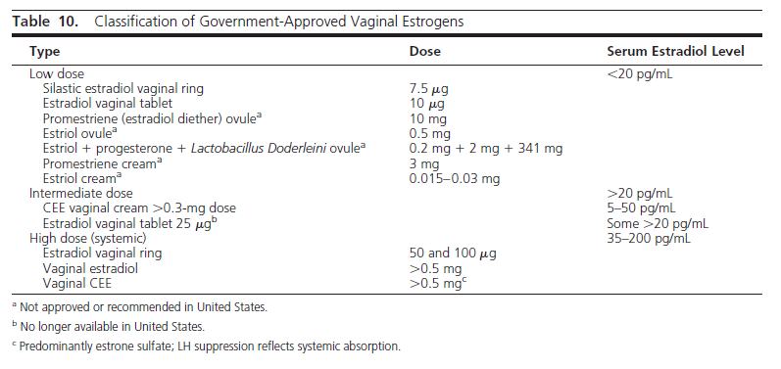

Slide 106
Low-dose therapies
Low-dose vaginal ring. Low-dose vaginal rings result in estradiol levels that remain within the normal postmenopausal range;
however, bone resorption and lipid levels decrease, suggesting possible systemic effects.
Insertion and removal at 3-month intervals may be difficult, the ring can be sensed during intercourse, and it can be expelled, particularly in women who have undergone a hysterectomy .
.

Slide 107
Vaginal estradiol tablets.
The 10-g tablet provides standard twice weekly dosing, relieves vaginal symptoms by 8 weeks, and is effective for at least 52 weeks .
Therapy is initiated with daily administration for 2 weeks, and then twice weekly thereafter.
Promestriene (estradiol diether). This is a low-dose estrogen used outside the United States.

Slide 108
Intermediate-dose vaginal estrogen
The 25-g estradiol tablets increase plasma estradiol from 3.1 ± 0.83 to 19.8± 6.1 pg/mL by 7 days .
Intermediate-dose estradiol and CEE creams provide flexibility of dosing, allow treatment from the introitus to the vaginal apex, and provide the emollient effect of vehicle. Some systemic absorption exists .

Slide 109
Systemic-dose vaginal estrogen
CEE 0.625- to 2.5-mg vaginal cream, administered daily, results in systemic effects as evidenced by LH and FSH suppression .

Slide 110
Other hormonal agents
Estriol vaginal preparations (gels and suppositories) are manufactured and government regulated in a number of countries outside the United States.
Estriol is considered a low-affinity estrogen and, despite increased plasma concentration after repeated vaginal administration, is not considered to have substantial systemic effects .

Slide 111
Adverse events
. Side effects include vulvovaginal candidiasis and, with higher dosing and systemic absorption, vaginal bleeding and breast pain .
Increased CVD or VTE risk has not been reported . This may reflect an actual neutral effect due to the absence of a first-pass hepatic effect by vaginal estrogens, or that studies of women at high CVD or VTE risk are lacking .

Slide 112
Evidence
Breast cancer
Whether small increases in circulating estrogens from low-dose vaginal estrogen can stimulate the growth of residual breast cancer cells remains an unanswered question.
However, for women taking aromatase inhibitors, the effectiveness of which dependsupon blocking up to 95% of estrogen synthesis and reducingcirculating estradiol levels to 1 pg/mL , caution is raised because minimal amounts of estrogen can be absorbed with low-dose vaginal ET.
In a cohort case-control study of 13 479 breast cancer survivors taking adjuvant tamoxifen or aromatase inhibitor therapy for at least 1 year, after 3.5 years of concurrent administration of the low-dose estrogen ring or 10-g vaginal tablet, breast cancer recurrence did not increase (relative risk, 0.78; 95% CI, 0.48–1.25). These data are insufficient, however, to conclude safety and to recommend this approach

Slide 113
Endometrial cancer
The effect of low-dose vaginal ET on endometrial cancer recurrence is unknown. The only RCT attempting to evaluate the effect of systemic ET on recurrence rate and survival in women after surgery for stage I or II endometrial cancer was closed prematurely without complete enrollment .
In the absence of RCT findings to guide practice recommendations, the decision to use ET remains controversial and involves assessing the severity of postmenopausal symptoms and tumor characteristics .

Slide 114
Evidence
Raloxifene has neutral vaginal effects . In two clinical trials, vaginal, but not oral ET, was safely used to treat vaginal symptoms in women taking raloxifene without untoward endometrial effects
5.2d For women using low-dose vaginal ET, we suggest against adding a progestogen (ie, no need for adding progestogen to prevent endometrial hyperplasia). (2QEEE)
5.2e For women using vaginal ET who report post menopausal bleeding or spotting, we recommend prompt evaluation for endometrial pathology. (1QQEE)

Slide 115
Evidence
Bleeding or spotting in a woman using only vaginal estrogens is uncommon in the absence of endometrial pathology.
The 2006 Cochrane review of 19 studies found no significant difference among vaginal creams, tablets, or rings in terms of endometrial thickness or hyperplasia or in the proportion of women with adverse events .

Slide 116
با تشکر

