Slide 1
IN THE NAME OF GOD

Slide 2


Slide 3
Thyroid lymphoma
By Dr Karimifar
Assistant Prof. of Endocrinology
Isfahan University of Medical Sciences

Slide 4
Primary lymphoma of the thyroid
Although rare, should always be considered in the differential diagnosis of patients with
thyroid nodules
goiter
Carcinomas
mainly because its prognosis and treatment differ substantially from that of the other disorders.

Slide 5
Thyroid lymphomas
Are nearly always of the non-Hodgkin's type, as Hodgkin lymphoma of the thyroid is exceedingly rare.
Only about 2 percent of extranodal lymphomas arise within the thyroid gland, and lymphomas represent no more than 2 percent of all malignant thyroid tumors.

Slide 6
The annual incidence rate
In a Danish epidemiologic survey, the annual incidence rate was estimated to be 2.1 per million persons,
Female/ Male=4/1 (1) 3/1 (2)
The mean and median ages at diagnosis are between 65 and 75 years.(1)
With males being affected 5–10 years earlier than females(2)
1=uptodate 2=Oncologist. 2013 Sep; 18(9): 994–1003.

Slide 7
ETIOLOGY
Chronic autoimmune (Hashimoto's) thyroiditis(1/2){the only known risk factor for primary thyroid lymphoma}
  The risk of PTL is between 40 and 80 times higher in patients with HT, which typically develops 20–30 years after the initial diagnosis. suggesting that chronic antigenic stimulation may play a role in pathogenesis.
May also commonly after iodine supplementation
No clear association between exposure to ionizing radiation
Chromosomal abnormalities are rare in thyroid lymphomas

Slide 8
CLASSIFICATION AND PATHOLOGY
(1)
Primary thyroid lymphoma is:
  B-cell lineage(almost always)
  T-cell lymphomas (Occasional)
    {often in areas endemic for HTLV-I-associated adult T-cell leukemia/lymphoma.}

Slide 9
CLASSIFICATION AND PATHOLOGY(2)
Diffuse large B-cell lymphomas (60-80%)
  and considered to be of follicle center cell origin.
  Diffuse B-cell lymphoma and mixed subtypes and pure MALT lymphomas.
Extranodal marginal zone lymphoma (30%)
  (mucosa-associated lymphoid tissue (MALT) type are generally associated with Hashimoto's thyroiditis)
Other less common histologic subtypes include
  follicular lymphomas;
  extranodal small lymphocytic lymphomas

Slide 10
Diffuse B-cell lymphomas have an aggressive clinical course and should be considered for multimodal treatment, whereas MALT lymphomas pursue a more indolent course and may be treated adequately with single therapeutic strategies.

Slide 11
Molecular abnormalities
Reportedly associated with marginal zone lymphomas (including thyroid) have included
a loss of expression of bcl-2 and
an increase in p53 inactivation with higher grade disease.
Although the pathogenic significance is unknown, Epstein-Barr virus gene expression has been reported in thyroid lymphomas.

Slide 12
CLINICAL PRESENTATION
Rapidly enlarging goiter [>90%] , painless goiter
Many patients have symptoms or signs of tracheal, esophageal or neck vein compression:
  dysphagia
  dyspnea
  stridor
  hoarseness
  neck pain
  facial edema
  Although these findings are usually present for only a few months, 10 to 20 percent of patients have a longstanding history of goiter, often in association with hypothyroidism.

Slide 13
CLINICAL PRESENTATION
Solitary nodule (occasional)
Small, slow-growing thyroid masses (some of the MALT lymphomas )

Slide 14
Lymphoma of the thyroid should be considered in all patients with:
a rapidly enlarging goiter
a solitary thyroid nodule
a dominant nodule in a multinodular goiter
and in any patient with Hashimoto's thyroiditis with an enlarging goiter.

Slide 15
Clinical characteristics of primary thyroid lymphoma In Koreans
Endocrine Journal 2009,56(3),399-405

Slide 16
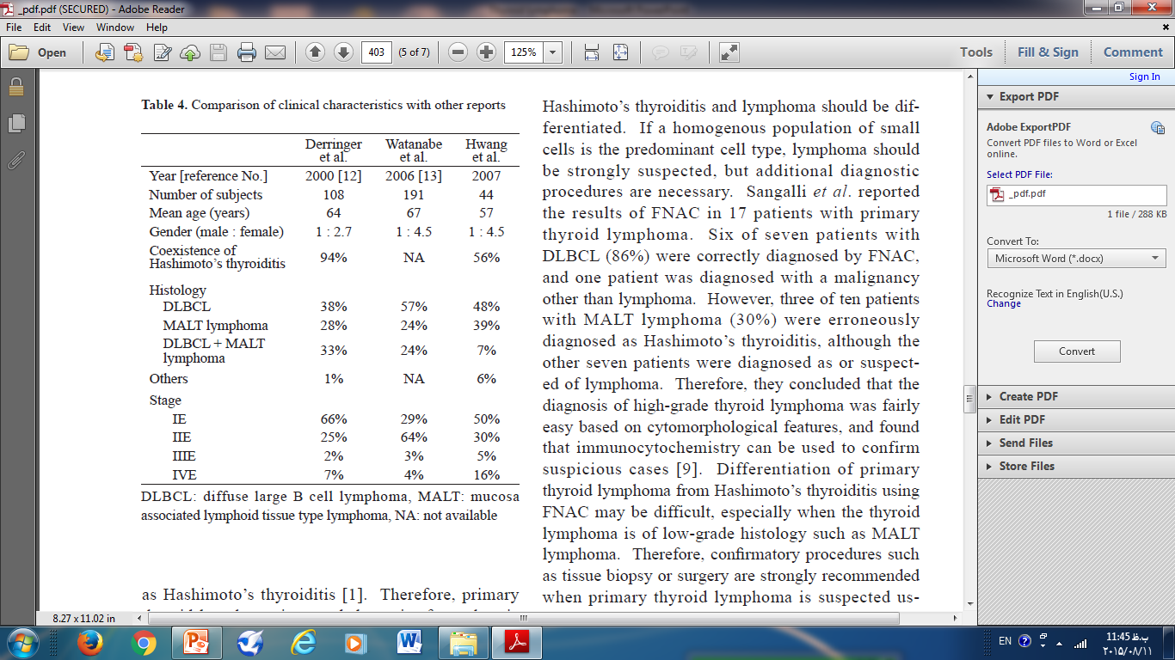

Slide 17
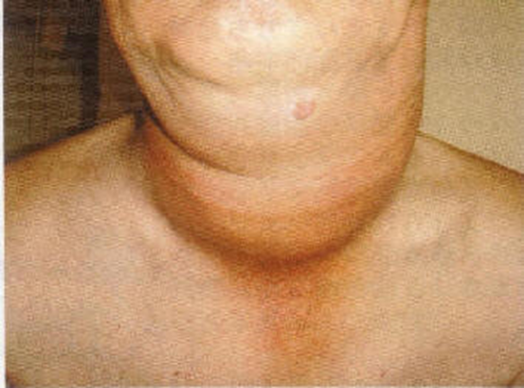
A large mass was evident in the anterior neck.

Slide 18
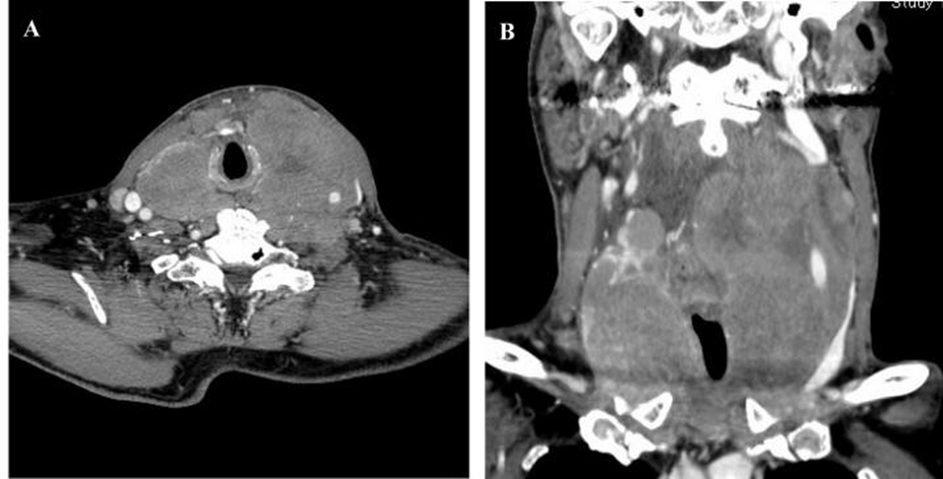
CT scan of the neck with enhancement revealed a large cervical mass arising from thyroid which completely encircled the narrowed trachea (A: coronal section; B: transverse section).

Slide 19
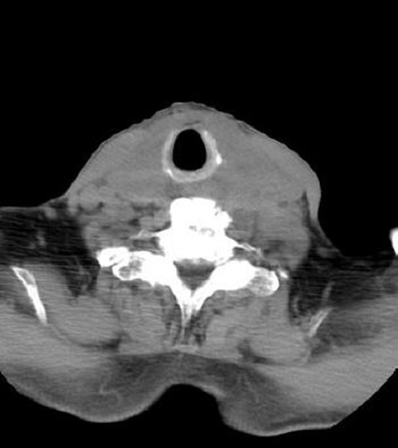
CT scan of the neck 3 weeks after the initiation of combination chemotherapy revealed the mass dramatically decreased in size.

Slide 20
Images from a 56-year-old man with hypothyroidism for 3 years and a recently enlarging neck mass.

Slide 21
Transverse sonogram of the left thyroid gland shows an enlarged and markedly hypoechoic mass compared with the hypoechogenicity of the right thyroid gland.

Slide 22
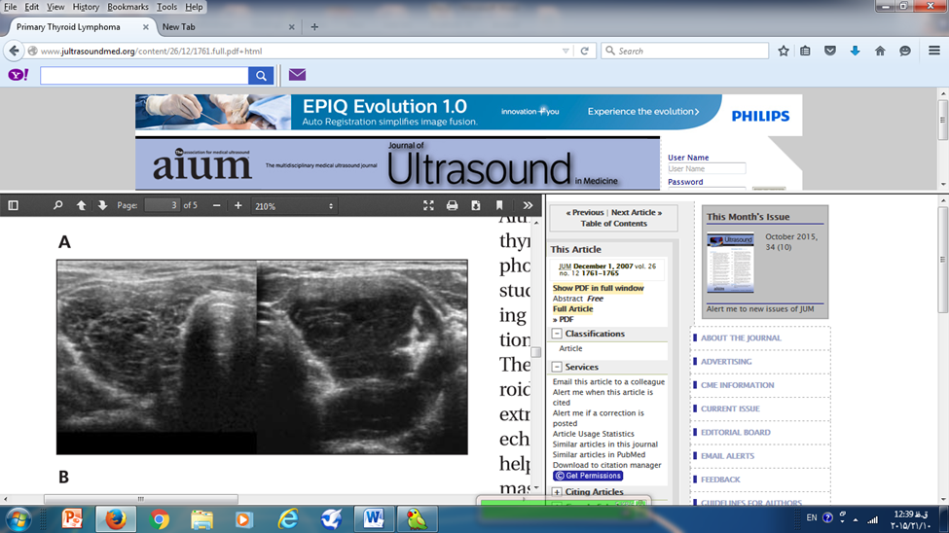

Slide 23
Diffuse large-cell type malignant lymphoma. (A)
Malignant lymphoid cells diffusely infiltrated the thyroid gland with residual thyroid follicles [haematoxylin and eosin (H&E) stain, low magnification].

Slide 24
Neoplastic cells with rounded nuclei and central nucleoli surrounding the thyroid follicle (H&E stain, high magnification).

Slide 25
Neoplastic cells plugging into the thyroid follicle (H&E stain, higher magnification).

Slide 26
On examination
The thyroid is:
Firm
Even hard
Slightly tender (may be )
Fixed to adjacent structures and immobile with swallowing (often).
Substernal extension (common)
Distinct intrathyroidal mass (the diameter is typically greater than 5 cm, but often the exact borders of the goiter cannot be defined.
Enlarged cervical or supraclavicular lymph nodes (About one-half of patients ).
Hoarseness (laryngoscopy will often reveal vocal cord paresis)

Slide 27
Systemic ("B") symptoms of lymphoma(10%), including:
  fever,
  night sweats
  weight loss (10 percent of body weight or more)
Hypothyroidism (10%)
  usually caused by Hashimoto's thyroiditis but occasionally due to diffuse infiltration of the thyroid by the lymphoma.
Hyperthyroidism (A few patients)
  caused by tumor-induced thyroid follicular inflammation and destruction , or preexisting Graves' hyperthyroidism .

Slide 28
DIAGNOSTIC EVALUATION
(laboratory abnormalities)
There are no laboratory abnormalities that are either specific to or diagnostic of thyroid lymphoma.
Hypothyroidism(some patients)
High serum concentrations of anti-TPO or anti-Tg (many), indicative of Hashimoto's thyroiditis.
Approximately 30 percent of patients have high serum concentrations of IgA, IgM, or IgG.

Slide 29
DIAGNOSTIC EVALUATION
An ultrasound scan of the thyroid gland
and needle biopsy or
excisional biopsy are usually recommended as initial diagnostic procedures.
Ultrasound of the thyroid typically demonstrates pseudocystic, hypoechoic areas that can easily be mistaken for cysts. In one series, thyroid ultrasound showed a characteristic asymmetrical pseudocystic pattern in 43 of 46 patients with thyroid lymphomas (93 percent).

Slide 30
Ultrasound scan of the thyroid gland
Hypoechogenic (difficult to differentiate from chronic thyroiditis)
the intensity of the echoes behind the lesion (due to enhanced transmission of the signal through uniform tissue that minimally reflects ultrasound).
Nodular lymphoma reportedly has a very uniform and hypoechoic pattern that may be sufficiently hypoechoic to be pseudo-cystic.
The border between lymphoma and non-lymphomatous tissue is well defined and the borderline may be "broccoli-like" or "coastline-like" irregular.
The mixed type lymphoma showed multiple, patchy hypoechoic lesions, each with enhanced posterior echoes.

Slide 31
FNA cytology is often nondiagnostic for thyroid lymphoma
Given the frequent coexistence of Hashimoto's thyroiditis, small lymphocytic lymphomas are more difficult to diagnose cytologically, and immunohistochemical staining or flow cytometry may be necessary to establish monoclonality and characterize surface markers

Slide 32
Large-bore needle biopsy or Excisional biopsy
When the fine needle aspiration biopsy results are suggestive of lymphoma or when the clinical suspicion for lymphoma is high in the presence of a nondiagnostic fine needle aspiration biopsy, subsequent large-bore needle biopsy or excisional biopsy is required in order to obtain sufficient material for definitive diagnosis by immunohistochemical studies, especially since curative treatment is available for some of these NHL variants.

Slide 33
Imaging
PET
Radioiodine scanning
CT
MRI

Slide 34
PET
Difficulty in distinguishing Hashimoto's thyroiditis from lymphoma can be a particular problem using 18-fluorodeoxyglucose (FDG) positron emission tomography (PET) imaging, as both can cause diffuse uptake throughout the gland, whereas mucosa-associated lymphoid tissue (MALT) lymphomas of the thyroid generally produce false negative PET imaging.
Fluorine-18-fluorodeoxyglucose positron emission tomography (FDG-PET) can be useful in staging and restaging or in assessing response to treatment in PTL

Slide 35
Radioiodine scanning
has no diagnostic role in patients with thyroid lymphomas because the malignant cells lack iodine-concentrating ability.

Slide 36
Radiographic Studies(1)
Are not helpful for diagnosis, they are useful in:
defining the extent of disease
planning therapy
and monitoring the response to treatment .
Imaging should include a contrast-enhanced computed tomography scan of the neck, (chest, abdomen, and pelvis)

Slide 37
Radiographic Studies(2)
CT and MRI are superior to ultrasonography for evaluating local extent because of their greater ability to detect :
tracheal invasion
substernal extension,
and involvement of cervical, mediastinal, or abdominal nodes.
MRI may be more sensitive for defining the extent of extrathyroidal invasion, but it costs more and its superiority is unproven. three Different appearances on CT (solitary nodule, multiple nodules, diffuse enlargement), with the most common pattern being diffuse enlargement.
Another characteristic CT finding is the so-called "donut sign," observed when the lymphoma completely encircles the trachea

Slide 38
Staging
The Lugano classification is the current staging system used for patients with NHL.
This staging system focuses on the:
number of tumor sites (nodal and extranodal) and
their location

Slide 39
Revised staging system for primary nodal lymphomas (Lugano classification)
Stage | Involvement | Extranodal (E) status
Limited
I | One node or a group of adjacent nodes | Single extranodal lesions without nodal involvement
II | Two or more nodal groups on the same side of the diaphragm | Stage I or II by nodal extent with limited contiguous extranodal involvement
II bulky* | II as above with "bulky" disease | Not applicable
Advanced
III | Nodes on both sides of the diaphragm; nodes above the diaphragm with spleen involvement | Not applicable
IV | Additional noncontiguous extralymphatic involvement | Not applicable

Slide 40
Lugano classification(2)
Extent of disease is determined by positron emission tomograph/computed tomography (PET/CT) for avid lymphomas and CT for nonavid histologies. Tonsils, Waldeyer's ring, and spleen are considered nodal tissue.
* Whether stage II bulky disease is treated as limited or advanced disease may be determined by histology and a number of prognostic factors.

Slide 41
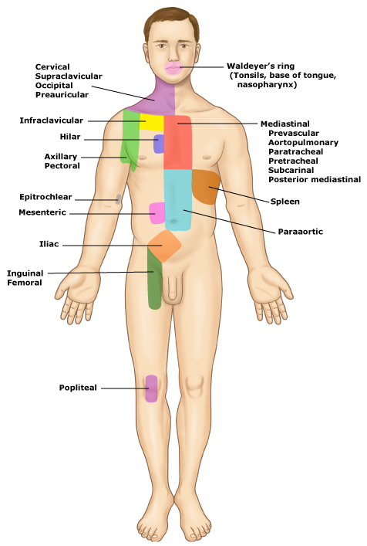

Slide 42
About 50 percent of patients present with disease limited to the thyroid gland, designated stage IE.
About 45 percent have disease limited to the thyroid and locoregional nodes, classified as stage IIE.
Only about 5 percent have lymphoma in nodal groups on both sides of the diaphragm (stage IIIE) or diffuse organ involvement (stage IV). Among the extranodal sites that have been reported are bone marrow, gastrointestinal tract, lungs, liver, pancreas, and kidney.

Slide 43
Initial staging work-up for a patient with primary thyroid lymphoma
TSH
and CT of the neck,
the same testing used for non-Hodgkin lymphoma of any site:
CBC diff, PLT, and examination of the peripheral smear for the presence of atypical cells, suggesting peripheral blood and bone marrow involvement
Biochemical tests including:
BUN, Cr, ALK P, AST, ALT, LDH, and Albumin
Serum calcium, electrolytes, and uric acid
Serum protein electrophoresis
HIV, hepatitis B and C serology
Beta-2 microglobulin levels (in patients with indolent lymphomas)

Slide 44
Bone marrow aspiration and biopsy (BM biopsy may not necessary if the PET indicates bone or marrow involvement).

Slide 45
TREATMENT

Slide 46
Severe airway compromise
May occur in up to 25 percent of patients with thyroid lymphoma, often precipitously due to rapid growth of an aggressive lymphoma variant (eg, diffuse large B-cell lymphoma [DLBCL]).
Such tumors shrink within hours after initiation of combination chemotherapy (eg, rituximab-CHOP), due to the rapid effect of the steroid component, potentially obviating the need for tracheotomy. Since such treatment also rapidly modifies tumor histopathology, tissue biopsy should be performed before such agents are started.

Slide 47
Surgery(1)
In most centers, definitive surgery for thyroid lymphoma is not usually performed and surgery is utilized for diagnostic biopsy only.

Slide 48
Surgery(2)
There is little evidence that thyroidectomy is of value in patients with stage IIE or IIIE thyroid lymphoma. This was illustrated by a report of 62 patients with thyroid lymphoma who were treated with either diagnostic biopsy or debulking surgery, both followed by radiation. There was no difference in the rate of complete remission or in cause-specific survival in patients who underwent debulking surgery plus adjuvant therapy compared with those treated with diagnostic biopsy and definitive radiation.

Slide 49
Surgery(3)
In patients with clinical stage IE disease (particularly mucosa-associated lymphoid tissue [MALT] lymphomas), surgery may permit the distinction between intrathyroid tumor, which may be treatable by local therapy alone (surgery followed by postoperative radiation), and extrathyroid extension, which appears to require systemic chemotherapy.
There may be a role for surgical intervention in MALT lymphomas, although its sole use remains debatable. Typically, MALT lymphomas are detected incidentally when the thyroid is removed for another indication and, if confined to the thyroid (stage IE), may not require further adjuvant treatment.

Slide 50
Surgery in MALT lymphomas is contraindicated
in lymphoma higher than stage IE
in bulky tumors greater than 10 cm
and in mixed tumors.
Given that MALT lymphomas do not compose the majority of PTL, surgery is not a mainstay of treatment.

Slide 51
Radiation and chemotherapy

Slide 52
Radiation and chemotherapy
Effective treatment of thyroid lymphoma depends upon the tumor type and extent of disease.

Slide 53
DLBCL of The Thyroid
Patients with localized, early stage disease can be treated with either :
Three courses of combination therapy (eg, CHOP plus rituximab ), followed by radiation therapy to the thyroid bed
or
Six to eight cycles of CHOP plus rituximab without radiation.

Slide 54
Localized extranodal marginal zone lymphoma of the thyroid or other indolent histologies (eg, follicular lymphoma, small lymphocytic lymphoma)
Can be effectively treated with
radiation therapy alone.
Those with advanced stage indolent histologies are usually treated with:
single agent rituximab or chemoimmunotherapy, depending on the clinical scenario.

Slide 55
Marginal zone lymphoma (MZL)
is a subtype of non-Hodgkin lymphoma (NHL) that includes three distinct diseases that have historically been classified together because they appear to arise from post-germinal center marginal zone B cells and share a similar immunophenotype:
Splenic marginal zone B cell lymphoma
Extranodal marginal zone B cell lymphoma of mucosa associated lymphoid tissue (MALT) type (MALT-type lymphoma, MALT lymphoma)
Nodal marginal zone B cell lymphoma

Slide 56
EXTRANODAL MARGINAL ZONE LYMPHOMA
Extranodal MZL, also called low grade B cell lymphoma of mucosa-associated lymphoid tissue (MALT), is an extranodal lymphoma that arises in a number of epithelial tissues, including the stomach, salivary gland, lung, small bowel, and elsewhere. For treatment purposes, extranodal MALT is separated into those developing in the stomach (gastric MALT) and those developing in non-gastric extranodal locations (non-gastric MALT).

Slide 57
Non-gastric MALT
— The most common non-gastric sites of extranodal MALT are the small intestine, salivary gland, lung, head and neck, ocular adnexa, skin, thyroid, and breast .
The treatment of non-gastric MALT depends principally upon the stage of disease at diagnosis. More than one-third of patients with non-gastric MALT will have advanced disease at the time of diagnosis.

Slide 58
MALT lymphoma
Limited stage(ie, stage I-II) is generally treated with:
local therapy
or
managed expectantly.
Advanced disease is treated with:
immunotherapy
or
chemoimmunotherapy
in a similar fashion to the more common indolent lymphoma, follicular lymphoma.

Slide 59
Of importance, patients with MALT of any stage who demonstrate coexistent large cell lymphoma are treated as diffuse large B cell lymphoma.

Slide 60
Patients with multifocal disease should have a bone marrow aspiration and biopsy to evaluate for bone marrow involvement. Stage is determined by with the Lugano modifications of the Ann Arbor staging system

Slide 61
Limited (stage I-II) disease extranodal MALT
— Limited stage extranodal MALT includes those patients with involvement of a single extralymphatic site (IE) or a lymph node extending into a contiguous extralymphatic organ or tissue (IIE).
Locoregional radiation therapy is the main treatment option for limited stage disease.
Surgery is typically used for diagnostic purposes only but may play a role in the treatment of tumors in areas not conducive to radiation therapy (eg, lung).
The addition of adjuvant chemotherapy or antibiotic therapy has not demonstrated improved disease-free or overall survival rates.
There are occasional patients with stage I disease who are not ideal candidates for radiation therapy and may be initially observed closely.
With this approach, rates of complete response and local control are in excess of 90 percent

Slide 62
Surgery
– Surgery may be used as initial therapy for early stage MALT in locations not amenable to radiation, although with the low doses of radiation required, nearly all sites can be treated . While surgery is not the initial treatment of choice for extranodal MALT, the pathologic diagnosis of MALT may become apparent only after a resection has taken place. If extranodal MALT lymphoma is diagnosed with an excisional biopsy and there is no evidence of residual disease, patients may be followed with close observation. However, if an initial surgical specimen demonstrates positive margins, adjuvant involved field RT is administered to avoid local recurrence

Slide 63
Adjuvant chemotherapy
•The addition of anthracycline-based chemotherapy to RT in one randomized study of 98 previously untreated patients with stage IE primary orbital MZL did not improve the results obtained following RT alone .
•A retrospective study of 38 patients with stage III/IV nongastric MZL reported that the use of an anthracycline-containing chemotherapy regimen after RT improved the rate of complete remission but not progression-free survival.

Slide 64
Advanced (stage III-IV) disease — Advanced stage extranodal marginal zone lymphoma (MZL) includes those patients with extranodal disease plus multiple sites of nodal involvement (stage III-IV).

Slide 65
Until more information is available on outcomes in this patient population, these patients are typically treated in a similar fashion to those with advanced stage follicular lymphoma.
Management usually includes:
immunotherapy with monoclonal antibodies directed at CD20 (eg, rituximab)
with or without chemotherapy.

Slide 66
PROGNOSIS
For patients with clinically localized thyroid lymphoma, prognosis is dependent upon:
histology
type of treatment
Stage
disease bulk
and other prognostic factors that are collectively grouped within available International Prognostic Indices for the non-Hodgkin lymphomas.

Slide 67
Thyroid function
In addition to hypothyroidism from:
underlying Hashimoto’s thyroiditis or
infiltration of the thyroid by the lymphoma,
patients who receive radiation to the thyroid (due to mantle, craniospinal, or total body irradiation)
are at risk for developing primary hypothyroidism.
The risk increases with higher doses of radiation and longer time interval from the initial radiation. High-dose radiation to the hypothalamic-pituitary area may increase the risk of central hypothyroidism. Chemoimmunotherapy (eg, CHOP plus rituximab) is not associated with hypothyroidism.

Slide 68
Checking Thyroid Function
We recommend checking thyroid function within:
six months after high-dose radiation,
and at least annually thereafter TSH for most patients
both TSH and free thyroxine [T4] if the hypothalamic-pituitary area has been irradiated).
Additionally, children and young adults with radiation exposure to the thyroid should be monitored for:
radiation-associated thyroid neoplasia
the highest risk is for exposures between 5 and 39 Gy and is lower above 40 Gy.

Slide 69
Most treatment failures occur:
in distant sites
which has led to the recommendation that:
combined modality therapy
should be considered in all but those with small tumors that are limited to the thyroid gland. The outcome may be better for patients treated with combined modality therapy.

Slide 70
In one series of 51 patients with localized (stage I or II) thyroid lymphoma, five-year failure-free survival rates were 76, 50, and 91 percent for patients treated with radiation, chemotherapy, or combined modality therapy, respectively .

Slide 71
In another series of 171 patients with localized (stage IE or IIE) thyroid lymphoma, five-year event-free survival rates for aggressive (diffuse large B-cell lymphoma [DLBCL] and DLBCL with mucosa-associated lymphoid tissue [MALT]) and indolent (MALT) lymphoma was 73 and 89 percent, respectively .The majority of patients were treated with combined modality therapy.

Slide 72
Rituximab, cyclophosphamide, doxorubicin, vincristine, and prednisone (R-CHOP21) for non-Hodgkin lymphoma^{[1]}
Cycle length: 21 days.
Drug | Dose and route | Administration | Given on days
Rituximab | 375 mg/m² IV | Dilute in normal saline (NS) or 5 percent dextrose in water (D5W) to a final concentration of 1 to 4 mg/mL. Initial infusion: start at 50 mg/hour; escalate in 50 mg/hour increments every 30 minutes to a maximum of 400 mg/hour, as tolerated^{[2]}. For subsequent infusions, administer 20 percent of the total dose over the first 30 minutes and the remaining 80 percent over 60 minutes, as tolerated. The 90-minute infusion schedule should NOT be used in patients who have clinically significant cardiovascular disease or have a circulating lymphocyte count ≥5000/microL. | Day 1
Cyclophosphamide | 750 mg/m² IV | Dilute in 250 mL NS or D5W and administer over 30 minutes. | Day 1
Doxorubicin | 50 mg/m² IV | Dilute in 50 mL NS or D5W and administer over three to five minutes. | Day 1
Vincristine | 1.4 mg/m² IV | Dilute in 50 mL NS or D5W and administer over 15 to 20 minutes. | Day 1
Prednisone | 100 mg orally | Administer 30 minutes prior to chemotherapy on day 1, then every 24 hours on days 2 to 5. | Days 1 to 5

Slide 73
Rituximab, cyclophosphamide, doxorubicin, vincristine, and prednisone (R-CHOP21) for non-Hodgkin lymphoma^{[1]}
Cycle length: 21 days.
Drug | Dose and route | Administration | Given on days
Rituximab | 375 mg/m² IV | Dilute in normal saline (NS) or 5 percent dextrose in water (D5W) to a final concentration of 1 to 4 mg/mL. Initial infusion: start at 50 mg/hour; escalate in 50 mg/hour increments every 30 minutes to a maximum of 400 mg/hour, as tolerated^{[2]}. For subsequent infusions, administer 20 percent of the total dose over the first 30 minutes and the remaining 80 percent over 60 minutes, as tolerated. The 90-minute infusion schedule should NOT be used in patients who have clinically significant cardiovascular disease or have a circulating lymphocyte count ≥5000/microL. | Day 1
Cyclophosphamide | 750 mg/m² IV | Dilute in 250 mL NS or D5W and administer over 30 minutes. | Day 1

Slide 74
Rituximab, cyclophosphamide, doxorubicin, vincristine, and prednisone (R-CHOP21) for non-Hodgkin lymphoma^{[1]}
Cycle length: 21 days.Continue
Doxorubicin | 50 mg/m² IV | Dilute in 50 mL NS or D5W and administer over three to five minutes. | Day 1
Vincristine | 1.4 mg/m² IV | Dilute in 50 mL NS or D5W and administer over 15 to 20 minutes. | Day 1
Prednisone | 100 mg orally | Administer 30 minutes prior to chemotherapy on day 1, then every 24 hours on days 2 to 5. | Days 1 to 5

Slide 75
Emerging Therapies(1)
Although molecular testing for mutations in the BRAF proto-oncogene is now used routinely to aid diagnosis and guide treatment of papillary thyroid carcinoma, protein kinase inhibition has not yet been applied in the management of thyroid lymphoma.
The mitogen-associated protein kinase pathway is involved in the development and growth of these aggressive tumors and may be a potential therapeutic target for treatment.
Oncologist. 2013 Sep; 18(9): 994–1003

Slide 76
Emerging Therapies(2)
Similarly, there has been increasing interest in the use of the vascular endothelial growth factor inhibitor bevacizumab.
These results suggest that targeting vascular endothelial growth factor may not a viable strategy in the treatment of PTL, and it has not been routinely incorporated into the treatment paradigm.
Oncologist. 2013 Sep; 18(9): 994–1003

Slide 77
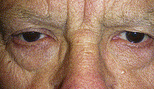
Rapidly enlarging neck masses of the thyroid with Horner's syndrome

Slide 78
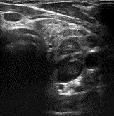

Slide 79
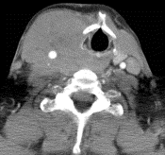

Slide 80


Slide 81
a 72-year-old woman with primary thyroid lymphoma.(A) Contrast-enhanced CT scan demonstrates a large mass in the left lobe of the thyroid gland with focal hypoattenuated portion (open arrow) suggesting necrosis. Enlarged internal jugular lymph node (arrow) and deviated trachea are noted. (B) CT scan more caudal than A shows homogeneous mass with a compressed rim (open arrow) of unaffected thyroid tissue.

Slide 82
a 65-year-old woman with primary thyroid lymphoma. (A) Contrast-enhance CT scan reveals multiple nodules isoattenuating to muscle in the both lobes of the thyroid gland with a peripheral rim of hyperattenuating thyroid tissue and septum (open arrow). (B) Histological specimen shows diffuse infiltration of lymphoma cells (L) and fibrous capsule (C). Follicular atrophy with oxyphilic change (arrow) and lymphocytic infiltration, which are compatible with those of Hashimoto’s thyroiditis, are seen in the area adjacent to the lymphoma. (Hematoxylin /eosin stain; original magnification, /40).

Slide 83
a 68-year-old woman with primary thyroid lymphoma.Contrast-enhanced CT scan shows an enlarged thyroid gland with reduced attenuation similar to that of muscle. Residual compressed thyroid is minimally noted slit-like appearance (open arrow).

Slide 84


