Slide 1


Slide 2
اصول تجویزومصرف منطقی داروها:
تیازولیدیندیونها
مهارکننده الفاگلوکوزیداز
دکترالهام فقیه ایمانی
فوق تخصص غدد
دیماه 1394

Slide 3
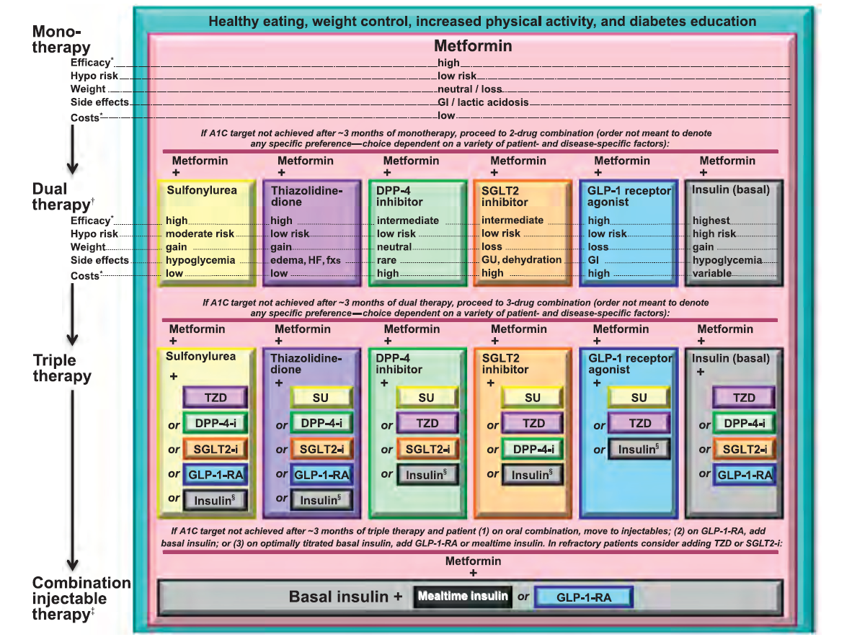

Slide 4
each new class of noninsulin agents added to initial therapy lowers A1C around 0.9–1.1%. If the A1C target is not achieved after approximately 3 months, consider a combination of metformin and one of these six treatment options: sulfonylurea, thiazolidinedione, DPP-4 inhibitors, SGLT2 inhibitors, GLP-1 receptor agonists, or basal insulin

Slide 5
Drug choice is based on patient preferences, disease and drug characteristics, with the goal of reducing blood glucose levels while minimizing side effects, especially hypoglycemia, AND cost.

Slide 6
THIAZOLIDINEDIONES

Slide 7
Two classes of oral hypoglycemic drugs improve insulin action as their primary effect: biguanides and thiazolidinediones
The TZD increase insulin sensitivity by acting on adipose, muscle, and liver to increase glucose utilization and decrease glucose production. They probably bind to and activate one or more peroxisome proliferator-activated receptors (PPARs), which regulate gene expression in response to ligand binding

Slide 8
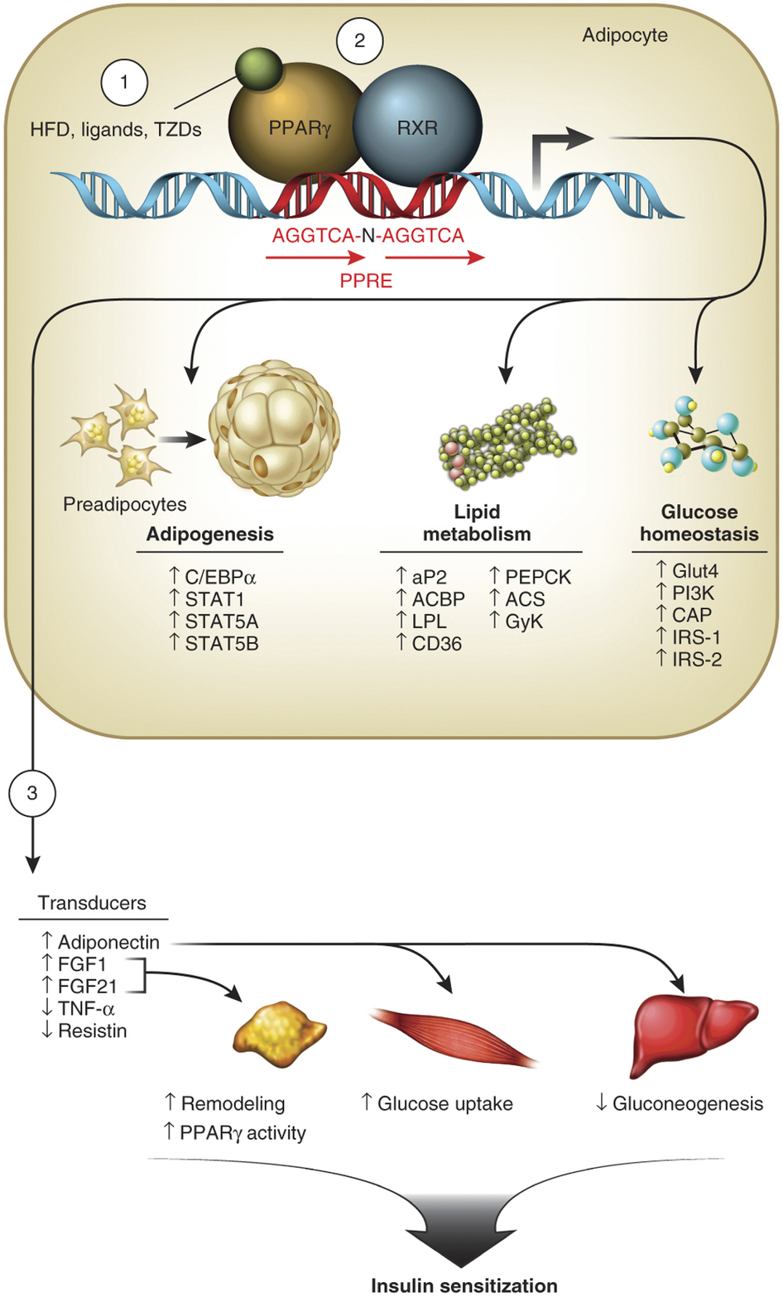

Slide 9
TZD are similar in efficacy to metformin as monotherapy. we do not generally choose TZD over metformin for initial therapy of type 2 diabetes due to concerns about adverse effect the predominant effect of metformin is to inhibit hepatic glucose production, whereas TZD act mainly by improving peripheral uptake of glucose in muscle and fat.

Slide 10
Do We Still Need Pioglitazone for theTreatment of Type 2 Diabetes?

Slide 11
Pioglitazone is known to improve insulin
sensitivity, glycemic control, dyslipidemia,
hypertension, and microalbuminuria in
patients with T2DM. Pioglitazone decreases
fasting and postprandial plasma glucose levels by improving the sensitivity of hepatic and peripheral (muscle) tissue to insulin.

Slide 12
Pioglitazone
LDL cholesterol remained constant
Triglyceride levels were decreased
HDL cholesterol was increased

Slide 13
The PROactive study was a large prospective, randomized, double-blind, secondary prevention study that investigated the effects of pioglitazone (45 mg/day)on macrovascular outcomes in 5,238 patients with T2DM and preexisting CVD

Slide 14
meta-analysis of this study revealed that the primary end point(a composite of all-cause mortality, nonfatal MI, acute coronary syndrome, stroke, major leg amputation, and coronary or leg revascularization) was significantly lower using pioglitazone compared with placebo

Slide 15
In contrast to treatment with insulin, sulfonylureas,or glinides, use of pioglitazone per se is not associated with an increased risk of hypoglycemia, which may be of particular relevance for the treatment of patients with CVD

Slide 16
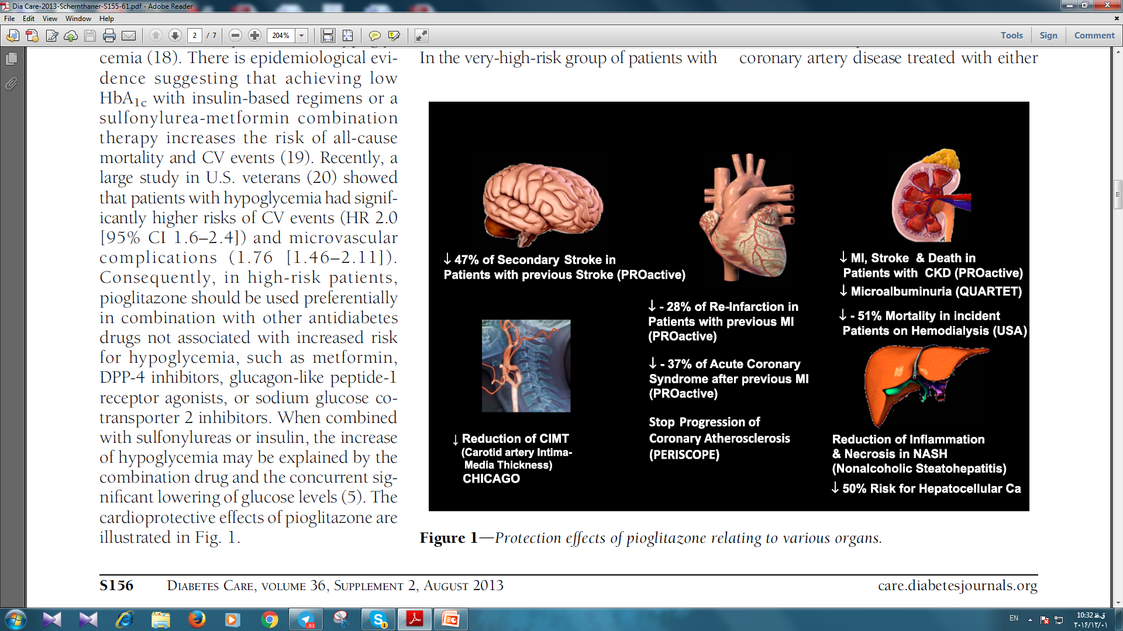

Slide 17
Decreased mortality with
pioglitazone monotherapy or
pioglitazone plus metformin
combination therapy in
observational studies

Slide 18
In 91,521 people with diabetes (follow-up 7yrs). pioglitazone was associated with a significant 31–39% reduced risk of all-cause mortality (P = 0.02 ) compared with metformin,
whereas first- or second generation sulfonylureas were associated with a significant 24–61% excess risk for all-cause mortality (P = 0.001) compared with metformin.

Slide 19
Effects of pioglitazone on
microalbuminuria and outcome in
T2DM patients with chronic kidney
Disease

Slide 20
In the QUARTET studies, a consistent lowering effect of pioglitazone on microalbuminuria was evident, which was not seen with metformin or sulfonylureas

Slide 21
Despite the positive findings in patients with CKD and end-stage renal disease and the fact that pioglitazone does not induce hypoglycemia, the drug should be used with caution in CKD stages 4 and 5 because of the risk of water and sodium retention and heart
failure.

Slide 22
Safety issues with pioglitazone
The clinical use of pioglitazone is limitedby the risk of adverse events, including weight gain, CHF, bone fractures, macular edema, and possibly bladder cancer.
Increase in mean body weight was 3.6 kg in the PROactive study

Slide 23
In a post hoc analysis of various adverse events in the PROactive Trial , the rate of bone fracture was increased by 5.1% in women taking pioglitazone vs. 2.5%in women taking placebo.

Slide 24
The mechanism responsible for TZD-related bone fractures remains unclear, although abnormalities in both bone formation and bone resorption have been suggested. TZDs affect the differentiation of mesenchymal stem cells, leading to increased adipogenesis at the expense of the formation of osteoblasts

Slide 25
In a large prospective observational
Study , pioglitazone use was associated with a modestly increased incidence of DME over 1 year (OR 1.6 [95% CI 1.4–1.8]), although
there was no dose-response effect

Slide 26
Concern exists about an association
between pioglitazone and bladder
cancer.

Slide 27
observational studies reported an increased risk of bladder cancer associated with pioglitazone, whereas Wei et al. who analyzed the risk of bladder cancer in 23,548 patients exposed to pioglitazone, could not find an increased risk for bladder cancer

Slide 28
pioglitazone
Our view is that physicians should remain aware of this highly specific potential hazard and include this in an overall risk-benefit–based decision about whether to prescribe this product.

Slide 29
recently published study in 600,000 patients with T2DM showed that the use of pioglitazone was associated with a significantly decreased liver cancer incidence.
a decreased risk of colorectal cancer was observed in patients who had used TZDs compared with those who had never used TZDs

Slide 30
pioglitazone monotherapy can be considered an alternative to metformin monotherapy if metformin cannot be used (not tolerated or is contraindicated), as a combination therapy if monotherapy with metformin alone does not achieve an HbA1c target, or a triple combination therapy.

Slide 31
the most insulin resistant patients: increased waist circumference, low HDL cholesterol level, and fatty liver may be the best candidates for pioglitazone. patients with CVD are also likely to benefit from pioglitazone.
It is our belief that pioglitazone represents an important therapeutic option in people with T2DM

Slide 32
So, to answer our original question:
yes, we still need pioglitazone for the treatment of T2DM.

Slide 33
pioglitazone
Monotherapy or combination therapy: 15-30 mg once daily
Maximum dose: 45 mg once daily
Tablet, Oral:
Actos: 15 mg, 30 mg, 45 mg
Generic: 15 mg, 30 mg, 45 mg

Slide 34
pioglitazone
Prior to initiation: Evaluate liver tests (ALT, AST,ALP, total bilirubin) and if abnormal, initiate with caution.
During therapy: If liver injury is suspected (eg, fatigue, jaundice, dark urine): Interrupt therapy, measure serum liver tests, and investigate possible etiologies:
If ALT >3 x ULN and without alternative etiologies: Do not reinitiate therapy.
If ALT elevated (but <3 x ULN) or total bilirubin elevated (but <2 x ULN) and with an alternative etiology: May reinitiate with caution

Slide 35
pioglitazone
Renal Impairment: No dosage adjustment necessary.
Hepatic Impairment: No dosage adjustment necessary.

Slide 36
Contraindications of pioglitazone
Hypersensitivity to pioglitazone
NYHA Class III/IV heart failure (initiation of therapy)
Pregnancy Risk Factor C
Breast-Feeding It is not known if pioglitazone is excreted in breast milk. the safety of pioglitazone during breast-feeding has not yet been established
Canadian labeling: Additional contraindications (not is U.S. labeling): Any stage of heart failure (eg, NYHA Class I, II, III, IV); serious hepatic impairment; active bladder cancer; history of bladder cancer; uninvestigated macroscopic hematuria; pregnancy

Slide 37
ALPHA-GLUCOSIDASE INHIBITORS

Slide 38
ALPHA-GLUCOSIDASE INHIBITORS
they inhibit the upper gastrointestinal enzymes (alpha-glucosidases) that convert complex polysaccharide carbohydrates into monosaccharides in a dose-dependent fashion. These drugs slow absorption of glucose; the slower rise in postprandial blood glucose concentrations is potentially beneficial in both type 1 and type 2 diabetes.

Slide 39
ACARBOSE
addition of acarbose in each groups reduced the mean postprandial blood glucose and lowered A1C values by 0.4 to 0.9%.
acarbose has resulted in greater improvement in A1C values than in fasting blood glucose concentrations, consistent with its predominant effect on postprandial hyperglycemia

Slide 40
ACARBOSE
acarbose is available as 25, 50 and 100 mg tablets which should be taken with the first bite of each meal. We begin with 25 or 50 mg three times daily.
Flatulence, diarrhea, and abdominal discomfort are dose related and almost always resolve if the dose is decreased. Few people tolerate more than 300 mg daily.

Slide 41
Adverse effects of acarbose
The main side effects are flatulence (which affected 73% of patients) and diarrhea.
In one prospective study of 893 patients treated with acarbose, only 16 to 20 percent were still taking the drug after one year and half of them stopped the drug during year two.

Slide 42
High serum aminotransferase concentrations have been reported
acarbose doses greater than 50 mg three times daily provided no additional glycemic benefit, but were associated with more side effects

Slide 43
Drug safety of ACARBOSE
Serum creatinine ≤2 mg/dL: There are no dosage adjustments.
Serum creatinine >2 mg/dL: Use not recommended (has not been studied).
Hepatic Impairment: There are no dosage adjustments
contraindicated in patients with cirrhosis.

Slide 44
Contraindications of ACARBOSE
Hypersensitivity to acarbose;
diabetic ketoacidosis;
cirrhosis;
IBD, colonic ulceration, partial intestinal obstruction, patients predisposed to intestinal obstruction; chronic intestinal diseases associated with marked disorders of digestion or absorption.

Slide 45
ACARBOSE
Pregnancy Risk Factor B
Adverse events have not been observed in animal reproduction studies.
Breast-feeding is not recommended by the manufacturer It is not known if acarbose is excreted in breast milk;.

Slide 46
References:
ADA 2016
UPTODATE 2015
DIABETES CARE, VOLUME 36, SUPPLEMENT 2, AUGUST 2013 care.diabetesjournals.org

Slide 47
THANK YOU FOR YOUR ATTENTION

