Slide 2
AACE/ACE Disease State Clinical Review AMERICAN ASSOCIATION OF CLINICAL ENDOCRINOLOGISTS AND AMERICAN COLLEGE OF ENDOCRINOLOGY DISEASE STATE CLINICAL REVIEW: The INCREASING INCIDENCE OF THYROID CANCER
ENDOCRINE PRACTICE VoL 21.6 JUNE 2015
by: Dr Narimani

Slide 3
INTRODUCTION
Thyroid cancer is the most common endocrine cancer.
Based on recent data, thyroid cancer is the fifth most common cancer in women , and in Italy, it is the second most frequent cancer in women below 45 years of age. Only in few countries (Norvay, Sweden) thyroid cancer incidence is decreased

Slide 4
Thyroid cancer has been much in the news lately because of reports of large increases in incidence.
It is now recognized that not all pathologic entities labeled as cancer act similarly, nor do they all act aggressively.
It is increasingly recognized that measures of incidence, mortality, and survival may be affected by many epidemiologic factors and may not always be reflective of either true increases in disease, treatment successes, or screening efforts

Slide 5
A current example is found in prostate cancer, a disease for which 20 years ago screening and aggressive treatment were recommended.
Screening now is no longer uniformly advised, after it was understood that the disease is present at autopsy in many asymptomatic men dying of other causes.
Although thyroid cancer is different from prostate cancer in that it is not detected through concerted screening programs, it does have a similar large subclinical reservoir and is often found at autopsy in asymptomatic people who died of other causes.

Slide 6
This has made it challenging to interpret observed trends in the incidence and mortality of thyroid cancer in the U.S.
Outline the current incidence and mortality trends for differentiated thyroid cancer and examine the 2 main hypotheses about the cause of the increasing incidence:
The detection of a subclinical reservoir
A true increase in the disease due to known or new risk factors.

Slide 7
METHODS Epidemiologic Data
Data on the incidence of thyroid cancer are from SEER 9 (Surveillance, Epidemiology and End Results) Program, supported by the National Cancer Institute, from 1975 to 2011. SEER 9 covers approximately 10% of the U.S.
population and includes the longest contributing sites to the program: Atlanta, Connecticut, Detroit, Hawaii, Iowa, New Mexico, San Francisco-Oakland, Seattle-Puget Sound, and Utah.

Slide 8
SEER is the best source of population based data available in the U.S.
For cancer incidence, histology, and initial treatment because it is gathered from high-quality registries chosen specifically to accurately represent the U.S. population and because it is extensively quality checked.
Mortality data are from the Centers for Disease Control National Vital Statistics System.

Slide 9
For all incidence calculations, we included all incident cases of cancer with “thyroid” as the site of origin (The International Classification of Diseases for histology,Third Revision [ICD-03].
Rates were calculated for each year using SEERStat v.8.1.5 (Surveillance Research Program of the National Cancer Institute, Rockville, MD). All rates were age adjusted to the 2000 standard population.

Slide 10
Histology was categorized as follows: papillary follicular, and poorly differentiated – a combination of medullary and anaplastic.
Histologic classification was accepted as reported by each registry, slides were not re-read by a central monitoring body.

Slide 11
Review of Contributors to Thyroid Cancer’s Increasing Incidence
An initial broad search of the literature was performed to identify commonly hypothesized reasons for the increasing incidence of thyroid cancer.
Next, a detailed literature search of PubMed for English-language studies published prior to December 31, 2013 was performed for the topic areas deemed likely to represent potential causes of the increasing incidence.
Two topic areas were not subjected to detailed search based on limited supporting evidence: bisphenol A and progesterone.
Studies were selected for inclusion if they were clinical trials, large cohort studies, or considered likely to be influential to research or clinical practice.

Slide 12
RESULTS Part I: Current Epidemiology of Thyroid Cancer in the U.S.
In 2014, it was estimated that there would be 62,980 new cases of thyroid cancer in the U.S. Thyroid cancer accounts for about 3.8% of new cancers diagnosed each year in the U.S. and is the ninth most common in incidence after prostate, breast, lung, colon, melanoma of the skin, bladder, non-Hodgkin’s lymphoma, and renal cancer.
Deaths due to thyroid cancer are uncommon. It was estimated that there would be an estimated 1,890 deaths due to thyroid cancer in the U.S. in 2014. The more common cancers, such as breast and lung, lead to deaths in the hundreds of thousands each year.

Slide 13
Overall Incidence Trends
Thyroid cancer incidence was relatively stable until the 1990s, when it began to increase dramatically (Fig. 1).
Overall thyroid cancer incidence increased from 4.9 per 100,000 population to 14.7 per 100,000 population in 2011.
The rise has been due almost entirely to papillary histology (rising from 3.4 to 13.1 per 100,000), with a tiny contribution from follicular histology (rising from a range of 0.75 to 1.0 per 100,000 in 1975-1977 to 0.97 to 1.15 per 100,000 in 2009-2011).

Slide 14
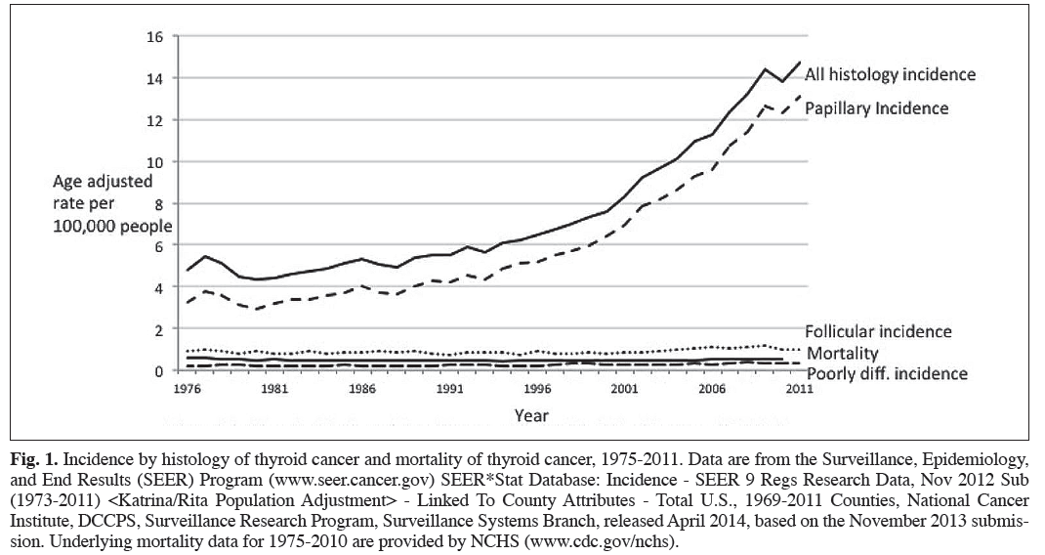

Slide 15
Trends in Incidence by Size
Examining incidence rates by size gives clues about potential causes of the increase.
Thyroid cancers of all sizes increased between 1983 and 2011, the greatest contribution in both relative and absolute terms came from small cancers (Fig. 2).
The incidence of the smallest cancers (2 cm or less) increased more than 4-fold, from 2 to 9.6 per 100,000 population. Cancers measuring 2.1 to 5 cm more than doubled in incidence, from 1.4 to 3.7 per 100,000 population. Cancers measuring greater than 5 cm are quite rare, but their rates tripled, from 0.2 to 0.7 per 100,000 population.

Slide 16
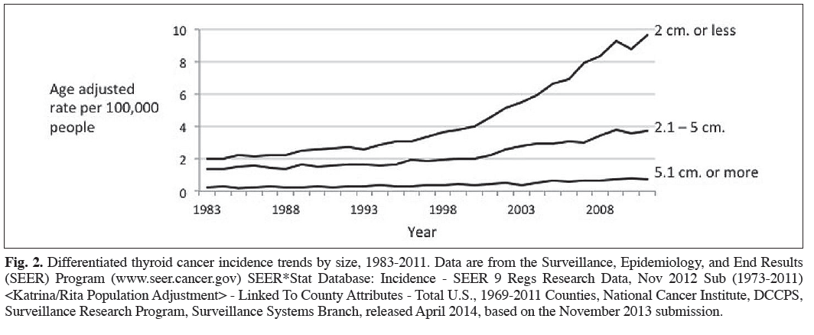

Slide 17
Trends in Incidence by Age Group
The incidence of thyroid cancer is highest among those over age 65 years. Since 1975, the incidence has risen dramatically in all age groups (Fig. 3).
The largest burden of the increase in absolute terms has been in those aged 65 years and over; the incidence increased from 8 to 23.4 per 100,000 population in 2011.
The greatest relative increase has been in those aged 20 to 64 years. The incidence rate went from 6.4 to 19.5 per 100,000 population in 2011, a 3.1-fold increase.
Among those aged 0 to 19 years, there has been a similar relative change of 2.6-fold, but thyroid cancer in this group is very rare and has risen in absolute terms from only 0.4 to 1 per 100,000 population in 2011.

Slide 18
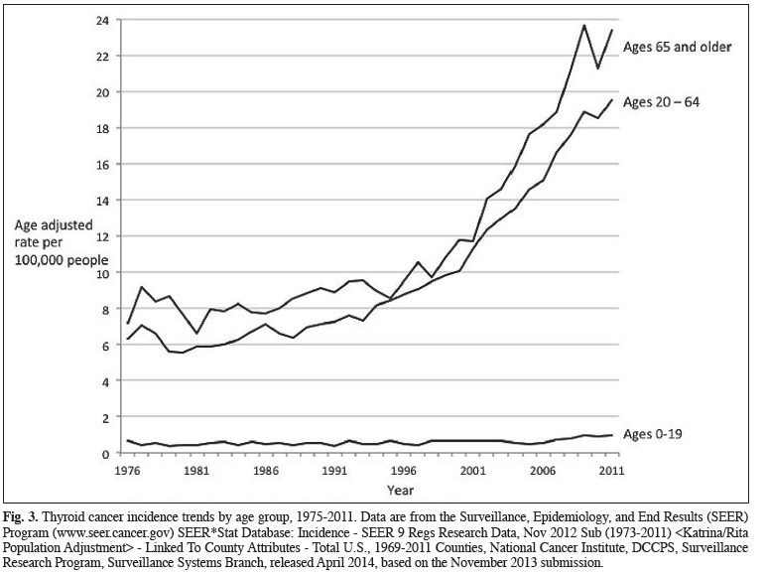

Slide 19
Current Trends in Mortality
Mortality from thyroid cancer hovers around 0.5 per 100,000 population. Between 1975 and 2010 (the most recent year for which data are available), the high was recorded in 1977, at 0.57 per 100,000 population (approximately 1,710 deaths per year nationwide), and the low was recorded in 1994, at 0.42 per 100,000 population (approximately 1,260 deaths per year nationwide).
Between 2001 and 2010, the mortality rate varied between 0.45 and 0.52 per 100,000 population, never moving outside the range we have seen over the past 30 years.

Slide 20
Because the mortality rate for thyroid cancer is so low, any fluctuations appear relatively large.
Thus, statistical tests of trend reported by SEER do show a 0.9% increase in this time period, but examination of the underlying data suggest that the trend is not indicative of clinically or epidemiologically relevant changes overall, because the data have not varied outside the range we have observed over the past 30 years.

Slide 21
Trends in Molecular Profiles
Studies of archival thyroid cancer specimens show historical shifts in the landscape of molecular alterations (e.g., rearrangements in the BRAF, RAS, and RET/PTC genes).
In a recent study analyzing trends in demographic, clinical, pathologic, and molecular characteristics of papillary thyroid cancer from 1974 to 2009, one group found 3 important trends in the mutational composition of papillary thyroid cancer over time:

Slide 22
(1) the overall proportion of RAS point mutations increased significantly after 2000, due entirely to increases in the follicular variant of papillary thyroid cancer;
(2) the proportion of BRAF mutations was stable over the time period;
(3) the proportion of RET/PTC rearrangements significantly decreased.

Slide 23
They concluded that rising percentages of the follicular variant histology and RAS mutations after 2000 suggest
new etiologic factors and
(b) The increased incidence is not likely due to radiation because RET/PTC rearrangements decreased.

Slide 24
In another recent study, the rate of the BRAF V600E mutation was seen to rise over 15 years of archived thyroid specimens.
The authors concluded that BRAF mutations in papillary thyroid cancer may be contributing to the increasing incidence of thyroid cancer.
Collectively, these data are intriguing, but because they are potentially confounded by secular trends in the detection of subclinical cancers, more work will be required to determine whether molecular changes are a significant contributor to the increasing incidence of thyroid cancer.

Slide 25
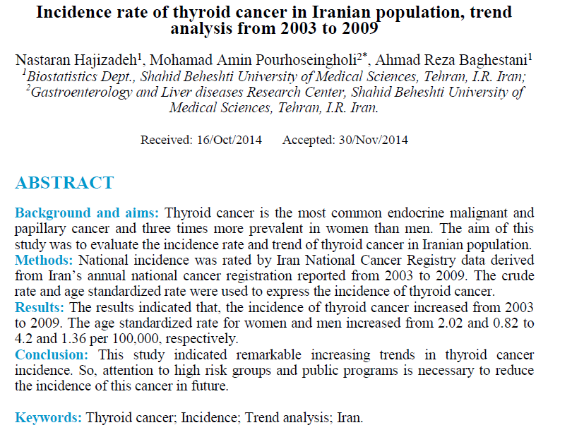

Slide 26
In a survey conducted by the Iranian Cancer Institute, 1.8% of all cancers and 76.1% of all endocrine cancers constituted by the neoplasm of thyroid gland;
In a study in Iran, mean age of Iranian patients was 42.8 years (95% CI: 41.9-43.7) with markedly older male patients.Also, the female to male ratio was about 1.8

Slide 27
based on the national registry data from 2003 to 2009 thyroid cancer represents 2.1% of all new cancer cases in the world, 3.0% in WHO Americas region, 2.4% in Iran, 2.2% in less developed regions, 2.1% in Asia, 2% in more developed regions, and 1.7% in WHO Europe Region.
The incidence of thyroid cancer increased from 2003 to 2009 in Iranian population. The age standardized rate for women and men increased from 2.02 and 0.82 to 4.2 and 1.36 per 100,000, respectively.

Slide 28
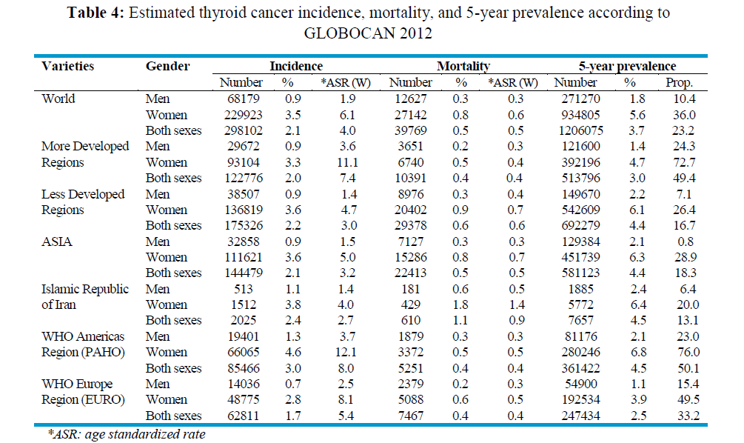

Slide 29
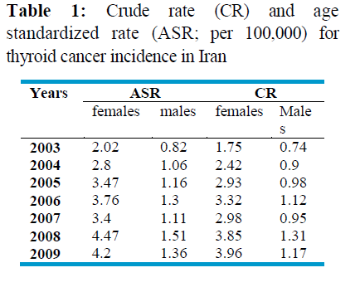

Slide 30
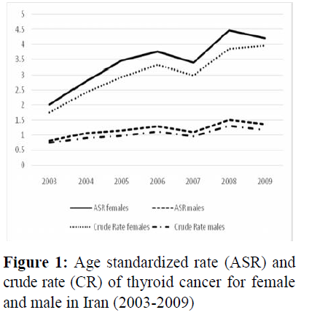

Slide 31
Part II: Examination of Hypotheses for the Increasing Incidence Hypothesis #1: The Increased Incidence of Thyroid Cancer is Due to Detection of Subclinical Disease

Slide 32
Evidence for and Against the Hypothesis
There is strong evidence to support the hypothesis that the increasing incidence of thyroid cancer is due to the detection of subclinical disease, termed ‘overdiagnosis’ in cancer epidemiology.
First, papillary thyroid cancer is commonly found at autopsy in people who died of other causes.
Estimates of the prevalence range from about 3 to about 35%, depending on the country of the study and the pathology methods used to examine the specimens.

Slide 33
Among thyroid specimens removed for benign disease, up to 50% harbor small, incidental papillary thyroid cancers
Another observation that supports the subclinical disease detection hypothesis is the fact that the majority of the increase has been observed in small cancers.
The largest rate increases have been observed in cancers that are too small even for most experienced clinicians to feel during thyroid palpation.

Slide 34
Small cancers are less likely to be causing symptoms at the time of their discovery and are in the size range commonly found in the autopsy studies described above.
Last, mortality rates have not changed substantially over the 30 years that thyroid cancer incidence has been rising.
Some argue that this is because of improving treatments.
For this to be the case, the changes in treatment would have had to exactly keep pace with the increasing incidence;

Slide 35
if improvements in treatment occurred too fast, the mortality line would fall. If improvements in treatment occurred too slowly, the mortality line would rise.
Although this is possible, it is not particularly plausible.
This finding of stable mortality means that in a setting of increasing numbers of thyroid cancers being detected, only a small constant number are aggressive, lethal cancers.

Slide 36
Proposed Mechanisms of Detection of Subclinical Thyroid Cancer
There are several interrelated mechanisms through which subclinical thyroid cancers might be detected.
These are outlined in Table 1 and detailed below.
Access to health care services has been shown to be a determinant of thyroid cancer incidence rates by making it more likely that a subclinical cancer is found.

Slide 37
A current example is South Korea. Between 1996 and 2010, the age-adjusted incidence of thyroid cancer in women residing in the Gwangju and Jeonnam provinces in South Korea increased from 10.6 to 111.3 per 100,000 population, and in men, the incidence increased from 1.9 to 27.0 per 100,000 population.

Slide 38
Despite these increases, thyroid cancer mortality remained stable.
The incidence change was mainly attributable to the detection of asymptomatic cancers (which increased from less than 5% to more than 50% of all cancers) and sub-centimeter cancers (the rate increased from 0 to 50 per 100,000 population).
The primary mechanism of detection has been physician-offered thyroid ultrasound screenings.
A 2009 survey showed 13% of South Korean adults had undergone a screening thyroid ultrasound.
The rate was higher among women, with the highest rate (26%) among women 50 to 59 years old .

Slide 39
Health care financing systems also affect thyroid cancer incidence rates. A 2012 study modeled thyroid cancer incidence based on the characteristics of national health systems.
Adjusted for gross domestic product and education levels, the share of health care expenditure that was privately funded was a significant predictor of thyroid cancer incidence (for women, P = .02; men, P = .09).
Health care systems with more fee for service, private models had higher incidence rates of thyroid cancer .

Slide 40
General increases in imaging rates have made thyroid findings more common.
In a recent study of a large health care system , people underwent an average of 1.18 imaging studies per year, of which 35% were advanced diagnostic imaging studies: computed tomography (CT), magnetic resonance imaging (MRI), nuclear medicine, or ultrasound.
Over the 15 years of the study, imaging rates for CT scanning increased 8% annually. MRI rates increased 10% annually, ultrasound 4%, and positron emission tomography scanning 57% (2004 to 2010 only).
It is likely that increased rates of imaging have led to more thyroid findings.

Slide 41
Physician management of identified thyroid nodules has also changed.
Guidelines were not common in the 1970s. One article from this era suggested that thyroid nodules smaller than 2 cm do not require intervention .
Guidelines from 2009 and 2010 suggest that in some circumstances, nodules of any size might be appropriate to biopsy .
Similarly, recommendations for thyroid surgery for small papillary cancers have also shifted. Until recently, at least one guideline still listed thyroid lobectomy as an appropriate treatment , but more recently, total thyroidectomy has been the standard recommendation for thyroid cancers of any size.

Slide 42
More frequent biopsies and larger specimens provide more opportunities for pathologists to find cancer; thus, it is likely that these 2 phenomena are contributing to the increasing incidence of thyroid cancer.
Thyroidectomy volumes have increased as a result of changes in imaging rates and physician behavior.
A study using the population-based Nationwide Inpatient Sample and National Survey of Ambulatory Surgery databases estimated that annual thyroid surgery volumes increased 39% over 10 years, from 66,864 in 1996 to 92,931 in 2006 .
More thyroidectomies means more specimens to examine for cancer, another contributing factor to increased detection.

Slide 43
Pathologist management of thyroid specimens has also changed.
Surgical pathology textbooks from the 1980s suggested 5 descriptive areas for a surgical pathology report of a thyroid specimen .
The 2012 guidelines from the College of American Pathologists list a minimum of 14 descriptive areas; each thyroid specimen is examined much more closely compared to the past .
Furthermore, whereas historically only representative sections of a thyroid specimen were examined by a pathologist, the thyroid specimen in its entirety is now typically examined, increasing the chances for identification of small cancers.

Slide 44
Lastly, although there has been no official change in the definition of follicular or papillary thyroid cancer by the World Health Organization, pathologists now categorize more cases as ‘follicular variant of papillary carcinoma’ rather than follicula adenoma.
Together with the increased numbers of thyroid specimens delivered to pathologists, these changes are likely a significant contributor to the increasing identification of thyroid cancer.

Slide 45
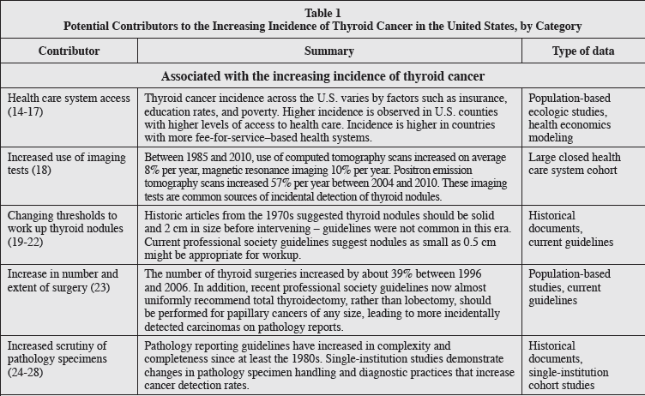

Slide 46
Hypothesis #2:
The Increased Incidence of Thyroid Cancer is Due to a True Rise in Disease

Slide 47
Evidence for and Against the Hypothesis
A major argument against detection of subclinical disease as a cause of the increasing incidence of thyroid cancer is that the entire increase in thyroid cancer incidence has not been due to the detection of small cancers.
Larger cancers and those diagnosed at a more advanced stage (i.e., with lymph node metastases) have also increased in incidence.

Slide 48
however, that even large cancers may be picked up incidentally, making it possible that the increasing incidence of large cancers is not due to a true rise in disease.
A recent paper reported that 38% of cancers larger than 4 cm had been found incidentally on imaging studies done for other reasons.
Some also suspect that mortality trends might not have changed yet due to long patient survival times with papillary thyroid cancer.

Slide 49
Some have suggested that the rise in papillary thyroid cancer alone suggests that increased detection is not occurring, because one would also expect increases across all specified histologies except anaplastic.
However, the SEER data available do not show a reciprocal decrease in the incidence of follicular thyroid carcinoma during the past decades, the most likely substitution for a diagnosis of papillary cancer

Slide 50
Proposed Mechanisms Causing a True Increase in the Incidence of Thyroid Cancer

Slide 51
I. Mechanisms with limited or unclear association with increasing incidence
Exposure to ionizing radiation is the most extensively studied and clearly defined risk factor for thyroid cancer.
Ionizing radiation causes DNA strand breaks and somatic mutations that are thought to be the cause of the cancers.

Slide 52
Radiation. Exposure to ionizing radiation is a well documented risk factor for cancer. The thyroid may be irradiated more than other tissues because of its position in the body and its ability to concentrate iodine.
Because one-third of all CT scans are performed in the head/neck region, the thyroid is particularly exposed to radiation.
Moreover, the use of iodinated contrast agents increases the radiation absorbed by the thyroid by up to 35% because iodine blocks photons, increasing the local radiation energy.

Slide 53
Children exposed to radiation frequently develop papillary thyroid cancer (PTC) as shown by the peak of thyroid cancers observed after the Chernobyl accident,when approximately 1.7 × 10⁸Bq of ₁₃₁I were released into the atmosphere.
On that occasion, the thyroid received a dose 500- to 1000-times higher than the rest of the body, and approximately 4,000 thyroid cancer cases were reported.

Slide 54
Radiation exposure only increases the risk of thyroid cancer when people are exposed as children, mostly under age 5 years.
No increased risk of thyroid cancer over the baseline in the population has been observed in patients are over age 20 years at the time of exposure
Some wonder if there has been more exposure to radiation in recent decades. Background radiation from natural sources in the environment has been stable at 3 mSv since the 1970s.
Ionizing radiation exposure to U.S. residents has doubled over the past 30 years that thyroid cancer rates have increased, but this is nearly entirely attributable to medical imaging.

Slide 55
In the U.S., the number of CT scans performed annually (a significant source of radiation exposure) increased from 3 million in 1980 to 62 million in 2007
Most CT scans are performed in patients over 55 years of age. By multiplying published utilization numbers by mean excess lifetime thyroid cancer risk per scan , one can estimate that approximately 150 to 350 excess thyroid cancers annually are attributable to pediatric CT scans.

Slide 56
Radiation exposure attributable to sources other than advanced imaging is minimal.
A bite-wing dental X-ray delivers 5 μGy (less than 1/1,000th of the dose of a CT scan); the estimated dose to the thyroid is essentially zero.
Moreover, a recent report indicates that dental X-rays may increase thyroid cancer risk also in adults . As a consequence, thyroid shielding has been recently recommended by the American Thyroid Association during diagnostic dental X-rays both in children and adults.

Slide 57
Radiation exposure from airplane travel is very low: 2 to 6 μGy per prolonged flight . For comparison, the increased background radiation one would receive moving from Minneapolis to Denver for one year is 150 μGy .
Another specific source of thyroid irradiation is thyroid imaging with ₁₃₁I that has been largely used for the diagnosis of thyroid diseases. Thyroid scans reached 13% of all nuclear medicine examinations in 1973 and thereafter decreased to the present rate of less than 1% with ₁₃₁I substituted by the less-dangerous 99mTc .
The therapeutic use of ₁₃₁I for hyperthyroidism, however, has continued or even increased, and a small increase in thyroid cancer has been observed in these adult patients . Other cancer types (stomach, kidney, and breast) are also increased in patients treated with RAI for hyperthyroidism

Slide 58
Thus, while ionizing radiation exposure has increased significantly due to wider use of medical imaging, elevated thyroid cancer risk is confined to people exposed as children.
Although the excess risk for children is significant, in absolute numbers it is quite small. By our estimates, pediatric CT scans probably account for less than 1% of the increased incidence in thyroid cancer.

Slide 59
Diabetes mellitus and obesity have also been proposed as a cause of the increasing incidence of thyroid cancer, it was weakly correlative and therefore unlikely to explain the marked rise in thyroid cancer incidence.
Proposed mechanisms are hypothetical: increased body mass index (BMI), elevated insulin, long-term elevation of thyroid-stimulating hormone, long-term exposure to high levels of glucose or triglycerides, and use of antidiabetic medications .

Slide 60
One study which found no correlation between diabetes and thyroid cancer did find a positive association between diabetes and the likelihood of undergoing thyroid ultrasound and thyroid fine-needle aspiration.
This suggests that a diagnosis of diabetes mellitus may be associated with increased screening for thyroid cancer rather than a true difference in cancer incidence.

Slide 61
The increasing incidence of thyroid cancer has paralleled a rising prevalence of obesity over the past 3 decades.
A large meta-analysis confirmed an association between BMI and thyroid cancer risk .
Proposed mechanisms include exposure to adipokines such as leptin and adiponectin, or thyroidstimulating hormone and estrogens; insulin resistance and the insulin- insulin–like growth factor 1 axis; increased aromatase activity; chronic inflammation; or oxidative stress

Slide 62
However, a causal relationship between obesity and thyroid cancer has not been proven.
The association may be attributable in part to increased diagnosis in obese persons, who utilize more health care and diagnostic services.
A study of obesity-related genetic polymorphisms did not demonstrate an association with thyroid cancer risk .

Slide 63
Two epidemiologic studies in European and Pacific countries comparing iodine-sufficient and –insufficient areas have shown opposite effects of iodine intake on thyroid cancer rates.
Iodine supplementation has coincided with increased thyroid cancer incidence in many countries, but these findings suffer from confounding due to the increasing application of sensitive imaging technologies, and recent epidemiologic studies of iodine and thyroid cancer risk are confounded by issues of local radiation exposure.
Thus, although iodine does have an association with thyroid cancer, it is not possible to conclude that changes in iodine intake or supplementation are the reason for increasing rates of thyroid cancer

Slide 64
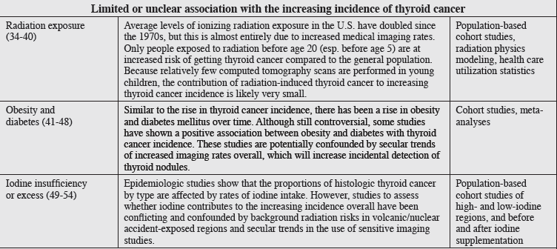

Slide 65
II. Mechanisms not shown to be associated with thyroid cancer
Estrogen has historically been proposed as a mechanistic cause of thyroid cancer, given the higher prevalence of thyroid cancer among women.
To date, positive research findings in this area are limited to cell line studies.
Laboratory studies using thyroid cancer cell lines show thyroid cancer proliferation is enhanced by estrogen stimulation through various mechanisms.

Slide 66
Additionally, estrogen stimulation may lead to an increased metastatic phenotype , possibly through induction of matrix metalloproteinase activity.
Furthermore, in cell lines, estrogen may promote thyroid cancer cell migration and invasion and angiogenesis through vascular endothelial growth factor pathways
Clinical studies linking estrogen to thyroid cancer are weaker.
One case control study showed higher estrogen- DNA adducts in the urine of women with thyroid cancer compared to women without thyroid cancer.

Slide 67
Another study showed thyroid cancers with estrogen receptor (ER)-α–positive, ER-β negative, and positive androgen receptor expression are associated with a more aggressive disease course.
Because much of the work in this field is cell line studies, and strong clinical and epidemiologic studies in patients are lacking, there is not yet evidence to support estrogen as a risk factor for the development of thyroid cancer or its increasing incidence.

Slide 68
Dietary nitrate is a contaminant of drinking water in agricultural areas and is found at high levels in some vegetables, such as beets.
Dietary nitrate is proposed to cause proliferative changes in follicular cells—including hypertrophy, hyperplasia, and neoplasia—through chronically elevated levels of thyroid-stimulating hormone.
Nitrate competes with uptake of iodide by the thyroid, potentially affecting thyroid function by binding to the sodium-iodide symporter on the surface of thyroid follicles.
This reduces the levels of the thyroid hormones triiodothyronine and thyroxin, leading to chronic elevations of thyroid-stimulating hormone. However, epidemiologic data are conflicting.

Slide 69
One study showed increased thyroid cancer risk in people with high dietary nitrate intake, but this was limited somewhat by confounding due to increasing use of sensitive imaging technology over the same time frame .
Two other studies showed mixed results, with increased risk in men shown in one study and increased risk in both sexes in another, but there was not a steady, dose-dependent trend with increasing dietary nitrate intake .
To show a relationship between dietary nitrate and thyroid cancer, larger-scale epidemiologic studies with more detail regarding confounders and other contributors to increased risk would be needed.

Slide 70
Autoimmune thyroid disease has been proposed as a cause of thyroid cancer; elevated levels of thyroid-stimulating hormone found in hypothyroid patients with autoimmune thyroid disease may stimulate follicular epithelial proliferation, promoting the development of papillary carcinoma
Autoimmune thyroiditis might influence cancer risk not only by increasing TSH levels but also because the autoimmune process per se, via the production of proinflammatory cytokines and oxidative stress, might enhance thyroid tumorigenesis

Slide 71
Although limited by the lack of definitive pathology for correlation testing, population-based fine-needle aspiration studies have not shown a statistically significant correlation between Hashimoto’s thyroiditis and papillary thyroid cancer.
Thyroidectomy studies, which in most cases report a statistically significant positive correlation, are subject to confounding by indication (i.e., people with a worrisome needle biopsy result are more likely to be taken to surgery than those without) .
More prospective studies with longer follow-up would be needed to test the relationship between autoimmune thyroid disease and thyroid cancer.

Slide 72
Thyroid Nodules. Whether the prevalence of thyroid cancer is different in thyroid glands with a single nodule (SN) versus multinodular goiter (MNG) remains uncertain.
The prevalence of malignancy in SN has been estimated at 5%.
Individual studies, however, provide cancer prevalence in patients with MNG that are lower (4.1%) or higher (18%).
A recent meta-analysis supported the inference that thyroid cancer is less frequent in MNG than in SN, although this finding appears to hold true mostly outside the United States, in iodine-deficient populations.

Slide 74
DISCUSSION
The incidence of thyroid cancer has tripled over the past 30 years, with the majority of the rise occurring in the past 15 years.
The overwhelming majority of the increase has been due to the increased detection of papillary cancer, a histologic type known to be commonly present at death without ever having caused symptoms.
Tumors of all sizes have increased in incidence, but in absolute and relative terms the greatest increase has been observed in cancers less than 2 cm in size.

Slide 75
Throughout, mortality has never moved substantially from about 0.5 per 100,000 population.
These epidemiologic facts, taken together, strongly suggest that the main contributor to the increasing incidence of thyroid cancer is detection of subclinical disease.
The mechanisms of detection of subclinical disease are incentives in the health care system, imaging practices, individual clinician behaviors around thyroid examination and testing, shifting surgical norms around thyroidectomy and neck dissection, and pathology management of thyroid glands once they are removed from the neck.

Slide 76
There is an argument against subclinical detection as the sole driver of the increasing incidence: large tumors are increasing in incidence as well, suggesting there might be new or increasing risk factors causing a true rise in the incidence.
Radiation, the only well-established risk factor for thyroid cancer, may be adding a small number of new cases each year, but this is likely to number in the low hundreds out of all thyroid cancer cases diagnosed each year.

Slide 77
Studies of other risk factors, such as obesity, diabetes, and iodine deficiency or excess show relationships that are correlative and fall short of establishing causality.
The association between thyroid cancer and diabetes/obesity may be secondary to these patients having more imaging and therefore more identification of subclinical disease.

Slide 78
Future research should focus on determining which cancers need which treatments, with the express intent of avoiding overtreatment of what amounts to generally indolent disease.
Study protocols should include detailed data on mode of detection of the thyroid finding that led to surgery and all known and suspected risk factors, so potential causes for a real rise in incidence can be clearly elucidated.

Slide 79
Epidemiologic data describing detection of subclinical disease are useful on a population.
Patients should be explicitly included in discussions of the management of their identified cancer and given the opportunity to understand both the benefits, as well as the potential harms, of treatment of an incidentally identified cancer.

Slide 80
CONCLUSION
Research should focus on illuminating which thyroid cancers need treatment.
Patients should be advised of the benefits as well as harms that can occur with treatment of incidentally identified, small, asymptomatic thyroid cancers.

