Slide 3
1.1 Ramadan fasting regulations
Fasting during Ramadan is one of the five pillars of Islam and commemorates the time when the Holy Quran was revealed to Muhammad.
The month-long (29–30 day) fast is obligatory for all healthy Muslims who have reached puberty, and is a time for spiritual contemplation and seeking nearness to God.
Followers must refrain from eating and drinking between dawn and sunset, and must also abstain from using oral medications, sexual activity and smoking.

Slide 4
1.1 Ramadan fasting regulations

Slide 5
1.2 The need for practical guidelines on diabetes management during Ramadan fasting
Evidence-based guidelines are important and, although the evidence available in this area continues to increase, more randomised controlled trials are needed to fully answer questions related to Ramadan fasting and diabetes, such as:
•• Is fasting during Ramadan associated with a significant risk?
•• What are the criteria that predispose patients with diabetes to increased risk during fasting?
•• What is the most appropriate oral anti-diabetic drug(s) for patients with type 2 diabetes (T2DM) who fast during Ramadan?
•• What is the most appropriate type and regimen of insulin for patients with diabetes who fast during Ramadan?

Slide 8
Education of physicians, especially in Muslim-minority countries, is also needed.
A study in France found that among general practitioners, medical understanding of fasting in patients with diabetes during Ramadan was lacking and resulted in suboptimal advice being given .
In the US, a study reported that while 67% of patients with diabetes consulted HCPs before Ramadan, the majority did not receive relevant advice regarding risks, breaking the fast, diet, exercise or medications.

Slide 11
2.1 The global impact of diabetes
The prevalence of diabetes has been increasing throughout the world over recent decades and the trend is set to continue .
Estimates for 2015 indicated that there were approximately 415 million people with diabetes in the world, which could rise to 642 million in 2040; a 55% increase .
In 2015, 5 million deaths were caused by diabetes, with all nations suffering the impact of this epidemic.
The worldwide financial burden of diabetes is also vast, consuming 11.6% of total global health spending in 2015 (USD 673 billion) .

Slide 12
The countries with the highest number of adults with diabetes in 2015 were China India and the United States of America,
with three Muslim-majority countries (Egypt, Indonesia and Bangladesh) being in the top 10.

Slide 14
Muslims comprise almost a quarter of the world’s population, with nearly 1.6 billion followers of Islam worldwide as of 2010 .
The worldwide Muslim population is projected to increase by 73% by 2050, which will make Islam the fastest-growing world religion over the next four decades .
Most Muslim majority countries are in less-developed regions of the world, and developing countries are disproportionately affected by diabetes .
Currently, 75% of people with diabetes live in low- and middle-income countries .

Slide 15
Fasting during Ramadan may provide enduring benefits.
Indeed, Ramadan can provide an opportunity for a better lifestyle, facilitating weight loss and smoking cessation .
For patients with diabetes who choose to fast, Ramadan may help to strengthen the therapeutic alliance between patient and physician, and may provide an opportunity to improve diabetes management, with a focus on self-care and the regulation of medication and meal timing.

Slide 16
2.3 The epidemiology of diabetes and Ramadan fasting
In the landmark Epidemiology of Diabetes and Ramadan (EPIDIAR) study, information was collected from 12,243 Muslim people living with diabetes across 13 countries in 2001 .
The population was mainly urban (80%), with a mean age of 31 and 54 years for type 1 diabetes (T1DM) and T2DM, respectively .
Only 67% of patients with T1DM and 37% of patients with T2DM were self-monitoring their blood glucose levels .

Slide 21
3.2 Ramadan physiology – fasting in the healthy individual
The impact of Ramadan on sleep includes decreased total sleep time, delayed sleep, decreased sleep period time, decreased rapid eye movement (REM) sleep duration, decreased proportion of REM sleep, and increased proportion of non-REM sleep .
Sleep deprivation has been associated with decreased glucose tolerance, and the correlation between sleeping duration and insulin resistance has been a subject of renewed medical interest .

Slide 22
Changes to sleep and food intake impact on circadian rhythms; several changes have been noted, including changes in body temperature and cortisol levels.
Compared with non-Ramadan periods, lower morning cortisol levels and higher evening cortisol levels have been observed during Ramadan .
One study indicated a shift in the cortisol curve on day 7 of Ramadan but on day 21 these changes had almost completely reverted to the pre-Ramadan profile .
Alterations in cortisol circadian rhythm may account, in part, for the feeling of lethargy felt by some Muslims during Ramadan .

Slide 24
3.2.2 Effects of Ramadan fasting on body weight in healthy subjects
Hunger–satiety cycles during Ramadan change in line with the shift in the timing of main meals, with the wider gap between meals intensifying feelings of hunger .
This increase in hunger rating during fasting hours is seen in both sexes and is intense by iftar time.
However, in females, some adaptation seems to occur, and by day 24 of Ramadan fasting, the hunger rating during fasting hours appears to reduce in intensity .

Slide 27
3.2.3 Effects of fasting on glucose homeostasis in healthy individuals
In healthy individuals, increased glucose levels in the blood after eating stimulates insulin secretion, which triggers the liver and muscles to store glucose as glycogen.

Slide 29
During fasting, circulating glucose levels fall and insulin secretion is suppressed .
Glucagon and catecholamine secretion is increased, stimulating glycogenolysis and gluconeogenesis, which then leads to an increase in blood glucose level.
Liver glycogen can provide enough glucose for the brain and peripheral tissues for around 12 hours .
When glycogen stores are depleted and levels of insulin are low, fatty acids are released from adipocytes and oxidised to generate ketones, which can be used as fuel by many organs, preserving glucose for the brain and erythrocytes .

Slide 31
3.2.4 Effects of fasting on other metabolic parameters in healthy individuals
Several studies have demonstrated Ramadan fasting to be associated with favourable effects on the lipid profile of healthy individuals.
A metaanalysis, published in 2014 and involving 30 articles investigating the effect of Ramadan fasting on parameters including blood lipids, found no change overall in high density lipoprotein (HDL) or triglyceride (TG) levels, but large significant decreases in low density lipoprotein (LDL) levels.
There were however some differences in the effects of fasting on lipid profile between genders, with a significant increase in HDL in females, and a small significant decrease in TG levels in males after Ramadan .

Slide 32
3.3 Pathophysiology of fasting in patients with diabetes
3.3.1 Glycaemic control and glucose variability
In individuals with diabetes, glucose homeostasis is disturbed by both the underlying pathophysiology and the medications used to treat the condition.
When fasting, insulin resistance/deficiency can lead to excessive glycogen breakdown and increased gluconeogenesis in patients with type 1 diabetes (T1DM) and T2DM; in addition, in T1DM, augmented ketogenesis can occur
As a result, the risks facing patients with diabetes are heightened during Ramadan. These include hypoglycaemia, hyperglycaemia, diabetic ketoacidosis, dehydration and thrombosis .

Slide 34
The landmark Epidemiology of Diabetes and Ramadan (EPIDIAR) study found that during Ramadan there was a 4.7-fold and 7.5-fold increase in the incidence of severe hypoglycaemic complications in patients with T1DM and T2DM, respectively, compared with non-Ramadan periods .

Slide 36
3.3.2 Other metabolic effects of Ramadan fasting in patients with diabetes
Effects on body weight
The EPIDIAR study showed that weight remained unchanged in the majority of patients with T1DM and T2DM (62.5% and 54.1%, respectively) at the end of Ramadan .

Slide 37
Effects on lipid metabolism
few studies have investigated changes in lipid profile in fasting patients with diabetes.
In those studies that have been performed, both favourable and unfavourable changes have been reported such as reduced cardiovascular risk, slightly decreased total cholesterol and increased total LDL cholesterol.

Slide 38
Other effects of Ramadan fasting in patients with diabetes
Two key concerns for patients with diabetes who fast during Ramadan are dehydration and thrombosis.
Dehydration may be compounded in hot climates or in individuals who undertake intensive physical labour, as well as by osmotic diuresis caused by hyperglycaemia.
Dehydration can lead to hypotension and subsequent falls or other injuries .
According to a survey in Saudi Arabia, the incidence of retinal vein occlusion increased during Ramadan when almost 30% of all cases occurred, significantly more than in other months of the year. Dehydration was proposed to be a possible cause .

Slide 39
Risk Stratification of Individuals with Diabetes before Ramadan

Slide 42
meals eaten during Ramadan are often large and contain fried and sugary food which can have an impact on blood glucose control .
Fluctuations in blood glucose levels, particularly postprandial hyperglycaemia, have been linked with oxidative stress and platelet activation as well as the development of cardiovascular disease in people with diabetes

Slide 43
4.2 Risk quantification
it has been estimated that more than 100 million people with diabetes fast during Ramadan and this number will continue to grow.

Slide 45
4.3 Risk stratification
The 2005 American Diabetes Association (ADA) recommendations for management of diabetes during Ramadan and its 2010 update categorised people with diabetes into four risk groups – very high risk, high risk, moderate risk and low risk .
These risk categories have been endorsed by the Islamic Organization for Medical Sciences and the International Islamic Fiqh Academy, who published a decree accepting and approving the ADA’s risk categories and outlined recommendations for who should not fast based on the probability of harm .

Slide 46
4.4 Special populations
4.4.1 Type 1 diabetes
People with T1DM will be advised not to fast because of the risks of severe complications.
However, recent studies involving young adults suggest that if the patient is stable, otherwise healthy, has good hypoglycaemic awareness and complies with their individualised management plan under medical supervision, then many of these patients can fast safely .
One study involving 33 adolescent children with T1DM found that 60.6% completed the fast without any serious problems.

Slide 47
4.4.2 The elderly

Slide 48
4.4.3 Pregnant women
Three quarters of Muslim pregnancies overlap with Ramadan and the risk to both the mother and foetus mean that pregnant women are exempt from fasting.
However, many of these women will choose to fast. The possible effects of fasting on mother.
. pregnant women with pre-existing diabetes or GDM are advised not to fast.

Slide 49
Diabetes and Ramadan:
A Medico-religiou Perspective

Slide 53
Pre-Ramadan education
The pivotal Epidemiology of Diabetes and Ramadan (EPIDIAR) study demonstrated that only around two-thirds of patients with diabetes received recommendations from their healthcare professionals (HCPs) regarding management of their condition during Ramadan, and highlighted a need for more intensive education prior to fasting .

Slide 54
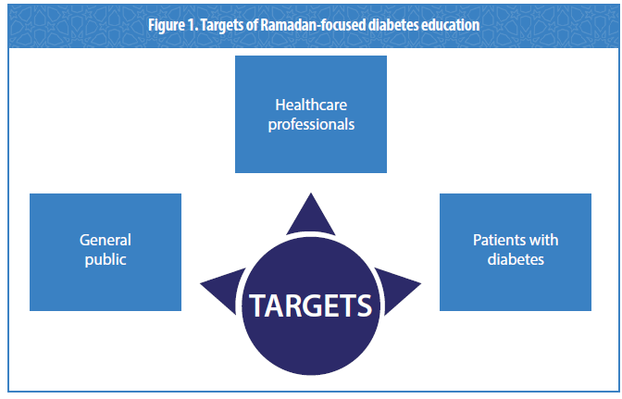

Slide 56
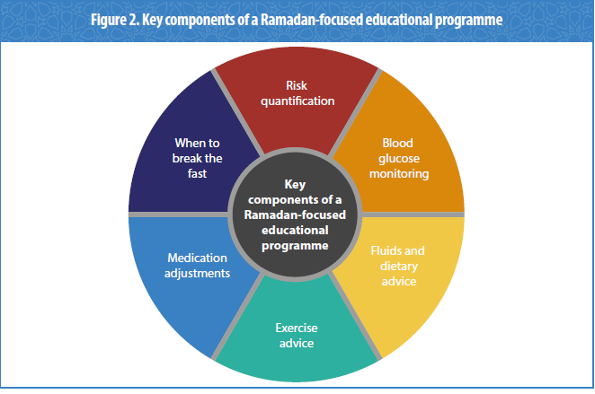

Slide 57
The frequency of SMBG depends on many factors including the type of diabete and current medications but should be carried out regularly by all. For those a moderate or low risk, this may be once or twice a day. Those at high or very high risk should check their blood glucose levels several times a day .

Slide 58
Fluids and dietary advice
The fasting and feasting nature of Ramadan can encourage the consumption of large, carbohydrate-heavy meals, and sugary drinks and treats that can impact blood glucose levels potentially increasing the risk of complications in patients with diabetes .
Providing dietary advice and meal planning can help patients with diabetes to follow a healthy balanced diet during Ramadan, reducing the likelihood of these complications. It may also lead to lifestyle changes that favour weight loss that may continue once fasting has stopped.

Slide 59
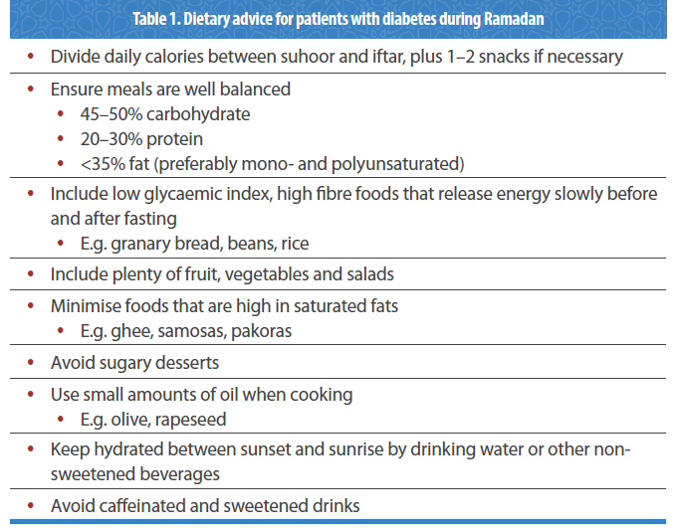

Slide 60
Exercise
Although rigorous exercise is not recommended during fasting because of the increased risk of hypoglycaemia and/or dehydration,
patients with diabetes should be encouraged to take regular light-to-moderate exercise during Ramadan.
Patients should be reminded that the physical exertions involved in Tarawih prayers, such as bowing, kneeling and rising, should be considered part of their daily exercise activities.

Slide 61
Medication adjustments during fasting

Slide 63
Evidence of benefit of Ramadan-focused diabetes education

Slide 64
Patient weight and the incidence of hypoglycaemic events before and after Ramadan were compared with that of a control group of 54 patients with T2DM who did not attend the educational programme.
One month after Ramadan, those who attended the programme demonstrated a significant loss in weight compared with before Ramadan (mean -0.7 kg, p<0.001) whereas there was a significant weight gain in the control group (mean +0.6 kg, p<0.001).
There was also a significant decrease in the number of hypoglycaemic events in the group that received diabetes education (from nine events pre-Ramadan to five during Ramadan), compared with an increase (from nine to 36 events) in the control group.
The study also demonstrated sustained glycaemic control in patients one year after attending the programme which was not evident in the control group .

Slide 65
The Ramadan Nutrition Plan (RNP) for Patients with Diabetes
The main aims of MNT (medical nutrition therapy )during Ramadan fasting are to ensure that:
1. Patients consume an adequate amount of calories, with balanced proportions of macronutrients, during the non-fasting period (i.e. sunset to dawn) to prevent hypoglycaemia during the fasting period
2. Patients distribute their carbohydrate intake equally among meals to minimise postprandial hyperglycaemia
3. Patients and HCPs consider comorbidities such as hypertension and dyslipidaemia

Slide 66
7.3 Risk avoidance during Ramadan
1. Hypoglycaemia, especially during the late period of fasting before iftar
2. Severe hyperglycaemia after each of the main meals
3. Dehydration, especially in countries with prolonged fasting hours and hot climates
4. Significant weight gain due to increased caloric intake and reduced physical activity
5. Electrolyte imbalance
6. Acute renal failure in patients prone to severe dehydration, particularly elderly patients and those with impaired kidney function.

Slide 67
6. Eating suhoor early, which may result in hypoglycaemia before iftar, especially when fasting hours are longer than usual
7. Consumption of large portions of high glycaemic index (GI) carbohydrates at suhoor, which can lead to postprandial hyperglycaemia
8. Frying food, which is particularly unhealthy, especially when using trans-fat margarine or oils rich in saturated fat (e.g. palm oil and coconut oil)
9. Changes in physical activity and sleeping patterns can affect metabolism and may contribute to weight gain .

Slide 68
7.5 Weight maintenance and weight reduction during Ramadan

Slide 69
7.6 The 10 principles of the RNP
1. Consume an adequate amount of total daily calories and divide them between suhoor, iftar and if necessary, 1–2 snacks
2. Meals should be balanced, with carbohydrates (low GI preferred) comprising around 45–50%; protein (legumes, fish, poultry or lean meat) comprising 20–30%; and fat (mono and polyunsaturated fat preferred) comprising <35% of the meal . Saturated fat should be limited to <10% of the total daily caloric intake
3. Use the “Ramadan plate” method for designing meals.

Slide 70
4. Sugar-heavy desserts should be avoided after iftar and between meals. A moderate amount of healthy dessert is permitted, for example a piece of fruit
5. Select carbohydrates with low GI, particularly those high in fibre (preferably whole grains). Consumption of carbohydrates from vegetables (cooked and raw), whole fruits, yoghurt and dairy products is encouraged.
Consumption of carbohydrates from sugar and highly processed grains (wheat flour and starches like corn, white rice and potato) should be avoided or significantly minimised.

Slide 71
6. Maintaining adequate hydration by drinking enough water and non-sweetened beverages at or between the two main meals is important and should be encouraged (diet beverages may be consumed). Sugary drinks, canned juices or fresh juices with added sugar should be avoided. Consumption of caffeinated drinks (coffee, tea as well as cola drinks) should be minimised as they are diuretics
7. Take suhoor as late as possible, especially when fasting for >10 hours
8. Consume an adequate amount of protein and fat at suhoor as foods with higher levels of these macronutrients and lower levels of carbohydrate have a lower GI than carbohydrate-rich foods, and do not have an immediate effect on postprandial blood glucose. Protein and fat also induce satiety better than carbohydrates

Slide 72
9. Iftar should begin with plenty of water to overcome dehydration from fasting, and 1–2 dried or fresh dates to raise blood glucose levels
10. If needed, a snack of one piece of fruit, a handful of nuts, or vegetables may be consumed between meals. Generally, each snack should be 100–200 calories, but this may be higher depending on the individual’s caloric requirement.
Some individuals may use a snack to break fasting and then eat iftar later in the evening.

Slide 76
Management of Diabetes during Ramadan
Due to the metabolic instability and change in lifestyle during the fasting and feasting hours, management of diabetes during Ramadan presents several challenges. One of the main concerns is the increased risk of hypoglycaemia.
in general, anti-diabetic drugs that act by increasing insulin sensitivity and have extra-pancreatic effects have a significantly lower risk of hypoglycaemia than drugs that act by increasing insulin secretion .

Slide 78
8.3.1 Pharmacological management of people with T2DM
Metformin
Metformin is the most commonly used first-line oral anti-diabetic drug (OAD) and works by preventing the liver from producing new glucose. It comes in an immediate-release preparation which may be taken up to three times a day and a prolonged-release formulation which is typically taken just once a day.
Severe hypoglycaemia in non-fasting patients receiving metformin is rare and while there are no randomised controlled trials (RCTs) on metformin use in patients with T2DM during Ramadan, it is considered safe for individuals on metformin to fast because the likelihood of hypoglycaemia is low.

Slide 80
Acarbose
Acarbose inhibits the actions of alpha-glucosidase, an enzyme that breaks down carbohydrates into glucose in the intestinal brush border, thereby slowing down the absorption of glucose and modifying insulin secretion. Like metformin, acarbose is typically introduced into treatment when healthy diet and exercise is not adequate for disease control.
No dose adjustment of acarbose is needed during Ramadan as the risk of hypoglycaemia is low.

Slide 82
Thiazolidinediones
Thiazolidinediones (TZDs) improve insulin sensitivity of fat, muscle, liver and peripheral tissue cells by specifically activating the peroxisome proliferator-activated receptor-γ. This receptor is involved in glucose metabolism and activation by TZDs can increase glucose uptake, particularly in adipose tissue, subsequently lowering glucose in the blood.
As TZDs function without increasing insulin secretion, the risk of hypoglycaemia on TZD monotherapy in non-fasting individuals is very low .
Pioglitazone is the only TZD widely approved for use in T2DM but there are limited clinical data on its use during Ramadan.

Slide 83
pioglitazone in addition to background OADs in 86 fasting Muslims during Ramadan . Compared with placebo, pioglitazone significantly improved glycaemic control during the early, mid- and post-Ramadan periods.
There was no difference in the number of hypoglycaemic events between the two treatment groups but a significant increase in weight of 3.02 kg was observed in the pioglitazone group compared with a non-significant loss in weight (-0.46 kg) in the placebo group .

Slide 85
Short-acting insulin secretagogues
Short-acting insulin secretagogues such as repaglinide and nateglinide stimulate pancreatic β cells to secrete more insulin, and are usually taken before meals.
in two randomised parallel-group trials, a low incidence of hypoglycaemic events was associated with repaglinide treatment during Ramadan.

Slide 87
Sulphonylureas
SUs are widely used as second-line treatment for T2DM after metformin and so there is a wealth of evidence and experience with this low cost efficacious drug class.
SUs stimulate insulin secretion from pancreatic β cells in a glucose-independent process. Because of this, SUs are associated with a higher risk of hypoglycaemia compared with other OADs, which has raised some concerns about their use during Ramadan.

Slide 88
These studies demonstrate that patients with T2DM may continue to use second generation SUs and fast safely during Ramadan.
The use of older drugs within this class such as glibenclamide should be avoided in favour of gliclazide and glimepiride,which carry a much lower risk of hypoglycaemia.
The use of these drugs should be individualised

Slide 90
Sodium-glucose co-transporter-2 (SGLT2) inhibitors
SGLT2 inhibitors including dapagliflozin, canagliflozin and empagliflozin, are the newest class of OADs. SGLT2 inhibitors have a unique mode of action whereby they increase excretion of glucose by the kidneys by reducing reabsorption in the proximal tubule, consequently decreasing blood glucose
SGLT2 inhibitors have demonstrated effective improvements in glycaemic control and weight loss, and are associated with a low risk of hypoglycaemia.
Because of this, it has been proposed that they provide a safe treatment option for patients with T2DM during Ramadan.
However, certain safety concerns have been raised, such as an increase in some infections (urinary tract infections and genital mycotic infections) and a risk of ketoacidosis . An increased risk of dehydration in vulnerable patients has also been described, which may be a particularly pertinent issue during Ramadan.

Slide 91
Currently, only one study has published data on the effectiveness of SGLT2 inhibitors during Ramadan
that SGLT2 inhibitors should be taken with iftar and the importance of taking on extra fluids during the evening after a fast was highlighted .

Slide 93
Dipeptidyl peptidase-4 (DPP-4) inhibitors
DPP-4 is an enzyme that rapidly metabolises glucagon-like peptide-1 (GLP-1), thereby regulating the activity of the hormone. By blocking this action, DPP-4 inhibitors effectively increase the circulating levels of GLP-1, which in turn stimulates insulin secretion in a glucose- dependent manner .
Currently available DPP-4 inhibitors include sitagliptin, vildagliptin, saxagliptin, alogliptin and linagliptin, which are administered orally once or twice a day.

Slide 95
Data relating to the use of newer GLP-1 RAs (lixisenatide, dulaglutide and albiglutide)during Ramadan are lacking.
These studies demonstrate that liraglutide is safe as an add-on treatment to metformin and can be effective in reducing weight and HbA1c levels during Ramadan.
Data on exenatide is limited to one study but the short duration of action and dosing of exenatide suggest that, like liraglutide, the risk of hypoglycaemia during Ramadan is low.

Slide 97
Insulin treatment for T2DM
Insulin treatment for T2DM may include the use of a long/intermediate-acting basal insulin (insulin glargine, insulin detemir or neutral protamine Hagedorn [NPH] insulin), possibly with a rapid or short-acting bolus/pre-meal insulin (lispro, aspart or regular human insulin) and may be used in conjunction with OADs.
Insulin use during prolonged fasting carries an increased risk of hypoglycaemia, particularlyfor those with T1DM but also for those with T2DM.
The use of insulin analogues is recommended over regular human insulin due to a number of advantages that include less hypoglycaemia .
Although a number of small randomised trials and observational studies have been conducted to assess some insulin regimens during Ramadan, large RCT data in this area are lacking.

Slide 102
Patients with T2DM and poor glycaemic control despite multiple daily injections(MDI) of insulin can possibly benefit from an insulin pump system with continuous subcutaneous insulin secretion .
While there are no data for insulin pump use during Ramadan for T2DM, studies have demonstrated that adults and adolescents with T1DM can fast safely using insulin pumps.

Slide 103
The regularity of the blood glucose checks is dependent on the frequency of insulin treatment and/or the risk of hypo- or hyperglycaemia.
To get a true understanding of how blood glucose changes while fasting, patients should be encouraged to keep a Ramadan logbook detailing the measurements .
All patients should comprehend the dangers of low and high blood glucose levels.

Slide 107
8.4 Post-Ramadan follow-up
A post Ramadan follow-up meeting with HCPs is advisable in order to discuss medication and regimen readjustments and assess how the patient handled the fasting.
It should be stressed to the patient that a safe fast one year does not automatically make them a low risk for the next year due to the progressive nature of the disease.

