Slide 1
IN THE NAME OF GOD

Slide 2
Primary ovarian insufficiency (POI)
POI is a rare but important cause of sex steroid deficiency and infertility in premenopausal women.
POI is characterized by menopausal levels of FSH and absent or irregular menstrual cycles before the age of 40 years.
Because the average age of natural menopause is 50– 51 years, women exhibiting these findings after age 40 but before age 45 are said to have early menopause .
Fertility and Sterility® Vol. 106, No. 7, December 2016 0015-0282/$36.00
Hormone replacement therapy in young women with primary ovarian insufficiency and early menopause

Slide 3
Primary ovarian insufficiency (POI)
Infertility
Bothersome menopausal symptoms
Decreased bone density
Increased risk of fractures
Early progression of cardiovascular disease
psychologic impact that may include
depression, anxiety, and decreased perceived psychosocial support
potential early decline in cognition
Dry eye syndrome
Increased risk of type 2 diabetes mellitus (T2DM) or pre-DM
Fertility and Sterility® Vol. 106, No. 7, December 2016 0015-0282/$36.00
Hormone replacement therapy in young women with primary ovarian insufficiency and early menopause
Notes:
Fertility and Sterility® Vol. 106, No. 7, December 2016 0015-0282/$36.00
Hormone replacement therapy in
young women with primary ovarian
insufficiency and early menopause

Slide 4
Screening before pregnancy for women with Turner syndrome. Consultation with cardiologist specializing in congenital heart disease Echocardiogram Electrocardiogram Cardiac magnetic resonance imaging (MRI) scan Assessment for hypertension TSH, free thyroxine (T4), antithyroid antibodies Fasting glucose and hemoglobin A1c Liver function testing with hepatic ultrasound if abnormal Renal ultrasound Renal function testing if renal anomaly or hypertension Gynecologic pelvic ultrasound with hysteroscopy if abnormal Papanicolaou smear
Notes:
Fertility, pregnancy, and medical management of Turner syndrome in the reproductive years
Fertility and Sterility® Vol. 98, No. 4, October 2012 0015-0282/$36.00

Slide 5
In vitro fertilization (IVF)
donated oocytes
Women with Turner syndrome are not recommended to become pregnant even with donor oocytes because of the high rates of mortality during pregnancy resulting from aortic aneurysm rupture.*
Pregnancy should be avoided in Turner syndrome.*
*=Obstet Gynecol Clin N Am 42 (2015) 153–161
Premature Ovarian Failure Clinical Presentation and Treatment
Notes:
Obstet Gynecol Clin N Am 42 (2015) 153–161
Premature Ovarian Failure Clinical Presentation and Treatment

Slide 6
Management of fertility and pregnancy in women with Turner syndrome
should undergo a complete medical evaluation before attempting pregnancy, with particular attention paid to cardiovascular and renal function, as recommended by the American Society of Reproductive Medicine (ASRM). Because of this, the ASRM considers Turner syndrome a relative contraindication for pregnancy but an absolute contraindication if there is a documented cardiac anomaly.
UPTodate Nov 28, 2016

Slide 7
Cardiovascular Disease

Slide 8
Cardiovascular Disease
Evidence points to estrogen deficiency as a driver of increased CVD risk associated with POI .
Women who experienced menopause before age 45 have a higher risk of CHD, cardiovascular mortality, and overall mortality compared with women who experienced menopause after age 50(meta-analysis)
Fertility and Sterility® Vol. 106, No. 7, December 2016 0015-0282/$36.00
Hormone replacement therapy in young women with primary ovarian insufficiency and early menopause

Slide 9
Overall mortality
Overall mortality was also found to be increased in women with POF.
Ischemic heart disease, stroke, and cancers were the most common causes for mortality in this study.
Fertility and Sterility® Vol. 106, No. 7, December 2016 0015-0282/$36.00
Hormone replacement therapy in young women with primary ovarian insufficiency and early menopause

Slide 10
Cardiovascular disease risk
A 2.1- fold increased risk for ischemic heart disease
(Danish Nurse Cohort study)
Obstet Gynecol Clin N Am 42 (2015) 153–161
Premature Ovarian Failure Clinical Presentation and Treatment
Notes:
It has been shown that the risk of aortic aneurysm rupture cannot be determined based on the size of the aortic root dilatation

Slide 11
Cardiovascular disease risk
Women with sPOI have reduced vascular endothelial function, an early sign of atherosclerosis.
Women with POI, regardless of the cause, have increased risks of CVD and ischemic stroke.
Fertility and Sterility® Vol. 106, No. 7, December 2016 0015-0282/$36.00
Hormone replacement therapy in young women with primary ovarian insufficiency and early menopause

Slide 12
Treatment with the use of HRT for 6 months significantly improved endothelial function in these women.
Fertility and Sterility® Vol. 106, No. 7, December 2016 0015-0282/$36.00
Hormone replacement therapy in young women with primary ovarian insufficiency and early menopause

Slide 13
CVD risk assessments and risk reduction
These include:
lifestyle modifications
management of lipid levels and
hypertension, and
early initiation of physiologic HRT
Fertility and Sterility® Vol. 106, No. 7, December 2016 0015-0282/$36.00
Hormone replacement therapy in young women with primary ovarian insufficiency and early menopause

Slide 14
MANAGEMENT of POF

Slide 15
HRT IN POF
The first goal of the management→Prevention of consequences of hypoestrogenemia
HRT as soon as POF is diagnosed

Slide 16
HORMONE REPLACEMENT THERAPY
The Women's Health Initiative study involved menopausal women who averaged 63 years of age.(hormone ‘‘extension)
The results should not be applied to young women with POI or early menopause. (hormone replacement)
Fertility and Sterility® Vol. 106, No. 7, December 2016 0015-0282/$36.00
Hormone replacement therapy in young women with primary ovarian insufficiency and early menopause
Notes:
Unfortunately, a recent study showed thatmore than one-half (52%) of young women with POI either never take HRT, start HRT many years after their diagnosis, and/or discontinue HRT use before age 45.

Slide 17
HORMONE REPLACEMENT THERAPY
Unfortunately, a recent study showed that more than one-half (52%) of young women with POI either never take HRT, start HRT many years after their diagnosis, and/or discontinue HRT use before age 45 .
Fertility and Sterility® Vol. 106, No. 7, December 2016 0015-0282/$36.00
Hormone replacement therapy in young women with primary ovarian insufficiency and early menopause

Slide 18
Transdermal or Transvaginal E2 therapy
The weight of evidence now favors transdermal or transvaginal E2 therapy as the first line of HRT for young women with POI or early menopause.
Fertility and Sterility® Vol. 106, No. 7, December 2016 0015-0282/$36.00
Hormone replacement therapy in young women with primary ovarian insufficiency and early menopause

Slide 19
Transdermal patch and the vaginal ring
The transdermal patch and the vaginal ring that deliver 0.100 mg E2 per day
These formulations mimic the daily ovarian production rate of E2 and achieve average serum E2 levels of 100 pg/mL; this is the average level that women with normal ovarian function experience across the menstrual cycle.
Fertility and Sterility® Vol. 106, No. 7, December 2016 0015-0282/$36.00
Hormone replacement therapy in young women with primary ovarian insufficiency and early menopause

Slide 20
Oral E2
An equivalent dose of oral E2 is also effective replacement; however, the transdermal and transvaginal routes of administration deliver hormone directly into the circulation, which avoids complications associated with the first-pass effect on the liver when estrogen is given orally.
Fertility and Sterility® Vol. 106, No. 7, December 2016 0015-0282/$36.00
Hormone replacement therapy in young women with primary ovarian insufficiency and early menopause

Slide 21
Oral E2
transdermal estradiol or vaginal ring (100 mcg daily)= 2 mg of oral micronized estradiol= 1.25 mg of oral conjugated equine estrogen= 10 mcg of oral ethinyl estradiol???
UPTODATE

Slide 22
Risk of venous thromboembolism
oral estrogen > transdermal estrogen
In the multicenter ESTHER study performed in postmenopausal women, the odds ratio (OR) for venous thromboembolism in women using oral estrogens was 4.2 (95% CI 1.5–11.6) compared with 0.9 (95% CI 0.4–2.1) in women using transdermal estrogen preparations.*
Estrogen and Thromboembolism Risk(ESTHER)
*Fertility and Sterility® Vol. 106, No. 7, December 2016 0015-0282/$36.00
*Hormone replacement therapy in young women with primary ovarian insufficiency and early menopause
Notes:
Estrogen and Thromboembolism Risk

Slide 23
Transdermal HRT
In addition, unlike oral estrogens, transdermal HRT does not adversely alter cardiovascular disease or thromboembolic risk markers.
Fertility and Sterility® Vol. 106, No. 7, December 2016 0015-0282/$36.00
*Hormone replacement therapy in young women with primary ovarian insufficiency and early menopause

Slide 24
venous thromboembolism risk
In women with underlying obesity or clotting disorders, the venous thromboembolism risk associated with oral estrogen is heightened further, to 5–8 times the risk seen in nonusers or users of transdermal estrogen preparations.
Fertility and Sterility® Vol. 106, No. 7, December 2016 0015-0282/$36.00
*Hormone replacement therapy in young women with primary ovarian insufficiency and early menopause

Slide 25
Also, relative risk of stroke is increased in postmenopausal women prescribed oral estrogen versus transdermal estrogen as part of their hormone therapy regimen.
Fertility and Sterility® Vol. 106, No. 7, December 2016 0015-0282/$36.00
*Hormone replacement therapy in young women with primary ovarian insufficiency and early menopause

Slide 26
Risk associated with oral estrogen compared with transdermal estrogen use
Risk associated | oral estrogen | transdermal estrogen
stroke | ↑↑ | ↑
VTE | ↑↑ | ↑
first-pass effect on the liver | + | –
cardiovascular disease | + | –

Slide 27
Contraceptive steroid hormone agents
have been associated with increased risk of:
Thromboembolism
Stroke
Subarachnoid hemorrhage
worsening cardiometabolic risk,including increase in
blood pressure and
unfavorable lipid profiles
Fertility and Sterility® Vol. 106, No. 7, December 2016 0015-0282/$36.00
*Hormone replacement therapy in young women with primary ovarian insufficiency and early menopause

Slide 28
Prevention of consequences of hypoestrogenemia
HRT (postmenopausal women)
However, women with POF may require higher doses of estrogen than postmenopausal women
Oral contraceptives (OCPs) present a good alternative to postmenopausal HRT regiments.
OCPs generally have 2-fold to 4-fold higher estrogen content than postmenopausal HRT regiments.
patients’ satisfaction
Obstet Gynecol Clin N Am 42 (2015)
Notes:
Obstet Gynecol Clin N Am 42 (2015)

Slide 29
Drosperinone-containing formulations
In particular, -containing formulations are associated with an approximately twofold increased risk of venous thromboembolism and arterial thrombotic events, including acute myocardial infarction and stroke
Fertility and Sterility® Vol. 106, No. 7, December 2016 0015-0282/$36.00
*Hormone replacement therapy in young women with primary ovarian insufficiency and early menopause

Slide 30
1-week ‘‘pill-free’’ period
Oral contraceptives typically have a 1-week ‘‘pill-free’’ period each month (or every 3 months with 3-month preparations), resulting in a regular temporary estrogen-deficient state.
Fertility and Sterility® Vol. 106, No. 7, December 2016 0015-0282/$36.00
*Hormone replacement therapy in young women with primary ovarian insufficiency and early menopause

Slide 31
oral contraceptives
1-week ‘‘pill-free’’ period(each month or every 3 months with 3-month preparations)→regular temporary estrogen-deficient state→return of unwanted menopausal symptoms(some)
Fertility and Sterility® Vol. 106, No. 7, December 2016 0015-0282/$36.00
*Hormone replacement therapy in young women with primary ovarian insufficiency and early menopause

Slide 32
A recent randomized controlled cross-over trial in young women with POI compared the cardiovascular effects of treatment with transdermal E2 plus cyclic progestin versus treatment with a combination oral contraceptive
Langrish JP, Mills NL, Bath LE, Warner P, Webb DJ, Kelnar CJ, et al. Cardiovascular
effects of physiological and standard sex steroid replacement regimens
in premature ovarian failure. Hypertension 2009;53:805–11.

Slide 33
Compared with the oral contraceptive, 12 months of transdermal physiologic HRT resulted in significantly lower blood pressure, better renal function, and reduced activation of the renin-angiotensin-aldosterone system.
This evidence suggests that transdermal physiologic HRT is superior to the combined oral contraceptive in promoting cardiovascular health in young women with POI.
Langrish JP, Mills NL, Bath LE, Warner P, Webb DJ, Kelnar CJ, et al. Cardiovascular
effects of physiological and standard sex steroid replacement regimens
in premature ovarian failure. Hypertension 2009;53:805–11.

Slide 34
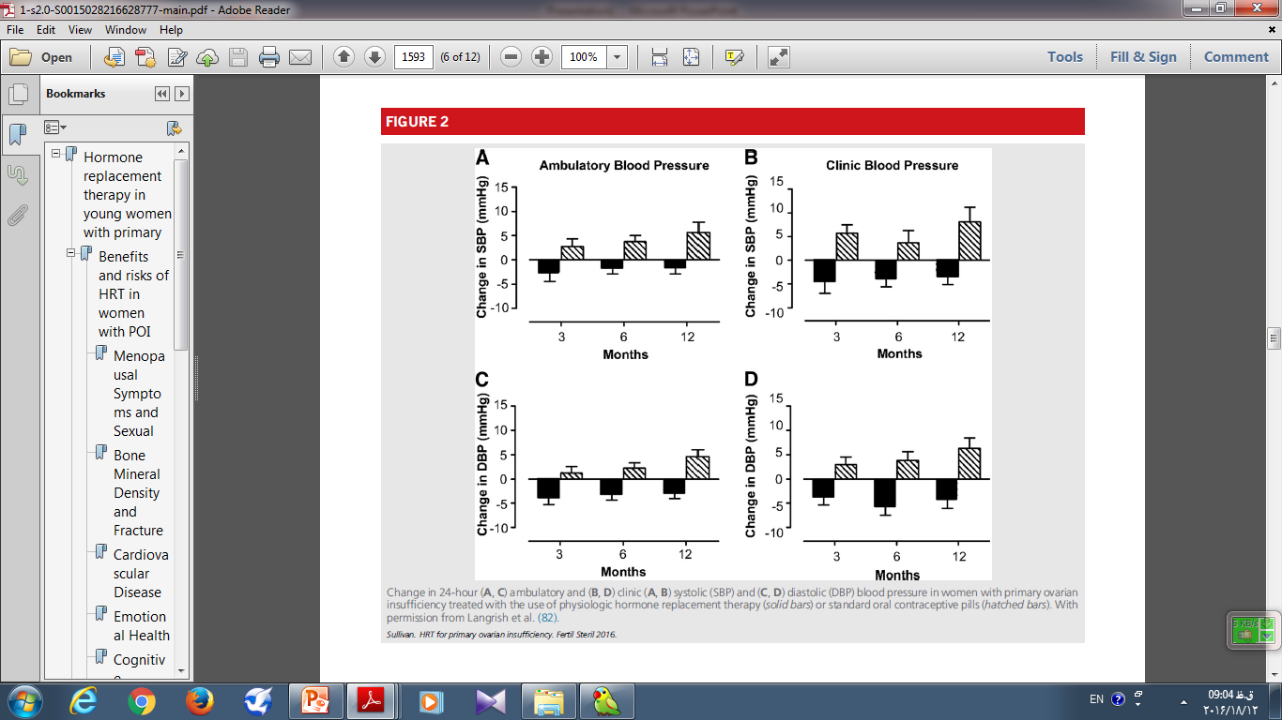

Slide 35
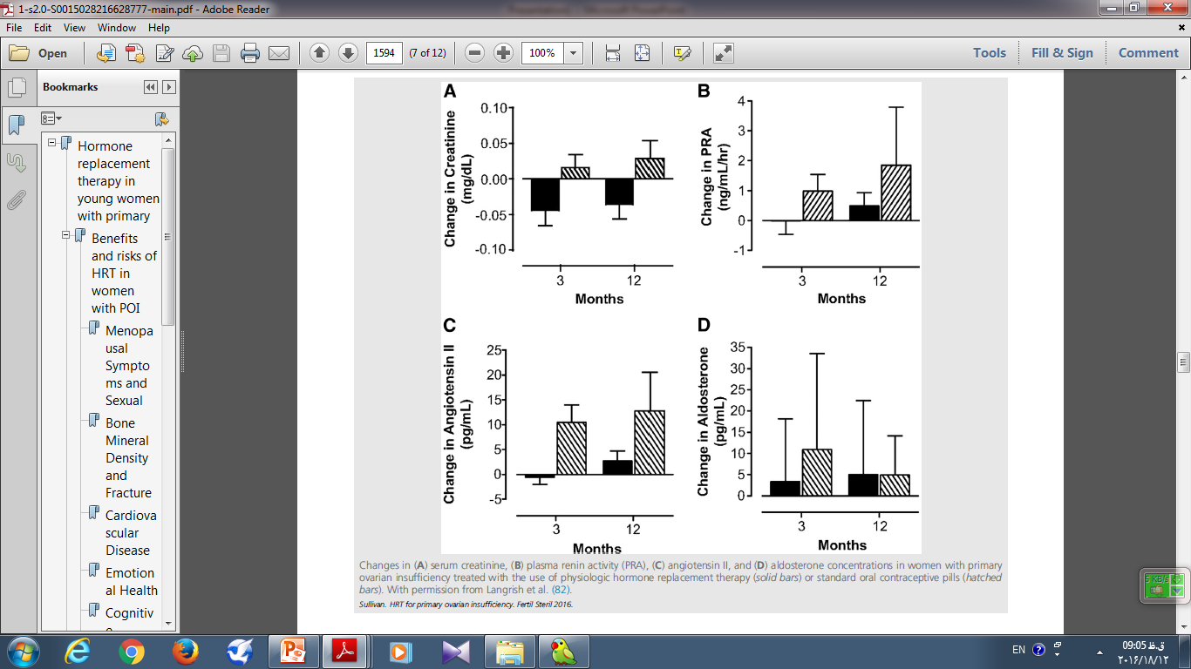

Slide 36
Progestins
Most women with POI have an intact uterus, so the recommended hormone replacement is both estrogen and progestin.
Cyclical progestin is recommended for endometrial protection.
Fertility and Sterility® Vol. 106, No. 7, December 2016 0015-0282/$36.00
*Hormone replacement therapy in young women with primary ovarian insufficiency and early menopause

Slide 37
The NIH study of HRT in POI
transdermal E2 (100 µg/d) with oral medroxyprogesterone acetate (10 mg/d for 12 days per month).
MPA (fully induce secretory endometrium in conjunction)
Cycling progestin courses given less frequently than monthly (termed ‘‘long-cycle HRT’’) is not recommended, because that approach increases the risk of endometrial hyperplasia and potentially of endometrial cancer
Fertility and Sterility® Vol. 106, No. 7, December 2016 0015-0282/$36.00
*Hormone replacement therapy in young women with primary ovarian insufficiency and early menopause

Slide 38
Medroxyprogesterone acetate
Is not derived from T and is a 21-carbon ‘‘pure’’ progestin, compared with the 19 norprogestins which may have associated androgenic effects
Fertility and Sterility® Vol. 106, No. 7, December 2016 0015-0282/$36.00
*Hormone replacement therapy in young women with primary ovarian insufficiency and early menopause

Slide 39
micronized P
The Postmenopausal Estrogen/Progestin Interventions (PEPI) Group did not investigate the efficacy of oral micronized P to effectively induce secretory endometrium in conjunction with a full replacement dose of estrogen.
Pharmacokinetics of oral micronized P
Fertility and Sterility® Vol. 106, No. 7, December 2016 0015-0282/$36.00
*Hormone replacement therapy in young women with primary ovarian insufficiency and early menopause

Slide 40
There is insufficient evidence to determine if medroxyprogesterone acetate and micronized P therapy differ significantly regarding association with the development of breast cancer.
Women who can not tolerate medroxyprogesterone acetate may be prescribed micronized P but should be monitored for endometrial suppression on at least an annual basis.
Fertility and Sterility® Vol. 106, No. 7, December 2016 0015-0282/$36.00
*Hormone replacement therapy in young women with primary ovarian insufficiency and early menopause

Slide 41
Cardiovascular risk and progestin
in combination with E2, both medroxyprogesterone acetate and micronized P improve cardiovascular risk markers, including serum high-density lipoprotein (HDL) and low-density lipoprotein levels, blood pressure, and fibrinogen levels.
improving HDL levels(micronized P may be superior)
In the Kronos Early Estrogen Prevention Study (KEEPS)
Fertility and Sterility® Vol. 106, No. 7, December 2016 0015-0282/$36.00
*Hormone replacement therapy in young women with primary ovarian insufficiency and early menopause

Slide 42
Risk associated with medroxyprogesterone acetate compared with progestin
Risk associated | micronized P | medroxyprogesterone acetate
breast cancer | insufficient evidence | insufficient evidence
Improving HDL levels | ++ | +
venous thromboembolism risk | does not alter | does not alter

Slide 43
Norpregnane derivatives
However, the use of norpregnane derivatives (nomegestrol acetate, promegestone), which are rarely used in the U.S., increases venous thromboembolism risk up to fourfold .
Fertility and Sterility® Vol. 106, No. 7, December 2016 0015-0282/$36.00
*Hormone replacement therapy in young women with primary ovarian insufficiency and early menopause

Slide 44
Testosterone
In premenopausal women, endogenous T production is 300 micg daily, with 50% produced by the adrenal glands and 50% by the ovaries
Currently, there is insufficient evidence to recommend the diagnosis or treatment of T deficiency in women, even those with POI.
Taken together, and given their deficient ovarian androgen production, it appears likely that with more research, T replacement in physiologic doses may ultimately prove to be of benefit to women with POI.
Fertility and Sterility® Vol. 106, No. 7, December 2016 0015-0282/$36.00
*Hormone replacement therapy in young women with primary ovarian insufficiency and early menopause

Slide 45
Benefit of physiologic T replacement
no benefit on:
quality of life
self-esteem
Mood
In another study improvements in:
BMD
cardio metabolic risk factors
neurocognitive measures
Libido
overall quality of life
Fertility and Sterility® Vol. 106, No. 7, December 2016 0015-0282/$36.00
*Hormone replacement therapy in young women with primary ovarian insufficiency and early menopause

Slide 46
Dehydroepiandrosterone
Taken together, however, the findings regarding fertility-enhancing effects of DHEA in women with ovarian insufficiency are still controversial and show minimal clinical benefit at most.
Fertility and Sterility® Vol. 106, No. 7, December 2016 0015-0282/$36.00
*Hormone replacement therapy in young women with primary ovarian insufficiency and early menopause

Slide 47
SPECIAL POPULATIONS

Slide 48
Turner Syndrome
women with Turner syndrome, 90% develop POI many girls with Turner syndrome require estrogen replacement for induction of puberty and menarche, to promote bone accrual early in life and later, and to promote maintenance of bone density

Slide 49
Hormonal Substitution Therapy in Hypogonadism
Girls
With a firmly established diagnosis of hypogonadism (e.g., girls with 45,X gonadal dysgenesis), begin hormonal substitution therapy at 12-13 yr of age Goal: to approximate normal adolescent development Initial therapy: ethinyl estradiol 5 mg? by mouth or conjugated estrogen 0.3 mg (or less) by mouth daily for 4-6 mo or preferably estradiol transdermally After 6 mo of therapy (or sooner if breakthrough bleeding occurs), begin cyclic therapy: Estrogen: first 21 days of month Progestagen: (e.g., medroxyprogesterone acetate 5 mg PO) 12th to 21st day of month Gradually increase dose of estrogen over next 2-3 yr to conjugated estrogen 0.6-1.25 mg or ethinyl estradiol 10-20 mg daily for first 21 days of month or estradiol patch
Notes:
Williams textbook CHAPTER 25 Physiology and Disorders of Puberty page : 1161

Slide 50
The preferred HRT regimen for women with Turner syndrome is 100 mg transdermal or transvaginal E2 daily with 10 mg cyclic medroxyprogesterone acetate daily for 12 days per month. This regimen is clinically available, supported by the best evidence, and currently best mimics physiologic patterns of normal ovarian function.
Fertility and Sterility® Vol. 106, No. 7, December 2016 0015-0282/$36.00
*Hormone replacement therapy in young women with primary ovarian insufficiency and early menopause

Slide 51
Breast and Ovarian Cancer
HRT is considered to be unsafe, and alternate measures should be used to reduce the risks and symptoms associated with POI . These may include:
1) low-dose vaginal estrogens or selective estrogen receptor modulators for vulvovaginal atrophy associated with estrogen deficiency
2) healthy lifestyle changes to reduce cardiometabolic risk
3) calcium and vitamin D supplementation and regular weight-bearing exercise to promote bone health
4) possibly antidepressants and/or psychotherapy if indicated for depressed mood .
Fertility and Sterility® Vol. 106, No. 7, December 2016 0015-0282/$36.00
*Hormone replacement therapy in young women with primary ovarian insufficiency and early menopause

Slide 52
Breastfeeding
According to FDA-approved drug labels, neither E2 in oral or transdermal forms nor hormonal contraceptives are recommended to be used during breastfeeding.
Small amounts of hormone are transmitted via breast milk, which may cause jaundice or breast enlargement in the neonate .
Additionally, estrogen use may interfere with lactation by decreasing the quantity and quality of breast milk .
A nursing mother with POI should be advised not to use HRT, including contraceptive steroids, until she has completely weaned her child .
Fertility and Sterility® Vol. 106, No. 7, December 2016 0015-0282/$36.00
*Hormone replacement therapy in young women with primary ovarian insufficiency and early menopause

Slide 53
After Age 50
The mean age of natural menopause is 50 ± 4 years
How to discontinue HRT?(individualized)
For example, women with a strong family history of breast cancer might decide to stop HRT at age 45 years.
Strong family history of osteoporosis or cardiovascular disease might wish to continue HRT until age 55 years.
Fertility and Sterility® Vol. 106, No. 7, December 2016 0015-0282/$36.00
*Hormone replacement therapy in young women with primary ovarian insufficiency and early menopause

Slide 54
After Age 50
Women with POI can be reassured that lower postmenopausal doses of HRT, when initiated within 10 years after menopause onset, have been associated with overall favorable risk-benefit profiles, including decreases in menopausal symptoms, fractures, CVD, type II diabetes mellitus, and mortality.
Fertility and Sterility® Vol. 106, No. 7, December 2016 0015-0282/$36.00
*Hormone replacement therapy in young women with primary ovarian insufficiency and early menopause

Slide 55
HRT in young women with surgical primary ovarian insufficiency
Most bilateral oophorectomies occur at the time of hysterectomy and most hysterectomies occur between ages 35 and 45 years,with more than half of all hysterectomies in women aged 45 years or younger
Hormone replacement therapy in young women with surgical primary ovarian insufficiency
Fertility and Sterility® Vol. 106, No. 7, December 2016 0015-0282/$36.00

Slide 56
HRT in young women with surgical primary ovarian insufficiency
The adverse effects of prophylactic oophorectomy are hormone deficiencyrelated symptoms
These effects are similar to women who develop POI by other mechanisms.
However, in Surgical POI symptoms are more sudden in onset and consequences can be more severe.
Hormone replacement therapy in young women with surgical primary ovarian insufficiency
Fertility and Sterility® Vol. 106, No. 7, December 2016 0015-0282/$36.00

Slide 57
Before 2002 >90% of women used estrogen therapy (ET) after bilateral salpingo-oophorectomy.
At present, the figure has declined to <10%.
Nevertheless, fear of taking any kind of hormone therapy (HT) is pervasive despite the evidence for the safety and efficacy of ET.
Hormone replacement therapy in young women with surgical primary ovarian insufficiency
Fertility and Sterility® Vol. 106, No. 7, December 2016 0015-0282/$36.00

Slide 58
menopausal symptoms
Women who develop surgical POI experience more severe and more frequent menopausal symptoms than women who experience natural menopause.
symptoms occur almost immediately and can persist for decades.
Hormone replacement therapy in young women with surgical primary ovarian insufficiency
Fertility and Sterility® Vol. 106, No. 7, December 2016 0015-0282/$36.00

Slide 59
Menopausal symptoms
Untreated, symptoms, such as:
hot flashes
sleep disturbance
fatigue
decreased sexual desire
anxiety and depressed mood Impaired cognition
impaired short-term memory
dementia
Often have a major impact on quality of life, capacity to function, and disease risk
Hormone replacement therapy in young women with surgical primary ovarian insufficiency
Fertility and Sterility® Vol. 106, No. 7, December 2016 0015-0282/$36.00

Slide 60
Hot flashes
are a state of vasomotor instability during which arterial flow is affected by surging levels of epinephrine and norepinephrine .
Vasodilation occurs in the skin as core blood flow shunts to the periphery.
Coronary artery constriction during hot flashes can occur with >30% of women experiencing chest pressure or pain during a severe episode
Hormone replacement therapy in young women with surgical primary ovarian insufficiency
Fertility and Sterility® Vol. 106, No. 7, December 2016 0015-0282/$36.00

Slide 61
Vaginal dryness
Vaginal dryness signals decreased genital blood flow and cell loss eventuating in genital atrophy and the urogenital syndrome of menopause.
Hormone replacement therapy in young women with surgical primary ovarian insufficiency
Fertility and Sterility® Vol. 106, No. 7, December 2016 0015-0282/$36.00

Slide 62
Following bilateral oophorectomy risk
all-cause mortality (28%)
coronary heart disease (33%)*
stroke (62%)
cognitive impairment (60%)
Parkinsonism (80%)
osteoporosis and bone fractures (50%)
Sexual dysfunction (40%–110%)
and, possibly, glaucoma
Hormone replacement therapy in young women with surgical primary ovarian insufficiency
Fertility and Sterility® Vol. 106, No. 7, December 2016 0015-0282/$36.00
Notes:
*These mechanisms include beneficial effects on cholesterol metabolism, direct actions in the arterial wall to inhibit atherosclerosis, and control of catecholamine
release

Slide 63
Starting ET at the time of oophorectomy
Perhaps most important, the Mayo Clinic study indicates that starting ET at the time of oophorectomy and continuing until at least the age of natural menopause (ages 51–52 years) significantly reduces most, but not all, of the increased risks seen in untreated women.
Hormone replacement therapy in young women with surgical primary ovarian insufficiency
Fertility and Sterility® Vol. 106, No. 7, December 2016 0015-0282/$36.00

Slide 64
Surges in catecholamine levels
Estrogen modulation of catecholamine release helps to prevent coronary constriction, whereas E withdrawal may trigger arterial instability and spasm .
These surges have been associated with
vasomotor instability
coronary spasm
myocardial infarction, and mortality
Hormone replacement therapy in young women with surgical primary ovarian insufficiency
Fertility and Sterility® Vol. 106, No. 7, December 2016 0015-0282/$36.00

Slide 65
BONE
At 6 years after oophorectomy, almost twice the rate of bone loss has been seen in women who undergo surgical POI compared with women with natural menopause
If ET is started within 3 years of the onset of surgical POI the bone density is restored to preoperative levels.
Hormone replacement therapy in young women with surgical primary ovarian insufficiency
Fertility and Sterility® Vol. 106, No. 7, December 2016 0015-0282/$36.00

Slide 66
E AND DECREASED RISK OF BREAST CANCER
In the WHI study and the Danish Osteoporosis Prevention Study, women using ET after hysterectomy compared with placebo showed more than a 20% reduced risk of developing breast cancer and more than a 60% reduced risk of dying of breast cancer.
These investigators highlight the suppressive
and apoptotic effects of E in breast cancer cells.
Hormone replacement therapy in young women with surgical primary ovarian insufficiency
Fertility and Sterility® Vol. 106, No. 7, December 2016 0015-0282/$36.00

Slide 67
IMPROVING CARE FOR WOMEN WITH SURGICAL POI
Decreasing the frequency of bilateral oophorectomy
ovary-sparing bilateral salpingectomy
evidence that 20%–30% of conserved ovaries fail within 6 months to 3 years after simple hysterectomy or bilateral salpingectomy;
these women should be regularly monitored for signs and symptoms of hormone deficiency
start ET soon after oophorectomy—with the utmost urgency in the youngest women
Hormone replacement therapy in young women with surgical primary ovarian insufficiency
Fertility and Sterility® Vol. 106, No. 7, December 2016 0015-0282/$36.00

Slide 68
HRT IN bilateral oophorectomy
Estrogen therapy is most beneficial when started at the time of oophorectomy and continued at least until age 50 years.
Extension of ET, for symptom control and disease prevention, at least until the age of 60 years, is supported by the findings of the WHI
Hormone replacement therapy in young women with surgical primary ovarian insufficiency
Fertility and Sterility® Vol. 106, No. 7, December 2016 0015-0282/$36.00

Slide 69
Topical supplementation
Topical estrogen supplementation should be used in women with POF who continue to have vaginal complaints despite the systemic HRT*(primary amenorrhea)
A topical approach is also an excellent option for progesterone supplementation because vaginal progesterone cream and pills are easily absorbed and yield very high tissue levels in the uterus. It has been estimated the tissue levels of progesterone are 4 times higher compared with intramuscular or oral use. Vaginal progesterone pills are less messy compared with the cream.*

Slide 70
Ospimefene
is a selective estrogen receptor modulator with estrogenic effects on the vaginal mucosa in clinical studies and antiestrogenic effects on the breast in animal studies.
Ospimefene can be considered for women with dyspareunia due to atrophic changes of the vagina if patients are adverse to vaginal treatments.

Slide 71
TURNER
The initial dose of estrogen should be low, eg, a transdermal estradiol patch at 3.125 to 6.25 micrograms daily (or even just applied overnight, to deliver approximately one-half this dose); depot estradiol at 0.2 to 0.4 mg monthly; or micronized estradiol at 0.25 mg daily by mouth.
When using transdermal estradiol patches, the lowest doses are achieved by cutting a matrix estrogen patch accordingly; the cutting technique cannot be used for a reservoir-type patch, as this would make the entire dose available at once.
UPTO

Slide 72
TURNER
The dose should be increased gradually during the following two years to a young adult dose. A typical adult dose is a transdermal estradiol patch (100 micrograms/day), applied weekly or twice weekly. The dose should be adjusted to maintain the serum estradiol concentration within the normal range. This dose is also roughly equivalent to 2 mg of oral micronized estradiol, approximately 10 to 20 mcg of oral ethinyl estradiol, or 1.25 mg of oral conjugated equine estrogen. Clinicians treating adult Turner syndrome patients can interchange between these formulations, but the transdermal route is preferred, as discussed in the following section .

Slide 73
Adjunctive progestins — Girls receiving estrogen must be given cyclic progestin therapy to prevent endometrial hyperplasia .
Progestin therapy should be begun after two years of estrogen monotherapy (typically around 13 or 14 years of age) or when vaginal breakthrough bleeding first occurs.
It is usually given as micronized progesterone at a dose of 200 mg daily for 12 days (days 1 to 12 of each calendar month).
UPTODATE

Slide 74
BMD
BMD should be evaluated using dual-energy x-ray absorptiometry (DXA) at the first visit with the adult provider. However, conventional BMD measurements (eg, DXA) tend to underestimate the true bone density of individuals with short stature . Some experts suggest bone size-independent methods, such as quantitative computerized tomography (QCT) or volumetric transformation of DXA in individuals shorter than 150 cm . If BMD is normal, additional follow-up is done when the patient stops estrogen replacement (around 50 years of age). If abnormal, further evaluation and treatment are the same as for other patients with low bone density or osteoporosis

