Slide 2
Premature adrenarche
Dr. Hashemi Assistant Prof. of Pediatric Endocrinologist
Isfahan University Of Medical Sciences

Slide 3
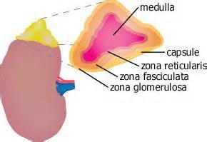
Zona Reticularis
The zona reticularis is predominantly responsible for the secretion of the adrenal androgens:
Dehydroepiandrosterone (DHEA)
DHEA sulfate (DHEAS)
Androstenedione (A4)
Arch Dis Child. 2012

Slide 4
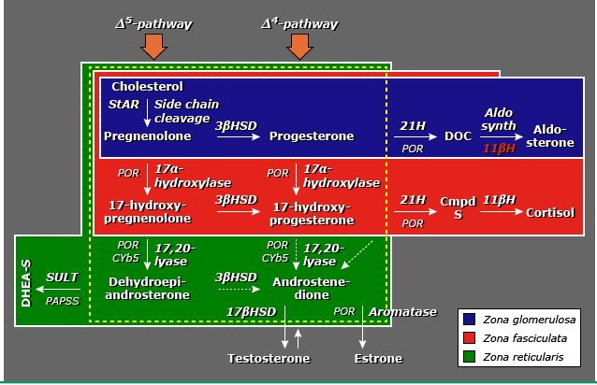
Steroidogenic pathways within the zona reticularis

Slide 5
Zona Reticularis
After birth, the zona reticularis involutes and by early to mid-childhood is largely inactive, secreting only small amounts of DHEA and A4.
Arch Dis Child. 2012

Slide 6
Zona Reticularis
Activation of the zona reticularis occurs at a mean age of 6 - 8 years in boys and girls.
Arch Dis Child. 2012

Slide 7
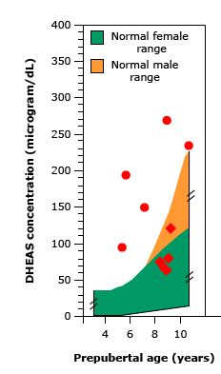
Adrenarche
Adrenarche :
Increase in adrenal androgen production that becomes biochemically apparent as a rise in DHEAS.

Slide 8
Mechanisms Of Adrenarche
Not completely understood.
It is independent of central puberty and gonadarche (hypogonadotrophic hypogonadism and gonadal dysgenesis).

Slide 9
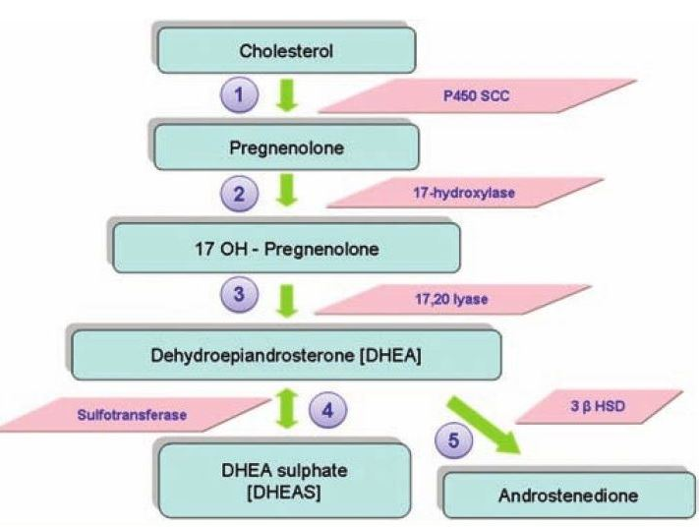
Mechanisms Of Adrenarche
Leptin may enhance the activity of 17,20-lyase .
Endocrinology 2000

Slide 10
Mechanisms Of Adrenarche
ACTH appears to play a facilitative rather than causal role in adrenarche. (Mediated activation of 17,20-lyase)
Arch Dis Child. 2012

Slide 11
Mechanisms Of Adrenarche
Rise in intra-adrenal cortisol probably leads to inhibition of 3β-HSD activity and increased DHEA, thereby initiating adrenarche.
J Clin Endocrinol Metab 2011

Slide 12
Pubarche
Definition:
Appearance of sexual hair (Tanner stage 3)
Pre-sexual hair (Tanner stage 2) is an unreliable sign of pubarche.

Slide 13
Premature pubarche
Definition:
Isolated appearance of sexual hair before the age of eight years in girls and nine years in boys .
Ratio of girls to boys is four to one .
Eur J Pediatr 2004

Slide 14
Premature pubarche
It typically occurs after the age of four to five years, but can occur before the age of two years.
It is because of :
Persistent fetal zone of the adrenal gland
Hypersensitivity of hair follicles
Both

Slide 15
Premature adrenarche
Definition:
It is an early maturational event of adrenal androgen production.
DHEAS = 40 to 115 mcg/dL
Testosterone ≤20 ng/dL

Slide 16
Premature adrenarche
It is accompanied by :
Axillary body odor
Seborrhea
Microcomedonal acne
Eur J Endocrinol 2009

Slide 17
Premature adrenarche
Sexual hair development increases slowly.
Bone age increases in proportion to linear growth.

Slide 18
Premature adrenarche
It is not accompanied by :
Other signs of puberty
Virilization
Advance bone age
Eur J Endocrinol 2009

Slide 19
Premature adrenarche
Some children have premature adrenarche with normal prepubertal serum levels of DHEAS and other androgens and premature adrenarche is detectable only by provocative testing with ACTH.
Eur J Endocrinol 2011

Slide 20
Premature adrenarche
Two possible explanations for these findings:
Coincidentally low sulfotransferase activity, thereby preventing an elevation in serum DHEAS.

Slide 21
Premature adrenarche
Adrenal 17-ketosteroid hyperresponsiveness to ACTH occurs in the absence of a high basal serum DHEAS concentration .
This may be related to the functional adrenal hyperandrogenism sometimes seen in adults with polycystic ovary syndrome.

Slide 22
Exaggerated adrenarche
Definition:
Premature adrenarche with 1 or more features of systemic androgen effect :
Increased linear growth
Modestly advanced bone age
Cystic acne
Insulin resistance (central adiposity or acanthosis nigricans)

Slide 23
Exaggerated adrenarche
DHEAS up to 130 mcg/dL
Testosterone up to 35 ng/dL

Slide 24
ETIOLOGY
The cause of premature adrenarche is unclear.

Slide 25
ETIOLOGY
Temporal lobe lesions
Poliomyelitic scoliosis
Adrenal androgen-stimulating factor (or zona reticularis growth factor) is controlled by neural pathways.
J Pediatric 1982

Slide 26
ETIOLOGY
Rapid early childhood weight gain ( IGF 1 – Insulin – Central fat deposition ) has been related to the mid-childhood DHEAS level .
Eur J Endocrinol 2009

Slide 27
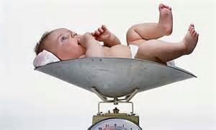
ETIOLOGY
Low birth weight
Subsequent obesity
Excessive adrenal steroidogenesis due to metabolic programming .
J Clin Endocrinol Metab 2007

Slide 28
ETIOLOGY
Heterozygosity for CAH may be a risk factor for premature adrenarche.

Slide 29
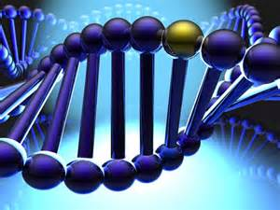
ETIOLOGY
Androgen receptor CAG repeat (shorter in girls with premature adrenarche).
Length of which correlates inversely with androgen sensitivity
J Clin Endocrinol Metab 2008

Slide 30
DIFFERENTIAL DIAGNOSIS
Hypertrichosis :
Excessive growth of vellus body hair in nonsexual areas .
Endocr Rev 2000

Slide 31
DIFFERENTIAL DIAGNOSIS
Idiopathic premature pubarche :
No evidence of adrenarche.
Bone age, plasma androgens are normal.
Increased sensitivity of the pilosebaceous unit to normal adrenarchal androgen .
Risk factor for idiopathic hirsutism.
J Clin Endocrinol Metab 2006

Slide 32
DIFFERENTIAL DIAGNOSIS
True precocious puberty:
Is accompanied by premature adrenarche in about half of cases.
Int J Pediatr Endocrinol 2010

Slide 33
DIFFERENTIAL DIAGNOSIS
CAH :
Serum testosterone and/or DHEAS are well above the normal adrenarchal range.
Significantly advanced bone age (>2.0 SD for age and >20 percent above height age) .

Slide 34
DIFFERENTIAL DIAGNOSIS
Glucocorticoid resistance :
Defects in glucocorticoid receptor
Inadequate negative feedback by cortisol, with consequent excessive ACTH release .
J Clin Endocrinol Metab 2008

Slide 35
DIFFERENTIAL DIAGNOSIS
Cortisone reductase deficiency :
Failure to regenerate cortisol from cortisone (HSD11B1, H6PDH)
Increased ACTH production
Proc Natl Acad Sci U S A 2011

Slide 36
DIFFERENTIAL DIAGNOSIS
Apparent DHEA sulfotransferase deficiency:
Defect in DHEA sulfation.
DHEAS levels are undetectable to very low.
Mutations in this gene cause spondyloepimetaphyseal dysplasia.
J Clin Endocrinol Metab 2015

Slide 37
DIFFERENTIAL DIAGNOSIS
Peripheral androgen metabolic disorder :
Congenital portosystemic shunting .
DHEA levels are high.
DHEAS levels are low to inappropriately normal.
Low hepatic sulfation of DHEA.
Hyperinsulinemia & TBG deficiency.
Horm Res Paediatr 2015

Slide 38
DIFFERENTIAL DIAGNOSIS
Cushing's syndrome
Virilizing tumors ( Adrenal or ovarian)
Exogenous androgen exposure
Pediatrics 2004

Slide 39
EVALUATION
History
Physical examination
Bone age
Other tests…

Slide 40
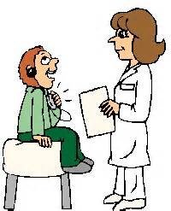
History and Examination
The age at onset of signs.
Tempo of their change (rapid progression in symptoms might not be consistent with simple premature adrenarche).

Slide 41
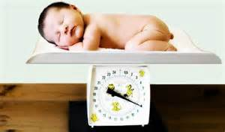
History and Examination
Birth weight
Horm Res Paediatr 2010

Slide 42
History and Examination
Premature adrenarche
PCOS
Type 2 diabetes mellitus

Slide 43
History and Examination
Recent acceleration in growth rate
Greasiness of hair and skin
Vaginal discharge
Mood swings
Body odour
Acne

Slide 44
History and Examination
Hirsutism
Acanthosis nigricans

Slide 45
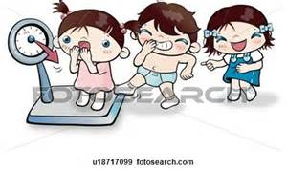
History and Examination
Height
Weight
BMI
Blood pressure (CAH, or adrenal tumours)

Slide 46
History and Examination
Puberty staging
External assessment of genitalia (clitoromegaly , penile enlargement).

Slide 47
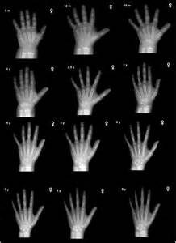
Bone age
Estimation of bone age is the single most important diagnostic test.

Slide 48
Bone age
If the bone age is normal ( within 2 SD of average) a serious cause for precocious pubarche is unlikely.
Every 3 months monitor clinical features and assess height velocity.
DHEAS , testosterone

Slide 49
When we should think about adrenal or virilizing disorders ?
If bone age >20 percent height age or > 2SD for age
If bone age/height age ratio >1.2
If there are any atypical features
If these measures worsen upon follow-up
If testosterone and DHEAS concentrations are in excess
Clin Endocrinol 2015

Slide 50
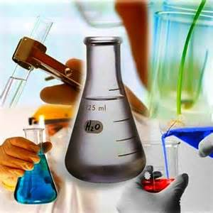
In this situations …
17 OHP

Slide 51
When we think about CAH ?
17OHP >200 ng/dL has 92 to 98 percent sensitivity and specificity for CAH .
17OHP >1500 ng/dL is diagnostic.
Clin Endocrinol 2015

Slide 52
ACTH stimulation test : Why ?
17OHP is intermediate ( between 200 and 1500 ng/dL)
Clinical picture suggests virilization in spite of a normal 17OHP level.
Clin Endocrinol 2015

Slide 53
How ? : ACTH stimulation test
Cosyntropin infused over one minute IV.
250 mcg (150 mcg per square meter)
Blood is sampled before and 30 to 60 minutes

Slide 54
ACTH stimulation test
17OHP > 1000 ng/dL is suggestive of 21-hydroxylase deficiency.
Peak > 1500 ng/dL is definitive .
Intermediate values are found in either a carrier state, 3ßHSD deficiency, or 11ßH deficiency.
Clin Endocrinol 2015

Slide 55
ACTH stimulation test
In nonclassic 3ßHSD deficiency, Post ACTH 17-hydroxypregnenolone > 5 SD or > 3000 ng/ dL .
Pediatric Endocronology Sperling 2014

Slide 56
When we should suspicious to virilizing tumors ?
DHEAS >700 µg/dL :
Imaging

Slide 57
Dexamethasone androgen suppression test
For differentiation of :
Virilizing tumor
Other forms of virilization
Endocrinol Metab Clin North Am 1993

Slide 58
Dexamethasone androgen suppression test
Dexamethasone :
1 mg/m²/day QID
Four days
Cortisol, DHEA-S, and androgens on the morning of the fifth day

Slide 59
DAS test
DHEAS fall by more than 75 %
Cortisol fall to under 1 mcg/dL
Androgens fall to prepubertal concentrations
exaggerated adrenarche

Slide 60
DAS test
One or more androgen levels remains above.
Normal cortisol suppression.
virilizing tumors

Slide 61
DAS test
None suppress normally.
Cushing's syndrome or glucocorticoid resistance

Slide 62
MANAGEMENT
No specific endocrine treatment is required for premature adrenarche , since this is a benign condition in children.

Slide 63
MANAGEMENT
Counseling about a diet and exercise program is indicated for obesity and metabolic syndrome, if present.

Slide 64
MANAGEMENT
Insulin resistance and a history of LBW, the option of treatment with insulin sensitising agents such as metformin may be considered .

Slide 65
MANAGEMENT
The parents should be evaluated for type 2 diabetes .

Slide 66
Precautions
Because the initial diagnosis may have been incorrect, these patients should be re-evaluated 3- 6 months later for evidence of virilization.

Slide 67
Precautions
Girls with premature pubarche appear to carry about a 15 to 20 percent risk of developing PCOS.

Slide 68
Precautions
Premature adrenarche may occasionally be a harbinger of type 2 diabetes or metabolic syndrome in adulthood.

Slide 69
Conclusions
Premature adrenarche is a common reason for children (particularly girls) to present either to the general pediatric or endocrine clinic.

Slide 70
Conclusions
It is a benign condition but other causes of hyperandrogenism must be excluded.

Slide 71
Conclusions
It may be associated with PCOS-like phenotype in conjunction with components of the metabolic syndrome.

Slide 72
با تشکر

