Slide 1


Slide 2
Postsurgical hypoparathyroidism definitions and management
AACE/ACE Disease State Clinical Review 2015

Slide 3
INTRODUCTION
Postsurgical hypoparathyroidism is the most common and often the most troubling long-term consequence of aggressive thyroid surgery.
Etiologies include injury to the parathyroid glands (or their blood supply) or inadvertent resection of parathyroid tissue.
may be either transient or permanent.

Slide 4
INTRODUCTION
The incidence of postsurgical hypoparathyroidism is difficult to define.
A review of the literature reveals a broad range of criteria and parameters that have been used to define postoperative patients for hypoparathyroidism
Including:
(1) clinical criteria, symptomatic versus asymptomatic;
(2) biochemical parameters, serum calcium and/ or intact PTH levels below specified levels;
(3) therapeutic criteria, requirement for calcium and or vitamin D treatment;
(4) duration of calcemic support, time interval of the above therapy.
Attempting to compare data from surgical series is difficult and likely inaccurate. Analysis is made even more formidable by the diversity of postoperative electrolyte supplementation protocols and discharge criteria utilized by different surgeons. Regimens vary from no supplementation (unless the patient exhibits symptoms of hypocalcemia) to empiric calcium, magnesium, and vitamin D derivative supplementation.

Slide 5
INTRODUCTION
Calculation of postoperative hypoparathyroidism rates is further complicated by the broad range of surgical approaches utilized to treat thyroid diseases.
A review of the literature reveals that in the hands of most high-volume thyroid/parathyroid surgeons, the risk of permanent hypoparathyroidism after a total thyroidectomy is <1%. The addition of a central compartment lymphadenectomy increases this risk to between 1 and 15%;
Whether a unilateral or bilateral paratracheal resection is performed appears to affect the incidence of hypoparathyroidism.

Slide 6
THYROID SURGERY
The manipulation of the parathyroid glands, even without their removal, can lead to transient disruption of PTH production and/or release. Given the short half-life of PTH (3-5 minutes), even a temporary drop in output can result in at least transient hypoparathyroidism with associated hypocalcemia, hypomagnesemia, and hyperphosphatemia.
Thus, bilateral central neck operations, including total thyroidectomy, bilateral central neck dissection, and total laryngectomy can result in hypoparathyroidism even in circumstances where the parathyroid glands themselves are identified and preserved.
Autoimmune and inflammatory thyroid disease, whether Hashimoto thyroiditis or Graves disease, increase the risk of postsurgical hypoparathyroidism with total thyroidectomy.
Preoperative disorders of calcium and vitamin D absorption and metabolism such as seen in patients who have undergone bariatric surgery (especially roux-en-Y gastric bypass) also increase the risk of postoperative hypocalcemia following bilateral central neck surgery.
Pregnancy, lactation, or a vitamin D deficiency may all place a patient at increased risk for postoperative hypocalcemia.
Unrecognized prior reduction in parathyroid function, such as following prior central neck surgery, where 1 or more parathyroid glands might have been unknowingly removed or compromised, increases the risk of hypoparathyroidism after additional central neck surgery. Such increased risk may not be detectable with preoperative testing.

Slide 7
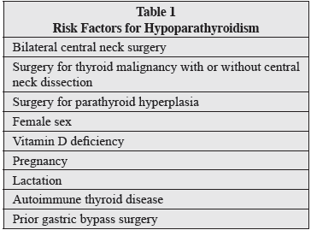

Slide 8
DEFINITIONS OF HYPOPARATHYROIDISM
Hypoparathyroidism following surgery is commonly classified as transient or permanent.
The most common time marker used to delineate between these 2 conditions is 12 months following surgery.

Slide 9
DEFINITIONS OF HYPOPARATHYROIDISM
transient hypoparathyroidism is treated with “parathyroid splinting,” which uses calcium supplementation and 1,25 dihydroxy cholecalciferol and occasionally magnesium supplementation.
Magnesium depletion may impair PTH release, and action and treatment of magnesium deficiency is sometimes required.
Laboratory testing is performed on a regular basis to monitor serum calcium, magnesium, and phosphorus and urinary calcium (as needed).
As parathyroid function returns, the regimen is tapered.

Slide 10
DEFINITIONS OF HYPOPARATHYROIDISM
Permanent hypoparathyroidism is defined when a medical regimen is required for longer than 12 months.
Patients with permanent hypoparathyroidism can be labile, difficult to manage, and experience significant morbidity; however, many can be maintained with a stable regimen of calcium and vitamin D

Slide 11
DEFINITIONS OF HYPOPARATHYROIDISM
Clinical hypoparathyroidism is defined as biochemical hypoparathyroidism accompanied by symptoms of hypocalcemia such as perioral and distal extremity dysesthesias/ hyperesthesia, lower extremity myoclonus, carpopedal spasm, weakness, headache, electrocardiogram changes, altered sensorium, and/or nausea as well as increased bone density.
Biochemical hypoparathyroidism is defined as a low intact PTH level often but not always below the lower limit of the laboratory standard (usually 12 pg/mL) accompanied by hypocalcemia and hyperphosphotemia.
Hypocalcemia lags behind hypoparathormonemia by hours. Hypoparathormonemia can be seen within minutes of surgical manipulation of the thyroid or parathyroid glands.
Biochemically, hypocalcemia is defined as a total serum ca corrected level <8.6 mg/dL or and ionized serum ca <1.15 mmol/L.

Slide 12
DEFINITIONS OF HYPOPARATHYROIDISM
Although usually linked, hypocalcemia can exist independent of hypoparathormonemia, but hypoparathormonemia will ultimately lead to hypocalcemia.
Relative hypoparathyroidism or parathyroid insufficiency may exist postoperatively and is defined as clinical symptoms of hypoparathyroidism requiring medical treatment, even though measured laboratory values may be within normal ranges.
Occasional patients will manifest clinical symptoms of hypocalcemia despite eucalcemia. This can be seen following surgery for primary or tertiary hyperparathyroidism or aggressive thyroid surgery and probably represents acute calcium lowering, which precedes a lagging reset of the calcium-sensing receptor system acclimatized to prior hypercalcemia.

Slide 13
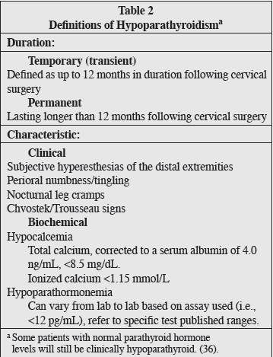

Slide 14
Preoperative Strategies
Patients can be tested for 25OHD blood levels preoperatively.
If the patient is identified as being vitamin D deficient (25OHD<20 ng/mL), then aggressive treatment with high-dose vitamin D should be considered.
If 25OHD is between 20 and 30 ng/mL, less aggressive replacement is sufficient. Typically, 50,000 IU vitamin D3 (cholecalciferol) is given by mouth weekly to correct the vitamin D deficiency and hopefully reduce the risk of postoperative hypocalcemia.
Ergocalciferol or vitamin D2 is also an option for replacement.
However, studies to date have not consistently been able to show any impact of preoperative vitamin D therapy on postoperative calcium levels.
Dexamethasone (8 mg IV) given 90 minutes before skin incision is not yet a standard but has been shown to reduce the rate of transient hypoparathyroidism and laryngeal nerve palsy in a single 2013 study.

Slide 15
Parathyroid Preservation/Autotransplantation
Intraoperative preservation of the parathyroid glands with their blood supply intact, typically from the inferior thyroid artery, is paramount for preventing hypoparathyroidism.
Every effort should be made to visually identify each parathyroid close to the thyroid gland, assessing the location of the vascular pedicle to the parathyroid. Preservation of the parathyroid gland is enhanced by a careful capsular dissection down and posterior off the thyroid capsule.
Thomusch et al performed a large study and demonstrated that at least 2 parathyroid glands should be identified and preserved during bilateral thyroid surgery to avoid permanent postoperative hypoparathyroidism.

Slide 16
Parathyroid Preservation/Autotransplantation
Parathyroid autotransplantation should be undertaken judiciously, with the realization that an in situ functional parathyroid is always preferable to an autograft with respect to short-term postoperative calcium homeostasis.
Parathyroid tissue color alone is not the definitive test of parathyroid viability; consideration of an intact vascular pedicle should also be assessed.
A prospective study of total or near-total thyroidectomy patients with 3 or 4 discolored parathyroid glands of the 4 visually identified parathyroid glands demonstrated only transiently impaired parathyroid function such that autotransplantation of discolored parathyroid glands was not recommended in the absence of other criteria for autotransplantation.

Slide 17
Parathyroid Preservation/Autotransplantation
Indication for autotransplantation : If the anatomic location of an identified parathyroid gland does not allow for preservation with its vascular pedicle intact during thyroidectomy or the parathyroid gland develops visible evidence of venous congestion or ischemia, then the parathyroid gland is placed in sterile iced saline. After frozen section confirms parathyroid tissue, the remaining parathyroid is minced into tiny fragments and autotransplanted, typically into 1 or more pockets of the sternocleidomastoid muscle with a marking suture or clip.
Parathyroid auto grafts typically return to function within 6 months as determined by PTH measurements (Table 3).
There is some literature suggesting that autotransplantation is not always functionally successful. The problem with many studies that have investigated autotransplantation following thyroid cancer surgery is that it is hard to know if residual parathyroid function is related to preserved glands or the transplanted glands.

Slide 18
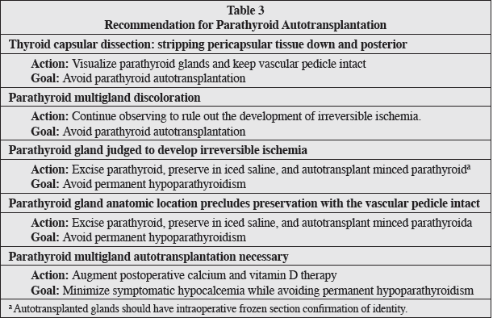

Slide 19
Parathyroid Preservation/Autotransplantation
Pathologists routinely indicate the presence or absence of microscopically identified parathyroids in the final pathology report. The challenge may be that the pathology processing protocols recommend minimal representative sampling in normal/goiterous thyroids without discrete encapsulated nodules. Because parathyroids are quite small and may resemble thyroid tissue, they may be missed on gross exam. Unfortunately, requesting meticulous pathologic dissection of the thyroid for large multinodular goiters is not practical.
In summary, the best approach for avoiding postoperative hypoparathyroidism is to have a technique that recognizes parathyroid glands, reduces trauma, and preserves the vascular pedicle. Surgeons should be vigilant for anatomic disruptions and parathyroid coloration changes that would make primary autotransplantation a prudent action.

Slide 20
Intraoperative/Immediate Postoperative Strategies
Intraoperative PTH (IOPTH) refers to blood specimens drawn during and shortly after central neck surgery (i.e., 5, 10, and 20 minutes after thyroidectomy is completed).
The results may become available while the patient is still in the operating room or once she/he has arrived in recovery. This data can expedite same-day discharge or predict the need for observation and postoperative calcium management.
Patients with a PTH value >15 ng/mL measured 20 minutes or longer after surgery can be discharged home on prophylactic calcium.
Patients with <15 ng/mL PTH should be started on calcitriol (0.5 mcg BID) in addition to calcium (and possibly magnesium) and observed overnight.

Slide 21
Intraoperative/Immediate Postoperative Strategies
Immediate postoperative care is defined as the first 24 hours following surgery. This would include use of PTH and calcium (and occasionally magnesium) values in the time period beyond 1 hour following excision or in recovery.
Intact PTH (iPTH) levels alone or combined with serum calcium levels can guide the decision to begin prophylactic oral calcium.
The normal short half-life of PTH (3-5 minutes) supports relying on early postoperative iPTH levels. Typically, an iPTH level <10 to 15 pg/mL is predictive of later hypocalcemia.

Slide 22
Intraoperative/Immediate Postoperative Strategies
Postoperative calcium testing has also been used as a means for assessing postoperative hypoparathyroid risk and stratifying patients for observation and/or discharge.
Unfortunately, the lag time for calcium changes is greate than that of PTH, and a calcium nadir may not occur for 24 to 72 hours following surgery.
Absolute numbers and trends of calcium as well as total versus ionized calcium measurements have been used to establish clinical guidance.
If calcium levels are stable or increase over an observation period, discharge is generally considered safe.
If calcium levels continue to decline despite medical treatment, these patients require optimization of calcium replacement therapy (and possibly magnesium) and ongoing observation until calcium stability or increase is observed.
Calcium levels, when used, are drawn the evening after surgery, the following morning, and every 6 to 12 hours thereafter as indicated.

Slide 23
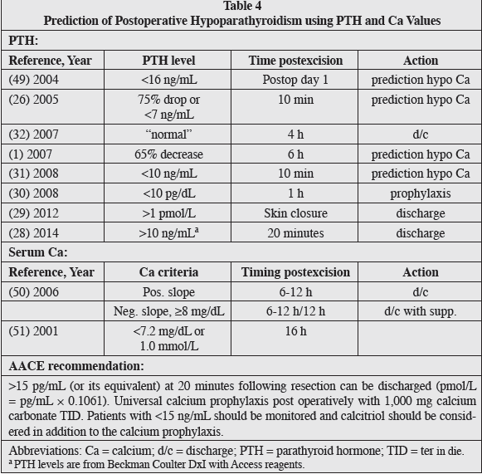
Table 4 reviews the recent literature on this topic and presents ranges of IOPTH values and the timing of sampling from surgery.
Several studies have demonstrated the effectiveness of iPTH levels in the early postoperative period from various time points: in the postanesthesia care unit immediately after surgery, to 1, 2, 4, 6, or 24 hours later. (Table 4)

Slide 24
PARATHYROID SURGERY
There can be many parallels between thyroid and parathyroid surgery when it comes to hypoparathyroidism. Manipulation or removal of 1 or more unilateral parathyroid glands (i.e., in focused parathyroid exploration or thyroid lobectomy), whether normal or hyperfunctioning, generally does not result in transient hypoparathyroidism (like thyroid lobectomy) as long as there are other ipsi- or contralateral normal and undisturbed parathyroid glands.
Hypocalcemia can occur in patients at risk for hungry bone syndrome including elderly patients with osteoporosis and those with very large parathyroid adenomas/longstanding parathyroid disease, but this is not true hypoparathyroidism. Hypocalcemia may also be a risk for patients with resected parathyroid cancer or those with “brown” (osteoclastic) tumors.

Slide 25
PARATHYROID SURGERY
In cases of total parathyroidectomy for multigland parathyroid disease with autotransplantation, whether primary or secondary, a period of postoperative hypoparathyroidism can be anticipated. For this reason, some surgeons prefer a subtotal parathyroid resection. Such patients will require medical support during the immediate postoperative period.
Close monitoring of return of function of the autotransplanted graft is required so as to not overshoot calcium and calcitriol replacement during the graft recovery period.
Parathyroid autotransplants may be placed in neck or forearm muscle. The latter may be preferred to avoid revision neck surgery and recurrent laryngeal nerve injury.

Slide 26
PARATHYROID SURGERY
Reoperative parathyroid surgery may cause permanent hypoparathyroidism in 15 to 30% of patients.
In the reoperative setting, a portion of the excised parathyroid tissue should be cryopreserved for possible later autotransplantation in case the primary autograft fails. Cryopreservation and reimplantation are challenging and are most successful in experienced hands.
Similar diagnostic criteria for hypoparathyroidism and the same treatment regimes that are employed for thyroid surgical patients would be utilized in parathyroid surgery patients as needed.
The same approach to identifying normal parathyroid glands and preserving their blood supply and autotransplanting ischemic normal glands with disrupted pedicles during surgery is also suggested.

Slide 27
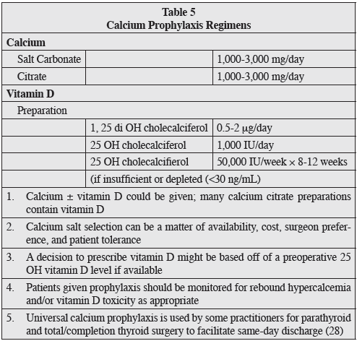

Slide 28
TREATMENT

Slide 29
Postoperative Prophylaxis
The best prophylaxis to avoid postoperative hypocalcemia after total thyroidectomy is intraoperative parathyroid gland preservation with a capsular dissection to maintain the blood supply to the parathyroid glands.
It is not always necessary to visually identify all 4 parathyroid glands to accomplish this.
One retrospective study demonstrated that operations identifying 1 or 2 parathyroid glands had less hypocalcemia than operations identifying 3 to 4 parathyroid glands. This suggests that parathyroid glands lying a slight distance from the thyroid gland are more difficult to identify but easier to maintain functionally intact.
Despite the goal of preserving parathyroid glands, hypocalcemia will occur after 10 to 20% of thyroidectomies and is increased to 30% or more after thyroidectomy for Graves disease or thyroid cancer, particularly when combined with a bilateral central compartment lymph node dissection.

Slide 30
Postoperative Prophylaxis
An all-inclusive prophylactic approach to preventing postoperative hypocalcemia is to routinely initiate treatment with oral calcium with or without calcitriol.
Typically, calcium carbonate is the preparation of choice, given as 500 to 1,000 mg 3 times a day. Routine oral calcium has been demonstrated to reduce postoperative hypocalcemia to approximately 10%.
Adding calcitriol, usually in a dose of 0.5 to 1.0 mcg a day, increases the effectiveness of the oral calcium.
In the hypomagnesemic patient, magnesium supplementation may hasten the return to eucalcemia and diminish the constipation that is inherent with high-dose calcium replacement.
A prospective, randomized study after total thyroidectomy showed that 1,500 mg oral calcium plus 1 mcg calcitriol BID was superior to 0.5 mcg of calcitriol BID or no calcitriol. This aggressive prophylactic approach can occasionally result in hypercalcemia on postoperative blood testing, but this occurs infrequently. Routine use of calcitriol is more expensive than calcium alone but is much less costly than hospital admission.

Slide 31
Postoperative Prophylaxis
There are 2 schools of thought regarding the approach to postoperative calcium management: parathyroid splinting versus “parathyroid stress testing.”
The former asserts that exogenous replacement of calcium and calcitriol allows for gradual parathyroid recovery while at rest, as the replacements are tapered over time and the parathyroid(s) recover from their transient ischemic insult.
The latter proposes that managed mild hypocalcemia will stimulate residual parathyroid tissue to recover by increasing demand for PTH through stimulation of the calcium-sensing receptor or by stimulating parathyroid cell growth. In fact, both theories are speculative, and neither has been proven.
Given the low cost and ease of prophylactic calcium therapy for patients at risk for hypoparathyroidism, universal calcium prophylaxis is recommended.

Slide 32
Acute Management of Hypoparathyroidism
Postoperative hypoparathyroidism can be quite dramatic, requiring aggressive intervention. Calcium levels should be monitored at least every 12 hours and more frequently if total calcium levels are <7 mg/dL, ionized calcium is <1.0 mmol/L, or if symptoms of hypocalcemia (e.g., perioral numbness/tingling, positive Chvostek or Trousseau sign, or carpopedal spasm) should occur.
Usually 1 to 3 grams of elemental calcium orally in divided doses is sufficient. Calcium carbonate (40% elemental calcium) or calcium citrate (21% elemental calcium) are most commonly prescribed and should be taken with meals.
The solubility of calcium carbonate is dependent upon acidification, and achlorhydria may impede absorption; however, this is controversial. Patients on a proton pump inhibitor or elderly subjects with achlorhydria should be at least initially treated with calcium citrate, which does not require an acidic environment for absorption.
If the calcium level is stable but remains <7 mg/dL, calcitriol (0.5 mcg twice daily) can be added.
Postoperative PTH below the lower limit of normal and falling serum calcium concentrations should be initially treated with 1,000 mg of elemental calcium 3 times daily and calcitriol (0.5 mg BID).
If the serum magnesium is <1.6 mg/dL in a patient without renal compromise, magnesium supplementation with magnesium oxide (400 mg BID) may enhance calcemic recovery.

Slide 33
Acute Management of Hypoparathyroidism
Hypocalcemic patients should be monitored overnight with frequent measurement of calcium and magnesium levels.
If severe hypocalcemia develops with symptoms, IV calcium should be administered as a bolus (1 to 2 g of calcium gluconate [9% elemental calcium] in 50 mL of 5% dextrose infused over 20 minutes) or infusion of a solution composed of 11 g calcium gluconate added to normal saline or 5% dextrose water to provide a final volume of 1,000 mL administered at 50 mL/hour (equivalent to 50 mg/hour) and adjusted to maintain the calcium level in the low normal range.
Higher doses of oral calcium (3 to 4 grams of elemental calcium daily given in 3 to 4 doses) should be initiated as soon as the patient can swallow oral medication.
Vitamin D analogs such as calcitriol should be employed but may take up to 72 hours to be effective.

Slide 34
Acute Management of Hypoparathyroidism
Calcitriol markedly increases the intestinal absorption of calcium and also liberates calcium from bone.
Calcitriol has a relatively short half-life, 5 to 8 hours, but this can double in patients with renal failure.
In contrast, fat-soluble vitamin D3, cholecalciferol, has a half-life of weeks to months. Therefore, toxicity from excessive calcitriol can be reversed in days, whereas vitamin D3 toxicity can last for weeks (with the potential for soft tissue calcification, renal stones, or permanent renal failure).
After discharge, calcium levels should be monitored at least twice weekly, anticipating a reduction in calcitriol after steady state is achieved in approximately 1 week.
Hypomagnesemia will result in PTH resistance, and magnesium should be replaced to facilitate calcium correction.

Slide 35
Acute Management of Hypoparathyroidism
The majority of patients that develop severe hypocalcemia due to “hungry bone” will have had long standing hyperparathyroidism or Graves’ disease or secondary hyperparathyroidism in the setting of chronic kidney disease.
Review of any available plain skeletal radiographs taken preoperatively may be helpful in identifying patients with evidence of a chronic increase in noncalcified bone, lytic lesions, brown tumors, subperiostial erosions, or osteitis fibrosa cystica.
Other risk factors for the development of hungry bone include older age, higher preoperative levels of calcium and PTH, chronic vitamin D deficiency, and the size of the resected parathyroid gland. These patients typically require early and aggressive calcium and vitamin D supplementation and prolonged monitoring.

Slide 36
Long-term Management of Hypoparathyroidism
There are no formal treatment guidelines for the longterm management of hypoparathyroidism.
The primary goal of chronic management is to maintain serum calcium within an asymptomatic range and to avoid significant hypo- or hypercalcemia.
To reduce the risk of symptoms, kidney stones, and ectopic soft tissue calcification, it is recommended that serum calcium and phosphorus be maintained in the low and high normal reference ranges, respectively.
Some authors have specifically recommended keeping the 24-hour urine calcium excretion <7.5 mmol/ day and the calcium-phosphorus product <55 mg2/dL2. A high calcium phosphorus product poses a risk for calciphylaxis.
Calcium is typically provided as calcium carbonate or calcium citrate. Doses ranging up to 9,450 mg per day have been reported, with most patients requiring 1,500 mg elemental calcium daily. Dosing is divided into 2 or 3 split doses to maximize absorption.
Calcitriol improves intestinal calcium absorption and is almost always required. Doses range from 0.125 to 4.0 mcg/day, with most patients requiring 0.25 mcg daily. The doses are typically divided when 1 mcg or more per day is required.
Vitamin D2 (ergocalciferol) or vitamin D3 (cholecalciferol) are occasionally used along with the activated metabolite of vitamin D (calcitriol) and may help to provide smoother control of calcium levels.

Slide 37
Long-term Management of Hypoparathyroidism
Thiazide diuretics can be added to the regimen when calcium control is difficult or hypercalcuria (>150 mg/24 h) is a problem.
Thiazide diuretics enhance distal renal tubular calcium reabsorption, thereby increasing serum calcium and reducing urinary calcium excretion.
Hydrochlorothiazide (12.5-50 mg daily) can be effective.
Vitamin D therapy has the unwanted effect of increasing intestinal phosphate absorption.
When severe hyperphosphatemia is problematic, intestinal phosphate binders may be necessary.
Thiazide diuretics may have cross reactivity in patients with a known sulfa allergy.
Serum calcium levels can still fluctuate once the patient is stabilized on a regimen. (In 1 retrospective chart review, 33% of patients required at least 1 emergency department visit during the 31-year study period). Calcium levels may rapidly become unstable in the setting of acute gastrointestinal disease or acute kidney injury because it can alter volume status, serum magnesium levels, or calcium/vitamin D absorption.
Pregnancy presents another dynamic situation typically requiring frequent adjustments in calcium and calcitriol supplements. During pregnancy, calcitriol requirements may increase or decrease. During lactation, calcitriol requirements may abruptly decrease, and failure to be cognizant of this can result in severe hypercalcemia.
Serum calcium should be monitored a minimum of twice annually in the otherwise stable patient.

Slide 38
Long-term Management of Hypoparathyroidism
The long-term consequences of permanent hypoparathyroidism include nephrolithiasis, nephrocalcinosis, basal ganglia calcifications, ectopic soft tissue calcification, cataracts, potential defects in bone metabolism, and an impaired quality of life.
Rarely, kidney failure requiring renal transplant has occurred.
Periodic measurement of 24-hour urine calcium is probably prudent, and some physicians perform periodic renal ultrasound monitoring.
Bone mineral content tends to be increased in hypoparathyroidism, but cancellous bone microarchitecture in hypoparathyroidism is abnormal, and the effect on fracture risk is uncertain.
Hypoparathyroidism may induce greater bone stiffness that could make the skeleton more predisposed to develop micro fractures when loaded. Dual-energy X-ray absorptiometry testing is not likely to help assess this risk.
One area particularly prone to ectopic calcification is the basal ganglion area of the brain, but there are currently no formal recommendations for routine head CT scanning.
Additionally, patients with hypoparathyroidism often report increased anxiety and decreased sense of well-being compared to controls. These symptoms are not improved with current therapies.

Slide 39
Long-term Management of Hypoparathyroidism
A new option for the treatment of hypoparathyroidism recently approved by the U.S. Food and Drug Administration in January 2015, is recombinant human PTH (1-84), which is identical in structure to the full length endogenous hormone.
The quality of life for these patients can be poor, requiring daily medication, frequent physician visits, and many episodes of breakthrough hypocalcemia symptoms.
Recombinant PTH was studied in the REPLACE trial. When injected subcutaneously into the thigh once daily, 53% of patients were able to reduce their calcium and vitamin D requirements by more than 50%, and 43% were able to achieve independence of vitamin D and reduction in calcium to <500 mg daily. Importantly, urinary calcium and serum phosphorus levels were also reduced.
The hope with these findings is there might be a reduction in renal calculi. Recombinant PTH may also restore normal bone metabolism and improve bone microarchitecture. Furthermore, there is evidence that PTH therapy improves quality of life indices (vitality, social functioning, mental health), as well as physical functioning compared with usual care.

Slide 40
Long-term Management of Hypoparathyroidism
The medication is marketed under the brand name Natpara®. It is indicated as an adjunct to calcium and vitamin D to control hypocalcemia in patients with hypoparathyroidism.
It is only recommended for patients who cannot be well-controlled on calcium supplements and active forms of vitamin D alone.
It was not studied in patients with acute postsurgical hypoparathyroidism.
The label carries a warning for potential risk of osteosarcoma, although this was only observed in rats that received the drug at higher levels than those used in humans.
The drug is initiated at a dose of 50 mcg once daily and can be titrate to doses of 25, 50, 75, or 100 mcg.
Serum calcium must be monitored 3 to 7 days after starting the drug or adjusting doses.

Slide 41
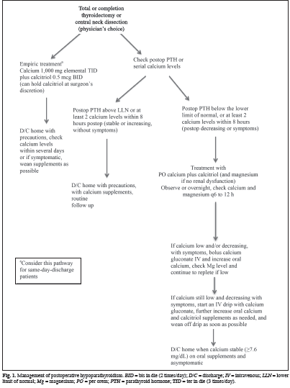

Slide 42
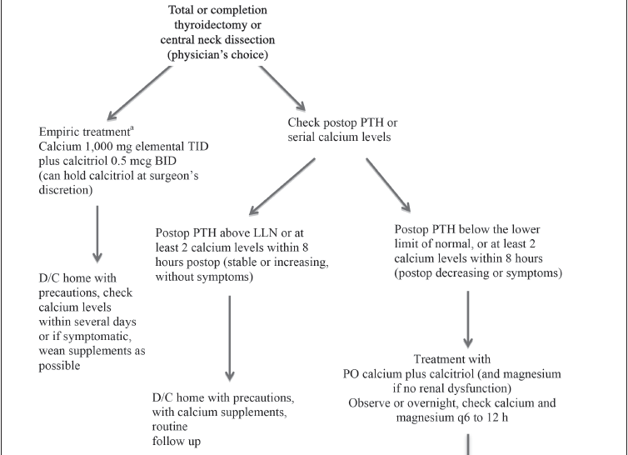

Slide 43
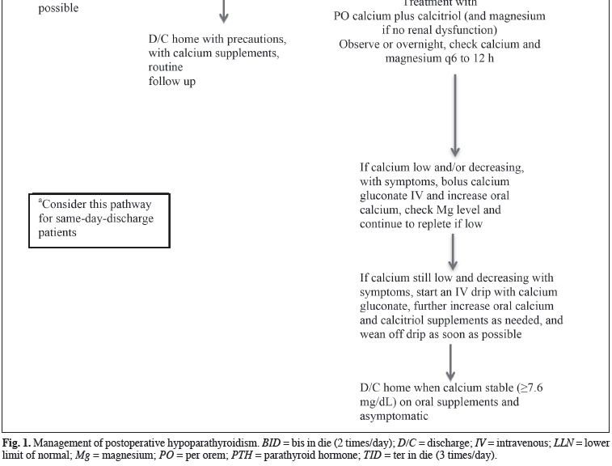

Slide 44

Thanks for your attention

