Slide 2
Pharmacotherapy for obesity and type 2 diabetes
By:dr narimani

Slide 4
REFERENCES
Guidelines for Obesity Management
Pharmacotherapy for Obesity
Type 2 Diabetes Treatment in the Patient with Obesity
Endocrinol Metab Clin N Am 45 (2016)

Slide 5
INTRODUCTION
An estimated 347 million adults live with type 2 diabetes (T2D) worldwide, about half of whom are undiagnosed.
Although the cause for T2D is multifactorial, nearly 80% of all people with T2D are obese.
This strongly suggests that obesity may play a central role in the progression from normal glucose tolerance to frank T2D.

Slide 6
The mechanism by which obesity promotes T2D is an area of intense research but inadequate compensation of the b cells in response to an increasingly insulin-resistant skeletal muscle and liver characterize T2D.
It is now recognized that individuals with impaired glucose tolerance (prediabetes) have lost upward of 80% of their b-cell function and have comparable degrees of insulin resistance to clinical T2D

Slide 7
In addition, adipose tissue is considered a chief culprit in the development of multiorgan insulin resistance and b-cell dysfunction through increased circulatory factors (free fatty acids, leptin, and so forth) that promote hyperglycemia.

Slide 8
Newer understandings of T2D pathophysiology acknowledge that the gastrointestinal tract (eg, small intestine), kidney, and brain in addition to the a forementioned organs collectively play an important role in the progression to T2D.

Slide 9
Thus, identification of end-organ targets that promote hyperglycemia is critical to the advancement of successful treatment strategies.
As a result, efforts are needed to make clinical decisions based on the underlying pathophysiologic abnormality.

Slide 10
Recently obesity has been considered a “disease” by major health organizations, although others consider obesity to be simply a side effect of energy imbalance.
Focus be placed on intensifying efforts to improve weight management and glycemic control to combat the increased incidence of cardiovascular disease (CVD) in people with T2D.

Slide 11
Here, we discuss studies relevant to addressing antiobesity therapeutic options for the individual with T2D and dual actions to improve glycemic control.
We present evidence suggesting that lifestyle modification directly and successfully induces meaningful weight loss by inducing a negative energy balance.

Slide 12
Also highlighted are recent advances in the understanding of pharmacologic interventions that drive weight loss and improve insulin sensitivity and b-cell function with or without lifestyle modification.
Lastly, we discuss the inclusion of bariatric surgery into the algorithm for diabetes therapy, and close with a discussion of the clinical importance of combining exercise and diet with pharmacology or bariatric surgery as needed disease modification.

Slide 13
Evaluation of the patient
body mass index (BMI)
the distribution of fat based upon the waist circumference
and investigations for comorbid conditions such as:
Diabetes mellitus
Dyslipidemia
Hypertension
heart disease, sleep apnea, and symptomatic osteoarthritis.

Slide 14
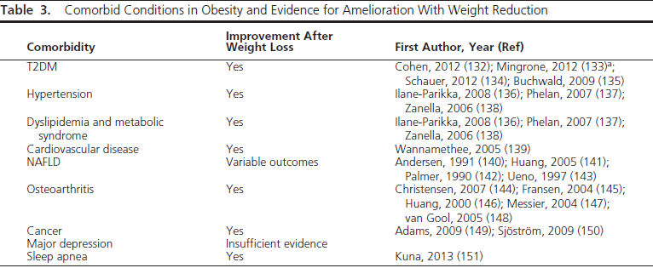

Slide 15
DIAGNOSIS OF OBESITY AND STAGING OF DISEASE
If patients meet criteria of overweight (BMI 25- <30 kg/m2) and there are risk factors or comorbidities present, then all relevant guidelines ,endorse medically directed weight loss intervention as a path to improve health risk.
obesity (BMI 30 kg/m2) mandates medical counseling for weight loss, with one exception. A discrepancy arises in guidance for individuals who have BMI of 30 kg/m2 or higher but have no risk factors.
This is sometimes referred to as “metabolically healthy obese” and by AACE4 as “obesity stage 0.”

Slide 16
According to the 2013 American Heart Association, American College of Cardiology, and The Obesity Society Guideline for the Management of Overweight and Obesity in Adults, pharmacotherapy for the treatment of obesity can be considered if a patient has:
A body mass index (BMI) 30 kg/m2
A BMI 27 kg/m2 with weight-related comorbidities, such as hypertension, type 2 diabetes, dyslipidemia, and obstructive sleep apnea

Slide 17
Anti obesity drugs alone?
Along with diet, exercise, and behavior modification, drug therapy may be a helpful component of treatment for patients who are overweight or obese.

Slide 18
MANAGEMENT OF TYPE 2 DIABETES FOLLOWING LIFESTYLE MODIFICATION
A central goal of diabetes care is to aid individuals in making better lifestyle decisions that lead to healthier body weights because obesity is the basic risk factor for T2D.
Indeed, sedentary behavior and increased caloric intake are two key factors known to trigger insulin resistance and force the b-cell to secrete more insulin

Slide 19
In contrast, lifestyle intervention consisting of increased physical activity and low-fat diet reducing weight by approximately 5 kg for 2 years or beyond lowers diabetes risk by 30% to 60%.
Weight loss of 2% to 5% over 1 to 4 years decreases hemoglobin (Hb) A1c by 0.2% to 0.3%.
losses of 5% to 10% at 1 year are associated with reductions in HbA1c of 0.6% to 1.0%.

Slide 20
The Finnish Diabetes Prevention Study provided advice for subjects to lose greater than 5% weight loss by:
1) decreasing total fat less than 30% of total calorie intake (with <10% coming from saturated fat)
2) increasing fiber consumption (ie, 15 g per 1000 kcal),
3) increasing physical activity (30 min/d)

Slide 21
This lifestyle prescription lowered the cumulative incidence of diabetes by 58% in people with prediabetes compared with control subjects.
The US Diabetes Prevention Program (DPP) Study, which recommended people with prediabetes exercise 150 min/wk and loss of 7% of weight showed that new diabetes cases were lowered by 58%
Subjects who lost the most weight and met physical activity/diet targets had greater than 90% risk reductions of diabetes

Slide 22
These reports are consistent with recent work showing that the combination of a wellbalanced diet (eg, low-fat and high-fiber diet) promoting approximately 5% to 8% weight loss with increased physical activity is a well-established strategy for managing T2D because higher doses of physical activity generally increase insulin sensitivity and b-cell function

Slide 23
Although caloric restriction is arguably the most important factor driving weight loss, it remains possible that low carbohydrate intake per se may yield greater reductions in circulating blood glucose and body weight, particularly during the first few months of a lifestyle program.
Nevertheless, increased physical activity is a primary determinant of maintaining the lost weight.

Slide 24
As such, structured exercise interventions in particular have been shown to significantly improve HbA1c levels, although some work suggests that not all people with hyperglycemia respond favorably to standard lifestyle interventions

Slide 25
weight loss may be the most important contributor to T2D prevention.
Further work is required to understand
why some people with hyperglycemia do not respond to traditional lifestyle modification?
to determine the optimal exercise prescription for diabetes prevention and treatment?

Slide 26
The role of drug therapy ??
has been questioned, because of concerns about:
efficacy
body weight slows and then plateaus with continued treatment
most patients regain weight when their weight-loss drugs are stopped.
safety

Slide 27
GOALS OF THERAPY
The ideal outcome is a return to normal body weight, but this is usually unrealistic?!
Success may be measured by the degree of weight loss and improvement in associated risk factors
Weight loss should exceed 2 kg during the first month of drug therapy (one pound per week)
fall > 5% below baseline between 3 to 6 months, and remain at this level to be considered effective
at least 5% statistically significant placebo-ad justed weight loss at 1 year or 35% or more of patients must achieve at least 5% weight loss (which must be at least twice that induced by placebo).

Slide 28
GOALS OF THERAPY ….
Improvement in baseline risk factors after weight loss is an important criterion in the determination of whether to continue therapy

Slide 29
Definitions (In drug trials ):
Good response or effective: > 5%
very good response: weight loss of 10 to 15 % using both drug and behavioral intervention
excellent response: weight loss exceeding 15 percent
However, a drug may produce side effects that can reduce its overall benefits.

Slide 30
Some facts:
Drug therapy does not cure obesity.
Patients with obesity given drugs should be advised that when the maximal therapeutic effect is achieved, weight loss ceases.
When drug therapy is discontinued, weight is expected to rise.

Slide 31
Pharmacologic options:
Orlistat
lorcaserin
Phentermine-extended release topiramate (in one capsule)
Bupropion-naltrexone (in one extended-release tablet)
Liraglutide (daily injection)
phentermine

Slide 32
Antiobesity drugs individualization
If weight loss is unsatisfactory (< 5 % below baseline at 3 to 6 months), then pharmacologic therapy can be discussed with the patient.
the decision to use pharmacologic therapy should be individualized,
The choice of antiobesity drugs is often governed by:
Comorbidities
relative contraindications

Slide 33
Drug selection for other diseases
When overweight patients have DM, depression, behavioral problems, or CVD, select drugs which produce weight loss, rather than weight gain, when benefits in total outweigh risks of adverse effects.
Several drugs are well known to produce weight gain and should be avoided if good alternatives are available
weight loss must be balanced against other factors (ability to achieve desired glycemic control, other side effects
and expense).

Slide 34
Weight centric approach
A drug that results in better glycemia at the expense of a few more kg of weight gain may still be preferable to more expensive , side-effect laden drugs that do not achieve goal glycemia.

Slide 35
MANAGEMENT OF TYPE 2 DIABETES USING PHARMACOLOGY
Despite randomized clinical trials showing the clear efficacy of lifestyle modification on weight loss, long-term adherence to diet and exercise remains difficult.
Less than 50% of people with T2D achieve adequate glucose control (HbA1c <7.0%) through this regimen, and many people regain weight over time.
Alarmingly, this traditional approach does not decrease the incidence of cardiovascular events in obese adults with T2D,and may not be adequate for maintaining improved insulin sensitivity or b-cell function.

Slide 36
Insulin Sensitizers
Metformin is the most widely prescribed drug to treat hyperglycemia in children and adults with T2D.
In fact, metformin is the first-line oral antidiabetic medication recommended by the American Diabetes Association, and individuals with prediabetes and at least one CVD risk factor (eg, hypertension, dyslipidemia, and so forth) are also encouraged to be treated with metformin

Slide 37
Current evidence suggests that the biguanidine increases insulin sensitivity through the:
1)Suppression of hepatic gluconeogenesis
2)opposition of glucagon action
3) stimulation of peripheral glucose uptake through activation of AMPK.
In the setting of T2D and obesity, metformin is an attractive therapeutic choice because of its ability to promote weight loss.

Slide 38
the longest and best study of metformin on body weight comes from the Diabetes Prevention Program.
Within the first 3 years of this double-blind randomized trial, the metformin group lost approximately 2.9 kg versus 0.42 kg in the control group.
Impressively, this weight loss effect persisted up to 15 years

Slide 39
metformin is a useful first-line pharmacotherapy for T2D to manage blood glucose and reduce body weight.
although it is worth noting that interactions of metformin pharmacotherapy with lifestyle changes is an area of needed research
metformin enhances, blunts, or has no effect on exercise-induced improvements in insulin sensitivity and glucose homeostasis.

Slide 40
Whether there is an optimal combination of metformin with exercise and/or diet remains to be determined.

Slide 41
Thiazolidinediones
Thiazolidinediones (TZDs; ie, pioglitazone) act on peroxisome proliferator–activated receptor g, and are effective at improving insulin sensitivity (eg, adipose, liver, and muscle) and improving/restoring pancreatic b-cell function.
Despite these glycemic benefits, many health care providers have reservations about prescribing TZDs because they promote substantial weight gain

Slide 42
this storage of excess fat is in part the mechanism by which TZDs increase insulin sensitivity and b-cell function.
TZDs are known to
lower circulating lipids (eg, free fatty acids)
2) reducing ectopic lipids (eg, intramuscular fat) and visceral fat
3) distributing circulating free fatty acids to subcutaneous fat in people with hyperglycemia.

Slide 43
In line with this redistribution of body fat, TZDs also have potent antiatherogenic effects that lower overall risk for CVD and even slow down the progression from prediabetes to T2D
be considered only as a second-line therapy for individuals who do not achieve glycemic control with metformin plus lifestyle modification.

Slide 44
Insulin Secretagogues and b-Cell Function Agonists Sulfonylureas
Sulfonylureas (SFUs) enhance insulin secretion through binding receptors associated with potassium channels on b cells.
Use of SFUs along with metformin in patients with T2D may be prudent to prevent further b-cell failure.
However, it was shown in the UK Prospective Diabetes Study that SFUs had no protective effects on the pancreatic b-cell in newly diagnosed patients with T2D

Slide 45
HbA1c levels showed a continuous rise regardless of SFU treatment when compared with control.
This decline in glycemic control was paralleled by a deterioration in b-cell function (via HOMA-b) such that approximately 50% of people required additional therapeutic agents to maintain HbA1c less than 7.0% at 3 years later.

Slide 46
Given that SFU usage :
carries a risk of inducing hypoglycemia,
2)does not preserve pancreatic function,
3)promotes weight regain compared with usage of oral insulin-sensitizing agents,
SFUs should be used with caution particularly in the setting of obesity.

Slide 47
Incretin analogues
Glucagon-like polypeptide (GLP)-1 and glucose-dependent insulinotropic peptide are incretin hormones that account for approximately 60% of the meal-stimulated insulin secretion,
important for
1)delaying gastric emptying and
2)reducing postprandial glucose levels by stimulating pancreatic function.

Slide 48
GLP-1 is considered the key incretin hormone and receptor agonists (eg, exenatide and liraglutide) are currently approved pharmacologic agents that simulate the action of GLP-1 or share 97% homology to native GLP-1 thereby extending the circulating half-life of GLP-1 from 1 to 2 minutes to 13 hours

Slide 49
GLP-1:
promote pancreatic b-cell insulin secretion
promote significant weight loss
a recent meta-analysis demonstrated that GLP-1 receptor agonists provided the greatest benefit to glycemic control when compared with various antidiabetic drugs added to existing metformin regimens.

Slide 50
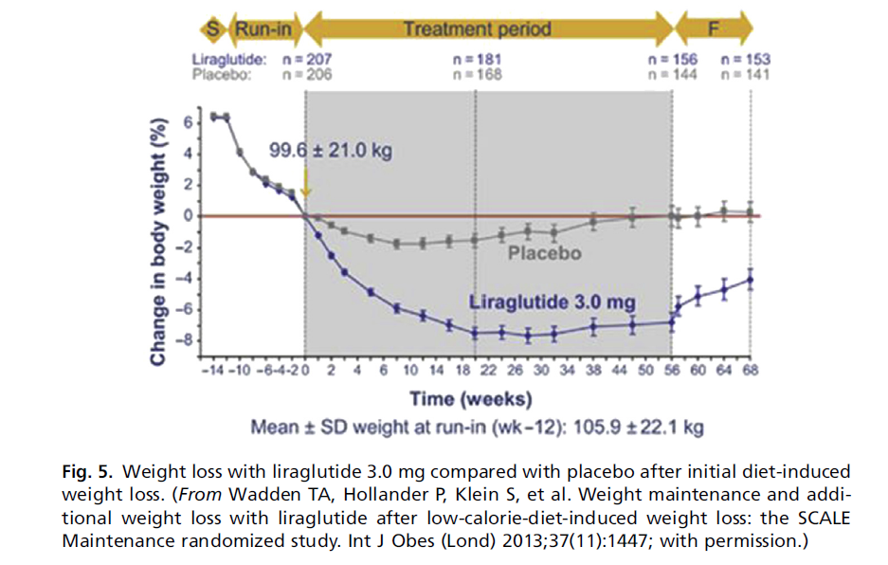
Given the capacity of GLP-1 to promote pancreatic b-cell insulin
secretion and promote significant weight loss, research effort to understand the
mechanism of improvement in glycemic control and weight loss observed has intensified.
35–37 In addition, a recent meta-analysis demonstrated that GLP-1 receptor agonists
provided the greatest benefit to glycemic control when compared with various
antidiabetic drugs added to existing metformin regimens

Slide 51
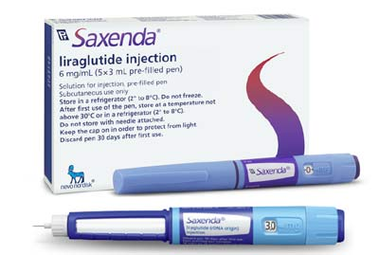

Slide 52
Dosing/Administration
Liraglutide is administered as a subcutaneous injection once daily into the abdomen, thigh, or upper arm irrespective of meals.
It is initiated at 0.6 mg daily for 1 week with instructions to increase by 0.6 mg weekly until 3.0 mg is reached.
Slower dose titration is effective in managing gastrointestinal side effects.
The medication should be discontinued if a patient has not achieved 4% weight loss at 16 weeks

Slide 53
Side Effects
The most common TEAEs with liraglutide 3.0 mg include the following:
Nausea/vomiting
Hypoglycemia
Diarrhea
Constipation
Headache
Decreased appetite
Dyspepsia
Fatigue
Dizziness
Abdominal pain
Increased lipase

Slide 54
Drug-Drug Interactions
Insulin (risk of hypoglycemia, although studies evaluating coadministration are ongoing)

Slide 55
Contraindications
Pregnancy
Personal or family history of medullary thyroid carcinoma or multiple endocrine neoplasia syndrome type 2 MEN2(black box warning because C-cell tumors were found in rodents given liraglutide, but there is no evidence in humans)
Prior serious hypersensitivity reaction to liraglutide or to any of the product components

Slide 56
Although GLP-1-centered therapies are encouraging, they are potentially associated with an increased risk of pancreatitis and pancreatic cancer.
Thus, given that hypoglycemia is mediated by combination therapies designed to increase insulin sensitivity and incretin hormones, caution regarding potential hypoglycemia must be taken before initiating therapy with incretin analogues.

Slide 57
Dipeptidyl-pepidase-IV inhibitors
Dipeptidyl-pepidase-IV (DPP-IV) is an enzyme that cleaves GLP-1, thereby limiting the glucoregulatory benefits of this incretin hormone action.
Inhibitors of DPP-IV also increase GLP-1 concentrations.
This is physiologically relevant because DPP-IV is thought to not only impair b-cell function but also worsen insulin resistance in adults with metabolic syndrome and prediabetes/T2D.
However, the action of DPP-IV inhibitors depends on endogenous secretion of GLP-1.

Slide 58
DPP-IV-inhibitor induced rises in GLP-1 are usually lower than GLP-1 analogue-related rises (see above).
Although there are limited data on the long-term utility of DPP-IV inhibitors, several studies show that this class of pharmacologic agents improve postprandial glucose metabolism.

Slide 59
The effectiveness of DPP-IV inhibitors on glycemic control is consistent with recent work demonstrating that lifestyle modifications in part lower CVD risk by reducing DPP-IV concentrations.
Nevertheless, DPP-IV inhibitors have no effect on weight loss, so this treatment regimen seems unique to glycemia per se and may not be appropriate for combating the obesity often associated with T2D.

Slide 60
Insulin
Patients with less than adequate responses to insulin sensitizers or secretagogues should be considered for treatment with basal insulin and prandial insulin as necessary.
Like SFUs, insulin use carries risk of hyperinsulinemic-induced hypoglycemia and weight gain.
However, evidence suggests that personalizing insulin titration in conjunction with oral hypoglycemic agents promotes better glycemic benefit in patients who do not respond to other oral agents.

Slide 61
obese patients with insulinrequiring T2D after gastric bypass surgery showed higher rates of complete remission at 1 year postsurgery with personalized insulin titration schedules and metformin compared with patients whose postsurgical medical care did not involve protocol driven pharmacologic treatment.

Slide 62
Although additional work is required to understand the optimal combination of pharmacologic and lifestyle therapy to improve glucose homeostasis, the collective literature does indicate that combinations of existing T2D therapeutics can provide adequate glycemic control despite the tendency of insulin use to cause weight gain of 2 kg to 9 kg within 6 to 12 months of treatment

Slide 63
Novel Glycemic Medication: Sodium-Glucose Cotransporter 2 Inhibitors
The kidney plays an important role in filtering approximately 160 g of glucose each day, and nearly 90% of all glucose is reabsorbed in the body by sodium-glucose cotransporter (SGLT)-2 transporters located in the promixmal tubule.
The result is less glucose excretion in urine. New work shows that SGLT2 inhibitors, or gliflozins, are novel antidiabetes agents that block glucose reabsorption in the renal tubules and promote loss of glucose in the urine.

Slide 64
A meta-analysis of 25 randomized trials concluded that use of SGLT2 inhibitors for T2D is associated with significant improvement in glycemic control and blood pressure and reduction in body weight.
This is consistent with other work in patients with poorly controlled T2D showing that SGLT2 treatment as an add-on therapy to metformin improves many CVD risk factors.
However, use of these drugs increases the risk of genital mycotic infections and lower urinary tract infections.

Slide 65
Nevertheless, given the favorable effects of SGLT2 inhibitors on glycemic control, weight loss, and blood pressure,
SGLT2 inhibitors constitute an attractive treatment modality in patients with T2D and obesity

Slide 66
Weight Loss Agents that Provide Glycemic Benefit

Slide 67
Phentermine-topiramate
Phentermine is a sympathomimetic drug that reduces appetite by stimulating norepinephrine action in the hypothalamus.
Topiramate is a carbonic anhydrase inhibitor and a monosaccharide that lowers food cravings, decreases lipogenesis, and increases energy

Slide 68
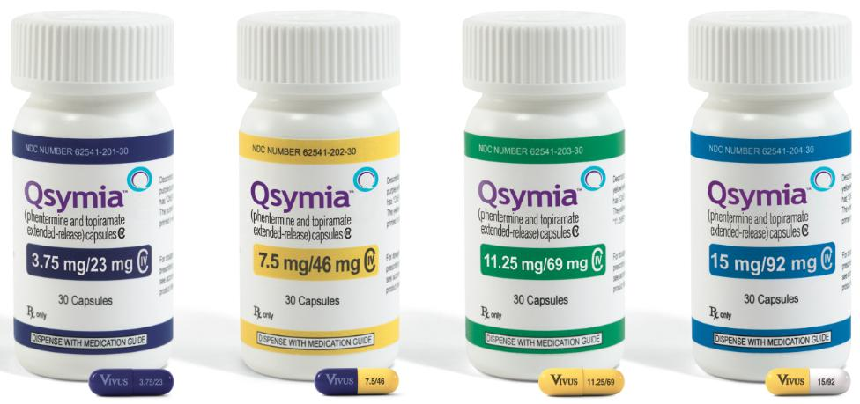

Slide 69
expenditure.In the SEQUEL trial, which is an extension of the CONQUER trial, phentermine-topiramate induced greater weight loss and HbA1c improvements in patients with T2D compared with patients treated with placebo alone
In fact, study participants with prediabetes, metabolic syndrome, or both who underwent treatment with phentermine-topirimate also had significant weight loss and reduced risk of T2D progression.
Therefore, because phentermine-topiramate seems to induce beneficial effects on weight loss and glycemic control, it warrants consideration as a potential obesity-related therapy for T2D.

Slide 70
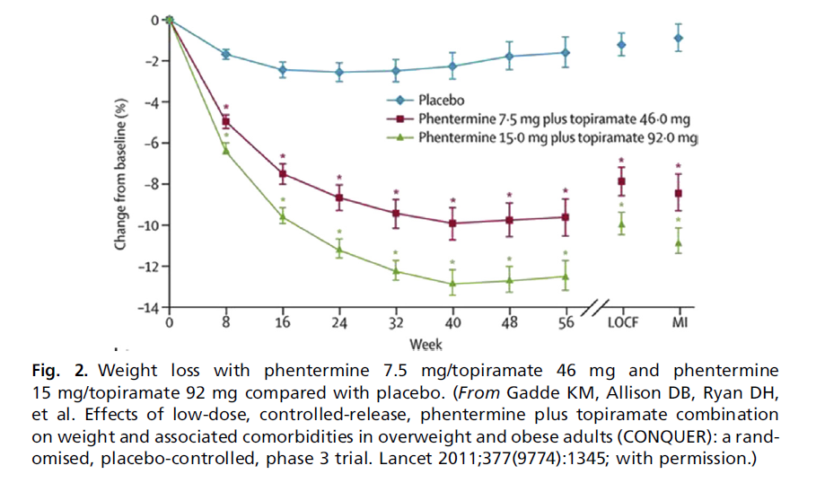

Slide 71
Dosing/Administration
Phentermine/topiramate ER is available in 4 doses, which are considerably lower than the maximum recommended doses of the individual medications for other indications.
Phentermine/topiramate ER should be taken once daily in the morning with or without food.
Evening administration should be avoided to prevent insomnia associated with phentermine.

Slide 72
Gradual dose escalation, which helps minimize risks and adverse events, should be done as follows:
3.75/23 mg daily for 14 days then 7.5/46 mg daily At 12 weeks: option to increase to 11.25/69 mg daily then 15/96 mg daily
The medication should be discontinued or the dose should be escalated if 3% weight loss is not achieved after
12 weeks at 7.5/46 mg daily.

Slide 73
In addition, if 5% weight loss is not achieved after 12 weeks on the maximum dose (15/92 mg), the medication should be discontinued.
Gradual discontinuation is recommended to prevent seizure from rapid withdrawal of topiramate.

Slide 74
The medication is pregnancy category X, and the FDA requires a Risk Evaluation and Mitigation Strategy (REMS) to inform prescribers and women of reproductive potential about the following:
Increased risk of congenital malformation, specifically orofacial clefts, in infants exposed to phentermine/topiramate ER during the first trimester of pregnancy
Importance of pregnancy prevention for women of reproductive potential receiving phentermine/topiramate ER Need to discontinue phentermine/topiramate ER immediately if pregnancy occurs

Slide 75
Side Effects
The most common TEAEs with phentermine/topiramate ER include the following:
Paresthesia
Dizziness
Dysgeusia
Insomnia
Constipation
Dry mouth

Slide 76
Drug-Drug Interactions
MAOIs
Sympathomimetic amines

Slide 77
Contraindications
Pregnancy (recommend pregnancy test before starting followed by monthly tests in appropriate patients)
Glaucoma
Hyperthyroidism
Use during or within 14 days of taking MAOIs

Slide 78
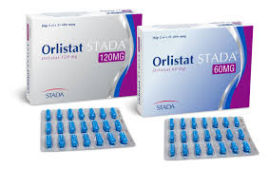
Orlistat
Orlistat is a gastric and pancreatic lipase inhibitor that blocks dietary fat absorption from the gastrointestinal system by approximately 30%.

Slide 79
Randomized trials and meta-analyses have demonstrated that orlistat treatment can produce weight loss and reduce the incidence of T2D in people with impaired glucose tolerance.
A recent randomized controlled trial over 1 year reported greater weight loss and improvements in insulin sensitivity in patients treated with orlistat as compared with those treated with placebo

Slide 80
Several mechanisms have been proposed to account for the antidiabetic effect of orlistat, such as
improved insulin sensitivity
incomplete dietary fat digestion
partial stimulation of GLP-1 release
decreases in visceral adiposity.

Slide 81
However, orlistat use predisposes patients to fecal urgency, mild steatorrhea, and flatus with discharge, and the drug may interfere with absorption of fat-soluble vitamins.
As such, orlistat should be used with caution to ensure healthy nutrient intake for the patient.

Slide 82
Dosing/Administration
The recommended dosage of orlistat is one 120-mg capsule (Xenical) or one 60-mg capsule (Alli) 3 times a day with each main meal containing fat.
It can be taken during or up to 1 hour after the meal. Patients should be advised to follow a nutritionally balanced, reduced-calorie diet with approximately 30% of calories from fat.
Additionally, the daily intake of fat, carbohydrate, and protein should be distributed over 3 meals.
As orlistat decreases the absorption of fat-soluble vitamins (A, D, E, and K), patients should take a multivitamin (separately fromthemedication) to ensure adequate nutrition

Slide 83
Side Effects
The most common TEAEs with orlistat include the following:
Oily spotting
Flatus with discharge
Fecal urgency
Fatty/oily stool
Oily evacuation
Increased defecation
Fecal incontinence

Slide 84
Drug-Drug Interactions
Cyclosporine (should be taken 2 hours before or after orlistat dose)
Levothyroxine
Warfarin
Antiepileptic drugs
Contraindications
Pregnancy
Chronic malabsorption syndrome
Cholestasis
Known hypersensitivity to orlistat or to any
component of the product

Slide 85
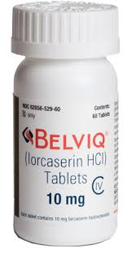
Lorcaserin
Lorcaserin is a selective agonist of the serotonin 2C receptor. It activates central serotonin 2C receptors with a functional selectivity of approximately 15 and 100 times over that for serotonin receptors 2A and 2B, respectively.
It reduces appetite and food intake thereby reducing body weight in men and women.

Slide 86
Currently, this treatment is recommended for obese (body mass index 30 kg/m2) individuals or overweight (body mass index 27 kg/m2) people who suffer from at least one weight-related complication, such as hypertension, T2D, or dyslipidemia

Slide 87
In a randomized trial called BLOOM-DM, 604 patients with T2D were randomly assigned to lorcaserin (10 mg once daily or twice daily) or placebo, and most patients were treated with metformin, an SFU, or both.
After 1 year, more patients lost greater than or equal to 5% of their body weight with lorcaserin compared with placebo (44.7%, 37.5%, and 16.1%, respectively).
There was also a significant reduction in HbA1c (1.0%, 0.9%, and 0.4% points, respectively) and fasting blood glucose (28.4, 27.4, and 11.9 mg/dL) in the lorcaserin compared with placebo group

Slide 88
Because lorcaserin seems to affect body weight and glycemic control, it seems to be an agent for promoting or maintaining weight loss.
However, future studies are needed to clarify the efficacy of lorcaserin in maintaining weight loss and blocking weight gain because of aging or use of other pharmacologic agents (eg,
TZDs, insulin).

Slide 89
Dosing/Administration
The recommended dosage of lorcaserin is 10 mg twice daily with or without food.
The medication should be discontinued if 5% or more weight loss is not achieved after 12 weeks.

Slide 90
Side Effects
The most common TEAEs with lorcaserin in nondiabetic patients include the following:
Headache
Dizziness
Fatigue
Nausea
Dry mouth
Constipation

Slide 91
The most common TEAEs with lorcaserin in patients with diabetes include the
following:
Hypoglycemia
Headache
Back pain
Cough
Fatigue

Slide 92
Drug-Drug Interactions
Serotonergic drugs (coadministration may lead to the development of potentially life-threatening serotonin syndrome or neuroleptic malignant syndromelike reactions, although none were reported in phase 3 studies)
Contraindications
Pregnancy
Valvular heart disease (but no significant risk of valvulopathy was found during
phase 3 studies)

Slide 93
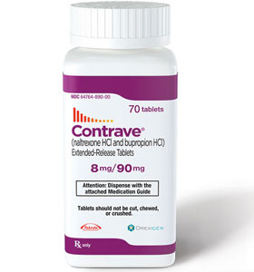
Naltrexone-bupropion
Naltrexone and bupropion have recently been combined (eg, Contrave) as a pharamacologic agent targeting the mesolimbic dopamine reward system and the hypothalamic melanocortin system to reduce food intake.
Naltrexone-bupropion induces significant weight loss and proportional reductions in fat mass and visceral adiposity

Slide 94
In addition, Hollander and colleagues demonstrated that overweight/ obese patients with T2D randomized to naltrexone-bupropion experienced significantly greater weight loss and improvements in HbA1c levels when compared with placebo.
Furthermore, a long-term cardiovascular
outcomes trial is currently being held to
understand the long-term safety and
utility of this agent.

Slide 95
Four 56-week phase 3 multicenter, double-blind, placebo-controlled trials were conducted to evaluate the effect of bupropion SR/naltrexone SR in subjects who were obese or overweight with at least 1 weight-related comorbidity:
Contrave Obesity Research I (COR-I)
Contrave Obesity Research II (COR-II)
Contrave Obesity Research Behavioral Modification (COR-BMOD)40
Contrave Obesity Research
Diabetes (COR-Diabetes).

Slide 96
In the COR-I trial, mean change in body weight was 6.1% in the naltrexone 32 mg plus bupropion group compared with 1.3% in the placebo group (P<.0001) (Fig. 4).
Forty-eight percent of the subjects in the naltrexone 32 mg plus bupropion group had a decrease in body weight of 5% or more compared with 16% assigned to placebo (P<.0001).

Slide 97
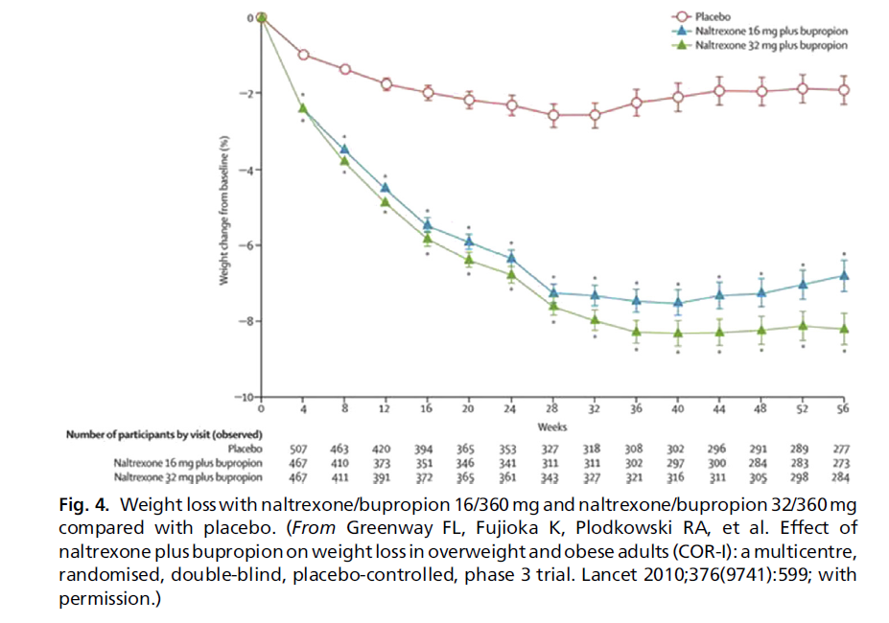

Slide 98
The COR-Diabetes study illustrated similar weight loss results: bupropion SR/ naltrexone SR resulted in significantly greater weight reduction (5.0% vs 1.8%; P<.001) and greater proportion of patients achieving 5% or more weight loss (44.5% vs 18.9%, P<.001) compared with placebo.
In addition, bupropion SR/ naltrexone SR resulted in significantly greater HbA1c reduction (0.6%) compared with placebo (0.1%, P<.001).

Slide 99
In the COR-BMOD trial, participants who received an intensive group behavioral modification program (BMOD) with placebo lost an average of 5.1% of initial weight in 56 weeks of treatment.
The addition of bupropion SR/naltrexone SR to BMOD significantly increased weight loss to 9.3% and resulted in 66.4% of participants losing 5% or more of initial weight, as compared with 42.5%
of those who received placebo
with BMOD.

Slide 100
All of the trials illustrated significant improvements in high-density lipoprotein and triglycerides and all trials besides COR-Diabetes found significant improvements in fasting insulin, insulin resistance index (HOMA-IR), and waist circumference.

Slide 101
Dosing/Administration
Naltrexone SR/bupropion SR tablets contain 8 mg naltrexone and 90 mg bupropion.
Initial prescription should be for 1 tablet daily with instructions to increase by 1 tablet a week to a maximum dosage of 2 tablets in the morning, 2 tablets in the evening (32/360 mg):
Week 1: 1 tablet in the morning
Week 2: 1 tablet twice daily
Week 3: 2 tablets in the morning, 1 table in the evening
Week 4: 2 tablets twice daily
The medication should be discontinued if
a patient has not achieved 5% weight loss
at 12 weeks.

Slide 102
Side Effects
The most common TEAEs with naltrexone SR/bupropion SR include the following:
Nausea/vomiting
Constipation
Headache
Dizziness
Insomnia
Dry mouth
Diarrhea

Slide 103
Drug-Drug Interactions
MAOIs (use during or within 14 days of administration)
Opioids, opioid agonists, opioid partial agonists (effect might be antagonized by naltrexone SR/bupropion SR; medication might provide inadequate pain relief)
Abrupt discontinuation of alcohol, benzodiazepines, barbiturates, and antiepileptic drugs

Slide 104
Contraindications
Pregnancy
Uncontrolled hypertension
Seizure disorder or history of seizures
Use of other bupropion-containing products
Bulimia or anorexia nervosa
Known allergy to bupropion, naltrexone, or any other component of the drug
History of suicidal behavior (black box warning for bupropion when used for
smoking cessation and depression, but no evidence of suicidality was found in phase 3 studies)

Slide 105
MANAGEMENT OF TYPE 2 DIABETES WITH BARIATRIC SURGERY
Several randomized trials have bolstered the claim of bariatric surgery being an effective treatment leading to T2D remission together with durable weight loss.
Subsequently, bariatric surgery has illuminated the gastrointestinal system as a key pathophysiologic culprit in the development of T2D

Slide 106
Although the literature is inconsistent with the definition of T2D remission, Ribaric and colleagues recently analyzed the remission criteria of each individual study to report an overall remission rate of patients with T2D who underwent bariatric surgery, and compared this with a rate of 15.6% with conventional therapy at a mean follow-up time of 17.3 months

Slide 107
The results of this work indicate that people undergoing bariatric surgery have 9.8 to 15.8 times the odds of reaching diabetes remission compared with conventional therapy.
As a result of the collective impact of these studies and the literature, the American Diabetes Association and the International Diabetes Federation have identified bariatric surgery as an effective treatment of T2D.

Slide 108
Use of bariatric surgery as not only a weight loss treatment option, but also a “metabolic surgery” that restores glucose homeostasis in people with T2DM

Slide 109
However, not all people remain in T2D remission 2 to 5 years post bariatric surgery and insulin resistance and b-cell dysfunction seem to be key factors explaining the relapse, which has a direct relationship to years after surgery.
Most recently, a follow-up report to the Swedish Obese Subjects study showed that T2D remission rates decreased from 72.3% at 2 years to 30.4% at
15 years after surgery.

Slide 110
indicators of inadequate b-cell function :
1) long preoperative T2D duration
2) insulin use
3) poor glycemic control despite oral hypoglycemic agents
4) microvascular complications
Although bariatric surgery is a highly effective tool for promoting the reversal of T2D, it does not seem to be a treatment that “cures” the disease in all people,
suggesting that continued
monitoring of glycemic control
is warranted.

Slide 111
Additional work is required to determine appropriate treatment plans with lifestyle modification or pharmacologic therapy for preventing the relapse in T2D

Slide 112
CLINICAL IMPLICATIONS AND CONCLUSIONS
The optimal treatment strategy for the obese person with T2D is likely going to vary between people based on the underlying pathophysiology.
The complicated etiology of T2D highlights that several therapeutic options will likely be required to correct varying disturbances with tissues (eg, skeletal muscle, liver, adipose, gut, kidney)

Slide 113
It is prudent to select therapies based on the underlying cause of T2D rather than purely on blood glucose concentrations.
Moreover, treatment earlier on in the disease is likely to preserve b-cell function and restore insulin sensitivity for long-term glycemic control and CVD risk reduction.

Slide 114
The available evidence and clinical experience suggest that T2D is related to weight gain combined with the exhaustion of insulin-secreting pancreatic b-cells caused by insulin resistance in skeletal muscle, liver, and adipose tissue

Slide 115
Although there are still challenges with adhering to lifestyle modification over time, exercise and diet are successful approaches that maintain long-term weight loss and glycemic control.
Thus, lifestyle modification should remain the first-line therapy for treatment of T2D.
However, not all people are able to perform the necessary levels of physical activity needed to maintain metabolic health.

Slide 116
As a result, pharmacologic intervention aimed at reducing weight and increasing insulin sensitivity (eg, metformin, TZDs, or canagliflozin), followed by treatments that promote insulin secretion, are appropriate treatment strategies.

Slide 117
In addition, several of these pharmacologic agents (metformin, GLP1 agonists, SLGT2) promote modest weight loss in obese individuals with T2D
The amount of weight loss following these pharmacologic treatment plans is modest (1–5 kg) relative to the amount needed for most obese people to achieve healthy weight status and/or optimal glycemic control and CVD risk reduction.

Slide 118
Thus, any one pharmacologic agent is unlikely to be a sole antiobesity agent, and these drugs should only be considered as an adjunctive therapy to exercise plus diet.
If these treatment strategies are inadequate for the obese patient with T2D, then bariatric surgery represents a viable alternative with the potential of
complete diabetes remission.

