Slide 2
Long-term safety of once-daily, dual-release hydrocortisone in patients with adrenal insufficiency: a phase 3b, open-label, extension study European Journal of Endocrinology (2017) 176, 715–725

Slide 3
Introduction
Adrenal insufficiency (AI) is a potentially fatal rare disease that requires lifelong glucocorticoid replacement therapy , and long-term clinical outcomes with standard treatments remain unsatisfactory .
Patients with primary AI have a mortality risk of more than double that of the general population, and quality of life (QoL) is impaired compared with that in healthy controls .
A recent prospective study also suggests that QoL continues to decline over time in patients with AI receiving conventional treatment .
Conventional glucocorticoid replacement with hydrocortisone or cortisone acetate needs to be administered multiple times each day to achieve adequate cortisol levels.

Slide 4
Glucocorticoid overexposure is associated with altered sleep and increased cardiometabolic risk, particularly when cortisol levels are elevated in the late afternoon and evening .
On the other hand, underexposure is associated with an increased risk of adrenal crisis (AC), and insufficient replacement therapy during intercurrent illness places the patient at risk of a life-threatening AC .
Current data suggest that the incidence of AC remains unacceptably high despite optimization of conventional, immediate-release hydrocortisone and patient education.
A once-daily, dual-release hydrocortisone (DR-HC) tablet, comprising an immediate-release coating and an extended-release core, has been developed for oral glucocorticoid replacement therapy in AI .

Slide 5
Clinical trials have demonstrated that DR-HC replacement resembles the daily normal cortisol profile more closely than conventional hydrocortisone replacement .
In addition, a 3-month randomized, controlled, two-way crossover, clinical trial conducted in patients with primary AI showed that DR-HC treatment was associated with significant improvements in cardiometabolic factors and QoL compared with conventional hydrocortisone tablets administered three times per day (TID) .
Other studies have shown that glucose homeostasis and serum lipid profiles are improved when switching from conventional replacement to DR-HC treatment and that body mass index (BMI) and waist circumference are reduced .
The primary objective of the current study was to investigate the long-term safety and tolerability of DR-HC in patients with primary AI, including assessments of glucose and lipid metabolism, blood pressure, body weight and QoL.

Slide 6
3.0 Treatment of primary adrenal insufficiency in adults
Glucocorticoid replacement regimen
3.1 We recommend glucocorticoid therapy in all patients
with confirmed PAI.
3.2 We suggest using hydrocortisone (15–25 mg) or cortisone acetate (20–35 mg) in two or three divided oral doses per day; the highest dose should be given in the morning at awakening, the next either in the early afternoon (2 h after lunch; two-dose regimen) or at lunch and afternoon (three-dose regimen).
3.3 As an alternative to hydrocortisone, we suggest using prednisolone (3–5 mg/d), administered orally once or twice daily, especially in patients with reduced compliance.
3.4 We suggest against using dexamethasone for the treatment of PAI because of risk of Cushingoid side effects due to difficulties in dose titration.

Slide 7
3.5 We suggest monitoring glucocorticoid replacement using clinical assessment including body weight, postural blood pressure, energy levels, signs of frank glucocorticoid excess.
3.6 We suggest against hormonal monitoring of glucocorticoid replacement and to adjust treatment only based on clinical response.

Slide 8
Evidence
Glucocorticoids are secreted in a pulsatile and circadian rhythm, with the highest peak in the morning, with low levels in the evening, reaching a nadir around midnight .
Mean cortisol production rates are influenced by age and body composition and have been reported to be about 5–8 mg/m2/d , which is equivalent to an oral replacement with 15–25 mg/d (with a tendency toward the lower margin to avoid overtreatment) of hydrocortisone or 20–35 mg of cortisone acetate in adults. In most industrialized countries, hydrocortisone is the preferred pharmacological replacement agent, but cortisone acetate is also in widespread use. In a number of countries, only prednisolone is available.
Hydrocortisone and prednisolone are active glucocorticoids, whereas cortisone acetate and prednisone require activation via hepatic 11-hydroxysteroid dehydrogenase type 1 activity before exerting biological activity. Replacement with inactive precursor glucocorticoids may result in broader interindividual variability of pharmacokinetic parameters , but this has not been studied systematically.

Slide 9
Because of the short plasma half-life of hydrocortisone (approximately 90 min) , multiple dosing is recommended to mimic physiological conditions.
The first and largest dose is suggested to be given upon awakening, the second dose after lunch, and, in case of a three-dose regimen, the last and smallest dose not later than 4–6 hours before bedtime. The rationale for this regimen is to try to mimic the circadian rhythm and also to avoid high doses in the evening, which may compromise sleep and insulin sensitivity .
Peacey et al (93) and Howlett (94) independently recommended 10 mg hydrocortisone on awakening, 5 mg at lunchtime, and 5 mg in the early evening.
Some patients appear to require higher glucocorticoid doses, but these must be used with caution.

Slide 10
In single dose morning studies of adrenal insufficiency patients, hydrocortisone adjusted by body surface area (5.5 mg/m2) or by weight (0.12 mg/kg) produced integrated cortisol levels over 6 hours reliably within the healthy control .
Hence, dose adjustment by weight or body surface area may produce more physiological cortisol levels in PAI patients than fixed dose regimens.
Laureti et al and Barbetta et al found that thrice-daily cortisone acetate lowered ACTH levels and gave 24-hour cortisol curves more similar to the endogenous cortisol rhythm compared with a two-dose regimen.
One doubleblind, randomized, crossover study evaluating two-dose vs four-dose hydrocortisone treatments concluded that cortisol pharmacokinetics were more physiological on the four-dose regimen; surprisingly, participating patients preferred this regimen.

Slide 11
Conversely, Alonso et al found that HRQoL scores were similar and on some parameters worse on thrice-daily compared with twice-daily hydrocortisone.
Weight-adjusted dosing will increase the chance of obtaining a cortisol value within the reference range.
However, outcome studies confirming this hypothesis are lacking, and less-frequent dosing may be associated with better compliance .

Slide 12
The absorption curve of cortisone acetate is less steep and is delayed compared with that of hydrocortisone , which might be favorable considering the short half-life of hydrocortisone.
When PAI patients fail to recover in terms of HRQoL and working capacity or have difficulty adhering to a multiple-dose regimen, prednisolone, 3–5 mg/d administered n one or two doses, can be prescribed.
Retrospective studies of patients taking higher doses of glucocorticoids in some cases, including prednisolone or dexamethasone,appear to show a tendency to adverse metabolic consequences including weight gain, dyslipidemia, and diabetes mellitus .

Slide 13
However, prospective studies comparing the safety and efficacy of prednisolone and hydrocortisone over time are not available.
It is the experience of some physicians that higher doses of prednisolone achieve good results is some patients.
Dexamethasone should be avoided because Cushingoid side effects frequently appear .
Alternatively, a newly marketed dual-release hydrocortisone preparation can be administered once daily .

Slide 14
However, whereas this dual-release hydrocortisone preparation was shown to slightly reduce blood pressure and HbA1c , such results may not always be desirable in patients with PAI.
Moreover, such variability can reflect differences in glucocorticoid bioavailability between the dual-release formulation and the hydrocortisone control dosing regimen.
Monitoring glucocorticoid replacement relies primarily on clinical assessment. Symptoms and signs of over replacement are weight gain, insomnia, and peripheral edema.

Slide 15
Insufficient dosing is characterized by nausea,poor appetite, weight loss, lethargy, and hyperpigmentation.
Detailed questioning about the patient’s daily habits, working patterns (eg, shift work), general feelings of energy, mental concentration, daytime somnolence, and dips in energy can help fine-tune when tablets should be taken,how often, and at what dose.
In cases when malabsorption is suspected, serum or salivary cortisol day curve monitoring may be useful to guide dosing.
Measurement of plasma ACTH to guide glucocorticoid replacement doses is not recommended because patients who receive appropriate replacement often have elevated ACTH levels, due to disturbance of the normal close relationship between ACTH and cortisol secretion and negative feedback.
Use of ACTH levels to adjust glucocorticoid replacement is clinically known to lead to over-replacement.

Slide 16
Subjects and methods
Study design
This was an open-label, multicenter, phase 3b, long-term extension study conducted at five university clinics in Sweden with a follow-up period of 5 years .
Enrolled patients were either newly recruited or they had completed a randomized, 3-month crossover study of once-daily DR-HC vs hydrocortisone TID plus a 6-month open-label extension period of DR-HC (referred to as the 9-month study hereafter).
After enrollment into the long-term extension study (baseline), patients underwent full clinical examination, which included medical history, physical examination, vital signs and laboratory parameters.

Slide 17
All patients returned to the clinic every 6 months.
Newly recruited patients also underwent a telephone assessment at 4 weeks and returned to the clinic at 3 and 6 months after enrollment. At clinic visits, patients had a full clinical examination, study drugs were dispensed, and patient questionnaires were collected. Participants were monitored throughout the study for the occurrence of adverse events .

Slide 18
Study participants
Male and female patients were eligible for inclusion if they were aged 18 years or more, had been diagnosed with primary AI at least 6 months previously and had been receiving stable doses of glucocorticoid replacement therapy (total dose: 15–40 mg/day) for at least 3 months prior to study entry.

Slide 19
Intervention
Patients were instructed to take DR-HC orally in the morning, directly after waking and in the fasting state.
The initial dose of DR-HC was the same as the total daily dose of hydrocortisone that they were receiving at enrollment.
Dose adjustments could be made according to the treating physician’s judgment based on clinical symptoms and signs associated with glucocorticoid excess or deficiency .
All patients received oral and written instructions to repeat their daily DR-HC dose once or twice at 6- to 8-h intervals during illness.

Slide 20
Outcomes
Safety and tolerability of DR-HC was assessed by reporting AEs, episodes of intercurrent illness, increased hydrocortisone need, laboratory parameters (e.g. glucose homeostasis and serum lipids) and vital signs.
Patients used a diary to record when and why extra doses of hydrocortisone were needed. This allowed increased hydrocortisone need to be categorized due to either intercurrent illness or other reasons (e.g. mental or physical stress).
Patient- and investigator-assessed treatment tolerability was evaluated using questionnaires.
QoL was evaluated using the Fatigue Impact Scale (FIS) and Psychological General Well-Being (PGWB) questionnaire .

Slide 21
Statistical analysis
Exposure and AE data are presented as descriptive statistics. Exploratory analyses evaluated changes over time (from baseline to 12, 36 and 60 months) in laboratory parameters, vital signs, patient-/investigator-assessed tolerability and QoL, using the Wilcoxon signed-rank test for continuous variables and the Sign test for categorical variables.

Slide 22
Results
Baseline demographics and disease characteristics
In total, 71 patients entered the 5-year extension study and were included in the safety population: 55 patients from the 9-month study and 16 newly recruited patients.
Sixty-three of 71 patients (89%) completed the 5-year visit.
Baseline demographics and disease characteristics for the safety population and subgroups are presented in Table 1.
Daily hydrocortisone doses at baseline were lower in the newly recruited subgroup than in those recruited from the 9-month study.
Hypertension was more common in the DM and elderly subgroups compared with the overall population.

Slide 23
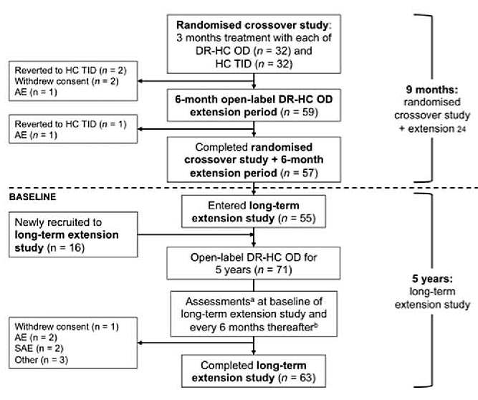
.

Slide 24
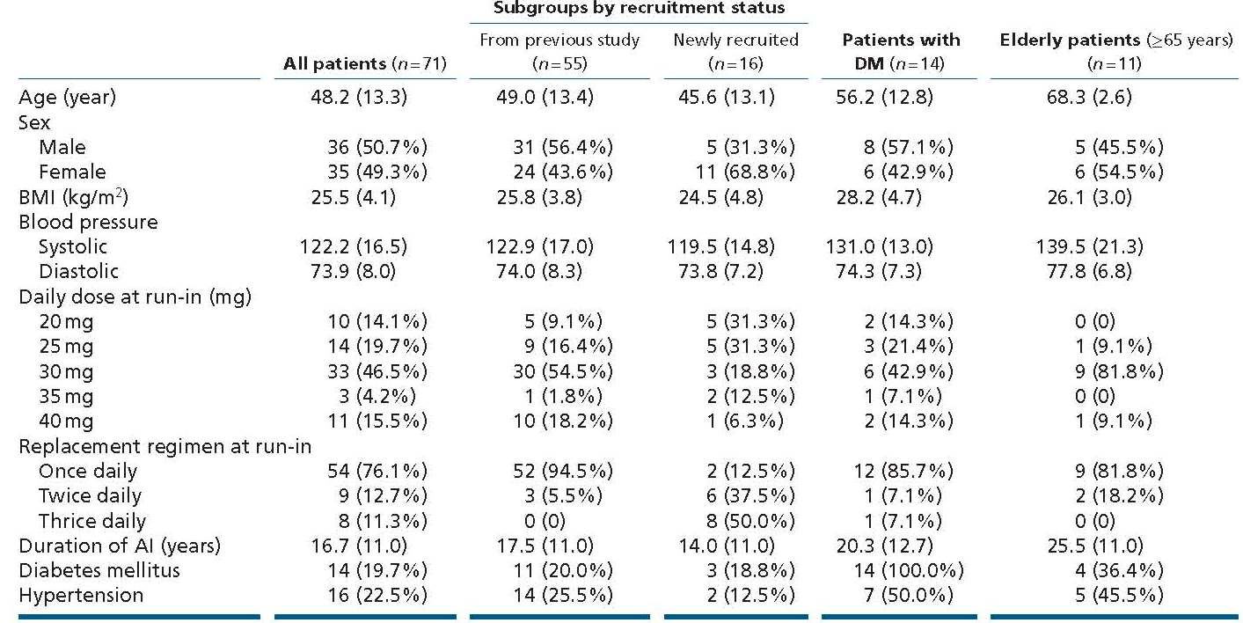

Slide 25
DR-HC exposure: maintenance dose and additional use
Mean total exposure per patient, accumulated over the 5-year study, was 49.7 g of DR-HC, of which 98% was the maintenance dose, 1% was due to intercurrent illness and 1% was increased use not related to intercurrent illness.
The total cumulative maintenance dose for each 12-month period of the study remained stable at a mean (s.d.) of 10.2 (2.9) g to 10.6 (2.3) g per patient per year, corresponding to an estimated 28–29 mg/day per patient.
Additional use of hydrocortisone due to intercurrent illness remained stable for the first 4 years (median (range) dose: 95.0 (5.0–850.0)–120.0 (5.0–840.0) mg per patient per year) but was reduced in the fifth year of treatment (60.0 (5.0–815.0) mg).
Additional use of hydrocortisone not due to intercurrent illness fluctuated (median (range) dose: 37.5 (5.0–1300.0)–90.0 (0.5–3405.0) mg per patient per year) .

Slide 26
Dose adjustments based on the physician’s judgment of individual patient’s needs were made throughout the study (Table 2).
Increased daily doses were observed over the 5-year study period in 10 patients receiving 20, 25 or 30 mg at baseline, whereas reductions in daily doses were observed in 13 patients on 25, 30, 35 or 40 mg at baseline.

Slide 28
Long-term safety of DR-HC
Seventy patients (99%) reported 1060 AEs .
The highest frequency of AEs was recorded in the second year (92.6% of patients), whereas the lowest frequency was recorded in the last year (78.1%).
The frequencies in the other years were as follows: year 1, 88.7%; year 3, 83.6% and year 4, 89.1%.
Newly recruited patients reported a higher frequency of AEs vs those recruited from the 9-month study .
Compared with the overall population, AE frequency was lower in patients with DM and elderly patients .
The most common AEs were nasopharyngitis (70% of patients), fatigue (52%) and gastroenteritis (48%).

Slide 29
Most AEs (85%) were considered to be unrelated to DR-HC, whereas 1% and 14% of AEs were assessed by the investigator as probably and possibly related to DR-HC respectively.
AEs considered to be probably related to DR-HC were four cases of fatigue and one case each of tachycardia, vertigo, nausea, asthenia, pyrexia, swelling, salt craving and headache.
AEs classified as possibly related to cortisol deficiency were reported by 73% of patients over the 5-year period and decreased over time (from 45% in the first year to 23% in the fifth year).

Slide 30
Thirty-two patients (45%) reported 65 serious AEs .
Of the 65 SAEs, four were considered possibly related to DR-HC: acute AI (n = 2), gastritis (n = 1) and syncope (n = 1).
The two acute AI SAEs considered to be possibly drug related resulted from infection (sore throat, vomiting and fatigue) and gastroenteritis.
Four additional acute AI events (3 SAEs and 1 AE) were reported, all of which were considered by the investigator to be unrelated to DR-HC and were associated with precipitating events (GI illness (n = 2), psychological stress (n = 1) and dehydration (n = 1)).
All 6 patients who experienced acute AI recovered.
Two SAEs resulted in death (fall from height and subarachnoid hemorrhage), both of which were classified as unrelated to DR-HC.

Slide 31
Episodes of intercurrent illness and increased hydrocortisone use
There were 709 episodes of intercurrent illness requiring additional hydrocortisone in 64 patients (median 6.0 episodes per patient with any episode) over the 5-year study (Table 3).
The median duration per episode was 2.6 days and the median dose of extra hydrocortisone was 19.8 mg per episode.
No clear trends over time were observed for number of intercurrent illness episodes, number of days per episode or hydrocortisone dose per episode. However, number of days per episode was the lowest in the fifth year of treatment.
Increased hydrocortisone was used for reasons other than intercurrent illness on 984 occasions in 43 patients (median of 10.0 episodes per patient with any episode) over the 5-year study (Table 4).
The median duration was 1.5 days per episode and the median dose of additional hydrocortisone was 13.3 mg per episode.

Slide 32
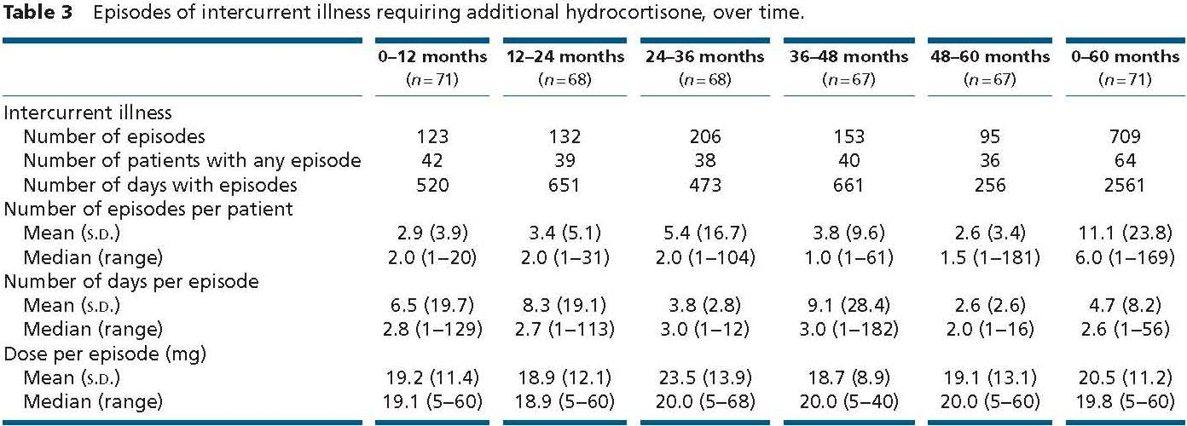

Slide 33
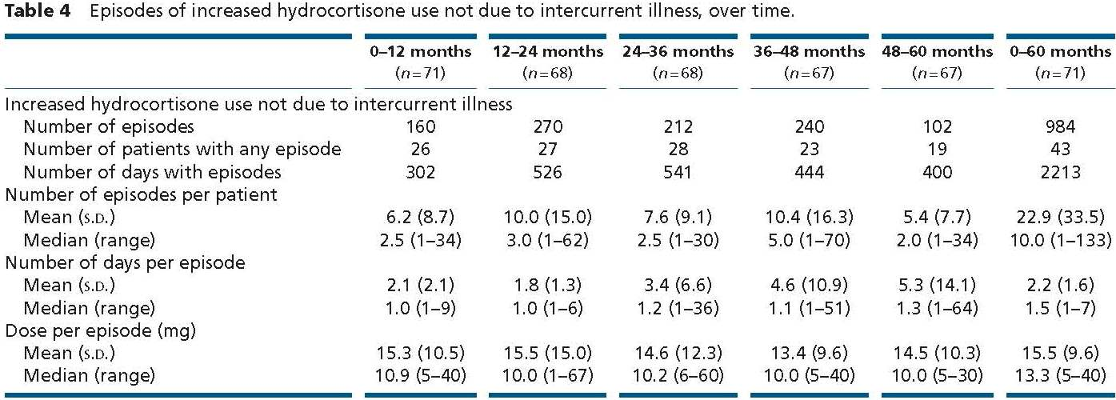

Slide 34
The main reasons for increased hydrocortisone need were physical stress (546 of 984 episodes) and mental stress (339 of 984 episodes).
No clear trends over time were observed for number of episodes, number of days per episode or hydrocortisone dose per episode. However, number of days per episode for non-illness-related events was highest in the fifth year of treatment.

Slide 35
Laboratory parameters and vital signs
Compared with baseline, small increases in mean fasting plasma glucose (0.4–0.7 mmol/L) were observed at 12, 36 and 60 months (all P < 0.001; Fig. 2).
There was no significant change in mean HbA1c from baseline to 5 years but small, significant increases were observed at 12 and 36 months (0.6 and 1.1 mmol/mol respectively; P < 0.05; Fig. 2).
Mean values for total serum cholesterol, LDL cholesterol and triglycerides were similar at baseline and after 5-year treatment with DR-HC in the overall safety population and the DM subgroup (Fig. 3).

Slide 36
In the overall safety population, small increases from baseline were observed for total cholesterol at 12 and 36 months (both 0.2 mmol/L; P < 0.05), LDL cholesterol at 36 months (0.2 mmol/L; P < 0.05) and HDL cholesterol at 12, 36 and 60 months (0.1–0.2 mmol/L; all P < 0.05; Fig. 3).
Serum lipids generally remained stable throughout the study in patients with DM, although small increases in mean HDL cholesterol were seen at 36 and 60 months (both 0.2 mmol/L; P < 0.05).

Slide 37
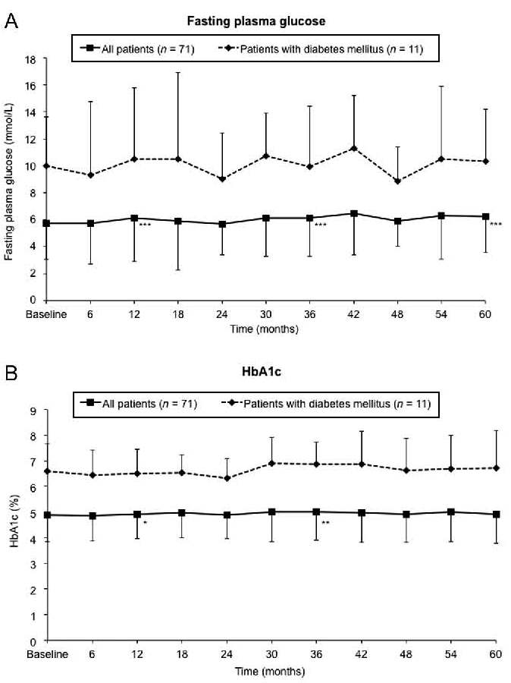

Slide 38
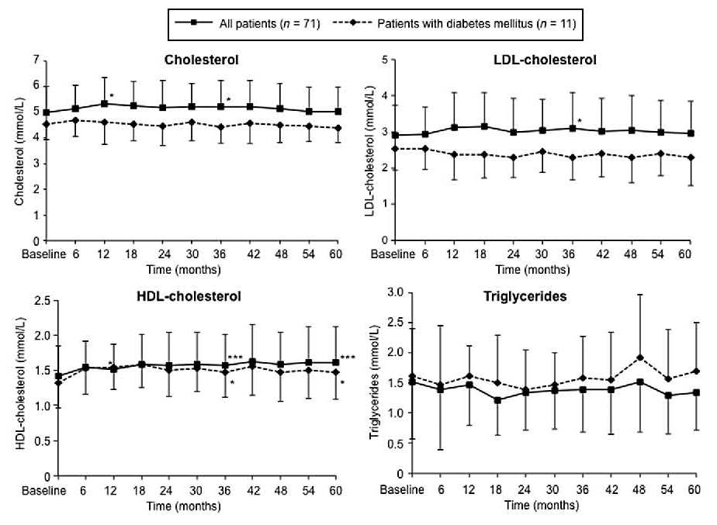

Slide 39
Patient- and investigator-assessed tolerability questionnaires
Overall, treatment tolerability assessed in patient and investigator questionnaires was significantly improved at 5 years vs baseline (Fig. 4).
For newly recruited patients, greater proportions of patients and investigators assessed treatment tolerability to be better at 5 years vs baseline (50% and 67% respectively) compared with the overall population (Fig. 4).
There were no significant changes in patient- or investigator-assessed tolerability for the subgroups of DM or elderly patients.
QoL
There were no significant changes in FIS or PGWB total scores from baseline to 5 years (Fig. 5).
However, all FIS scores were worse at 3 years and FIS physical functioning score remained worse at 5 years (change from baseline: 1.8; P = 0.008).

Slide 40
There were no clinically relevant changes in clinical chemistry variables or hematologic parameters, and there were no statistically significant changes in blood pressure, heart rate, body weight or BMI in the overall safety population or any of the subgroups.
Notably, small reductions in systolic blood pressure were seen from baseline to 5 years in all patients (−0.8 mmHg; P = 0.974) and patients with DM (−2.9 mmHg; P = 0.697);
small reductions in diastolic blood pressure were also observed (all patients: −0.8 mmHg; P = 0.550; patients with DM: −2.9 mmHg; P = 0.209).
Body weight remained stable from baseline to 5 years in all patients and the DM subgroup.

Slide 41
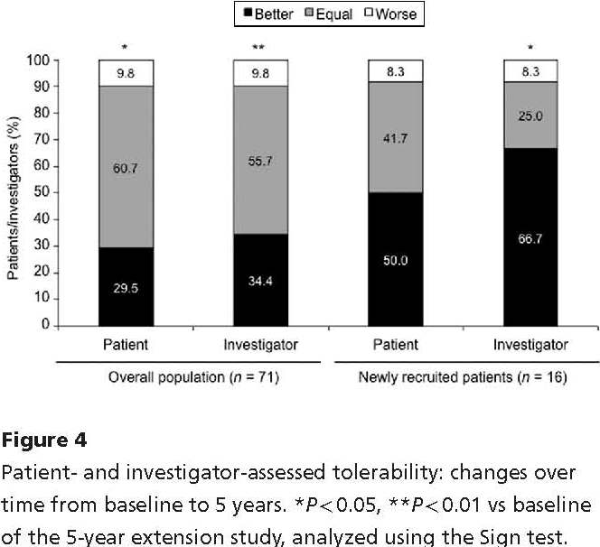

Slide 42
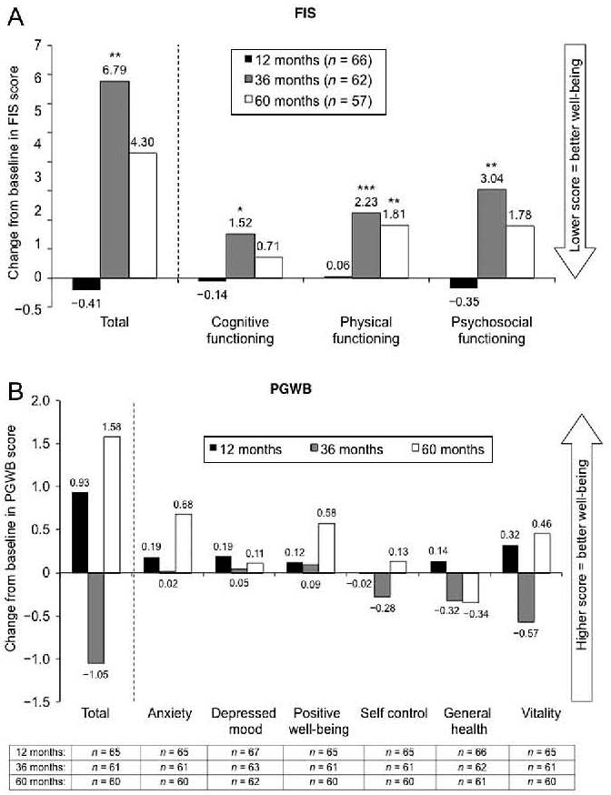

Slide 43
Discussion
This is the first prospective, long-term study to investigate the safety and tolerability of glucocorticoid replacement therapy in patients with primary AI.
The results demonstrate that the newly developed treatment option, DR-HC, is well tolerated with no safety concerns during at least 5-year treatment in patients with primary AI, including those with DM and elderly patients.
The frequency of AEs and SAEs remained stable throughout the 5-year study, no patients died due to AC and the rate of discontinuation was low.
Moreover, patient- and investigator-assessed tolerability of DR-HC significantly improved with long-term treatment compared with baseline.
The stable safety and tolerability profile seen with DR-HC correlates well with its pharmacokinetic profile showing that within-subject, day-to-day variability in cortisol–time exposure is low with DR-HC treatment .

Slide 44
The estimated daily maintenance dose of 28–29 mg DR-HC used in this study is somewhat higher than the daily dose of conventional hydrocortisone currently recommended in international guidelines for the management of primary AI (approximately 15–25 mg).
However, dosing in the present study is consistent with data from the Swedish Addison Registry of 660 patients, in which the mean hydrocortisone dose was 28.1 mg/day among the 89% of patients who received regular hydrocortisone replacement .
To date, this is the only prospective clinical study that has evaluated the management of intercurrent illness episodes over the long term in patients with AI.

Slide 45
Results from the preceding 3-month randomized crossover study indicated that DR-HC was at least as effective as hydrocortisone TID in the management of intercurrent illness episodes.
In the 5-year extension study, the number of intercurrent illness episodes and need for additional hydrocortisone remained stable over 5-year treatment with DR-HC.
Importantly, the frequency of AC appears to be lower with long-term DR-HC compared with previous reports in patients with chronic AI treated with conventional glucocorticoids , suggesting that intercurrent illnesses were managed effectively.

Slide 46
Six acute AI SAEs (ACs), two of which were assessed as possibly drug related, were documented in the present 5-year extension study.
This corresponds to 1.8 ACs per 100 patient-years, a markedly lower frequency compared with the 8.3 ACs per 100 patient-years recorded in a large prospective study of patients with AI receiving standard replacement therapy .
High AC-associated mortality (6%) has also been reported previously , but none of the 6 ACs that occurred during DR-HC treatment in the 5-year extension study or the 2 ACs that occurred in the preceding 9-month study resulted in death.
In the preceding 9-month study, DR-HC was associated with favorable effects on cardiovascular risk factors, including blood pressure and glucose metabolism, compared with hydrocortisone TID in the overall population and the subgroup with DM .

Slide 47
This extension study was not designed to identify small changes in lipids or glucose metabolism, as laboratory analyses were not performed centrally.
However, the study does indicate that there is no clear change over time with DR-HC in these parameters, and importantly no deterioration, and no new cases of diabetes.
The minimal changes in serum lipids with DR-HC are in contrast to standard glucocorticoid therapy at doses of ≥20 mg/day, which has been shown to be associated with an adverse cardiovascular risk profile .

Slide 48
The maintenance of stable blood pressure throughout the 5-year study is particularly noteworthy in the elderly and patients with DM who are more likely to have hypertension Indeed, age-dependent changes would likely become evident during this period in DM patients.
For example, blood pressure may be expected to increase by approximately 1 mmHg and, in patients with type 2 diabetes, HbA1c has been shown to deteriorate by 0.5% per year.
However, long-term trends should be interpreted with caution given that there was no control group, the number of subjects was small and changes in antidiabetic, antihypertensive and lipid-lowering medications were not recorded in this study.

Slide 49
Switching from conventional hydrocortisone to DR-HC has been shown to significantly improve glucose and lipid metabolic parameters, central adiposity and QoL vs baseline or continued conventional hydrocortisone .
The stable metabolic profile observed with DR-HC may be attributed to the particular cortisol release profile of DR-HC that resembles the daily normal cortisol profile more closely than twice- or thrice-daily conventional hydrocortisone .
Overall, DR-HC appears to provide sustained improvements in cardiovascular risk factors in patients with AI.

Slide 50
Higher doses of conventional hydrocortisone during long-term glucocorticoid replacement have been shown to be associated with worsening QoL .
By contrast, 10 weeks of treatment with higher doses of hydrocortisone was shown to improve health-related QoL vs lower doses in a recent randomized, double-blind crossover trial in 47 patients with secondary AI .
In the 3-month comparison with hydrocortisone TID, DR-HC significantly improved total scores and several domain scores on the FIS and the PGWB questionnaire despite an average 20% reduction in cortisol exposure .
In the 5-year extension study, the physical functioning score on the FIS significantly worsened, but there were trends toward improvement from baseline to 5 years in PGWB total score and several domains.
It is possible that the reported worsening of physical functioning over time may reflect the decline in QoL commonly seen with both aging and chronic diseases .

Slide 51
However, the conflicting results on the two general QoL tools used in this study prevent meaningful conclusions to be drawn about the long-term effects of DR-HC on the QoL of patients with primary AI.
When the study was initiated, there were no validated disease-specific QoL instruments for AI but the introduction of the Addison’s Disease-specific QoL questionnaire (AddiQoL) may be useful for future evaluations of QoL in AI .
Indeed, a recent 12-month study showed that the total score on the 30-item AddiQoL significantly improved after patients with primary AI switched from conventional hydrocortisone to DR-HC .

Slide 52
The main limitations of the present study are the uncontrolled, open-label design and the lack of statistical power for comparisons between baseline and subsequent time points.
Hence, any statistically significant changes were from exploratory analyses and should be interpreted with caution.
Another limitation arises from this being the first prospective study investigating the long-term treatment of primary AI, meaning that there are no other data against which to make valid comparisons.
As primary AI is a rare disease, there are few patients available for enrollment in clinical studies, restricting the sample size.
Inclusion bias may also affect interpretation, as patients were stable with good QoL at baseline.

Slide 53
In summary, long-term DR-HC therapy for patients with AI was well tolerated with no safety concerns.
Intercurrent illness episodes and need for additional hydrocortisone remained relatively stable over at least 5 years of DR-HC treatment and the frequency of AC was lower than that previously reported.
The safety surveillance of glucose, lipid and blood pressure did not indicate any cardiometabolic risk with long-term use of DR-HC.
This study indicates that DR-HC has the potential to provide effective glucocorticoid replacement therapy for primary AI while avoiding the detrimental cardiovascular and metabolic effects that are common during conventional treatment.

