Slide 2
HYPERGLYCEMIA MANAGEMENT IN PATIENTS WITH POST-TRANSPLANTATION DIABETES
Emerging treatments for post-transplantation diabetes mellitus
Jenssen, T. & Hartmann, A. Nat. Rev. Nephrol. advance online publication 28 April 2015; doi:10.1038/nrneph.2015.59
.
2015 AACE.

Slide 3
Post-Transplantation Diabetes (PTDM) is a common occurrence after solid organ transplantation and is associated with increased morbidity, mortality and healthcare costs.
There is limited number of studies addressing strategies for hyperglycemia management in this population, with few articles emerging recently.

Slide 4
Introduction:
Post-Transplantation Diabetes Mellitus (PTDM), formerly known as New Onset Diabetes After Transplantation (NODAT), is one of the most problematic comorbidities of solid organ transplantation.
PTDM is associated with increased mortality, overall graft failure, rate of acute rejection, infections, major-cardiovascular events . and earlier onset of diabetes-related microvascular complications .

Slide 5
INCIDENCE AND IMPACT OF NODAT IN RENAL TRANSPLANT PATIENTS
The reported incidence of NODAT greatly depends on the length of follow-up, diagnostic criteria, and immunosuppression regimen.
The true incremental incidence of diabetes occurs mainly during the first 6 months posttransplantation, when patients are treated with high doses of immunosuppression. After 6 months, the annual incidence of diabetes is similar to that observed in patients on the waiting list (∼6% per year) .
Thus, late-onset cases of NODAT may be difficult to distinguish from genuine cases of type 2 diabetes.
The most accurate incidence of NODAT under calcineurin inhibitor (CNI) therapy is provided by the prospective study of Vincenti et al. reporting an incidence of NODAT reaching 20.5% within the first 6 months postrenal transplantation.

Slide 6
Post-transplantation diabetes mellitus (PTDM), also known as new-onset diabetes mellitus (NODM),
occurs in 10–15% of renal transplant recipients and is associated with cardiovascular disease and reduced lifespan.

Slide 7
Even though this disorder has been recognized for several years, it was not until the publication of a guideline in 2003 that the term “NODAT” and its definition were widely accepted .
Transplant centers may be unable to effectively recognize dysglycemia during the pre-transplant evaluation; the term “New-Onset Diabetes After Transplantation” may therefore be misleading.
Recently, an international consensus meeting acknowledged this concern and suggested using the term PTDM.

Slide 8
A historical overview of several terms used for transplant-related dysglycemia is illustrated in Figure 1.

Slide 9
Diagnosis :
Current PTDM guidelines recommend the use of:
fasting blood glucose,
2-hours oral glucose tolerance test
and/or A1c for diagnosis, as endorsed by the American Diabetes Association .
.

Slide 10
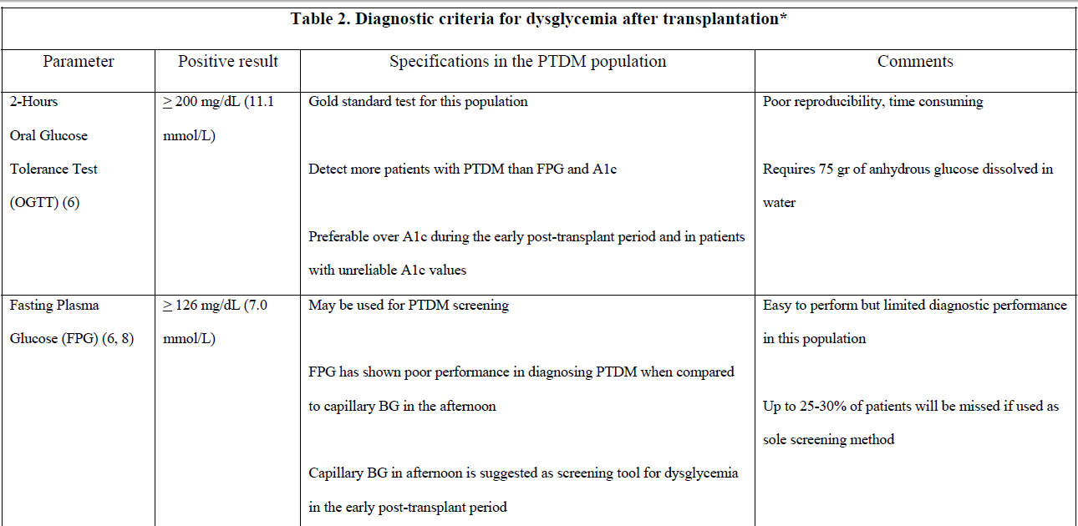

Slide 12
the posttransplant period is frequently associated with anemia (due to surgical blood loss, iron deficiency, immunosuppressive drugs, graft dysfunction, and abrupt discontinuation of erythropoietin administration), resulting in spurious A1C results .
Likewise, glucose levels rather than A1C must be used as screening in case of rapid onset of diabetes, a situation encountered after high-dose glucocorticoid administration.

Slide 13
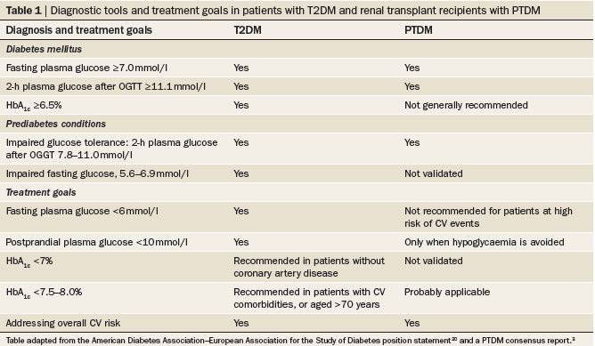

Slide 14
Thus, maintaining A1c < 7% is generally recommended with the understanding that no definitive data exists for this population.
The concept of individualized glycemic targets based on risk assessment is widely used, thus A1c goals of up to 8% in patients with high risk of hypoglycemia, limited life expectancy, advanced micro/macrovascular complications or extensive co-morbidities may be acceptable .

Slide 15
Methods:
We performed a Pubmed search of studies published in English addressing hyperglycemia management of PTDM/NODAT. Relevant cited articles were also retrieved.
Our review was designed to answer the following questions:
1) what is the efficacy of various available therapies for hyperglycemia management in PTDM and
2) what is known about the safety of available glucose-lowering agents in this population?

Slide 16
and Our inclusion criteria were: adult subjects (>18 years of age), diagnosis of NODAT and use of glucose-lowering therapy.
We excluded children (< 18 years of age), patients with known pre-transplant diabetes and studies not addressing glucose-lowering agents.
Out of 400 abstracts matching the search criteria, 25 studies that met our inclusion criteria are reviewed here.

Slide 17
Results:
Most of the 25 publications eligible for review were retrospective studies.
Insulin therapy during the early post-transplantation period has shown promise in preventing PTDM development.
Thiazolidine diones have shown glycemia control, mostly, in retrospective studies, at the expense of weight gain and fluid retention.
Evidence with metformin, sulfonylureas and meglitinides is very limited.
Incretins have shown promising results in small prospective studies using sitagliptin, linaglitpin and vildagliptin and in a case series using liraglutide.

Slide 19
Renal transplant recipients with NODAT exhibit similar complications as those seen in the general population with type 2 diabetes, but at an accelerated rate .
As a consequence, NODAT is associated with worse outcomes after renal transplantation, such as a higher risk of major cardiovascular events, graft failure, death-censored graft failure, and death .
In addition, this metabolic complication substantially increases medical costs .

Slide 20
RISK FACTORS Risk factors shared with type 2 diabetes in the general population
As observed in type 2 diabetes in the general population, older age is a strong independent risk factor of NODAT. There is a 90% increase of relative risk (RR) in renal transplant patients aged 45–59 and a 160% increase in patients ≥60 (versus 18–44 years as a reference).
The RR of NODAT is increased by 32–68% in black patients and by 35% in Hispanic patients in comparison with white patients.
Overweight or obese patients have a higher risk of developing NODAT, with an RR of 1.4 for patients with a BMI between 25 and 30 kg/m² and an RR of 1.7–1.8 for patients with a BMI >30 kg/m².
The RR of NODAT associated with a positive hepatitis C virus (HCV) serology ranges from 1.3 to 1.4 .

Slide 21
With regard to cytomegalovirus (CMV), a group showed that both ganciclovir-treated and asymptomatic CMV infection episodes are independent risk factors of NODAT.
Likewise, there is no clear relationship between positive CMV serological status and the risk of type 2 diabetes in the general population.

Slide 22
The role of a family history of diabetes in predicting NODAT is unclear, as it has not been evaluated in large registry reports. However, a family history of type 2 diabetes emerged as a significant risk factor associated with NODAT in multivariate analysis of several studies.
Retrospective studies reported a higher incidence of NODAT in patients with a metabolic syndrome at baseline. Patients with an increasing number of criteria are more likely to develop NODAT (74% of patients with five pretransplant criteria developed NODAT) .

Slide 23
The risk of NODAT increases stepwise with pretransplant FPG level (FPG 101–110, odds ratio [OR] 1.5; FPG 110–125, OR 7.6) . The 2-h plasma glucose level after an oral glucose tolerance test (OGTT) correlates with the risk of NODAT (OR 1.26 per 1 mmol/L or 18 mg/dL).
Pretransplantation hypertriglyceridemia was also shown to correlate with NODAT .

Slide 24
Since the first genome-wide association study (GWAS) in 2007, >40 confirmed loci have been associated with type 2 diabetes in the general population.
. One of the largest ORs was 1.55 and was observed in nonobese patients with genetic polymorphism rs7903146 (T allele), a common variant in the TCF7L2 (transcription factor 7-like 2) gene .
This allele has been associated with impaired insulin secretion, incretin effect, and enhanced rate of hepatic glucose production in humans .

Slide 25
Thus, although the association of TCF7L2 with NODAT highlights a major common mechanistic pathway with type 2 diabetes,
we do not currently recommend genotyping TCF7L2 for individual risk prediction of NODAT today.

Slide 28
Hypomagnesemia induced by CNIs (more common with tacrolimus) is due to renal magnesium wasting occurring through transcriptional inhibition of the renal magnesium transporter in the distal collecting tubule.
Recently, posttransplantation hypomagnesemia was found to be an independent predictor of NODAT in both renal and liver transplant.
This finding is in line with data from the general population where hypomagnesemia cross-sectionally associates with insulin resistance in obese children and with a metabolic syndrome in both diabetic and nondiabetic adults.

Slide 29
hypomagnesemia might merely represent a surrogate marker or be a consequence of insulin resistance, inflammation, or endothelial dysfunction, which are all risk factors for diabetes in the general population.
Although magnesium supplementation has previously demonstrated a beneficial impact on insulin resistance in the general population,
randomized, controlled trials assessing the impact of early posttransplantation magnesium supplementation on glucose metabolism, which are ongoing, will hopefully shed light on this still controversial issue .

Slide 30
Specific factors related to transplantation
Although the type of donor (deceased versus living) is not an independent risk factor for NODAT, immunosuppression is a major factor contributing to the risk of NODAT.
The diabetogenic effect of glucocorticoids, mainly due to insulin resistance, is mediated by both impaired insulin-dependent glucose uptake in the peripheral tissues and enhanced gluconeogenesis in the liver.
High-dose glucocorticoid regimens used during the 1970s were associated with a very high incidence of so-called “steroid diabetes,” which declined when cyclosporine was introduced as an immunosuppressant in the 1980s.

Slide 31
However, pulse glucocorticoid therapy still given in the context of acute rejection treatment remains an independent risk factor of NODAT .
. However, both steroid-sparing strategies were associated with higher acute rejection rates and higher risk of graft loss excluding death .
Therefore, in patients at high risk of NODAT, a glucocorticoid minimization strategy should be balanced with the immunological risk profile to avoid acute rejection and graft loss.

Slide 32
CS may lead to increased hepatic gluconeogenesis, development of insulin resistance and defective insulin secretion .
Improvement of insulin sensitivity in post-transplant subjects was noticed upon CS dose reduction and withdrawal , suggesting a dose-related increase in insulin resistance.

Slide 33
CNIs are diabetogenic by inducing a defect in insulin secretion by interfering with the nuclear factor of activated T-cell signaling in pancreatic β.
Tacrolimus induces a reversible suppression of insulin secretion at the level of insulin mRNA transcription, mediated by the binding of the drug to FK506 binding protein-12 and a subsequent inhibition of calcineurin in the β-cells.
The high level of FK506 binding protein-12 present in pancreatic β-cells might explain why tacrolimus more profoundly inhibits insulin secretion than cyclosporine.

Slide 34
Registry analyses, meta-analyses, and the prospective study of Vincenti et al. showed that the risk of NODAT was significantly higher in patients on tacrolimus versus cyclosporine .
Recent data suggest that tacrolimus may also induce beta-cell apoptosis .

Slide 35
The risk of NODAT related to tacrolimus is dose dependent and high trough levels enhance this risk, in particular during the early posttransplant period .
Indeed, studies comparing belatacept (a molecule that inhibits T-cell activation) with a cyclosporine-based regimen showed that NODAT developed in 6.7% of patients on cyclosporine versus 3.5% of belatacept patients at 12 months (P = 0.018).
We showed that 42% of switched patients experienced a resolution of NODAT, whereas this never occurred in patients remaining on tacrolimus, after a follow-up of 1 year .

Slide 36
There is now strong evidence that m-TOR (mammalian target of rapamycin) inhibitors cause alterations in glucose metabolism. This diabetogenic effect is probably due to a combination of an insulin secretion defect (toxicity to β-cells) and insulin resistance.
Sirolimus has been associated with an increased risk of NODAT in large North American and European cohorts. The risk is particularly high when sirolimus is associated with a CNI.
Experimental and clinical data on everolimus, the other m-TOR on the market, are more scant.

Slide 37
Acute vs chronic hyperglycemia
Many patients develop inpatient post-transplantation hyperglycemia, afflicting > 80% of patients without pre-transplant diabetes .
It is currently recommended to differentiate this common phenomenon from that of PTDM – a more persistent and chronic insulin-deficient and resistant state .

Slide 38
Current guidelines recommends:
waiting for up to 45 days post-transplantation before assigning the diagnosis of PTDM,
but recommended treating patients with early post-transplant hyperglycemia with insulin therapy, especially in the hospital.

Slide 39
Chronic Hyperglycemia: Transient/Reversible vs Persistent vs Recurrent PTDM
Many patients will have improvement of their dysglycemia once the dose of immunosuppressive therapies is decreased.
Consequently, PTDM has been classified as
early-onset or late-onset, based on the time of diagnosis (before or after 3 months), or as
persistent, recurrent and reversible (transient), based on the long-term clinical evolution.

Slide 40
Acute hyperglycemia management during the inpatient/peri-transplant period
Extensive literature supports inpatient glucose control to improve hospital-related outcomes and mortality in the general patient population .
However, the literature is remarkably limited in the transplant population . Only one prospective randomized trial has been published on the acute management of hyperglycemia during the peri-transplant period.

Slide 41
Hermayer et al. showed that intensive glycemic control (blood glucose target of 70-110 mg/dl) compared to standard-of-care (blood glucose target < 180 mg/dl) in the immediate 3-day-posttransplant period was associated with:
increased incidence of graft rejections (p=0.012),
delayed graft function (18% vs 24%, p=0.46)
and more hypoglycemic events (p=0.08) in kidney transplant recipients.
This study, however, only included patients with pretransplant diabetes .

Slide 42
A retrospective study of 92 heart transplant recipients, 28% of whom had preexisting DM, who were managed with insulin in the early post-transplant period was recently published.
The authors reported their experience using a standardized insulin infusion protocol while in the intensive care unit (ICU) and a basal-bolus insulin regimen, with a target fasting blood glucose of 80-110 mg/dl. There were no significant differences in blood glucose, 30-day all-cause mortality, ICU length-of-stay, rejection episodes, 30- day readmission rate between patients with preexisting DM and those who were newly experiencing hyperglycemia. However, the rates of moderate hypoglycemia (40-69 mg/dl) were 19% when using insulin infusion protocols and 27% while on the subcutaneous basal-bolus regimen .

Slide 43
Hypoglycaemia
Hypoglycaemic episodes are detrimental in patients with advanced arteriosclerosis, and in some cases, asymptomatic coronary artery disease, and hypoglycaemic episodes are common in patients with uraemia.
In the absence of renal failure, the kidneys contribute 50% of total gluconeogenesis, which equates to 25% of total endogenous glucose production
Hypoglycaemia might also cause lengthening of the QT interval observed by echocardiography and induce pro-arrhythmic repolarization changes.

Slide 44
Based on the available but limited information, glycemic targets of 140-180 mg/dl (with a lower target of 110-140 mg/dl for selected patients at a lower risk of hypoglycemia) seem reasonable for critically ill patients, as generally recommended.
For non-critically ill patients, a target pre-meal blood glucose <140 mg/dl and random blood glucose < 180 mg/dl is recommende.

Slide 45
Wide and abrupt changes in glycemia can occur during these periods, requiring daily evaluation of the insulin regimen.
Several factors such as nutrition, pain, infection and steroid dose may drastically change during this period, influencing the insulin doses.

Slide 46
There are no studies specifically addressing whether early insulin therapy is better than non-insulin agents in this population. However, a recent pilot study by Hecking et al suggested that early basal insulin reduces the risk of PTDM.
The authors suggested that early exogenous insulin supplementation might prevent beta-cell exhaustion while it’s exposed to the toxic effects of immunosuppressants and inflammatory stress .

Slide 47
Insulin is the preferred agent during the immediate and early post-transplant period, particularly during acute illness or when high doses of corticosteroids or CNIs are used.
Oral agents with low risk for hypoglycemia such as DDP-4 inhibitors and meglitinides - particularly in patients with renal dysfunction - might be more appropriate after the immediate post-transplant/stress response period or hospitalization.

Slide 48
Chronic Hyperglycemia
There is insufficient evidence to recommend a first choice agent for chronic hyperglycemia in these patients. Special consideration should be given to the side effect.
profile as well as the effectiveness of each agent in achieving glycemic targets, drug interactions and medication cost.
There is extensive evidence of the benefits of long-term glycemia control in preventing microvascular and macrovascular complications in the general diabetes population .

Slide 49
Glucose-lowering treatment
Glucose-lowering therapy in PTDM involves three approaches:
lifestyle intervention,
changes in the immunosuppressive regimen
initiation of glucose-lowering treatment

Slide 50
General measures:
Transplant recipients have a tendency to gain weight after transplantation. Obesity is associated with increased risk for development of PTDM and worse transplant-related outcomes .
A healthy diet and regular exercise is encouraged.
. A randomized control trial in kidney transplant recipients studied the effect of an immunomodulatory diet, rich in omega-3 and omega-9 fatty acids.
Patients who received L-arginine supplements and canola oil had decreased rejection rates, CNIs toxicity and lower incidence of PTDM .

Slide 51
Intensive life-style modifications (dietitian referral, exercise program, weight loss advice) resulted in 15% improvement of post-prandial glucose based on oral-glucose tolerance test (OGTT) in renal transplant recipients with impaired glucose tolerance (IGT) (n: 25) and PTDM (n: 7).

Slide 52
Glucose-lowering therapy must be compatible with :
immunosuppressant agents,
reduced glomerular filtration rate (GFR)
and severe arteriosclerosis
elicit weight gain.
Such therapy should not place the patient at risk by inducing hypoglycaemic episodes or exacerbating renal function owing to adverse gastrointestinal effects with hypovolaemia.

Slide 53
Short-term use of the DPP‑4 inhibitors sitagliptin and vildagliptin, as well as glinides have been shown to be safe and effective in small clinical trials
The use of GLP‑1 analogues, SGLT2 inhibitors, and metformin at GFR <60 ml/min/1.73 m2 needs to be explored among patients with PTDM

Slide 54
immunosuppressive agents:
The usual immunosuppressive regimen in most organ transplant recipients is a triple combination of :
glucocorticosteroid (for example, prednisolone),
CNI
antiproliferative agent (for example, mycophenolate acid).
.

Slide 55
Previous guidelines for NODAT recommended starting with
life-style modification, followed by oral agents and finally insulin if no glycemia control is achieved with oral agents.
However, the United States Renal Data System data showed contrasting provider preferences in 2009-2011.
Insulin was the most common prescribed medication (~30%) in patients without pre-transplant diabetes during the initial six months after transplantation.
The second most common agents were sulfonyureas (~10%), followed by thiazolinediones, biguanides, meglitinides and DPP-4 inhibitors (smaller rates ~<5%) .

Slide 56
Such stepwise approach might be considered in patients with late-onset PTDM as endorsed by the recent guidelines, but it has several limitations for those with early posttransplant hyperglycemia .
PTDM has a more rapid onset and progression than T2DM. High doses of steroids and immunosuppressive agents are usually required initially after transplantation leading to swift beta-cell damage, with subsequent reduction in insulin secretion, and periods of transient high insulin resistance.

Slide 57
Therefore, agents that prevent beta-cell exhaustion, such as insulin and/or incretins , hold particular therapeutic promise.
However, to our knowledge, there are no reported studies addressing the use of insulin therapy for long-term hyperglycemia management beyond three months after transplant.

Slide 59
Metformin:
Metformin is considered first-line therapy in Type 2 Diabetes Mellitus (T2DM).
This agent decreases hyperglycemia by inhibiting hepatic gluconeogenesis, delaying intestinal glucose absorption and increasing insulin-mediated glucose uptake by muscle.

Slide 60
Common side effects include diarrhea and bloating. Metformin is contraindicated in patients with impaired renal function, alcoholism, hemodynamic instability and metabolic/lactic acidosis
Concerns of lactic acidosis in kidney disease have limited its use in transplant patients. However, recent reports suggest that patients with mild to moderate chronic kidney disease may still benefit from this therapy, provided appropriate dose adjustment based on the glomerular filtration rate and close monitoring of renal function .

Slide 61
The authors felt that despite the small study population, metformin use appeared to be safe in this population as only two patients discontinued metformin in the setting of decreased renal function and there was not recorded cases of lactic acidosis .
Soliman et al reported their experience with sitagliptin vs glargine as add-on therapy to metformin (n: 62), but there were no comments on lactic acidosis .
The use of metformin, however, is not advocated for use in the USA in patients with a GFR <60 ml/min/1.73 m2 (creatinine level <1.5 mg/dl)

Slide 62
Phenformin is another biguanide derivative; however, clinical development of this drug was abandoned because of fatal lactic acidosis among patients with renal failure
The risk of fatal lactic acidosis is lower with metformin as compared with phenformin.
Most cases of lactic acidosis with metformin have been reported when it is combined with angiotensin-converting-enzyme (ACE) inhibitors or angiotensin II-receptor blockers in patients with a reduced GFR.

Slide 63
Experimental studies in rats have shown that metformin reduces hyperglycaemia induced by immunosuppressant drugs and decreases exocrine apoptosis.
Some evidence suggests that high doses of metformin could antagonize cancer progression in vitro,
whereas other studies have suggested that metformin might prevent cancer progression in a clinical setting.
Metformin has been recommended as the first-line hypoglycaemic agent in patients with normal renal function, since the identification of a cardioprotective effect in a small subset of obese patients in the UK Prospective Diabetes study.

Slide 64
Thiazolidinediones (TZD):
Rosiglitazone and pioglitazone are two members of this class.
TZDs improve insulin sensitivity by activating the peroxisome proliferator-activated receptor gamma nuclear transcription factor.
Common side effects include weight gain, edema/fluid retention and congestive heart failure (CHF). Liver enzyme elevation has been described less commonly .

Slide 65
There has been controversy about a potential association of rosiglitazone (not available in Europe) with increased risk of myocardial infarction and pioglitazone with increased bladder cancer risk.
TZDs have been linked to accelerated bone loss, decrease bone formation and also with increased risk for fractures . TZDs are contraindicated in patients with CHF (class III –IV). Given the side effect profile and ongoing controversy, patients should be actively involved in the risk-benefit discussion of TZD therapy.

Slide 66
The findings of the prospective pioglitazone clinical trial in macrovascular events (PROactive) study suggested that:
pioglitazone produced a cardiovascular protective effect in patients with T2DM and cardiovascular disease possibly due to an increase in the concentration of HDL.
Peripheral edema developed in 13% of patients but none required discontinuation of therapy.

Slide 67
Sulfonylureas (SU):
SUs induce insulin secretion by binding to the SU-receptor in the pancreatic beta cell and activating ATP-dependent K-channels.
Common side effects are hypoglycemia and weight gain. Most SUs are metabolized in the liver to compounds with little activity.
Thus, patients with liver disease may have active drug accumulation and increased hypoglycemia risk, in addition to disease-related impaired gluconeogenesis.
Moreover, accumulation of active SU metabolites occurs with decreased renal function leading to increased risk of hypoglycemia.

Slide 68
Sulphonylureas are metabolized in the liver and active metabolites are excreted in the urine. The half life of these drugs is prolonged among patients with renal failure, and thus their use should be avoided in patients with GFR <30 ml/min/1.73 m2.
A large cohort study in patients with T2DM showed increased mortality with sulphonylurea drugs as compare to metformin.
Sulphonylurea receptors are also present in the myocardium, and it has been speculated that closure of the K+–ATP channels reduces myocardial preconditioning during hypoxia.
This adverse effect seems less pronounced with glimepiride, a third-generation sulphonylurea.

Slide 69
In patients with impaired renal function, glipizide is the preferred agent as only a limited amount (<5%) of the intact drug is renally excreted .
That said, even glipizide should be avoided in patients with severe renal impairment to avoid hypoglycemia. Glipizide was found not to change cyclosporine levels in kidney transplant recipients with PTDM .
Moreover, many transplant recipients require prophylactic antibiotics, such as: sulfamethoxazole-trimethoprim, which was recently found to increase the risk of hypoglycemia in patients taking SUs .
In PTDM patients, particularly initially in the disease course, beta-cells are exposed to severe injury from immunosuppressive agents. The additional concern of SU-induced beta-cell apoptosis questions their utility early in the disease .

Slide 70
Meglitinides:
Repaglinide and nateglinide are short acting insulin secretagogues that predominantly reduce post-prandial hyperglycemia.
The risk of hypoglycemia is lower compared to SU .
In contrast to nateglinide, repaglinide has been used in patients with renal dysfunction without significant risk of hypoglycemia .
Serum creatinine and CNI levels did not change significantly .

Slide 71
Given its lower hypoglycemia risk compared to SU and expected post-prandial hyperglycemia in PTDM, these agents may be suitable for use in these patients, particularly if renal failure is a concern.
A three-times-daily dosing regimen may limit adherence in a population with an already heavy medication burden.

Slide 72
Incretins:
Incretins [glucagon-like peptide-1 (GLP-1) and glucose-dependent insulinotropic polypeptide (GIP)] are gut hormones secreted in response to food ingestion.
The half-life of GLP-1 is very short due to the rapid degradation by dipeptidyl peptidase-4 (DPP-4) enzyme and renal clearance.
Two groups of agents have been developed to treat T2DM: injectable GLP-1 agonists and oral enhancers of endogenous incretin action (DDP-4 inhibitors).

Slide 73
DPP-4 inhibitors boost GLP-1 action by increasing endogenous levels.
Hypoglycemic action of incretins is mediated by an increase in glucose-dependent insulin secretion, decrease of glucagon production and delay in gastric emptying.
GLP-1 agonists also stimulate satiety and promote weight loss, while DPP-4 inhibitors are considered weight-neutral
Overall, incretin therapy has a favorable side effect profile with very low risk of hypoglycemia.
Animal studies suggest a potential protective effect against beta cell apoptosis and preliminary human trials have shown beneficial effect on beta-cell function.

Slide 74
GLP-1 agonists may cause dose-dependent nausea, vomiting or diarrhea.
The link between incretin therapy and pancreatitis, pancreatic cancer or medullary c-cell carcinoma of the thyroid in humans has recently generated some controversy, as it has not been clinical trials .
In patients with renal impairment the dose should be adjusted based on their glomerular filtration rate (GFR), except with linagliptin, dulaglutide, albiglutide and liraglutide .

Slide 75
The SAVOR-TIMI 53 study generated some concerns with the use of saxagliptin in patients with type 2 diabetes and high cardiovascular risk.
The authors found a significant increase of CHF in patients taking the drug compared to placebo (3.5% vs 2.8%, HR 1.27, 95% CI 1.07-1.51, p- 0.007) .
However, the recently published TECOS trial (n: 14 671) found that the rate of major cardiovascular events and hospitalization for CHF did not differ between the sitagliptin and the placebo group.

Slide 76
The only published observation on GLP-1 agonist use post-transplant is a retrospective study of 5 kidney-transplant recipients using tacrolimus.
In this case series, liraglutide showed good safety and did not interfere with tacrolimus levels or induce hypoglycemia. Moreover, it decreased post-prandial blood glucose at 60 and 120 minutes and produced weight loss (-2.1 +/- 1.3 kg after 21 days), but did not impact fasting blood glucose .
These agents should probably not be used in patients with GFR <30 ml/min/1.73 m2, and they have not yet been validated in individuals with PTDM.

Slide 77
SGLT2 inhibitors
SGLT2 inhibitors lower blood glucose by inducing renal glucose excretion, and in the long term cause weight reduction due to caloric loss.
Recovered glucose is actively reabsorbed in the proximal tubules by the ATP-dependent sodium–glucose co-transporters 1 and 2 (SGLT1 and SGLT2).
SGLT2 is a low-affinity high-capacity transporter located within the S1 segment of the proximal tubule that is responsible for ~90% of the glucose reabsorption.

Slide 78
A normoglycaemic individual weighing 70 kg produces ~180 g glucose per day from endogenous sources, and has a daily glucose intake from exogenous sources of ~180 g per day.
Tubular reabsorption of glucose, therefore, accounts for ~50% of total daily glucose turnover.

Slide 79
Dapagliflozin, canagliflozin, and empagliflozin are SGLT2 inhibitors that are currently in clinical use.
These compounds partly reverse the reabsorption of glucose, leading to daily excretion of 70 g glucose (corresponding to 280 kcal) and a moderate osmotic diuresis of 200–300 ml per day.
Hyperglycaemia is reduced and a loss of 2–5 kg in body weight is observed together with a slight reduction in blood pressure.
A sustained effect on glucose lowering and persistent weight loss has been shown for up to 2 years among patients with T2DM.

Slide 80
The use of SGLT2 inhibitors has not yet been investigated in PTDM.
Reabsorption of glucose depends on glycaemia and GFR, consequently the rate of reabsorption is low among patients with a low GFR.
The efficiency of SGLT2 inhibitors in recipients of a renal transplant might therefore be questioned.

Slide 81
Insulin:
The natural history of PTDM is characterized by early severe hyperglycemia immediately after transplantation that transitions to legitimate diabetes within months that may or may not spontaneously abate .
This trajectory is likely related to the postsurgical stress and high doses of immunosuppressive agents used in the early posttransplantation period.
Thus, it’s been suggested that insulin therapy might prevent beta cell exhaustion and progression into diabetes .

Slide 82
Insulin is the most commonly used agent during the first six months after kidney transplantation in the US .
To our knowledge, there are no reported studies addressing the use of insulin therapy for long term hyperglycemia management after three months. Recent recommendations support the use insulin as a safe and effective agent during the early transplantation period as aforementioned
. Studies addressing different insulin approaches to inpatient/early or late hyperglycemia are needed.
Oral medications can be subsequently considered if the insulin dose required to maintain glycaemic control is <20 units per day

Slide 83
Future therapies
Several novel agents are currently in development for T2DM that might also hold promise for the treatment of PTDM.

Slide 84
Amylin analogues
Amylin is a β‑cell hormone that is released together with insulin. Pramlintide, an amylin analogue, is available for use in the USA in conjunction with insulin therapy.
Amylin analogues are administered by subcutaneous injection and they inhibit glucagon production, delaygastric emptying, and increase satiety.
Although pramlintide can be used in patients with moderate renal impairment (GFR ≥20 ml/min/1.73 m2),
it has not been tested in patients with PTDM. Hypoglycaemia and nausea are important adverse effects that are particularly undesirable for renal transplant recipients.

Slide 85
Glucokinase activators
Glucose must be converted to glucose‑6-phosphate by glucokinase after cellular uptake before it can undergo glycolysis or be used for glycogen synthesis.
Glucokinase acts as a glucose sensor and is expressed in numerous cell types, including β cells.
The safety and efficacy of glucokinase activators are currently being evaluated in phase I and phase II clinical trials.

Slide 86
Glucagon antagonists
T2DM is a condition with adversely high glucagon secretion and increased hepatic glucose output.
A new class of agents that block the effect of glucagon on its corresponding receptor in liver cells is being developed.
These agents are presently undergoing phase I and II clinical trials.

Slide 87
Bile acid sequestrants
Cholestyramine, colestimide, and colesevelam are bile acid sequestrants that inhibit the reabsorption of bile acids in the gut and are used in the treatment of hypercholesterolemia.
Bile acid sequestrants also exhibit a modest glucose-lowering effect, which has been explored in small clinical trials.
Known adverse effects of these drugs are borborygmi (stomach rumbling), nausea, diarrhoea, and impaired absorption of fat-soluble vitamins A, D, and K.
These adverse effects might limit their use in transplant recipients.

Slide 88
Sevelamer, a phosphate binder, was also reported to have a glucose-lowering effect,
but of modest and probably insignificant magnitude.

Slide 92
MANAGEMENT OF NODAT Pretransplant evaluation
Currently, pretransplant risk assessment should be based on the phenotype and the medical history of the patient.
The following factors associated with a higher risk of NODAT should be considered:
an age >45 years old,
a familial history of type 2 diabetes,
a personal history of NODAT with previous graft or a gestational diabetes,
IFG, impaired glucose tolerance
, criteria for metabolic syndrome,
a BMI >30 kg/m²,
and a positive hepatitis C serology.

Slide 93
The screening should include an evaluation of the glucose metabolism status by FPG and/or OGTT.
A recent large study (N = 889) has underlined the low sensitivity of FPG in detecting pretransplant glucose metabolism abnormalities in patients with ESRD because of insulin resistance.
An FPG screening should be performed in all candidates, followed ideally by an OGTT in patients with FPG between 92 and 125 mg/dL (±50% of patients). This should allow the identification of >80% of pretransplant diabetes

Slide 94
. The use of A1C is not recommended for the screening given the low sensitivity of the test in ESRD patients .
Patients should be screened for risk factors before transplantation in order to prospectively tailor their immunosuppression and minimize the risk of NODAT.
Patients at risk should be counseled on the importance of lifestyle intervention, including weight control, diet, and physical activity; as such strategy is efficient in patients at risk for type 2 diabetes.

Slide 95
Posttransplant monitoring of glucose metabolism status
Recent guidelines recommend screening all kidney transplant recipients with FPG, OGTT, and/or A1C assay at least weekly for 4 weeks, every 3 months for 1 year, and annually thereafter. .
Additionally, A1C could be assayed at 3 and 6 months, and then yearly, to improve NODAT diagnostic accuracy.
Self-monitoring of blood glucose should ideally be performed in patients treated by insulin or oral hypoglycemic agents, as in type 2 diabetic patients .

Slide 96
Management of immunosuppression
We suggest an algorithm for the management of immunosuppression in order to both minimize the risk of developing NODAT and improve established NODAT, based on published data
The choice of immunosuppression should first take into account the immunological risk of the patients in order to avoid acute rejection.
In patients with a low immunological risk and a high risk of NODAT, the first choice might be a cyclosporine- or belatacept-based immunosuppressive regimen.
In patients with a high immunological risk .tacrolimus is still preferred.

Slide 97
. In patients who develop NODAT, a reduction in the exposure to diabetogenic drugs such as CNIs and glucocorticoids should be done carefully and progressively.
Likewise, mycophenolic acid (MPA) should be closely monitored to avoid rejection in the context of glucocorticoid tapering.

Slide 98
In tacrolimus-treated patients whose diabetes is difficult to control (A1C >7% and/or insulin requirement), a switch to cyclosporine might be considered in cases of high immunological risk,
whereas a switch to belatacept might also be considered in cases of low immunological risk.

Slide 99
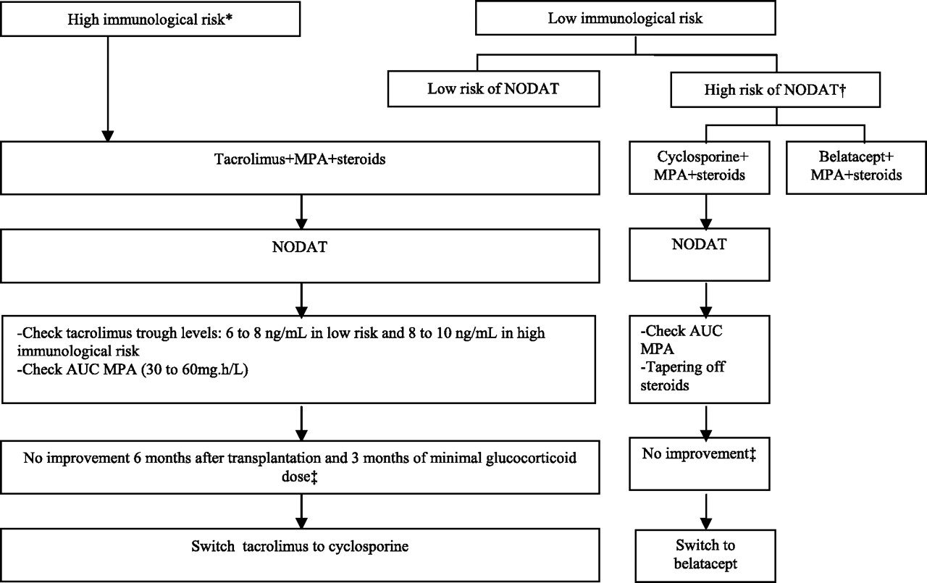
gent.
Notes:
Management of immunosuppression to minimize the risk of developing NODAT and to improve established NODAT. *Third or fourth transplantation, second transplantation if the first was lost <2 years, presence of anti-HLA antibodies/high panel-reactive antibody, five to six HLA mismatches. †Age >45 years, black or Hispanic ethnicity, familial history of type 2 diabetes, personal history of gestational diabetes or NODAT, metabolic syndrome, abnormal pretransplant fasting or 2-h postload OGTT plasma glucose, BMI >30 kg/m2, positive hepatitis C serology. ‡NODAT requiring insulin or A1C level >7% with glucose-lowering agent.

Slide 100
Glucose-lowering agents used in kidney transplant patients with NODAT

Slide 102
Conclusions:
This detailed review of hyperglycemia management in PTDM demonstrates that there is a lack of studies addressing hyperglycemia in this population.
There is a significant need for future research studies, particularly using metformin and incretins

Slide 103
THANKS FOR Your ATTENTION

