Slide 1
اصول تجویز و مصرف منطقی متفورمین و گلینیدها
94/10/24 دکتر وهابی

Slide 3
Endocrine effects of insulin

Slide 4
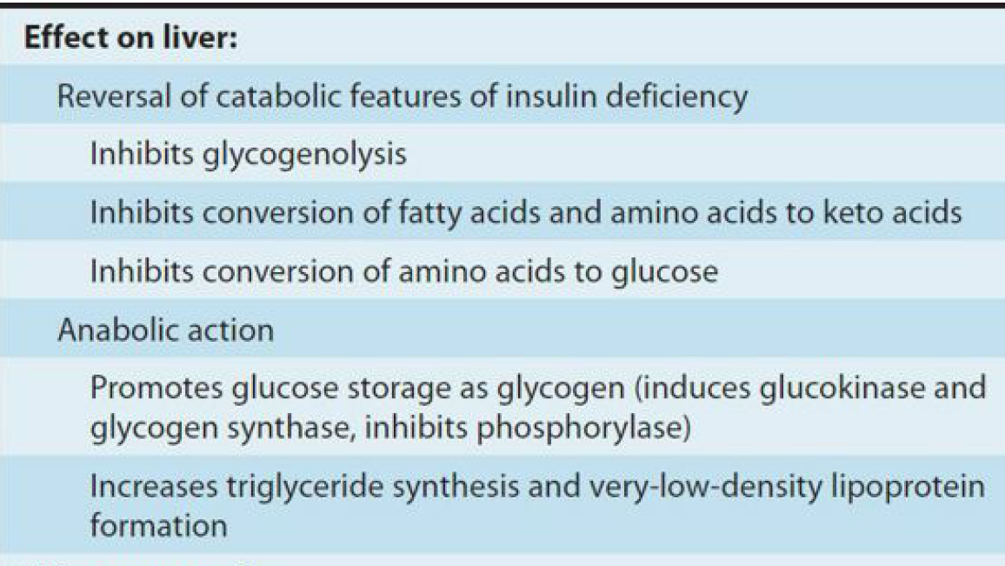

Slide 5
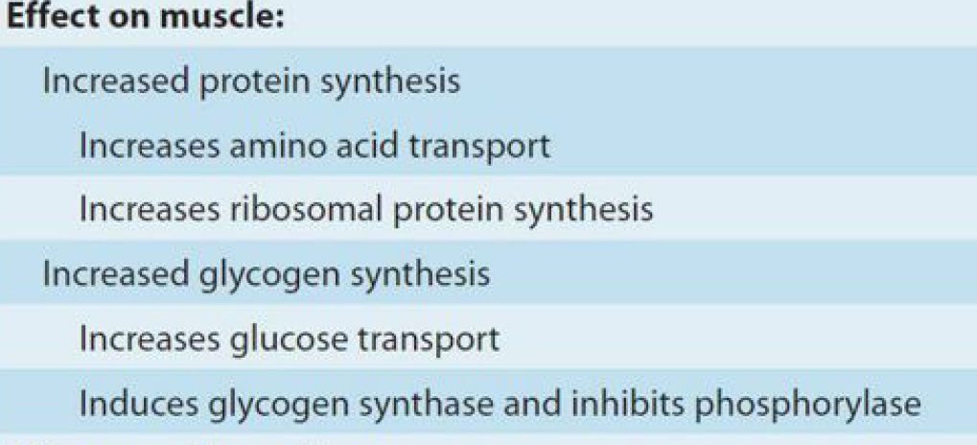

Slide 7
ORAL ANTIDIABETIC AGENTS

Slide 8

Several categories of oral antidiabetic agents are now available for the treatment of persons with type 2 diabetes:
(1) agents that bind to the sulfonylurea receptor and stimulate insulin secretion
(2) agents that lower glucose levels by their actions on liver, muscle, and adipose tissue (biguanides,thiazolidinediones);
(3) agents that principally slow the intestinal absorption of glucose (α-glucosidase inhibitors)
(4) agents that mimic incretin effect or prolong incretin action
(5) agents that inhibit the reabsorption of glucose in the kidney
(6) agents that act by other or ill-defined mechanisms
(pramlintide, bromocriptine, colesevelam).

Slide 9
BIGUANIDES

Slide 10
Metformin is the only biguanide currently available in the United States.

Slide 11
ADA 2016
Metformin, if not contraindicated
and if tolerated, is the preferred
initial pharmacological agent for
type 2 diabetes.

Slide 12

Insulin can be considered a first-line therapy for all patients with type 2 diabetes, presenting with A1C >10 percent, fasting plasma glucose >250 mg/dL (13.9 mmol/L), random glucose consistently >300 mg/dL (16.7 mmol/L), or ketonuria.

Slide 13
Metformin has a longstanding evidence base for efficacy and safety, is inexpensive, and may reduce risk of cardiovascular events and death
ADA 2016

Slide 14

Other effects of metformin
The beneficial effect of metformin on macrovascular complications through mechanisms independent of glycemic control is certainly plausible and is supported by such observations as metformin-associated modest reductions in LDL, triglycerides, blood pressure, and procoagulant factors.

Slide 15
Metformin has lipid-lowering activity, resulting in a decrease in serum triglyceride and free fatty acid concentrations, a small decrease in serum low-density-lipoprotein (LDL) cholesterol concentrations, and a very modest increase in serum high-density-lipoprotein (HDL) cholesterol concentrations
UP TO DATE 2015

Slide 16
CANCER INCIDENCE
Observational data suggest that use of metformin decreases cancer incidence.
In contrast to the observational data, a meta-analysis of randomized trials comparing metformin to a comparator did not show a reduction in cancer incidence.
UP TO DATE 2015

Slide 17
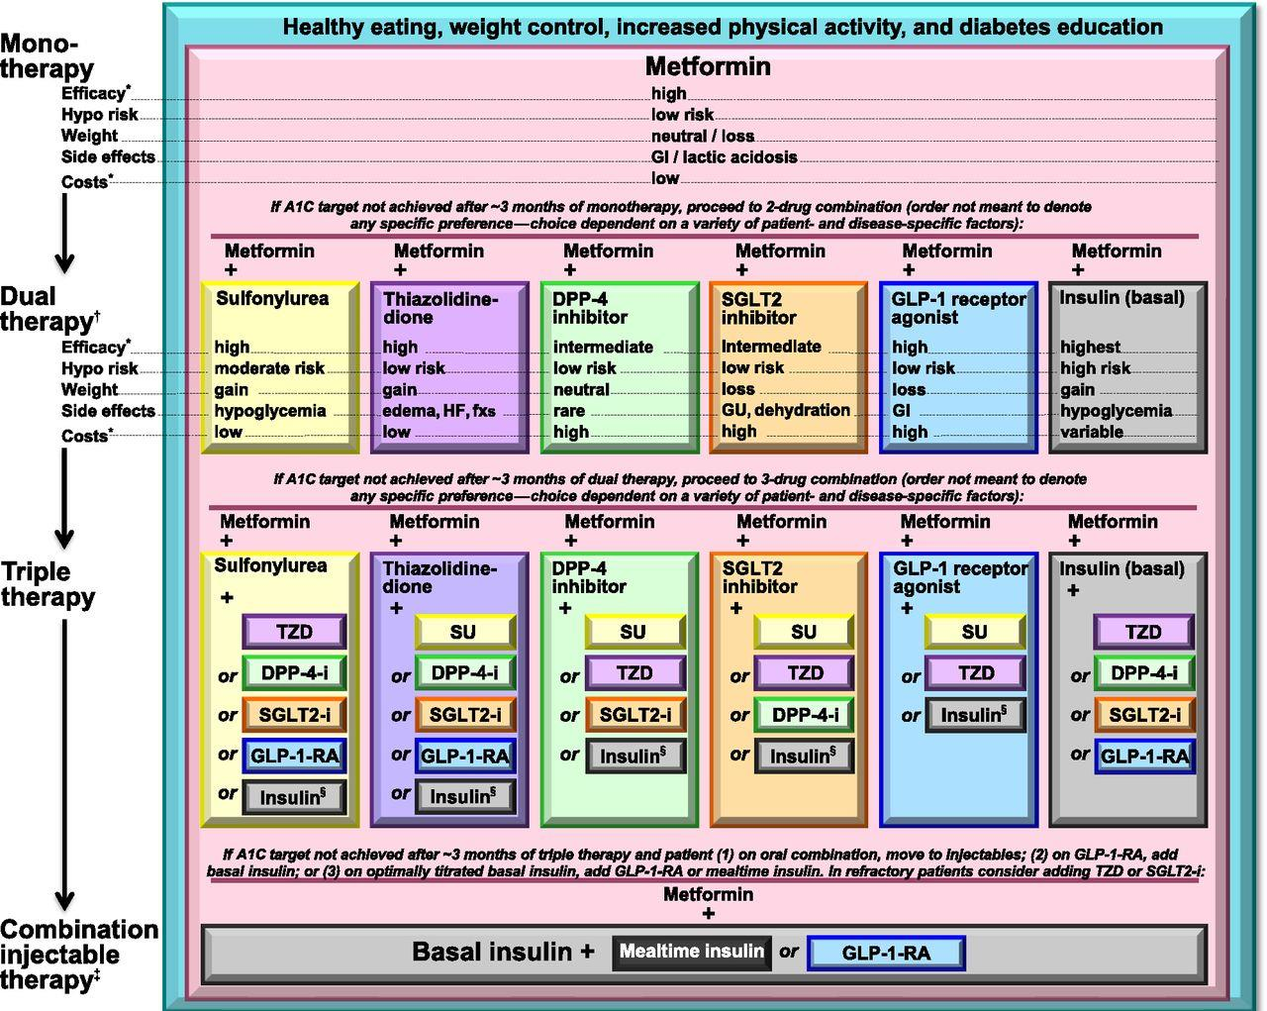
Antihyperglycemic Therapy in
Type 2 Diabetes
American Diabetes Association Standards of Medical Care in Diabetes. Approaches to Glycemic Treatment. Diabetes Care 2016; 39 (Suppl. 1): SX
Notes:
This slide summarizes the general recommendations for antihyperglycemic therapy in type 2 diabetes, as outlined in the ADA-European Association for the Study of Diabetes (EASD) position statement
Definitions: DPP-4-i,DPP-4 inhibitor; Fx’s, bone fractures; GI, gastrointestinal; GLP-1-RA, GLP-1 receptor agonist; HF, heart failure; SU, sulfonylurea; TZD, thiazolidinedione
This 2015 position statement is less prescriptive than prior algorithms and discusses advantages/disadvantages of the available medication classes and considerations for use
A patient-centered approach is stressed, including patient preferences, cost and potential side effects of each class, effects on body weight, and hypoglycemia risk
Metformin is reaffirmed as the preferred initial agent, barring contraindication or intolerance, either in addition to lifestyle counseling and support for weight loss and exercise, or when lifestyle efforts alone have not achieved or maintained glycemic goals
The progressive nature of type 2 diabetes and its therapies should be regularly and objectively explained to patients
Equipping patients with an algorithm for self-titration of insulin doses based on SMBG results improves glycemic control in type 2 diabetic patients initiating insulin³
17
References
American Diabetes Association. Standards of medical care in diabetes—2014. Diabetes Care 2014;37(suppl 1):S25; Figure 2
Inzucchi SE, Bergenstal RM, Buse JB, et al., American Diabetes Association (ADA); European Association for the Study of Diabetes (EASD). Management of hyperglycemia in type 2 diabetes: a patient-centered approach. Position statement of the American Diabetes Association (ADA) and the European Association of the Study of Diabetes (EASD). Diabetes Care 2012;35:1364-1379
Blonde L,MerilainenM, Karwe V, Raskin P; TITRATE Study Group. Patient-directed titration for achieving glycaemic goals using a once-daily basal insulin analogue: an assessment of two different fasting plasma glucose targets the TITRATE study. Diabetes Obes Metab 2009;11:623–631

Slide 18
Mechanisms of Action
Some studies suggest that it activates AMPK, that has been implicated in stimulation of skeletal muscle glucose uptake and inhibition of hepatic gluconeogenesis, whereas more recent studies implicate inhibiting mitochondrial glycerophosphate dehydrogenase as the primary action.

Slide 19
Mechanisms of Action
By inhibiting a specific mitochondrial isoform of glycerophosphate dehydrogenase (mGPD), an enzyme responsible for converting glycerophosphate to dihydroxyacetone phosphate, preventing glycerol from contributing to the gluconeogenic pathway . In addition, inhibition of mGPD leads to accumulation of cytoplasmic NADH and a decrease in the conversion of lactate to pyruvate, limiting lactate contributions to hepatic gluconeogenesis. Excess glycerol and lactate are released into the plasma.
UP TO DATE 2015

Slide 20
Mechanisms of Action
Metformin also activates the enzyme AMP-activated protein kinase (AMPK) in hepatocytes, which appears to be the mechanism by which metformin lowers serum lipid concentrations . AMPK-dependent inhibitory phosphorylation of acetyl-coA carboxylases Acc1 and Acc2 suppresses lipogenesis and lowers cellular fatty acid synthesis in liver and muscle. LKB1 is a tumor suppressor, and activation of AMPK through LKB1 may play a role in inhibiting cell growth .
UP TO DATE 2015

Slide 21
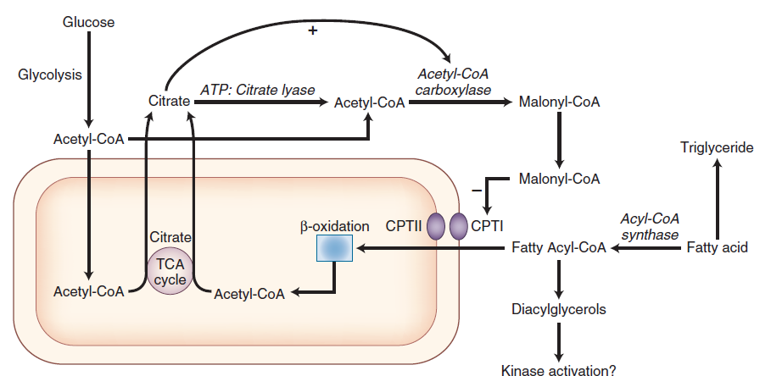

Slide 22
ACTIVITY
The major clinical activity of metformin is to reduce hepatic gluconeogenesis and glucose production. It has more inconsistently improved insulin sensitivity in peripheral tissues

Slide 23

Metabolism & Excretion
Metformin has a half-life of 1.5–3 hours, is not bound to plasma proteins, is not metabolized, and is excreted by the kidneys as the active compound.
As a consequence of metformin’s blockade of gluconeogenesis, the drug may impair the hepatic metabolism of lactic acid.
.

Slide 24
Because of its limited duration of action, it is usually taken at least twice daily, although a sustained-release formulation is available.

Slide 25
As a result of the improvement in glycemic control, serum insulin concentrations decline slightly
UP TO DATE 2015

Slide 26
Adverse events
Because biguanides do not increase insulin levels, they are not associated with a significant risk of hypoglycemia.
UP TO DATE 2015

Slide 27
Adverse events
The most common adverse events are gastrointestinal:
nausea, diarrhea,
crampy abdominal pain,
and dysgeusia

Slide 28
This distress can be minimized by starting with a low dose once
daily with meals and titrating upward slowly (over weeks)

Slide 29
Sustained-release metformin is associated with less frequent and less severe upper gastrointestinal symptoms, the more common of the adverse effects of metformin, but it can increase the frequency of diarrhea, a much less common adverse effect overall

Slide 30
Effect on weight
Perhaps as a result of clinical or subclinical gastrointestinal effects, metformin is associated with less weight gain than other
antihyperglycemic agents, and in some studies it has been associated with a modest weight loss(weight neutral)

Slide 31
TOXICITY
Metformin interferes with the calcium-dependent absorption of vitamin B12-intrinsic factor complex in the terminal ileum, and vitamin B12 deficiency can occur after many years of metformin use.
Increased intake of calcium may prevent the metformin-induced B12 malabsorption
BASIC AND CLINICAL PHARMACOLOGY(KATZUNG)

Slide 32
TOXICITY
Lactic acidosis

Slide 33
Lactic acidosis
Symptoms of lactic acidosis are nonspecific and may include anorexia, nausea, vomiting, abdominal pain, lethargy, hyperventilation, and hypotension

Slide 34
Lactic acidosis
Metformin-induced lactic acidosis can occur in patients with normal renal and hepatic function. One such setting is a purposeful metformin overdose.
In addition, patients with the genetic diabetes syndrome, maternally-inherited diabetes and deafness (MIDD), are at increased risk of developing lactic acidosis with metformin therapy

Slide 35
Lactic acidosis Predisposing factors
hypoperfusion and hypoxemia (, acute or progressive heart failure, acute pulmonary decompensation, sepsis, dehydration)
acute or progressive renal impairment this finding has resulted in the development of standard contraindications to metformin, including a serum creatinine level ≥1.4 mg/dL (124 micromol/L) in women and ≥1.5 mg/dL (133 micromol/L) in men,
heart failure, liver disease, and excessive alcohol intake

Slide 36
HOLD
We prefer to hold metformin in patients who are about to receive intravenous iodinated contrast material (with potential for contrast-induced renal failure) or undergo a surgical procedure (with potential compromise of circulation), irrespective of baseline renal function, until stable renal function can be established.

Slide 37
HOLD
We advise patients to stop taking metformin if they have any illness, such as influenza, upper respiratory infection, or urinary tract infection, until the condition has resolved

Slide 38
RADIOCONTRAST
Radiocontrast administration can cause acute kidney failure in patients with diabetes and incipient nephropathy. Metformin therapy should therefore be temporarily halted on the day of radiocontrast use and restarted a day or two later after confirmation that renal function has not deteriorated.

Slide 39
How supplied?
Metformin is available as 500, 850, or 1000 mg tablets, and should be taken with meals.

Slide 40
prescription
. We begin with 500 mg once daily with the evening meal and, if tolerated, add a second 500 mg dose with breakfast. The dose can be increased slowly (one tablet every one to two weeks) as necessary . The usual effective dose is 1500 to 2000 mg/day per day; the maximum dose of 2550 mg/day (850 mg three times daily) provides only marginally better glycemic control and is often not tolerated due to gastrointestinal side effects

Slide 41
Insulin Secretagogues
Currently available insulin secretagogues all bind to the SUR1, a subunit of the KATP potassium channel on the plasma membrane of pancreatic beta cells.

Slide 42
Insulin Secretagogues
The major differences among the insulin secretagogues seem to be related to duration of action and to subtle variations in hypoglycemic
potential.

Slide 43
Insulin Secretagogues
Sulfonylureas
Glinides

Slide 44
Glinides
Repaglinide
Nateglinide

Slide 45
Repaglinide
Repaglinide is a member of the meglitinide family
of insulin secretagogues, distinct from the sulfonylureas. It
has a short half-life and a distinct SUR1 binding site. As a
result of more rapid absorption, it produces a generally
faster and briefer stimulus to insulin secretion.

Slide 46
Repaglinide
it is typically taken with each meal and provides better postprandial control and generally less hypoglycemia and weight gain than glyburide

Slide 47
Repaglinide
Repaglinide does seem to have
a long residence time on the SUR1 and a prolonged effect on FPG, even though its pharmacologic half-life is quite short.

Slide 48
Repaglinide
Repaglinide is available in 0.5-, 1-, and 2-mg tablets.
The maximum dose is 4 mg with each meal.
As with the sulfonylureas, there is only a modest glucose-
lowering advantage of high doses compared with moderate
doses of repaglinide

Slide 49
Repaglinide
Is principally metabolized by the liver , with less than 10 percent renally excreted. Dose adjustment with this agent do not appear to be necessary in patients with renal insufficiency.
Up To Date 2015

Slide 50
Nateglinide
It is a derivative of phenylalanine and is structurally distinct from both sulfonylureas and the
meglitinides.

Slide 51
Nateglinide
It has a quicker onset and a shorter duration of action than repaglinide.
As a result, its effect in lowering postprandial glucose is quite specific, and it has little effect in lowering FPG (less hypoglycemia,less glucose lowering)

Slide 52
Nateglinide
Nateglinide is most appropriately used when FPG levels are modestly elevated in early diabetes or in combination with
insulin sensitizers or long-acting evening insulin

Slide 53
Nateglinide
It is available as 120-mg tablets and is taken
with each meal .
A 60 mg tablet is available but is not generally
used except in patients with minimal hyperglycemia.

Slide 54
Nateglinide
It is metabolized by liver,with renal excretion of active metabolites . With renal failure,the accumolation of active metabolites and hypoglycemia has occured

Slide 55
Furthermore, these newer agents demonstrate little binding to the vascular
smooth muscle and cardiac SUR2 receptors.

Slide 56
However, the use in the United States of these newer glinide agents has been modest, in part because of the need for multiple daily doses, greater expense than with sulfonylureas, and lack of head-to-head comparative studies that demonstrate superiority over newer sulfonylureas, which are already perceived
as having low potential for producing hypoglycemia
and weight gain.

Slide 57
Adverse effect
Hypoglycemia

Slide 59
Thank you for your attention

