Slide 1


Slide 2
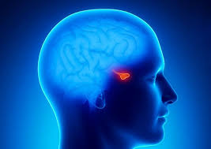
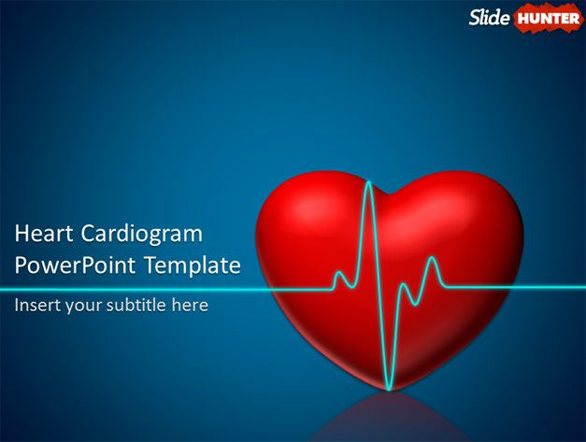
Effect of Somatostatin Analogs on the Cardiovascular System in Acromegaly:
A Metaanalysis

Slide 3
INTRODUCTION
Chronic GH/IGF-1 secretion in patients with acromegaly is associated with a specific cardiomyopathy that is characterized by biventricular hypertrophy, impaired left ventricular ejection fraction (LVEF) response to exercise, and decreased exercise tolerance .
The acromegalic cardiomyopathy develops in three main stages.

Slide 4
acromegalic cardiomyopathy
1-cardiac involvement is asymptomatic, and consists mainly of myocardial hypertrophy.
2- concentric or eccentric cardiomyopathy, diastolic filling abnormalities at rest, and impaired cardiac performance at peak physical exercise are evident.
3-cardiac valve disease and impaired systolic and diastolic performance with a low cardiac output even at rest have been reported.

Slide 8
Rationale for Combining Studies
“Many of the groups…are far too small to allow of any definite opinion being formed at all, having regard to the size of the probable error involved.”
Pearson, 1904

Slide 9
Definition
“Meta-analysis refers to the analysis of analyses…the statistical analysis of a large collection of analysis results from individual studies for the purpose of integrating findings.
Glass, 1976

Slide 10
What is meta analysis?
Quantitative approach for systematically combining results of previous research to arrive at conclusions about the body of research.

Slide 11
Steps of Meta-analysis
Define the Research Question
Perform the literature search
Select the studies
Extract the data
Analyze the data
Report the results

Slide 12
The four elements of a well-formed clinical question
1-Patients
2-Intervention
3-Comparision
4-Outcome

Slide 14
literature search

Slide 15


Slide 16
Identification of relevant trials
I searched the medical literature for reports on the cardiac effects of somatostatin analogs in acromegaly.
I searched three electronic databases, Medline (Ovid), EMBase, and Cochrane from 2006 to May 2016.
I used a combination of the following key words: lanreotide, octreotide, somatostatin analog, ventricular, heart, and acromegaly
The search strategy was not limited by study design

Slide 17
Inclusion criteria

Slide 18
I first included all studies of somatostatin analogs in acromegaly.
The selected publications had to report at least one of the following outcome measures: heart rate (HR), interventricular septum (IVS), left ventricular (LV) posterior wall (LVPW), left ventricular end-diastolic dimension (LVEDD), LV end-systolic diameter (LVESD), LV mass (LVM), LV mass index (per square meter of body surface area) (LVMi), left ventricular ejection fraction (EF) and ratio of early to late mitral diastolic flow (E/A)

Slide 19
Search Strategy in Medline (Ovid)
1 | exp Acromegaly/
2 | "acromegal*".tw.
3 | 1 or 2
4 | exp Octreotide/
5 | Octreotide.tw.
6 | pasireotide.tw.
7 | lanreotide.tw.
8 | Sandostatin LAR Depot.tw.
9 | Sandostatin.tw.
10 | angiopeptin.tw.
11 | Signifor.tw.
12 | Signifor LAR.tw.
13 | Somatuline Depot.tw.
14 | "somatostatin analog* ".tw.
15 | 4 or 5 or 6 or 7 or 8 or 9 or 10 or 11 or 12 or 13 or 14
16 | exp Cardiovascular Diseases/
17 | 3 and 15 and 16
18 | limit 16 to yr="2007 -Current"

Slide 20
Search Strategy in EMBase
#1 | 'acromegaly'/exp
#2 | acromegal*:ab,ti
#3 | #1 OR #2
#4 | 'octreotide'/exp
#5 | 'pasireotide'/exp
#6 | 'angiopeptin'/exp
#7 | 'sandostatin lar depot':ab,ti
#8 | sandostatin:ab,ti
#9 | signifor:ab,ti
#10 | 'signifor lar':ab,ti
#11 | 'somatuline depot':ab,ti
#12 | 'lanreotide':ab,ti
#13 | 'somatostatin analog*':ab,ti
#14 | #4 OR #5 OR #6 OR #7 OR #8 OR #9 OR #10 OR #11 OR #12 OR #13
#15 | 'cardiovascular disease'/exp
#16 | #3 AND #14 AND #15
#17 | #16 AND [embase]/lim
#17 | #16 AND AND [2007-2016]/py

Slide 21
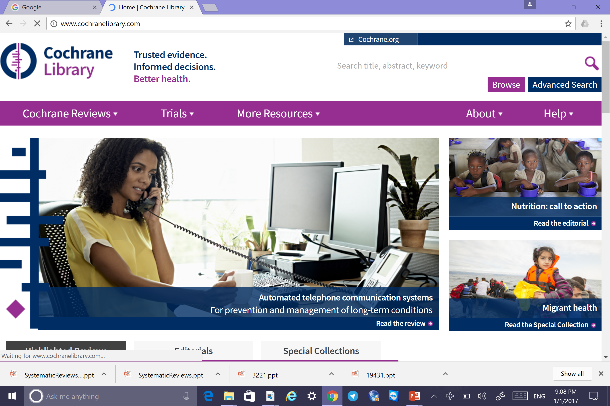

Slide 22
99 patients

Slide 23
45 patients

Slide 24
36 patients

Slide 25
8 patients

Slide 26
56 patients

Slide 27
18 patients

Slide 28
Quality Assessment

Slide 36

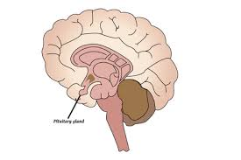
PRISMA 2009 Flow Diagram
Records identified through database searching
(n = 394 )
Additional records identified through other sources
(n = 5 )
Identification
Records after duplicates removed
(n =352 )
Screening
Records screened
(n = 352 )
Records excluded
(n = 238 )
Full-text articles assessed for eligibility
(n = 114 )
Full-text articles excluded,
(n = 101 )
Eligibility
Studies included in qualitative synthesis
(n = 13 )
Included
Studies included in quantitative synthesis (meta-analysis)
(n =11 )

Slide 37
Data extraction

Slide 38
Data were extracted from published reports on to standardized forms by two metaanalysts.
Discrepancies were resolved by discussion among the authors of the present paper.
The following data were extracted: mean age, sex, number of patients included, duration of acromegaly, conventional heart failure therapy, somatostatin analog name, target dose, treatment duration, GH concentration at baseline, IGF-I decline during treatment, study quality (design, blinding, statistical methods), losses to follow-up for each outcome measure.

Slide 39


Slide 40
We explored heterogeneity across studies with the Q test. When the effect size was significant in a fixed model but the Q test was significant, the analyses were repeated with a random-effects model to confirm the result.
Funnel plots were drawn and their asymmetry was measured to assess the possible influence of publication and location biases

Slide 41
REPORT THE RESULTS

Slide 42

THANKS FOR YOUR
ATTENTION

