Slide 1
EFFECT of Somatostatin Analogs on the CARDIOVASCULAR SYSTEM in Acromegaly: A Metaanalysis

Slide 2
Acromegaly is characterized by excessive growth hormone (GH) secretion and is primarily caused by a GH-secreting pituitary adenoma, which stimulates the growth of various tissues and impairs the structures and functioning of the heart and great vessels

Slide 3
Cardiovascular disease is known to be the most important complication of acromegaly, accounting for the increased morbidity and decreased life expectancy of these patients . In the absence of other known cardiac diseases, cardiovascular disease in acromegaly is characterized by acromegalic cardiomyopathy, which was first defined in 1895

Slide 5
The most common feature of acromegalic cardiomyopathy is concentric biventricular hypertrophy , which consists of both structural and functional abnormalities. hypertrophy occurring in 90% of patients with hypertension and long disease durations. cardiovascular disease is the cause of death in 60% of these patients

Slide 8
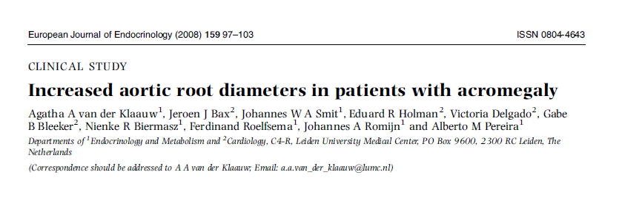

Slide 10
The global prognosis of acromegalic patients with chronic CHF remains poor. In one series, the mortality / transplantation rate was 25% at 1 yr and 37.5% at 5 yr. These rates are very similar to those seen in patients with other causes of systolic heart failure

Slide 11
GUIDELINE

Slide 12
Treatment
Medical therapy
1- We recommend medical therapy in a patient with persistent disease following surgery.
2- In a patient with significant disease (ie, with moderate- to-severe signs and symptoms of GH excess and without local mass effects), we suggest use of either a SRL or pegvisomant as the initial adjuvant medical therapy.
3-We suggest use of an SRL as primary therapy in a patient who cannot be cured by surgery, has extensive cavernous sinus invasion, does not have chiasmal compression, or is a poor surgical candidate.

Slide 13
Octreotide and lanreotide are somatostatin analogues, which are the medical therapy of choice; they are efficacious, have good patient compliance and are well tolerated. These somatostatin analogues are the most commonly-used adjuvant medical therapy in those patients for whom surgery does not provide a curative solution.

Slide 14
Somatostatin analogues can improve cardiac function through the inhibition of excessive GH and IGF-1 production.
In addition, octreotide and lanreotide may have direct beneficial effects on the cardiovascular system by acting through somatostatin receptors on cardiac cells.

Slide 15
Somatostatin receptor subtypes sst1,2,4 and sst5 are co-expressed in human arterial and ventricular tissue; cardiac fibroblasts express all four of these somatostatin receptor subtypes and cardiac myocytes express sst1 and sst2

Slide 16
Octreotide and lanreotide are active at sst2 and sst5 and, therefore, may mediate effects on both cell types. Octreotide and lanreotide treatments have all been reported to improve acromegalic cardiomyopathy. However, a recent metaanalysis demonstrated that there is more evidence for beneficial cardiac effects with octreotide than with lanreotide

Slide 17
CV Effects
1-significant reduction in LV mass
2-improve diastolic filling
3-increase exercise-induced change in LVEF
4-decrease ECG abnormality
5-Increase exercise capacity
6-decrease SVT & VT

Slide 18
However, most studies involving somatostatin analogs involved small numbers of patients, raising the possibility that nonsignificant results were related to inadequate statistical power. Therefore Maison et al , conducted a metaanalysis to obtain a more accurate picture of the impact of somatostatin analogs on the heart in patients with acromegaly.(2007)

Slide 21
In conclusion, this metaanalysis confirms that somatostatin analog treatment targeting stringent control of GH/IGF-I concentrations has a significant positive effect on LVM, LVPW thickness, LVEDD, E/A, and EF (as assessed by echocardiography), and on exercise duration, in patients with acromegaly.

Slide 22
Most parameters differed widely among the studies, possibly owing to differences in patient populations. Nevertheless, our analysis supports differences in the treatment effects according to age and the degree of hypertrophy . Larger trials or metaanalysis of individual data is needed to explore these sources of variability and their interactions.

Slide 24
36 patients

Slide 25
8 patients

