Slide 2
Diagnostic tests of cushing syndrome
بسم الله الرحمن الرحیم
Dr. A. R. Goharian
Endocrinologist

Slide 3
Investigation of Patients With Suspected Cushing Syndrome
There are two stages in the investigation of suspected Cushing syndrome:
(1) Does this patient have Cushing syndrome ?
And
(2) If the answer is “yes,” what is the cause?

Slide 5
Confirmatory tests

Slide 6
Because the circadian rhythm is lost in patients with Cushing syndrome
We know that :
a midnight cortisol level greater than 200 nmol/L
(>7.5 μg/dL) indicates Cushing syndrome.

Slide 7
false-positive results
However, various factors such as :
- stress of venipuncture,
- intercurrent illness, and
- admission to hospital may lead to false-positive results.
Conversely, if a serum cortisol value is less than 50 nmol/L
(1.87 µg/dl ) at midnight, Cushing syndrome is excluded at
that time.

Slide 8
Salivary Cortisol
CBG is absent from saliva , and the use of salivary
cortisol measurements offers a sensible alternative
in that the test does not require hospitalization.

Slide 9
Read GF, Walker RF, Wilson DW, Griffiths K 1990 Steroid analysis in saliva for the assessment of endocrine function. Ann NY Acad Sci 595:260–274
Biologically active free cortisol in the blood is in equilibrium with cortisol in the saliva, and the concentration of salivary cortisol does not appear to be affected by the rate of saliva production.
Furthermore, an increase in blood cortisol is reflected by a change in the salivary cortisol concentration within a few minutes .

Slide 10
60. Laudat MH, Cerdas S, Fournier C, Guiban D, Guilhaume B, Luton JP 1988 Salivary cortisol measurement: a practical approach to assess pituitary-adrenal function. J Clin Endocrinol Metab 66:343–348 61. Luthold WW, Marcondes JA, Wajchenberg BL 1985 Salivary cortisol for the evaluation of Cushing’s syndrome.Clin Chim Acta 151:33–39 62. Papanicolaou DA, Mullen N, Kyrou I, Nieman LK 2002 Nighttime salivary cortisol: a useful test for the diagnosis of Cushing’s syndrome. J Clin Endocrinol Metab 87:4515–4521 63. Putignano P, Toja P, Dubini A, Pecori Giraldi F, Corsello SM, Cavagnini F 2003 Midnight salivary cortisol versus urinary free and midnight serum cortisol as screening tests for Cushing’s syndrome. J Clin Endocrinol Metab 88:4153–4157 64. Raff H, Raff JL, Findling JW 1998 Late-night salivary cortisol as a screening test for Cushing’s syndrome. J Clin Endocrinol Metab 83:2681–2686
Various methods have been used to measure cortisol in the saliva, resulting in different reference ranges and yielding differences in sensitivity and specificity .

Slide 11
Baid SK, Sinaii N, Wade M, Rubino D, Nieman LK 2007 Radioimmunoassay and tandem mass spectrometry measurement of bedtime salivary cortisol levels: a comparison of assays to establish hypercortisolism. J Clin Endocrinol Metab 92:3102–3107
The best-validated assays used in the United States to measure salivary cortisol are an ELISA and an assay performed by LC-MS/MS .
When these two assay techniques are used, normal subjects usually have salivary cortisol levels at bedtime, or between 2300 and 2400 h, of less than
145 ng/dl (4 nmol/liter).

Slide 12
Baid SK, Sinaii N, Wade M, Rubino D, Nieman LK 2007 Radioimmunoassay and tandem mass spectrometry measurement of bedtime salivary cortisol levels: a comparison of assays to establish hypercortisolism. J Clin Endocrinol Metab 92:3102–3107
Baid et al. measured bedtime salivary cortisol levels in a large number of obese subjects and found a specificity of only 85% when they used a RIA technique,
but a better specificity of 92% when tandem mass spectrometry was used.

Slide 13
64. Raff H, Raff JL, Findling JW 1998 Late-night salivary cortisol as a screening test for Cushing’s syndrome. J Clin Endocrinol Metab 83:2681–2686. 65. Trilck M, Flitsch J, Ludecke DK, Jung R, Petersenn S 2005 Salivary cortisol measurement—a reliable method for the diagnosis of Cushing’s syndrome. Exp Clin Endocrinol Diabetes 113:225–230 . 66. Viardot A, Huber P, Puder JJ, Zulewski H, Keller U,Muller B 2005 Reproducibility of nighttime salivary cortisol and its use in the diagnosis of hypercortisolism compared with urinary free cortisol and overnight dexamethasone suppression test. J Clin Endocrinol Metab 90:5730–5736 . 67. Yaneva M, Mosnier-Pudar H, Dugue MA, Grabar S, Fulla Y, Bertagna X 2004 Midnight salivary cortisol for the initial diagnosis of Cushing’s syndrome of various causes. J Clin Endocrinol Metab 89:3345 – 3351 .
Using a variety of assays and diagnostic criteria, investigators from different countries have reported that late-night salivary cortisol levels yield a 92–100% sensitivity and a 93–100% specificity for the diagnosis of Cushing’s syndrome .

Slide 14
Elamin MB, Murad MH, Mullan R, erickson D, Harris K, Nadeem S, Ennis R, Erwin PJ, Montori VM 2008 Accuracy of diagnostic tests for Cushing syndrome: a systematic review and meta-analyses. J Clin Endocrinol Metab 93:1553–1562
Overall, the evidence in adults suggests that the accuracy of salivary test is similar to that of UFC .

Slide 15
Salivery cortisol Martinelli Jr CE, Sader SL, Oliveira EB, Daneluzzi JC, Moreira AC 1999 Salivary cortisol for screening of Cushing’s syndrome in children. Clin Endocrinol (Oxf) 51:67–71 .
This easily performed, noninvasive test has been used in children to differentiate patients with Cushing’s syndrome from those with simple obesity.
Investigators have reported high sensitivity (100%) and specificity (95.2%) for Cushing’s syndrome in this setting.

Slide 16
William's textbook of endocrinology 2016
The cutoff points that define disease vary depending on the assay used.
In one study, a cortisol value greater than 2.0 ng/mL (5.5 nmol/L) had a 100% sensitivity and a 96% specificity for diagnosis of Cushing syndrome.253,256,257

Slide 17
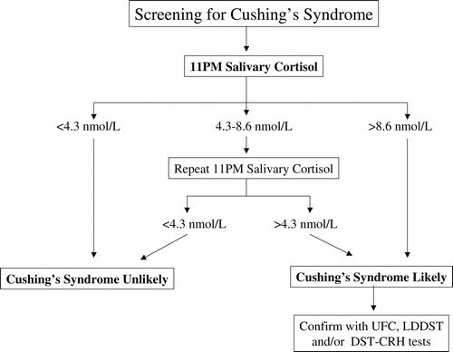

Slide 18
Late-night salivary cortisol
Late-night salivary cortisol has also been shown to be useful to identify patients with pseudo-Cushing’s syndrome, i.e. the presence of the Cushingoid habitus associated with alcohol intake, type 2 diabetes, and major depression (28, 32).
There are several conditions such as hypertension, advanced age, and psychiatric diagnoses that may lead to false-positive late-night salivary cortisol results (33).
However, repeat testing is often normal in these false-positive situations, whereas it is usually not in true endogenous Cushing’s syndrome (29, 33).

Slide 19
It is important to note, however, that late-night salivary cortisol tends to increase with age and cardiovascular comorbid conditions such as hypertension and diabetes, and thus the discriminating power diminishes in the elderly population.258
Shift workers
(Butler PW, Besser GM 1968 Pituitary-adrenal function in severe depressive illness. Lancet 1:1234–1236
Pfohl B, Sherman B, Schlechte J, Stone R 1985 Pituitaryadrenal axis rhythm disturbances in
psychiatric depression. Arch Gen Psychiatry 42:897–903)

Slide 20
Liu H, Bravata DM, Cabaccan J, Raff H, Ryzen E 2005 Elevated late-night salivary cortisol levels in elderly male type 2 diabetic veterans. Clin Endocrinol (Oxf) 63:642–649
In a study of men aged 60 yr or older, Liu et al. reported that 20% of all participants and 40% of diabetic hypertensive subjects had at least one elevated late-night salivary cortisol measurement.

Slide 21
Late-night salivary cortisol
Saliva is collected either by passive drooling into a plastic tube or by placing a cotton pledget (salivette) in the mouth and chewing for 1–2 min.
The sample is stable at room or refrigerator temperature for several weeks and can be mailed to a reference laboratory.

Slide 22
Poll EM, Kreitschmann-Andermahr I, Langejuergen Y,Stanzel S, Gilsbach JM, Gressner A, Yagmur E 2007 Saliva collection method affects predictability of serum cortisol. Clin Chim Acta 382:15–19
When samples were obtained at the same setting, those collected using the salivette device had lower cortisol concentrations than those collected from passive drooling, but they correlated better with total and free serum cortisol levels .

Slide 23
Smith RE, Maguire JA, Stein-Oakley AN, Sasano H,Takahashi K, Fukushima K, Krozowski ZS 1996 Localization of 11&bgr;-hydroxysteroid dehydrogenase type II in human epithelial tissues. J Clin Endocrinol Metab 81:3244–3248
The salivary glands express 11β -hydroxysteroid dehydrogenase type 2 (11β -HSD2), which converts the biologically active cortisol to inactive cortisone .
It is theoretically possible that individuals using licorice or chewing tobacco (both of which contain the 11β-hydroxysteroid dehydrogenase type 2 inhibitor glycyrrhizic acid) may have a falsely elevated late-night salivary cortisol.

Slide 24
Badrick E, Kirschbaum C, Kumari M 2007 The relationship between smoking status and cortisol secretion. J Clin Endocrinol Metab 92:819–824
Patients who smoke cigarettes also have been shown to have higher late night salivary cortisol measurements than do nonsmokers .
Although the duration of this effect is not known, it seems prudent to avoid cigarette smoking on the day of collection.

Slide 25
Direct contamination of the salivette by steroid-containing lotion or oral gels also may result in false-positive results.
Because the test assumes a nadir of cortisol in the late evening, it may not be appropriate for shift workers or those with variable bedtimes, and the timing of the collection should be adjusted to the time of sleeping for those with bedtimes consistently long after midnight.

Slide 26
Kivlighan KT, Granger DA, Schwartz EB, Nelson V,Curran M, Shirtcliff EA 2004 Quantifying blood leakage into the oral mucosa and its effects on the measurement of cortisol, dehydroepiandrosterone, and testosterone in saliva. Horm Behav 46:39–46
Theoretically, contamination with blood might increase salivary cortisol levels.
Although Kivlighan et al. reported that minor to moderate blood leakage as a result of vigorous tooth brushing had no effect on salivary cortisol values, the possible effect of gingivitis or oral sores or injury is not known.

Slide 27
Urinary Free Cortisol Excretion

Slide 28
U.F.C
Normal values depend on the assay used and tend to be lower when analyzed by liquid chromatography and tandem mass spectrometry.
Although in widespread use,urinary free cortisol is less sensitive that salivary cortisol and dexamethasone suppression testing.

Slide 29
U.f.c
Patients should make two or three complete consecutive collections to account for patient error in collecting samples and for episodic cortisol secretion, notably from adrenal adenomas.

Slide 30
William's textbook of endocrinology 2016
Urinary free cortisol is a useful screening test, although it is accepted that the value can be normal in up to 8% to 15% of patients with Cushing syndrome.253,254,259

Slide 31
William's textbook of endocrinology 2016
Variations in U.F.C levels of up to 50% have been observed in patients with proven Cushing disease, reinforcing the need for multiple collections. 260

Slide 32
Cutoff point > 25 nmol/mmol
Measurement of the cortisol-to-creatinine ratio in the first urine specimen passed on waking obviates the need for a timed collection and has been used as a screening test , particularly when cyclic Cushing syndrome is suspected. 261

Slide 33
Low-Dose Overnight Dexamethasone Suppression Tests ( Odst )

Slide 34
William's textbook of endocrinology 2016
The overnight test is a useful outpatient screening test, in which 1 mg of dexamethasone is given at 11 PM.
A normal response is a plasma cortisol level of less than 50 nmol/L (<1.8 μg/dL) between 8 and 9 AM the following morning.
The outpatient overnight test has high sensitivity (95%) but lower specificity, and further investigation is often required.

Slide 35
lddst
In the 48-hour low-dose dexamethasone test, plasma cortisol is measured at 9 AM on day 0 and again 48 hours later, after administration of dexamethasone 0.5 mg every 6 hours for 48 hours. [ D1( 9 – 15 – 21); D2( – 3 – 9 – 15 – 21); D3 – 3 ]
Using a postdexamethasone plasma cortisol concentration of less than 50 nmol/L (<1.8 μg/dL) as the cutoff point, this test is reported to have a 97% to 100% true-positive rate and a
false-positive rate of less than 1%.

Slide 36
false-positive results
Certain drugs (e.g., phenytoin, rifampicin) may increase
the metabolic clearance rate of dexamethasone, leading to
false-positive results of LDDST .

Slide 37
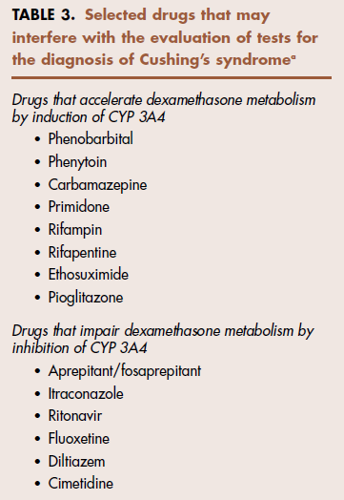

Slide 38
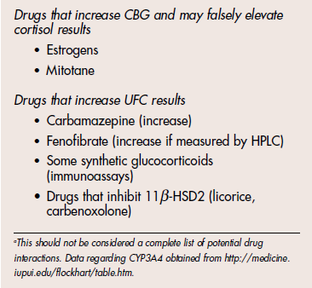

Slide 39
The Endocrine Society , in collaboration with the European Society for Endocrinology
Diagnostic Guidelines

Slide 40
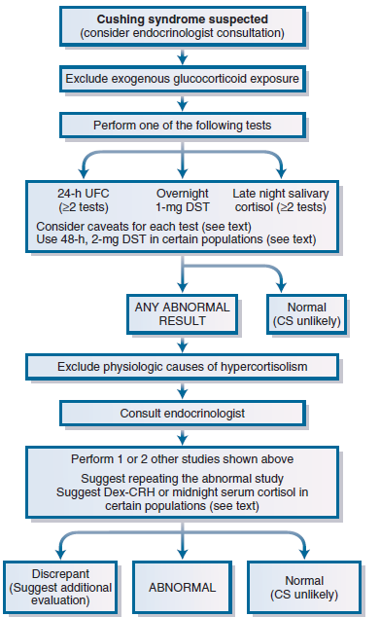
a late night salivary cortisol concentration greater than 145 ng/dL (>4 nmol/L).

Slide 41
Question 2 : What Is the Cause of Cushing Syndrome in This Patient ?
DDX

Slide 42
Morning Plasma ACTH
NO 1

Slide 43
Morning Plasma ACTH
Method : two-site immunoradiometric assay.
Such a test differentiates ACTH-dependent from ACTH-independent causes.
The samples should be taken in ice cold tubes and immediately separated ahead of storage at −40° C ahead of analysis to prevent inadvertent degradation.

Slide 44
Morning Plasma ACTH
In Cushing disease, 50% of patients have a 9 AM ACTH level within the normal reference range (2 to 11 pmol/L [9 to 52 pg/mL]); in the remainder, it is modestly elevated.
Occasionally, due to episodic secretion, levels may be very low, and thus measurement of at least two values is recommended to avoid misclassification of mild Cushing disease as ACTH-independent.

Slide 45
Morning Plasma ACTH
ACTH levels in the ectopic ACTH syndrome are high (usually >20 pmol/L [>90 pg/mL]); nevertheless, overlap values are seen in Cushing disease in 30% of cases. (267)
In patients with adrenal tumors, plasma ACTH is invariably undetectable (<1 pmol/L).
The presence of plasma ACTH levels that are low-normal or intermittently detectable, which may occur in MAH, is problematic.

Slide 46
NO 2. Plasma Potassium
Hypokalemic alkalosis is present in more than 95% of patients with the ectopic ACTH syndrome ,
but in fewer than 10% of those with Cushing disease.
And higher levels of DOC

Slide 47
High-Dose Dexamethasone Suppression Test
In the modern test, the plasma or urinary free cortisol (or both) is measured at 0 and +48 hours, and a greater than 50% suppression of plasma cortisol from the basal value has been used to define a positive response .
Greater suppression is often observed in patients with lower basal cortisol values.

Slide 48
the low-dose dexamethasone suppression test in establishing the diagnosis and differential diagnosis of Cushing’s syndrome. J Clin Endocrinol Metab. 2003;88(11):5299-5306.
Today , logic is in favor of IPSS.
Moreover, if the low-dose dexamethasone suppression test has been used in the diagnosis of Cushing syndrome and a greater than 50% fall in cortisol is observed, there is no added value in the high-dose dexamethasone suppression test.

Slide 49
Corticotropin-Releasing Hormone Test

Slide 50
Corticotropin-Releasing Hormone Test
The test involves the intravenous injection of either ovine or human sequence CRH in a dose of 1 μg/kg body weight or a single dose of 100 μg .
The test can be performed in the morning or afternoon.
After basal sampling, CRH is administered and blood samples for ACTH and cortisol are then taken every 15 minutes for 1 to 2 hours. (261,263,269,270 )

Slide 51
Corticotropin-Releasing Hormone Test
In normal subjects, CRH produces a rise in ACTH and cortisol of 15% to 20%.
This response is exaggerated in Cushing disease, in which typically an ACTH increase greater than 50% and a cortisol rise greater than 20% over baseline values are seen.
has a specificity and a sensitivity of approximately 90% .
False Negative in Cushing Disease : up to 10%

Slide 52
Crh test
However, a positive response defined as an ACTH increase of 100% or a cortisol rise of 50% over baseline values effectively eliminates a diagnosis of ectopic ACTH syndrome .

Slide 53
Inferior Petrosal Sinus Sampling & Selective Venous Catheterization
The most robust test to distinguish Cushing disease from the ectopic ACTH syndrome is IPSS. 177
IPS / Peripheral blood ACTH Concentration Ratio :
- Without CRH Stimulation > 2
- With CRH Stimulation > 3 ( Sensitivity = 95% ;
Specificity # 100% )

Slide 54
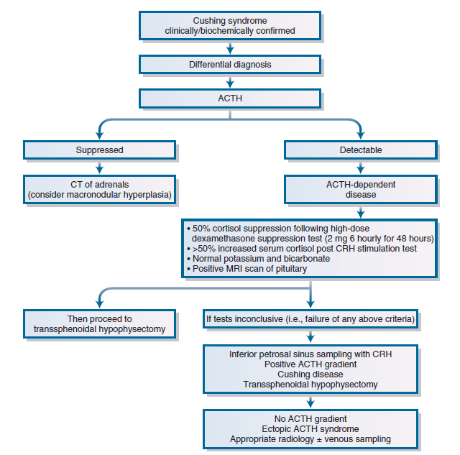

Slide 55
CT/MRI Scanning of Pituitary and Adrenal Glands
Imaging

Slide 56
Pituitary MRI
It is essential that the results of any imaging technique be interpreted alongside the biochemical results if mistakes are to be avoided.
Prevalence of pituitary incidentalomas in general population is # 10 % .
Pituitary MRI is the investigation of choice once the biochemical tests have suggested Cushing disease, with a sensitivity of 60% and specificity of 87%.

Slide 57
با سپاس از توجه شما
خدا قوت

