Slide 2
Diabetes and Ramadan: Practical guidelines

Slide 3
1. Introduction
Fasting during Ramadan is one of the ﬁve pillars of Islam and is obligatory for all healthy adult Muslims.
The timing of Ramadan is based on the lunar calendar (355 days per year), which means that the start of Ramadan varies from year to year. In some parts of the world, daylight can last up to 20 h in the peak of summer. Climate conditions also vary according to the date of Ramadan, with people fasting in very dry and hot weather some years.
Some regions with a high Muslim population, including the Middle East, Africa and South East Asia, are expected to see the number of patients with diabetes more than double in the next 25 years .

Slide 4
The Epidemiology of Diabetes and Ramadan (EPIDIAR) study performed in 2001 found that 42.8% and 78.7% of patients with Type 1 or Type 2 diabetes mellitus (T1DM/T2DM), respectively, fasted for at least 15 days during Ramadan.
More recently, the CREED study reported that 94.2% of T2DM patients fasted for at least 15 days and 63.6% fasted every day .
Sleeping patterns are often altered during Ramadan and several circadian rhythm changes have been noted, including changes in body temperature and cortisol levels.
When fasting, insulin resistance/deﬁciency can lead to excessive glycogen breakdown and increased gluconeogenesis in patients with diabetes, as well as ketogenesis in patients with T1DM.

Slide 5
As a result, the risks facing patients with diabetes, including hypoglycaemia, hyperglycaemia, diabetic ketoacidosis, dehydration and thrombosis, are heightened during ramadan.
Existing recommendations on the management of people with diabetes who fast during Ramadan are mostly based on expert opinion rather than evidence gained from clinical studies. With so many Muslims with diabetes choosing to fast and with the numbers predicted to rise sharply over the coming years, there is an immediate requirement for evidence-based practical management guidelines.
The International Diabetes Federation (IDF) and the Diabetes and Ramadan (DAR) International Alliance have come together to deliver comprehensive guidance on this subject.
The IDF-DAR Practical Guidelines provide HCPs with relevant background information and practical recommendations, allowing them to deliver the best
possible care and support to patients with diabetes during Ramadan, while minimising the risk of complications.

Slide 6
2. Methods
The IDF and DAR International Alliance invited recognised experts in the ﬁeld to develop joint practical guidelines for the management of diabetes during Ramadan.
This panel met on several occasions, and extensive literature searches for studies related to diabetes and Ramadan fasting were conducted. Relevant publications were identiﬁed and results from pertinent clinical studies were used to develop the recommendations outlined in this article.

Slide 7
3. Physiology of Ramadan and fasting and diabetes
As a result of daylight fasting, the time between meals during Ramadan is much longer than at other times of the year, and sleep patterns often change.
The physiological impact of such changes is most marked when Ramadan falls during the longer summer days in countries at higher latitudes.
Typically, sleep is broken before dawn to enable Muslims to eat before fasting begins (suhoor) .
Many will return to sleep afterwards and wake for a second time to start the day, and some may sleep in the afternoon. Following the evening meal (iftar), many Muslims stay awake late into the night.
Although the physiological relevance of these sleep changes is unknown, there is evidence to suggest that glucose intolerance and insulin resistance may be linked to sleep deprivation .

Slide 8
Shifts in cortisol circadian rhythm have been observed during Ramadan fasting [7], which may be partly responsible for the feeling of lethargy felt by some Muslims during Ramadan.
Hunger rating increases progressively during fasting hours and can be intense by iftar time [12]. Interestingly, as Ramadan progresses, this tends to be less severe in women compared with men [12].
Fasting can result in excessive glycogenolysis and gluconeogenesis in individuals with T1DM or T2DM, and increased ketogenesis in those with T1DM .
As a consequence, individuals with diabetes are at increased risk of hypoglycaemia, hyperglycaemia and diabetic ketoacidosis (DKA) .

Slide 9
A continuous glucose monitoring (CGM) study before and during Ramadan found a remarkable stability of blood glucose during fasting hours in healthy subjects, followed by a minimal rise in blood glucose at iftar (Fig. 1A) .
However, major intra- and inter-individual variability in CGM proﬁles were observed in patients with diabetes. A rapid rise in glucose level after iftar was seen (Fig. 1B), most probably due to the carbohydrate-rich foods typically taken at this meal .
Ramadan fasting can be associated with favourable physiological changes among healthy individuals, such as decreased body weight and beneﬁcial changes in lipid proﬁle
The picture is not so clear for individuals with diabetes and the risks posed by the pathophysiology that disrupts normal glucose homeostatic mechanisms need further studies.

Slide 10
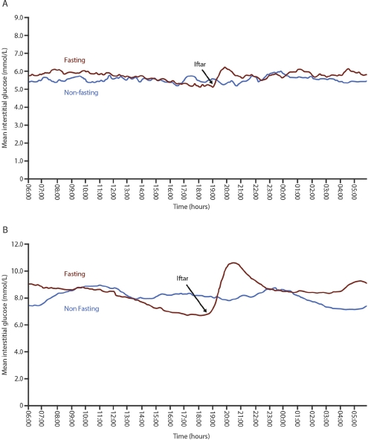
Fig. 1 – Mean continuous glucose monitoring proﬁles before and during Ramadan in healthy subjects (A) and patients with diabetes (B)

Slide 11
4. Risk stratiﬁcation of individual with diabetes during Ramadan
The principal risks for people with diabetes who participate in Ramadan are hypoglycaemia, hyperglycaemia, DKA, dehydration and thrombosis.
The EPIDIAR study recorded higher rates of severe hypoglycaemia in people with T1DM or T2DM during Ramadan compared with before Ramadan (4.7-fold and 7.5-fold increases, respectively) .
Hyperglycaemia incidence increased 5-fold among patients with T2DM .
A study in Pakistan, carried out by Ahmedani et al., found that of the 388 patients with diabetes who chose to fast, symptomatic hypoglycaemia was reported by 35.3% and 23.2% of patients with T1DM and T2DM, respectively, and symptomatic hyperglycaemia by 33.3% and 15.4%, respectively .

Slide 12
Lower ﬁgures were observed in the CREED study, where only 8.8% of patients with T2DM reported a hypoglycaemic event; a majority of these episodes, however, required further assistance or breaking of the fast .
In another study, the rate and duration of hospital admission for DKA during Ramadan and the following month (Shawal) were higher than the average monthly rate over the preceding six months. Many of those with DKA during Ramadan had experienced DKA in the previous few months .
Taking all these risks into account, it is easy to see why religious regulations, as well as medical recommendations, allow exemption from fasting for some people with diabetes .

Slide 13
However, for many such individuals, fasting is a deeply spiritual experience and they will insist on taking part, perhaps unaware of the risks they are taking.
HCPs caring for these patients must be conscious of the potential dangers and should quantify and stratify the risks for every patient individually in order to provide the best possible care.
Safety of fasting is paramount and various elements should be considered when quantifying the risk for such patients, such as type of diabetes, type of medication, presence of comorbidities and personal circumstances .
The 2005 American Diabetes Association (ADA) recommendations for management of diabetes during Ramadan, and its 2010 update, categorised people with diabetes into four risk groups (very high risk, high risk, moderate risk and low risk) .

Slide 14
The CREED study reported that 62.6% of physicians referred to guidelines for the management of fasting and, of these, the majority were using the ADA recommendations .
Surprisingly, the numbers of days fasted by the highest and the lowest risk groups only varied by 3 days, indicating that either these risk categories are not efﬁciently applied by HCPs or people with diabetes.
The IDF-DAR Practical Guidelines propose three categories of risk, based on the most recent available information from science and clinical practice during Ramadan fasting (Table 1).
Importantly, these recommendations have been approved by the Mofty of Egypt, the highest religious regulatory authority in Egypt.
Religious opinion on fasting for each of the three categories is included in the risk stratiﬁcation table (Table 1).

Slide 15
All patients are instructed to follow medical advice and should not fast if the probability of harm is high. It should be noted that this opinion may not reﬂect the religious rulings in all countries, therefore further regional discussions are needed.
Patients who are in the two highest categories of IDF-DAR risk should not fast; however, as previously mentioned, many of these patients will choose to do so.
These patients need to be aware of the risks associated with fasting, and of techniques to decrease this risk.
Those patients stratiﬁed to the moderate/low risk category may be able to fast if both HCP and patient agree, but appropriate advice and support must be provided to ensure safety.

Slide 16
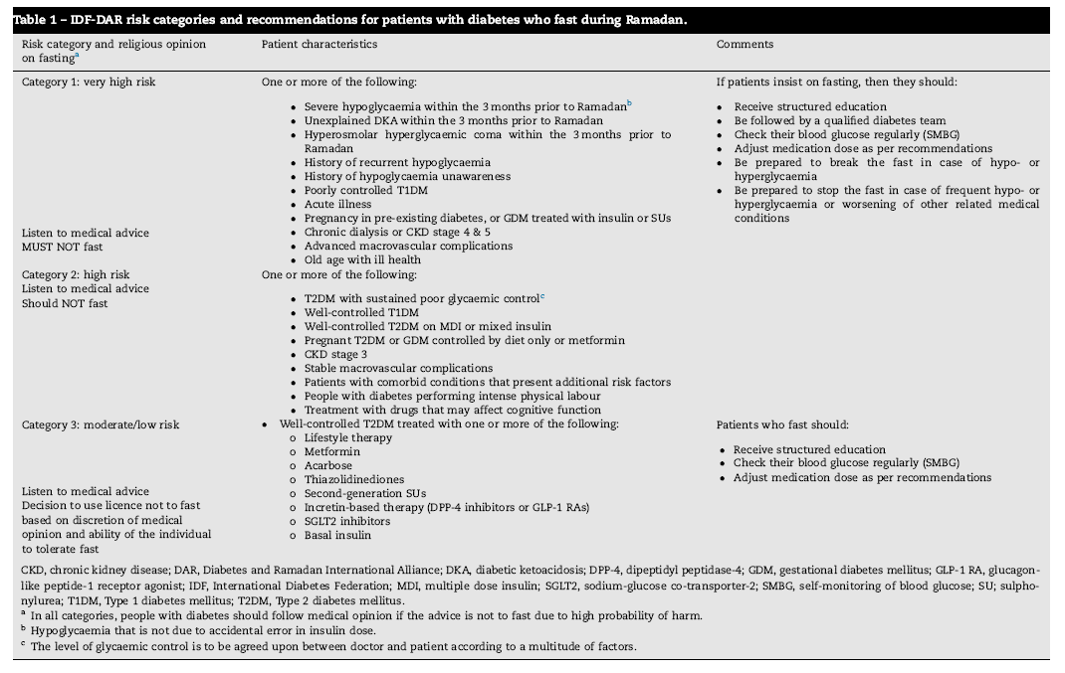

Slide 17
5. Pre-Ramadan education
Ramadan-focused diabetes education is centred around empowering patients with the knowledge to make informed decisions regarding how to manage their condition during Ramadan.
The key components are risk quantiﬁcation, blood glucose monitoring, nutritional advice, exercise advice, medication adjustments and knowing when to break the fast to minimise acute complications.
The Ramadan Education and Awareness in Diabetes (READ) study demonstrated a signiﬁcant decrease in the number of hypoglycaemic events in a group of patients with T2DM that received diabetes education (from nine events pre-Ramadan to just ﬁve during Ramadan) compared with an increase (from nine to 36 events) in a control group that did not receive the educational advice (p < 0.001) .

Slide 18
The impact of an educational programme on the occurrence of diabetes complications during Ramadan was also assessed in the Ramadan Diabetes Prospective study, which revealed a downward trend in symptomatic hypoglycaemic episodes from week 1 to week 4, with only one patient experiencing a severe hypoglycaemic event .
SMBG should be performed multiple times during the day and, most importantly, whenever symptoms of hypoglycaemia or acute illness occur.
Patients should break the fast if blood glucose is <70 mg/dL (3.9 mmol/L) or >300 mg/dL (16.7 mmol/L) and should not fast if they feel unwell .
Low risk patients also need to perform SMBG at the following times: pre-suhoor, midday, pre-iftar and whenever symptoms of hypoglycaemia or acute illness occur .
Dietary recommendations should be individualised and tailored to patients’ lifestyle requirements, age, comorbidities and other medical needs .

Slide 19
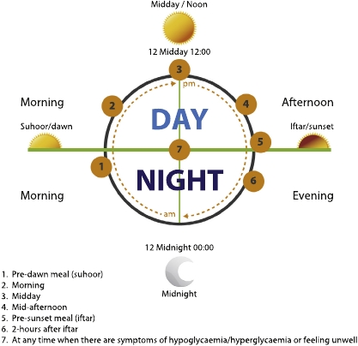
Fig. 2 – Recommended timings to check blood glucose levels during Ramadan fasting.

Slide 20
Accordingly, the DAR International Alliance has developed the Ramadan Nutrition Plan (RNP), a web-based tool designed to help HCPs in delivering patient-speciﬁc medical nutrition therapy (MNT) during Ramadan fasting (http://www.daralliance.org/daralliance/).
Cultural and regional differences can make it challenging for HCPs to deliver individualised patient-applicable dietary advice.
To assist in this regard, the RNP includes meal plans for different countries and in different languages.
This may aid HCPs and patients to plan daily meals with the aim of maintaining body weight if they are lean, or reducing body weight if they are overweight or obese.

Slide 21
6. Diabetes management during Ramadan
All patients with diabetes wishing to fast should have a pre Ramadan assessment with their HCP, ideally 6–8 weeks before the start of Ramadan. This allows enough time to review the patient’s medical history, stratify the risk of fasting and develop a Ramadan management plan.

Slide 22
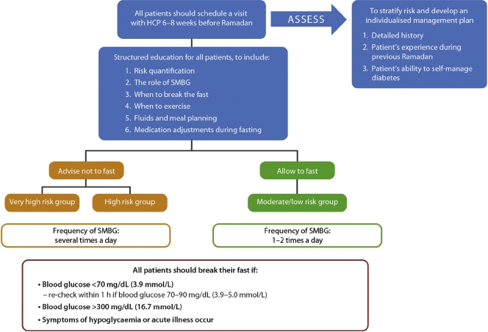
Fig. 3 – Ramadan patient assessment ﬂowchart. HCP, healthcare professional; SMBG, self-monitoring of blood glucose.

Slide 23
6.1. pharmacological management of people with T2DM
A cornerstone of a Ramadan individualised management plan is therapeutic modiﬁcation.
A summary of the recommendations for non-insulin therapies and insulin can be found in Figs. 4 and 5, respectively.
6.1.1. Metformin and a-glucosidase inhibitors (acarbose)
Severe hypoglycaemia in non-fasting patients receiving metformin and/or acarbose is rare.
There are no randomised controlled trials (RCTs) on these agents, however, metformin and/or acarbose use in patients with T2DM during Ramadan is considered safe. No dose modiﬁcation is needed but timings should be changed depending on the frequency of dose (Fig. 4).

Slide 24
6.1.2. Thiazolidinediones (TZD)
Clinical data on pioglitazone use during Ramadan is limited to one study .
This study found that compared with placebo, pioglitazone signiﬁcantly improved glycaemic control during the early, mid- and post-Ramadan periods.
There was no difference in the number of hypoglycaemic events between the two treatment groups, but a signiﬁcant increase in weight of 3.02 kg (p = 0.001) was observed in the pioglitazone group compared with a non-signiﬁcant loss in weight
(–0.46 kg) in the placebo group .
No adjustment to TZD medication is needed during Ramadan and doses can be taken with iftar or suhoor (Fig. 4).

Slide 25
6.1.3. Short-acting insulin secretagogues (meglitinides)
Meglitinides such as repaglinide are usually taken before meals.
In two small observational studies, no hypoglycaemic events were reported in patients treated with repaglinide during Ramadan .
A third study demonstrated no difference in hypoglycaemia when compared with insulin glargine or glimepiride, a sulphonylurea (SU) therapy . Similarly, in two randomised parallel-group trials, a low incidence of hypoglycaemic events was associated with repaglinide treatment during Ramadan, occurring in similar proportions of patients treated with glibenclamide and glimepiride .
The short duration of action and low risk of hypoglycaemia of these agents make them appealing for use in Ramadan. The daily dose (based on a three-meal dosing) may be reduced or redistributed to two doses (taken before iftar and suhoor) during Ramadan, according to meal size (Fig. 4).

Slide 26
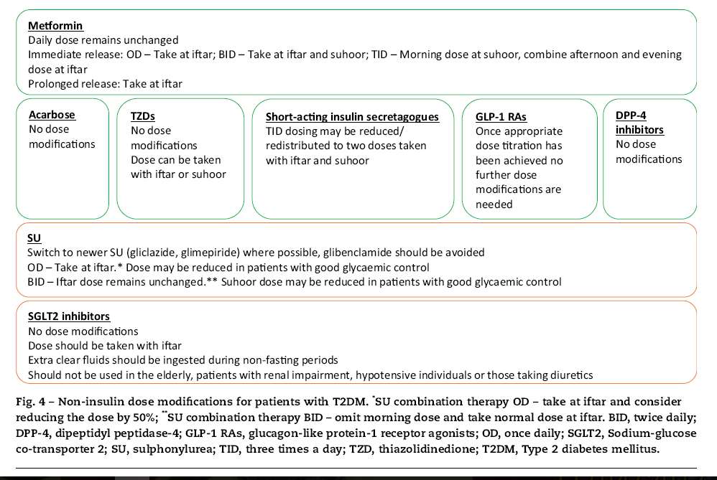

Slide 27
6.1.4. Sulphonylureas (SU)
SUs are associated with a higher risk of hypoglycaemia compared with other oral anti-diabetic drugs (OADs), which has raised some concerns about their use during Ramadan. However, this risk varies across medications within this class due to differing receptor interactions, binding afﬁnities and durations of action.
In a multinational observational study of 1378 patients with T2DM treated with SUs, approximately one-ﬁfth of patients experienced a symptomatic hypoglycaemic event during Ramadan.
When this was broken down by drug, the highest incidence was associated with glibenclamide (25.6%), followed by glimepiride (16.8%), and gliclazide (14.0%) .

Slide 28
Glibenclamide similarly showed the highest incidence of hypoglycaemic events in other studies when compared with second-generation SUs and lowering the dose of glibenclamide did not seem to reduce the incidence of hypoglycaemia.
In some studies, the proportion of patients on gliclazide who experienced symptomatic hypoglycaemic events has been found to be similar to the dipeptidyl peptidase-4 (DPP-4) inhibitors, sitagliptin (6.6% vs. 6.7%, respectively) or vildagliptin (6.0% vs. 8.7%, respectively), and lower than sitagliptin in one study (1.8% vs. 3.8%, respectively) .
The recorded incidence of hypoglycaemia during Ramadan has also been low for glimepiride . Data on glipizide are too sparse to provide speciﬁc advice on its use in Ramadan.
These studies demonstrate that many patients with T2DM may continue to use second-generation SUs and fast safely during Ramadan.
Glibenclamide should be used with caution during Ramadan. The use of these drugs should be individualised following clinician guidance, and medication adjustments are outlined in Fig. 4.

Slide 29
6.1.5. Sodium-glucose co-transporter-2 (SGLT2) inhibitors
SGLT2 inhibitors have demonstrated effective improvements in glycaemic control and weight loss, and are associated with a low risk of hypoglycaemia.
Because of this, these drugs could be a safe treatment option for patients with T2DM during Ramadan.
However, certain safety concerns have been raised, such as an increase in dehydration or postural hypotension as well as the risk of ketoacidosis .
Patients with T2DM were randomised to receive either dapagliﬂozin or to continue with SU therapy. Signiﬁcantly fewer patients in the dapagliﬂozin group reported hypoglycaemia than in the SU arm (6.9% vs. 28.8%, respectively; p = 0.002).
Incidences of postural hypotension were greater in the dapagliﬂozin group but did not reach signiﬁcance , and no increased risk of dehydration was evident with dapagliﬂozin treatment .

Slide 30
Patients deemed more at risk of complications, such as the elderly, patients with renal impairment, hypotensive individuals or those taking diuretics, should not be treated with SGLT2 inhibitors.
Most physicians agreed that SGLT2 inhibitors should be taken with iftar, and the importance of taking on extra ﬂuids during the evening after a fast was highlighted .
Due to the low risk of hypoglycaemia with SGLT2 inhibitors, no dose adjustment is required (Fig. 4).

Slide 31
6.1.6. Dipeptidyl peptidase-4 (DPP-4) inhibitors
four RCTs have examined the effects of switching from SU therapy to either vildagliptin or sitagliptin prior to Ramadan compared with continuing on Sus.
The largest of these studies compared the incidence of self-reported hypoglycaemic events in 1066 patients with T2DM treated with sitagliptin or SUs during Ramadan.
Overall, the risk of hypoglycaemia was signiﬁcantly lower in patients on the sitagliptin-based regimen compared with those continuing with SU treatment (relative risk ratio [95%CI] = 0.51 0.34, 0.75]; p < 0.001) .
The risk of hypoglycaemia between sitagliptin and gliclazide were equal.
In the multinational STEADFAST study, patients with T2DM were randomised to receive either vildagliptin or gliclazide during Ramadan.

Slide 32
No signiﬁcant difference in the reporting of any hypoglycaemic event was observed between the two groups.
However, the proportion of patients experiencing at least one conﬁrmed hypoglycaemic event during Ramadan was lower on vildagliptin compared with gliclazide (3.0% vs. 7.0%, p = 0.039).
A number of observational studies have examined the efﬁcacy and safety of DPP-4 inhibitor treatment during Ramadan .
In the VECTOR study, no self-reported hypoglycaemic events were reported in the vildagliptin group compared with 35 events in 15 patients (41.7%) in the gliclazide arm (including one severe event).
In addition, the change in glycated haemoglobin (HbA1c) from baseline to post Ramadan was signiﬁcantly greater in the vildagliptin group compared with the gliclazide group (p = 0.026) .

Slide 33
The VERDI study compared the incidence of hypoglycaemic events during Ramadan in patients who received vildagliptin or SU/glinide and found no signiﬁcant difference in the number of patients experiencing at least one hypoglycaemic event .
However, the proportion of patients experiencing a severe hypoglycaemic event and/or an unscheduled medical visit due to hypoglycaemia was signiﬁcantly lower in the vildagliptin group (p = 0.029) .
The VIRTUE study, conducted in the Middle East and Asia, is the largest of the observational studies to date and enrolled >1300 patients with T2DM. Like the smaller studies, signiﬁcantly fewer patients treated with a DPP-4 inhibitor (vildagliptin) experienced at least one hypoglycaemic event during Ramadan compared with those on SUs (5.4% vs. 19.8%, p < 0.001).
Patients on vildagliptin also demonstrated signiﬁcantly greater reductions in HbA1c and body weight from baseline compared with those on SUs (both p < 0.001) .

Slide 34
The results of the studies described above indicate that vildagliptin is effective in improving glycaemic control and that both vildagliptin and sitagliptin are associated with low rates of hypoglycaemia during fasting, making them attractive treatment options during Ramadan.
These drugs do not require any treatment modiﬁcations during Ramadan .
Other more recently-approved DPP-4 inhibitors (alogliptin, saxagliptin and linagliptin) have yet to be studied during Ramadan.

Slide 35
6.1.7. Glucagon-like peptide-1 receptor agonists (GLP-1 RAs)
A number of studies on the use of GLP-1 RAs during Ramadan have been published recently.
The TREAT4 Ramadan trial examined the safety and efﬁcacy of liraglutide compared with SU treatment in T2DM patients during Ramadan .
More patients in the liraglutide group achieved the composite endpoint of HbA1c <7%, no weight gain and no severe hypoglycaemia 12 weeks post-Ramadan compared with the SU group (26.7% vs. 10.3%, respectively), but this did not reach statistical signiﬁcance.
The incidence of self-reported hypoglycaemic events was lower in the liraglutide group .
In the open-label LIRA-Ramadan study conducted in several countries in Africa and Asia, patients with T2DM were randomised to switch to liraglutide or continue on SU treatment .

Slide 36
Signiﬁcantly more patients in the liraglutide group reached the composite endpoint (HbA1c <7.0%, no weight gain, no hypoglycaemia) than in the SU group at the end of Ramadan (51.3% vs. 17.7%; p < 0.0001).
Patients in the liraglutide arm also demonstrated better weight control and fewer conﬁrmed hypoglycaemic episodes compared with the SU group .
Adding liraglutide to pre-existing anti-diabetic regimens (including SU and insulin) during Ramadan resulted in 16.2% of patients developing symptoms of hypoglycaemia, but no severe events were recorded .
A small observational study in patients with T2DM treated with exenatide reported no signiﬁcant differences in weight or hypoglycaemic episodes .
These studies demonstrate that liraglutide is safe as an add-on treatment to pre-existing anti-diabetic regimens and can be effective in reducing weight and HbA1c levels during Ramadan.

Slide 37
Data on exenatide is limited to one study but, like liraglutide, the risk of hypoglycaemia during Ramadan is low.
As long as GLP-1 RAs have been appropriately dose-titrated prior to Ramadan (6 weeks before), no further treatment modiﬁcations are required (Fig. 4).
6.1.8. Insulin treatment for T2DM
Insulin use during prolonged fasting carries an increased risk of hypoglycaemia, particularly for those with T1DM but also for those with T2DM.
The use of insulin analogues (basal, prandial and premix) is recommended over regular human insulin due to a number of advantages, including lower rates of hypoglycaemia .
Although a number of small randomised trials and observational studies have been conducted to assess some insulin regimens during Ramadan (Table S1), large RCT data in this area are lacking.

Slide 38
A multinational study reported a signiﬁcant increase in mild hypoglycaemic events during Ramadan compared with the pre-Ramadan period in patients treated with insulin glargine plus glimepiride (p < 0.001) .
Two smaller observational studies found insulin glargine to be safe to use during Ramadan, with no signiﬁcant increases in hypoglycaemia when compared with non-fasting individuals or when compared with those taking OADs .
A comparison of rapid-acting analogue insulin lispro and short-acting soluble human insulin, taken before iftar, revealed that the postprandial rise in blood sugar levels after iftar and the rate of hypoglycaemia were both signiﬁcantly lower in the lispro group (p < 0.01 and p < 0.002, respectively).

Slide 39
A comparison of insulin lispro Mix25 (25% short-acting lispro/75% intermediate-acting lispro protamine) with human insulin 30/70 (30% short-acting soluble human insulin/70% intermediate-acting neutral protamine Hagedorn [NPH]) during Ramadan found that overall glycaemia was signiﬁcantly lower for patients on insulin lispro Mix25 (p = 0.004), with the greatest between-treatment difference evident before and after iftar .
Similarly, in another study insulin lispro Mix50 (50% lispro/50% lispro protamine) in the evening and regular human insulin with NPH (30:70) in the morning improved glycaemic control without increasing the incidence of hypoglycaemic events compared with regular human insulin with NPH (30:70) given twice daily .
A new regimen in which 40% of the daily insulin dose was given as insulin detemir at suhoor and 60% was given as NovoMix70, a biphasic insulin aspart, before iftar has been assessed and was found to be non-inferior to standard care with a signiﬁcantly lower hypoglycaemic event rate.

Slide 40
Another study found that compared with pre-Ramadan baseline levels, biphasic insulin aspart reduced all glycaemic indices following Ramadan without an increase in body weight or risk of hypoglycaemia .
Insulin treatment must be appropriately individualised, and the recommended medication adjustments and SMBG- guided dose titrations can be found in Fig. 5..
If a patient is taking NPH or premixed insulin at suhoor, it is important to check blood glucose at noon before uptitration of the pre-suhoor dose. If noon blood glucose is <110 mg/dL and pre-iftar blood glucose is not at target, long acting insulin analogues are preferred.
It is important to note that many patients may be on multiple therapies for diabetes management. The adjustment of each drug is stated above. For those on insulin and SU, a decision on the need to reduce doses of both agents, or to start with insulin only, is required based on individual assessment.

Slide 41
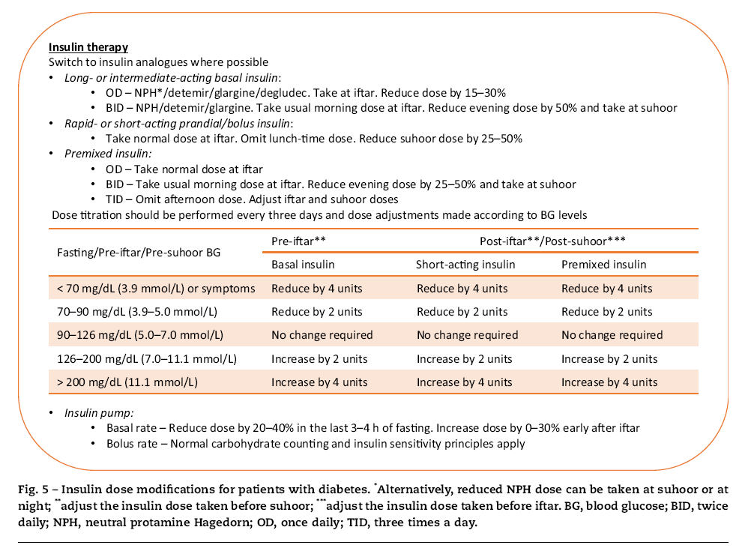

Slide 42
6.2. Pharmacological management of high risk populations
6.2.1. Adults with T1DM
People with T1DM who fast can develop serious health problems
. Indeed, religious leaders, in uniﬁcation with many diabetes experts, do not recommend fasting in individuals with T1DM, and such patients are categorised as very high risk. In general, patients with T1DM who have any of the following conditions must not fast
History of recurrent hypoglycaemia.
Hypoglycaemia unawareness.
Poor diabetes control.
Brittle diabetes.
Non-compliance with medical treatment.
Patients who are ‘unwilling’ or ‘unable’ to monitor and
manage their blood glucose levels.

Slide 43
Those who insist on fasting must be aware of all the potential risks associated with fasting and must have close medical supervision .
A Ramadan study using CGM found that some patients experienced signiﬁcant periods of hypoglycaemia while fasting, without being aware of the problem .
Patients are advised to test their blood glucose levels regularly throughout the fasting period .
Most importantly, glucose levels should be checked at any time when symptoms of hypoglycaemia are recognised .
All patients should comprehend the dangers of low and high blood glucose levels, know when to break the fast, and must not fast if they are unwell .

Slide 44
In a non-Ramadan study, patients with T1DM taking the long-acting insulin, glargine, could fast safely for 18 h with only mild hypoglycaemic episodes reported .
A limited number of studies have shown that some patients with T1DM can tolerate Ramadan fasting.
Two small observational studies reported that patients taking ultralente or insulin lispro could fast without experiencing severe hypoglycaemic episodes .
More recent studies in patients using insulin pumps reported no cases of severe hypoglycaemia, although some episodes of hypoglycaemia required the fast to be broken and adjustments to the basal rate were needed .
If patients with T1DM insist on fasting, then the recommended adjustments to insulin medication and/or dosing regimen during Ramadan are outlined in Fig. 5.

Slide 45
6.2.2. Young adults/adolescents with T1DM
Once a child reaches puberty he/she is expected to fast during Ramadan.
There have been a number of studies, albeit with a limited number of patients, that have investigated fasting in adolescents with T1DM.
No severe hypoglycaemic episodes have been observed, but signiﬁcant periods of hypoglycaemia during fasting hours have gone unnoticed by the paitent.
The general consensus is that fasting should be avoided due to the observation of unrecognised hypoglycaemia.
However, those patients who insist on fasting need to have good hypoglycaemia awareness, good glycaemic control pre-Ramadan, have the knowledge and willingness to test their blood glucose levels, be able to adjust medication as needed and be carefully supervised by an expert physician.

Slide 46
As with adults, adolescents with T1DM who fast (and their parents) must be aware of all potential risks associated with Ramadan fasting.
Frequent SMBG, knowing when to break the fast, and avoiding fasting on ‘sick days’ are all essential to avoid complications .
Children and adolescents on a conventional twice a day regimen should take their usual morning dose before iftar and short-acting insulin at suhoor.
Adolescents on multiple daily injections should take long/intermediate acting insulin at iftar but reduce the dose by 30–40%, and take a normal dose of short-acting insulin at iftar but reduce suhoor dose by 25–50%. For those using insulin pumps, the changes to dose are the same as those for adults .

Slide 47
6.2.3. Pregnant women
All pregnant women have the option not to fast if they are worried about either their health or that of their foetus.
Many do decide to participate as they feel guilty if they do not .
In fact, evidence from some countries indicates that 70–90% of pregnant women observe the fast although surveys suggest that they may not manage the full month .
Some studies in healthy pregnant women, without diabetes, have shown no harmful effects of fasting on baby or mother although other studies have reported some negative outcomes .

Slide 48
Pregnant women with hyperglycaemia (gestational diabetes mellitus [GDM] or pre-existing diabetes) are stratiﬁed as very high risk and are advised against fasting during pregnancy .
However, fasting in Ramadan is a personal decision, and a practical approach would be to explain the potential effects on mother and foetus, thereby empowering women with knowledge and education regarding self-management skills for good pregnancy outcomes.

Slide 49
Women with GDM who are well-controlled pre-Ramadan on diet or metformin are at low risk of hypoglycaemia, however they must ensure that they are achieving post-prandial glucose targets, which is a difﬁcult task after a prolonged fast.
Patients on SU therapy and/or insulin should be strongly advised against fasting due to the higher risk of hypoglycaemia.
Modiﬁcations to diet and insulin regimens such as those outlined for patients with T1DM will be required in conjunction with frequent SMBG, focused education and strict medical supervision by an expert team .

Slide 50
7. Conclusions
With so many Muslims with diabetes choosing to fast during Ramadan, potentially in some, against medical advice, there is an immediate need for practical management guidelines that enable HCPs to offer the most up-to-date information, advise patients if fasting should not be undertaken, and support those that do fast
A pre-Ramadan assessment is vital for any patient with diabetes who intends to fast in order to evaluate the risks, educate the patient in self-management of the condition during Ramadan and to produce a patient-speciﬁc treatment plan describing any medication adjustments needed.

Slide 51
Ramadan-focused education and a better knowledge of nutrition during Ramadan are essential elements for safer fasting during Ramadan.
The IDF-DAR Practical Guidelines propose three categories of risk, with patients stratiﬁed to the very high or high risk groups being advised not to fast.
With the correct advice and support from HCPs, many people with T2DM may be able to fast safely during Ramadan.
Patients taking metformin, SUs or insulin will need to make adjustments to dose and/or timings to reduce the risk of complications.
Newer anti-glycaemic medications, including incretin based therapies, are associated with a lower risk of hypoglycaemia and may be preferable for use during Ramadan.

Slide 52
Patients classiﬁed as very high or high risk, including those with T1DM and pregnant women with diabetes, need close medical supervision if they insist on Ramadan fasting.
The implementation of these guidelines will require the involvement of religious leaders in community alongside HCPs, to ensure that patients receive advice combining religious and medical directives.
The IDF-DAR Practical Guidelines have been approved by the Mofty of Egypt but religious opinions in other countries may differ, therefore further regional discussions are warranted.

