Slide 1
IN THE NAME OF GOD
IN THE NAME OF GOD

Slide 2
DPP-4 inhibitors
By Dr Karimifar
Assistant Prof. of Endocrinology
Isfahan University of Medical Sciences

Slide 3
Incretin
The incretins identified in the 1930s
IN”testin, se“CRET”ion, and “IN”sulin

Slide 4
Incretins
The incretins identified in the 1930s were associated with intestinal synthesis of hormones similar to insulin and were, thus, responsible for the introduction of this term, which was originated from the junction of fragments of the words “IN”testin, se“CRET”ion, and “IN”sulin. Basically, an incretin describes a factor that reduces blood glucose levels without affecting exocrine pancreatic secretion.

Slide 5
In 1964
Mcintyre et al. were the first to demonstrate the “incretin effect” in 1964, by observing that oral administration of glucose caused a greater increase in insulin secretion than the same amount of glucos administered intravenously, despite the higher blood glucose levels registered by the intravenous route.

Slide 6
The Incretin Effect Demonstrates the Response to Oral vs IV Glucose
Oral Glucose
IV Glucose
11
2.0
*
1.5
*
*
*
Incretin Effect
*
5.5
C-peptide (nmol/L)
*
Venous Plasma Glucose (mmol/L)
1.0
*
0.5
0
0.0
0₁
0₂
60
120
180
0₁
0₂
60
120
180
Time (min)
Time (min)
Mean ± SE; N = 6; *p≤.05; 0₁-0₂ = glucose infusion time.
Nauck MA, et al. Incretin effects of increasing glucose loads in man calculated from venous insulin and C-peptide responses. J Clin Endocrinol Metab. 1986;63:492-498. Copyright 1986, The Endocrine Society.
Notes:
DISCUSSION
The incretin effect is essentially the difference in β-cell response between administration of oral glucose and intravenous (IV) glucose
There is a sharp difference between the insulin response to oral glucose (as measured by C-peptide, a surrogate marker for insulin) compared with the insulin response to IV glucose. That difference, or effect, is the incretin effect, which is shown on the right graph by the shaded area.
There is little difference between the venous plasma glucose profiles over time in response to oral glucose compared with the response to IV glucose
BACKGROUND
This was a crossover study involving healthy subjects
Six young healthy subjects were given a 25, 50, or 100 g oral glucose load or isoglycaemic intravenous glucose infusions. The 50 g data is shown above.
C-peptide may be a better measure of insulin secretion than plasma insulin, because C-peptide levels are not affected by hepatic insulin extraction
This difference in C-peptide levels in response to oral vs intravenous glucose suggests that other factors (incretins), and not merely the direct actions of plasma glucose, affect the insulin secretory response

Slide 7
GLP1 and GIP
In humans, this effect seems to be primarily mediated by GLP1 and GIP(Glucose-dependent insulinotropic polypeptide) . GLP1 is produced from the proglucagon gene in intestinal L cells and is secreted in response to nutrients.

Slide 8
GIP and GLP-1
Both incretins are secreted in the intestinal mucosa;
GIP is secreted from the K-cells (enterochromaffin cells) located mainly in the
stomach,
duodenal mucosa
proximal jejunum
whereas L-cells produce GLP-1 and are located
more distally in the ileum and colon .
Within minutes of nutrient ingestion, both incretins (GIP and GLP-1) are released into the bloodstream and stimulate insulin secretion.

Slide 9
Gastroenteropancreatic endocrine cells
Substance | Cell type | Location
Secretin | S cells | Small intestine
Ghrelin | P/D1 | Stomach
Gastrin | G cells | Gastric antrum
 |  | Duodenum
Cholecystokinin | I cells | Small intestine
Glucagon | α cells | Pancreas
Insulin | β cells | Pancreas
Pancreatic polypeptide | PP cells | Pancreas
Somatostatin | δ cells | Pancreas
 |  | Stomach
 |  | Small and large intestine
Glucose-dependent insulinotropic peptide | K cells | Small intestine
Motilin | Mo cells | Small intestine
Histamine | ECL cells | Stomach
Peptide YY | L cells | Small and large intestine
Glucagon-like peptide | L cells | Small and large intestine
PP: pancreatic polypeptide; ECL: enterochromaffin-like. UP

Slide 10
Gastrointestinal peptide families
Family | Members
Secretin-glucagon family | Secretin
 | Glucagon
 | Vasoactive intestinal polypeptide
 | Glucagon-like peptides (GLP-1 and GLP-2)
 | Peptide histidine-isoleucine (PHI)
 | Glucose-dependent insulinotrophic polypeptide (also called gastric inhibitory polypeptide)
 | Pituitary adenylate cyclase-activating polypeptide (PACAP)
………. | ………

Slide 11
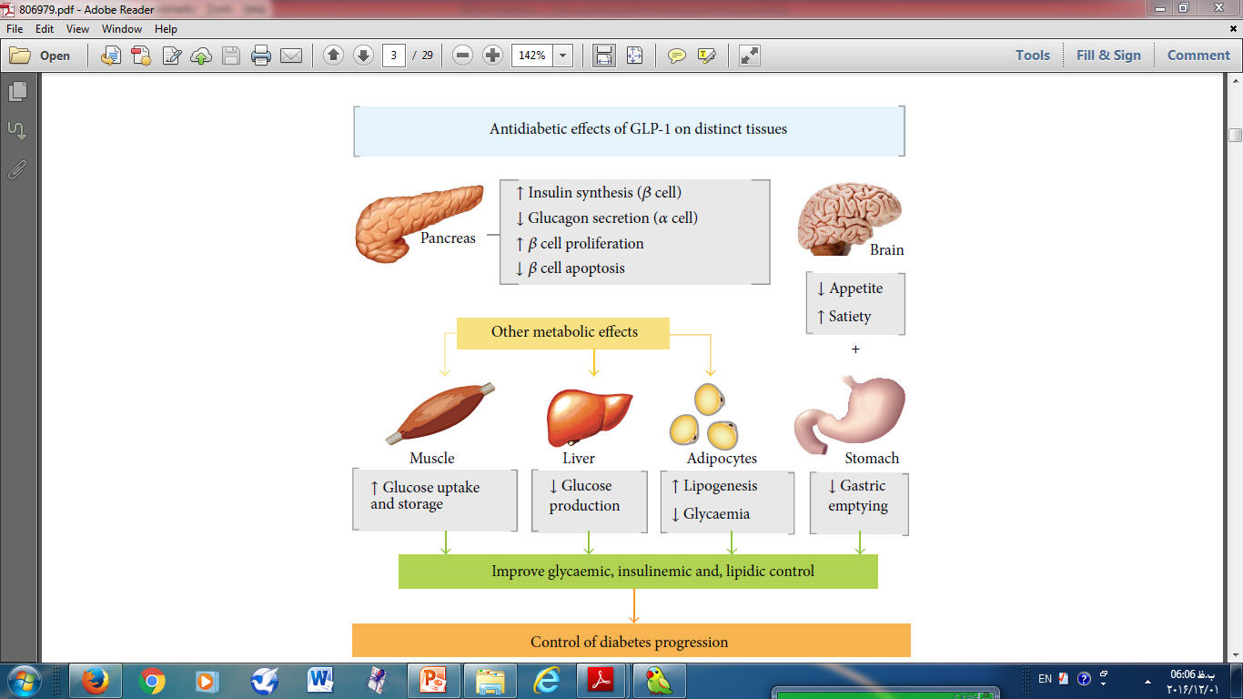

Slide 12
Incretin-Related Therapies
GLP1:
1-Stimulates insulin secretion in a glucose-dependent fashion
2-Inhibits inappropriate hyperglucagonemia
3-Slows gastric emptying
4-Reduces appetite and improves satiety
5-Beta-cell proliferative, antiapoptotic, and differentiation effects at least in vitro and in preclinical models. (Williams)

Slide 13
Incretin-Related Therapies
GLP1 has a very short half-life in plasma (1 to 2 minutes) due to aminoterminal degradation by the enzyme dipeptidyl peptidase IV (DPP4). (Williams)

Slide 14
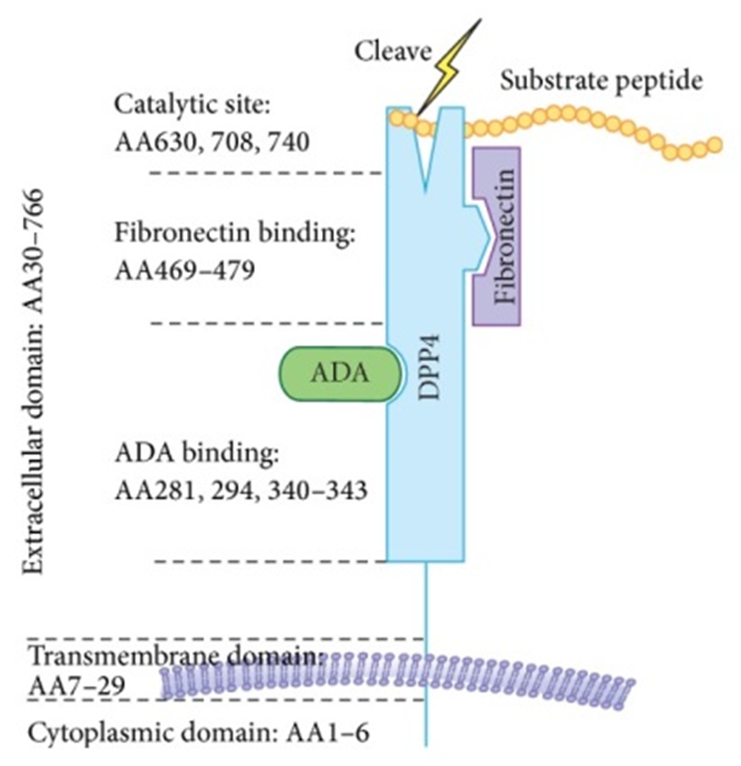
DPP4 molecular structure: DPP4 consists of a 6-aminoacid cytoplasmic tail, a 22-amino-acid transmembrane domain, and a large extracellular domain.The extracellular domain is responsible for the dipeptidyl-peptidase activity and binding to its ligands such as ADA and fibronectin. AA, amino acid; ADA, adenosine deaminase.(R1)

Slide 15
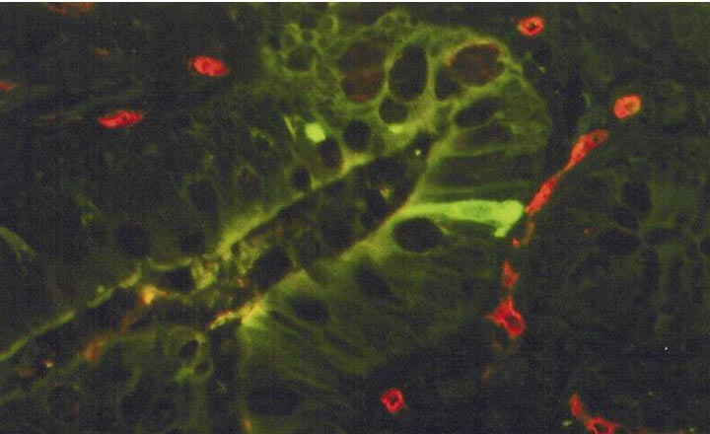
Native GLP-1 is rapidly degraded by DPP-IV
Human ileum,
GLP-1 producing
L-cells
Capillaries,
DPP-IV (Di-Peptidyl
Peptidase-IV)
Double immunohistochemical staining for DPP-IV (red) and GLP-1 (green) in the human ileum
Adapted from: Hansen et al. Endocrinology 1999;140:5356–5363.
Notes:
Native GLP-1 is rapidly degraded by DPP-IV
GLP-1 is stored in intestinal L-cells. As active GLP-1 is secreted from these cells, it is rapidly degraded by the enzyme dipeptidyl peptidase IV (DPP IV) resulting in the inactive, N-terminally truncated form, GLP-1-(9-36)amide. More than 50% of plasma GLP-1 appears to be in this inactive form.
In this slide, immunohistochemical staining shows the very close proximity of active GLP-1 in the L-cells and DPP-IV in the capillaries within the human ileum.
References
Hansen et al. Endocrinology 1999;140:5356–5363

Slide 16
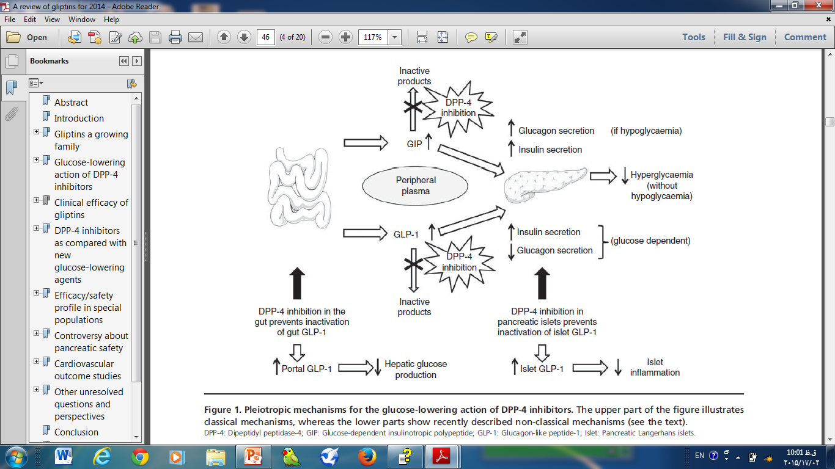

Slide 17

Role of Incretins in Glucose Homeostatis
Ingestion of food
Pancreas
Glucose-dependent insulin from beta cells
(GLP-1, GIP)
Glucose
uptake by
muscles
Release of gut hormones –
Incretins
Beta cells
Alpha cells
Blood
Glucose
Active
GLP-1 & GIP
Glucose dependent glucagon from alpha cells
(GLP-1)
GI tract
DPP-4
enzyme
Glucose
production
by liver
Inactive
GLP-1
Inactive
GIP
DPP-4=dipeptidyl peptidase–4
GIP=glucose-dependent insulinotropic peptide
GLP-1=glucagon-like peptide–1
Notes:
Role of Incretins in Glucose Homeostasis
This slide summarizes the effect of incretins in glucose regulation. Although glucagon-like peptide–1 (GLP-1) is a native hormone released by intestinal L cells in response to ingested food, its limitations in managing the progressively challenging glucose homeostasis of type 2 diabetes are related to its rapid and extensive inactivation. Deacon and colleagues found that GLP-1 was quickly cleaved at its N-terminus by dipeptidyl peptidase–4 (DPP-4), an enzyme that circulates freely in plasma and exists at the surface of endothelial cells. Under normal conditions, GLP-1 has a half-life of only 1 to 2 minutes. Therefore, to correct this system, one needs to either administer GLP-1 in a continuous manner or inhibit the DPP-4 enzyme.
Reference:
Kieffer TJ, McIntosh CH, Pederson RA. Degradation of glucose-dependent insulinotropic polypeptide and truncated glucagon-like peptide 1 in vitro and in vivo by dipeptidyl peptidase IV. Endocrinology. 1995;136:3585-3596.
http://www.ncbi.nlm.nih.gov/entrez/query.fcgi?db=pubmed&cmd=Retrieve&dopt=AbstractPlus&list_uids=7628397
Ahrén B. Gut peptides and type 2 diabetes mellitus treatment. Curr Diab Rep. 2003;3:365-372.
http://www.ncbi.nlm.nih.gov/entrez/query.fcgi?db=pubmed&cmd=Retrieve&dopt=AbstractPlus&list_uids=12975025
Drucker DJ. Enhancing incretin action for the treatment of type 2 diabetes. Diabetes Care. 2003;26:2929-2940.
http://www.ncbi.nlm.nih.gov/entrez/query.fcgi?db=pubmed&cmd=Retrieve&dopt=AbstractPlus&list_uids=14514604
Holst JJ. Therapy of type 2 diabetes mellitus based on the actions of glucagon-like peptide-1.
Diabetes Metab Res Rev. 2002;18:430-441.
http://www.ncbi.nlm.nih.gov/entrez/query.fcgi?db=pubmed&cmd=Retrieve&dopt=AbstractPlus&list_uids=12469357

Slide 18
Incretin-Related Therapies
GLP1 receptor agonists, which are peptides that produce increases of 10-fold or higher in GLP1 activity
DPP4 inhibitors, which are small molecule inhibitors of the degradation of GLP1 and GIP as well as other hormones.
These agents produce approximately twofold increases in fasting and postprandial GLP-1 and GIP levels, with subsequent HbA1c reductions of approximately 0.7%.

Slide 19
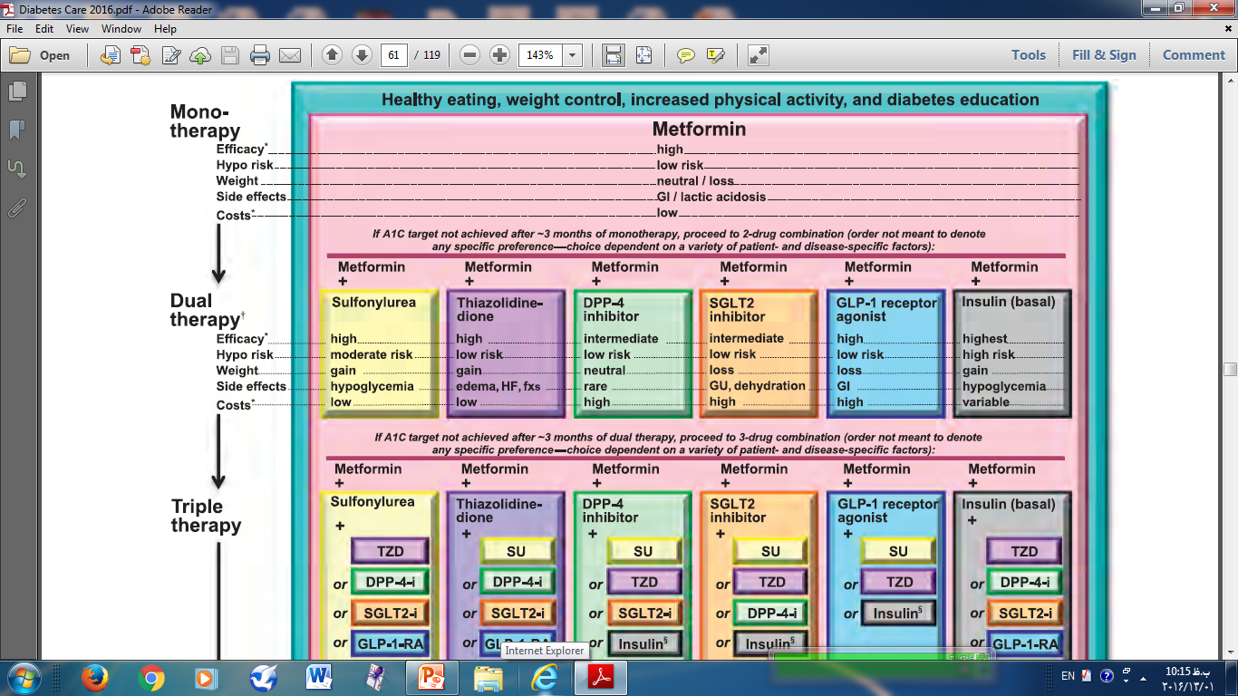

Slide 20
CANDIDATES
— Dipeptidyl peptidase 4 (DPP-4) inhibitors are not considered as initial therapy for the majority of patients with type 2 diabetes.
Initial therapy in most patients with type 2 diabetes should begin with diet, weight reduction, exercise, and metformin (in the absence of contraindications).

Slide 21
CANDIDATES2
DPP-4 inhibitors can be considered as monotherapy in patients who are
intolerant of or
have contraindications to metformin, sulfonylureas, or thiazolidinediones, such as patients with chronic kidney disease -
or who are at particularly high risk for hypoglycemia.
DPP-4 inhibitors can be considered as add-on drug therapy for patients who are inadequately controlled on metformin, a thiazolidinedione, or a sulfonylurea. However, the modest glucose-lowering effectiveness, expense, and limited clinical experience temper our enthusiasm for these drugs. Therapeutic options for initial and subsequent therapy are reviewed in detail separately. There are inadequate data to support the use of DPP-4 inhibitors in combination with prandial insulin.

Slide 22
DPP-4 inhibitors may be used in the:
full spectrum of type 2 diabetes (T2DM):
  monotherapy in drug-naive patients,
  dual or triple oral therapies
  or even as add-onto insulin. (Andre J Scheen)

Slide 23
Special populations
elderly people,
patients with renal impairment
or patients at risk of hypoglycaemia
(‘personalized medicine’). (Andre J Scheen)

Slide 24
The pancreatic safety remains a matter of debate and requires careful post-marketing surveillance.

Slide 25
DDP4 inhibitors
These agents produce approximately twofold increases in fasting and postprandial GLP1 and GIP levels, with subsequent HbA1c reductions of approximately 0.7%.
well tolerated
Specifically, they are not associated with nausea.
because of the lesser increase in GLP1 activity than with the GLP1 receptor agonists, there is no weight loss with DPP4 inhibitors; they tend to be weight neutral

Slide 26
Clinical indications of DDP4 inhibitors for the management of hyperglycaemia in type 2 diabetes.

Slide 27
Positioning | Comment
Monotherapy (add-on to diet and exercise) | Mainly when metformin contra-indicated or not tolerated
Dual therapy as add-on to metformin | Less hypoglycaemia and weight gain compared to sulphonylureas Less weight gain and better tolerance compared to pioglitazone
Dual therapy as add-on to a sulphonylurea | Mainly when metformin contra-indicated or not tolerated
Dual therapy as add-on to a thiazolidinedione | Mainly tested with the combination alogliptin-pioglitazone
Dual therapy as add-on to α-glucosidase inhibitors | Mainly studied in Asian patients
Triple therapy as add-on to metformin plus sulphonylurea | Before considering shift to injectable drugs (insulin or glucagon-like peptide-1 receptor agonists)
Triple therapy as add-on to metformin plus pioglitazone | Less hypoglycaemia and weight gain compared to sulphonylureas
As add-on to insulin therapy | Better glucose control with less insulin and no increase of hypoglycaemia

Slide 28
Table 1. The family of commercialized dipeptidyl peptidase-4 inhibitors.
Generic name | Country | Brand name | Fixed-dose combination | Brand name
Sitagliptin | Europe, US, Japan | Januvia | Sitagli+Met Sitagli+ simva | Janumet Juvisync
Vildagliptin | Europe, Japan | Galvus, Equa | Vildagli+Met | Eucreas, Galvusmet
Saxagliptin | Europe, US | Onglyza | Saxagli+Met | Komboglyze, Kombiglyze
Linagliptin | Europe, US, Japan | Trajenta, Tradjenta, Trazenta | Linagli+Met | Jentadueto
Alogliptin | Europe, US, Japan | Vipidia, Nesina | Alogli+Met Alogli+ piogli | Vipdomet,Kazano Oseni
Anagliptin | Japan | Suiny
Teneligliptin | Japan | Tenelia
Gemigliptin | Korea | Zemiglo

Slide 29
Sitagliptin
Dosing: Adult Type 2 diabetes: Oral: 100 mg once daily
Concomitant use with insulin and/or insulin secretagogues (eg, sulfonylureas): Reduced dose of insulin and/or insulin secretagogues may be needed
Tablet, oral:
25 mg, 50 mg, 100 mg
Administration: Administer without regard to meals.

Slide 30
Sitagliptin
Dosing: Renal Impairment
Cl_{cr} ≥50 mL/minute | No adjustment required
Cl_{cr} ≥30 to <50 mL/minute | 50 mg once daily
S_{cr}: Males: >1.7 to ≤3.0 mg/dL
S_{cr} Females: >1.5 to ≤2.5 mg/dL
Cl_{cr}<30 mL/minute | 25 mg once daily
S_{cr}: Males: >3.0 mg/dL
S_{cr} Females: >2.5 mg/dL
ESRD requiring hemodialysis or peritoneal dialysis | 25 mg once daily (administered without regard to timing of hemodialysis)

Slide 31
Dosing: Hepatic Impairment
Mild-to-moderate impairment (Child-Pugh classes A and B): No dosage adjustment required
Severe impairment (Child-Pugh class C):
US labeling: There are no dosage adjustments provided in the manufacturer’s labeling (has not been studied).
Canadian labeling: Use is not recommended.

Slide 32
Pregnancy Risk Factor
Pregnancy Risk Factor B ?
Breast-Feeding Considerations It is not known if sitagliptin is excreted in breast milk. The manufacturer recommends that caution be used if administered to breast-feeding women.

Slide 33
Monitoring Parameters Hb A_{1c}, serum glucose; renal function prior to initiation and periodically during treatment

Slide 34
ADVERSE EFFECTS

Slide 35
The dipeptidyl peptidase 4 (DPP-4) inhibitors were well tolerated in short-term studies.
no effects on body weight or
risk of hypoglycemia (in the absence of concomitant treatment with insulin or sulfonylureas).

Slide 36
Commonly reported side effects include
headache
nasopharyngitis
upper respiratory tract infection
Some , but not all , studies have reported a slight increased risk of gastrointestinal side effects with sitagliptin. The long-term safety with DPP-4 inhibitors has not been established.

Slide 37
Immune function
However, a meta-analysis of sitagliptin and vildagliptin studies with available side effect data reported a small increased risk of
nasopharyngitis (relative risk [RR] 1.2, 95% CI 1.0-1.4)
urinary tract infection (RR 1.5, 95% CI 1.0-2.2), and
headache (RR 1.4, 95% CI 1.1-1.7) [7

Slide 38
ADVERSE EFFECTS
Postmarketing cases of pancreatitis have been reported for the DPP4 inhibitors.
Specificity for DPP4 appears to be crucial, because less specific inhibitors have demonstrated adverse effects on immune function and cancer growth in animal studies.

Slide 39
Pancreas
There have also been reports of an increased risk of subclinical pancreatic inflammation, pancreatic cancer, and neuroendocrine tumors in sitagliptin users . A causal relationship has not been established.
: Cases of acute pancreatitis (including hemorrhagic and necrotizing with some fatalities) have been reported with use. Monitor for signs/symptoms of pancreatitis; discontinue use immediately if pancreatitis is suspected and initiate appropriate management. Use with caution in patients with a history of pancreatitis as it is not known if this population is at greater risk.

Slide 40
Adverse Reactions
Significant Reported with monotherapy.
1% to 10%:
Cardiovascular: Peripheral edema (2%)
Endocrine & metabolic: Hypoglycemia (1%)
Gastrointestinal: Diarrhea (4%), constipation (3%), nausea (2%)
Neuromuscular & skeletal: Osteoarthritis (1%)
Respiratory: Nasopharyngitis (5%), pharyngitis (1%), upper respiratory tract infection (viral; 1%)
<1% (important or life-threatening): Acne rosacea, acute pancreatitis (including hemorrhagic or necrotizing forms with some fatalities), acute renal failure (possibly requiring dialysis), anaphylaxis, anemia, angioedema, bundle branch block, depression, erectile dysfunction, exfoliative dermatitis, gastritis (Helicobacter), gastroesophageal reflux disease, hypertension, hypersensitivity, hypersensitivity vasculitis, hypotension, increased liver enzymes, liver steatosis, migraine, orthostatic hypotension, peripheral neuropathy, renal insufficiency, severe arthralgia (FDA Safety Alert, Aug 28, 2015), Stevens-Johnson syndrome

Slide 41
Contraindications
Serious hypersensitivity (eg, anaphylaxis, angioedema) to sitagliptin or any component of the formulation.

Slide 42
hypersensitivity reactions
Serious hypersensitivity reactions have been reported, including:
anaphylaxis,
angioedema,
and exfoliative skin conditions with sitagliptin, but causality has not been substantiated due to the rarity of events.
Joint pain

Slide 43
May cause joint pain
The FDA has issued a warning that the type 2 diabetes medications sitagliptin, saxagliptin, linagliptin, and alogliptin may cause joint pain that can be severe and disabling. Thirty-three cases of severe arthralgia were reported between 2006 and 2013. The time of onset of symptoms following initiation varied from 1 day to years, but in a majority of cases the pain appeared within a month of initiation. Symptoms resolved with discontinuation of the medication, although some patients had recurrence of symptoms when the medication was reinitiated or another DPP-4 (dipeptidyl peptidase-4) inhibitor was used. Patients taking DPP-4 inhibitors should contact their health care providers immediately if they experience severe and persistent joint pain. Patients should not stop taking DPP-4 inhibitors without first discussing it with their health care providers.

Slide 44
Concerns related to adverse effects:
• Arthralgia: Severe and disabling arthralgia has been reported with DPP-IV inhibitor use; onset may occur within one day to years after treatment initiation and may resolve with discontinuation of therapy. Some patients may experience a recurrence of symptoms if DPP-IV inhibitor therapy resumed.
• Hypersensitivity reactions: Serious hypersensitivity reactions, including anaphylaxis, angioedema, and exfoliative skin reactions, such as Stevens-Johnson syndrome, have been reported; discontinue if signs/symptoms of hypersensitivity reactions occur. Events have generally been noted within the first 3 months of therapy, and may occur with the initial dose. Use with caution if patient has experienced angioedema with other dipeptidyl peptidase IV (DPP-IV) inhibitor use.
• Pancreatitis: Cases of acute pancreatitis (including hemorrhagic and necrotizing with some fatalities) have been reported with use. Monitor for signs/symptoms of pancreatitis; discontinue use immediately if pancreatitis is suspected and initiate appropriate management. Use with caution in patients with a history of pancreatitis as it is not known if this population is at greater risk.

Slide 45
Disease-related concerns:
Cardiovascular disease:
Diabetic ketoacidosis: Not indicated for the treatment of diabetic ketoacidosis due to lack of efficacy in this patient population.
Diabetes mellitus, type 1: Not indicated for use in patients with type 1 diabetes mellitus (insulin dependent) due to lack of efficacy in this patient population.
Hepatic impairment: Canadian labeling recommends against use in patients with severe hepatic impairment.
Renal impairment: Worsening renal function, including acute renal failure, sometimes requiring dialysis has been reported. Use with caution in patients with moderate to severe renal dysfunction and end-stage renal disease (ESRD) requiring hemodialysis or peritoneal dialysis; dosing adjustment required.

Slide 46
Drug Interactions
ACE Inhibitors: DPP-IV Inhibitors may enhance the adverse/toxic effect of ACE Inhibitors. Specifically, the risk of angioedema may be increased. Risk C: Monitor therapy
Digoxin: SitaGLIPtin may increase the serum concentration of Digoxin. Risk C: Monitor therapy
Hypoglycemia-Associated Agents: Antidiabetic Agents may enhance the hypoglycemic effect of Hypoglycemia-Associated Agents. Risk C: Monitor therapy
Insulin: DPP-IV Inhibitors may enhance the hypoglycemic effect of Insulin. Management: Consider a decrease in insulin dose when initiating therapy with a dipeptidyl peptidase-IV inhibitor and monitor patients for hypoglycemia. Risk D: Consider therapy modification
MAO Inhibitors: May enhance the hypoglycemic effect of Blood Glucose Lowering Agents. Risk C: Monitor therapy
Pegvisomant: May enhance the hypoglycemic effect of Blood Glucose Lowering Agents. Risk C: Monitor therapy

Slide 47
Drug Interactions
Quinolone Antibiotics: May enhance the hypoglycemic effect of Blood Glucose Lowering Agents. Quinolone Antibiotics may diminish the therapeutic effect of Blood Glucose Lowering Agents. Specifically, if an agent is being used to treat diabetes, loss of blood sugar control may occur with quinolone use. Risk C: Monitor therapy
Salicylates: May enhance the hypoglycemic effect of Blood Glucose Lowering Agents. Risk C: Monitor therapy
Selective Serotonin Reuptake Inhibitors: May enhance the hypoglycemic effect of Blood Glucose Lowering Agents. Risk C: Monitor therapy
Sulfonylureas: DPP-IV Inhibitors may enhance the hypoglycemic effect of Sulfonylureas. Management: Consider a decrease in sulfonylurea dose when initiating therapy with a dipeptidyl peptidase-IV inhibitor and monitor patients for hypoglycemia. Risk D: Consider therapy modification
Thiazide Diuretics: May diminish the therapeutic effect of Antidiabetic Agents. Risk C: Monitor therapy

Slide 48
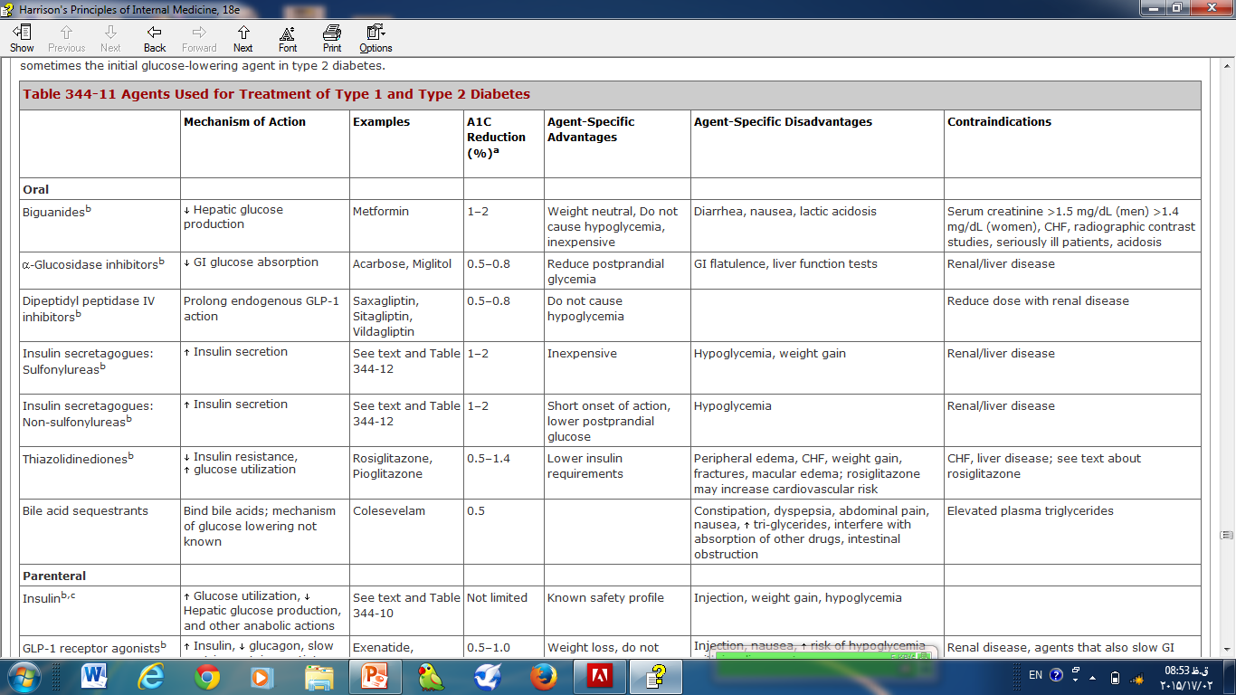

Slide 49
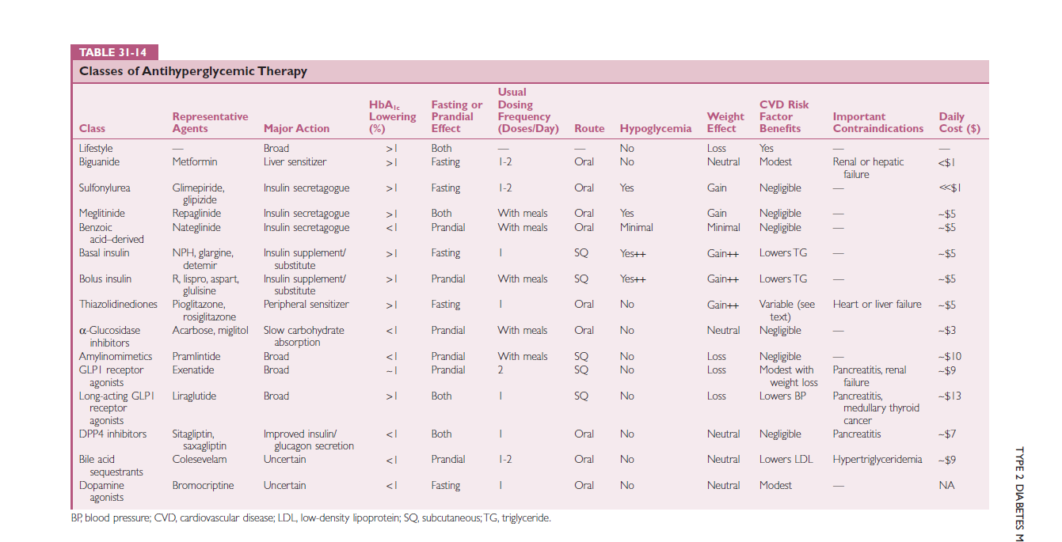

Slide 50
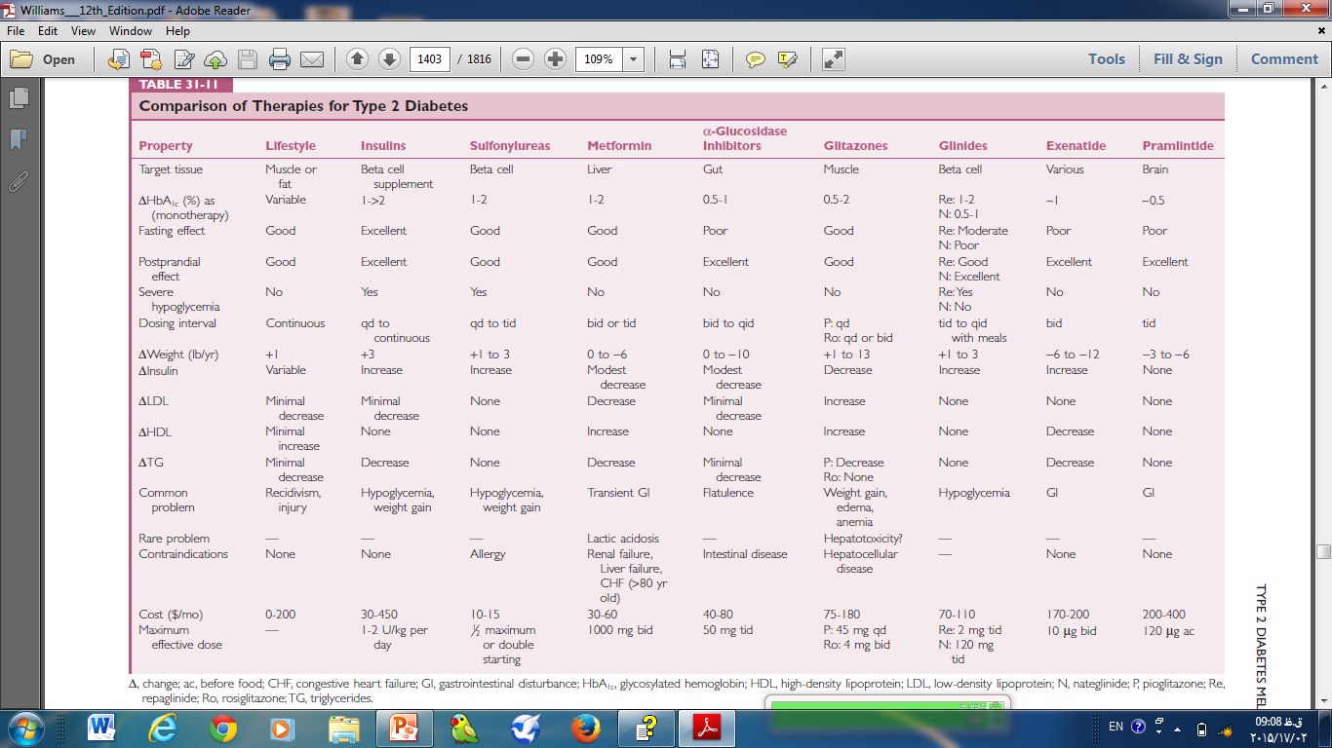

Slide 51
 | Sitagliptin | Vildagliptin | Saxagliptin | Alogliptin | Linagliptin
Dosing 50mg | 100mg qd | 50mg bid | 5mg qd | 25mg qd | 5mgqd
Max. DPP-4 inhibition (%) | ±97 | ±95 | 70–80 | >90 | >90
Selectivity for DPP-4 | High | High | Moderate | High | High
∗HbA1c reduction % | 0.5–1.0 | 0.9 (mean value) | 0.5–1.0 | 0.6 (mean value) | 0.5–0.7
Hypoglycaemic risk | Low | Low | Low | Low | Low
Half-life(h) | ±12 | 1.5–3 | ±2.5 | 11–22 | >100
Bioavailability | ±87 % | ±85 % | ±67 % | — | ±30 %
Metabolism/ elimination | Renal excretion almost unchanged (70–80% parent) | Renal excretion (±26% parent and ±55% as metabolite obtained after hydrolysis) | Liver metabolized to active metabolite by P450 3A4/5 and renal excretion (12–29% unchanged parent and 21–52% as metabolite) | Renal excretion almost unchanged parent (60–70%) | Biliary excretion almost unchanged (>70% unchanged parent) and renal (<6%)

Slide 52
 | Sitagliptin | Vildagliptin | Saxagliptin | Alogliptin | Linagliptin
Dosing 50mg | 100mg qd | 50mg bid | 5mg qd | 25mg qd | 5mgqd
Max. DPP-4 inhibition (%) | ±97 | ±95 | 70–80 | >90 | >90
Selectivity for DPP-4 | High | High | Moderate | High | High
∗HbA1c reduction % | 0.5–1.0 | 0.9 (mean value) | 0.5–1.0 | 0.6 (mean value) | 0.5–0.7
Hypoglycaemic risk | Low | Low | Low | Low | Low

Slide 53
 | Sitagliptin | Vildagliptin | Saxagliptin | Alogliptin | Linagliptin
Half-life(h) | ±12 | 1.5–3 | ±2.5 | 11–22 | >100
Bioavailability | ±87 % | ±85 % | ±67 % | — | ±30 %
Metabolism/ elimination | Renal excretion almost unchanged (70–80% parent) | Renal excretion (±26% parent and ±55% as metabolite obtained after hydrolysis) | Liver metabolized to active metabolite by P450 3A4/5 and renal excretion (12–29% unchanged parent and 21–52% as metabolite) | Renal excretion almost unchanged parent (60–70%) | Biliary excretion almost unchanged (>70% unchanged parent) and renal (<6%)

Slide 54


Slide 55
R1=Hindawi Publishing Corporation
Journal of Diabetes Research
Volume 2015, Article ID 606031, 14 pages
http://dx.doi.org/10.1155/2015/606031
Recent Advances in Dipeptidyl-Peptidase-4 Inhibition Therapy:
Lessons from the Bench and Clinical Trials

Slide 56
The hepatic metabolism of sitagliptin is minimal
(mainly by cytochrome P450 3A4) and it is largely (70–80%)
excreted by the urine in its unchanged form, with a halflife
of around 12 hours [135]. As a result of its metabolism
and elimination, dose adjustment is required in patients
with severe renal impairment, but not in those with mild or
moderate renal or hepatic impairment [136, 137]. No dosage
adjustment is necessary on the basis of age, gender, race, or
body mass index; in addition, sitagliptin has a low propensity
for pharmacokinetic drug interactions [93

Slide 57
Sitagliptin has a neutral effect on bodyweight, as reported
in almost all of the studies previously mentioned [138–142].
Concerning the impact of sitagliptin on lipid profile, the
available data showed no consistency, but the majority of
studies reported a beneficial effect on TGs, HDL-c, and LDLc,
as concluded in a systematic review and meta-analysis of
14 trials with incretin therapy in patients with T2DM [173].
In addition, some studies suggested a reduction of blood
pressure in patients under sitagliptin treatment [174–176].The
reduction of global cardiovascular risk factors by sitagliptin
seems to be important for improving outcomes in patients
with T2DM [177].

Slide 58
Sitagliptin is well tolerated and the risk of adverse events,
including hypoglycaemia, is very low [132, 147, 155, 162].
The most common are GI disturbances, including abdominal
pain, nausea, vomiting, and diarrhoea, which are rare when
used in monotherapy [67]. Nasopharyngitis, upper respiratory
tract infections, and headache occur in a low percentage
of patients (versus placebo) [173]. The prescribing information
for sitagliptin includes information regarding postmarketing
reports of acute pancreatitis, but the association
between DPP-4 inhibitor use and pancreatitis remains controversial,
as further discussed.

Slide 59
