Slide 1


Slide 2
The Evolution of the Primary Aldosteronism Syndrome: Updating the Approach
jcem August 2020
BY LEILA ASHRAFI

Slide 3
Evidence was gathered from
published guidelines
studies identified from PubMed by searching for primary aldosteronism, aldosterone, renin, and hypertension.
Williams 2020

Slide 4
Case Presentation:
A 58 year old man was referred to endocrinology for further evaluation of hypertension and hypokalemia. He was diagnosed with hypertension when he was 38 years old but was not treated with medications.
At the age of 43 years, his blood pressure was noted to be 200/100 mmHg and he was started on lisinopril. By age 50 years, he had been evaluated in an emergency room and admitted to a hospital more than three times for hypertensive urgency and hypokalemia.
Electrocardiograms and echocardiograms had confirmed left ventricular hypertrophy.

Slide 5
Case Presentation
By age 58 years he was treated with lisinopril 40mg daily, nifedipine 60mg daily, and carvedilol 50mg daily, and his blood pressure ranged from 135-156/80-90 mmHg.
However, his serum potassium continued to range from 3.1-3.4 mEq/L and his serum bicarbonate ranged from 25-30 mEq/L.
He had never undergone an evaluation for secondary causes of hypertension, and specifically, had never had an assessment of aldosterone or renin.

Slide 6
Introduction
Recently ,improvement of screening diagnostics and dynamic confirmatory tests showed that primary aldosteronism is not rare at all. Rather, it could be detected in 5-10% of hypertensive adults.
Current estimates suggest that up to 30% of hypertensive adults have an overt form of primary aldosteronism.

Slide 7
Also, it has become evident that primary aldosteronism is better characterized as a syndrome of renin-independent aldosterone production that ranges in the blood pressure spectrum, from subclinical forms in adults with normal blood pressure to overt forms in resistant hypertension.
We review evidence indicating that primary aldosteronism is a prevalent syndrome that is mostly unrecognized, and present a pathophysiology-based approach to improve diagnosis and treatment.

Slide 8
Defining Primary Aldosteronism
There are a number of possible ways to define primary aldosteronism, including pathophysiologic principles, diagnostic methods, and treatment responses.
To increase the detection of the primary aldosteronism, we focus on the syndrome using pathophysiologic principles and did not use strict diagnostic thresholds and/or treatment responses.
In this regard, three main pathophysiologic features of primary aldosteronism, initially described by Conn at al, and still used today .

Slide 9
The first manifestation of primary aldosteronism pathophysiology is suppression of baseline renin secretion.
As Conn et al. described in 1964: “since primary aldosteronism is associated with an increase in intra-vascular volume…the renin-angiotensin system should be suppressed.”
The second cardinal feature is the inability to stimulate renin secretion normally.
That is, in spite of physiologic stimulants that normally raise renin (such as upright posture, volume contraction, sodium depletion, or angiotensin converting enzyme inhibition), renin remains relatively low.

Slide 10
These conditions can induce a rise in renin, especially in milder instances of primary aldosteronism; however, this rise is not remarkable compared to the normal physiologic response.
extreme dietary sodium restriction
volume contraction with diuretics
adequate doses of mineralocorticoid receptor antagonists
and high doses of converting enzyme inhibitors

Slide 11
The third major feature is inappropriate and non-suppressible aldosterone production, despite sodium and extracellular volume expansion, suppression of renin and angiotensin II and hypokalemia, which normally inhibits aldosterone biosynthesis.

Slide 12
An important note here is that hypertension and hypokalemia are not main characteristics of primary aldosteronism, rather they are dependent features that manifest when:
intra-arterial volume expansion exceeds the vascular capacity to maintain normal blood pressure
and/or when distal nephron sodium delivery, leading to accelerated sodium-potassium exchange and kaliuresis, exceeds the threshold of potassium intake.

Slide 13
Thus, the more severe and prolonged the exposure to renin-independent aldosterone production and a sodium-retention state, the higher the risk of severe hypertension and hypokalemia.
We will provide evidence that suggests a simplified approach, based on these three principal pathophysiologic characteristics, can be used to diagnose and treat primary aldosteronism.

Slide 14
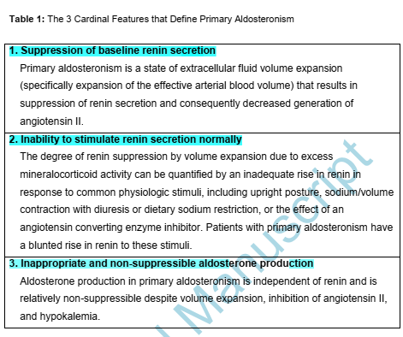

Slide 15
Evidence from Renin-Physiology Demonstrates a High Prevalence of Primary Aldosteronism
Although a random low renin level may indicate volume expansion due to mineralocorticoid excess, it could also be a physiologic result of high dietary sodium intake.
Physiologically, dietary sodium restriction induces near-maximal stimulation of renin secretion.

Slide 16
Normotensive and hypertensive individuals with the greatest inability to stimulate renin have the highest:
blood pressure
urinary potassium excretion rates
aldosterone-to-renin ratios (ARRs)
most non-suppressible aldosterone production, even within the range of “normal”.
In other words, greater renin suppression and poorer renin stimulation are biomarkers for unrecognized primary aldosteronism.

Slide 17
Ultimately, although aldosterone is often the primary focus when assessing for primary aldosteronism, the cardinal signs focusing on renin pathophysiology may be more sensitive biomarkers of inappropriate aldosterone production and responsiveness to mineralocorticoid receptor antagonism.
As demonstrated recently in the PATHWAY-2 clinical trials, even after overt primary aldosteronism was excluded among participants (because aldosterone levels were not “high” enough), the most robust blood pressure lowering with spironolactone was observed in individuals with suppressed renin and higher aldosterone levels within the “normal” range.

Slide 18
These findings show that when assessing for primary aldosteronism, we should focus on whether aldosterone is appropriate or inappropriate relative to renin, or put another way, that almost any aldosterone level in the setting of renin suppression could represent a phenotype of the primary aldosteronism syndrome that may be responsive to mineralocorticoid receptor antagonists.

Slide 19
Prevalence of Primary Aldosteronism in Normotension
Although clinical indications for primary aldosteronism screening generally focus on individuals with hypertension, evidence indicates that a primary aldosteronism phenotype can be detected even among those with normal blood pressure (sometimes referred to as subclinical or non-classical primary aldosteronism).
Several studies have demonstrated a primary aldosteronism phenotype in normotensive individuals, and that this phenotype is associated with an increased risk of blood pressure elevation and incident hypertension.

Slide 20
Vasan et al. reported that 50% of normotensives from the Framingham Offspring Study had a plasma aldosterone concentrations greater than 11 ng/dL and that 25% had concentrations greater than 19 ng/dl.
These authors showed that at least 6.4% of normotensives (3.1% of men and 8.9% of women) had a positive or elevated ARR.
The most important finding, was that the phenotype of renin-independent aldosterone production in normotensive individuals was associated with higher risk of increases in blood pressure and development of hypertension.

Slide 21
In a study from the Multi-Ethnic Study of Atherosclerosis, with a nationwide sample from the US, Brown et al. showed that normotensive participants with a suppressed renin phenotype had a 68% higher risk of incident hypertension in the next five years when compared to normotensive participants with a normal renin phenotype.
Markou et al. conducted fludrocortisone-dexamethasone suppression tests in normotensive women, without any pre-screening for ARR or renin, discovering that 13% of their cohort had overt primary aldosteronism.

Slide 22
An important prognostic testament of this phenotype was that 85% of these individuals with normotensive primary aldosteronism developed hypertension within the next 5 years, as compared to only 11% of normotensive individuals without primary aldosteronism.
Importantly, the greater the magnitude of aldosterone production in the setting of suppressed renin activity, the greater the kaliuresis and the greater the aldosterone response to angiotensin stimulation.

Slide 23
Thus, the prevalence of overt primary aldosteronism in normotensive individuals may range from 6-14%, and in some instances up to 25%, depending on the specific population demographics and the modality of testing employed (elevated ARR, dynamic confirmatory testing, or both).
Importantly, these estimates result from dynamic confirmatory testing without reliance on previous screening with an ARR.

Slide 24
Although the explanation why primary aldosteronism is so common in the normotensive population is still under investigation, an important hypothesis is the accumulation of pathogenic somatic mutations over the lifespan that result in inappropriately high aldosterone synthase expression, seen as aldosterone-producing cell clusters on immunohistochemistry, a phenomenon that has been observed in the adrenal cortex of normotensive and hypertensive individuals.
Also, this hypothesis shows that primary aldosteronism , even in morphologically normal adrenal glands, is caused by abnormal aldosterone synthase expression in contrast to hyperplastic or neoplastic transformation.

Slide 25
Prevalence of Primary Aldosteronism in Hypertension
Population-based studies have used the ARR to estimate the potential prevalence of primary aldosteronism.
For example, in the Framingham Offspring Cohort, 12.0% of untreated participants with hypertension had a positive screening ARR, and similarly, in a German cohort of hypertensive participants up to 7.0% had a positive screening ARR.
In the Multi-Ethnic Study of Atherosclerosis, untreated participants with hypertension had a mean plasma aldosterone concentration of 14 ng/dL, mean plasma renin activity of 0.7 ng/mL/h, and mean ARR of ~20.

Slide 26
However, hypertensive participants with suppressed renin had a mean ARR of ~30, and higher aldosterone levels were associated with higher risk for incident coronary artery calcification and all-cause mortality.
Numerous studies from across the world have assessed the prevalence of primary aldosteronism using a 2-step approach where a screening ARR is first used to identify those at highest risk, followed by dynamic confirmatory testing in only this selected sub-group.

Slide 27
the prevalence of overt primary aldosteronism using this 2-step approach has been reported to range from 2-19%, with lower prevalence estimates in mild (or stage I) hypertension, and the highest prevalence estimates in those with more severe or resistant hypertension with other comorbidities.
In contrast, studies that conducted dynamic confirmatory tests in hypertensive participants without a pre-specified screening ARR threshold have observed much higher prevalence estimates.

Slide 28
Many patients with primary aldosteronism , as a result of the variability of aldosterone production, can have an unremarkable ARR and/or aldosterone value on a single screening assessment.
Therefore, the 2-step approach is likely to underestimate the true prevalence detected by dynamic confirmatory testing by excluding many potential cases.

Slide 29
For example, when Tsiavos et al. systematically conducted fludrocortisone-dexamethasone suppression testing, they found that 28-30% of participants with hypertension had overt primary aldosteronism.
Similarly, when Parasiliti-Caprino et al. systematically conducted saline suppression tests in a population with confirmed resistant hypertension, they discovered that 29% of their participants had overt primary aldosteronism.

Slide 30
We evaluated the prevalence of overt primary aldosteronism and milder renin-independent aldosterone production in hypertension using the oral sodium suppression test.
The crude prevalence of overt primary aldosteronism was 15.7% in stage I hypertension, 20.7% in stage II hypertension, and 24.0% in resistant hypertension.
When data were restricted to participants with suppressed renin activity, these prevalence estimates increased to 18.8%, 25.0%, and 52.1%, respectively.

Slide 31
Renin-independent aldosterone production phenotype is associated with cardiometbolic disease and shows dramatic blood pressure lowering when treated with mineralocorticoid receptor antagonists.
Generally, the higher the aldosterone in the setting of renin suppression, the greater the efficacy of mineralocorticoid receptor antagonists in lowering blood pressure.

Slide 32
Although this observation has recommended using mineralocorticoid receptor antagonists in resistant hypertension, but we suggest that mineralocorticoid receptor antagonists should also be considered in patients with renin suppression and milder phenotypes of hypertension and primary aldosteronism.

Slide 33
The Failure to Implement and Raise Awareness for Screening
Despite the large number of studies indicating that the prevalence of the primary aldosteronism syndrome is high and that this disorder can be treated to modify cardiovascular risk, this information has not yet resulted in higher screening rates or changes to hypertension treatment algorithms.
Most expert guidelines recommend screening for primary aldosteronism in populations with resistant or severe hypertension and/or hypokalemia.
However, even in this high-risk group where the prevalence of the primary aldosteronism syndrome can exceed 25-50%, less than 3% of eligible patients in the U.S and less than 8% in Italy and Germany undergo screening.

Slide 34
Some official guidelines also recommend screening adults with hypertension and obstructive sleep apnea (although this indication has been questioned), yet less than 2% of eligible patients are screened.
Because screening for primary aldosteronism is so low, the detection of true cases and doing of targeted therapy with mineralocorticoid receptor antagonists or curative unilateral adrenalectomy is lower compared to the true prevalence of the syndrome.

Slide 35
One cause of this discrepancy is the lack of education of primary care providers .
Efforts to increase awareness among these clinicians and those managing patients with hypertension are critical to increase the screening rates for primary aldosteronism.
A second problem is that many clinicians worry that the process may include medication withdrawals and complex diagnostic interpretations.
Efforts to simplify diagnostic approaches are necessary.

Slide 36
Pitfalls in Interpretation of Screening Measurements
Unfortunately, even when screening for primary aldosteronism occurs, there is a relatively high risk that the results will be misinterpreted. This is due to several factors.
First, reliance only on the ARR, rather than the individual components (renin and aldosterone), can introduce misinterpretations where the denominator (renin) may be very low (inflating the ARR) or not low enough (reducing the ARR; due to limitations in the lower limit of assay reporting or certain medication classes that raise renin).

Slide 37
The second factor which is the variability in circulating aldosterone levels, which similarly, the numerator (aldosterone) can change substantially and sometimes may not be “high” enough.
Circulating aldosterone levels vary throughout the day because of diurnal variation, as well as fluctuations that may be influenced by factors such as corticotropin release/stress, diet, posture, and timing of medication dosing.
Therefore,it will increase the risk of excluding the diagnosis by mistake.

Slide 38
For example, patients with confirmed primary aldosteronism can frequently have circulating aldosterone concentrations that are <15 ng/dL or even <10 ng/dL, and rarely as low as 5 ng/dL, levels that usually exclude the possibility of primary aldosteronism.

Slide 39
A Simplified Proposal to Maximize Detection of Primary Aldosteronism and Implement of Targeted Therapy
We propose a diagnostic approach algorithm to increase the detection of the primary aldosteronism syndrome .
The objectives of this algorithm are to simplify the process for primary care and general medical clinicians, regardless of access to advanced resources and specialists, and mineralocorticoid receptor antagonist therapy is prescribed when it may be beneficial.

Slide 40
When to screen:
Populations which should be screened for primary aldosteronism ,include patients with :
resistant hypertension (requiring 4 or more medications to control blood pressure or uncontrolled blood pressure despite 3 medications)
severe hypertension (blood pressure > 150/100 mmHg)
hypertension with an incidental adrenal mass
hypertension with atrial fibrillation
any hypokalemia regardless of blood pressure.
Beyond these critical populations, we should screen all patients with stage II hypertension ( 140/90 mmHg) where the prevalence of the primary aldosteronism syndrome is considerable .

Slide 41
sustained blood pressure >150/100 mm Hg
hypertension resistant to three conventional antihypertensive drugs
controlled blood pressure on four or more antihypertensive drugs
hypertension and spontaneous or diuretic-induced hypokalemia
hypertension and adrenal incidentaloma
hypertension and sleep apnea
hypertension and a family history of early onset hypertension or cerebrovascular accident at a young age.
Due to the excess cardiovascular morbidity and nephrotoxicity associated with primary aldosteronism
all patients with hypertension should be tested for this disorder at least once.
Endocrine Hypertension Williams

Slide 42
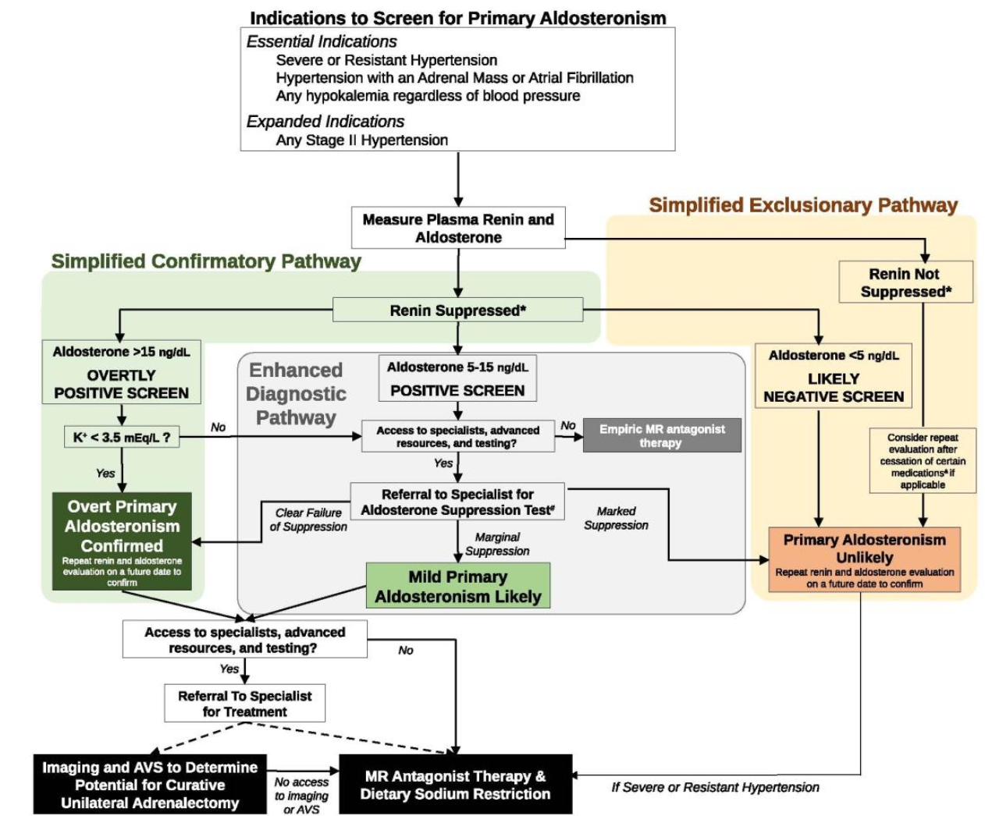

Slide 43
How to screen:
The ARR is a well-accepted screening metric. If used, we recommend using an ARR threshold of 20 to maximize true case detection.
However, our preference is to use the individual components of the ARR; that is, to evaluate the renin and aldosterone values independently to identify phenotypes suggestive of renin-independent aldosterone production.
We do not advise medication withdrawal or specific times for testing to minimize burden on patients and clinicians.

Slide 44
At the time of the patient encounter, testing should be performed without delay, with the patient in the seated position.
If renin is suppressed, the influence of medications dose not interfere with diagnostic decision making, and the aldosterone level can be interpreted.
In other words, if renin is suppressed, a medication washout is not needed to interpret the results of the screening test, next confirmatory tests, and even adrenal venous sampling results.

Slide 45
If renin is not suppressed, and the pre-test probability for primary aldosteronism is high, a medication washout (minimum of 4 weeks) should be considered for mineralocorticoid receptor antagonists and epithelial sodium channel inhibitors with testing repeated following the washout.
Angiotensin converting enzyme inhibitors and angiotensin receptor blockers do not significantly raise renin in true primary aldosteronism (in fact, this is the basis of the captopril challenge test), although sometimes they may lower aldosterone concentrations; a washout of these medication classes is rarely necessary.

Slide 46
The use of gliflozins (inhibitors of sodium-glucose transport protein 2) can contract intravascular volume and increase renin in normal physiology; however, whether this effect is observable in patients with primary aldosteronism, and could contribute to potential false-negative testing, has not been reported.

Slide 47
Simplified Confirmatory Pathway
Suppressed renin is a key biomarker for a population that is susceptible to primary aldosteronism; that is, at high risk for future cardiovascular events, and most likely to respond to mineralocorticoid receptor antagonists.
Although there is no single definition for suppressed renin, we think the ideal representation is plasma renin activity <0.6 ng/mL/h or plasma renin concentration <5 mU/L; however, more liberal thresholds of <1.0 ng/mL/h and <8.2 mU/L can be used.
In this setting, a plasma aldosterone concentration >15 ng/dL should be considered an “overtly positive screen.”

Slide 48
When the pre-test probability for the primary aldosteronism is high (for example in a patient with resistant hypertension and/or hypokalemia), these results should be interpreted as confirmatory for the diagnosis (no further dynamic testing is needed).
We do recommend repeating the aldosterone and renin measurements on a separate day, when possible, to ensure consistency and to minimize the small risk for false-positive testing.

Slide 49
Simplified Exclusionary Pathway
The simplest method to exclude the possibility of primary aldosteronism is detection of non-suppressed renin, which is incompatible with the pathophysiology.
Exceptions to this rule include factors that can induce remarkable volume contraction in a patient with true primary aldosteronism, such as:
extreme dietary sodium restriction
on-going and aggressive diuresis (usually with loop diuretics)
use of therapeutic doses of mineralocorticoid receptor antagonists
and/or use of therapeutic doses of epithelial sodium channel inhibitors

Slide 50
When the pre-test probability for primary aldosteronism is reasonably high, a medication washout can be conducted to assess the true renin phenotype .
The other pathway to excluding primary aldosteronism is very low aldosterone concentration in the setting of suppressed renin .
We advise using a threshold <5 ng/dL to be conservative and minimize the risk of false-negatives considering the variability of circulating aldosterone levels .

Slide 51
Data suggesting that even relatively low circulating aldosterone levels in the context of suppressed renin may be a manifestation of the primary aldosteronism syndrome, especially when measured using modern LC-MS/MS assays.
We also suggest that the aldosterone and renin be repeated on a separate day to increase confidence that primary aldosteronism can be excluded.

Slide 52
Enhanced Diagnostic Pathway
When renin is suppressed but aldosterone levels are neither overtly high nor very low (5-15 ng/dL), we suggest considering these values as a “positive screen” for primary aldosteronism .
These patients are likely to either have overt primary aldosteronism or a clinically relevant phenotype of renin-independent aldosterone production (i.e. mild primary aldosteronism) that is likely to respond to mineralocorticoid receptor antagonists with a substantial reduction in blood pressure.

Slide 53
If access to specialists and advanced healthcare resources is not available, empiric mineralocorticoid receptor antagonist therapy should be recommended for these patients unless they have an estimated glomerular filtration rate < 30 mL/min/1.73m2 and/or hyperkalemia.
When resources permit, we advise referral to specialists who can conduct one of several recommended formal aldosterone suppression tests to confirm or exclude overt primary aldosteronism .

Slide 54
Confirmed Primary Aldosteronism
When primary aldosteronism is confirmed, it is recommended to refer to an experienced specialist to:
guide localization tests (cross-sectional imaging and adrenal venous sampling)
and candidacy for curative unilateral adrenalectomy
or medical therapy with mineralocorticoid receptor antagonists
and dietary sodium restriction

Slide 55
When access to specialists or adrenal venous sampling is unavailable, empiric mineralocorticoid receptor antagonist therapy (and advice to restrict dietary sodium intake) should be recommended to control and normalize blood pressure, maintain circulating potassium in the normal range, and normalize renin.

Slide 56
Exclusion of Primary Aldosteronism
Even after excluding primary aldosteronism, we strongly suggest addition of mineralocorticoid receptor antagonist therapy for patients with suppressed renin, particularly if they have uncontrolled blood pressure or resistant hypertension.
In this regard, for all patients with suppressed renin, our clinical approach concludes that mineralocorticoid receptor antagonists should be prescribed .

Slide 57
Case Presentation Continued
The patient was screened for primary aldosteronism for the first time at the age of 58 years, and taking lisinopril, nifedipine, and carvedilol, his plasma renin activity was measured to be <0.6 ng/mL/h and his plasma aldosterone concentration was 5.2 ng/dL (ARR greater than 9).
The screening results were interpreted as “negative” because the aldosterone and ARR values were considered to be “too low” for primary aldosteronism.

Slide 58
Three months later, after another emergency room visit for hypokalemic myopathy, a serum potassium of 2.9 mEq/L, and a blood pressure of 188/98 mmHg, he was referred to endocrinology.
Repeat testing, while seated in the endocrinology clinic showed a plasma renin activity of <0.6 ng/mL/h and a plasma aldosterone concentration of 9.5 ng/dL.
These testing results were considered to represent a “positive screen” .
A 1mg dexamethasone suppression test and plasma metanephrines were normal.

Slide 59
Case Presentation Conclusion:
Based on the clinical history of chronic hypertension and hypokalemia, and the biochemical testing suggesting a “positive screen,” the patient was evaluated using the “Enhanced Diagnostic Pathway” .
An oral sodium suppression test was conducted and showed a 24-hour aldosterone excretion rate of 15 mcg with a concurrent 24-hour urinary sodium excretion of 276 mEq (an aldosterone excretion rate of > 12 mcg/24h on a high sodium balance is the conventional threshold to confirm primary aldosteronism).

Slide 60
Considering the failure to suppress aldosterone production in the face of volume and sodium loading, the patient was diagnosed with primary aldosteronism. Abdominal computed tomography revealed bilateral adrenal thickening without a clear adenoma.
He was advised to undergo adrenal venous sampling to evaluate his candidacy for a potential curative adrenalectomy.
However, the patient declined adrenal venous sampling on the basis of multiple reasons, including: a fear of procedures and surgery, a general distrust of the medical system.

Slide 61
He emphasized his preference to try medical therapy first. Therefore, he was counseled to restrict dietary sodium intake and prescribed spironolactone.
One year later, while on spironolactone 75mg daily, nifedipine 60mg daily, and carvedilol 25mg daily, his blood pressure was 122-130/66-80 mmHg, his serum potassium was normal without supplemental potassium intake, and his plasma renin activity had increased to 1.3 ng/mL/h.

Slide 62
Conclusions
The current state-of-the-science characterizes primary aldosteronism as a syndrome of renin-independent aldosterone production that is highly prevalent and contributes to the pathogenesis of hypertension and cardiovascular disease.
The antiquated dogma that considered primary aldosteronism to be a “secondary” cause of hypertension should be retired; in its stead, primary aldosteronism should be regarded as common cause of primary hypertension, a major contributor to cardiovascular disease, and a condition that can manifest in a spectrum from mild to severe phenotypes.

Slide 63
Therefore, we suggest a simplified pathophysiology-based diagnostic algorithm that can be used by generalists, as well as specialists, to increase the rate of screening , to facilitate the doing of targeted treatments and to mitigate the adverse outcome of primary aldosteronism.

Slide 64


Slide 66
The most recommended and widely used dynamic confirmatory tests include :
oral sodium suppression test
seated intravenous saline suppression test
fludrocortisone suppression test
captopril challenge test

Slide 67
Saline infusion test

Slide 68
Oral sodium loading test

Slide 69
Fludrocortisone suppression test

Slide 70
Captopril challenge test

Slide 71
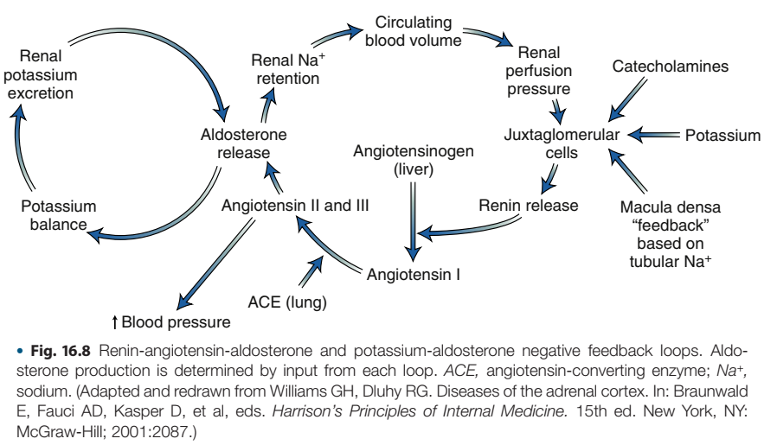

Slide 72
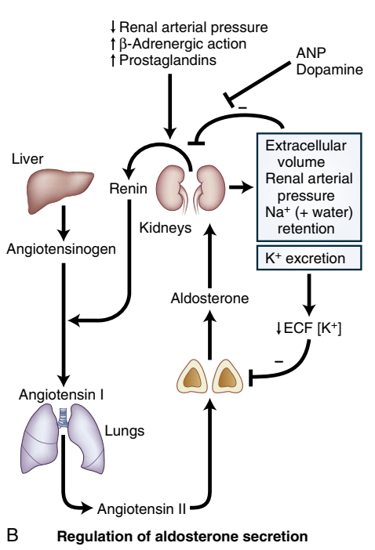

Slide 73
A recent small study of young men with normal blood pressure (median age of 25.7 years) found that when consuming a diet approximating the high sodium balance needed for an oral sodium suppression test (mean urinary sodium excretion ~200 mmol/24h) and the average American potassium intake (mean urinary potassium excretion 67.5 mmol/24h), the 75th percentile for 24h urinary aldosterone excretion was 10 mcg/24h, corresponding to the lower limit for confirming overt primary aldosteronism.
In other words, even among very young and healthy normotensive people, one quarter meet the definition of mild primary aldosteronism based on the accepted thresholds of the oral sodium suppression test.

