Slide 1
IDF-DaR Guideline for people with diabetes who want to fast in Ramadan
بنام خداوند جان و خرد
Mansour Siavash; MD.
Professor of endocrinology
Isfahan Endocrine and Metabolism Research Center
Isfahan University of medical sciences
Winter 2021

Slide 2
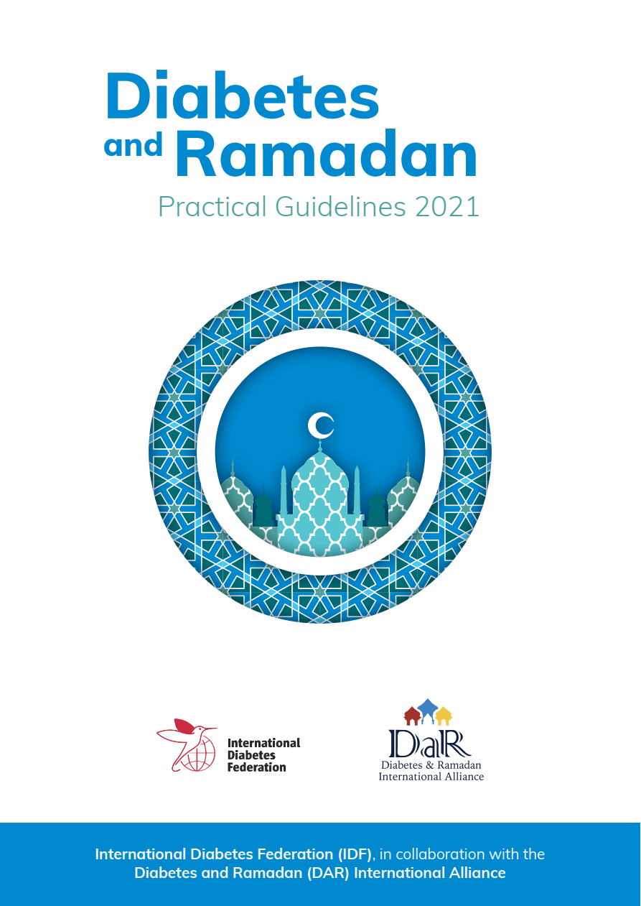

Slide 3
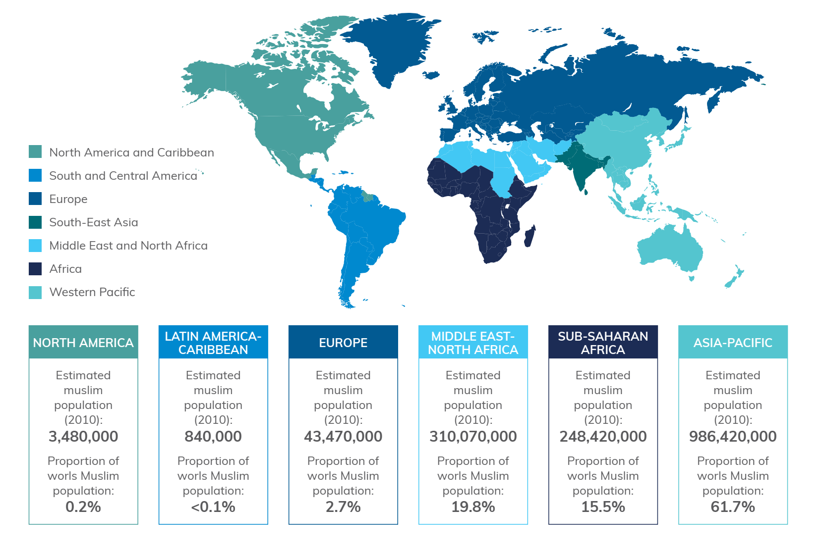

Slide 4
Risk stratification of people with diabetes before Ramadan
Risks associated with fasting in people with diabetes
Risk stratification
Risk levels and associated recommendations
Summary

Slide 5
Risks associated with fasting in people with diabetes
Fasting during Ramadan for people with diabetes carries considerable challenges.
However,despite these challenges many still insist on fasting.
The main risks reported with fasting are:
hypoglycaemia
Hyperglycaemia
Ketoacidosis
Dehydration
Thrombosis

Slide 6
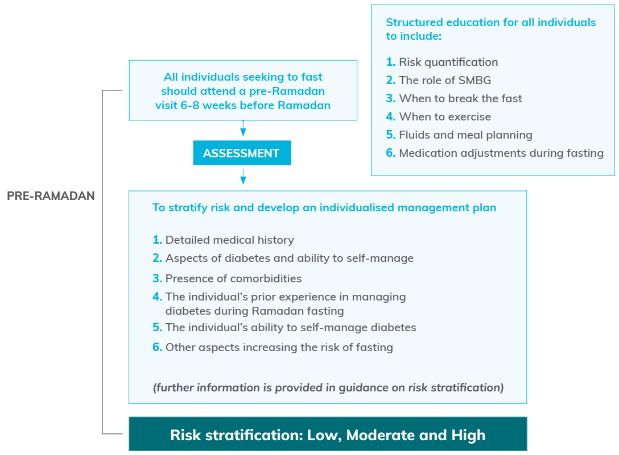
The pre-ramadan assessment

Slide 7
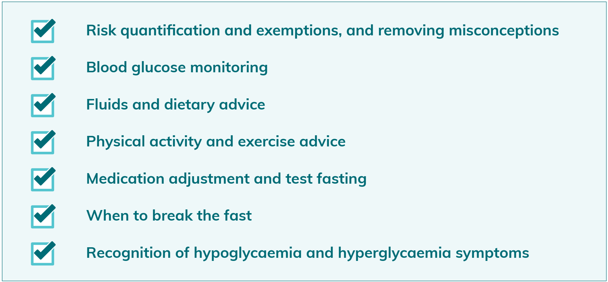
Key Components of a Ramadan-focused Educational Program

Slide 8
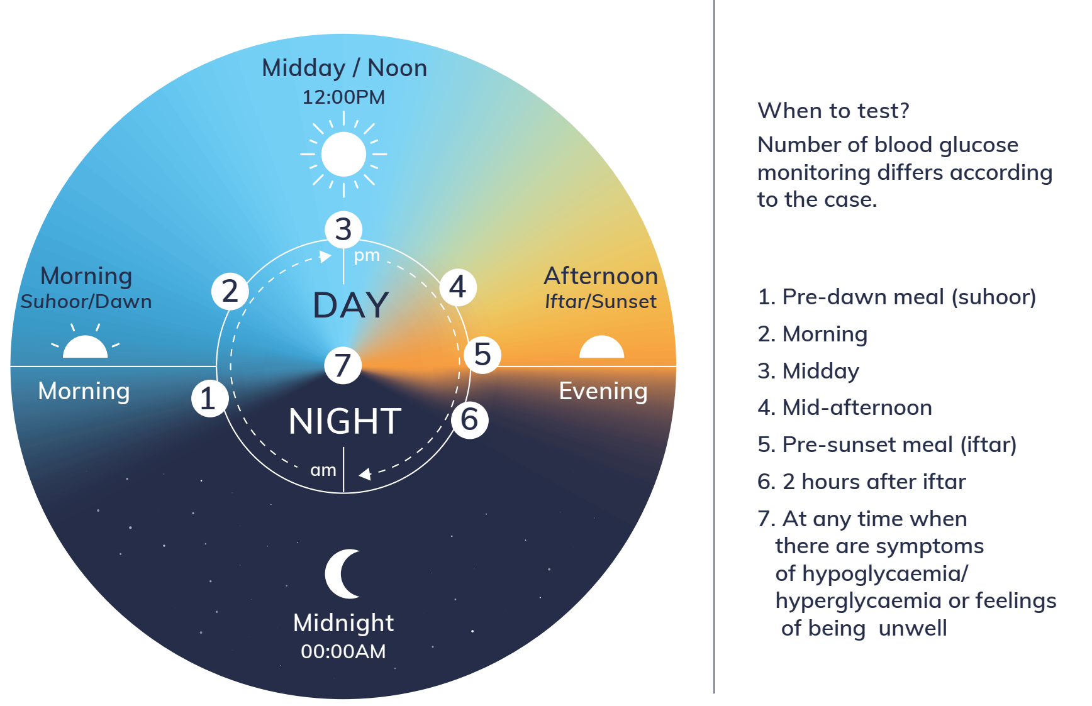
Self-Monitoring of Blood Glucose (SMBG) - 7 point guide for Ramadan

Slide 9
Risk stratification of people with diabetes before Ramadan
All people with diabetes should attend a pre-Ramadan assessment with their HCP 6–8 weeks before the start of Ramadan.
In the assessment, the risks to people with diabetes who intend to fast should be quantified.
Factors that contribute to the risk include the type of diabetes, current diabetes medication, individual social and work circumstances, individual hypoglycaemic risk, self-management capabilities and the presence of any complications and/ or comorbidities.
Individuals can then be stratified according to their potential risk and an individualized approach to disease management provided to ensure optimal care is delivered.

Slide 10
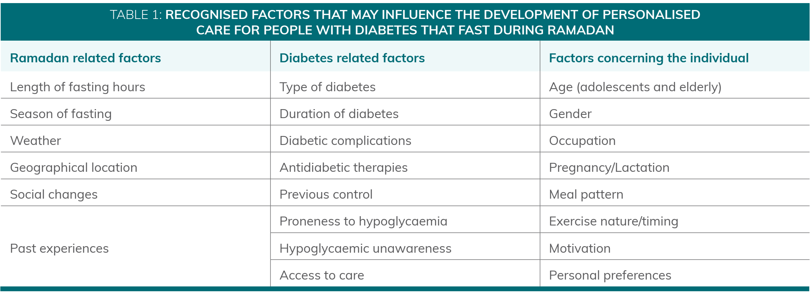
Factors that should be considered

Slide 11
Risk stratification
Risk stratification is an essential aspect of all diabetes and Ramadan recommendations.
Despite all these recommendations, many people with diabetes that are categorized as high risk were still fasting.
However, in light of emerging evidence highlighting the ability of some high risk individuals to fast when provided with the right circumstances, many felt that the current scoring system was too rigid.
Surprisingly, the numbers of days fasted by the highest and the lowest risk group only differed by 3 days.
There is a clear need to reconsider the risk categories and to provide a flexible means of taking into account an individual’s circumstances and an individualized plan that would help people with diabetes and their HCPs to make better decisions about fasting during Ramadan.

Slide 12
New Risk stratification is needed due to:
Emerging evidence
Clear need to reconsider the risk categories
Need to provide a flexible means of taking into account the individual’s circumstances and an individualized plan.
Wide variation in practices among physicians even from within the same country.
Wider variations of fasting practices among many countries.

Slide 13
Elements for risk calculation and suggested risk score for people with diabetes mellitus (dm) that seek to fast during ramadan
Risk Element | Risk Score
1. Diabetes type and duration
Type 1 diabetes | 1
Type 2 diabetes | 0
A duration of ≥ 10 | 1
A duration of < 10 | 0
2. Presence of hypoglycaemia
Hypoglycaemia unawareness | 5
Recurrent/severe hypoglycaemia | 4
Daily mild hypoglycaemia | 3
Hypoglycaemia 1–6 times per week | 2
Hypoglycaemia less than 1 time per week | 1
No hypoglycaemia | 0
Risk Element | Risk Score
3. Characteristics of glycaemic control
HbA1c levels > 9% (11.7 mmol/L) | 2
HbA1c levels 7.5–9% (9.4–11.7 mmol/L) | 1
HbA1c levels < 7.5% (9.4 mmol/L) | 0
4. Self-Monitoring of Blood Glucose (SMBG)
Indicated but not conducted | 2
Indicated but conducted suboptimally | 1
Conducted as indicated | 0

Slide 14
Elements for risk calculation and suggested risk score for people with diabetes mellitus (dm) that seek to fast during ramadan
Risk Element | Risk Score
5. Acute complications
DKA/ HONC in the last 3 months | 3
DKA/ HONC in the last 6 months | 2
DKA/ HONC in the last 12 months | 1
No DKA or HONC | 0
6. Chronic Complications/Comorbidities
Unstable angina/Heart failure/eGFR < 30 mL/min | 6
eGFR 30–45 mL/min | 4
Stable CVD/eGFR 45–60 mL/min | 2
No CVD and normal eGFR | 0
Risk Element | Risk Score
7. Pregnancy
Pregnant not within targets | 4
Pregnant within targets | 2
Not pregnant | 0
8. Frailty and Cognitive function
Impaired cognitive function | 4
Frail | 3
> 70 years old with no home support | 1
No frailty or loss in cognitive function | 0

Slide 15
Elements for risk calculation and suggested risk score for people with diabetes mellitus (dm) that seek to fast during ramadan
Risk Element | Risk Score
9. Physical Labour
Intense physical labour | 1
No physical labour | 0
Risk Element | Risk Score
10. Previous Ramadan Experience
Overall negative experience | 1
No negative or positive experience | 0
11. Fasting hours (location)
≥ 16 hours | 1
< 16 hours | 0
Risk Element | Risk Score
12. Diabetes treatment
Multiple daily mixed insulin Injections | 3
Basal Bolus/Insulin pump | 2.5
Once daily Mixed insulin | 2
Basal Insulin | 1.5
Glibenclamide | 1
Gliclazide/MR or Glimepride or Repeglanide | 0.5
Other therapy not including SU or Insulin | 0

Slide 16
Risk score and risk categories

Slide 17
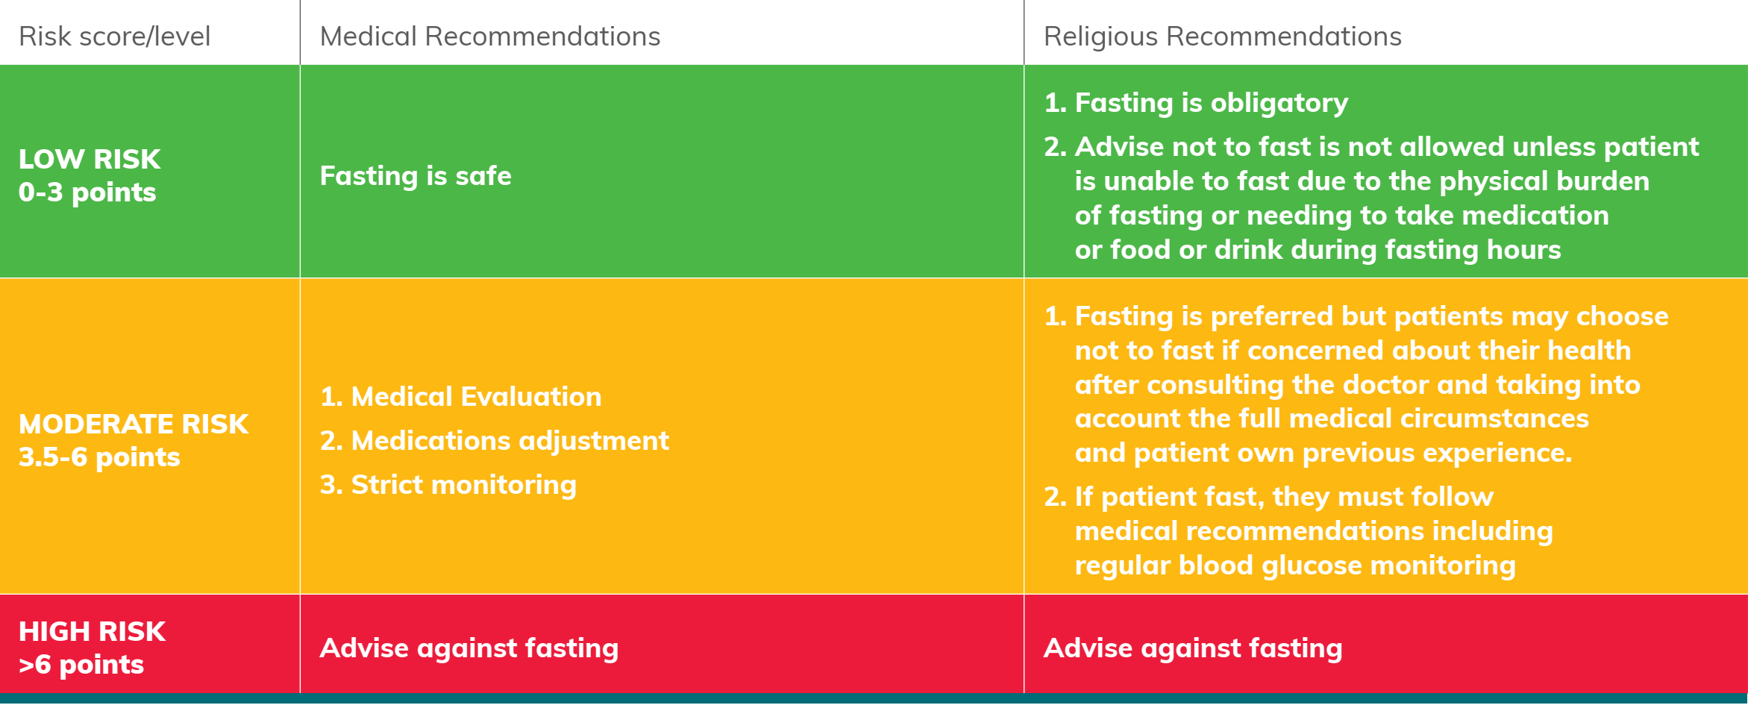
MEDICAL & RELIGIOUS RISK SCORE RECOMMENDATIONS

Slide 18
Risk score and risk categories
The strategies to ensure the safety of individuals that are fasting in all risk categories include:
Ramadan focused medical education
A pre-Ramadan medical assessment, including a robust assessment of hypoglycemia awareness
Following of a healthy diet and a physically active lifestyle
Frequent SMBG or continuous glucose monitoring (CGM)
Modifications to treatment regimens

Slide 19
Risk levels and associated recommendations
Individuals who are in the high risk category should not fast.
If they do still insist on fasting, the utmost care and monitoring should be provided alongside the strategies and recommendations mentioned above.
Those at the moderate risk level are advised not to fast.
If these individuals choose to fast, then they would need to be cautious and discontinue fasting if any problems arise. They also need to be aware of the techniques or strategies to decrease this risk.
Those at the low risk level should be able to fast.
Even in these patients circumstances can change leading to a change in the risk scoring. Therefore, risk stratification should be conducted annually to review the level of risk in advance of Ramadan.

Slide 20
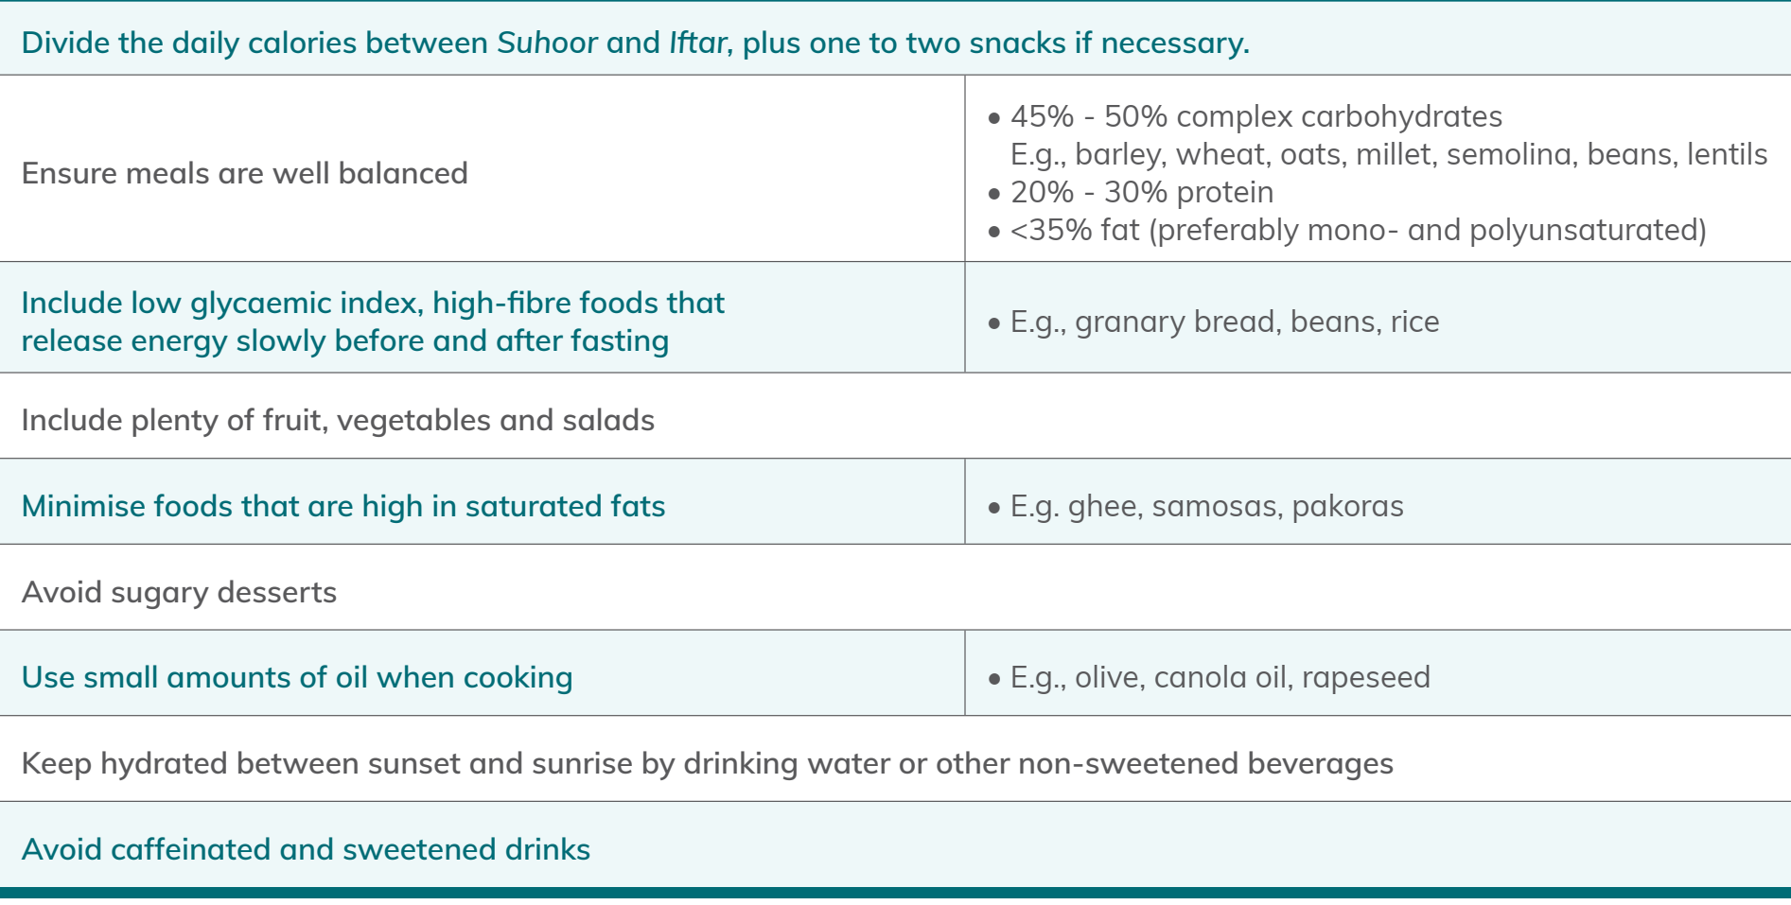
Dietary advice for people with diabetes fasting during Ramadan

Slide 21
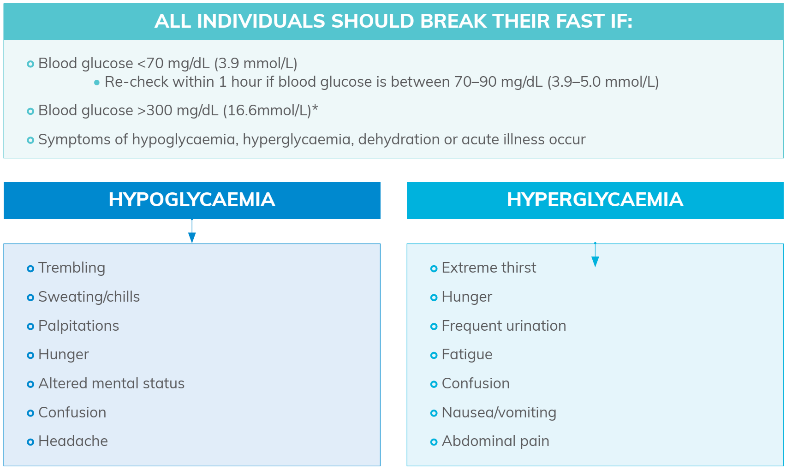
Braking the fast

Slide 22
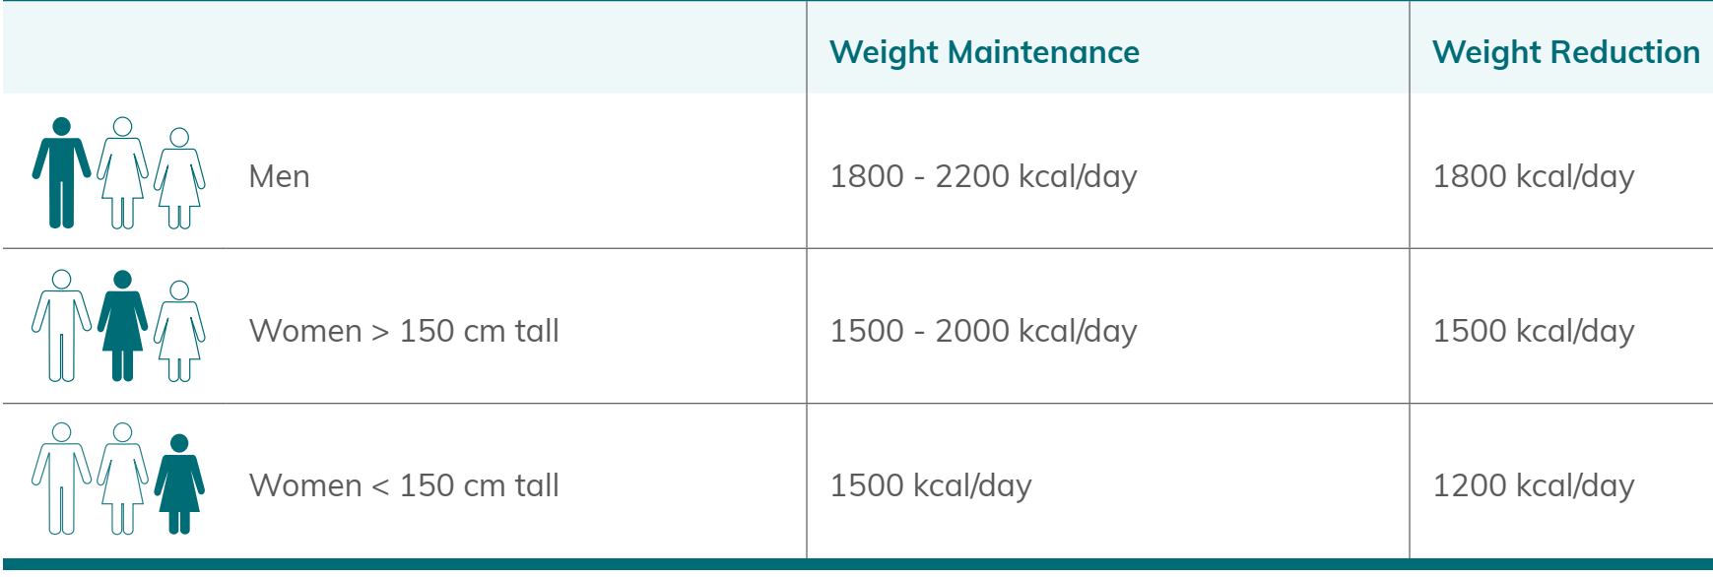
Caloric targets for men and women when fasting during Ramadan

Slide 23
Calorie and carbohydrate distributions for the Ramadan nutrition plan

Slide 24
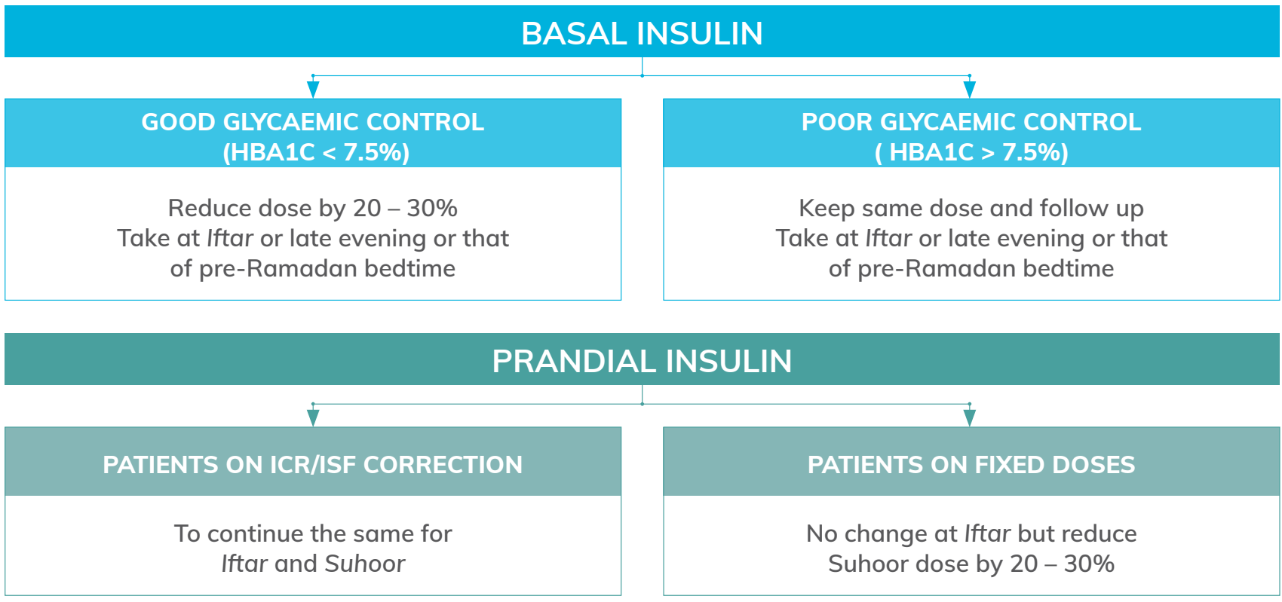
The recommended use of MDI therapy in adolescents with T1DM that are fasting during Ramadan

Slide 25
The recommended use of MDI therapy in adolescents with T1DM that are fasting during Ramadan

Slide 26
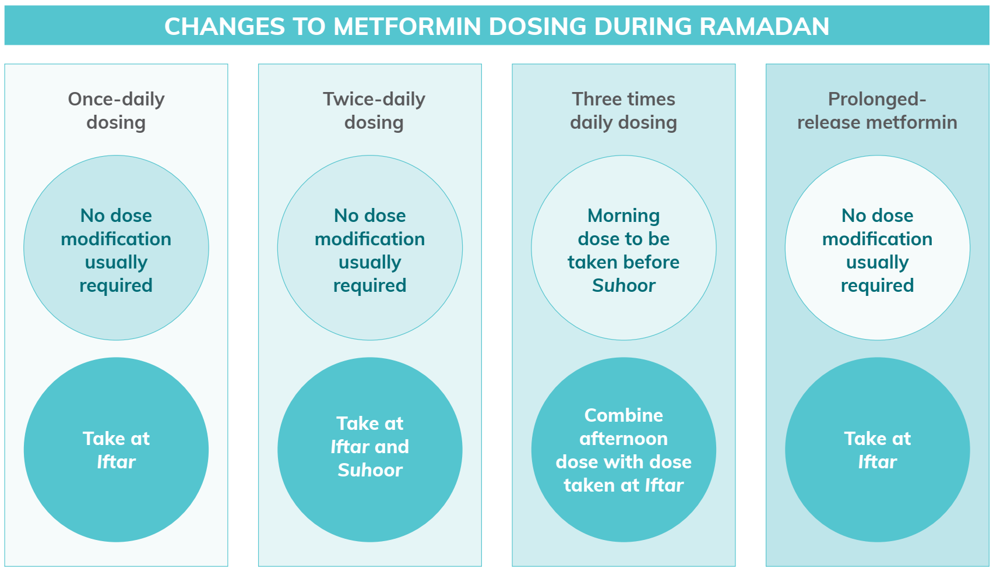

Slide 27
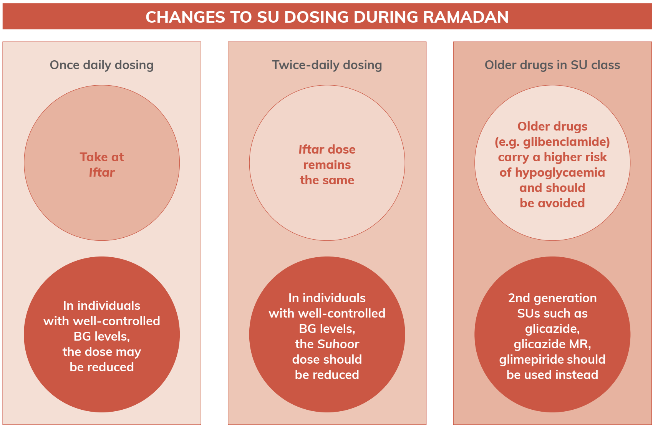

Slide 28
Due to the low risk of hypoglycemia with pioglitazone, no dose modification is required during Ramadan, but dose should be taken with Iftar.
While no RCTs have been conducted on Acarbose in people with T2DM that fast during Ramadan, no dose modification is considered necessary as the risk of hypoglycemia is low.
The daily dose of short-acting insulin secretagogues (based on a three-meal dosing) may be reduced or redistributed to two doses during Ramadan according to meal sizes.
As long as liraglutide, lixesenatide, exenatide have been appropriately dose-titrated prior to Ramadan (at least 2–4 weeks), no further treatment modifications are required.
DPP4-I Do not require treatment modifications during Ramadan.
SGLT2 inhibitors have a low risk of hypoglycemia. No dose adjustments are required during Ramadan.

Slide 29
SGLT2 inhibitors have a unique mode of action whereby they increase the excretion of glucose by the kidneys by reducing reabsorption in the proximal tubule, consequently decreasing blood glucose.
SGLT2 inhibitors have demonstrated effective improvements in glycemic control and weight loss and are associated with a low risk of hypoglycemia.
Because of this, it has been proposed that they can be a safe treatment option for people with T2DM that fast during Ramadan.
However, some safety concerns were raised, such as an increased risk of dehydration in vulnerable patients, which may be a particularly pertinent issue during Ramadan.

Slide 30
The previous 2016 IDF-DAR guidelines were in favor of using SGLT2I, but there remains a need for caution during among those on loop diuretics, the elderly and those with renal impairment.
Over the last 5 years, a greater number of studies assessing the use of SGLT2I have been published.
The results of these studies, alongside the importance of SGLT2I as a class for people with or at risk of CVD/CKD, prompted the authors of the Canadian diabetes and Ramadan guidelines to advise on withholding SGLT2I only in circumstances of significant volume depletion such as frequent vomiting or diarrhea and in situations where medications such as ACE-I and diuretics are used.

Slide 31
These studies indicate the following recommendations:
For stabilization, SGLT2Is should be initiated at least two weeks to one month prior to Ramadan.
SGLT2Is are recommended to be administered at the time of evening meal (Iftar).
However, if the indication for SGLT2I initiation is cardiovascular or renal protection, then the pre-Ramadan initiation should be conducted with a lower dose.
Increasing fluid intake during the non-fasting hours of Ramadan is recommended.
Raising awareness among physicians about recent guideline changes and the benefits of new anti-hyperglycemic agents is important.
When choosing an anti-hyperglycemic therapy, the impact on heart failure and renal function must be considered.
SGLT2I do not require treatment modifications during Ramadan, however if an individual is on multiple medications a review of the doses should be made to avoid the risk of hypoglycemia.
SGLT2I use when fasting during Ramadan should be in accordance with the usual safety and prescribing measures as recommended by each drug SMP.

Slide 32
CONSIDERATIONS AND RECOMMENDATIONS

Slide 33
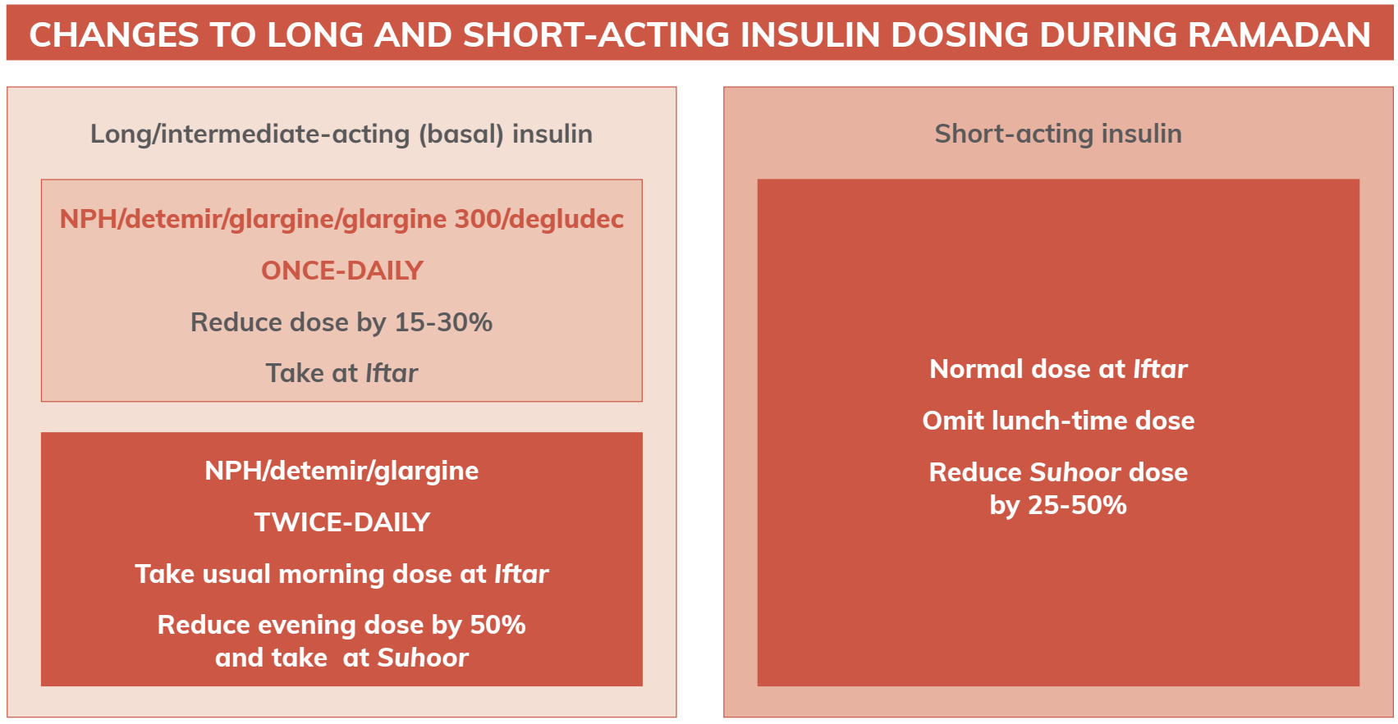
Dose adjustments for long or short-acting insulins

Slide 35
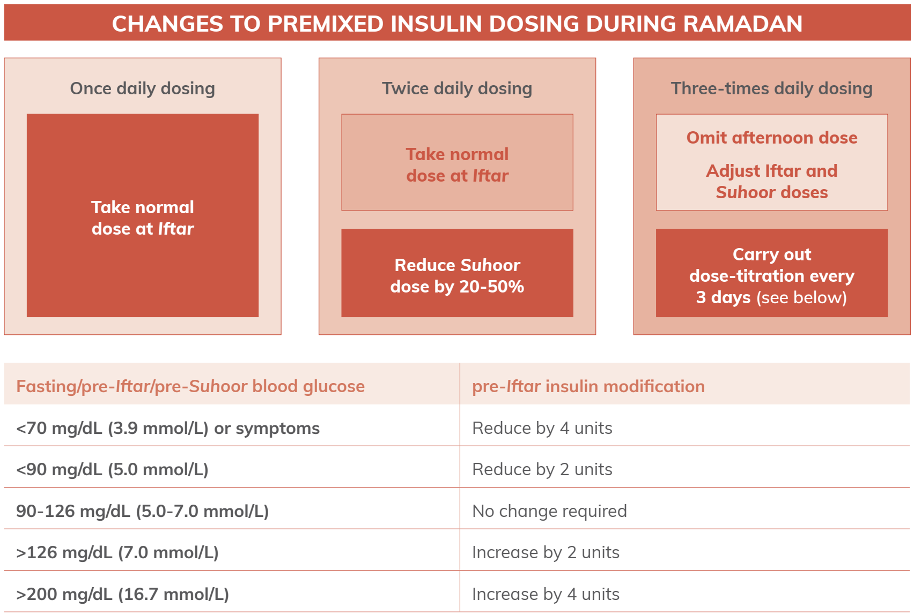
Dose adjustments for premixed insulin

Slide 36
Dose adjustments for insulin pump therapy

Slide 37
Management of hyperglycemia in pregnancy when fasting during Ramadan
Many pregnant women with pre-existing diabetes or GDM are considered as high-risk group for fasting during Ramadan.
Multiple factors influence the risk assessment of a pregnant women with hyperglycemia and these should be carefully reviewed prior to Ramadan.
Patient education prior to Ramadan is essential to ensure mother and fetus safety regardless of fasting decision.
Regular SMBG should be conducted and at the very least once before the sunset meal; 1-2 hours after meals; once while fasting; anytime feeling unwell.
Pregnant women must break their fast if they feel unwell; BG levels drop below 70 mg/dL (3.9 mmol/L); or identify a reduction in fetal movement.
Patients treated with insulin should have doses adjusted according to their insulin regimen.

Slide 38
Cardiovascular/microvascular disease
Fasting during Ramadan with stable CVD does not increase hospitalizations or worsening of the underlying heart condition. However further research is needed into individuals with diabetes and pre-existing CVD to carry any specific recommendations to individuals with diabetes and CVD.
Studies investigating the risks of fasting on stroke are conflicting and greater research is needed in individuals with diabetes with pre-existing stroke.
Fasting during Ramadan with stable CKD or having undergone a kidney transplant does not increase eGFR and any biochemical changes are transient.

Slide 39
Cardiovascular/microvascular disease
This may also apply to individuals with diabetes, but further research is needed into individuals with pre-existing diabetes and CKD.
Individuals that have undergone a kidney transplant or have stage 3-5 CKD are at high-very high risk of fasting during Ramadan. These will require careful monitoring and specialized tailored advice before fasting during Ramadan. The conditions required to safely fast in other chapters of these guidelines must be met as a pre-requisite.
Larger prospective studies are needed; these include randomized trials and studies assessing the effect of fasting in individuals with diabetes and its complications on microvascular and macrovascular complications.

Slide 40
Summary
The risks of fasting include hypoglycaemia, hyperglycaemia, DKA and dehydration.
Physicians must quantify these risks and stratify each individual accordingly.
With the correct guidance, many people with diabetes can fast during Ramadan safely but they must be under the close supervision of HCPs and made aware of the risks of fasting.
The new IDF-DAR risk stratification defines three risk categories and provides a risk score that includes multiple factors that plays an important role in the fasting decision recommended for each patient.
Individuals who fast against the advice provided by their healthcare professionals should follow expert and detailed guidance to avoid the development of serious complications.

Slide 41
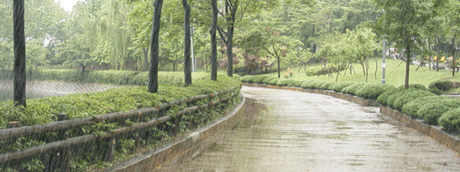
Thank you and hope for a good rain

