Slide 2
Dyslipidemia in children
Dr. Hashemi Pediatric Endocrinologist Isfahan University Of Medical Sciences

Slide 3
Outlines :
Introduction (Definition , Prevalence , Etiology)
Blood Lipid Screening
Risk Assessment
Choice of Screening Test
Management of Dyslipidemia in children
Some cases

Slide 4
Dyslipidemia
Dyslipidemia often begins in childhood and adolescence.
Identifying children with dyslipidemia and improving their lipid profile may reduce their risk of accelerated atherosclerosis and premature CVD.

Slide 5
Normative values
Normal lipid and lipoprotein values in children vary by age and sex.
Lipid levels change with normal growth and maturation.

Slide 6
Normative values
Lipoproteins are very low in cord blood at birth and rise slowly in the first two years of life.
Higher cholesterol levels are seen in breastfed babies related to the higher saturated fat content of breast milk .
Lipid levels are relatively stable from two years of age until adolescence.

Slide 7
Normative values
During puberty, TC and LDL-C levels decrease with increasing age, before rising in the late teenage years.
Males experience a decrease in HDL levels during late puberty, whereas HDL levels remain stable in females until menopause.
African American children have higher TC and HDL-C levels and lower triglyceride levels compared with other racial/ethnic groups.

Slide 8
Lipid and lipoprotein distributions in subjects aged 5 to 19 years

Slide 9
Definition of pediatric dyslipidemia
Based on normative data:
“Acceptable"
“Borderline"
“Abnormal"

Slide 10
Definition of lipid levels in children
Category | Acceptable mg/dl | Borderline mg/dl | High mg/dl
TC | < 170 | 170 - 199 | ≥ 200
LDL - C | < 110 | 110 - 129 | ≥ 130
NON – HDL - C | < 120 | 120 - 144 | ≥ 145
TG
0 – 9 years | < 75 | 75 - 99 | ≥ 100
10 – 19 years | < 90 | 90 - 129 | ≥ 130
APO B | < 90 | 90 - 109 | ≥ 110

Slide 11
Definition of lipid levels in children
Category | Acceptable mg/dl | Borderline mg/dl | Low
HDL - C | > 45 | 40 - 45 | < 40
APO A | > 120 | 115 - 120 | < 115

Slide 12
PREVALENCE
Approximately 20 percent of children (age 6 to 19 years) have adverse levels of one or more lipid value .

Slide 13
PREVALENCE
Normal weight : % 14
Overweight : % 22
Obese : % 43

Slide 14
ETIOLOGY
● Dietary causes :
Excessive dietary intake of saturated and trans fats is an important cause or contributor to dyslipidemia.
● Secondary causes :
Obesity, Diabetes mellitus, Nephrotic syndrome… .

Slide 15
Causes of secondary dyslipidemia in children

Slide 16
ETIOLOGY
● Genetic causes :
Monogenic
( FH, familial defective apolipoprotein B or PCSK9, and familial hypertriglyceridemia )
Polygenic

Slide 17
Screening and Diagnosis

Slide 18
Benefits of screening
Early identification and control of pediatric dyslipidemia will reduce the risk and severity of CVD in adulthood.
Lipid disorders are clinically silent in the vast majority of cases.

Slide 19
Who should be screened?
Age-based universal screening
Selective screening

Slide 21
Choice of screening test
Fasting Lipid Profile
In children with CVD risk factors

Slide 22
Choice of screening test
Non –HDL - C
In children without risk factors

Slide 23
Choice of screening test
TC
HDL-C
NON- HDL - C

Slide 24
Lipid profile
Measurement of TC, HDL-C & TG
TG are influenced by recent food intake.
Differences in TC and HDL-C between the fasting or nonfasting state are small and clinically insignificant.

Slide 25
Lipid profile
LDL-C are calculated using the Friedewald formula .
The formula is valid only if the TG is <400 mg/dL .
In patients with more pronounced hypertriglyceridemia, LDL-C levels must be measured directly (direct LDL).

Slide 26
Non–HDL-C
Non-HDL-C includes all cholesterol present in lipoprotein particles that are considered atherogenic, including LDL-C, lipoprotein(a), IDL & VLDL .
TC and HDL-C can be measured accurately in plasma from nonfasting individuals, making it a more practical screening test for pediatric patients than a fasting lipid profile.

Slide 27
FOLLOW-UP AFTER SCREENING
After the initial screening test, repeat testing is required for those with abnormal results to confirm the diagnosis of pediatric dyslipidemia and determine the need for intervention .

Slide 28
Confirmatory testing
Two separate occasions two weeks to three months apart .
Repeated testing is required because there is considerable intraindividual variability.
Counseling regarding dietary and other lifestyle changes should begin with the first abnormal test.

Slide 29
Overview of follow-up of children undergoing lipid screening

Slide 30
Secondary causes of hypercholesterolemia
ALT
Alb
FBS
BUN
Cr
TSH
U/A ,….

Slide 31
Management of Dyslipidemia in children
Nonpharmacologic :
(dietary modification, physical activity, weight loss, and avoidance of nicotine)
Pharmacologic therapy

Slide 32
Nonpharmacologic
All children should be encouraged to eat a diet :
High in fiber from fruits, vegetables, and whole grains
High in polyunsaturated and monounsaturated fats
Low in saturated fat; and devoid of trans fats
Fat should comprise 30 % of total energy intake
Saturated fats should be limited to < 10 % of total energy intake

Slide 33
Nonpharmacologic
For patients with persistent hypercholesterolemia despite appropriate dietary modification:
Limiting total fat to 25 to 30 % of total calories
Saturated fat to ≤7 % of total calories

Slide 34
Nonpharmacologic
Plant stanols and sterols
These compounds are found naturally in fruits, vegetables, vegetable oils, nuts.
Stanols and sterols decrease absorption of fat-soluble vitamins and beta-carotene.
Children taking these supplements should therefore take a daily multivitamin.

Slide 35
Nonpharmacologic
Garlic, is not effective
Omega-3 fatty acids, as found in fish oil supplements, are not recommended for children with hypercholesterolemia, as they may increase LDL-C levels.

Slide 37
Pharmacologic therapy
The decision to initiate lipid-lowering medication depends upon :
Age of the child
Severity of dyslipidemia
CVD risk factors

Slide 38
Management of hypercholesterolemia LDL-C ≥ 130 mg/dL , TC ≥ 200 mg/dL
Risk-based ( high , moderate , at risk , Non )
Age

Slide 40
Pharmacologic therapy
In children <10 years of age:
High-risk CVD condition
LDL-C levels >400 mg/dL
Very elevated triglyceride TG ( >1000 )
Vey strong family history of premature atherosclerotic CVD events

Slide 41
Statin therapy
Statins are the preferred first-line agents for treatment of hypercholesterolemia in children who meet criteria for pharmacotherapy.

Slide 42
Statin therapy

Slide 43
Statin therapy

Slide 44
Statin therapy

Slide 45
Statin therapy
Although statins are best given in the evening to coincide with the peak cholesterol biosynthesis at night, and the long-acting statins, atorvastatin and rosuvastatin, may be given any time.

Slide 46
Statin therapy
Pravastatin at 8 years old and older, all others (simvastatin,fluvastatin, lovastatin, atorvastatin, and rosuvastatin) at 10 years old and older is approved .
Each doubling of the statin dose only results in approximately a 6% reduction in LDL-C.

Slide 47
Statin therapy Adverse effects
Adverse effects
Myopathy, New-onset type 2 diabetes mellitus, Hepatic enzyme elevation , myositis , rhabdomyolysis , angioedema (rare) , Headache
Side effects occur at higher doses and in patients taking other medications (cyclosporine, azole antifungal agents, grapefruit)

Slide 48
Statin therapy Adverse effects
Adolescent females should be counseled about the possibility of drug teratogenicity and appropriate contraceptive methods while receiving statin therapy.
Use of statins by breastfeeding mothers is discouraged.

Slide 49
Statin therapy Monitoring
Monitoring
baseline laboratory evaluation prior to initiating statin therapy:
●Fasting lipid profile
●Serum creatine kinase
●Serum alanine aminotransferase
●Blood glucose and hemoglobin A1c levels
●Pregnancy test, if clinically indicated

Slide 50
Statin therapy Monitoring
Fasting lipid profile, CPK , ALT , BS & HbA1c are repeated four and eight weeks after starting therapy .
Once on stable therapy, lipid levels, BS and Hb A1c are repeated every six months.
Repeated testing of liver function tests and CPK in asymptomatic patients is controversial.

Slide 51
Statin therapy Dose titration
If the targeted value is met and there are no laboratory abnormalities, therapy is continued at the same dose.
If the targeted value is not met, the dose is increased (usually by an increment of 10 to 20 mg). Reassessment is performed in four weeks.

Slide 52
Statin therapy Dose titration
If goals are not met after increasing the dose, but the treatment is well tolerated, one of the following options are followed:
The dose of statin may be increased further until the target is met, the maximum dose is reached ,or there is evidence of toxicity.
Another drug (ezetimibe or a bile acid sequestrant) may be added to statin therapy.
Side effects : 2 weeks stop

Slide 53
Cholesterol absorption inhibitors
Ezetimibe
Prevents intestinal absorption of cholesterol and plant sterols.
In combination with statins, further lowers serum LDL-C .
Monotherapy is effective .
Side effects are mild .
Lowers LDL-C by up to 15-20%

Slide 54
Cholesterol absorption inhibitors

Slide 55
Bile acid sequestrants
BAS are not as effective as statins in lowering LDL-C and have adverse side effects (constipation and bloating).
For these reasons, are used relatively infrequently.
Recommended in children, as early as 6 years of age .
Reduce LDL levels by ~20% .

Slide 56
Bile acid sequestrants
Contraindications :
Complete biliary obstruction
Chronic constipation
Severe hypertriglyceridemia(TG >400 mg/dL)

Slide 57
Bile acid sequestrants

Slide 58
Bile acid sequestrants
Colesevelam is the best tolerated of these agents .
These agents can affect the absorption of folate and fat-soluble vitamins, appropriate supplementation and monitoring.

Slide 59
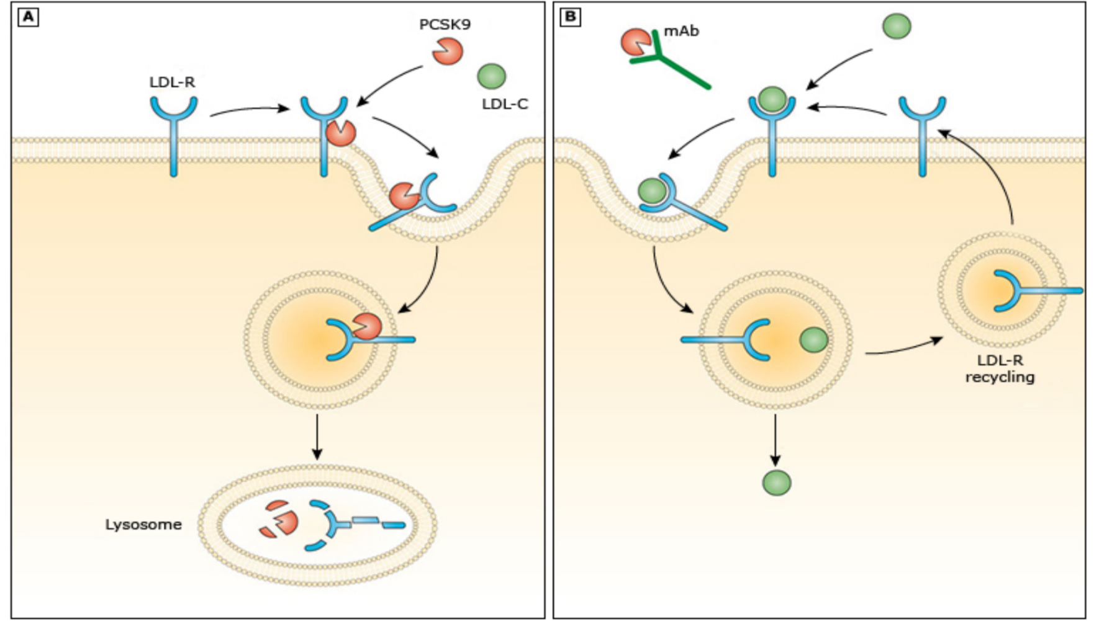
PCSK9 inhibitors

Slide 60
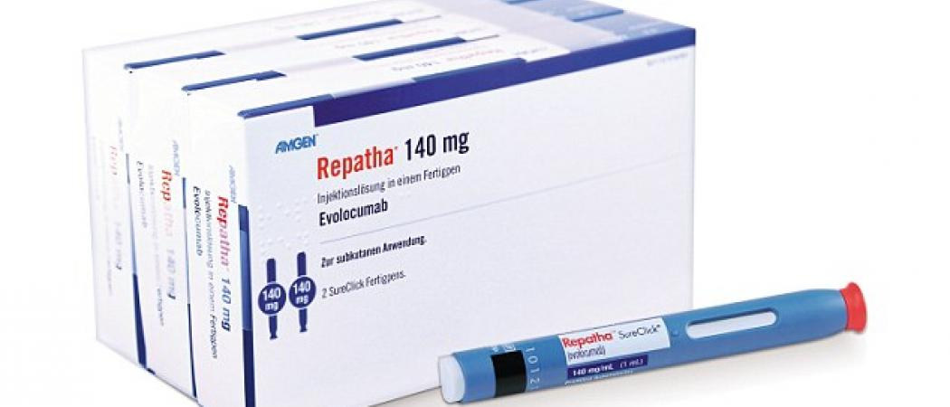
PCSK9 inhibitors
Evolocumab is approved in adolescents (≥12 years old) with homozygous FH (140 mg subcutaneously every two weeks or 420 mg once monthly)

Slide 61
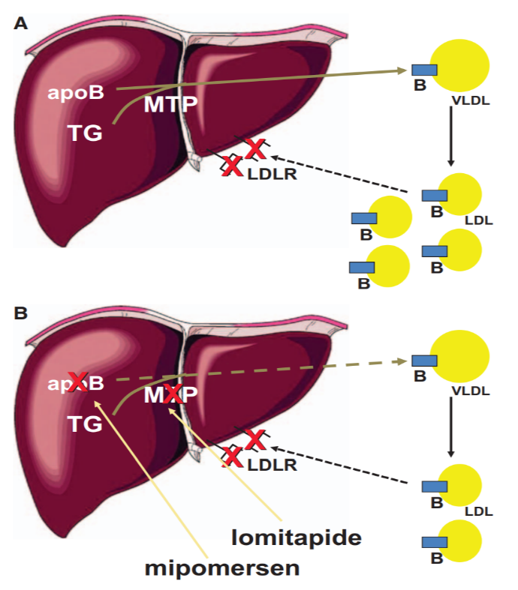
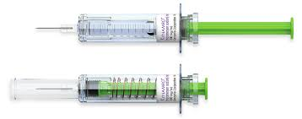
Mipomersen
≥12 years
Once weekly subcutaneous injection.
200 mg per week (160 mg if body weight was <50 kg)

Slide 62
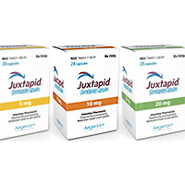
Lomitapide
≥18 years (0.03 - 1 mg/kg/ day ).

Slide 63
Lipoprotein apheresis
If the patient fails to reach the following LDL-C targets with diet and pharmacotherapy:
●LDL-C ≥160 mg/dL in children with established atherosclerotic CVD.
●LDL-C ≥250 mg/dL in children without established atherosclerotic CVD.

Slide 64
Lipoprotein apheresis
Long-term lipoprotein apheresis can contribute to plaque regression and/or stabilisation and improve prognosis .
Treatment should be started by age 5 .
The procedure is performed weekly or biweekly.
Lowers LDL-C acutely by 50 to 76 percent.

Slide 65
Lipoprotein apheresis
Side effects : hypotension, anemia, nausea, flushing, and headache.
Venous access is necessary.

Slide 66
Other treatment
Liver transplantation
Gene therapy
CETP inhibition
Antibody removal of resistin
ETC-1002

Slide 67
HYPERTRIGLYCERIDEMIA ( management)
TG >100 mg/dL in children <10 years
TG >130 mg/dL in children >10 years
Lifestyle modification
●Encouraging physical activity
●A low-saturated fat diet
● weight loss
●High-dose fish oil (omega-3 fatty acid / 2 to 4 g per day)

Slide 68
HYPERTRIGLYCERIDEMIA ( management )
Indications for pharmacologic treatment:
●TG levels >400 mg/dL
● 150 mg/dl < TG < 399 mg/dL and a non-HDL-C ≥145 mg/dL

Slide 69
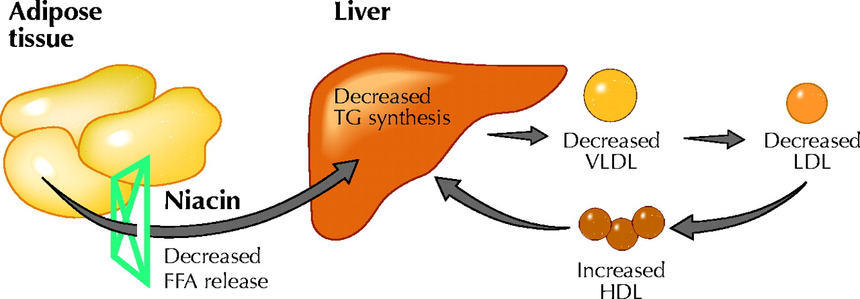
HYPERTRIGLYCERIDEMIA ( management )
Niacin is rarely used because of high rates of side effects and limited evidence of benefit.
Adverse effects:
Flushing
Palpitations
GIT disturbances
Hyperuricemia
Impaired glucose tolerance

Slide 70
HYPERTRIGLYCERIDEMIA ( management )
Fibric acid derivatives ( gemfibrozil, fenofibrate , clofibrate )
Ligand for peroxisome proliferator-activated receptor-α (PPAR- α) in the liver, heart, kidney, & skeletal muscle.
PPAR-a are a class of intracellular receptors that modulate fat metabolism.

Slide 71
HYPERTRIGLYCERIDEMIA ( management )

Slide 72
HYPERTRIGLYCERIDEMIA ( management )

Slide 73
Goals of therapy
Targeted values for TG :
●Minimal value, TG < 500 mg/dL
●Optimal value, TG < 200 mg/dL

Slide 74
Case 1
The patient is a 4-year-old male who presented with cutaneous xanthomas on the extensor surfaces of his arms, knees, elbows, and Achilles tendon.
He had these xanthomas since he was 1 year old.
LDL - C = 600 mg/dL & TG= 170 mg/dL.

Slide 75
Cutaneous xanthomas on the knees of patient

Slide 76
Cutaneous xanthomas on the hand of patient

Slide 77
Cutaneous xanthomas on the left elbow of patient

Slide 78
What is your diagnosis ?

Slide 79
Familial hypercholesterolemia (Physical examination)
Abnormal deposits of cholesterol in the skin and eyes

Slide 80
Juvenile xanthogranuloma

Slide 81
Corneal arcus

Slide 82
Xanthelasma

Slide 83
Tuberous xanthoma

Slide 84
Achilles tendon xanthoma

Slide 85
Tendon xanthomata

Slide 86
Case 2
A 13-year-old boy presented with history of progressive, non-itchy, yellowish, irregular plaques on elbows, knees, shoulders and buttocks since infancy.
His father had acute myocardial infarction at the age of 42 years.

Slide 87
yellowish, irregular plaques on elbows and buttocks

Slide 88
Case 2
TG = 350 mg/dl
TC = 375 mg/dl
HDL = 45 mg/dl

Slide 89
What is your diagnosis ?

Slide 90
Familial dysbetalipoproteinemia
It is a rare familial dyslipidemia characterized by approximately equally elevated TC and TG levels.
Mutation in the gene for apo E .

Slide 91
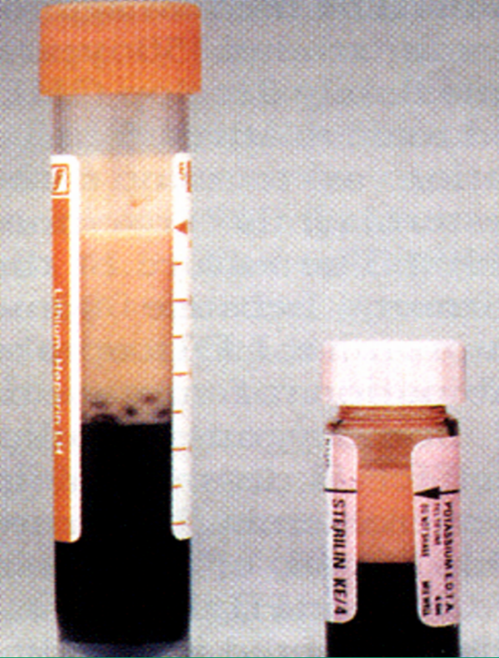
Case 3
A 5 year old girl was admitted with abdominal pain .
In the course of blood sampling , serum color was milky .
TG = 2040 mg/dl
TC = 280 mg/dl
High levels of amylase & lipase

Slide 92
What is your diagnosis ?

Slide 93
Chylomicronemia
It is characterized by TG levels above the 99th percentile in association with a creamy plasma.

Slide 94
Lipemia Retinalis
Xanthomata

Slide 95
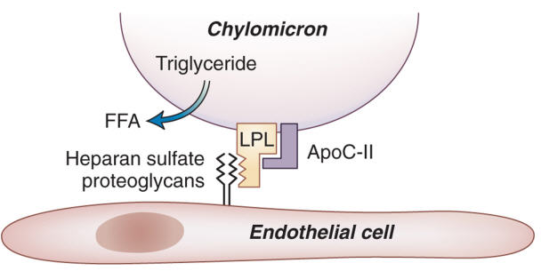
Chylomicronemia (Pathophysiology)
Complete absence of LPL or apo C-II

