Slide 2
IN THE NAME OF GOD
Pediatric Type 2 Diabetes: Not a Mini Version of Adult Type 2 Diabetes
Dr.kachuei

Slide 3
PREVALENCE, INCIDENCE OF PEDIATRIC TYPE 2 DIABETES
The incidence of pediatric T2DM has been increasing since it was first described in the 1980s and corresponds with the increasing childhood obesity rates. SEARCH found that, from 2002 to 2015, the pediatric T2DM incidence in the United States increased by 4.8% annually (from 9.0 cases per 100,000 youths per year in 2002–2003 to 13.8 cases per 100,000 youths per year in 2014–2015).

Slide 4
A rise in prevalence of T2DM is occurring worldwide in parallel with an increasing prevalence of obesity in children In the early 1990s, T2DM represented approximately 3 percent of pediatric diabetes in the United States. By 2003, T2DM represented approximately 20 percent of pediatric diabetes and, depending on locale, nearly one-half of the cases of diabetes among adolescents 15 to 19 years of age.

Slide 5
Japan – A population-based study from Tokyo of school-aged children (6 to 15 years of age) demonstrated an increased incidence of T2DM after 1981 compared with before 1981 (2.76 versus 1.73 per 100,000), which corresponded to an increase in the number of obese children during the same time period.in United states a 30.5 percent (95% CI 17.3-45.1) adjusted increase in the overall prevalence of T2DM between 2001 and 2009 . Increases were evident in both sexes; across all age groups 10 to 19 years old; and in white, Hispanic, and black youth.

Slide 6
Risk factors
●Obesity
●Positive family history
●Specific racial and ethnic groups
●Female sex
●Conditions associated with insulin resistance

Slide 7
Genetic susceptibility
One-half to three-quarters of children and adolescents with T2DM have at least one affected parent . As an example, in the baseline data from the TODAY study (Treatment Options for Type 2 Diabetes in Adolescents and Youth), 60 percent of study participants had a positive family history of diabetes in a first-degree relative, while 89 percent had a positive family history of diabetes with the addition of grandparents.

Slide 8
The offspring of a parent with T2DM has an estimated 20 percent risk of developing T2DM by late adulthood (approximately 3.5 times the risk of an individual without parental T2DM) . The risk rises to 30 percent if both parents are affected (approximately six times the risk of an individual without parental T2DM). Gene identification has been difficult because of the complex inheritance patterns and interactions with the environment .

Slide 9
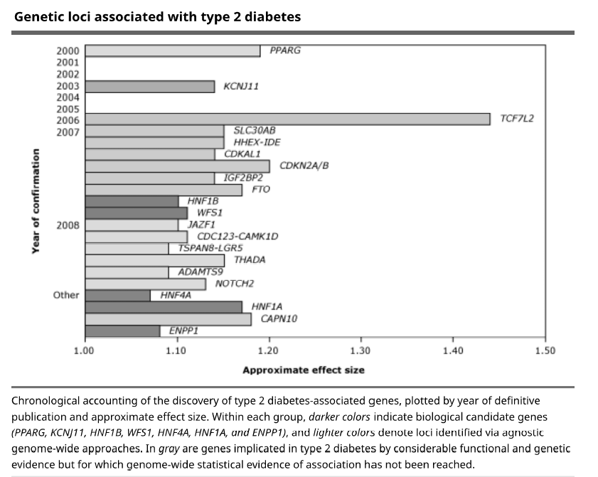

Slide 10
Age and sex
Girls are 1.3 to 1.7 times more likely than boys to develop T2DM during adolescence. Although the reason for this increased risk in girls is not clear, it may be related to an increased risk of insulin resistance, as seen in adolescent girls with polycystic ovary syndrome (PCOS).

Slide 11
Many patients with pediatric T2DM present at the onset of puberty (mean age of 13.5 years) , a stage of development when there is physiologic insulin resistance . Approximately 40 percent of pediatric cases occur between 10 and 14 years of age and the remaining 60 percent between 15 and 19 years . During puberty, insulin sensitivity decreases by approximately 30 percent, related to the increased activity of growth hormone.

Slide 12
Low birth weight & GDM
Low birth weight for gestational age resulting from intrauterine undernutrition is associated with insulin resistance. The combination of low birth weight and weight gain in adult middle age increases insulin resistance and the risk for T2DM. Gestational diabetes – The abnormal intrauterine metabolic environment of a pregnancy complicated by diabetes appears to increase the risk of T2DM. Intrauterine exposure to hyperglycemia and hyperinsulinemia may affect the development of adipose tissue and pancreatic beta cells, leading to future obesity and altered glucose metabolism.

Slide 13
CLINICAL PRESENTATION
Asymptomatic – Approximately 40 percent
Symptomatic (eg, polydipsia and polyuria) without ketonuria or acidosis – 57 to 70 percent
Diabetic ketoacidosis (DKA) – 5 to 12 percent
Hyperosmolar hyperglycemic state (HHS) – Uncommon but serious1

Slide 14
Asymptomatic
Approximately 40 percent of children and adolescents with T2DM are identified while asymptomatic. These patients may be tested for T2DM because of risk factors or because glycosuria was detected on a urinalysis obtained as part of a routine physical examination.

Slide 15
Symptomatic
The main symptoms of T2DM are due to hyperglycemia and commonly include polyuria, polydipsia, and nocturia, as in patients with type 1 diabetes mellitus (T1DM). Symptomatic patients also may have experienced recent weight loss, although this is rarely a presenting complaint, and the percentage of weight loss is typically less than in patients with T1DM. In adolescent girls, vaginal discharge or vulvovaginitis due to candidiasis can be the initial chief complaint.

Slide 16
Diabetic ketoacidosis
Occasionally, children with T2DM present with DKA (hyperglycemia, ketonuria, and acidosis). Symptoms are due to hyperglycemia and include polyuria (due to the glucose osmotic diuresis), polydipsia (due to increased urinary losses), fatigue, and lethargy. The reported frequency of DKA as the initial presentation for childhood T2DM varies from 5 to 12 percent .

Slide 17
Hyperosmolar hyperglycemic state
Adolescents with T2DM may present with HHS, also referred to as hyperosmolar hyperglycemic nonketotic syndrome (HHNK). This condition is characterized by marked hyperglycemia (plasma glucose >600 mg/dL), hyperosmolality (serum osmolality >330 mOsm/kg), and severe dehydration but little or no ketonuria .

Slide 18
SCREENING
Indications — (ADA) and International Society for Pediatric and Adolescent Diabetes (ISPAD) recommend testing asymptomatic children and adolescents for T2DM after the onset of puberty or ≥10 years, whichever occurs earlier, if they meet the following screening criteria:
Overweight or obese (body mass index [BMI] ≥85th percentile) and have one or more of the following additional risk factors :
●T2DM mellitus in a first- or second-degree relative
●Member of a high-risk racial/ethnic group: Native American, African American, Latino, Asian American, or Pacific Islander
●Maternal history of diabetes or gestational diabetes during the child's gestation
●Signs of insulin resistance or conditions associated with insulin resistance (eg, hypertension, dyslipidemia, acanthosis nigricans, polycystic ovary syndrome [PCOS], or small for gestational age birth weight).

Slide 19
T2DM in pediatrics
poses a major challenge to population health, with an increasing incidence (highest in patients of racial minorities and of lower socioeconomic status) and a high rate of complications.Childhood onset T2DM also shows more rapid progression to beta-cell failure, with high treatment failure rates .

Slide 20
TODAY (Treatment Options for Type 2 Diabetes in Adolescents and Youth) trial, the largest multicenter randomized controlled trial on treatment options in pediatric T2DM, in which children with T2DM were randomized to 1 of 3 treatment arms (metformin monotherapy, metformin plus lifestyle intervention, and metformin plus rosiglitazone) and the primary outcome was treatment failure, defined by persistently increased hemoglobin A1c (HbA1c) level (>8%) over a 6-month period or inability to wean from temporary insulin therapy within 3 months.

Slide 21
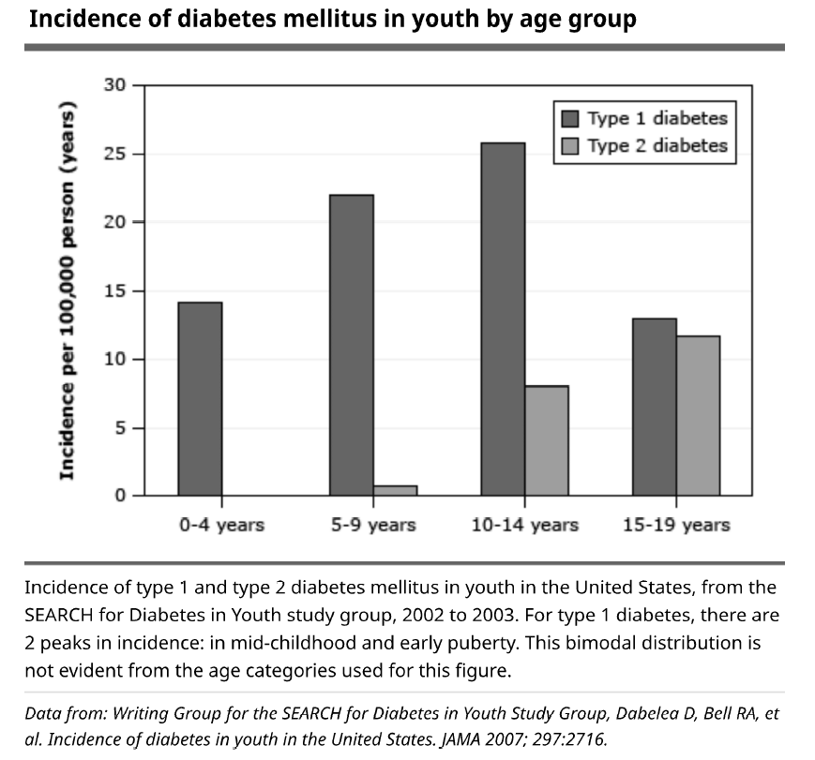

Slide 22
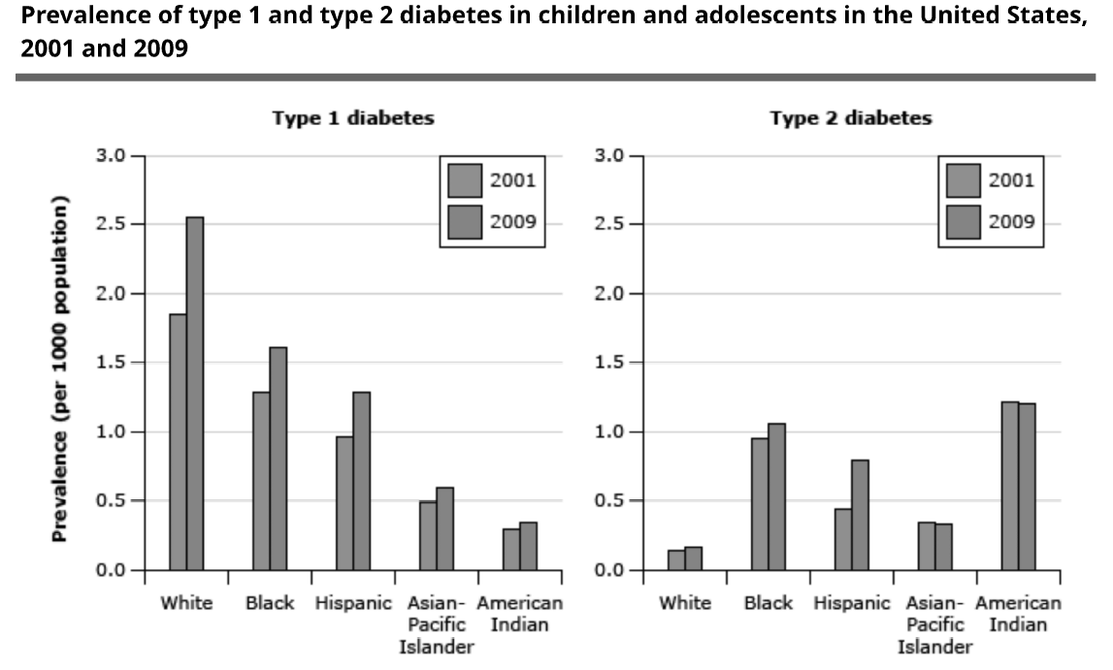

Slide 23
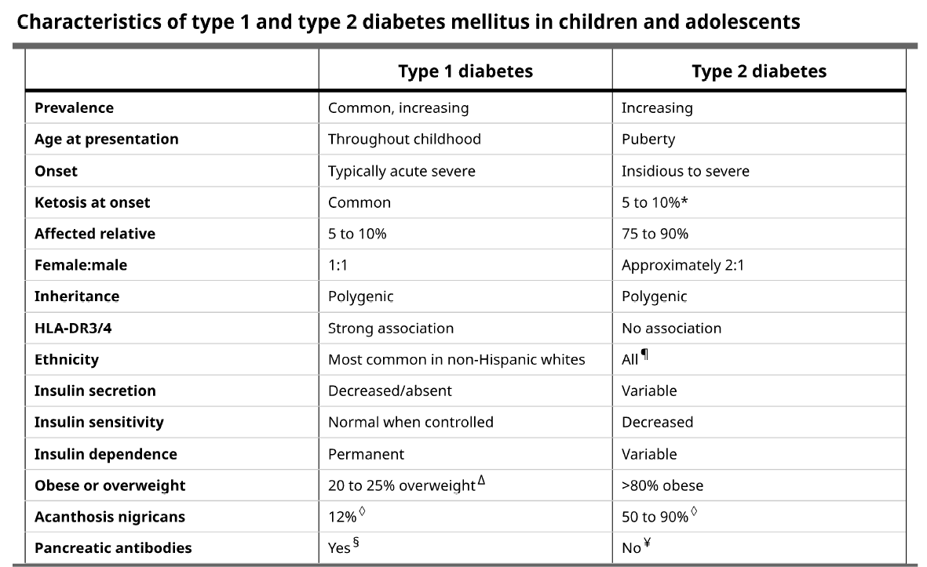

Slide 24
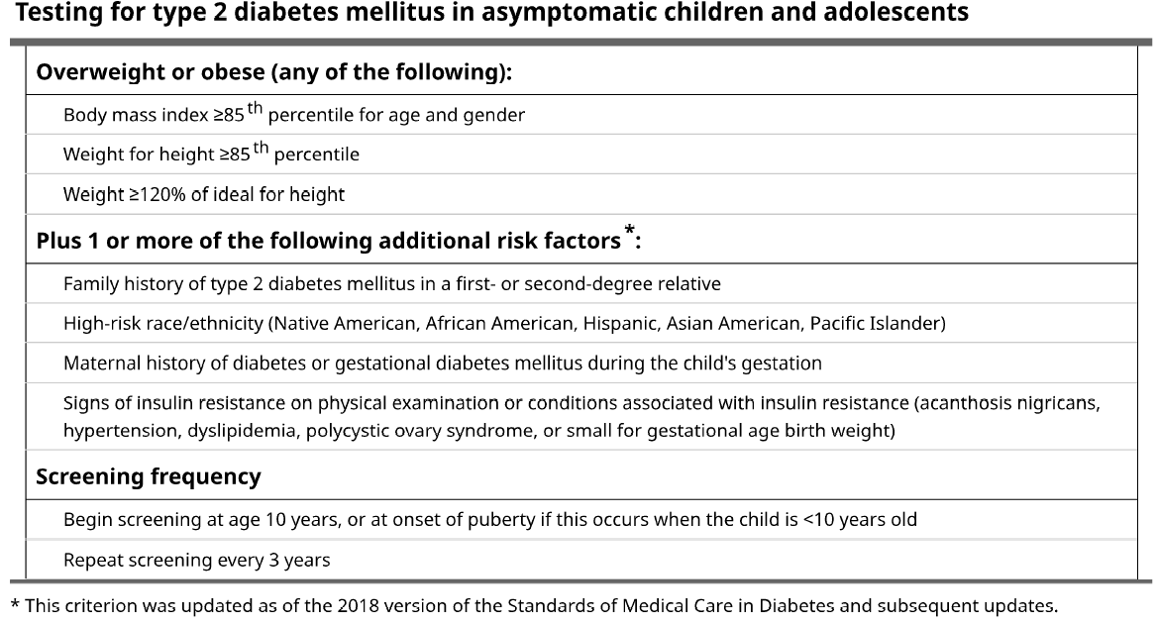

Slide 25
PATHOPHYSIOLOGY AND GENETICS OF PEDIATRIC TYPE 2 DIABETES
The pathophysiology of T2DM starts with declines in skeletal muscle, adipose tissue, and hepatic insulin sensitivity, which necessitates increased pancreatic beta-cell insulin secretion to maintain glucose homeostasis. Hyperglycemia develops when compensatory insulin secretion fails to counter worsening insulin sensitivity and manifests as prediabetes and, ultimately, T2DM. Hyperglycemic clamp testing has shown that, compared with obese controls without T2DM, youth who develop pediatric T2DM have 50% reduced insulin sensitivity, increased fasting hepatic glucose production, and an 86% lower disposition index .

Slide 26
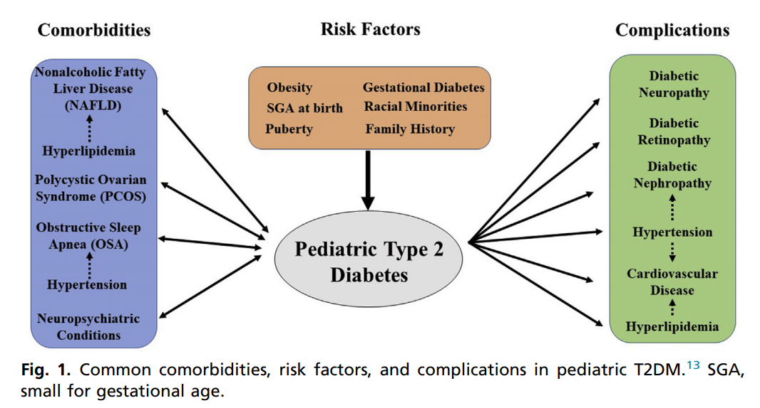

Slide 28
SCREENING AND DIAGNOSIS OF PEDIATRIC TYPE 2 DIABETES MELLITUS
The American Diabetes Association (ADA) currently recommends screening for T2DM with HbA1c in youth “after the onset of puberty or greater than or equal to 10 years of age, whichever occurs earlier, who are overweight (body mass index 85th percentile) or obese 95th percentile), and who have 1 or more additional risk factors for diabetes. If HbA1c level is normal, the ADA recommends repeat testing at a minimum of 3-year intervals. The ADA recommends testing for T2DM and prediabetes in obese youth more frequently, such as every 2 years, as suggested by an expert committee obesity guidelines, if BMI continues to increase. Children identified with prediabetes should have at least annual repeat testing.

Slide 29
At present, the ADA recommends HbA1c testing for pediatric T2DM screening and ease of use because patients do not need to fast. Other measures of average glycemia, such as fructosamine, can be used in diseases such as iron deficiency anemia, sickle cell disease, thalassemia, and other hemoglobinopathies. Glycemic screening includes fasting blood glucose test and oral glucose tolerance test (OGTT), although how these methods compare with HbA1c in pediatrics is unclear.

Slide 30
The diagnostic criteria for diabetes and prediabetes
Differentiating among pediatric T2DM, type 1 diabetes mellitus (T1DM), and monogenic diabetes (MODY) can be difficult because overweight, obesity, and acanthosis nigricans can be present in children with T1DM and MODY. In addition, T2DM can present with ketosis or DKA. Testing for diabetes-associated pancreatic islet autoantibodies can be useful to distinguish between T1DM and T2DM. However, these autoantibodies can be positive in patients who seem to have a clinical course more consistent with T2DM. In the TODAY study, 9.8% (118) of the 1206 youth with T2DM screened had positive pancreatic autoantibodies: 71 (5.9%) were positive for a single antibody (29 anti-GAD-65 antibody, 42 anti-IA-2 antibody), and 47 (3.9%) were positive for both antibodies. The number of positive antibodies can assist in distinguishing between T2DM and T1DM because the risk of developing T1DM is high in children with more than 1 positive pancreatic islet autoantibody.

Slide 31
MODY has also been noted in up to 8% of youth with features suggestive of T2DM. Thus, genetic testing should be considered in youth with multiple family members with diabetes without typical features of T1DM or T2DM, such as negative diabetes autoantibodies, nonobese, and lacking other features of metabolic syndrome. Markers of beta-cell insulin secretion, including a fasting C peptide and urinary C peptide/creatinine ratio (UCPCR), may be useful in distinguishing among T2DM, T1DM, and MODY. Katz and colleagues showed that fasting C-peptide level greater than 0.85 ng/mL at diagnosis can differentiate T1DM from T2DM with a sensitivity of 83% and a specificity of 89%, and UCPCR greater than 0.7 nmol/ mmol has been shown by Besser and colleagues to have 100% sensitivity and 81% specificity to distinguish between T1DM and non-T1DM (MODY or T2DM).

Slide 32
COMORBIDITIES IN PEDIATRIC TYPE 2 DIABETES MELLITUS
adults with T2DM, the prevalence of concurrent nonalcoholic fatty liver disease (NAFLD) ranges from 40% to 70%. In a cohort study of 675 children with NAFLD, 30% had comorbid T2DM or prediabetes. the risk factors for NAFLD in pediatrics are aspects associated with metabolic syndrome, including central obesity (waist circumference >102 cm in boys and 88 cm in girls), higher triglyceride level (>150 mg/dL), high total cholesterol level (>200 mg/dL), higher low-density lipoprotein (LDL) cholesterol level (>130 mg/ dL), higher systolic (>130 mm Hg) and diastolic (>85 mm Hg) blood pressure, and lower high-density lipoprotein (HDL) cholesterol levels .

Slide 33
Signs of NAFLD include increased liver enzyme levels or signs of fatty liver on ultrasonography. Children with NAFLD and comorbid pediatric T2DM have 3.1 times higher odds of developing nonalcoholic steatohepatitis (NASH), a progressive form of NAFLD that has a greater risk of progressing to cirrhosis.

Slide 34
Obstructive sleep apnea (OSA)
Obstructive sleep apnea (OSA) is also associated with central obesity and insulin resistance and is an additional independent risk factor for cardiovascular complications, including increased blood pressure, in children and adults. Pediatric patients with obesity should be screened for symptoms of OSA, including habitual snoring, apneic pauses while sleeping, or excessive daytime sleepiness; however, history and physical examination have low positive predictive value (65%) in identifying OSA in youth. In addition, sleep disruption and OSA are associated with reduced insulin sensitivity in adults with T2DM, and treatment of OSA may improve glycemic control in patients with pediatric T2DM.

Slide 35
PCOS
PCOS characterized by hyperandrogenism and chronic anovulation, has a higher prevalence in youth with obesity, is associated with insulin resistance with or without obesity, and predisposes youth and adults to the development of diabetes. Insulin resistance is present in 30% to 40% of adults with PCOS, including both obese and nonobese. In 27 youth with PCOS and BMIs ranging from 20.4 to 54.4 kg/m2 , OGTT identified impaired glucose tolerance (IGT) in 30% and T2DM in 4%. No relationship between BMI and 2-hour OGTT plasma glucose was found, and the patient with the lowest BMI had IGT.

Slide 36
Psychiatric comorbidities are also common with pediatric T2DM. In a retrospective chart review of 237 patients with pediatric T2DM, Katz and colleagues showed neuropsychiatric disease was present in 19% of patients at diabetes presentation; diagnoses included depression, attention-deficit hyperactivity disorder, schizophrenia, bipolar disorder, and neurodevelopmental disorders.

Slide 37
TREATMENT OF PEDIATRIC TYPE 2 DIABETES MELLITUS
At this time, although several pharmacologic medication categories are available for treatment of adult T2DM, only 3 pharmacologic medications are currently FDA approved for pediatric patients with T2DM: metformin, insulin, and the glucagon-like peptide 1 (GLP-1) receptor agonist liraglutide. ADA guidelines recommend monitoring of HbA1c level every 3 months to inform treatment. The ADA suggests a target Pediatric Type 2 Diabetes HbA1c in pediatric T2DM of less than 7% but also states that goal HbA1c less than 6.5% could be used. The latter is supported by the TODAY study, in which hypoglycemia was rare even for patients who progressed to insulin therapy and 5-year diabetic complication rates were high.

Slide 38
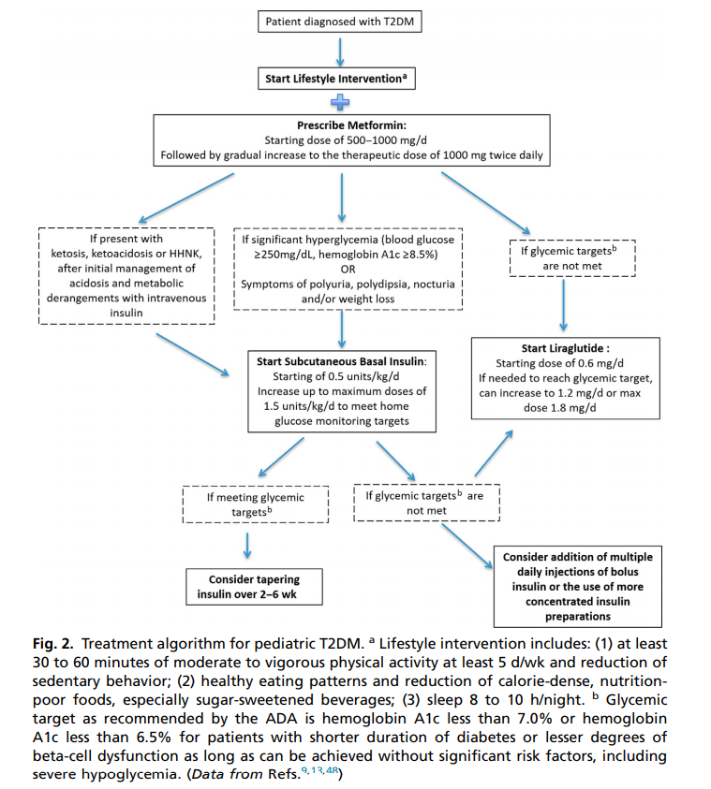

Slide 39
Metformin is recommended as the first-line therapy for T2DM in adults and youth with normal renal function . Basal insulin should be initiated in patients with significant hyperglycemia; ketosis; symptoms of polyuria, polydipsia, nocturia, and/or weight loss; or who are failing to reach glycemic targets on other pharmacologic therapies, but should be tapered once meeting the glycemic targe.

Slide 40
Liraglutide, a daily injectable GLP-1 agonist, was approved for use in pediatric T2DM in spring 2019. Liraglutide is indicated in patients greater than or equal to 10 years of age on metformin plus or minus basal insulin therapy and who have not met glycemic targets HbA1c.

Slide 41
Weight loss can improve insulin sensitivity in pediatric T2DM. In a randomized controlled behavioral weight loss trial, an 8% reduction in BMI was associated with improved insulin sensitivity in obese adolescents.In addition, the TODAY trial showed that weight loss was associated with improved cardiometabolic outcomes, including decreases in systolic blood pressure, LDL cholesterol, triglycerides, total cholesterol levels, and increases in HDL cholesterol level over 24 months.

Slide 42
bariatric surgery
For youth with T2DM who fail lifestyle modifications and continue to have morbid obesity, bariatric surgery could be considered as a potential treatment option. Qualifications for bariatric surgery per American Society for Metabolic and Bariatric Surgery guidelines include class III obesity (BMI>140% of the 95th percentile or BMI 40 kg/ m2 ) or class II obesity (120% of the 95th percentile or BMI 35 to 39 kg/m2 ) with a comorbidity. Of the 30 participants (baseline BMI 54.4 kg/m2 ) in the Teen-Longitudinal Assessment of Bariatric Surgery (Teen-LABS) study with baseline T2DM who underwent bariatric surgery, mean HbA1c level decreased from 6.8% to 5.5%.

Slide 43
PROGRESSION OF PEDIATRIC TYPE 2 DIABETES MELLITUS
Pediatric T2DM has been shown to have higher rates of treatment failure compared with adult T2DM. In the TODAY trial, youth with T2DM showed a 45.6% overall treatment failure defined by persistently increased HbA1c level greater than 8% or inability to wean off insulin therapy. Treatment failure at 5 years with metformin monotherapy is higher in pediatric (51.7%) versus adult (21%) T2DM In addition to high treatment failure rates, pediatric T2DM also has faster progression to beta-cell failure than adult T2DM. Adult patients with T2DM have gradual beta-cell function decline occurring over 10 to 12 years at average rate of 7% per year, whereas youth with T2DM show declines as high as 35% per year.

Slide 44
Worsening diabetes control on metformin monotherapy occurring as early as 1.5 to 2 years after diagnosis is a manifestation of this rapid beta-cell function decline. Higher frequency of DKA in youth with new-onset T2DM also attests to these higher rates of beta-cell failure in pediatric T2DM. Baseline predictors of treatment failure and beta-cell decline in pediatric patients are higher fasting glucose level, higher HbA1c level, and DKA. These findings suggest earlier diagnosis and treatment may be protective against beta-cell decline

Slide 45
COMPLICATIONS OF PEDIATRIC TYPE 2 DIABETES
Diabetes can lead to microvascular complications (ie, nephropathy, retinopathy, and neuropathy) and macrovascular complications (ie, cardiac, cerebrovascular, and peripheral vascular diseases) .These complications have been described in pediatric T1DM and adult-onset T2DM and generally occur about 15 to 20 years following diagnosis. However, pediatric T2DM is associated with higher risk of complications than pediatric T1DM.

Slide 46
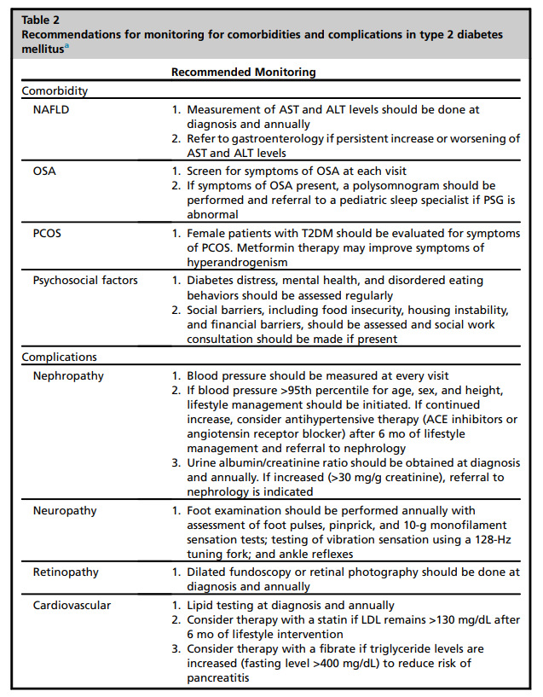

Slide 47
By the end of the TODAY trial’s 5-year study, increases were found in rates of hypertension from 11.6% to 33.8%, microalbuminuria from 6.3% to 16.6%, and LDL cholesterol from 4.5% to 10.7%. In addition, at the end of the TODAY trial, 14% of participants had retinopathy. The annual albuminuria progression rate in youth based on the TODAY study is 2.6%, similar to the finding in the UK Prospective Diabetes Study (UKPDS) in adults of 2.0%. In a cohort study of 342 youth with T2DM, major diabetic complications (eg, dialysis, blindness, and amputations) were noted in 1.1% at 10 years, 26% at 15 years, and 47.9% at 20 years after diagnosis.

Slide 48
In a retrospective analysis with greater than 20 years of data from 354 patients with T2DM and 470 patients with pediatric T1DM of similar age of onset, pediatric T2DM was also noted to have a significantly higher mortality at shorter disease duration than pediatric T1DM, likely driven by this study’s demonstrated higher rate of cardiovascular deaths in T2DM. in the TODAY cohort, in which increased mean left ventricular (LV) mass and mean left atrial size and abnormal LV geometry were noted. Carotid intima media thickness, a strong predictor of cardiovascular events in adults, is also high in youth with obesity and T2DM.

Slide 49
In addition, cardiac autonomic instability, as measured by heart rate variability, was present in 8% of the TODAY cohort and associated with increased arterial stiffness, as measured by carotid-femoral pulse-wave velocity . pediatric T2DM in the TODAY trial also had significant dyslipidemia and inflammation, contributors to premature atherosclerosis, with increases in LDL cholesterol level and use of statins (8.6% to 22%) and triglyceride, plasma nonesterified fatty acid, and high-sensitivity C-reactive protein levels, higher endothelial dysfunction, measured by lower brachial flow–mediated dilatation, in T2DM youth compared with youth with T1DM .

Slide 50
Pregnancy complications are also seen in women who have had pediatric-onset T2DM. Pregnancies occurred in 10% of the TODAY study cohort, 26% of whom had loss or stillbirth, and, of the live births, 15.4% were preterm and 20.5% had congenital anomalies (50% cardiac, 50% other). These statistics show the significant complications in pediatric T2DM, particularly compared with pediatric T1DM, and underscore the need for a clear understanding of the cause and progression of pediatric T2DM.

Slide 51
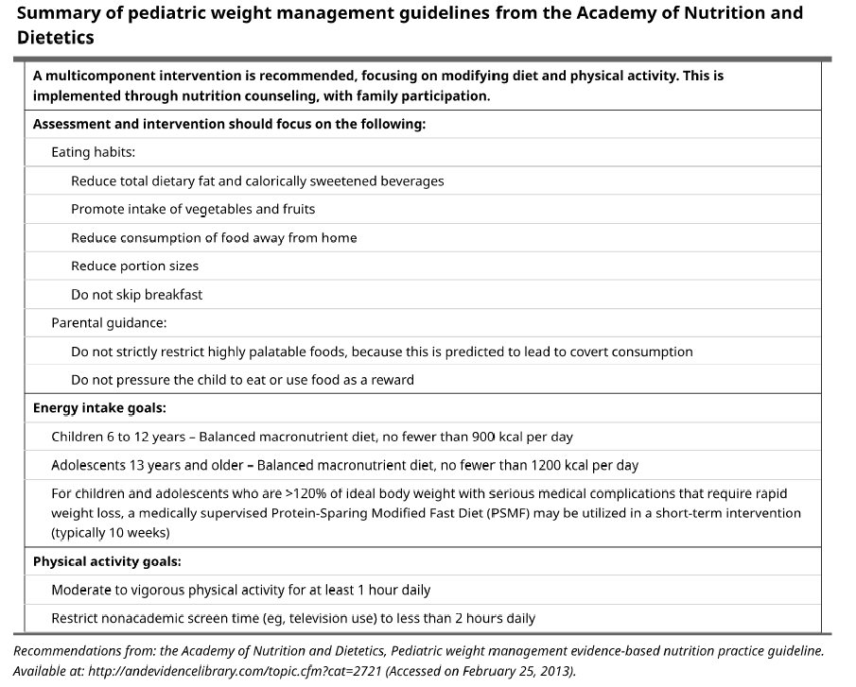

Slide 52
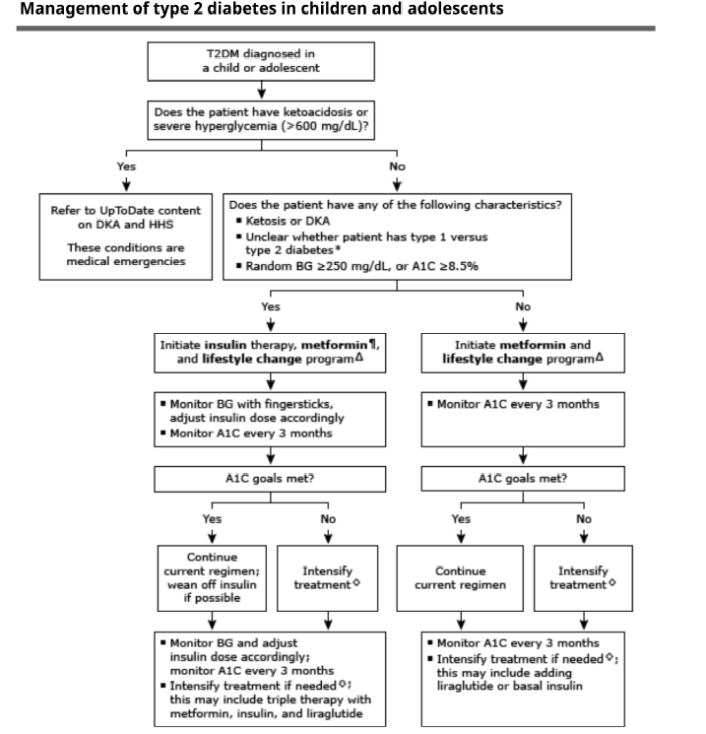

Slide 53
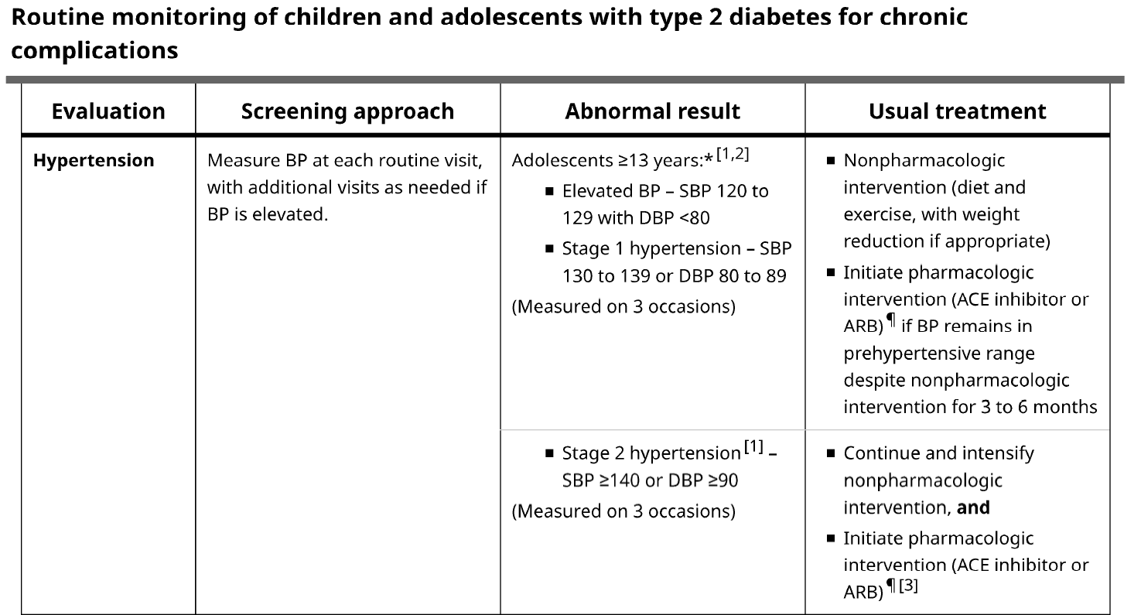

Slide 54
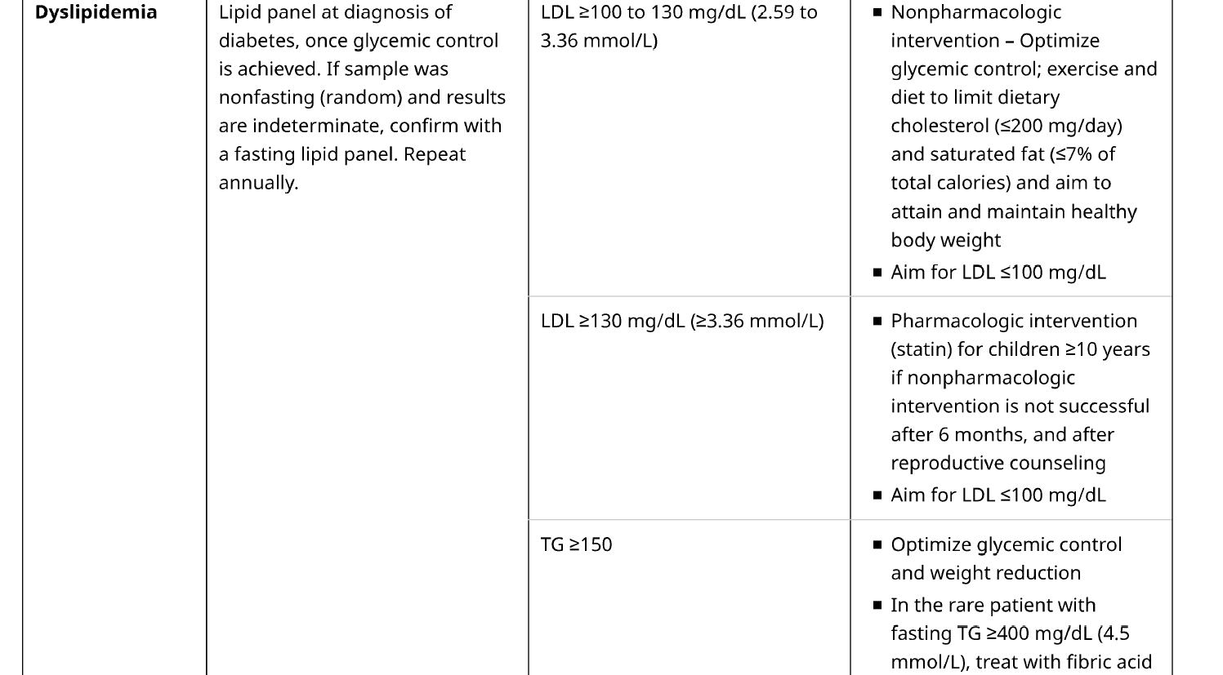

Slide 55
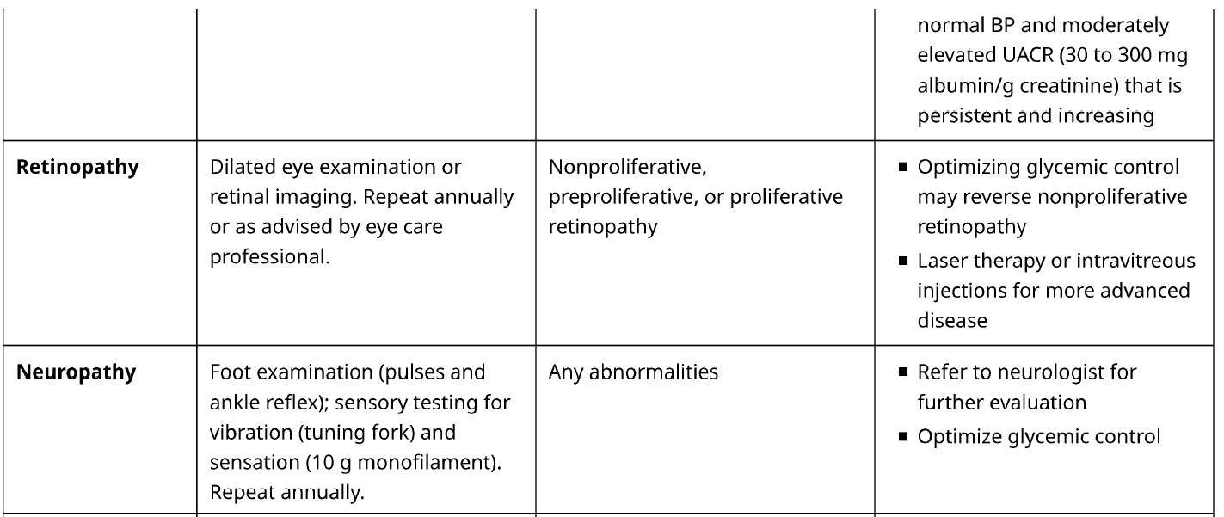

Slide 56
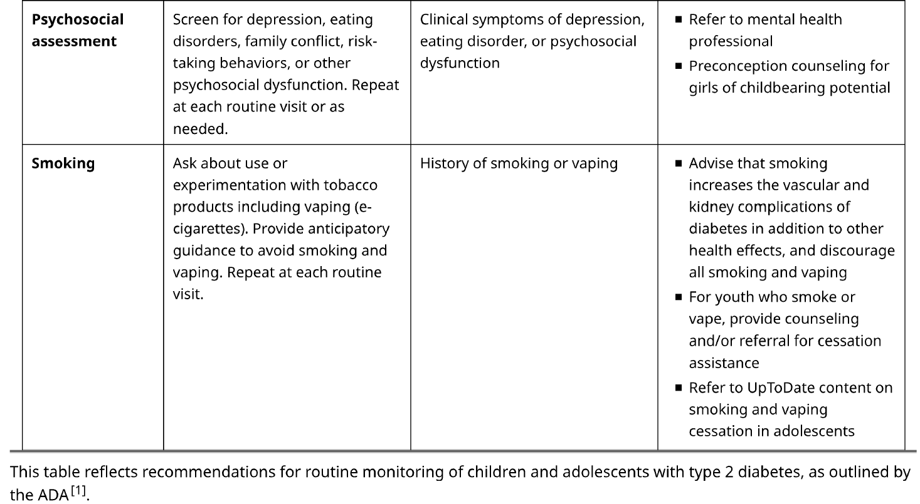

Slide 57
SUMMARY AND FUTURE DIRECTIONS
Pediatric T2DM is an increasing public health concern with an increasing incidence corresponding with the increase in pediatric obesity. Despite a similar pathophysiology to adult T2DM, pediatric T2DM shows faster pancreatic beta-cell decline and increased treatment failure rates compared with adult T2DM. Youth with T2DM will be entering adulthood with significant risks for morbidity and mortality at younger ages than the adult T2DM population. The available treatment options have not been effective in reducing beta-cell decline and are complicated by high nonadherence. Early diagnosis and treatment of pediatric T2DM and development of new pharmacologic therapies; trials of approved adult T2DM therapies, such as the recently approved liraglutide; and effective behavioral interventions are critically needed to stem the continued increase in pediatric T2DM and its sequelae.

