Slide 1

Yinour Text Here
In the name of allah

Slide 2
Lipid Management in Patients with Endocrine Disorders: An Endocrine Society Clinical Practice Guideline
The Journal of Clinical Endocrinology & Metabolism,2020, Vol. 105, No. 12, 1–70

Slide 3
Introduction

Slide 4
Hormones modulate every pathway involved in lipopro-tein metabolism.
This includes:
expression of lipoprotein receptors,
production of apolipoproteins (apos),
the ac-tivity of plasma lipoprotein–modifying enzymes,
circulating levels of substrates such as fatty acids and glu-cose used for triglyceride (TG) synthesis..

Slide 5
Therefore, it is anticipated that endocrine diseases might alter the lipid profile and enhance atherosclerotic cardiovascular dis-ease (ASCVD) risk.
However, with the exception of type 2 diabetes (T2D), many endocrine diseases are not men-tioned, or not described in detail, in cholesterol manage-ment guidelines.
The present guideline addresses this gap in information

Slide 6
Based upon the available evidence, recommendations are made for direct lipid treatment and endocrine disease treatment to manage dyslipidemia in endocrine diseases.

Slide 7
Measurement of lipids
In adults with endocrine disorders, we recommend a lipid panel for the assessment of triglyceride levels and for calculating low-density lipoprotein cholesterol.

Slide 8
Non-fasting lipid panels are acceptable for initial screening.
If triglyceride levels are elevated or if genetic dyslipidemia is suspected, repeat a fasting lipid panel.
If lipoprotein(a) levels are measured, fasting or nonfasting samples can be obtained.

Slide 9
In adults, the long-standing standard clinical approach for lipid assessment uses blood obtained after an 8- to 10-hour fast overnight, allowing only water and noncaffeinated beverages.
The lipid panel consists of plasma or serum concentrations of total cholesterol, TG, HDL-C, and a calculated value of LDL-C.
In people with high TG, estimated low LDL-C, diabetes, or obesity:
apolipoprotein B (apoB)
or non-HDL-C
may be useful for assessment of ASCVD risk.

Slide 10
HDL-C, and TG have normal ranges based upon population distribution.
LDL-C does not have a normal range because “optimal” LDL-C concen-trations vary according to the degree of ASCVD risk of the individual

Slide 11
Friedewald formula
The Friedewald formula, subse-quently introduced in the 1970s, has been widely used to estimate LDL-C by subtracting the sum of HDL-C and very low-density lipoprotein (VLDL) cholesterol (estimated by TG/5) from total cholesterol, and used fasting data

Slide 12
Friedewald formula
This equation uses a fixed ratio of 5:1 between TG andVLDL cholesterol.
The Friedewald formula is generally considered accurate within serum TG levels under 150 mg/dL (1.7 mmol/L) and LDL-C levels of at least 70 mg/dL (1.8 mmol/L)

Slide 13
Friedewald formula
Since it has become evident that the Friedewald formula underestimates LDL-C as serum TG levels increase above 150 mg/dL (1.7 mmol/L) or with LDL-C levels under 70 mg/dL (1.8 mmol/L), new and more accurate approaches to es-timate LDL-C have been developed.

Slide 14
Martin-Hopkins formula
The Martin-Hopkins formula is gaining wider use for calculation of LDL-C and uses an adjustable correction factor based on TG and non-HDL-C levels.
It appears to have greater accuracy in both fasting and nonfasting samples as well as in settings of low LDL-C and high TG .
The Martin-Hopkins equa-tion reduces the need for routine, direct measurement of LDL-C and is gaining wider use.

Slide 15
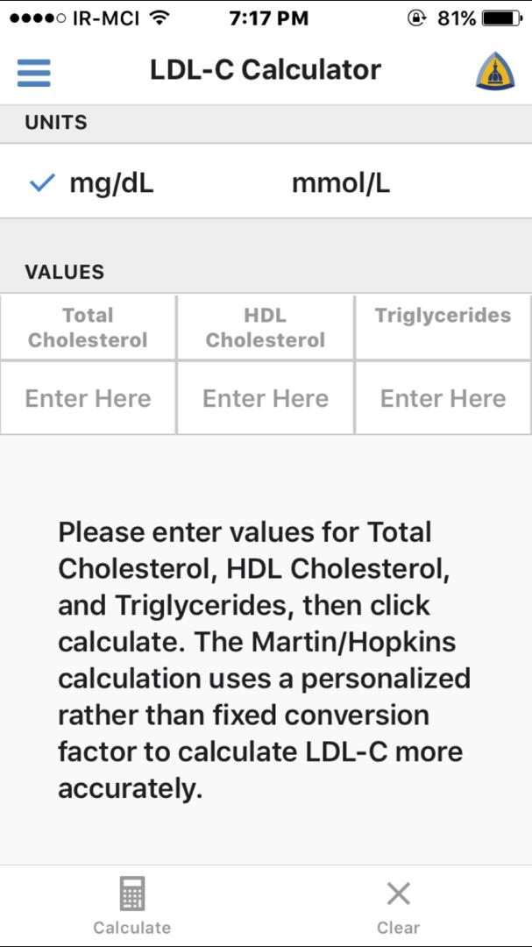

Slide 16
Recently, in 2020, a new equation developed from the NIH proposes LDL-C estima-tion that can be used in patients with TG up to 800 mg/dL (9.0 mmol/L)

Slide 17
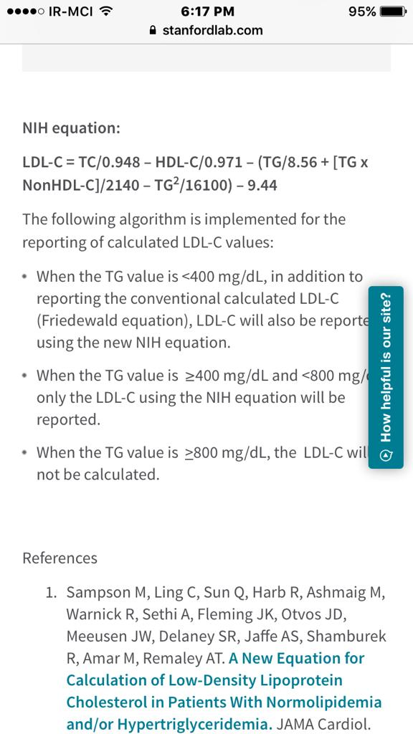

Slide 18
Fasting versus nonfasting lipid testing
In the past decade, there has been a push toward nonfasting measurements of lipids because of convenience and practi-cality.
Nonfasting blood samples :
simplify the process for patients, laboratories, and clinicians and
are likely to im-prove patient follow-through with lipid testing.
There is some evidence that nonfasting lipid panels may improve cardiovascular (CV) risk prediction

Slide 19
Further, almost all clinical trials with lipid-lowering drugs have used fasting lipid samples.
Limited data suggests that for the same individual, fasting and nonfasting lipid levels are similarly associated with Cv events
however, no randomized outcomes trials have been conducted using nonfasting TG as a key biomarker.

Slide 20
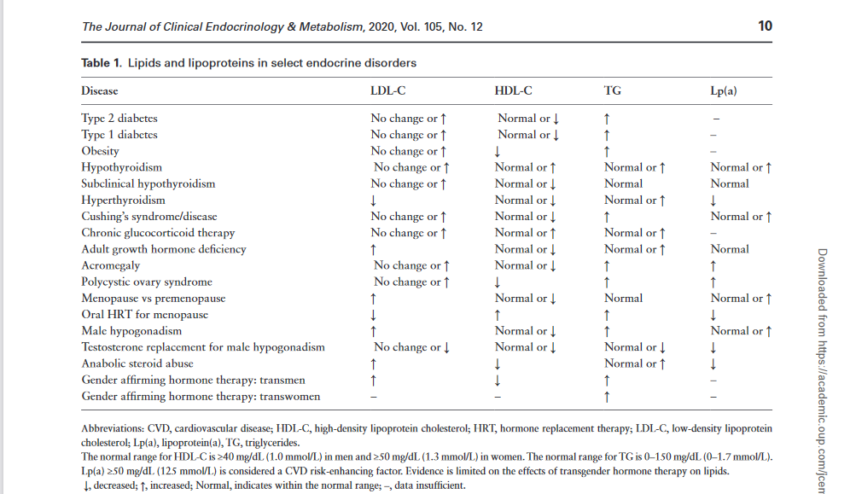

Slide 21
Cardiovascular risk assessment
In adults with endocrine disorders, we recommend conducting a cardiovascular risk assessment by evaluating traditional risk factors, including the calculation of 10-year atherosclerotic cardiovascular disease risk using a tool such as the Pooled Cohort Equations.

Slide 22
This risk al-gorithm uses traditional risk factors, including
age,
sex,
race,
systolic blood pressure, treatment for hypertension,
total cholesterol,
HDL-C,
smoking,
and diabetes,
for the calculation of 10-year risk of myocardial infarction (MI), stroke, and CV death.

Slide 23
Additional risk-enhancing factors
family history of premature coronary artery dis-ease (CAD),
metabolic syndrome (MetS),
chronic kidney disease (CKD),
chronic inflammatory conditions such as rheumatoid arthritis,
history of early menopause,
or preeclampsia,
and high-risk race/ethnicities, including South Asian ancestry
ApoB ≥130 mg/dL (1.3 g/L) or non-HDL >190 mg/dL (4.9 mmol/L) should be considered risk-enhancing factors

Slide 24
Borderline and intermediate cardiovascular risk are defined as 5%–7.4% and 7.5%–19.9% 10-year atherosclerotic cardiovascular disease risk using the Pooled Cohort Equations

Slide 25
In particular, non-HDL-C (total choles-terol – HDL-C), which can be calculated from a standard fasting or nonfasting lipid panel, predicts risk similarly to apoB testing or other advanced lipid testing

Slide 26
coronary artery calcium score
Common imaging tests for advanced risk assessment are aimed at directly assessing the burden of subclinical ath-erosclerosis.
Most notable among these are carotid ultra-sound tests for carotid intima-media thickness (cIMT) and carotid plaque,
and
cardiac-gated computed tomography (CT) scans for the assessment of CAC.
These tests have the advantage of directly assessing end-organ damage

Slide 27
coronary artery calcium score
CAC can be performed on any modern multidetector CT scanner in about 10 to 15 minutes with about 1 mSv of radiation (approximately similar to a bilateral mammo-gram).
When the CAC score is zero (CAC = 0), patients are low risk and can be reclassified into lower-risk groups with less aggressive lipid therapies
When the CAC score is elevated (CAC >100 or >75th percentile for age, sex, and race), patients can be moved into higher-risk categories and treated more aggressively, using statins with or without nonstatin therapies to achieve lower LDL-C levels .

Slide 28
coronary artery calcium score
In adults with endocrine disorders at borderline or intermediate risk (10-year atherosclerotic cardiovascular disease risk 5%–19.9%), particularly those with additional risk-enhancing factors, in whom the decision about statin treatment and/or other preventive interventions is uncertain, we suggest measuring coronary artery calcium to inform shared decision making.

Slide 29
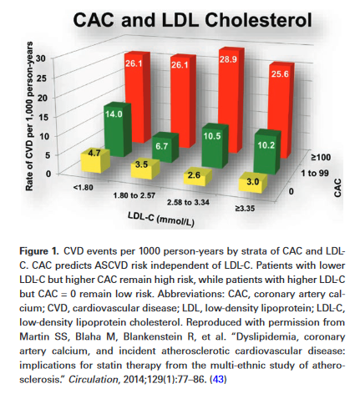

Slide 30
The 2018 AHA/ACC Cholesterol Guidelines endorse CAC, with an IIA recommendation in patients at
borderline-to-intermediate risk (10-year ASCVD risk 5–19.9%) and
in highly selected lower-risk patients with risk-enhancing factors

Slide 31
According to the AHA/ACC guidelines, risk-enhancing factors that can be used to jus-tify CAC scanning include
MetS,
inflammatory disorders (eg, rheumatoid arthritis, systemic lupus erythematosus, ankylosing spondylitis),
HIV,
hypertriglyceridemia,
South Asian ancestry,
history of premature menopause (before age 40 years),
and pregnancy-related complications such as preeclampsia.

Slide 32
The present Endocrine Society guideline identifies additional disorders that enhance ASCVD risk:
Cushing syndrome,
Cushing disease,
high-dose chronic glucocorticoid therapy,
and possibly
adult GHD,
acro-megaly,
and hypothyroidism

Slide 33
In patients with an initial CAC of zero, a repeat CAC test should be considered to re-assess the CAC score and therefore possible risk (and treatment) reclassification;

Slide 34
recent data from an analysis of CAC scores and coronary events in Multi-Ethnic Study of Atherosclerosis supports the following schedule:
low-risk patient (10-year ASCVD risk <5%, 5 to 7 years),
borderline-to-intermediate risk patient (10-year ASCVD risk 5% to 19.9%, 3 to 5 years),
high-risk patient (10-year ASCVD risk ≥20%, 3 years) or
pa-tient with diabetes (3 years)

Slide 35
Coronary artery calcium should generally not be repeated in already aggressively treated patients, as it is not designed to be a measure of lipid-lowering treatment efficacy.

Slide 36
Caution must be taken!!!!
when applying CAC scoring to patients with high risk, such as genetically proven familial hypercholesterolemia (FH).
As CAC identifies only the cal-cified component of coronary plaque (as seen first in a type 4 atheroma),
early noncalcified plaque can be missed
In young patients with high risk, genetically proven FH or other atherogenic endocrine conditions that might have been present from a young age (eg, severe obesity, diabetes), such early plaque is indicative of the need for continued ag-gressive lipid lowering, and CAC should not be used as the only deciding factor about the intensity of lipid-lowering therapy

Slide 37
Caution…
In limited scenarios, CT angiography can be used to detect early noncalcified plaque, although such testing is generally reserved for symptomatic patients.
Caution also is advised in interpreting CAC as zero in active smokers, who have additional thrombotic risk beyond their burden of atherosclerosis

Slide 38
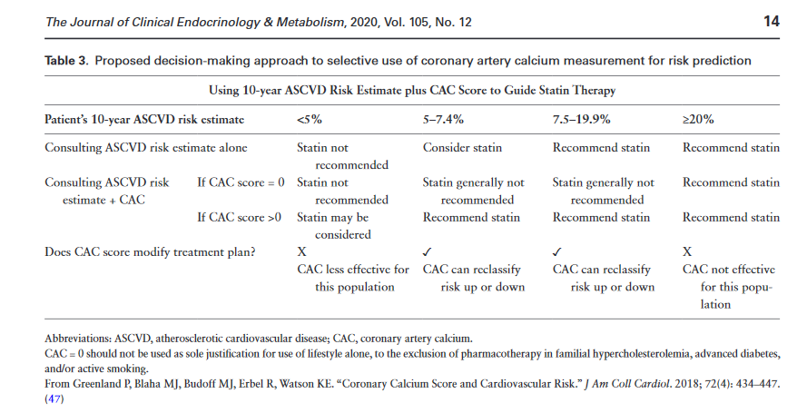

Slide 39
Statin recommend…
In patients without diabetes or atherosclerotic cardiovascular disease and with low-density lipoprotein >70 mg/dL (1.8 mmol/L),
and
10-year atherosclerotic cardiovascular disease risk >7.5%,
10-year atherosclerotic cardiovascular disease risk of 5% to 7.4% plus 1 or more risk-enhancing factors,
coronary artery calcium score over the 75th percentile for age, sex, and race, or coronary artery calcium score >100,

Slide 40
Lipoprotein(a)
Lp(a) is a modified low-density lipoprotein (LDL)-like particle in which apolipoprotein a (apo[a]), a large protein with structural similarity to plasminogen, is covalently bound to apoB.
Circulating Lp(a) levels are primarily determined by the apo(a) genotype, without significant dietary or environmental influences

Slide 41
Lipoprotein(a)
Epidemiological studies, Mendelian randomization studies, and genome-wide association studies all show increased CVD risk in individuals with elevated Lp(a), but clinical trial data showing CV benefit of lowering Lp(a) are lacking.
Standardized immunoassays for Lp(a) are now widely available .

Slide 42
Lipoprotein(a)
Lp(a) levels can be very helpful for assessment of fa-milial risk.
In cases of early advanced atherosclerosis, Lp(a) testing may also be useful to explain less-than-expected LDL-C reduction with statins, since statins do not lower Lp(a) levels, but when these are elevated, the cholesterol content of Lp(a) contributes significantly to calculated and directly measured LDL-C

Slide 43
Lipoprotein(a)
However, this test adds little in terms of global risk assessment across the general popu-lation and thus does not have characteristics of a good screening test
However, some experts believe that every patient should have Lp(a) measured once, perhaps in childhood or early adulthood during routine lipid screening

Slide 44
In appropriately selected patients with familial risk, elevated Lp(a) ≥50 mg/dL or ≥125 nmol/L should be con-sidered a risk-enhancing factor that may drive more aggres-sive treatment or the need for advanced risk assessment.
Evidence from the Women’s Health Study and the Women’s Health Initiative suggest that elevated Lp(a) only predicts ASCVD in women with total cholesterol above 220 mg/dL (5.7 mmol/L

Slide 45
we suggest measuring lipoprotein(a)
In adult patients with a family history of premature atherosclerotic cardiovascular disease,
or a personal history of atherosclerotic cardiovascular disease
or a family history of high lipoprotein(a)
t o inform decision-making about short-term and lifetime atherosclerotic cardiovascular disease risk and the need to intensify low-density lipoprotein cholesterol–lowering therapy.

Slide 46
Lipoprotein(a)
Lipoprotein(a) ≥50 mg/dL (125 nmol/L) enhances the risk of atherosclerotic cardiovascular disease.
Lipoprotein(a) testing does not need to be repeated if it has previously been measured (ie, in childhood or early adulthood).
It is not yet known whether reducing lipoprotein(a) reduces atherosclerotic cardiovascular disease risk

Slide 47
serum biomarkers
Multiple serum biomarkers have been proposed for ad-vanced risk assessment that test for inflammation, oxida-tive stress, endothelial dysfunction, thrombosis, and other important pathways
In general, although widely available, serum markers suffer from higher intertest vari-ability.
At this time, even multiple biomarker panels have been shown to add little to global risk assessment

Slide 48
Only elevated high-sensitivity C-reactive protein (hsCRP) ≥2.0 mg/L (19.0 nmol/L), a serum biomarker of inflammation supported by robust risk-prediction litera-ture, should be used as a risk-enhancing factor that may drive more aggressive treatment or the need for advanced risk assessment

Slide 49
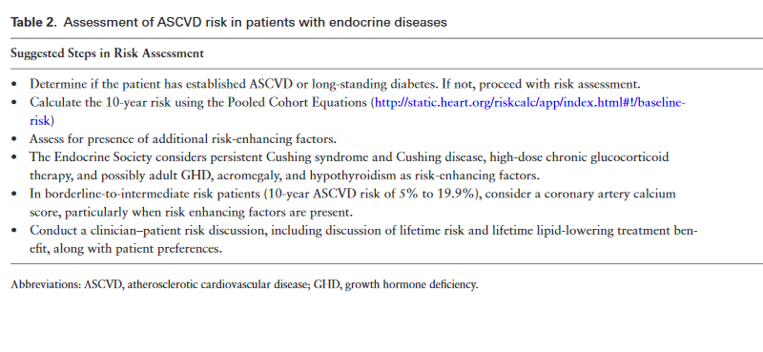

Slide 50
Hypertriglyceridemia

Slide 51
in adults with fasting triglyceride levels over 500 mg/dL (5.6 mmol/L), we recommend pharmacologic treatment as adjunct to diet and exercise to prevent pancreatitis.
Medications such as statins, fibrates, and omega-3 fatty acids, as adjunct to lifestyle modifi-cation, can adequately reduce TG in patients with TG 500 to 1000 mg/dL (5.6 to 11.3 mmol/L), and thereby reduce the risk of pancreatitis.

Slide 52
Patients with triglyceride levels over 1000 mg/dL (11.3 mmol/L) often do not get an adequate response to medications and, therefore,
control of diabetes,
modification of diet, a very low fat diet,
and weight loss
avoidance of alcohol,
may be needed to prevent pancreatitis.

Slide 53
volanesorsen
Recently, investigational antisense oligonucleo-tide to apoC3, has been reported to dramatically reduce TG levels in patients with severe TG elevation (fasting chylomicronemia syndrome) due to homozygous lipo-protein lipase (LPL) deficiency
However, safety considerations include thromobocytopenia, which can be severe and is unpredictable.
was not approved by the US Food and Drug Administration (FDA);
however, has been approved for use in the European Union

Slide 54
Although the relationship between severe hyper-triglyceridemia and incident acute pancreatitis is well es-tablished, the lack of randomized-controlled trials (RCTs) testing whether TG reduction does prevent pancreatitis has led some to question whether the relationship is causal
In patients with marked hypertriglyceridemia, it is important to assess medications, and if possible, discon-tinue those such as estrogen and bile acid sequestrants that contribute to TG elevations.

Slide 55
Plasmapheresis
Plasmapheresis has been suggested to be useful for the acute management of TG-induced pancreatitis .
However, for most cases of TG-induced
pancreatitis, there is no evidence to support its superiority over cessation of oral fat intake, after which TG levels fall rapidly if no additional chylomicrons enter the circulation.
Moreover, plasmapheresis only improves TG levels temporarily without addressing the underlying cause .

Slide 56
In patients with triglyceride-induced pancreatitis,
we suggest against the use of acute plasmapheresis as a first-line therapy to reduce triglyceride levels.
Plasmapheresis may be useful:
in those who do not respond to conventional methods of lowering triglycerides, such as individuals who have extraordinarily elevated triglyceride levels (eg, over 10 000 mg/dL [112.9 mmol/L]) or
in extremely high-risk situations, such as pregnancy.
plasma exchange to supply apolipoprotein CII is benefi-cial in the extremely rare patients with apolipoprotein CII deficiency

Slide 57
insulin infusion
There is little data to support the use of insulin infu-sion in TG-induced pancreatitis. In nonhyperglycemic patients, low-dose insulin (1 to 2 units per hour) is usu-ally sufficient to:
block adipose tissue lipolysis,
reduce circulating free fatty acid (FFA) levels,
and theoretic-ally reduce TG production by the liver.
Insulin also can increase LPL activity, which may accelerate the clear-ance of TG from plasma.

Slide 58
Although a reduction in TG after insulin infusion in individuals without diabetes who have TG-induced pancreatitis has been reported in several case studies , whether similar changes would have occurred simply by restricting oral intake without the use of insulin is unclear .

Slide 59
insulin infusion
In patients without diabetes and who have triglyceride-induced pancreatitis, we suggest against the routine use of insulin infusion

Slide 60
A single study of chylomicronemia associated with uncontrolled dia-betes demonstrated that fasting plus insulin infusion led to more rapid TG lowering than insulin alone .
This is likely due to a reduction in adipose tissue lipolysis leading to reduced hepatic TG synthesis; plasma FFAs are normally reduced with very low doses of insulin. Given there is no clear evidence and only small studies in which possible efficacy cannot be ruled out, judicious use of low-dose insulin could be considered.

Slide 61
When uncontrolled diabetes is present, insulin therapy should be used to normalize glucose levels

Slide 62
The use of high doses of insulin, such as the amounts routinely used for diabetic ketoacidosis (>0.1 units/kg), increases the risk of acute hypoglycemia.
When used with concomitant glucose infusion to prevent hypoglycemia, it is likely to lead to carbohydrate-induced increase in TG pro-duction, which would be counterproductive

Slide 63
hypertriglyceridemia and in-creased CV risk
The relationship between hypertriglyceridemia and in-creased CV risk has been known for nearly 50 years.
This association was found in several epidemiology studies and was stronger in women
Within the last decade, a number of genetic analyses implicated genes that modulate TG levels to be causal in the pathophysiology of athero-sclerosis and CVD , and they have confirmed that heterozygous deletion and other types of mutations of LPL increase CVD risk

Slide 64
Multiple trials have failed to show any CVD benefit of 1 g/d of mixed EPA + docosahexanoic acid (DHA), generally as omega-3 acid ethyl esters (O3AEE) .
In contrast, in a double blind RCT, REDUCE-IT, in a high-risk statin treated population with LDL-C below100 mg/dL (2.6 mmol/L) and elevated fasting TG up to 500 mg/dL (5.6 mmol/L), EPA ethyl ester 4 g daily re-duced CVD events (relative risk reduction [RRR] 25%) .

Slide 65
REDUCE-IT was not the first randomized CVD out-comes trial to show benefit with pure EPA.
The CVD benefit seen in REDUCE-IT does not apply to other omega-3 fatty acids, particularly those with a mix of EPA and DHA
No data are yet available to support the use of supplements containing both EPA and DHA to reduce ASCVD risk

Slide 66
Type 2 diabetes mellitus

Slide 67
Dyslipidemia in T2D is characterized by:
hyper-triglyceridemia,
low levels of HDL-C
average or borderline elevations of LDL-C .
LDL particles are typ-ically small and dense
Total apoB levels are elevated,
reflecting an increase in the number of TG-rich lipo-protein and small, dense LDL particles.
Similar lipid abnor-malities are often observed in MetS in the absence of overt diabetes

Slide 68
glucose-lowering therapy in Dyslipidemia
Dyslipidemia often improves following the initiation of all modalities of glucose-lowering therapy.
In particular, the initiation of insulin often leads to TG reduction.
Metformin, which often is the first drug used for treatment of T2D, can lower TG and lead to small improvements in HDL-C How much of these changes is due to glucose lowering versus weight reduction is unclear.
Other glucose-lowering drugs associated with beneficial changes in the lipid profile include glucagon-like peptide (GLP-1) receptor agonists and thiazolidinediones

Slide 69
Sodium-glucose co-transporter 2 (SGLT2) inhibitors can modestly increase LDL-C levels
Sulfonylureas, dipeptidyl peptidase-4 inhibitors, meglitinides, and α-glucosidase inhibitors are generally considered to be lipid neutra

Slide 70
In adults with type 2 diabetes and other cardiovascular risk factors, we recommend statin therapy in addition to lifestyle modification in order to reduce cardiovascular risk.
High-intensity statins should be chosen in patients with
atherosclerotic cardiovascular disease,
or
those with risk factors for atherosclerotic cardiovascular disease
Or
risk-enhancing factors..

Slide 71
Statins should not be used in women who are pregnant or trying to become pregnant
In patients over the age of 75, continuation of statin treatment or initiation of statin treatment depends upon:
-- atherosclerotic cardiovascular disease risk,
-- prognosis
-- potential interacting medications and polypharmacy,
-- mental health,
-- and the wishes of the patient.

Slide 72
In adults with type 2 diabetes and other cardiovascular risk factors, we suggest lowering low-density lipoprotein cholesterol to achieve a goal of low-density lipoprotein cholesterol <70 mg/dL (1.8 mmol/L) in order to reduce cardiovascular risk

Slide 73
A statin should be added to lifestyle modifications if low-density lipoprotein cholesterol is >70 mg/dL (1.8 mmol/L).
Low-density lipoprotein cholesterol should be <55 mg/dL (1.4 mmol/L) in patients with established cardiovascular disease or multiple risk factors.
Additional low-density lipoprotein-lowering therapy (ezetimibe, proprotein convertase subtilisin/kexin type 9 inhibitor) may be needed if the low-density lipoprotein cholesterol goal is not reached with statins.
Risk factors include traditional risk factors and risk-enhancing factors.

Slide 74
the greater the reduction in LDL-C levels……
Considerable evidence from RCTs of statins, and trials of statins in combination with ezetimibe or monoclonal anti-bodies to PCSK9, conducted in patients with and without ASCVD and in subgroups including patients with diabetes, demonstrates that the greater the reduction in LDL-C levels, the greater the reduction in the risk of CV events .
This benefit depends upon the absolute reduc-tion in LDL-C and the baseline risk of ASCVD .

Slide 75
The CTT individual participant data meta-analysis of 26 statin trials found that for every 1 mmol/L (39 mg/dL) reduction in LDL-C, there was a 22% RRR in major ASCVD events (HR 0.78; 95% CI: 0.76–0.80; P < 0.0001).

Slide 76
In the PROVE-IT TIMI 22 trial, conducted in very high-risk patients with acute coronary syndrome, there was a progressive reduction in risk (death, MI, stroke, recurrent ischemia, revascularization), as LDL-C levels fell
from 80 to 100 mg/dL (2.1 to 2.6 mmol/L)
through 60 to 80 mg/dL (1.6 to 2.1 mmol/L),
through 40 to 60 mg/dL (1.0 to 1.6 mmol/L),
and <40 mg/dL (1.0 mmol/L) .

Slide 77
Today, very low LDL-C levels can be achieved with either a combin-ation of statins plus ezetimibe,
Or
PCSK9 inhibitors with or without statins and/or ezetimibe.

Slide 78
PCSK9 antibodies
They trap PCSK9 in plasma, thereby preventing PCSK9 from binding to LDL receptors at the hepatocyte surface.
As a result, LDL receptors are targeted for recyc-ling to the cell surface rather than for lysosomal degrad-ation.
Because of the resulting increase of LDL receptors at the cell surface, PCSK9 antibodies lower LDL-C levels be-yond those usually achievable with statins with or without ezetimibe

Slide 79
The benefits of achieving very low cholesterol levels are a reduction in CVD events (fatal and nonfatal MI, is-chemic stroke, coronary revascularization procedures) and mortality.

Slide 80
Whether low LDL-C levels confer a risk to the patient???
It has been addressed by data from numerous RCTs of statins, meta-analyses of the RCTs, and, more re-cently, RCTs of PCSK9 inhibitors.
These trials have found that low LDL-C levels, including LDL-C as low as 10 to 20 mg/dL (0.3 to 0.5 mmol/L) in patients taking PCSK9 inhibitors, are not associated with an increase in serious adverse events

Slide 81
Observational studies in 1989 and 1994 reported an association of high cholesterol with thrombo-embolic or nonhemorrhagic stroke but, in contrast, an in-verse relationship between cholesterol and intracerebral hemorrhage .
However, subsequent large out-come trials of statins did not confirm this.
Individual trials and meta-analyses of these RCTs, which included about 170 000 subjects followed for a mean of 4 years, found that, in people without a history of stroke, LDL-C reduction reduced ischemic stroke and did not increase hemorrhagic stroke .

Slide 82
Statin and dm risk…
In several clinical trials and meta-analyses, statins produced a small increase in HbA1c of the magnitude of 0.1%, which seems unlikely to significantly change CVD risk .
Statins, however, increase the risk of developing diabetes , with an absolute increase of 0.2% per year in major statin RCTs , but the benefit/risk ratio is favorable because of the significant reduc-tion in the high risk of MI and stroke in diabetes
The risk of newly diagnosed diabetes is especially increased in those taking high doses of potent statins and individuals predisposed to diabetes, such as those with MetS .

Slide 83
These findings are consistent with Mendelian Randomization studies that show an association between low LDL-C and diabetes risk .
However, the PCSK9 antibody evolocumab, in the FOURIER trial , and alirocumab in ODYSSEY OUTCOMES did not increase the risk of new-onset diabetes or worsen glycemia in patients with diabetes, although these studies were relatively short term and, therefore, cannot be con-sidered definitive

Slide 84
T2dm and ckd and statin
In adults with type 2 diabetes with chronic kidney disease stages 1–4 and postrenal transplant, we suggest statin therapy, irrespective of the cardiovascular risk score, to reduce cardiovascular risk.

Slide 85
When selecting the statin, consider the renal clearance of the statin.
Pitavastatin, pravastatin, and rosuvastatin all have at least partial clearance through the kidney,
whereas atorvastatin, fluvastatin, lovastatin, and simvastatin are cleared via the liver.
All statins require dose adjustments in chronic kidney disease, except for atorvastatin and fluvastatin.

Slide 86
CVD is the leading cause of death in individuals with CKD
ESRD is associated with very high risk for CVD events.
Diabetes is the leading cause of both CKD and ESRD.

Slide 87
The SHARP study, which examined the effect of LDL-C lowering by a statin (simvastatin) plus ezetimibe on CVD outcomes in pa-tients with moderate-to-severe CKD, showed a reduction in MACE associated with LDL lowering, especially in those with high baseline LDL-C levels . However, the prog-nostic value of on-treatment LDL-C appears to be less in those with CKD due to diabetic kidney disease than other causes

Slide 88
Cholesterol lowering by statins failed to reduce CVD endpoints in patients with ESRD on dialysis in either the 4D or AURORA trials .
After renal transplantation, statin treatment significantly reduced cardiac death and nonfatal MI but not the primary CVD endpoint in the ALERT trial . However, the extension trial did find a significant reduction in risk of cardiac death, nonfatal MI, and cardiac inter-ventional procedures .

Slide 89
Based on small number of clinical trials, we suggest initiating statins to prevent CVD outcomes in patients with early-to-moderate CKD inde-pendent of other risk factors but not in patients with ESRD on dialysis.
Continuation of statin treatment in a patient whose CKD progresses to requiring dialysis can be left to clinical judgement

Slide 90
Omega-3
Omega-3 fatty acids are effective at lowering elevated TG levels .
Some data suggests that EPA ethyl ester, a highly purified EPA ethyl ester, reduces selected inflammatory markers in patients with elevated TG and may have other biological effects that could play a role in reducing atherosclerosis .
In the placebo-controlled trial REDUCE-IT, in 8179 subjects, a high dose (4 g/day) of EPA ethyl ester, lowered major adverse cardiac events (MACE) by an additional 25% in statin-treated subjects, with residual fasting hypertriglyceridemia and either established ASCVD or T2D and 2 additional risk factors

Slide 91
Based on the small number of clinical trials of omega-3 fatty acids with CV endpoints, positive results, which were confined to EPA ethyl esters, and because the benefits of fibrates are limited to post hoc analyses, the guideline writing committee suggests:

Slide 92
In adults with type 2 diabetes on a statin at low-density lipoprotein goal with residual triglycerides over 150 mg/dL (1.7 mmol/L) + two additional traditional risk factors or risk-enhancing factors
adding eicosapentaenoic acid ethyl ester to reduce cardiovascular risk.
Consider 4 g/day of eicosapentaenoic acid ethyl ester.
• If eicosapentaenoic acid ethyl ester is not available or accessible, then it is reasonable to consider a fibrate such as fenofibrate.

Slide 93
diabetic retinopathy
Although the primary CV endpoint was not statistic-ally significant in the placebo-controlled FIELD study of fenofibrate in patients with T2D, a surprising finding was the reduction of retinopathy requiring laser treatment in the fenofibrate group compared with the placebo group .
Fenofibrate also delayed progression of retinop-athy in the ACCORD trial, in which tight glycemic con-trol but not blood pressure control had a beneficial effect on retinopathy .

Slide 94
diabetic retinopathy
In adults with type 2 diabetes and diabetic retinopathy, we suggest fibrates in addition to statins to reduce retinopathy progression
This recommendation applies regardless of triglyceride levels.
The preferred fibrate is fenofibrate.
Fenofibrate is preferred to gemfibrozil because fenofibrate was studied in RCTs, and because gemfibrozil in combination with a statin is associated with increased risk of myopathy

Slide 95
Type 1 diabetes mellitus
In adults with type 1 diabetes,
age 40 years and older
and/or with duration of diabetes >20 years,
and/or microvascular complications
we suggest statin therapy, irrespective of the cardiovascular risk score, to reduce cardiovascular risk.

Slide 96
Low-density lipoprotein should be the primary target for lipid-lowering therapy.
Consider therapy if low-density lipoprotein is over 70 mg/dl (1.8 mmol/L).
Statins should not be used in women who are pregnant or trying to become pregnant.
In adults with type 1 diabetes with chronic kidney disease in stages 1–4, we suggest statin therapy, irrespective of the cardiovascular risk score, to reduce cardiovascular risk.

Slide 97
Statins ap-pear to be equally effective in lipid lowering for patients with T1D vs T2D and those without diabetes.

Slide 98
A meta-analysis of statin use in 18 686 subjects with diabetes (1466 of whom had T1D) in 14 randomized trials of statins reported a 21% reduction in major CVD events and a 13% reduc-tion in vascular mortality for every 1.0 mmol/L (approxi-mately 40 mg/dL) drop in LDL during a mean follow-up of 4.3 years

Slide 99
there is a paucity of data regarding the age at which to start statin therapy in subjects with T1DM
A recent study by Rawshani et al demonstrates that age of T1D onset has a significant impact on CVD risk, with greatest risk in those with earliest onset of T1D (defined as <10 years old)
Thus, although specific evidence is lacking to guide which age and/or diabetes duration to initiate therapy, there is good evidence that duration of dia-betes predicts increased CVD risk, and statin therapy re-duces CVD risk in subjects with T1Dm

Slide 100
The presence of renal disease in diabetes increases CVD risk, but, even in the absence of renal disease, T1D confers increased CVD risk
However, although renal disease is a CVD risk factor, especially in T1D, there is no evidence that statins (or any other lipid-lowering agents) improve renal outcomes
thus, the use of lipid-lowering therapy is aimed at reducing CVD risk, not CKD risk.

Slide 101
We suggest that lipid-lowering therapy should be initiated in patients with T1D with CKD stages 1–4 or postrenal transplant;
if a patient progresses to stage 5, the lipid-lowering therapy may be continued, but it should not be initiated in a pa-tient in stage 5 CKD

Slide 102
The treatment of hyperglycemia reduces TG levels.
Observational studies sug-gest that intensive glycemic control reduces CVD events .
Furthermore, as shown in the DCCT/EDIC study in T1D , even a relatively short period of good glycemic control is associated with decreased CVD events years later, termed a “legacy effect.
” However, those that gained excessive weight with intensive therapy appear to have less benefit than those who gained less weight

Slide 103
Thus, individuals with T1D who develop features of MetS (central obesity, high TG, and low HDL-C) appear to be at increased CVD risk and should be treated with lipid-lowering therapy, in addition to diet and increased physical activity.
Early addition of blood pressure and/or lipid-lowering therapy may help reduce the risk associated with increased weight gain, but there is no data to support the timing of additional therapy

Slide 104
Low-density lipoprotein should be the primary target for lipid-lowering therapy.
Ezetimibe can be added to the statin if required to lower low-density lipoprotein cholesterol further.
No dose adjustments of ezetimibe are needed in chronic kidney disease.

Slide 105
In adults with type 1 diabetes
with obesity,
or with high triglycerides and low high-density lipoprotein cholesterol
we suggest statin therapy, irrespective of the cardiovascular risk score, to reduce cardiovascular risk.

Slide 106
Low-density lipoprotein should be the primary target for lipid-lowering therapy.
Consider therapy if low-density lipoprotein cholesterol is over 70 mg/dL (1.8 mmol/L).

Slide 107
In adults with type 1 diabetes and diabetic retinopathy, we suggest statin therapy, irrespective of the cardiovascular risk score, to reduce cardiovascular risk
Low-density lipoprotein should be the primary target.
Consider therapy if low-density lipoprotein cholesterol is over 70 mg/dL (1.8 mmol/L).

Slide 108
A meta-analysis of 20 studies of 19 234 patients with T1D (n = 4438) or T2D (n = 14 896) found that the presence of any degree of diabetic retinopathy increased all-cause mortality and CVD events compared with those without diabetic retinopathy.
The RR was greater for those with T1D than for those with T2D and remained significant even after adjusting for traditional CVD risk factors

Slide 109
Obesity

Slide 110
Obesity is frequently associated with MetS, which is a risk-enhancing factor for ASCVD, and is treated initially by life-style modifications, including a healthy diet and physical activity.
Lipid abnormalities in MetS include elevated TG, low HDL-C, and increased non-HDL-C.
Although LDL-C may not be above the threshold considered appropriate for initiating statin treatment, apoB and small dense LDL-C may be increased

Slide 111
In individuals who have obesity, we advise assessment of components the metabolic syndrome and body fat distribution to accurately determine the level of cardiovascular disease risk

Slide 112
Diagnosis of MetS
requires the presence of three of the following criteria:
Elevated triglycerides ≥150 mg/dL (1.7 mmol/L) or on triglyceride-lowering medication.
Reduced high-density lipoprotein cholesterol <50 mg/dL (1.3 mmol/L) in women and <40 mg/dL (1.0 mmol/L) in men.

Slide 113
Diagnosis of MetS
Systolic blood pressure ≥130 mm Hg or diastolic blood pressure ≥85 mm Hg or on blood pressure medication.
Elevated waist circumference (men ≥ 40 in [102 cm] and women ≥ 35 in [88 cm]), except for East and South Asian men (≥ 35 in [90 cm]) and women (≥ 31.5 in [80 cm]).
Hyperglycemia (but not yet with type 2 diabetes) is defined by cutoffs for prediabetes according to fasting blood glucose, oral glucose tolerance, and/or hemoglobin A1c.

Slide 114
Most epidemiological studies define obesity based on BMI, which has been shown to be a strong predictor of CVD mortality.
Anthropometric methods such as waist circumference and waist/hip ratio have been demonstrated to be better meas-ures of central obesity and better predictors of risk for ASCVD and diabetes than weight or BMI .
Increased waist circumference has been associated with in-creased mortality within each BMI category

Slide 115
Reduction in waist circumference by diet and/or exer-cise improves cardiometabolic risk factors regardless of weight loss .
Measurement of waist circumfer-ence is relatively simple and can be done either at the iliac crest or midway between the level of the last rib and the iliac crest
Normal values vary by sex and by ethni-city.

Slide 116
A 2020 Consensus Statement of the IAS (International Atherosclerosis Society) and the ICCR (International Chair on Cardiovascular Risk) Working Group concluded that BMI and waist circumference identify high risk better than either measurement alone .
The consensus statement recommended the routine measurement of waist circumfer-ence in clinical practice as another vital sign that will help determine the efficacy of diet and exercise

Slide 117
In individuals who have obesity, we suggest lifestyle measures as the first-line treatment to reduce plasma triglycerides to lower cardiovascular and pancreatitis risk.
Reductions in low-density lipoprotein cholesterol and increases in high-density lipoprotein cholesterol are modest compared to the decrease in triglycerides with lifestyle measures that produce weight loss.

Slide 118
Lifestyle therapy–induced changes in the lipid profile in obesity have not been shown to reduce cardiovascular disease events.
In individuals who have obesity, we recommend the assessment of 10-year risk for atherosclerotic cardiovascular disease to guide the use of lipid-lowering therap
Elevated low-density lipoprotein cholesterol is predictive of cardiovascular risk

Slide 119
Weight loss can be achieved and maintained with
calorie restriction
healthy diet,
behavioral interventions,
and physical activity.
A loss of >5% of body weight is associ-ated with amelioration of some of the comorbidities asso-ciated with obesity.
Weight loss has a greater effect on TG than LDL-C.

Slide 120
The 2013 National Heart, Lung, and Blood Institute Systematic Review noted a dose–response relationship between the amount of lifestyle-related weight loss and improvement in the lipid profile in people with overweight or obesity :
Weight loss of 3 kg was as-sociated with TG reductions of approximately 15 mg/dL (0.17 mmol/L),
whereas weight loss of 5 to 8 kg was associ-ated with LDL-C reduction of 5 mg/dL (0.13 mmol/L) and an increase in HDL-C of 2 to 3 mg/dL (0.5 to 0.8 mmol/L)

Slide 121
The Endocrine Society designed a protocol for a meta-analysis to assess changes in lipids and lipoproteins in adults with overweight or obesity after 6 to 12 months of weight-reducing interventions:
lifestyle, pharmacotherapy (US FDA drugs approved for weight reduction plus metformin), or bariatric surgery.
The most favorable effect of weight loss on lipids was observed in TG .
With diet, exercise, or a combination of the 2, TG were reduced by about 4 mg/dL (0.05 mmol/L) per kg of weight loss,
whereas the reduction in LDL-C was -1.3 mg/dL (0.03 mmol/L) per kg of weight loss.
HDL-C increases at 12 months were 0.5 mg/dL (0.01 mmol/L) per kg of weight loss.

Slide 122
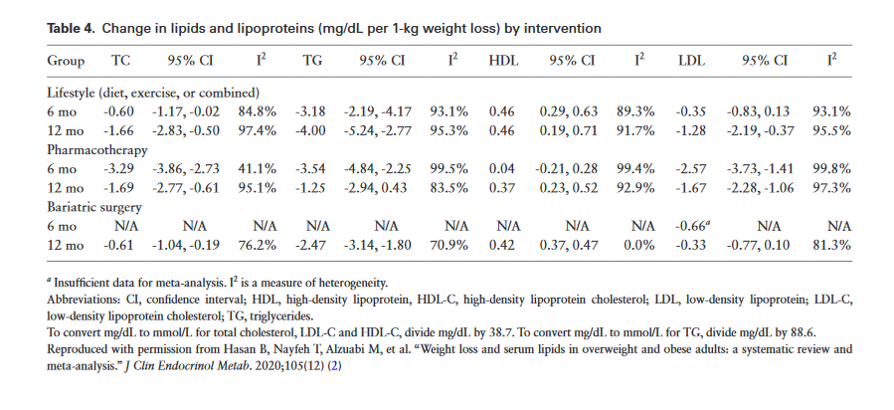

Slide 123
As the decision to initiate statin treatment as adjunct to diet and exercise depends upon the 10-year risk of ASCVD, we recommend the calculation of 10-year risk in people with obesity.
In individuals who have obesity and are on pharmacological therapy for weight reduction, we suggest reassessment of the lipid profile to evaluathe risk of CVD and pancreatitist

Slide 124
As there are no data on the timing of lipid measurements after weight loss, we suggest reassessment of lipids after 5% weight loss and periodically thereafter, when the weight is stable
Medications indicated for weight reduction, in combination with diet and exercise, have variable effects on lipids.

Slide 125
With the exception of orlistat, these medications act in the central nervous system, particularly the hypothalamus.
Orlistat decreases intestinal absorption of fat, thus redu-cing chylomicron production and TG in chylomicronemia.
Case studies have reported that orlistat reduces TG in pa-tients with monogenic LPL deficiency
To date, there is no evidence that medications at the doses approved for weight reduction reduce CV mor-tality or morbidity in individuals with obesity.

Slide 126
LEADER, a noninferiority, placebo, controlled trial of liraglutide that used the lower doses approved for diabetes, found that liraglutide, median dose 1.78 mg, reduced the rate of major CV events (HR 0.87, 95% CI: 0.78–0.97), with statistical significance for superiority as well as noninferiority

Slide 127
However, there is no evidence that higher-dose (3.0 mg/d) liraglutide has the same effect in patients with obesity who do not have diabetes.
Dulaglutide and semaglutide, both GLP1-receptor agonists approved for glycemic control in T2D, are both known (and indicated) to reduce CVD, as well as to cause modest weight loss, although neither is officially approved for the latter indication.

Slide 128
SGLT2, primarily indicated for glycemic control in T2D, also cause weight loss, although none is indicated for this use
Empagliflozin , canagliflozin, and dapagliflozin significantly reduced CV morbidity and mortality in RCTs of patients with diabetes who had or were at risk of ASCVD

Slide 129
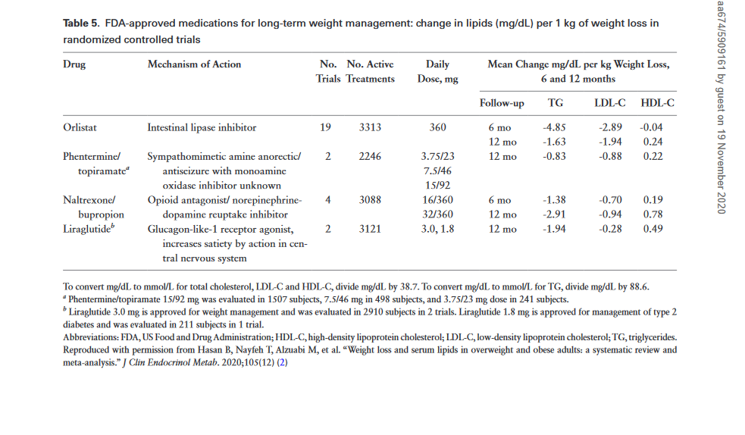

Slide 130
bariatric surgery
Guidelines recommend consideration of bariatric surgery in people with BMI ≥ 40 kg/m2 or BMI ≥35 kg/m2 and 1 or more weight-related comorbidities, who have not achieved suffi-cient weight loss following lifestyle and behavioral treatment, with or without pharmacotherapy .

Slide 131
bariatric surgery
In individuals with obesity, (body mass index >40 or >35 kg/m2 with comorbidities) who undergo bariatric surgery, we suggest the measurement of the lipid profile after bariatric surgery to assess cardiovascular risk
Malabsorptive bariatric surgery procedures (eg, Roux-en-Y gastric bypass) are more effective than restrictive procedures (eg, banding, sleeve gastrectomy) in decreasing low-density lipoprotein cholesterol levels.
Both restrictive and malabsorptive procedures decrease triglycerides..

Slide 132
Reassess the lipid profile 1 to 3 months after bariatric surgery and periodically thereafter and when the weight is stable

Slide 133
In the observa-tional Swedish Obese Subjects (SOS) study, bariatric surgery was associated with significant reductions in CV death (HR, 0.47; P = 0.002) and CV events (MI or stroke; HR, 0.67; P<0.001), respectively .

Slide 134
In a matched, observational co-hort of people with obesity and T2D in Sweden, RYGB was associated with a reduction in the risk of fatal and nonfatal MI by 49% (HR, 0.51; 95% CI: 0.29–0.91) and CV death by 59% (HR, 0.41; 95% CI: 0.19–0.90) .
A meta-analysis has confirmed that bariatric surgery is associated with signifi-cantly reduced CV-related mortality

Slide 135
SG and RYGB lead to significant body-weight reduction and improvement of metabolic comorbidities, including dyslipidemia.
Improvement in the lipid profile is not related to the amount of weight loss but rather to the type of surgery .

Slide 136
Although SG and RYGB decrease TG and increase HDL-C to a similar extent, reduction in plasma LDL-C is more pronounced after a malabsorptive procedure (RYGB, biliopancreatic diversion) than a restrictive (SG, gastric banding) procedure .

Slide 137
These clinical observations suggest that the underlying cel-lular and molecular mechanisms that modulate LDL-C me-tabolism may differ between bariatric procedures .

Slide 138
Thyroid disease

Slide 139
Hypothyroidism
Thyroid dysfunction has major effects on lipoprotein me-tabolism.
Hypothyroidism is associated with
reduced LDL receptors,
reduced cholesterol 7 alpha-hydroxylase,
low chol-esterol ester transfer protein,
and decreased lipoprotein lipase,
which, together, may lead to :
---an elevation in total cholesterol, TG, LDL-C, and apoB.
---High-density lipoprotein cholesterol has been reported to increase, remain unchanged, or decrease.
--- Increased LDL oxida-tion has also been demonstrated .

Slide 140
Hypothyroid patients often have elevated Lp(a) and apoB.
These lipid abnormalities, along with reduced endothelial function and hypercoagulability, may contribute to an increased risk of atherosclerosis in patients with hypothyroidism

Slide 141
In patients with hyperlipidemia, we recommend ruling out hypothyroidism as the cause of the hyperlipidemia before treatment with lipid-lowering medications
Hypothyroidism can elevate both cholesterol and triglyceride levels, which improve with treatment.

Slide 142
overt hyperthyroidism
Hyperthyroidism, unless transient, such as in thyroiditis, results in
decreased levels of total cholesterol and LDL-C
as well as reduced HDL-C, Lp(a), apoA-1, and apoB .
The effects on TG are variable

Slide 143
Mechanism…
Thyroid hormone stimulates hepatic clearance of choles-terol by increasing biliary secretion .
The increase in bile acids reduces the cholesterol in the liver, which results in compensatory increase in hepatic cholesterol synthesis and the uptake of cholesterol to restore hepatic cholesterol.
Thyroid hormone diminishes the intestinal absorption of dietary cholesterol ,
increases LDL receptor number ,
and increases HMGCoA mRNA, protein, and ac-tivity .
Thyroid hormone also stimulates LDL receptor gene synthesis
and increases the activity of enzymes that metabolize lipoproteins, including hepatic lipase, LPL, cholesteryl ester transfer protein (CETP), and lecithin cholesterol acyltransferase (LCAT)

Slide 144
In patients with hyperthyroidism, we recommend re-evaluating the lipid panel after the patient becomes euthyroid.
Changes in low-density lipoprotein cholesterol have been observed as early as 3 months after the patient is euthyroid

Slide 145
In patients with overt hyperthyroidism, treatment with antithyroid medication, surgery, or radioiodine sig-nificantly increased total chol and LDL-C and HDL-C, but the increase in TG was not statistically significant
Treatment of subclinical hyperthyroidism did not alter lipid parameters.

Slide 146
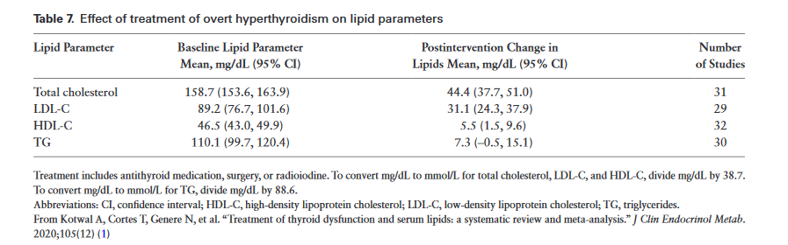

Slide 147
Recent studies suggest that control of hyper-thyroidism may lead to BMI values that exceed premorbid levels.
Therefore, it is prudent to re-assess not only the lipid profile, but other factors that increase CV risk at that point

Slide 148
In patients with overt hypothyroidism, we suggest against treating hyperlipidemia until the patient becomes euthyroid in order to more accurately assess the lipid profile

Slide 149
Some data suggest that coronary disease is more likely in patients with hypertension and hypothyroidism than in patients with hypertension who are euthyroid .
Whether this observation is due to dyslipidemia, the asso-ciated autoimmunity, or other effects of hypothyroidism could not be determined.

Slide 150
Hypothyroidism decreases cardiac work and oxygen demand but decreases cardiac contractility, often resulting in worsened angina.
However, classic studies found evidence that general surgery can be safely performed in patients with hypothyroidism.
In patients with hyperlipidemia, several studies have shown the prevalence of preexisting overt hypothyroidism to be between 1.4% and 13%.

Slide 151
The Cardiovascular Health Study, however, found no association of subclinical or overt hypothyroidism with either increased CV outcomes or with mortality .
In the Endocrine Society-planned meta-analysis of clin-ical trials that evaluated the effects of treatment of thyroid disease on lipid parameters, total cholesterol, LDL-C, HDL-C, and TG decreased in patients with overt hypothyroidism treated with LT4 but were not significantly changed in patients treated with a combination of LT4 and T3

Slide 152
In the Endocrine Society meta-analysis of patients with SCH, total cholesterol, LDL-C, and TG were reduced after LT4 treatment, but the magnitude of these changes was less in comparison to patients with overt hypothyroidism .
In patients with SCH who were not treated with LT4, lipids did not change over time

Slide 153
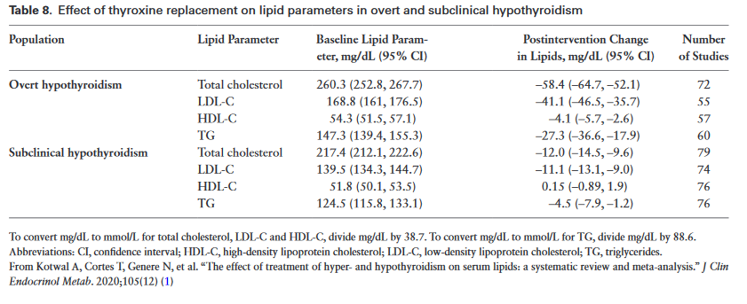

Slide 154
In patients with subclinical hypothyroidism (thyroid-stimulating hormone <10 mIU/L) with associated hyperlipidemia, we suggest considering thyroxine treatment as a means of reducing low-density lipoprotein levels.
Take into consideration the patient’s age and general health, the possibility of suppression of thyroid-stimulating hormone, and whether the patient has cardiovascular disease.
The impact of T4 replacement on long-term CV outcomes is unknown

Slide 155
Excess glucocorticoids

Slide 156
In adult patients with Cushing syndrome, we recommend monitoring the lipid profile in order to identify cases of dyslipidemia.
Monitor lipid profile at the time of diagnosis and periodically afterwards at the discretion of the treating physician.

Slide 157
Dyslipidemia is a common metabolic abnormality in Cushing syndrome, Estimates for the prevalence of dyslipidemia in active Cushing disease range from 38% to 71% .
The dyslipidemia in Cushing syndrome is characterized by elevated plasma total cholesterol and TG due to increased circulating VLDL and LDL particles , and variable levels of HDL-C .

Slide 158
Patients with Cushing syn-drome have increased hepatic synthesis and secretion of VLDL and also demonstrate increased visceral fat dis-tribution compared with controls .
Dyslipidemia se-verity can be influenced by the severity and duration of hypercortisolemia, presence of diabetes, and degree of vis-ceral obesity

Slide 159
short-term increases in glucocorticoids stimulate lipolysis,
proadipogenic effects are more prominent in chronic hypercortisolism.
Glucocorticoids stimulate preadipocyte differentiation and inhibit adenosine monophosphate (AMP)-activated protein kinase (AMPK) in visceral adi-pose tissue, leading to increased lipogenesis and fat storage. Glucocorticoids stimulate AMPK in the liver, promoting fatty acid and cholesterol synthesis, and contributing to de-velopment of hepatic steatosis .

Slide 160
Patients who achieve successful remission of Cushing syndrome after treatment do experience improvement in dyslipidemia and other CV risk factors such as obesity, hypertension, and diabetes .
However, these risk fac-tors persist after cure in a significant proportion of patients .
Therefore, patients may require monitoring and treatment for dyslipidemia after successful biochemical re-mission of Cushing disease

Slide 161
In adults with persistent endogenous Cushing syndrome, we suggest statin therapy, as adjunct to lifestyle modification, to reduce cardiovascular risk, irrespective of the cardiovascular risk score

Slide 162
Low-density lipoprotein cholesterol should be the primary target, and therapy should be considered if low-density lipoprotein cholesterol is over 70 mg/dL (1.8 mmol/L).
Patients receiving mitotane therapy for Cushing syndrome commonly develop secondary dyslipidemia from therapy.
Lipid-lowering therapy may not be appropriate for patients with limited life expectancy, such as those with an underlying malignancy

Slide 163
In adults with cured Cushing syndrome, we advise the approach to cardiovascular risk assessment and treatment be the same as in the general population.
Chronic hypercortisolism due to Cushing syndrome is as-sociated with the development of MetS with hypertension, insulin resistance, dyslipidemia, a prothrombotic state, and visceral obesity, which may increase the risk of ASCVD.

Slide 164
Patients with active Cushing disease have a high prevalence of hypertension (55% to 85%), obesity (32% to 41%), and diabetes mellitus (20% to 47%)
A long-term follow-up study and meta-analysis of patients with Cushing disease demonstrated that overall mortality is 2.2-fold greater than in the general population
CVD (MI, stroke) is the most common cause of death in Cushing syndrome

Slide 165
Several medications used for the treatment of Cushing syndrome have important effects on lipids:

Slide 166
Ketoconazole
Ketoconazole is an imidazole derivative that inhibits several key en-zymes in cortisol biosynthesis. Ketoconazole is also an in-hibitor of cholesterol biosynthesis, and treatment can lead to an approximately 25% reduction in apoB and LDL-C levels
Importantly, ketoconazole is a potent in-hibitor of cytochrome P450 3A4 (CYP3A4) and can mark-edly increase plasma levels of certain statins, specifically simvastatin, lovastatin, and, to a lesser extent, atorvastatin.

Slide 167
This can significantly increase the risk of myotoxicity from statin therapy.
Therefore, statins not metabolized by the CYP3A4 system (including fluvastatin, pravastatin, and rosuvastatin) should be used when cholesterol-lowering therapy is required in the setting of ketoconazole therapy.

Slide 168
Mifepristone
Mifepristone, a glucocorticoid-receptor antagonist, has been shown to improve glycemic control, diastolic blood pressure, and weight in patients with endogenous Cushing syndrome.

Slide 169
After 24 weeks of mifepristone treat-ment, mean HDL-C was significantly reduced by 14.2 ± 11.9 mg/dL (0.37 ± 0.31 mmol/L) from a mean baseline of 62.3 ± 27.8 mg/dL (1.6 ± 0.72 mmol/L);
there were no stat-istically significant changes in LDL-C or TG .
Weight loss achieved with mifepristone treatment persisted for 2 additional years in patients who remained on therapy

Slide 170
Pasireotide
Pasireotide, a somatostatin analogue, has been shown to significantly decrease cortisol levels in Cushing disease.
A phase 3 double-blind trial of pasireotide administered sub-cutaneously twice daily in patients with Cushing disease re-ported significant reductions in systolic and diastolic blood pressure, weight, and LDL-C (-15 mg/dL [-0.4 mmol/L]; 95% CI, -23 to -8 mg/dL [-0.6 to -0.2 mmol/L]) (

Slide 171
Another phase 3 trial of a longer acting formulation of pasireotide, administered once a month, also found a reduc-tion in blood pressure and weight, but LDL-C levels were not reported .
In both studies, the use of pasireotide was associated with a significant increase in hyperglycemia, HbA1c, and in some cases new diabetes

Slide 172
Mitotane
Mitotane, a diphenylmethane derivative that acts as a mitochondrial toxin in adrenal tissue, has been used for the treatment of adrenal cortical carcinoma and refractory Cushing syndrome.
The drug also inhibits cortisol synthesis through the inhibition of multiple enzymes .
Mitotane use commonly causes an increase in cholesterol and TG levels, with maximal changes in cholesterol occurring 1 to 5 months after drug initiation .

Slide 173
Mitotane…
Mitotane can in-crease cholesterol levels by over 60%, but this can be suc-cessfully managed with statin therapy
Mitotane is a lipophilic agent that binds to lipoproteins in serum, and such binding inhibits the activity of mitotane in vivo, sug-gesting that the lipoprotein-free fraction is the more active form
It has been suggested that statins, by decreasing the lipoprotein-bound fraction, might increase mitotane effi-cacy in patients with adrenocortical carcinoma

Slide 174
chronic glucocorticoid therapy
In adults receiving chronic glucocorticoid therapy above replacement levels, we suggest assessment and treatment of lipids and other cardiovascular risk factors because of the increased risk of cardiovascular disease

Slide 175
The literature on the prevalence of glucocorticoid therapy–induced dyslipidemia (elevated total and LDL-C and TG) is conflicting, with 1 large study demonstrating no clear association and another in patients with hypopitu-itarism on glucocorticoid replacement demonstratinga dose-dependent effect on total cholesterol, LDL, and TG levels .
The effects of exogenous glucocorticoid therapy on lipid metabolism are influenced by many fac-tors, including dose and route of administration, duration of therapy, underlying medical conditions, and concurrent medications

Slide 176
Several observational studies have found a signifi-cant association between chronic glucocorticoid therapy and the risk of ASCVD.
However, there are currently no studies that clearly delineate the optimal glucocorticoid regimen in terms of metabolic profile and ASCVD risk.

Slide 177
There are a lack of high-quality clinical outcome studies evaluating the effect of lipid therapy on ASCVD out-comes specifically in Cushing syndrome as well as in patients taking glucocorticoids chronically.
Evaluating CV risk associated with chronic glucocorticoid therapy is complicated by the wide variability in the CV risks of the underlying conditions that are being treated with glucocorticoid therapy, dose and duration of gluco-corticoid therapy, and the presence of other ASCVD risk factors in the population.

Slide 178
The advice to assess and treat dyslipidemia and other risk factors places higher value on the observational evidence that chronic gluco-corticoid therapy is a relevant marker of increased CV risk and should be a consideration when engaging pa-tients in shared decision-making regarding the benefits and risks of lipid-lowering therapy.

Slide 179
Disorders of GH secretion

Slide 180
GHD
In adults with growth hormone deficiency associated with hypopituitarism, we suggest assessment and treatment of lipids and other cardiovascular risk factors
Low-density lipoprotein cholesterol should be the primary target.
Consider therapy if low-density lipoprotein cholesterol is over 70 mg/dl

Slide 181
GHD adversely affects the lipid profile
Adults with GHD commonly develop dyslipidemia characterized by elevated plasma total cholesterol and LDL-C; effects on TG and HDL-C are variable.
Increased small dense LDL-C particles have been observed and, in 1 study, increased postprandial remnant lipopro-teins, which decreased after GH replacement
There are no consistent alterations in apoB, apoA-1, or Lp(a) levels

Slide 182
GH treat-ment of GHD adults has been shown to decrease plasma LDL-C levels by increasing clearance of LDL and apoB-100 and VLDL.
GHD results in body composition changes with decreased lean body mass and increased vis-ceral adiposity, a phenotype associated with increased in-sulin resistance and dyslipidemia
Insulin resistance is considered a low-grade inflammatory state, and increased CRP levels and interleukin-6 levels have been observed in GHD

Slide 183
Long-term GH replacement improves the lipid profile in patients with GHD, with a decrease in total cholesterol and LDL-C, no change or increase in HDL-C, and no change in TG levels
The reduction in LDL-C is much smaller than that achieved with statin therapy, and LDL particle size may remain unchanged
Treatment with GH increases apoA and Lp(a) levels

Slide 184
GH replacement results in a small reduc-tion in LDL-C, which is of a much lower magnitude com-pared with the reduction observed with statins.
There is insufficient evidence to show that GH replacement has a beneficial effect on ASCVD outcomes
In adult patients with growth hormone deficiency, we recommend against using growth hormone replacement solely to lower low-density lipoprotein cholesterol to reduce cardiovascular risk.

Slide 185
Growth hormone excess (acromegaly)
In adults with acromegaly, we suggest measurement of the usual lipid profile before and after treatment of growth hormone exces.

Slide 186
exposure to excess GH is associated with 2- to 3-fold in-crease in mortality and morbidity ,manifested as
hypertrophic cardiomyopathy,
diastolic and systolic dys-function,
hypertension,
arrhythmias,
valvular diseases,
and/or accelerated atherosclerosis.
Metabolic complications such as T2D and associated dyslipidemia can also occur.
Whether the risk of ASCVD in acromegaly is increased needs further investigation.

Slide 187
The most common lipid abnormality in acromegaly is mild-to-moderate hypertriglyceridemia
Effects of GH excess on plasma cholesterol levels are variable
Increased small, dense LDL particles can occur des-pite lower LDL-C levels
HDL-C levels may be unchanged or reduced.

Slide 188
Several studies have examined changes in lipids after sur-gical and medical treatment of acromegaly.
After surgery, TG returned to normal, and total and LDL-C remained unchanged.
Treatment of acromegaly with octreotide reduced TG and LDL-C and increased HDL-C but had no effect on plasma lipids when ad-ministered after surgery

Slide 189
Even incomplete biochemical improvement (characterized by inadequate GH suppression after oral glucose tolerance test or absence of normalization of insulin-like growth factor 1 levels) appeared to be suffi-cient to improve total cholesterol, LDL-C, TG, and Lp(a) levels compared with pretreatment levels
GH-receptor antagonist therapy with pegvisomant increased TG levels in healthy men and increased total and LDL-C levels in patients with acromegaly

Slide 190
Polycystic ovary syndrome
(PCO)

Slide 191
PCOS is a complex phenotypically heterogenous dis-order in women of reproductive age characterized by hyperandrogenism, ovulatory dysfunction, and/or polycystic ovarian morphology.
Metabolic abnormalities, primarily insulin resistance and compensatory hyperinsulinemia, are evident in many affected women

Slide 192
In women with polycystic ovary syndrome, we recommend obtaining a fasting screening lipid panel at diagnosis to assess cardiovascular risk.
Polycystic ovary syndrome is associated with cardiovascular risk factors.
Conduct lipid screening both before and intermittently during hormonal therapy.

Slide 193
in polycystic ovary syndrome, hypertriglyceridemia is the most common lipid abnormality.

Slide 194
In women who do not desire conception, statin therapy may be considered based on risk factors, with lower LDL-C goals in those with MetS, T2D, or overt vascular or renal disease
we suggest against using lipid-lowering therapies to treat hyperandrogenism or infertility.

Slide 195
There is limited to no evidence for use of statins as ad-junct therapy during in vitro fertilization procedures; there-fore, it is not recommended

Slide 196
Menopause and HRT

Slide 197
In postmenopausal women, we recommend treating dyslipidemia with statin therapy, rather than hormone therapy
Hormone therapy is a risk factor for increased cardiovascular disease.

Slide 198
In postmenopausal women on hormone therapy and with other risk factors for cardiovascular disease, we recommend statin therapy to reduce cardiovascular risk

Slide 199
Menopause may be associated with an increase in low-density lipoprotein cholesterol and a decrease in high-density lipoprotein cholesterol.

Slide 200
In women who enter menopause early (<40 to 45 years old), we recommend assessment and treatment of lipids and other cardiovascular risk factors.
Early menopause enhances cardiovascular disease risk.
Atherosclerotic cardiovascular disease risk should be calculated and followed after menopause

Slide 201
Hypogonadism and testosterone
replacement and abuse

Slide 202
In patients with low testosterone levels, we suggest testosterone therapy as symptomatically indicated, and not as an approach to improve dyslipidemia or cardiovascular disease risk.

Slide 203
In patients with low high-density lipoprotein (<30 mg/dL [0.8 mmol/L]), especially in the absence of hypertriglyceridemia, we advise clinical or biochemical investigation of anabolic steroid abuse.
Supraphysiological doses of androgens will reduce high-density lipoprotein cholesterol levels

Slide 204
Gender-affirming hormone
therapy

Slide 205
In transwomen and transmen who have taken or are taking gender-affirming hormone therapy, we advise assessing cardiovascular risk by guidelines for nontransgender adults.
There are no data to guide the selection of a gender marker in risk calculators for individuals on gender-affirming hormone therapy.

Slide 206
Lifestyle therapy

Slide 207
A healthy diet and physical activity are essential compo-nents of a treatment plan for dyslipidemia to prevent or reduce ASCVD
Food groups for a healthy diet include vegetables, fruits, legumes (lentils, beans, peas, chickpeas), whole grain cereals, bread, low fat dairy products (skimmed milk, low-fat yogurt), low-fat poultry without skin, lean and oily fish without the skin, nontropical vegetable oils, and nuts.

Slide 208
The dietary components may be modified for individuals with diabetes or other disorders that benefit from nutrition therapy, and the calories may be adjusted for maintenance of weight loss or for weight reduction.
Calories from saturated fat should constitute no more than 5% to 6% of the total calorie count and should avoid trans-fat.
Sodium restriction to 2 g daily is recommended for those with high blood pressure.
The DASH diet and the AHA diet use this general approach.
Reductions in TG are usually greater than reductions in LDL-C

Slide 209
Reduced risk of ASCVD has been demonstrated with the Mediterranean diet supplemented with extra virgin olive oil or nuts in the PREDIMED randomized trial in high-risk subjects with no history of ASCVD
US government guidelines recommend a total of 150 to 300 minutes a week of moderate intensity aerobic phys-ical activity,
or 75 to 150 minutes a week of vigorous exer-cise,
as well as resistance training at least twice a week for adults .

Slide 210
These recommendations also apply to older adults, who should add balance training.
Studies of the ef-fects of physical activity on lipids are inconsistent .
The 2018 Physical Activity Guidelines Advisory Committee concluded, from a review of meta-analyses and individual studies, that physical activity decreased LDL-C by 2.5 to 6.0 mg/dL (0.1 to 0.2 mmol/L) but had no consistent effect on TG

Slide 211
statins

Slide 212
Statins are the first line of pharmacological treatment as ad-junct to diet and exercise to reduce LDL-C.
Statins reduce LDL-C by inhibiting HMG-Co A reductase, which controls the rate-limiting step in the cholesterol synthesis pathway, thereby reducing LDL-C synthesis, which leads to upregulation of LDL receptors.
Numerous long-term RCTs of a median duration of 5.1 years, and meta-analyses of these trials have proven that statins reduce atherosclerotic vascular events in patients with and without ASCVD by 22% per mmol/L (38.6 mg/dL) reduction in LDL-C

Slide 213
The decision to start a statin depends upon the LDL-C level and the ASCVD risk of the patient, taking into account risk-enhancing factors, potential risks and benefits, and patient preference.
Assessment of 10-year ASCVD risk in adults with an LDL-C of 70 to 190 mg/dL (1.8 to 4.9 mmol/L) and without a history of ASCVD should be done by the AHA/ACC Pooled Cohort Equations calculator.
The choice of a moderate or high-intensity statin is dependent upon the ASCVD risk of the patient and the baseline LDL-C.

Slide 214
Specific goals for LDL-C (<130 mg/dL [3.4 mmol/L], <100 mg/dL [2.6 mmol/L], <70 mg/dL [1.8 mmol/L], <55 mg/dL [1.4 mmol/L]), which are risk dependent, are recom-mended in some guidelines

Slide 215
However, the 2018 ACC/AHA guideline for cholesterol management recommends monitoring the percentage of the reduction in LDL-C and specifies a threshold for LDL-C in high-risk patients (LDL-C 70 mg/dL [1.8 mmol/L]), which, when exceeded, warrants intensification of statin treatment and possibly the addition of a nonstatin drug.

Slide 216
Statins in elderely
The use of statins in patients over the age of 75 years has been debated.
Data published in 2019 from a participant-level meta-analysis of 28 RCTs (median duration 4.9 years) in 186 854 participants (including 14 483 older than 75 years at randomization) found a significant 21% RR reduction in major vascular events per every 1.0 mmol/L (38.7 mg/dL) reduction in LDL-C in adults older than 75 years at randomization

Slide 217
Statins in elderely
This RR reduction did not differ among the 6 subgroups by age (≤ 55, 56 to 60, 61 to 65, 66 to 70, 71 to 75, and >75 years).
These data suggest a benefit in continuing statin therapy in adults over the age of 75 who have an intermediate or high risk of ASCVD, and the consideration of using a moderate inten-sity statin at a lower dose, or a low intensity statin.

Slide 218
Factors to consider in older patients are
polypharmacy,
potential drug interactions,
mental health,
the prognosis of other dis-eases,
and the wishes of the patient.

Slide 219
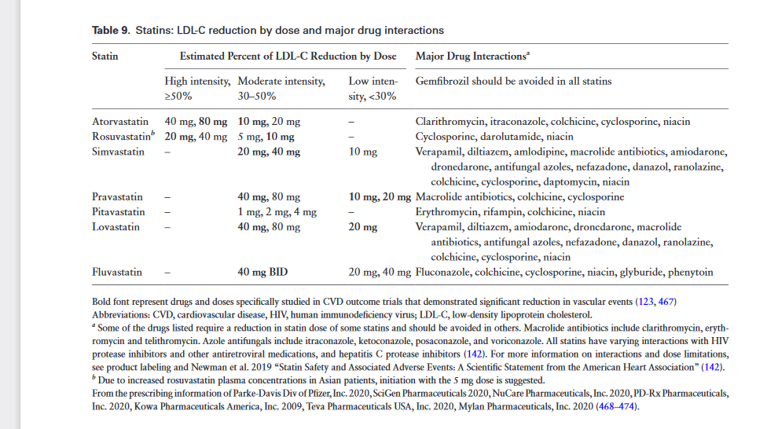

Slide 220
Non-statin LDL-C–lowering
medications

Slide 221
ezetimibe
Nonstatin medications are useful when, despite lifestyle changes and maximally tolerated statin therapy, more LDL-C reduction is needed.
The first medication to consider as adjunct to statin treat-ment is ezetimibe 10 mg, which is an inhibitor of the crit-ical mediator of cholesterol absorption in the intestine, the Niemann-Pick-C1-like 1 receptor. This receptor is also ex-pressed in the liver.
Ezetimibe is generally used with a statin.

Slide 222
PCSK9 inhibitors indication
For additional LDL-C reduction in patients taking a statin, subcutaneous injection (every 2 weeks or once a month) of monoclonal antibodies to PCSK-9 (alirocumab and evolocumab) may be used either with the statin or with the statin plus ezetimibe.
These medications block the effects of PCSK9 (a proprotein convertase) on degradation of LDL receptors in the liver

Slide 223
PCSK9 inhibitors indication
They are indicated as adjunct to diet, and either alone or in combination with other lipid lowering medications,
for reducing CV events in people with ASCVD,
and for reducing LDL-C in patients with FH (eg, heterozygous FH).
Evolocumab also has an indication as adjunct to diet and lipid-lowering medications for treat-ment of homozygous FH.
The cost of PCSK9 inhibitors may be prohibitive for some patients.

Slide 224
bile acid sequestrant
If more LDL-C reduction is desired in patients taking maximally tolerated statin therapy and ezetimibe, and cost or intolerance of injections prevent the use of monoclonal antibodies to PCSK9, a bile acid sequestrant may be added provided that TG are below 500 mg/dL (5.6 mmol/L).
Bile acid–binding resins include colestipol, cholestyramine, and colesevelam, which are generally used in combination with a statin or a statin and ezetimibe.
Bile acid sequestrants lower cholesterol by binding to bile acids in the gastro-intestinal (GI) tract, preventing their absorption, thereby increasing hepatic synthesis of bile acids, which reduces the amount of cholesterol in the liver.
Reduced hepatic choles-terol leads to the upregulation of LDL receptors

Slide 225
Bempedoic acid
Bempedoic acid is an adenosine-triphosphate citrate lyase inhibitor approved by the US FDA in 2020 for use as an adjunct to diet and maximally tolerated statin therapy in adults with heterozygous FH or established ASCVD, who require additional reduction in LDL-C .
The effect of bempedoic acid on CV morbidity and mortality has not been determined but is under investigation

Slide 226
Treatment for hypertriglyceridemia

Slide 227
In patients with elevated TG, initial management in-cludes :
the identification and treatment of secondary fac-tors that raise TG,
and the initiation or adjustment of lifestyle therapy.

Slide 228
Secondary factors include :
endocrine dis-eases discussed in this guideline,
chronic liver and kidney disease,
and medications (estrogens, glucocorticoids, mitotane, tamoxifen, raloxifene, bile acid resins, protease inhibitors, retinoids, hydrochlorothiazide, propranolol, metoprolol, cyclosporine, tacrolimus, phenothiazine, aripiprazole, olanzapine, quetiapine, and risperidone

Slide 229
For patients with persistent elevation in TG up to 500 mg/dL (5.6 mmol/L) per day, statins are the first choice of pharmacological therapy as adjunct to lifestyle changes.
A fibrate may also be used with the caution that the combination of a fibrate and a statin increases the risk of myopathy. This risk is more common with gemfibrozil compared with fenofibrate .

Slide 230
In addition, as noted in this guideline, EPA ethyl ester is recommended to reduce ASCVD risk in
statin-treated patients
with
TG of 150–499 mg/dL (1.7–5.6 mmol/L),
and
--either ASCVD
or
--T2D
And
2 additional risk factors

Slide 231
The risk of pancreatitis increases with TG > 500 mg/dL (5.6 mmol/L) and is even greater as TG rise to 1000 mg/dL (11.3 mmol/L) or higher.
Diet and exercise, and the treat-ment of secondary factors, may lower TG.
However, if TG reduction is not sufficient, pharmacological therapy (statin, fibrates, or omega-3 fatty acids) should be considered.

Slide 232
Patients with TG levels of about 1000 mg/dL (11.3 mmol/L) or greater may have 1 or multiple genetic mutations, and a greater sensitivity to medications and other secondary factors that increase TG.
Monogenetic hypertriglyceridemia, such as LPL deficiency, is rare and is often diagnosed in childhood or adolescence.
For such extreme elevations in TG, a diet with very low-fat content, as little simple sugar as possible, and no alcohol may reduce TG.
The addition of fibrates or omega-3 fatty acids may be useful. Niacin also reduces TG but has safety concerns

Slide 233
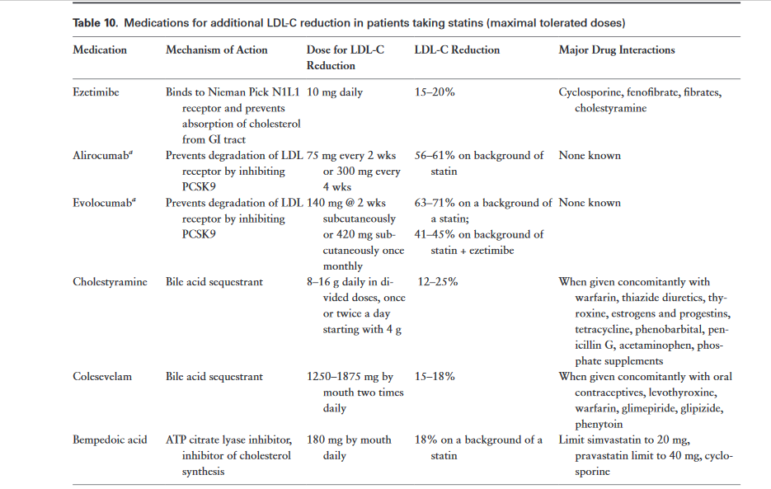

Slide 234
Safety of lipid-lowering
medications

Slide 235
Hypercholesterolemia
Statins

Slide 236
Myopathy/rhabdomyolysis
The hallmark serious adverse effect of statins is myop-athy (incidence <0.1%), defined as:
unexplained muscle pain or weakness (or other muscle symptoms such as stiffness or cramping), with creatine kinase (CK) elevation >10 times the upper limits of normal (ULN)

Slide 237
As women generally have lower CK levels than men , if a sex-adjusted normal range is not used, myopathy may present in women at lower-fold elevations in CK.
African American women have similar CK levels compared with non-Hispanic white men, and African American men have higher CK levels compared with non-Hispanic white men.

Slide 238
The time from initiation of statin treatment to myop-athy varies and may occur years after statin initiation.
When CK levels are extremely high, such as above 10 000 IU/L or greater than 40 times ULN, rhabdomyolysis, which is a severe form of myopathy, should be considered.
Rhabdomyolysis may be associated with renal impairment, including acute renal failure and myoglobinuria, but not in all cases.
This is a medical emergency

Slide 239
Myopathy is rare, with incidence <0.1% for most statins and 1% for simvastatin 80 mg, a dose no longer used
The incidence of rhabdomyolysis is even lower at <0.01%

Slide 240
risk factors
Possible risk factors formyopathy/rhabdomyolysis in-clude
older age
female sex,
diabetes,
Chinese ancestry
renal insufficiency,
pre-existing muscle dis-ease,
hypothyroidism,
drug interactions.

Slide 241
The mech-anism of myopathy is not known.
In a patient with unexplained muscle symptoms, CK levels will distinguish nonserious muscle symptoms from myopathy.

Slide 242
In patients with myopathy, discontinuation of the statin usually results in resolution of muscle symptoms within days, and reduction in CK, which returns to normal within 2 to 3 weeks.
If rhabdomyolysis is suspected, inten-sive hydration is usually effective in preventing renal failure .
Other causes or precipitating factors of myopathy should be considered and interacting medications discon-tinued, if possible

Slide 243
About 10% of patients stop statin use because of ad-verse symptoms, not necessarily caused by the statin, and are often labeled statin intolerant .
The most common symptoms are muscle weakness or pain, and these are usually not accompanied by increases in CK.
Statin-associated muscle symptoms are caused by the statin in <1% of patients

Slide 244
In the 2016 meta-analysis of 12 statin CVD outcome studies in 97 000 subjects, myalgia or muscle ache occurred in 5162 (11.7%) participants allocated statins versus 5015 (11.4%) partici-pants allocated placebo (P = 0.10).
In 4 double-blind, placebo-controlled, randomized trials of statins that specif-ically queried muscle symptoms, none found a statistically significant difference in muscle symptoms between statin and placebo groups, using the intention-to-treat analyses

Slide 245
In an electronic database review, 90% of statin-intolerant patients tolerated the same or a different statin when re-challenged,
in 2 RCTs, in patients labeled statin intolerant the vast majority could tolerate a statin under double-blind conditions.
These data taken together suggest that the intolerance is not pharma-cologic in most patients

Slide 246
New-onset diabetes
Randomized-controlled trials and meta-analyses of RCTs show that statins increase the risk of newly diagnosed dia-betes mellitus most commonly in pa-tients with multiple risk factors for diabetes with an absolute risk of about 0.2% per year depending upon the baseline risk of the population
The mechanisms are not fully known.
Despite the increased risk of newly diagnosed diabetes, statins still have a favor-able benefit/risk ratio, even in patients predisposed to de-velop diabetes, and are usually continued in those patients who develop new diabetes

Slide 247
Hepatic adverse events
Statins, which act in the liver, cause confirmed, dose-related, asymptomatic elevations in hepatic trans-aminases greater than 3 times ULN, with elevation in alanine aminotransferase (ALT) greater than aspartate aminotransferase (AST), in up to 1% of patients in clinical trials but these patients usually do not develop severe liver disease
Studies including an RCT in pa-tients with chronic liver disease, show that statins are safe in patients with nonalcoholic fatty liver disease, including those with modest elevations in transaminases (<3 times ULN)

Slide 248
Therefore, statins may be safely initiated when needed for LDL-C and/or CV risk reduction in indi-viduals with transaminase elevations up to 3 times ULN and/or other evidence of hepatic steatosis.
Severe liver injury (hepatoxicity) is extremely rare, estimated to occur in about 1 in 100 000 patients and not detectable in clinical trials.
Monitoring of ALT and AST does not prevent severe liver disease

Slide 249
Steroidogenesis
Although statins inhibit HMG-CoA reductase, the rate-limiting enzyme in the cholesterol synthesis pathway, studies of lovastatin, simvastatin, and pravastatin show that these statins do not have a clinically significant effect on steroid hormone synthesis, although some evidence suggests that statins reduce androgen levels in patients with PCOS

Slide 250
Hormones evaluated include cortisol, adrenocorticotropic hormone, basal or human chorionic gonadotropin (HCG)-stimulated testosterone, free testosterone index, sex hormone–binding globulin (SHBG), LH, or follicle-stimulating hormone (FSH)

Slide 251
Nonstatin therapies

Slide 252
Pcsk9 inhibitors
The most common adverse effect of evolocumab and alirocumab is injection site reaction, which occurs in about 2% to 4% of patients
Severe hypersensitivity reactions are rare, as are other allergic reactions, including urticaria, nummular eczema, and hypersensitivity vascu-litis.
Available data show no effect on steroidogenesis and lipid-soluble vitamins

Slide 253
Ezetimibe
Elevated transaminases have been observed but are rare in patients taking ezetimibe, and likely not caused by ezetimibe.
However, the drug should not be used in patients with moderate or severe liver disease.

Slide 254
Randomized-controlled trial data during 6 years of follow-up found no evidence that ezetimibe caused
my-opathy/rhabdomyolysis,
more than a 3-fold elevation in hepatic transaminases,
gallbladder problems (including cholecystectomy),
or cancer
Ezetimibe increases plasma levels of cyclosporine; therefore, levels of cyclo-sporine should be monitored

Slide 255
Bile acid–binding resins
Adverse effects of bile acid–binding resins include
consti-pation,
abdominal pain,
bloating,
flatulence,
and increased hepatic transaminases.
Of the medications in this class, colesevelam seems to be the best tolerated.
Bile acid binding decreases the absorption of folic acid and fat-soluble vita-mins and a variety of medicines.

Slide 256
To prevent this, medica-tions should be taken 2 to 4 hours before or 4 to 6 hours after the bile acid–binding resin.
Colesevelam appears to cause fewer GI side-effects, and so is likely the best-tolerated agent in this class.
Further, it has greater select-ivity for bile acids and so seems less likely to interfere with absorption of other medications and nutrients.

Slide 257
Bile acid resins may cause a 10% to 20% increase in TG in individuals with TG levels above 500 mg/dL (5.6 mmol/L), and so are contraindicated in this setting

Slide 258
In a meta-analysis, TG were also shown to increase significantly after the use of a newer bile acid sequestrant, colesevelam
Due to the variability of the response, we suggest checking plasma TG before starting and again several weeks after initiating a bile acid sequestrant
In patients with elevated triglycerides (>150 mg/dL to 499 mg/dL [1.7 mmol/L to 5.6 mmol/L]), we suggest checking triglycerides before and after starting a bile acid sequestrant

Slide 259
Bempedoic acid
Bempedoic acid was approved by the FDA in 2020, and therefore safety data were limited at the time of writing this guideline.
Drug interactions of bempedoic acid with simvastatin and pravastatin increase concentrations of these statins, which could increase the risk of myopathy
Therefore, concomitant simvastatin should be limited to a dose of 20 mg, and pravastatin to a dose of 40 mg

Slide 260
Bempedoic acid increases uric acid levels, and gout was observed in 1.5% of patients taking bempedoic acid in clinical trials compared with 0.4% of patients on placebo.
The placebo-corrected incidence of other adverse effects in clinical trials were benign prostatic hyperplasia in about 1% of patients and tendon rupture in 0.5% of patients.

Slide 261
An increase in hemoglobin of ≥2 g/dL in 3% of patients,
an in-crease in platelet counts of 5%
and transient elevations of AST and/or ALT to above 3 times the upper limit of normal n about 1% of patients
usually resolved or improved with continued treatment or after discontinuation of treatment

Slide 262
Hypertriglyceridemia

Slide 263
Fibrates
Fenofibrate is much less likely than gemfibrozil to in-duce myopathy when administered with a statin
For this reason, the recommendation in statin labels is to avoid gemfibrozil.

Slide 264
Omega-3 fatty acids
Omega-3 fatty acids, which can be a combination of eicosapentanoic acid (EPA) and docosapentaenoic acid or EPA alone, reduce the production of very low density lipo-proteins in the liver, which are TG-rich and may also in-crease the clearance of TG-rich lipoproteins by increasing LPL activity.

Slide 265
Omega-3-acid-ethyl-esters (combination of EPA and DHA), which are indicated to lower the risk of pancreatitis in patients with TG >500 mg/dL (5.6 mmol/L), but do not have evidence for reduction in ASCVD risk,
have been as-sociated with an increase in atrial fibrillation and bleeding

Slide 266
Niacin
Niacin reduces TG, total cholesterol and LDL-C, and in-creases HDL-C.
Prescription niacin is no longer available in Europe because of its adverse safety profile.
The most common adverse events are flushing and pruritis.
Niacin also increases plasma glucose and worsens glycemic control, and it is associated with an increased risk of newly diagnosed diabetes .

Slide 267
Other serious adverse effects of niacin include :
hepatotoxicity (which is rare)
infection,
GI bleeding,
and myopathy.
niacin should have limited use today and should probably not be used in people with diabetes or im-paired glucose tolerance.

Slide 268

So blessed be allah, the best of creators!!!
TNX FOR ATTENTION

