Slide 2
Clinical assessment for high-risk patients with non-alcoholic fatty liver disease in primary care and diabetology practices
Dr. Amir Reza Goharian
Endocrinologist
12/10/99

Slide 3
The most recent estimates suggest that almost 40% of adults in the US are obese, and obesity is one of the five most common risk factors for global mortality.
In fact, the presence of obesity seems to decrease lifespan by 3-8 years, and the addition of diabetes to obesity will reduce lifespan by up to 20 years. 7,8

Slide 4
In the context of this rising epidemic of obesity, the worldwide prevalence of NAFLD is estimated to be 25%. (9)
However, the prevalence can be higher, ranging from 30% up to 90% based on certain risk factors (body composition, presence T2DM, ethnicity, age) and the modality used to establish the diagnosis of NAFLD. (6,10-13)

Slide 5
In fact, obesity (regardless of presence of other metabolic factors) is an independent risk factor for NAFLD, and individuals with obesity are at four-folds higher risk of having NAFLD as compared to individuals with normal weight. (14,15)
The relationship between increase in weight and risk of NAFLD is dose dependent.
In fact, there is a 20% increase risk for NAFLD with for every unit increase in BMI. (16)

Slide 6
In addition to obesity, T2DM is another strong risk factor for NAFLD.
In a recent meta-analysis, the prevalence of NAFLD among patients with T2DM was found to be 55.5%. (17)
Indeed, numerous studies have shown that the stage of liver fibrosis is the most important determinant of patient outcomes and mortality. (18-21)
Considering invasiveness of liver biopsy and the large number of potential patients with NAFLD in the community, liver biopsy is not a practical tool to assess the stage of liver disease in NASH.

Slide 7
Over the last several years , established non-invasive tools (NITs) have been used to estimate the stage of liver disease in NASH.
These NITs have been found to be helpful to clinicians with the identification of patients at high risk with NASH so that targeted management and long-term monitoring can be accomplished. (22)

Slide 8
Importance
NASH has now become the second leading indication for liver transplantation (LT) in the US, while being the most common LT indication among women. (26,27)
Furthermore, NASH is recognised not only as the third most common, but also as the most rapidly growing aetiological causes of HCC in the US. (28)

Slide 9
NASH=Progressive form of NAFLD
NAFLD is a spectrum of hepatic pathology that includes non-alcoholic fatty liver (NAFL), defined as >5% of steatosis found within the liver cells but without concurrent inflammation or liver cell injury.
NASH is histologically distinct from NAFL, and is characterized by hepatic inflammation and cellular injury in addition to steatosis, with potential of progression to fibrosis and cirrhosis.

Slide 10
Pathology
The necroinflammatory features of NASH on histology include a distinctive form of liver injury characterised by cellular ballooning of hepatocytes, often including lobular inflammation, varying degrees of hepatic fibrosis and sometimes Mallory-Denk bodies within hepatocytes.

Slide 11
All forms of NAFLD can be asymptomatic and detected either incidentally by imaging or by investigating incidental elevation of liver enzymes.
NASH cirrhosis ( fibrosis stage 4 /4) is the result of progressive fibrosis and can result in progressive synthetic dysfunction of the liver and can be initially seen as the development of portal hypertension.

Slide 12
EPIDEMIOLOGY OF NAFLD
As mentioned above, the global prevalence of NAFLD exceeds 25% of all adults, although there is significant geographical variation.
South America and the Middle East have the highest reported NAFLD prevalence of more than 30%, while Africa has the lowest NAFLD prevalence of 13%. (9)
Asia, due in part to rapid urbanisation, also has a high (27%-29%) and growing prevalence of NAFLD. (32)

Slide 13
EPIDEMIOLOGY OF NAFLD
In the US , the prevalence of NASH in the general population is estimated to be between 1.5 and 6.5%. (9)
It was estimated that the number of NASH patients with advanced fibrosis in the US will double by 2030. (34)

Slide 14
lean NAFLD
Although the majority of patients with NAFLD present with obesity, about 30% of patients with NAFLD are either of normal weight (BMI <25 kg/m2 for Western countries and <23 kg/m2 for Eastern countries) or can be considered as nonobese (BMI <30 kg/m2 for Western countries and 25-27 kg/m2 for Eastern countries). (9,35)
The prevalence of lean NAFLD in the US general population is about 7.4%. (36)

Slide 15
EPIDEMIOLOGY OF NAFLD
In fact, adults with NAFLD frequently have concurrent metabolic disease with 30% having insulin resistance or T2DM , ≥50% having HTN , HLP or metabolic syndrome. (9)
The global prevalence of NAFLD among patients with T2DM is estimated to be about 55.5% (95% CI 47.3-63.7). (17)
On the other hand, the prevalence of NASH among those with T2DM is 37.3% (24.7%-50.0%) (17)

Slide 16
ethnic heterogeneity
Hispanic and Caucasian males are more likely to have NAFLD, whereas African Americans are at a lower risk for NAFLD.
The patatin-like phospholipase domain-containing 3 gene (PNPLA3) which has been associated with higher prevalence of NAFLD and more progressive disease. (37,38)

Slide 17
ethnic heterogeneity
It appears that this single variant in the PNPLA3 gene, I 148 M , is found in greater frequency in Hispanics and non-Hispanic whites, but less frequently in African Americans. (37-39)

Slide 18
NATURAL HISTORY OF NAFLD
However, around 10%-15% of patients with histological NASH can progress to cirrhosis and will be at risk for hepatocellular carcinoma , liver transplantation or death. (6,40-43)
Risk factors for progression include : T2DM, insulin resistance and the other components of metabolic syndrome.
In fact, the more components of metabolic syndrome, the higher the risk of advanced liver disease and mortality. (44)

Slide 19
NATURAL HISTORY OF NAFLD
Cardiovascular disease (CVD) mortality is the most common cause of death until patients reach advanced stages of NASH with cirrhosis where liver mortality becomes the predominant cause of death. (45)
Therefore , it is of utmost importance that optimal management of the cardiometabolic risk factors in patients with NAFLD be obtained.

Slide 20
NATURAL HISTORY OF NAFLD
Progression of fibrosis in NASH is not linear or unidirectional. In fact, patients can progress and regress spontaneously. (46)
Third, patients with NASH can develop HCC with or without cirrhosis. (40,47,48)
However, the rate of HCC in NAFLD without cirrhosis is 0.5 cases 1000 person - years. (47)
Patients with NAFLD are at increased risk for extrahepatic cancers, including colon, gastric and pancreatic cancers. (50,51)

Slide 21
2030
In fact, a recent modelling study from the US suggested that NAFLD is projected to increase by 21% (100.9 million cases) by 2030 leading to an overall prevalence among adults (≥15 years old) of almost 34%.

Slide 22
PREDICTORS OF DISEASE PROGRESSION IN NAFLD
Currently, patients with NASH and advanced fibrosis (termed ‘bridging fibrosis’ or F3 on a scale of F0-F4) and those with cirrhosis (F4) are in most urgent need for intervention. (41,42)
In addition, there are multiple studies suggesting that NAFLD patients with T2DM are at risk for increased mortality. (53,54)
In fact, the larger the number of components of metabolic syndrome, the higher the risk of mortality. (44)

Slide 23
Liver Biopsy
Liver biopsy remains the gold standard to assess liver fibrosis stage and establish the histological diagnosis of steatohepatitis.
However, liver biopsy is limited due to its invasiveness, sampling error, cost and inter-/intraobserver variability of pathologic interpretation. (55,56)

Slide 24
STAGING FIBROSIS IN NAFLD: NONINVASIVE TESTS

Slide 25
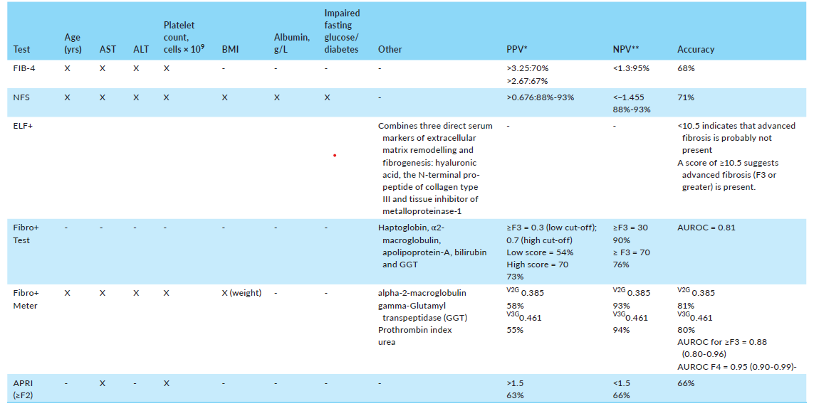

Slide 26
1- Fibrosis-4 test (FIB-4)
The FIB-4 score is derived from common laboratory results:
AST, ALT and platelet count in addition to age
The FIB-4 can be easily calculated online at : https://www.mdcalc.com/fibro sis-4-fib-4-index-liver -fibrosis and is derived from the formula:
FIB-4 = Age (years) × AST (U/L)/[PLT(109/L) × ALT ½ (U/L)].

Slide 27
(FIB-4)
At a cut-off score of <1.3 the FIB-4 has a negative predictive value (NPV) of 90%-95% for F3-F4 fibrosis and an accuracy of 68% , while a cut-off score of >2.67 has an 80% positive predictive value (PPV) for F3-F4.
Grey Zone = 1.3 – 2.7
The NASH Council recommends that a patient who has a FIB-4 score of >1.3 be referred to a specialist and for those that have a score ≤1.3 undergo lifestyle intervention with their primary provider.

Slide 28
(FIB-4)
for those over the age of 65 years old, a FIB-4 score of >2.0 should be used as the cut-off at which to refer so those with a score of <2.0 need not be referred . (68,69)
Conversely, for those under the age of 35,the FIB-4 score may not be as accurate, and therefore, other factors such as: family history of NASH cirrhosis, the number of metabolic syndrome components present or the presence of T2DM should be taken into consideration when deciding whether to refer to a specialist.

Slide 29
2 - NAFLD fibrosis score (NFS)
The formula is NFS = −1.675 + 0.037 × age (years) + 0.094 × BMI (kg/m2) + 1.13 × IFG/diabetes (yes = 1, no = 0) + 0.99 × AST/ALT ratio − 0.013 × platelet (×109/l) − 0.66 × albumin (g/dL).
The NFS can be calculated online at https://www.mdcalc.com/nafld -non-alcoholic-fatty -liver - disease-fibrosis-score.

Slide 30
2 - NAFLD fibrosis score (NFS)
The accuracy of the NFS in predicting the fibrosis stage is 67.5%-100% for those aged 35-64 years old. (70)
However, despite the good parameters of the NFS, there remains an indeterminate zone between −1.455 and 0.676 .

Slide 32
3 - AST to platelet ratio index: APRI
The sensitivity and specificity of a score >1 for significant fibrosis were 30.0% (95% CI: 17.2-45.4%) and 92.8% (95% CI: 88.2%-95.8%) respectively.
However, the APRI cannot discriminate between intermediate stages of fibrosis.

Slide 34
4 - Enhanced liver fibrosis score—ELF (Siemens)
ELF uses an algorithm that combines three direct serum markers of extracellular matrix remodelling and fibrogenesis: hyaluronic acid, the N-terminal pro-peptide of collagen type III and tissue inhibitor of metalloproteinase-1. (73,74)
The ELF test has been shown to identify patients with advanced liver fibrosis with AUROC of 0.92 (95% CI: 0.89-0.96), 0.82 for moderate fibrosis and of 0.76 for no fibrosis.

Slide 35
4 - Enhanced liver fibrosis score—ELF (Siemens)
Advanced fibrosis can be ruled out in primary care settings for patients with NAFLD with an ELF score below 10.5 .
Therefore, the National Institute for Health and Care from UK has recommended the use of 10.5 as a cut-off point with <10.5 indicating that advanced fibrosis in NAFLD is not present and a score of ≥10.5 advanced fibrosis (F3 or greater) may be present. (74)

Slide 36
4 - Enhanced liver fibrosis score—ELF (Siemens)
Furthermore, the 5-year risk of death with an ELF score of ≥10.5 seems to be 25%, which is 20 folds higher compared to those with very low ELF score of <7.7. (73,74)

Slide 37
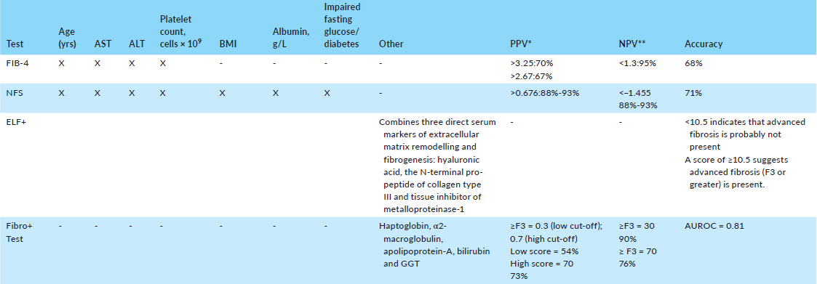

Slide 38
5 - FibroTest (aka, NASH Fibrosure)
FibroTest (Biopredictive) is a commercially available algorithm that combines age, gender, alpha-2-macroglobulin, haptoglobin, apolipoprotein, total bilirubin and gamma-glutamyl transferase (GGT).
The urrent recommended cut-off for advanced fibrosis (F3>) is 0.58 . (76-79)
The formula for Fibrotest is quite complicated, and due to the variability of components assays and analysers, FibroTest assays can only be performed in validated laboratories.

Slide 39
5 - FibroTest (aka, NASH Fibrosure)
The current cut-offs for F3 is 0.59-0.72 and for F3/F4 is ≥0.73 .
An important limitation of this test is related to the fact that it was developed to determine fibrosis in those with hepatitis C and has not been fully validated in all NASH subpopulations.

Slide 41
6 - Fibrometer
The Fibrometer (Echosens) is also a commercial test that is comprised of age, AST, ALT, platelet count, weight, alpha-2-macroglobulin, GGT, prothrombin index and urea.
There are two versions of the Fibrometer test but both have similar results.
For the V2G at a value of 0.385 (value suggested for the presence of fibrosis stage 3 or greater), the PPV is 58% and the NPV is 93%.

Slide 42
6 - Fibrometer
For the V3G at a value of 0.461 (value suggested for the presence of fibrosis stage 3 or greater), the PPV is 55% and the NPV is 94%.
Both have an accuracy of at least 80% and an AUROC for a fibrosis score of 3 or greater of 0.88 and for a fibrosis score of 4, the AUROC is 0.95. (79)

Slide 43
RADIOGRAPHIC ASSESSMENT OF FIBROSIS IN NASH

Slide 44
Vibration-controlled transient elastography (VCTE)
Vibration-controlled transient elastography (Fibroscan®—Echosens) uses an ultrasound-based technique in which a low-frequency (50 Hz) elastic shear wave is generated by a hand-held transducer.
As the shear wave spreads through the hepatic parenchyma, it measures a volume of the liver that is 100 times larger than a liver biopsy sample.

Slide 45
The speed of propagation is proportional to the stiffness of the crossed tissue and its measurement can, through specific software, provide liver stiffness measurement (LSM) expressed in kilopascal (kPa).
The final value is the median of 10 valid measurements reported in kPa as described above.
A cut-off of 9.9 kPa or greater for predicting advanced NAFLD-related fibrosis is reported to be 95% sensitive and 77% specific, with an AUROC of 0.93 (95% CI: 0.86-0.96). (81)

Slide 46
Vibration-controlled transient elastography (VCTE)
These values range from 8.2 kPa for fibrosis stage 2, 9.7 kPa for fibrosis stage 3 and 13.6 kPa for fibrosis stage 4. (84)
Although, it is possible that the greatest utility of Fibroscan is its ability to predict the absence of advanced fibrosis such that a normal or mildly elevated score of kPa <6.9 produces a NPV = 95%. (85,86)

Slide 47
Vibration-controlled transient elastography (VCTE)
An XL probe is suggested for use especially when a patients' skin-liver capsule distance (SCD) is ≥25 mm.
Technical failure rate of approximately 10%-16% (variables associated with failure: women, adults age >50, the presence of type 2 diabetes mellitus and/or hypertension, operator experience)

Slide 48
Acoustic radiation force impulse (ARFI—Siemens medical solutions, Mountain View, CA)
In ARFI, the elastography system is integrated onto an ultrasound machine, allowing the operator to select the site of LSM through a real-time B-mode ultrasonography, and localise the shear wave to avoid blood vessels and ribs.
ARFI uses short-term acoustic pulses to produce shear waves with the results expressed in m/s.

Slide 49
Supersonic shear imaging (SSI, Supersonic Shear Imagine, Aix-en-Provence, France)
Supersonic shear imaging, sometimes referred to as shear wave elastography (SWE) is also built on an ultrasound platform.
The SSI transducer emits several wave fronts at increasing depth, with a frequency band ranging from 60 to 6000 Hz, which allows one to remotely generate and follow a transient plane shear wave that is propagating in vivo in real time.

Slide 50
The LSM is estimated from the shear wave local velocity.
In a recent prospective study, the three elastographic methods were compared on staging fibrosis among 291 patients with biopsy characterised NAFLD.
The results showed ROC's for advanced fibrosis (F3) of 0.89 (SSI), 0.86 (FibroScan) and 0.84 (ARFI) /
For cirrhosis (F4) were 0.88 (SSI), 0.87 (FibroScan) and 0.84 (ARFI).

Slide 51
Obesity (BMI >30 kg/m2), a waist circumference ≥102 cm or increased chest or abdominal wall thickness were associated with technical failure on determining the LSM with SSI or FibroScan, and the results were unreliable with use of ARFI.

Slide 52
Magnetic resonance elastography (MRE)
MRE combines the advantages of MR with elastography to provide information about the liver tissue texture which allows the assessment of the entire liver rather than a small part. (93-95)
For MRE, using a cut-off of 3.63 kPa for distinguishing between advanced fibrosis (F3-F4) and fibrosis stages 0-2 produced an AUROC of 0.924, with a sensitivity of 0.86, specificity of 0.91, PPV of 0.68 and NPV or 0.97.

Slide 53
FAST ™
FAST™ combines liver stiffness results obtained from FibroScan measurements (LSM), degree of steatosis obtained through the Fibroscan's controlled attenuation parameter (CAP™) measurement, and the degree of hepatic inflammation assessed by the serum AST value.
A single score can be generated and interpreted by the healthcare provider at the bedside through the MyFibroscan™ app.

Slide 54
FAST ™
The FAST score ranges between 0 and 1. In its validation cohort, investigators found that as the score increased, the likelihood of mild fibrosis decreased and the number of biopsies needed was reduced; however, as the score increased so did the number of missed cases.
Additionally, FAST does not replace the need for exercising clinical judgement, given that low FAST scores can sometimes be obtained despite the presence of abnormal liver stiffness. (96)

Slide 55
FAST ™
FAST may provide the most utility with liver stiffness scores between 5 and 10 kPa.
The FAST cut-off value for specificity (≥0.90) was 0.67 in the derivation cohort with a positive predictive value (PPV) of 0.83 (95% CI 0.75-0.87),

Slide 56
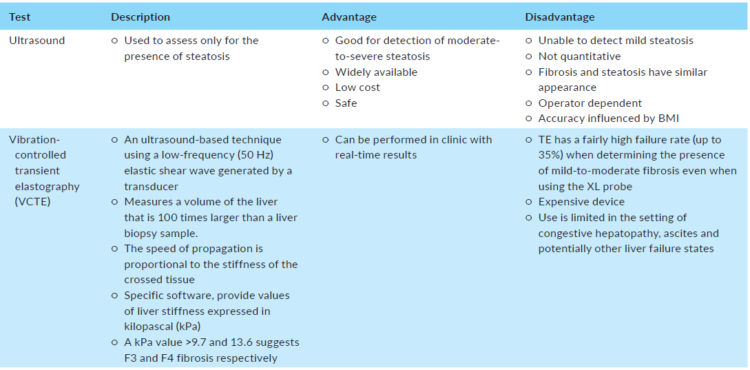

Slide 58
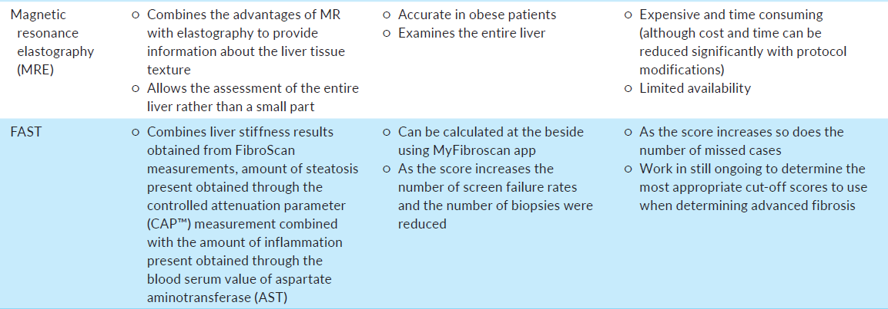

Slide 59
CLINICAL SCENARIO IN PRIMARY CARE OR DIABETOLOGY PRACTICE SETTINGS

Slide 60
other causes of liver disease such as alcohol-related, viral hepatitis, autoimmune liver disease, hemochromatosis, alpha-1-antitrypsin deficiency and medication related liver injury need to be excluded.
Once fatty liver is established and other causes of liver disease are excluded, the next step is to risk stratify NAFLD patients to high or low risk based on the FIB-4 score.

Slide 61
(≥2.0 in those 65 years and older)
(<2.0 in those 65 years and older)

Slide 62
For those patients who fall into the indeterminant area using these initial NITs, MRE can be considered as the next step.
In this context, MRI-PDFF is highly accurate for determining hepatic fat and MR elastography is also quite accurate for measurement of liver stiffness.
Finally, liver biopsy should be reserved for those patients with suspicion for other coexisting liver disease (such as autoimmune liver disease), or when clinically advisable by the specialty assessment.

Slide 63
It is also important to recognise that NAFLD patients (regardless of the stage of liver disease) are at significantly increased risk for cardiovascular mortality.
Therefore, all NAFLD patients must undergo a careful assessment for their 10-year CVD risk.

Slide 64
The US Members of the Global NASH council recommend that PCP's and diabetologists use clinical risk stratification to identify which patients are at risk for liver fibrosis.

Slide 65
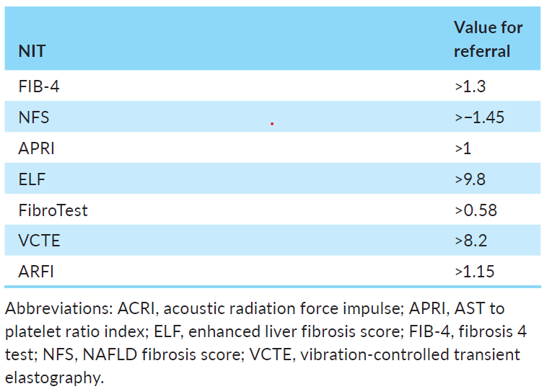

Slide 66
However, a purely ‘liver-centric’ approach to NAFLD/NASH is not sufficient so treatment of NAFLD/NASH needs to shift to a more patient-centred, multidisciplinary team-based approach.
Since more patients with NAFLD will die from CVD complications rather than the consequences of their liver disease, it is necessary that PCPs and diabetologists provide a careful assessment of the 10-year CVD risk for all persons with NAFLD as well as providing early and aggressive treatment for all coexisting cardiometabolic risk factors.

Slide 67
ممنون ازتوجه وهمراهی شما

