Slide 1
ADA 2021 REVIEW
Parichehr Vahabi Anaraki MD
25th December 2020

Slide 2
Section 2.
Classification and Diagnosis of Diabetes

Slide 3
Classification
Classification and Diagnosis of Diabetes
Diabetes can be classified into the following general categories:
Type 1 diabetes (due to autoimmune ß-cell destruction, usually leading to absolute insulin deficiency, including latent autoimmune diabetes of adulthood)
Type 2 diabetes (due to a progressive loss of ß-cell insulin secretion frequently on the background of insulin resistance)
Specific types of diabetes due to other causes, e.g., monogenic diabetes syndromes (such as neonatal diabetes and maturity-onset diabetes of the young), diseases of the exocrine pancreas (such as cystic fibrosis and pancreatitis), and drug- or chemical-induced diabetes (such as with glucocorticoid use, in the treatment of HIV/AIDS, or after organ transplantation)
Gestational diabetes mellitus (diabetes diagnosed in the second or third trimester of pregnancy that was not clearly overt diabetes prior to gestation)

Slide 4
A1C (continued)
Classification and Diagnosis of Diabetes
2.3 In conditions associated with an altered relationship betweenA1C and glycemia, such as hemoglobinopathies including sickle cell disease, pregnancy (second and third trimesters and the postpartum period), glucose-6-phosphate dehydrogenase deficiency, HIV, hemodialysis, recent blood loss or transfusion, or erythropoietin therapy, only plasma blood glucose criteria should be used to diagnose diabetes. B

Slide 5
Cystic Fibrosis-Related Diabetes
Classification and Diagnosis of Diabetes
2.15 Annual screening for cystic fibrosis–related diabetes (CFRD) with an oral glucose tolerance test should begin by age 10 years in all patients with cystic fibrosis not previously diagnosed with CFRD. B
2.16 A1C is not recommended as a screening test for cystic fibrosis–related diabetes.. B
2.17 Patients with cystic fibrosis–related diabetes should be treated with insulin to attain individualized glycemic goals.. A
2.18 Beginning 5 years after the diagnosis of cystic fibrosis–related
diabetes, annual monitoring for complications of diabetes is recommended. E

Slide 6
Posttransplantation Diabetes Mellitus
Classification and Diagnosis of Diabetes
2.19 Patients should be screened after organ transplantation for hyperglycemia, with a formal diagnosis of posttransplantation diabetes mellitus being best made once a patient is stable on an immunosuppressive regimen and in the absence of an acute infection. B
2.20 The oral glucose tolerance test is the preferred test to make a diagnosis of posttransplantation diabetes mellitus. B
2.21 Immunosuppressive regimens shown to provide the best outcomes for patient and graft survival should be used, irrespective of posttransplantation diabetes mellitus risk. E

Slide 7
Monogenic Diabetes Syndromes
Classification and Diagnosis of Diabetes
2.22 All children diagnosed with diabetes in the first 6 months of life should have immediate genetic testing for neonatal diabetes. A
2.23 Children and those diagnosed in early adulthood who have diabetes not characteristic of type1 or type 2 diabetes that occurs in successive generations (suggestive of an autosomal dominant pattern of inheritance) should have genetic testing for maturity- onset diabetes of the young. A
2.24 In both instances, consultation with a center specializing in diabetes genetics is recommended to understand the significance of these mutations and how best to approach further evaluation, treatment, and genetic counseling. E

Slide 8
Classification and Diagnosis of Diabetes
The diagnosis of monogenic diabetes should be considered in children and adults diagnosed with diabetes in early adulthood with the following findings:
Diabetes diagnosed within the first 6 months of life (with occasional cases presenting later, mostly INS and ABCC8 mutations)
Diabetes without typical features of type 1 or type 2 diabetes (negative diabetes-associated autoantibodies, nonobese, lacking other metabolic features, especially with strong family history of diabetes)
Stable, mild fasting hyperglycemia (100–150 mg/dL [5.5–8.5 mmol/L]), stable A1C between 5.6% and 7.6% (between 38 and 60 mmol/mol), especially if nonobese

Slide 9
Gestational Diabetes Mellitus
Classification and Diagnosis of Diabetes
2.25 Test for undiagnosed prediabetes and diabetes at the first prenatal visit in those with risk factors using standard diagnostic criteria. B
2.26 Test for gestational diabetes mellitus at 24–28 weeks of gestation in pregnant women not previously found to have diabetes. A
2.27 Test women with gestational diabetes mellitus for prediabetes or diabetes at 4–12 weeks postpartum, using the 75-g oral glucose tolerance test and clinically appropriate nonpregnancy diagnostic criteria. B

Slide 10
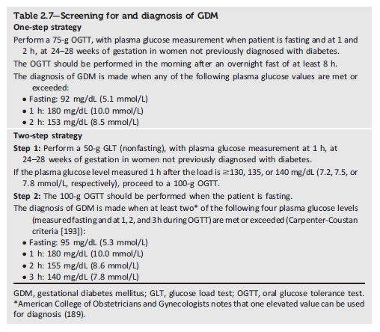
Classification and Diagnosis of Diabetes
Classification and Diagnosis of Diabetes:
Standards of Medical Care in Diabetes - 2021. Diabetes Care 2021;44(Suppl. 1):S15-S33

Slide 11
Section 4.
Comprehensive Medical Evaluation and Assessment of Comorbidities

Slide 12
Immunizations
Comprehensive Medical Evaluation and Assessment of Comorbidities
4.6 Provide routinely recommended vaccinations for children and adults with diabetes as indicated by age (see Table 4.5 for highly recommended vaccinations for adults with diabetes). A

Slide 13
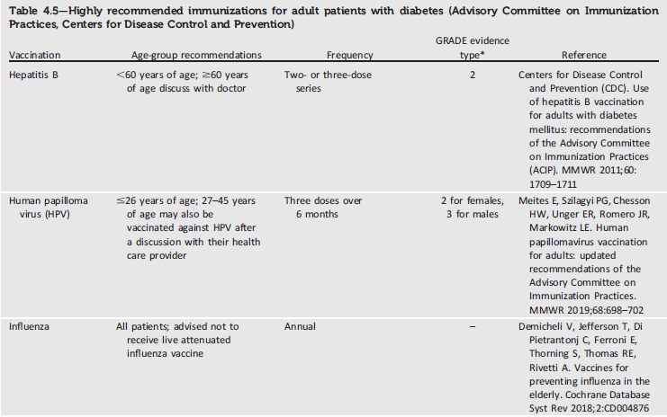
Immunizations
Comprehensive Medical Evaluation and Assessment of Comorbidities

Slide 14
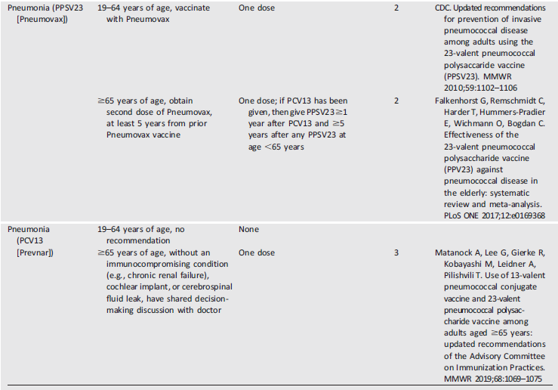
Immunizations
Comprehensive Medical Evaluation and Assessment of Comorbidities

Slide 15
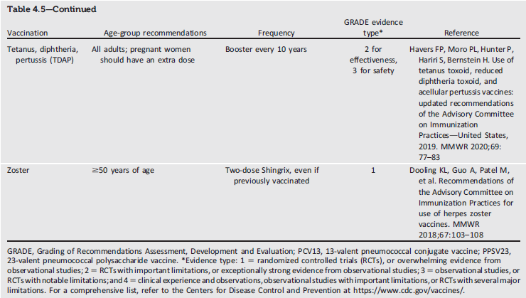
Immunizations
Comprehensive Medical Evaluation and Assessment of Comorbidities

Slide 16
All children are recommended to receive a four-dose series of PCV13 by 15 months of age.
For children with diabetes who have incomplete series by ages 2–5 years, the CDC recommends a catch-up schedule to ensure that these children have four doses.
Children with diabetes between 6–18 years of age are also advised to receive one dose of PPSV23, preferably after receipt of PCV13.
©

Slide 17
For adults with diabetes, one dose of PPSV23 is recommended between the ages of 19–64 years and another dose at 65 years of age.
The PCV13 is no longer routinely recommended for patients over 65 years of age because of the declining rates of pneumonia due to these strains. Older patients should have a shared decision-making discussion with their provider to determine individualized risks and beneﬁts.
PCV13 is recommended for patients with immunocompromising conditions such as asplenia, advanced kidney disease, cochlear implants, or cerebrospinal ﬂuid leaks.
Some older patients residing in assisted living facilities may also consider PCV13.
If the PCV13 is tobe administered, it should be given prior to the next dose of PPSV23

Slide 18
Section 6.
Glycemic Targets

Slide 19
Glycemic Assessment
Glycemic targets
6.1 Assess glycemic status (A1C or other glycemic measurement) at least two times a year in patients who are meeting treatment goals (and who have stable glycemic control).E
6.2 Assess glycemic status at least quarterly, and as needed, in patients whose therapy has recently changed and/or who are not meeting glycemic goals. E

Slide 20
Glucose Assessment by Continuous Glucose Monitoring
Glycemic targets
6.3 Standardized, single-page glucose reports from continuous glucose monitoring (CGM) devices with visual cues, such as the ambulatory glucose profile (AGP), should be considered as a standard printout for all CGM devices. E
6.4 Time in range (TIR) is associated with the risk of microvascular complications, should be an acceptable end point for clinical trials moving forward, and can be used for assessment of glycemic control.
Additionally, time below target (<70 and <54 mg/dL [3.9 and 3.0 mmol/L]) and time above target (>180mg/dL [10.0 mmol/L]) are useful parameters for reevaluation of the treatment regimen. C

Slide 21
Glycemic Goals
Glycemic targets
6.5a An A1C goal for many nonpregnant adults of <7%(53 mmol/mol) without significant hypoglycemia is appropriate. A
6.5b If using ambulatory glucose profile/glucose management indicator to assess glycemia, a parallel goal is a time in range of >70% with time below range <4% (Fig. 6.1). B
6.6 On the basis of provider judgment and patient preference, achievement of lower A1C levels than the goal of 7% may be acceptable, and even beneficial, if it can be achieved safely without significant hypoglycemia or other adverse effects of treatment. C

Slide 22
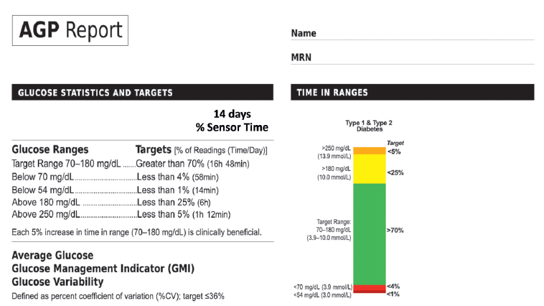
Glycemic targets
Glycemic Targets:
Standards of Medical Care in Diabetes - 2021. Diabetes Care 2021;44(Suppl. 1):S73-S84

Slide 23
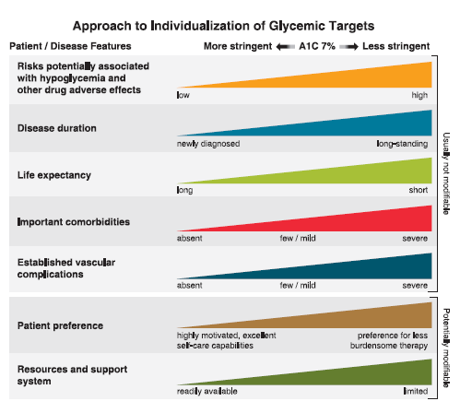
Glycemic targets
Glycemic Targets:
Standards of Medical Care in Diabetes - 2021. Diabetes Care 2021;44(Suppl. 1):S73-S84

Slide 24
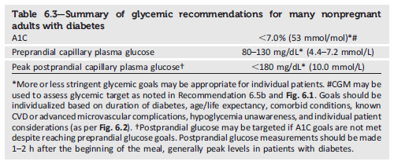
Glycemic targets
Glycemic Targets:
Standards of Medical Care in Diabetes - 2021. Diabetes Care 2021;44(Suppl. 1):S73-S84

Slide 25
Hypoglycemia (continued)
Glycemic targets
6.13 Insulin-treated patients with hypoglycemia unawareness, one level 3 hypoglycemic event, or a pattern of unexplained level 2 hypoglycemia should be advised to raise their glycemic targets to strictly avoid hypoglycemia for at least several weeks in order to partially reverse hypoglycemia unawareness and reduce risk of future episodes. A
6.14 Ongoing assessment of cognitive function is suggested with increased vigilance for hypoglycemia by the clinician, patient, and caregivers if low cognition or declining cognition is found. B

Slide 26
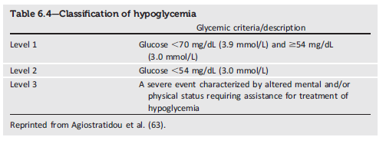
Glycemic targets
Glycemic Targets:
Standards of Medical Care in Diabetes - 2021. Diabetes Care 2021;44(Suppl. 1):S73-S84

Slide 27
Section 8.
Obesity Management for the Treatment of Type 2 Diabetes

Slide 28
Assessment
Obesity Management for the Treatment of Type 2 Diabetes
8.1 Use patient-centered, nonjudgmental language that fosters collaboration
between patients and providers, including people-first language (e.g., “person with obesity” rather than “obese person”). E
8.2 Measure height and weight and calculate BMI at annual visits or more frequently. Assess weight trajectory to inform treatment considerations. E

Slide 29
Diet, Physical Activity, & Behavioral Therapy
Obesity Management for the Treatment of Type 2 Diabetes
8.5 Diet, physical activity, and behavioral therapy designed to achieve and maintain ≥5% weight loss is recommended for most patients with type 2 diabetes who have overweight or obesity and are ready to achieve weight loss. Greater benefits in control of diabetes and cardiovascular risk may be gained from even greater weight loss. B
8.6 Such interventions should include a high frequency of counseling (≥16 sessions in 6 months) and focus on dietary changes, physical activity, and behavioral strategies to achieve a 500–750 kcal/day energy deficit. A

Slide 30
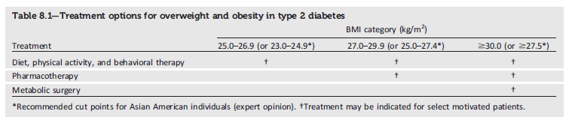
Obesity Management for the Treatment of Type 2 Diabetes
Obesity Management for the Treatment of Type 2 Diabetes:
Standards of Medical Care in Diabetes - 2021. Diabetes Care 2021;44(Suppl. 1):S100-S10

Slide 31
Pharmacotherapy (continued)
Obesity Management for the Treatment of Type 2 Diabetes
8.15 If a patient’s response to weight loss medication is effective (typically defined as >5%weight loss after 3 months’ use), further weight loss is likely with continued use. When early response is insufficient (typically <5% weight loss after 3 months’ use), or if there are significant safety or tolerability issues, consider discontinuation of the medication and evaluate alternative medications or treatment approaches. A

Slide 34
Metabolic Surgery
Obesity Management for the Treatment of Type 2 Diabetes
8.16 Metabolic surgery should be recommended as an option to treat type 2 diabetes in screened surgical candidates with BMI ≥40 kg/m² (BMI ≥37.5 kg/m² in Asian Americans) and in adults with BMI 35.0–39.9 kg/m² (32.5— 37.4 kg/m² in Asian Americans) who do not achieve durable weight loss and improvement in comorbidities (including hyperglycemia) with nonsurgical methods. A
8.17 Metabolic surgery may be considered as an option to treat type 2 diabetes in adults with BMI 30.0–34.9 kg/m2 (27.5–32.4 kg/m2 in Asian Americans) who do not achieve durable weight loss and improvement in comorbidities (including hyperglycemia) with nonsurgical methods. A

Slide 35
Metabolic Surgery (continued)
Obesity Management for the Treatment of Type 2 Diabetes
8.20 People being considered for metabolic surgery should be evaluated for comorbid psychological conditions and social and situational circumstances that have the potential to interfere with surgery outcomes. B
8.21 People who undergo metabolic surgery should routinely be evaluated to assess the need for ongoing mental health services to help with the adjustment to medical and psychosocial changes after surgery. C

Slide 36
Section 9.
Pharmacologic Approaches to Glycemic Treatment

Slide 37
Pharmacologic Therapy for Type 1 Diabetes
Pharmacologic Approaches to Glycemic Treatment
9.1 Most people with type 1 diabetes should be treated with multiple daily injections of prandial and basal insulin, or continuous subcutaneous insulin infusion. A
9.2 Most individuals with type 1 diabetes should use rapid-acting insulin analogs to reduce hypoglycemia risk. A
9.3 Patients with type 1 diabetes should be trained to match prandial insulin doses to carbohydrate intake, premeal blood glucose, and anticipated physical activity. C

Slide 38
Pharmacologic Therapy for Type 2 Diabetes
Pharmacologic Approaches to Glycemic Treatment
9.4 Metformin is the preferred initial pharmacologic agent for the treatment of type 2 diabetes. A
9.5 Once initiated, metformin should be continued as long as it is tolerated and not contraindicated; other agents, including insulin, should be added to metformin. A
9.6 Early combination therapy can be considered in some patients at treatment initiation to extend the time to treatment failure. A
9.7 The early introduction of insulin should be considered if there is evidence of ongoing catabolism (weight loss), if symptoms of hyperglycemia are present, or when A1C levels (>10% [86 mmol/mol]) or blood glucose levels (≥300 mg/dL [16.7 mmol/L]) are very high. E

Slide 39
Pharmacologic Therapy for Type 2 Diabetes (continued)
Pharmacologic Approaches to Glycemic Treatment
9.8 A patient-centered approach should be used to guide the choice of pharmacologic agents. Considerations include effect on cardiovascular and renal comorbidities, efficacy, hypoglycemia risk, impact on weight, cost, risk for side effects, and patient preferences(Table 9.1 and Figure 9.1). E
9.9 Among patients with type 2 diabetes who have established atherosclerotic cardiovascular disease or indicators of high risk, established kidney disease, or heart failure, a sodium–glucose cotransporter 2 inhibitor or glucagon- like peptide 1 receptor agonist with demonstrated cardiovascular disease benefit (Table 9.1, Table 10.3B, Table 10.3C) is recommended as part of the glucose-lowering regimen independent of A1C and in consideration of patient-specific factors (Fig. 9.1 and Section 10).A

Slide 40
Pharmacologic Therapy for Type 2 Diabetes (continued)
Pharmacologic Approaches to Glycemic Treatment
9.13 Clinicians should be aware of the potential for over basalization with insulin therapy. Clinical signals that may prompt evaluation of overbasalization include basal dose more than ~0.5 IU/ kg, high bedtime-morning or post-preprandial glucose differential, hypoglycemia (aware or unaware), and high variability. Indication of overbasalization should prompt reevaluation to further individualize therapy. E

Slide 41
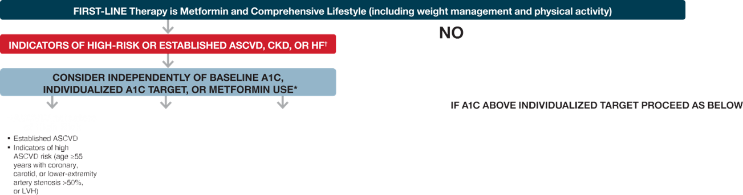

Slide 42
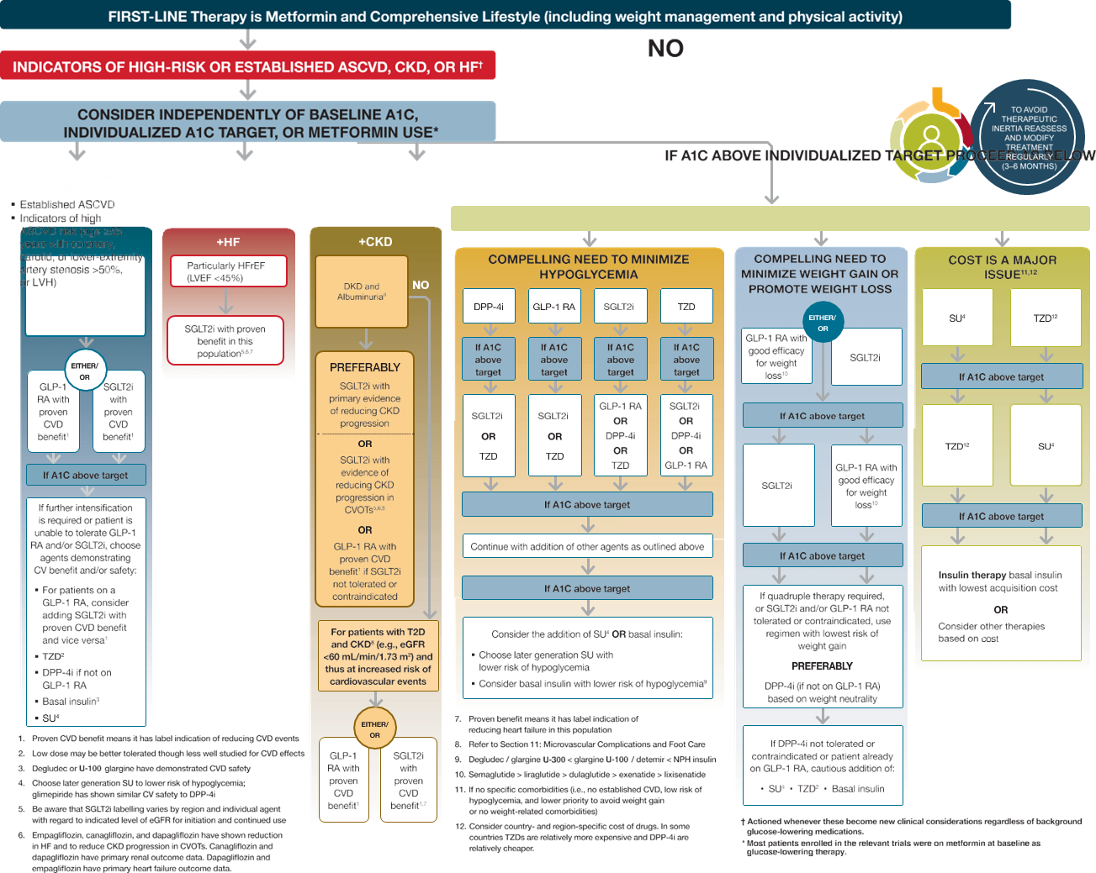

Slide 43
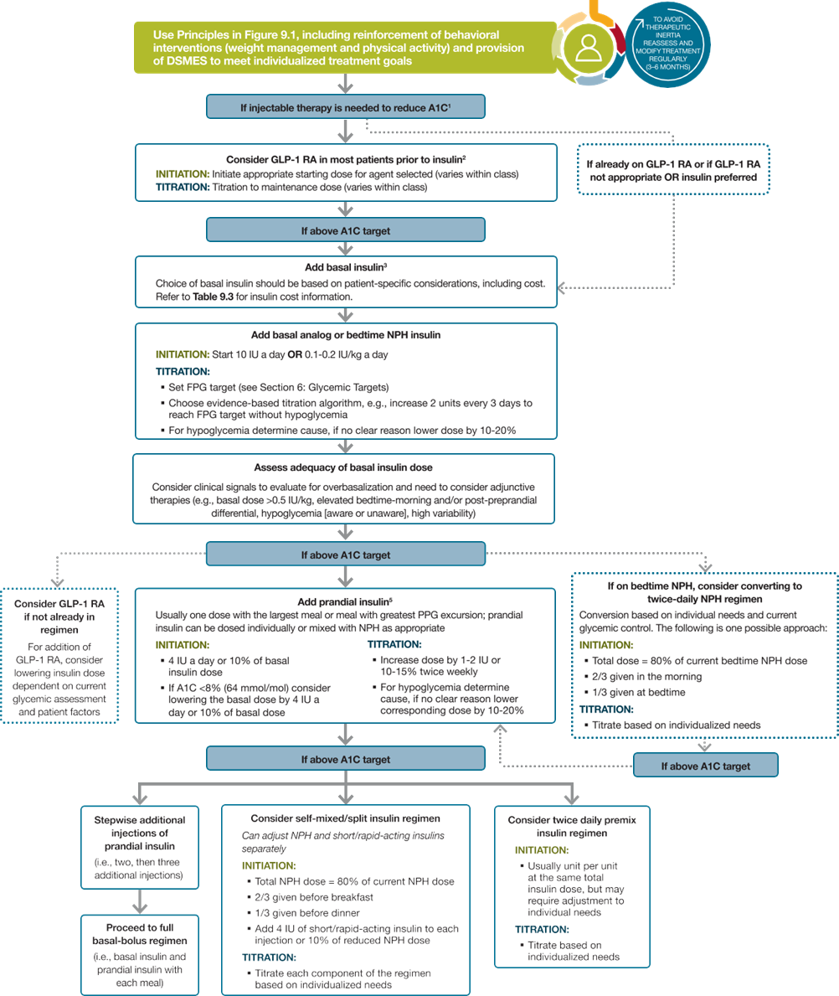

Slide 45
Section 10.
Cardiovascular Disease and Risk Management

Slide 46
Screening and Diagnosis
Cardiovascular Disease and Risk Management
10.1 Blood pressure should be measured at every routine clinical visit. Patients found to have elevated blood pressure (≥140/90 mmHg) should have blood pressure confirmed using multiple readings, including measurements on a separate day, to diagnose hypertension. B
10.2 All hypertensive patients with diabetes should monitor their blood pressure at home. B

Slide 47
Treatment Goals
Cardiovascular Disease and Risk Management
10.3 For patients with diabetes and hypertension, blood pressure targets should be individualized through a shared decision-making process that addresses cardiovascular risk, potential adverse effects of antihypertensive medications, and patient preferences. C
10.4 For individuals with diabetes and hypertension at higher cardiovascular risk (existing atherosclerotic cardiovascular disease [ASCVD] or 10-year ASCVD risk ≥15%), a blood pressure target of, 130/80 mmHg may be appropriate, if it can be safely attained. C
10.5 For individuals with diabetes and hypertension at lower risk for cardiovascular disease (10-year atherosclerotic cardiovascular disease risk <15%), treat to a blood pressure target of <140/90 mmHg. A

Slide 49
Treatment Goals (continued)
Cardiovascular Disease and Risk Management
10.6 In pregnant patients with diabetes and preexisting hypertension, a blood pressure target of 110–135/85mmHgis suggested in the interest of reducing the risk for accelerated maternal hypertension A and minimizing impaired fetal growth. E

Slide 50
It may be reasonable to target blood pressure ,130/80 mmHg among patients with diabetes and either clinically diagnosed cardiovascular disease (particularly stroke, which was signiﬁcantly reduced in ACCORD BP) or 10-year ASCVD risk >15%, if it can be attained safely.
This approach is consistent with guidelines from the American College of Cardiology/American Heart Association, which advocate a blood pressure target ,130/80 mmHg for all patients, with or without diabetes

Slide 51
Patients with older age, chronic kidney disease, and frailty have been shown to be at higher risk of adverse effects of intensive blood pressure control.
In addition, patients with orthostatic hypotension, substantial comorbidity, functional limitations, or polypharmacy may be at high risk of adverse effects, and some patients may prefer higher blood pressure targets to enhance quality of life.
Patients with low absolute cardiovascular risk (10- year ASCVD risk <15%) or with a history of adverse effects of intensive blood pressure control or at high risk of such adverse effects should have a higher blood pressure target.

Slide 52
Treatment Strategies—Lifestyle Intervention
Cardiovascular Disease and Risk Management
10.7 For patients with blood pressure >120/80 mmHg, lifestyle intervention consists of weight loss when indicated, a Dietary Approaches to Stop Hypertension (DASH)-style eating pattern including reducing sodium and increasing potassium intake, moderation of alcohol intake, and increased physical activity. A

Slide 53
Treatment Strategies—Pharmacologic Interventions
Cardiovascular Disease and Risk Management
10.8 Patients with confirmed office-based blood pressure ≥140/90 mmHg should, in addition to lifestyle therapy, have prompt initiation and timely titration of pharmacologic therapy to achieve blood pressure goals. A
10.9 Patients with confirmed office based blood pressure ≥160/100 mmHg should, in addition to lifestyle therapy, have prompt initiation and timely titration of two drugs or a single-pill combination of drugs demonstrated to reduce cardiovascular events in patients with diabetes. A
10.10 Treatment for hypertension should include drug classes demonstrated to reduce cardiovascular events in patients with diabetes. A ACE inhibitors or angiotensin receptor blockers are recommended first-line therapy for hypertension in people with diabetes and coronary artery disease. A

Slide 54
Treatment Strategies—Resistant Hypertension
Cardiovascular Disease and Risk Management
10.14 Patients with hypertension who are not meeting blood pressure targets on three classes of antihypertensive medications (including a diuretic) should be considered for mineralocorticoid receptor antagonist therapy. B

Slide 55
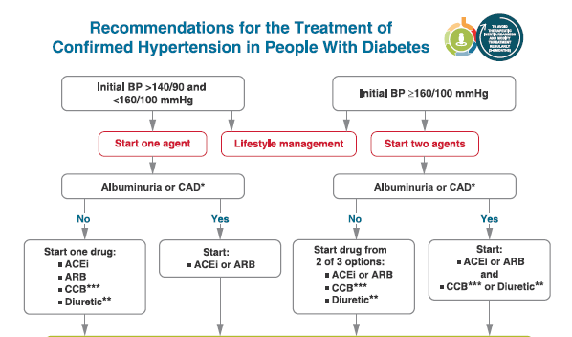
Cardiovascular Disease and Risk Management
Recommendations for the Treatment of Confirmed Hypertension in People with Diabetes (1 of 2)
Cardiovascular Disease and Risk Management:
Standards of Medical Care in Diabetes - 2021. Diabetes Care 2021;44(Suppl. 1):S111-S150

Slide 56
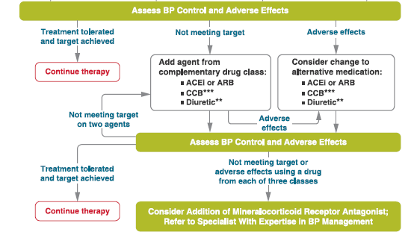
Cardiovascular Disease and Risk Management
Recommendations for the Treatment of Confirmed Hypertension in People with Diabetes (2 of 2)
Cardiovascular Disease and Risk Management:
Standards of Medical Care in Diabetes - 2021. Diabetes Care 2021;44(Suppl. 1):S111-S150

Slide 57
Lipid Management—Lifestyle Intervention
Cardiovascular Disease and Risk Management
10.15 Lifestyle modification focusing on weight loss (if indicated); application of a Mediterranean style or Dietary Approaches to Stop Hypertension (DASH) eating pattern; reduction of saturated fat and trans fat; increase of dietary n-3 fatty acids, viscous fiber, and plant stanols/sterols intake; and increased physical activity should be recommended to improve the lipid profile and reduce the risk of developing atherosclerotic cardiovascular disease in patients with diabetes. A
10.16 Intensify lifestyle therapy and optimize glycemic control for patients with elevated triglyceride levels (≥150 mg/dL [1.7 mmol/L]) and/or low HDL cholesterol (<40 mg/dL [1.0 mmol/L] for men, <50 mg/dL [1.3 mmol/L] for women).C

Slide 58
Statin Treatment—Primary Prevention
Cardiovascular Disease and Risk Management
10.19 For patients with diabetes aged 40–75 years without atherosclerotic cardiovascular disease, use moderate-intensity statin therapy in addition to lifestyle therapy. A
10.20 For patients with diabetes aged 20–39 years with additional atherosclerotic cardiovascular disease risk factors, it maybe reasonable to initiate statin therapy in addition to lifestyle therapy. C
10.21 In patients with diabetes at higher risk, especially those with multiple atherosclerotic cardiovascular disease risk factors or aged 50–70 years, it is reasonable to use high-intensity statin therapy. B
10.22 In adults with diabetes and 10-year ASCVD risk of 20% or higher, it may be reasonable to add ezetimibe to maximally tolerated statin therapy to reduce LDL cholesterol levels by 50% or more. C

Slide 59
Statin Treatment—Secondary Prevention
Cardiovascular Disease and Risk Management
10.23 For patients of all ages with diabetes and atherosclerotic cardiovascular disease, high intensity statin therapy should be added to lifestyle therapy. A
10.24 For patients with diabetes and atherosclerotic cardiovascular disease considered very high risk using specific criteria, if LDL cholesterol is ≥70 mg/dL on maximally tolerated statin dose, consider adding additional LDL-lowering therapy (such as ezetimibe or PCSK9 inhibitor). A Ezetimibe may be preferred due to lower cost.
10.25 For patients who do not tolerate the intended intensity, the maximally tolerated statin dose should be used. E

Slide 60
Statin Treatment—Secondary Prevention (continued)
Cardiovascular Disease and Risk Management
10.26 In adults with diabetes aged >75 years already on statin therapy, it is reasonable to continue statin treatment. B
10.27 In adults with diabetes aged >75 years, it may be reasonable to initiate statin therapy after discussion of potential benefits and risks. C
10.28 Statin therapy is contraindicated in pregnancy. B

Slide 61
Treatment of Other Lipoprotein Fractions or Targets
Cardiovascular Disease and Risk Management
10.29 For patients with fasting triglyceride levels ≥500 mg/dL, evaluate for secondary causes of hypertriglyceridemia and consider medical therapy to reduce the risk of pancreatitis. C
10.30 In adults with moderate hypertriglyceridemia (fasting or nonfasting triglycerides 175–499 mg/dL),clinicians should address and treat lifestyle factors (obesity and metabolic syndrome), secondary factors (diabetes, chronic liver or kidney disease and/or nephrotic syndrome, hypothyroidism), and medications that raise triglycerides. C
10.31 In patients with atherosclerotic cardiovascular disease or other cardiovascular risk factors on a statin with controlled LDL cholesterol but elevated triglycerides (135–499 mg/dL), the addition of icosapent ethyl can be considered to reduce cardiovascular risk . A

Slide 62
Other Combination Therapy
Cardiovascular Disease and Risk Management
10.32 Statin plus fibrate combination therapy has not been shown to improve atherosclerotic cardiovascular disease outcomes and is generally not recommended. A
10.33 Statin plus niacin combination therapy has not been shown to provide additional cardiovascular benefit above statin therapy alone, may increase the risk of stroke with additional side effects, and is generally not recommended. A

Slide 63
Antiplatelet Agents
Cardiovascular Disease and Risk Management
10.34 Use aspirin therapy (75–162 mg/day) as a secondary prevention strategy in those with diabetes and a history of atherosclerotic cardiovascular disease. A
10.35 For patients with atherosclerotic cardiovascular disease and documented aspirin allergy, clopidogrel (75 mg/day) should be used. B
10.36 Dual antiplatelet therapy (with low-dose aspirin and a P2Y12 inhibitor) is reasonable for a year after an acute coronary syndrome and may have benefits beyond this period. A
10.37 Long-term treatment with dual antiplatelet therapy should be considered for patients with prior coronary intervention, high ischemic risk, and low bleeding risk to prevent major adverse cardiovascular events. A

Slide 64
Antiplatelet Agents (continued)
Cardiovascular Disease and Risk Management
10.38 Combination therapy with aspirin plus low-dose rivaroxaban should be considered for patients with stable coronary and/or peripheral artery disease and low bleeding risk to prevent major adverse limb and cardiovascular events. A
10.39 Aspirin therapy (75–162 mg/day) may be considered as a primary prevention strategy in those with diabetes who are at increased cardiovascular risk, after a comprehensive discussion with the patient on the benefits versus the comparable increased risk of bleeding. A

Slide 65
Recommendations for using aspirin as primary prevention include both men and women aged >50 years with diabetes and at least one additional major risk factor (family history of premature ASCVD, hypertension, dyslipidemia, smoking, or chronic kidney disease/ albuminuria) who are not at increased risk of bleeding (e.g., older age, anemia, renal disease) .
Noninvasive imaging techniques such as coronary calcium scoring may potentially help further tailor aspirin therapy, particularly in those at low risk

Slide 66
For patients over the age of 70 years (with or without diabetes), the balance appears to have greater risk than beneﬁt.
Thus, for primary prevention, the use of aspirin needs to be carefully considered and may generally not be recommended

Slide 67
Cardiovascular Disease—Screening
Cardiovascular Disease and Risk Management
10.40 In asymptomatic patients, routine screening for coronary artery disease is not recommended as it does not improve outcomes as long as atherosclerotic cardiovascular disease risk factors are treated. A
10.41 Consider investigations for coronary artery disease in the presence of any of the following: atypical cardiac symptoms (e.g., unexplained dyspnea, chest discomfort); signs or symptoms of associated vascular disease including carotid bruits, transient ischemic attack, stroke, claudication, or peripheral arterial disease; or electrocardiogram abnormalities (e.g., Q waves).E

Slide 68
Cardiovascular Disease—Treatment
Cardiovascular Disease and Risk Management
10.42a In patients with type 2 diabetes and established atherosclerotic cardiovascular disease, multiple atherosclerotic cardiovascular disease risk factors, or diabetic kidney disease, a sodium–glucose cotransporter 2 inhibitor with demonstrated cardiovascular benefit is recommended to reduce the risk of major adverse cardiovascular events and/or heart failure hospitalization. A
10.42b In patients with type 2 diabetes and established atherosclerotic cardiovascular disease or multiple risk factors for atherosclerotic cardiovascular disease, a glucagon-like peptide 1 receptor agonist with demonstrated cardiovascular benefit is recommended to reduce the risk of major adverse cardiovascular events. A

Slide 69
Cardiovascular Disease—Treatment (continued)
Cardiovascular Disease and Risk Management
10.43 In patients with type 2 diabetes and established heart failure with reduced ejection fraction, a sodium–glucose cotransporter 2 inhibitor with proven benefit in this patient population is recommended to reduce risk of worsening heart failure and cardiovascular death. A
10.44 In patients with known atherosclerotic cardiovascular disease, particularly coronary artery disease, ACE inhibitor or angiotensin receptor blocker therapy is recommended to reduce the risk of cardiovascular events. A
10.45 In patients with prior myocardial infarction, b-blockers should be continued for 3 years after the event. A

Slide 70
Cardiovascular Disease—Treatment (continued)
Cardiovascular Disease and Risk Management
10.46 Treatment of patients with heart failure with reduced ejection fraction should include a b-blocker with proven cardiovascular outcomes benefit, unless otherwise contraindicated. A
10.47 In patients with type 2 diabetes with stable heart failure, metformin may be continued for glucose lowering if estimated glomerular filtration rate remains .30 mL/min/1.73m2 but should be avoided in unstable or hospitalized patients with heart failure. B

Slide 71
Section 11.
Microvascular Complications and Foot Care

Slide 72
Chronic Kidney Disease—Screening
Microvascular Complications and Foot Care
11.1a At least annually, urinary albumin (e.g., spot urinary albumin-to-creatinine ratio) and estimated glomerular filtration rate should be assessed in patients with type 1 diabetes with duration of ≥5 years and in all patients with type 2 diabetes regardless of treatment. B
11.1b Patients with diabetes and urinary albumin.300 mg/g creatinine and/or an estimated glomerular filtration rate 30–60 mL/min/1.73 m2 should be monitored twice annually to guide therapy. B

Slide 73
Chronic Kidney Disease—Treatment
Microvascular Complications and Foot Care
11.2 Optimize glucose control to reduce the risk or slow the progression of chronic kidney disease. A
11.3a For patients with type 2 diabetes and diabetic kidney disease, consider use of a sodium–glucose cotransporter 2 inhibitor in patients with an estimated glomerular filtration rate ≥30 mL/min/1.73 m2 and urinary albumin >300 mg/g creatinine. A
11.3b In patients with type 2 diabetes and diabetic kidney disease, consider use of sodium–glucose cotransporter 2 inhibitors additionally for cardiovascular risk reduction when estimated glomerular filtration rate and urinary albumin creatinine are >30 mL/min/1.73 m2 or.300 mg/g, respectively. A

Slide 74
Chronic Kidney Disease—Treatment (continued)
Microvascular Complications and Foot Care
11.3c In patients with chronic kidney disease who are at increased risk for cardiovascular events, use of a glucagon-like peptide 1 receptor agonist reduces renal end point, primarily albuminuria, progression of albuminuria, and cardiovascular events (Table 9.1). A
11.4 Optimize blood pressure control to reduce the risk or slow the progression of chronic kidney disease. B
11.5 Do not discontinue renin-angiotensin system blockade for minor increases in serum creatinine (<30%) in the absence of volume depletion. B

Slide 75
Chronic Kidney Disease—Treatment (continued)
Microvascular Complications and Foot Care
11.6 For people with nondialysis dependent chronic kidney disease, dietary protein intake should be approximately 0.8 g/kg body weight per day (the recommended daily allowance). A For patients on dialysis, higher levels of dietary protein intake should be considered, since malnutrition is a major problem in some dialysis patients. B
11.7 In nonpregnant patients with diabetes and hypertension, either an ACE inhibitor or an angiotensin receptor blocker is recommended for those with modestly elevated urinary albumin-to-creatinine ratio (30–299 mg/g creatinine) B and is strongly recommended for those with urinary albumin- to-creatinine ratio ≥300mg/g creatinine and/or estimated glomerular filtration rate <60 mL/min/1.73 m2. A

Slide 76
Chronic Kidney Disease—Treatment (continued)
Microvascular Complications and Foot Care
11.8 Periodically monitor serum creatinine and potassium levels for the development of increased creatinine or changes in potassium when ACE inhibitors, angiotensin receptor blockers, or diuretics are used. B
11.9 An ACE inhibitor or an angiotensin receptor blocker is not recommended for the primary prevention of chronic kidney disease in patients with diabetes who have normal blood pressure, normal urinary albumin-to-creatinine ratio (<30 mg/g creatinine), and normal estimated glomerular filtration rate. A

Slide 77
Chronic Kidney Disease—Treatment (continued)
Microvascular Complications and Foot Care
11.10 Patients should be referred for evaluation by a nephrologist if they have an estimated glomerular filtration rate <30 mL/min/1.73 m2. A
11.11 Promptly refer to a physician experienced in the care of kidney disease for uncertainty about the etiology of kidney disease, difficult management issues, and rapidly progressing kidney disease. A

Slide 78
An active urinary sediment (containing red or white blood cells or cellular casts), rapidly increasing albuminuria or nephrotic syndrome, rapidly decreasing eGFR, or the absence of retinopathy (in type 1 diabetes) suggests alternative or additional causes of kidney disease

Slide 80
Moreover, two long-term, double-blind studies demonstrate no renoprotective effect of either ACE inhibitors or ARBs in type 1 and type 2 diabetes among those who were normotensive with or without high albuminuria (formerly microalbuminuria)

Slide 81
Diabetic Retinopathy
Microvascular Complications and Foot Care
11.12 Optimize glycemic control to reduce the risk or slow the progression of diabetic retinopathy. A
11.13 Optimize blood pressure and serum lipid control to reduce the risk or slow the progression of diabetic retinopathy. A

Slide 82
Diabetic Retinopathy—Screening
Microvascular Complications and Foot Care
11.14 Adults with type 1 diabetes should have an initial dilated and comprehensive eye examination by an ophthalmologist or optometrist within 5 years after the onset of diabetes. B
11.15 Patients with type 2 diabetes should have an initial dilated and comprehensive eye examination by an ophthalmologist or optometrist at the time of the diabetes diagnosis. B
11.16 If there is no evidence of retinopathy for one or more annual eye exams and glycemia is well controlled, then screening every 1–2 years may be considered. If any level of diabetic retinopathy is present, subsequent dilated retinal examinations should be repeated at least annually by an ophthalmologist or optometrist. If retinopathy is progressing or sight-threatening, then examinations will be required more frequently. B

Slide 83
Diabetic Retinopathy—Screening (continued)
Microvascular Complications and Foot Care
11.18 Women with preexisting type 1 or type 2 diabetes who are planning pregnancy or who are pregnant should be counseled on the risk of development and/or progression of diabetic retinopathy. B
11.19 Eye examinations should occur before pregnancy or in the first trimester in patients with preexisting type 1 or type 2 diabetes, and then patients should be monitored every trimester and for 1 year postpartum as indicated by the degree of retinopathy. B

Slide 84
Diabetic Retinopathy—Treatment (continued)
Microvascular Complications and Foot Care
11.22 Intravitreous injections of anti–vascular endothelial growth factor are not inferior to traditional panretinal laser photocoagulation and are also indicated to reduce the risk of vision loss in patients with proliferative diabetic retinopathy. A
11.23 Intravitreous injections of anti–vascular endothelial growth factor are indicated for central involved diabetic macular edema, which occurs beneath the foveal center and may threaten reading vision. A
11.24 The presence of retinopathy is not a contraindication to aspirin therapy for cardioprotection, as aspirin does not increase the risk of retinal hemorrhage. A

Slide 85
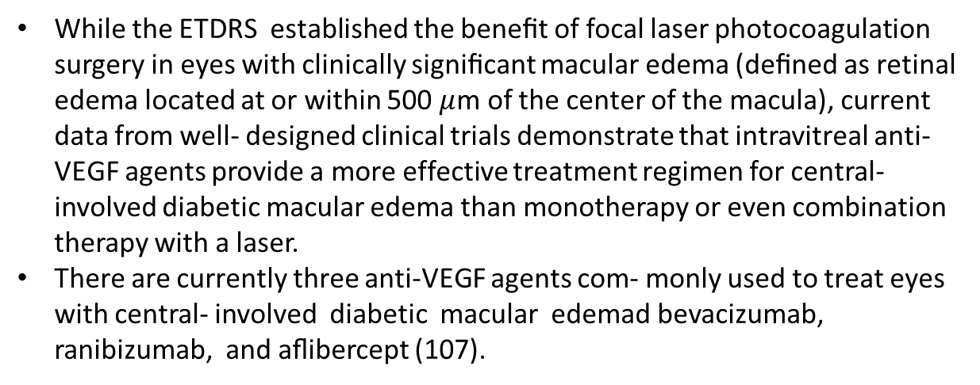
While the ETDRS established the beneﬁt of focal laser photocoagulation surgery in eyes with clinically signiﬁcant macular edema (deﬁned as retinal edema located at or within 500 $μ$m of the center of the macula), current data from well- designed clinical trials demonstrate that intravitreal anti-VEGF agents provide a more effective treatment regimen for central-involved diabetic macular edema than monotherapy or even combination therapy with a laser.
There are currently three anti-VEGF agents com- monly used to treat eyes with central- involved diabetic macular edemad bevacizumab, ranibizumab, and aﬂibercept (107).

Slide 86
Neuropathy—Screening
Microvascular Complications and Foot Care
11.25 All patients should be assessed for diabetic peripheral neuropathy starting at diagnosis of type 2 diabetes and 5 years after the diagnosis of type 1 diabetes and at least annually thereafter. B
11.26 Assessment for distal symmetric polyneuropathy should include a careful history and assessment of either temperature or pinprick sensation (small fiber function) and vibration sensation using a 128-Hz tuning fork (for large fiber function). All patients should have annual 10-g monofilament testing to identify feet at risk for ulceration and amputation. B
11.27 Symptoms and signs of autonomic neuropathy should be assessed in patients with microvascular complications. E

Slide 87
Neuropathy—Treatment
Microvascular Complications and Foot Care
11.28 Optimize glucose control to prevent or delay the development of neuropathy in patients with type 1 diabetes A and to slow the progression of neuropathy in patients with type 2 diabetes. B
11.29 Assess and treat patients to reduce pain related to diabetic peripheral neuropathy B and symptoms of autonomic neuropathy and to improve quality of life. E
11.30 Pregabalin, duloxetine, or gabapentin are recommended as initial pharmacologic treatments for neuropathic pain in diabetes. A

Slide 88
. Major clinical manifestations of diabetic autonomic neuropathy include hypoglycemia unawareness, resting tachycardia, orthostatic hypotension, gastroparesis, constipation, diarrhea, fecal incontinence, erectile dysfunction, neurogenic bladder, and sudomotor dysfunction with either increased or de- creased sweating.

Slide 89
Orthostatic hypotension: Ensuring adequate salt intake, avoiding medications that aggravate hypotension, or using compressive garments over the legs and abdomen and pharmacologic measures. Physical activity and exercise should be encouraged to avoid decondi- tioning, which is known to exacerbate orthostatic intolerance, and volume repletion with ﬂuids and salt is critical.
Additionally, supine blood pressure tends to be much higher in these patients, often requiring treatment of blood pressure at bedtime with shorter-acting drugs that also affect baroreceptor activity such as guanfacine or clonidine, shorter-acting calcium blockers (e.g., isra- dipine), or shorter-acting b-blockers such as atenolol or metoprolol. Alternatives can include enalapril if patients are unable to tolerate preferred agents (. Midodrine and droxidopa are approved by the FDA for the treat- ment of orthostatic hypotension

Slide 90
Treatment for diabetic gastroparesis may be very challenging. A low-ﬁber, low-fat eating plan provided in small frequent meals with a greater proportion of liquid calories may be useful.
In addition, foods with small particle size may improve key symptoms. Withdrawing drugs with adverse effects on gastrointestinal motility, including opioids, anticholinergics, tricyclic antidepressants, GLP-1 RAs, pramlintide, and possibly dipeptidyl peptidase 4 inhibitors, may also improve intestinal motility

Slide 91
Only metoclopramide, a prokinetic agent, is approved by the FDA for the treatment of gastroparesis.
However, the level of evidence regarding the beneﬁts of metoclopramide for the management of gastroparesis is weak, and given the risk for serious adverse effects (extrapyramidal signs such as acute dystonic reactions, drug- induced parkinsonism, akathisia, and tardive dyskinesia), its use in the treatment of gastroparesis beyond 12 weeks is no longer recommended by the FDA or the European Medicines Agency. It should be reserved for severe cases that are unresponsive to other therapies

Slide 92
Foot Care
Microvascular Complications and Foot Care
11.31 Perform a comprehensive foot evaluation at least annually to identify risk factors for ulcers and amputations. B
11.32 Patients with evidence of sensory loss or prior ulceration or amputation should have their feet inspected at every visit. B
11.33 Obtain a prior history of ulceration, amputation, Charcot foot, angioplasty or vascular surgery, cigarette smoking, retinopathy, and renal disease and assess current symptoms of neuropathy (pain, burning, numbness) and vascular disease (leg fatigue, claudication). B

Slide 93
Foot Care (continued)
Microvascular Complications and Foot Care
11.34 The examination should include inspection of the skin, assessment of foot deformities, neurological assessment (10-g monofilament testing with at least one other assessment: pinprick, temperature, vibration), and vascular assessment including pulses in the legs and feet. B
11.35 Patients with symptoms of claudication or decreased or absent pedal pulses should be referred for ankle-brachial index and for further vascular assessment as appropriate. C
11.36 A multidisciplinary approach is recommended for individuals with foot ulcers and high-risk feet (e.g., dialysis patients and those with Charcot foot or prior ulcers or amputation). B

Slide 94
Foot Care (continued)
Microvascular Complications and Foot Care
11.37 Refer patients who smoke or who have histories of prior lower extremity complications, loss of protective sensation, structural abnormalities, or peripheral arterial disease to foot care specialists for ongoing preventive care and lifelong surveillance. C
11.38 Provide general preventive foot self-care education to all patients with diabetes. B
11.39 The use of specialized therapeutic footwear is recommended for high-risk patients with diabetes including those with severe neuropathy, foot deformities, ulcers, callous formation, poor peripheral circulation, or history of amputation. B

Slide 95
Microvascular Complications and Foot Care
The risk of ulcers or amputations is increased in people who have the following risk factors:
  Poor glycemic control
  Peripheral neuropathy with LOPS
  Cigarette smoking
  Foot deformities
  Pre-ulcerative callus or corn
  PAD
  History of foot ulcer
  Amputation
  Visual impairment
  CKD (especially patients on dialysis)

Slide 96
Section 13.
Children and Adolescents

Slide 97
Diabetes Self-management Education & Support (Type 1)
Children and Adolescents
13.1 Youth with type 1 diabetes and parents/caregivers (for patients aged <18 years) should receive culturally sensitive and developmentally appropriate individualized diabetes self-management education and support according to national standards at diagnosis and routinely thereafter. B

Slide 98
Nutrition Therapy (Type 1)
Children and adolescents
13.2 Individualized medical nutrition therapy is recommended for children and adolescents with type 1 diabetes as an essential component of the overall treatment plan. A
13.3 Monitoring carbohydrate intake, whether by carbohydrate counting or experience-based estimation, is key to achieving optimal glycemic control. B
13.4 Comprehensive nutrition education at diagnosis, with annual updates, by an experienced registered dietitian nutritionist is recommended to assess caloric and nutrition intake in relation to weight status and cardiovascular disease risk factors and to inform macronutrient choices. E

Slide 99
Physical Activity and Exercise (Type 1)
Children and adolescents
13.5 Exercise is recommended for all youth with type 1 diabetes with the goal of 60 min of moderate-to- vigorous intensity aerobic activity daily, with vigorous muscle-strengthening and bone-strengthening activities at least 3 days per week. C
13.6 Education about frequent patterns of glycemia during and after exercise, which may include initial transient hyperglycemia followed by hypoglycemia, is essential. Families should also receive education on prevention and management of hypoglycemia during and after exercise, including ensuring patients have a pre-exercise glucose level of 90–250 mg/dL (5.0–13.9 mmol/L) and accessible carbohydrates before, during, and after engaging in activity, individualized according to the type/intensity of the planned physical activity. E

Slide 100
As hyperglycemia can occur before, during, and after physical activity, it is important to ensure that the elevated glucose level is not related to insulin deﬁciency that would lead to worsening hyperglycemia with exercise and ketosis risk.
Intense activity should be postponed with marked hyperglycemia (glucose >350 mg/dL [19.4 mmol/ L]), moderate to large urine ketones, and/ or β-hydroxybutyrate (B-OHB) >1.5 mmol/L. Caution may be needed when B-OHB levels are >0.6 mmol/L

Slide 101
The prevention and treatment of hypoglycemia associated with physical activity include decreasing the prandial insulin for the meal/snack before exercise and/or increasing food intake.
Patients on insulin pumps can lower basal rates by ;10–50% or more or suspend for 1–2 h during exercise (18). Decreasing basal rates or long-acting insulin doses by ≠20% after exercise may reduce delayed exercise-induced hypoglycemia

Slide 102
For low-to-moderate intensity aerobic activities (30–60 min), and if the patient is fasting, 10–15 g of carbohydrate may prevent hypoglycemia.
After insulin boluses (relative hyperinsulinemia), consider 0.5–1.0 g of carbohydrates/kg per hour of exercise (30–60 g), which is similar to carbohydrate requirements to optimize performance in athletes without type 1 diabetes

Slide 103
Physical Activity and Exercise (Type 1) (continued)
Children and adolescents
13.8 Frequent glucose monitoring before, during, and after exercise, with or without use of continuous glucose monitoring, is important to prevent, detect, and treat hypoglycemia and hyperglycemia with exercise. C

Slide 104
Psychosocial Issues (Type 1)
Children and adolescents
13.9 At diagnosis and during routine follow-up care, assess psychosocial issues and family stresses that could impact diabetes management and provide appropriate referrals to trained mental health professionals, preferably experienced in childhood diabetes. E
13.10 Mental health professionals should be considered integral members of the pediatric diabetes multidisciplinary team. E
13.11 Encourage developmentally appropriate family involvement in diabetes management tasks for children and adolescents, recognizing that premature transfer of diabetes care to the child can result in diabetes burnout nonadherence and deterioration in glycemic control. A

Slide 105
Psychosocial Issues (Type 1) (continued)
Children and adolescents
13.15 Offer adolescents time by themselves with their care provider(s) starting at age 12 years, or when developmentally appropriate. E
13.16 Starting at puberty, preconception counseling should be incorporated into routine diabetes care for all girls of childbearing potential. A
13.17 Begin screening youth with type 1 diabetes for eating disorders between 10 and 12 years of age. The Diabetes Eating Problems Survey-Revised (DEPS-R) is a reliable, valid, and brief screening tool for identifying disturbed eating behavior. B

Slide 106
Glycemic Control (Type 1)
Children and adolescents
13.18 Whenever possible, children and adolescents with type 1 diabetes should be treated with intensive insulin regimens, either via multiple daily injections or continuous subcutaneous insulin infusion. A
13.19 All children and adolescents with type 1 diabetes should self-monitor glucose levels multiple times daily (up to 6–10 times/day by glucose meter or continuous glucose monitoring), including prior to meals and snacks, at bedtime, and as needed for safety in specific situations such as exercise, driving, or the presence of symptoms of hypoglycemia. B
13.20 When used properly, real-time continuous glucose monitoring in conjunction with insulin therapy is a useful tool to lower and/or maintain A1C levels and/or reduce hypoglycemia. A

Slide 107
Glycemic Control (Type 1) (continued)
Children and adolescents
13.21 When used properly, intermittently scanned continuous glucose monitoring in conjunction with insulin therapy can be useful to replace self-monitoring of blood glucose. B
13.22 Automated insulin delivery systems may be considered to improve glycemic control. A
13.23 A1C goals must be individualized and reassessed over time. An A1C of <7% (53 mmol/mol) is appropriate for many children. B

Slide 108
Glycemic Control (Type 1) (continued)
Children and adolescents
13.24 Less stringent A1C goals (such as <7.5% [58 mmol/mol]) may be appropriate for patients who cannot articulate symptoms of hypoglycemia; have hypoglycemia unawareness; lack access to analog insulins, advanced insulin delivery technology, and/or continuous glucose monitoring; cannot check blood glucose regularly; or have nonglycemic factors that increase A1C (e.g., high glycators). B
13.25 Even less stringent A1C goals (such as <8% [64 mmol/mol]) may be appropriate for patients with a history of severe hypoglycemia, limited life expectancy, or where the harms of treatment are greater than the benefits. B

Slide 109
Glycemic Control (Type 1) (continued)
Children and adolescents
13.26 Providers may reasonably suggest more stringent A1C goals (such as <6.5% [48 mmol/mol]) for selected individual patients if they can be achieved without significant hypoglycemia, negative impacts on well-being, or undue burden of care, or in those who have nonglycemic factors that decrease A1C (e.g., lower erythrocyte life span). Lower targets may also be appropriate during the honeymoon phase. B
13.27 Continuous glucose monitoring (CGM) metrics derived from CGM use over the most recent 14 days (or longer for patients with more glycemic variability), including time in ranges (within target, below target, and above target), are recommended to be used in conjunction with A1C whenever possible. E

Slide 110
The carbohydrate ratio is the number of grams of carbohydrate covered by 1 unit of insulin (roughly 450 divided by the total daily insulin dose, TDD).
Next, the person will determine the amount of insulin required to correct for the premeal blood glucose level, using his or her individualized correction factor (also sometimes called sensitivity factor or sensitivity index).
Correction factor is the expected decrease in blood glucose resulting from 1 unit of insulin (approximately 1650 divided by the total daily insulin dose, TDD). e bolus delivered with the meal or snack is the sum of the calculated carbohydrate coverage and the calculated blood glucose correction. Most patients do these calculations by hand, mental math, or calculators, or with the help of apps or pump pen bolus wizards, but some families require sliding scales or charts for determination of bolus dosing.
Williams textbook of endocrinology 2020

Slide 111

Rapid-acting insulin boluses should be given 10 to 15 minutes before the start of a meal or snack because onset of action is about 15 minutes.
In cases where food intake is less predictable (e.g., very young children, gastroenteritis), postprandial administra- tion of a rapid-acting insulin bolus is safe and e ective.241 Since rapid-acting insulin has a 3-

Slide 112
Autoimmune Conditions
Children and adolescents
13.28 Assess for additional autoimmune conditions soon after the diagnosis of type 1 diabetes and if symptoms develop. B
Subclinical hypothyroidism may be associated with increased risk of symptomatic hypoglycemia and reduced linear growth rate.
Hyperthyroidism alters glucose metabolism and usually causes deterioration of glycemic control.

Slide 113
Thyroid Disease (Type 1)
Children and adolescents
13.29 Consider testing children with type 1 diabetes for antithyroid peroxidase and antithyroglobulin antibodies soon after diagnosis. B
13.30 Measure thyroid-stimulating hormone concentrations at diagnosis when clinically stable or soon after glycemic control has been established. If normal, suggest rechecking every 1–2 years or sooner if the patient has positive thyroid antibodies or develops symptoms or signs suggestive of thyroid dysfunction, thyromegaly, an abnormal growth rate, or unexplained glycemic variability. B

Slide 114
Celiac Disease (Type 1)
Children and adolescents
13.31 Screen children with type 1 diabetes for celiac disease by measuring IgA tissue transglutaminase (tTG) antibodies, with documentation of normal total serum IgA levels, soon after the diagnosis of diabetes, or IgG to tTG and deamidated gliadin antibodies if IgA deficient. B
13.32 Repeat screening within 2 years of diabetes diagnosis and then again after 5 years and consider more frequent screening in children who have symptoms or a first-degree relative with celiac disease. B
13.33 Individuals with confirmed celiac disease should be placed on a gluten-free diet for treatment and to avoid complications; they should also have a consultation with a dietitian experienced in managing both diabetes and celiac disease. B

Slide 115
A small bowel biopsy in antibody-positive children is recommended to conﬁrm the diagnosis.
European guidelines on screening for celiac disease in children (not speciﬁc to children with type 1 diabetes) suggest that biopsy may not be necessary in symptomatic children with high antibody titers (i.e., greater than 10 times the upper limit of normal) provided that further testing is performed (veriﬁcation of endomysial antibody positivity on a separate blood sample).
Whether this approach may be appropriate for asymptomatic children in high-risk groups remains an open question, though evidence is emerging.
It is also advisable to check for celiac disease–associated HLA types in patients who are diagnosed without a small intestinal biopsy

Slide 116
Management of Cardiovascular Risk Factors—Hypertension Screening (Type 1)
Children and adolescents
13.34 Blood pressure should be measured at each routine visit. Children found to have elevated blood pressure (systolic blood pressure or diastolic blood pressure ≥90th percentile for age, sex, and height or, in adolescents ≥13 years, systolic blood pressure 120–129mmHg with diastolic blood pressure ˂80 mmHg) or hypertension (systolic blood pressure or diastolic blood pressure ≥95th percentile for age, sex, and height or, in adolescents ≥13 years, systolic blood pressure ≥130 mmHg or diastolic blood pressure ≥80 mmHg) should have elevated blood pressure confirmed on three separate days. B

Slide 117
Management of Cardiovascular Risk Factors —Hypertension Treatment (Type 1)
Children and adolescents
13.35 Initial treatment of elevated blood pressure (systolic blood pressure or diastolic blood pressure consistently ≥90th percentile for age, sex, and height or ≥120/80 mmHg in adolescents ≥13 years) includes dietary modification and increased exercise, if appropriate, aimed at weigh control.
If target blood pressure is not reached within 3–6months of initiating lifestyle intervention, pharmacologic treatment should be considered. E
13.36 In addition to lifestyle modification, pharmacologic treatment of hypertension (systolic blood pressure or diastolic blood pressure consistently ≥95th percentile for age, sex, and height or ≥140/90 mmHg in adolescents ≥13years) should be considered as soon as hypertension is confirmed. E

Slide 118
Management of Cardiovascular Risk Factors—Hypertension Treatment (Type 1) (continued)
Children and adolescents
13.37 ACE inhibitors or angiotensin receptor blockers should be considered for the initial pharmacologic treatment of hypertension E in children and adolescents, following reproductive counseling due to the potential teratogenic effects of both drug classes. E
13.38 The goal of treatment is blood pressure consistently ˂90th percentile for age, sex, and height or ˂120/˂80 mmHg in children ≥13 years. E

Slide 119
Management of Cardiovascular Risk Factors—Dyslipidemia Testing (Type 1)
Children and adolescents
13.39 Initial lipid testing should be performed when initial glycemic control has been achieved and age is ≥2 years. If initial LDL cholesterol is ≤100 mg/dL (2.6 mmol/L), subsequent testing should be performed at 9-11 years of age. B
Initial testing may be done with a nonfasting non-HDL cholesterol level with confirmatory testing with a fasting lipid panel.
13.40 If LDL cholesterol values are within the accepted risk level
(˂100 mg/dL [2.6 mmol/L]), a lipid profile repeated every 3 years is reasonable. E

Slide 120
Management of Cardiovascular Risk Factors—Dyslipidemia Treatment (Type 1)
Children and adolescents
13.41 If lipids are abnormal, initial therapy should consist of optimizing glucose control and medical nutrition therapy to limit the amount of calories from fat to 25–30%, saturated fat to <7%, cholesterol <200 mg/day, avoidance of trans fats, and aim for ~10% calories from monounsaturated fats. A
13.42 After the age of 10 years, addition of a statin may be considered in patients who, despite medical nutrition therapy and lifestyle changes, continue to have LDL cholesterol >160 mg/dL (4.1 mmol/L) or LDL cholesterol >130 mg/dL (3.4 mmol/L) and one or more cardiovascular disease risk factors, following reproductive counseling for females because of the potential teratogenic effects of statins. E
13.43 The goal of therapy is an LDL cholesterol value <100 mg/dL (2.6 mmol/L). E

Slide 121
Microvascular Complications—Nephropathy Screening (Type 1)
Children and adolescents
13.46 Annual screening for albuminuria with a random (morning sample preferred to avoid effects of exercise) spot urine sample for albumin-to-creatinine ratio should be considered at puberty or at age >10 years, whichever is earlier, once the child has had diabetes for 5 years. B

Slide 122
Microvascular Complications—Nephropathy Treatment (Type 1)
Children and adolescents
13.47 An ACE inhibitor or an angiotensin receptor blocker, titrated to normalization of albumin excretion, maybe considered when elevated urinary albumin-to-creatinine ratio (>30 mg/g) is documented (two of
three urine samples obtained over a 6- month interval following efforts to improve glycemic control and normalize blood pressure). E

Slide 123
The AdDIT study in adolescents with type 1 diabetes demonstrated the safety of ACE inhibitor treatment, but the treatment did not change the albumin-to-creatinine ratio over the course of the study .

Slide 124
Retinopathy
Children and adolescents
13.48 An initial dilated and comprehensive eye examination is recommended once youth have had type 1 diabetes for 3–5 years, provided they are aged ≥11 years or puberty has started, whichever is earlier. B
13.49 After the initial examination, repeat dilated and comprehensive eye examination every 2 years. Less frequent examinations, every 4 years, may be acceptable on the advice of an eyecare professional and based on risk factor assessment, including a history of glycemic control with A1C <8%. B

Slide 125
Microvascular Complications—Neuropathy (Type 1)
Children and adolescents
13.50 Consider an annual comprehensive foot exam at the start of puberty or at age ≥10 years, whichever is earlier, once the youth has had type 1 diabetes for 5 years. B

Slide 126
Screening and Diagnosis (Type 2)
Children and adolescents
13.51 Risk-based screening for prediabetes and/or type 2 diabetes should be considered in children and adolescents after the onset of puberty or ≥10 years of age, whichever occurs earlier, with overweight (BMI ≥85th percentile) or obesity (BMI ≥95thpercentile) and who have one or more additional risk factors for diabetes (see Table 2.4 for evidence grading of other risk factors).
13.52 If tests are normal, repeat testing at a minimum of 3-year intervals E, or more frequently if BMI is increasing. C

Slide 127
Screening and Diagnosis (Type 2) (continued)
Children and adolescents
13.53 Fasting plasma glucose, 2-h plasma glucose during a 75-g oral glucose tolerance test, and A1C can be used to test for prediabetes or diabetes in children and adolescents. B
13.54 Children and adolescents with overweight or obesity in whom the diagnosis if type 2 diabetes is being considered should have a panel of pancreatic autoantibodies tested to exclude the possibility of autoimmune type 1 diabetes. B

Slide 128
Management—Lifestyle Management (Type 2)
Children and adolescents
13.55 All youth with type 2 diabetes and their families should receive comprehensive diabetes self management education and support that is specific to youth with type 2 diabetes and is culturally appropriate. B
13.56 Youth with overweight/obesity and type 2 diabetes and their families should be provided with developmentally and culturally appropriate comprehensive lifestyle programs that are integrated with diabetes management to achieve 7–10% decrease in excess weight. C
13.57 Given the necessity of long-term weight management for children and adolescents with type 2 diabetes, lifestyle intervention should be based on a chronic care model and offered in the context of diabetes care. E

Slide 129
Management—Glycemic Targets (Type 2)
Children and adolescents
13.60 Home self-monitoring of blood glucose regimens should be individualized, taking into consideration the pharmacologic treatment of the patient. E
13.61 Glycemic status should be assessed every 3 months. E
13.62 A reasonable A1C target for most children and adolescents with type 2 diabetes treated with oral agents alone is <7% (53mmol/mol).More stringent A1C targets (such as <6.5% [48 mmol/mol]) may be appropriate for selected individual patients if they can be achieved without significant hypoglycemia or other adverse effects of treatment. Appropriate patients might include those with short duration of diabetes and lesser degrees of b-cell dysfunction and patients treated with lifestyle or metformin only who achieve significant weight improvement. E

Slide 130
Management—Glycemic Targets (Type 2) (continued)
Children and adolescents
13.63 Less stringent A1C goals (such as 7.5% [58 mmol/mol]) may be appropriate if there is increased risk of hypoglycemia. E
13.64 A1C targets for patients on insulin should be individualized, taking into account the relatively low rates of hypoglycemia in youth-onset type 2 diabetes. E

Slide 131
Pharmacologic Management (Type 2)
Children and adolescents
13.65 Initiate pharmacologic therapy, in addition to behavioral counseling for healthful nutrition and physical activity changes, at diagnosis of type 2 diabetes. A
13.66 In incidentally diagnosed or metabolically stable patients (A1C <8.5% [69 mmol/mol] and asymptomatic), metformin is the initial pharmacologic treatment of choice if renal function is normal. A
13.67 Youth with marked hyperglycemia (blood glucose ≥250 mg/dL [13.9 mmol/L], A1C ≥8.5% [69 mmol/mol]) without acidosis at diagnosis who are symptomatic with polyuria, polydipsia, nocturia, and/or weight loss should be treated initially with basal insulin while metformin is initiated and titrated. B

Slide 132
Pharmacologic Management (Type 2) (continued)
Children and adolescents
13.68 In patients with ketosis/ketoacidosis, treatment with subcutaneous or intravenous insulin should be initiated to rapidly correct the hyperglycemia and the metabolic derangement. Once acidosis is resolved, metformin should be initiated while subcutaneous insulin therapy is continued. A
13.69 In individuals presenting with severe hyperglycemia (blood glucose ≥600 mg/dL [33.3 mmol/L]), consider assessment for hyperglycemic hyperosmolar nonketotic syndrome. A
13.70 If glycemic targets are no longer met with metformin (with or without basal insulin), liraglutide (a glucagon-like peptide 1 receptor agonist) therapy should be considered in children 10 years of age or older if they have no past medical history or family history of medullary thyroid carcinoma or multiple endocrine neoplasia type 2. A

Slide 133
Pharmacologic Management (Type 2) (continued)
Children and adolescents
13.71 Patients treated with basal insulin who do not meet glycemic target should be moved to multiple daily injections with basal and premeal bolus insulins. E
13.72 In patients initially treated with insulin and metformin who are meeting glucose targets based on home blood glucose monitoring, insulin can be tapered over 2–6 weeks by decreasing the insulin dose 10–30% every few days. B
13.73 Use of medications not approved by the U.S. Food and Drug Administration for youth with type 2 diabetes is not recommended outside of research trials. B

Slide 134
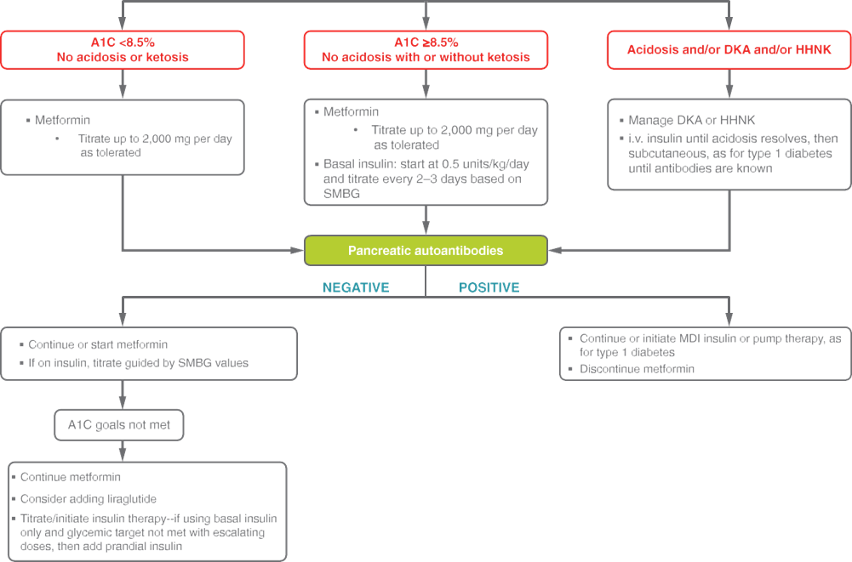

Slide 135
Management—Metabolic Surgery (Type 2)
Children and adolescents
13.74 Metabolic surgery may be considered for the treatment of adolescents with type 2 diabetes who have severe obesity (BMI >35 kg/m2) and who have uncontrolled glycemia and/or serious comorbidities despite lifestyle and pharmacologic intervention. A
13.75 Metabolic surgery should be performed only by an experienced surgeon working as part of a well-organized and engaged multidisciplinary team including a surgeon, endocrinologist, dietitian nutritionist, behavioral health specialist, and nurse. A

Slide 136
Prevention & Management of Complications—Nephropathy (Type 2)
Children and adolescents
13.76 Blood pressure should be measured at every visit. A
13.77 Blood pressure should be optimized to reduce risk and/or slow the progression of diabetic kidney disease. A
13.78 If blood pressure is ≥90th percentile for age, sex, and height or, in adolescents ≥13 years, blood pressure is ≥120/80mmHg, increased emphasis should be placed on lifestyle management to promote weight loss. If blood pressure remains above the 90th percentile or, in adolescents ≥13 years, blood pressure is ≥120/80 after 6months, antihypertensive therapy should be initiated. C

Slide 137
Prevention & Management of Complications—Nephropathy (Type 2) (continued)
Children and adolescents
13.79 In addition to lifestyle modification, pharmacologic treatment of hypertension (systolic blood pressure or diastolic blood pressure consistently ≥95th percentile for age, sex, and height or ≥140/90 mmHg in adolescents ≥13 years) should be considered as soon as hypertension is confirmed. E
13.80 Initial therapeutic options include ACE inhibitors or angiotensin receptor blockers. Other blood pressure–lowering agents may be added as needed. C
13.81 Protein intake should be at the recommended daily allowance of 0.8 g/kg/day. E

Slide 138
Prevention & Management of Complications—Nephropathy (Type 2) (continued)
Children and adolescents
13.82 Urine albumin-to-creatinine ratio should be obtained at the time of diagnosis and annually thereafter. An elevated urine albumin-to-creatinine ratio (>30 mg/g creatinine) should be confirmed on two of three samples. B
13.83 Estimated glomerular filtration rate should be determined at the time of diagnosis and annually thereafter. E
13.84 In nonpregnant patients with diabetes and hypertension, either an ACE inhibitor or an angiotensin receptor blocker is recommended for those with modestly elevated urinary albumin-to-creatinine ratio (30–299 mg/g creatinine) and is strongly recommended for those with urinary albumin-to-creatinine ratio >300 mg/g creatinine and/or estimated glomerular filtration rate <60 mL/min/1.73 m2. E

Slide 139
Prevention & Management of Complications—Nephropathy (Type 2) (continued)
Children and adolescents
13.85 For those with nephropathy, continued monitoring (yearly urinary albumin-to-creatinine ratio, estimated glomerular filtration rate, and serum potassium) may aid in assessing adherence and detecting progression of disease. E
13.86 Referral to nephrology is recommended in case of uncertainty of etiology, worsening urinary albumin-to-creatinine ratio, or decrease in estimated glomerular filtration rate. E

Slide 140
Prevention & Management of Complications—Neuropathy (Type 2)
Children and adolescents
13.87 Youth with type 2 diabetes should be screened for the presence of neuropathy by foot examination at diagnosis and annually. The examination should include inspection, assessment of foot pulses, pinprick and 10-g monofilament sensation tests, testing of vibration sensation using a 128-Hz tuning fork, and ankle reflex tests. C
13.88 Prevention should focus on achieving glycemic targets. C

Slide 141
Prevention & Management of Complications—Retinopathy (Type 2)
Children and adolescents
13.89 Screening for retinopathy should be performed by dilated fundoscopy or retinal photography at or soon after diagnosis and annually thereafter. C
13.90 Optimizing glycemia is recommended to decrease the risk or slow the progression of retinopathy. B
13.91 Less frequent examination (every 2 years) may be considered if there is adequate glycemic control and a normal eye exam. C

Slide 142
Prevention & Management of Complications—Nonalcoholic Fatty Liver Disease (Type 2)
Children and adolescents
13.92 Evaluation for nonalcoholic fatty liver disease (by measuring AST and ALT) should be done at diagnosis and annually thereafter. B
13.93 Referral to gastroenterology should be considered for persistently elevated or worsening transaminases. B

Slide 143
Prevention & Management of Complications—Obstructive Sleep Apnea (Type 2)
Children and adolescents
13.94 Screening for symptoms of sleep apnea should be done at each visit, and referral to a pediatric sleep specialist for evaluation and a polysomnogram, if indicated, is recommended. Obstructive sleep apnea should be treated when documented. B

Slide 144
Prevention & Management of Complications—Polycystic Ovary Syndrome (Type 2)
Children and adolescents
13.95 Evaluate for polycystic ovary syndrome in female adolescents with type 2 diabetes, including laboratory studies when indicated. B
13.96 Oral contraceptive pills for treatment of polycystic ovary syndrome are not contraindicated for girls with type 2 diabetes. C
13.97 Metformin in addition to lifestyle modification is likely to improve the menstrual cyclicity and hyperandrogenism in girls with type 2 diabetes. E

Slide 145
Prevention & Management of Complications—Cardiovascular Disease (Type 2)
Children and adolescents
13.98 Intensive lifestyle interventions focusing on weight loss, dyslipidemia, hypertension, and dysglycemia are important to prevent overt macrovascular disease in early adulthood. E

Slide 146
Prevention & Management of Complications—Dyslipidemia (Type 2)
Children and adolescents
13.99 Lipid testing should be performed when initial glycemic control has been achieved and annually thereafter. B
13.100 Optimal goals are LDL cholesterol <100mg/dL (2.6 mmol/L), HDL cholesterol >35 mg/dL (0.91 mmol/L), and triglycerides <150 mg/dL (1.7mmol/L). E
13.101 If lipids are abnormal, initial therapy should consist of optimizing glucose control and medical nutritional therapy to limit the amount of calories from fat to 25–30%, saturated fat to <7%, cholesterol <200 mg/day, avoid trans fats, and aim for ~10% calories from monounsaturated fats for elevated LDL. For elevated triglycerides, medical nutrition therapy should also focus on decreasing simple sugar intake and increasing dietary n-3 fatty acids in addition to the above changes. A

Slide 147
Prevention & Management of Complications—Dyslipidemia (Type 2) (continued)
Children and adolescents
13.102 If LDL cholesterol remains >130 mg/dL after 6 months of dietary intervention, initiate therapy with statin, with a goal of LDL <100 mg/dL, following reproductive counseling for females because of the potential teratogenic effects of statins. B
13.103 If triglycerides are >400 mg/dL (4.7 mmol/L) fasting or >1,000 mg/dL (11.6 mmol/L) nonfasting, optimize glycemia and begin fibrate, with a goal of <400 mg/dL (4.7 mmol/L) fasting (to reduce risk for pancreatitis). C

Slide 148
Prevention & Management of Complications—Cardiac Function Testing (Type 2)
Children and adolescents
13.104 Routine screening for heart disease with electrocardiogram, echocardiogram, or stress testing is not recommended in asymptomatic youth with type 2 diabetes. B

Slide 149
Transition from Pediatric to Adults Care
Children and adolescents
13.110 Pediatric diabetes providers should begin to prepare youth for transition to adult health care in early adolescence and, at the latest, at least 1 year before the transition. E
13.111 Both pediatric and adult diabetes care providers should provide support and resources for transitioning young adults. E
13.112 Youth with type 2 diabetes should be transferred to an adult-oriented diabetes specialist when deemed appropriate by the patient and provider. E

Slide 150
Section 14.
Management of Diabetes in Pregnancy

Slide 151
Preconception Counseling
Management of Diabetes in Pregnancy
14.1 Starting at puberty and continuing in all women with diabetes and reproductive potential, preconception counseling should be incorporated into routine diabetes care. A
14.2 Family planning should be discussed, and effective contraception (with consideration of long-acting, reversible contraception) should be prescribed and used until a woman’s treatment regimen and A1C are optimized for pregnancy. A
14.3 Preconception counseling should address the importance of achieving glucose levels as close to normal as is safely possible, ideally A1C <6.5% (48 mmol/mol), to reduce the risk of congenital anomalies, preeclampsia, macrosomia, and other complications. B

Slide 152
Preconception Care
Management of Diabetes in Pregnancy
14.4 Women with preexisting diabetes who are planning a pregnancy should ideally be managed beginning in preconception in a multidisciplinary clinic including an endocrinologist, maternal-fetal medicine specialist, registered dietitian nutritionist, and diabetes care and education specialist, when available. B
14.5 In addition to focused attention on achieving glycemic targets A, standard preconception care should be augmented with extra focus on nutrition, diabetes education, and screening for diabetes comorbidities and complications. E

Slide 153
Preconception Care (continued)
Management of Diabetes in Pregnancy
14.6 Women with preexisting type 1 or type 2 diabetes who are planning pregnancy or who have become pregnant should be counseled on the risk of development and/or progression of diabetic retinopathy.
Dilated eye examinations should occur ideally before pregnancy or in the first trimester, and then patients should be monitored every trimester and for 1 year postpartum as indicated by the degree of retinopathy and as recommended by the eye care provider. B

Slide 154
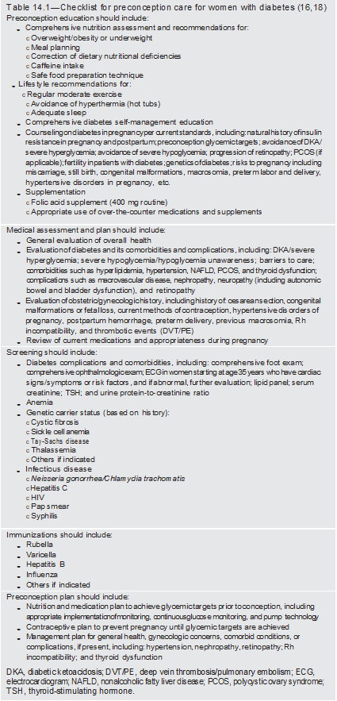
Management of Diabetes in Pregnancy
Management of Diabetes in Pregnancy:
Standards of Medical Care in Diabetes - 2021. Diabetes Care 2021;44(Suppl. 1):S200-S210

Slide 155
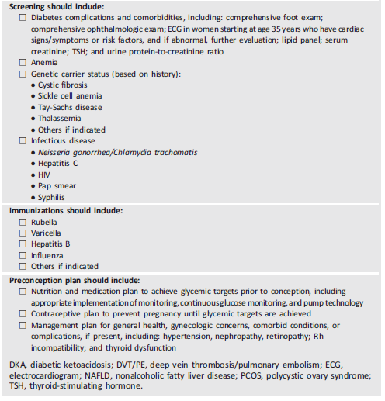
Management of Diabetes in Pregnancy
Management of Diabetes in Pregnancy:
Standards of Medical Care in Diabetes - 2021. Diabetes Care 2021;44(Suppl. 1):S200-S210

Slide 156
Glycemic Targets in Pregnancy
Management of Diabetes in Pregnancy
14.7 Fasting and postprandial self-monitoring of blood glucose are recommended in both gestational diabetes mellitus and preexisting diabetes in pregnancy to achieve optimal glucose levels.
Glucose targets are fasting plasma glucose <95 mg/dL (5.3 mmol/L) and either 1-h postprandial glucose <140 mg/dL (7.8mmol/L) or2-h postprandial glucose <120 mg/dL (6.7 mmol/L). Some women with preexisting diabetes should also test blood glucose preprandially. B
14.8 Due to increased red blood cell turnover, A1C is slightly lower in normal pregnancy than in normal nonpregnant women. Ideally, the A1C target in pregnancy is <6% (42 mmol/mol) if this can be achieved without significant hypoglycemia, but the target may be relaxed to <7% (53mmol/mol) if necessary to prevent hypoglycemia. B

Slide 157
Glycemic Targets in Pregnancy (continued)
Management of Diabetes in Pregnancy
14.9 When used in addition to pre and postprandial self-monitoring of blood glucose, continuous glucose monitoring can help to achieve A1C targets in diabetes and pregnancy. B
14.10 When used in addition to self-monitoring of blood glucose targeting traditional pre- and postprandial targets, continuous glucose monitoring can reduce macrosomia and neonatal hypoglycemia in pregnancy complicated by type 1 diabetes. B
14.11 Continuous glucose monitoring metrics may be used as an adjunct but should not be used as a substitute for self-monitoring of blood glucose to achieve optimal pre- and postprandial glycemic targets. E
14.12 Commonly used estimated A1C and glucose management indicator calculations should not be used in pregnancy as estimates of A1C. C

Slide 158
Management of Diabetes in Pregnancy
Similar to the targets recommended by ACOG (the same as for GDM), the ADA-recommended targets for women with type 1 or type 2 diabetes are as follows:
Fasting glucose 70–95 mg/dL (3.9–5.3mmol/L) and either
One-hour postprandial glucose 110–140 mg/dL (6.1–7.8 mmol/L) or
Two-hour postprandial glucose 100–120 mg/dL (5.6–6.7 mmol/L)

Slide 159
Management of Gestational Diabetes Mellitus
Management of Diabetes in Pregnancy
14.13 Lifestyle behavior change is an essential component of management of gestational diabetes mellitus and may suffice for the treatment of many women. Insulin should be added if needed to achieve glycemic targets. A
14.14 Insulin is the preferred medication for treating hyperglycemia in gestational diabetes mellitus.
Metformin and glyburide should not be used as first-line agents, as both cross the placenta to the fetus. A Other oral and noninsulin injectable glucose-lowering medications lack long-term safety data.
14.15 Metformin, when used to treat polycystic ovary syndrome and induce ovulation, should be discontinued by the end of the first trimester. A

Slide 160
Management of Diabetes in Pregnancy
After diagnosis, treatment starts with medical nutrition therapy, physical activity, and weight management depending on pregestational weight, as outlined in the section below on preexisting type 2 diabetes, as well as glucose monitoring aiming for the targets recommended by the Fifth International Workshop-Conference on Gestational Diabetes Mellitus:
Fasting glucose <95 mg/dL (5.3 mmol/L) and either
One-hour postprandial glucose <140 mg/dL (7.8 mmol/L) or
Two-hour postprandial glucose <120 mg/dL (6.7 mmol/L)

Slide 161
Management of Preexisting Type 1 Diabetes and Type 2 Diabetes in Pregnancy
Management of Diabetes in Pregnancy
14.16 Insulin should be used for management of type 1 diabetes in pregnancy. A Insulin is the preferred agent for the management of type 2 diabetes in pregnancy. E
14.17 Either multiple daily injections or insulin pump technology can be used in pregnancy complicated by type 1 diabetes. C

Slide 162
Preeclampsia and Aspirin
Management of Diabetes in Pregnancy
14.18 Women with type 1 or type 2 diabetes should be prescribed low-dose aspirin 100–150 mg/ day starting at 12 to 16 weeks of gestation to lower the risk of preeclampsia. E A dosage of 162mg/day may be acceptable; currently in the U.S., low-dose aspirin is available in 81-mg tablets. A

Slide 163
Pregnancy and Drug Considerations
Management of Diabetes in Pregnancy
14.19 In pregnant patients with diabetes and chronic hypertension, a blood pressure target of 110–135/85 mmHg is suggested in the interest of reducing the risk for accelerated maternal hypertension A and minimizing impaired fetal growth. E
14.20 Potentially harmful medications in pregnancy (i.e., ACE inhibitors, angiotensin receptor blockers, statins) should be stopped at conception and avoided in sexually active women of childbearing age who are not using reliable contraception. B

Slide 164
Postpartum Care
Management of Diabetes in Pregnancy
14.21 Insulin resistance decreases dramatically immediately postpartum, and insulin requirements need to be evaluated and adjusted as they are often roughly half the prepregnancy requirements for the initial few days postpartum. C
14.22 A contraceptive plan should be discussed and implemented with all women with diabetes of reproductive potential. A
14.23 Screen women with a recent history of gestational diabetes mellitus at 4–12 weeks postpartum, using the 75-g oral glucose tolerance test and clinically appropriate nonpregnancy diagnostic criteria. B

Slide 165
Postpartum Care (continued)
Management of Diabetes in Pregnancy
14.24 Women with a history of gestational diabetes mellitus found to have prediabetes should receive intensive lifestyle interventions and/or metformin to prevent diabetes. A
14.25 Women with a history of gestational diabetes mellitus should have lifelong screening for the development of type 2 diabetes or prediabetes at least every 1-3 years. B
14.26 Women with a history of gestational diabetes mellitus should seek preconception screening for diabetes and preconception care to identify and treat hyperglycemia and prevent congenital malformations. E
14.27 Postpartum care should include psychosocial assessment and support for self-care. E

Slide 166


Slide 167
Section 12.
Older Adults

Slide 168
Overall
Older adults
12.1 Consider the assessment of medical, psychological, functional (self management abilities), and social geriatric domains in older adults to provide a framework to determine targets and therapeutic approaches for diabetes management. B
12.2 Screen for geriatric syndromes (i.e., polypharmacy, cognitive impairment, depression, urinary incontinence, falls, and persistent pain) in older adults as they may affect diabetes self-management and diminish quality of life. B

Slide 169
Neurocognitive Function
Older adults
12.3 Screening for early detection of mild cognitive impairment or dementia should be performed for adults 65 years of age or older at the initial visit and annually as appropriate. B

Slide 170
Hypoglycemia
Older adults
12.4 Because older adults with diabetes have a greater risk of hypoglycemia than younger adults, episodes of hypoglycemia should be ascertained and addressed at routine visits. B
12.5 For older adults with type 1 diabetes, continuous glucose monitoring should be considered to reduce hypoglycemia. A

Slide 171
Treatment Goals
Older adults
12.6 Older adults who are otherwise healthy with few coexisting chronic illnesses and intact cognitive function and functional status should have lower glycemic goals (such as A1C <7.0–7.5% [53–58 mmol/mol]), while those with multiple coexisting chronic illnesses, cognitive impairment, or functional dependence should have less stringent glycemic goals (such as A1C <8.0–8.5% [64–69 mmol/mol]). C
12.7 Glycemic goals for some older adults might reasonably be relaxed as part of individualized care, but hyperglycemia leading to symptoms or risk of acute hyperglycemia complications should be avoided in all patients. C

Slide 172
Treatment Goals (continued)
Older adults
12.8 Screening for diabetes complications should be individualized in older adults. Particular attention should be paid to complications that would lead to functional impairment. C
12.9 Treatment of hypertension to individualized target levels is indicated in most older adults. C
12.10 Treatment of other cardiovascular risk factors should be individualized in older adults considering the time frame of benefit. Lipid-lowering therapy and aspirin therapy may benefit those with life expectancies at least equal to the time frame of primary prevention or secondary intervention trials. E

Slide 173
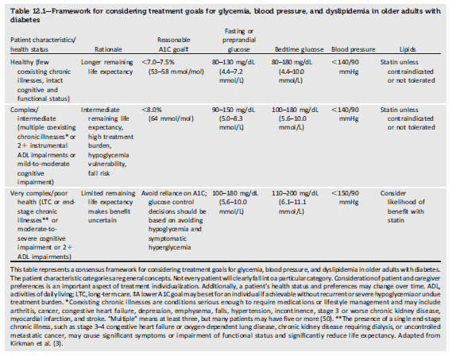
Older adults
Table 12.1—Framework for considering treatment goals for glycemia, blood pressure, and dyslipidemia in older adults with
diabetes
Older Adults:
Standards of Medical Care in Diabetes - 2021. Diabetes Care 2021;44(Suppl. 1):S168-S179

Slide 174
Lifestyle Management
Older adults
12.11 Optimal nutrition and protein intake is recommended for older adults; regular exercise, including aerobic activity, weightbearing exercise, and/or resistance training, should be encouraged in all older adults who can safely engage in such activities. B
12.12 For older adults with type 2 diabetes, overweight/obesity, and capacity to safely exercise, an intensive lifestyle intervention focused on dietary changes, physical activity, and modest weight loss (e.g., 5–7%) should be considered for its benefits on quality of life, mobility and physical functioning, and cardiometabolic risk factor control. A

Slide 175
Pharmacologic Therapy
Older adults
12.13 In older adults with type 2 diabetes at increased risk of hypoglycemia, medication classes with low risk of hypoglycemia are preferred. B
12.14 Overtreatment of diabetes is common in older adults and should be avoided. B
12.15 Deintensification (or simplification) of complex regimens is recommended to reduce the risk of hypoglycemia and polypharmacy, if it can be achieved within the individualized A1C target. B
12.16 Consider costs of care and insurance coverage rules when developing treatment plans in order to reduce risk of cost related nonadherence. B

Slide 176
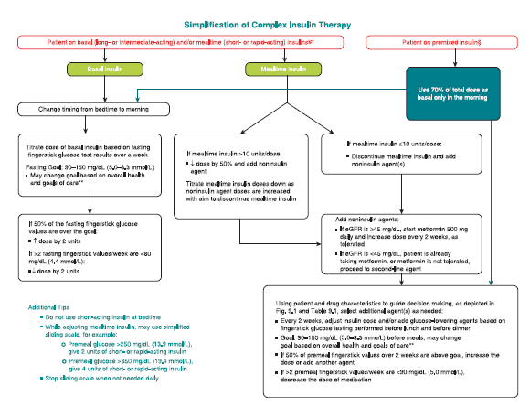
Older adults
Figure 12.1—Algorithm to simplify insulin regimen for older patients with type 2 diabetes.
Older Adults:
Standards of Medical Care in Diabetes - 2021. Diabetes Care 2021;44(Suppl. 1):S168-S179

Slide 177
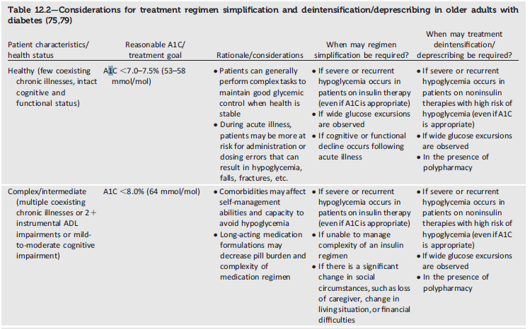
Older adults
Table 12.2—Considerations for treatment regimen simplification and deintensification/deprescribing in older adults with
diabetes.
(1 of 2)
Older Adults:
Standards of Medical Care in Diabetes - 2021. Diabetes Care 2021;44(Suppl. 1):S168-S179

Slide 178
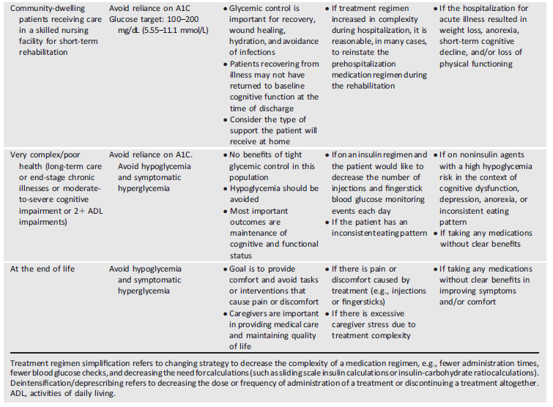
Older adults
Table 12.2—Considerations for treatment regimen simplification and deintensification/deprescribing in older adults with
diabetes.
(2 of 2)
Older Adults:
Standards of Medical Care in Diabetes - 2021. Diabetes Care 2021;44(Suppl. 1):S168-S179

Slide 179
Treatment in Skilled Nursing Facilities and Nursing Homes
Older adults
12.17 Consider diabetes education for the staff of long-term care and rehabilitation facilities to improve the management of older adults with diabetes. E
12.18 Patients with diabetes residing in long-term care facilities need careful assessment to establish individualized glycemic goals and to make appropriate choices of glucose-lowering agents based on their clinical and functional status. E

Slide 180
Older adults
The following alert strategy could be considered:
Call provider immediately in cases of low blood glucose levels (<70 mg/dL [3.9 mmol/L]).
Call as soon as possible when
a) glucose values are 70–100 mg/dL (3.9 and 5.6 mmol/L) (regimen may need to be adjusted),
b) glucose values are >250 mg/dL (13.9mmol/L)within a 24-h period,
c) glucose values are >300 mg/dL (16.7 mmol/L) over 2 consecutive days,
d) any reading is too high for the glucometer, or
e) the patient is sick, with vomiting, symptomatic hyperglycemia, or poor oral intake.

Slide 181
End-of-Life Care
Older adults
12.19 When palliative care is needed in older adults with diabetes, providers should initiate conversations regarding the goals and intensity of care. Strict glucose and blood pressure control may not be necessary E, and reduction of therapy may be appropriate. Similarly, the intensity of lipid management can be relaxed, and withdrawal of lipid-lowering therapy may be appropriate. A
12.20 Overall comfort, prevention of distressing symptoms, and preservation of quality of life and dignity are primary goals for diabetes management at the end of life. C

Slide 182
Older adults
Different patient categories have been proposed for diabetes management in those with advanced disease:
1. A stable patient: Continue with the patient’s previous regimen, with a focus on the prevention of hypoglycemia and the management of hyperglycemia using blood glucose testing, keeping levels below the renal threshold of glucose. There is very little role for A1C monitoring and lowering.
2. A patient with organ failure: Preventing hypoglycemia is of greater significance. Dehydration must be prevented and treated. In people with type 1 diabetes, insulin administration may be reduced as the oral intake of food decreases but should not be stopped. For those with type 2 diabetes, agents that may cause hypoglycemia should be reduced in dose. The main goal is to avoid hypoglycemia, allowing for glucose values in the upper level of the desired target range.

Slide 183
Older adults
Different patient categories have been proposed for diabetes management in those with advanced disease (continued):
3. A dying patient: For patients with type 2 diabetes, the discontinuation of all medications may be a reasonable approach, as patients are unlikely to have any oral intake. In patients with type 1 diabetes, there is no consensus, but a small amount of basal insulin may maintain glucose levels and prevent acute hyperglycemic complications.

Slide 184
Section 15.
Diabetes Care in the Hospital

Slide 185
Hospital Care Delivery Standards
Diabetes Care in the Hospital
15.1 Perform an A1C test on all patients with diabetes or hyperglycemia (blood glucose >140 mg/dL [7.8 mmol/L]) admitted to the hospital if not performed in the prior 3 months. B
15.2 Insulin should be administered using validated written or computerized protocols that allow for predefined adjustments in the insulin dosage based on glycemic fluctuations. C

Slide 186
Diabetes Care Providers in the Hospital
Diabetes Care in the Hospital
15.3 When caring for hospitalized patients with diabetes, consult with a specialized diabetes or glucose management team when possible. C

Slide 187
Glycemic Targets in Hospitalized Patients
Diabetes Care in the Hospital
15.4 Insulin therapy should be initiated for treatment of persistent hyperglycemia starting at a threshold ≥180 mg/dL (10.0 mmol/L). Once insulin therapy is started, a target glucose range of 140–180 mg/dL (7.8–10.0 mmol/L) is recommended for the majority of critically ill patients and noncritically ill patients. A
15.5 More stringent goals, such as 110–140 mg/dL (6.1–7.8 mmol/L), may be appropriate for selected patients if they can be achieved without significant hypoglycemia. C

Slide 188
Glucose-lowering Treatment in Hospitalized Patients
Diabetes Care in the Hospital
15.6 Basal insulin or a basal plus bolus correction insulin regimen is the preferred treatment for noncritically ill hospitalized patients with poor oral intake or those who are taking nothing by mouth. A
15.7 An insulin regimen with basal, prandial, and correction components is the preferred treatment for noncritically ill hospitalized patients with good nutritional intake. A
15.8 Use of only a sliding scale insulin regimen in the inpatient hospital setting is strongly discouraged. A

Slide 189
Hypoglycemia
Diabetes Care in the Hospital
15.9 A hypoglycemia management protocol should be adopted and implemented by each patient. A plan for preventing and treating hypoglycemia should be established for each patient. Episodes of hypoglycemia in the hospital should be documented in the medical record and tracked. E
15.10 The treatment regimen should be reviewed and changed as necessary to prevent further hypoglycemia when a blood glucose value of <70 mg/dL (3.9 mmol/L) is documented. C

Slide 190
Transition from the Hospital Setting to the Ambulatory Setting
Diabetes Care in the Hospital
15.11 There should be a structured discharge plan tailored to the individual patient with diabetes. B

Slide 191
Diabetes care in the hospital
The Agency for Healthcare Research and Quality (AHRQ) recommends that, at a minimum, discharge plans include the following:
Medication Reconciliation
The patient’s medications must be cross-checked to ensure that no chronic medications were stopped and to ensure the safety of new prescriptions.
Prescriptions for new or changed medication should be filled and reviewed with the patient and family at or before discharge.

Slide 192
Diabetes care in the hospital
The Agency for Healthcare Research and Quality (AHRQ) recommends that, at a minimum, discharge plans include the following (continued):
Structured Discharge Communication
  Information on medication changes, pending tests and studies, and follow up needs must be accurately and promptly communicated to outpatient physicians.
  Discharge summaries should be transmitted to the primary care provider as soon as possible after discharge.
  Scheduling follow-up appointments prior to discharge increases the likelihood that patients will attend.

Slide 193
Diabetes care in the hospital
It is recommended that the following areas of knowledge be reviewed and addressed prior to hospital discharge:
Identification of the health care provider who will provide diabetes care after discharge.
Level of understanding related to the diabetes diagnosis, self-monitoring of blood glucose, home blood glucose goals, and when to call the provider.
Definition, recognition, treatment, and prevention of hyperglycemia and hypoglycemia.
Information on making healthy food choices at home and referral to an outpatient RD/RDN to guide individualization of meal plan, if needed.
If relevant, when and how to take blood glucose–lowering medications, including insulin administration.
Sick-day management.
Proper use and disposal of needles and syringes.

