Slide 1
How to use TBS in combination with BMD in clinical practice
H.Rezvanian

Slide 2
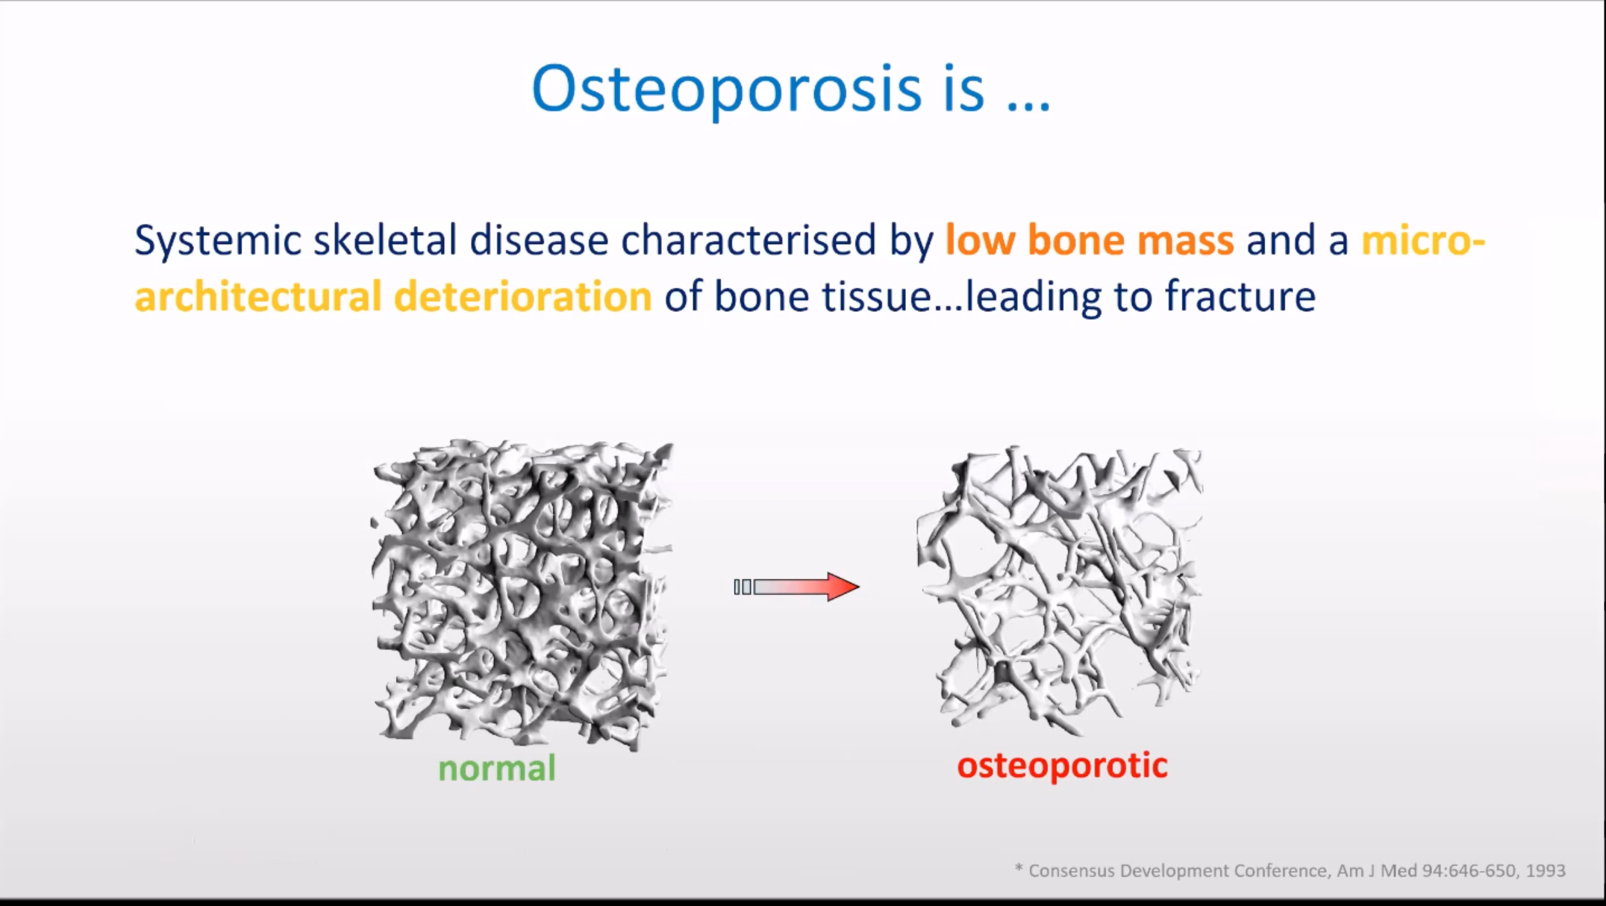

Slide 3
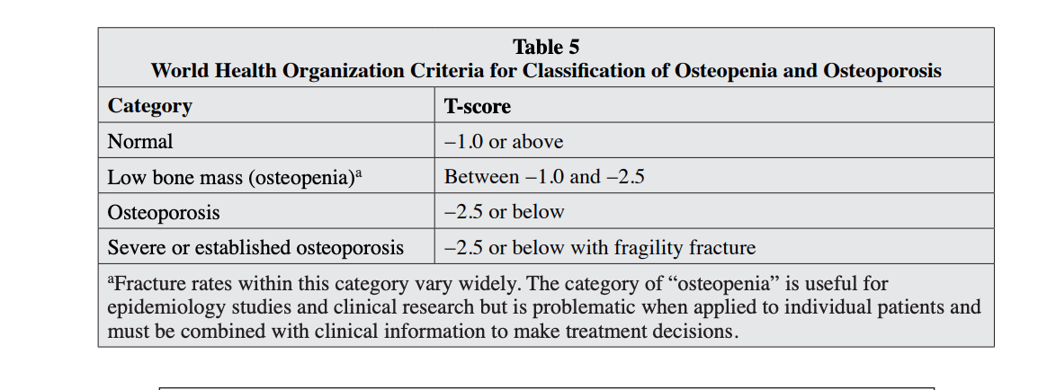

Slide 4
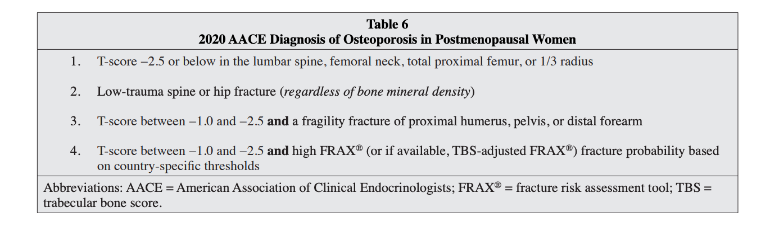

Slide 5
Endocrine Society Guideline Update 2020
: (1) low risk includes
no prior hip or spine fractures,
a BMD T-score at the hip and spine both above −1.0,
a 10-year hip fracture risk < 3%, and 10-year risk of major osteoporotic fractures < 20%;

Slide 6
Endocrine Society Guideline Update 2020
(2) moderate risk includes
no prior hip or spine fractures,
a BMD T-score at the hip and spine both above −2.5,
and 10-year hip fracture risk < 3% or risk of major osteoporotic fractures < 20%;

Slide 7
Endocrine Society Guideline Update 2020
(3) high risk includes
a prior spine or hip fracture,
or a BMD T-score at the hip or spine of −2.5 or below,
or 10-year hip fracture risk ≥ 3%, or risk of major osteoporotic fracture risk ≥ 20%;

Slide 8
Endocrine Society Guideline Update 2020
(4) very high risk includes
multiple spine fractures
and a BMD T-score at the hip or spine of −2.5 or below.

Slide 9
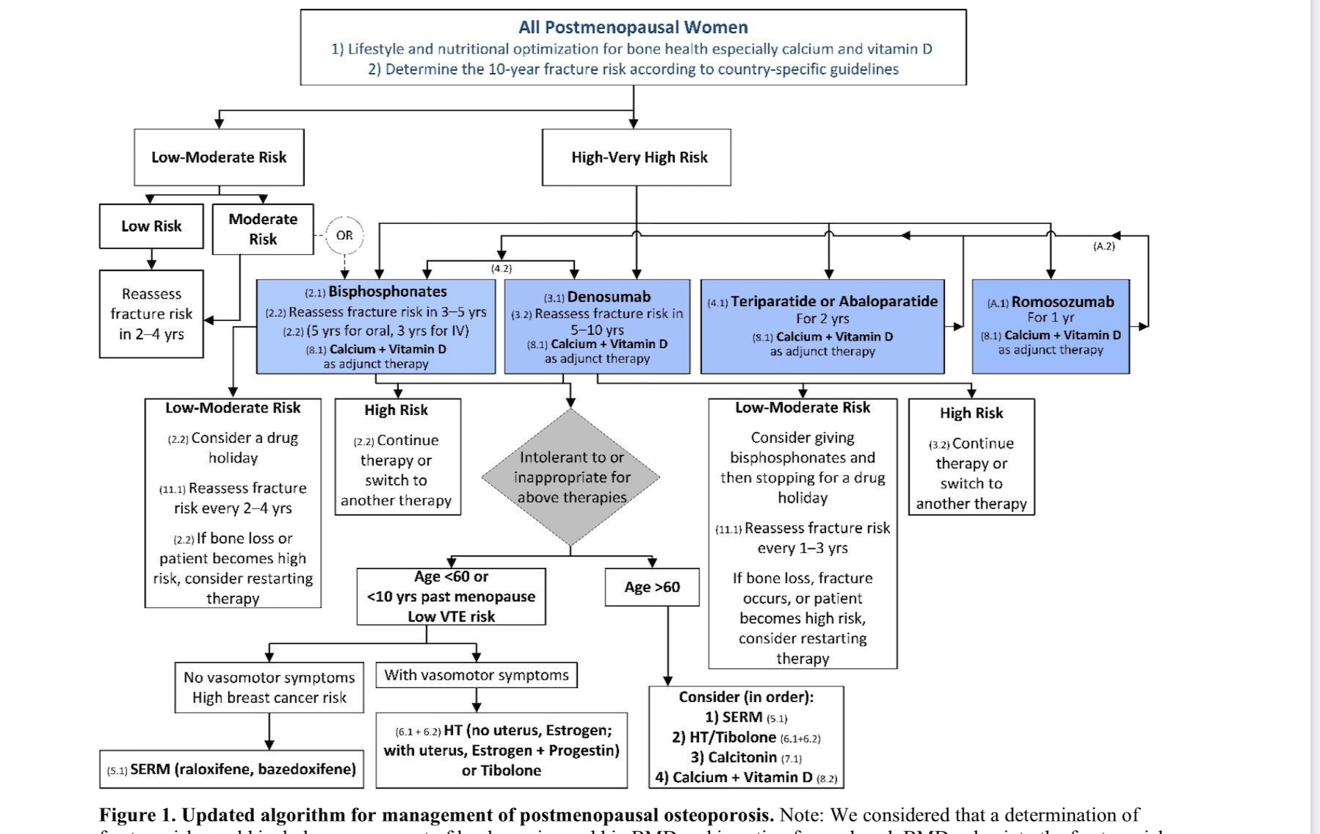

Slide 10
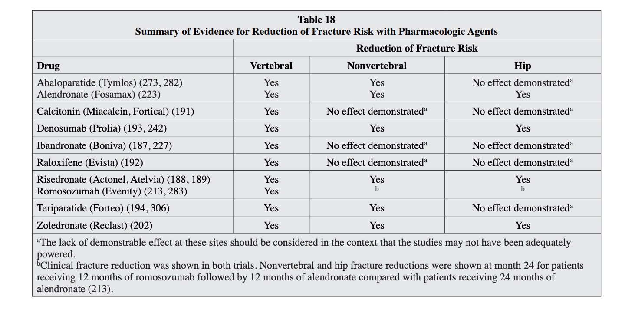

Slide 11
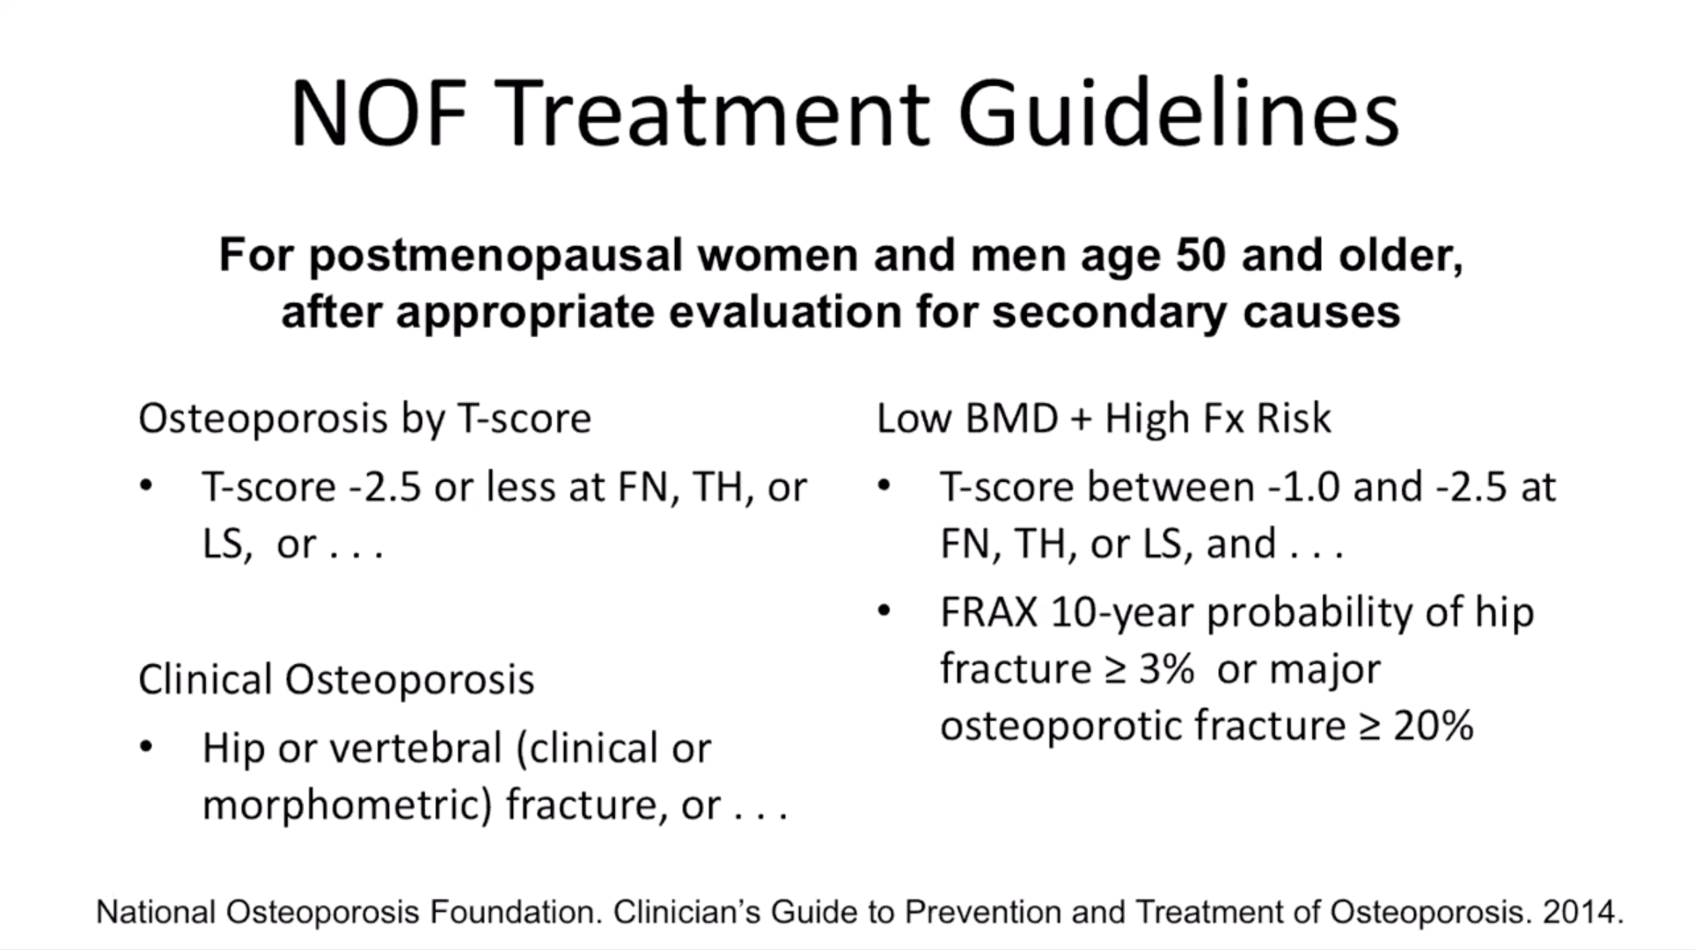

Slide 12
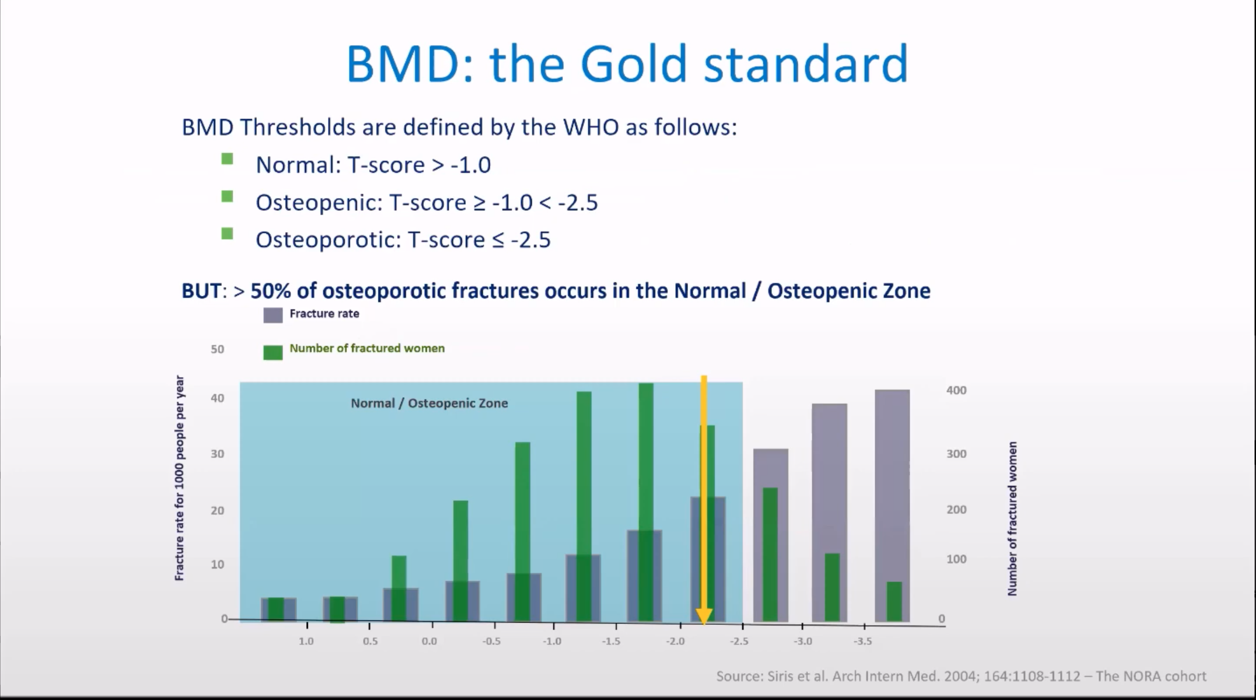

Slide 13
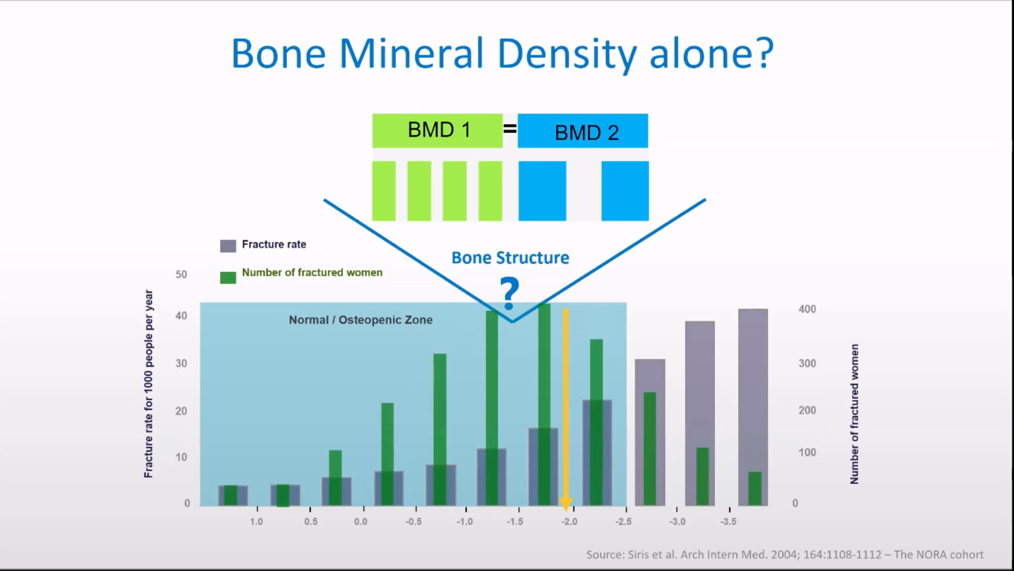

Slide 14
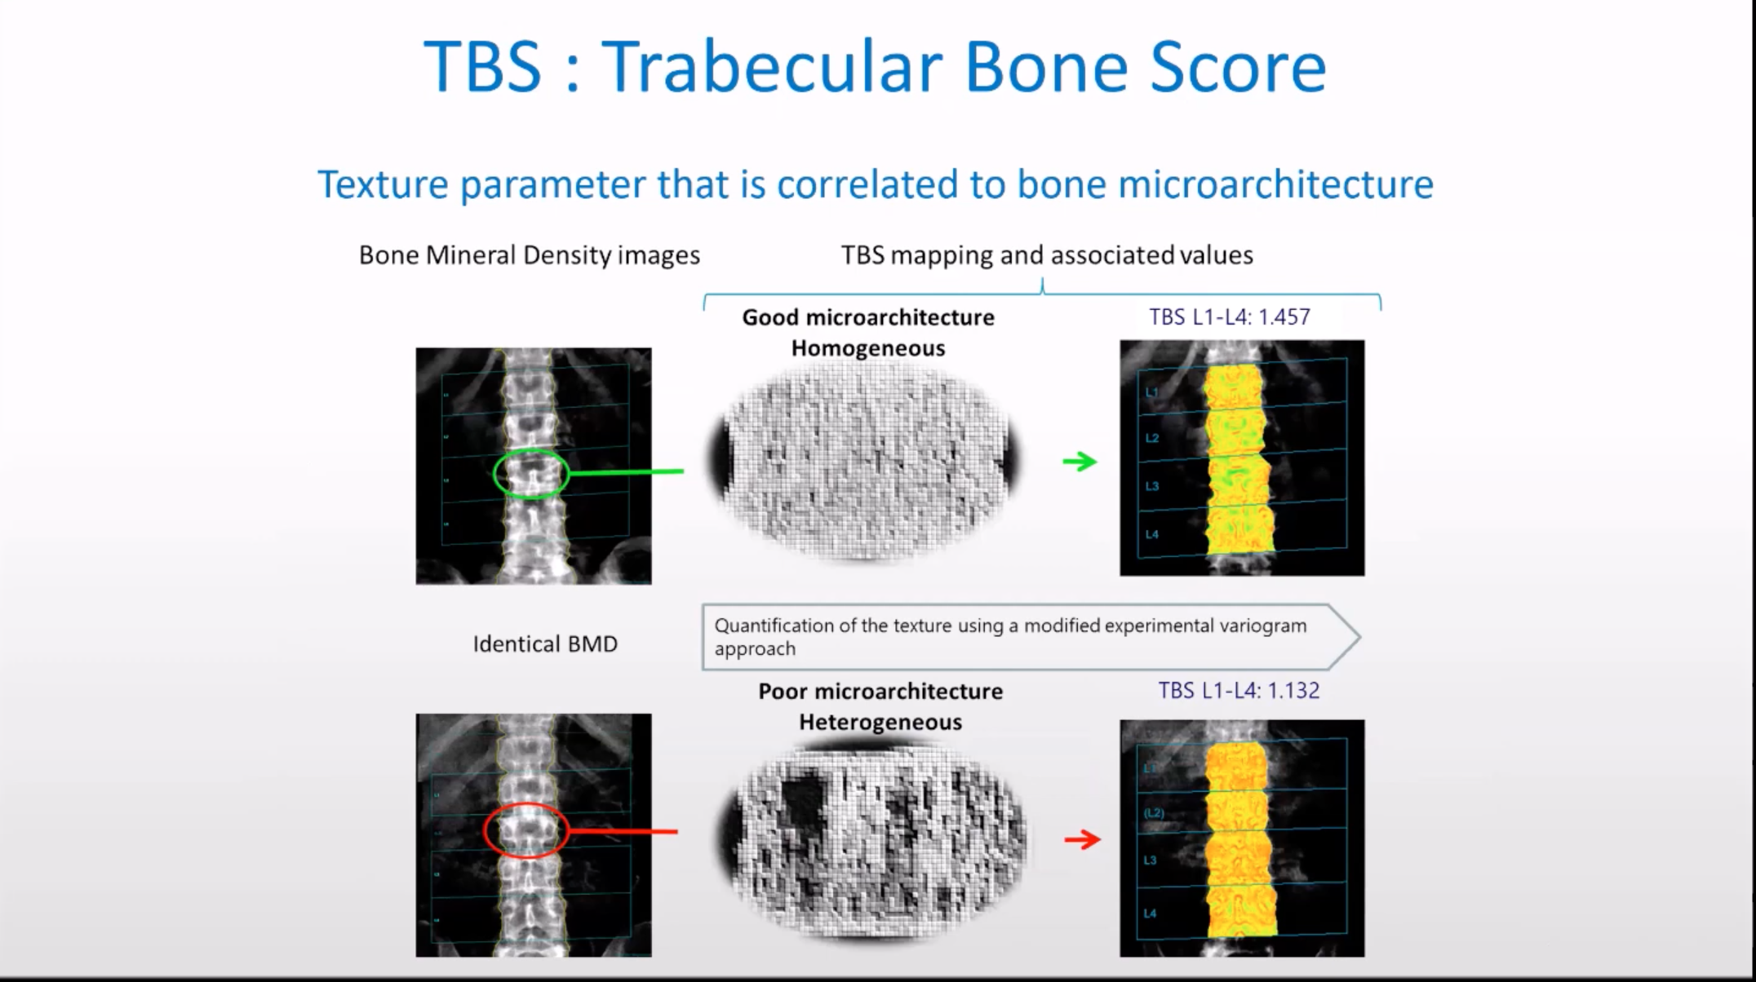

Slide 15
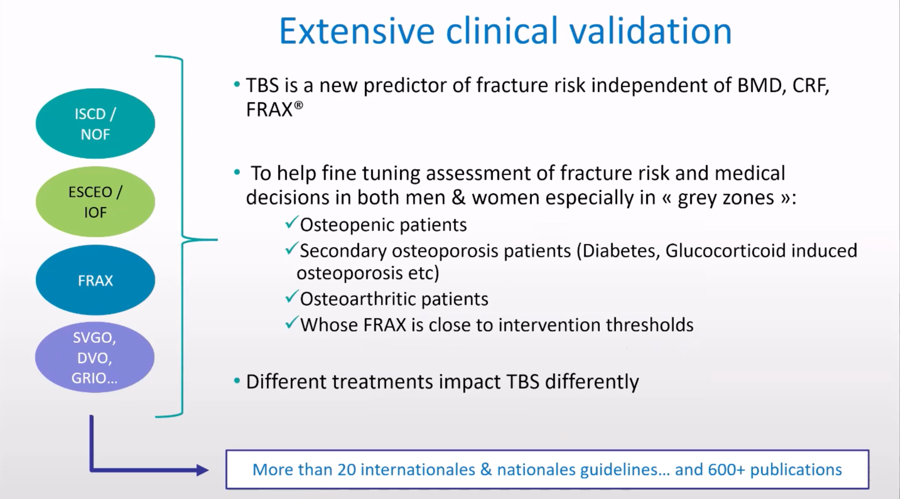

Slide 16
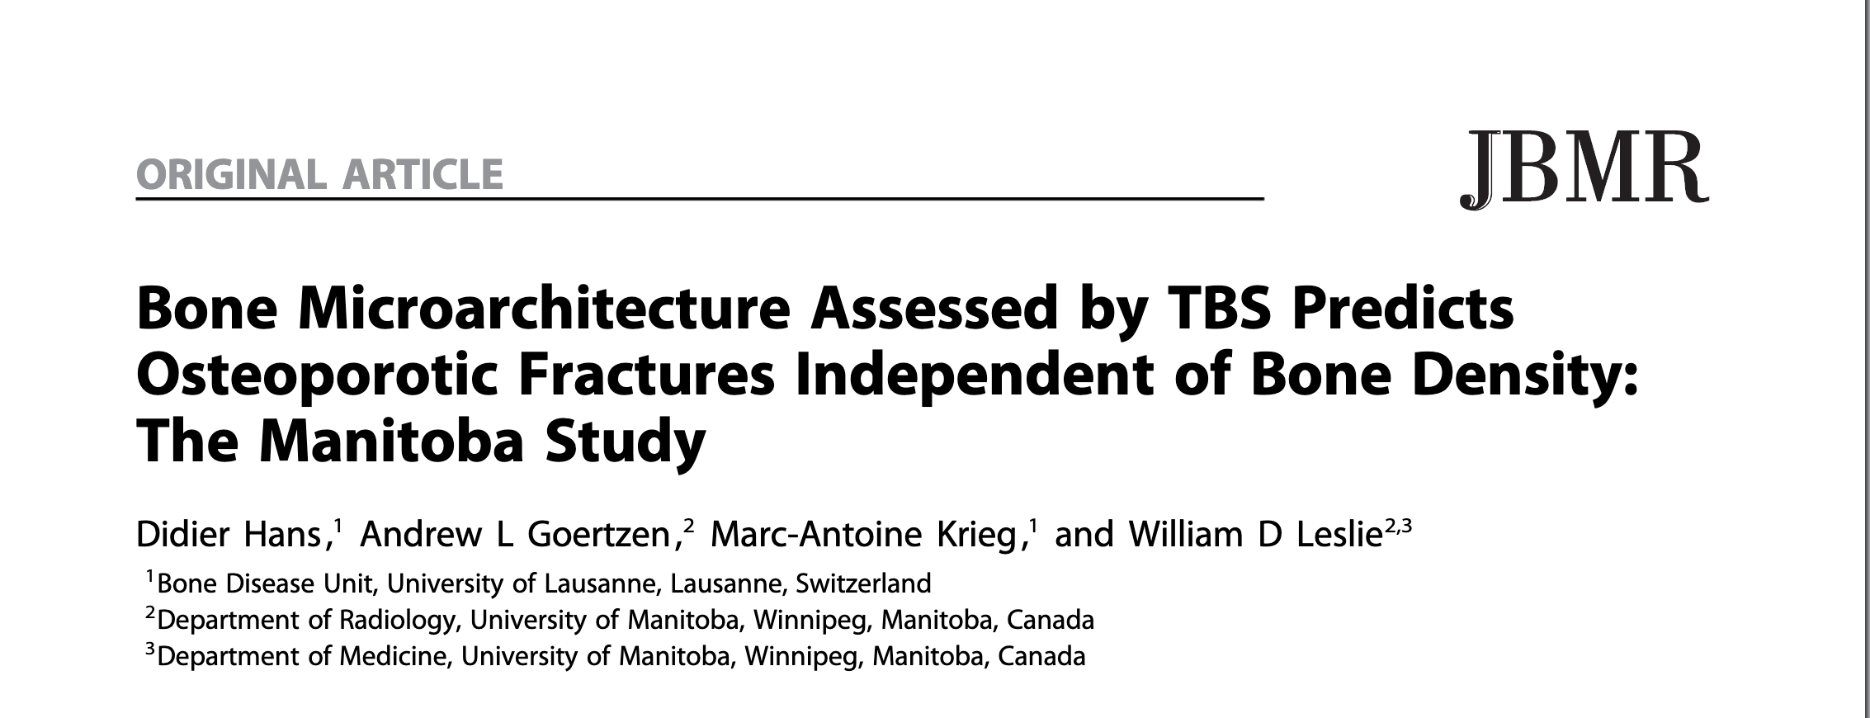
The trabecular bone score (TBS), a novel gray-level texture measurement that can be extracted from DXA images, correlates with 3D parameters of bone microarchitecture.

Slide 17
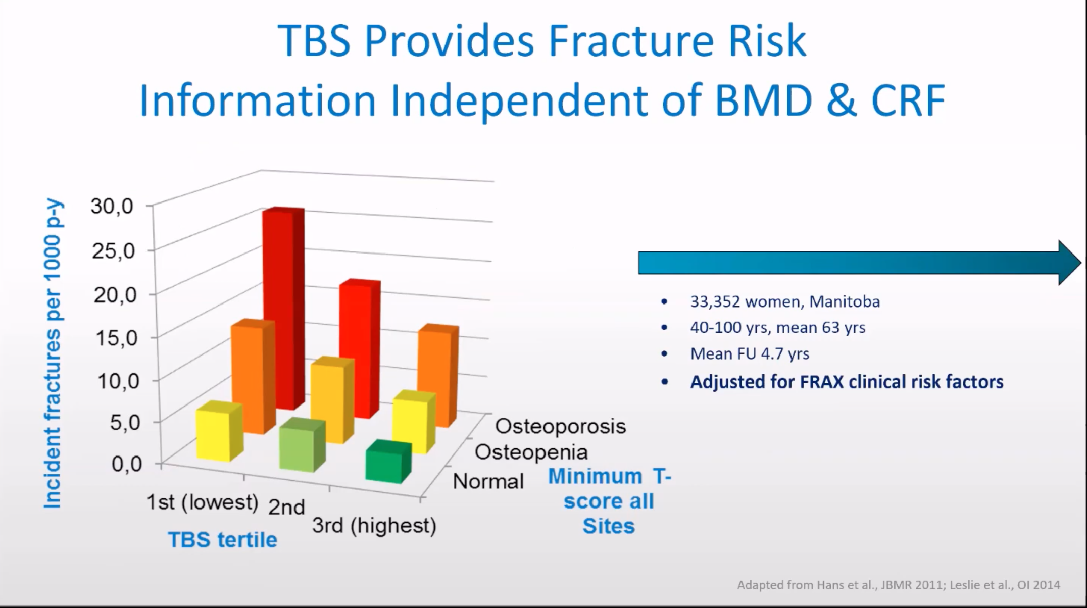

Slide 18
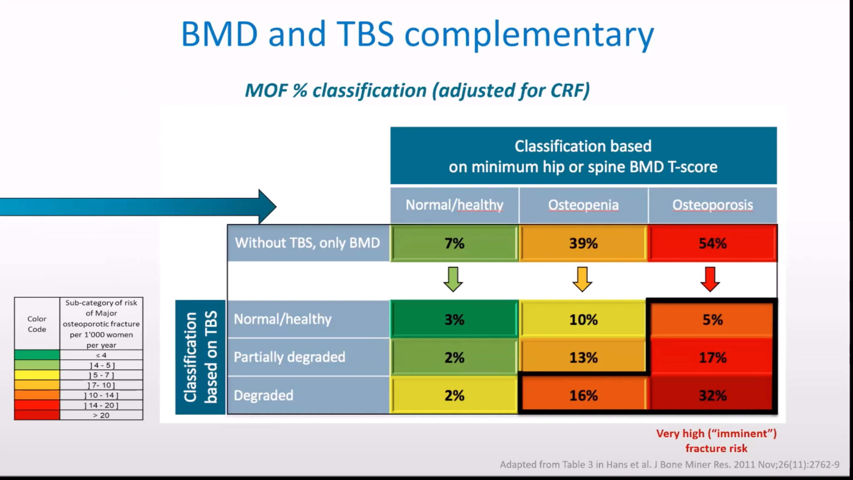

Slide 19
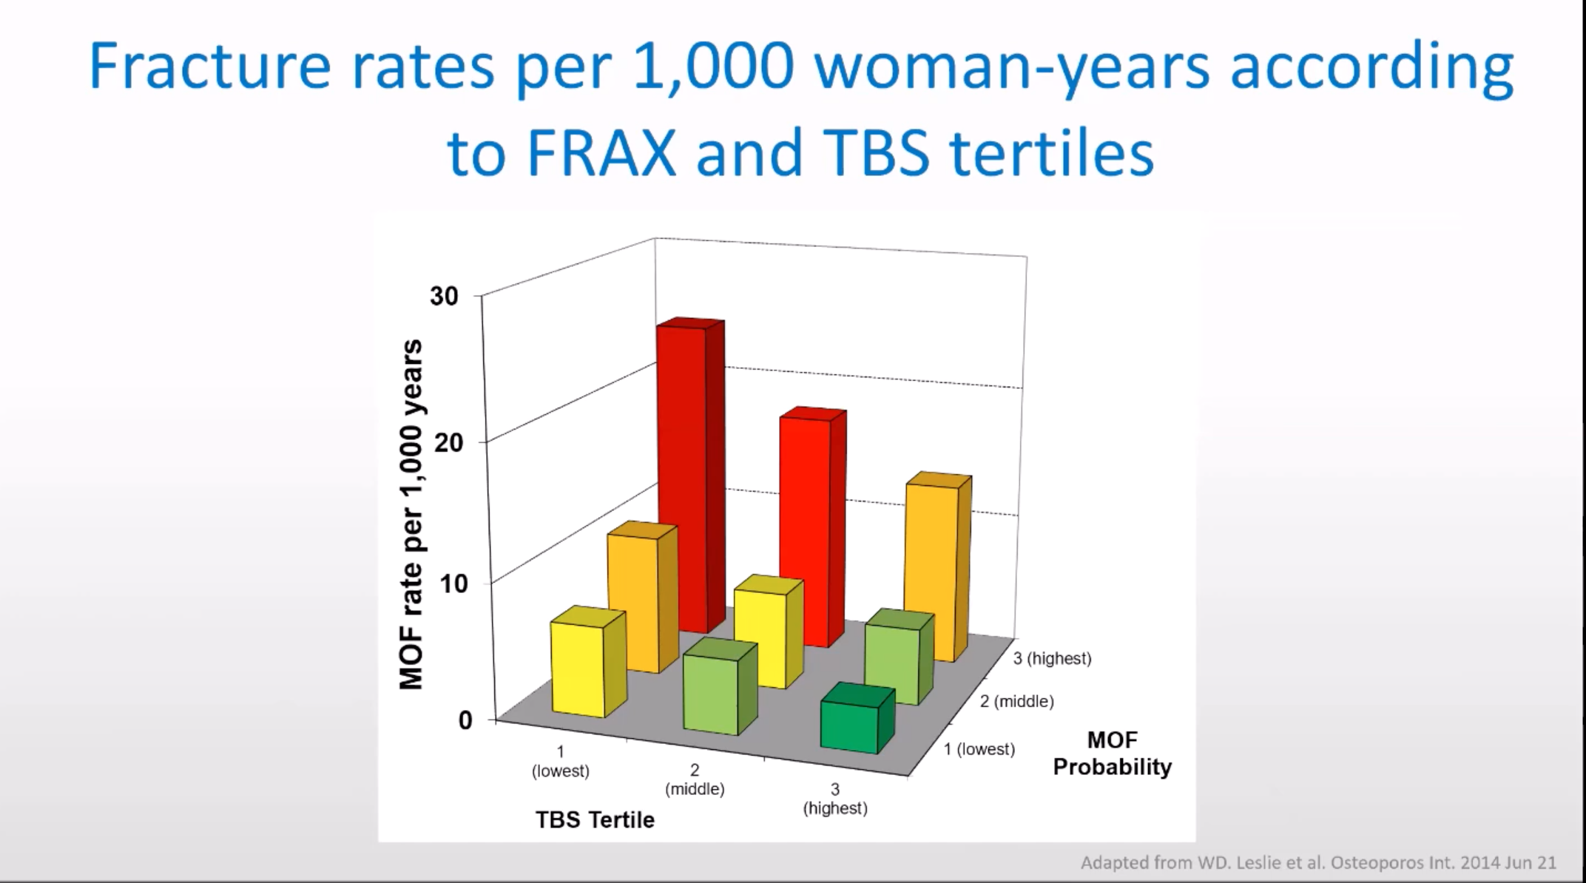

Slide 20
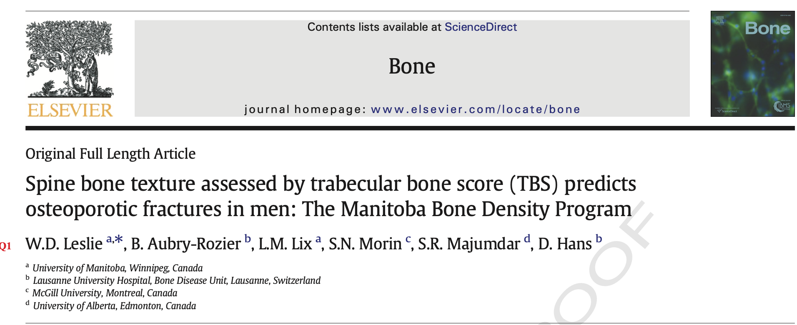
One quarter of osteoporotic fractures occur in men.

Slide 21
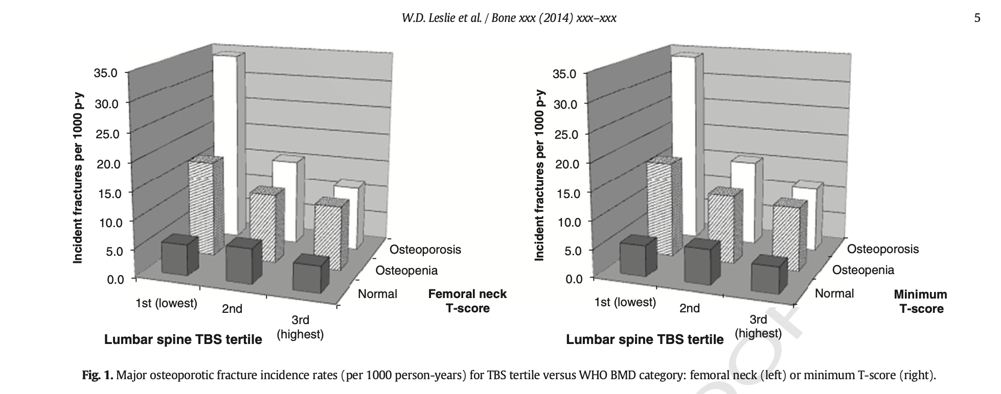

Slide 22
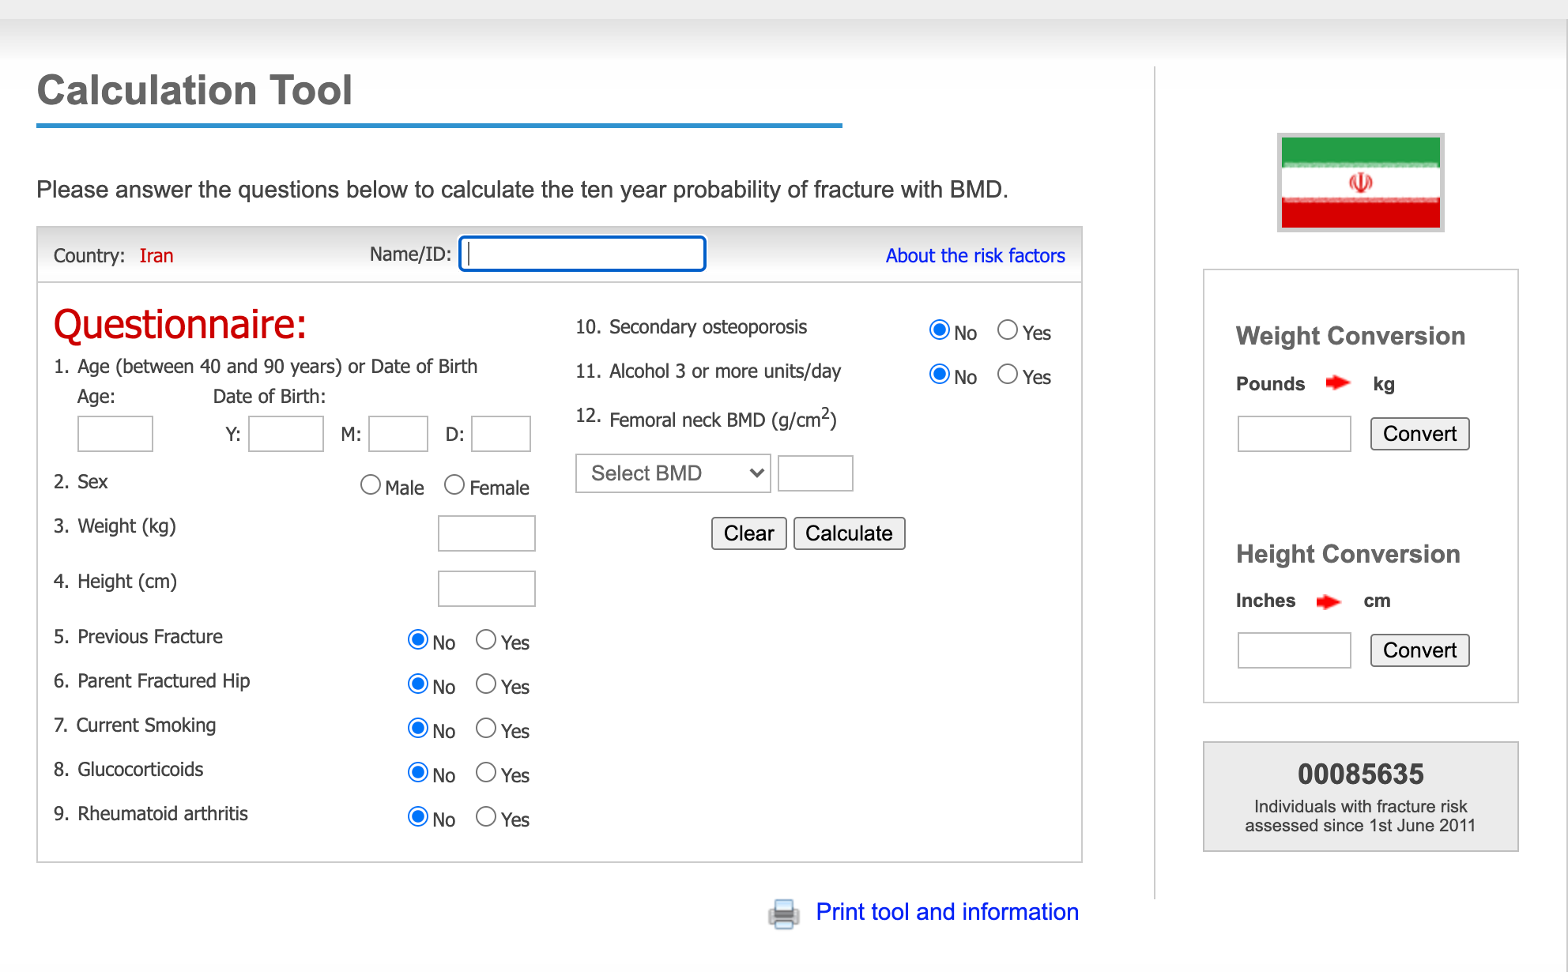

Slide 23
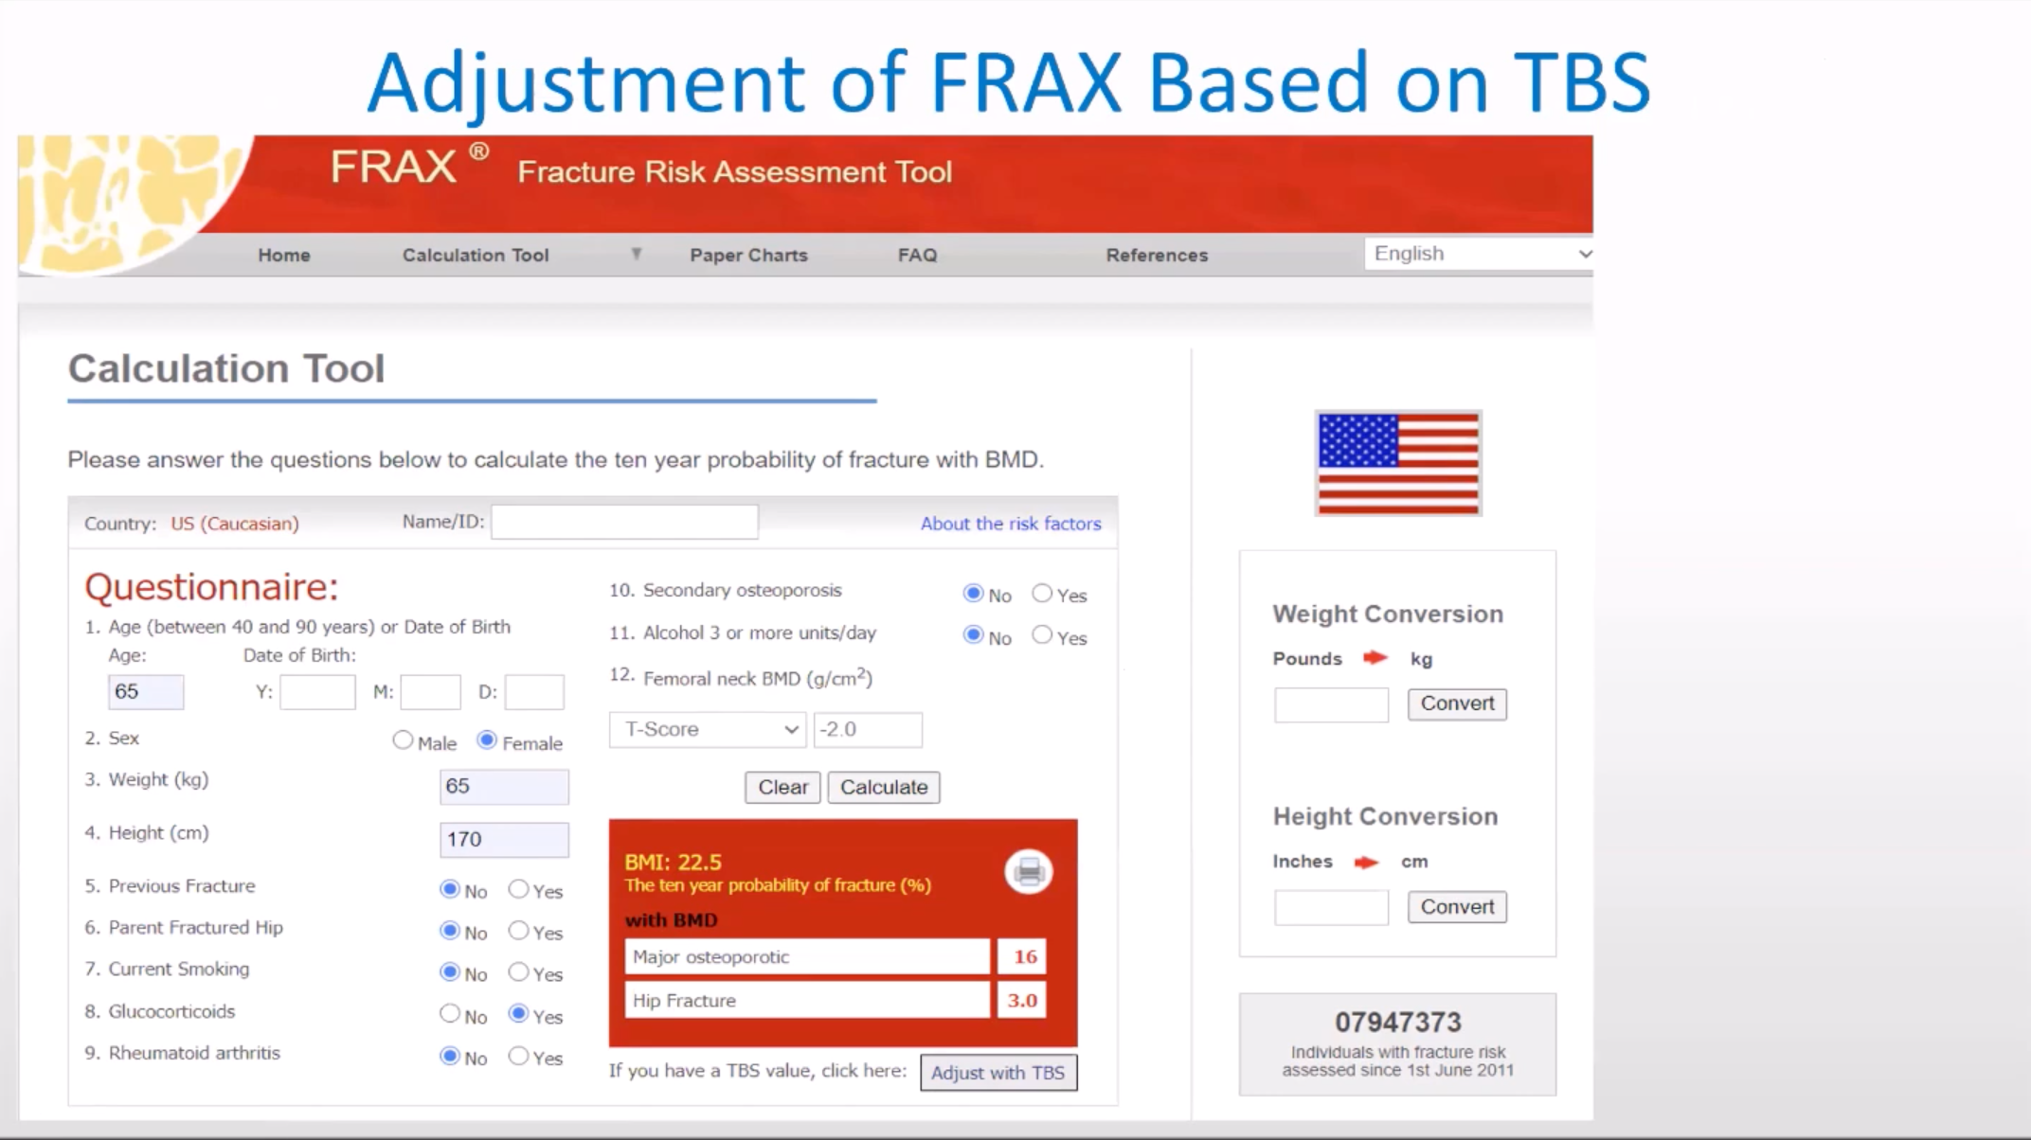

Slide 24
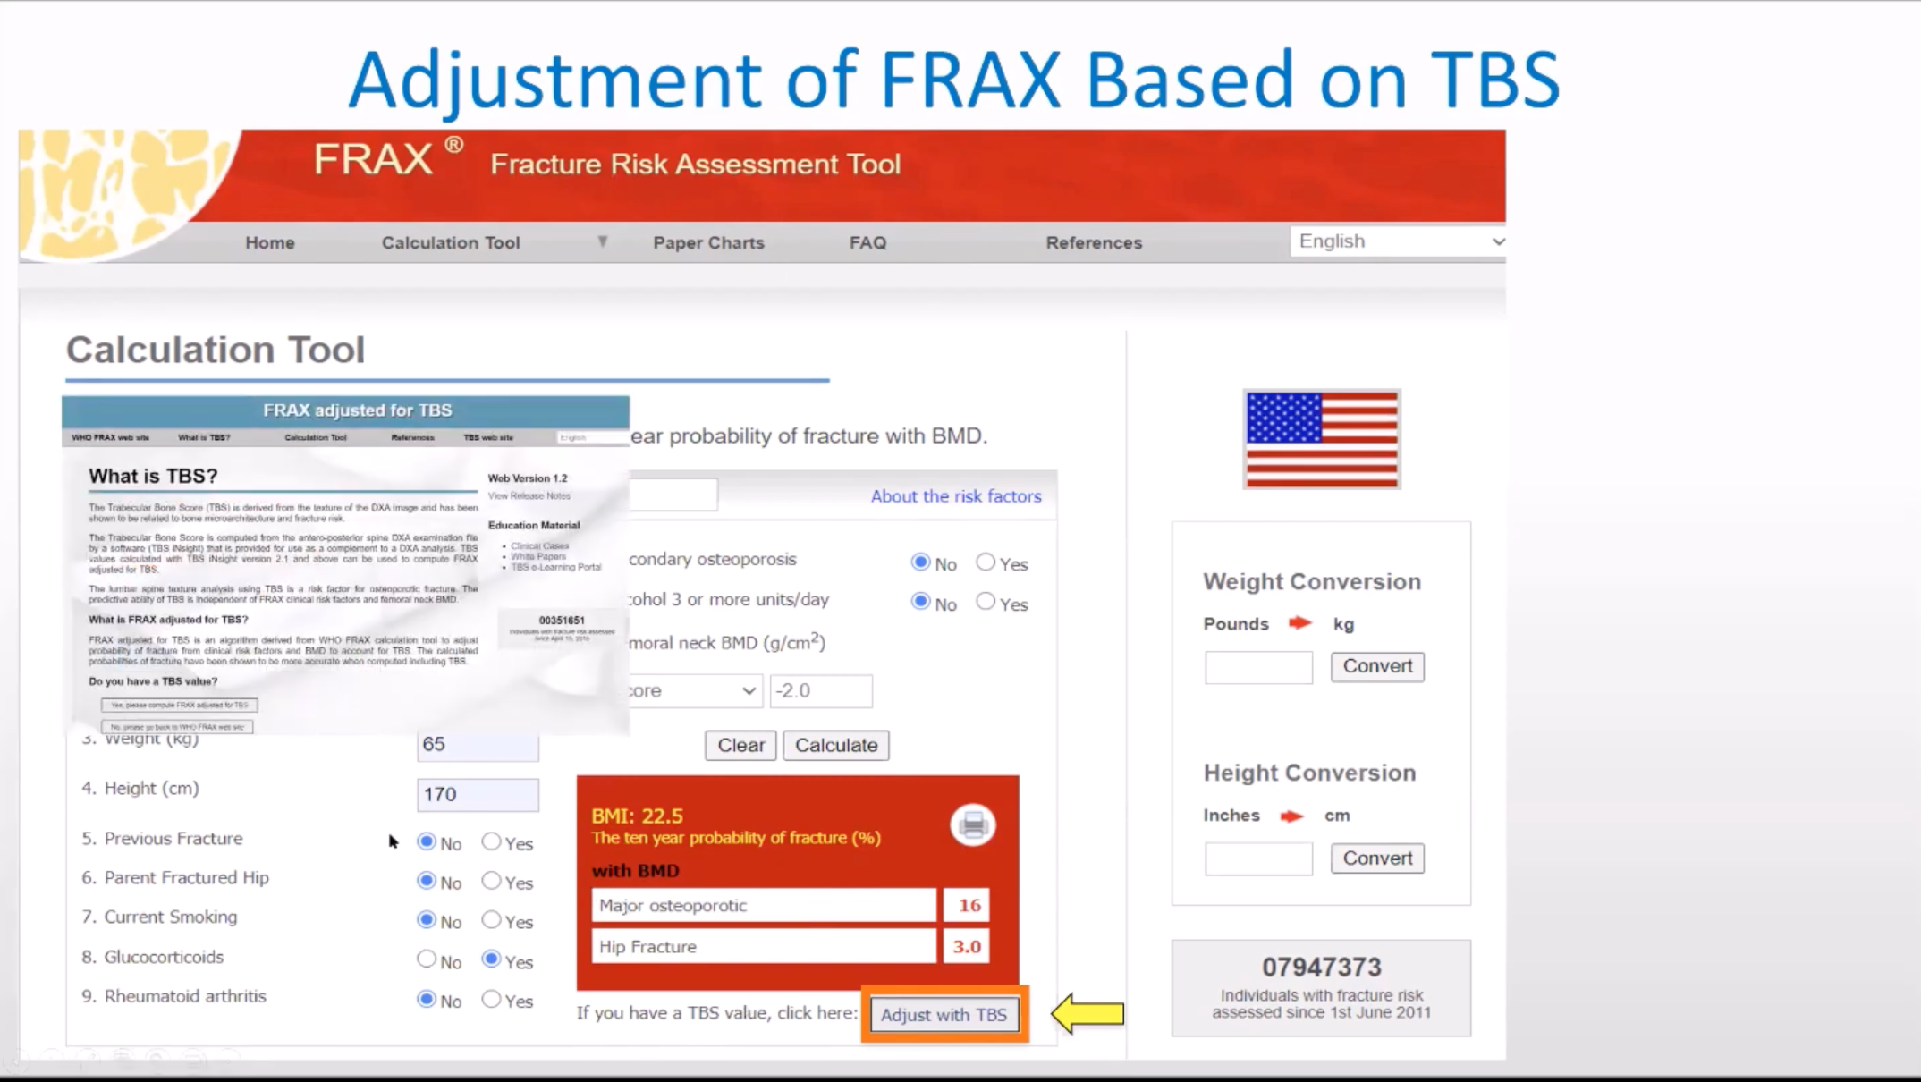

Slide 25
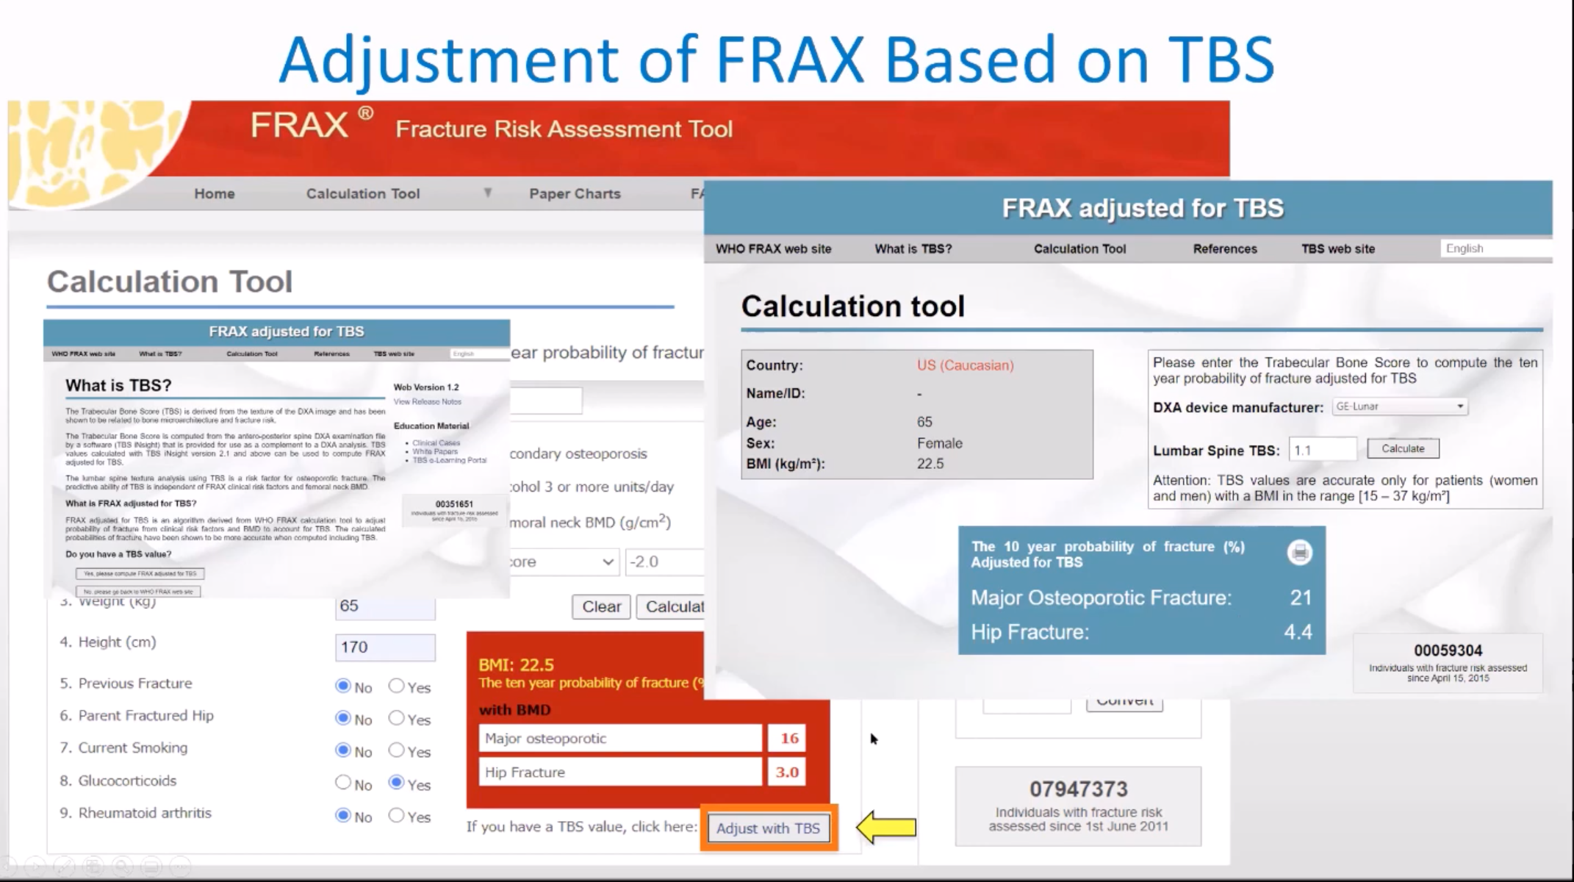

Slide 26
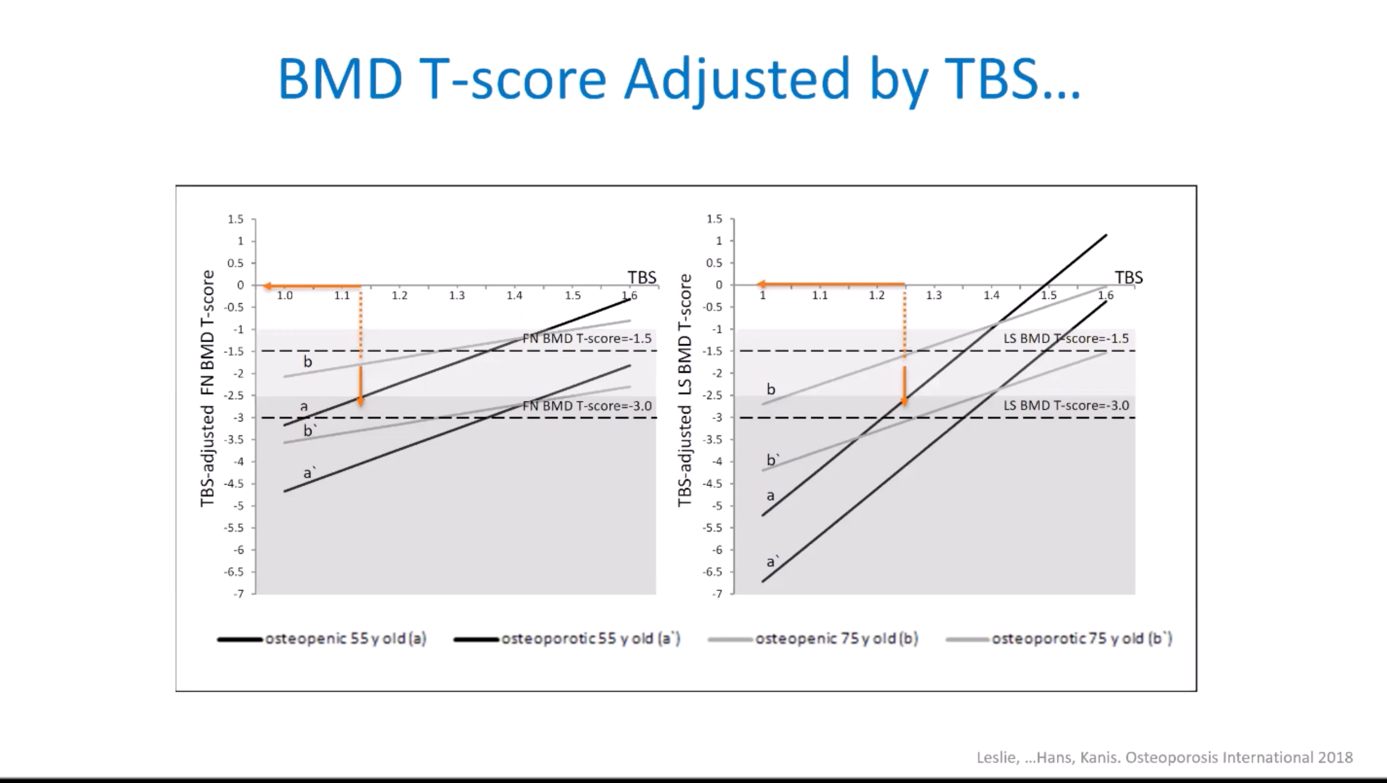

Slide 27
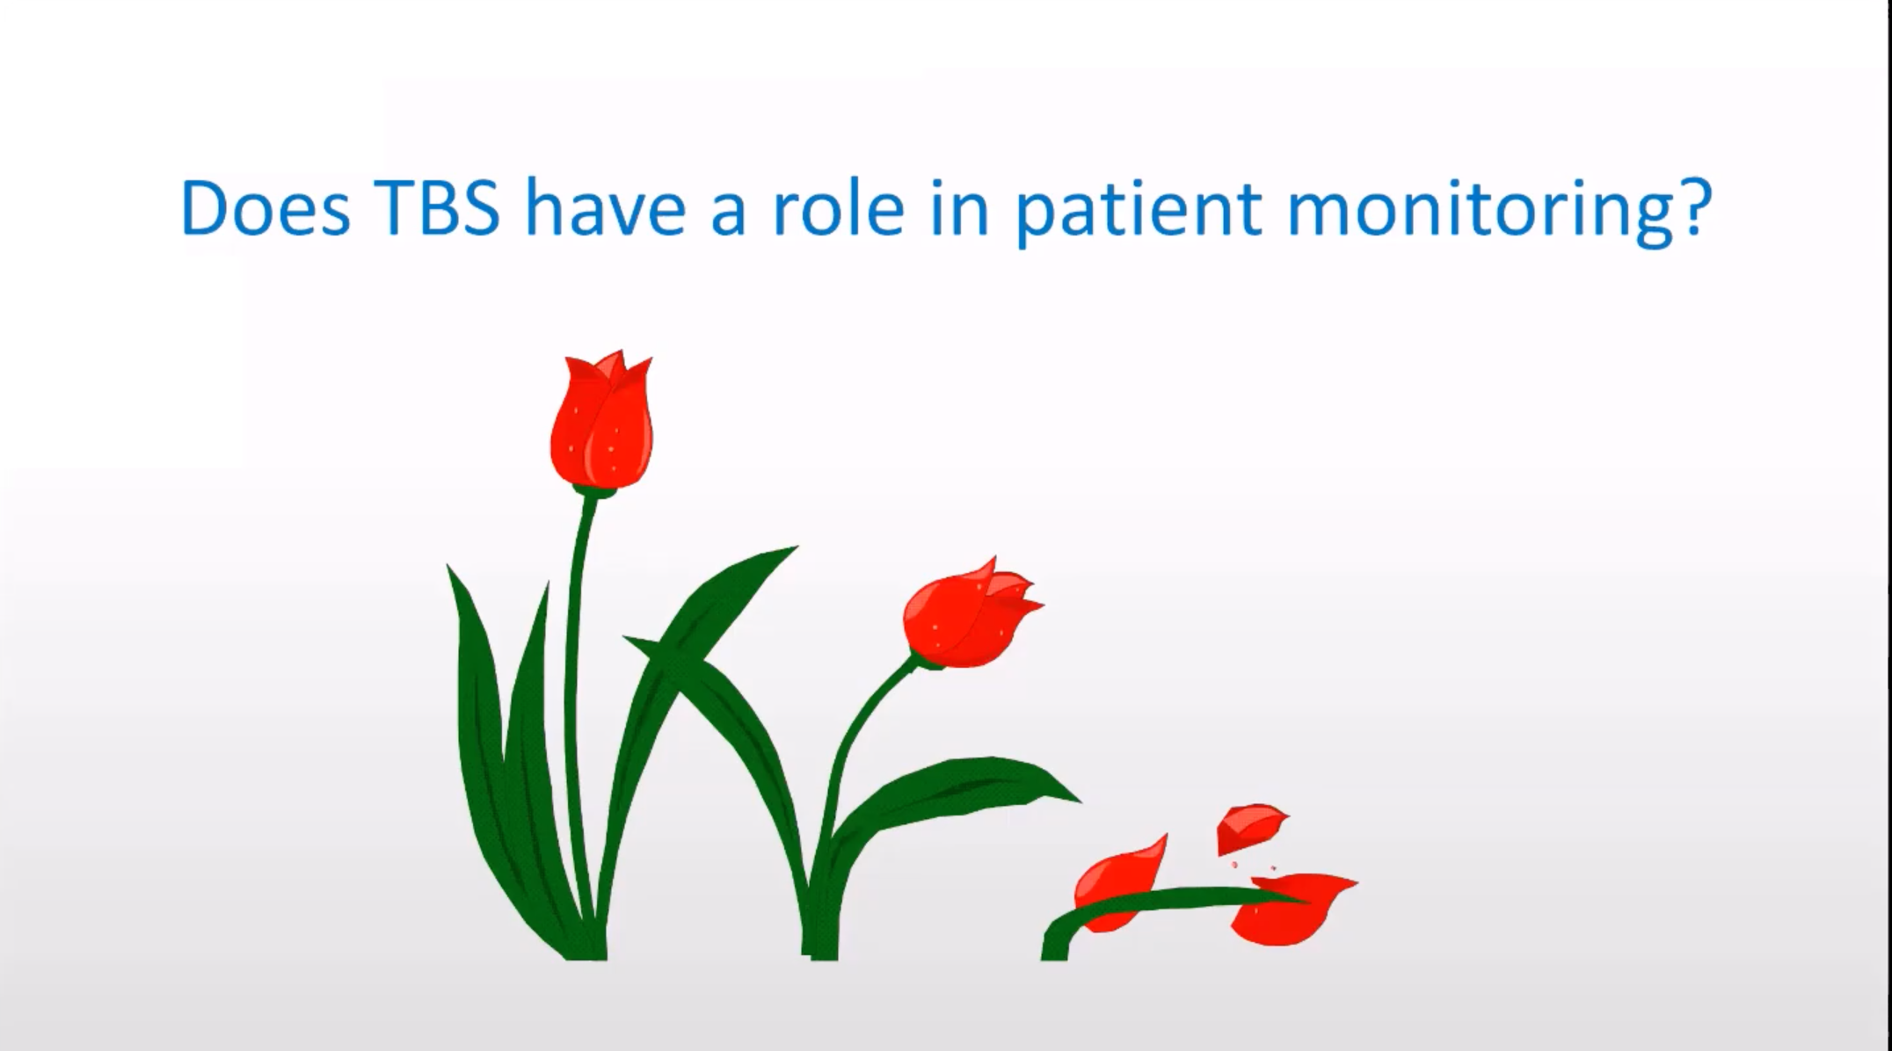

Slide 28
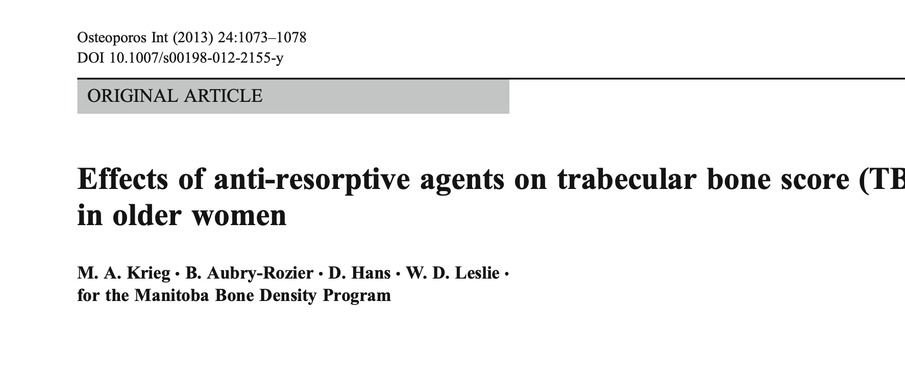

Slide 29
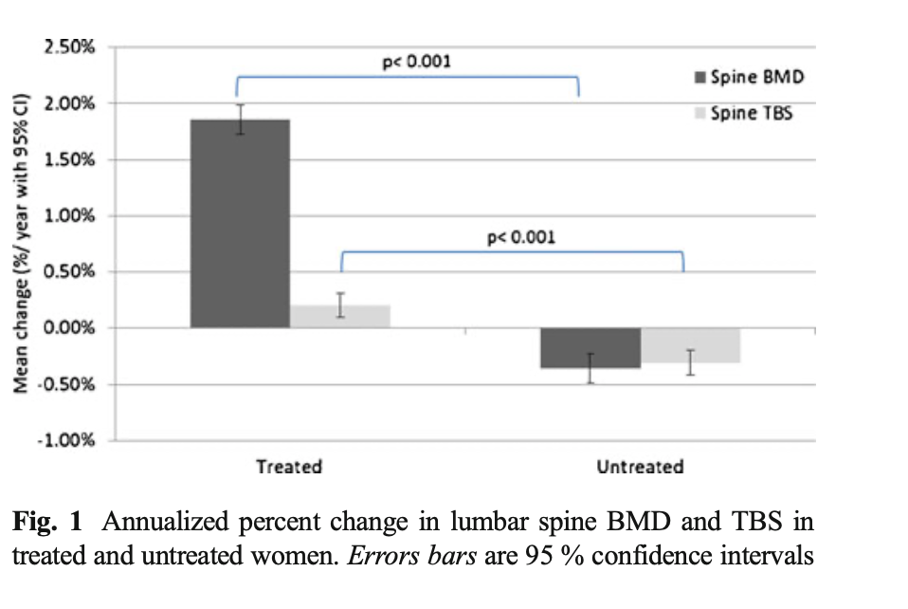

Slide 30
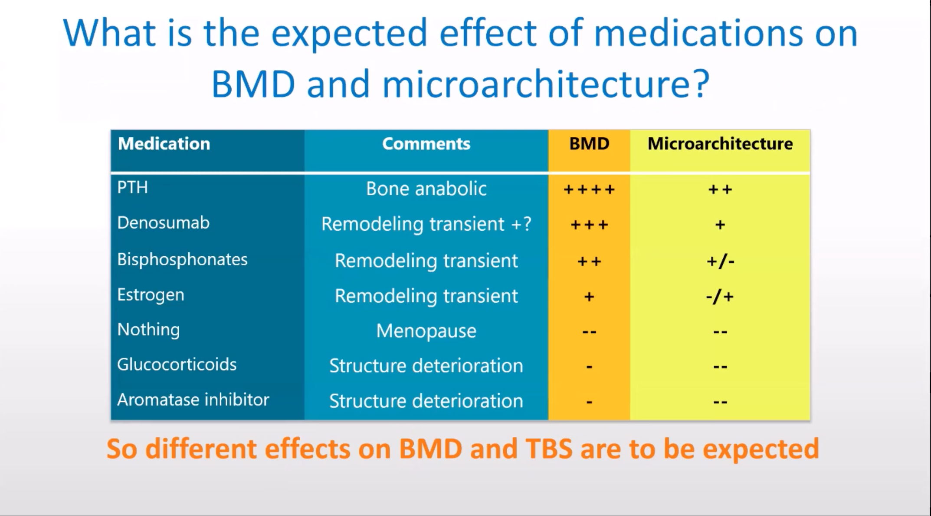

Slide 31
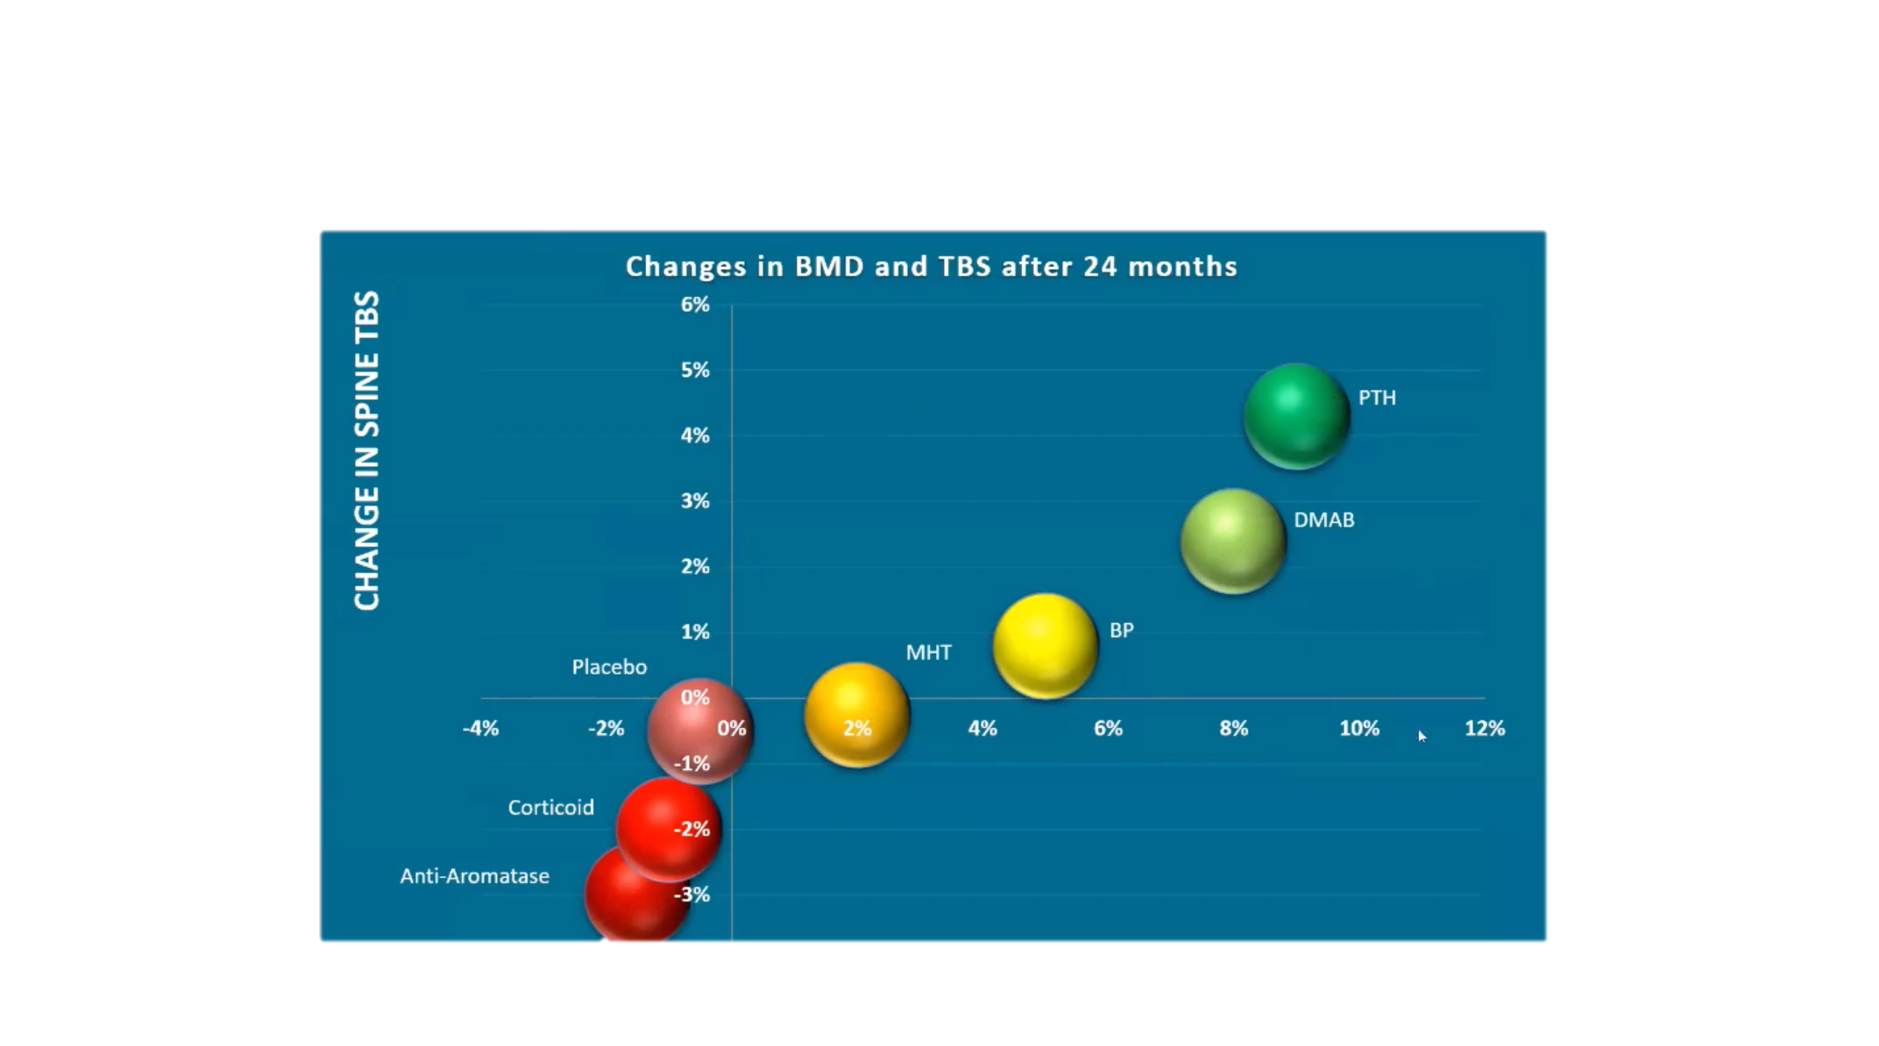

Slide 32
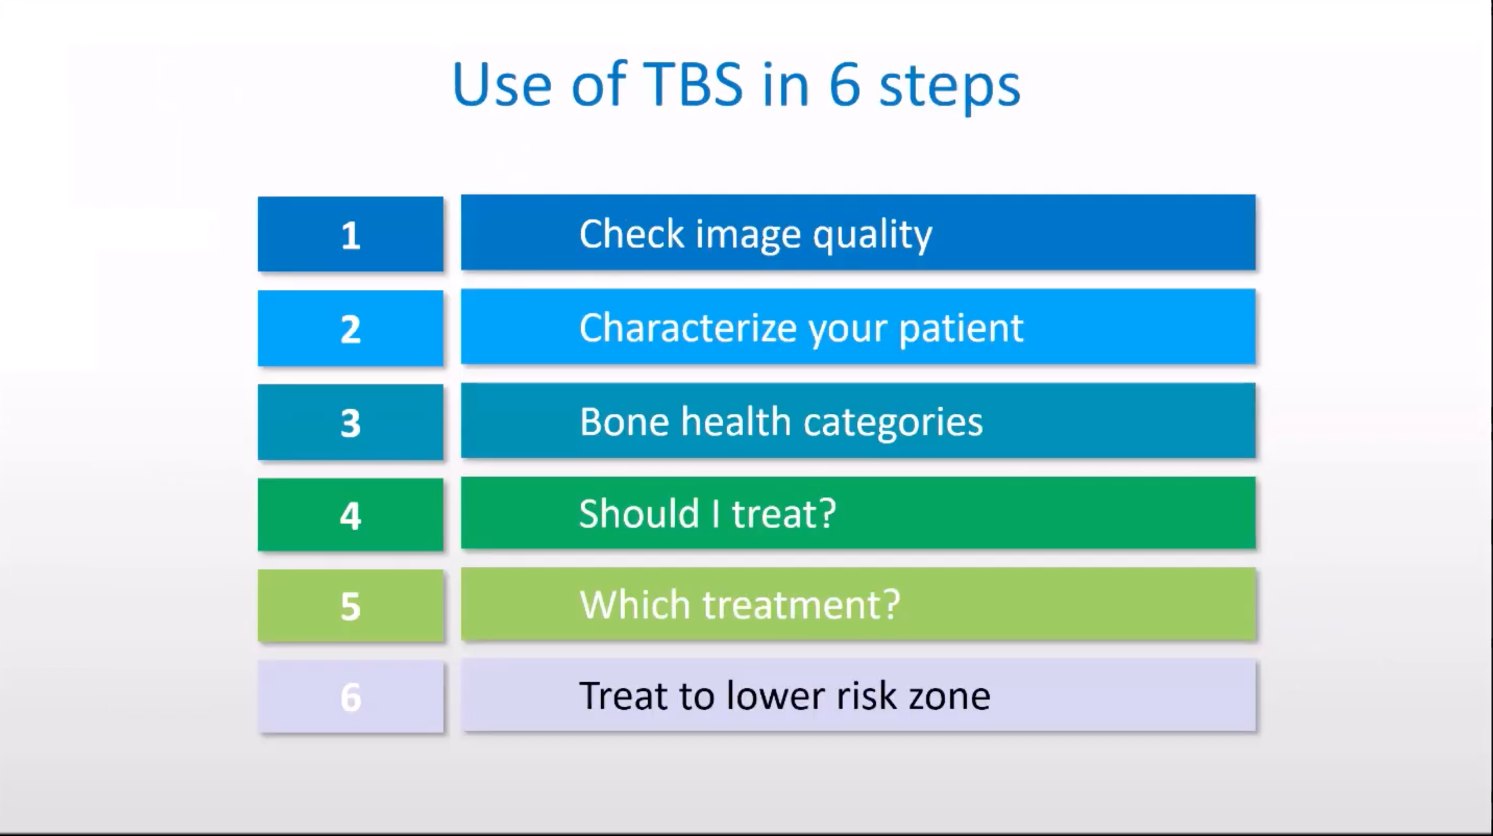

Slide 33
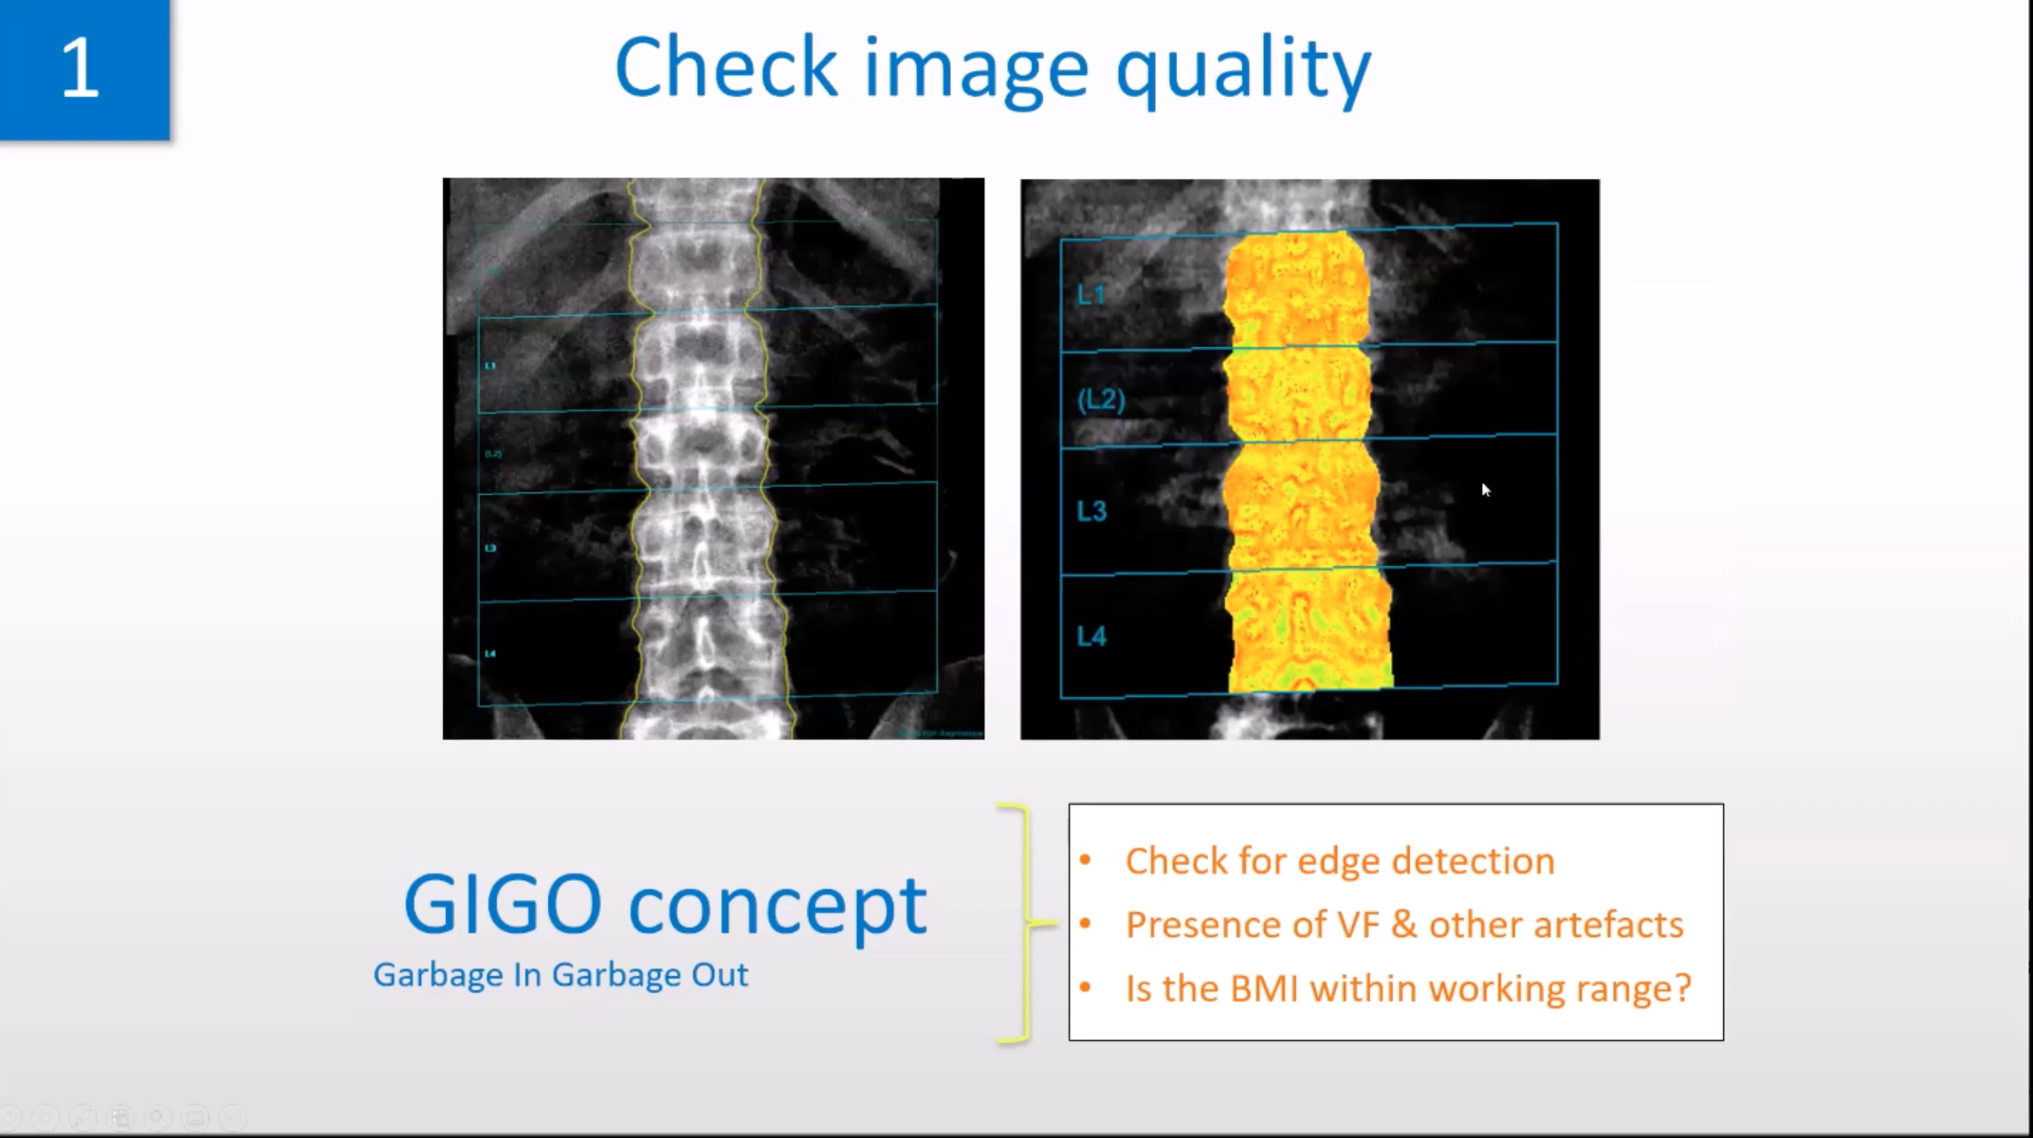

Slide 34
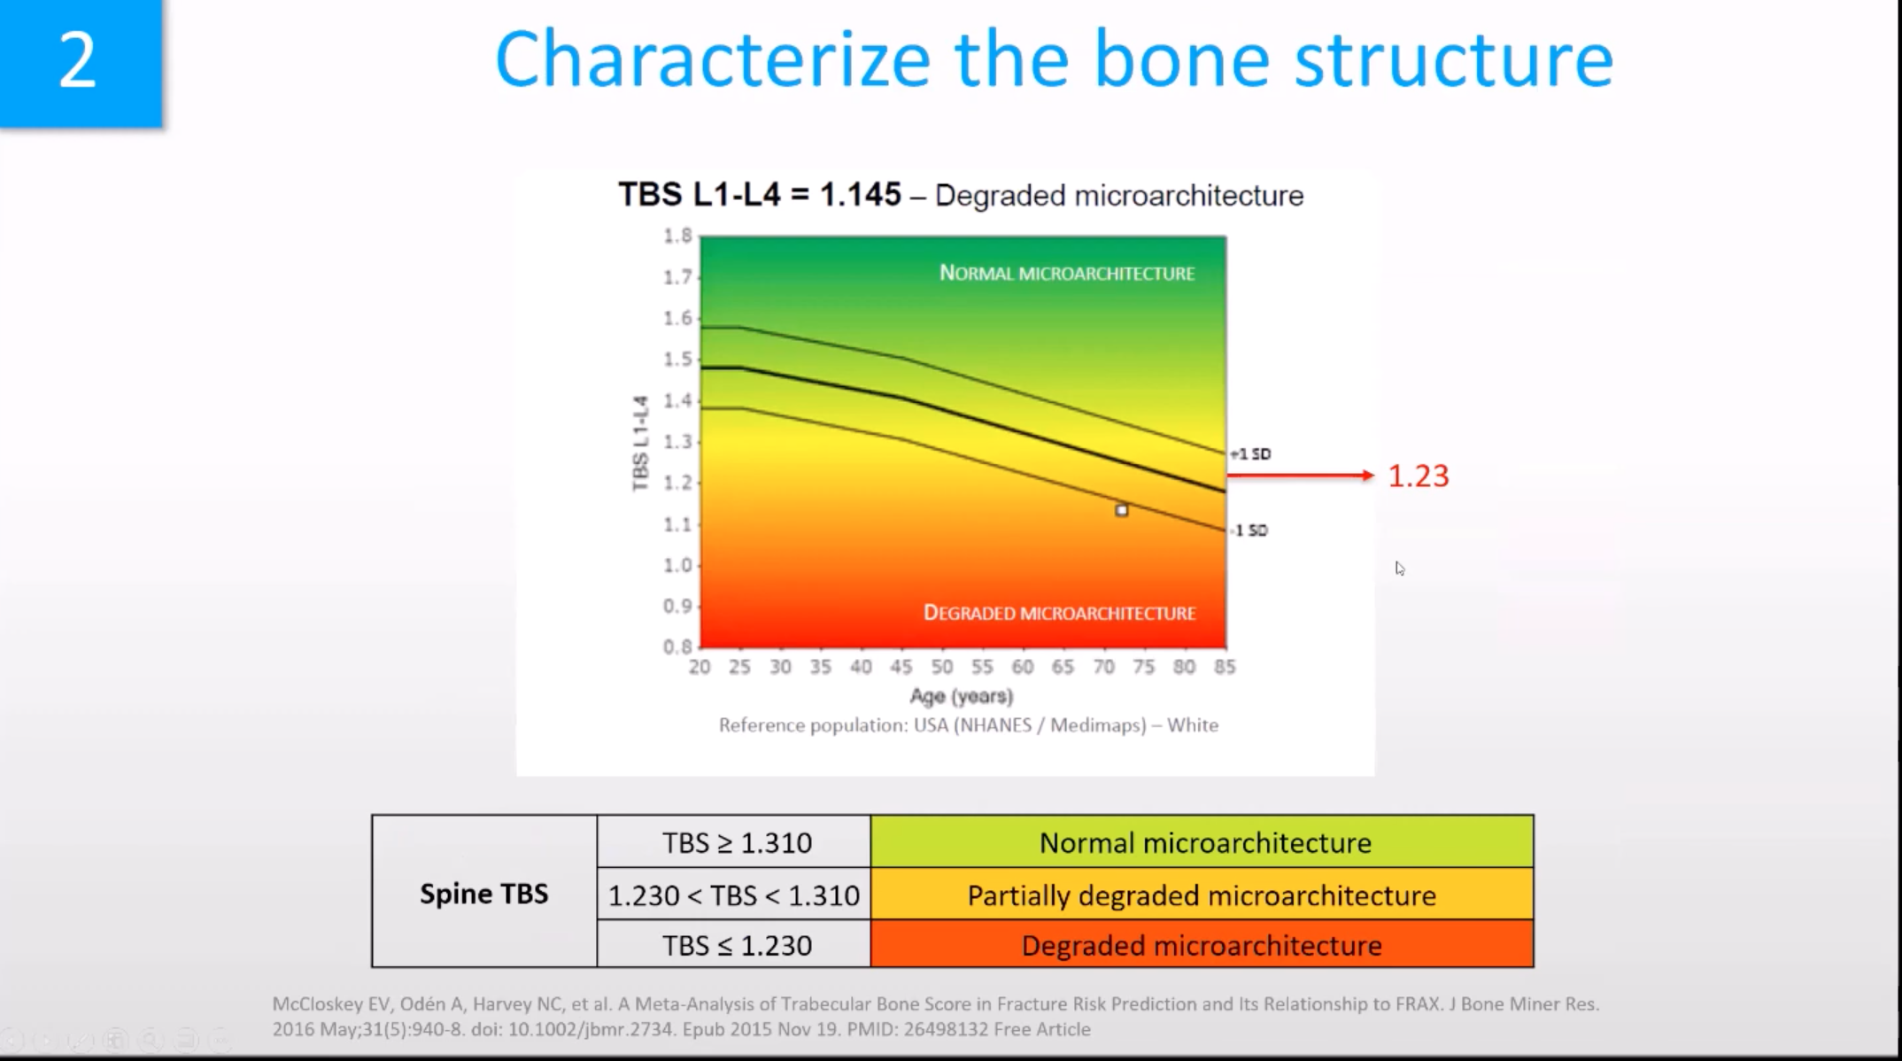

Slide 35
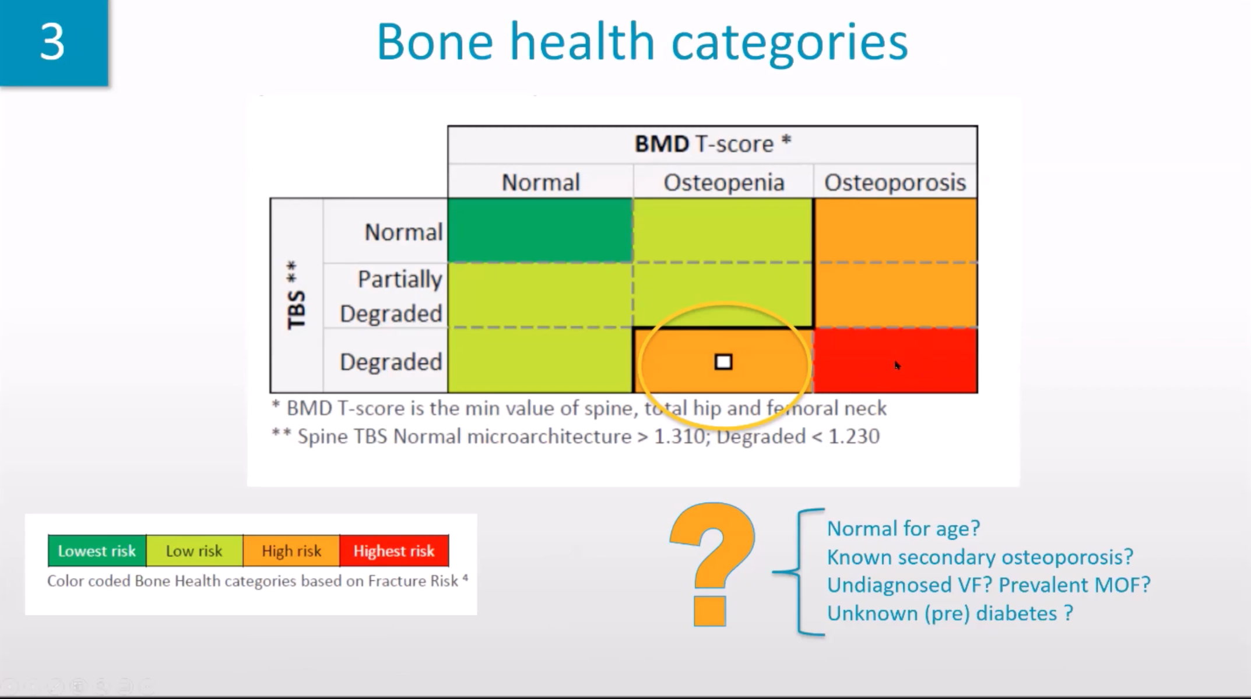

Slide 36
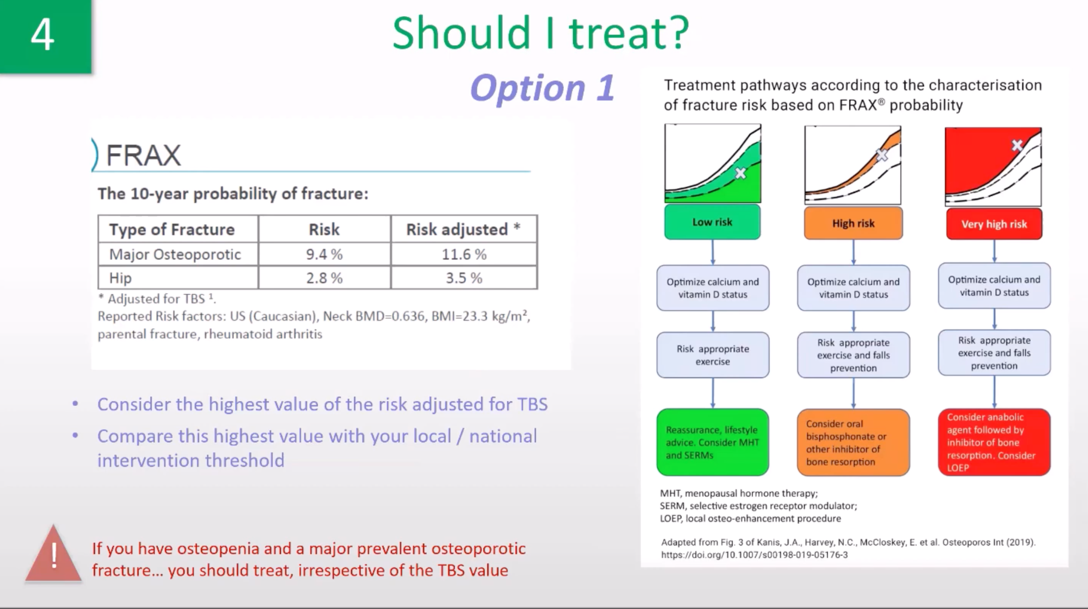

Slide 37
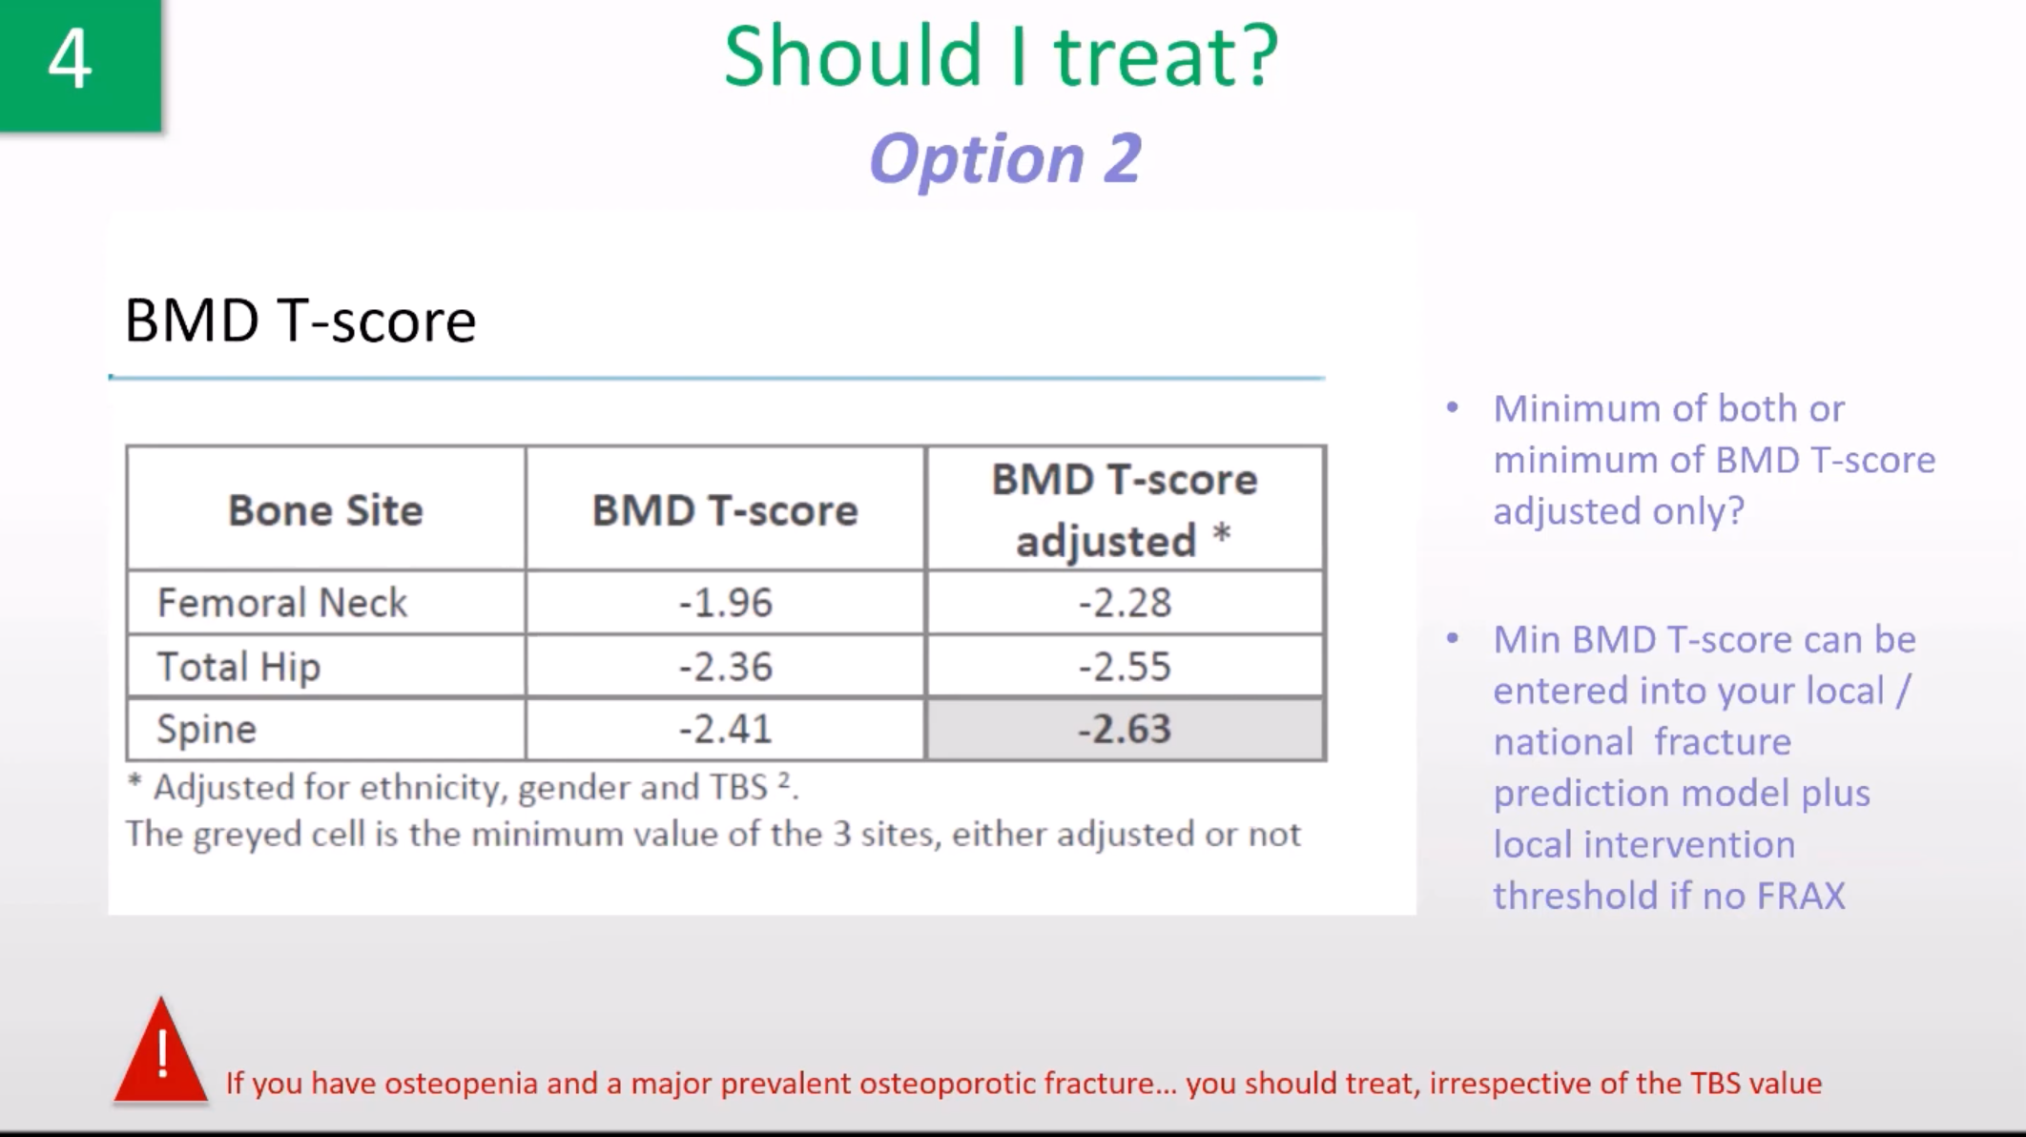

Slide 38
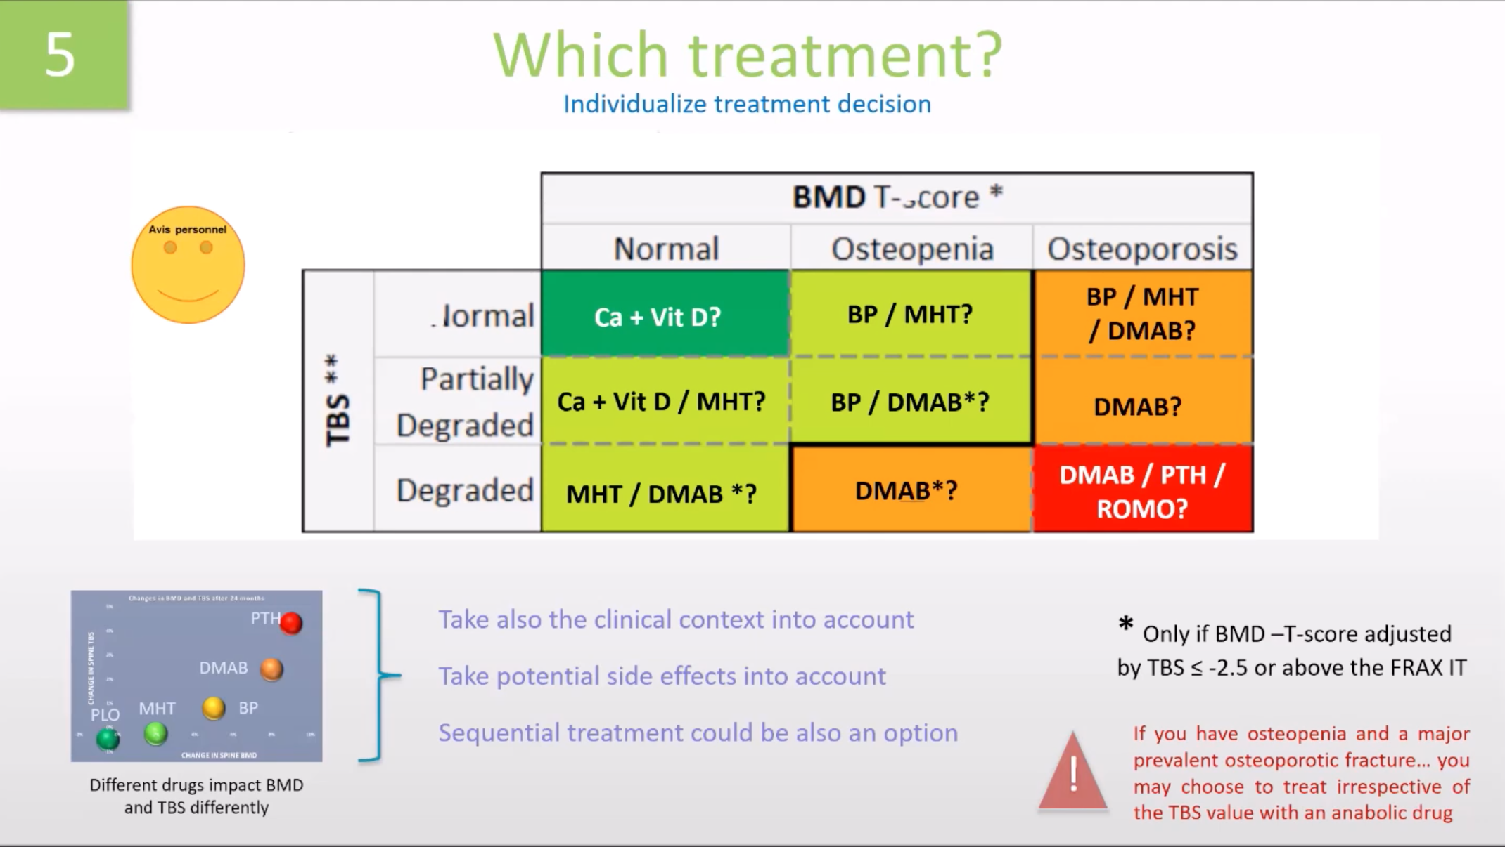

Slide 39
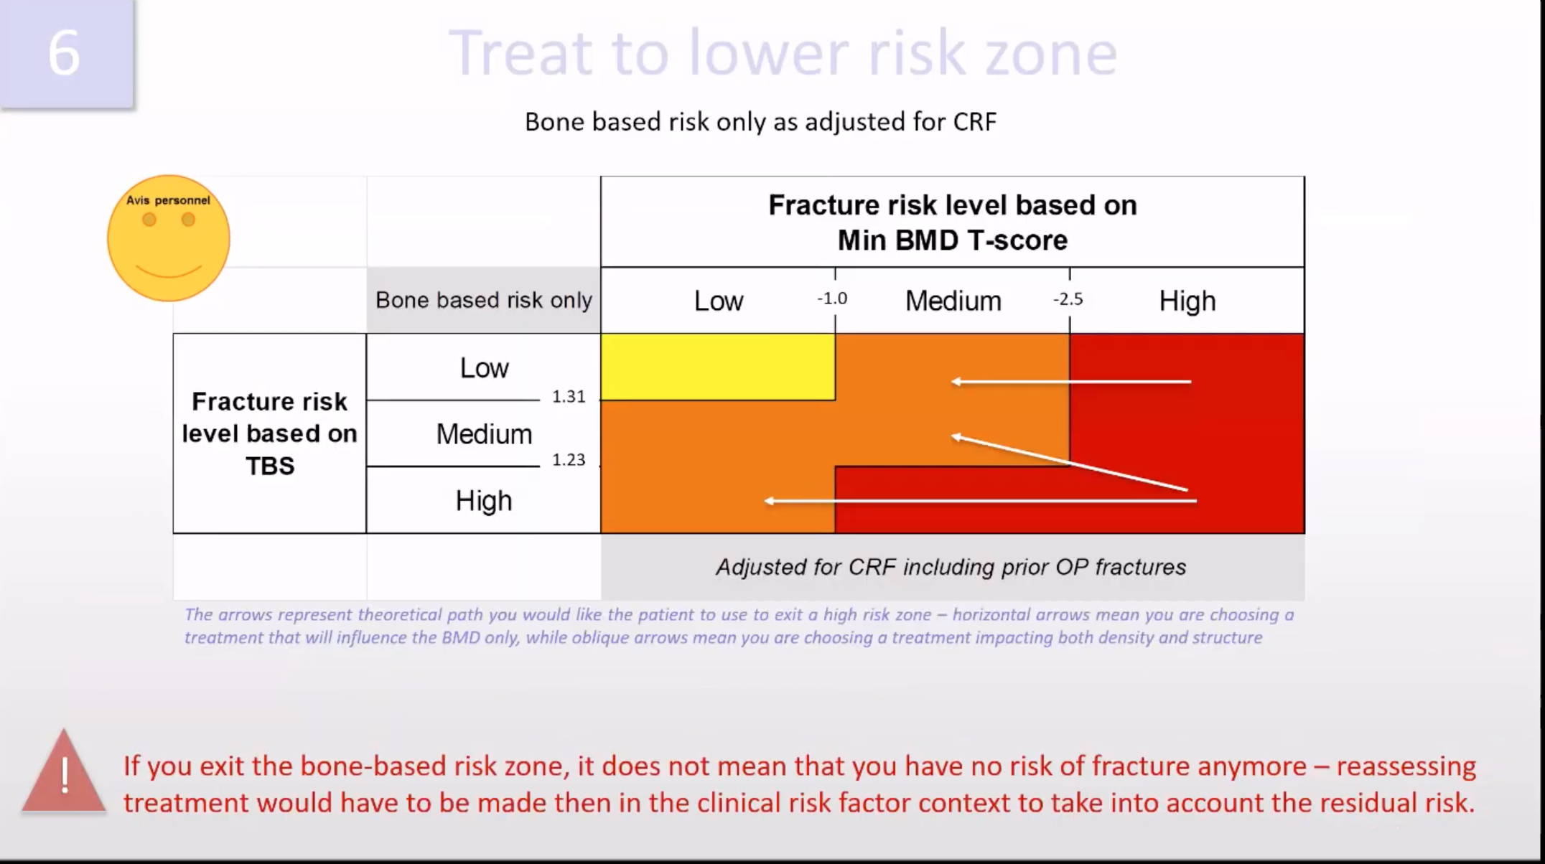

Slide 40


Slide 41
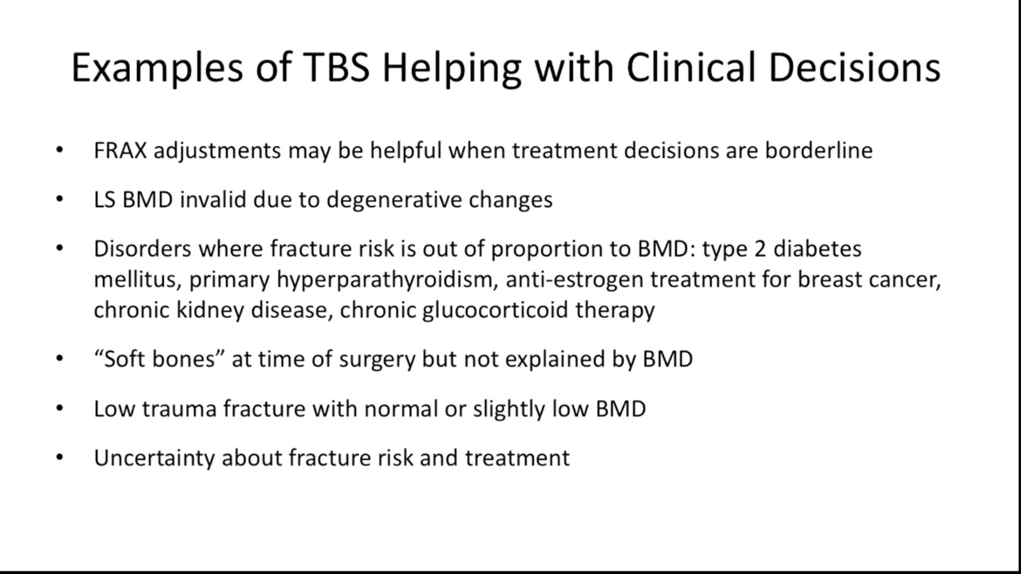

Slide 42
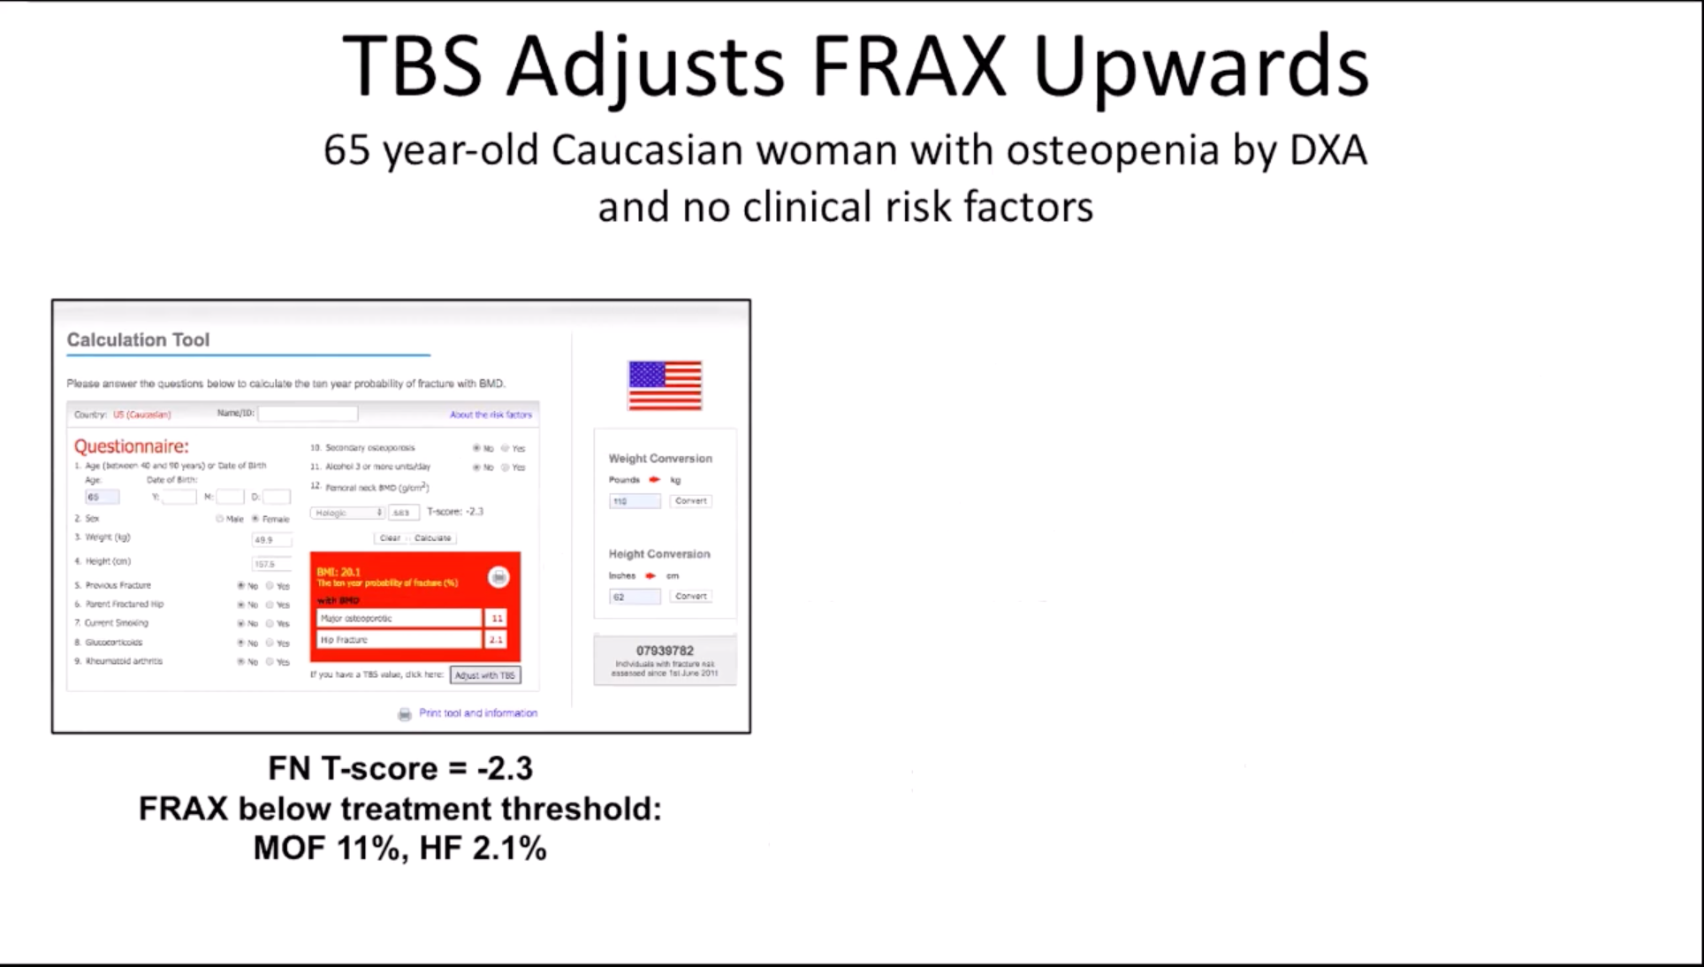

Slide 43
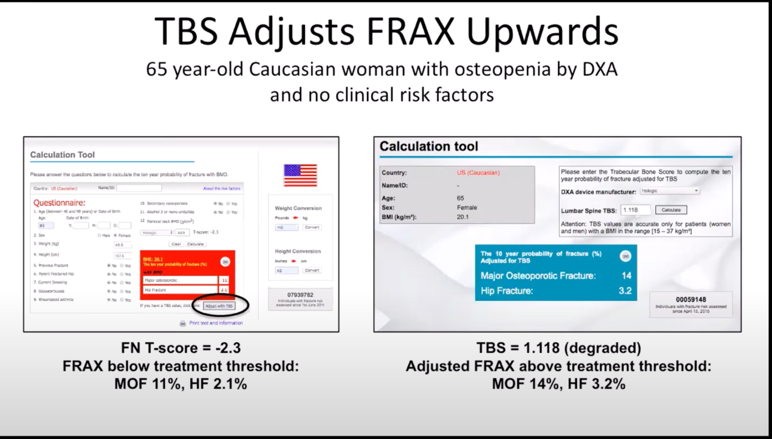

Slide 44
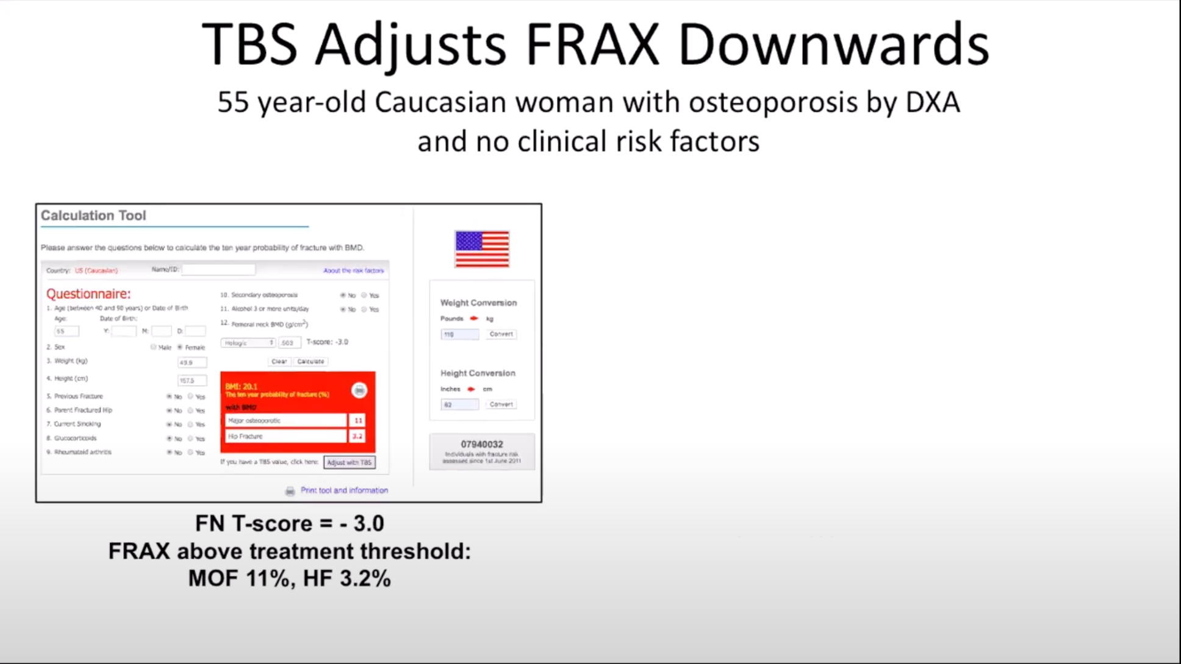

Slide 45
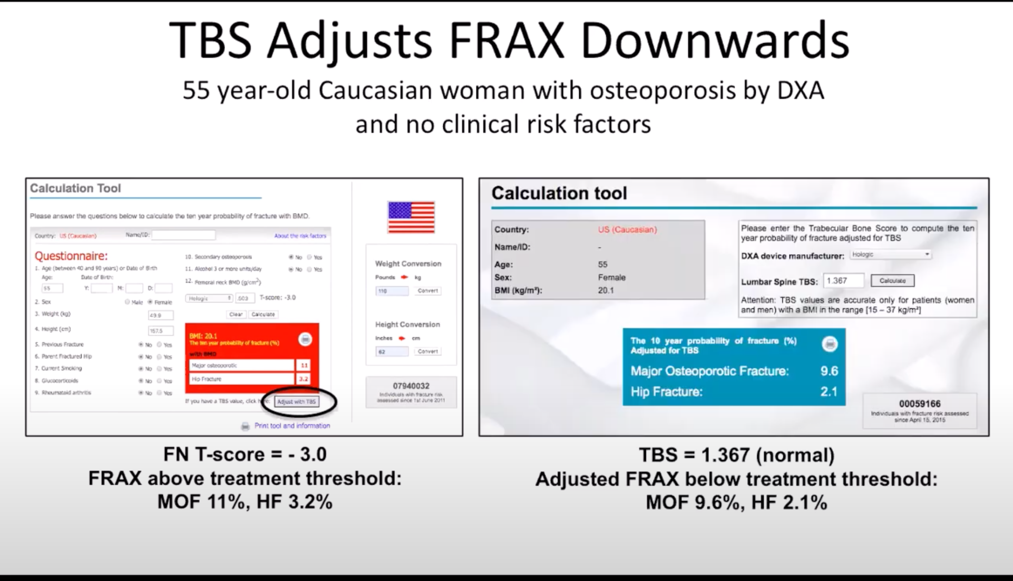

Slide 46
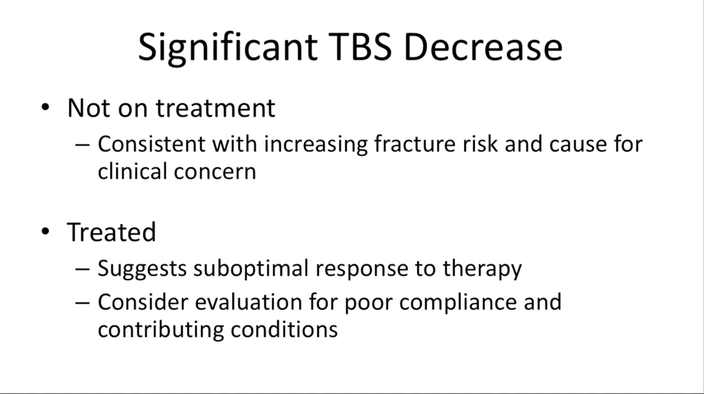

Slide 47
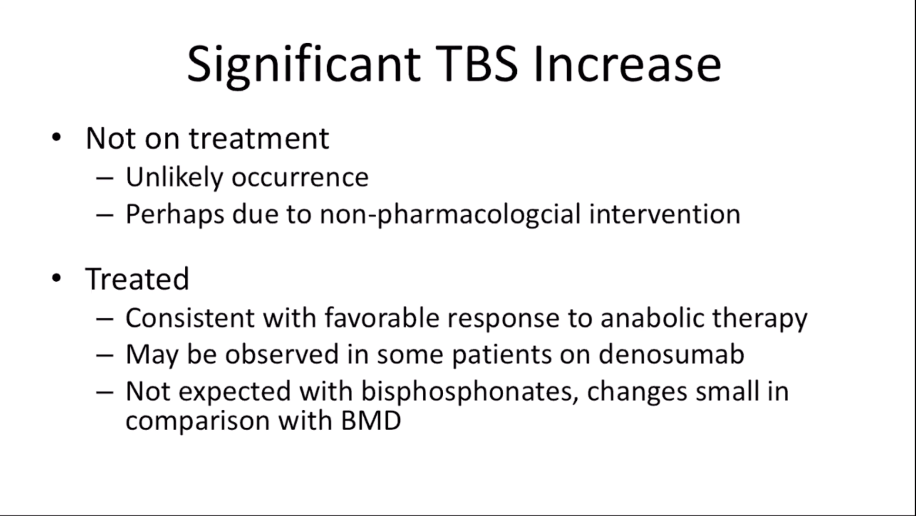

Slide 48
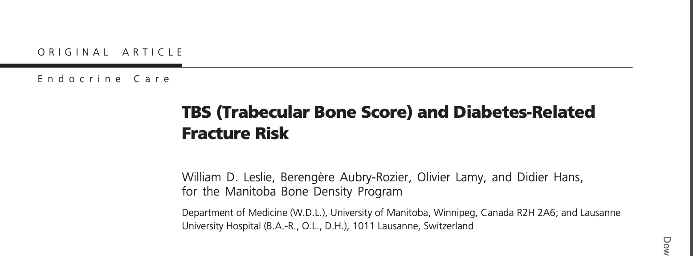
Context: Type 2 diabetes is associated with increased fracture risk but paradoxically greater bone mineral density (BMD). Trabecular bone score (TBS) is derived from the texture of the spine dual x-ray absorptiometry (DXA) image and is related to bone microarchitecture and fracture risk, providing information independent of BMD.

Slide 49
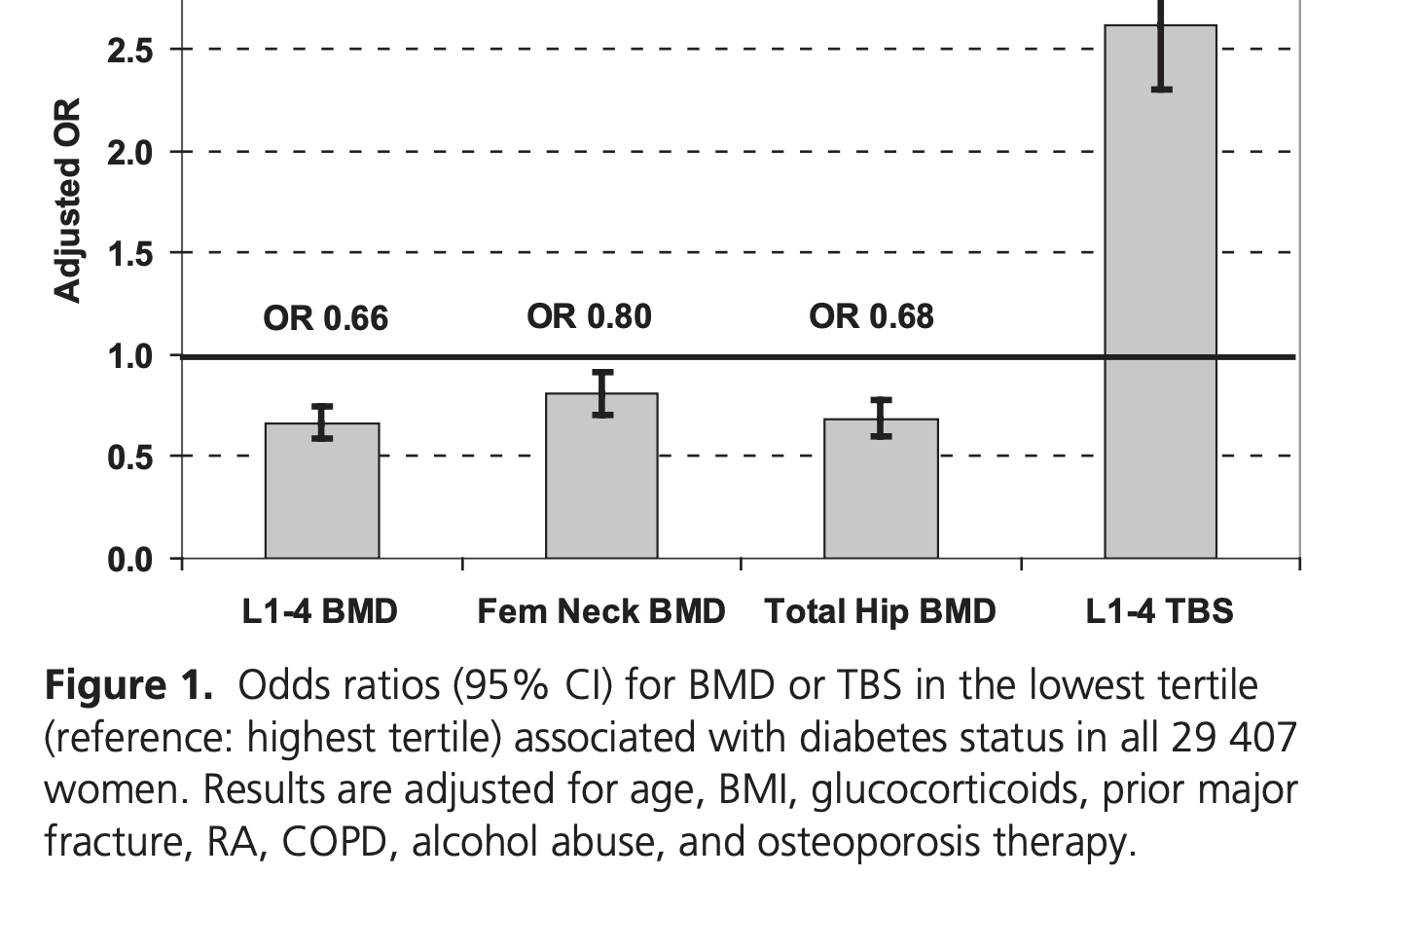
Patients: We included 29,407 women 50 years old and older with baseline DXA examinations, among whom 2356 had diagnosed diabetes.

Slide 50
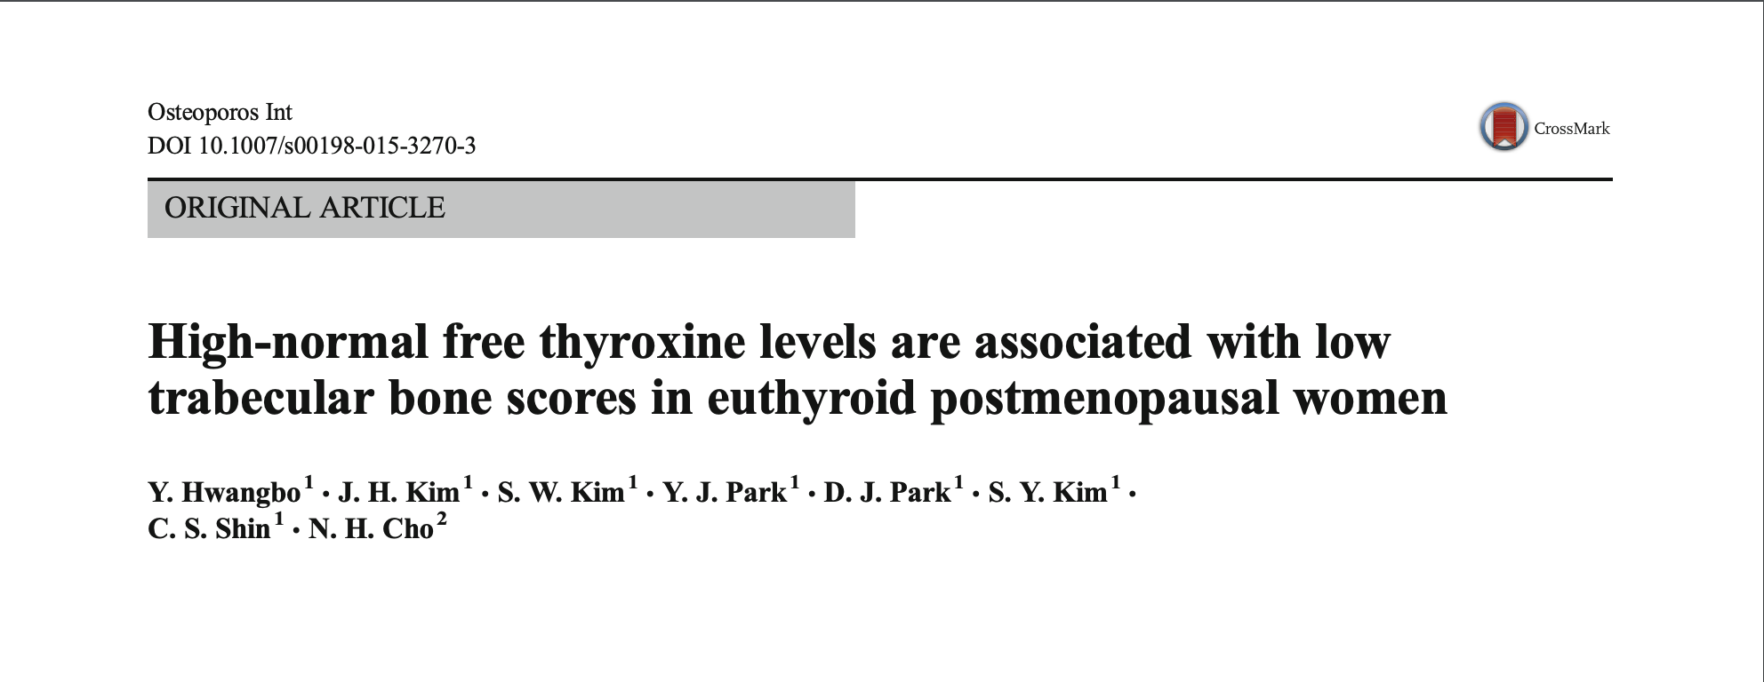

Slide 51
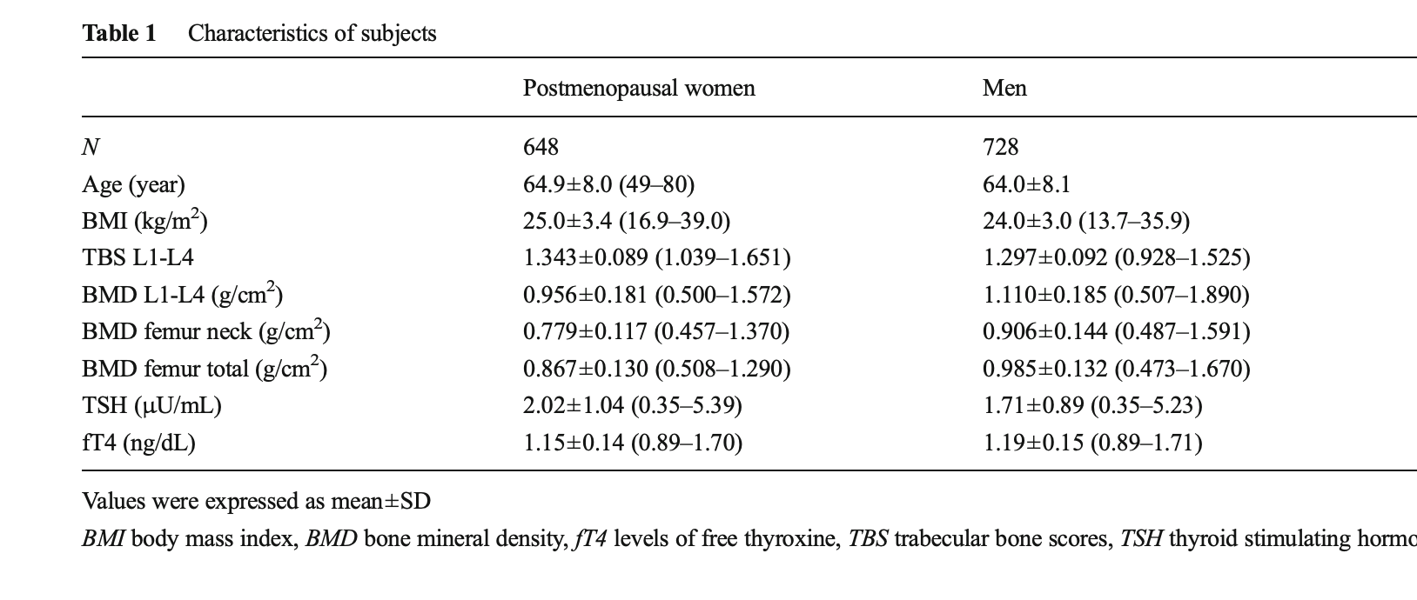

Slide 52
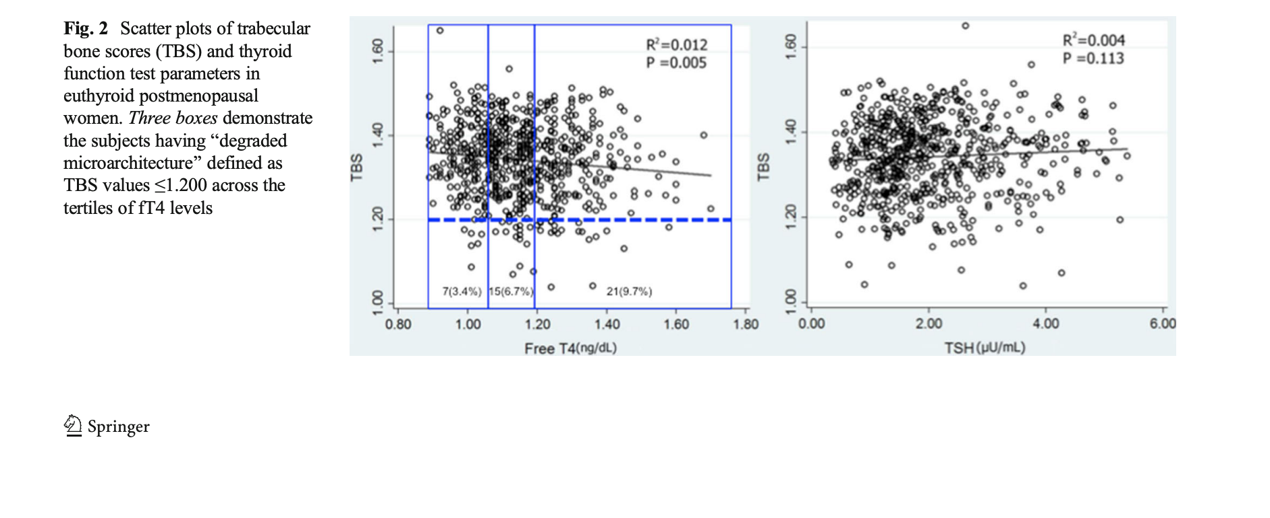

Slide 53
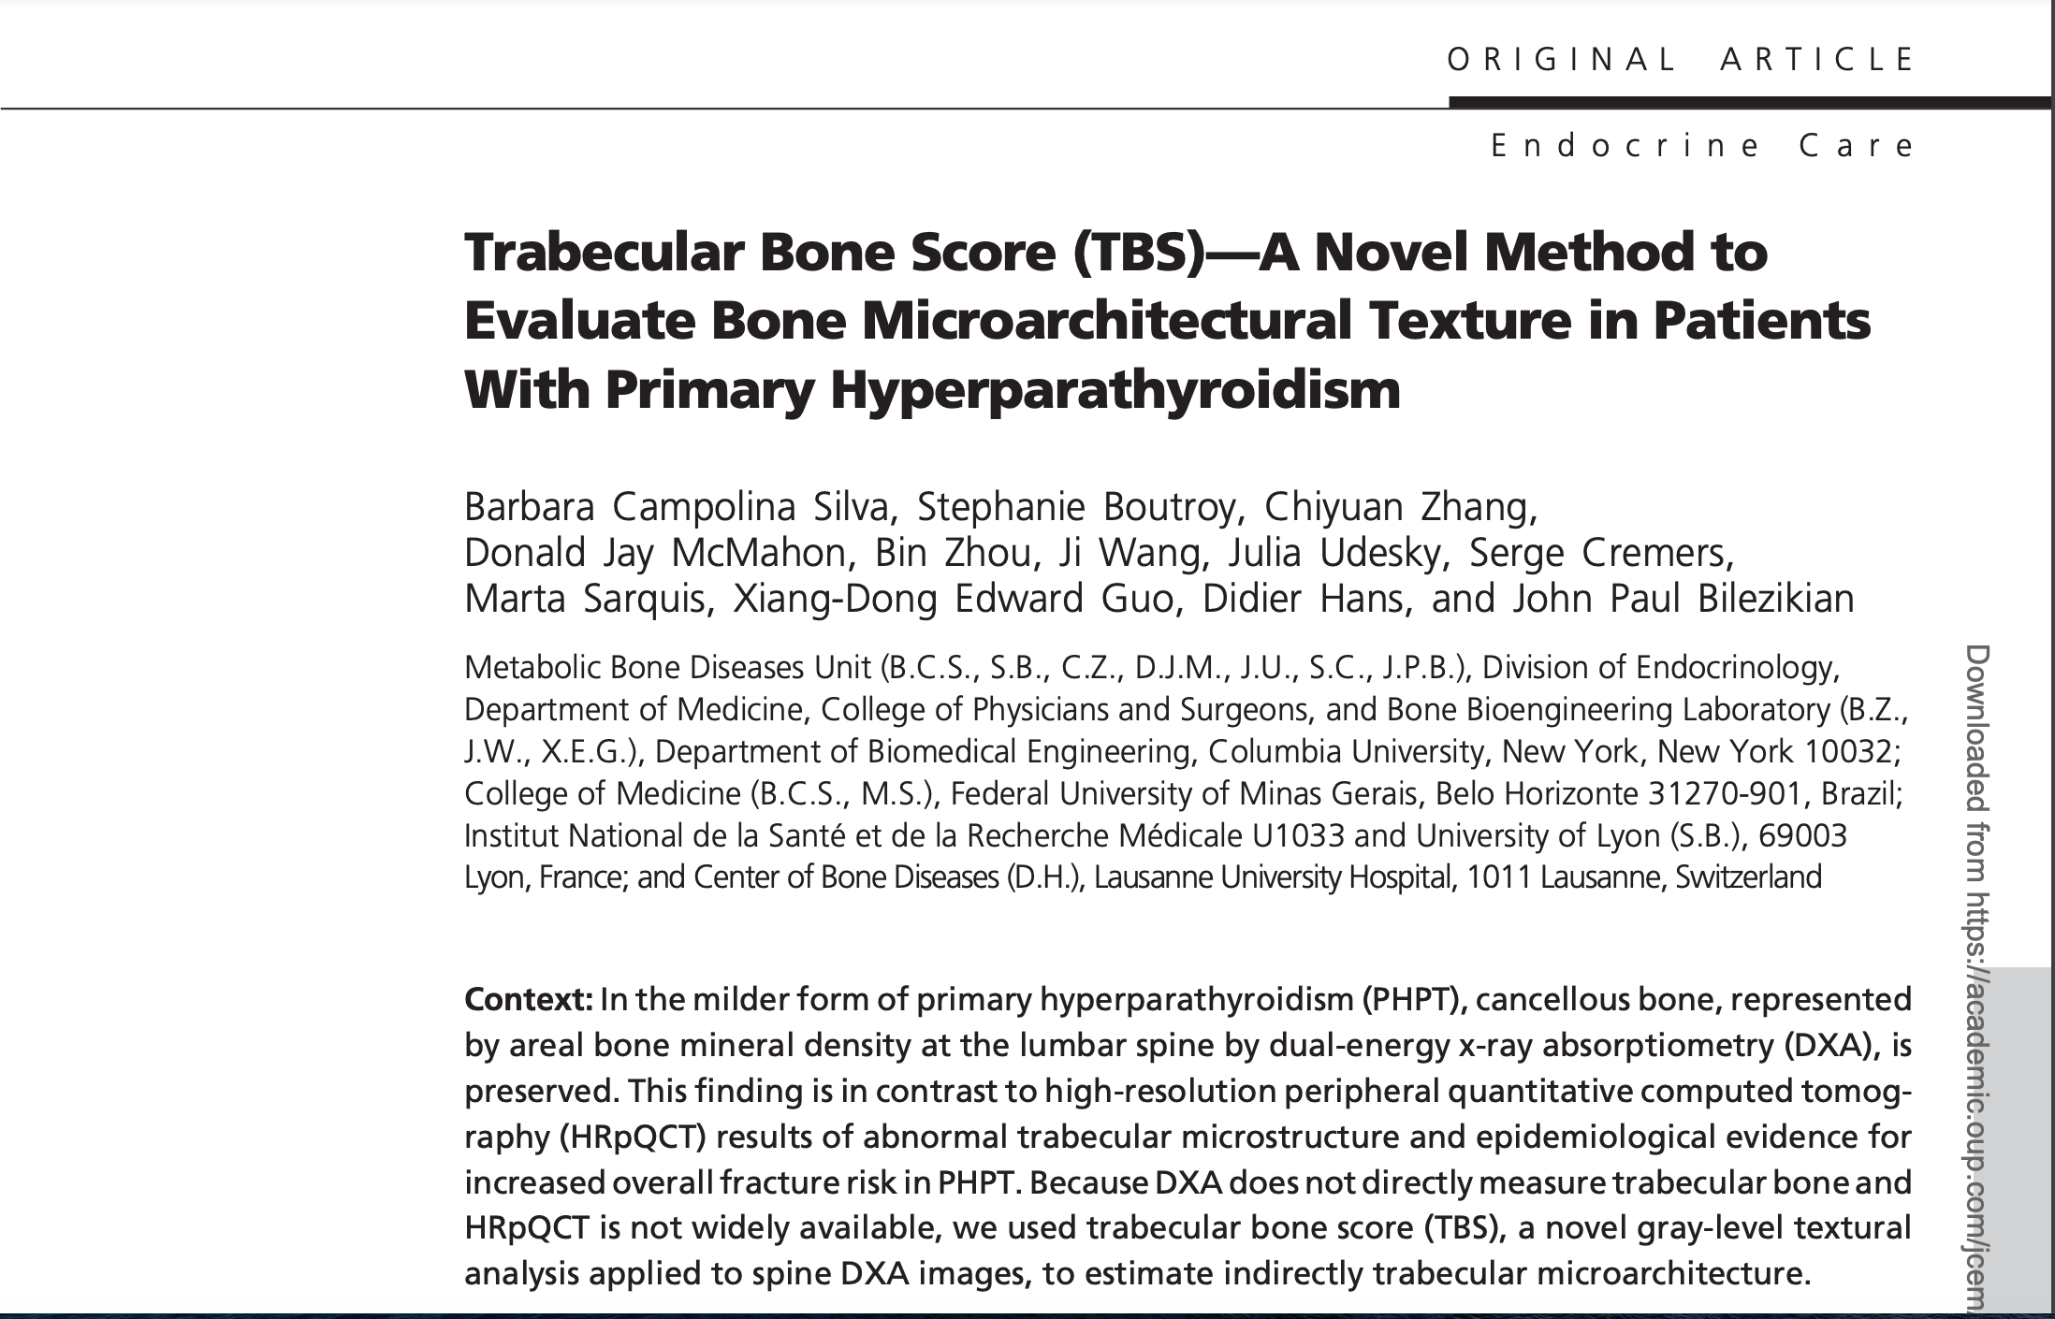
TBS in Prrimary hyperparathyroidism

Slide 54
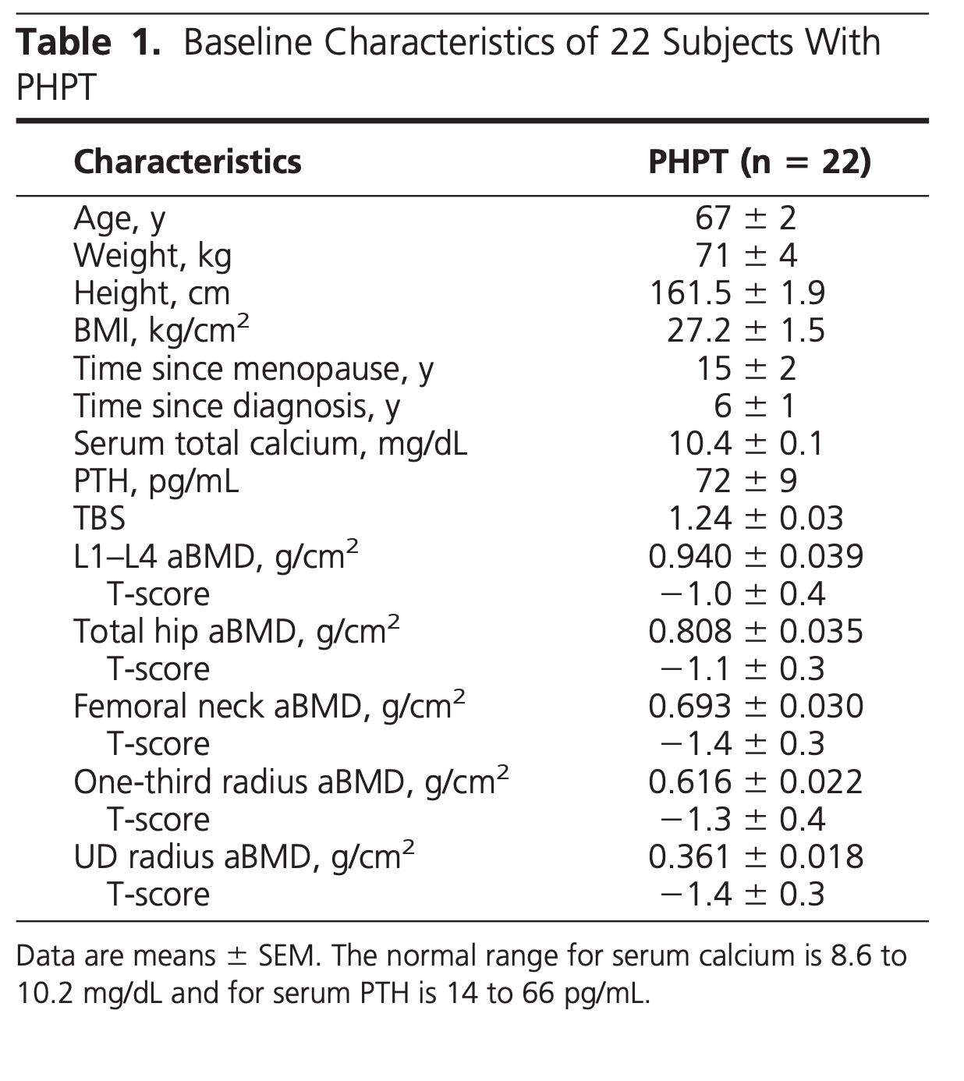
TBS in Prrimary hyperparathyroidism

Slide 55
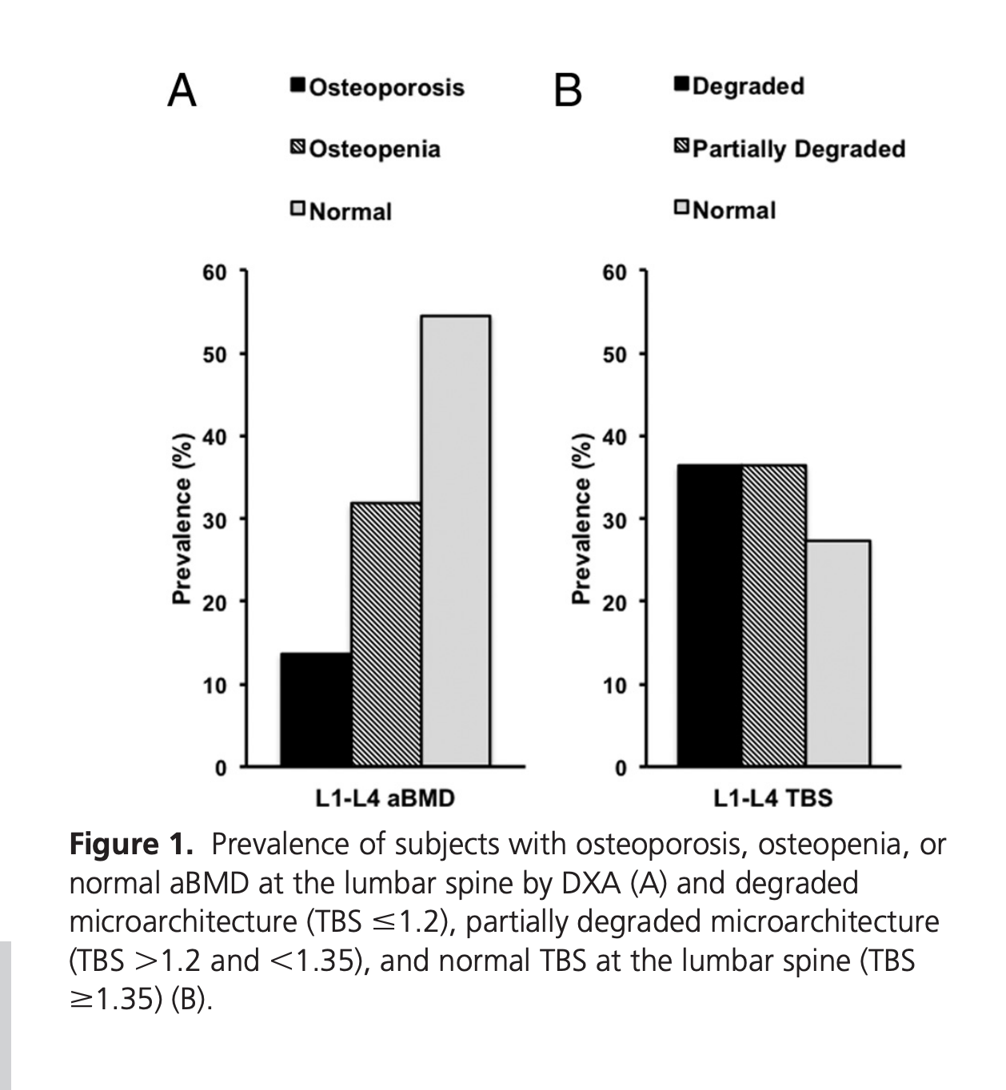
TBS in Prrimary hyperparathyroidism

Slide 56
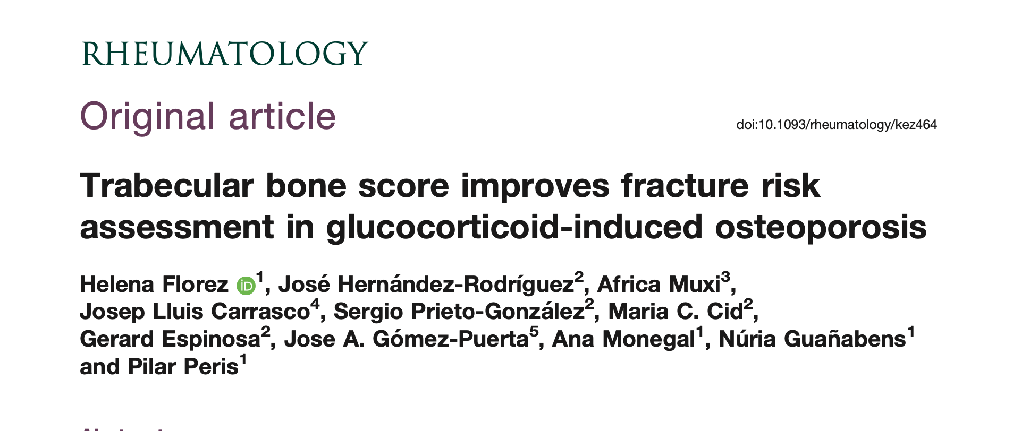

Slide 57

TBS in glucocorticoid-induced osteoporosis

Slide 58


Slide 59


Slide 60


Slide 61


Slide 62


Slide 63


Slide 64


Slide 65


