Slide 1
GLP-1 AGONISTS vs SGLT2-inh ECE 2020
H.Rezvanian .MD
Endocrinologist

Slide 2
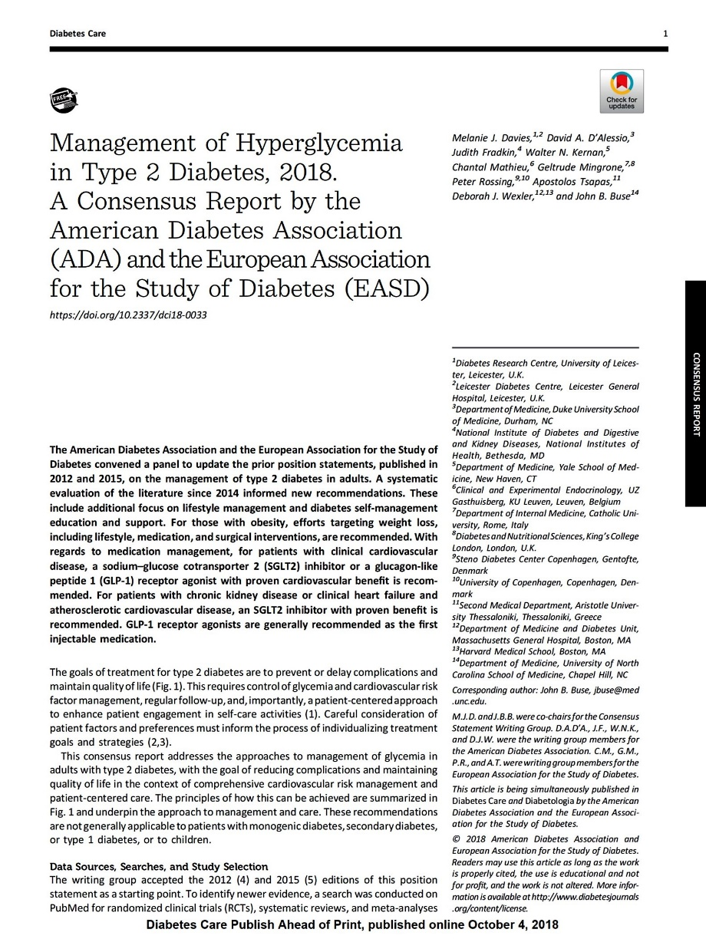
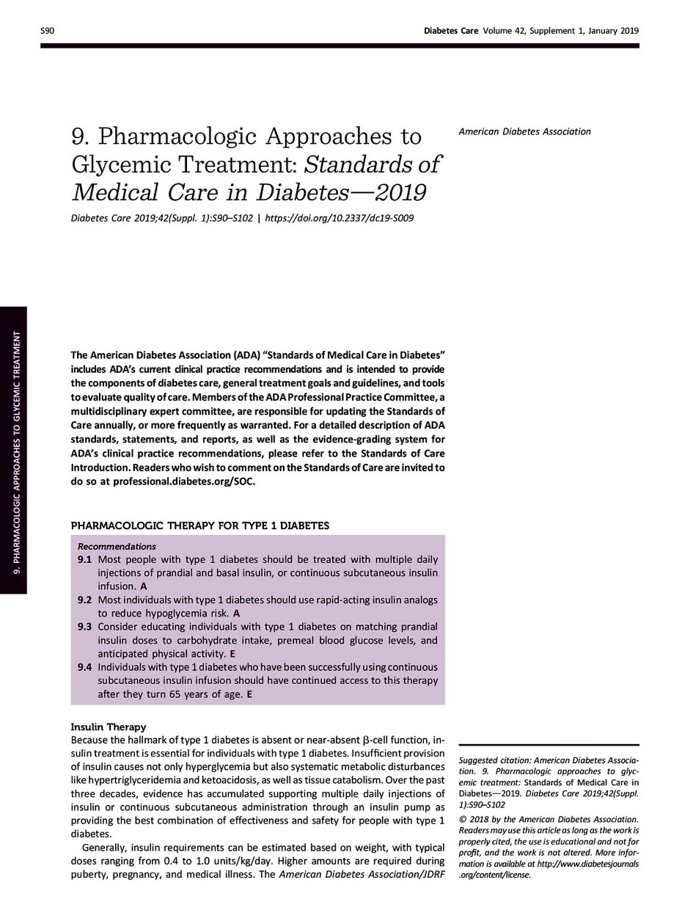

Slide 3
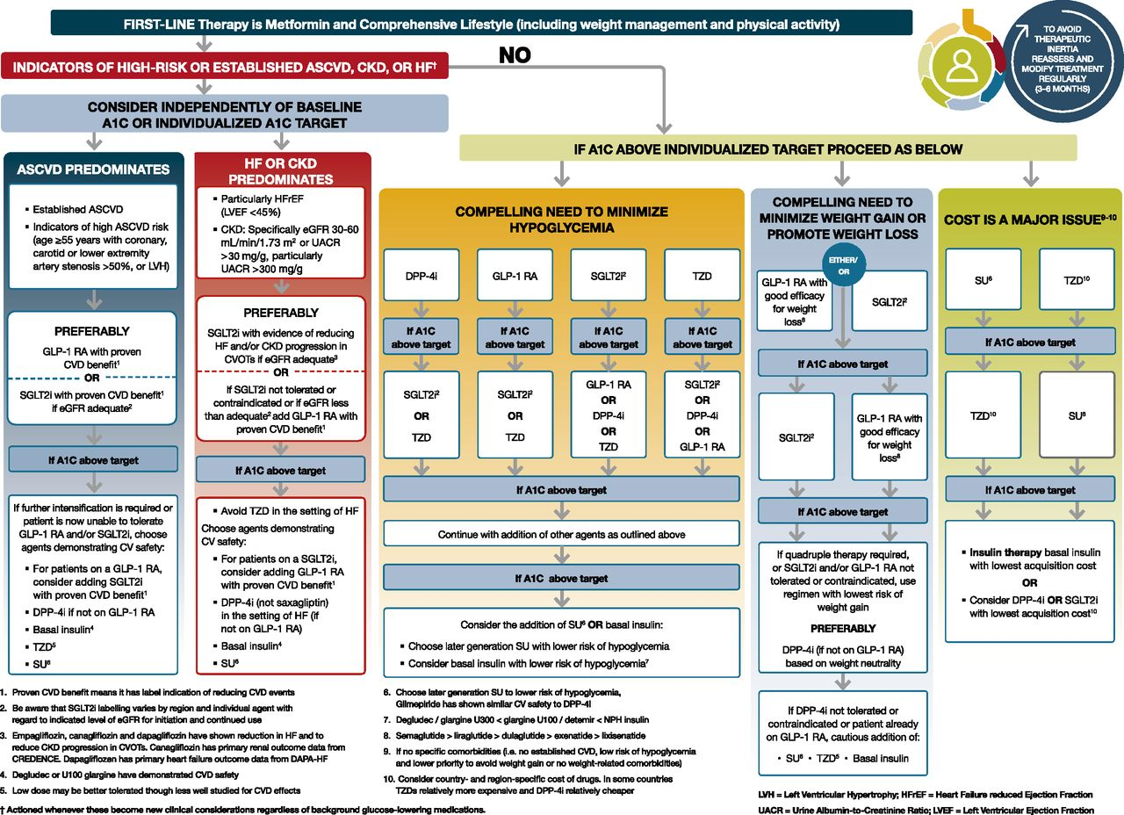
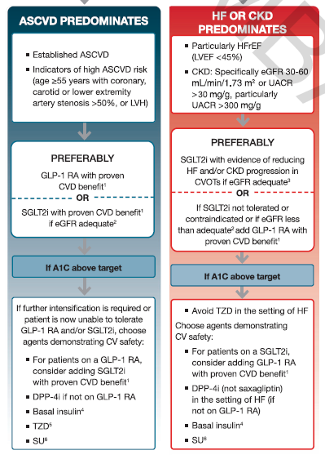
Indicators of high ASCVD risk
(age≥55 years with coronary, carotid or lower extremity artery stenosis >50%, or LVH)

Slide 5
