Slide 1
Dietary fats and Health outcome
Dr. Rezvan Salehidoost

Slide 2
Dietary fats
Lipids include sterols and fat.
However, this distinction is not always clear, and sometimes the term fats also include other lipids, such as cholesterol.

Slide 3
Dietary fats
Dietary fats molecules originate from plants and animals.
In plants, they are found in seeds (e.g. rapeseed, cottonseed, sunflower, peanut, corn and soybean), fruits (e.g. olive, palm fruit and avocado) and nuts (e.g. walnuts and almonds).
Common animal fat sources are meat, (oily) fish (e.g. salmon, mackerel), eggs and milk.

Slide 4
Molecular structure of dietary fats
Over 90% of dietary fats are in the form of triglycerides, which consist of a glycerol backbone with fatty acids esterified on each of the three hydroxyl groups of the glycerol molecule.

Slide 6
Molecular structure of dietary fats
Fatty acids have a backbone made of carbon atoms. They vary in the number of carbon atoms, and in the number of double bonds between them.

Slide 8
Classification according to the number of carbon atoms
Short-chain fatty acids (SCFA) are fatty acids with up to 5 carbon atoms
medium-chain fatty acids (MCFA) have 6 to 12
long-chain fatty acids (LCFA) 13 to 21
very long chain fatty acids (VLCFA) are fatty acids with more than 22 carbon atoms.
The majority of naturally occurring fatty acids, both in the diet and in the body, contain 16-18 carbon atoms.

Slide 9
Classification according to the number of double bonds
Fatty acids are classified according to the presence and number of double bonds in their carbon chain.
Saturated fatty acids (SFA) contain no double bonds
monounsaturated fatty acids (MUFA) contain one
polyunsaturated fatty acids (PUFA) contain more than one double bond.

Slide 11
Classification of unsaturated fatty acids (cis and trans)
Unsaturated fatty acids can also be classified as "cis" (bent form) or "trans" (straight form), depending on whether hydrogen is bound on the same, or on the opposite side of the molecule.
Most naturally occurring unsaturated fatty acids are found in cis form.
Trans fatty acids (TFA) can be divided in two groups: artificial TFA (industrial) and natural TFA (ruminant).

Slide 12
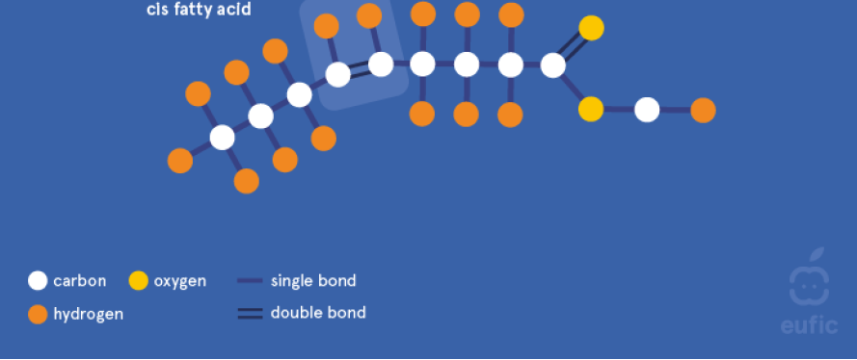

Slide 13
Trans fatty acid
Industrial TFA are produced by humans and can be found in products containing vegetable oils/fats that have undergone a hardening process known as partial hydrogenation.
Small amounts of TFA can also be generated during the deodorization of vegetable oils/fats.

Slide 14
Hydrogenation
Hydrogenation is a process that converts liquid vegetable oils, depending on the level of hydrogenation (from partial to full hydrogenation) into semi-solid or solid fats to make them suitable for food manufacturing purposes.
Hydrogenated vegetable oils are usually cheaper than animal fat with the same physical properties, they are more heat-stable, and have increased shelf life.

Slide 15
Hydrogenation
The hydrogenation process entails the direct addition of a hydrogen atom to the double bonds in the fatty acid chains of the triglycerides and thereby the molecule becomes more ‘saturated’ and thus the fat more solid as the double bonds disappear.

Slide 17
Hydrogenation
Partial hydrogenation reduces most but not all, of the double bonds and modifies the properties of the oil without increasing the SFA content to a great extent. The level of saturation of the fatty acids can be controlled, so that a range of consistencies, with increasing viscosity and melting temperature, can be realised.
However, partial hydrogenation results in part of the cis isomers of the unsaturated fatty acids to be converted into trans isomers.

Slide 18
Hydrogenation
Full hydrogenation, on the other hand, does not result in TFA, as all of the fatty acid molecules have been saturated. Thus, oil that has not undergone the full hydrogenation process contains TFA, which has been linked to adverse health effects.

Slide 19
Classification of PUFA (omega fatty acids)
PUFA categorised into three main families according to the position of the first double bond starting from the methyl-end (the opposite side of the glycerol molecule) of the fatty acid chain:
Omega-3 (or n-3) fatty acids have the first double bond at the third carbon atom and include mainly alpha linolenic acid (ALA) and its derivatives eicosapentaenoic acid (EPA) and docosahexaenoic acid (DHA).
Omega-6 (or n-6) fatty acids have the first double bond at the sixth carbon atom and include mainly linoleic acid (LA) and its derivative arachidonic acid (AA).
Omega-9 (or n-9) fatty acids have the first double bond at the ninth carbon atom and include mainly oleic acid.

Slide 20
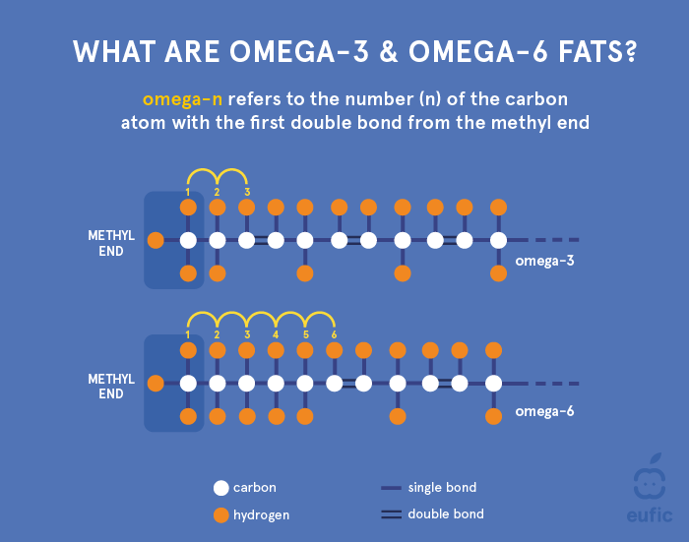

Slide 23
Saturated fats and health outcomes

Slide 25
Saturated fats and health outcomes
In the United States, SFAs account for ~11% of daily energy intake on average.
Studies show that replacing dietary carbohydrates with SFAs increases both (LDL-C) and (HDL-C) without significantly changing total cholesterol/HDL-C ratio.

Slide 26
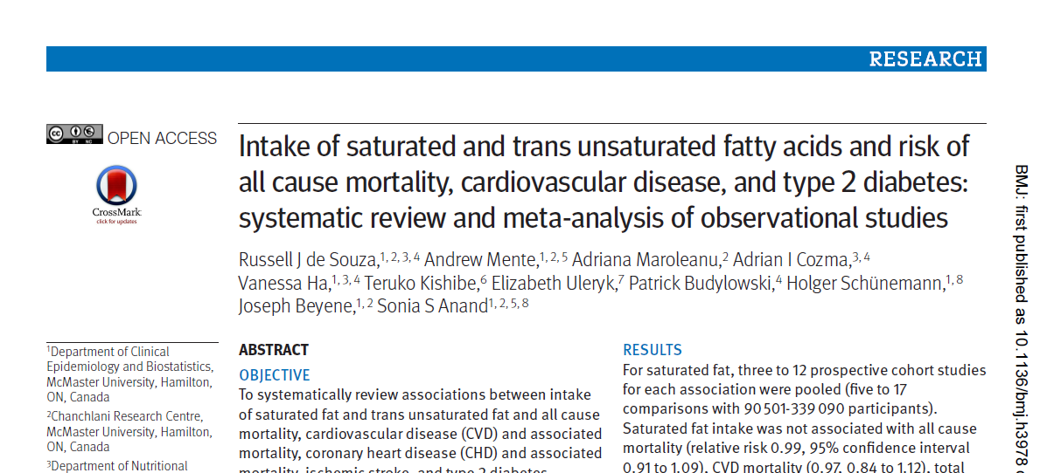

Slide 28
Conclusions
Saturated fats are not associated with all cause mortality, CVD, CHD, ischemic stroke, or type 2 diabetes, but the evidence is heterogeneous with methodological limitations.

Slide 29
Saturated fats and health outcomes
A prospective analysis of associations between food sources rich in saturated fatty acids and incidence of type 2 diabetes from 3349 Spanish men and women from the PREvención con DIeta MEDiterránea (PREDIMED) study indicated that whereas total dietary fat, monounsaturated fatty acids, polyunsaturated fatty acids, and trans-fatty acids were not associated with type 2 diabetes, the highest versus the lowest quartile of saturated and animal fat consumption was associated with the incidence of type 2 diabetes.
These findings were in agreement with those from the Malmö Diet and Cancer Cohort in which the highest versus the lowest quintile of meat consumption was associated with increased risk for type 2 diabetes.

Slide 30
Saturated fats and health outcomes
In prospective observational studies, replacing SFAs with whole grains or unsaturated FAs, PUFAs in particular, did reduce CHD risk.

Slide 31
Trans fats and health outcomes

Slide 33
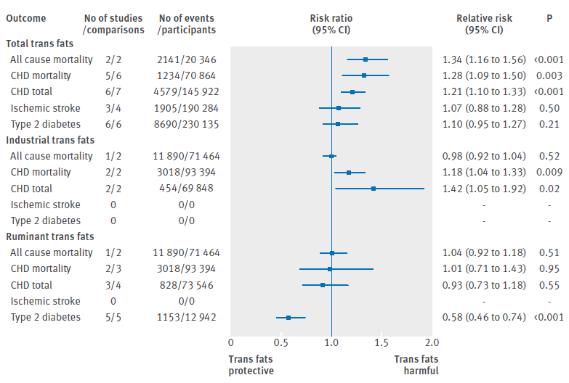

Slide 34
Trans fats and health outcomes
Consumption of trans unsaturated fatty acids, however, was associated with a 34% increase in all cause mortality, a 28% increased risk of CHD mortality.
No associations were observed for ruminant trans fat.

Slide 35
Mono unsaturated fats and health outcomes

Slide 36
Mono unsaturated fats and health outcomes
The most common MUFA in human diets is oleic acid, accounting for ~90% of all dietary MUFAs.
MUFAs comprise ~16–29% of total energy intake in a typical Mediterranean diet, mostly from olive oil.
Epidemiological studies found low CHD prevalence in Mediterranean populations despite high total fat intake.
MUFA intake improves a number of CVD risk factors, including lipid profile, insulin sensitivity, inflammatory markers, and thrombogenic markers.

Slide 37
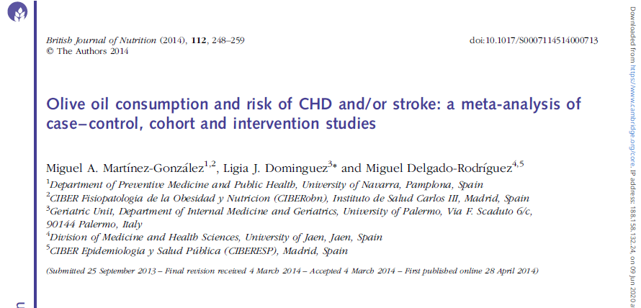

Slide 39
Mono unsaturated fats and health outcomes
Olive oil intake was inversely associated with CVD risk in several studies. Increasing olive oil intake by 25 g/day reduced CVD risk by 18% in a meta-analysis of 9 studies including 1 clinical trial.

Slide 40
N-3 Polyunsaturated fats and health outcomes

Slide 41
N-3 Polyunsaturated fats and health outcomes
N-3 PUFAs include:
alpha-linolenic acid (18:3n-3), derived from plants
eicosapentaenoic acid (EPA; 20:5n-3) , derived from animals
docosahexaenoic acid (DHA; 22:6n-3) , derived from animals
docosapentaenoic acid (22:5n-3) , derived from animals

Slide 43
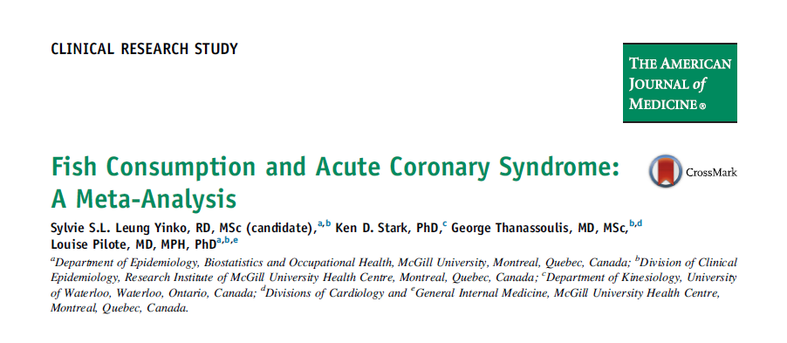

Slide 45
N-3 Polyunsaturated fats and health outcomes
In a primary-prevention meta-analysis, risk for acute coronary syndrome was 22% lower in participants who ate seafood ≥4 times weekly than in participants who ate seafood <1 time monthly, with higher consumption associated with greater benefit.

Slide 49
N-3 Polyunsaturated fats and health outcomes
Dose- response analysis showed a linear relationship between fish intake and stroke and the risk of stroke decreased by 2%-12% with increasing intake of fish up to 100- 700 g/week.
A meta-analysis showed a negative association of high fish intake with total stroke risk.

Slide 50
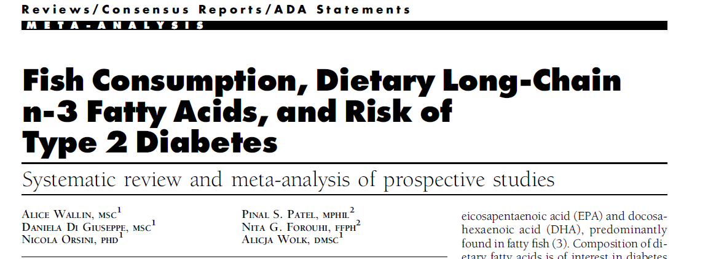

Slide 51
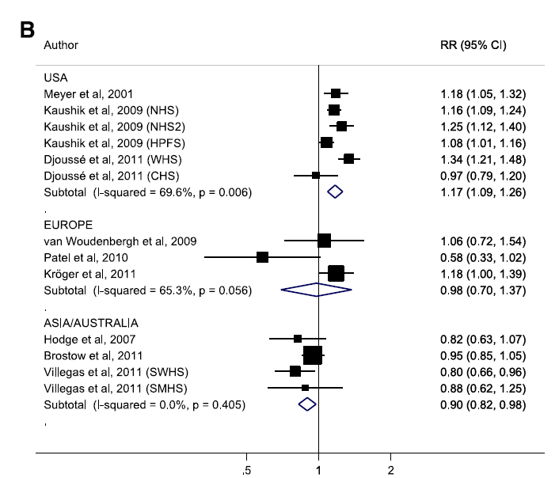

Slide 52
Current available evidence indicates that fish and marine n-3 fatty acid consumption may reduce the risk for type 2 diabetes in Asian populations and that more research is necessary to better understand the associations between fish, marine n-3 fatty acids, and type 2 diabetes among Western populations.

Slide 53
n-6 Polyunsaturated fats and health outcomes

Slide 54
n-6 Polyunsaturated fats and health outcomes
The major n-6 PUFAs are linoleic acid and arachidonic acid.
linoleic acid, found mainly in vegetable oils, nuts, and seeds, is the predominant dietary n-6 PUFA.
whereas arachidonic acid, found mainly in red meat, eggs, algae, and fish oil, has low consumption (~100 mg/day compared with 15 g/day of LA).

Slide 55
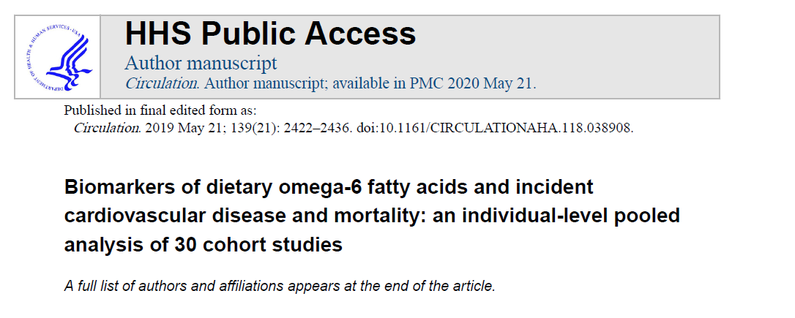

Slide 57
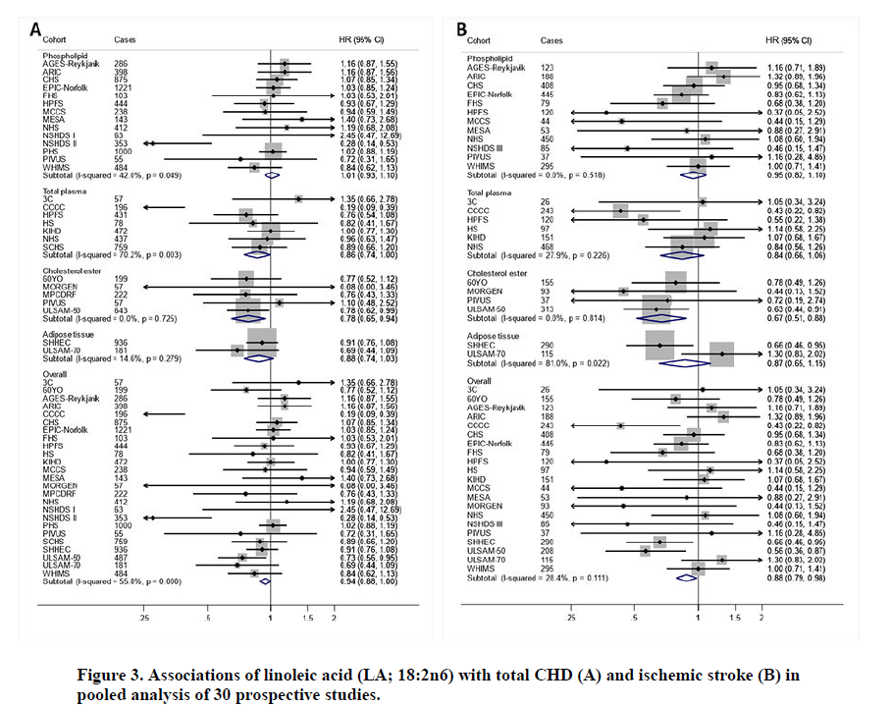

Slide 59
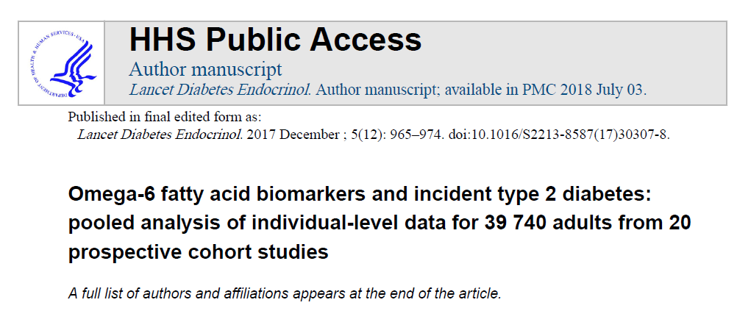

Slide 61
n-6 Polyunsaturated fats and health outcomes
Findings suggest that linoleic acid has long-term benefits for the prevention of type 2 diabetes and that arachidonic acid is not harmful.

Slide 62
Effects and mechanisms of PUFA on ASCVD risks

Slide 63
Reductions of plasma triglycerides (TGs)
n-3 PUFAs, particularly high-dose prescription formulations, lower plasma TG levels .
This effect may result from reduced hepatic VLDL synthesis, which involves multiple mechanisms:
decreased de novo lipogenesis(predominant)
increased fatty acid ᵦ-oxidation,
reduced hepatic lipogenic enzyme activity,
increased hepatic synthesis of phospholipids in place of TGs.

Slide 64
Reductions of plasma triglycerides (TGs)
The TG-lowering effect of n-3 PUFAs is generally linear and dose dependent, but varies between individuals and is usually greater in individuals with higher TG levels at baseline.

Slide 65
Anti-inflammatory effect
n-3 PUFAs lower several inflammatory markers associated with CVD risk.
In clinical studies in hypertriglyceridemic patients, prescription EPA as compared to placebo reduced plasma hs-CRP, lipoprotein-associated phospholipase A2, and oxidized LDL levels and arachidonic acid/EPA ratio.

Slide 66
Antithrombotic effect
Hyper-reactivity of platelets leading to thrombus formation is the major cause for MI.
n-3 PUFAs reduce platelet aggregation and may therefore have antithrombotic effects, likely because of their incorporation into platelet membrane and their role in reducing production and signaling of thromboxane A2.

Slide 67
Effect on endothelial function
Endothelial cell dysfunctions play a crucial role in development of ASCVD.
Earlier tissue culture and animal studies indicate that n-3 PUFA improves endothelial function and reduces expression of adhesion molecules, thereby decreasing endothelial–leukocyte interactions and subsequent leukocyte infiltration, a key step in atherosclerosis.

Slide 68
Molecular Mechanisms
The molecular mechanisms whereby n-PUFAs exert the above effects are multifactorial and not fully understood.
First, n-3 PUFAs are incorporated into cell and organelle membrane and alter membrane lipid environments and fluidity, which are involved in various cellular functions such as signal transduction and protein trafficking and may contribute to the observed beneficial effects of n-3 PUFAs on inflammation, platelet function, and monocyte phenotypes in humans with hypertriglyceridemia.

Slide 69
Conclusion
American Heart Association recommends lowering intake of SFAs and replacing SFAs with unsaturated FAs, especially PUFAs, to reduce risk of CVD and also to include 1–2 seafood meals per week to reduce risk of CHD, ischemic stroke, and sudden cardiac death.

Slide 70
Conclusion
2015–2020 Dietary Guidelines for Americans and the Scientific Report of the 2015 US Dietary Guidelines Advisory Committee recommend using nonhydrogenated vegetable oils high in unsaturated fats and relatively low in SFAs (soybean, corn, olive, canola) instead of animal fats or tropical oils (palm, palm kernel, coconut).

Slide 71
Conclusion
Instead of reducing total fat, the type of fat should be optimized.
At least 2 servings (3.5 oz per serving) of seafood should be consumed weekly to provide ~250 mg/day EPA plus DHA and replace other animal sources of protein.
While salmon, swordfish, and mussel contain high amounts of EPA and DHA, some other commonly consumed fish, such as tilapia have very little EPA and DHA.

