Slide 2
Pharmacological Management of Osteoporosis in Postmenopausal Women: An Endocrine Society Clinical Practice Guideline
J Clin Endocrinol Metab 104: 1595–1622, March 2019
An Endocrine Society Guideline Update
J Clin Endocrinol Metab 105: 587–594, April 2020
BY:Leila Ashrafi

Slide 3
Introduction
Postmenopausal osteoporosis is common, and fractures are injurious to patients and costly to the health care system. One in two postmenopausal women will have an osteoporotic fracture in her lifetime .
Those who have had a fracture are at high risk of subsequent fractures. Fractures can cause pain, decreased mobility and function, and fear of falling and are associated with decreased quality of life and increased mortality.
However, many postmenopausal women at highest risk do not receive treatment to prevent major osteoporotic fractures and their associated morbidity and mortality .

Slide 4
Recently, the American College of Physicians (ACP) published their guidelines for the treatment of low bone mineral density (BMD) or osteoporosis to prevent fractures in women and men .
The ACP recommends that physicians should treat women with osteoporosis with drug therapy for 5 years and recommends against monitoring the BMD during that period.
No differentiation between bisphosphonates and denosumab was made for duration of therapy even though the pharmacokinetics of the two classes of drugs are quite different.

Slide 5
The ACP guidelines also do not include recommendations regarding the use of abaloparatide, a new bone formation therapy, which was approved by the Food and Drug Administration just prior to the release of the guidelines.
The ACP guidelines recommend against using menopausal hormone therapy (HT) or raloxifene, for osteoporosis treatment and do not consider teriparatide a potential treatment option for patients severely affected by the disease.
The Endocrine Society’s international guideline Writing Committee has reviewed current evidence and has different recommendations regarding pharmacotherapies to treat osteoporosis in postmenopausal women.

Slide 6
Recommendations
Who to Treat
1.1 We recommend treating postmenopausal women at high risk of fractures, especially those who have experienced a recent fracture, with pharmacological therapies, as the benefits outweigh the risks.

Slide 7
The goal of using pharmacological therapies to treat low BMD or osteoporosis in postmenopausal women is to decrease the pressure of major osteoporotic fractures.
Various scientific centers from different countries have determined treatment thresholds based on either a BMD T-score or various risk assessment tools such as the Fracture Risk Assessment Tool (FRAX).
In the United States, pharmacological therapy is recommended for postmenopausal women with hip or vertebral fractures; those with T-scores of -2.5 or less in the femoral neck, total hip, or lumbar spine;
and those with T-scores of -1 to -2.5 and a 10-year probability of ≥20% for major osteoporotic fractures or ≥3% for hip fractures based on the US adapted FRAX tool.

Slide 8
Pharmacological therapies should be initiated without delay in patients with recent fractures to prevent more fractures, based on their fracture risk.
Data on optimal timing of initiation of therapy after a fracture are scant. Based on the Horizon trial ,we would suggest initiating therapy 2 weeks or more after a hip fracture.

Slide 9
2. Bisphosphonates
2.1 In postmenopausal women at high risk of fractures, we recommend initial treatment with bisphosphonates (alendronate, risedronate, zoledronic acid, and ibandronate) to reduce fracture risk.
Ibandronate is not recommended to reduce nonvertebral or hip fracture risk.
2.2 In postmenopausal women with osteoporosis who are taking bisphosphonates, we recommend that fracture risk be reassessed after 3 to 5 years, and women who remain at high risk of fractures should continue therapy, whereas those who are at low-to moderate risk of fractures should be considered for a “bisphosphonate holiday.”

Slide 10
A shorter reassessment period of 3 years is more appropriate for annual IV zoledronic acid (5 mg) based on evidence from RCTs showing residual effects after 3 years of annual use.
Once a bisphosphonate holiday is initiated, reassess fracture risk at 2- to 4-year intervals and consider reinitiating osteoporosis therapy earlier than the 5-year suggested maximum if there is a significant decline in BMD, an intervening fracture, or other factors that alter the clinical risk status.

Slide 11
Long-term bisphosphonate treatment beyond 5 years
Bisphosphonates are distinct from other osteoporosis therapies in that their positive effects persist for several years after discontinuation.
For alendronate and zoledronic acid, two moderate-sized randomized, placebo-controlled trials (1099 and 1233 women, respectively) of long-term use (10 years vs 5 years for alendronate and 6 vs 3 years for zoledronic acid) form the primary evidence base.
For the Fracture Intervention Trial Long-term Extension(FLEX) trial with alendronate, during the 5 years of the study, BMD (the primary endpoint) decreased gradually in the the placebo compared with the continued alendronate group.

Slide 12
Thus, at the end of 5 years, ;50% to 75% of the BMD gains during the initial treatment period were lost in those who discontinued alendronate.Similarly, bone turnover gradually increased.
Among those who continued alendronate compared with those who discontinued its use, vertebral fracture risk was significantly lower, but there were no significant reductions in non vertebral or hip fractures.
In the extension study with zoledronic acid, BMD fell more slowly after discontinuation compared with the study with alendronate, and levels of bone turnover markers (BTMs) rose more slowly.

Slide 13
Bisphosphonate treatment holidays
A bisphosphonate holiday is defined as a temporary discontinuation of bisphosphonate for up to 5 years.This period may be longer depending on the BMD and clinical conditions of the individual patient.
The risk of AFFs and ONJ, particularly with long-term bisphosphonate use beyond 5 years, has prompted concerns about defining the treatment course .
The American Society for Bone and Mineral Research (ASBMR) Task Force on Long-Term Bisphosphonates has proposed that AFF risk might be reduced, by taking a temporary holiday from oral bisphosphonates after 5 years and after 3 years of IV bisphosphonates, in patients who are not at high risk of fracture .

Slide 14
Balance of benefits and harms
Original safety concerns for oral bisphosphonates focused on upper gastrointestinal irritation. However, in practice, these adverse effects can be minimized by careful adherence to correct dosing procedures even in patients with esophageal disease .
For IV zoledronic acid, an acute-phase reaction (flu-like symptoms) is common (one in four), but usually only after the first infusion, and lasts for 1 to 7 days.The frequency and severity can be reduced by pretreatment with agents such as acetaminophen or ibuprofen.
Due to concerns about renal toxicity, bisphosphonates are indicated only for patients with eGFR>30 mL/min for risedronate and ibandronate and >35 mL/min for alendronate and zoledronic acid.
A meta-analysis of the effect of bisphosphonate treatment on atrial fibrillation concluded that zoledronic acid may modestly increase the risk, but not the other bisphosphonates

Slide 15
3. Denosumab
3.1 In postmenopausal women with osteoporosis who are at high risk for osteoporotic fractures, we recommend using denosumab as an alternative initial treatment.
The recommended dosage is 60 mg subcutaneously every 6 months. The effects of denosumab on bone remodeling, reflected in BTMs, reverse after 6 months if the drug is not taken on schedule. Thus, drug holiday or treatment interruption are not recommended with this agent.

Slide 16
3.2 In postmenopausal women with osteoporosis who are taking denosumab, we suggest that the fracture risk be reassessed after 5 to 10 years and that women who remain at high risk of fractures should either continue denosumab or be treate with other osteoporosis therapies.
3.3 In postmenopausal women with osteoporosis taking denosumab, administration of denosumab should not be delayed or stopped without subsequent antiresorptive (e.g., bisphosphonate, HT, or selective estrogen receptor modulator) or other therapy administered to prevent a rebound in bone turnover and to decrease the risk of rapid BMD loss and an increased risk of fracture. (Ungraded Good Practice Statement)

Slide 17
There are no published data on the use of denosumab beyond 10 years of treatment. Shorter courses of therapy with this agent may be considered depending on the BMD response and the ongoing fracture risk assessment done by the treating clinician.
However, BMD gains are rapidly lost with cessation of denosumab and another therapy such as a bisphosphonate should be given after a course of denosumab is ended to maintain the BMD gains of the treatment course.

Slide 18
One limitation in the use of denosumab is the risk of hypocalcemia due to concomitant medical conditions such as malabsorption or chronic kidney disease (CKD).
In contrast to the bisphosphonates, denosumab may be administered to patients with CKD and those with eGFRs of ≤35 mL/min/1.73 m2.
Serum calcium levels may be checked prior to each dose of denosumab. Individuals at risk for hypocalcemia should be educated about the signs and symptoms of hypocalcemia before administration of the agent.

Slide 19
Adverse events assessed in the phase 3 FREEDOM trial (Fracture Reduction Evaluation of Denosumab in Osteoporosis Every 6 Months) included infections, inflammatory disorders, and malignancies, as well as ONJ, AFFs, and hypocalcemia.
In the first 3 years of the FREEDOM trial, there were no statistically greater risks of cancer, infection, delayed fracture union, hypocalcemia, or ONJ.
In the FREEDOM Extension during 10 years, adverse events and serious adverse events did not increase with time.
In the FREEDOM and the FREEDOM Extension trials ,there was an excess occurrence of multiple new vertebral fractures in patients who discontinued denosumab vs placebo, but those rates did not exceed the baseline fracture rate.

Slide 20
4. Teriparatide and Abaloparatide (PTH and PTH-Related Protein Analogs)
4.1 In postmenopausal women with osteoporosis at very high risk of fracture, such as those with severe or multiple vertebral fractures, we recommend teriparatide or abaloparatide treatment of up to 2 years for the reduction of vertebral and nonvertebral fractures.
4.2 In postmenopausal women with osteoporosis who have completed a course of teriparatide or abaloparatide, we recommend treatment with antiresorptive osteoporosis therapies to maintain bone density gains.

Slide 21
Anabolic agents increase BMD by increasing bone formation when administered intermittently (i.e., daily).There are now two licensed peptides that are anabolic for bone: PTH(1–34) (teriparatide) and a PTH-related protein analog (abaloparatide).
Side-effects of teriparatide (20 mg dose) vs placebo included greater rates of dizziness and leg cramps ,while side-effects of abaloparatide that led to study discontinuation were nausea, postural hypotension, dizziness, headache, and palpitations.

Slide 22
A significant increase in osteosarcoma in rats given lifelong treatment with teriparatide or abaloparatide led to black box warnings for both of these agents with limits for lifetime therapy to a maximum of 24 months.
However, since the introduction of teriparatide in 2002, with>1 million human users, the rate of osteosarcoma has not been greater than expected, with only one case reported as of 2016 .

Slide 23
Teriparatide and abaloparatide have been shown to increase serum calcium slightly and can result in cases of hypercalcemia.
It is recommended that serum calcium should be assessed prior to use and that neither agent be used in patients with elevated serum calcium.
there are two important limitations of these medications.First, they require a daily injection, which some patients may not be willing to do.
Second, both teriparatide and abaloparatide are much more expensive than other therapies, particularly when insurance coverage may be limited.

Slide 24
UPDATE A (2020). Romosozumab
A.1 In postmenopausal women with osteoporosis at very high risk of fracture, such as those with severe osteoporosis (low T-score < −2.5 and fractures) or multiple vertebral fractures, we recommend romosozumab treatment for up to 1 year for the reduction of vertebral, hip, and nonvertebral fractures.
• The recommended dosage is 210 mg monthly by subcutaneous injection for 12 months.

Slide 25
• Women at high risk of cardiovascular disease or stroke should not be considered for romosozumab.Further studies on cardiovascular risk associated with this treatment.
High risk includes prior myocardial infarction or stroke.
A.2 In postmenopausal women with osteoporosis who have completed a course of romosozumab, we recommend treatment with antiresorptive osteoporosis therapies to maintain bone mineral density gains and reduce fracture risk.

Slide 26
Romosozumab is an anabolic agent that increases bone formation and also reduces bone resorption.
It is administered subcutaneous injections once monthly for 1 year and produces marked increases in spine and hip BMD, almost certainly as a result of an early increase in bone modeling.
Romosozumab should be considered as a first-line therapy in patients with multiple vertebral fractures or hip fracture and BMD in the osteoporotic range(severe osteoporosis).
This agent also could be considered in individuals who have failed antiresorptive treatments.

Slide 27
Romosozumab, a new type of anabolic agent for the treatment of osteoporosis that differs from teriparatide and abaloparatide in its mechanism of action.
Unlike the latter drugs which work directly through the parathyroid hormone (PTH) type 1 receptor, romosozumab works by blocking the actions of sclerostin, an inhibitor of bone formation that binds to the low-density lipoprotein receptor-related protein (LRP)5/6 component of the LRP5/6-frizzled co-receptor complex that mediates Wnt signaling.

Slide 28
5. Selective Estrogen Receptor Modulators
5.1. In postmenopausal women with osteoporosis at high risk of fracture and with the patient characteristics below, we recommend raloxifene or bazedoxifene to reduce the risk of vertebral fractures.
Patient characteristics: With a low risk of deep vein thrombosis (DVT) and for whom bisphosphonates or denosumab are not appropriate, or with a high risk of breast cancer.

Slide 29
6. Menopausal Hormone Therapy and Tibolone
6.1 In postmenopausal women at high risk of fracture and with the patient characteristics below, we suggest menopausal HT, using estrogen only in women with hysterectomy, to prevent all types of fractures.
Patient characteristics: Under 60 years of age or,10 years past menopause; at low risk of DVT; those in whom bisphosphonates or denosumab are not appropriate; with bothersome vasomotor symptoms; with additional climacteric symptoms; without contraindications; without prior myocardial infarction or stroke; without breast cancer; willing to take menopausal HT.

Slide 30
6.2 In postmenopausal women with osteoporosis at high risk of fracture and with the patient characteristics below, we suggest tibolone to prevent vertebral and nonvertebral fractures.
Patient characteristics: Under 60 years of age or ,10 years past menopause; with a low risk of DVT; those in whom bisphosphonates or denosumab are not appropriate; with bothersome vasomotor symptoms; with additional climacteric symptoms; without contraindications; without prior myocardial infarction or stroke or high risk for cardiovascular disease; without breast cancer;willing to take tibolone.
Tibolone is not available in the United States or Canada.

Slide 31
Several potential side effects limit use, including venous thromboembolism, stroke, myocardial infarction, cancer (breast, endometrial, ovary), dementia, gallbladder disease, and urinary incontinence .
Recent data from the Women’s Health Initiative Study covering 13 years showed reversal of most of these risks after stopping therapy; also, the risks with estrogen alone (e.g., breast cancer) are less than those with the combination .
Benefits include relief of menopausal symptoms (e.g., hot flushes), less diabetes, and a lower risk of colon cancer.

Slide 32
7. Calcitonin
7.1 In postmenopausal women at high risk of fracture with osteoporosis, we suggest that nasal spray calcitonin be prescribed only in women who cannot tolerate raloxifene, bisphosphonates, estrogen, denosumab, tibolone, abaloparatide, or teriparatide or for whom these therapies are not considered appropriate.

Slide 33
The meta-analysis that compared calcitonin with placebo showed a 46% reduction in the risk of vertebral fractures ,but no significant effect on reduction in the risk of hip or nonvertebral fractures.
Recent studies have caused doubt about the long-term safety of nasal spray calcitonin due to an increased risk of prostate and liver cancer and other malignancies, although the pathophysiologic basis is unclear.
The European Medicines Agency and Health Canada have both withdrawn nasal spray calcitonin from the market.

Slide 34
8. Calcium and Vitamin D
8.1 In postmenopausal women with low BMD and at high risk of fractures with osteoporosis, we suggest that calcium and vitamin D be used as an adjunct to osteoporosis therapies.
8.2 In postmenopausal women at high risk of fracture with osteoporosis who cannot tolerate bisphosphonates, estrogen, selective estrogen response modulators, denosumab, tibolone, teriparatide, and abaloparatide, we recommend daily calcium and vitaminD supplementation to prevent hip fractures.

Slide 35
The meta-analysis that compared calcium with placebo showed no significant effect on reduction in the risk of vertebral or hip fractures, but a 37% reduction in the risk of nonvertebral fractures.
The meta-analysis that compared vitamin D with placebo showed no significant effect on reduction in the risk of vertebral or hip fractures, but a 56% reduction in the risk of nonvertebral fractures .

Slide 36
There is no evidence that supplementation with vitamin D of up to 4000 IU/d is associated with any safety issues beyond hypercalciuria .
However, when combined with high amounts of supplemental calcium, there is the potential for a greater risk of kidney stones .
Additionally, there is evidence from two randomized trials that high-dose intermittent vitamin D (500,000 IU/y or 20,000 IU/wk) can lead to a greater risk of falls and fractures.

Slide 37
The Institute of Medicine recommends 1000 to 1200 mg of calcium per day in diet and/or supplements .
Writing Committee members prefer encouraging women to increase their dietary intake of calcium and to keep calcium supplement intake ,1000 mg/d because of potential safety concerns with supplements, particularly renal calculi.
There is no agreement about a threshold level of vitamin D that should be reached when supplementing postmenopausal women.

Slide 38
However, all postmenopausal women with a confirmed diagnosis of osteoporosis should be screened with a serum level of 25-hydroxyvitamin D.
The preference of the Writing Committee is that adequate serum25-hydroxy vitamin D levels in women with osteoporosis should be at least 20 ng/mL (50 nmol/L) as noted by European guidelines, although Endocrine Society guideline recommends a threshold of 30 ng/mL (75nmol/L), either of which can often be met by ingesting 1000 IU of vitamin D per day.

Slide 39
Osteonecrosis of the jaw
ONJ is a non healing wound in the oral mucosa with exposed bone that lasts> 8 weeks, usually associated with an invasive dental procedure such as dental extraction or implantation but can occur de novo as well.
The absolute risk of ONJ in osteoporosis patients was estimated to range from 1 in 10,000 to 1 in 100,000 .
Higher doses and more frequent use of bisphosphonate and denosumab have been associated with greater ONJ risks in the oncology setting ,but these patients have other risk factors such as cancer, chemotherapy, radiation therapy, and antiangiogenic therapies.

Slide 40
In osteoporosis patients on long-term oral bisphosphonate therapy, the risk of ONJ has been reported to be 21 in 10,000 (or 0.21%) for patients on>4 years of therapy .
Tooth extraction in a patient exposed to bisphosphonate therapy has a 0.5% risk of developing ONJ .
Currently, the American Dental Association does not recommend stopping bisphosphonates for dental procedures; however, if a tooth extraction or implant is planned or ongoing, initiation of potent anti resorptive therapy could be deferred until the area healed .
In contrast, the American Association of Oral and Maxillofacial Surgeons recommends a 2-month drug holiday for those who have taken>4 years of bisphosphonates .

Slide 41
Atypical femoral fractures
AFFs are insufficiency stress fractures of the femoral shaft first noted in case reports in about 2007 that suggested a possible association with bisphosphonate use.
AFFs have been most studied in relationship to bisphosphonate use but have been noted with other osteoporosis medications including denosumab, odanacatib, and romosozumab .
Patients often present with pain or aching in the thigh or groin with or after weight-bearing activities.
The pathogenesis of these fractures is not understood, although a number of hypotheses including factors related to femur shape, genetics, and ethnicity have been advanced .

Slide 42
Calculation of AFF incidence restricted to studies with radiographic evaluation shows incidence to be very low.
Despite low incidence rates, studies with radiographic assessment have shown strong increases in AFFs with longer duration of bisphosphonate use.
Despite this increase, risks of hip and other osteoporotic fractures that can be prevented by treatment are much higher, suggesting a positive benefit-risk ratio even for long-term treatment, particularly in older women at highest risk of hip and other osteoporotic fractures.
Drugs that decrease bone resorption have been associated with 2 adverse events on bone, osteonecrosis of the jaw (ONJ) and atypical femur fractures (AFFs).

Slide 43
11. Monitoring
11.1 In postmenopausal women with a low BMD and at high risk of fractures who are being treated for osteoporosis, we suggest monitoring the BMD by dual-energy X-ray absorptiometry at the spine and hip every 1 to 3 years to assess the response to treatment.
Monitoring BTMs (serum CTX for anti resorptive therapy or P1NP for bone anabolic therapy) is an alternative way of identifying poor response or nonadherence to therapy.

Slide 44
In general, we consider loss of BMD greater than the least significant change (usually 5% in the lumbar spine, 4% in the total hip, and 5% in the femoral neck) over 2 years and BTM decrease on antiresorptive drugs less than the least significant change as “failure” of therapy.
It is important to rule out secondary osteoporosis when a patient “fails” therapy, as intervening medical conditions (such as multiple myeloma) or medications (such as tenofovir or over supplementation of thyroid hormone in hypothyroidism) may be the root cause of BMD loss or fracture, rather than failure of osteoporosis drug therapy.

Slide 45
Patients for whom we would consider switching From an antiresorptive to a bone formation therapy include the following: a woman with recurrent vertebral fractures due to osteoporosis, a woman at high fracture risk who has been on long-term potent anti resorptive therapy and is sustaining fractures, and a woman with ONJ or an AFF on anti resorptive therapy.

Slide 46
Figure 1. Updated algorithm for management of postmenopausal osteoporosis

Slide 47
We considered that a determination of fracture risk would include measurement of lumbar spine and hip BMD and inserting femoral neck BMD value into the fracture risk assessment (FRAX) tool.Using that FRAX algorithm, we define the following risk categories:
(1) low risk includes no prior hip or spine fractures, a BMD T-score at the hip and spine both above −1.0, a 10-year hip fracture risk < 3%, and 10-year risk of major osteoporotic fractures < 20%;
(2) moderate risk includes no prior hip or spine fractures, a BMD T-score at the hip and spine both above −2.5, and 10-year hip fracture risk < 3% or risk of major osteoporotic fractures < 20%;
(3) high risk includes a prior spine or hip fracture, or a BMD T-score at the hip or spine of −2.5 or below, or 10-year hip fracture risk ≥ 3%, or risk of major osteoporotic fracture risk ≥ 20%;
(4) very high risk includes multiple spine fractures and a BMD T-score at the hip or spine of −2.5 or below.

Slide 48
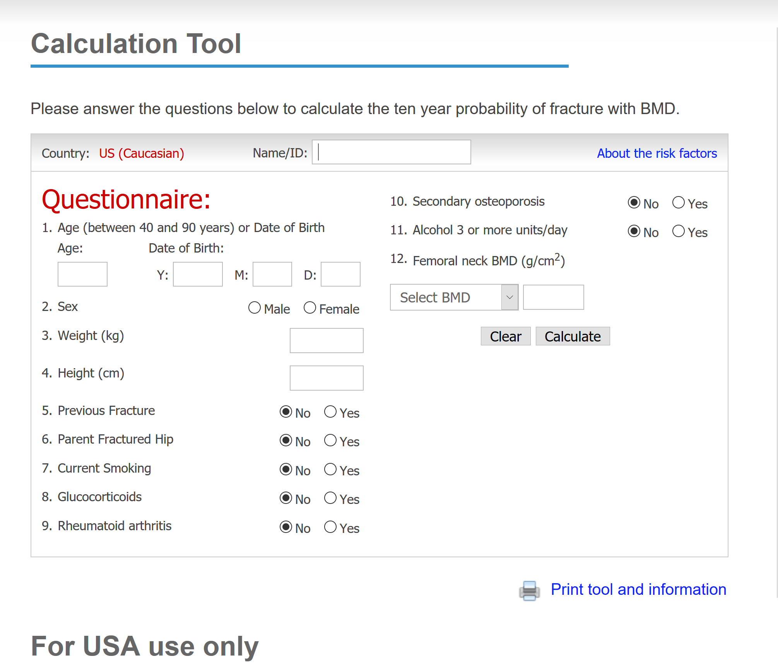

Slide 50
Bisphosphonate treatment up to 5 years
The meta-analysis comparison of alendronate with placebo showed a 44% reduction in vertebral fracture risk, a 40% reduction in hip fracture risk ,and a 17% reduction in nonvertebral fracture risk .
The meta analysis comparison of risedronate with placebo showed a 36% reduction in vertebral fracture risk ,a 26% reduction in hip fracture risk ,and a 20% reduction in nonvertebral fracture risk .
The meta-analysis comparison of ibandronate with placebo showed a 31% reduction in the vertebral fracture risk .There was no evidence for a reduction in hip or nonvertebral fracture risk.

Slide 51
The meta-analysis comparing zoledronic acid with placebo showed a 56% reduction in vertebral fracture risk ,a 42% reduction in hip fracture risk and an 18% reduction in nonvertebral fracture risk .
One large trial of zoledronic acid conducted among women and men after hip fracture found a 35% (significant) reduction in all clinical fractures, supporting the value of bisphosphonate treatment after a hip fracture .
In this trial, there was also evidence of 28% (significant) reduction in mortality ,although a reduction in mortality has not been shown in other trials with zoledronic acid.

Slide 52
Adverse events
Adverse events from the FRAME and ARCH trials included the first 12 months of each study, which was the romosozumab treatment period.
During the 12-month, double-blind portion of FRAME, there was 1 case of ONJ in a participant receiving romosozumab and none in participants receiving placebo. In ARCH, there were no cases of ONJ during the 12-month, double-blind treatment period (first year).
One AFF occurred in a patient who received romosozumab in FRAME. During the ARCH trial, 6 AFFs occurred in the second year of the trial.

Slide 53
Neoplasms were carefully assessed in these trials because of the known role of the Wnt signaling pathway, in regulating cell proliferation.Overall romosozumab treatment did not contribute to new tumor development in these trials.
Injection-site reactions were observed in 3% of placebo-treated and 5% of romosozumab-treated patients in FRAME, with few subjects discontinuing therapy .Similar rates of these reactions were seen in the ARCH trial.

