Slide 1
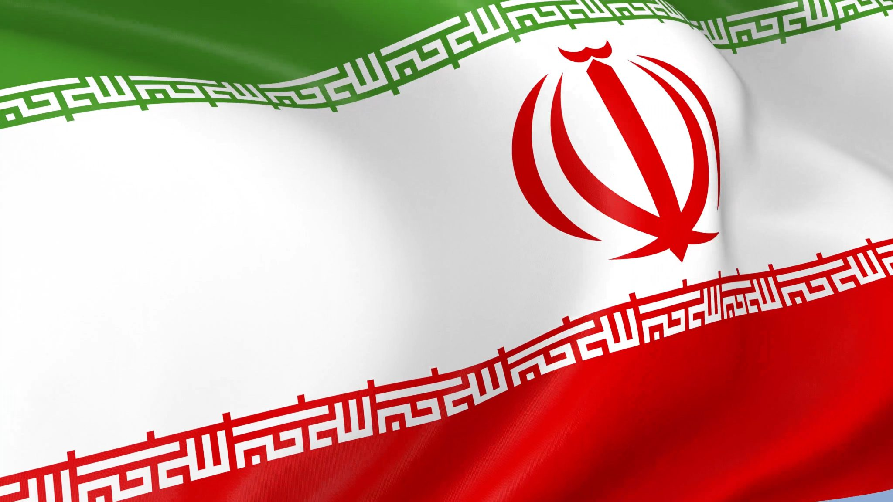
Diabetes & Ramadan Fasting
Dr. Amir Reza Goharian
Endocrinologist
2020 / April / 21

Slide 3
Ramadan
The duration of fast varies between 10 - 20 h per geographical location of the region and season.
Epidemiology of Diabetes and Ramadan (EPIDIAR) conducted across 13 countries and data was collected from 12,243 Muslim patients with diabetes in 2001.
‘Suhoor’ =سحری ‘Futoor’ = افطاری

Slide 4
Pathophysiology of fasting in Ramadan in Diabetic Patients
In diabetic patients, during fasting glycogenolysis accelerates due to insulin absence or resistance, and gluconeogenesis and ketogenesis are enhanced as well.
The depletion of stored Glycogen at around Iftar time promotes ketogenesis [8]. Moreover, in the fasting state, impaired glucagon response to hypoglycemia precipitates risk of severe hypoglycemia in them.
These risks further complicated if there is coexistent autonomic neuropathy with impaired catecholamines and glucagon release [9].

Slide 5
Pathophysiology of fasting in Ramadan in Diabetic Patients
This risk may increase further by the effect of antidiabetic agents like sulfonylurea, and insulin that may result in more potent and unpredictable hypoglycemia [10], especially if not modified in Ramadan, as evident in many previous studies [5].
 [5] Salti I, Benard E, Detournay B, Bianchi-Biscay M, Le Brigand C, Voinet C, et al. A population-based study of diabetes and its characteristics during the fasting month of Ramadan in 13 countries: results of the epidemiology of diabetes and Ramadan 1422/2001 (EPIDIAR) study [Internet] Diabetes Care 2004 Oct [cited 2017 Apr 27];27(10):2306e11. Available from: http://www.ncbi.nlm. nih.gov/pubmed/15451892.

Slide 6
Risks of Ramadan fasting in diabetes:
The risks associated with fasting Ramadan include :
1- hypoglycemia,
2- hyperglycemia,
3- acute metabolic complication; like diabetic
ketoacidosis and hyperosmolar hyperglycemia,
4- dehydration , hypotension or hypertension
5- and thrombosis.

Slide 7
(6-8 weeks)

Slide 8
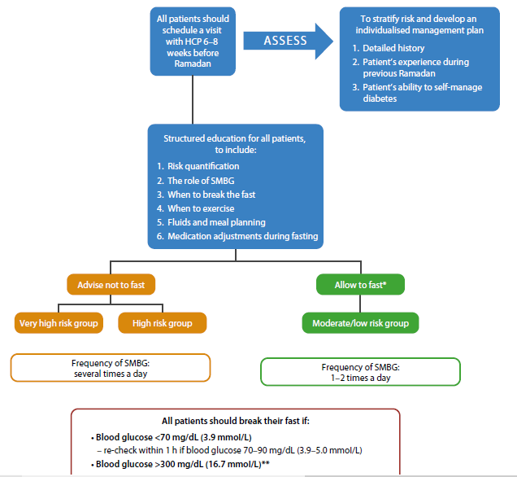

Slide 9
Studies on the impact of Ramadan focused education on fasting outcomes
1- The Ramadan Education and Awareness in Diabetes (READ) is a prospective
Study from Pakistan
2 - A multicenter prospective study in 2014 done in Pakistan with the aim to
observe the outcome of Ramadan fasting in those patients with diabetes
who received the Ramadan-focused education [20].
3 - Another multinational study by McEwen et al. (2015) done on 774 patients
with type 2 diabetes. Patients were recruited from the clinics in
Egypt , Iran , Jordan and Saudi Arabia who fasted for two days during
Ramadan 2014 [16].

Slide 13
risk categorisation

Slide 14
Must not Fast

Slide 15
Should Not Fast

Slide 16
IDF – DAR practical Guideline :
﴿Patients who are in the two highest categories of risk
are advised not to fast ; however, many of these patients will choose to do so and this must be respected

Slide 17
May be have a License for Fasting

Slide 18
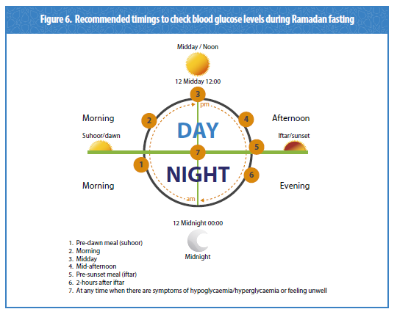

Slide 19
Pharmacologic management of diabetes during Ramadan fasting in the current era

Slide 21
- Insulin use in patients with diabetes was considered as high risk for fasting even in patients with type 2 diabetes.
- The use of insulin analogues is recommended over regular human insulin due to a number of advantages that include less hypoglycaemia [38].
- Basal insulin , is better than Premixed insulin - Both hypoglycemia and the nocturnal was significantly lower in the IDegAsp arm compared within the BIAsp 30 arm.

Slide 22
IDegAsp Vs BIAsp30

Slide 23
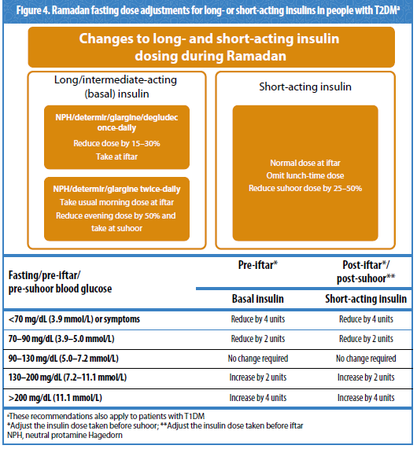

Slide 24
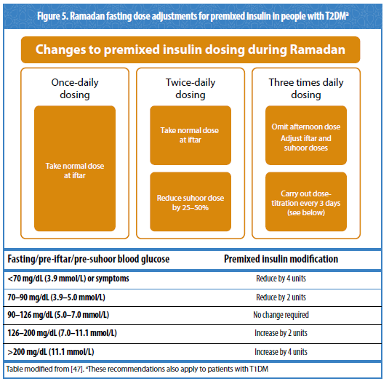

Slide 25
Insulin
Patients with T2DM and poor glycaemic control despite multiple daily injections (MDI) of insulin can possibly benefit from an insulin pump system with continuous subcutaneous insulin secretion [48].
While there are no data for insulin pump use during Ramadan for T2DM, studies have demonstrated that adults and adolescents with T1DM can fast safely using insulin pumps.

Slide 27
Ramadan Fasting in patients with type 2 diabetes using secretagogues {Sulfonylurea (SU) and Repaglinide}
Hypoglycemia due to Gliclazide ,was the lowest , in comparison with glimipride , and glibenclamide.

Slide 32
Gliclazide VS Vildagliptin

Slide 34
Ramadan fasting and DPP4 inhibitors
DPP4 inhibitors are oral ADA that works through the glucose dependent release of insulin and thus considered to carry a low risk of hypoglycemia even in fasting state [45].
Since the last IDF guideline about Ramadan and diabetes [12], the patients on DPP4 therapy were considered as a low risk of fasting without a need for dose titration and many trials were conducted for the safety of this class of antihyperglycemic agents with or without SU during Ramadan fasting.

Slide 35
DPP4 Inh.
In 2011, one small observational study by Hassanein et al. (VECTOR) done in patients on Vildagliptin (n = 23) with or without metformin.
Results : overall a safer profile for Ramadan fasting in patients on Vildagliptin compared to
Gliclazide [49].
In the STEADFAST study (2014), a multiregional, double-blinded RCT involving 557 patients with type 2 diabetes and mean baseline HBA1c = 6.9%.
Results : the incidence of confirmed hypoglycemia (blood glucose < 3.9mmmol) was 3.0%
with Vildagliptin and 7.0% with Gliclazide and any hypoglycemia was 6.0%and
8.0% respectively.

Slide 36
DPP4 Inh.
Later further observational studies from different countries as Lebanon [52](2014), India [53], and France [54] also reaffirmed the above findings.
They also documented the Safety of Vildagliptin in Ramadan fasting regarding the lesser incidence of hypoglycemia.
It may also carry the additional benefits of better glycemic and weight control than Sulfonylurea.

Slide 38
Ramadan fasting and GLP-1 RA
By glucose-dependent insulin release.
It also decreases glucagon secretion, enhances glucose uptake and storage in muscles, reduces glucose production by the liver.
Moreover, it delays gastric emptying and stimulating satiety centre by its central effect [55].
GLP -1 receptor agonists are considered as low risk for hypoglycemia as monotherapy but in combination with secretagogues or, insulin may have the potential for hypoglycemia [56].

Slide 39
Ramadan fasting and GLP-1 RA
Another recent, larger multinational open-label RCT (LIRA - RAMADAN) was done to assess the effect of Liraglutide in Ramadan compared to SU involving 343 subjects with T2DM who intend to fast.
- Results : Liraglutide group had no major hypoglycemic events, and they achieve target
HBA1c of <7.0% (53.9%) compared with SU (23.5%) P < 0.001.
However symptomatic hypoglycemic episodes were present in 3 patients on
Liraglutide (2.0%), while 18 patients on SU (11.0%).
Additionally, they experienced statistically significant weight loss during Ramadan
[ETD:- 0.54 kg (95% CI:- 0.94; -0.14); p = 0.0091].

Slide 40
Ramadan fasting and sodium glucose co-transporter 2 (SGLT2) inhibitors
The glucose-lowering action of this class is insulin independent and thus carry less risk of causing hypoglycemia unless combined with insulin and other secretagogues [62].
The novel mechanism of action results in mild diuresis and is a concern for volume depletion especially in hot climates and during fasting for long hours.

Slide 41
SGLT 2 Inh.

Slide 42
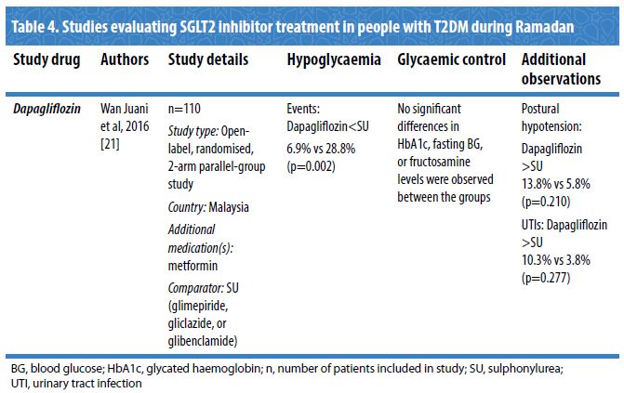

Slide 43
Singapore 2018
Another study from Singapore evaluated the effect of using SGLT2i during Ramadan and the impact on the kidney function and the ketone levels [67].
This study was a single-centre prospective observational controlled cohort study; 68 , all with eGFR >45.5 ml/min/1.73m2.
Both groups group had a similar change in weight (LS mean change of -1.8 versus -1.1 kg, p = 0.205), eGFR (LS mean change of 6.0 versus 4.2 ml/min/1.73m2, p =0.399, sitting systolic, sitting diastolic BP and plasma ß-hydroxybutyrate level.

Slide 45
TZD
For pioglitazone, only one double-blind RCT done in India. ( 2006 )
It showed significant improvement in fructosamine and less hypoglycemic events compared to placebo [68].

Slide 46
Acarbose
No prospective observational studies or RCT is available in Acarbose, but as with metformin due to very low risk of hypoglycemia, no dose adjustment has been suggested during fasting.

Slide 47
The Ramadan Nutrition Plan (RNP) for Patients with Diabetes
IDF – DAR Guideline

Slide 48
( SMBG )

Slide 49
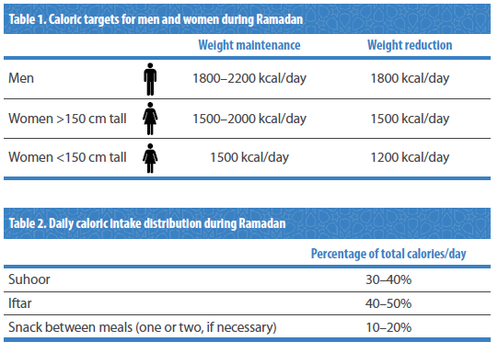

Slide 50
Macronutrient meal composition

Slide 51
Macronutrient meal composition

Slide 52
Macronutrient meal composition

Slide 53
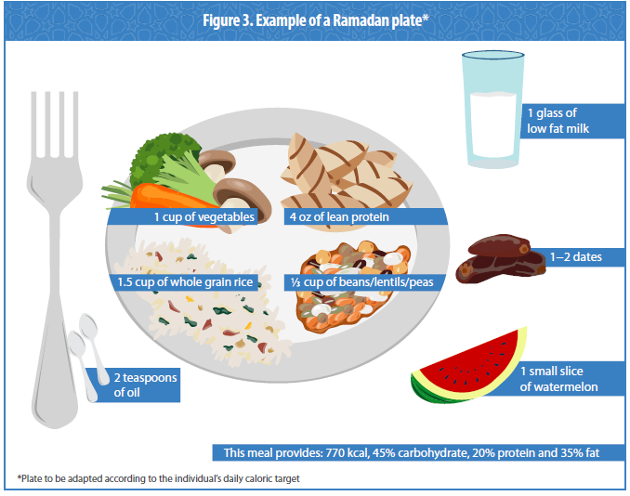

Slide 54
Conclusions
Basal ultra-Lente insulin-like glargine and Degludec due to their flat action are better than SU.
It can be concluded from 4 prospective observational studies and RCT from different parts of the world that ; insulin therapy during Ramadan fasting is safer with insulin analogues compared to human insulin.

Slide 55
Conclusions
Premixed insulin at the time of breaking fast (Iftar) gives better glycemic control as a higher proportion of rapid-acting insulin regulates the glucose excursion accompanied by high intake of carbohydrate at that point.
All the patients need active dose titration and pre-Ramadan counselling to avoid hypoglycemia [72].

Slide 56
Conclusions
Most of these recent studies found the use of short-acting secretagogues like Repaglinide and Gliclazide safer than longer acting and potent SU, e.g. Glibenclamide and glimepiride [30,47].

Slide 57
Conclusions
Since the FDA approval of Sitagliptin as a first DPP4 Inhibitors in 2006 followed by many other DPP4 Inhibitors, and then GLP 1 agonist, management of diabetes is revolutionised as these agents are not only efficacious but also carry a small risk of hypoglycemia relative to conventional hypoglycemia agents available before [73].
Their use is now 2nd line after diet and metformin as per all the current guidelines for diabetes management.

Slide 58
Conclusions
Postural hypotension, dry skin and UTI were, as expected, higher in SGLT2i groups.
At the same time no signs of higher risk of ketonemia, deterioration of renal parameters in those patients on SGLT2i during Ramadan [65 - 67].

Slide 59
تشکرازتوجه شما
شب بخیر

