Slide 1
IN THE NAME OF GOD

Slide 3
PROLACTINOMA IN PREGNANCY AND MENOPAUSE

Slide 4
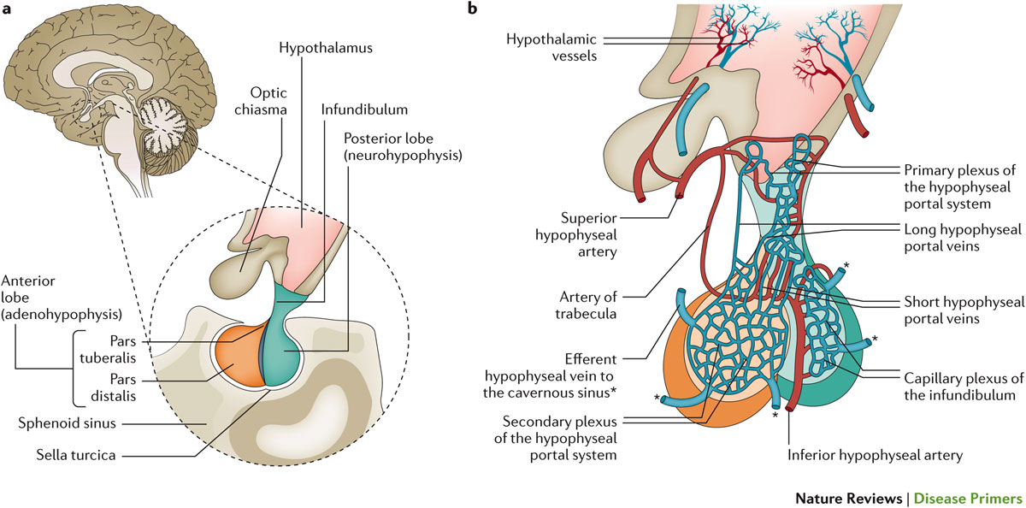

Slide 7
Prolactinomas which affect 100 cases per million-year .
mostly women in their 3rd and 4th decades of life, often lead
to hypogonadotrophic hypogonadism and infertility . The
main mechanism involves inhibition of GnRH pulsatility,
via kisspeptin , but also direct effects on inhibition of
gonadotrophins secretion and gonadal steroidogenesis are
described.

Slide 8
Hyperprolactinemia suppresses pituitary gonadotropin secretion, resulting in irregular menstrual cycles and anovulatory infertility. Serum prolactin concentrations between 50 to 100 ng/mL (normal <15 to 20 ng/mL), typically cause either amenorrhea or oligomenorrhea, while levels greater than 100 ng/mL result in deficient estradiol and progesterone secretion and amenorrhea.

Slide 9
Prolactinoma diagnosis is based on clinical, laboratory and imaging characteristics. Most women harbor microprolactinomas in which symptomatology is related to hypogonadism and galactorrhea. Patients with macroprolactinomas often present, in addition, mass effects symptoms, as headache, visual disturbances and additional hypopituitarism.

Slide 10
Medical treatment with dopamine agonists (DA), the gold standard approach for MIC and MAC, effectively restores eugonadism and promotes tumor reduction. Cabergoline (CAB), due to better tolerability and higher affinity to D2R as compared to bromocriptine (BRC), is currently the preferred DA. Nonetheless, due to its shorter half-life,with a faster clearance than CAB, BRC is still the recommended drug in the pregnancy context. However, although DA is usually withdrawal after pregnancy confirmation, the embryo is exposed to the drug in an important embryogenesis period, even when BRC is used.

Slide 12
●For cabergoline, start at 0.25 mg twice a week. If the serum prolactin concentration is not normal after one to two months, the dose can be increased to 0.5 mg twice a week or, if necessary, 1 mg twice a week. Sometimes, even higher doses are needed .
●For bromocriptine, start with 1.25 mg at bedtime for one week, then 1.25 mg twice a day for one to two months. If the serum prolactin concentration does not fall to near normal or normal by then, the dose can be increased to 2.5 mg twice a day and, if necessary, to 5 mg twice a day. If nausea occurs or if serum prolactin does not decrease to normal, consider changing to cabergoline.

Slide 13
The occurrence of regular menstrual cycles during treatment indicates that the woman is probably ovulating. Following correction of hyperprolactinemia, approximately 80 percent of women will ovulate, and pregnancy rates of 70 to 80 percent can be achieved. Neither cabergoline nor bromocriptine has been associated with an increased risk of miscarriage, congenital malformations, or pregnancy complications such as preterm deliveries.

Slide 14
For women who do not ovulate or do not conceive with dopamine agonist therapy, clomiphene citrate may be added. If unsuccessful, gonadotropin therapy may be needed, although this therapy is associated with high serum estradiol concentrations during treatment and a significant risk of multiple gestations.

Slide 15
Data from over 6000 pregnancies suggest that the administration of bromocriptine during the first month of pregnancy does not harm the fetus. In this series, the incidence of spontaneous abortions (9.9 percent), multiple births (1.7 percent), and malformations (1.8 percent) was no higher than in the general population. In addition, in a study of children followed for up to nine years after exposure to bromocriptine in utero, no harmful effects were noted .

Slide 16
Continuous use of bromocriptine during pregnancy has been reported in approximately 100 women. Although the rate of congenital malformations did not appear to be higher than nonexposed pregnancies, there was one case of undescended testis and one of talipes deformity.

Slide 17
We also recommend surgery in a woman whose macroadenoma (≥10 mm) is unresponsive to bromocriptine or cabergoline, even if it is not elevating the optic chiasm, because medical treatment would not likely be effective if the adenoma enlarges during pregnancy.

Slide 18
Serum prolactin — During normal pregnancy, serum prolactin concentrations increase to as high as 400 ng/mL.
The Endocrine Society guidelines recommend against measuring prolactin during pregnancy, because it can be difficult to distinguish the normal pregnancy-associated rise in prolactin from that associated with adenoma growth. However, we do measure prolactin in women with both macro- and microadenomas every three months during pregnancy because we find it reassuring if the prolactin does not increase above 400 ng/mL. If the prolactin does increase to >400 ng/mL, we obtain visual field testing.

Slide 19
Visual field testing — For most pregnant women with lactotroph adenomas, routine visual field testing is not indicated. However, women who develop visual symptoms during pregnancy should have visual field testing. In addition, women whose macroadenomas extend above the sella should undergo visual field testing before pregnancy and every three months during the pregnancy, even if the patient has no visual symptoms. If a visual field defect consistent with a sellar mass is found , (MRI) without contrast should be performed. If the adenoma has enlarged to a degree that could account for the headaches and/or visual field defect, the woman should be treated with cabergoline or bromocriptine throughout the remainder of the pregnancy.

Slide 20
Pituitary apoplexy — Pituitary apoplexy refers to sudden hemorrhage into the pituitary, a rare event with potential serious neurologic and endocrine consequences. Apoplexy can occur in patients with pituitary micro- or macroadenomas, including women with lactotroph macroadenomas during pregnancy. In its most dramatic presentation, apoplexy causes the sudden onset of excruciating headache, diplopia due to pressure on the oculomotor nerves, and hypopituitarism. All pituitary hormonal deficiencies can occur, but the sudden onset of corticotropin (ACTH) and therefore cortisol deficiency is the most serious because it can cause life-threatening hypotension. It should be treated with high-dose hydrocortisone.

Slide 21
Breastfeeding and dopamine agonists — Breastfeeding increases serum prolactin concentrations but does not appear to increase the risk of lactotroph adenoma growth. Therefore, breastfeeding is an option for women with micro- and macroadenomas that remained stable in size during pregnancy. Dopamine agonist therapy, which lowers serum prolactin and inhibits lactation, should be withheld until breastfeeding is completed.

Slide 23
surgical series at child-bearing age women , data are limited. In one study, in 138 patients harboring prolactinomas younger than 40 yrs submitted to transsphenoidal surgery, normal PRL levels were achieved in 86% of 21 MIC and in 74% of 117 MAC, with better results in non-invasive cases. Hypopituitarism was described in only two patients (1.5%). Other authors described normal PRL values in 81% of
MIC and 52% of MAC, amongst 99 females at child-bearing age operated on, and gestation was achieved in 14 from 17 patients willing this outcome.

Slide 24
In fact, surgery, by the transsphenoidal approach, does not seem to impair the gonadal axis in the majority of cases, mainly concerning MIC. Nevertheless, surgical results depend on the surgeon skillfulness and experience, Colao reviewing large series from the literature, including both genders, reported hyperprolactinemia remission in 73.3% of 1211 MICs and in 38.0% of 1480 MACs.

Slide 25
Surgery before pregnancy can be a therapeutic option in patients resistant to DA and in those without tumor shrinkage even in the presence of PRL normalization. Despite the effectiveness and relative safety of pituitary surgery,mainly in MIC, this approach should be reserved for resistant/intolerant tumors or patient preference. Additionally, surgery may be indicated for another complication related to pregnancy: pituitary tumor apoplexy with severe neurologic and visual symptoms.

Slide 26
Therefore, in patients with extrasselar tumors, pregnancy should be allowed only after tumor shrinks within sellar boundaries, especially those with suprasellar extension, preferably after at least 1 year of treatment . Regarding cavernous sinus extension, the potential risk of cranial nerve impairment should be considered.

Slide 27
BRC and CAB were formerly classified as category B by the FDA , in an Australian classification BRC is category A (no human risks, similar miscarriage rates, no increase in malformations and no teratogenic effects) and CAB is category B (no animal risks, waiting for more human data).

Slide 28
In fact, DA has been used throughout pregnancy in a limited number of patients. As dopamine is a ubiquitous neurotransmitter, the impact of DA on DA brain circuitry could potentially interfere in the neuropsychological development of children. Amongst 100 women who maintained BRC, one case of cryptorchidism and another case of
congenital talipes were described. More recently, Rastogi et al.
described three malformations (neural tube defect) only in the group of patients on CAB throughout gestation (n = 25), compared to no cases in the group of patients who withdrew the DA after pregnancy confirmation (n = 23) .

Slide 29
Before conception:
DA of choice: BRC has been the recommended drug for pregnancy induction, although cumulative data do not point to harmful outcomes with CAB. MIC and intrasselar MAC: pregnancy can be recommended
once the gonadotrophic axis is restored. Expansive/invasive MAC: pregnancy can be recommended once the gonadotrophic axis is restored and only after tumor is reduced within the sellar boundaries,
especially in those with suprasellar expansion. Otherwise, pituitary surgery is indicated.

Slide 30
Pregnancy confirmation:
MIC and intrasselar MAC: DA should be withdrawn.
Expansive/invasive MAC: DA maintenance at the physician discretion and frequent monitoring.

Slide 31
During pregnancy:
MIC and intrasselar MAC: clinical evaluation each trimester, serum PRL level evaluation not indicated. If symptoms related to tumor growth as headache and/or visual impairment occur, sellar MRI without contrast and neuroophtalmologic evaluation must be performed. Expansive/invasive MAC: DA maintenance at the physician discretion. Monthly clinical evaluation and visual assessment each trimester is recommended. If symptoms related to tumor mass effect as headache and/or visual impairment occur, sellar MRI without contrast must be performed. If sellar MRI depicts significant tumor growth related to clinical picture, reintroduction of DA is the first approach. In case of failure, neurosurgery is indicated, preferentially at the second trimester. If gestation is near-term, delivery can be considered.

Slide 34
Prolactinomas and menopause

Slide 35
A physiologic decrease in prolactin levels occurs after
menopause with an overall linear correlation between
estradiol and prolactin levels. The question of whether
the hypoestrogenic environment of menopause affects the
natural course of prolactinomas arises.

Slide 36
The higher prevalence of prolactinomas in women of reproductive age and its decline with menopause conforms to the well-recognized stimulatory effect of estrogen on prolactin secretion and lactotroph proliferation. This estrogen-driven effect underlies the high prolactin levels and pituitary enlargement during pregnancy, as well as the physiological decline of prolactin levels in post-menopausal
Women.

Slide 37
Prolactin secreting tumors in males had a higher number of mitoses and Ki-67 index compared with tumors from female patients irrespective of tumor size . When the comparison was restricted to macroprolactinomas, still the Ki-67 immuno-reactivity index was higher in tumors from male patients. Interestingly, estrogen receptor (ER) α expression score, as analyzed by immunohistochemistry, was significantly lower in men and was inversely correlated with tumor size and proliferative activity. Low ERα expression was also a hallmark of dopamine agonist-resistant, invasive and proliferative tumors .

Slide 38
Prolactinomas diagnosed in the post‑menopausal period
Prolactinomas diagnosed during the post-menopausal period are rare. Tumor induced menstrual disturbances that lead to the diagnosis in young patients cannot be detected in women already amenorrheic as a function of menopause. Tumors may remain unrecognized; therefore the true prevalence of prolactinomas during the menopausal period cannot be accurately determined. Although large tumors presenting with symptoms related to tumoral mass effects on adjacent structures are readily detected, microadenomas and small intrasellar macroadenomas are probably underdiagnosed due to the lack of endocrine manifestations.

Slide 39
Three small clinical case series encompassing 37 women diagnosed after menopause were identified Mean age at diagnosis was 60.8 years. The vast majority had macroadenomas, one quarter of which were giant tumors. Still, 19% of tumors were diagnosed incidentally (mean diameter 17 ± 8.4 mm vs. 28.2 ± 12 mm in symptomatic patients, p = 0.054). Headaches and visual deterioration (37.8%) were the most common symptoms leading to diagnosis. Two patients presented with apoplexy.

Slide 41
Prolactinomas at menopause: should they be treated?
Is untreated hyperprolactinemia deleterious
in post‑menopausal women?

Slide 42
prolactin is a pleiotropic hormone with a broad range of physiologic roles in multiple species, including regulation of metabolic homeostasis, immune function, hemostasis, skin biology, and bone metabolism ,regulation of glucose metabolism, and expansion of pancreatic β-cell mass hyperprolactinemia has been associated with weight gain and metabolic syndrome.

Slide 43
Santharam et al reported outcomes of DA agonist withdrawal in patients entering menopause (n = 30, 24 micro- and 6 macroprolactinomas) compared with treatment interruption during the premenopausal period (n = 28, 23 micro- and five macroprolactinomas). In post-menopausal women, prolactin levels remained normal in 69% of women who were normoprolactinemic compared with 25% of women who were hyperprolactinemic at thetime of treatment withdrawal.

Slide 44
Prolactinoma patients treated with cabergoline experienced improvement in insulin sensitivity and lipid profile, and a decrease in waist circumference, inflammation markers and carotid intima thickness. The mechanisms by which DA treatment leads to improvement in metabolic parameters is not clearly understood and is
probably multifactorial. there is no data indicating that hyperprolactinemia increases cardiovascular morbidity, or that normalization of prolactin levels by medical treatment prevents
cardiovascular events.

Slide 45
Another area of concern is the possible association
between prolactin action and increased risk of malignancy.
Autocrine or paracrine activation of the prolactin receptor
by locally produced extra-pituitary prolactin has been
implicated in tumorigenesis of breast and prostate cancer.

Slide 46
The prevalence of breast cancer was not increased in large cohorts of women with hyperprolactinemia from the Netherlands and
Scotland compared with the general population.

Slide 47
steroid hormone deficiency rather than prolactin excess is
the main mediator of bone loss in hypogonadal women.Bone density was low in patients with amenorrhea, irrespective of the etiology,
compared with patients with hyperprolactinemia with normal
menses and healthy women.

Slide 48
Conclusion
There is no evidence that justifies changing current recommendations to withhold medical treatment of microprolactinomas in asymptomatic
post-menopausal women. Macroprolactinoma patients should be treated according to standard clinical practice.

