Slide 2
Thermal Ablation for Papillary Thyroid Microcarcinomas PTMCs
Bijan Iraj,MD
Assistant Professor of Internal Medicine and Endocrinology
Department of Endocrinology and Metabolism
Isfahan Medical School

Slide 3
The incidence of papillary thyroid carcinoma (PTC) and the number of these patients
requiring subsequent surgery have markedly increased over the past 20 years. These
increases are due primarily to the incidental detection of small, subclinical PTCs and/or
early ultrasound screening.

Slide 4
PTMC usually does not become clinically evident and is associated with an
excellent prognosis, either because the rate of progression is very slow or because the tumor does not progress.

Slide 5
The American Thyroid Association guidelines suggested that an active surveillance can be considered in PTMC patients without local invasion or clinically evident metastases,
and in patients who have high surgical risk, short remaining life span or concurrent medical issues requiring priority treatment.

Slide 6
The indolent characteristics of PTC have reduced the need for immediate surgery, as surgery has several important drawbacks, including vocal cord paralysis, hypoparathyroidism, and post‐surgical complications.

Slide 7
Active surveillance (AS) is considered the alternative first‐line option for patients with low‐risk papillary thyroid microcarcinoma (PTMC), as it reduces overtreatment and unnecessary surgery, while showing favorable results, in these patients.

Slide 8
According to a recent systematic review and meta‐analysis, AS shows acceptable size enlargement and lymph node metastasis during 5 year follow‐up (pooled proportion of
5.3% and 1.6%, respectively).
Sakai T, Sugitani I, Ebina A, Fukuoka O, Toda K, Mitani H, Yamada K 2019 Active Surveillance for T1bN0M0 Papillary Thyroid Carcinoma. Thyroid : official journal of the American Thyroid Association 29:59‐63.

Slide 9
Active surveillance can be an important management alternative for these patients. however, considering that over 10% of patients stopped active surveillance and underwent surgery without progression of disease in observational trials for PTMC.

Slide 10
However, a large proportion (ranged 8.7 to 32 %) of patients underwent delayed surgery. Among them, a substantial proportion (ranging from 50 to 69%) of the reasons for delayed surgery were distinct from size enlargement or lymph node metastasis.
Cho SJ, Suh CH, Baek JH, Chung SR, Choi YJ, Chung KW, Shong Y, Lee JH 2019 Active Surveillance for Small Papillary Thyroid Cancer: A Systematic Review and Meta‐Analysis. Thyroid : official journal of the American Thyroid Association.

Slide 11
Anxiety is one of the main reasons for delayed surgery.

Slide 12
Moreover, the tumor could evoke
considerable patient anxiety when it is left untreated.

Slide 13
Active surveillance does not seem to be a perfect strategy for all patients.

Slide 14
In recent years, image-guided ablations including ethanol injection, radiofrequency ablation (RFA) and microwave ablation
(MWA) have attracted much interest in the minimally invasive treatment of various tumors such as neoplasm's of the liver, kidney and lung.

Slide 15
These techniques have been regarded as an alternative to surgery. Several studies
showed that RFA and MWA have been used to treat thyroid nodules and metastatic lymph nodes from PTC, yielding favorable results.

Slide 16
Thermal ablation included MWA, LA, and RFA.

Slide 17
US-guided laser ablation (LA) has also been demonstrated to be an effective method to reduce the volume of benign thyroid nodules , and to treat malignant diseases such as early hepatocellular carcinoma and metastatic lymph nodes from PTC.

Slide 18
However, several recent studies have suggested the application of RFA for low-risk PMC
Kim et al. reported their indications as follows:
Pathologically confirmed PTC without cytological aggressiveness,
Single PTC without extrathyroidal extension,
No metastatic tumours
Ineligibility for surgery

Slide 19
Zhang M, Luo Y, Zhang Y, et al. (2016). Efficacy and safety of
ultrasound-guided radiofrequency ablation for treating low-risk
papillary thyroid microcarcinoma: a prospective study. Thyroid
26:1581–7.
Sun J, Liu X, Zhang Q, et al. (2016). Papillary thyroid carcinoma
treated with radiofrequency ablation in a patient with hypertrophic
cardiomyopathy: a case report. Korean J Radiol 17:558–61.
Kim JH, Baek JH, Sung JY, et al. (2017). Radiofrequency ablation
of low-risk small papillary thyroidcarcinoma: preliminary results
for patients ineligible for surgery. Int J Hyperthermia 33:212–19.

Slide 20
Techniques:
Before starting ablation, the target tumor is divided into multiple conceptual ablation units, and RFA is performed in a unit-by-unit manner by moving the electrode tip.
The use of local anaesthesia rather than general anaesthesia or sedation.
If a metastatic tumour exists adjacent to these nerves, the hydrodissection technique is useful to prevent thermal injury.

Slide 21
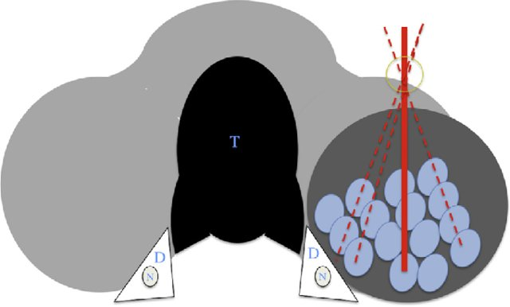

Slide 22
Danger triangle, i.e. the tracheoesophageal
groove including the RLN, trachea, and esophagus.

Slide 23
Ablation should be terminated when all conceptual units have changed to transient hyper echoic zones.
RFA is usually performed on both the tumor and the surrounding normal tissue in order to prevent local recurrence.

Slide 24
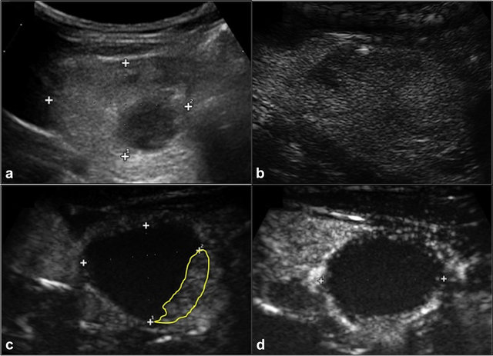

Slide 25
If patients cannot tolerate the pain during ablation, lidocaine injection around the tumour is recommended.

Slide 26
Based on the clinical framework for risk stratification in determining whether AS is appropriate for PTMC categorized patients as ideal, appropriate, or inappropriate for AS based on imaging findings, and the characteristics of the patient and/or medical team.

Slide 27
“low-risk” has been described as the absence of clinically evident metastases, local invasion and aggressive cytological evidence.

Slide 28
Based on strict stratification, the patients classified as inappropriate for AS should not be considered for thermal ablation. However, patients with a fear of undergoing surgery can be considered for thermal ablation.

Slide 29
However, patients with a fear of undergoing surgery can be considered for thermal ablation.

Slide 30
Treatment efficacy:
Volume reduction , therapeutic success rate (volume reduction >50%) , complete disappearance of the treated cancer, serum thyroglobulin concentration, cancer perfusion,
and changes in echogenicity.
Ethanol and thermal ablation for malignant
So Yeong Jeong, Jung Hwan Baek, Young Jun Choi & Jeong Hyun Lee
International Journal of Hyperthermia
2017

Slide 31
The efficacy of RFA:
The mean reduction in tumour volume ranged from 50.9% to 84%; complete disappearance is noted in 25–94% of cancers ; therapeutic success rates range from 75% to 97% ; symptom improvement is observed in 64% of patients ; and decreases in serum thyroglobulin concentration are noted in most patients.

Slide 32
The efficacy of EA:
The reduction in the mean cancer volume following EA reportedly ranges from 37.5% to 96%; complete disappearance is noted in31–65% of treated cancers ; therapeutic success rates range from 70.8% to 98% ; and reductions in serum thyroglobulin concentration are noted in some patients.

Slide 33
RFA is superior to EA because of its better efficacy, fewer mean number of treatment sessions required, and wider extent of the ablation zone. However, RFA demonstrates a
higher tendency and severity of voice complications than EA in the treatment of central neck lesions.

Slide 34
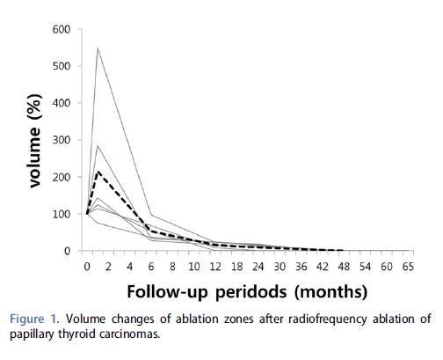

Slide 35
Thermal Ablation for Papillary Thyroid Microcarcinomas: Systematic Review and Meta‐Analysis:
THYROID-2019

Slide 36
503 low‐risk PTMCs in 470 patients treated by
thermal ablation from 9 studies.

Slide 37
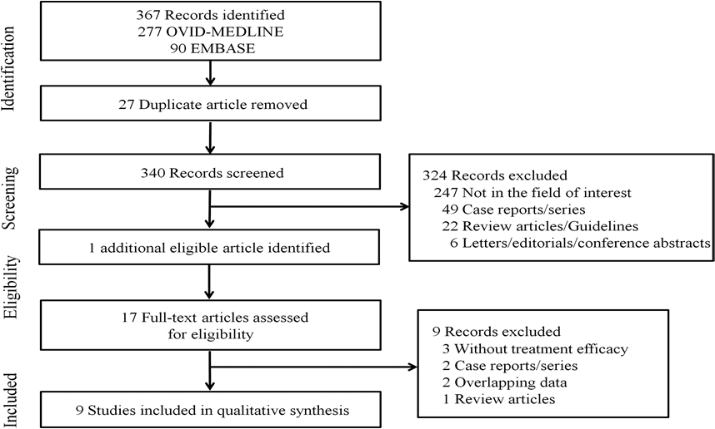

Slide 38
Inclusion Criteria:
1- Greatest tumor dimension ≤ 10 mm;
2- Diagnosis by cytology or biopsy,
3-Absence of lymph node (LN) metastasis, distant metastasis, and gross extra thyroidal extension
4-Included evaluation of efficacy after thermal ablation.
Thermal ablation included MWA, LA, and RFA.

Slide 39
Results of Ablation:
The mean FU duration after ablation ranged from 7.8 months to over 53 months.
The mean size of the index tumor before and immediately after ablation and at last FU ranged from 4.3 to 7.5 mm (41 to 157 mm3), 11.8 to 14.1 mm (517.6 to 3099.4 mm3), and 0 to 4mm (0 to 70 mm3), respectively.

Slide 40
Disappearance rates ranged from 33.7% to 100%.

Slide 41
Disappearance rate was defined as complete tumor disappearance or the presence of residual scar‐like changes.

Slide 42
None of these patients experienced local tumor recurrence or distant metastasis. However, two patients developed LN metastasis during FU.
In addition, one patient developed a new cancer, which completely disappeared following additional ablation.

Slide 43
During follow‐up, no patient experienced local tumor
recurrence or distant metastasis, whereas two patients (0.4%) experienced lymph node metastasis.
One patient (0.2%) developed a new PTMC, which was successfully treated by additional ablation.
Five patients (1.1%) underwent delayed surgery after ablation, including the two patients with lymph node metastasis and three additional patients with unknown etiology.

Slide 44
The finding, that most of the complications were minor, with transient hoarseness being the most frequent complication, indicates that the operator should be thoroughly trained in US‐based anatomy, especially in the evaluation of the danger triangle.

Slide 45
The rate of minor complications per tumor
in the other four studies were 3.4%, 4.3%, 5.4%, and 19%, respectively, with the most
common complication being transient hoarseness.

Slide 46
Li J, Liu Y, Liu J, Qian L 2018 Ultrasound‐guided percutaneous microwave ablation
versus surgery for papillary thyroid microcarcinoma. International journal of
hyperthermia : the official journal of European Society for Hyperthermic Oncology,
North American Hyperthermia Group 34:653‐659.
Teng D, Sui G, Liu C, Wang Y, Xia Y, Wang H 2018 Long‐term efficacy of ultrasoundguided
low power microwave ablation for the treatment of primary papillary
thyroid microcarcinoma: a 3‐year follow‐up study. Journal of cancer research and
clinical oncology 144:771‐779.
Teng DK, Li HQ, Sui GQ, Lin YQ, Luo Q, Fu P, Du JR, Jin CX, Wang H 2019 Preliminary
report of microwave ablation for the primary papillary thyroid microcarcinoma: a
large‐cohort of 185 patients feasibility study. Endocrine 64:109‐117.
Yue W, Wang S, Yu S, Wang B 2014 Ultrasound‐guided percutaneous microwave
ablation of solitary T1N0M0 papillary thyroid microcarcinoma: initial experience.
International journal of hyperthermia : the official journal of European Society for
Hyperthermic Oncology, North American Hyperthermia Group 30:150‐157.
Zhang L, Zhou W, Zhan W, Peng Y, Jiang S, Xu S 2018 Percutaneous Laser Ablation of
Unifocal Papillary Thyroid Microcarcinoma: Utility of Conventional Ultrasound and
Contrast‐Enhanced Ultrasound in Assessing Local Therapeutic Response. World
journal of surgery 42:2476‐2484.

Slide 47
Fatal complications, such as injury to the oesophagus, trachea, or other nerves (i.e. phrenic nerve and brachial plexus), following the treatment of primary or recurrent thyroid cancers, which are often located adjacent to these structures, have not been reported.

Slide 48
Moreover only 1.1% of patients in the present study underwent delayed surgery after thermal ablation, with none undergoing delayed surgery because of the patient’s anxiety about tumor progression. By treating the primary tumor, thermal ablation may alleviate or eliminate patient anxiety.

Slide 49
Some limitations to this therapy:

Slide 50
Multifocality was reported to be unilateral or bilateral in 20–40% of patients with PTMC , however, it could not be absolutely excluded without surgical excision.

Slide 51
LA could not eradicate these occult tumors that are invisible on US, and multifocality is also significantly associated with lymph node metastasis and disease recurrence in PTMC.

Slide 52
Because the ablation procedure is totally operator dependent, the qualities of the operator and the treatment center are essential.

Slide 53
The operator needs to being fully competent with the technical aspects of thermal ablation, including the use of a small active tip, the moving shot technique, and hydro‐dissection, thereby maximizing the efficacy and minimizing complications associated with thermal ablation.

Slide 54
The operator should be thoroughly trained in US‐based anatomy, especially in the evaluation of the danger triangle, i.e. the tracheoesophageal groove including the RLN, trachea, and esophagus.

Slide 55
In the LA group, there was no guarantee that all patients had no central lymph node metastasis. Therefore, the decision to perform
LA instead of surgery to treat PTMC should be
made cautiously.

Slide 56
Pathologically confirmed PTC without cytological aggressiveness,
Single PTC without extra thyroidal extension
No metastatic tumors at the time of treatment,
Recently, papillary thyroid carcinoma variants detected via US have been reported .

Slide 59
Tall Cell Variant
On ultrasonography, TCV tumors often appear as microlobulated, markedly hypoechoic nodules with microcalcifications and extrathyroidal extension, and are always associated with lymph node metastasis.

Slide 60
Columnar Cell Variant
On US, encapsulated tumors appear as
circumscribed hypoechoic nodules with or without microcalcifications and aggressive tumors as large microlobulated hypoechoic nodules, often with capsular protrusions representing extrathyroidal extension and neck nodal metastasis.

Slide 61
Hobnail Variant
This variant has been found to show a
palpable mass appearing as a microlobulated hypoechoic nodule with microcalcifications and multiple metastatic lymph nodes on US.

Slide 64
In conclusion that thermal ablation methods are safe and effective for local tumor control in patients with low‐risk PTMCs, minimizing the delayed surgery rate.
Strict inclusion criteria and technical proficiency are required to maximize favorable results.

Slide 65
Among them, aggressive variants should be carefully evaluated before ablation. Furthermore, the operator should carefully evaluate thyroid capsule invasion or lymph node metastasis.

