Slide 1
2019 European Thyroid Association Guidelines for the Treatment and Follow-Up of Advanced Radioiodine-Refractory Thyroid Cancer
2019 European Thyroid Association Published by S. Karger AG, Basel

Slide 2
Abstract
The vast majority of thyroid cancers of follicular origin (TC) have a very favourable outcome, but 5–10% of cases will develop metastatic disease.
Around 60–70% of this subset, hence less than 5% of all patients with TC, will become radioiodine refractory (RAI-R), with a significant negative impact on prognosis and a mean life expectancy of 3–5 years

Slide 3
Epidemiology and Classification of TC
According to the European Network of Cancer Registries in Europe an estimated 53,000 TC cases were newly diagnosed in 2012.
In the same year, 6,300 Europeans are estimated to have died of TC.
Women have a 3-fold higher estimated age-standardized rate of TC incidence (IRR) than men, with 9.3 and 3.1 cases per 100,000 person-years, respectively (mean 6.3 cases).

Slide 4
The 5-year relative survival of TC in Europe ranges from 80 to 90%.
TC includes histological types with extremely different prevalence. Among tumours originating from the follicular epithelium, differentiated TC (DTC) is the most common type and includes the papillary and follicular histotypes, making up about 85–95% of all TCs.
whereas Hürtle cell carcinomas (HC) and poorly differentiated TC account for 2–5% each.

Slide 5
Anaplastic thyroid carcinoma comprises approximately 1.7% of all cases of TC and is a very aggressive malignancy with an average survival time following diagnosis of 6 months or less.
Finally, medullary TC, originating from the parafollicular C cells of neuroendocrine origin, accounts for 3–5% of all TCs. It can be classified as sporadic (75% of cases), or familial MTC.

Slide 6
Familial forms are generally bilateral with multiple foci, are due to germline mutations in the RET gene and can associate with other diseases in the context of Multiple Endocrine Neoplasias, MEN 2A, and MEN 2B.

Slide 7
These guidelines focus on radioiodine refractory (RAIR) TCs; hence, only TCs originating from the follicular epithelium and predicted to be capable of radioiodine uptake, will be discussed.

Slide 8
Among DTCs, papillary TC (PTC) is the most common type, and it is defined as a malignant epithelial tumour with evidence of follicular differentiation and a series of specific nuclear features.
According to the last WHO classification, it can be sub-classified according to the pathological features as papillary microcarcinoma, as encapsulated, follicular, diffuse sclerotizing, tall cell, columnar cell, cribriform-morular, and hobnail cell variants, and as fibromatosis/fasciitis stroma, solid/trabecular, oncocytic, fusiform cell, clear cell and Warthin type variants.

Slide 9
Follicular TC (FTC) is defined as a malignant tumour lacking the nuclear characteristics of PTC.
Three main subtypes are established: (1) minimally invasive FTC (encapsulated and with invasion only of the capsule); (2) encapsulated angioinvasive FTC (3) widely invasive FTC.

Slide 10
In the new classification of the WHO, HC or oncocytic tumours are regarded as a separate group.
The HC carcinomas are divided into minimally invasive, encapsulated angioinvasive, and widely invasive subtypes, following the same criteria as those applied to FTC.

Slide 11
Poorly differentiated thyroid carcinoma (PDTC) is a follicular neoplasm that shows limited evidence of follicular cell differentiation, which lies morphologically and behaviourally between differentiated (follicular and papillary) and anaplastic carcinomas.

Slide 12
The histopathological diagnostic criteria for PDTC are defined in the Turin Consensus proposal: (1) malignant thyroid follicular cell neoplasm (presence of invasion and/or metastasis) (2) solid, trabecular, or insular growth pattern; (3) absence of the conventional nuclear features of PTC; (4) at least one of the following three features:
convoluted nuclei (defined as a small round hyperchromatic nuclei with convolutions of the nuclear membrane), 3 or more than 3 mitoses per 10 high-power fields, and tumour necrosis.

Slide 13
Vascular invasion, lymph node metastases, extrathyroidal tumour extension are very common in PDTC, and distant metastases may be detected at presentation or shortly after initial diagnosis .
PDTCs are frequently resistant to radioactive iodine, and have a 5-year overall survival rate of 60–85% .
PDTC with predominant oncocytic features defines the oncocytic variant of PDTC, which is characterized by an even poorer prognosis in terms of overall and tumour specific survival.

Slide 14
DTCs, HCs, or PDTCs which, during tumour progression, lose their ability to uptake and concentrate radioiodine, and in some cases to produce thyroglobulin (Tg), are commonly clinically defined as dedifferentiated TCs (DeDTC).
DeDTC is not a histopathological entity and can be thus diagnosed only during the course of the disease.

Slide 15
Indeed, current WHO classification does not precisely define the pathological criteria of dedifferentiation, though pathologists refer to this term when they observe signs of dedifferentiation in nuclei, in the growth pattern, a high mitotic activity, and necrosis in the recurrent or metastatic lesion of a patient with primary diagnosis of DTC.

Slide 16
The molecular pattern of DTCs is often characterized by mutations in the MAPK and PI3K pathways, prevalently BRAF and RAS mutations in PTC and RAS and PAX8/PPARγ mutations in FTC .
During the dedifferentiation process, DTCs acquire subsequent mutations, and they frequently harbour, as PDTC, multiple somatic genetic alterations including TERT promoter and EIF1AX mutations.

Slide 17
In terms of mortality, the IRR are 0.7 and 0.5 cases per 100,000 person-years for women and men, respectively (mean 0.6 deaths).
The vast majority of TCs have an excellent prognosis, but 5–10% of cases (6–7 new cases/ year/million) will develop metastatic disease, mostly located in lungs and bones.

Slide 18
The prognosis of these metastatic cases remains favourable as long as they maintain a response to the treatment with radioiodine.
Unfortunately, around 60–70% of this subset, still less than 5% of all patients with TC, will become RAI-R, representing 4–5 new cases/year/million. This has a significant impact on prognosis, with the 10-year survival rate dropping to less than 20% and the mean life expectancy to 3–5 years once the disease is RAI-R.

Slide 19
Recommendation
[R1] The development of dedifferentiation and RAI refractoriness during the course of the DTC should be taken into consideration.
[R2] Poorly differentiated TC is frequently RAI-R and harbours a high risk of recurrent or metastatic disease and cancer related death.
[R3] RAI refractoriness occurs in around 60–70% of metastatic TCs, but less than 5% of all patients with TC.

Slide 20
Definition of RAI-R TC
In recent years, many new drugs have been investigated for the treatment of progressive RAI-R TC.
Currently, 2 multikinase inhibitors (MKI) have been approved for treatment by the Food and Drug Administration (FDA) and the European Medicines Agency (EMA), e.g. sorafenib and lenvatinib. The efficacy of both drugs has been demonstrated in phase III studies (DECISION study for sorafenib and SELECT study for lenvatinib and has been confirmed in “real-life” studies.

Slide 21
Although criteria for prescribing both MKIs include RAI-R disease and progression, the definition of both categories can be challenging in clinical practice. In international guidelines and scientific publications ,there is no consensus on the definition of RAI-R disease.
In most publications, the following categories are proposed: (1) the absence of uptake of RAI in all lesions on scintigraphy; (2) the absence of RAI uptake in some but not all lesions; (3) progression despite uptake of RAI (4) reaching the maximum recommended activity of RAI.

Slide 22
Absence of Uptake of RAI on Scintigraphy
Publications differ in their criteria for absence of RAI uptake on scintigraphy, some stating post-RAI therapy scintigraphy ,others diagnostic scintigraphy or both .
It should be noted that diagnostic scintigraphy, even with I-124, is inferior to post-therapeutic scintigraphy .

Slide 23
In addition, factors that influence RAI uptake, including patient preparation, administered activity, and scanning protocols are often not specified, though these factors may influence RAI accumulation by the tumour and the sensitivity of detection .
In contrast, the presence of RAI uptake does not guarantee RAI sensitive disease.

Slide 24
Absence of RAI Uptake in Some but Not All Lesions Although a mixed pattern with some lesions accumulating RAI and others not is also considered RAI refractory disease in most publications, it is uncertain whether this is correct, as no study has shown that continuation of RAI treatment in this situation is not beneficial.
A combination of RAI therapy for RAI-avid lesions and local treatment for one or a limited number of RAI refractory lesions may be considered in certain patients.

Slide 25
Progression despite Uptake of RAI Although most publications agree that progression is a criterion for RAI-R disease, huge variation exists in the definition of progression.
Radiological progression is widely accepted as an important criterion, but some studies also include biochemical progression .
Metrics for radiological progression are not specified in most publications. In clinical trials, RECIST 1.1 criteria are strictly followed to define progression.

Slide 26
Nevertheless, it should be noted that these criteria are not designed for individual patient care since progression, as defined by RECIST, is not identical to clinically relevant progression.
As an example, the appearance of a small new lesion is technically defined as radiological progression, but can be clinically irrelevant.
On the other hand, even a minor increase in volume can have a major clinical impact depending on the anatomical position of the metastatic lesion.

Slide 27
A second uncertainty in defining progression is progression rate. In most publications, there is no time frame indicated concerning progression. In the DECISION and SELECT trials, time periods were defined as 14 and 12 months, respectively, some publications mention intervals of 6–12 months, whereas others do not specify time frames.

Slide 28
Reaching the Maximum Activity of RAI In a study from France, it was observed that after a cumulative activity of 22.2 GBq, no further complete remissions were achieved in patients with metastasized TC.
Hence, it was concluded that further RAI treatment exceeding 22 GBq would not be beneficial.
However, this conclusion, based on one study, cannot be translated into a universal cut-off value for RAI activity. For instance, if a patient has stable disease after multiple therapies with RAI, this should not be regarded as RAIR disease, as is acknowledged in the ATA guidelines.

Slide 29
Recommendation
[R4] In patients with radiologically proven lesions, RAI-R disease is almost certain in the absence of RAI uptake on SPECT-CT, performed after high-activity RAI and prepared with high TSH and a diet with low iodine content.
[R5] The question of whether to continue with RAI therapy or not in a patient without RAI uptake, or with a mixed pattern of uptake, or progressing despite RAI uptake, can only be addressed in a multidisciplinary team (MDT), weighing the benefits and disadvantages of continuing RAI eventually combined with local treatments.

Slide 31
[R6] The question of whether RAI therapy should be continued in patients who have received multiple treatments with RAI can only be addressed in an MDT, weighing the benefits and disadvantages of continuing RAI.
[R7] Progression should be defined as radiological progression, according to RECIST 1.1 criteria, within a clinically relevant time frame, which is usually considered 6–12 months.
Tg can be used as an indicator for progression, but not as a surrogate for radiological assessment. The question whether progression is clinically meaningful cannot be answered from the literature and should be addressed in an MDT.

Slide 32
Diagnostic Tools
Diagnostics in advanced TC are directed to assess tumour biology and tumour burden.
Clinical examination will clarify to what extent the patient is affected by local and distant tumour manifestations, e.g. tracheal and/or esophageal compression, metastases to bone, lung, and brain.
It should also include assessment of general symptoms such as pain, fatigue, changes in weight and appetite, and importantly the impact of disease on daily life.

Slide 33
The latter is critical in relation to treatment with MKIs since side effects may significantly impact daily activities in an otherwise asymptomatic patient.
Tumour biology comprises the histological and molecular features of TC, its functional properties, in particular the ability to concentrate iodine in a therapeutically relevant manner, and the rate of tumour growth.

Slide 34
The contribution of pathology to determining tumour biology resides on two principles:
first, a careful review of the initial histopathology and, if required, a second assessment by a thyroid reference pathologist may both help to understand the aggressive disease course observed.
Second, molecular pathology, in particular screening for BRAF mutations and ALK, NTRK, RET rearrangements may have a therapeutic impact, e.g. for considering targeted treatment.

Slide 35
Tumour growth is assessed by sequential CT scanning, most commonly at 6- to 12-month intervals and applying RECIST 1.1 criteria to determine disease status.
Recently, Tuttle and co-workers proposed that changes in lesion volume, e.g. in lung metastases, may be a more reliable prognostic marker for tumour growth than RECIST and may possibly facilitate the decision when to start MKI therapy.

Slide 36
In addition to morphological imaging, important prognostic indicators may be derived from FDG-PET/CT.
In a pilot study, TC patients with FDG-PET-positive tumour lesions had a significantly shorter survival than patients with metastatic TC, but no increased glucose uptake .
Furthermore, by comparison with RAI avidity, FDG positivity had a more profound negative impact on survival, as confirmed in an independent second study.

Slide 37
Tumour burden describes the total tumour mass in the body.
Its assessment should be based on imaging including high-resolution neck ultrasonography, or CT scanning of neck, chest, abdomen, and brain, in addition to assessment for bone metastases by scintigraphy and CT.

Slide 38
Alternatively and due to its prognostic impact, FDGPET/CT scanning should be considered in RAI-R disease.
Moreover, focused diagnostics, e.g. bronchoscopy or oesophago duodenoscopy, may be indicated to clarify local tumour extension with current, imminent, or likely complications.

Slide 39
Tumour burden can be roughly estimated by Tg levels, as well as the rapid progression and poor prognosis of the disease can be predicted by a Tg doubling time < 1 year .
However, in some aggressive TC, with a poor level of Tg secretion, Tg level might underestimate tumour burden. Furthermore, in the presence of TgAb, Tg cannot be used as a reliable tumour marker.
It is worth noting that in patients with advanced TC, rhTSH test is not performed since data on the Tg-stimulated levels do not add any additional relevant information for the management of these patients.

Slide 40
All patients with advanced TCs require control of their thyroid function in order to maintain suppressed TSH levels. Thus, TSH and fT4 serum concentrations should be obtained at 6- to 12-month intervals and more frequently if MKI treatment is started. In case of postoperative hypoparathyroidism, regular control of calcium status is required following the recent recommendations of the American Thyroid Association.

Slide 41
Recommendation
[R8] A careful clinical assessment is recommended at every follow-up visit. Particular attention should be paid to clinical manifestations of advanced disease and quality of life.
[R9] Laboratory assessment should include TSH, fT4, and calcium status in case of postoperative hypoparathyroidism. Tg and Tg antibody titre should be assessed using the locally available Tg assay and relying on dynamics in sequential measurements rather than absolute Tg concentrations. A change in assays should be avoided.

Slide 42
[R10] In advanced TC, serial imaging at 6- to 12-month intervals, e.g. with whole-body CT and applying RECIST, is useful to assess dynamics of tumour growth. 18-FDG-PET/CT scanning may yield additional information on tumour biology with a negative prognostic impact for lesions with increased glucose uptake.
[R11] No single imaging modality provides “one and all” information on tumour biology; hence, a combination of imaging techniques and where indicated, other diagnostics, e.g. endoscopy, are required to unravel which tumour lesions require local or systemic intervention.

Slide 43
[R12] Histopathology together with molecular pathology may be predictive of the course of TC, but so far has limited impact on management. However, molecular pathology may be useful for individualized, off-label targeted therapies, when no clinical studies are available.
[R13] Interpretation of all diagnostics investigations that contribute to the assessment of advanced TC biology requires a multidisciplinary board of physicians with expertise in endocrinology, endocrine oncology, endocrine surgery, radiologist, nuclear medicine, and pathology.

Slide 44
Local Treatments
Before starting systemic therapy with MKIs, a careful analysis of some clinical features of the patient, such as age and general health conditions, as well as some considerations about the number, the size, the site, and the rate of growth of the lesions should be performed.
The reason for this reappraisal is related to the awareness of the negative impact of these drugs on the quality of life of patients.

Slide 45
As a consequence, whenever possible a local treatment, including surgery, should be preferred, and systemic therapy should be postponed until evidence of a multimetastatic progressive disease (Fig. 1).
The possibility of using the same types of local treatments should be considered also when the patient is already receiving MKI treatment with a good control of the majority of systemic disease with the exception of only one lesion.

Slide 46
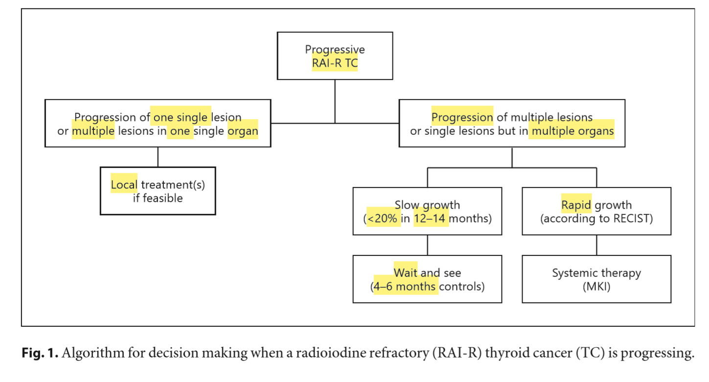

Slide 48
External Beam Radiotherapy
Although RAI-R TC are not very sensitive to radiation, external beam radiotherapy (EBRT) may be indicated in some specific cases .
The primary objective of EBRT in these tumours is to stop the growth or at least to reduce the rate of growth in order to control or prevent symptoms.
For this reason, EBRT can be used for the treatment of inoperable primary or locally recurrent TC. Similarly, it can be considered in case of recurrent lymph node metastases after repetitive surgery.
EBRT is associated with improved local disease control and a longer progression free survival time.

Slide 49
With the same medical objective, but also to reduce the pain, EBRT can be used in bone metastases.
Brain metastases may be also treated with EBRT, with a stereotactic radiosurgery and/or whole brain radiotherapy, and a rapid and reliable response may be obtained.
The recent introduction of stereotactic EBRT has opened up the possibility of treating small metastatic lesions in any organ including lungs, for which a diffuse radiation exposure is contraindicated due to the high risk of radiation fibrosis and respiratory dysfunction.

Slide 50
Treatment of Tracheal Infiltration or Compression
When the trachea is infiltrated and tumour invasion of the tracheal lumen is found at bronchoscopy, an ablative laser treatment to minimize obstruction can be performed.
If necessary, this treatment can be periodically repeated, possibly not more frequently than every 6 months.

Slide 51
This treatment should be preferred to EBRT of the trachea in patients who are candidates for MKI treatment, since, in real life, patients previously submitted to external radiotherapy seem to be at risk to develop an irreparable fistula (Fig. 2) If the trachea is not infiltrated but progressively compressed by the local tumour mass, an endotracheal stent may be applied to reduce the risk of suffocation.

Slide 52
Metastasectomy of Bone and Lung Metastases
With the improvement of surgical skills and techniques, bone metastases (e.g., vertebral lesions) can be safely removed .
Similarly, selected lung nodules can be removed under thoracoscopy without surgical morbidity.

Slide 53
Percutaneous Interventional Techniques
They can be classified as vascular, ablative or consolidative treatments. The vascular techniques include the transarterial embolization and the transarterial chemoembolization (TACE) and exploit the hyper-vascular characteristic of the TC visceral or bone metastases.

Slide 54
The ablative techniques are applied to achieve partial or complete necrosis of the neoplastic tissue by causing a dramatic increase (≥55 ° C in radiofrequency) or decrease (around –40 ° C through cryoablation) of the intra-tumoral temperature in the visceral or bone metastases.
The necrotic process can be also achieved by the ultrasound guided ethanol injection, usually in metastatic lymph nodes.

Slide 55
Conventional TACE
This technique is commonly used for palliative treatment of advanced hepatocellular carcinoma, but in some advanced cases of liver metastatic disease can also be applied in other human tumours including advanced TC.
This procedure seems to have a clinical benefit when liver metastases are smaller than 3 cm and liver involvement is less than 30%.
It is yet unproven if conventional TACE used in selected patients with advanced TC is really effective at prolonging survival or at least progression-free survival. Cases are relatively rare, and a prospective study is still missing

Slide 56
Recently, the transarterial delivery of Y90 radiolabelled resin microspheres, named radioembolization (or cTARE), has been successfully introduced into clinical practice for treatment of hepatocellular carcinoma and neuroendocrine tumours, but studies on liver metastasis of RAI-R TC are missing.

Slide 57
Radiofrequency Thermoablation
This procedure is based on the use of electromagnetic waves that induce movement and consequently the production of heat to destroy tumour cells.
The technique was initially developed for the treatment of primary and metastatic liver malignancies .This treatment can be applied to local disease, such as metastatic lymph nodes but also to bone, liver, and lung lesions, if technically possible and clinically indicated.

Slide 58
Thus, it might be performed when the lesion to be treated is the only site of disease or the only one amongst others that is growing, and where there is no surgical option.
Radiofrequency thermoablation is a safe procedure to treat the viable tumour tissue and to reduce the volume of a metastatic lesion ,which can be after wards submitted to surgical removal.

Slide 59
Ultrasound-Guided Percutaneous Ethanol Ablation
In case of neck relapse, small metastatic lymph nodes < 1.0–1.5 cm can be frequently found.
If smaller than 1.5 cm in the largest diameter, they can just be periodically observed (every 6–12 months) until the evidence of a stable volume and a stable number.
If growing, they can be successfully and safely treated with ultrasound-guided percutaneous ethanol ablation that can be repeated in case of recurrence.

Slide 60
This procedure is often manageable at ambulatory level, does not require hospitalization, and has a very low cost.
However, it is worth to note that in advanced and progressive TC, neck lymph node metastases are often a negligible problem compared to the other types of metastases, and therefore observation may be sufficient.

Slide 61
Cementoplasty of Bone Metastases
It is a palliative treatment for osteolytic bone metastases, to be performed alone or in combination with other local treatments, such as radiofrequency ablation or EBRT.
Its aim is to obtain the reinforcement of bone defect through percutaneous injection of polymethylmethacrylate cement. This minimally invasive technique can be performed in any metastatic site and results in significant pain relief, offering stability of the affected bones.

Slide 62
Recommendation
[R14] If the progression is limited to a single lesion or more than one lesion within the same organ, the possibility of performing a local treatment should be considered.
[R15] Local treatment can be also done during systemic therapy if only a single lesion starts to grow. In this case, local therapy can be considered without interrupting MKI treatment temporarily or withdrawing it just for few days.

Slide 63
When to Start Treatment with MKIs?
The conclusion that a patient has RAI-R disease and/ or disease progression should not automatically lead to the initiation of treatment with MKI.
In answering the question whether or not initiation of MKI is beneficial, the following questions are relevant.

Slide 64
Tumour Load
Currently, no studies have been published on the relationship between tumour load and efficacy of MKIs.
Subgroup analyses of the DECISION and SELECT studies indicated that sorafenib and lenvatinib were more effective in smaller tumours ,however, no definite cut-off level with respect to tumour size can be derived from the literature.

Slide 65
Symptoms
No studies are available on the relationship between clinical symptoms and efficacy of MKIs.
Subgroup analyses of the DECISION and SELECT studies did not show differences in efficacy in relation to the presence of symptoms, Consequently, it cannot be concluded from the literature if an MKI should be initiated before the occurrence of clinical symptoms or when clinical symptoms have occurred.
However, ECOG is a major criterion with treatment being more efficient in patients with ECOG 0–1. Currently, an international prospective observational trial is being performed to address this issue.

Slide 66
Location of Metastases
No relationship has currently been identified between location of metastases and efficacy of MKIs.
Subgroup analyses of the DECISION and SELECT studies did not show differences in efficacy in relation to location of metastases
Brain and liver metastases might be less responsive than other sites.

Slide 67
Age
In a sub-analysis of the SELECT trial by Brose et al. the safety and efficacy of treatment with lenvatinib were compared between a group of patients with a median age of 56 years, and a group of older patients with a median age of 71 years.
The incidence of severe treatment-related adverse events (AEs) was significantly higher in older patients versus younger patients (89 vs. 67%, respectively; p < 0 .001).

Slide 68
Older patients were also more likely to experience AEs requiring dose modifications, and they received a lower median daily dose, though no significant difference was observed in progression-free survival between the two groups.
This highlights the importance to accurately evaluate risks and benefits of MKI treatment in each patient.

Slide 69
Genetic Profile
Although MKIs have distinct invitro activity in relation to molecular targets, no clear relationships have been identified between genetic profiles of TC in patients and efficacy of drugs.
Subgroup analyses of the DECISION and SELECT studies did not show differences in efficacy in relation to BRAF or RAS genetic alterations.

Slide 70
The decision on when to start treatment with MKIs should be addressed in an MDT, weighing all the benefits and disadvantages.

Slide 72
Recommendation
[R16] As currently no curative drug treatments for RAI-R TC are present, and MKIs are accompanied by side effects, experts agree that treatment with MKIs should only be considered in patients with progressive RAI-R disease, with considerable tumour load and when, according to a multidisciplinary group of experts, refraining from treatment with MKIs would lead to considerable harm/clinical complications within the near future.
Before starting MKIs, local treatments should be considered.

Slide 73
[R17] The decision to start MKIs should include patient-related medical factors (age, health status, comorbidities, and contraindications) and patient preferences with respect to treatment goals and values, and acceptance of adverse effects.

Slide 74
Dosage
Following the DECISION trial, approval for sorafenib was given at the dosage of 400 mg (2 × 200-mg tablets) twice daily (adult patients) .
The drug should be taken 12 h apart, without food, at least 1 h before or 2 h after a meal.
Following the SELECT trial, approval for lenvatinib was given at the dosage of 24 mg (2 × 10-mg and 1 × 4-mg tablets), once daily (adult patients) .
Capsules can be swallowed whole or, in selected cases, they can be dissolved in a small amount of water and administered with or without food intake.

Slide 75
In case of severe renal impairment (creatinine clearance less than 30 mL/min calculated by the Cockcroft-Gault equation using actual body weight), or in case of severe hepatic impairment (Child-Pugh C), the recommended dosage of lenvatinib for DTC patients is 14 mg orally once.

Slide 76
Globally, in case of grade 3 or grade 4 AEs, it is recommended to with hold the drug until improvement to grade 0 or 1 or baseline and then to either resume at a reduced dose or to discontinue.
However, this depends on the type of AE, and in some cases such as fistulas, it is recommended to withdraw permanently.
For sorafenib, dosage may be reduced to 400 mg once daily or to a single 400 mg dose every other day.

Slide 77
For lenvatinib, first reduction is to 20 mg, second to 14 mg, third to 10 mg.
There are no data on the use of sorafenib in children, whereas lenvatinib was given in children at the dose of 14 mg/m2.

Slide 78
Data from the phase III trials showed that 64% of the patients under sorafenib and 68% of the patients under lenvatinib needed a dose reduction.
66% of the patients under sorafenib and 88% of the patients under lenvatinib required a temporary dose interruption.
and 19% of the patients under sorafenib and 14% under lenvatinib needed withdrawal due to side effects.

Slide 79
Although for lenvatinib a correlation was shown between the drug exposure and the percent of tumour size decrease ,it should be noted that patients over the age of 65 years old, who represent the majority of patients with advanced TC, have more AEs than those < 65 years old .
Based on these results, the question of starting lenvatinib at a lower dosage has been raised, a prospective phase II trial is ongoing comparing the dosage of 24 mg with 18 mg, in order to evaluate if starting lenvatinib at a lower dosage decreases secondary effects without altering treatment efficacy.

Slide 80
Recommendation
[R18] With the exception of patients with severe renal or liver dysfunction, treatment should be started at the approved dosage. However, active management of AEs should be organized in order to decrease the dose in case of AE.
Special attention should be given to older patients because of a higher rate of AEs.

Slide 81
How to Advise the Patient and the Family
Decisions regarding the management of advanced RAI-R TCs are complicated and challenging for the patient and the medical team. As in all situations in medicine, a careful decision making process involving medical, emotional, social, and spiritual factors is essential to find the optimal approach for a patient.

Slide 82
History
Before management proposals can be formulated, information should be collected on the following items: (a) The medical state of the patient, including the disease status, physical performance, presence of comorbidities and co-medication. (b) The emotional situation of the patient. What is the degree of anxiety? Is there depression? (c) The social situation of the patient, including dependency, competences and vulnerabilities and the supportive network. (d) The personal expectations, perspectives, goals, and needs of the patient.

Slide 83
Recommendation
[R19] Gather extensive information on the patients’ psychophysical status before formulating management proposals.
[R20] Develop management plans mostly based on expert opinion of an MDT.
[R21] Inform patient and relatives on benefits and disadvantages of the different available management plans and together decide on appropriate management for the individual patient.

Slide 85
Duration of Treatment and Follow-Up
Tyrosine kinase inhibitors are cytostatic, and not cytotoxic drugs; thus, they exert a break to the cell growth that can restart immediately when the break is removed .
This is the rationale why an MKI therapy should be continued until the evidence of no further clinical benefit. The concept of clinical benefit is not well defined, but we can recapitulate it according to a series of clinical factors such as: (a) the evidence of partial remission or stabilization of the tumour burden, (b) the improvement of symptoms, (c) the slow progression of the disease or the progression of only one lesion while the others are stable

Slide 86
Moreover, there is evidence, at least for sorafenib, that patients who entered into progression and continued to be treated with the drug showed a slower progression than those who stopped the drug .
On the basis of this evidence, the best option for the patient is to continue the drug at least until the evidence that a second line of MKI or a clinical trial with new experimental drugs is available and, at this point, it could be useful to switch the therapy.

Slide 87
Sometimes, MKI therapy leads to severe side effects and if the degree of severity, according to the Common Terminology Criteria for Adverse Events (CTCAE) scale, is ≥3, the drug must be stopped until recovery from the side effects, but then it should be restarted at a lower daily dose.
However, patients must be clearly instructed to report side effects even when they are still low grade in order to avoid MKI interruption. Overall dose reduction, which can be effective when a side effect is still low grade, should be preferred. The final objective is to find a daily dose that can provide a good balance between the quality of life of the patient and the positive effect of the drug.

Slide 89
Follow-Up
[R22] MKI treatment should be continued as long as there is evidence of clinical benefit.
[R23] MKI should be stopped only when another therapeutic option is available or the side effects are intolerable or treatment is no longer providing clinical benefit or at patients’ request.
[R24] In case of side effects, MKI daily dose should be reduced to maintain a balance between a good quality of life and control of disease.

Slide 90
[R25] Patients must be strictly followed during the first 2 months of therapy with blood tests, ECG, and clinical monitoring.
[R26] After 2–3 months of therapy, a first imaging evaluation should be performed to verify the effectiveness of MKI.
[R27] Follow-up visits should be performed every 2 weeks during the first 2 months of MKI therapy, and then every month until the first 6 months, every 3 months within the first year, and after that every 4 months

Slide 91
Management of Side Effects

Slide 93
Among the most frequent AEs (≥50% of patients), are hypertension, particularly in patients taking lenvatinib diarrhoea, weight loss, and fatigue.
Dermatological AEs, such as palmar-plantar erythrodysaesthesia syndrome, skin rash, and alopecia are more frequent during sorafenib therapy.
while mucositis/ stomatitis seem to occur more often during lenvatinib treatment.

Slide 94
AEs occur at a median time of 3–12 weeks after the start of the MKIs and, generally, the frequencies of AEs are higher in the earlier cycles of treatment and diminish over the course of treatment ,indicating that they may be self-limiting in some cases. The response to toxicities should include therapies to rapidly .

Slide 95
Hypertension
It is a frequent AE of MKI treatment and often is grade 2 or 3. Interestingly, recent data in patients with RAI-R TC treated with lenvatinib showed that hypertension significantly correlated with improved outcomes, indicating that it may be predictive of drug efficacy .
Blood pressure and left ventricular ejection fraction should be measured and optimized before starting treatment.

Slide 96
The choice of the antihypertensive drug should be individualized, using angiotensin-converting enzyme inhibitors and/or calcium channel blockers, alone or in association, as the first-line drugs.
If this is not effective, a diuretic should be added, electrolytes monitored, and dehydration avoided.
Patients should check their blood pressure at home, with a daily or biweekly frequency, in order to allow a closer monitoring and titration of antihypertensive therapy, with a target blood pressure ≤140/90 mm Hg (lower in case of overt proteinuria).

Slide 97
Diarrhoea
It is an extremely frequent AE, involving around 80% of patients taking MKIs, and is likely one of the most disabling when the degree of severity is high .
It occurs mostly as grade 1 or grade 2, has a slow onset, and is typically intermittent (2 or 3 episodes per week).
When the degree of severity is < 3, it can be managed with dietary adjustments, with fluid and electrolyte replacement, usually accompanied by pharmacological interventions (such as loperamide, amisulpride, codeine).

Slide 98
Some patients report benefits upon intermittent or prophylactic consumption of natural remedies such as aloe or probiotics.
In case of grade 3 or 4, a dose reduction or interruption until diarrhoea returns to grade 1 is needed.

Slide 99
Weight Loss
It is one of the most important AEs on MKIs, particularly frequent in the real-life experiences with lenvatinib (Table 2).
Anorexia in general or limited to some foods is frequent, and together with diarrhoea is one of the main causes of weight loss.
Further AEs can contribute to weight loss, such as dysgeusia, oral mucositis, dyspepsia, and nausea which can improve by treatment with metoclopramide or serotonin receptor antagonists. MKIs seem to mostly affect muscular mass, but the fat mass is involved too.

Slide 100
Anorexia and weight loss should be carefully managed by nutritional assessment at baseline and then periodically, always with the support of an expert nutritionist. Oral protein-rich, hypercaloric supplements (200–250 kcal/100 ml) should be given at the first demonstration of weight loss, eventually associated with antioxidants. Enteral nutrition (1,000–1,200 kcal/L) should be given in more severe cases.

Slide 101
Fatigue
It is one of the most common and probably one of the most disabling AE observed during MKI treatment. In the registration studies as well as in real-life studies ,fatigue was recorded in around 50–70% of patients, and it was a common reason for drug discontinuation or dose reduction.
Several recommendations are given to patients, such as exercising (to maintain muscle mass), taking caffeine, MKI intake in the evening, monitoring electrolytes, haemoglobin, and TSH, maintaining hydration and adequate food intake, but in most cases these recommendations are not effective

Slide 102
It has been recently reported that primary adrenal insufficiency (PAI) occurs frequently in patients treated with lenvatinib, and that replacement treatment with cortisone acetate consequently leads to relief of fatigue.

Slide 103
Dermatological AEs
Cutaneous alterations, such as the palmar-plantar erythrodysaesthesia syndrome (“hand-foot syndrome”), are rare during lenvatinib treatment, but extremely frequent under sorafenib, being the most common reason for dose reduction, interruption, and withdrawal (Fig. 3).
The intensity is variable and increases in the first months of therapy with a progressive decrease thereafter.

Slide 104
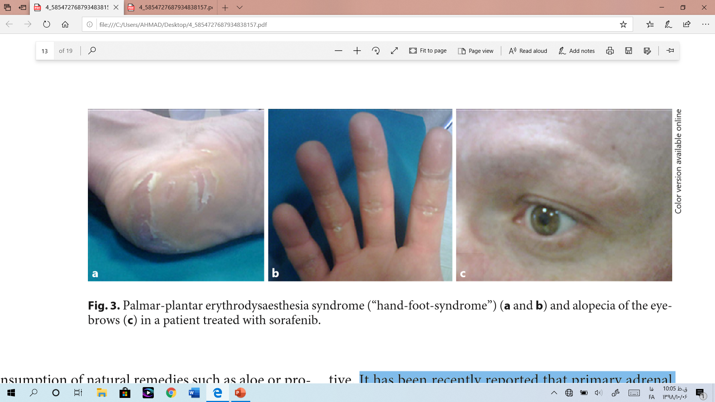

Slide 105
Management includes keeping hands and feet well hydrated, wearing comfortable shoes, avoiding hot water and trauma, removing calluses, and using pain medication as needed. In more severe cases, ibuprofen (600 mg three times a day) can be prescribed, though dose reduction or short interruptions of MKIs can be required.
Skin rash/sun burn after outdoor activities are also underestimated AEs and can be prevented by avoiding direct sunlight exposure, wearing protective clothing, including a hat and using sunblock (UF ≥50).

Slide 106
Mucositis/Stomatitis
Oral AEs usually occur within 2–4 weeks of initiating therapy. Oral hygiene and frequent mouthwash with water and baking soda, high-molecular-weight hyaluronic acid, or aloe vera extracts are recommended.
Topical anaalgesics alone or in combination (lidocaine 2%, diphenhydramine, bismuth subsalicylate, aluminum or magnesium hydroxide) can be used in more severe cases .

Slide 107
Proteinuria
Baseline and periodic assessment of urinary protein excretion is mandatory particularly in lenvatinib treatment. Angiotensin-converting enzyme inhibitors or angiotensin receptor antagonist are generally effective. In the rare occurrence of nephrotic syndrome, MKI treatment must be temporarily discontinued.

Slide 108
Increase in TSH Levels
Thyroid function should be monitored every 1–2 months since thyroxine dosage needs to be increased in many TC patients on MKIs .

Slide 109
Delay in Wound Healing
Inhibition of the VEGFR signalling pathway impairs angiogenesis and can delay the wound healing process. It is thus recommended to withdraw MKI treatment 3–10 days before and after surgery or tooth extraction, depending on the extent of the procedure.

Slide 110
Rare AEs
Some rare AEs are the consequence of MKI-induced hypertension, such as congestive heart failure, haemorrhage, and cardiac infarction. Arterial thrombotic events, in particular acute coronary syndrome, require immediate cardiological treatment.
The occurrence of arterial thrombotic events may require permanent drug withdrawal.
Venous thrombotic events should be managed by low-molecular-weight heparin.

Slide 111
Alterations in blood cell count can occur during MKI treatment, and in most cases are grade 1 and 2 .
Arthralgias and myalgias occur in around 10% of patients and can be managed by analgesia and if required corticosteroid therapy.
Hoarseness has been reported in around 15% of lenvatinib-treated patients.

Slide 112
A rare but severe AE is the reversible posterior leukoencephalopathy syndrome. At onset, neurological symptoms can be observed, and alterations of the white matter, consistent with toxic encephalopathy, can be documented on cranial MRI. MKI treatment must be stopped and a “restitution ad integrum” is usually observed within 2–3 weeks.

Slide 113
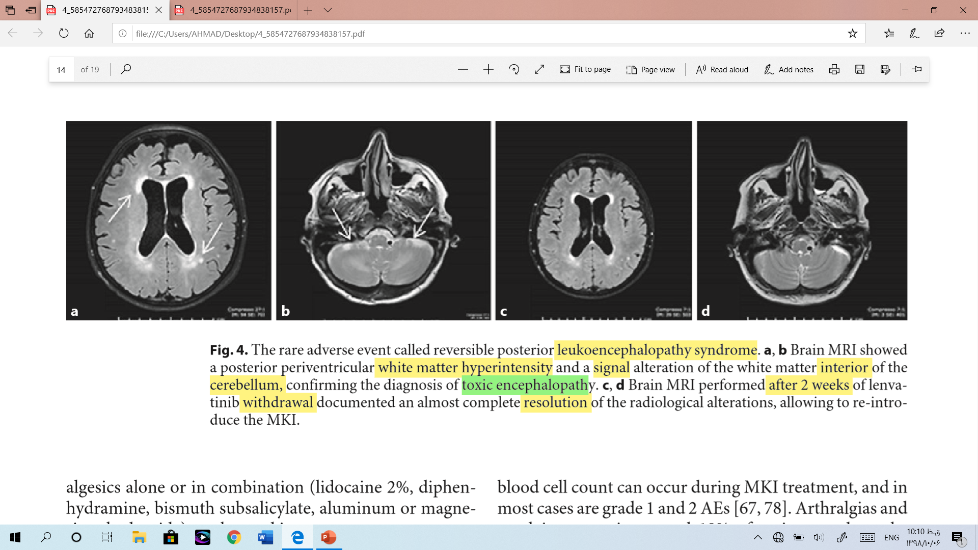

Slide 114
A range of potentially serious gastrointestinal (GI) tract AEs, such as haemorrhage, intestinal perforation and GI and non-GI (i.e., tracheal or oesophageal) fistulas can be observed .
The risk of intestinal perforation with MKIs is probably higher in patients with a history of bowel conditions, such as colitis or diverticulitis, and tracheal or oesophageal fistulas preferentially occur at site of previous surgery or irradiation.

Slide 115
Treatment must be discontinued if a perforation or a fistula occurs.
Lenvatinib-induced renal failure has recently been reported, due to glomerular damage with proteinuria or tubulointerstitial injury without proteinuria.

Slide 116
Recommendation
[R28] An accurate multidisciplinary evaluation of the clinical features of the patient should be performed before starting MKIs.
[R29] Patient and carer education regarding potential toxicities and their management should be provided prior to initiation of treatment.
[R30] Patients must be instructed to report AEs, even when they are still low grade.
[R31] Patients must be treated by a TC specialist within an MDT and timely and effective supportive care and MKI dose adjustment should be given as needed.

Slide 117
Recommendation
[R32] Clinical and biochemical controls (including clinical examination, evaluation of AEs, blood count, urine analysis, renal and hepatic function, TSH, calcium) must be performed every 2 weeks during the first 2 months of treatment.
[R33] In order to limit the number of visits and to increase the compliance of patients, it is suggested to establish a dedicated contact number.
[R34] Every effort and intervention should be made in order to limit dose reduction and to avoid drug discontinuation.

Slide 118
Palliative Treatments
[R35] Early involvement of the palliative care team is encouraged to optimize symptom control and psychosocial support in patients with advanced TC.
[R36] Consideration should be given to locally ablative therapies to palliate specific symptoms.
[R37] Consideration should be given to the systemic management of bone metastases to minimize SREs

Slide 119
Ethical Considerations
[R38] The management of patients with advanced RAI-R TC should respect general ethical principles, such as: equality, competence, cultural values, physician-patient communication, privacy and confidentiality, and conflicts of interest. Physicians are obliged to respect autonomous patients’ preference. [R39] Once approved therapies have failed or if there are reasons for rejecting them, patients with advanced TC should be treated preferably within randomized clinical trials to provide evidence-based data on adequate therapeutic approach.

Slide 121
با تشکر از توجه شما

