Slide 2
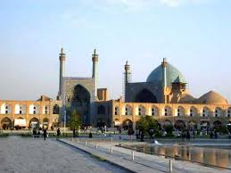
Familial hypercholesterolemia in children “Diagnosis and Treatment “
Dr . Hashemi
Pediatric Endocrinologist
Isfahan University Of Medical Sciences

Slide 3
Definition of pediatric dyslipidemia
Based on normative data:
“Acceptable"
“Borderline"
“Abnormal"

Slide 4
Definition of lipid levels in children
Category | Acceptable mg/dl | Borderline mg/dl | High mg/dl
TC | < 170 | 170 - 199 | ≥ 200
LDL - C | < 110 | 110 - 129 | ≥ 130
NON – HDL - C | < 120 | 120 - 144 | ≥ 145
TG
0 – 9 years | < 75 | 75 - 99 | ≥ 100
10 – 19 years | < 90 | 90 - 129 | ≥ 130
APO B | < 90 | 90 - 109 | ≥ 110

Slide 5
Definition of lipid levels in children
Category | Acceptable mg/dl | Borderline mg/dl | Low
HDL - C | > 45 | 40 - 45 | < 40
APO A | > 120 | 115 - 120 | < 115

Slide 6
PREVALENCE
Approximately 20 percent of children (age 6 to 19 years) have adverse levels of one or more lipid value .

Slide 7
PREVALENCE
Normal weight : % 14
Overweight : % 22
Obese : % 43

Slide 8
ETIOLOGY
Monogenic
Secondary
Related to specific diseases
Idiopathic
Related to polygenic defects
Single gene defect

Slide 9
Familial hypercholesterolemia

Slide 10
INTRODUCTION
Familial hypercholesterolemia (FH) is an autosomal dominant disorder in which mutations occur in the low-density lipoprotein (LDL) receptor and its related genes.

Slide 11
INTRODUCTION
The associated impairment in function of these receptors results in reduced clearance of LDL-C particles from the circulation and an elevation in serum LDL-C.

Slide 12
CLASSIFICATION
Homozygous FH
Heterozygous FH

Slide 13
Homozygous Familial Hypercholesterolemia
Homozygous (HoFH) is a rare and life-threatening disease.
Markedly elevated circulating levels of LDL-C.
Accelerated, premature atherosclerotic cardiovascular disease (ACVD).

Slide 14
HoFH
The first major CV events often occur during adolescence, although angina pectoris, myocardial infarction and death have been reported in early childhood.

Slide 15
Prevalence of HoFH
The condition occurs in 1 in 1,000,000 persons. ( 160 – 300000 )

Slide 16
Genetics of HoFH
LDL receptor mutation ( 85 to 90 % )
APOB mutations ( 1 to 12 % )
Gain-of function PCSK9 mutations ( 2 to 4 % )
LDLRAP1 mutation ( AR )

Slide 17
Combination of genetic mutation showing Homozygous FH

Slide 18
Genetics of HoFH
LDLR-negative, <2% residual activity, clinical severity is greater than LDLR-defective, 2-25% residual activity.

Slide 20
Diagnosis of HoFH
Genetic confirmation of two mutant alleles (LDLR, APOB, PCSK9 or LDLRAP1 )
OR
An untreated LDL-C > 500 mg/dl or treated LDL-C ≥ 300 mg/dL together with either:
Cutaneous or tendon xanthoma before age 10 years or
Untreated elevated LDL-C levels in both parents
These LDL-C levels are only indicative, and lower levels, especially in children or in treated patients, do not exclude HoFH.

Slide 21
Clinical Features of Homozygous FH
Cholesterol : threefold to sixfold average (600 - 1,200 mg/dL)
LDL-C : 550 - 950 mg/dL
Triglyceride levels are normal to mildly elevated.
HDL levels may be slightly decreased.

Slide 22
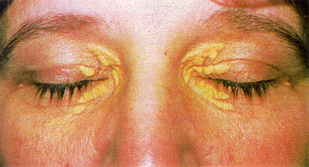
Clinical Features of Homozygous FH
Xanthelasma
Cholesterol-filled, soft, yellow plaques that usually appear on the medial aspects of the eyelids.

Slide 23
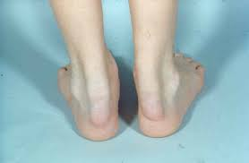
Clinical Features of Homozygous FH
Tendon xanthomata
Are most common in the Achilles tendons and dorsum of the hands but can occur at other sites.

Slide 24
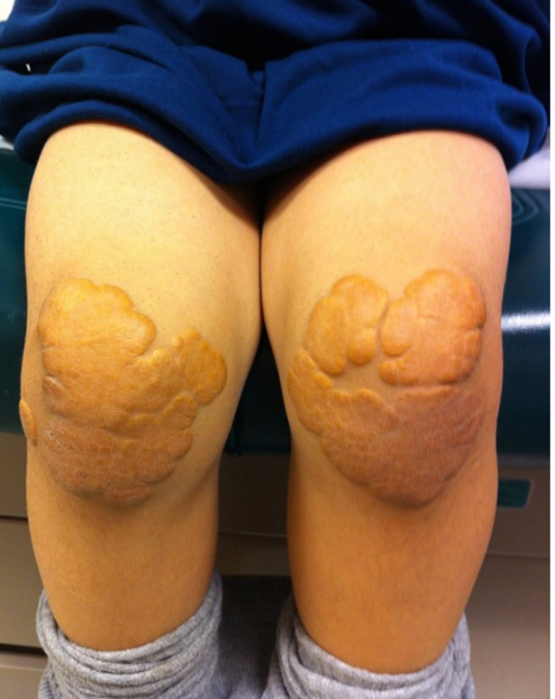
Clinical Features of Homozygous FH
Tuberous xanthomata
Typically occur over extensor surfaces such as the knee and elbow

Slide 25
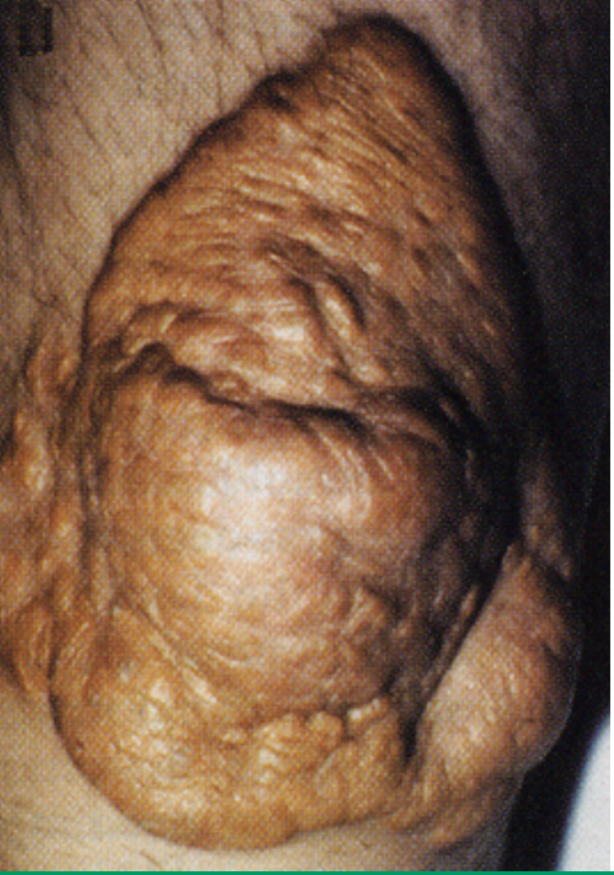
Clinical Features of Homozygous FH
Planar xanthomas
Occur on the palms of the hands and soles of the feet and are often painful

Slide 26
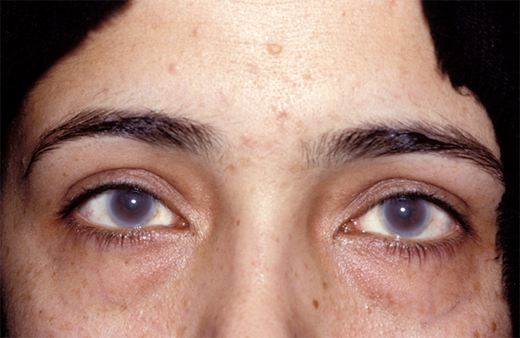
Clinical Features of Homozygous FH
Premature arcus cornea
White or grey arc or ring around the cornea due to deposition of cholesterol (age < 40Y )

Slide 27
Management of HoFH
Lifestyle intervention and maximal statin therapy are the mainstays of treatment, and should be started :
In the first year of life
OR
At initial diagnosis
Typically start statin therapy simultaneously with lifestyle changes.

Slide 28
Management of HoFH (Lifestyle intervention)
Lifestyle intervention — dietary modification, physical activity, weight loss for obese children, and avoidance of nicotine exposure.

Slide 29
Dietary modification
Children should be encouraged to eat a diet that is :
High in fiber from fruits, vegetables, and whole grains
High in polyunsaturated and monounsaturated fats
Low in saturated fat and devoid of trans fats
Fat should comprise approximately 30 percent of total energy intake, and saturated fats should be limited to <10 percent of total energy intake.

Slide 30
Dietary modification
For patients with persistent hypercholesteremia despite appropriate dietary modification, further restricting fat intake may be reasonable:
Limiting total fat to 25 to 30 percent of total calories and saturated fat to ≤7 percent of total calories.
1 to 2 years: Fat and cholesterol intake are not restricted.

Slide 31
Management of HoFH (Statins)
Decrease cholesterol synthesis, increase LDL receptor-mediated removal of LDL

Slide 32
Management of HoFH (Statins)

Slide 34
Timing of administration
The majority of cholesterol synthesis appears to occur at night , presumably reflecting the effects of a fasting state.

Slide 35
Timing of administration
FDA has recommended evening administration for statins with shorter half-lives (lovastatin 2 h , simvastatin < 5 h , and fluvastatin < 3 h).
FDA suggests daytime administration for statins with longer half-lives (atorvastatin 14 h , rosuvastatin 19 h , and pravastatin 22 h).

Slide 36
Side effects of Statins
Side effects with statins are rare and include :
Myopathy ( hypothyroidism may predispose )
New-onset type 2 diabetes mellitus
Hepatic enzyme elevation ( 0.5 to 3.0 %, first 3 months of therapy and is dose-dependent )
Renal dysfunction (proteinuria through tubular inhibition of active transport of small MWP)

Slide 37
Other possible associations with Statins
Cancer
Cataract
Neuropathy
Lupus
Androgen synthesis
Immune response
Risks in pregnancy and breastfeeding

Slide 38
Monitoring
Baseline laboratory evaluation prior to initiating statin therapy:
FLP
Serum creatine kinase (CK)
Serum alanine aminotransferase (ALT)
Blood glucose and hemoglobin A1C levels
Pregnancy test, if clinically indicated
FLP, ALT, glucose, and hemoglobin A1C are repeated four and eight weeks after starting therapy to determine the efficacy of the treatment and to assess for adverse effects.

Slide 39
Monitoring
Once on stable therapy, lipid levels, glucose, and A1C are repeated every six months.
Ongoing monitoring of growth and other measures of general and cardiovascular health (eg, blood pressure) should also occur at each visit.
Repeated testing of liver function tests and CK in asymptomatic patients is controversial, and many clinicians consider this unnecessary.

Slide 40
Management of HoFH
Even at the highest doses of the most efficacious Statins, only modest reductions in LDL levels are observed.
Combination of statin plus Ezetimibe can produce a further decrease in LDL levels of 10-15%.

Slide 41
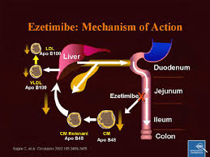
Management of HoFH (Cholesterol absorption inhibitors)
Ezetimibe (10 mg / day)
Side effects : diarrhea, myalgia

Slide 42
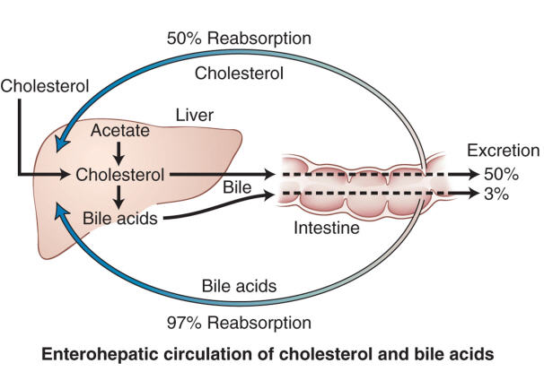
Management of HoFH (Bile acid sequestrants)
BAS are not as effective as statins in lowering LDL-C and have adverse side effects (constipation and bloating).
For these reasons, are used relatively infrequently.

Slide 44
Management of HoFH (Bile acid sequestrants)

Slide 45
Management of HoFH (Bile acid sequestrants)
Colesevelam is the best tolerated of these agents .
These agents can affect the absorption of folate and fat-soluble vitamins, appropriate supplementation and monitoring.

Slide 46
Management of HoFH
Minimal target is <150 mg/dL .
Very rarely achieved with conventional treatments.

Slide 47
Management of HoFH (Lipoprotein apheresis)
If the patient fails to reach the following LDL-C targets with diet and pharmacotherapy:
●LDL-C ≥160 mg/dL in children with established atherosclerotic CVD.
●LDL-C ≥250 mg/dL in children without established atherosclerotic CVD.

Slide 48
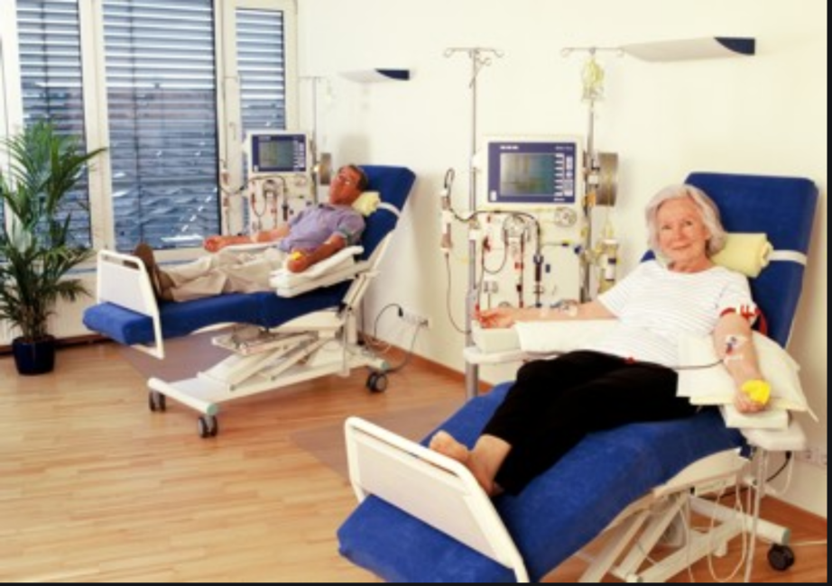
Management of HoFH (Lipoprotein apheresis)
LDL apheresis refers to the extracorporeal removal of circulating apo B-containing lipoproteins, including LDL, lipoprotein (a), and VLDL.
(Dextran sulphate cellulose adsorption, heparin-induced extracorporeal LDL cholesterol precipitation, immunoadsorption, and double filtration plasma pheresis of lipoproteins)

Slide 49
Management of HoFH (Lipoprotein apheresis)
Long-term lipoprotein apheresis can contribute to plaque regression and/or stabilisation and improve prognosis .
Treatment should be started by age 5 .
The procedure is performed weekly or biweekly.
Lowers LDL-C acutely by 50 to 76 percent.

Slide 50
Management of HoFH (Lipoprotein apheresis)
Side effects : hypotension, anemia, nausea, flushing, and headache.
Venous access is necessary.

Slide 51
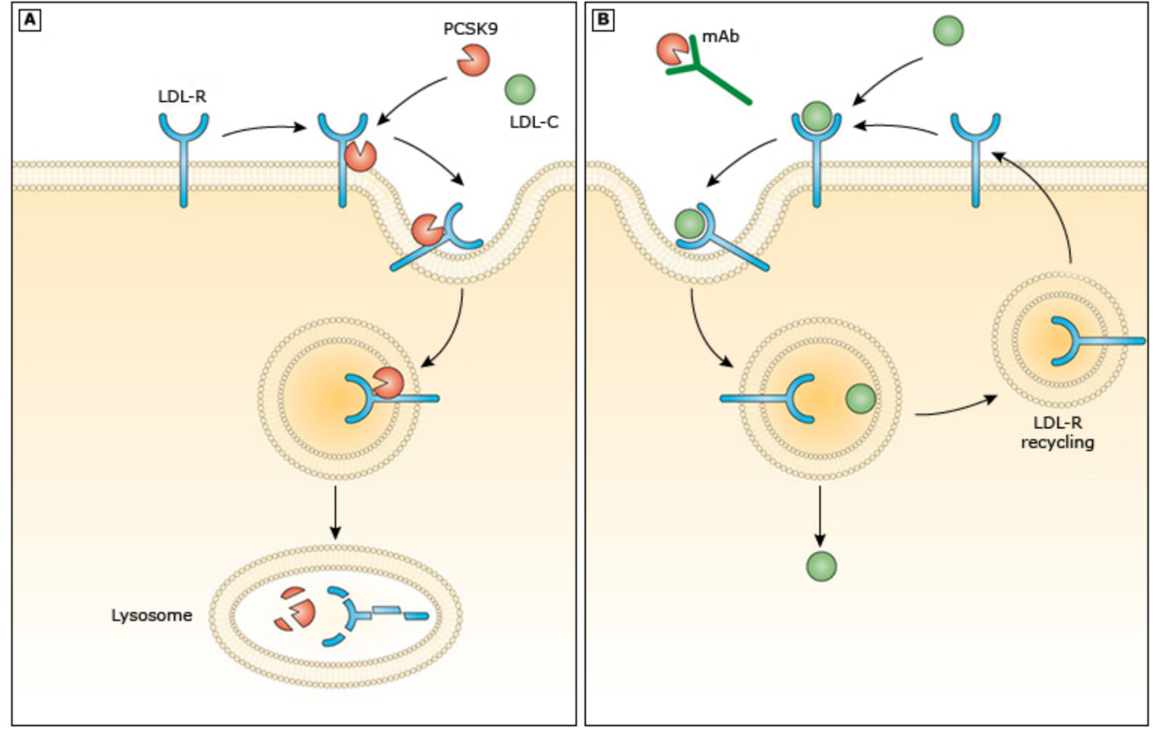
Management of HoFH (PCSK9 inhibitors)

Slide 52
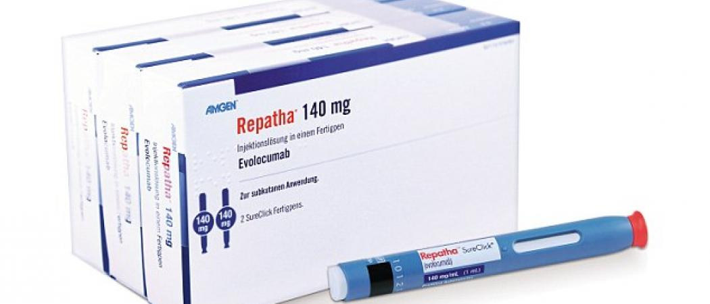
Management of HoFH (PCSK9 inhibitors)
Evolocumab is approved in adolescents (≥12 years old) with homozygous FH (140 mg subcutaneously every two weeks or 420 mg once monthly)

Slide 53
Side effects of PCSK9 inhibitors
Immunologic and allergic effects — Hypersensitivity reactions such as rash, pruritus, and urticaria .
Hepatitis C virus (HCV) infectivity — Theoretically, PCSK9 antibodies can boost HCV entry into the liver by upregulation of LDL-R and CD81 on hepatocytes .

Slide 54
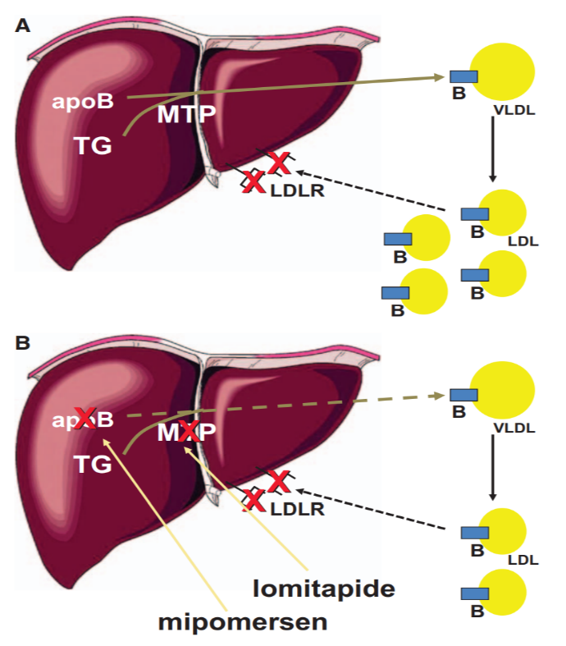
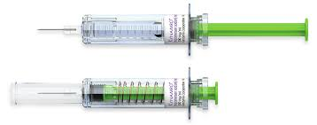
Management of HoFH (Mipomersen)
≥12 years
Once weekly subcutaneous injection.
200 mg per week (160 mg if body weight was <50 kg)

Slide 55
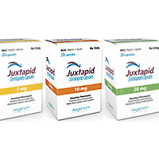
Management of HoFH (Lomitapide)
Lomitapide (inhibitor of microsomal triglyceride transfer protein)
≥18 years (0.03 - 1 mg/kg/day ).

Slide 56
Side effects of Lomitapide
Liver toxicity
Embryotoxic
Severe diarrhea ( strict low fat diet )

Slide 57
Management of HoFH
Liver transplantation is increasingly considered as a therapeutic approach in difficult cases.

Slide 58
POTENTIAL FUTURE APPROACHES
Gene therapy
CETP inhibition
Antibody removal of resistin (down-regulate LDL-receptor expression, potentially by increasing the expression of PCSK9)
ETC-1002 (novel, small molecule regulator of lipid and carbohydrate metabolism)

Slide 59
Comprehensive cardiovascular evaluation
At diagnosis testing includes:
Electrocardiogram
Echocardiography
Coronary artery imaging ( cardiac catheterization or CT)
Angiography is then performed every two to three years.

Slide 60
Prognosis of Homozygous FH
Symptomatic CHD can occur before age 10 years.
Susceptible to both valvular and supravalvular aortic stenosis.
If not treated, these persons usually die from myocardial infarction by age 20 years.

Slide 61
Heterozygous Familial Hypercholesterolemia
Heterozygous FH is one of the most common single-gene mutations.

Slide 62
Clinical Features of Heterozygous FH
Plasma cholesterol : twofold to threefold average (>300 mg/ dl)
LDL-C is > 250 mg/dL .

Slide 63
Clinical Features of Heterozygous FH
These children usually present with xanthomas (75%)
Premature arcus cornea
Affected subjects may have no physical findings.

Slide 64
Prevalence of HeFH
HeFH is common, present in ∼1 per 200–250 of the general population.

Slide 65
Management of HeFH
Lifestyle modification
Lipid-lowering agents

Slide 66
Management of HeFH
If dietary and lifestyle modifications fail to achieve this, pharmacologic treatment with statins is recommended beginning at ages 8-10 years.

Slide 67
Management of HeFH
Pravastatin has FDA approval for children age ≥ 8 years with HeFH. Lovastatin, simvastatin, fluvastatin, atorvastatin, and rosuvastatin have been approved for children ≥10 years with HeFH.

Slide 68
Management of HeFH
Target LDL-C level < 130 mg/dl OR 50% reduction from pre-treatment

Slide 69
Prognosis of Heterozygous FH
Premature coronary artery disease is common
Age of onset of coronary disease is about 45 years in men and women.

Slide 70
DIFFERENTIAL DIAGNOSIS
Familial combined hyperlipidemia
(some hypertriglyceridemia, some hypercholesterolemia, some both, DM, Obesity)
Polygenic hypercholesterolemia
(elevated LDL-C , normal TG , tendon xanthoma are not seen)
Familial dysbetalipoproteinemia
(elevated LDL-C = elevated TG , xanthoma , rarely in < 20 y )
Secondary causes of dyslipidemia

Slide 71
DIFFERENTIAL DIAGNOSIS
Sitosterolemia
ABCG5 – ABCG8
Hyperabsorption of cholesterol and plant sterols from the intestine.
Tendinous and/or tuberous xanthomas in childhood.
High plasma cholesterol and atherosclerotic complications.
Typically respond well to diet , BAS , and ezetimibe.

Slide 72
DIFFERENTIAL DIAGNOSIS
Cerebrotendinous xanthomatosis
Deficiency of 27 hydroxylase
Block in bile acid synthesis
Neurologic, cognitive, Ophthalmic symptoms, Osteoporosis
Xanthoma
High level of Cholesterol

Slide 73
Uptodate 2019
Williams text book of endocrinology 2018
Emedicine
Nelson text book of pediatric 2020
Guidance for Pediatric Familial Hypercholesterolemia 2017

