Slide 1
Management Of Graves Orbitopathy
by: atefeh rezaeifar
Endocrinology fellow
Nov 2019

Slide 2
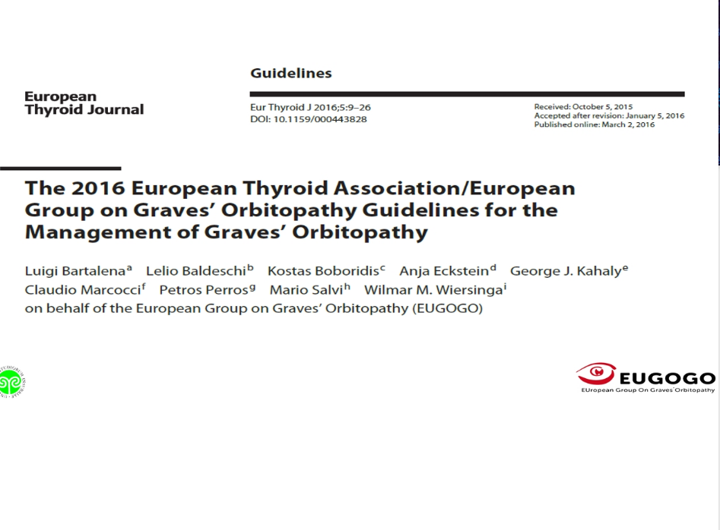

Slide 3
incidence of Graves’ hyperthyroidism in the general population of Sweden :
210 per million per year, female:male ratio of 3.9: 1 and a peak incidence between 40 and 60 years .
incidence of GO 42.2 per million per year (20.1% of the incidence of Graves’ hyperthyroidism)
incidence of GO In Denmark:
Incidence of moderate-to-severe and very severe GO is 16.1 per million per year in
the general population, with a female:male ratio of 5: 1 and a peak incidence between 40 and 60 years.

Slide 4
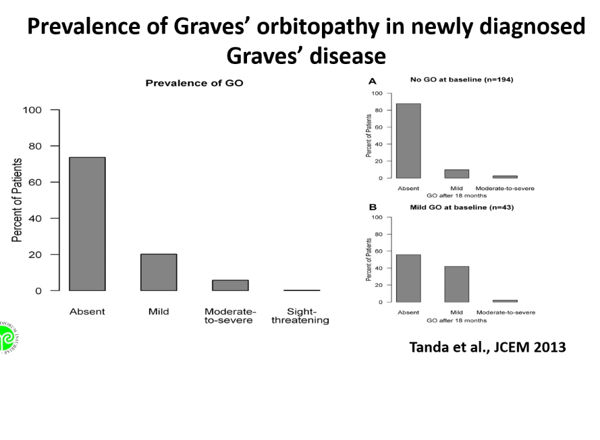

Slide 5
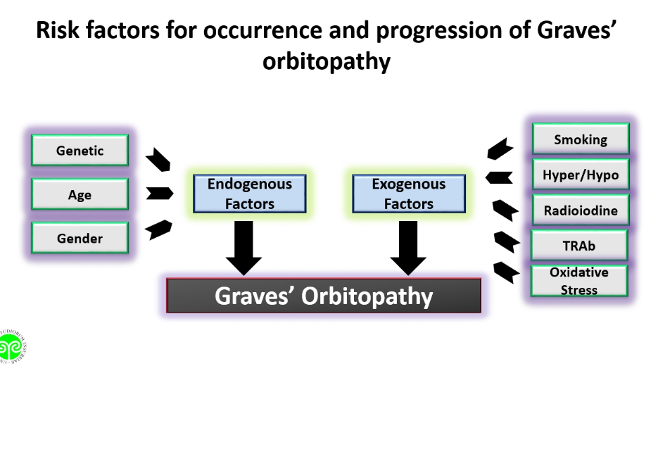

Slide 6
What Should Be the Clinicians’ General Approach to Patients with GO?
quality of life (QoL) surveys :
reduced QoL, equivalent to having diabetes or certain cancers
Optimal treatment has been shown to improve QoL in such patients.
Direct and indirect costs : disabilityand/or unemployment) are significant

Slide 7
Recommendation1
We recommend a patient-focused approach to the treatment of patients with GO, which encompasses the effects of the disease and its treatment on QoL and psychosocial well-being.
Use of GOQoL, a disease specific and validated tool, is recommended in routine clinical practice .( (1, ∅ ∅ ○○)

Slide 8
Why and How Should Activity and Severity of GO Be Assessed?
Selecting the most appropriate treatment for individual patients depends on the activity and severity of the eye changes.
Activity is easily measured by the clinical activity score (CAS).
CAS ≥3 is indicative of active GO.

Slide 9
Recommendation2
We recommend that activity and severity of GO be assessed according to standardized criteria and that GO be categorized as active or inactive and as mild, moderate to severe or sight threatening.
(1, ∅ ∅ ∅ ○)

Slide 11
GO severity assessment according to EUGOGO
* Mild GO
features of GO have only a minor impact on daily life insufficient to justify immunosuppressive
or surgical treatment. one or more of thefollowing:
minor lid retraction (<2 mm), mild soft-tissue involvement, exophthalmos <3 mm above nl ,no or intermittent diplopia and corneal exposure responsive to lubricants
* Moderate-to-severe GO
without sight-threatening GO
eye disease has sufficient impact on daily life to justify the risks of immunosuppression (if active) or surgical intervention (if inactive)
. two or more of the following:
lid retraction ≥2 mm
moderate or severe soft-tissue involvement
exophthalmos ≥3 mm above normal
inconstant or constant diplopia
* Sight-threatening GO (very severe GO)
Patients with DON and/or corneal breakdown

Slide 12
Should All Patients with GO Be Referred to Specialized Centers or Thyroid-Eye Clinics?
GO appears to be less frequent and milder in patients with newly diagnosed Graves’ hyperthyroidism now than some years ago and rarely progressive to more severe forms
Also, patients referred to tertiary referral centers have less severe and, more often, inactive GO than in the past
These trends may reflect earlier diagnosis of GO and more effective management
strategies of Graves disease by endocrinologists and ophthalmologists, and under score
the role of specialized centers for early clinical care of these patients.
.

Slide 13
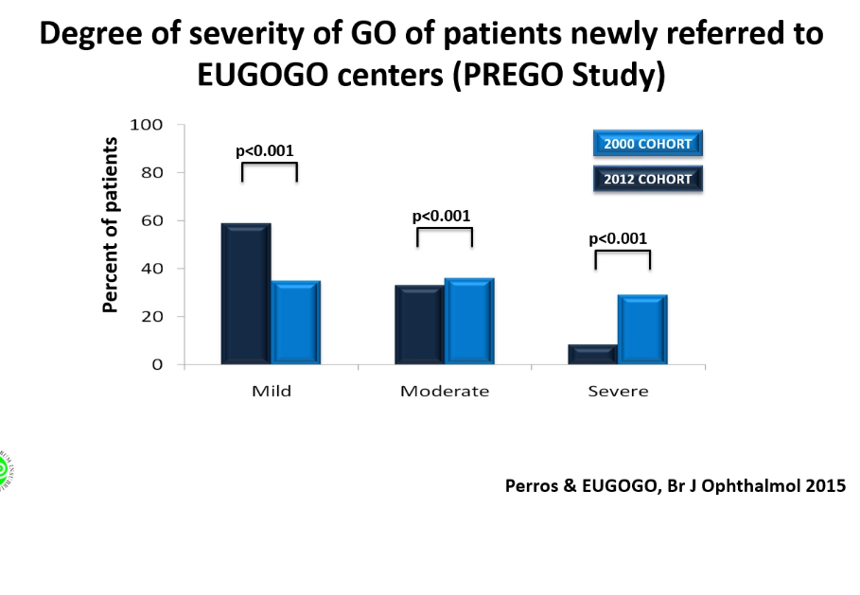

Slide 14
Recommendation3
We recommend that primary-care physicians, general practitioners,
general internists and specialists should refer patients with GO to combined thyroid-eye clinicsor specialized centers providing endocrinological and
ophthalmological expertise – except for the mildest cases improving with normalizing thyroid status and local lubricants.
(1, ∅ ∅ ○○)

Slide 15
How Should Risk Factors for GO Occurrence or Progression Be Managed?
Smoking
The association between smoking and GO is well established
smokers have more severe GO than nonsmokers
smokers are more likely to show progression or denovo occurrence of GO after radioiodine treatment .
smoking delays or worsens the outcome of immunosuppressive treatment for GO
smoking cessation was associated with a better outcome of GO
all patients with Graves’ hyperthyroidism, irrespective of the presence or absence of GO,
should be urged to quit smoking.

Slide 16
Recommendation4
We recommend that physicians urge all patients withGraves’ hyperthyroidism, irrespective of the presence/absence of GO, to refrain
from smoking, if necessary with the help of specialized smoking
cessation programs or clinics.
(1, ∅ ∅ ∅ ○)

Slide 18
Thyroid Dysfunction and Treatment:
Restoration and maintenance of euthyroidism is imperative in the presence of GO,
because both hyper- and hypothyroidism have a negative impact on GO
Antithyroid drugs and thyroidectomy :per se donot appear to affect the natural
course of GO .
Radioiodine treatment confers a small, but definite risk of exacerbation or de novo
development of GO particularly in smokers, in severe hyperthyroidism(high free thyroid
hormone levels and/or TSHreceptor autoantibodies) and hyperthyroidism of recent onset

Slide 19
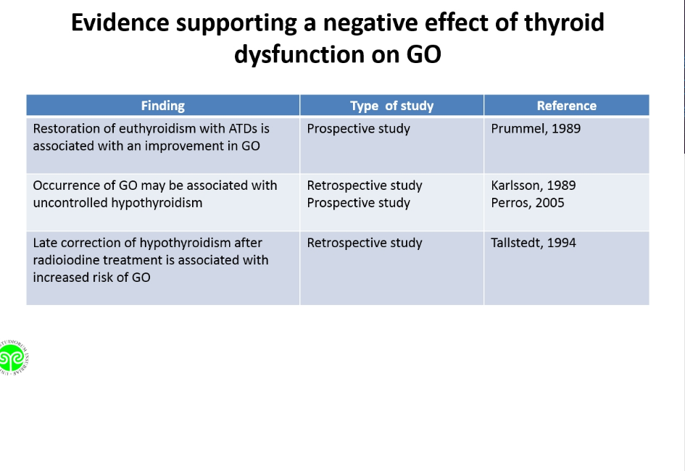

Slide 20
This detrimental effect can be nearly always prevented in patients at risk by oral
prednisone prophylaxis given concomitantly with radioiodine treatment.
. The original schedule used a starting dose of 0.3–0.5 mg prednisone/kg/day,
and duration of treatment was 3 months . It was subsequently shown that a 6-week course using lower doses (starting dose, 0.2 mg prednisone/kg /day) was equally effective.
However, a recent randomized prospective study from Japan showed that the low-dose oral prednisone schedule may not always be sufficient .

Slide 21
after radioiodine treatment;
Vigilance is required to anticipate and prevent thyroid dysfunction
if dysthyroidism occurs, it should be corrected promptly .
Antithyroid drugs, thyroidectomy and radioiodine treatment (with steroid prophylaxis if indicated) :
effective treatments for hyperthyroidism, and there is no evidence of a substantial difference on the impact that they have on GO.
The choice between these three options:
depends on the individual circumstances of patients and their preference.

Slide 22
Recommendations5
We recommend that euthyroidism be promptly restored and stably maintained in all patients with GO
(1, ∅ ∅ ∅ ∅ )
6 We recommend that oral prednisone prophylaxis,
starting with a daily dose of 0.3–0.5 mg prednisone/kg/day, be given in radioiodine-treated patientsat high risk of progression or de novo development ofGO.
Lower-dose prednisone can be used in low-risk patients.
Patients with inactive GO can safely receive radioiodine without steroid cover
, as long as hypothyroidism is avoided, if other risk factors for GO progression, particularly smoking, are absent.
(1, ∅ ∅ ∅ ∅ )

Slide 24
The Rationale for the Use of Topical Treatments at All Times in the Course of GO:
Ocular surface inflammatory disease and dry eye are frequent findings in patients with Graves’ hyperthyroidism even before the onset of overt GO
increased palpebral fissure width, exophthalmos, blink rate, lid lag, lag ophthalmos,
deficit in elevation can all potentially cause drying of the ocular surface.

Slide 25
the damage to the ocular surface depends mainly on widened palpebral fissure, which increases ocular surface evaporation resulting in an
elevated tear film osmolarity similar to that of Keratoconjunctivitis sicca.
. Rose bengal and lissamine green staining clearly demonstrated a significant presence of drying epithelial cells in early as well as in late GO patients
compared to controls.

Slide 26
  When active GO has been specifically studied, ocular surface damage correlated
  significantly with a reduced tear secretion.
  The lacrimal gland physiologically expresses the TSH receptor, which, in active GO, can bind with circulating anti-TSHR autoantibodies and contribute to lacrimal gland impairment .
  This is an immune mediated lacrimal gland dysfunction initially characterized by inflammation
  and followed by gland fibrosis and dropout, manifesting as a secondary Sjögren’s syndromein long-lasting disease .
  Elevated tear osmolarity is the main component of dry eye in GO, leading to symptomatic
  ocular surface disease that significantly affects QoL.

Slide 27
Recommendation7
We recommend that all patients with GO be evaluated for ocular
surface disease and treated extensively with nonpreserved artificial tears with osmoprotective properties at all times in the course of their disease
unless corneal exposure requires the higher protection that gels or ointment
can offer especially at nighttime. (1, ∅ ∅ ○○)

Slide 28
Local measures
eye shades,
artificial tears (saline eye drops)
raising the head of the bed at night.
dark glasses and artificial tears every two to three hours during the day
and lubricants(1% methylcellulose drops and/or petrolatum jelly, at night relieved Photophobia and sensitivity to wind or cold air
Treatment of Graves' orbitopathy (ophthalmopathy) up to date

Slide 29
How Should Mild GO Be Managed?
In most patients with mild GO, a watch ful strategy is sufficient
Control of thyroid dysfunction, refraining from smoking and local measures (artificial tears or ointments) should be implemented
. Occasionally, objectively mild GO has a profound impact on QoL:
these cases may be considered as moderate-to-severe GO and offered immunosuppressive treatment or rehabilitative surgery.

Slide 30
Selenium is incorporated as selenocysteine into several selenoproteins,
which have a major role in the maintenance of the cellular redox state
In vivo and invitro studies have shown that increased generation of reactive oxygen species may be involved in the pathogenesis of GO
The effect of selenium supplementation on the course of mild
GO was evaluated in a large, multicenter, randomized, double-blind, placebo-controlled trial.

Slide 31
Patients were randomly assigned to 6 months of treatment with
sodium selenite (100 μg twice daily, corresponding to 93.6 μg of elemental selenium/day) or placebo.
The primary outcomes were changes in the QoL and overall ocular involvement at 6 months.
Both improved significantly in the selenium group compared to the placebo group (overall ocular improvement: 61 vs. 36% in the placebo group, p < 0.001), and improvement was maintained at 12 months, after selenium withdrawal;

Slide 32
in addition, the rate of progression of GO to more severe forms after intervention was
significantly lower in the selenium group (7 vs. 26% in the placebo group, p <0.001)
. No selenium-related adverse events were observed.
Whether selenium supplementation is beneficial and safe also for patients with mild GO residing in selenium-sufficient areas is unclear.
In long-standing, inactive, mild GO, there is no evidence that selenium is effective.
In these cases, rehabilitative surgery can be performed, as needed

Slide 33
Recommendations8
We recommend that mild GO be treated with local treatments and general measures
to control risk factors;
if the impact of the disease on QoL outweighs risks, then immunosuppressive
therapy (for active GO) or rehabilitative surgery (for inactive GO) may be justified.
(1, ∅ ∅ ∅ ○)
9 We recommend that a 6-month selenium supplementation be given to patients
with mild GO of relatively short duration, because it improves eye manifestations
and QoL and prevents GO progression to more severe forms.
(1, ∅ ∅ ∅ ○)

Slide 34
Additional treatment according to severity of orbitopathy
Mild symptoms
(mild chemosis, mild-to-moderate eyelid swelling, proptosis <3 mm aboveULN for race, no or intermittent diplopia, corneal exposure responsive to lubricants),
local measures
sufficient relief of eye symptoms, and no additional treatment is needed.
selenium (100 mcg twice daily) for six months :
improve soft-tissue swelling and quality-of-life measures , no adverse effects.
(NSAIDs), including cyclooxygenase 2 (COX-2) inhibitors:
mild symptoms of eye irritation
no clinical trials supporting
Treatment of Graves' orbitopathy (ophthalmopathy) up to date

Slide 36
How Should Moderate-to-Severe and Active GO Be Managed?
First-Line Treatment
High-dose systemic glucocorticoids (GCs) are currently the first-line treatment for moderate-to-severend active GO.
Intravenously administered GCs are more effective and better
tolerated than oral GCs (rate of adverse events: 39 vs. 81%, p < 0.001).
Intravenous GCs exert their immunosuppressive effect via both nongenomic (quick effect, within minutes) and genomic (long-term effect) pathways.

Slide 37
The most common schedule for intravenous GC therapy:
cumulative dose of 4.5 g of methylprednisolone, divided into 12 weekly infusions (6 weekly infusions of 0.5 g, followed by 6 weekly infusions of 0.25 g)
the highest dose should be reserved to more severe cases :
High daily doses (0.5–1.0 g) administered several times per week for 2 consecutive weeks are
usually necessary inpatients with sight-threatening GO
but high single(>0.5 g) and/or cumulative doses (>8 g) of intravenous GCs are associated with a 2-fold higher rate of adverse events (56 vs. 28%, p < 0.001, and 52 vs. 33%, p = 0.034,
respectively) including serious cardiovascular, cerebrovascular and hepatic toxicity .

Slide 38
single doses should not exceed 0.75 g, cumulative doses should be less than 8.0 g, and consecutive-day therapy should be avoided.
prior to GC therapy:
. Assessment of liver enzymes, viral markers for hepatitis, fasting serumglucose levels and
hepatic ultrasound is advised
Contraindications therapy:
evidence of recent viral hepatitis, significant hepatic dysfunction, severe cardiovascular
morbidity, uncontrolled hypertension, psychiatric disordersand inadequately controlled diabetes.

Slide 39
Liver enzymes, glucose levels and blood pressure are best monitored monthly
during treatment.
Proton pump inhibitors to prevent peptic ulcer are recommended,
bone protection may be required, especially in patients with multiple risk factors for osteoporosis.

Slide 41
Recommendations
We recommend that high-dose intravenous GCs be considered as first-line treatment for moderate-to-severeand active GO. Intravenous GC therapy should be performed in experienced centers that can safely manage potentially serious adverse events.
(1, ∅ ∅ ∅ ∅ )
We recommend an intermediate-dose schedule of methylprednisolone
, a starting dose of 0.5 g onceweekly for 6 weeks, followed by 0.25 g once weekly for6 weeks (4.5 g cumulative dose) (1, ∅ ∅ ∅ ∅ )

Slide 42
What Are the Indications for Withdrawing GCs?
Some patients respond early to intravenous GCs, while others take longer.
Anecdotal experience suggests that early (within 2 weeks) response may be predictive of longterm response to GCs.
Current evidence suggests that intravenous GC pulse should not continue for more than12 weeks and the cumulative dose of methylprednisolone should not exceed 8 g

Slide 43
Recommendation
We suggest that clinicians should monitor each individual patient receiving GC therapy for
response to treatment and adverse effects. When side effects outweigh benefits, clinicians should consider withdrawal of GC treatment in favor of another modality or watchful monitoring.
(∅ ∅ ○○)

Slide 44
Second-Line Treatments:
Although intravenous GCs are the first-line and generally effective treatment for
moderate-to-severe and active GO,
partial or inadequate responses or recurrences are not uncommon
Management of patients experiencing medical treatment failure to intravenous GCs
is a major challenge due to the limited evidence about the efficacy of alternative treatment regimens in this clinical setting.
This may be further complicated if patients do not wish to recommence GC or when they have experienced trouble some side effects of GC therapy.

Slide 45
Several options can be planned if GO is still active:
(a) A second course of intravenous GCs can be administered if the patient tolerates
it and a cumulative dose of 8 g of methylprednisolone is not exceeded.
(b) Orbital radiotherapy
improving diplopia and range of ductions
Orbital radiotherapy has been shown in randomized clinical trials to synergistically potentiate the effects of oral GCs
It is possible that orbital radiotherapy may also potentiate the effects of intravenous
GCs, but evidence on this specific issue is currently missing.

Slide 46
A cumulative dose of 20 Gy per orbit fractionated in 10 daily doses given over a
2-week period is commonly used
but an alternative regimen of 1 Gy per week over a 20-week period was shown to be equally effective and better tolerated.
Mild and transient exacerbation of ocular symptoms induced by irradiation may occur,
but can be controlled by concomitant low-dose oral GC administration.
Data on long-term safety are reassuring

Slide 47
(c) cyclosporine with oral GCs :
more effective than either treatment alone
inpatients with moderate-to-severe and active GO Combined treatment was
associated with a better ocular outcome and a significantly lower rate of recurrences of GO.
The most common adverse events related to cyclosporine are dose-dependent:
liver and renal toxicities, and gingival hyperplasiaand transient rise in blood pressure.

Slide 48
d) Rituximab :
off-label in autoimmune disorders because of its direct
B-cell-depleting action and modulation of all B-cell functions.
In one study of 31 patients treated with rituximab(n = 15) or intravenous GCs (n = 16), GO was
more significantly inactivated after rituximab (100 vs. 69% after intravenousGCs).
diseasereactivation never occurred after rituximab, although it did in 31% of patients after intravenous GCs.
Rituximab was slightly more effective than intravenous GCs on ocular motility and QoL.

Slide 49
rituximab should not be used in patients with impending DON (dysthyroid optic neuropathy ) or long duration of disease.
Infusion-related reactions are the most frequently reported short-term side
effects of rituximab may occur in about 10–30% ofpatients at first infusion
and can be minimized by premedication with antihistamine and 100 mg of hydrocortisone prior to infusion.

Slide 50
Rarely, transient, but significant periorbital edema and inflammation
may occur.
Progressive multifocal leukoencephalopathy has been reported in patients
receiving rituximab associated with other immunosuppressants, mostly in patients with systemic lupus erythematosus.
Watchful monitoring may be indicated in some patients after GC withdrawal
, because ocular findings of orbital vascular congestion can show similarities
with active GO, such as eyelid edema, eyelid and conjunctival redness,
and chemosis more frequently in patients with longer disease duration.

Slide 51
Other Treatments
Peri ocular injections of triamcinolone acetate (40 mg/ml) were shown
to reduce diplopia and extraocular muscle size in recent-onset and active GO by two randomized clinical trials, with no serious local or
systemic adverse effects.
Subconjunctival triamcinolone injections were effective in resolving eyelid swelling and mild degrees of retraction in recent-onset GO, the only side effect being a transient elevation in intraocular pressure.

Slide 52
Treatment with other drugs, including azathioprine, ciamexone and somatostatin analogues, has marginal or unproven beneficial effects on GO.
Their use cannot be recommended for moderate-to-severe and active GO.
Intravenous immunoglobulins were found to be comparably effective to high doses of oral GCs in one randomized and in one prospective controlled trial
however, the high costs and, at that time, putative viral (hepatitis and HIV)
transfer markedly limited the widespread use of this cumbersome treatment.

Slide 53
Botulinum toxin can also be beneficial to treat upper-lid retraction
and lag ophthalmos.
The use of botulinum introduces an additional variable that needs to be considered when following the patients.

Slide 54
Moderate-to-severe or progressive symptoms
(inflamed eyes and increasing diplopia or proptosis [≥3 mm aboveULN ,mild corneal irritation),
prednisone, 30 mg/day for four weeks:
European Thyroid Association :initial treatment with IV glucocorticoids (cumulative dose 4.5to 5 g over 12 weeks),
If high-dose glucocorticoid therapy is contraindicated, cannot be tolerated, or is ineffective:
Rituximab:glucocorticoid-refractory disease who wish to avoid decompression surgery or, rarely, as initial therapy if glucocorticoids are contraindicated or poorly tolerated(steroid psychosis, poorly controlled diabetes).
external orbital radiation
orbital decompression surgery.
External orbital radiation
refractory disease if edema predominates and the local expertise is available.
tocilizumab (interleukin-6 antibody)
teprotumumab (insulin-like growth factor-1 [IGF-1] receptor antibody)
Treatment of Graves' orbitopathy (ophthalmopathy) up to date

Slide 55
Ineffective medical therapies:
Somatostatin analogs
no role in the routine treatment
slightly lower clinical activity score than placebo
no advantages for other important outcomes (diplopia, proptosis, lid aperture)
Diuretics
diuretics are not helpful but continue to be widely prescribed for this condition.
Treatment of Graves' orbitopathy (ophthalmopathy) up to date

Slide 56
How Should Moderate-to-Severe and Inactive GO Be Managed?
This condition can require different degrees of surgical rehabilitation. The type and
extension of surgeries depends on the amount of disfigurement and/or Functional
impairment that persists in the post inflammatory phase of the disease.
Decompression surgery, strabismus surgery, lid lengthening and cosmetic periorbital
Surgeries can be necessary and should be performed in the given order as the preceding
step may influence the necessity or the extension of the step that follows.

Slide 57
Decompression Surgery
depending on the severity of the orbitopathy, anatomical background,
concomitant diseases, patient expectations and social/cultural background.
No technique fits all.
Minimally invasive approaches are preferred.
Decompression surgery is aimed at reducing the raised intraorbital pressure
which is responsible for the typical signs and symptoms of the disease.

Slide 58
When decompression surgery is performed on patients affected with moderate-to-severe and inactive GO, expected beneficial effects include reduction in exophthalmos, periorbital puffiness (swelling and fat prolapse)
and lid retraction

Slide 59
Other positive effects of decompression include a decrease in intraocular tension and relief of pain, improvement inpreexisting strabismus/requirement for subsequent surgical correction and cure of postural visual obscuration in patients with orbital and optic nerve microvasculopathy.
The most common complications are new onset or worsening of preexisting strabismus and globe dystopia .

Slide 60
Squint Surgery
Squint surgery aims firstly to restore fusion in primary position avoiding diplopia in down
gaze and then to correct residual incomitances
This is achieved by means of extension of extraocular rectus muscle recessions and retroequatorial myopexias
. Extraocular muscle recessions often need to be generous, thus tendons elongations and
simultaneous conjunctiva recession are mandatory for maintaining the contact arch and avoiding loss of effectiveness of recession surgery.
Rarely, oblique muscles need to be operated.
Topical anesthesia can be used; general anesthesia is to be considered when more muscles need to be operated or when correcting residual incomitances

Slide 61
Eyelid Surgery
In GO, upper- and lower-lid retraction are due to a combination of inflammation,
fibrosis, adrenergic stimulation and restriction of vertical rectus muscles.
Exophthalmos also contributes to increasing eyelid aperture by displacing either the upper or the lower lid.

Slide 62
A number of autologous, homologous, xenogenic and synthetic materials :
ethanol-preserved donor sclera,
upper-lid tarsus,
cartilage grafts,
porous polyethylene,
Poly tetrafluoroethylene or polyester meshes.
Auto genous hard-palate mucosal grafts :
Thickness and stiffness, have a mucosal surface, have no risk of rejection and undergo minimal shrinkage following grafting.

Slide 63
Treatment of persistent upper-eyelid retraction is surgical and by far less predictable
than that of the lower lid.
Medical therapy with α-blocker eye drops or with post ganglial adrenergic blocker
drugs is not very effective or limited by side effects.
Botulinum toxin is an effective option,:
but its effect is transient, and repeated injections are necessary.
Temporary undercorrection or overcorrectioncan occur, and thus impaired elevation
and paralysis of the orbicularis muscle

Slide 64
Recommendation :We recommend that elective rehabilitative surgery be offered to patients with GO when
the disease is associated with a significant impact on visual function or QoL after the disease has been inactive for at least 6 months.
If more than one surgical procedure is required, orbital decompression should precede
Squint surgery and be followed by lid surgery.
Patients should be referred to specialized centers and specialized surgeons able to tailor different possible surgeries to the specific need of the individual patient.
(1, ∅ ∅ ○○)

Slide 65
How Should Sight-Threatening GO Be Managed?
Sight-threatening GO due to DON and/or severe corneal exposure (large epithelial and/or stromal defects) or corneal breakdown (descemetocele or frank perforation)
is an emergency that should be treated immediately.
Eyeball subluxation should be regarded as a potential cause of optic nerve stretching (DON) and/or corneal breakdown.

Slide 66
Very high doses of intravenous GCs (500–1,000mg of methylprednisolone for 3 consecutive days or on alternate days during the 1st week) are usually the firstline treatment for DON.
This course can be repeated after a week and is effective in approximately 40%
of patients with recovery of normal or near-normal vision.

Slide 67
If the response is absent or poor, or when there is rapid deterioration in visual function (acuity/visual field):
urgent decompression surgery should be performed.
In the case of optic nerve compression: apex decompression can be better achieved by means of medial orbital wall removal; however, several studies have shown that
targeting other orbital bony or fat territories is equally effective in restoring optic nerve function.

Slide 68
Any form of decompression surgery aimed at substantial reduction of intraorbital
pressure and exophthalmos is the treatment of choice for DON because of optic nerve
stretching and eyeball subluxation
Additionally, it can be beneficial for choroidal folds and severe corneal exposure
when lubricants, moisturized chamber, blepharorrhaphy, tarsorraphy, lid lengthening and/or extraocular muscle recession fail to protect the cornea.
Gluing or transplantation may be necessary when there is corneal breakdown.

Slide 69
Recommendations
We recommend that severe corneal exposure be treated medically or by means of progressively
more invasive surgeries as soon as possible in order to avoid progression to corneal breakdown. The latter should be immediately addressed surgically.
(1, ∅ ∅ ∅ ○)
We recommend that DON be treated immediately with very high doses of intravenous GCs (500–1,000mg of methylprednisolone for 3 consecutive days or on alternate days during the 1st week),
and urgent orbital decompression be performed if response is absent or poor within 2 weeks
. If DON has resolved or improved after 2 weeks, pulses of weekly intravenous methylprednisolone should be continued as described for the management of moderate-to-severe and active GO.
(1, ∅ ∅ ∅ ○)

Slide 70
Sight threatening
loss of vision, loss of color vision, is a medical emergency.
immediate glucocorticoid intravenously (dexamethasone, 4 mg IV)
Decompression surgery :
progress of the disease and preserves vision if performed in time.
Rituximab, an anti-B cell monoclonal antibody:
fall in thyrotropin receptor antibody (TRAb) levels
depletion of B cells retro-orbital tissues
lower doses (two infusions of 1 g each) may be effective in Graves' orbitopathy and allow side effects to be avoided.
critical, and patients with severe, new-onset Graves' ophthalmopathy
Treatment of Graves' orbitopathy (ophthalmopathy) up to date

Slide 71
Although GO is the most frequent extra thyroidal manifestation of Graves’ disease, it is a rare disorder
However, it has a large negative impact on QoL of affected individuals even when mild
Minimizing GO-associated morbidity, improving patients’ QoL and preventing the occurrence of GO in at-risk individuals
an earlier diagnosis and management of Graves’ hyperthyroidism and GO as well as a
more effective use of preventive measures, including antismoking measures, use of antioxidants (selenium) in mild forms, better control and stricter follow-up of thyroid
dysfunction.

Slide 72
Randomized clinical trials have been published, either defining optimization of old treatments,
such as high-dose GCs, or proposing novel biological treatments, such as rituximab
. Other ongoing studies are evaluating the efficacy (and safety) of immunosuppressants, such as mycophenolate, or biologics, such as tocilizumab or anti-IGF-1 receptor monoclonal antibody.
Recommendations about the role of these novel agents will have to await the results
of large randomizedcontrolled studies

Slide 73
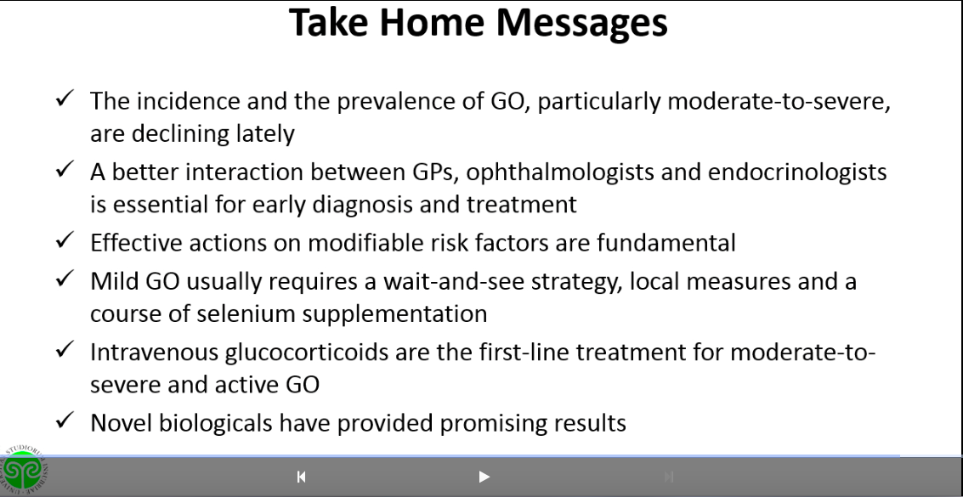

Slide 74

THANKS FOR Attention

