Slide 1

IN THE NAME OF GOD

Slide 2
Medical Management of Cushing’s Syndrome

Slide 3
Introduction
Cushing’s syndrome (CS) is defined as the composite of symptoms, signs and metabolic abnormalities resulting from an inappropriate and chronic exposure to excessive levels of glucocorticoids (GCs), either endogenous or exogenous.
Notes:
Medical Management of Cushing’s Syndrome: Current and Emerging Treatments: J. M. Hinojosa‑Amaya et al. Drugs (2019) 79:935–956https://doi.org/10.1007/s40265-019-01128-7

Slide 4
The most common cause of endogenous hypercortisolism
Cushing’s disease (CD)
Adrenal Cushing’s syndrome (ACS)
ACTH-dependent ectopic
Cushing’s syndrome (ECS)
Notes:
Medical Management of Cushing’s Syndrome: Current and Emerging Treatments: J. M. Hinojosa‑Amaya et al. Drugs (2019) 79:935–956https://doi.org/10.1007/s40265-019-01128-7

Slide 5
Cushing’s Disease
The most common cause of endogenous hypercortisolism
ACTH-secreting adenoma (70–80%)
Disease persistence is associated with ↑ morbidity and mortality among the affected individuals.
Notes:
Medical Management of Cushing’s Syndrome: Current and Emerging Treatments: J. M. Hinojosa‑Amaya et al. Drugs (2019) 79:935–956https://doi.org/10.1007/s40265-019-01128-7

Slide 6
Treatment of Cushing’s disease
Transsphenoidal surgery
Medical therapy
Radiotherapy

Slide 7
The primary treatment of Cushing’s disease
Transsphenoidal surgery (TSS) with remission rates up to 70% for combined micro- and macroadenomas.
Up to 30% of patients will suffer recurrence in the long-term following TSS.
Notes:
Medical Management of Cushing’s Syndrome: Current and Emerging Treatments: J. M. Hinojosa‑Amaya et al. Drugs (2019) 79:935–956https://doi.org/10.1007/s40265-019-01128-7

Slide 8
Medical therapy
is sometimes prescribed:
Severe hypercortisolism (presurgically)
Significant comorbidities
Non-remission or recurrence (after TSS )
Notes:
Medical Management of Cushing’s Syndrome: Current and Emerging Treatments: J. M. Hinojosa‑Amaya et al. Drugs (2019) 79:935–956https://doi.org/10.1007/s40265-019-01128-7

Slide 9
Radiotherapy or stereotactic radiosurgery
Relapsing CD
Aggressive corticotroph tumors
Nelson’s syndrome
Long-term side effects:
Hypopituitarism
Cerebrovascular disease
Secondary intracranial tumors
Notes:
Medical Management of Cushing’s Syndrome: Current and Emerging Treatments: J. M. Hinojosa‑Amaya et al. Drugs (2019) 79:935–956https://doi.org/10.1007/s40265-019-01128-7

Slide 10
Severe hypercortisolism criteria
1 or more | Plus recent onset of ≥ 1
Serum cortisol ≥ 41 μg/dL (1100 nmol/L) 24-h UFC > 4-fold ULN Severe hypokalemia (< 3.0 mmol/L) | Sepsis Opportunistic infection Intractable hypokalemia Uncontrolled hypertension Edema Heart failure Intestinal hemorrhage Acute psychosis (glucocorticoid induced) Progressive debilitating myopathy Thromboembolism Uncontrolled hyperglycemia/DKA
Notes:
Medical Management of Cushing’s Syndrome: Current and Emerging Treatments: J. M. Hinojosa‑Amaya et al. Drugs (2019) 79:935–956https://doi.org/10.1007/s40265-019-01128-7

Slide 11
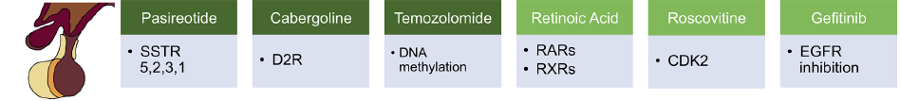
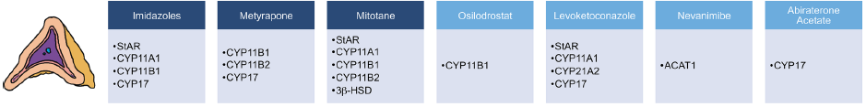

Notes:
Main mechanism of action for the medical treatment of CS, including pituitary-directed therapies (green), steroidogenesis inhibitors (blue), and GR antagonists (orange). CDK2 cyclin-dependent kinase 2, CS Cushing’s syndrome, D2R dopamine type 2 receptor, EGFR epidermal growth factor receptor, GR glucocorticoid receptor,
RAR retinoic acid receptor, RXR retinoic acid X receptor, SSTR somatostatin
receptor

Slide 12

Adrenal‑Directed Drugs

Slide 13
Current Adrenal Steroidogenesis Inhibitors
Reduce/normalize serum cortisol levels in both:
ACTH- and
Non-ACTH-dependent CS

Slide 14
Benefits should be weighed against side effects
Accumulation of cortisol synthesis precursors (i.e., HTN and ↓K due to 11-deoxycortisol increment after 11 B-hydroxylase [CYP11B1] inhibition)
↑synthesis of non-blocked steroids (i.e., hirsutism in women due to increased [DHEA] and androstenedione production after CYP11B1 inhibition),
or the consequence of direct drug side effects (i.e., hepatotoxicity due to ketoconazole

Slide 15
Adrenal-directed drugs
(side effects)
11 B-hydroxylase
inhibition
↑synthesis of non-blocked
steroids
↑cortisol synthesis precursors
(11-deoxycortisol )
Androstenedione
↑DHEA (hirsutism)
hypertension and hypokalemia

Slide 16
Adrenal-directed drugs
(side effects)
Direct drug side effects
Hepatotoxicity
Adrenal insufficiency (AI)

Slide 17
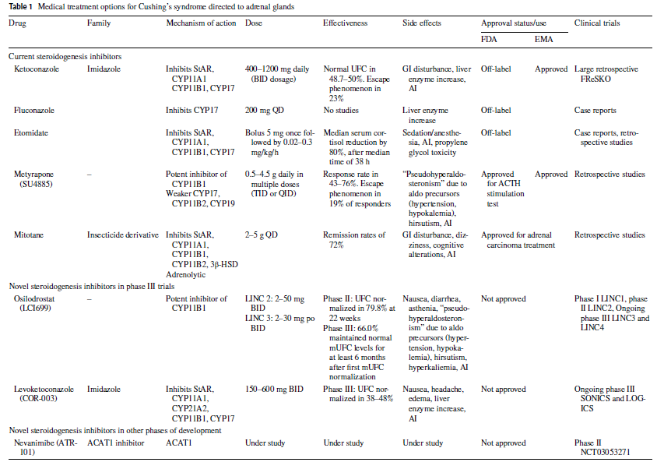
Notes:
European Medicines Agency (EMA)

Slide 18
3β-HSD 3β-hydroxysteroid dehydrogenase, ACAT1 acyl-coenzyme A:cholesterol O-acyltransferase 1, ACTH adrenocorticotrophic hormone, AI adrenal insufficiency, BID twice daily, CYP11A1
20,22-desmolase, CYP11B1 11β-hydroxylase, CYP11B2 aldosterone synthase (18-hydroxylase), CYP17 17α-hydroxylase/17,20-lyase, CYP19 aromatase (19-hydroxylase), CYP21A2 21-hydroxylase,
EMA European Medicines Agency, FDA Food and Drug Administration, GI gastrointestinal, mUFC median urinary free cortisol, po by mouth, QD once daily, QID four times daily, StAR
steroidogenic acute regulatory protein, TID thrice daily, UFC urinary free cortisol

Slide 19
Medical treatment options for Cushing’s syndrome to directed adrenal glands
Current steroidogenesis inhibitors Ketoconazole
Drug Family | Mechanism of action | Dose | Effectiveness | Side effects | Approval status/use FDA | Approval status/use EMA | Clinical trials
Imidazole | Inhibits StAR, CYP11A1 CYP11B1, CYP17 | 400–1200 mg daily (BID dosage) | Normal UFC in 48.7–50%. Escape phenomenon in 23% | GI disturbance, liver enzyme increase, AI | Off-label | Approved | Large retrospective FReSKO
Notes:
side-chain cleavage complex (steroidogenic acute regulatory protein [StAR]
20,22-desmolase [CYP11A1]), 17α-hydroxylase/17,20-lyase (CYP17)
EMA European Medicines Agency

Slide 20
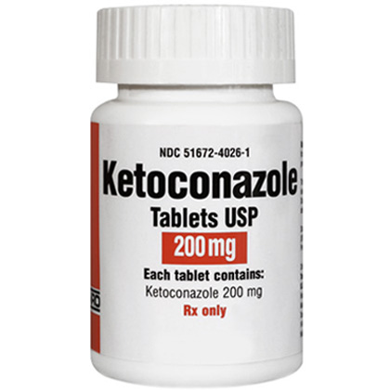
Ketoconazole

Slide 21
Ketoconazole & ACTH
After cortisol level reduction, the expected increment of ACTH is not always observed with ketoconazole; therefore, some controversy exists as to whether ketoconazole has an additional inhibitory effect in corticotroph reduced ACTH secretion.

Slide 22
ketoconazole & escape from the enzyme inhibition
This is probably related to an adrenal compensatory increment of cortex enzymes.

Slide 23
Ketoconazole & liver enzymes
Moderately increased liver enzymes should
not preclude ketoconazole therapy in severe, life-threatening hypercortisolism.

Slide 24
Ketoconazole & and drug interactions leading to QT prolongation:
Coadministration of the following drugs with ketoconazole is contraindicated:
dofetilide quinidine pimozide
cisapride methadone disopyramide dronedarone ranolazine
Notes:
UPTODATE 2019

Slide 25
Ketoconazole is a potent inhibitor of CYP450 3A4
Co-administration of:
Cyclosporine →↑ cyclosporine levels 5- to 10 fold
→ nephro- and neurotoxicity
Statins → ↑statin levels → myopathy and rhabdomyolysis
Benzodiazepines → ↑benzodiazepine (↓ clearance)→prolonged sedation and impairment of psychomotor performance
Co-administration of Ketoconazole and Benzodiazepines is contraindicated.

Slide 26

Ketoconazole
Oral: Initial: 400 to 600 mg daily in 2 or 3 divided doses; may increase dose by 200 mg daily every 7 to 28 days up to a maximum of 1,200 mg daily in 2 or 3 divided doses
Notes:
UPTODATE 2019

Slide 27
Ketoconazole
Dosing: Renal Impairment: Adult
There are no dosage adjustments provided in the manufacturer’s labeling. However, some resources suggest that no dosage adjustment is necessary in mild-to-severe impairment (Aronoff 2007)
End-stage renal disease (ESRD) on intermittent hemodialysis: Supplemental dose is not necessary (Aronoff 2007). Not dialyzable.
Notes:
UPTO DATE2019

Slide 28
Ketoconazole
Dosing: Hepatic Impairment: Adult
Use is contraindicated in acute or chronic liver disease
Hepatotoxicity during treatment:
US labeling: If ALT >ULN or 30% above baseline (or if patient is symptomatic), interrupt therapy and obtain full hepatic function panel. Upon normalization of liver function, may consider resuming therapy if benefit outweighs risk (hepatotoxicity has been reported on rechallenge).
Notes:
UPTODATE 2019

Slide 29
Ketoconazole
Dosing: Hepatic Impairment: Adult
Canadian labeling:
Discontinue therapy for liver function tests >3 times ULN or if abnormalities persist, worsen, or are associated with hepatotoxicity symptoms.
Notes:
Uptodate 2019

Slide 30
Medical treatment options for Cushing’s syndrome to directed adrenal glands
Drug Family | Mechanism of action | Dose | Effectiveness | Side effects | Approval status/use FDA | Approval status/use EMA | Clinical trials
Current steroidogenesis inhibitors (Imidazole)
Fluconazole | Inhibits CYP17 | 200 mg QD | No studies | Liver enzyme increase | Off-label |  | Case reports
Notes:
Fluconazole is another antifungal imidazole that inhibits CYP17 and CYP11B1
but also has a decreased risk of hepatotoxicity

Slide 31
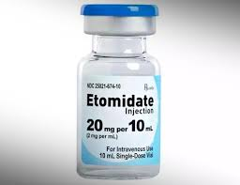
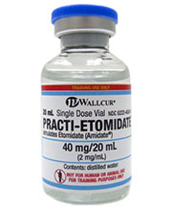
Etomidate
2 mg/mL

Slide 32
Medical treatment options for Cushing’s syndrome to directed adrenal glands
Etomidate(benzylimidazole) Current steroidogenesis inhibitors (General Anesthetic) benzylimidazole
Mechanism of action | Dose | Effectiveness | Side effects | Approval status/use FDA | Approval status/use EMA | Clinical trials
Inhibits StAR, CYP11A1, CYP11B1, CYP17 | Bolus 5 mg once followed by 0.02–0.3 mg/kg/h | Median serum cortisol reduction By 80%, after median time of 38 h | Sedation/ anesthesia, AI, propylene glycol toxicity | Off-label |  | Case reports, retrospective studies
Notes:
Cushing syndrome (off-label use): IV: Initial: 0.04 to 0.05 mg/kg/hour (usually equates to ~2.5 to 3 mg/hour). Titrate to serum cortisol of 18 to 29 mcg/dL (500 to 800 nmol/L) in a physiologically stressed patient or 5.5 to 11 mcg/dL (150 to 300 nmol/L) in a non-physiologically stressed patient. For complete blockade, titrate infusion rate to achieve a cortisol level <5.5 mcg/dL (<150 nmol/L). Hydrocortisone IV is required if complete blockade desired rather than partial blockade (‘block and replace’) (Preda 2012). Note: Studies have not reported sedation at these etomidate doses; however, patients should be managed in an intensive care unit with sedation scoring every 2 hours initially for the first 24 hours, then every 12 hours. Cortisol levels should be measured every 4 to 6 hours (ES [Nieman 2015]; Preda 2012).uptodate2019

Slide 33
Etomidate
only IV therapy available for CS
its use is limited for cases with:
very severe hypercortisolism
fast-acting therapy when life-threatening hypercortisolism

Slide 34
Maximal Effect of Etomidate
Significant suppression can be seen after 5 h of treatment, and maximal effect is reached after 11 h
“Block and replacement” therapy may be needed to prevent AI after 24 h of etomidate infusion

Slide 35
Etomidate
Dosing: Renal Impairment:
There are no dosage adjustments provided in the manufacturer's labeling; use with caution, risk of toxicity is greater in patients with renal impairment.

Slide 36
Etomidate
Dosing: Hepatic Impairment:
There are no dosage adjustments provided in the manufacturer's labeling.

Slide 37
Medical treatment options for Cushing’s syndrome to directed adrenal glands
Current steroidogenesis inhibitors Metyrapone (SU4885)
Mechanism of action | Dose | Effectiveness | Side effects | Approval status/use FDA | Approval status/use EMA | Clinical trials
Potent inhibitor of CYP11B1 Weaker: CYP17, CYP11B2, CYP19 | 0.5–4.5 g daily in multiple doses (TID or QID | Response rate in 43–76%. Escape phenomenon in 19% of responders | “Pseudohyperaldosteronism” due to aldo precursors (hypertension, hypokalemia), hirsutism, AI | Approved for ACTH stimulation test | Approved | Retrospective studies

Slide 38
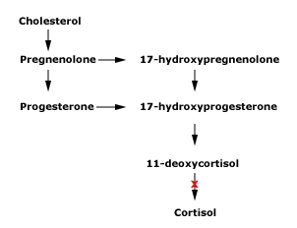
Metyrapone
Metyrapone inhibits cortisol production by blocking the conversion of 11-deoxycortisol to cortisol by 11-beta-hydroxylase (CYP11B1).

Slide 39
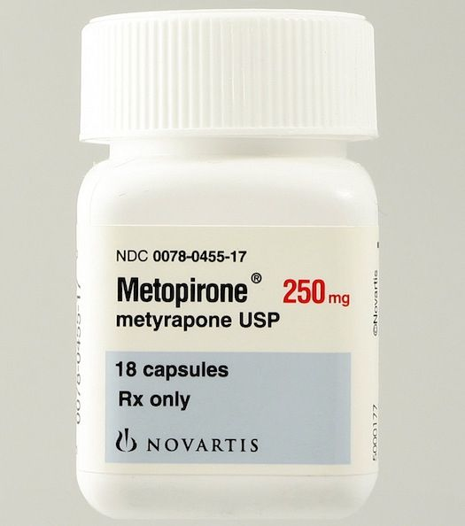
Metyrapone
Metyrapone is a fast-acting inhibitor of steroid 11-β-monooxygenase.
Cortisol levels start to decrease within 2 h of the first dose.

Slide 40
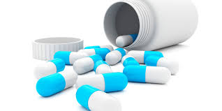
Escape Effect of Metyrapone
↓Cortisol→↑ACTH release→stimulate type 2 melanocortin receptor (MC2R)→a drug “escape effect”(19%)
Therefore, drug dose may be ↑from 500mg →6 g/day
Some studies have shown a sustained long-term response to metyrapone

Slide 41

Metyrapone & safety in pregnancy
Use of metyrapone has been rarely reported during pregnancy; however, safety in pregnancy has not been confirmed by well- designed clinical studies.

Slide 42
Mitotane

Slide 43
Medical treatment options for Cushing’s syndrome to directed adrenal glands
Current steroidogenesis inhibitors Mitotane
Mechanism of action | Dose | Effectiveness | Side effects | Approval status/use FDA | Approval status/use EMA | Clinical trials
Inhibits StAR, CYP11A1, CYP11B1, CYP11B2, 3β-HSD Adrenolytic | 2–5 g QD | Remission rates of 72% | GI disturbance, dizziness, cognitive Alterations, AI | Approved for adrenal carcinoma treatment | Approved | Retrospective studies
Notes:
An analog of the insecticide dichlorodiphenyltrichloroethane,
mitotane {brand name Lysodren; formula 1-(o-chlorophenyl)-1-(p-chlorophenyl)-2,2-dichloroethan [o,p’-DDD]},

Slide 44
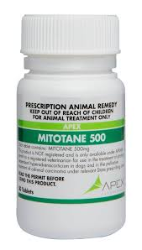
Mitotane has 3 different adrenal effects(1):
An adrenolytic action caused by lipid accumulation and atrophy of the fascicularis and reticularis regions of the adrenal cortex; zona glomerulosa affects are observed only after long term therapy.

Slide 45
Mitotane has three different adrenal effects(2):
Inhibition of steroidogenesis enzymes such as side-chain cleavage complex, CYP11B1, CYP11B2 and 3β-hydroxysteroid dehydrogenase (3β-HDS).

Slide 46
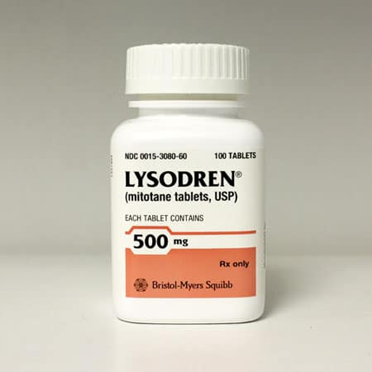
Mitotane has three different adrenal effects(3):
↑CBG →↓ free active cortisol

Slide 47
Mitotane (onset of action )
Is very slow (3 months on average)
Remission rates in patients with pituitary irradiation are almost 100%
Without an escape phenomenon due to the adrenolytic action

Slide 48
Pediatric use of mitotane
Low-dose mitotane (up to 2 g/daily) improved growth velocity and BMI z-scores, as well as pubertal development, without significant body mass index (BMI) differences when compared with TSS-treated patients.

Slide 49
Mitotane ( prolonged half-life)
a prolonged half-life (160 days)
AEs may persist long after drug discontinuation, and circulating levels of cortisol remain low.

Slide 50
Mitotane activates cytochrome P450 enzymes
Mitotane activates cytochrome P450 enzymes 3A4 (CYP3A4), which increases metabolism of synthetic GCs, and supraphysiological levels of hydrocortisone are necessary to treat mitotane-induced AI.

Slide 51
Mitotane & opioid
Potential risk of opioid overdose when mitotane is discontinued

Slide 52
Recommended monitoring during mitotane treatment*of Adrenocortical carcinomas
Parameter | Interval | Comment
Mitotane blood level | Every 4 to 6weeks¶ | Target: 14 to 20 mcg/ml.
Adverse effects | At every visit (initially, every 4 weeks; after 6 months, every 8 weeks) | Gastrointestinal adverse effects: Use antiemetics (eg, metoclopramide or a 5-HT3 blocker) or loperamide.
Notes:
UPTODATE 2019
5-HT3 blocker:ndansetron, granisetron, dolasetron, and palonosetron

Slide 53
Recommended monitoring during mitotane treatment*of Adrenocortical carcinomas
Parameter | Interval | Comment
ACTH | Suspected glucocorticoid deficiency or excess | CNS side effects (ataxia, confusion, speech or visual problems): Interrupt therapy or reduce dosage. Glucocorticoid status is difficult to determine. Target: ACTH in the normal range or slightly above. Because of an increased glucorticoid clearance, high-dose glucocorticoid replacement is needed (most patients require at least 50 mg hydrocortisone per day).
Serum sodium and potassium | At every visit
Notes:
UPTODATE

Slide 54
Recommended monitoring during mitotane treatment*of Adrenocortical carcinomas
Parameter | Interval | Comment
24-hour urine free cortisol | At every visit | Aim for mid-normal range.
GOT, GPT, bilirubin, GGT | Initially, every 4 weeks; after 6 months, every 8 weeks | GGT is invariably elevated without clinical consequences. If other liver enzymes are rapidly increasing (greater than threefold of baseline), there is risk of liver failure: Stop mitotane.
GOT: glutamic-oxaloacetic transaminase; GPT: glutamate pyruvate transaminase; GGT: gamma glutamyltransferase
Notes:
UPTODATE

Slide 55
Recommended monitoring during mitotane treatment*of Adrenocortical carcinomasa
Parameter | Interval | Comment
TSH, fT3, fT4 | Every 3 to 4 months | Disturbance of thyroid hormones is frequent. Thyroid hormone replacement is recommended in patients with clinical symptoms of hypothyroidism and low fT4 values. (Hypothyroidism with low TSH is frequent)
Renin | Every 6 months | If renin is elevated, add fludrocortisone.

Slide 56
Recommended monitoring during mitotane treatment*of Adrenocortical carcinomas
Parameter | Interval | Comment
Testosterone | Every 3 to 4 months | Hypogonadism frequently occurs. Replacement should be initiated in men with symptoms of hypogonadism.
Cholesterol ( LDL), triglycerides | Every 3 to 4 months (in an adjuvant setting) | If LDL cholesterol are highly elevated, consider treatment with statins.(pravastatin and rosuvastatin)
Blood count | Every 3 to 4 months | Check for relevant leucopoenia, thrombocytopenia, and anemia (rare).
Notes:
Uptodate 2019

Slide 57
Mitotane increases the rate of metabolism of cortisol
the induction of hepatic cytochrome P450 enzymes by mitotane
increases the rate of metabolism of cortisol, dexamethasone , and fludrocortisone.
Mitotane can also eventually cause aldosterone deficiency.
fludrocortisone (0.1 to 0.3 mg daily)
Notes:
UPTODATE

Slide 58
Novel Adrenal Steroidogenesis Inhibitors in Development

Slide 59
Medical treatment options for Cushing’s syndrome to directed adrenal glands
Novel steroidogenesis inhibitors in phase III trials Osilodrostat (LCI699)
Mechanism of action | Dose | Effectiveness | Side effects | Approval status/use FDA EMA |  | Clinical trials
Potent inhibitor of CYP11B1 | LINC 2: 2–50 mg BID LINC 3: 2–30 mg po BID | Phase II: UFC normalized in 79.8% at 22 weeks Phase III: 66.0% maintained normal mUFC levels for at least 6 months after first mUFC normalization | Nausea, diarrhea, asthenia, “pseudohyperaldosteronism” due to aldo precursors (hypertension, hypokalemia), hirsutism, hyperkaliemia, AI | Not approved |  | Phase I LINC1, phaseII LINC2, Ongoing phase III LINC3 and LINC4
Notes:
Osilodrostat (formerly LCI699) is a potent inhibitor of CYP11B1, which catalyzes the final step of cortisol synthesis

Slide 60
Drug | Effectiveness
Etomidate | Median serum cortisol reduction by 80%, after median time of 38 h
Mitotane | Remission rates of 72%
Osilodrostat | Phase II: UFC normalized in 79.8% at 22 weeks Phase III: 66.0% maintained normal mUFC levels for at least 6 months after first mUFC normalization
Metyrapone | Response rate in 43–76%. Escape phenomenon in 19% of responders
Ketoconazole | Normal UFC in 48.7–50%. Escape phenomenon in 23%
Levoketoconazole | Phase III: UFC normalized in 38–48%
Nevanimibe | Under study
Fluconazole | No studies
Abiraterone acetate | Under study

Slide 61
Osilodrostat
Inhibits aldosterone synthase
↓BP in patients with essential HTN and primary aldosteronism

Slide 62
Osilodrostat
(Enzyme inhibition)
↑ ACTH
↑11-deoxycorticosterone (DOC)
Hypertension
Hypokalemia
↑ androgens through higher CYP17 activity that may lead to ↑ testosterone levels
  Hirsutism

Slide 63
Medical treatment options for Cushing’s syndrome to directed adrenal glands
Novel steroidogenesis inhibitors in phase III trials Levoketoconazole (COR-003) Imidazole
Mechanism of action | Dose | Effectiveness | Side effects | Approval status/use FDA EMA |  | Clinical trials
Inhibits StAR, CYP11A1, CYP21A2, CYP11B1, CYP17 | 150–600 mg BID | Phase III: UFC normalized in 38–48% | Nausea, headache, edema, liver enzyme increase, AI | Not approved |  | Ongoing phase III SONICS and LOGICS

Slide 64
Levoketoconazole
Significant reductions were
↓FBS
↓HbA1c
↓LDL cholesterol
and
BP (no significant changes )
↑ HDL (slight)
↑ Triglycerides (slight)

Slide 65
Levoketoconazole
QTc prolongation of 60 ms presented in 10.2%, and QTc surpassed 500 ms in 2% of subjects.
No drug-related deaths

Slide 66
Medical treatment options for Cushing’s syndrome to directed adrenal glands
Drug Family | Mechanism of action | Dose | Effectiveness |  | Side effects | Approval status/use FDA EMA |  | Clinical trials
Novel steroidogenesis inhibitors in other phases of development
Nevanimibe (ATR- 101) cholesterol acyltransferase 1 (ACAT1) inhibitor | ACAT1 | Under study |  | Under study | Under study | Not approved |  | Phase II NCT03053271

Slide 67
Nevanimibe (ATR‑101)
ACAT1 creates a cholesterol ester reservoir for steroid formation by catalyzing cholesterol ester formation in the adrenal cortex. Inhibition of this enzyme leads to a decrease of adrenal steroid formation, and at higher doses, causes free cholesterol accumulation that leads to adrenocortical cell stress and apoptosis.

Slide 68
Medical treatment options for Cushing’s syndrome to directed adrenal glands
Drug Family | Mechanism of action | Dose | Effectiveness |  | Side effects | Approval status/use FDA EMA |  | Clinical trials
Novel steroidogenesis inhibitors in other phases of development Abiraterone acetate
Abiraterone acetate Androgen biosynthesis inhibitor | CYP17 CYP21A2 CYP11B1 | 250–500 mg BID |  | Under study | “Pseudohyperaldosteronism” (hypertension, hypokalemia), AI | Not approved |  | Phase II NCT03145285

Slide 69
Abiraterone Acetate
FDA and EMA approved
Abiraterone acetate (CB7630; Zytiga), currently US FDA and EMA approved for the treatment of
castration-resistant prostate carcinoma, prevents adrenal androgen production by inhibiting CYP17
with secondary inhibition of serum cortisol in those patients.
Notes:
EMA European Medicines Agency

Slide 70
Azd4017
The 11β-hydroxysteroid dehydrogenase type 1 inhibitor
(AZD4017) is a new oral, fully reversible and potent inhibitor of human recombinant 11β-hydroxysteroid dehydrogenase type 1 (11β-HSD1).
Notes:
Yeast picha pastoris and Ecoli

Slide 71
Azd4017
AZD4017 (2-[(3S)-1[5(cyclohexylcarbamoyl)-6-propylsulfanylpyridin-2-yl]-3-piperidyl]acetic acid) has been evaluated for the treatment of:
idiopathic intracranial hypertension
CS

Slide 72
Azd4017
11β-HSD1 is a nicotinamide adenine dinucleotide (NADP) reduced form, NADPH dependent enzyme expressed in the liver, adipose tissue and brain.
11β-HSD1 catalyzes the conversion of the inactive steroid cortisone to active , playing an important role in the regulation of intracellular cortisol concentrations.
There is a phase II clinical trial (Targeting Iatrogenic
Cushing’s Syndrome With 11β-hydroxysteroid Dehydrogenase Type 1 Inhibition [TICSI]; NCT03111810) aimed at preventing the metabolic adverse features of iatrogenic CS.

Slide 73

Pituitary‑directed Drugs

Slide 74
Current pituitary-directed therapies Pasireotide (SOM-230)
Target | Mechanism of action | Dose | Effectiveness | Side effects | Approval status/Use | Clinical trials
SSTRs 5,2,3,1 Agonist | Decreases ACTH secretion and tumor cell proliferation | 600-900 μg BID. LAR: 10–30 mg/month | Hypercortisolism improvement in 34.5–50%. Tumor volume decrease 9.1–43.8% | Transient diarrhea and nausea; cholelithiasis; hyperglycemia | Approved for CD | Phase III Pasireotide 2305 Expanded Pasireotide 2305
Notes:
CD Cushing’s disease

Slide 75
Pasireotide
Hypercortisolism → ↓Cell membrane expression of somatostatin receptor (SSTR) subtype 2
while SSTR5 (unaffected or even ↑)
Octreotide and lanreotide, which exhibit strong affinity to SSTR2
Pasireotide (highest affinity for SSTR5)

Slide 76
Pasireotide
Side effects
GI discomfort (The most common)
Hyperglycemia-related
  ↓insulin secretion and incretin hormone responses
Metformin and/or DPP-4I or GLP-1 agonists
  Have been suggested as first-line options

Slide 77
Pasireotide
UFC or LNSC
In the phase III, pasireotide long-acting repeatable (LAR) study, agreater proportion of patients achieved normal median UFC than median LNSC.
Only 17.7% normalized both, and these patients displayed the greatest changes in blood pressure and weight.
LNSC =late-night salivary cortisol
Notes:
LNSC late-night salivary cortisol

Slide 78
moderate correlation between median UFC and median LNSC
this discrepancy may be because
dose titration was in reference to median UFC or
due to an intra-patient coefficient of variation of ~ 50% in patients with CD

Slide 79
Medical treatment options for Cushing’s syndrome directed to pituitary gland and glucocorticoid receptor antagonists
Current pituitary-directed therapies Cabergoline Ergot derivative
Target | Mechanism of action | Dose | Effectiveness | Side effects | Approval status/use | Clinical trials
DR type 2 Agonist | Decreases ACTH secretion | 0.5–7 mg/week (mean 3.5 mg/ week) | Normal UFC in 30–40% | Nausea and dizziness (usually transient) | Approved for CD | Retrospective study Prospective study Large retrospective multicenter
Notes:
CD Cushing’s disease

Slide 80
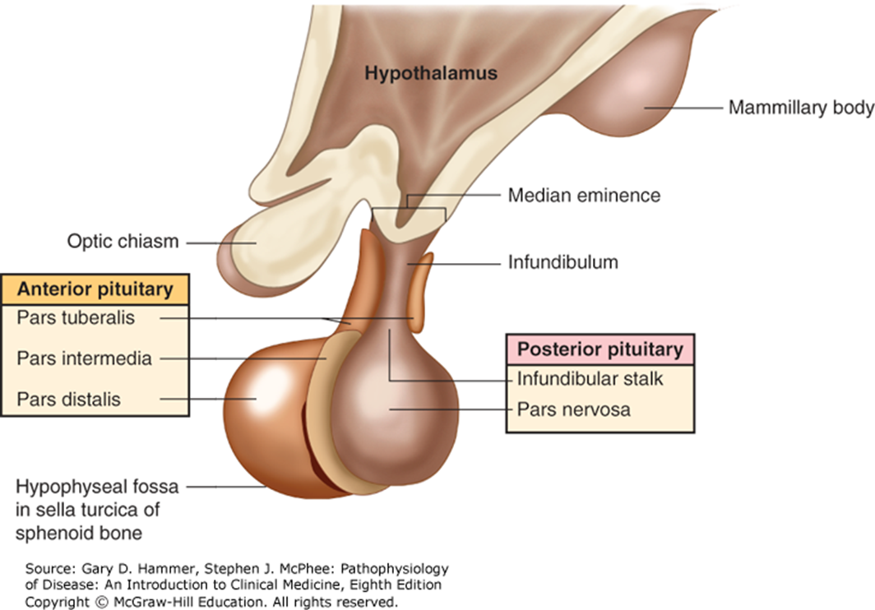
Dopamine D2 receptors (D2Rs)
Dopamine D2 receptors (D2Rs) are mostly expressed in the anterior and intermediate lobes of the pituitary gland.

Slide 81
Dopamine D2 receptors (D2Rs)
Tonic inhibitory control of hypothalamic dopamine on prolactin (PRL) and melanocyte stimulating hormone (MSH) secretion
Functional D2Rs are also present in
Prolactinoma
Corticotroph adenoma
Nonfunctioning pituitary adenoma (NFPA)
Notes:
R:Medical Management of Cushing’s Syndrome: Current and Emerging Treatments

Slide 82
Cabergoline
The “escape phenomenon” is found in up to one third of responsive patients
tumor shrinkage is rare
Notes:
R:Medical Management of Cushing’s Syndrome: Current and Emerging Treatments

Slide 83
Cabergoline & tricuspid regurgitation
however, a new meta-analysis found an association with increased asymptomatic tricuspid regurgitation in hyperprolactinemic patients treated even with low-dose cabergoline .
As doses used in CD patients are much higher, serially performed echocardiogram (ECHO) might be needed.
Notes:
R:Medical Management of Cushing’s Syndrome: Current and Emerging Treatments

Slide 84
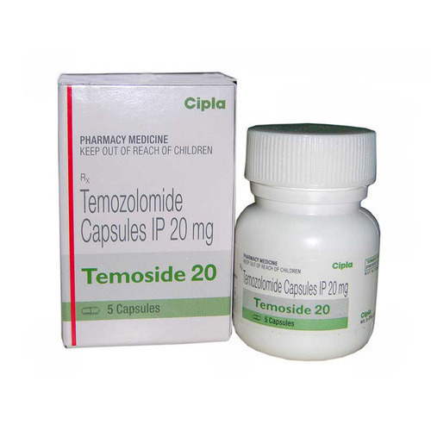
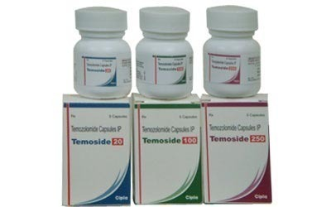
Temozolomide

Slide 85
Current pituitary-directed therapies Temozolomide (TMZ; Temodar)
Family | Target | Mechanism of action | Dose | Effectiveness | Side effects | Approval | Clinical trials
Alkylating agent | DNA Alkylation | Metabolite MTIC, causes DNA methylation | 150–200 mg/m²/ Day for 5 days each month per cycle | Small studies: tumor regression 50%, ↓ACTH by 88% and ↓UFC by 98% (MGMT (−) MSH-6 (+) could be a predictive factor) | Fatigue, hearing loss, phlegmon, UTI, liver enzyme increase, hematological (cytopenia) | Off-label | Case reports Retrospective Studies Case series
MTIC 3-methyl-(triazen-1-yl)imadazole-4 carboxamide MGMT O-6-methylguanine-DNA methyltransferase, MSH-6 DNA mismatch repair protein Msh6
Notes:
CD Cushing’s disease
MTIC 3-methyl-(triazen-1-yl)imadazole-4 carboxamide
MGMT O-6-methylguanine-DNA methyltransferase, MSH-6 DNA mismatch repair protein Msh6
R:Medical Management of Cushing’s Syndrome: Current and Emerging Treatments

Slide 86
Temozolomide(TMZ; Temodar)
regression of corticotroph pituitary adenomas refractory to:
medical
surgical
radiation therapy
pituitary carcinoma (may improve survival)

Slide 87
Temozolomide(TMZ; Temodar)
TMZ is US FDA approved for refractory anaplastic astrocytoma
and its use for aggressive corticotroph or other pituitary adenomas and pituitary carcinoma is off label.
Notes:
R:Medical Management of Cushing’s Syndrome: Current and Emerging Treatments

Slide 88

Novel Pituitary‑Directed Therapies in Clinical
Trials

Slide 89
The Retinoic Acid Receptor, Retinoid X Receptor, and Vitamin A Derivatives

Slide 90
Medical treatment options for Cushing’s syndrome directed to pituitary gland and glucocorticoid receptor antagonists
Novel pituitary-directed therapies in phase II clinical trials Retinoic acid
Family | Target | Mechanism of action | Dose | Effectiveness | Side effects | Approval status/use | Clinical trials
Vitamin A derivatives | RARs and RXRs Agonist | Inhibits POMC transcription and ACTH secretion. Tumor cell apoptosis | RA: 10–80 mg QD Isotretinoin: 20–80 mg QD | RA: normal UFC 43% Isotretinoin: normal LNSC and UFC in 25% | Conjunctival irritation, nausea, headache and arthralgia | Not approved | Prospective multicenter Study Phase II prospective open-label
RAR retinoic acid receptor RXR retinoid X receptor LNSC late-night salivary cortisol
Notes:
CD Cushing’s disease
RAR retinoic acid receptor
RXR retinoid X receptor
R:Medical Management of Cushing’s Syndrome: Current and Emerging Treatments

Slide 91
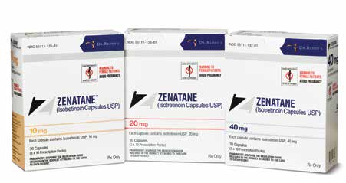
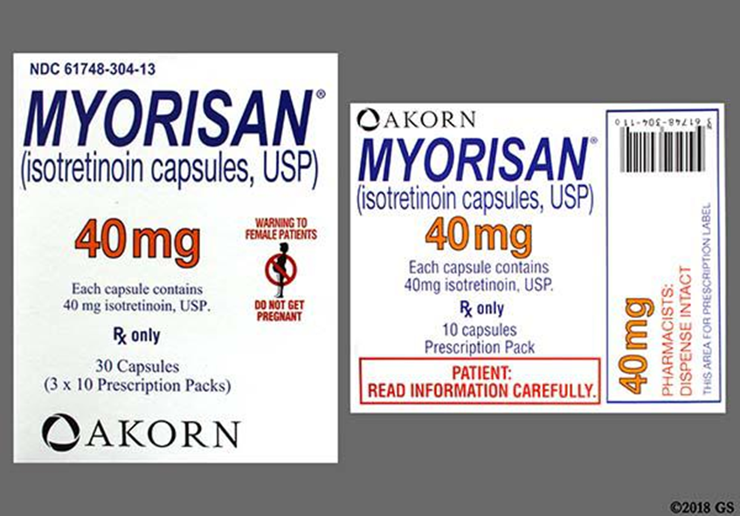
Isotretinion

Slide 92
Retinoic acid
Tretinoin
Isotretinion
Vesanoid(Capsule, Oral 10 mg)
Absorica
Amnesteem
Claravis
Myorisan
Zenatane
Dosage Forms: Canada
Accutane
Clarus
Epuris

Slide 93
Novel pituitary-directed therapies in phase II clinical trials R-roscovitine (CYC202, seliciclib) Purine analog
Target | Mechanism of action | Dose | Effectiveness | Side effects | Approval status/use | Clinical trials
CDK2 Antagonist | Dissociates CDK2/cyclin E complex, inducing cell senescence. Suppresses ACTH secretion and tumor growth | 400 mg BID (4 days/wk) | Under study | Asthenia, nausea and hypokalemia | Not approved | Ongoing phase II Prospective NCT02160730
CDK2 cyclin-dependent kinase type 2,
Notes:
CD Cushing’s disease
R:Medical Management of Cushing’s Syndrome: Current and Emerging Treatments

Slide 94
Novel pituitary-directed therapies in phase II clinical trials Gefitinib (ZD1839) Tyrosine kinase inhibitor
Target | Mechanism of action | Dose | Effectiveness | Side effects | Approval status/use | Clinical trials
EGFR Antagonist | Inhibits USP8 Mutation induced EGFR overexpression | 250 mg QD | Under study | Rash and diarrhea | Not approved | Ongoing phase II Prospective USP8 mutated CD
EGFR Epidermal growth factor receptor, ubiquitin-specific protease 8 gene (USP8)
Notes:
CD Cushing’s disease
Medical Management of Cushing’s Syndrome: Current and Emerging
Treatments

Slide 95
Gefitinib (EGFR Inhibitor)
Epidermal growth factor receptor (EGFR) is expressed in both:
the normal pituitary and in
corticotroph pituitary adenomas.
Notes:
Medical Management of Cushing’s Syndrome: Current and Emerging
Treatments

Slide 96
Future Targets at the Pituitary Level

Slide 97
Ubiquitin‑Specific Protease 8 Gene
Induced EGFR overexpression
Notes:
Medical Management of Cushing’s Syndrome: Current and Emerging
Treatments

Slide 98
USP8 inhibitor
A USP8 inhibitor (9-ehtyloxyimino-9H-indeno[1,2- b]pyrazine-2,3dicarbonitrile) is available, but has not been extensively studied. USP8 inhibition in mouse AtT20 pituitary corticotroph cells downregulated EGFR expression,
↓ ACTH synthesis
induced apoptosis
Notes:
Medical Management of Cushing’s Syndrome: Current and Emerging
Treatments

Slide 99
Vemurafenib the BRAF kinase inhibitor (Zelboraf)
Recent whole exome sequencing revealed recurrent mutations
in USP48 and BRAF genes in the presence of wild USP8 phenotype.
Notes:
kinase
n. an enzyme that catalyzes the conversion of a proenzyme to an active enzyme
Medical Management of Cushing’s Syndrome: Current and Emerging
Treatments

Slide 100
Vemurafenib
is a BRAF inhibitor marketed to treat:
BRAF mutation– positive melanoma
BRAF V600-mutation–positive Erdheim- Chester disease(Non Langerhans cell histiocytosis)
Notes:
Medical Management of Cushing’s Syndrome: Current and Emerging
Treatments

Slide 101
Silibinin
HSP90 inhibitors

Slide 102
HSP90 & GR
The GR of the corticotroph cell suppresses transcription of POMC, a direct precursor of ACTH.
Heat shock protein 90 (HSP90)
  is essential for proper folding of the ligand binding domain of GRs.
  However, the excessive expression and continued binding of HSP90 to GRs inhibits the GR transcriptional activity by reducing DNA binding, resulting in partial corticotroph adenoma GC resistance.
Notes:
Medical Management of Cushing’s Syndrome: Current and Emerging Treatments

Slide 103
Silibinin
Therefore, HSP90 inhibitors may release GRs from HSP, restoring GC sensitivity
Notes:
Medical Management of Cushing’s Syndrome: Current and Emerging
Treatments

Slide 104
Silibinin (Legalon)
a compound obtained from the milk thistle plant (Silybum marianum), is a C-terminal inhibitor
of HSP90 that has been used for the treatment of amatoxin poisoning-induced hepatotoxicity, with a good safety profile
Prostate cancer
Breast cancer
Hepatocellular carcinoma
Lymphoblastic leukemia
Notes:
Medical Management of Cushing’s Syndrome: Current and Emerging
Treatments

Slide 105
Testicular Orphan Receptor 4(TR4)
nuclear receptor
lacks a specific ligand
Corticotroph tumors have an over expression of TR4:
↑POMC transcription
cell proliferation
Blunting the interaction of cortisol with GR
but there are no developed molecules known to inhibit or antagonize this orphan receptor activity.
Notes:
Medical Management of Cushing’s Syndrome: Current and Emerging Treatments
TR4 also decreases negative feedback on POMC transcription/ ACTH secretion of corticotroph cells by blunting the interaction of cortisol with GR and, in the latter, with the promoter region of POMC

Slide 106
Monoclonal Antibodies Against ACTH
ALD1613 is a novel long-acting monoclonal antibody that
controls ACTH-driven pharmacology.
To date, there are no ongoing clinical phase I studies for this drug.
Notes:
Medical Management of Cushing’s Syndrome: Current and Emerging
Treatments

Slide 107
MicroRNA Manipulation
Likewise, miRNAs seem to influence various genes associated with the pathogenesis of pituitary adenomas, and altered expression has been described in a specific fashion related to clinical and therapeutic characteristics of the adenomatous tissue, including ACTH-secreting tumors.
Notes:
Medical Management of Cushing’s Syndrome: Current and Emerging
Treatments

Slide 108
Glucocorticoid Receptor Antagonists

Slide 109
Current glucocorticoid receptor antagonist Mifepristone (RU486)
Family | Target | Mechanism of action | Dose | Effectiveness | Side effects | Approval status/use | Clinical trials
Antiprogestogen and antiglucocorticoid | PR and GR Antagonist | Blocks PR and GR, preventing activation despite high cortisol levels | 300–1200 mg daily | Glucose improvement 60%. HTN improvement 38%. | Nausea, fatigue, headache, hypokalemia, arthralgia, peripheral edema, endometrial thickening, vaginal bleeding, AI | Approved for hyperglycemia associated with CS | Phase III SEISMIC
Notes:
CD Cushing’s disease
PR progestin receptor ,GR glucocorticoid receptor
Medical Management of Cushing’s Syndrome: Current and Emerging
Treatments

Slide 110
Mifepristone
GR antagonism at higher doses
Affinity to GR is 4 times higher than dexamethasone and 18 times higher than cortisol, with no biological activity.
It also has a weak anti-androgenic effect, but does not bind to mineralocorticoid and estrogen receptors.
Notes:
Medical Management of Cushing’s Syndrome: Current and Emerging
Treatments

Slide 111
Mifepristone
CYP450 3A4→ ↓ mifepristone
Notes:
Medical Management of Cushing’s Syndrome: Current and Emerging
Treatments

Slide 112
Mifepristone
(predict AI)
There are no biochemical tests
Close clinical evaluation
AI will require treatment with high-dose dexamethasone (to overcome the GR blockade) and mifepristone withdrawal or dose reduction.
Notes:
Medical Management of Cushing’s Syndrome: Current and Emerging
Treatments

Slide 113
Mifepristone
severe hypokalemia:
  supplementation of potassium salts
  spironolactone
Endometrial hyperplasia in women may be another complication
  vaginal bleeding and further evaluation will be necessary.
  This drug is also contraindicated if pregnancy is planned.
Notes:
Medical Management of Cushing’s Syndrome: Current and Emerging
Treatments

Slide 114
Mifepristone
Should symptoms of AI occur, we suggest giving
dexamethasone 4 mg to overcome the blockade

Slide 115
Novel GR antagonist: Relacorilant (CORT125134)
Target | Mechanism of action | Dose | Effectiveness | Side effects | Approval | Clinical trials
GR Antagonist | Blocks GR, preventing activation despite high cortisol levels | 100–400 mg QD Oral | Glucose improvement in 81.8%. HTN improvement in 45.5% | Musculoskeletal and gastrointestinal, AI | Not approved | Phase I prospective Ongoing phase II
Notes:
CD Cushing’s disease
PR progestin receptor ,GR glucocorticoid receptor
Medical Management of Cushing’s Syndrome: Current and Emerging
Treatments

Slide 116
Relacorilant
Selective anti-GC with very high affinity to GR
Does not bind PR
Have not antiprogestin side effects such as termination of pregnancy, endometrial hyperplasia or vaginal bleeding
Notes:
Medical Management of Cushing’s Syndrome: Current and Emerging
Treatments

Slide 117
Combination Therapies
Ketoconazole and Metyrapone
Ketoconazole, Metyrapone and Mitotane
Cabergoline and Ketoconazole
Pasireotide and Cabergoline
Cabergoline, Ketoconazole and Pasireotide
Bromocriptine and Retinoic Acid
Notes:
R:Medical Management of Cushing’s Syndrome: Current and Emerging Treatments

Slide 118
Choice of Medical Therapy and Monitoring

Slide 119
CS treatment goals
are multiple and include:
reversal of clinical features
normalization of biochemical parameters
tumor control
minimizing morbidity
long-term remission

Slide 120
an ideal medical agent
cost-effective
have a favorable pharmacokinetic profile
be safe
well tolerated
encourage high patient adherence
improve patient satisfaction

Slide 121
Severe or life-threatening hypercortisolism
Etomidate is the only IV medication available with a quick onset of action
Metyrapone and Ketoconazole are also fast-acting alternative drugs

Slide 122
For longer term therapy
ketoconazole
is preferred in female patients due to the inhibitory activity of CYP17 that blocks adrenal androgen synthesis and diminishes hirsutism.
Ketoconazole is less convenient for men, who may experience primary hypogonadism as a drug side effect.
liver enzymes:
Use in patients with severe liver abnormalities at baseline needs cautious monitoring.

Slide 123
Metyrapone
May cause hirsutism in women and may be preferred for men as initial therapy

Slide 124
Mitotane
Adrenal carcinoma
but neurological side effects, adrenolysis
and teratogenesis may limit drug use to treat other forms of CS.

Slide 125
Pituitary-directed drugs
should only be attempted in patients with CD

Slide 126
Pasireotide
can provide both:
Biochemical
Tumor size shrinkage
Initial treatment:
post-surgery in the presence of a macroadenoma
or a growing pituitary adenoma, regardless of size

Slide 127
Pasireotide
Pasireotide use may be limited by:
Uncontrolled hyperglycemia
Liver enzyme elevation
Gallbladder disease

Slide 128
Cabergoline
higher doses
but does not induce adenoma shrinkage per se
Cabergoline contraindications
Pre-existing psychiatric
Heart valve disease
Pulmonary fibrosis

Slide 129
TMZ
Either with or after radiotherapy, should only be used in the case of aggressive adenomas refractory to all other treatment modalities, or for a pituitary carcinoma.

Slide 130
GR antagonists
Severe hyperglycemia
Should not be treated with mifepristone
women with a history of endometrial hyperplasia or
vaginal bleeding or
women desiring pregnancy

Slide 131
Patients with polypharmacy or high-risk CYP450 3A4 metabolized drugs
may benefit from medications other than:
Ketoconazole
Mitotane
Mifepristone

Slide 132
Severe HTN or pre-existent hypokalemia
limit the use of:
Metyrapone
Mifepristone

Slide 133
Assess treatment efficacy
There is no one test
Careful review of symptoms, hypercortisolism
or AI, as well as a thorough review of side effects
physical exam should always precede biochemical interpretation.

Slide 134
Assessments for biochemical tests
Based on the mechanism of action of the medication

Slide 135
A baseline laboratory workup
Liver function tests
Glucose
Serum electrolytes
ECG (necessary for all drugs that are known to prolong QTc)

Slide 136
The biochemical control target
For most drugs:
UFC
and/or LNSC normalization
Most studies to date have used
UFC > LNSC

Slide 137
UFC
At least 2 repeated tests are necessary to confirm biochemical control, as it is known that UFC has a within-patient variability of 52%

Slide 138
Careful education
Careful education on identifying and reporting symptoms of AI and the side effects of each drug should be provided to all patients, as well as emergency actions to take.
Furthermore, for patients taking mifepristone, they should be made aware that cortisol will not be an indicator of AI.

Slide 139
At all visits
BP should be monitored at all visits and serum potassium levels assessed.
If patients are taking anti-diabetic medications, doses might be reduced with CS improvement.

Slide 140
Etomidate infusion
Serum cortisol should be measured every 6 h while on an etomidate infusion
The patient should have hourly neurological assessments because of the hypnotic effects of the drug.

Slide 141
Etomidate infusion
If a drop in cortisol is abrupt or serum cortisol measurements cannot be obtained frequently, block-replacement therapy may be required.
Since patients taking etomidate are admitted to the ICU, supraphysiological (stress) doses of steroids should be started as replacement.

Slide 142
Laboratory tests at follow-up
There is no prospective data
patient’s symptoms
clinical findings and baseline results

Slide 143
Conclusion
These new targets are not only limited to novel, steroidogenesis inhibitors and prevention of steroid substrate uptake by the adrenals, but have expanded to include
decreased target tissue corticosteroid concentrations,
target tissue GR blockage,
Restoration of negative feedback on the pituitary,
decreasing POMC transcription and ACTH secretion,
inducing adenomatous corticotroph cell senescence and
apoptosis, as well as
Preventing secreted ACTH reaching target receptors.

Slide 144

THANKS FOR YOUR ATTENTION

Slide 145
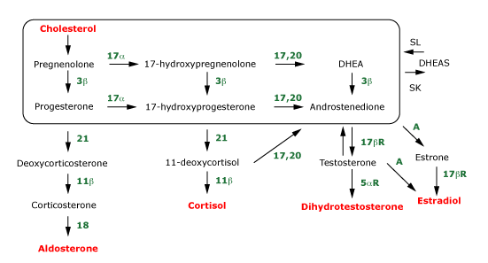
Notes:
The first step in adrenal steroid synthesis is the combination of acetyl CoA and squalene to form cholesterol, which is then converted into pregnenolone. The enclosed area contains the core steroidogenic pathway utilized by the adrenal glands and gonads. 17α: 17α-hydroxylase (CYP17, P450c17); 17,20: 17,20 lyase (also mediated by CYP17); 3β: 3β-hydroxysteroid dehydrogenase; 21: 21-hydroxylase (CYP21A2, P450c21); 11β: 11β-hydroxylase; (CYP11B1, P450c11); 18 refers to the two-step process of aldosterone synthase (CYP11B2, P450c11as), resulting in the addition of an hydroxyl group that is then oxidized to an aldehyde group at the 18-carbon position; 17βR: 17β-reductase; 5αR: 5α-reductase; DHEA: dehydroepiandrosterone; DHEAS: DHEA sulfate; A: aromatase (CYP19).

Slide 146
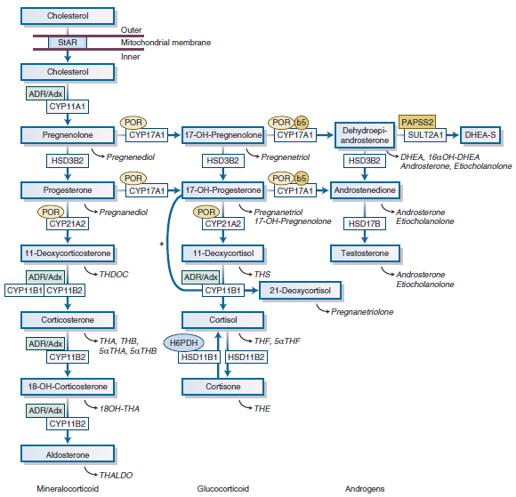
Notes:
Williams 2015 p:494
Figure 15-4 Adrenal steroidogenesis. After the steroidogenic acute regulatory (StAR) protein-mediated uptake of cholesterol into mitochondria within adrenocortical cells,
aldosterone, cortisol, and adrenal androgens are synthesized through the coordinated action of a series of steroidogenic enzymes in a zone-specific fashion. The mitochondrial
cytochrome P450 (CYP) type I enzymes (CYP11A1, CYP11B1, CYP11B2) requiring electron transfer via adrenodoxin reductase (ADR) and adrenodoxin (Adx) are marked with a box
labeled ADR/Adx. The microsomal CYP type II enzymes (CYP17A1, CYP21A2) receive electrons from P450 oxidoreductase (circle labeled POR). The 17,20-lyase reaction catalyzed
by CYP17A1 requires, in addition to POR, cytochrome b5, indicated by a circle labeled b5. Urinary steroid hormone metabolites are given in italics below the plasma hormones.
The asterisk (*) indicates 11-hydroxylation of 17-OH-progesterone to 21-deoxycortisol in cases of 21-hydroxylase deficiency. The adrenal conversion of androstenedione to
testosterone is catalyzed by the aldo-keto reductase AKR1C3 (HSD17B5). CYP11A1, P450 side-chain cleavage enzyme; CYP11B1, 11β-hydroxylase; CYP11B2, aldosterone synthase;
CYP17A1, 17α-hydroxylase; CYP21A2, 21-hydroxylase; DHEA, dehydroepiandrosterone; DHEA-S, dehydroepiandrosterone sulfate; H6PDH, hexose-6-phosphate dehydrogenase;
HSD11B1, 11β-hydroxysteroid dehydrogenase 1; HSD11B2, 11β-hydroxysteroid dehydrogenase 2; HSD17B, 17β-hydroxysteroid dehydrogenase; HSD3B2, 3β-hydroxysteroid
dehydrogenase type 2; 17-OH-progesterone, 17α-hydroxyprogesterone; PAPSS2, 3′-phosphoadenosine, 5′-phosphosulfate synthase 2; SULT2A1, sulfotransferase 2A1;
THA, tetrahydro-11-dehydrocorticosterone; THB, tetrahydro-corticosterone; THALDO, tetrahydro-aldosterone; THDOC, tetrahydro-11-deoxycorticosterone; THF, tetrahydro-cortisol;
THS, tetrahydro-11-deoxycortisol.

Slide 147


