Slide 2
The Indeterminate Thyroid Nodule
Bijan Iraj,MD
Assistant Professor of Internal Medicine and Endocrinology
Department of Endocrinology and Metabolism
Isfahan Medical School

Slide 3
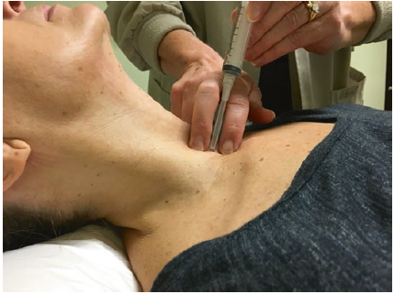

Slide 4
The indeterminate category includes
(1) atypia of undetermined significance/follicular lesion of undetermined significance (AUS/FLUS).
(2) follicular neoplasm/suspicious for follicular neoplasm (FN/SFN), a category that also encompasses the diagnosis of Hürthle cell neoplasm/suspicious for Hürthle cell neoplasm.
(3) suspicious for malignancy (SUSP).

Slide 5
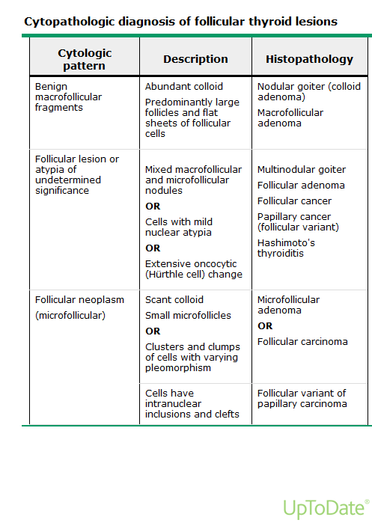

Slide 6
Follicular lesion or atypia of undetermined significance (FLUS/AUS)
This category (Bethesda III) includes lesions with mild nuclear atypia, mixed macro- and microfollicular lesions where the proportion of macro- and microfollicles is similar, lesions with extensive oncocytic (Hürthle cell) change, and specimens that are compromised because of poor fixation or obscuring blood.

Slide 7
The rate of malignancy within each category varies with a predicted probability of cancer of 5–15 % for AUS/FLUS, 15–30 % for FN/SFN, and 60–75 % for SUSP .

Slide 8
Atypia of Undetermined Significance or Follicular Lesion of Undetermined Significance (AUS/FLUS)
This is the range that is considered by some
to be not high enough for immediate surgical
intervention but too high for routine follow-up.

Slide 9
Any type of lesion identified on cytology with a malignancy risk higher than benign but lower
than follicular neoplasia/suspicious for follicular neoplasia or suspicious for malignancy,i.e., in the range of 5–15 %

Slide 10
Follicular architectural atypia (FLUS) is commonly seen in nodular goiter (including autonomous nodules), follicular neoplasms, follicular cancer, follicular variant papillary cancer, and noninvasive follicular tumors with papillary-like nuclear features (NIFTP).

Slide 11
Nuclear atypia is commonly seen in hyperplastic nodular goiter, papillary cancer, follicular variant papillary cancer, and NIFTP.

Slide 12
The lesion may not be well represented on the aspirate slides due to various reasons such as low cellularity, obscuring hemorrhage, and preservation/staining artifacts, or the clinical background may only partially explain the atypia seen in the specimen, such as Hashimoto thyroiditis, history of radiation exposure, or drugs such as carbimazole.

Slide 13
Considering the recent reported findings in
the current literature, this category can, at least
theoretically, be divided into the following
Subgroups:

Slide 14
PTC
Aspirates of classic papillary thyroid carcinoma
are typically hypercellular, with the cells typically arranged in
monolayered sheets, swirls, or papillary structures. These papillary
clusters often exhibit branching.

Slide 15
Nuclear membrane irregularities manifest as linear nuclear grooves (more sensitive) and intranuclear cytoplasmic inclusions (more specific).

Slide 16
AUS with nuclear atypia, concerning for papillary thyroid carcinoma (PTC);
findings are not sufficient for a diagnosis of “suspicious for malignancy”or “malignancy.” These mostly include atypia in a limited number of cells. There is a significant body of literature showing that this group has the
highest risk of malignancy, ranging from 28 to 56 %.

Slide 17
These cases show focal nuclear enlargement and nuclear membrane irregularities
including grooves and homogenous pale chromatin in an otherwise benign FNA.

Slide 18
It should be noted that, in many series, it may be appropriate to place these cases into the “suspicious for malignancy” category instead of AUS.

Slide 19
AUS/FLUS nodules with cellular atypia compared to a predominant microfollicular pattern have been observed to have a higher risk of malignancy .

Slide 20
These include nuclear enlargement and often elongation with pale, powdery nuclear chromatin, enhanced nuclear membranes, and micronucleoli.

Slide 21
AUS with prominent microfollicles in a sparsely cellular specimen or in the background of a mixed pattern where findings are not supportive of a diagnosis of follicular neoplasm
Overall, the risk of malignancy in this category is relatively low, on average 5–25 %, depending on how the data is
obtained. In our experience, the risk is closer to the lower end of the spectrum.

Slide 22
AUS with predominance of Hürthle cells in a sparsely cellular specimen or in the background of Hashimoto thyroiditis or multinodular goiter.
This category seems to be more heterogeneous and complex; however, it seems to have a very low risk of malignancy, less than 10 % in most series.

Slide 23
AUS, not otherwise specified (NOS),
involving other cellular components,including lymphoid cells in Hashimoto thyroiditis or atypia that cannot be
Characterized due to specimen processing and staining problems.Obviously, this is a mixed group with overall risk of malignancy averaging 8–36 %.

Slide 24
Follicular Neoplasm/Suspicious for Follicular Neoplasm (Including Oncocytic Lesions)
Follicular-patterned lesions form the largest and most heterogeneous group in the thyroid ranging from benign, non-neoplastic follicular hyperplasias to follicle-forming infiltrating carcinomas.

Slide 25
The border between the Bethesda system categories of AUS/FLUS and FN is not well defined; however, increased cellularity with microfollicles and “uniformity”of both cells and architecture are reliable signs of neoplasia.

Slide 26
These lesions share common morphologic features on cytology, and FNA is not a reliable tool for differentiating these lesions on cytologic grounds. Diagnosis of malignancy relies on histologic evidence of an infiltrative
lesion, which cannot be assessed on aspiration specimens.

Slide 27
Therefore, a follicular neoplasia (FN) diagnosis on cytology covers the main differential of cellular hyperplastic nodules, follicular adenomas, follicular carcinomas, and follicular variant ofpapillary thyroid carcinoma (FVPTC).

Slide 28
Bland hypercellular follicular lesions:
However, those lesions with marked cellularity, overcrowding, and abundant microfollicles with scant backgroucellular hyperplastic nodules on one end and invasive follicular carcinomas on the other.

Slide 29
Microfollicular lesions with nuclear atypia

Slide 30
Hürthle cell neoplasias:
Hürthle cells are morphologically distinct follicular cells with abundant, granular cytoplasm with enlarged, round-to-oval nuclei and prominent nucleoli. Cytoplasmic granularity is the result of abundant mitochondria,which also show irregular morphologic features.

Slide 31
Follicular neoplasias, not otherwise specified:
As with other classification schemes, not all cases can be categorized into certain groups, and there will be cases with morphologic features not specific enough for any further classification. In our experience, some medullary carcinomas,parathyroid lesions, poorly differentiated carcinomas, and some metastatic lesions may show features of FN.

Slide 32
Suspicious for Malignancy:
1. Patchy malignant nuclear changes in a benign background
2. Incomplete nuclear changes of malignancy
3. Features of malignancy in a sample with very low cellularity
4. Nuclear atypia in a cystic background

Slide 33
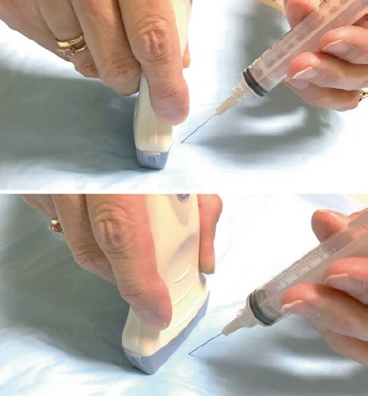

Slide 34
Treatment Options:
Management of the indeterminate nodule includes consideration of clinical, sonographic,
cytologic and molecular risk factors.

Slide 36
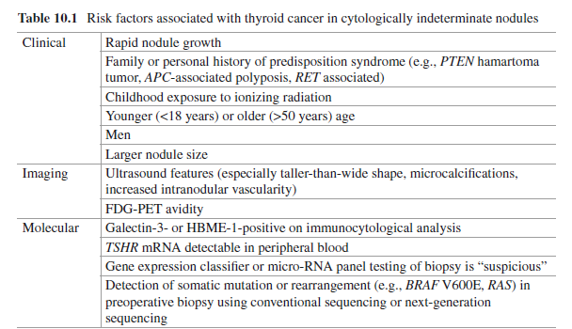

Slide 37
Clinical Risk Factors:
Clinical Rapid nodule growth
Family or personal history of predisposition syndrome (e.g., PTEN hamartoma tumor, APC-associated polyposis, RET associated)
Childhood exposure to ionizing radiation
Younger (<18 years) or older (>50 years) age
Men
Larger nodule size

Slide 38
Clinical Risk Factors:
Physical exam: fixation of nodule to surrounding neck structures and palpable
lymphadenopathy are also concerning features.

Slide 39
The association between gender and an increased risk of malignancy has
been inconsistent, but in a meta-analysis inclusive of 19 studies with “indeterminate”
nodules, men had a 1.5-fold higher risk for malignancy compared to women.

Slide 40
Increased risk has been seen with both younger and older patients . In another large single institution series of 639 patients with indeterminate nodules, Banks et al. observed that age was an independent predictor of malignancy on multivariate analysis; patients’ age <50 years had a 3 % increase in risk of cancer for each year younger in age, and patients’ age >50 years had a 3.4 % increase in cancer risk for each year older in age .

Slide 41
An age of 50 years has also been
shown to be the threshold for increased cancer risk in other studies .

Slide 42
Pediatric patients (age ≤18 years) have an overall higher risk of malignancy associated with thyroid nodules (15–30 %), and the risk can be up to 50 % in nodules with indeterminate cytology.

Slide 43
The 2015 American Thyroid Association guidelines for pediatric patients recommend surgery for all indeterminate
FNA results in children.

Slide 44
Thyroid Nodules in Children:
Surgery may be indicated in the absence of confirmed differentiated thyroid cancer;
the most recent ATA guidelines recommend surgery (at least a lobectomy and
isthmectomy) for any indeterminate cytology on FNA (Bethesda III–V) due to the
high risk of cancer in these patients (48% in the pooled data).

Slide 45
Surgery is usually recommended in large benign lesions (>4 cm) due to the
high false-negative rate of FNA in large nodules.

Slide 46
The current ATA guidelines recommend that all children requiring treatment for
autonomous thyroid nodules, i.e., those with symptomatic hyperthyroidism, proceed
to surgical resection rather than an alternative treatment for their hyperthyroidism;
however, children without symptoms with subclinical hyper thyroidismcan be observed.

Slide 47
This recommendation is based predominantly on a lack of follow-up studies on pediatric patients treated with alternative modalities and an Italian study showing a differentiated thyroid cancer in 29% of 31 children with hot
Nodules.

Slide 48
Nodule size

Slide 49
Larger nodule size has been reported to be associated with a higher risk of malignancy especially for follicular neoplasms and Hürthle cell neoplasms.

Slide 50
In a study of 149 nodules with FN/SFN cytology, Tuttle et al. found that the risk of malignancy was ~threefold higher in nodules >4 cm as measured by palpation ,
while Baloch et al. found that ≥3 cm was associated with a twofold greater risk of malignancy in a single institution series of 184 follicular neoplasm nodules.

Slide 51
Imaging Risk Factors:
In studies inclusive of all thyroid nodules, ultrasound features that increase concern for cancer includes marked hypoechogenicity, spiculated or ill-defined margin, taller-than-wide shape, and microcalcifications .
However, whether these features are useful in nodules with indeterminate cytology remains unclear.

Slide 52
In a study of 180 patients who had thyroid nodules with
indeterminate cytology (follicular neoplasm, Hürthle cell neoplasm, and SUSP),a taller-than-wideshape was associated with 99 % specificity and 92 % positive predictive value for malignancy. When ≥2 concerning ultrasound features were present, the risk of malignancy was >70 % . Taller-than-wide shape was also
shown to be associated with cancer in a series of 61 patients who all had thyroidectomy for AUS/FLUS cytology . But in another study of 505 follicular and
Hürthle cell neoplasms, malignancy was associated with only microcalcifications.

Slide 53
In a meta-analysis by Brito et al., nodules with indeterminate cytology were evaluated in a subset analysis; they found that suspicious features did not accurately predict malignancy with the exception of increased intranodular vascularity, which was likely due to the increased frequency of follicular neoplasms in the study population
. Use of color Doppler to evaluate intranodular vascularity may be helpfulfor evaluating follicular neoplasms as it is theorized that these contain higher cellularity and variation in echogenicity and internal vascularity compared to PTC .
However, interpretation of flow on color Doppler may be associated
with up to 30 % interobserver variability, limiting its utility.

Slide 54
In a study of 155 nodules with AUS/FLUS cytology, nodules were classified by ATA sonographic pattern . Only 8% of nodules with very low-risk sonographic features were malignant, while 58% with low or intermediate risk and 100% with high-risk appearances were malignant.

Slide 56
Avidity on fluorodeoxyglucose-positron emission tomography (FDG-PET) may also increase cancer risk, but the high cost of FDG-PET scans limitstheir widespread use as part of diagnostic evaluation.

Slide 57
Molecular Risk Factors:
The use of molecular testing for indeterminate nodules should consider the test
strengths and planned clinical management. For example, the GEC can help identify
nodules that may be more likely to be benign.

Slide 58
Currently, publications are primarily based upon small, single-institution
experiences, with suboptimal methodology, and data must be interpreted
in the context of these limitations.

Slide 59
With widespread use of these tests, our understanding of their limitations also
has become apparent. Population diversity and practice variation lead to substantial
differences in test performance from site to site and best explain differences in published
experiences.

Slide 60
Therefore, GEC does not provide any
added utility if active surveillance is not a clinical consideration due to patient preference, associated symptoms, or presence of other concerning clinical or radiographic
features.

Slide 61
The 7-gene panel may help identify nodules with a higher risk of cancer and guide extent of thyroidectomy. Thus, such panel will not add to clinical decision-making if total thyroidectomy is already indicated due to preexisting thyroid dysfunction, contralateral dominant nodule, or patient preference. No study todate has yet determined the clinical or cost efficacy when using >1 molecular test on the same nodule.

Slide 62
classified as indeterminate, of which the Veracyte Afirma® gene expression classifier
and the 17 gene mutation panels have been the most independently studied and
analyzed. Confirmation in large-scale, prospective, and blinded investigations will
be critical to the full understanding of test performance of many molecular tests
being introduced..

Slide 63
Such variation is a limitation that must be acknowledged and will never disappear. Separately, this field is increasingly seeking to better understand the meaning of all molecular changes. Increased and improved understanding
of mutations that exist in benign thyroid nodules will help to expand our knowledge of when genetic alterations (base pair change or translocations) do not necessarily imply malignant transformation.

Slide 64
Surgical intervention:
The goal of thyroid surgery for indeterminate thyroid nodules is to establish a definitive
diagnosis while minimizing the risk of surgery and, if possible, perform the appropriate oncological operation up front if a diagnosis of malignancy can be established.

Slide 65
Based on these data, thyroid lobectomy should be considered strongly for patients with suspicious-appearing nodules on ultrasound.

Slide 66
Total or Near Total in AUS/FLUS,FN:
Bilateral nodular disease
Significant medical co morbidity
Positive FH of cancer
Radiation His
High suspicious US
Size > 4 cm
Hyperthyroidism
Patient preference
Extra thyroid extension or lym node met

Slide 67
If histopathology from thyroid lobectomy reveals that the tumor is an intermediate-
or high-risk thyroid cancer, a completion thyroidectomy is recommended.

Slide 68
Intra operative frozen section/touch prep analyses are not routinely recommended
for indeterminate nodules as they are seldom helpful.

Slide 69
In a study by Chen et al. 120 patients with follicular neoplasms on FNA were treated with thyroid lobectomy with intraoperative frozen section. Frozen section only identified malignancy in 4 patients (3.3%), nondiagnostic in 104 patients (87%), and falsely positive in 6 patients (5%).

Slide 70
Cost analysis by Zanocco et al. comparing intraoperative frozen section for follicular neoplasms vs thyroid lobectomy alone revealed that intraoperative frozen section was not cost-effective. Frozen section/touch prep is unable to evaluate for capsular or vascular invasion to diagnose follicular/Hurthle cell cancer so should be reserved for situations when there are clinical features that are highly suspicious for malignancy, such as extrathyroidal extension or lymph node
metastases.

Slide 71
For nodules without high-risk sonographic appearance, repeat FNA with or without molecular testing may be helpful to further risk stratify the nodule and guide treatment, and clinical context and patient preference should be taken into consideration.

Slide 72
Alternatively, surveillance with ultrasound may be employed, particularly for nodules
with very low-risk sonographic appearance and/or nodules in patients with high surgical risk.

Slide 73
Thyroid lobectomy should be considered for nodules that increase in size or take on suspicious ultrasound features during surveillance.

Slide 74
Treatment Options
Repeat biopsies are typically reserved for nodules with initial cytology classified as AUS/FLUS.
a repeat FNA can result in a benign cytology diagnosis in up to 50 % of nodules For low-risk lesions without any concomitant risk factors and/or for AUS/.
FLUS nodules in patients who are poor surgical candidates, active surveillance can be considered.

Slide 75
Treatment Options

Slide 76
The lesion may not be well represented on the aspirate slides due to various reasons such as low cellularity, obscuring hemorrhage, and preservation/staining artifacts, or the clinical background may only partially explain the atypia seen in the specimen, such as Hashimoto thyroiditis, history of radiation exposure, or drugs such as carbimazole.

Slide 77
AUS/FLUS:
High interobserver variability:
Refer to expert cytopathologist
May reclassify in to benign or non diagnostic

Slide 78
Clinical Risk Factors
Imaging Risk Factors
Cytology and subgroups (NA)
Molecular Risk Factors

Slide 80
AUS/FLUS nodules with cellular atypia compared to a predominant microfollicular pattern have been observed to have a higher risk of malignancy .
Repeat FNA can be benign in 40–50 % of nodules and should be considered in nodules that lack concerning clinical or imaging features .

Slide 81
Molecular testing can certainly be considered if clinically indicated, and its accuracy is dependent on the prevalence of cancer in the tested population of nodules.

Slide 82
Many centers collect an extra fine-needle aspiration (FNA) sample at the time of the initial biopsy to be used for molecular testing should the cytology be read as FLUS or AUS. Further management then depends on the results of molecular testing

Slide 83
Treatment Options:
Observe
Repeated FNA
Diagnostic Surgery (Lobectomy)

Slide 85
Thyroid lobectomy should be considered for nodules that increase in size or take on suspicious ultrasound features during surveillance.

Slide 86
FN/SFN The incidence of an FN/SFN biopsy is 5–20 %, and nodules within the
FN/SFN category were found to have a risk of cancer after removal of 20–30 % .
Therefore, diagnostic surgical excision has been the standard of care for the management of FN/SFN cytology nodules.

Slide 87
Follicular neoplasm
●Evaluation – For patients with cytology suggesting follicular neoplasms (microfollicular, cellular, or indeterminate), we proceed with diagnostic lobectomy in certain clinical settings, eg, young patients with large nodules.

Slide 88
FN
If the clinical setting is not worrisome, we send the FNA aspirate for molecular testing (if available). If an extra FNA sample was not obtained, FNA is repeated in 6 to 12 weeks, or earlier, to obtain a sample for molecular testing. Further management then depends on the results of molecular testing.

Slide 89
FN
Some experts first perform thyroid scintigraphy if not previously obtained, particularly if the TSH is in the lower end of the normal range (eg, less than 1 mU/L) Molecular testing is then performed only for patients with nonfunctioning nodules.

Slide 90
FN
If molecular diagnostic testing is not available, we suggest diagnostic thyroid lobectomy. In the absence of capsular or vascular invasion (on surgical histology), the lesion is classified as a benign adenoma or NIFTP and no further treatment is required.

Slide 91
For patients whose surgical histology shows follicular thyroid cancer (or follicular variant papillary thyroid cancer), completion thyroidectomy may be necessary in selected cases (eg, when radioiodine treatment is indicated due to the size or invasiveness of the tumor or because of the presence of metastatic disease).

Slide 92
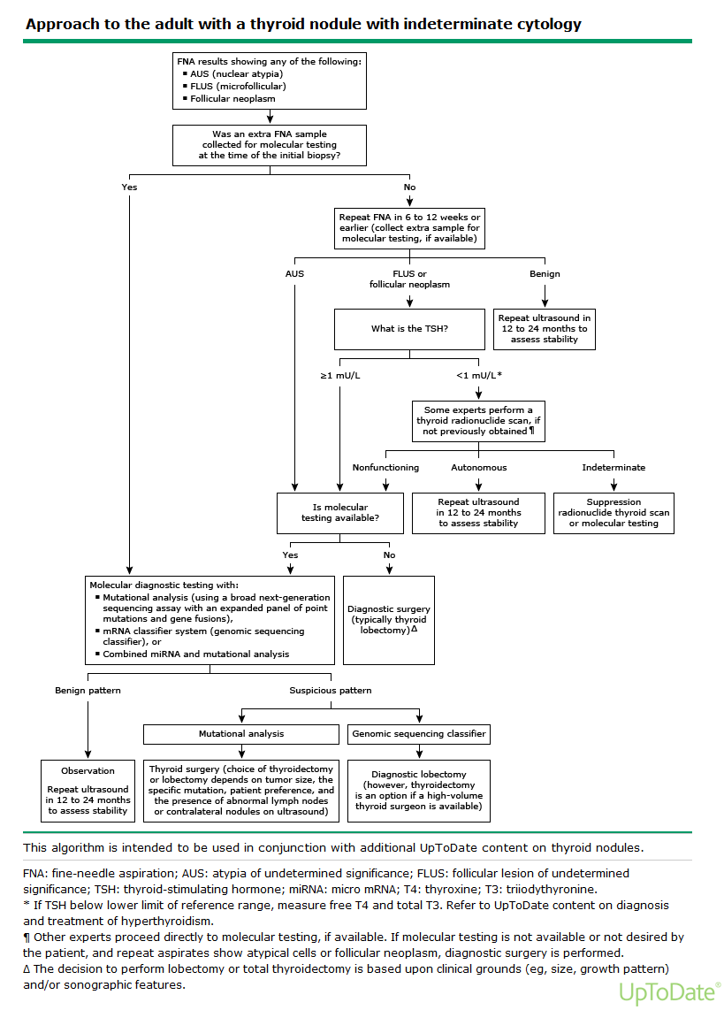

Slide 93
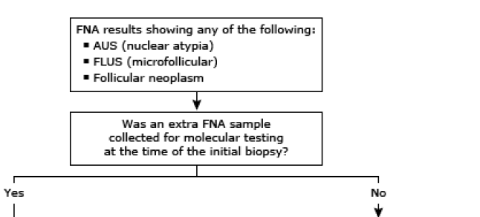

Slide 94
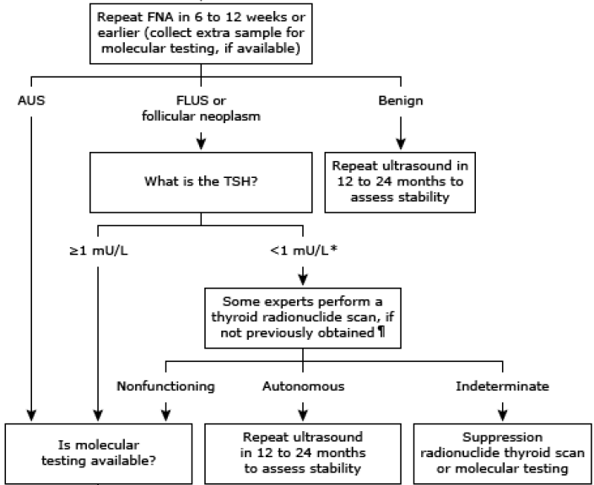

Slide 95
Repeat FNA is the preferred approach for AUS/FLUS unless management is already decided and unlikely to change with a different cytological diagnosis.

Slide 96
Repeat FNA:
A repeated AUS/FLUS biopsy carries a 30–50 %
risk of cancer, and either thyroid lobectomy or
total thyroidectomyshould be considered.

Slide 99
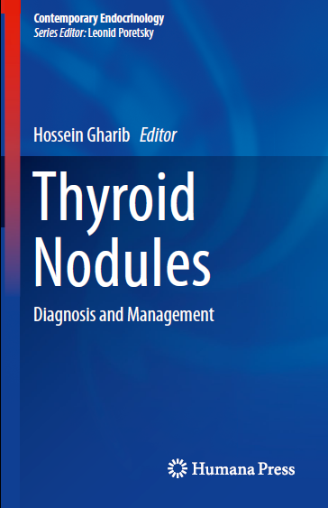

Slide 100
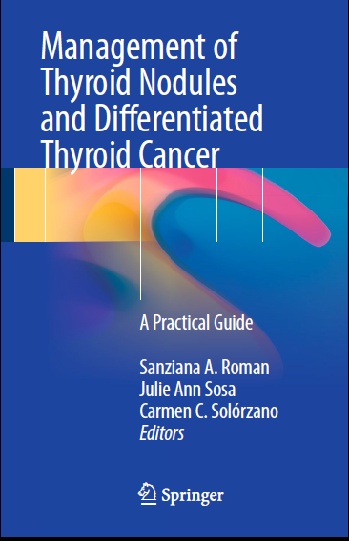

Slide 101
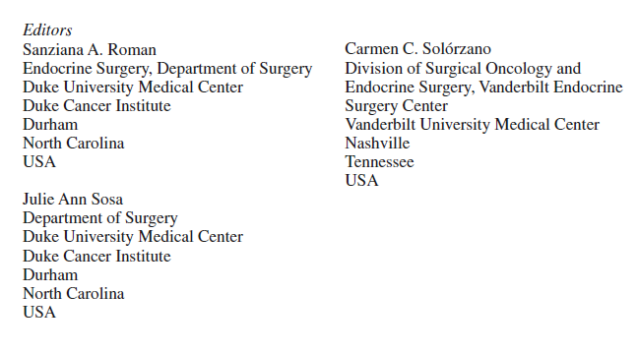

Slide 102
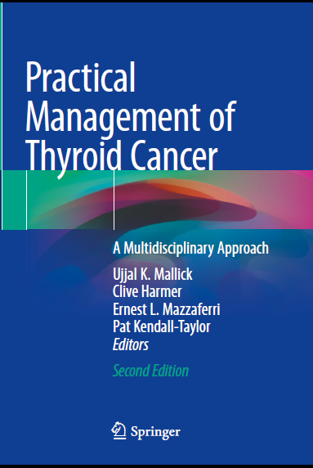

Slide 104
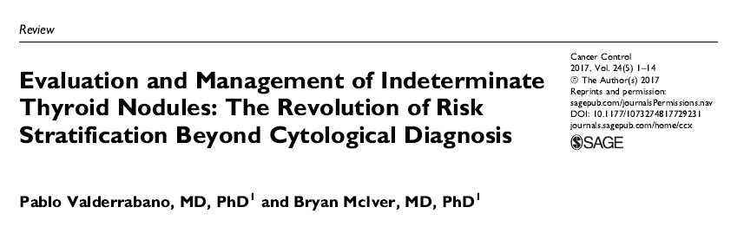

Slide 105
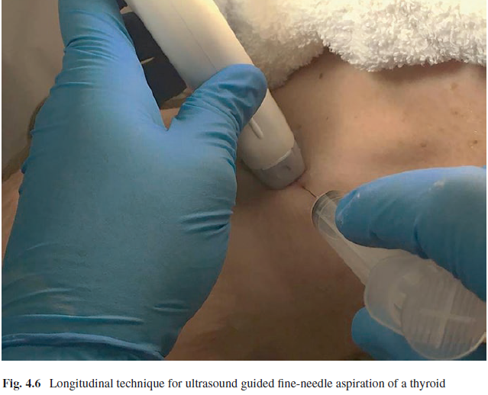

Slide 106
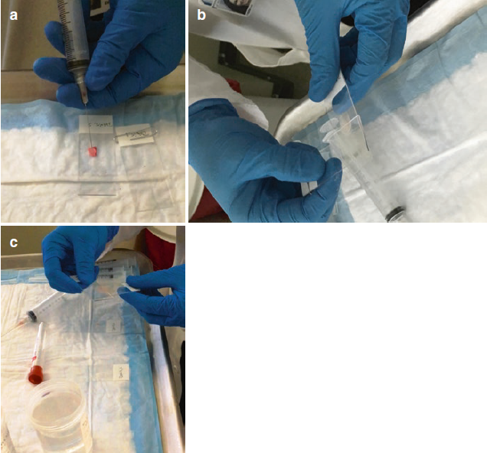

Slide 107
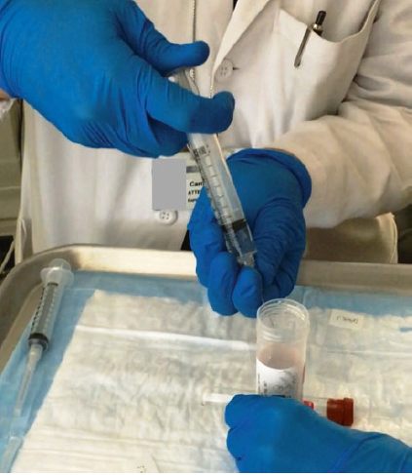

Slide 108
