Slide 1
THE EVALUATION OF INCIDENTALLY DISCOVERED ADRENAL MASSES
ENDOCRINE PRACTICE Vol 25 No. 2 February 2019

Slide 2
The prevalence of incidentally discovered adrenal masses (also referred to as adrenal incidentalomas or adrenal nodules) has grown substantially with the increased use of cross-sectional imaging such as computed tomography (CT) and magnetic resonance imaging (MRI).

Slide 3
Though adrenal masses, or adrenal hyperplasia or thickening, of any size may have clinical relevance, this review will focus on the evaluation of incidentally discovered adrenal masses greater than or equal to 1 cm in size.

Slide 4
on 25 postmortem series is about 6% (range, 1.1 to 32%) .
The prevalence of incidentally discovered adrenal masses using high-resolution CT scans is slightly lower, at approximately 4%
generally observed to be higher with older age

Slide 5
CASE 1: A 50-year-old woman presented to the emergency department with worsening left lower-quadrant pain. An abdominal CT scan with intravenous contrast was performed to evaluate for diverticulitis. No gastrointestinal abnormalities were seen; however, a right adrenal mass was noted. She was seen by her primary care doctor 1 month later.
She was normotensive, normokalemic, and had no signs or symptoms of Cushing syndrome (CS)

Slide 6
A repeat CT scan without intravenous contrast was ordered to specifically evaluate the right adrenal mass, which was noted to be 1.0 cm in size and described as being round and homogenous with an unenhanced attenuation of 8 Hounsfield units (HU) (Fig. 1). The left adrenal gland was normal.
A 1-mg dexamethasone suppression test was performed, yielding a morning cortisol of 1.3 μg/dL

Slide 8
Does this adrenal mass represent a malignancy?

Slide 9
No, the radiographic characteristics of this patient’s incidentally discovered right adrenal mass are suggestive of a benign adrenocortical adenoma.

Slide 10
Although primary adrenal malignancy (adrenocortical carcinoma) is very rare, the prevalence of metastases to the adrenal from extra-adrenal malignancies is not uncommon and may be increasing as cancer survival improves.
The determination of malignant potential is usually a function of the radiographic appearance and size of the adrenal mass.
Adrenocortical adenomas are usually lipid-rich, a feature that classically manifests as a low attenuation on unenhanced CT (<10 HU) and/or the presence of chemical shift on MRI (Table 2)

Slide 12
followed by administration of intravenous contrast and repeat imaging at 1 minute and again at 15 minutes.
Benign and lipid-rich adenomas are not contrast avid and will usually exhibit a >60% absolute washout of contrast after 15 minutes, with a >40% relative washout

Slide 13
MRI is an alternative with no radiation exposure
however, the procedure takes longer than CT and is more costly.

Slide 15
2. Is there evidence for clinically relevant and autonomous adrenal hormone excess?

Slide 16
This patient exhibits no evidence of clinically relevant hypercortisolism.
There is no strong indication to screen for primary aldosteronism in the absence of hypertension or hypokalemia
and the imaging characteristics are not suggestive of pheochromocytoma.

Slide 17
Even when radiographic characteristics support an adrenal mass as being benign, a biochemical evaluation for adrenal hormone excess should be considered.
Since most adrenal masses are detected incidentally, these patients usually do not exhibit symptoms or signs of an overt syndrome of adrenal hormone excess such as CS, primary aldosteronism, or pheochromocytoma.

Slide 18
However, even mild or autonomous hypercortisolism (discussed in more detail in Case 3) can increase the risk for future cardiometabolic and skeletal risk .

Slide 19
Accordingly, it is generally recommended that all patients with an adrenal mass be evaluated with an overnight 1-mg dexamethasone suppression test, where postdexamethasone morning cortisol values ≤1.8 μg/dL are considered to be “normal” or indicative of “nonfunctional” status .
Patients with hypertension and/or hypokalemia should be screened for primary aldosteronism.

Slide 20
and screening for pheochromocytoma should be considered in all patients with a lipid-poor adrenal mass, since it is important to detect pheochromocytoma prior to the development of overt adrenergic symptoms (Table 3).
Patients with a homogenous, non– contrast avid, and lipid-rich adrenal mass (<10 HU) do not require biochemical evaluation for pheochromocytoma because the case detection in such scenarios is close to zero and complicated by a relatively high rate of false-positive biochemical testing.

Slide 21
3. Would a biopsy of the adrenal mass help with diagnosis or management

Slide 22
There is no role for an adrenal biopsy in this case.

Slide 23
The role of adrenal mass biopsy is limited.
A biopsy should be considered when an extra-adrenal metastasis or an infection are the suspected etiology of the adrenal mass(es)
and when the information from cytology is likely to influence management.

Slide 24
Extra-adrenal metastases should be suspected when a patient has a history of nonadrenal cancer, when there are bilateral adrenal masses, and the radiographic appearance of the masses is dense and vascular and/or with an irregular shape (classically, neither round nor with smooth contour).

Slide 25
In these situations, a biopsy can determine the type and stage of the primary cancer, which may influence subsequent management.
A biopsy may also be considered when an infiltrative infection to the adrenal glands is suspected, such as by Mycobacterium or fungal organisms, and there are no other means to confirm the diagnosis.

Slide 26
Patients with infectious adrenal infiltrations are often partially immunocompromised or had lived or traveled in potentially endemic regions.
A biopsy in this situation may inform therapy towards specific antimicrobials rather than surgical procedures.

Slide 27
A biopsy is not recommended to distinguish a primary adrenocortical adenoma from a carcinoma
biopsy in these situations may be inaccurate and/or falsely reassuring due to sampling bias
and there is a theoretical risk of tumor seeding the needle track.

Slide 28
When concern for a primary adrenal malignancy is raised based on radiographic imaging characteristics, a cancer-focused surgery should be strongly considered for diagnosis, prognosis/ staging, and treatment

Slide 29
In this circumstance, a biopsy of a likely malignant mass may be considered.
Biopsy is contra-indicated in any mass which could represent a pheochromocytoma due to concern of precipitating a catecholamine crisis ;rather, biochemical diagnosis, pre-operative adrenergic receptor blockade, and surgery should be pursued

Slide 30
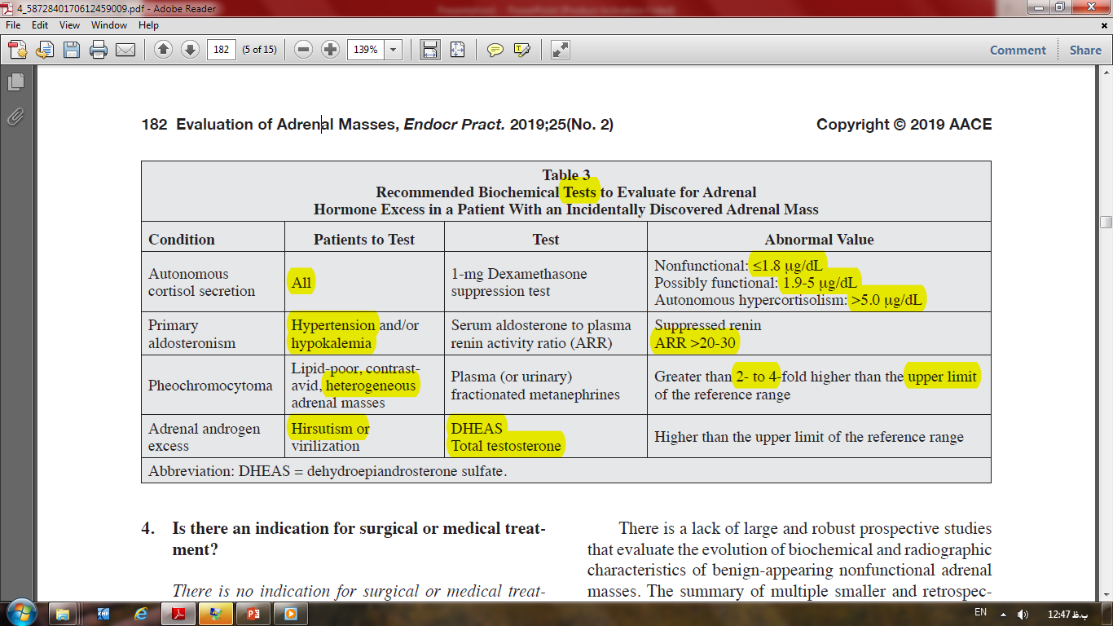

Slide 31
4. Is there an indication for surgical or medical treatment?

Slide 32
There is no indication for surgical or medical treatment in this case, since the adrenal mass is neither suspicious for malignancy nor hormonally active.

Slide 33
mass are asymptomatic and do not exhibit an obvious syndrome of adrenal hormone excess and have normal values on biochemical screening.
In these instances, the radiographic characteristics of the adrenal mass dictate subsequent management.

Slide 34
Adrenal masses that display suspicious or concerning features for a potential malignancy can be further characterized using alternative imaging modalities if needed, and if unilateral, surgically removed.
When there is uncertainty regarding malignant potential or ambiguous characterization that prevent firm decision making, repeated imaging can be performed in 3 to 6 months to reassess for progressive radiographic or biochemical features that may confirm suspicions of a potential malignancy

Slide 35
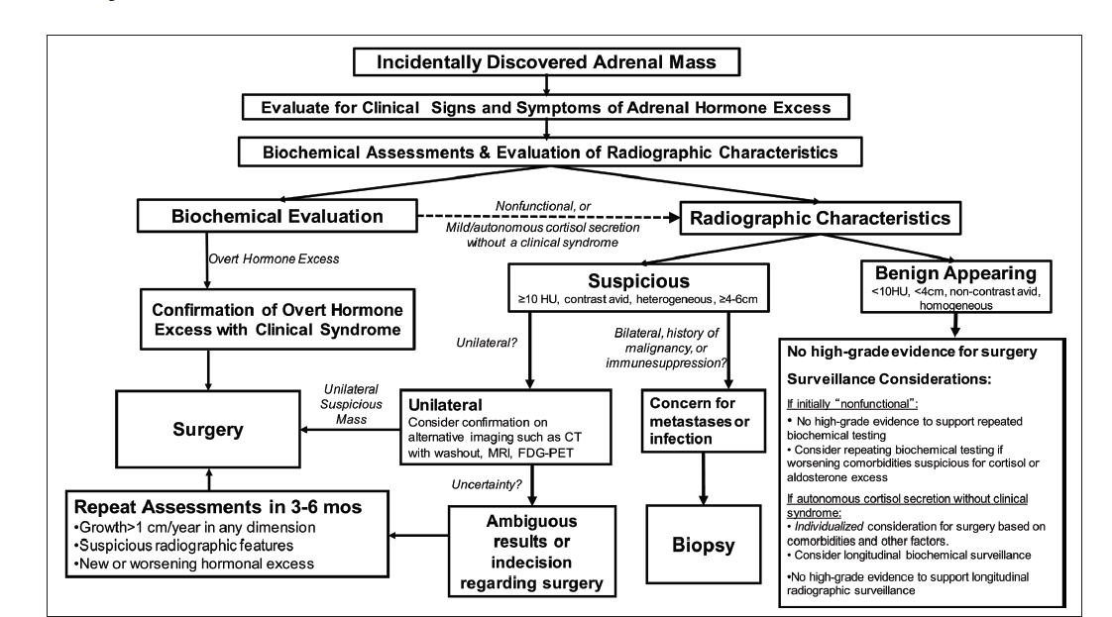

Slide 36
5. Is there any indication for longitudinal surveillance with imaging and/or biochemical testing? If so, how frequently and for what duration?

Slide 37
There is no strong evidence supporting longitudinal biochemical or radiographic surveillance for this patient.

Slide 38
There is a lack of large and robust prospective studies that evaluate the evolution of biochemical and radiographic characteristics of benign-appearing nonfunctional adrenal masses.
The summary of multiple smaller and retrospective studies suggests that a nonfunctional and lipid-rich appearing adrenal mass that is <4 cm in size is extremely unlikely to represent a malignancy, and therefore, there is no strong evidence to repeat imaging studies.

Slide 39
While there are rare reported cases where an adrenocortical carcinoma developed in a patient with a prior history of benign adrenocortical adenoma based on imaging criteria ,it is not clear if the adrenocortical carcinoma in such cases developed from the adenoma or was an independent occurrence.
Furthermore, it is not known whether imaging surveillance would have changed the clinical outcome in these rare scenarios.

Slide 40
Accordingly, the authors do not feel that such rare cases should change imaging surveillance strategies for millions of benign-appearing adenomas until a better understanding of adrenocortical carcinoma pathogenesis and development is available.

Slide 41
Development of mild or autonomous hypercortisolism (previously referred to as “subclinical hypercortisolism” or “subclinical Cushing syndrome”) is the most commonly reported hormonal excess during long-term follow-up of adrenal incidentalomas ;however, robust data to support serial biochemical evaluations are lacking.

Slide 42
Rather, an individualized approach should be taken for each patient.
Patients, and their primary care clinicians, should be educated about potential signs and symptoms of hypercortisolism and hyperaldosteronism that should trigger re-evaluation.
The development of new or unexpectedly worsening hyperglycemia, diabetes, hypertension, hypokalemia, weight gain or lipodystrophy, and/or low bone mineral density or fractures in this patient may raise concern for hypercortisolism or hyperaldosteronism, and biochemical screening can be repeated

Slide 43
CASE 2: A 71-year-old woman presented to the emergency department with right flank pain. An abdominal CT scan was performed without contrast to evaluate for nephrolithiasis. Imaging revealed a small non obstructing kidney stone and an incidentally observed 3.8 × 2.9 × 1.9 cm diffuse left adrenal thickening/mass that was poorly circumscribed, had a 25 HU unenhanced attenuation with an absolute contrast washout of 30% after 15 minutes

Slide 44
In addition, the right adrenal gland was noted to be diffusely thickened without a discrete mass .There were no other abdominal abnormalities, and subsequent imaging of the chest showed no abnormalities.

Slide 45
The patient had a history of breast cancer diagnosed 10 years earlier (positive for the estrogen and progesterone receptors and negative for Her2/neu) that was treated with lumpectomy, chemotherapy, and subsequently 7 years of aromatase inhibitor therapy.
She had undergone surveillance imaging annually until 2 years prior to the current presentation.
Prior imaging of her abdomen 2 years earlier revealed normal adrenal glands; thus, the current adrenal abnormalities were new.

Slide 46
The patient denied any symptoms of a pheochromocytoma, CS, or hyperandrogenism, and had no hypertension or hypokalemia. Plasma metanephrines were normal, and a 1-mg dexamethasone suppression test resulted in a morning cortisol of 0.9 μg/dL.

Slide 48
Does this adrenal mass represent a malignancy?

Slide 49
These imaging characteristics are concerning for a malignancy.

Slide 50
The unenhanced attenuation of 25 HU suggests a lipid-poor entity.
Further, low absolute washout percentage, the lack of smooth contours and irregular shape, bilateral adrenal involvement, and the background of a prior history of breast cancer not only raise concern for a malignant process but raise the specter of adrenal metastases.
Metastases to the adrenal glands can be bilateral and may appear dense and irregular in shape on imaging.
A primary adrenal malignancy or infection are less likely scenarios

Slide 51
2. Is there evidence for clinically relevant and autonomous adrenal hormone excess?

Slide 52
There is no clinically apparent evidence of hypercortisolism, pheochromocytoma, androgen-secreting tumor, or primary aldosteronism.
Furthermore, a 1-mg dexamethasone suppression test and plasma metanephrines were normal.

Slide 53
Would a biopsy of the adrenal mass help with diagnosis or management?

Slide 54
Yes, an adrenal biopsy may influence management decisions.

Slide 55
Since the primary consideration is metastatic breast cancer and there are no other metastatic lesions to sample, an adrenal biopsy could provide a tissue diagnosis which would also confirm the disease as advanced or stage 4.
After excluding a pheochromocytoma, a biopsy may influence whether the appropriate treatment should involve systemic medical therapy versus surgical therapy

Slide 56
In this case, a biopsy of the left adrenal mass revealed malignant cells consistent with breast cancer that was positive for the estrogen and progesterone receptors and negative for Her2/neu.
This finding confirmed that the patient had a recurrence of her breast cancer presenting with isolated adrenal metastases nearly 10 years after her original disease.

Slide 57
4. Is there an indication for surgical treatment?

Slide 58
Surgery to remove an adrenal metastasis is reasonable to consider.
However, in this case, the findings suggest that medical therapy for metastatic breast cancer might be a potential option.

Slide 59
This patient was resumed on an aromatase inhibitor, and 1 year later, imaging revealed complete regression of her adrenal metastases.
Although medical therapy was effective in this case, surgical metastasectomy should be considered on a case-by-case basis, especially when a patient’s malignancy is considered unlikely to respond to chemotherapies or targeted treatments.

Slide 60
5. Is there an indication for longitudinal surveillance with imaging and/or biochemical testing?

Slide 61
Yes, this patient should be closely monitored for primary adrenal insufficiency.

Slide 62
Given bilateral adrenal metastases, it would have been reasonable to evaluate adrenocorticotropic hormone (ACTH) and cortisol levels at the time of diagnosis of metastatic breast cancer to establish a baseline with which to compare subsequent assessments.
This patient was followed for signs and symptoms of primary adrenal insufficiency and routine morning cortisol and ACTH levels.

Slide 63
Approximately 1 year after resuming the aromatase inhibitor, her morning cortisol levels declined and her ACTH levels rose, indicating the development of primary adrenal insufficiency.
She was treated with replacement hydrocortisone and fludrocortisone.

Slide 64
CASE 3: A 68-year-old man with a history of osteoporosis, hyperlipidemia, and pre diabetes was incidentally found to have a right-sided lipid-rich adrenal mass (<10 HU on unenhanced CT imaging), size 4.6 × 3.5 × 3.5 cm, on a CT scan performed to evaluate back pain (Fig. 4). The CT scan also noted vertebral compression fractures of his spine

Slide 65
Physical exam was unremarkable and there was no evidence of supraclavicular fat pads, striae, or proximal muscle weakness.
Biochemical evaluation excluded pheochromocytoma and primary hyperaldosteronism.
Laboratory data showed an undetectable morning ACTH, a morning cortisol ≥5.0 μg/dL following 1-mg overnight dexamethasone suppression test on two separate occasions, a normal 24-hour urinary free cortisol (UFC), and a low dehydroepiandrosterone sulfate (DHEAS)

Slide 67
Does this adrenal mass represent a malignancy?

Slide 68
No, the imaging characteristics show a lipid-rich mass that is suggestive of benign entity.

Slide 69
The unenhanced CT images show a round right adrenal mass with low attenuation (<10 HU). In addition, the adrenal mass displayed no evidence of local invasion or calcifications. Despite being slightly more than 4 cm in size, the other features of this tumor strongly suggest that it is benign.

Slide 70
Some experts recommend surgical adrenalectomy when lipid-rich adrenal masses are greater than 4 cm in size, owing to concerns that small malignant foci may not be recognized in larger-sized masses
however, this recommendation is not supported by high-grade evidence and should be considered on a case-by-case basis.

Slide 71
2. Is there evidence for clinically relevant and autonomous adrenal hormone excess?

Slide 72
Despite the lack of classical physical features on examination suggestive of CS, the biochemical evaluation suggests autonomous hypercortisolism.

Slide 73
Patients with mild or autonomous hypercortisolism typically do not have overt manifestations of CS on physical physical examination .
The prevalence of autonomous hypercortisolism with incidentally discovered adrenal masses has been reported as approximately 5% among more than 2,000 patients from 13 different studies

Slide 74
A post dexamethasone cortisol value <1.8 μg/dL is considered to represent a “nonfunctional” tumor.
False-positive results are not uncommon and may occur in patients receiving medications that accelerate dexamethasone metabolism (such as phenytoin, carbamazepine, rifampin, and phenobarbital), increase corticosteroid-binding globulin (such as estrogen and mitotane), or in patients with depression and alcohol use.

Slide 75
A post dexamethasone cortisol value ≥5.0 μg/dL is regarded to represent “autonomous” cortisol secretion.
Post dexamethasone cortisol levels between 1.8 and 5.0 μg/ dL indicate “possible” hypercortisolism, or milder degrees of hypercortisolism, where additional investigations may be helpful

Slide 76
In such circumstances, detection of any of the following results may provide additional support for autonomous, and ACTH-independent, hypercortisolism: low or suppressed ACTH (<10 pg/mL), in addition to low DHEAS, and elevated late-night salivary cortisol or 24-hour UFC .
It is important to underscore the detection of ACTH-independent hypercortisolism when implicating the adrenal mass; non suppressed ACTH levels indicate an ACTH-dependent hypercortisolism and attention should be paid to a hypothalamic-pituitary or ectopic source of ACTH.

Slide 77
When ACTH values are inconsistent with expectations or the clinical context, it may be reasonable to consider falsely elevated values due to assay interference .
The dexamethasone suppression test and late-night salivary cortisol test are most sensitive at detecting subtle forms of non physiologic and autonomous cortisol secretion, whereas the 24-hour UFC is frequently normal in mild autonomous cortisol excess.
The dexamethasone suppression test may also be repeated a few months later to evaluate for consistently elevated results.

Slide 78
In this case, the patient has multiple lines of evidence suggestive of autonomous and ACTH-independent hypercortisolism and clinical evidence associated with cortisol excess (fragility fractures, dyslipidemia, and prediabetes).
These collective results may suggest a causal relationship between the hypercortisolism and the adverse clinical outcomes that is amenable to treatment

Slide 79
3. Would a biopsy of the adrenal mass help with diagnosis or management?

Slide 80
There is no role for adrenal biopsy, as imaging characteristics reveal a benign adrenal adenoma.
There is no indication of a malignancy or infiltrative adrenal disease.

Slide 81
Is there an indication for surgical or medical treatment?

Slide 82
Surgery should be considered for patients with overt hypercortisolism and CS.
For patients with mild or autonomous hypercortisolism CS, an without clinical evidence of CS, individualized approach for surgery must be taken depending on the presence of cortisol-related comorbidities, patient preference for surgery versus medical monitoring, and other individual patient- and tumor-related factors.

Slide 83
There are no robust randomized controlled studies evaluating the efficacy and value of adrenalectomy for mild or autonomous hypercortisolism.
The decision to pursue surgery is based on interpretations of observational data.

Slide 84
Observational data from cross-sectional and cohort studies have suggested that autonomous hypercortisolism without overt clinical manifestations of CS is associated with a higher risk for cardiovascular disease, diabetes, hypertension, dyslipidemia, obesity, and fragility fracture .
In parallel, several case series and small uncontrolled intervention studies have suggested that adrenalectomy may improve blood pressure, glycemic control, skeletal health, and weight loss

Slide 85
After discussing the option of surgical adrenalectomy versus close medical monitoring for new or progressive cortisol-related adverse clinical outcomes, this patient chose to proceed with adrenalectomy.
Three months following his surgery, he had a normal (nonsuppressed) ACTH, and his hemoglobin A1c was lower.

Slide 86
When surgical adrenalectomy is pursued for autonomous hypercortisolism, it is often recommend that peri-operative glucocorticoid treatment be administered, since it is difficult to assess which patients will develop clinically significant adrenal insufficiency postoperatively .
In a systematic review of the literature evaluating 28 different studies, the prevalence of some degree of adrenal insufficiency following surgery for autonomous hypercortisolism was approximately 65%

Slide 87
Glucocorticoids can be gradually tapered following the surgery depending on the patient’s recovery.
As an alternative strategy, patients can safely undergo surgical resection of their tumor and have their cortisol levels measured on the morning of the first postoperative day. An early morning or random cortisol >15 μg/dL provides reassurance that the function of the contralateral adrenal gland is relatively normal and obviates the need for glucocorticoid therapy

Slide 88
Patients with a morning cortisol level <10 μg/dL should be treated with supplemental glucocorticoid therapy with gradual tapering of doses until their hypothalamic-pituitary-adrenal function normalizes.
Morning cortisol levels in the 10 to 15 μg/dL range may need glucocorticoid therapy and should be monitored closely to make this determination

Slide 89
5. Is there an indication for longitudinal surveillance with imaging and/or biochemical testing? If so, how frequently and for what duration?

Slide 90
Yes, if surgery is not pursued, then annual clinical assessment for new or worsening cortisol-related comorbidities such as low bone density, diabetes, weight gain, hyperlipidemia, and hypertension should be performed.
The added value of repeating dexamethasone suppression testing annually in a patient with known autonomous hypercortisolism is not clear.

Slide 91
CASE 4: A 71-year-old man with a history of hyperlipidemia and prediabetes presented to the endocrine clinic with incidentally discovered bilateral lipid-rich adrenal masses when he underwent a CT scan for back pain.

Slide 92
The right adrenal mass measured 1.7 × 1.4 × 1.5 cm, and the left adrenal mass measured 1.2 × 0.9 × 1.0 cm (Fig. 5).
There were no radiologic features suspicious for malignancy, such as heterogeneity, irregular borders, or local invasion.
The non contrast CT attenuation values for the right and left adrenal masses were −10 and −5 HU, respectively.
Physical examination was unremarkable.

Slide 93
The patient was not overweight and had no supraclavicular fat pads, striae, or proximal muscle weakness.
Bone mineral density was normal.
Biochemical evaluation was negative for a pheochromocytoma and primary aldosteronism.

Slide 94
A morning cortisol was 14.8 μg/dL, with an ACTH of 26 pg/mL and a 24-hour UFC of 10.1 μg.
However, a post dexamethasone cortisol was 2.5 μg/dL

Slide 95
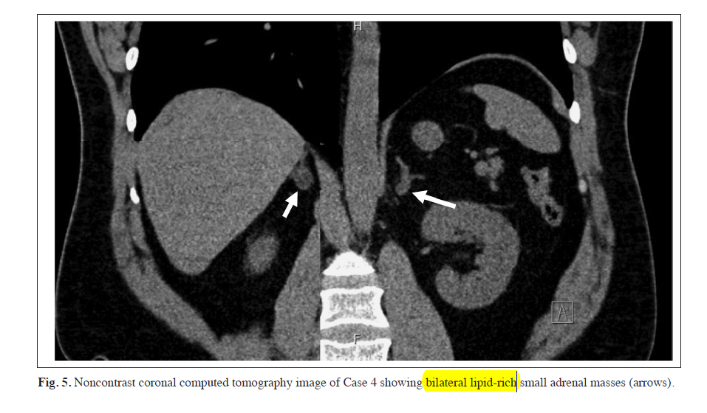

Slide 96
Does this adrenal mass represent a malignancy?

Slide 97
No. The imaging characteristics of both adrenal masses are consistent with benign lipid-rich adenomas.

Slide 98
Incidentally discovered adrenal masses may be unilateral or bilateral. Observational series suggest that bilateral adrenal masses can be detected in ~14% of cases and that the left adrenal mass is usually larger than the right
whereas unilateral left-sided masses are detected in ~65% of cases and unilateral right-sided masses in ~21% of cases

Slide 99
It is speculated that incidental adrenal masses are more frequently detected on the left rather than the right adrenal gland because small abnormalities on the right adrenal gland are harder to appreciate given its proximity to the liver and kidney.
Bilateral adrenal masses may represent nonfunctional adenomas, pheochromocytoma, congenital adrenal hyperplasia, macronodular cortical adenomas that cause hypercortisolism (primary macronodular adrenal hyperplasia) or primary aldosteronism, adrenal metastases, lymphomas, and/or infections

Slide 101
2. Is there evidence for clinically relevant and autonomous adrenal hormone excess?

Slide 102
The cortisol following overnight dexamethasone administration was slightly elevated at 2.5 μg/dL, consistent with mild or possible autonomous hypercortisolism.
The clinical significance of this biochemical abnormality in this patient is unclear; the relation of this potential hypercortisolism with the patient’s prediabetes and dyslipidemia is uncertain.

Slide 103
Although the cortisol level post dexamethasone did not suppress as low as is typically desired, the 24-hour UFC was normal (suggesting the lack of overt hypercortisolism)
the morning ACTH concentration was not suppressed (arguing against autonomous and ACTH-independent pathophysiology), and unlike Case 3)
there were no other overt clinical manifestations to suggest hypercortisolism

Slide 104
Prior observational studies have indicated that even this mild degree of hypercortisolism may contribute to a higher incident risk of cardio metabolic outcomes; however, whether a medical or surgical intervention here could mitigate this risk is unclear.
Thus, the finding of mild hypercortisolism may serve as a prognostic risk factor until additional studies (i.e., randomized controlled trials) provide more concrete evidence on how best to manage them.

Slide 105
Would a biopsy of the adrenal mass help with diagnosis or management?

Slide 106
There is no indication for a biopsy.

Slide 107
Is there an indication for surgical or medical treatment?

Slide 108
There is no strong evidence to support any treatment at this time.

Slide 109
An individualized treatment plan is recommended for patients with evidence for autonomous or subclinical hypercortisolism (Fig. 2).
Unlike in Case 3, this patient has no visible clinical manifestations of hypercortisolism and no suppression of ACTH. Observational data suggest that surgical adrenalectomy may have beneficial cardiometabolic effects in some instances of autonomous cortisol excess

Slide 110
however, until high-grade evidence from randomized intervention studies are available, strong recommendations for this patient cannot be made, and an individualized approach is required.

Slide 111
When treatment is warranted in patients with bilateral adrenal tumors and autonomous hypercortisolism, several options could be considered, including
observation and repeated testing at a later time (in the absence of overt comorbidities associated with hypercortisolism or a suppressed ACTH)
medical therapy to decrease cortisol secretion or action
unilateral adrenalectomy of the larger adrenal mass, or bilateral adrenalectomy

Slide 112
Adrenal vein sampling for cortisol and metanephrines (at specialized and experienced centers) may be considered in select cases with bilateral adenomas of similar size prior to considering surgery

Slide 113
Is there an indication for longitudinal surveillance with imaging and/or biochemical testing? If so, how frequently and for what duration?

Slide 114
Annual clinical assessment for signs and symptoms of hypercortisolism, with repeated dexamethasone suppression testing to assess progression in the severity of hypercortisolism, should be considered.

Slide 115
CASE 5: A 65-year-old man with a history of depression and osteoarthritis was found to have a lipid-poor adrenal mass that was 5.0 × 4.5 × 5.0 cm on a CT scan performed to evaluate back pain. The mass was lobular and heterogeneous, with a noncontrast CT attenuation of 55 HU.

Slide 116
Physical exam was unremarkable. He was a tall, thin man without supraclavicular fat pads, striae, or proximal muscle weakness.
Biochemical evaluation revealed normal plasma metanephrines and aldosterone-to-renin ratio.
However, the patient had an abnormal dexamethasone suppression test, with a posttest cortisol of 8 μg/dL. DHEAS was elevated at 550 μg/dL (normal, 40 to 100 μg/dL).

Slide 118
Does this adrenal mass represent a malignancy?

Slide 119
The imaging characteristics of this adrenal mass are concerning for adrenal malignancy.

Slide 120
The large size, heterogeneous content, lobular contours, and lipid-poor density on unenhanced CT imaging are all concerning for a malignant entity.
The elevated DHEAS and abnormal dexamethasone suppression results further indicate a high likelihood of primary adrenocortical carcinoma that is secreting cortisol and adrenal androgens.

Slide 121
2. Is there evidence for clinically relevant and autonomous adrenal hormone excess?

Slide 122
There is no overt physical evidence for adrenal hormone excess.
However, the patient had an abnormal dexamethasone suppression test and elevated DHEAS.
The combination of glucocorticoid and androgen cosecretion is highly suggestive of adrenocortical carcinoma

Slide 123
Adrenal cortical carcinoma can present with clinical and/or biochemical hyperandrogenism or hypercortisolism ;however, they may also present as hormonally silent.
Less frequently, adrenocortical carcinoma may present with hyperaldosteronism or estradiol excess.
Patients who develop adrenal cortical carcinoma tend to have rapid tumor growth. As a result, in the case of a secreting tumor, clinical manifestations can also develop and progress rapidly

Slide 124
3. Would a biopsy of the adrenal mass help with diagnosis or management?

Slide 125
A biopsy is not indicated.

Slide 126
If there is suspicion that a patient has adrenocortical carcinoma based on radiographic and/or biochemical findings, then a biopsy is not indicated.
The main reason to avoid biopsy is that adrenocortical carcinomas are sufficiently heterogeneous that focal sampling may not be diagnostic, and in some cases, may falsely suggest a benign diagnosis .
A biopsy may be useful for diagnosing extra-adrenal metastases or invasive adrenal infections after a pheochromocytoma has been excluded.

Slide 127
4. Is there an indication for surgical or medical treatment?

Slide 128
Yes, adrenalectomy should be performed by a surgeon with a high level of experience in performing adrenal cancer surgeries.

Slide 129
When the concern for adrenocortical carcinoma arises, the most appropriate diagnostic, prognostic, and therapeutic intervention is an open and radical adrenalectomy. This intervention offers the ability to obtain gross pathology that can confirm the diagnosis as well as the grade and stage of the tumor and also permits removal of the tumor along with exploration of lymph nodes.

Slide 130
Currently, the only cure for adrenocortical carcinoma is a complete surgical resection, which also remains the best therapy to prolong survival time .
This patient should be treated by a multidisciplinary team including dedicated experts in endocrinology, endocrine surgery, medical oncology, radiation oncology, and pathology. If such expertise is not available locally, referral to the nearest adrenal center is advised to ensure the best outcome.

