Slide 1
Treatment of Diabetes in Older Adults An Endocrine Society Clinical Practice Guideline
D. LeRoith, et al., J Clin Endocrinol Metab 104: 1–55, 2019
Presented by G. Taghipour, MD

Slide 2
Older adults
defined here as age 65 years or older
Among older adults with diabetes, >90% have type 2 diabetes (T2D)

Slide 3
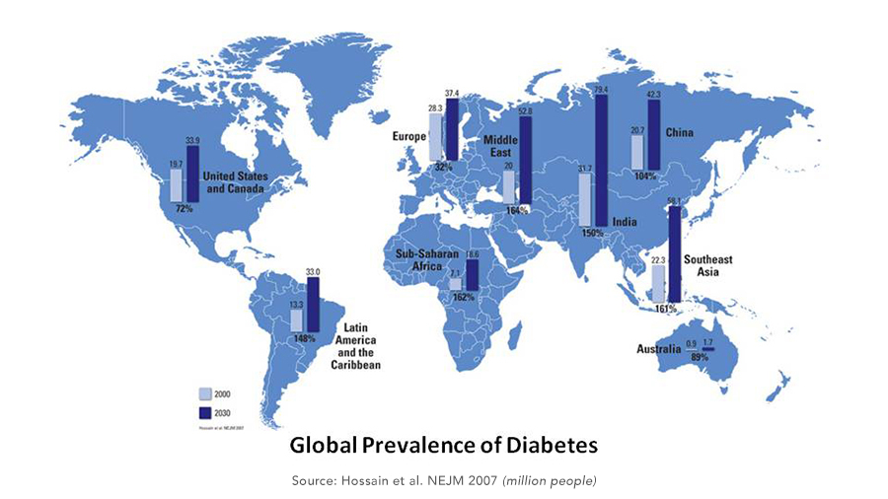
Epidemiology
33% | 50% | aged 65 to 79 years
T2D is an age-related disease | older people meet the criteria for prediabetes | The incidence of newly diagnosed diabetes is highest

Slide 4
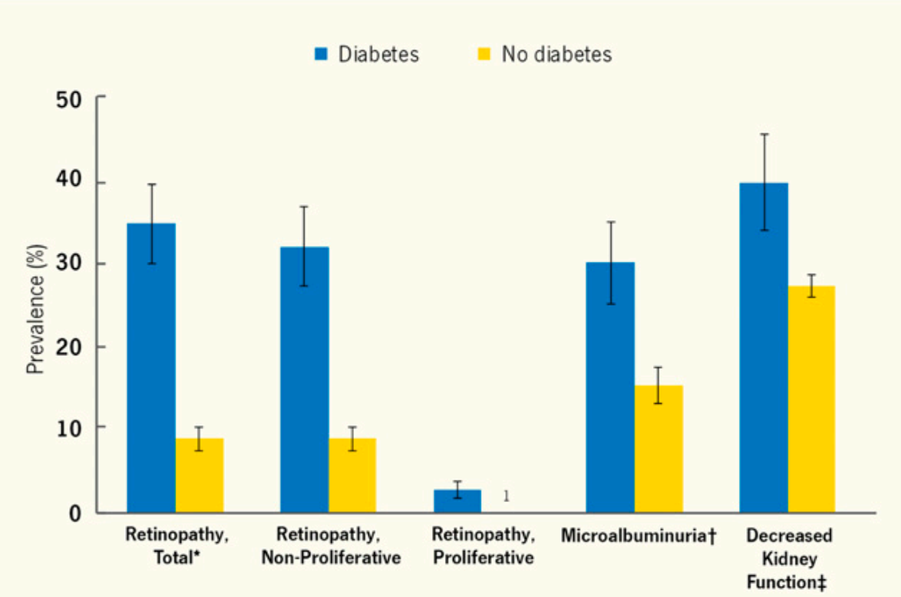
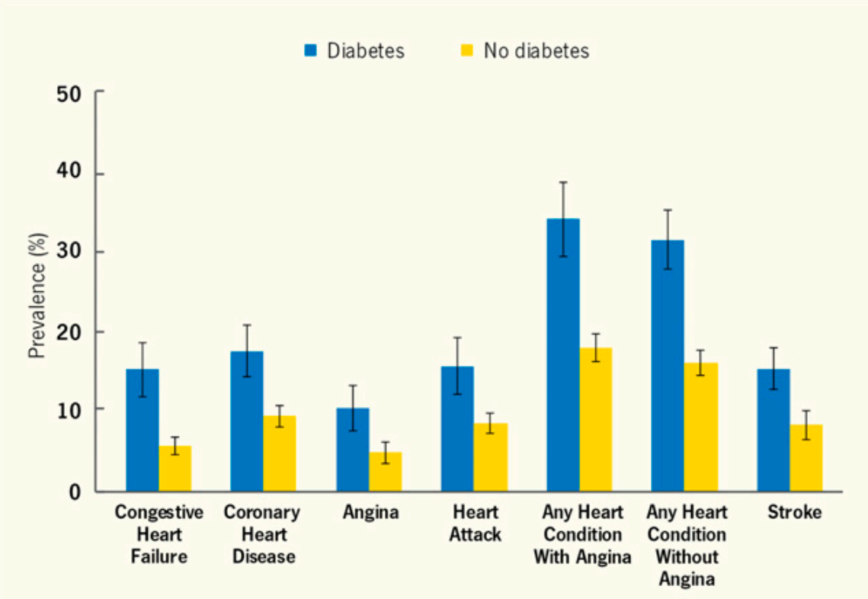
Epidemiology
Microvascular complications among adults age ≥ 65 y, by diabetes status
Cardiovascular complications among adults age ≥ 65 y, by diabetes status

Slide 5
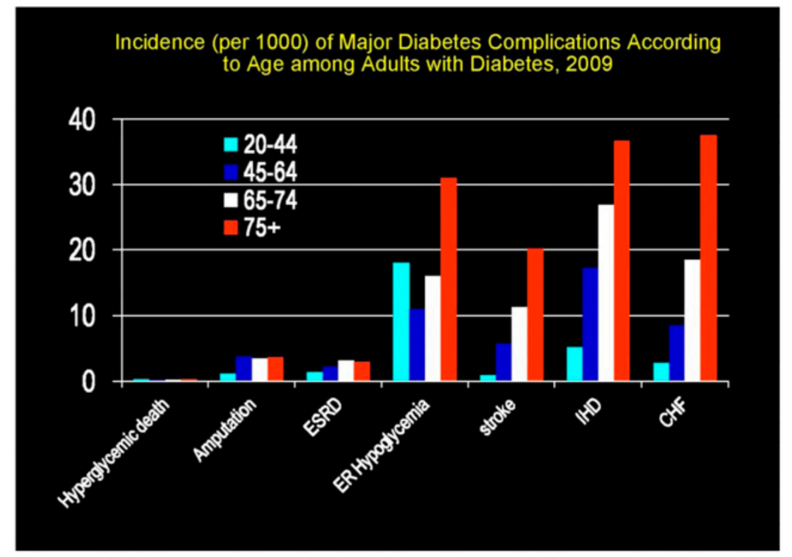
Epidemiology
Incidence (per 1000) of major diabetes complications according to age among adults with diabetes,
~50% of individuals over age 65 years with diabetes have diabetic nephropathy, which manifests as albuminuria, impaired glomerular filtration rate (GFR), or both.
Diabetic kidney disease accounts for nearly half of all cases of end-stage renal disease in the United States, and the rate is highest among those
aged ≥ 75 years.
The risk for lower extremity amputation is 10-fold greater in older people with diabetes than in those without diabetes.

Slide 6
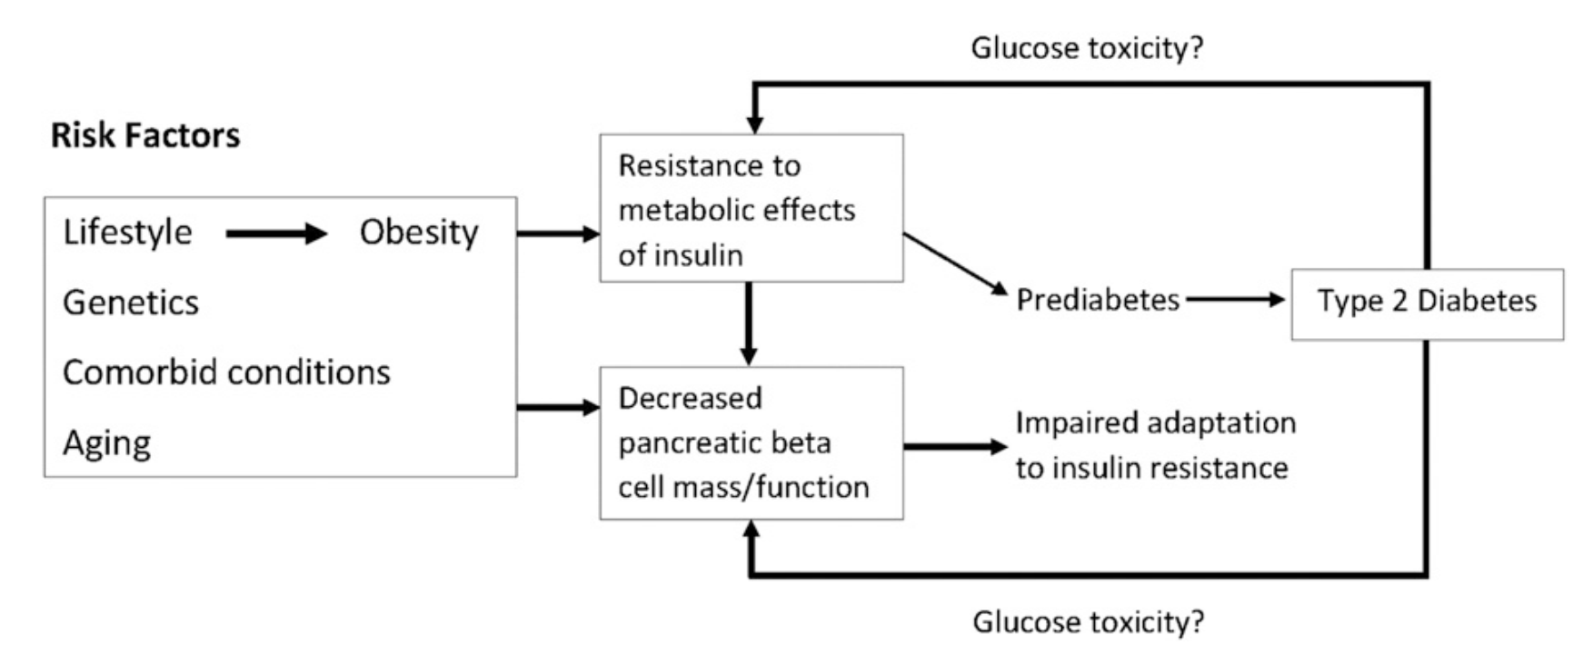
Pathophysiology of hyperglycemia
Notably, consistent declines in β cell function and insulin secretion are hallmarks of aging in rodents and humans.

Slide 7
1. Role of the Endocrinologist and Diabetes Care Specialist
1.1
In patients aged 65 years and older with newly diagnosed diabetes, we advise that an endocrinologist or diabetes care specialist should work with the primary care provider, a multidisciplinary team, and the patient in the development of individualized diabetes treatment goals.
1.2
In patients aged 65 years and older with diabetes, an endocrinologist or diabetes care specialist should be primarily responsible for diabetes care if the patient has T1D, or requires complex hyperglycemia treatment to achieve treatment goals, or has recurrent severe hypoglycemia, or has multiple diabetes complications.

Slide 8
Evidence
The endocrinologist or diabetes care specialist functions as the leader of the diabetes care team, which includes a nurse educator, dietician, and others (e.g., pharmacist, psychologist, social worker).
Possible roles of the endocrinologist or diabetes care specialist include the following:
1- No role:
An endocrinologist or diabetes care specialist may not be needed for patients whose hyperglycemia and CVD prevention treatment goals are easily achieved with lifestyle alone or with simple oral agent therapy (one or two medications).

Slide 9
Evidence
2- Consultant-only collaborative care:
The endocrinologist or diabetes care specialist assists in assessing the patient’s diabetes status and related complications and setting treatment goals with recommendations for specific interventions. Consultation may occur at the time of original diabetes diagnosis or when there is a change in the patient’s diabetes status (e.g., treatment goals no longer being achieved, recurrent hypoglycemia, development of one or more diabetes complications).

Slide 10
Evidence
3-Overall diabetes management:
the endocrinologist or diabetes care specialist and the diabetes care team are primarily responsible for diabetes care and collaborate with providers who manage the patient’s other health problems and comorbidities. This situation may occur by default if the patient has no primary care provider or if the patient is already under the care of the endocrinologist or diabetes care specialist for long-standing T1D or other endocrine conditions.

Slide 11
2. Screening for Diabetes and Prediabetes, and Diabetes Prevention
2.1
In patients aged 65 years and older without known diabetes, we recommend fasting plasma glucose and/or HbA1c screening to diagnose diabetes or prediabetes.
Technical remark:
The measurement of HbA1c may be inaccurate in some people in this age group because of comorbidities that can affect the lifespan of red blood cells in the circulation.
Although the optimal screening frequency for patients whose initial screening test is normal remains unclear, the writing committee advocates repeat screening every 2 years thereafter.

Slide 12
2. Screening for Diabetes and Prediabetes, and Diabetes Prevention
2.2
In patients aged 65 years and older without known diabetes who meet the criteria for prediabetes by fasting plasma glucose or HbA1c, we suggest obtaining a 2-hour glucose post–oral glucose tolerance test measurement.
Technical remark:
This recommendation is most applicable to high-risk patients with any of the following characteristics: overweight or obese, first-degree relative with diabetes, high-risk race/ ethnicity (e.g., African American, Latino, Native American, Asian American, Pacific Islander), history of CVD, hypertension (≥140/90 mm Hg or on therapy for hypertension), high-density lipoprotein cholesterol level <35 mg/dL (0.90 mmol/L) and/or a triglyceride level >250 mg/dL (2.82 mmol/L), sleep apnea, or physical inactivity.

Slide 13
2. Screening for Diabetes and Prediabetes, and Diabetes Prevention
2.3
In patients aged 65 years and older who have prediabetes, we recommend a lifestyle program similar to the Diabetes Prevention Program to delay progression to diabetes.
Technical remark:
Metformin is not recommended for diabetes prevention at this time, as it is not approved by the Food and Drug Administration for this indication.
As of 2018, a Diabetes Prevention Program–like lifestyle intervention is a covered benefit for Medicare beneficiaries in the United States who meet the criteria for prediabetes.

Slide 14
Evidence
The prevalence of disorders of sleep increases with age, and such disorders
have been associated with the development or exacerbation of diabetes and risks of cardiovascular events.
Therefore, assessment for sleep disorders and their treatment should be considered in older patients at risk for and with diabetes.
In people over the age of 60 years in the Diabetes Prevention Program, lifestyle intervention to reduce bodyweight and increase physical activity
reduced the rate of progression to diabetes by 71% during 4 years.
Metformin was less effective in people over the age of 60 years (estimated
number needed to treat, 39.2) in the Diabetes Prevention.

Slide 15
3. Assessment of Older Patients With Diabetes
3.1
Overall health framework
In patients aged 65 years and older with diabetes, we advise assessing the patient’s overall health (see Table 2) and personal values prior to the
determination of treatment goals and strategies (see Table 3).

Slide 16
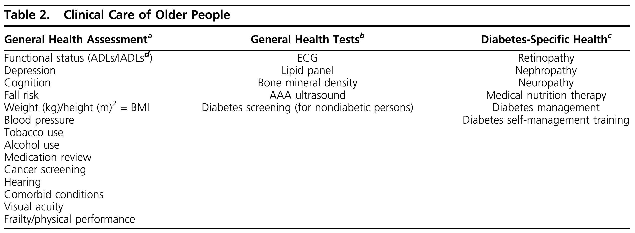
Evidence
a: All items are required services to qualify for Medicare coverage of annual wellness examinations for people in the United States >65 y of age, except for frailty/physical performance. These are generally conducted by primary care providers.
b: All items are services covered by Medicare for people in the United State >65 y of age as part of annual wellness examinations at intervals varying from annually to once per lifetime.
c: All items are services covered by Medicare for people in the United States >65 y of age as part of standard diabetes care. These are covered annually except for diabetes management visits, which are covered as recommended by the diabetes care team.
d: Functional status is based on assessment of independence or dependency (having difficulty and receiving assistance) of five ADLs (bathing, dressing, eating, toileting, and transferring) and five IADLs (preparing meals, shopping, managing money, using the telephone, and managing medications).

Slide 17
Evidence
Functional status is most often documented using subsets of specific activities that are necessary for living independently.
They include activities of daily living (ADLs), that is, bathing, dressing, eating, toileting, and transferring, as well as instrumental ADLs (IADLs), that is, preparing meals, shopping, managing money, using the telephone, and managing medications (Table 2).
In patients with diabetes, deficits in IADLs identified during routine evaluation should trigger a more in-depth evaluation of the patient, including a detailed assessment of hypoglycemia and hyperglycemia, microvascular and
macrovascular complications, and cognition

Slide 18
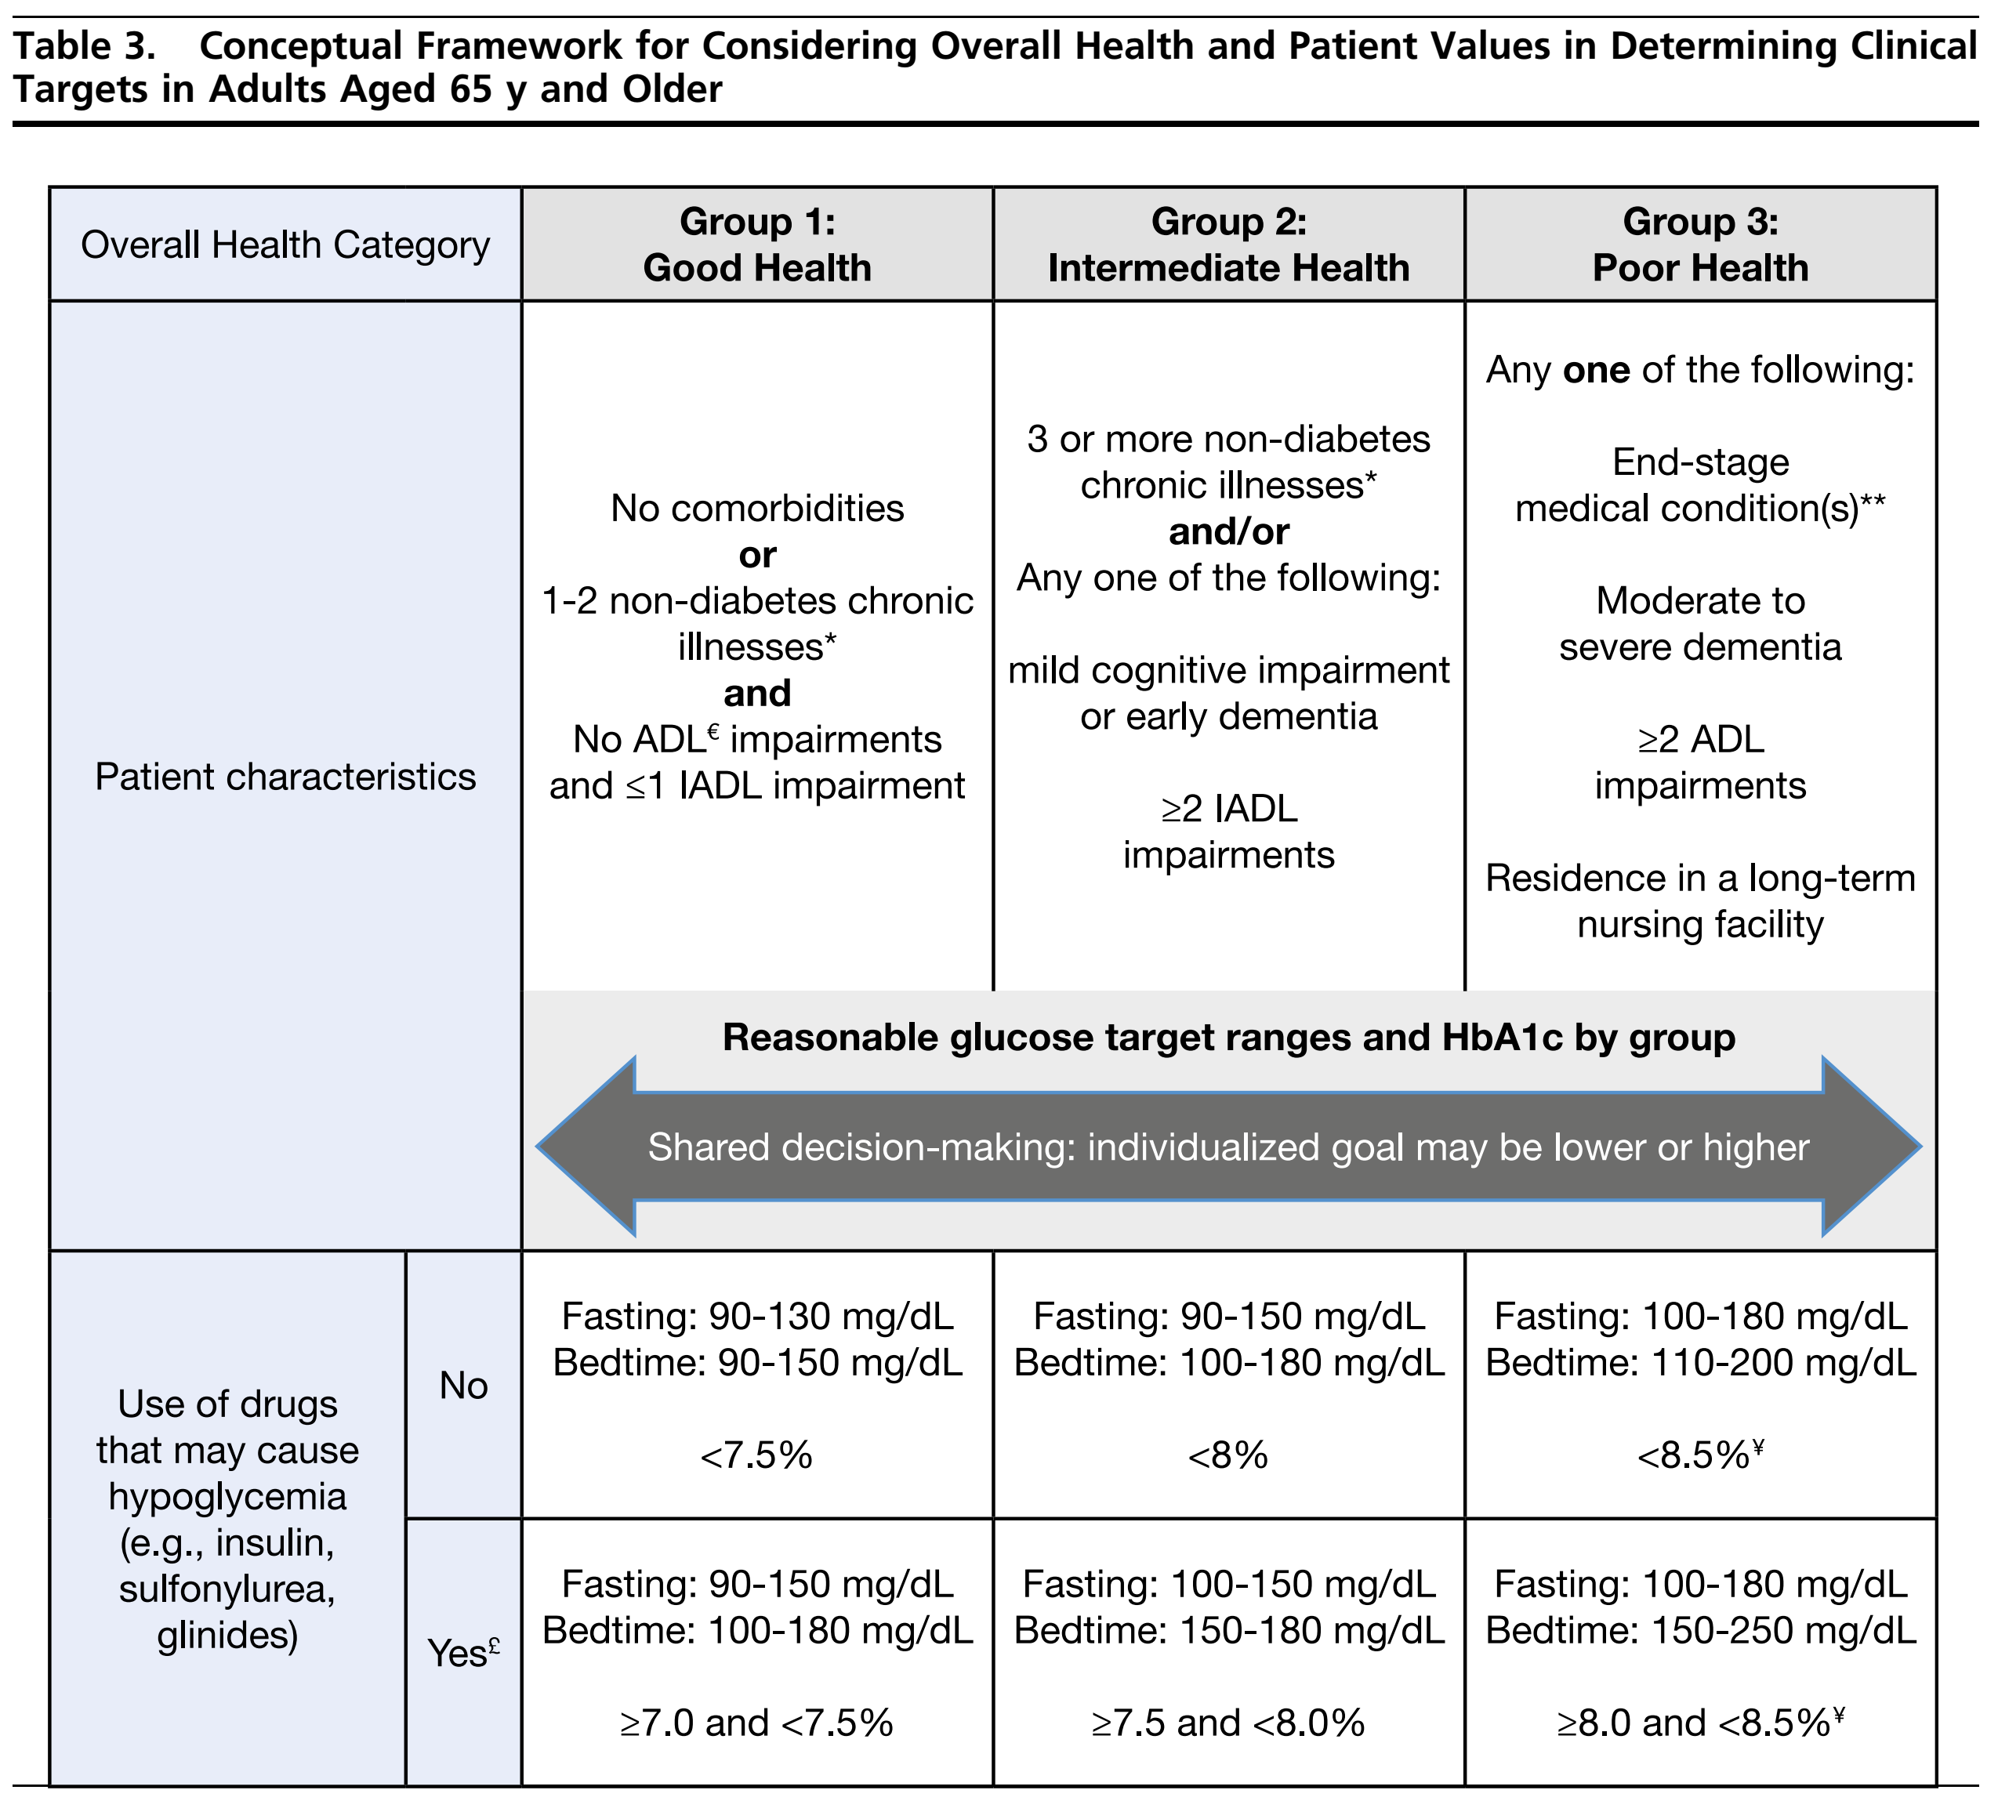
Evidence
* Coexisting chronic illness may include osteoarthritis, hyper tension, chronic kidney disease stage 1-3, or stroke, among others.
** One or more chronic illness with limited treatments and reduced life expectancy. This include metastatic cancer, oxygen dependent lung disease, end-stage kidney disease requiring dialysis and advanced heart failure.
ADLs include bathing, dressing, eating, toileting, and transferring.
IADLs include preparing meals, shopping, managing money, using telephone, and managing medications.

Slide 19
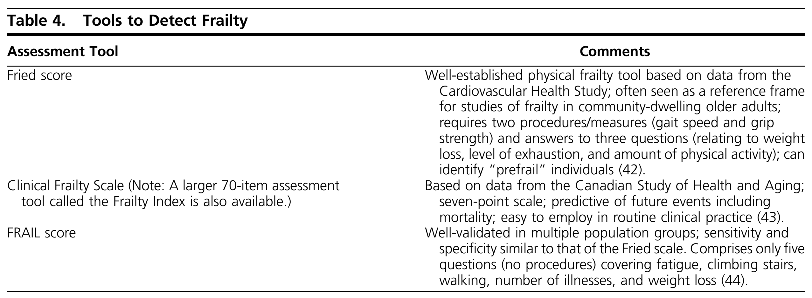
Frailty
Frailty can be defined as a state of increased vulnerability to physical or psychological stressors because of decreased physiological reserves in multiple organ systems that cause a limited capacity to maintain homeostasis.

Slide 20
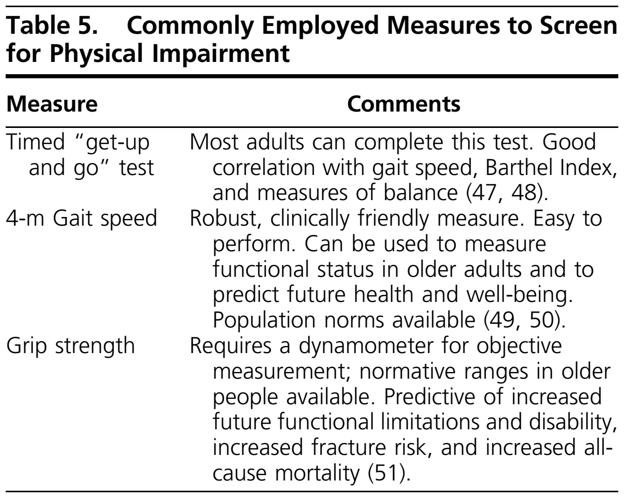
Frailty
Any report of a change in mobility, presence of falls, noticeable decrease in IADLs after recent discharge from a hospital, or presence of continuing fatigue should prompt the clinician to screen for functional loss and/or frailty [Table 4].
An initial screen for physical impairment can be obtained by using the following commonly employed measures in geriatric practice [Table 5].

Slide 21
Sarcopenia
Sarcopenia is an age-related loss of muscle mass that has now been linked to progressive loss of muscle strength and reduced physical performance.
Clinicians can refer patients with possible sarcopenia for a dual-energy X-ray absorptiometry scan, but this procedure is expensive and may not be convenient.
Bioelectrical impedance analysis is an alternative method for the assessment of lean muscle mass and may be considered in place of dual-energy X-ray absorptiometry scanning.
Alternatively, a rapid screening test for sarcopenia in a clinical setting can be obtained using a simple five-question instrument called the Sarc-F, which looks at fall history, ability to lift objects, and difficulties with mobility.

Slide 22
Cognitive impairment
The population burden of cognitive impairment in older individuals is even larger
if predementia stages of cognitive dysfunction, such as mild cognitive impairment (MCI), are also considered.
Overall relative risk (RR) for dementia in people with diabetes of 1.73 compared to people without diabetes. This increased risk was present in both Alzheimer’s disease and vascular dementia.
Moreover, diabetes is associated with an increased risk of MCI and an increased rate of conversion from MCI to dementia.
Cognitive impairment in patients with diabetes is associated with poorer diabetes self-management and glycemic control, an increased frequency of hospital admissions and occurrence of severe hypoglycemic episodes, and an increased occurrence of major cardiovascular events and death.

Slide 23
3. Assessment of Older Patients With Diabetes
3.2 Detection and diagnosis
In patients aged 65 years and older with diabetes, we suggest that periodic cognitive screening should be performed to identify undiagnosed cognitive impairment.
Technical remark:
Use of validated self-administered tests is an efficient and cost-effective way to implement screening. Alternative screening test options, such as the Mini-Mental State Examination or Montreal Cognitive Assessment, are widely used.

Slide 24
Evidence
Technical remark: continue…
An initial screening should be performed at the time of diagnosis or when a patient enters a care program.
Screening should be repeated every 2 to 3 years after a normal screening test result for patients without cognitive complaints or repeated 1 year after a borderline normal test result. Always evaluate cognitive complaints and assess cognition in patients with complaints.
No evidence supports a benefit of intensive glycemic treatment to preserve cognitive function in patients with diabetes.
However, further trials are underway, and cognition is increasingly considered an (secondary) outcome measure in drug trials in diabetes.

Slide 25
3. Assessment of Older Patients With Diabetes
3.3
Management and treatment
In patients aged 65 years and older with diabetes and a diagnosis of cognitive impairment (i.e., MCI or dementia), we suggest that medication
regimens should be simplified (see recommendation 3.1) and glycemic targets tailored (i.e., be more lenient; see recommendation 4.1) to improve compliance and prevent treatment-related complications.

Slide 26
Evidence
Technical remark:
Medical and nonmedical treatment and care for cognitive symptoms in people with diabetes and cognitive impairment is no different from those in people without diabetes and cognitive impairment.
Depending on the situation and preferences of the patient, a primary caregiver can be involved in decision-making and management of medication.
HbA1c levels <8.0% (64 mmol/mol) have been proposed for mild-to-moderate cognitive impairment, and those below 8.5% (69 mmol/mol) for moderate to severe cognitive impairment

Slide 27
4. Treatment of Hyperglycemia
4.1 Setting glycemic targets and goals
In patients aged 65 years and older with diabetes, we recommend that outpatient diabetes regimens be designed specifically to minimize hypoglycemia.
Technical remark:
Although evidence for specific targets is lacking, glycemic targets should be tailored to overall health and management strategies (e.g., whether a medication that can cause hypoglycemia is used) (see Table 3).

Slide 28
Evidence
In the adult population aged 65 years and older, hypoglycemia appears to increase the risk of traumatic falls and has a bidirectional relationship with cognitive dysfunction.
The authors reported that severe hypoglycemia was associated with an approximate doubling of the adjusted risks of major macrovascular and microvascular events, death from a cardiovascular cause and death from any cause (P <0.001).
As first noted in the Diabetes Control Complications Trial (DCCT), achieving a lower mean glucose to reduce complications may come at the cost of increased hypoglycemia risk

Slide 29
4. Treatment of Hyperglycemia
4.2
Assessing glycemia in older adults with diabetes
In patients aged 65 years and older with diabetes who are treated with insulin, we recommend frequent fingerstick glucose monitoring and/or continuous glucose monitoring (to assess glycemia) in addition to HbA1c.

Slide 30
4. Treatment of Hyperglycemia
4.3
Lifestyle interventions for older adults with diabetes
Lifestyle modifications
In patients aged 65 years and older with diabetes who are ambulatory, we recommend lifestyle modification as the first-line treatment of hyperglycemia.

Slide 31
Evidence
In overweight patients, lifestyle modifications resulting in as little as 5% weight loss can improve glycemic control and the need for medications to control glucose levels.
Nonetheless, older patients face a number of issues related to nutrition and exercise capacity.
Weight loss should be approached with caution in older adults, as both intentional and unintentional weight loss may lead to severe nutritional deficiencies.
An increase in physical activity in older adults should reduce sedentary
behavior, and moderate-intensity aerobic activity should be emphasized.

Slide 32
Nutrition
Nutrition is an integral component of diabetes self care for all people with diabetes regardless of age.
Notably, nutritional guidelines do not differ for older adults with or without diabetes.

Slide 33
4. Treatment of Hyperglycemia
4.4
Lifestyle interventions for older adults with diabetes
Nutrition
In patients aged 65 years and older with diabetes, we recommend assessing nutritional status to detect and manage malnutrition.
Technical remark:
Nutritional status can be assessed using validated tools such as the Mini
Nutritional Assessment and Short Nutritional Assessment Questionnaire.

Slide 34
4. Treatment of Hyperglycemia
4.5
Lifestyle interventions for older adults with diabetes
Nutrition
In patients aged 65 years and older with diabetes and frailty, we suggest the use of diets rich in protein and energy to prevent malnutrition and weight loss.

Slide 35
Evidence
PROT-AGE study group has recently recommended an average daily intake in the range of 1.0 to 1.2 g/kg body weight/d for healthy older people and even 1.2 to 1.5 g/kg body weight/d in older patients with acute or chronic diseases.
Furthermore, experts have proposed a protein intake of at least 1.5 g/kg/d (15% to 20% of the total caloric intake) in sarcopenic or cachectic older individuals.
The Societyfor Sarcopenia, Cachexia, and Wasting Diseases recommends measuring 25-hydroxyvitamin D levels and replacing them if low in all sarcopenic patients.

Slide 36
Evidence
We must emphasize healthful eating patterns consisting of nutrient-dense, high-quality foods rather than specific nutrients to improve overall health regarding body weight; glycemic, BP, and lipid targets; and reductions in the risk of diabetes complications.
The Mediterranean, Dietary Approaches to Stop Hypertension (DASH), and
plant-based diets are all examples of healthful eating patterns.
Dietary guidelines recommend an increase in fiber intake of 25 to 35 g/d.
Increasing fiber should be avoided in cases of delayed gastric emptying (gastroparesis).
People with diabetes should limit their sodium consumption to <2300 mg/d.

Slide 37
4. Treatment of Hyperglycemia
4.6
Lifestyle interventions for older adults with diabetes
Nutrition
In patients aged 65 years and older with diabetes who cannot achieve glycemic targets with lifestyle modification, we suggest avoiding the use of restrictive diets and instead limiting consumption of simple sugars if patients are at risk for malnutrition.
Technical remark:
Patients’ glycemic responses to changes in diet should be monitored closely. This recommendation applies to both older adults living in the community and those in nursing homes.

Slide 38
Evidence
For nursing home residents, some studies suggest that it is better to use regular diets for nursing home residents with diabetes.
Diets tailored to a patient’s culture, preferences, and personal goals might increase quality of life, satisfaction with meals, and nutritional status.
For community-dwelling older adults, maintaining a nutrient-dense diet is essential for promoting health and preventing nutrition-related complications.
Evidence indicates that restrictive diets impose significant risks of sarcopenia and malnutrition in community dwelling older adults.

Slide 39
4. Treatment of Hyperglycemia
4.7
Drug therapy for hyperglycemia
Glycemic management of diabetes in older individuals
In patients aged 65 years and older with diabetes, we recommend metformin as the initial oral medication chosen for glycemic management in addition to lifestyle management.
Technical remark:
This recommendation should not be implemented in patients who have significantly impaired kidney function [estimated GFR (eGFR) <30 mL/min/1.73 m²] or have a gastrointestinal intolerance.

Slide 40
Evidence
Metformin is highly effective, may reduce cardiovascular events and mortality, and does not cause hypoglycemia or weight gain.
As clinical events that may precipitate acute kidney injury, such as radiocontrast dye, nephrotoxic drugs, hypotension, heart failure, and surgery, may cause metformin accumulation, with a potential risk for lactic acidosis, metformin use is often stopped when patients are hospitalized.
An additional concern is the development of vitamin B12 deficiency, and levels should be monitored yearly.

Slide 41
4. Treatment of Hyperglycemia
4.8
Drug therapy for hyperglycemia
Glycemic management of diabetes in older individuals
In patients aged 65 years and older with diabetes who have not achieved glycemic targets with metformin and lifestyle, we recommend that other oral or injectable agents and/or insulin should be added to metformin.
Technical remark:
To reduce the risk of hypoglycemia, avoid using sulfonylureas (SUs) and
glinides, and use insulin sparingly. Glycemic treatment regimens should be kept as simple as possible.

Slide 42
Evidence
SUs and glinides: SUs, repaglinide, and nateglinide can cause hypoglycemia and weight gain. Glyburide should be avoided in older individuals because of a substantially increased risk of hypoglycemia compared with that of glimepiride and glipizide.
Thiazolidinediones: Pioglitazone and rosiglitazone can cause fluid retention and may precipitate or worsen heart failure; indeed, these drugs are contraindicated in patients with class III and IV heart failure. Furthermore, these medications are associated with increased fracture rates and bone loss in women.
α-Glucosidase inhibitors: α -Glucosidase inhibitors have only modest efficacy, and in older individuals, the gastrointestinal adverse effects of flatulence and diarrhea tend to cause a relatively high rate of nonadherence.

Slide 43
Evidence
Dipeptidyl peptidase-4 inhibitors: DPP-4 inhibitors are generally well tolerated. Importantly, early concerns regarding an increased risk of pancreatitis have not been borne out.
Sodium-glucose cotransporter 2 inhibitors: SGLT2 inhibitors reduce
HbA1c by ~0.8%, can reduce weight, and do not cause hypoglycemia. Because adverse effects related to volume depletion were more frequent in older
patients treated with canagliflozin, recommendations limit the dosage to 100 mg/d in such patients. Canagliflozin has also been shown to be associated with a decrease in bone mineral density at the hip, but not the femoral neck, lumbar spine, or distal radius, with a significant increase in fractures of arms and legs but not the spine.
Glucagon-like peptide 1 receptor agonists: Liraglutide and semaglutide have been found to improve cardiovascular outcomes.

Slide 44
Evidence
Insulin: If fasting glucose is near goal but the HbA1c remains above goal, rapid-acting insulin can be added first, prior to the largest meal and then prior
to other meals, as necessary. Additionally, premixed insulins (neutral protamine hagedorn with regular or analog insulin) given twice daily may be a simpler approach, but the lack of flexibility, especially in patients who may skip or delay meals, may increase the risk of hypoglycemia.
A low dosage of the combination is started, and then the dosage is gradually titrated upward. Interestingly, studies have reported excellent reduction in
HbA1c with less hypoglycemia and weight loss rather than weight gain compared with increased titration of basal insulin alone or intensification with basal/bolus
Insulin.

Slide 45
Evidence
Because T2D slowly worsens over time, increasing dosages and numbers of medications may be needed to control glucose levels.
The sequence in which drugs should be added after metformin is not
clear.
Recent recommendations indicate that GLP-1 receptor agonists and SGLT2 inhibitors be prescribed early, given their beneficial cardiovascular outcomes

Slide 46
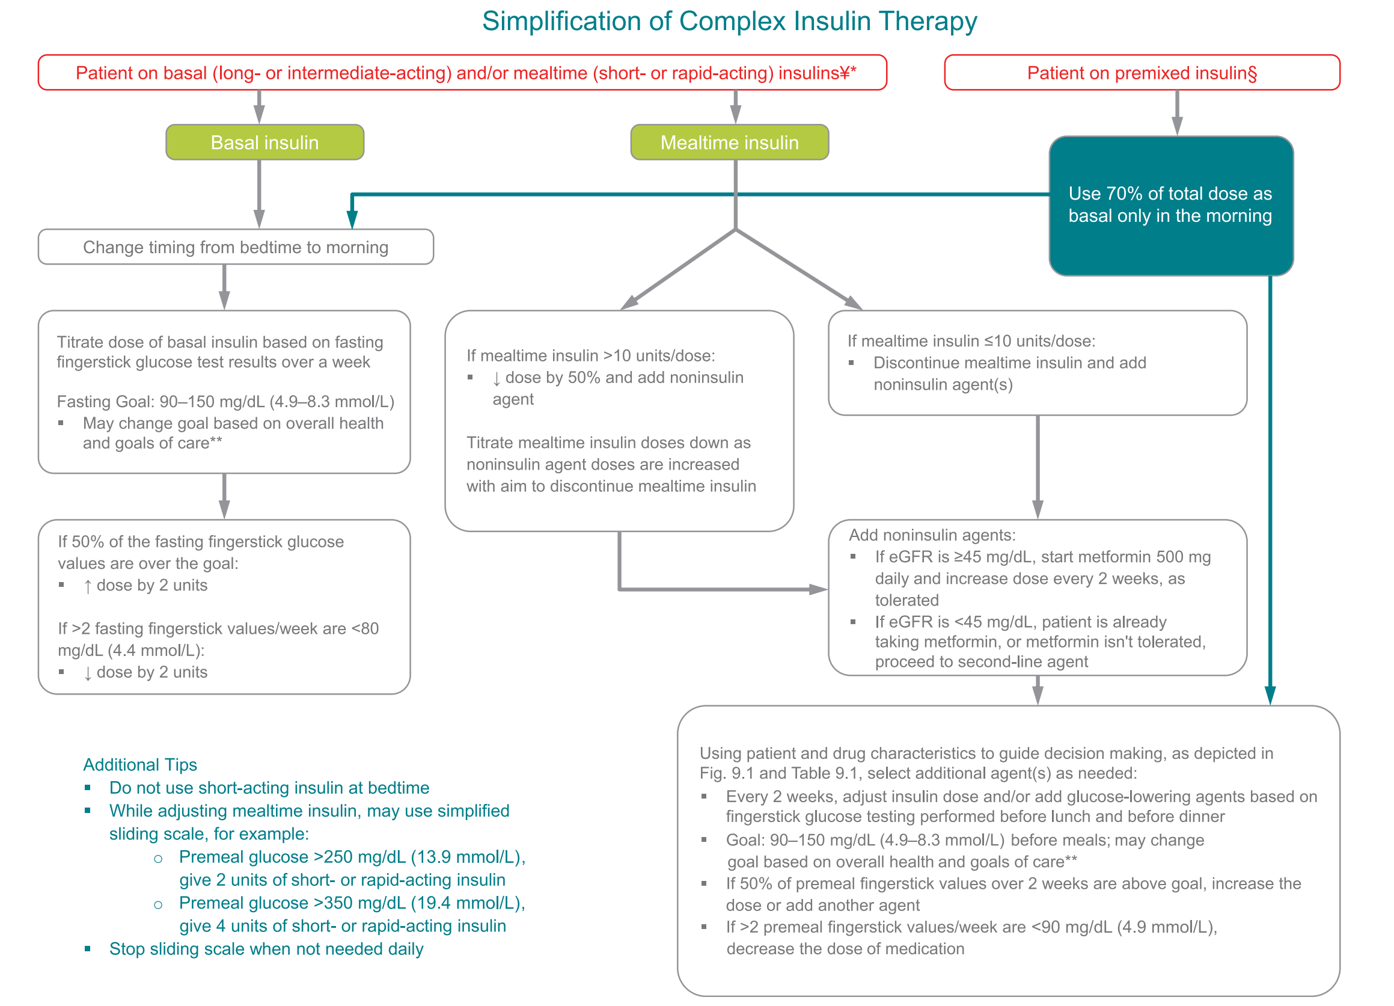
ADA

Slide 47
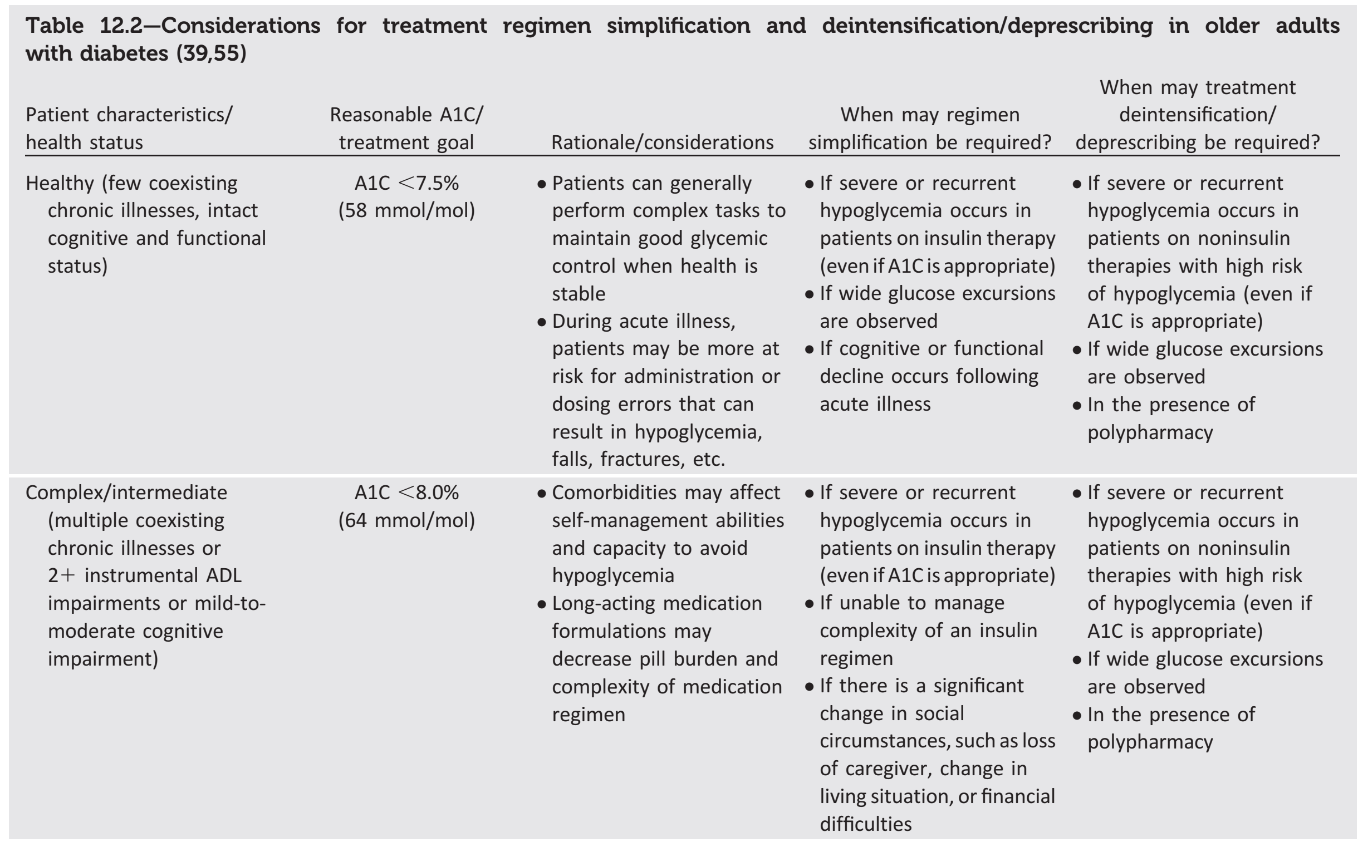
ADA

Slide 48
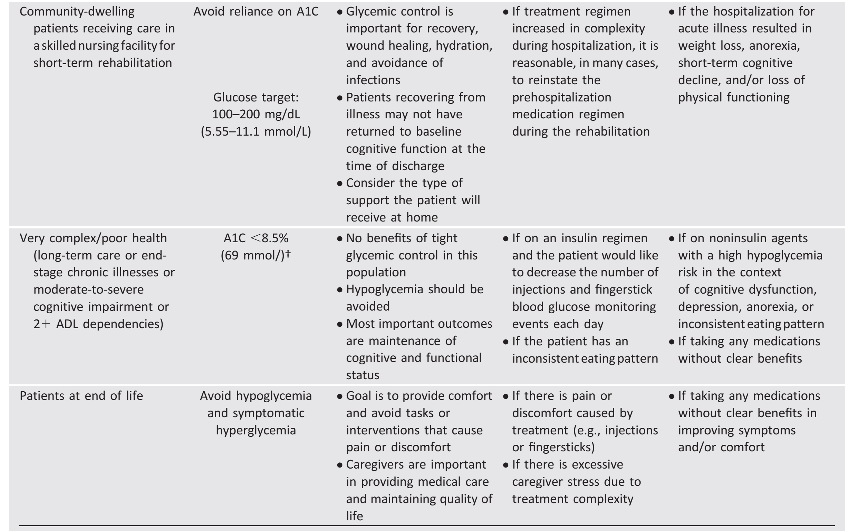
ADA

Slide 49
5. Treating Complications of Diabetes
5.1 Macrovascular disease
Management of hypertension in older adults with diabetes
In patients aged 65 to 85 years with diabetes, we recommend a target BP of 140/90 mm Hg to decrease the risk of CVD outcomes, stroke, and progressive CKD.
Technical remark:
Patients in certain high-risk groups could be considered for lower BP targets
(130/80 mm Hg), such as those with previous stroke or progressing CKD (eGFR <60 mL/min/ 1.73 m² and/or albuminuria).

Slide 50
Evidence
Technical remark:
If lower BP targets are selected, careful monitoring of such patients is needed to avoid orthostatic hypotension. Patients with high disease complexity (group 3, poor health, Table 3) could be considered for higher BP targets (145 to 160/90 mm Hg). Choosing a BP target involves shared decision-making between the clinician and patient, with full discussion of the benefits and risks of each target.
Hypertension is a well-known risk factor for cardiovascular and kidney disease. Lifestyle modification is generally advocated as the first treatment modality

Slide 51
Evidence
Importantly, consideration should also be given to a higher BP target if the patient develops symptomatic orthostatic hypotension, and medications that tend to cause orthostatic hypotension should be avoided.
Additionally, prescribing one or more hypertension medications to be taken at bedtime may have additional CVD benefits.

Slide 52
5. Treating Complications of Diabetes
5.2 Macrovascular disease
Management of hypertension in older adults with diabetes
In patients aged 65 years and older with diabetes and hypertension, we recommend that an angiotensinconverting enzyme inhibitor or an angiotensin receptor blocker should be the first-line therapy..
Technical remark:
If one class is not tolerated, the other should be substituted.

Slide 53
Evidence
Several studies have demonstrated a reduction in the progression of diabetic CKD with the use of angiotensinconverting enzyme (ACE) inhibitors and angiotensin receptor blockers (ARBs) in patients with hypertension and advanced CKD.
ACE inhibitors have been shown to significantly reduce the risk of all-cause and CVD mortality, MACE, and heart failure, whereas ARBs significantly reduce only the risk of heart failure. Neither drug class has been shown to
significantly reduce the risk of stroke. ACE inhibitors also appear to reduce the progression of retinopathy.

Slide 54
Evidence
Two drugs should be started together if the initial BP is ≥160/100 mm Hg. The calcium channel blocker amlodipine has been shown to provide better cardiovascular outcomes than other agents by the ACCOMPLISH study and is therefore commonly added as a secondary antihypertensive agent.
If coronary artery disease is significant, a beta-blocker may be appropriate and can be added as a fourth drug to a prior three-drug regimen. If a betablocker is used, carvedilol has been shown to have fewer metabolic effects than metoprolol. Notably, when BP is not controlled with three or more medications, referral to a hypertension specialist is indicated.

Slide 55
5. Treating Complications of Diabetes
Management of hyperlipidemia in older adults with diabetes
5.3
In patients aged 65 years and older with diabetes, we recommend an annual lipid profile.
5.4
In patients aged 65 years and older with diabetes, we recommend statin therapy and the use of an annual lipid profile to achieve the recommended
levels for reducing absolute CVD events and allcause mortality.

Slide 56
Evidence
Technical remark:
The Writing Committee did not rigorously evaluate the evidence for specific
LDL-C targets in this population, so we refrained from endorsing specific LDL-C targets in this guideline.
For patients aged 80 years old and older or with short life expectancy, we advocate that LDL-C goal levels should not be so strict.
Cholesterol-lowering treatment with statins is equally efficacious in reducing RR and more effective in reducing absolute CVD events in older adults than in younger individuals because the older patients have a higher absolute risk for CVD.

Slide 57
Evidence
Because LDL-C may be normal but LDL particles may be small, risk stratification should be used to determine the level of LDL-C that should be achieved in older patients with diabetes using statins.
Calculated non-HDL, which reflects all atherogenic particles, adds to the assessment of atherogenicity.
Apolipoprotein B measurement can be useful in some patients to help refine their LDL treatment goal.

Slide 58
5. Treating Complications of Diabetes
5.5
Management of hyperlipidemia in older adults with diabetes
In patients aged 65 years and older with diabetes, we suggest that if statin therapy is inadequate for reaching the LDL-C reduction goal, either because of side effects or because the LDL-C target is elusive, then alternative or additional approaches [such as including ezetimibe or proprotein convertase subtilisin/kexin type 9 inhibitors (PCSK9)] should be initiated.

Slide 59
Evidence
Additionally, PCSK9 inhibition has been shown to reduce LDL-C levels more than high-dose statins and to also reduce CVD outcomes.
PCSK9 inhibitors have been approved for patients who are unable to reach the LDL goal with the maximally tolerated statin dose, those with
clinical CVD on high-dose statins who have not reduced their LDL-C levels to target, and those with familial hypercholesterolemia.

Slide 60
5. Treating Complications of Diabetes
5.6
Management of hyperlipidemia in older adults with diabetes
In patients aged 65 years and older with diabetes and fasting triglycerides >500 mg/dL, we recommend the use of fish oil and/or fenofibrate to reduce the risk of pancreatitis.

Slide 61
Evidence
Importantly, fibrates in combination with statin therapy should be used together cautiously in view of an enhanced risk of myopathy, although this combination can be useful in treating patients with triglyceride levels >500 mg/mL and who are at risk for pancreatitis.
There is also evidence that fenofibrate may be valuable in preventing the progression of retinopathy.

Slide 62
CHF
Aging increases vascular stiffness and reduces elasticity, leading to increased SBP, myocyte hypertrophy, and impaired diastolic function.
Diabetes increases the risk of CHF due to associated comorbidities
such as hypertension and complications such as macrovascular and microvascular disease and also directly affects the myocardium, causing cardiomyopathy.

Slide 63
5. Treating Complications of Diabetes
Management of congestive heart failure in older adults with diabetes
5.7
In patients aged 65 years and older who have diabetes and CHF, we advise treatment in accordance with published clinical practice guidelines on CHF.
5.8
In patients aged 65 years and older who have diabetes and CHF, the following oral hypoglycemic agents should be prescribed with caution to prevent worsening of heart failure: glinides, rosiglitazone, pioglitazone, and DPP-4 inhibitors.

Slide 64
Evidence
In a systematic review of observational studies including 34,000 patients with diabetes and CHF, metformin was associated with reduced mortality, reduced all-cause hospitalizations, and low risk of lactic acidosis.
Moreover, rosiglitazone increased the risk of all-cause mortality and hospitalizations for CHF.
The HR was significant for saxagliptin, marginally increased but not significant for alogliptin, and neutral for sitagliptin.
In contrast to the effects on the heart, an increase in lower extremity amputations was observed in patients taking canagliflozin in another long-term cardiovascular outcome study (CANVAS), and the FDA now requires a boxed warning regarding this effect of this medication.

Slide 65
Atherosclerosis
Aging and diabetes have a synergistic effect on the structure and function of the vascular system that increases the risk of vascular disease.
According to one recent study, there is little or no increase in risk of mortality, myocardial infarction, or stroke if the following five risk factors are within normal ranges in patients with T2D: HbA1c, LDL, albuminuria, smoking status, and BP.
Lifestyle interventions including exercise and weight loss in obese older patients reduce intrahepatic fat content, increase insulin sensitivity, and improve overall metabolic risk factors for atherosclerosis.

Slide 66
5. Treating Complications of Diabetes
5.9
Management of atherosclerosis in older adults with diabetes
In patients aged 65 years and older with diabetes and a history of atherosclerotic CVD, we recommend low-dosage aspirin (75 to 162 mg/d) for secondary prevention of CVD after careful assessment of bleeding risk and collaborative decision-making with the patient, family, and other caregivers.

Slide 67
Evidence
The evidence for use of aspirin in primary prevention, however, has been conflicting and unclear.
Currently, the use of aspirin for primary prevention must remain a decision by the clinician on an individualized basis.

Slide 68
Microvascular disease
The duration of diabetes predicts the presence of retinopathy, and control of hyperglycemia profoundly affects the onset and progression of diabetic retinopathy in both T1D and T2D.
In addition to poor glycemic control, the presence of albuminuria, hypertension, and dyslipidemia predict retinopathy.
The use of ACE inhibitors or ARBs may have beneficial effects on retinopathy.
Treatment with fenofibrate in trials intended for assessing cardiovascular protection has suggested that this drug may reduce the progression of diabetic retinopathy, but continued treatment beyond the closing of the clinical trials may be required to confer this benefit

Slide 69
5. Treating Complications of Diabetes
5.10
Microvascular disease
Eye complications in older adults with diabetes
In patients aged 65 years and older with diabetes, we recommend annual comprehensive eye examinations to detect retinal disease
Technical remark:
Screening and treatment should be conducted by an ophthalmologist or optometrist in line with present-day standards.

Slide 70
Evidence
Panretinal photocoagulation is the mainstay of treatment of proliferative retinopathy but may produce an exacerbation of diabetic macular edema, a condition that affects a substantial number of older patients.
Intravitreal anti-VEGF therapy may be the most effective front-line modality for macular edema and may be an alternative to panretinal photocoagulation in the treatment of proliferative diabetic retinopathy.
Open-angle glaucoma and cataracts occur more commonly among
persons with diabetes. Moreover, the risk for glaucoma increases with the duration of diabetes and fasting hyperglycemia.

Slide 71
5. Treating Complications of Diabetes
Neuropathy, falls, and lower extremity problems in older adults with diabetes
5.11
In patients aged 65 years and older with diabetes and advanced chronic sensorimotor distal polyneuropathy, we suggest treatment regimens that minimize fall risk, such as the minimized use of sedative drugs or drugs that promote orthostatic hypotension and/or hypoglycemia.
5.12
In patients aged 65 years and older with diabetes and peripheral neuropathy with balance and gait problems, we suggest referral to physical therapy or a fall management program to reduce the risk of fractures and fracture-related complications.

Slide 72
Evidence
Manifestations of the most common form of diabetic neuropathy, chronic sensorimotor distal polyneuropathy, may include not only a history of pain but also advanced findings of proprioceptive deficit, motor strength loss, contractures, deformities, weakness of the extremities, and/or Charcot arthropathies.
Persons treated with metformin and having neuropathic manifestations should be evaluated because metformin may cause vitamin B12 deficiency.
Persons with diabetes are at increased risk of falls and hip fracture. Thus, inquiry about falls should occur at least annually.

Slide 73
Evidence
Evidence is inconclusive on whether specific glycemic targets or antihyperglycemic treatment regimens promote falls.
Thiazolidinediones and SGLT-2 inhibitors might worsen fall-related outcomes by increasing fracture risk.
Furthermore, hypoglycemia may be a risk factor for adverse outcomes of falls.
Pharmacologic therapy for painful diabetic neuropathy requires caution in
older adults, with special concern for polypharmacy, oversedation, and orthostasis.
Neuropathy is associated with increased risk of falls in older individuals with diabetes.

Slide 74
5. Treating Complications of Diabetes
5.13
Microvascular disease
Neuropathy, falls, and lower extremity problems in older adults with diabetes
In patients aged 65 years and older with diabetes and peripheral neuropathy and/or peripheral vascular disease, we suggest referral to a podiatrist, orthopedist, or vascular specialist for preventive care to reduce the risk of foot ulceration and/or lower extremity amputation

Slide 75
Evidence
Variably reported individual patient risk factors for lower extremity amputation may include peripheral sensory neuropathy, autonomic neuropathy, gait abnormalities, peripheral vascular disease, foot ulcer, history of previous amputation, certain foot deformities, greater body mass, chronic renal failure, poor vision, older age, and higher HbA1c.
We endorse the standard of care concerning foot care as expressed by the ADA, which recommends patient self care education, specifies the content and frequency of periodic comprehensive foot evaluations, recommends a multidisciplinary approach for foot ulcers and high-risk feet, and presents indications for referral for further vascular assessment, ongoing preventive care, and lifelong surveillance by foot care specialists

Slide 76
5. Treating Complications of Diabetes
Chronic kidney disease in older adults with diabetes
5.14
In patients aged 65 years and older with diabetes who are not on dialysis, we recommend annual screening for CKD with an eGFR and urine
albumin-to-creatinine ratio.
5.15
In patients aged 65 years and older with diabetes who are in group 3 (poor health, see Table 3) of the framework and have a previous albumin-to- creatinine ratio of <30 mg/g, we suggest against additional annual albumin-to-creatinine ratio measurements.

Slide 77
5. Treating Complications of Diabetes
5.16
Microvascular disease
Chronic kidney disease in older adults with diabetes
In patients aged 65 years and older with diabetes and decreased eGFR, we recommend limiting the use or dosage of many classes of diabetes medications to minimize the side effects and complications associated with CKD.
Technical remark:
Specific use/dosing guidance on each class of diabetes medication is provided in Table 7.

Slide 78
Table 7: Medications Used to Treat Hyperglycemia and Special Concerns With Use in Older Patients With CKD and CVD

Slide 79
Table 7: Medications Used to Treat Hyperglycemia and Special Concerns With Use in Older Patients With CKD and CVD

Slide 80
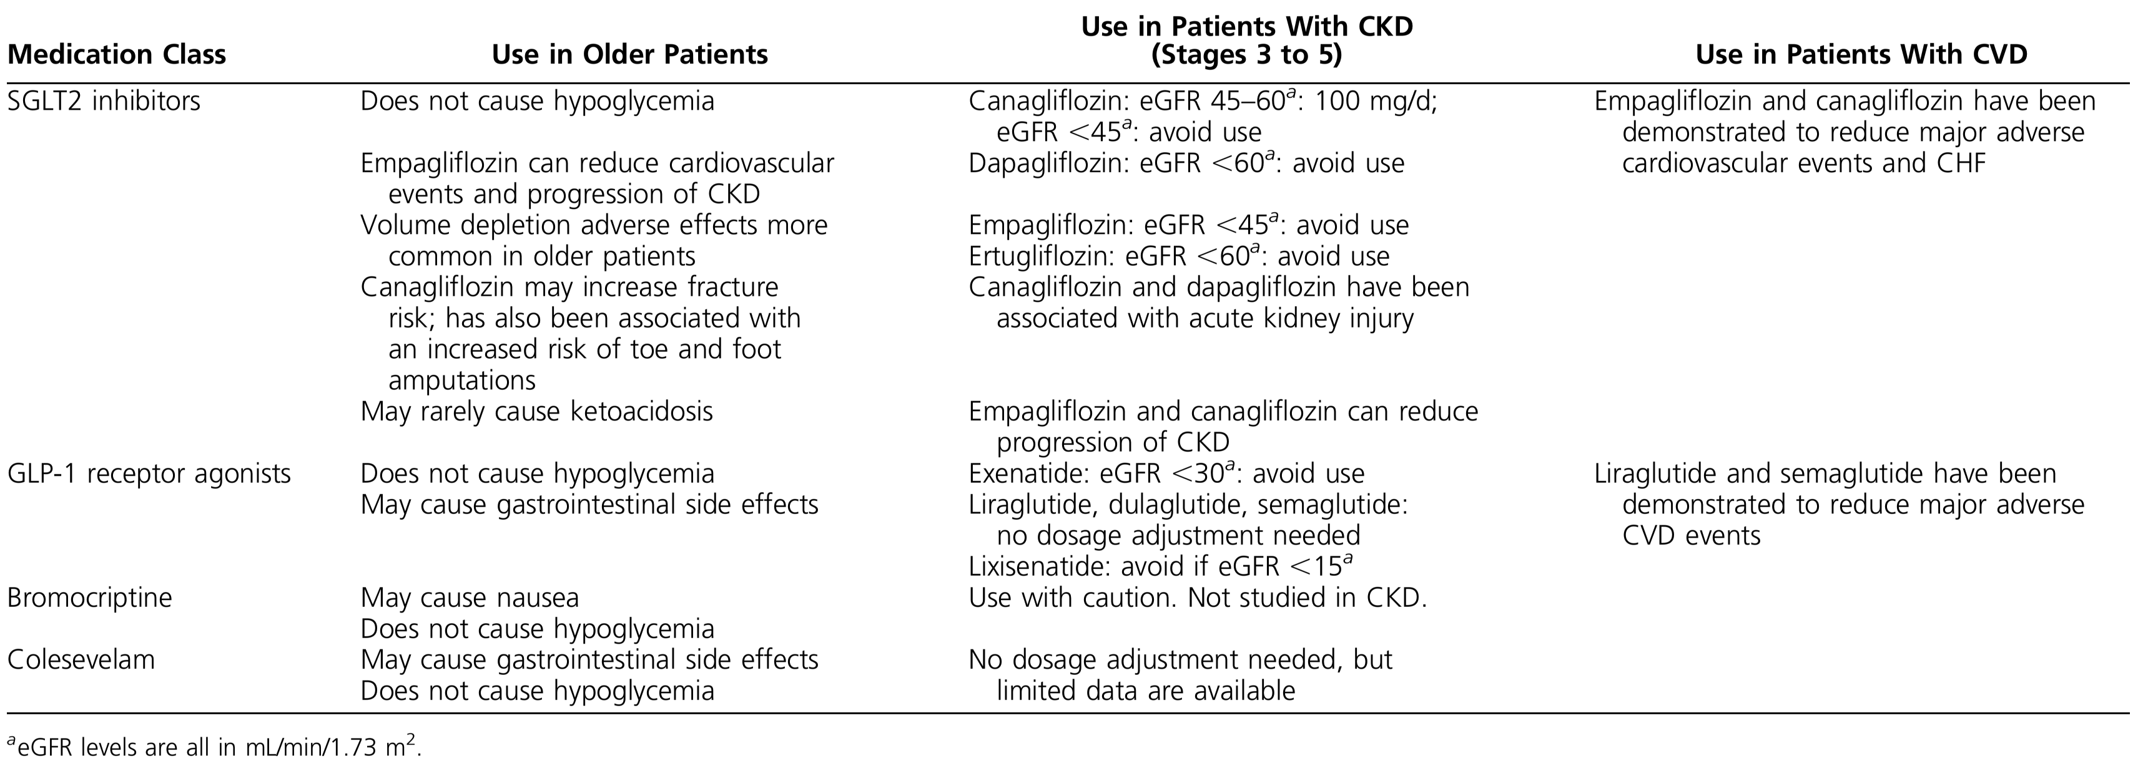
Table 7: Medications Used to Treat Hyperglycemia and Special Concerns With Use in Older Patients With CKD and CVD

Slide 81
Evidence
Insulin:
Reduced kidney function results in a prolongation of insulin half-life and a decrease in insulin requirements.
All insulin preparations can be used in patients with CKD, and no specific reductions in dosing are necessary for patients.
Patients with stages 4 to 5 CKD (eGFR <30 mL/min/1.73 m²) often have delayed gastric emptying; administering rapid-acting insulin after the meal may be helpful for matching the insulin peak with the time of the postprandial blood glucose peak.
Postprandial rapid-acting insulin with a dose adjustment for the amount eaten may help patients with varying food intakes.

Slide 82
Special Settings and Populations
T1D: There appears to be two reasons for the increasing number of older adults with T1D
First, those diagnosed with childhood T1D have taken advantage of the improved therapies for glycemic management and nonglycemic measures for the prevention and treatment of long-term complications.
Second, for reasons that are unclear, the number of cases of adult-onset T1D has increased. Given these factors, “geriatric T1D” is anticipated to become more common over the next decade.

Slide 83
Special Settings and Populations
Hypoglycemia
No RCTs have assessed outcomes for older individuals with T1D.
In general, near normal glycemic targets are reserved for individuals with shorter durations of diabetes prior to the development of microvascular or macrovascular complications.
Furthermore, the aggressiveness of glucose control needs to be balanced against the risks of hypoglycemia, which is generally a more
dangerous side effect of insulin therapy in an older population.

Slide 84
Special Settings and Populations
Cognitive dysfunction
Routine self-care of T1D requires sufficient cognitive capabilities due to the complexity of disease management.
patients with a history of severe hypoglycemia or CVD were more susceptible to cognitive decline than were the control patients.
Cognitive decline in older adults with T1D often requires simplification of insulin regimens.

Slide 85
Special Settings and Populations
Functionality
The typical reduced physical function of older adults may be exacerbated by T1D. Neuropathy, visual impairment, and hypoglycemia unawareness may make driving an impossible task.
Due to all of these concerns, less stringent glycemic targets are appropriate for older adults with T1D, particularly those with a >40-year duration of diabetes, when severe hypoglycemia becomes more common.

Slide 86
Special Settings and Populations
Hypertension and hypercholesterolemia
BP targets with or without kidney disease have not been studied in older adults with T1D.
Because the duration of diabetes seems to be a risk factor for CVD, which is also the leading cause of mortality, it seems appropriate that most older adults with T1D should be treated similarly to those with T2D.

Slide 87
6. Special Settings and Populations
Management of diabetes away from home—in hospitals and long-term care facilities—and transitions of care
Older patients with diabetes mellitus are frequently admitted to the hospital for non-diabetes–related problems such as cardiovascular and respiratory disorders and digestive, genitourinary, and infectious problems

Slide 88
6. Special Settings and Populations
6.1
Management of diabetes away from home—in hospitals and long-term care facilities—and transitions of care
In patients aged 65 years and over with diabetes in hospitals or nursing homes, we recommend establishing clear targets for glycemia at 100 to 140 mg/dL (5.55–7.77 mmol/L) fasting and 140 to 180 mg/dL (7.77–10 mmol/L) postprandial while avoiding hypoglycemia.
Technical remark:
An explicit discharge plan should be developed to re-establish long-term-glycemic treatment targets and glucose-lowering medications as the patient transitions to post hospital care.

Slide 89
Evidence
Continuous enteral or parenteral nutrition produces a constant “postprandial” state with glycemic targets between 140 and 180 mg/dL (7.77 to 10 mmol/L).
Aiming at glycemia targets below this range is dangerous.
Most missteps in diabetes management occur not at the selection of the initial doses of insulin but because of poor follow-up and lack of appropriate and timely adjustments.

Slide 90
6. Special Settings and Populations
Management of diabetes away from home—in hospitals and long-term care facilities—and transitions of care
6.2
In patients aged 65 years and older with diabetes and a terminal illness or severe comorbidities, we recommend simplifying diabetes management
strategies.
6.3
In patients aged 65 years and older without diagnosed diabetes, we suggest routine screening for HbA1c during admission to the hospital to
ensure detection and treatment where needed (see the technical remark in recommendation 2.1).

Slide 91
THANK YOU!

