Slide 1
به نام خدا

Slide 3
Definition and clinical significance of primary aldosteronism
PA is a group of disorders in which aldosterone production is inappropriately high for sodium status, relatively autonomous of the major regulators of secretion (angiotensin II, plasma potassium concentration), and nonsuppressible by sodium loading.
Such inappropriate production of aldosterone causes hypertension, cardiovascular damage, sodium retention, suppression of plasma renin, increased potassium excretion that (if prolonged and severe) may lead to hypokalemia.

Slide 4
PA is commonly caused :
Adrenal adenoma
Unilateral or bilateral adrenal hyperplasia (BAH)
Adrenal carcinoma (rare)
Familial hyperaldosteronism (inherited conditions)
PA is also known as Conn’s syndrome.

Slide 5
How common is primary aldosteronism?
Most experts previously described PA in < 1% of patients with mild-to-moderate essential hypertension and had assumed that hypokalemia was a sine qua non for diagnosis .
Cross-sectional and prospective studies report PA in >5% and possibly >10% of hypertensive patients, both in general and in specialty settings.

Slide 6
How frequent is hypokalemia in primary aldosteronism?
Only a minority of patients with PA (9 to 37%) has hypokalemia.
Normokalemic hypertension constitutes the most common presentation of the disease, with hypokalemi aprobably presentin only the more severe cases.
Thus, the presence of hypokalemia has low sensitivity for the diagnosis of PA.

Slide 7
Why is primary aldosteronism important?
This condition is important not only because of its prevalence, but also because patients with PA have higher cardiovascular morbidity and mortality than age-and sex matched patients with essential hypertension and the same degree of BP elevation.
Furthermore, specific treatments are available that ameliorate the impact of this condition on important patient outcomes.
Treating PA either by MR antagonists or unilateral adrenalectomy (where indicated) resolves hypokalemia ,lowers BP, reduces the number of antihypertensive medications required, and improves parameters of impaired cardiac and renal function.

Slide 8
1.0 Case detection
Sustained BP above 150/100 mmHg on each of three measurements obtained on different days
with hypertension (BP> 140/90 mmHg) resistant to three conventional antihypertensive drugs (including a diuretic)
or controlled BP (<140/90 mm Hg) on four or more antihypertensive drugs
Hypertension and spontaneous or diuretic-induced hypokalemia
Hypertension and adrenal incidentaloma
Hypertension and sleep apnea
Hypertension and a family history of early onset hypertension or cerebrovascular accident at a young age (<40 years)
All hypertensive first-degree relatives of patients with PA

Slide 9
Evidence
Indirect evidence links the detection of PA with improved patient outcomes.
There is strong evidence linking improved BP control and/or reduction in aldosterone levels to improved cardiac and cerebrovascular outcomes and quality of life.

Slide 10
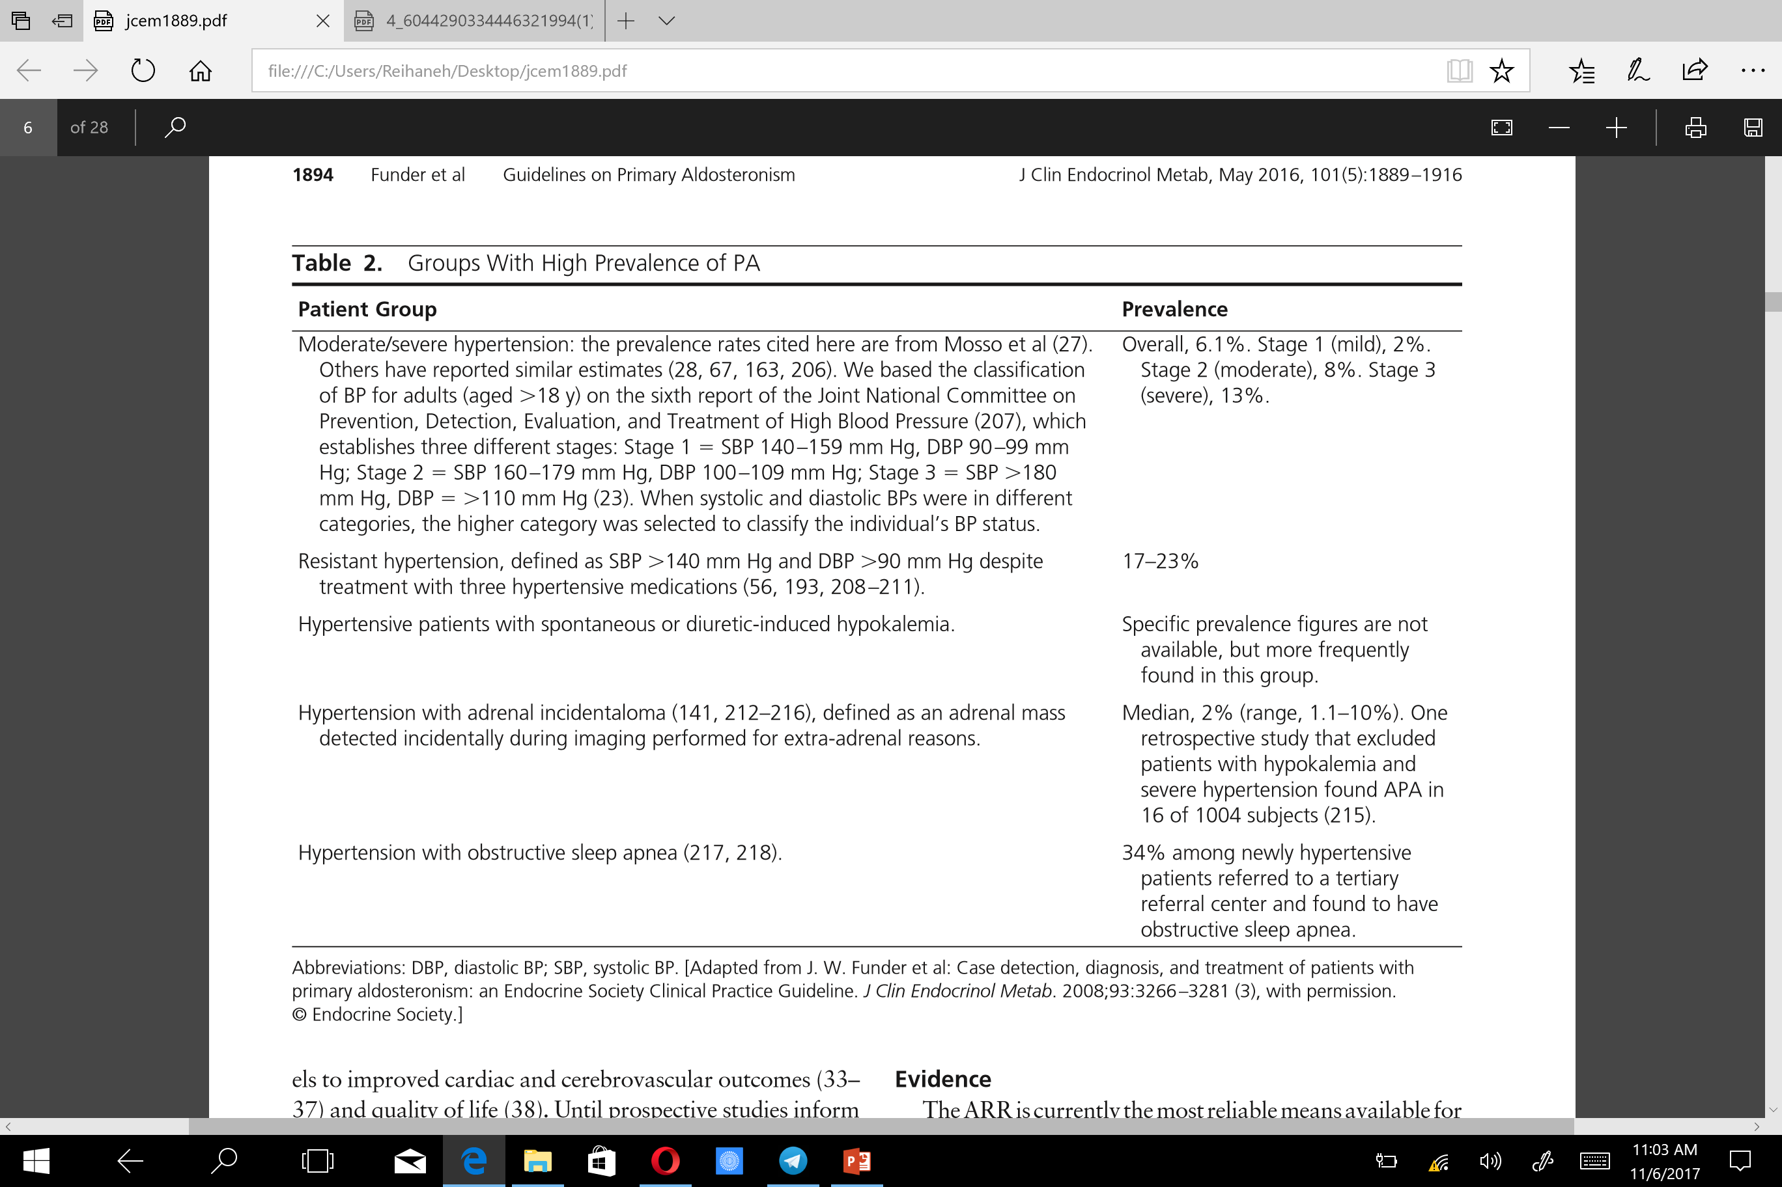

Slide 11
Values :
Our recommendation to detect cases of PA places a high value on avoiding the risks associated with missing a PA diagnosis(and thus for going the opportunity of a surgical cure or amelioration of excess cardiovascular morbidity through specific medical treatment); a high value on avoiding the risk associated with missing a diagnosis of unilateral forms of PA and thus the opportunity of possibly curative intervention by unilateral adrenalectomy leading to the reduction or complete cessation of antihypertensive medications and the reduction of target organ damage.

Slide 12
it places a lower value on avoiding the risk of falsely classifying a hypertensive patient as having PA and exposing him or her to additional diagnostic testing
it places a lower value on avoiding the risks of exposing patients with bilateral PA (who are rarely candidates for surgical treatment) to additional diagnostic testing.
1.2 We recommend using the plasma ARR to detect possible cases of PA in these patient groups.

Slide 13
Evidence
The ARR is currently the most reliable means available for screening for PA.
Although valid estimates of test characteristics of the ARR are lacking , numerous studies have demonstrated the ARR to be superior in measuring potassium or aldosterone (both of which have lower sensitivity)or renin( which is less specific) in isolation.
Like all biochemical case detection tests, the ARR is not without false positives and false negatives.

Slide 14
Table 3 documents the effect of medications and conditions on the ARR.
The ARR should therefore be regarded as a detection test only and should be repeated if the initial results are inconclusive or difficult to interpret due to suboptimal sampling conditions (eg, maintenance of some medications listedin Table3),or if PA is strongly suspected clinically but the initial screening results are negative.

Slide 15
Investigation of PA should include a screening step based on the measurement of plasma renin activity (PRA) or direct renin concentration (DRC), assays for aldosterone and the calculation of the aldosterone-to-renin ratio (ARR).
These assay results are effective in screening for PA with a sensitivity of 68–94%.

Slide 17
Values
The duration of hypertension has been reported by several investigators to be a negative predictor of outcome after unilateral adrenalectomy for APA , suggesting that delays in diagnosis may result in a poorer response to specific treatment once PA is finally diagnosed.

Slide 20
Remarks:
Technical aspects required for the correct implementation of recommendation
Testing conditions:
The ARR test is most sensitive when samples are collected in the morning after patients have been out of bed for at least 2 hours, usually after they have been seated for 5–15 minutes (Table 4).
Ideally, patients should have unrestricted dietary salt intake before testing and should be potassium-replete. It is recommended that during the 3 days preceding the confirmatory test, patients consume a normal sodium diet which would be reflected by urinary sodium levels of 100–200 mmol/L

Slide 21
In particular , MR antagonists should be withdrawn for at least 4 weeks before ARR testing.
other antihypertensive drugs should be withdrawn for at least 2 weeks.
These include β-blockers which decrease renin secretion, diuretics which increase aldosterone and renin concentrations by decreasing blood volume, angiotensin-converting enzyme inhibitors and angiotensin II receptor antagonists which stimulate renin secretion by suppressing angiotensin II negative feedback on renal juxta-glomerular cells .
Products containing liquorice and non-steroidal anti-inflammatory drugs should also be withdrawn at least 3 weeks prior to the test, and estrogen-progestin compounds should ideally be withdrawn for 6 weeks.

Slide 22
In many cases, the ARR can be confidently interpreted despite the effect of continued medications or other suboptimal conditions of testing.
A washout of all interfering antihypertensive medications is feasible in patients with mild hypertension but is potentially problematic in others.
The complete cessation of all antihypertensive treatment is usually unnecessary because there are substitute medications that have a minimal effect on the ARR (Table 5).
If all potentially problematic agents cannot be safely withdrawn,an ARR should be performed and the results considered in the light of the potential confounding factors. For example, in some patients with severe PA, treatment with an MR antagonist cannot be safely discontinued; in this setting, PA-related testing can be pursued as long as renin is suppressed.

Slide 24
Interpretation
A limitation of the ARR is that in the presence of very low renin levels (for example, at PRA values of 0.1 ng/ mL/h), the ARR may be elevated even when plasma aldosterone is also low and is almost certainly not consistent with PA.
To avoid this problem , some investigators include a minimum PAC of >15 ng/dL (410 pmol/L) within the screening criteria.
Some investigators therefore proceed with a diagnostic work up for PA in all patients with elevated ARR unless the PAC is below the level used to define normal suppression during confirmatory suppression testing .
Table 6 lists ARR cut off values using some commonly expressed assay units for PAC, PRA, and the direct measurement of plasma renin concentration.

Slide 25
Several conditions may affect the level of circulating renin and therefore the ARR, including renal impairment which decreases renin and cardiac impairment which increases renin concentrations.

Slide 27
2.0 Case confirmation
2.1 Instead of proceeding directly to subtype classification, we recommend that patients with a positive ARR undergo one or more confirmatory tests to definitively confirm or exclude the diagnosis.
in the setting of spontaneous hypokalemia, plasma renin below detection levels, plus PAC >20 ng/dL (550 pmol/L), we suggest that there may be no need for further confirmatory testing.

Slide 28
The four common confirmatory tests include the Fludrocortisone Suppression Test, which is considered which is considered the most effective for complete RAAS suppression, the Saline Infusion Test which is the most widely used test, the Captopril Challenge Test, which is simple and innocuous, and the Oral Sodium Loading Test which is one of the tests used historically but is at present rarely used in expert centers.
Other tests including the Losartan Suppression Test, the Furosemide Upright Test and the Captopril/Valsartan/Dexamethasone Combination Test have also been described.
The procedures and interpretation of confirmatory tests are described in Table 1.

Slide 29
The FST is regarded by some authors as the most effective confirmatory test for the demonstration of angiotensin II independency of aldosterone secretion, but demands intensive work-up, must be done as an inpatient procedure, and includes special dietary and posture requirements and monitoring of blood pressure and plasma potassium levels.
The test consists of the oral administration of 0.1 mg fludrocortisone every 6 h over 4 days, with slowrelease potassium chloride supplementation every 6 h in order to maintain plasma potassium level, which is checked every 6 h, as close as possible to 4 mmol/L and of controlled sodium intake of 6 g/day, in order to maintain 24-h urine sodium content, from day 3 to day 4, greater than 200 mEq/day.

Slide 30
An alternative procedure named Fludrocortisone Dexamethasone Suppression test (FDST) includes the administration of 1 mg dexamethasone on the last day of the FST in order to eliminate any stimulatory ACTH effect on aldosterone secretion.
Plasma sampling on day 4 may include assays for plasma cortisol at 07:00 and 10:00 h, and plasma aldosterone and DRC at 10:00 h .
The test is considered to be valid when DRC is below 8.4 mU/L on day 4 and plasma cortisol level is lower at 10:00 h than at 07:00 h, thereby excluding an inadvertent rise in ACTH which may prevent aldosterone suppression.
In these strict conditions, failure of standing 10:00 h plasma aldosterone to be suppressed to less than 6 ng/dL (165 pmol/L) confirms the diagnosis of PA.

Slide 31
Saline infusion test (SIT)
The SIT is widely used internationally and consists of a sodium load delivered by acute administration of a venous infusion of saline in order to suppress RAAS activity and ultimately suppress aldosterone secretion.
To perform the test, the patient should remain in a supine, or alternatively seated, position for 30–60 min before and during the test.
Commencing between 08:00 and 09:00 h, 2 L of 0.9% saline is infused over 4 h and blood samples are drawn at time 0 and 4 h for plasma aldosterone and renin measurements.

Slide 32
Hourly monitoring of arterial blood pressure is recommended during the test .
At the 4-h time point, a plasma aldosterone level, measured in the supine position, of less than 5 ng/dL (140 pmol/L) makes the diagnosis of PA unlikely, whereas a level greater than 10 ng/dL (280 pmol/L) confirms PA.
Aldosterone levels between 5 and 10 ng/dL (140– 280 pmol/L) are considered to be in the ‘gray zone’ and therefore inconclusive.
However, the diagnostic cutoff has been the subject of extensive discussion by expert teams, and a cutoff of 6.8 ng/dL (190 pmol/L) provides the best diagnostic performance for several authors.

Slide 33
Oral sodium loading test (OSLT)
The OSLT consists of the assessment of urinary aldosterone concentration following oral salt loading to diagnose PA.
The test can be performed in an outpatient setting except in those patients at risk of eventual adverse side effects.
The test consists of the oral administration of 6 g sodium chloride/day for 3 days, in order to achieve a 24-h urine sodium excretion of greater than 200 mmol/day.
Adequate potassium chloride supplementation is given to maintain plasma potassium level above 4 mmol/L.

Slide 34
Urine sodium and aldosterone measurements are performed on the third day of the test and a 24-h urinary aldosterone concentration greater than 12 or 14 µg/24h (33 or 39 nmol) is regarded as diagnostic for PA, whereas a level below 10 µg/24 h (28 nmol) excludes PA.

Slide 35
Captopril challenge test (CCT)
The CCT consists of the acute blockade of the RAAS by the angiotensin-converting enzyme inhibitor captopril.
Patients receive 25–50 mg captopril orally after sitting for at least 1 h with blood samples drawn at time zero and after 2 h for PRA/DRC, plasma aldosterone and plasma cortisol measurements .
Plasma aldosterone is normally suppressed by more than 30% but remains elevated in PA, with cutoff values ranging from 8.5 ng/ dL (246 pmol/L) to 13.9 ng/dL (390 pmol/L) reported by different expert teams .
Another criterion of PA includes a post-captopril plasma aldosterone-to-PRA (pg/mL per ng/mL/h) greater than 200 or plasma aldosteroneto-DRC above 40.

Slide 36
Losartan test (LT)
Patients receive 50 mg losartan after sitting for at least 1 h with blood samples taken at time zero and 2 h or 4 h later for PRA and plasma aldosterone measurements.
A plasma aldosterone-to-PRA ratio (ng/dL per ng/mL/h) greater than 25 or 35 provides better accuracy for PA diagnosis

Slide 37
Furosemide upright test (FUT)
The FUT is based on the ability of an acute infusion of furosemide to physiologically enhance PRA, a response that is lacking in the case of PA.
After 30 min in the supine position, patients receive an i.v. bolus of 40 mg furosemide and blood samples are drawn after 2-h upright posture for PRA measurement.
A PRA value below 2 ng/mL/h is diagnostic for PA

Slide 38
Side effects and precautions associated with confirmatory tests
Confirmatory tests based on sodium overload for RAAS suppression (i.e. SIT, OSLT and FST) share the same side effects and require the same precautions to be taken during their administration.
The FST is requires hospital admission and both sodium chloride and potassium chloride monitoring.
The FST may actually induce profound hypokalemia and cardiac arrhythmia and therefore requires close monitoring of potassium levels at 6-hourly intervals for the duration of the test.

Slide 39
The SIT should be performed on an inpatient basis since it may increase arterial blood pressure and even trigger acute pulmonary edema.
The OSLT should be performed on an outpatient basis, though it is sometimes performed as an inpatient or should possibly be avoided particularly in cases of heart failure or serious cardiac arrhythmia.
The SIT and the OSLT share the same contraindications, i.e. severe uncontrolled hypertension, kidney failure and profound uncorrected hypokalemia.
Careful monitoring of blood pressure is recommended in the case of renovascular hypertension or angioedema due to possible captopril induced excessive decrease in blood pressure . The DCVT is contraindicated in severe kidney failure where creatinine clearance is less than 30 mL/min

Slide 40
The FUT is contraindicated in subjects with advanced atherosclerosis at high risk of cerebrovascular events and in those at risk of diuretic-induced arrhythmia .
It may also evoke orthostatic hypotension and worsen pre-existing hypokalemia.
Conversely, the CCT is almost devoid of side effects and may be performed in subjects with severe hypertension or heart failure.

Slide 41
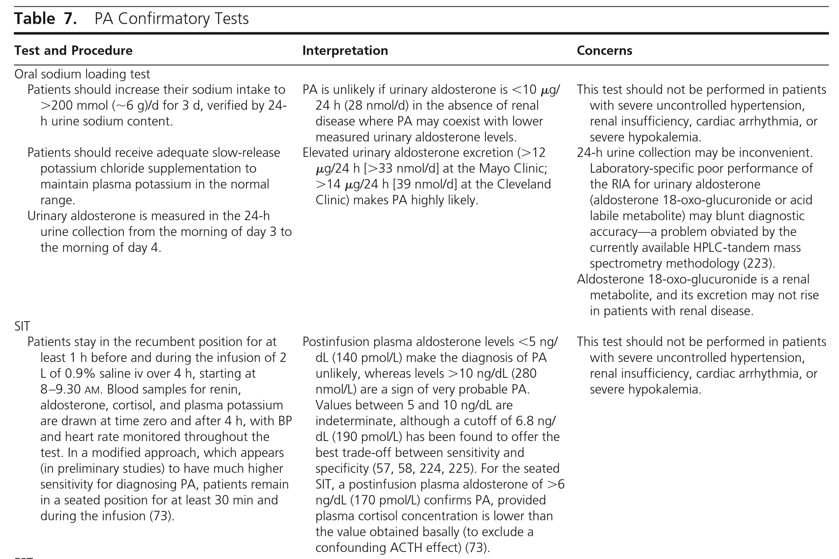

Slide 42
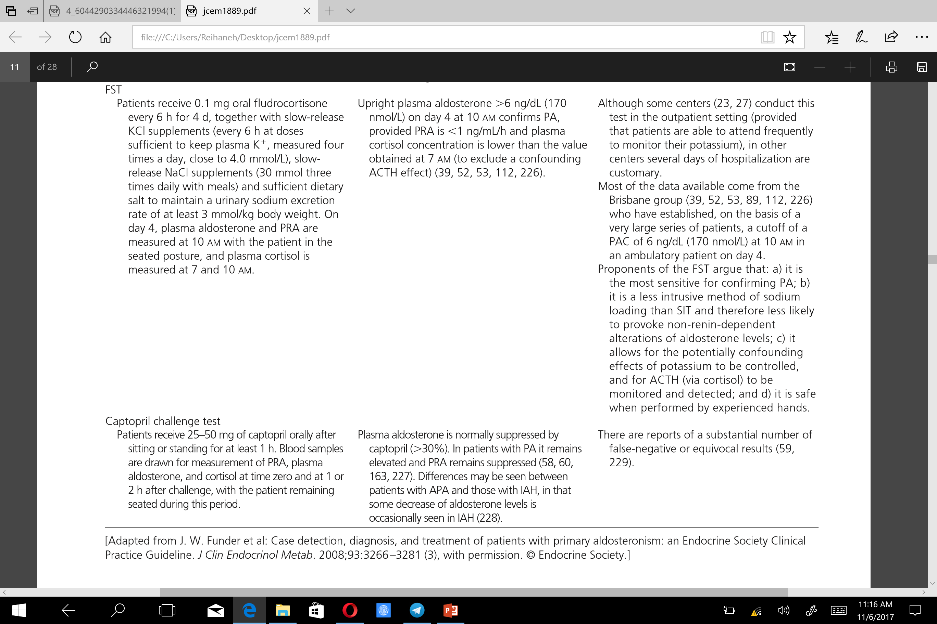

Slide 44
Evidence
The current literature does not identify a “gold standard” confirmatory test for PA.
The same authors reported that the captopril challenge test (CCT) showed similar accuracy when performed under adequate sodium intake conditions (, although Mulatero et al suggested caution in the interpretation of the CCT because of differences between patients regarding the bioavailability of the drug.
Although these tests may differ in terms of sensitivity, specificity, and reliability, the choice of confirmatory test is commonly determined by considering cost, patient compliance ,laboratory routine,and local expertise (Table 7).

Slide 45
Values
Confirmatory testing places a high value on sparing patients with false-positive ARR tests from undergoing costly and intrusive lateralization procedures.

Slide 46
International guideline recommendations for the use of confirmatory tests for PA diagnosis
Between 2011 and 2016, three international guidelines and recommendations on PA management were released by US, French and Japanese expert teams .
The US guidelines also assess that confirmatory tests should be avoided in patients unwilling or unable to proceed further in the diagnosis and surgical cure of an aldosteroneproducing adenoma.
US and French guidelines is to perform at least one of the available tests, the SIT being favored by the latter, while the Japanese guidelines recommend performing at least two consecutive tests out of the three (i.e. SIT, CCT or FUT).

Slide 48
3.0 Subtype classification
3.1 We recommend that all patients with PA undergo adrenal CT as the initial study in subtype testing to exclude large masses that may represent adrenocortical carcinoma and to assist the interventional radiologist and surgeon where anatomically appropriate.

Slide 49
Evidence:
Clinicians use the findings from adrenal CT—normal appearing adrenals, unilateral macroadenoma (>1 cm), minimal unilateral adrenal limb thickening, unilateral micro adenomas (≤ 1 cm), or bilateral macro- or micro adenomas (or a combination of the two)—in conjunction with AVS and (if needed) ancillary tests to guide treatment decisions in patients with PA.
APA may appear as small hypo dense nodules (usually < 2 cm in diameter) on CT.
Idiopathic adrenal hyperplasia (IAH) adrenal glands may be normal on CT or may show nodular changes.
Aldosterone-producing adrenal carcinomas are almost always 4 cm in diameter, but occasionally smaller, and like most adrenocortical carcinomas have a suspicious imaging phenotypeon CT.

Slide 50
Large benign-appearing unilateral masses may represent an aldosterone-and cortisol-secreting adenoma.
If this proves to be the case on dexamethasone suppression testing, some centers require AVS, whereas others proceed directly to unilateral adrenalectomy; in either case, patients will require hydrocortisone support postoperatively.

Slide 51
Adrenal CT has several limitations.
Radiologists might interpret small APAs incorrectly as“IAH”on the basis of CT findings of bilateral nodularity or normal-appearing adrenals.
Moreover, apparent adrenal microadenomas may actually represent areas of hyperplasia or nonfunctioning nodularity, and unilateral adrenalectomy would be inappropriate.
In addition, nonfunctioning unilateral adrenal macroadenomas are not uncommon, especially in older patients (< age 35 years), and are in distinguishable from APAs on CT.
UAH may be visible on CT,or the UAH adrenal may appear normal on CT.

Slide 52
AVS is essential to direct appropriate therapy in patients with PA who seek a potential surgical cure.
CT is particularly useful, however, for detecting larger lesions (eg, <4 cm) that may warrant consideration for removal based on malignant potential.
In addition, CT is useful for localizing the right adrenal vein as it enters into the inferior vena cava, thus aiding cannulation of the vein during AVS .
Finally, the findings on CT may be very helpful in young patients with marked PA.

Slide 53
Remarks
MRI has no advantage over CT in subtype evaluation of PA because it is more expensive and has less spatial resolution than CT.
3.2 We recommend that when surgical treatment is feasible and desired by the patient , an experienced radiologist should use AVS to make the distinction between unilateral and bilateral adrenal disease .
Younger patients (<age 35 years) with spontaneous hypokalemia, marked aldosterone excess,and unilateral adrenal lesions with radiological features consistent with a cortical adenoma on adrenal CT scan may not need AVS before proceeding to unilateral adrenalectomy.

Slide 54
Evidence
Lateralization of the source of the excessive aldosterone secretion is critical to guide the management of PA.
Distinguishing between unilateral and bilateral disease is important because unilateral adrenalectomy in all patients with APA or UAH results in the normalization of hypokalemia ;hypertension is also improved in all and cured in 30–60% of these patients .
In bilateral IHA and GRA, unilateral or bilateral adrenalectomy seldom corrects the hypertension,and medical therapy is the treatment of choice.
Unilateral disease may be treated medically if the patient declines or is not a candidate for surgery.

Slide 55
Imaging cannot reliably visualize microadenomas or distinguish nonfunctioning incidentalomas from aldosterone-producing adenomas with confidence in most patients, making AVS the most accurate means of differentiating unilateral from bilateral forms of PA.
AVS is expensive and invasive, and so it is highly desirable to avoid this test in patients who do not have PA .
Because ARR testing can be associated with false positives, confirmatory testing should eliminate the potential risk that patients with false-positive ARR undergo AVS.

Slide 56
The sensitivity and specificity of AVS (95 and 100%, respectively) for detecting unilateral aldosterone excess are superior to that of adrenal CT (78 and 75%, respectively).
AVS is the“gold standard”test to distinguish unilateral (APA or UAH) from bilateral (IHA) disease in patients with PA .
Some centers perform AVS in all patients who have the diagnosis of PA .
A radiologist experienced with and dedicated to AVS is necessary to implement this recommendation.

Slide 57
.
There are three protocols for AVS:
1) unstimulated sequential or simultaneous bilateral AVS
2)unstimulated sequential or simultaneous bilateral AVS followed by bolus cosyntropin-stimulated sequential or simultaneous bilateral AVS
3) continuous cosyntropin infusion with sequential bilateral AVS.

Slide 58
Simultaneous bilateral AVS is difficult to perform and is not used at most centers .
Many groups advocate the use of continuous cosyntropin infusion during AVS to:
1) minimize stress-induced fluctuations in aldosterone secretion during nonsimultaneous (sequential) AVS
2) maximize the gradient in cortisol from adrenal vein to inferior vena cava and thus confirm successful sampling of the adrenal vein
3) Maximize the secretion of aldosterone from an APA and thus avoid the risk of sampling during a relatively quiescent phase of aldosterone secretion.

Slide 59
clinicians use a cut off of the cortisol-corrected aldosterone ratio from high-side to low-side of more than 4:1 to indicate unilateral aldosterone excess;a ratio of 3:1 is suggestive of bilateral aldosterone hyper secretion.
Some investigators consider a cortisol-corrected aldosterone lateralization ratio(high to low side) of more than 2:1 in the absence of cosyntropin as consistent with unilateral disease.

Slide 60
Values
Our recommendation to include AVS in the subtype evaluation of most patients with PA who are candidates for surgery places a high value on avoiding the risk of an unnecessary unilateral adrenalectomy based on adrenal CT and a relatively low value on avoiding the potential complications of AVS.

Slide 61
Cosyntropin use
If clinicians do not use cosyntropin infusion, they should perform AVS in the morning hours after overnight recumbency.
This approach avoids the confounding effects of changes in posture on aldosterone levels in patients with angiotensin II-responsive varieties of PA and takes advantage of the effect of high early morning endogenous ACTH levels on aldosterone production in all subtypes of PA .

Slide 62
For continuous cosyntropin, clinicians should begin an infusion of 50 microg/h of cosyntropin 30 minutes before adrenal vein catheterization and continue it throughout the procedure .
The bolus cosyntropin technique involves AVS before and after the iv administration of 250 microg of cosyntropin.
some groups have suggested that when clinicians administer a bolus injection of cosyntropin and sample the adrenal veins simultaneously, cosyntropin does not improve the diagnostic accuracy of AVS, and , infact,cosyntropin may increase secretion from the nonadenomatous gland to a greater degree than from the APA.

Slide 63
Iodocholesterol scintigraphy
iodomethyl-19-norcholesterol(NP-59) scan , performed with dexamethasone suppression, had the putative advantage of correlating function with anatomical abnormalities.
However ,the sensitivity of this test depends heavily on the size of the adenoma.
Because tracer uptake is poor in adenomas smaller than 1.5 cm in diameter, this method often is not helpful in interpreting micronodular findings obtained with high-resolution CT and rarely plays a role in subtype evaluation.

Slide 64
18-Hydroxycorticosterone levels
Patients with APA generally have recumbent plasma 18-OHB levels greater than 100 ng/dL at 8:00 a.m., whereas patients with IAH have levels that are usually less than 100 ng/dL .

Slide 65
(11)C-Metomidate positron emission tomography-computed tomography
Metomidate is a potent inhibitor of adrenal steroidogenic enzymes.
A study of 25 patients with PA that used (11)C-metomidate—a positron emission tomography radiotracer—reported a specificity of 87% and sensitivity of 76% for APA.
In the future, APA-specific positron emission tomography radiotracers may have a major role in the subtype evaluation of PA.

Slide 66
In patients with an onset of confirmed PA earlier than 20 years of age and in those who have a family history of PA or strokes at a young age (≤ 40 years), we suggest genetic testing for FH-I(GRA).
In very young patients with PA, we suggest testing for germline mutations in KCNJ5 causing FH-III.

Slide 67
Testing for familial forms of primary aldosteronism: familial hyperaldosteronism type 1 (glucocorticoid remediable aldosteronism)
The FH-I syndrome is inherited in an autosomal dominant fashion and is responsible for 1% of cases of PA .
The mutation in patients with GRA is fusion of the promoter region of the gene for CYP11B1 and the coding sequences of CYP11B2, resulting in a CYP11B1/ CYP11B2 chimeric gene.
GRA is a form of hyperaldosteronism in which the hypersecretion of aldosteroneis dependent upon endogenous ACTH secretion which activates aldosterone synthesis.

Slide 68
GRA presentation is highly variable, with some patients presenting with normal BP and some characterized by aldosterone excess, suppressed PRA , and hypertension of early onset that is usually severe and refractory to conventional antihypertensive therapies.
Genetic testing by either Southern blot or long PCR techniques for the underlying hybrid CYP11B1/ CYP11B2 mutation is sensitive and specific for GRA and should replace indirect testing (eg, urinary levels of 18 oxocortisol and 18-hydroxy-cortisol, or dexamethasone suppression testing), both of which may be misleading .
Genetic testing for GRA should be considered for PA patients with a family history of PA or of strokes at a young age , or with onset at a young age (eg, < 20 years).

Slide 69
Testing for familial forms of primary aldosteronism: familial hyperaldosteronism type II
FH-II is an autosomal dominant disorder and possibly genetically heterogeneous.
Although FH-II is more common than FH-I, accounting for at least 7% of patients with PA in one series, its true prevalence is unknown.
Unlike FH-I, the hyperaldosteronism in FH-II does not suppress with dexamethasone.
FH-II families may have APA, IAH, or both and are clinically
Indistinguishable from patients with apparent nonfamilial PA.
The molecular basis for FH-II is unclear.

Slide 70
Testing for familial forms of primary aldosteronism: familial hyperaldosteronism type III
FH-III was first described in a family characterized by severe hypertension in early childhood associated with hyper aldosteronism, hypokalemia, and resistance to antihypertensive therapy, requiring bilateral adrenalectomy.
The cause of FH-III is a mutation in the KCNJ5 gene encoding the potassium channel, resulting in increased sodium conductance and cell depolarization.This opens voltage-activated calcium channels leading to increased calcium signaling, followed by increased aldosterone production and cell proliferation.

Slide 71
Multiple endocrine neoplasia type 1
Finally, APA may rarely but on occasion be seen in multiple endocrine neoplasia type 1.

Slide 72
Treatment
Cardiovascular complications
Hypertension is the rule in patients diagnosed with PA and is cured or improved by unilateral adrenalectomy in patients with unilateral disease and improved by MR antagonists in the remaining patients.
Aldosterone excess has deleterious effects on the cardiovascular system, at least partly independent of its effects on BP.
Such studies showed increased left ventricular (LV) dimensions and myocardial fibrosis, increased carotid intima-media thickness, and increased femoral pulse wave velocity and reduced endothelial function.

Slide 73
Several outcome studies also have provided evidence that PA patients are particularly at risk of cardiovascular/ renal complications, including arrhythmias, myocardial infarction, strokes, chronic kidney disease, and death, compared with age-, sex-, and BP-matched essential hypertensives.
cardiovascular mortality to be the main cause of death in PA.
Either unilateral adrenalectomy or MR antagonist therapy can reverse the cardiovascular morbidity caused by aldosterone excess.

Slide 74
4.1 We recommend unilateral laparoscopic adrenalectomy for patients with documented unilateral PA.
If a patient is unable or unwilling to undergo surgery, we recommend medical treatment including a MR antagonist .
If an ARR-positive patient is unwilling or unable to undergo further investigations, we similarly recommend medical treatment including an MR antagonist.

Slide 75
Evidence
Clinicians use unilateral laparoscopic adrenalectomy in patients with unilateral PA because BP and serum potassium concentrations improve in nearly 100% of patients postoperatively.
In addition,adrenalectomy induces a significant and sustained reduction in LV mass index due to a reduction in LV diameter and volume with a reduction in LV work load (improvement in diastolic dysfunction).
Adrenalectomy also appears to reverse the increase in carotid intima-media thickness and arterial stiffness in patients with unilateral PA.
Two prospective studies reported the reversal of albuminuria 1 year after adrenalectomy, reported significant improvement in quality of life by 3 months sustained at 6 months.

Slide 76
Factors associated with hypertension resolution in the postoperative period include having one or no first-degree relative with hypertension and preoperative use of two or fewer antihypertensive drugs.
Other factors that have been reported to predict cure, but have only been evaluated by univariate analysis or when the cutoff for BP resolution was <160/95mmHg, include:duration of hypertension <5 years , higher PAC: PRA ratio preoperatively , higher urinary aldosterone secretion , or positive preoperative response to spironolactone .
The most common reasons for persistently increased BP after adrenalectomy are coexistent primary hypertension (of unknown cause) and older age and/or longer duration of hypertension.

Slide 77
Values
Our recommendation that laparoscopic adrenalectomy is preferable to other methods of treatment in patients with unilateral adrenal disease places a high value on the normalization of endogenous aldosterone secretion, the resolution of hypokalemia, and the reduction of BP and/or the numbe r of medications necessary to control BP.
This benefit is far greater than the risks of surgery and postoperative management, which are very low.

Slide 78
Preoperative management
Both hypertension and hypokalemia should be well controlled before patients undergo surgery.
Obtaining such control may require a delay in surgery and the addition of an MR antagonist.

Slide 79
Postoperative management
Clinicians should measure plasma aldosterone and renin activity levels shortly after surgery as an early indication of biochemical response, although renin levels may not fall immediately.
They should also withdraw potassium supplementation on postoperative day 1, discontinue spironolactone, and reduce antihypertensive therapy, if appropriate.
Postoperative iv fluids should be normal saline without potassium chloride unless serum potassium levels remain very low (ie, <3.0 mmol/L).

Slide 80
During the first few weeks after surgery,clinicians should recommend agenerous sodium diet to avoid the hyperkalemia that can develop from hypoaldosteronism due to chronic contralateral adrenal gland suppression
Persistent hypoaldosteronism requiring mineralocorticoid replacement therapy (fludrocortisone) may occur in up to 5% of adrenalectomized patients .
Preoperative reduced glomerular filtration rate and increased serum creatinine as well as postoperative increased creatinine and microalbuminuria are significant predictors of postoperative hyperkalemia.

Slide 81
BP typically normalizes or shows maximum improvement in 1–6 months after unilateral adrenalectomy for unilateral APA but can continue to fall for up to 1 year in some patients.
Some investigators have employed postoperative FST (performed at least 3 months after surgery to permit recovery of the contralateral gland) to assess whether the PA has been cured from a biochemical perspective .
In patients with PA due to bilateral adrenal disease, we recommend medical treatment with an MR antagonist.
we suggest spironolactone as the primary agent,with eplerenone as analternative.

Slide 82
EVIDENCE
Bilateral adrenal disease includes IAH, bilateral APA, and GRA.
A randomized controlled trial has demonstrated that spironolactone may be more effective than eplerenone in controlling BP in patients with PA.
The doses of spironolactone were higher than commonly employed and eplerenone was only given once daily.

Slide 83
MR antagonists
MR antagonists appear to be effective at controlling BP and protecting target organs independent of effects on BP.

Slide 84
Spironolactone
For more than five decades, the MR antagonist spironolactone has been the agent of choice in the medical treatment of PA.
Several observational studies in patients with IAH have reported mean reductions in systolic BP of 25% and diastolic BP of 22% in response to spironolactone 50–400 mg/d for 1–96 months.
The incidence of gynecomastia with spironolactone therapy is dose-related.
The exact incidence of menstrual disturbances in premenopausal women with spironolactone therapy is unknown.
Small dose of a thiazide diuretic, triamterene, or amiloride can be added to attempt to avoid a higher dose of spironolactone,which may cause side effects.

Slide 85
Eplerenone
Eplerenone is a newer, selective MR antagonist without antiandrogen and progesterone agonist effects, thus reducing the rate of adverse endocrine side effects.
Eplerenone in vivo has 50% of the MR antagonist potency of spironolactone.
Reflectingits shorter half-life,eplerenone should be given twice daily for optimal effect.

Slide 86
Other agents
The up-regulation of distal tubular sodium epithelial channel activity is a major mechanism whereby aldosterone exertsits actions on sodium and potassium handling.
Of the two available epithelial sodium channel antagonists amiloride and triamterene, amiloride has been the more studied as a mode of treatment for PA.
Although less efficacious than spironolactone , amiloride does have some advantages.
Being a potassium-sparing diuretic,amiloride can ameliorate both hypertension and hypokalemia inpatients with PA and is generally well tolerated.

Slide 87
Calcium channel blockers, angiotensin-converting enzyme inhibitors, and angiotensin receptor blockers have been evaluated in very few patients with PA,and in general they are antihypertensive without a major effect on MR activation.
They are, nevertheless, commonly used to lower BP (in combination with MR antagonists) if BP remains above normal.
Aldosterone synthase inhibitors may play a role in the future.

Slide 88
Values
This recommendation places a relatively higher value on normalizing serum potassium concentrations;reducing BP;and eliminating the vascular, cardiac,and renal effects of aldosterone with the minimum number of pharmacological agents, and a relatively lower value on side effects such as gynecomastia and erectile dysfunction in men and menstrual irregularities in women.
Eplerenone, given its selectivity and despite its cost, is an alternative if the side effects of spironolactone prove difficult to tolerate.

Slide 89
Remarks
The starting dose for spironolactone should be 12.5 to 25 mg/d in a single dose.
The lowest effective dose should be found by very gradually titrating up ward,if necessary, to a maximum dose of 100 mg/d.
The starting dose for eplerenone is 25 mg twice daily.
In patients with stage III chronic kidney disease (ie, glomerular filtration rate < 60 mL/min/1.73 m2), clinicians should administer spironolactone and eplerenone with caution because of the risk of hyperkalemia.
clinicians should avoid administering MR antagonists in patients with stage IV disease.

Slide 90
Observations suggest that patients with PA may have reversible reduction in intrarenal vascular resistance and glomerular hyperfiltration,which may disguise the underlying renal injury, including declining glomerular filtration rate and albuminuria .
Treating PA by adrenalectomy or with an MR antagonist frequently unmasks the underlying reduction in renal function inpatients with PA.
In patients with GRA, we recommend administering the lowest dose of glucocorticoid to lower ACTH and thus normalize BP and potassium levels as first-line treatment.

Slide 91
Inaddition,if BP fails to normalize with glucocorticoid alone, an MR antagonist may be added.
For children, glucocorticoid dosage should be adjusted for age and body weight, and BP targets should be determined from age- and gender-specific published normative data.
The starting dose of dexamethasone in adults is 0.125– 0.25 mg/d.
The starting dose of prednisoneis 2.5–5 mg/d.
For each, treatment is usually administered at bedtime.

Slide 93
با تشکر

