Slide 1
Sglt2 inhibitor
Dr. NOUSHIN-KHALILI
ENDOCRINOLOGIST
97.12.7

Slide 2
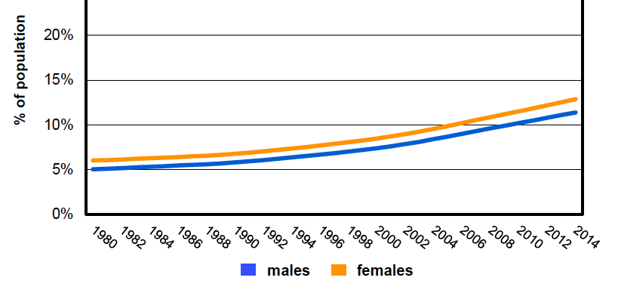
Diabetes Prevalence in Iran
1980-2014
 | Male | Female | Total
Diabetes | 9.6% | 11.1% | 10.3%
Overweight | 58% | 63% | 60.5%
Obese | 19.3% | 30.6% | 31.9%
WHO report 2016

Slide 3
Algorithms and Guidelines for the Management of T2DM
GLUCOCENTRIC: Primarily Focused on Glycemia and HbA1c
(Addition of Lifestyle, BP and Lipid control plus ASA to the management)
GLUCOCENTRIC +++: Paradigm Change to Focus on Glucose-Lowering PLUS other outcomes (CVD, Renal, Microvascular

Slide 4
Major Challenges in the Management of T2DM
Cardiovascular disease
Microvascular disease
Retinopathy
Nephropathy
Neuropathy
Hypoglycemia
Weight control

Slide 5
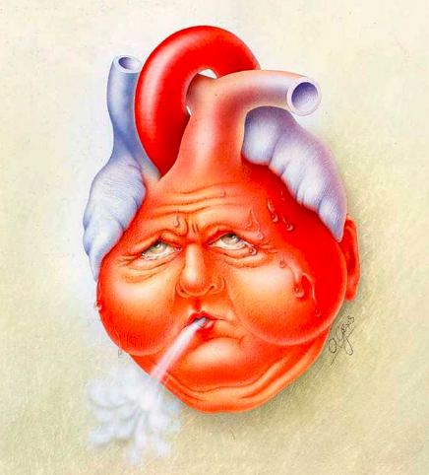
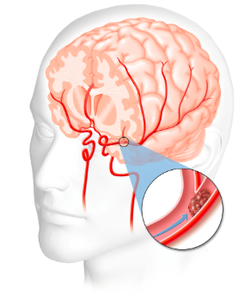

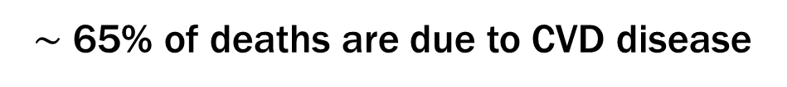
Cardiovascular disease and Diabetes
$\sim$ 65% of deaths are due to CVD disease
Cardiovascular complications of T2DM
Coronary Heart Disease deaths 2- to 4 - fold
Stroke risk
2- to 4 - fold
Heart Failure 2- to 5 - fold
Bell, D. S. H. Diabetes Care, (2003). 26(8), 2433–2441

Slide 6






Life Expectancy Is Reduced by ~12 Years in Diabetes Patients with Previous CVD
60
yrs
End of life
No diabetes
Diabetes
–6
yrs
Diabetes + MI
–12
yrs
Notes:
Abbreviations
CVD, cardiovascular disease; MI, myocardial infarction
Reference
The Emerging Risk Factors Collaboration. JAMA 2015;314:52

Slide 7
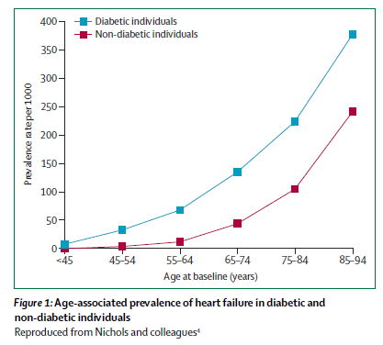
Age Associated Prevalence of Heart Failure in Diabetic and Non-Diabetic Individuals
Nichols et al

Slide 8
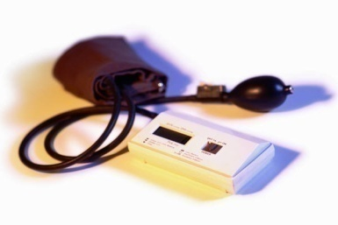

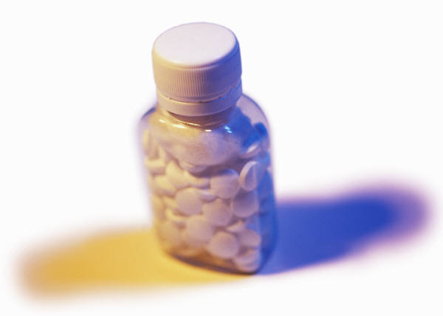
Use a Multifaceted Vascular Protection Strategy to Reduce Cardiovascular Risk
Healthy
Lifestyle/weight
Smoking Cessation
Physical
Activity
BP <130/80
A1C ≤7%
Rx
Statins
ACEi/ARB
Notes:
Pictorial demonstration that combination of emphasis of healthy lifestyle (stop smoking, PA, weight, diet) in addition to Rx to maintain BP/lipid/glycemic targets is essential in the care of the patient with diabetes

Slide 9
Glucose Lowering Agents
Impact on Mortality and Heart Failure
Glycemic Agent | CVD Mortality / MI / Stroke | Heart Failure
Insulin | ? Neutral | ?
Metformin | ? Neutral / ⬇ | ?
Sulphonylurea / Glinide | ? | ?
TZD | ? ⬇ | ⬆
DPP4 i | Neutral | Neutral Saxagliptin increased risk
GLP1 agonist | Lixisenatide neutral Liraglutide ⬇CV mortality Semaglutide ⬇ CVD/ MI /CVA | Neutral Neutral
SGLT2 inhibitor | Empagliflozin ⬇CV mortality | Empaglifozin ⬇HF

Slide 10
DPP4 Clinical Trials CVD Outcomes
HbA_{1c}
Range, %
Primary
End point
Duration of Treatment (as part of usual care)
6.5–11.0
Alogliptin
Non Inferior
CV death,
Nonfatal MI, or
Nonfatal stroke
EXAMINE¹
R
Placebo
6.5–12.0
Saxagliptin
Heart failure hospitalization
Saxagliptin 3.5%; Placebo 2.8%
HR 1.27 (95% CI 1.07–1.58)
NNH = 142
Non Inferior
CV death,
Nonfatal MI, or
Nonfatal stroke
SAVOR-
TIMI²
R
Placebo
6.5–8.0
Sitagliptin
Non Inferior
CV death, MI,
stroke, or UA
TECOS³
R
Placebo
7.0–11.0
Linagliptin
Non Inferior
CV death,
Nonfatal MI, or
Nonfatal stroke
CARMELINA⁴
R
  Median Duration of Follow-upª
Placebo
  Median Duration of Follow-upª
Randomization
Year 1
Year 2
Year 3
Up to
Year 4
Zannad F et al. Lancet 2015;385:2067 2. Scirica BM et al. N Engl J Med 2013;369:1317
3. Green JB et al. N Engl J Med 2015;373:232 4. Pfeffer MA et al. N Engl J Med 2015;373:2247
Notes:
All the three trials reported so far indicate the primary MACE endpoint showed non-inferiority ie no worse than placebo. HF signal in SAVOR
Purpose
To review the designs and patient populations of EXAMINE, SAVOR-TIMI, and TECOS CV outcomes trials.
Takeaway
EXAMINE, SAVOR-TIMI, and TECOS were designed to assess the CV risk associated with DPP-4 inhibitors in patients with diabetes and high risk of CV events.
1. White WB et al. N Engl J Med. 2013;369:1327–1335. 2. Scirica BM et al. N Engl J Med 2013;369:1317–1326. 3. Green JB et al. Am Heart J. 2013;166:983–989.e7.

Slide 11
GLP1 Agonist Trials and CVD Outcomes
HbA_{1c}
Range, %
Primary
End point
Duration of Treatment (as part of usual care)
> 7.0%
Liraglutide
Superior
⬇ CV death or
~ Nonfatal MI or
~ Nonfatal stroke
LEADER
R
Placebo
> 7.0%
Semaglutide
Superior
CV death or
Nonfatal MI or
⬇ Nonfatal stroke
SUSTAIN 6
  Median Duration of Follow-upª
R
Placebo
7.0–11.0
Albiglutide
Superior
CV death or
Nonfatal MI, or
Nonfatal stroke
HARMONY
  Median Duration of Follow-upª
R
Placebo
7.0–11.0
Lixisenatide
Non Inferior
CV death,
Nonfatal MI, or
Nonfatal stroke or
Hosp for Unstable Angina
ELIXA
  Median Duration of Follow-upª
R
Placebo
7.0–11.0
Exenatide
Non Inferior
CV death,
Nonfatal MI, or
Nonfatal stroke or
Hosp for Unstable Angina
EXSCEL
  Median Duration of Follow-upª
R
Placebo
Randomization
  Median Duration of Follow-upª
Year 4
Year 1
Year 2
Year 3
Notes:
All the three trials reported so far indicate the primary MACE endpoint showed non-inferiority ie no worse than placebo. HF signal in SAVOR
Purpose
To review the designs and patient populations of EXAMINE, SAVOR-TIMI, and TECOS CV outcomes trials.
Takeaway
EXAMINE, SAVOR-TIMI, and TECOS were designed to assess the CV risk associated with DPP-4 inhibitors in patients with diabetes and high risk of CV events.
1. White WB et al. N Engl J Med. 2013;369:1327–1335. 2. Scirica BM et al. N Engl J Med 2013;369:1317–1326. 3. Green JB et al. Am Heart J. 2013;166:983–989.e7.

Slide 12
SGLT2i and CVD Outcomes
HbA_{1c}
Range, %
Primary
End point
Duration of Treatment (as part of usual care)
7-10%
Empagliflozin
Superior
CV death or
MI or
Stroke
EMPA REG
Outcome
R
Placebo
> 7.0%
Canagliflozin
Superior
CV death or
MI or
Sroke
CANVAS
  Median Duration of Follow-upª
R
Placebo
> 7.0%
Dapagliflozin
Superior
CV death / HFH
CVD/ MI /Stroke ns
DECLARE
  Median Duration of Follow-upª
R
Placebo
  Median Duration of Follow-upª
Randomization
Year 1
Year 2
Year 3
Year 4
Notes:
All the three trials reported so far indicate the primary MACE endpoint showed non-inferiority ie no worse than placebo. HF signal in SAVOR
Purpose
To review the designs and patient populations of EXAMINE, SAVOR-TIMI, and TECOS CV outcomes trials.
Takeaway
EXAMINE, SAVOR-TIMI, and TECOS were designed to assess the CV risk associated with DPP-4 inhibitors in patients with diabetes and high risk of CV events.
1. White WB et al. N Engl J Med. 2013;369:1327–1335. 2. Scirica BM et al. N Engl J Med 2013;369:1317–1326. 3. Green JB et al. Am Heart J. 2013;166:983–989.e7.

Slide 13
Glucose transporters
Glucose transporters are classified into two families:
facilitative glucose transporters (GLUTs)
sodium-dependent glucose transporters (SGLTs)
13

Slide 14
Glucose Transporters
Gluts
High Glucose
Low Glucose
Glucose
Glucose
SGLTs
High Glucose
High Na⁺
Low Glucose
Low Na⁺
Glucose
Na⁺

Slide 15

Renal Handling of Glucose
(180 L/day) (900 mg/L)=162 g/day
Glucose
SGLT2
S1
SGLT1
90%
S3
10%
No Glucose
Notes:
15
15
The major role of the kidney in human physiology is to maintain intravascular volume and an acid-based electrolyte balance. Approximately 180 L of plasma per day pass through the kidney’s glomerular filtration system, wherein minerals such as sodium, potassium, and chloride are absorbed and returned to the bloodstream rather than passed out in the urine. Glucose is also filtered in this manner in order to retain energy essential for physiologic functioning between meals.¹
With a daily glomerular filtration rate of 180 L, approximately 162 g of glucose must be reabsorbed each day to maintain a plasma glucose concentration of 5.6 mmol/L (101 mg/dL). As shown on the slide, reabsorption of glucose occurs mainly in the proximal tubule and is mediated by 2 different transport proteins, sodium-glucose cotransporters 1 and 2 (SGLT1 and SGLT2). SGLT1, which occurs in the straight section of the tubule (S3), is responsible for approximately 10% of glucose reabsorption in the kidney. The other 90% is mediated by SGLT2, which occurs in the convoluted section on the tubule (S1).¹
Although it varies from person to person, the maximal reabsorptive capacity of the proximal tubule averages 375 mg per minute. Because the filtered glucose load in healthy nondiabetic subjects is less than this, all filtered glucose is returned to circulation and none is excreted in the urine.²
Wright EM, Hirayama BA, Loo DF. Active sugar transport in health and disease. J Intern Med. 2007;261:32-43.
Abdul-Ghani MA. Inhibition of renal glucose absorption: a novel strategy for achieving glucose control in type 2 diabetes mellitus. Endocr Pract. 2008;14:782-790.

Slide 16
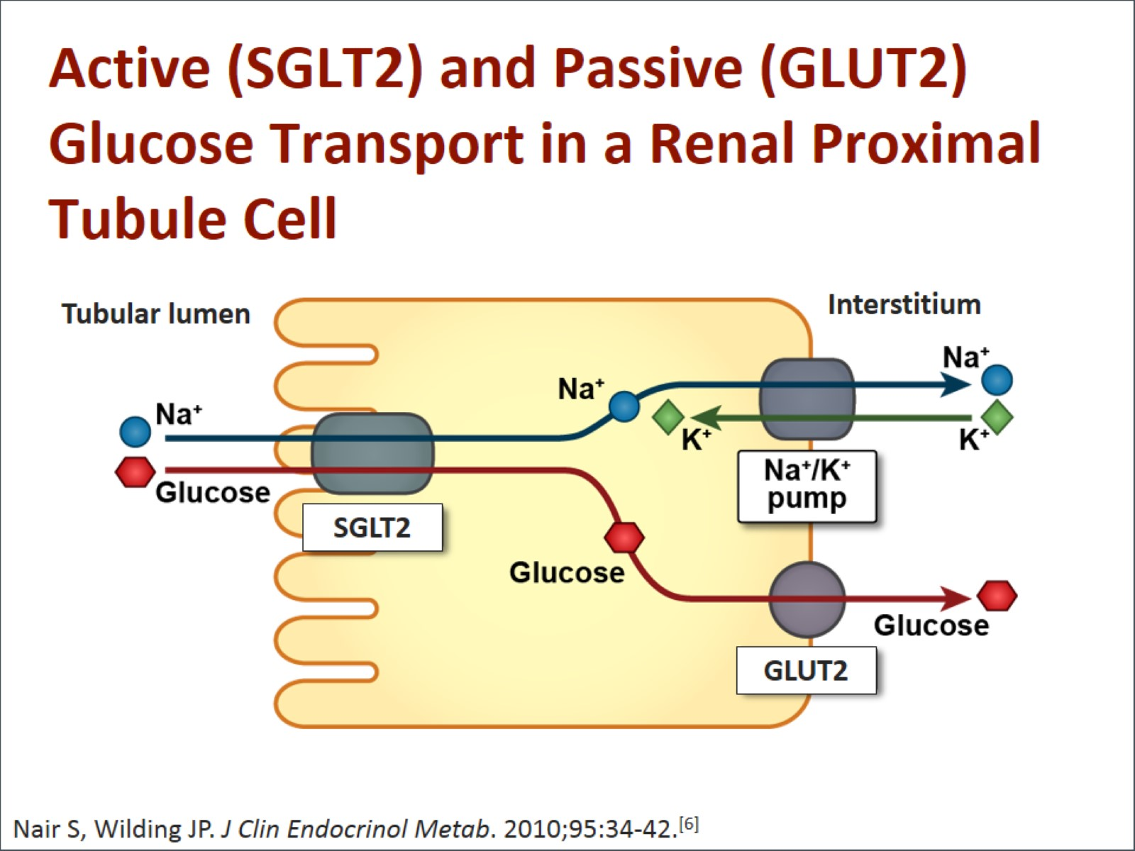
Active (SGLT2) and Passive (GLUT2) Glucose Transport in a Renal Proximal Tubule Cell

Slide 17
The Renal Glucose Threshold (RT_{G}) Concept in Healthy Subjects
Below RT_{G}
Minimal Glucosuria Occurs
Above RT_{G}
Glucosuria Occurs
Urinary Glucose Excretion (g/d)
Healthy
RT_{G}
~10 mmol/L
0
2
4
6
8
10
12
14
16
Plasma Glucose (mmol/L)
Guyton AC, Hall JE. Textbook of Medical Physiology. 11th ed. Philadelphia, PA: Elsevier Saunders; 2006.
DeFronzo RA, et al. Diab Obes Metab. 2012;14:5-14.
17
Notes:
Urinary glucose excretion is commonly described as a threshold relationship.
Glucose is filtered by the kidneys and the vast majority is reabsorbed through the sodium-dependent glucose transporters SGLT2 and SGLT1.
The renal glucose transporters are able to reabsorb virtually all glucose when plasma glucose concentrations are in the normal range.
When plasma glucose increases and filtered glucose load exceeds the maximal renal reabsorption capacity, glucose is excreted into urine in direct proportion to the plasma glucose level.
The lowest plasma glucose concentration at which appreciable urinary glucose excretion occurs is termed the renal threshold for glucose excretion (RT_{G}). This is commonly quoted to be 10-11 mmol/L in normoglycemic, healthy subjects.
The true relationship between the renal threshold for glucose excretion and urinary glucose excretion is not a perfect threshold as shown on the slide; there is some splay in the relationship.
References:
Adapted from:
Guyton AC, Hall JE. Textbook of Medical Physiology. 11th ed. Philadelphia, PA: Elsevier Saunders; 2006
DeFronzo RA, et al. The role of the kidneys in glucose homeostasis: a new path towards normalizing glycemia. Diab Obes Metab 2012;14:5-14.

Slide 18

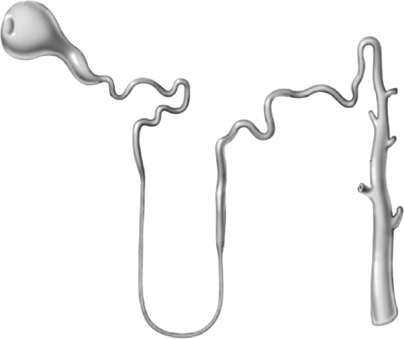

Renal glucose re-absorption in healthy individuals
Filtered glucose load 180 g/day
SGLT2
~ 90%
SGLT1
~ 10%
Gerich JE. Diabet Med. 2010;27:136–142.
18
Notes:
In healthy subjects, in the kidney, the amount of glucose re-absorbed through the SGLT1 and SGLT2 transporters is equal to the amount of glucose that is filtered by the glomerulus. Glucose re-absorption by the proximal tubule increases linearly with increasing glucose concentration, up to a theoretical threshold of ~ 180 mg/dL.
The SGLT2 transporter mediates 90% of renal glucose re-absorption by coupling glucose transport to the electrochemical sodium gradient. The other 10% of renal glucose re-absorption occurs through SGLT1, a high-affinity, low-capacity transport protein that is found in the more distal, straight section of the proximal tubule (S3), where there is less luminal glucose.
Recent studies suggest that in subjects with low blood glucose, SGLT1 is responsible for a higher percentage of renal re-absorption.

Slide 19
Renal threshold
The lowest plasma glucose concentration at which appreciable urinary glucose excretion occurs is termed the renal threshold for glucose excretion (RT_{G}). This is commonly quoted to be 10-11 mmol/L in normoglycemic, healthy subjects.
19

Slide 20
Sodium-Glucose Co-transporters
 | SGLT1 | SGLT2
Site | Intestine, kidney | Kidney
Sugar specificity | Glucose or galactose | Glucose
Glucose affinity | High K_{m}=0.4 mM | Low K_{m}=2 mM
Glucose transport capacity | Low | High
Role | Dietary absorption of glucose and galactose Renal glucose reabsorption | Renal glucose reabsorption
Notes:
20
This slide describes the differences between the 2 sodium-glucose transport proteins.
SGLT1 is a high-affinity, low-capacity transport protein that resides in both the gut and the proximal tubule in the kidney. It plays a role in both dietary absorption and renal reabsorption of glucose. Inhibition of SGLT1 can result in malabsorption of glucose and other nutrients from the intestine, leading to osmotic diarrhea. For example, in glucose-galactose malabsorption syndrome, mutations in the gene for SGLT1 result in impaired absorption of glucose and galactose and severe diarrhea. Individuals with this condition must receive all carbohydrates in the form of fructose, or malnutrition and even death may result.
In contrast, SGLT2 is a low-affinity, high-capacity transport protein that resides in the proximal tubule alone. Specific inhibition of SGLT2 as a rational target of therapy for type 2 diabetes is based on familial renal glucosuria. Patients with this benign, inherited condition have a defective SGLT2 protein and excrete large amounts of glucose in their urine, with few if any adverse effects, as shall be discussed in later slides.
Wright EM, Hirayama BA, Loo DF. Active sugar transport in health and disease. J Intern Med. 2007;261:32-43.

Slide 21
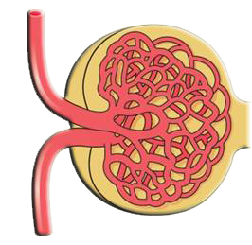
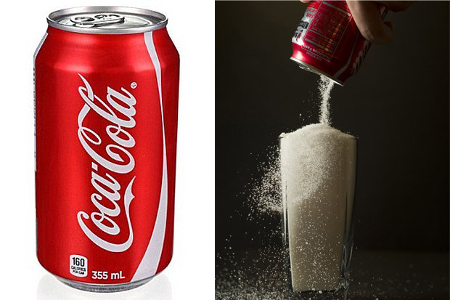
SGLT2 Inhibition Reduces
Renal Glucose Reabsorption
Collecting
duct
Glomerulus
Proximal
tubule
Distal
tubule
Glucose
filtration
S1
SGLT2
SGLT1
S3
Na⁺ & Glucose
reabsorption
90%
10%
SGLT2
inhibitor
Increased
glucose
excretion
Minimal
glucose
excretion
Loop of Henle
-
- 70-80 g/day
( - 280-320 Kcal/day)
Wright EM. Am J Physiol Renal Physiol. 2001;280:F10-F18; Lee YJ et al. Kidney Int Suppl. 2007;106:S27-S35; Han S. Diabetes. 2008;57:1723-1729.
Notes:
The kidneys play an essential role in maintenance and regulation of glucose homeostasis
About 180 g of glucose is filtered from plasma by the renal corpuscles. Normally, virtually all of the filtered glucose is reabsorbed into blood by the proximal convoluted tubules mediated by an active process in the brush border membrane of the tubular epithelium and a facilitated process in the basolaterial membrane¹
SGLT2 is responsible for reabsorbing up to 90% (animal data) of the glucose filtered at the glomerulus^{1,2}
The remaining 10% (animal data) is reabsorbed by SGLT1 that is expressed on the luminal (brush border) surface of cells of the S3 segment of the proximal tubule^{1,2}
References:
Wright EM. Am J Physiol Renal Physiol 2001;280:F10–8.
Lee YJ, et al. Kidney Int Suppl 2007;106:S27–35.

Slide 22
Increased Glucose Transporter Proteins and Activity in Type 2 DM
SGLT2
GLUT2
AMG Uptake
8
P<0.05
2000
P<0.05
6
1500
Normalized Glucose
Transporter Levels
CPM
4
1000
P<0.05
2
500
0
0
NGT
T2DM
NGT
T2DM
NGT
T2DM
AMG=methyl-α-D-[U¹⁴C]-glucopyranoside; CPM=counts per minute.
Rahmoune H, et al. Diabetes. 2005;54:3427-3434.
Notes:
22
Human exfoliated proximal tubular epithelial cells (HEPTECs), which can be isolated from urine, continue to express a variety of proximal tubular markers, including SGLT2 through several subsequent subcultures.
In this study, HEPTECs isolated from individuals with NGT and type 2 diabetes were cultured in a hyperglycemic environment. As shown in the left graph, the cells from the type 2 diabetes patients expressed significantly more SGLT2 and GLUT2 proteins than cells from NGT individuals. In addition, renal glucose uptake, measured using the glucose analogue methyl-α-D-[U¹⁴C]-glucopyranoside (AMG), was significantly greater in the type 2 diabetes HEPTECs than the NGT cells.
These findings demonstrate that type 2 diabetes is associated with increases in renal glucose transporter expression and activity.
Rahmoune H, Thompson PW, Ward JM, Smith CD, Hong G, Brown J. Glucose transporters in human renal proximal tubular cells isolated from the urine of patients with non-insulin- dependent diabetes. Diabetes. 2005;54:3427-3434.

Slide 23
Upregulation of SGLT2 Transporter and Enhanced Cellular Glucose Uptake in Type 2 Diabetes
Protein Expression
Glucose Uptake
by Tubular Cells
P < 0.05
P < 0.05
Normalized Glucose
Transporter Levels (mean ±SE)
AMG* Uptake
(CPM; mean ±SE)
P < 0.05
Rahmoune H, et al. Diabetes. 2005;54(12):3427-3434.
23
Notes:
Limited data (in 4 people) suggest patients with type 2 diabetes mellitus experience increased reabsorption of glucose.
Exfoliated proximal tubule epithelial cells from urine of 50 healthy patients and 50 patients with type 2 diabetes were placed into cell culture and examined for renal glucose transporter expression. In parallel, they were also examined for cellular glucose uptake.
Subjects with type 2 diabetes showed significantly increased amounts of SGLT2 and GLUT2, compared with healthy subjects. In addition, subjects with diabetes also demonstrated increased cellular uptake of glucose (up to 3 times greater) than healthy volunteers. A radio-labelled glucose substitute was used for this determination.
.Note that as these are only in vitro data, results still need to be confirmed by in vivo/clinical studies before definite conclusions can be made about increased glucose reabsorption in patients with type 2 diabetes.
Several preclinical studies show that expression of SGLT1, SGLT2, and GLUT2 in the kidney is upregulated in experimentally-induced and genetic forms of diabetes in rats.
References:
Rahmoune H, Thompson PW, Ward JM, Smith CD, Hong G, Brown J. Glucose transporters in human renal proximal tubular cells isolated from the urine of patients with non-insulin-dependent diabetes. Diabetes. 2005;54:3427-3434.
*Uptake of AMG is Na+ dependent and is a measure of transport by SGLTs rather than GLUTs.
AMG=methyl-α-D-[U-14C]-glucopyranoside; CPM=counts per minute.

Slide 24
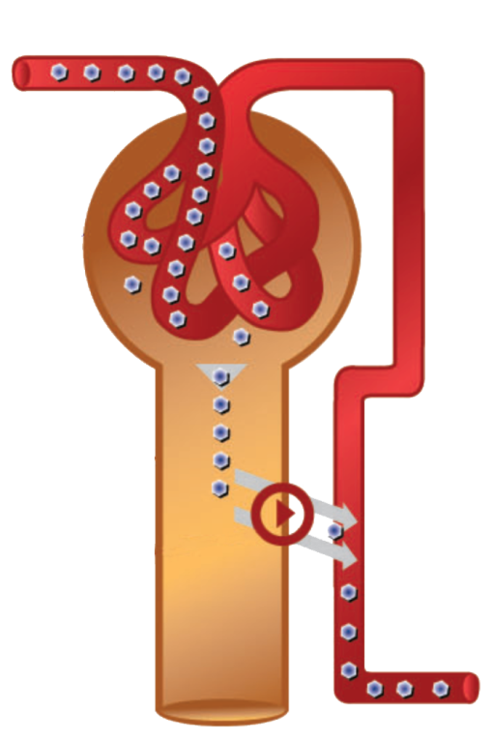
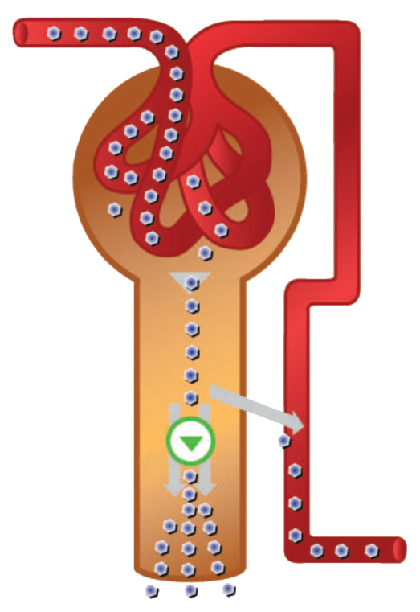
Renal SGLT2 Inhibition: A novel approach to type 2 Diabetes
Patients with type 2 diabetes
Type 2 diabetes with SGLT2 inhibition
Excess glucose
Excess glucose
Glomerulus
Glomerulus
Renal
proximal
tubule
Renal proximal tubule
Reduced blood glucose levels resulting from less glucose reabsorption
Glucose reabsorption
Glucose
Glucose excretion enabled through SGLT2 inhibition
Urinary
excretion
Glucose excretion
Chao EC & Henry RR. Nature Reviews Drug Discovery, 2010;9:551-559.
DeFronzo RA, et al. Diab Obes Metab, 2012;14:5-14.
Washburn WN. J Med Chem, 2009;52:1785-1794.
24
Notes:
Plasma glucose filtered in the kidney glomeruli, is reabsorbed into the systemic circulation by sodium glucose transporters (SGLTs) in the proximal tubule.
In patients with type 2 diabetes, the reabsorption of glucose helps sustain hyperglycemia.
By redirecting excess glucose via urinary excretion, SGLT2 inhibition represents a novel approach to type 2 diabetes.
SGLT2 inhibitors block glucose reabsorption, increasing urinary glucose excretion. There is substantive decrease in net glucose entering the system plasma glucose is lowered.
Glucosuria leads to loss of ~80-100 g of glucose/day (~3-4 g/h) in subjects with type 2 diabetes mellitus.
References:
Adapted from:
Chao EC & Henry RR. SGLT2 inhibition — a novel strategy for diabetes treatment. Nature Reviews Drug Discovery 2010;9:551-559.
DeFronzo RA, et al. The role of the kidneys in glucose homeostasis: a new path towards normalizing glycemia. Diab Obes Metab 2012;14:5-14.
Washburn WN. Development of the renal glucose reabsorption inhibitors: a new mechanism for the pharmacotherapy of diabetes mellitus type 2. J Med Chem. 2009;52(7):1785-1794.

Slide 25
Renal Glucose Handling Before and After Inhibition of SGLT2
22
T_{max}
Pre-inhibition of SGLT2
21
=
Post-inhibition
of SGLT2
11
Pre-inhibition
of SGLT2
Rate of glucose filtration/reabsoprtion/excretion
(mmol per min)
Re-absorption
Post-inhibition
of SGLT2
5.5
Excretion
Theoretical threshold
=
=
0
Actual threshold
10
11
16.65
Plasma Glucose (mmol/L)
Chao EC & Henry RR. Nature Reviews Drug Discovery 2010;9:551-559.
Guyton AC & Hall JE. Textbook of Medical Physiology. 11th ed. Philadelphia, PA: Elsevier Saunders; 2006.
25
Notes:
This slide shows a schematic of renal glucose reabsorption (purple line) and excretion (green line) in normal individuals. The amount of glucose reabsorbed by the kidneys is essentially equivalent to the amount entering the system, with reabsorption increasing with glucose concentrations up to approximately 11 mmol/L. At this threshold, the system becomes saturated and the maximal resabsorption rate, or glucose transport maximum (TmG), is reached. No more glucose can be absorbed, and instead the kidneys begin excreting it in the urine.
Although 11 mmol/L represents the theoretical threshold glucose concentration, the actual concentration varies due to nephron heterogeneity, resulting in slight differences in actual glucose reabsorption levels and TmG values between individual tubules. Thus, the actual threshold is not a single point but a curve, where excretion begins to occur at plasma glucose levels of ~10 mmol/L, and increases more gradually than sharply.
Likewise, as reabsorption approaches the TmG, it tails off in parallel to the glucose concentration threshold. The difference between the actual and theoretical TmG is known as splay.
In diabetes due to up-regulation of SGLT2, the reabsorption curve is shifted to the right.
SGLT2 inhibition may reduce plasma glucose levels by decreasing TmG, increasing the glucose excretion rate, or both.
In normal individuals, SGLT2 inhibition has no effect on plasma glucose concentration, because the liver increases glucose production to compensate for glycosuria.
In diabetes however, administration of an SGLT2 inhibitor produces both dose-dependent glucosuria and a significant reduction in plasma glucose concentrations. SGLT2 inhibitors lower both the saturation threshold and the transport maximum (Tmax) for glucose. This results in increased glucosuria for a given plasma glucose level, shown here as a left shift of the glucosuria curve.
In essence, SGLT2 inhibition “resets” the system by lowering the threshold for glucosuria; consequently, plasma glucose levels decrease and glucotoxicity declines.
References:
Adapted from:
Chao EC & Henry RR. SGLT2 inhibition — a novel strategy for diabetes treatment. Nature Reviews Drug Discovery 2010;9:551-559.
Guyton AC, Hall JE. Textbook of Medical Physiology. 11th ed. Philadelphia, PA: Elsevier Saunders; 2006

Slide 26
Renal Reuptake Summary
In type 2 diabetes, enhanced renal glucose reabsorption contributes to hyperglycemia
The glucose transporter SGLT2 is responsible for 90% of this glucose reabsorption
Inhibition of SGLT2 will
  Decrease glucose reabsorption
  Increase urinary glucose excretion
Predict weight loss and reduction in blood pressure
26

Slide 27
Diabetic kidney Disease
Reversible glomerular hyperfiltration
The tubular hypothesis implicates that impaired tubuloglomerular feedback (TGF) due to upregulation of SGLT2 plays a central role in hyperfiltration in diabetic patients, leading to albuminuria and decline in renal function
Normal glomerular filtration and normal albuminuria
Normal or decreasing glomerular filtration and micro albuminuria
Declining glomerular filtration and macro albuminuria
End-stage renal disease.
The American Journal of Medicine, Vol 130, No 6S, June 2017
27

Slide 28
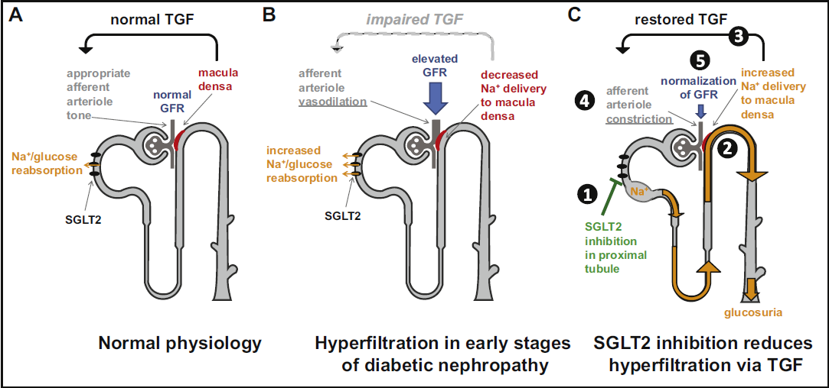
Wanner et.al, American Journal of Medicine, 130(6), S63–S72.

Slide 29
Empagliflozin treatment
Blocks proximal tubule glucose and sodium reabsorption
Increased sodium delivery to the macula densa.
Afferent arteriol vasoconstriction
Restores TGF(tubuloglomerular feedback )
Reduced renal plasma flow and hyperfiltration
29

Slide 30
Mechanism of Action of
SGLT2 Inhibitors
Inhibition of SGLT2
Reversal of glucotoxicity
Insulin sensitivity in muscle
  ↑ GLUT4 translocation
  ↑ Insulin signaling
  Other
Insulin sensitivity in liver
  ↓ Glucose- 6-phosphatase
Gluconeogenesis
  Decreased Cori cycle
  ↓ PEP carboxykinase
β-Cell function
Phosphoenolpyruvate carboxykinase (PEPCK) is an enzyme in the lyase family used in the metabolic pathway of gluconeogenesis. It converts oxaloacetate into phosphoenolpyruvate and carbon dioxide
Notes:
30
30
SGLT2 inhibitors improve glucose control by reducing plasma glucose levels, which in turn reverses the effects of glucotoxicity, as follows:
Insulin sensitivity in muscle increases via increased GLUT4 translocation and insulin signaling as well as other mechanisms.
Insulin sensitivity also improves in the liver, with a decrease in glucose-6-phosphatase levels.
Gluconeogenesis in the liver decreases as a result of a reduction in the Cori cycle and decreased PEP carboxykinase.
β-Cell function improves.

Slide 31
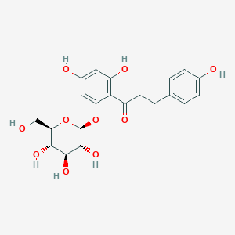
SGLT2-inhibition
Phlorizin
DECLARE – TIMI 58
CANVAS
EMPA-REG
CVD-REAL

Slide 32
Effect of Dapagliflozin in Type 2 Diabetes
Multicenter trial; 546 adult patients
Double-blind, parallel group, placebo-controlled
Inadequate control with metformin
Assigned to 4 groups:
- 2.5 mg qd
- 5.0 mg qd
- 10.0 mg qd
- placebo
Continued on metformin
Primary outcome = change in HbA1c at 24 weeks
Bailey, C., et al. Lancet. 375:2223 – 2233, 2010

Slide 33
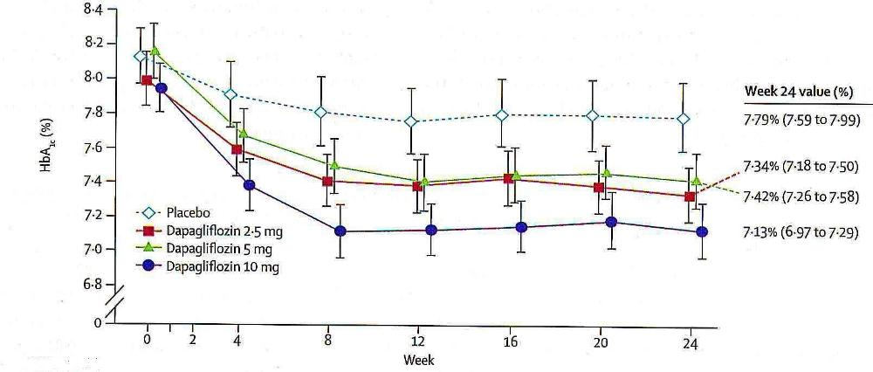
Effect of Dapagliflozin in Type 2 Diabetes
Bailey, C., et al. Lancet. 375:2223 – 2233, 2010

Slide 34
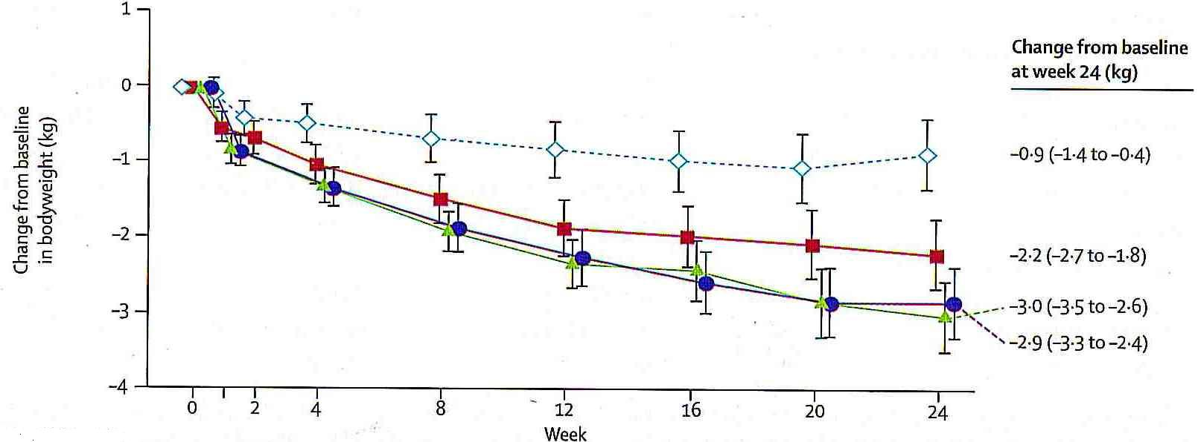
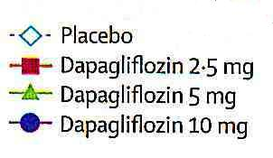
Effect of Dapagliflozin in Type 2 Diabetes
Bailey, C., et al. Lancet. 375:2223 – 2233, 2010

Slide 35
EMPA-REG OUTCOME® included patients with
T2D and established CV disease
✓
Established CV disease History of MI or stroke >2 months before study Coronary artery disease Peripheral occlusive arterial disease
Adults (≥18 years of age) with T2D
BMI ≤45 kg/m²
HbA1c ≥7% and ≤10%*
eGFR <30 ml/min/1.73 m² (MDRD)
Acute coronary syndrome, stroke or transient ischaemic attack within 2 months before informed consent
✓
✓
✓
✓
✗
✗
*Stable background therapy for ≥12 weeks before randomisation: for insulin, dose was to remain unchanged by >10% from the dose received 12 weeks before randomisation); for drug-naïve: HbA1c ≥7% and ≤9%
BMI, body mass index; CV, cardiovascular; eGFR, estimated glomerular filtration rate; HbA1c, glycated haemoglobin; MDRD, Modification of Diet in Renal Disease; MI, myocardial infarction; T2D, type 2 diabetes
Zinman B et al. N Engl J Med 2015;373:2117

Slide 36

Study medication was given on top of background standard of care for CV risk reduction and glucose control
Placebo
Empagliflozin 10 mg
Empagliflozin 25 mg
Screening
Randomised and treated
3.1 years median
observation time
(N=11,531)
(n=7020)
Stable background glucose-lowering medication for first 12 weeks and then adjusted to achieve glycaemic equipoise

Slide 37
Baseline Characteristics
Age |  | 63.1 ± 8.6
Male |  | 72%
BMI |  | 30.6 ± 5.2
eGFR | 30-60 ml/min/ 1.7m² | 26%
CV Disease | Prior CVD | 99.2%
 | MI | 46.6%
 | CABG | 24.7%
 | Stroke | 23.3%
 | Heart failure | 10.1%
Data are mean ± SD or % in 7020 patients treated with ≥1 dose of study drug.
Zinman B et al. N Engl J Med 2015;373:2117-28.

Slide 38
CV risk factor management at baseline
Glycemic management | HbA1c, % | 8.07 ± 0.85
 | Any metformin | 74.0%
 | Any insulin | 48.2%
Blood pressure management | SBP/DBP, mmHg | 136/77
 | SBP <140 and DBP <90 mmHg | 61.3%
 | Any BP-lowering drug | 95.0%
 | ACE inhibitor/ARB | 80.7%
Lipid management | LDL-cholesterol, mg/dL | 2.19 ± 0.92
 | Statin | 77.0%
Anti-platelet therapies | Acetylsalicylic acid | 82.7%
Data are mean ± SD or % in 7020 patients treated with ≥1 dose of study drug.
Zinman B et al. N Engl J Med 2015;373:2117-28.

Slide 39
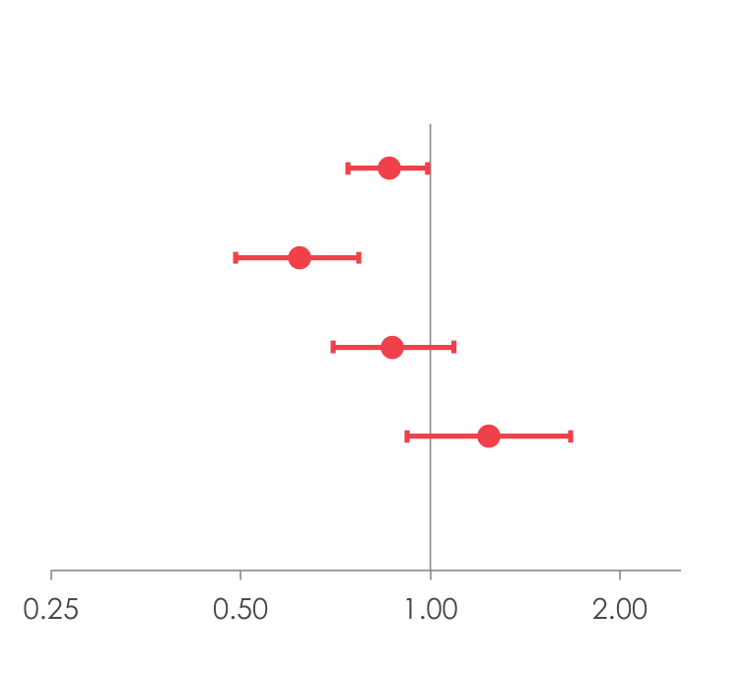
CV death, MI and stroke
Patients with event/analysed
 | Empagliflozin |  | Placebo |  | HR | (95% CI) |  | p-value
3-point MACE |  | 490/4687 |  | 282/2333 | 0.86 | (0.74, 0.99)* |  | 0.0382
CV death |  | 172/4687 |  | 137/2333 | 0.62 | (0.49, 0.77) |  | <0.0001
Non-fatal MI |  | 213/4687 |  | 121/2333 | 0.87 | (0.70, 1.09) |  | 0.2189
Non-fatal stroke |  | 150/4687 |  | 60/2333 | 1.24 | (0.92, 1.67) |  | 0.1638
Favours empagliflozin
Favours placebo
Zinman et al N Engl J Med 2015 DOI: 10.1056/NEJMoa1504720
Notes:
Table 15.2.4.1.1: 1
Table 15.2.4.1.2: 1
Table 15.2.4.1.3: 1
Table 15.2.4.1.5: 1
Table 15.2.4.1.8: 1
Table 15.2.4.1.9: 1

Slide 40
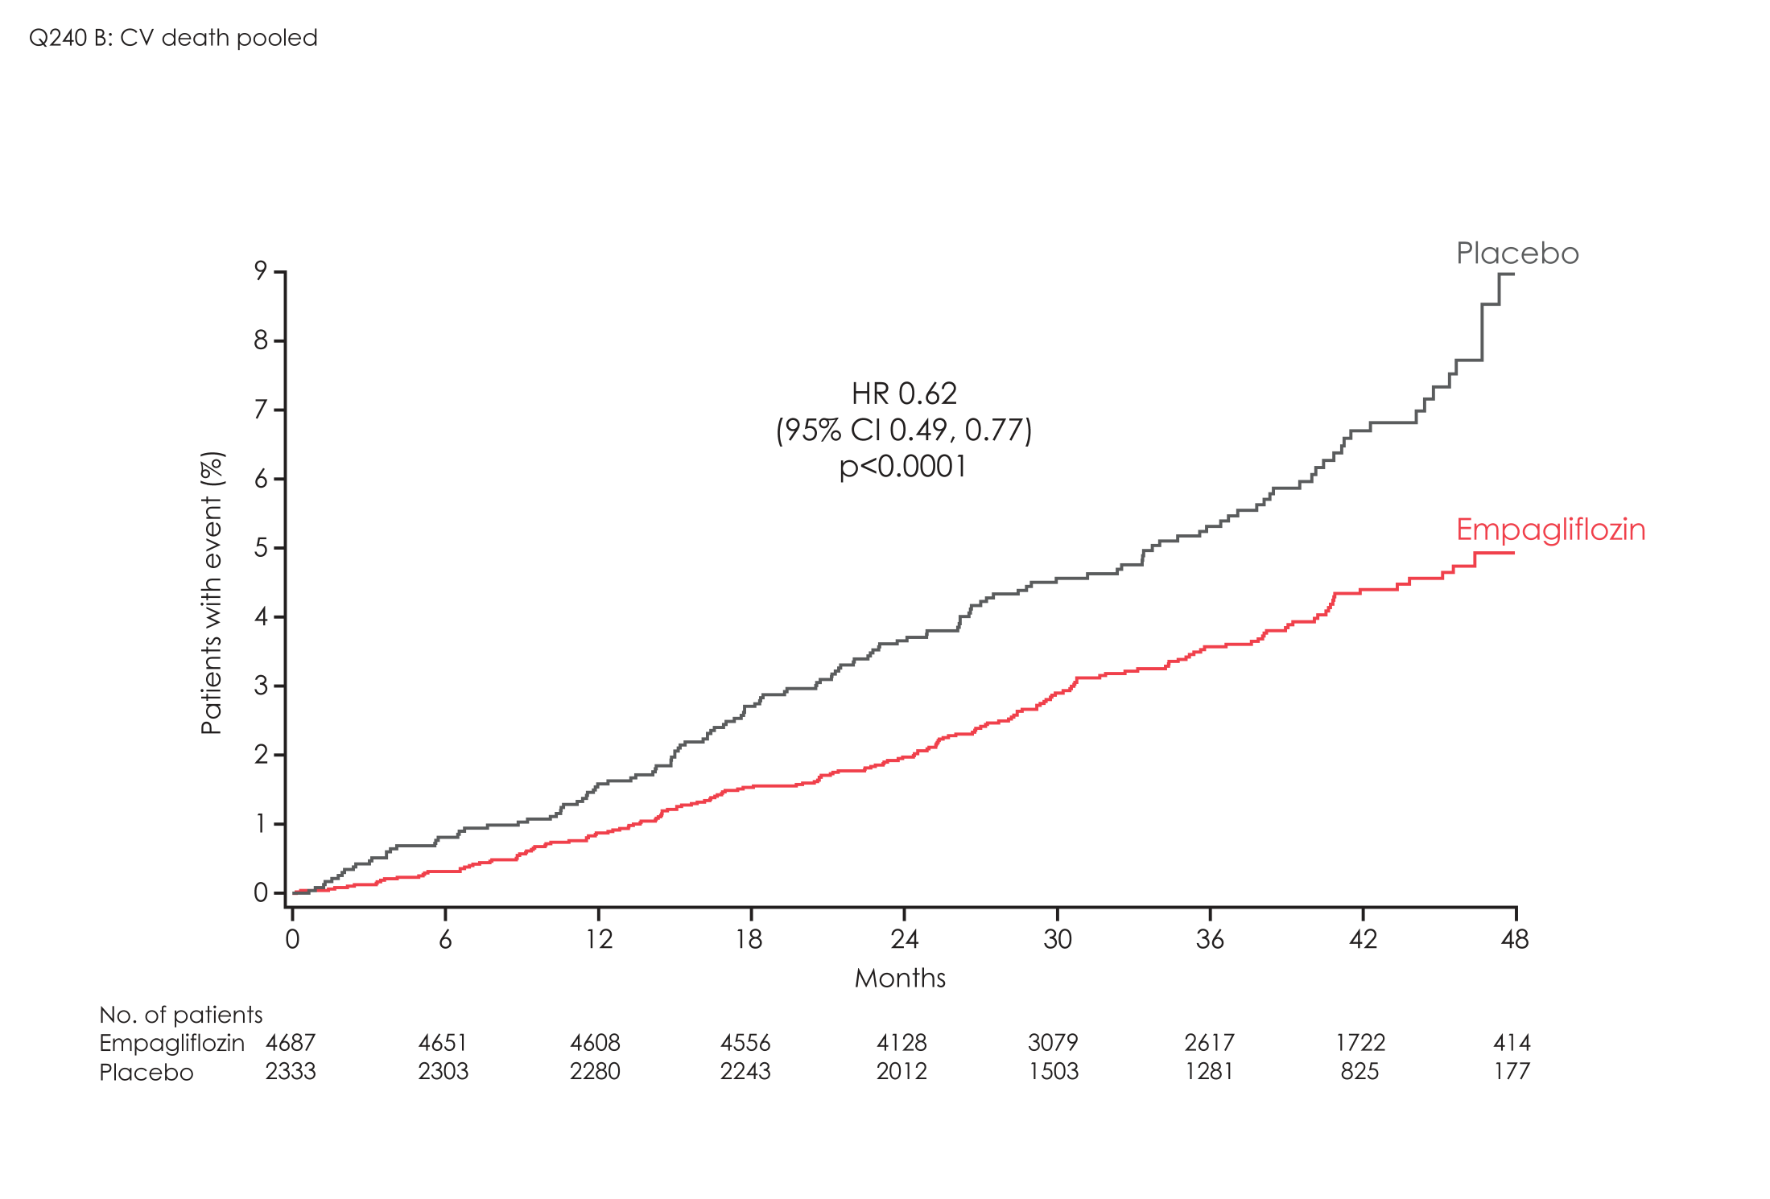
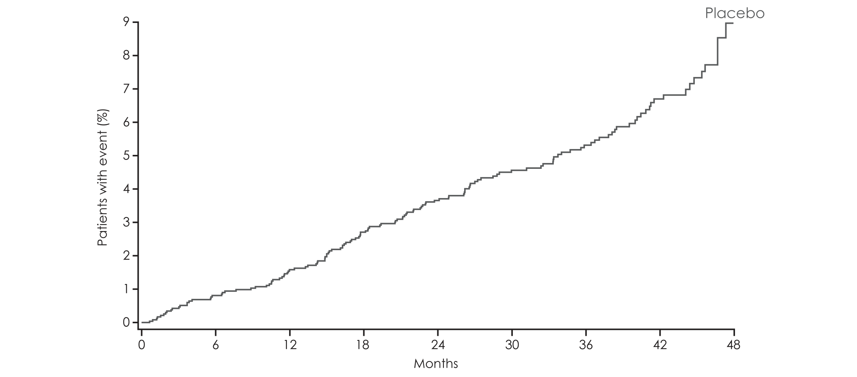
CV death
HR 0.62
(95% CI 0.49, 0.77)
p<0.0001
Empagliflozin in Indonesia is not indicated to reduce CV Death
Further information refer to local prescribing information
CI, confidence interval; HR, hazard ratio.
Zinman et al. N Engl J Med 2015:373:2117-

Slide 41
CV death (Empagliflozin 10mg and 25mg doses)
Empagliflozin in Indonesia is not indicated to reduce CV Death
Further information refer to local prescribing information
CI, confidence interval; HR, hazard ratio.
Zinman et al. N Engl J Med 2015:373:2117-

Slide 42
Modes of CV death
 | Empagliflozin |  | Placebo |  | HR (95% CI) |  | p-value
 | Patients with Events | Rate/ 100 PY | Patients with Events | Rate/ 100 PY
All CV Deaths | 172/4687 (3.7%) | 1.24 | 137/2333 (5.9%) | 2.02 |  | 0.62 (0.49, 0.77) | <0.0001
Fatal MI | 15/4687 (0.3%) | 0.11 | 11/2333 (0.5%) | 0.16 |  | 0.68 (0.31, 1.48) | 0.3271
Fatal Stroke | 16/4687 (0.3%) | 0.12 | 11/2333 (0.5%) | 0.16 |  | 0.72 (0.33, 1.55) | 0.4015
Worsening Heart Failure | 14/4687 (0.3%) | 0.10 | 22/2333 (0.9%) | 0.32 |  | 0.32 (0.16, 0.62) | 0.0008
Sudden death | 53/4687 (1.1%) | 0.38 | 38/2333 (1.6%) | 0.56 |  | 0.69 (0.45, 1.04) | 0.0766
Other CV Causes* | 3/4687 (0.06%) | - | 2/2333 (0.09%) | - |  | - | -
Presumed CV Death (? Sudden) | 71/4687 (1.5%) | 0.51 | 53/2333 (2.3%) | 0.78 |  | 0.66 (0.46, 0.94) | 0.0218
ARR
2.2%
0.3%
0.6%
0.5%
0.8%
Non-vascular / All CV Deaths
1.9% / 2.2%
Favours empagliflozin
Favours
placebo
Empagliflozin in Indonesia is not indicated to reduce CV Death
Further information refer to local prescribing information
Notes:
Empagliflozin reduced the risk of CV death by 38%. The HR is 0.62
All categories of CV death – fatal MI, fatal stroke, HF death, sudden death, other causes of CV death, and presumed CV death - contributed to this outcome.
The HRs for these endpoints, including presumed CV death, were consistently around 0.7, expect Death due to heart failure with a HR of 0.32.
Pause
To better understand the category of presumed CV death, we looked at the investigator-reported adverse events leading to death in these patients.

Slide 43
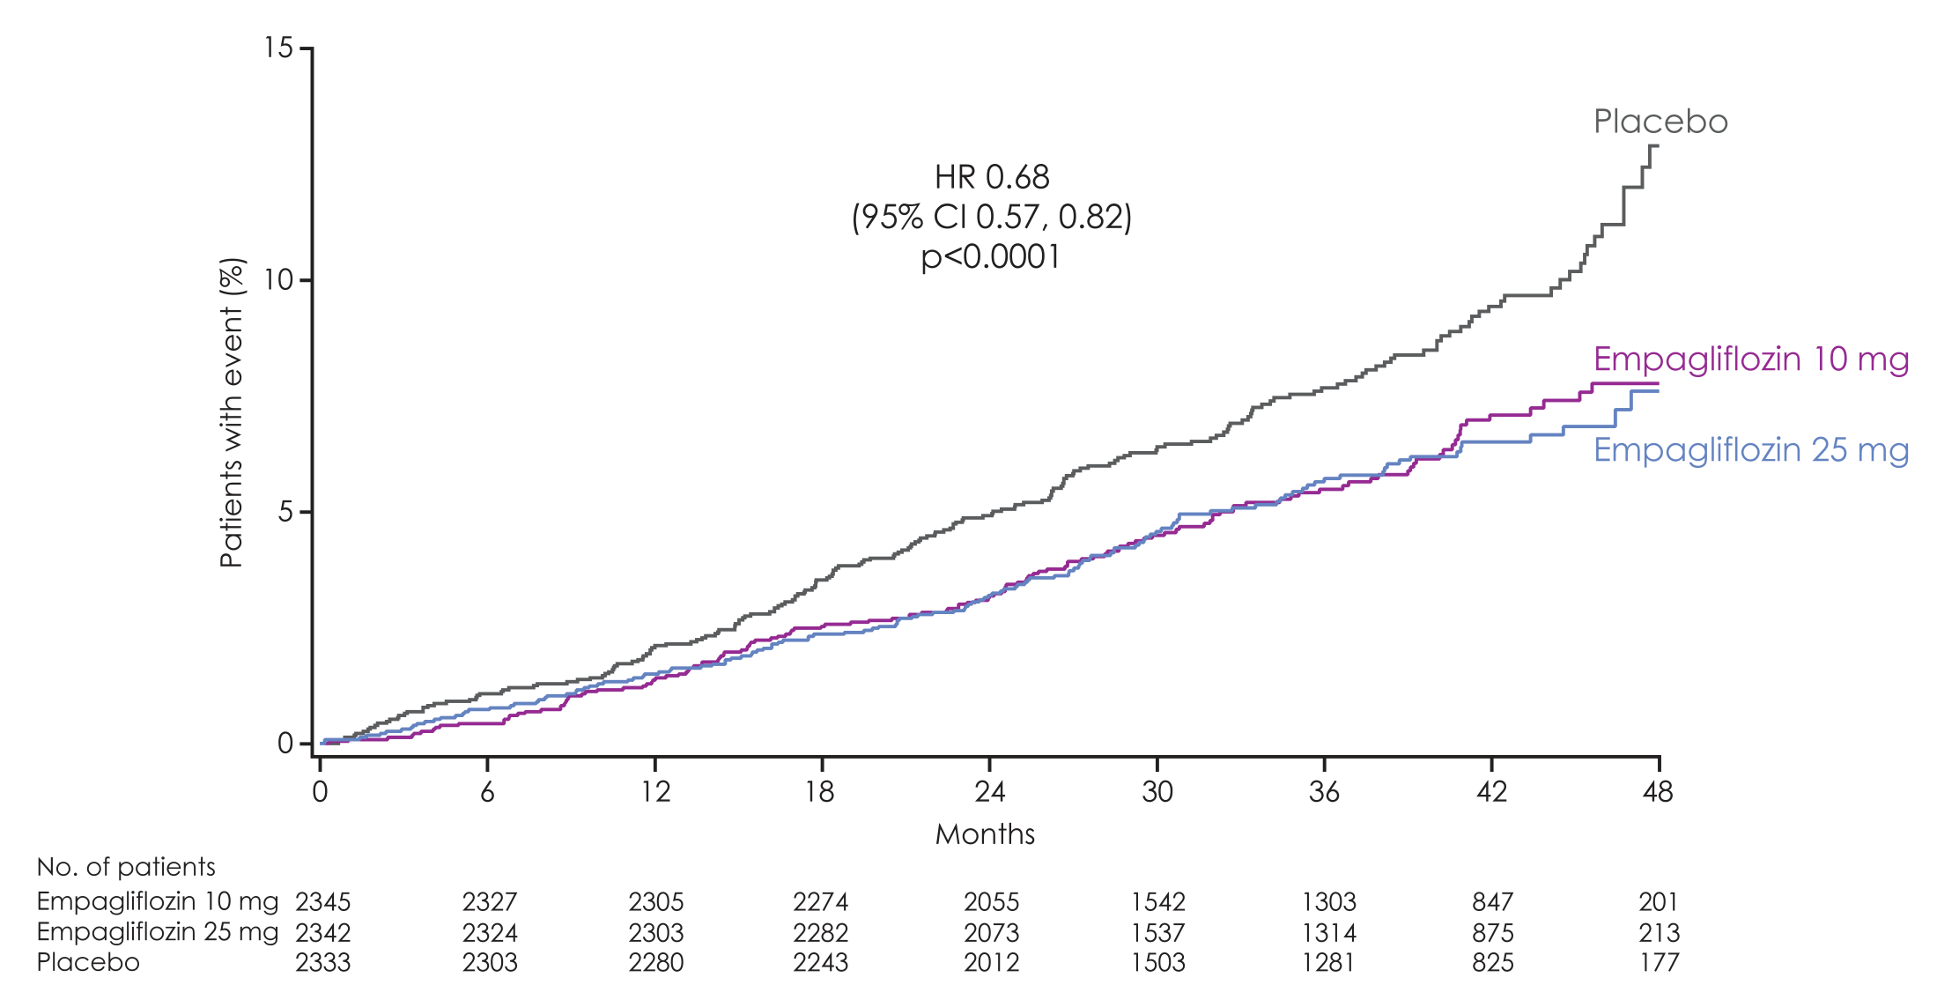
All-cause mortality
Empagliflozin 10 mg
HR 0.70
(95% CI 0.56, 0.87)
p=0.0013
Empagliflozin 25 mg
HR 0.67
(95% CI 0.54, 0.83)
p=0.0003
HR 0.68
(95% CI 0.57, 0.82)
p<0.0001
Empagliflozin in Indonesia is not indicated to reduce CV events
Further information refer to local prescribing information
CI, confidence interval; HR, hazard ratio.
Zinman et al. N Engl J Med 2015:373:2117-2128.

Slide 44
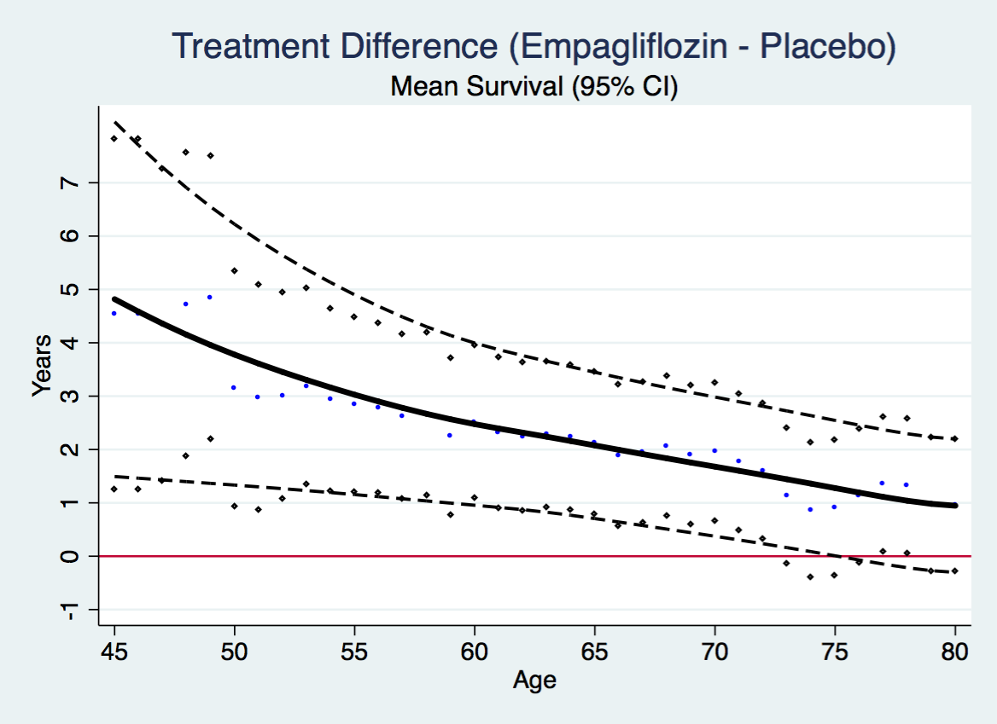
Impact of Empagliflozin on Life Expectancy
Empagliflozin in Indonesia is not indicated to reduce mortaliity
Further information refer to local prescribing information
Claggett et al Circulation 2018;138:1599

Slide 45
Consistent reduction of CV Mortality across wide range of subgroups
Age
Gender
Baseline CVD (CHD, MI, Stroke PVD, Prior CABG, AF)
CVD / HF risk (TRS 2º P and ABC Scores)
HF at baseline
Renal function
A1C at baseline and A1C change
Medications
Asian patients
Empagliflozin in Indonesia is not indicated to reduce CV Death
Further information refer to local prescribing information

Slide 46
Incident or worsening nephropathy and its components
 | Empagliflozin | Placebo
 | n with event/ N analyzed |  | Hazard ratio (95% CI) |  | p-value
Incident or worsening nephropathy | 525/4124 | 388/2061 | 0.61 (0.53, 0.70) |  | <0.0001
New onset macroalbuminuria | 459/4091 | 330/2033 | 0.62 (0.54, 0.72) |  | <0.0001
Doubling of serum-creatinine* | 70/4645 | 60/2323 | 0.56 (0.39, 0.79) |  | 0.0009
Initiation of renal replacement therapy | 13/4687 | 14/2333 | 0.45 (0.21, 0.97) |  | 0.0409
0.5
1
2
Favors empagliflozin
Favors placebo
Empagliflozin in Indonesia is not indicated as treatment for kidney disease
Further information refer to local prescribing information
*Accompanied by eGFR (MDRD) ≤45 mL/min/1.73m².
Cox regression analyses.

Slide 47
Adverse events
 | Placebo (n=2333) | Empagliflozin 10 mg (n=2345) | Empagliflozin 25 mg (n=2342)
 | n (%) | n (%) | n (%)
Confirmed hypoglycaemic adverse events | 650 (27.9%) | 656 (28.0% | 647 (27.6%)
Events requiring assistance | 36 (1.5%) | 33 (1.4%) | 30 (1.3%)
Diabetic ketoacidosis* | 1 (<0.1%) | 3 (0.1%) | 1 (<0.1%)
Acute kidney injury† | 155 (6.6%) | 121 (5.2%) | 125 (5.3%)
Lower limb amputation | 43 (1.8%) | 42 (1.8%) | 45 (2.0%)
Bone fractures† | 91 (3.9%) | 92 (3.9%) | 87 (3.7%)
Zinman et al N Engl J Med 2015 DOI: 10.1056/NEJMoa1504720
Notes:
Table 15.3.1.1: 1 (tir), n(%)

Slide 48
Adverse events consistent with genital infection
 | Placebo (n=2333) |  | Empagliflozin 10 mg (n=2345) |  | Empagliflozin 25 mg (n=2342)
 | n (%) | Rate | n (%) | Rate | n (%) | Rate
Events consistent with genital infection | 42 (1.8%) | 0.73 | 153 (6.5%) | 2.66 | 148 (6.3%) | 2.55
Events leading to discontinuation | 2 (0.1%) | 0.03 | 19 (0.8%) | 0.32 | 14 (0.6%) | 0.23
Rate = per100 patient-years
Genital infections: Mycotic (candida species)
Men Balanitis Women Vulvo-Vaginiitis
Zinman et al N Engl J Med 2015 DOI: 10.1056/NEJMoa1504720
Notes:
Overall: table 15.3.1.8: 1
Serious: table 15.3.1.8: 4
Leading to discontinuation: table 15.3.1.8: 5

Slide 49





Empagliflozin reduced micro- and macrovascular risk in patients with T2D and established CV disease, compared with placebo
3P-MACE
CV death
All-cause mortality
HHF
Incident or worsening nephropathy
Relative risk reduction:
↓14%
↓38%
↓32%
↓35%
↓39%
With no significant increase of serious adverse side effects
Increase in genital candidiasis
Rarely leads to treatment discontinuation

Slide 50
Number needed to treat (NNT) to prevent one death across landmark trials in patients with high CV risk
  Simvastatin¹
  for 5.4 years
  Ramipril²
  for 5 years
  Empagliflozin³
  for 3 years
  Liraglutide⁴
  for 3 years
30
56
39
98
High CV risk
5% diabetes, 26% hypertension
High CV risk
38% diabetes, 46% hypertension
T2DM with high CV risk
92% hypertension
T2DM with high CV risk
93% hypertension
<29% statin
>80% ACEi/ARB
>75% statin
>80% ACEi/ARB
>70% statin
Pre-statin era
1994
2000
2015
2016
Notes:
All cause death
Simva: 182 / 2221 (8,2%), placebo: 256 / 2223 (11,5%) HR= 0,71[0,59, 0,85]
Pooled empa : 269 / 2333 (5.7%), placebo : 194 / 4687 (8.3%) HR= 0.68 [0.57, 0.82]
Liraglutide: 381 / 4668 (8.2%), placebo 447 / 4672 (9.6%) HR= 0.85 [0.74, 0.97]
Ramipril: 482 / 4645 (10,4%), placebo : 569 / 4652 (12,2%) HR=0,85[0,76, 0,95]

Slide 51
EMPA REG, CANVAS, DECLARE
Comparisons
 | Patients enrolled | FU Yrs | MACE ARR p RRR | Mortality ARR p RRR | CV mortality /HF ARR p RRR | HF Hosp ARR p RRR
EMPA REG Empagliflozin | CVD | 3 | 1.6% 0.04 14% | 2.6% <0.001 32% NNT 3yrs 40 | 1.04% 34% | 1.4% <0.002 35%
CANVAS Canagliflozin | CVD + 30% High risk | 3.2 | 1.5% 0.02 14% | 0.7% ns 13% | 4.5% 22% | 1.0% <0.05 33%
DECLARE Dapagliflozin | CVD + 60% High risk | 4.3 | 0.6% ns | 0.4% ns | 1.0% 0.005 17% | 0.92% 27%
ARR Absolute risk reduction, RRR Relative risk reduction HFH Heart failure hospitalisation

Slide 52
EMPA-REG OUTCOME® CANVAS and DECLARE
Adverse Outcomes
 | EMPA REG Outcome | CANVAS | DECLARE
Hypoglycemia | No increase | No increase | No increase
Genital Infection (Rx discontinuation) | 3-4x (0.6%) | 3-4 x (NA) | NA (0.8%)
Volume depletion | No increase | Increased 0.7% | No increase
Acute kidney injury | No increase | No increase | Decreased 1 /1000/yr
DKA | No increase | No Increase | Increased 0.5 / 1000 /yr
Amputations | No increase | Increased 2x 9 / 1000pts / 3yrs | No increase
Fractures | No increase | Increased 25% 11 /1000pts / 3yrs | No increase

Slide 53
Practical Considerations for the Use of SGLT2 Inhibitors
Renal function – threshold for treatment
    Empagliflozin eGFR > 45 Canagliflozin eGFR > 45 Dapagliflozin eGFR > 60
Risk of hypotension
  Reduce diuretics / hypotensive agents with SBP <100
Risk of hypoglycemia is low but
  Consider reducing SU and or insulin dose especially if high risk
    Elderly, history of hypoglycemia, Severe obesity, Irregular eating habits
DKA
  Check for plasma ketones in any patient unwell / nauseated irrespective of plasma glucose
Intercurrent illness / Major trauma or surgery
  “Sick day” Temporary discontinuation to prevent acute kidney injury or DKA
Mycotic Genital Infections
  Encourage genital hygiene, changing pads / tampons frequently, avoid tight synthetic underwear
Amputation risk
  Only observed with canagliflozin
  Avoid SGLT2i in patients with prior amputation or ischemic feet

Slide 54
Should Metformin remain “First Line” Treatment?
For
Cheap
Generally well tolerated
Effective glucose lowering
No hypoglycemia
Weight neutral
One RCT with 340 patients showed CV benefit
Against
Meta-analyses show no CV outcome / mortality benefit
Comparative effectiveness of Metformin and SUs uncertain due to inconsistent evidence and risk of methodological bias
Griffin et al Diabetologia 2017;60:1620
Palmer and Strippoli Lancet 2018;392:120
Now we have agents with proven CV benefit,
the primacy of metformin needs re-evaluation
Notes:
ound that the comparative effectiveness of these two medications was very uncertain because of inconsistencies in existing evidence and risks of methodological bias in the source trials

Slide 55
Potential Mechanisms of Action of SGLT2 Inhibition for Reduction of CV Death and Heart Failure
Haemodynamic
  Improvement in ventricular loading
    BP Decreased central aortic pressure, and arterial stiffness
    Plasma volume (pre-load) but no RAAS activation
Metabolic
  Improve Cardiac Metabolism and Bioenergetics
    Less reliance on NEFA
    Ketones are more efficient fuel
  Na-H exchanger inhibition
    Results in higher mitochondial Ca
  Alteration of adipokines (leptin) and cytolines (IL6)
Cardio Renal interactions

Slide 57
SGLT2 Inhibitors
Canagliflozin , Dapagliflozin, and Empagliflozin
Advantages
Insulin-independent glucose reduction (A1C ↓0.8% to 1.2%)
Low risk of hypoglycemia
Weight loss (to 4% BW)
Blood pressure-lowering
Once daily
Effects of fatty liver
Effects on insulin resistance
Effect independent of insulin resistance or secretion
CVD and Renal Effects (Empagliflozin)
Disadvantages
Osmotic diuresis
Bacterial urinary tract infections (≈5%)
Fungal infections (≈10%)
Increased LDL cholesterol
Hyperkalemia
Bladder cancer (dapagliflozin ?)
Euglycemic DKA
Amputations (Canagliflozin)

Slide 58
Potential Mechanisms By Which SGLT2i’s Reduce CVD Events
Lowered Blood Glucose (and insulin)
Increase Plasma Ketones
Reduced Plasma Uric Acid
Weight Loss
Decreased BP
Decrease Blood (Plasma) Volume
Increased Hematocrit
Impaired Arterial Elasticity
Direct Effect on Myocardium
Decreased Insulin Resistance

Slide 59
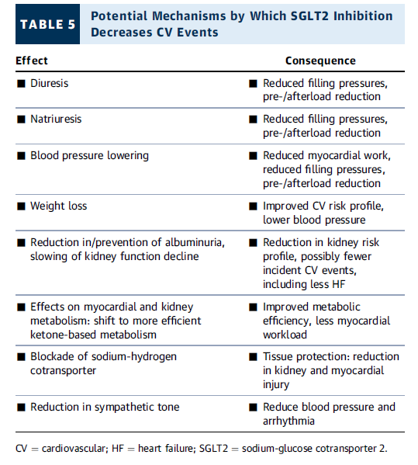

Slide 60
Effect of Glucose-Lowering Drugs on
Hypoglycemia and Weight
Therapeutic Options
Hypoglycemia
Weight
Sulfonylurea
Yes
TZD
Subq fat, edema
Visceral fat
No
Insulin
Yes
Metformin
No
or
DPP-4 inhibitor
No
GLP-1 receptor agonist
No
SGLT-2 Inhibitors
No
A1C = glycated hemoglobin; DPP-4 = dipeptidyl peptidase-4; GLP-1 = glucagon-like peptide-1; SGLT-2 = sodium glucose co-transporter-2; TZD = thiazolidinedione

Slide 61
Risk of CVD outcomes, CVD-related and all-cause mortality, side effects, and cost associated with use of listed agents
Agent | MACE* | CVD mortality | All-cause mortality | HF admissions† | Hypoglycemia risk‡ | Weight change | Cost
Pioglitazone | ê | çè | çè | é | Low | é | Low
Empagliflozin | ê | ê | ê | ê | Low | ê | High
Liraglutide | ê | ê | ê | çè | Low | ê | High
Semaglutide | ê | çè | çè | çè | Low | ê | High
Ismail-Beigi F et al, J Gen Internal Med, 32:1044-1051 (2017)

Slide 62
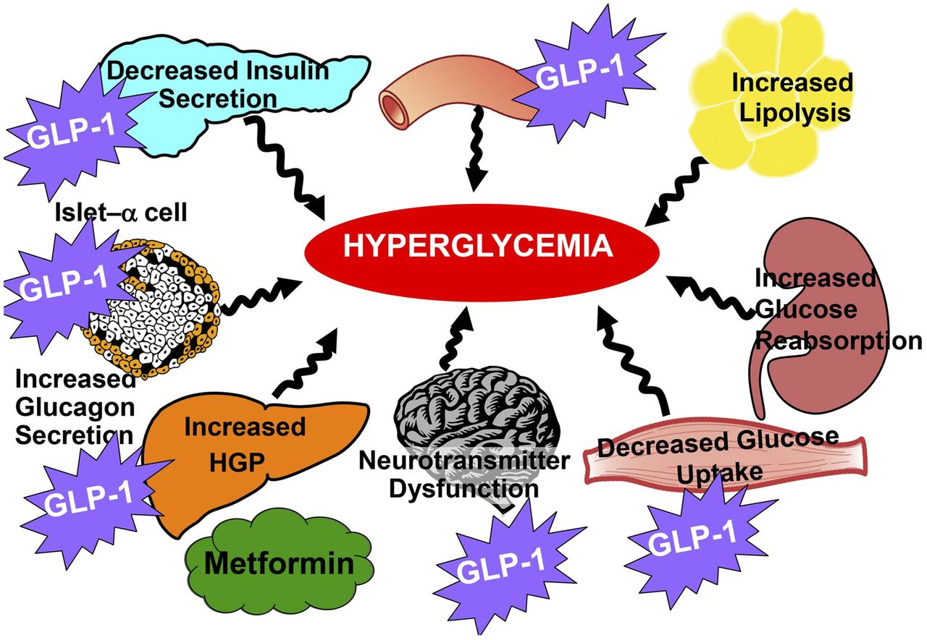
Use of GLP-1 RA, SGLT2i, and TZD in T2DM
TZD
SGLT2i
SGLT2i
TZD
SGLT2i
SGLT2i
TZD
SGLT2i
TZD
SGLT2i
Modified from et al. DeFronzo R. Diabetes Care. 36:S127-S138. 2013

Slide 63
Lupsa B, Inzucchi S. Diabetologia 61:2118-2125, 2018

Slide 67
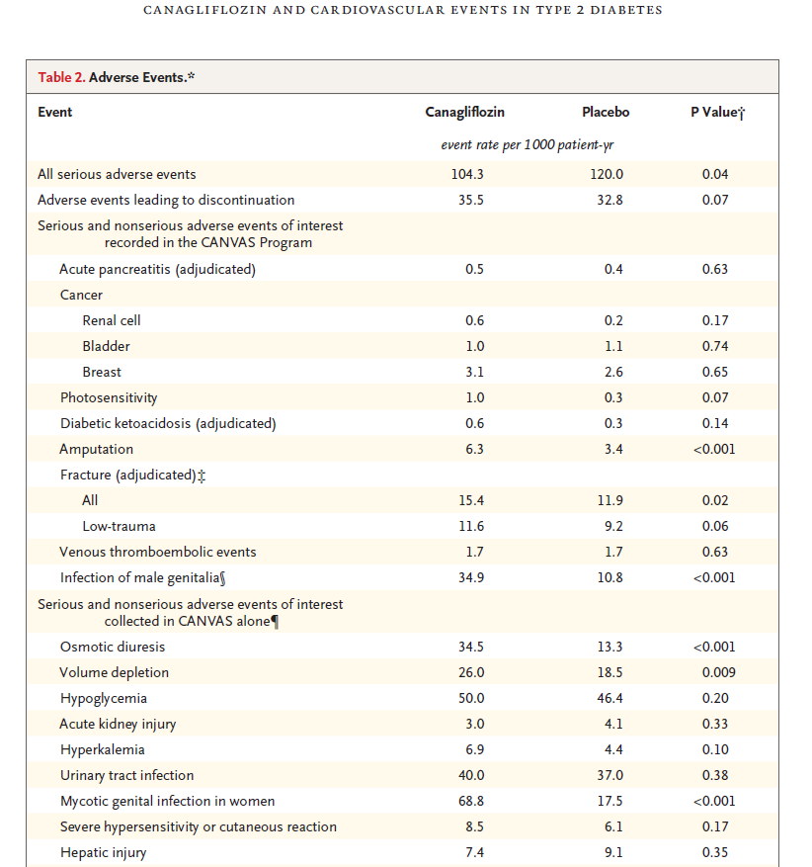

Slide 69
THANK YOU

