Slide 2
Osteoporosis results from reduced bone mass and
disruption of the micro-architecture of bone, giving
decreased bone strength and increased risk of
fracture, particularly of the spine, hip, wrist,
humerus, and pelvis.

Slide 3
Bone densitometry
Non-invasive test for measurement of BMD
Major technologies:
Dual-energy X-ray Absorptiometry (DEXA)
Quantitative Ultrasound (QUS)
Quantitative Computerized Tomography (QCT)

Slide 4
Bone densitometry with DEXA
“Gold-standard” for BMD measurement
- Measures “central” or “axial” skeletal sites:
spine and hip
- May measure other sites: total body and forearm
- Extensive epidemiologic data
- Correlation with bone strength in-vitro
- Validated in many clinical trials
- Widely available

Slide 5
Dual-energy x-ray absorptiometry (DEXA)
leverages the differential attenuation of photons
of disparate energies to determine an areal bone
mineral density (BMD).

Slide 6
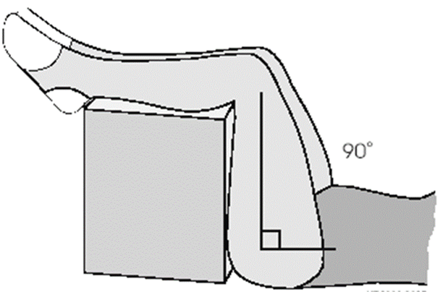
AP lumbar spine
- Knee positioner
- Helps to keep the back flat
reduces lordotic curve of spine
- 3 different patient heights:
small, medium, large

Slide 7
- Place foot (feet) into
positioning device
- Internally rotate leg
to specified angle
- Place shaft of femur
parallel to scanner axis

Slide 8
Spine region of interest is L1
through L4 vertebrae.
Correct placement of the top
and bottom of the spine is
critical.
Five lumbar vertebrae and the
last set of ribs on T12 in 85% of
people.

Slide 9
The hip region of interest include the femoral neck, trochanter and total hip.
GE Lunar:
The box is located by the analysis program at the narrowest and lowest density section of the neck.
Hologic:
The corner of the box should touch
the notch where the trochanter
and femoral neck come together.

Slide 10
Forearm Scan
- Forearm appears straight &
centered in image window
- Image includes first row of carpal
bones
- Ulna side contains enough air
(= to shaft width of ulna)

Slide 11
Although there are differing designs of DEXA
scanners, they all serve to produce attenuation
maps of the regions studied, typically comprising
the lumbar spine and hip and occasionally
including the forearm as well.

Slide 12
By applying semiautomated regions-of-interest
(ROIs) to the BMD map, an areal average density
for each ROI is obtained and compared with
population norms, yielding T and Z scores.

Slide 13
As a rule, the state of bone mineralization is
reﬂected by the T and Z scores, Whereas the rate
of change of mineralization is indicated by
variation in areal BMD measurements over time.

Slide 14
Artifacts are frequently observed in the
assessment of BMD using DEXA.
It has been reported that approximately one-third
of patients have ﬁndings on lumbar spine DEXA
imaging, which lead to the exclusion of at least
one vertebral level.

Slide 15
Owing to the high prevalence of artifacts, clinicians
should be aware of the gamut of artifactual ﬁndings
to properly interpret the studies.
For example, BMD derived from a region with
artifactually elevated or diminished BMD should
be discounted as a reliable measure of bone mass
for the purpose of predicting fracture risk.

Slide 16
In the spine, this may entail excluding individual
vertebral bodies from analysis, and more
extensive involvement will require abandoning
the lumbar spine altogether.

Slide 17
BMD derived from a hip region affected by artifact
should likewise be discounted; the contralateral
hip or forearm may be chosen as an alternate
measurement site.

Slide 18
In this article, we systematically review both
artifacts that can lead to incorrect interpretation
of DEXA studies and incidental ﬁndings that do
not affect BMD but may have relevance to the
patient’s medical condition, all illustrated with
examples from our own clinical experience.

Slide 19
For categorization, we have subdivided osseous conditions into focal and diffuse, the latter category affecting the spine and hip alike in a relatively symmetric manner.

Slide 20
Osseous Conditions With Focal Increase
In BMD
Measurements The so-called “degenerative
changes,” more accurately described as
osteoarthritic changes, are the most common
source of artifact encountered on DEXA
studies.

Slide 21
Frequently seen in older patients, these changes
manifest in the lumbar spine as end-plate
Osteophytosis, sclerosis, disk space narrowing,
and facet joint arthropathy.
On DEXA, boney proliferation and sclerotic change
results in an increase in the measured BMD in
excess of what would be measured in patients
without such changes.

Slide 22
Even mild osteophytosis can increase lumbar spine
BMD by 24%. Although localized disease is
relatively easy to detect, when multiple levels of
the lumbar spine exhibit degenerative change in a
relatively homogeneous manner, presence of
osteoarthritic change may be paradoxically difﬁcult
to appreciate.

Slide 23
In this case, elevated T and Z scores may suggest a
sclerosing process, especially when there is a disparity
between spine and hip or forearm, where DEXA ROIs are
less prone to artifact from osteoarthritis.

Slide 24
Figure 1: Degenerative changes are an extremely common ﬁnding in patients undergoing DEXA. The patient in (A)shows severe end-plate sclerosis of the L4/L5 disc space (arrow) with a signiﬁcantly increased BMD value at L4 compared with L1-L3. Individual lumbar body T score values have been listed on the image. Note the abrupt increase in T score at the L4 level. When L4 is omitted from the analysis, the resultant lumbar T score is -̶ 1.3 rather than the originally calculated value
of ̶ 1.0.

Slide 25
The contribution of osteoarthritic changes to net
BMD will result in the overestimation of effective
bone mass within the affected regions and will
therefore underestimate the fracture risk.

Slide 26
It has been suggested that lateral DEXA
measurements of the lumbar spine would
minimize the effect of degenerative changes.
However, current International Society for
Clinical Densitometry guidelines do not support
this variation in standard clinical practice.

Slide 27
Although osteoarthritic changes of the hip can also
lead to inﬂated BMD values, the femoral neck and
radial distal-third region are only minimally
affected by degenerative change, rendering
these areas relatively spared by this artifact.

Slide 28
Diffuse idiopathic skeletal hyperostosis (DISH) is a
spondyloarthropathy of the spine characterized by
ossiﬁcation of the anterior and posterior longitudinal
ligaments and paraspinal connective tissues.
These changes can lead to overestimation of lumbar
BMD by 24%-39% as compared with quantitative CT,
which assays only the unaffected “true” trabecular
bone.

Slide 29
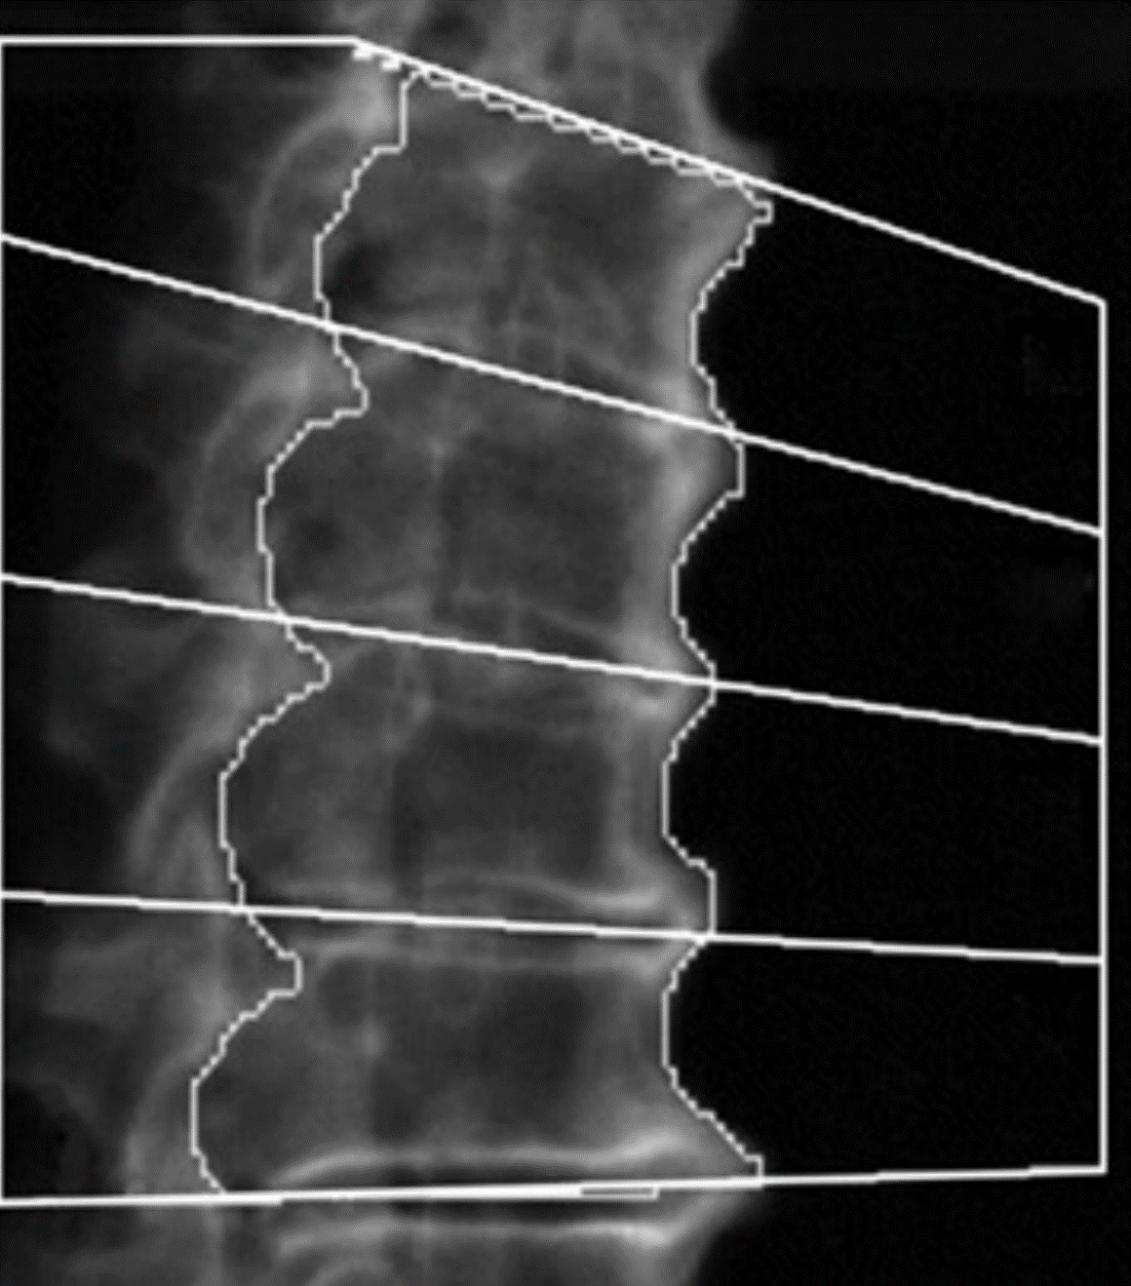

Slide 30
In spite of an increase in the apparent BMD, it has
been suggested that fracture risk is actually increased
in patients with DISH.
DEXA-derived BMD values have also been reported
to be elevated in the hip and distal radius in this
condition.

Slide 31
Ankylosing spondylitis is a chronic inﬂammatory
disease with male predominance affecting the axial
skeleton, which usually develops in early adulthood.
The radiological manifestations include sclerotic
changes at the vertebral end plates, syndesmophytic
ankylosis, as well as calciﬁcation of the interspinous
ligaments.

Slide 32
These lead to the classic radiological descriptions
of the “shiny corner sign,” “bamboo spine,” and
“dagger spine” respectively, all of which
can elevate BMD results.

Slide 33
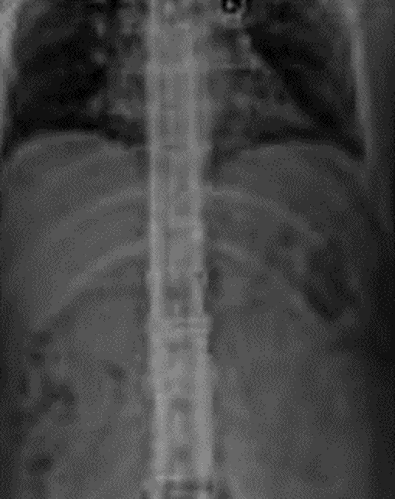
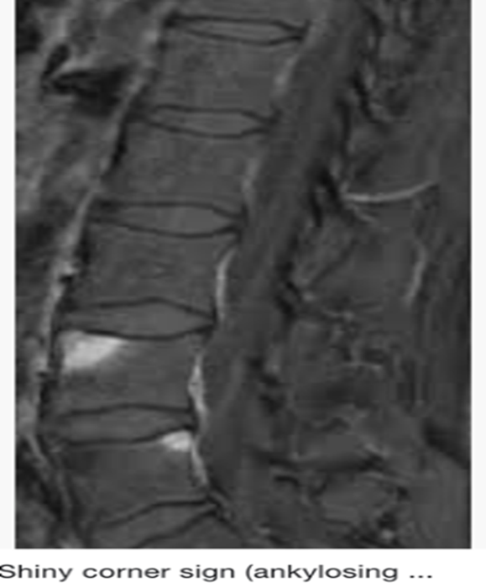
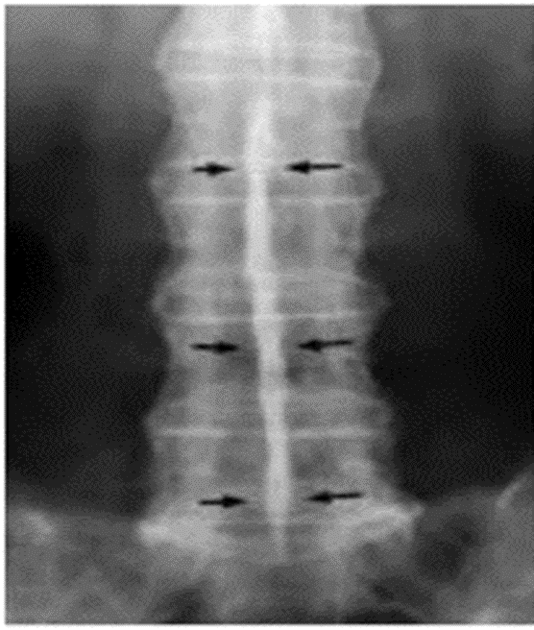
Bumbo Spine as a result of shiny corner sign due to reactive A single central radiodense
vertebral body fusion by sclerosis secondary to inflammatory line due to ossification of
marginal syndesmophytes. Erosions at the superior and inferior supraspinous and
endplates interspinous ligaments

Slide 34
(C) In a patient with
ankylosing spondylitis, the
classic ﬁnding of “dagger
spine,” caused by calciﬁcation
of the interspinous ligament,
is apparent (arrows).
Elevated T scores are noted
throughout the spine.

Slide 35
BMD measured in the distal appendicular skeleton
appears unaffected by artifact; it has been suggested
that in this patient population, BMD measurement
can most reliably be obtained from the femur.

Slide 36
Fractures do not change the amount of calciﬁcation
present within vertebrae; however, loss of height
leads to a relative concentration of bone resulting
in an absolute increase in the areal bone density.
Vertebral fractures are easily recognized on DEXA
images owing to the loss of vertebral body height
coupled with a sclerotic appearance.

Slide 37
Figure 2 (A) An 88-year-old
woman with fracture of the
L2 vertebral body (arrow)
demonstrates diffusely
decreased BMD with
exception of the level of
the compression fracture.

Slide 38
(B) Correlative radiograph
illustrates severe disk
disease with narrowing of
the disk space, osteophyte
formation, and adjacent
sclerosis, all at the L4-L5
level (arrow).

Slide 39
In a similar manner, condensation
of the bone in avascular necrosis
results in deformity and increased
density.
(B) A patient with avascular
necrosis of the left femoral
head (arrow).
The femoral head appears
dense and is associated
with ﬂattening and
deformity.

Slide 40
Treatment of vertebral fractures by vertebroplasty
will also increase the measured BMD, owing to
density of the polymethylmethacrylate cement
preparation, which has purposefully been rendered
radiopaque.

Slide 41
(C) DEXA image in a
patient status post
vertebroplasty of L2 and
L3 with introduction of
radiopaque cement
preparation (arrows).

Slide 42
A study using single photon absorptiometry
demonstrated that following wrist fracture, BMD
of the forearm is initially decreased but ultimately
becomes persistently increased by 10 years after
fracture.

Slide 43
Sclerotic osseous metastases, not uncommon in the
age group being studied by DEXA, can cause
increased BMD; prostate cancer in men and breast
cancer in women represent the most frequent
etiologies in this age group.

Slide 44
It is important to maintain a high suspicion for
Boney metastases, as DEXA may be ﬁrst
examination to detect abnormality.

Slide 45
Figure 3 Sclerotic metastases on
DEXA (arrows). A 65-year-old
woman, with known breast cancer
for evaluation of BMD
before therapy.
DEXA images of the spine (A)

Slide 46
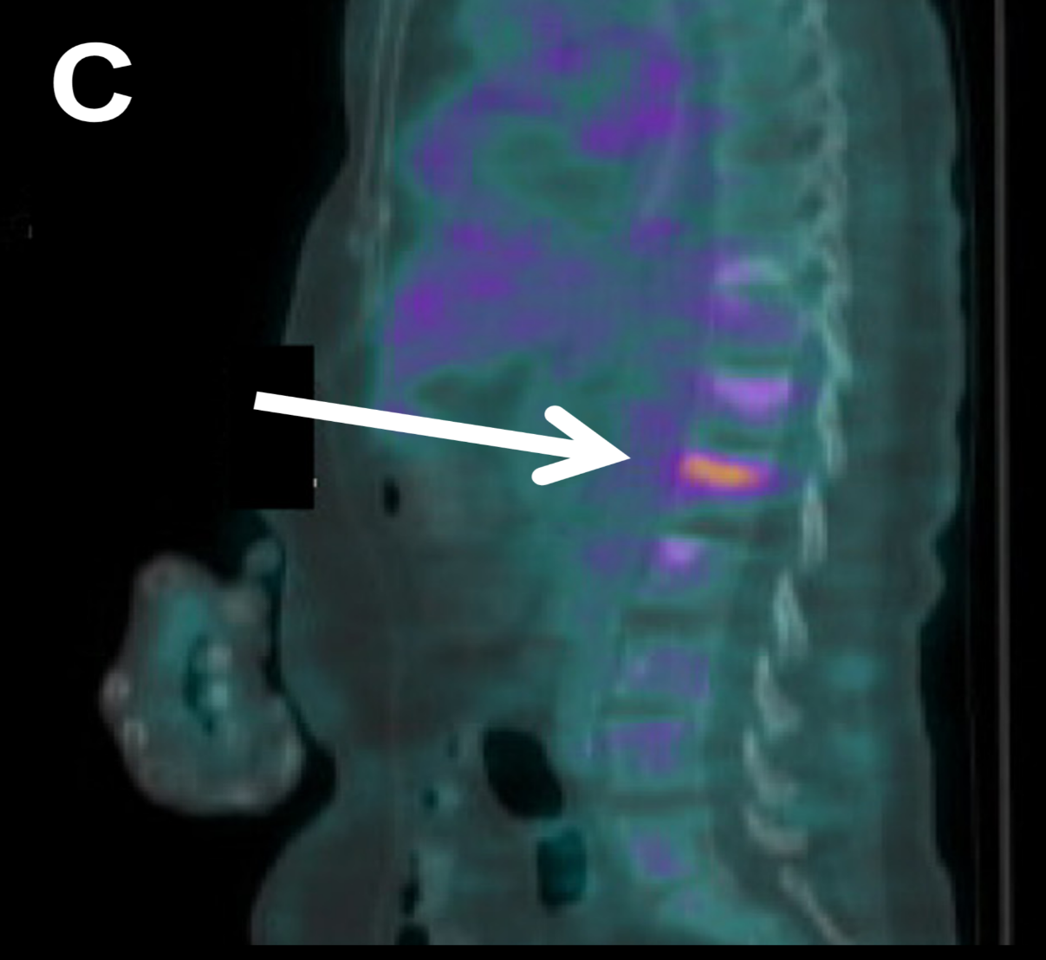
And hip (B) demonstrate sclerotic boney metastases, corroborated on representative sagittal FDG-PET/CT image (C).

Slide 47
A 67-year-old man
with prostate
cancer Metastases
to the spine are
noted on DEXA

Slide 48
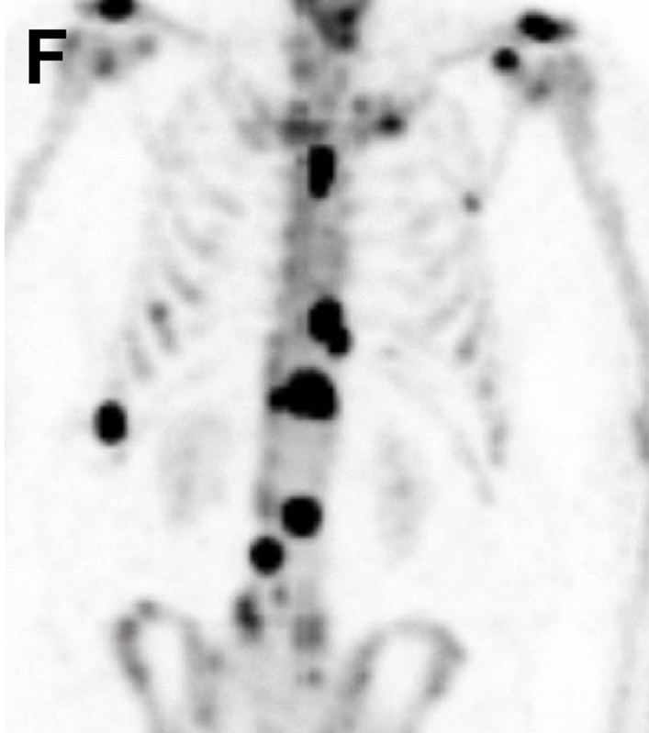
CT (E) Radionuclide Bone Scan (F)

Slide 49
Benign bone neoplasms such as osteoblastoma and
enostosis can also lead to focally increased bone
density.
Correlation with conventional imaging is required
to further characterize osseous lesions as DEXA
images are not optimized for this purpose.

Slide 50
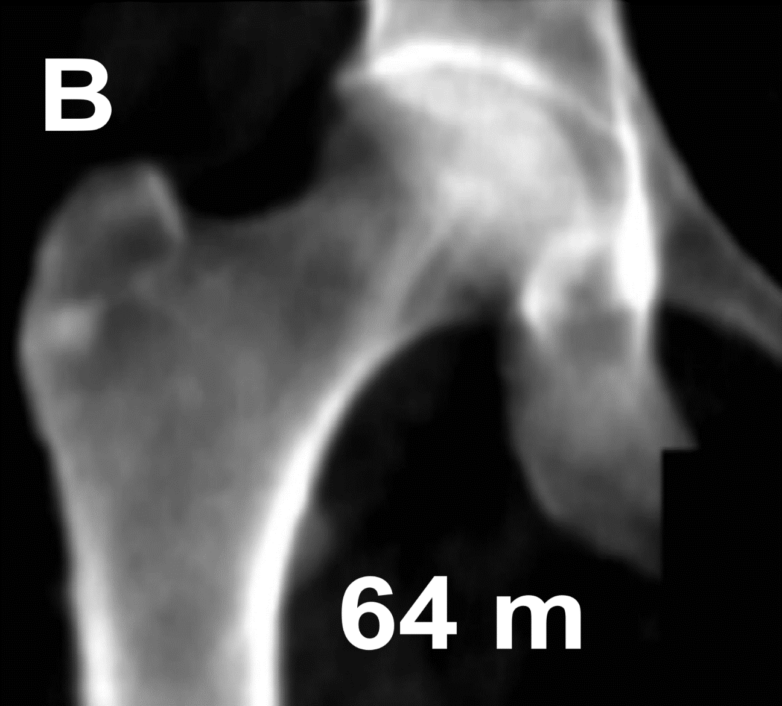
Figure 4 Benign bone lesions. (A-D) A 71-year-old woman with slowly growing enostosis at the base of the greater trochanter within the “total hip” ROI (arrow), slowly growing over the span of 9 years. Interval (in months) between image A and subsequent studies is indicated.

Slide 51
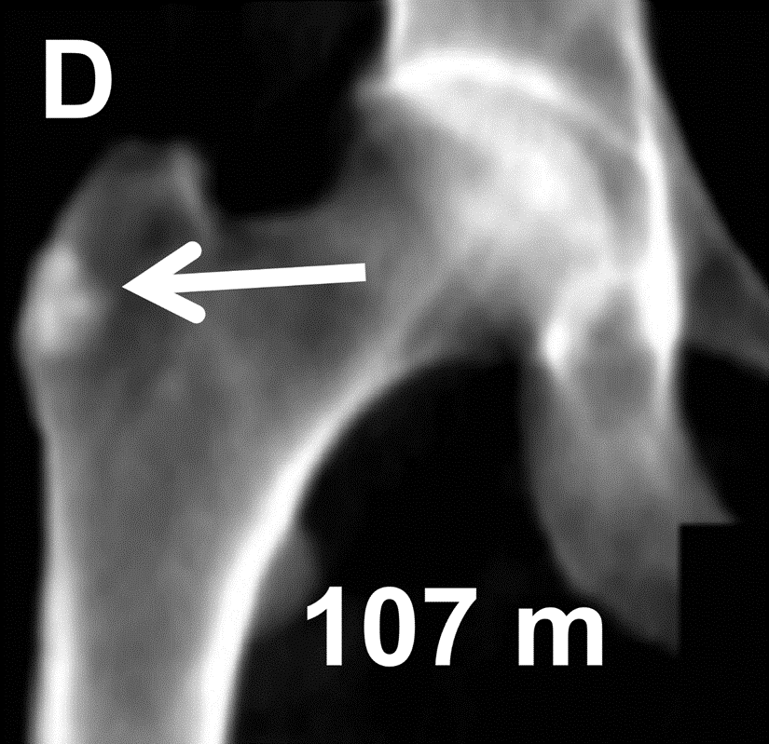

Slide 52
(E) Enostosis
located in the L3
pedicle (arrow).
This vertebral
body level should
be excluded from
the lumbar ROI.

Slide 53
(F) Enchondroma
incidentally
detected in the
proximal femoral
shaft, below the
right hip ROI
(arrow).

Slide 54
Paget disease frequently involves sites imaged on
DEXA including the spine, pelvis, and proximal
femurs and accounts for approximately 1.4% of
incidentally found elevated BMD values.

Slide 55
Radiological ﬁndings include thickening of the
cortical bone “picture frame sign.” and
coarsening of the trabeculae, which on DEXA,
will demonstrate diffuse sclerosis.
Despite associated increase in BMD, fracture
risk actually appears to be increased.

Slide 56
Figure 5 A 50-year-old woman with a sclerotic L2 vertebral body, typical of Paget disease
(arrow). Prior study from 5 years earlier (B) does not evidence these ﬁndings.

Slide 57
Recent 99mTc-MDP bone scan (C) and lateral view of the lumbar spine (D) conﬁrm presence
of a pagetoid vertebral body (arrows).

Slide 58
Osseous Conditions With Generalized
Increase in BMD Measurements
Though rare, elevated BMD may be present diffusely
throughout all bones. It has suggested that BMD Z
scores above +2.5 should be “ﬂagged” as abnormally
elevated.

Slide 59
Gregson et al. have published a thorough review of
causes of diffusely increased BMD, subdivided into
acquired and inherited conditions.
Because ﬁndings are not speciﬁc, clinical evaluation
and correlative imaging must be consulted to arrive
at a diagnosis.

Slide 60
The term renal osteodystrophy includes several
disparate disorders of bone metabolism;
however, all are characterized by some combination
of abnormal mineralization, hormonal dysregulation,
variations in microarchitecture, and extraskeletal
calciﬁcation.

Slide 61
The main subtypes of renal osteodystrophy include
osteitis ﬁbrosa cystica, adynamic bone disease,
osteomalacia, and mixed uremic osteodystrophy.
Although many of these conditions are associated with
decreased BMD, elevated values have been reported
in patients with osteitis ﬁbrosa cystica.

Slide 62
A classic rugger-jersey spine appearance is
caused by sclerotic bands at the superior and
inferior vertebral end plates
(sclerotic-lucent-sclerotic appearance)

Slide 63
Differential diagnosis
Hyperparathyroidism
Osteopetrosis
Renal Osteodystrophy

Slide 64
Skeletal ﬂuorosis can result in diffusely elevated
BMD, owing to dietary, environmental, and
industrial exposure.
Approximately 50% of ingested ﬂuoride
localizes to the bones within 24 hours whereas
the remainder undergoes renal clearance.

Slide 65
Retained ﬂuoride associates with hydroxyapatite and
is incorporated within the boney matrix, serving to
increase osteoblastic activity. Radiological features
of ﬂuorosis are variable but include calciﬁcation of
the ligaments, tendons, muscles, and interosseous
membranes, as well as osteosclerosis.

Slide 66
Although osteopenia and osteoporosis have also been reported in patients with ﬂuorosis, more commonly, patients exhibit elevated lumbar BMD values.

Slide 67
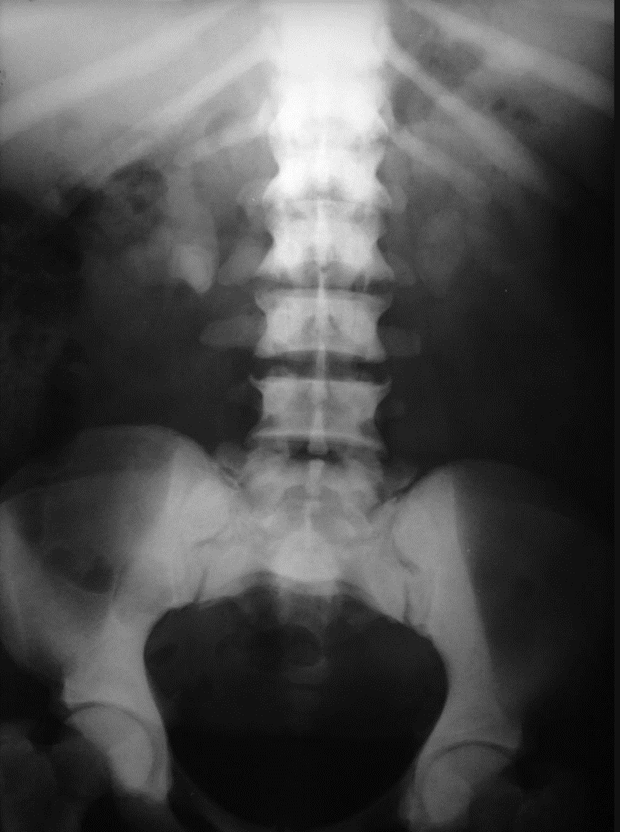
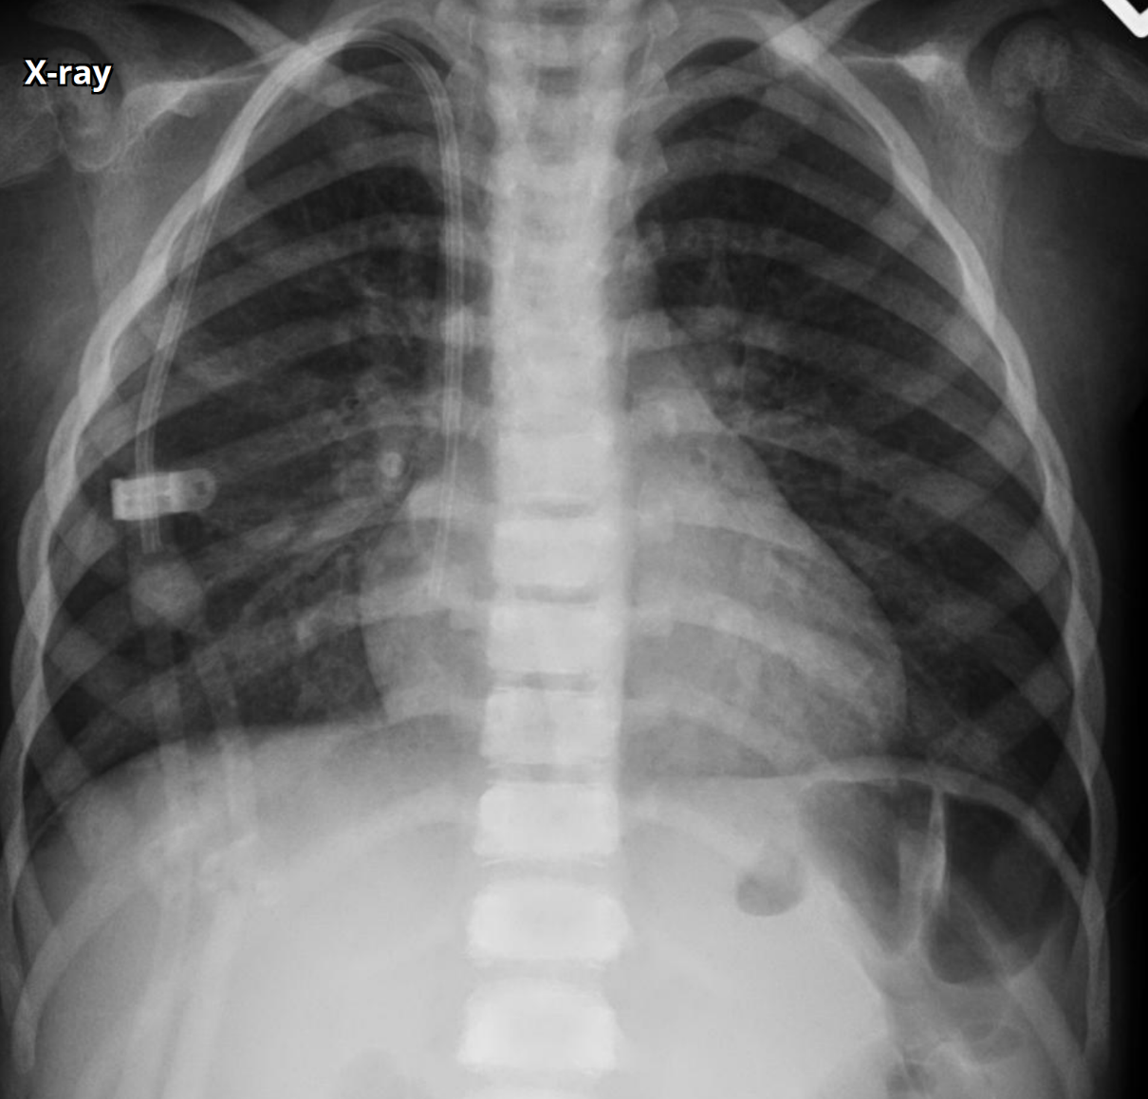
Skeletal fluorosis Renal osteodystrophy

Slide 68
Other rare causes of diffusely increased BMD include
hereditable conditions such as Camurati-Engelmann
disease (progressive diaphyseal dysplasia)

Slide 70
Figure 7 A female patient in her third decade demonstrates markedly increased BMD in
the spine (A) and hip (B), with Z scores in the 7-8 range.
Albers- Schonberg disease (osteopetrosis, autosomal dominant type 2)

Slide 71
Review of the patient's imaging (C and D) and medical history resulted in a diagnosis of
Albers- Schonberg disease (osteopetrosis, autosomal dominant type 2).

Slide 72
Acromegaly can result
in diffusely increased
BMD

Slide 73
Myeloproliferative disorders such as
myeloﬁbrosis as well as infectious causes,
such as hepatitis C –associated osteosclerosis,
can also diffusely elevate BMD whereas
mastocytosis results in either
diffuse osteopenia or sclerosis.

Slide 74
In many of these conditions, the patient’s
systemic disorders are apparent and already
known at the time of bone density examination.

Slide 75
Nonosseous Causes of Elevated
BMD Measurements
Cholelithiasis, nephrolithiasis, and calciﬁed
leiomyoﬁbroma are frequently seen on DEXA.
Porcelain gallbladders are occasionally noted, as are
mesenteric calciﬁcations, phleboliths, and calcinosis
cutis.

Slide 76
Figure 8 Illustration of six examples of calciﬁcation on DEXA imaging (arrows).
(A) Porcelain gall bladder, (B) gallstones

Slide 77
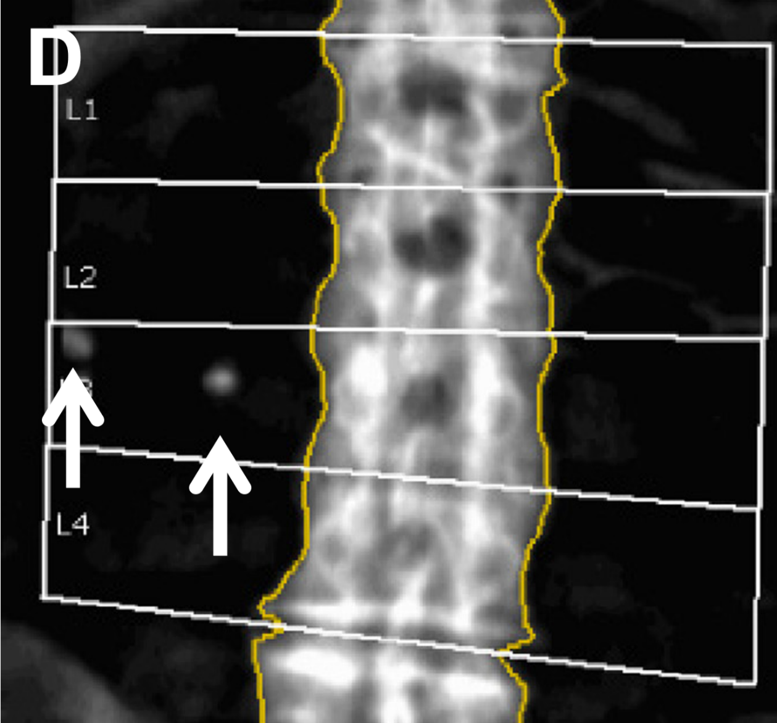
(C) Huge leiomyoﬁbroma with extensive calciﬁcations overlapping lumbar spine,
(D) Calciﬁed retroperitoneal lymph nodes

Slide 78
(E) Left renal stones, and (F) Buttock granulomata overlying hip ROIs.

Slide 79
These extraskeletal calciﬁcations represent a common
manifestation of several pathophysiological processes.
When overlapping boney ROIs, these densities can directly
elevate the apparent BMD.
The effect of aortic calciﬁcations on lumbar spine BMD is
much discussed in the literature.

Slide 80
Though not universal, most authors report that
vascular calciﬁcations have no signiﬁcant effect on
BMD, which is fortunate given the prevalence of
atherosclerotic disease in the typical population
studied.

Slide 81
In addition to calciﬁed structures, metallic objects,
located both within and outside of the patient, can
be visualized on DEXA images including bra wires,
body jewelry, spinal fusion hardware, and various
other medical devices that have the potential to
artifactually elevate BMD.

Slide 82
Figure 9 Illustration of six examples of metallic hardware. (A) Ventriculo-peritoneal shunt connector (right upper corner), (B) ventricular pacemaker wire (right upper corner),

Slide 83
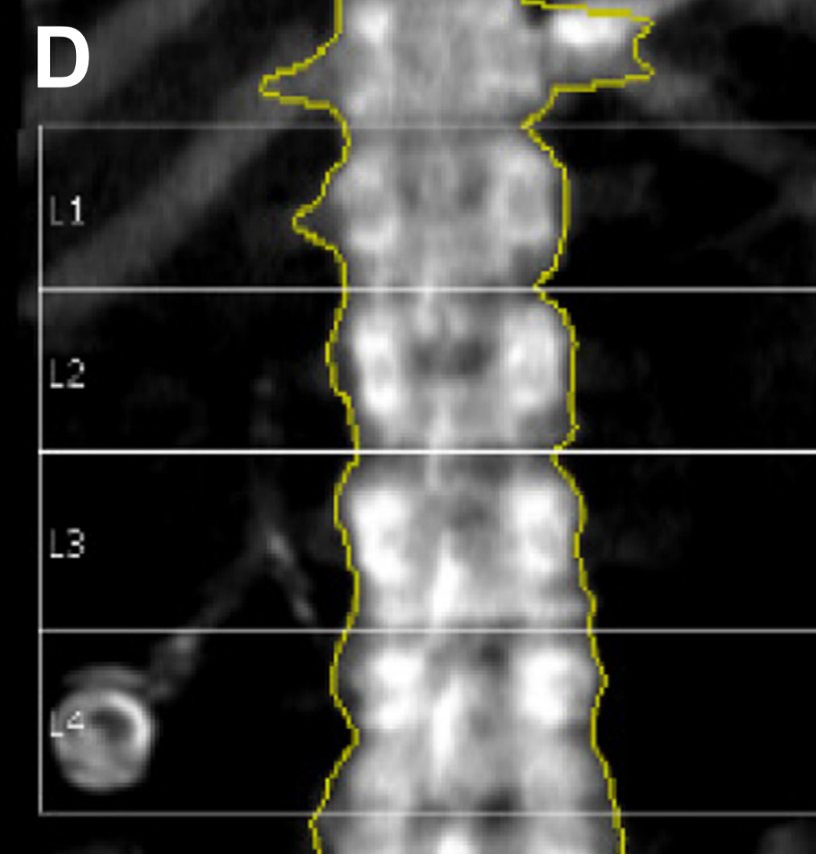
(C) L4-L5 fusion hardware, (D) lap-band port (left lower corner)

Slide 84
(E) Sacral nerve stimulator (left lower corner), and (F) Body piercing jewelry (see insert).

Slide 85
Radiopaque medications, such as undigested
calcium pills within the bowel, may overlie the
lumbar spine.
Patients should also be screened for recent
radiological procedures to avoid scanning
individuals with retained bowel contrast, which
has the potential to increase apparent BMD.

Slide 86
It has been reported that the presence of dense
metal overlying the lumbar spine can actually
result in a “black hole artifact,” which, dependent
on the software used, may decrease the measured
BMD value for the affected vertebral level.

Slide 87
Certain types of metallic objects
apparently have high attenuation
(a white image) on dual-energy
X-ray absorptiometry (DXA) scan
images, but instead show up as
black (black hole artifacts).
When small, these artifacts may
easily be missed on visual
inspection.

Slide 88
Factors Leading to Decreased BMD
Measurements
Systemic causes of diffusely decreased BMD are
the usual subject of DEXA analysis and include
postmenopausal changes, endocrine disorders,
gastrointestinal disorders, marrow-related disease,
rare genetic causes…

Slide 89
Chemotherapy and medication, and a variety
of other miscellaneous conditions often
indistinguishable from each other on DEXA.

Slide 90
Lytic bone lesions affecting single or multiple
vertebral levels can reduce measured BMD values.
These lesions are typically seen in multiple
myeloma and other lytic malignancies including
breast cancer, renal cell carcinoma, melanoma,
thyroid cancer, and hepatocellular carcinoma.

Slide 91
Although the imaging ﬁndings on DEXA may
be subtle, careful attention may reveal
heterogeneity or focal lucency, suspicious
for metastatic disease.
Correlation with radiographs is warranted.

Slide 92
In addition to lytic bone metastases, Gaucher
disease, spinal hemangiomas, aneurysmal
bone cysts, and ﬁbrous dysplasia are all
potential causes of focally decreased BMD.

Slide 93
A ﬁnding of focally decreased BMD should be
reconciled with the patient’s medical history, and
correlative imaging as a new diagnosis of osseous
metastases or other signiﬁcant disorder is
occasionally made on DEXA.
As in the case of artifactually elevated BMD, regions
affected by these processes should be omitted from
analysis.

Slide 94
Laminectomy is a common surgical treatment of
spinal stenosis. This procedure consists of surgical
resection of the laminae and occasionally spinous
process of the affected vertebral bodies.
Treated patients will demonstrate decreased BMD
owing to the lack of posterior elements.

Slide 95
Prior laminectomy is readily identiﬁed on DEXA
images, and a history of spinal surgery should be
evident on patient questionnaires.
Patients with spina biﬁda similarly will have
decreased BMD values, owing to the congenital
absence of posterior vertebral elements.

Slide 96
Figure 10 Illustration of four conditions with defects of the posterior elements of the spine.
(A) L4 laminectomy, (B) L3-L5 laminectomy and incidentally noted right renal calculus (arrow),

Slide 97
(C) spina biﬁda involving L3-L5, and (D) spina biﬁda with extensive involvement of the
entire spine. BMDs of the affected levels are markedly reduced and should not be
used to assess fracture risk.

Slide 98
Technical Factors Leading to Erroneous
BMD Measurements
Multiple reports have been published regarding
the effect of prior radionuclide administration
on apparent BMD values.

Slide 99
It appears that the radionuclide photons down-
scatter into the DEXA windows and decrease
apparent attenuation, thereby resulting in falsely
lowered BMD.
Not all investigators have noted a signiﬁcant effect;
it appears that the magnitude of reduction is
related to system and technical factors.

Slide 100
Proper patient positioning, a topic in its own right,
is essential to obtain an accurate BMD
measurement.
Variation in positioning will lead to alteration
(often increase) in measured hip BMD and may
also affect radius measurements.

Slide 101
Patients with scoliosis can not lie with their
spines straight on the table, which can make
it difﬁcult to properly delineate vertebral levels.

Slide 102
Proper assignment of ROIs on DEXA images is also
essential to obtain accurate BMD values.
Variation in assigning the appropriate ROI can
lead to erroneous BMD values in the spine, hip,
and radius and bias serial measurements as well.

Slide 103
In the spine, the types of error that most
commonly occur include misidentiﬁcation of
vertebral end plates, miscategorization of
opaque artifacts as bone, oversizing of ROIs,
and mislabeling of vertebrae.

Slide 104
This latter error is likely related to the fact that
15% of the population has four or six lumbar
vertebrae, with the last pair of ribs on T11 or L1.

Slide 105
Another potential source of error is incorrectly
assigning the race, sex and age of a patient which
can undergoing DEXA, result in artifactually
increased or decreased Z scores.

Slide 106
Change in patient weight, as may be seen after
bariatric surgery, may cause variation in perceived
BMD. The Canadian Association of Radiologists
has recommended that a 10% or greater change
in weight over the period of monitoring should
be noted as possibly leading to artifactual
variation in BMD.

Slide 107
Conclusion
DEXA examinations are a frequently performed
study used for screening and monitoring of
bone health.
Not infrequently, artifacts and incidental
ﬁndings may be observed which warrant
recognition by the interpreting physician.

