Slide 1
Important Issues in Pregnancy:
    Iodine supplementation,
    2. Thyroid auto-antibody and pregnancy outcome ?
    Hypothyroidism in pregnancy ?
    Screening in pregnancy for thyroid dysfunction ?

Slide 2
Miscarriage = spontaneous abortion : fetal death before 20 weeks of gestation,
Stillbirth : Fetal death after 20 weeks of pregnancy.
Preterm birth = premature birth = preterm labor : The birth of a baby at fewer than 37 weeks' gestational age.
wikipedia

Slide 3
    Iodine supplementation in pregnancy

Slide 4
ASSESSMENT OF IODINE NUTRITION at the community level :
by measurements of :
Urinary iodine concentration (μg ⁄ L) ,
Thyroid size,
Neonatal serum TSH,
Serum thyroglobulin.
Urinary iodine concentration most often used to determine iodine nutrition at the population level.
uptodate

Slide 5
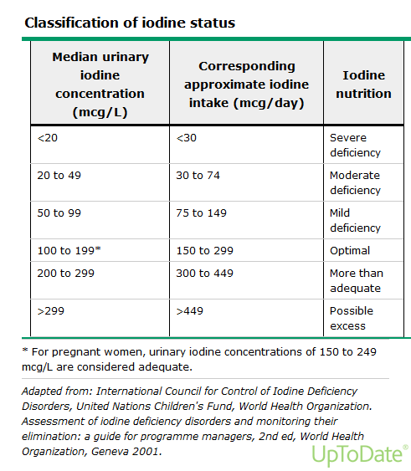

Slide 6
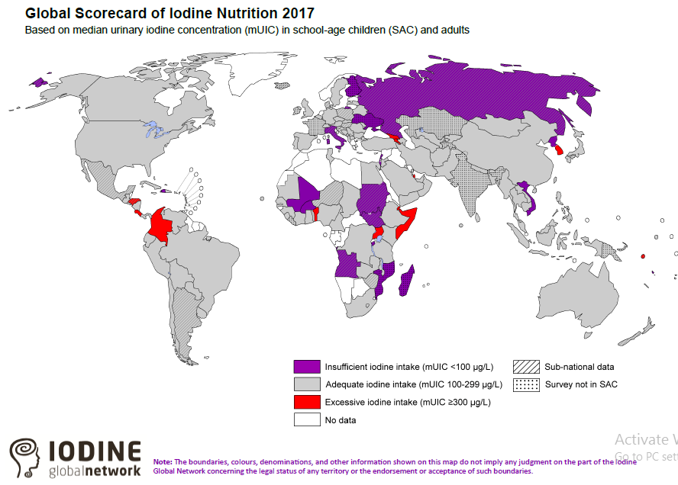

Slide 7
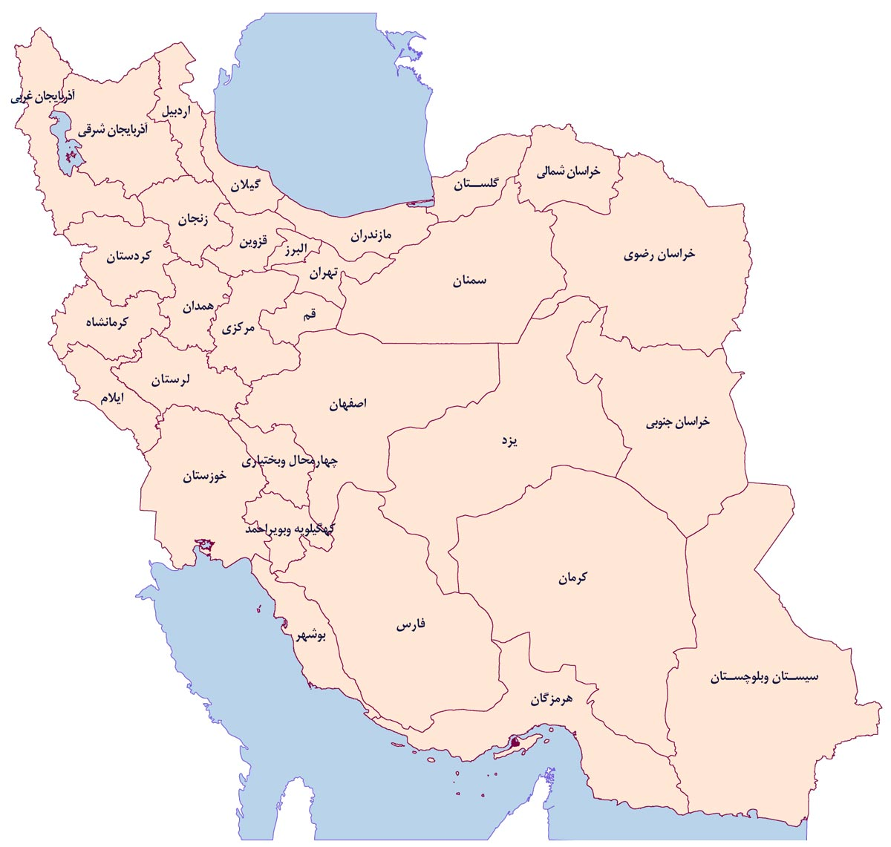
MUI <100 µg/L
MUI 100-150

Slide 8
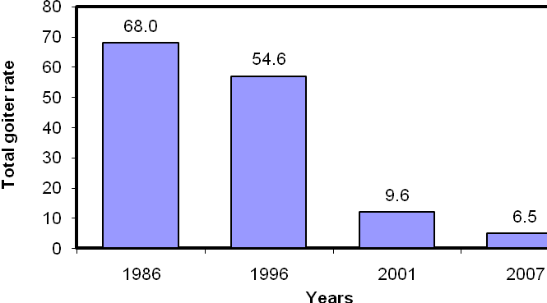
Median urinary iodine excretion in 4 national surveys in the I.R.Iran
Total goiter rate in 4 national surveys in the I.R. Iran
Azizi F. Thyroid International 2009;4:1

Slide 9
Iodine Requirement in Pregnancy (μg / day)
During pregnancy
Basal 150
50 % increased T4 requirements 50-100
Transfer of T4 and I from mother to fetus 50
Increased renal clearance of I 50
Total requirement 250-300
Delange: Int.J. Endocrinol. Metab. 2: 1, 2004, with permission of prof. Azizi

Slide 10

Criteria for Iodine Nutrition in Pregnant Women,
with permission of prof. Azizi
Median Urinary Iodine (MUI) (µg/L) | Iodine Intake
≥ 500 | excessive
250～499 | More than adequate
150～249 | Adequate
＜150 | insufficient
100～150 | marginal insufficient
50～99 | moderate insufficient
＜50 | severe insufficient
2nd ed. Geneva, Switzerland: WHO, 2007
Notes:
7

Slide 11
The Role of Thyroid Hormones in Fetal Brain Development
Maternal thyroid hormones : in the embryonic cavities ~4 weeks after conception,
Thyroid hormones : not play a role in early fetal development, Because thyroid hormones receptors present in the fetal brain from ~8–9 weeks gestation. (reaching adult levels by 18 weeks gestation).
The first stage of thyroid hormone dependent neurodevelopment depends on an adequate supply of maternal fT4, and begins in the second half of the first trimester.
Iodine Deficiency in Pregnancy: The Effect on Neurodevelopment in the Child, Nutrients 2011, 3, 265-273;

Slide 12
The fetal thyroid development :
At the beginning of the second trimester the fetal thyroid produce hormones,
however, the full development of the pituitary-portal vascular system in the fetus does not occur until ~18–20 weeks gestation.
the reserves of the fetal gland are low and the gland itself does not fully mature until birth, thus maternal thyroid hormones continue to contribute to total fetal thyroid hormone concentrations until birth.
Iodine Deficiency in Pregnancy: The Effect on Neurodevelopment in the Child, Nutrients 2011, 3, 265-273;

Slide 13
The impact of severe iodine deficiency on the mother, fetus, and child?
fetus, and child : fetal goiter, Cretinism (profound intellectual impairment), deaf-mutism, and motor rigidity.
Pregnant woman : maternal goiter, pregnancy loss, stillbirth.
2017 Guidelines of the ATA(the Diagnosis and Management of Thyroid Disease During Pregnancy and the Postpartum)

Slide 14
The impact of mild to moderate iodine deficiency on the mother, fetus, and child ?
Mother: Goiter, thyroid disorders,
Child : Attention deficit and hyperactivity disorders , impaired cognitive outcomes.
2017 Guidelines of the ATA ( Diagnosis and Management of Thyroid Disease During Pregnancy and the Postpartum)

Slide 15
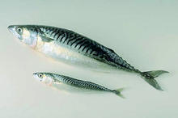
Major dietary iodine sources :
seafood,
iodized salt,
egg,
dairy products
Recommended daily dietary intake (WHO/ICCIDD/UNICEF)
  - 90 μg for pre-school children (0–6 years)
  - 120 μg for school children (6–12 years)
  - 150 μg for adolescents (>12 years) and adults
  - 250 μg for pregnant and lactating women
WHO/UNICEF/ICCIDD. Assessment of iodine deficiency disorders and monitoring their elimination. 3rd ed. 2007, p.6, WHO Library Geneva

Slide 16
How much iodine we get from iodized salt ? (numbers in red are daily iodine intake)*
Daily salt intake (gm) | Amount of iodine in table salt
 | 20 ppm | 30 ppm | 40 ppm
2 | 40 | 60 | 80
4 | 80 | 120 | 160
6 | 120 | 180 | 240
240
* Daily requirement of pregnant women: 200-300 μg/day, with permission of prof. Azizi

Slide 17
Iodine Supplementation in Pregnancy
    Before conception & First trimester:
      Folic Acid + Iodine 150 μg
    Second and third trimesters:
      Multivitamins + Iodine 150 μg
      or Folic Acid + Iodine 150 µg
      lactose intolerant and vegan individuals may have additional needs for supplementation.
      with permission of prof. Azizi

Slide 18
Iodine supplementation in pregnancy, from which time?
Iodized salt consumption started at pregnancy: 38% thyroid failure, hypothyroxinemia with normal serum TSH MUI = 63 μg/L Iodized salt consumption begun 2yr prior to pregnancy: 6.4% thyroid failure MUI= 115 μg/L Lesson: By the time women become pregnant, it may be too late for iodized salt to be effective
Moleti M, et al. JCEM 2008; 93: 2616

Slide 19
All pregnant women ingest 250 µg iodine daily.
women planning pregnancy or currently pregnant, should supplement their diet with an oral supplement that contains, 150 µg of iodine in the form of potassium iodide.
This is optimally started 3 months in advance of planned pregnancy.
No need to iodine supplementation in pregnant women, treated for hyperthyroidism or who are taking LT4.
2017 Guidelines of the ATA(the Diagnosis and Management of Thyroid Disease During Pregnancy and the Postpartum)

Slide 20
Excessive doses of iodine exposure during pregnancy?

Slide 21
Excessive doses of iodine exposure during pregnancy be avoided, except in preparation for the surgical treatment of GD.
iodine intake from diet and supplements exceeding 500 µg daily be avoided during pregnancy, due to concerns about the fetal thyroid dysfunction.
(The ability to escape from acute Wolff–Chaikoff effect does not fully mature in the fetus until about week 36 of gestation)
2017 Guidelines of the ATA(the Diagnosis and Management of Thyroid Disease During Pregnancy and the Postpartum)

Slide 22
THYROID AUTO-ANTIBODIES AND PREGNANCY OUTCOMES ?

Slide 23
Any link between thyroid-autoimmunity in pregnant woman and
spontaneous pregnancy loss ?
premature labor ?
Infertility?

Slide 24

حکایت فیل در تاریکی (مثنوی مولوی)

Slide 25
حکایت فیل در تاریکی (مثنوی مولوی)
هیچ‌کس تصویر کلان فیل را ندیده است
هیچ‌کدام از آن افراد، حرف نادرستی نمی‌زنند؛ بلکه تنها بخشی از آن موجود را دیده‌اند

Slide 26
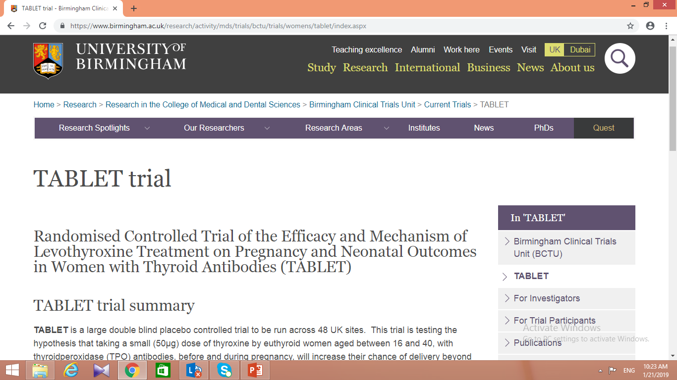

Slide 27
Thyroid AUTO-ANTIBODIES AND pregnancy loss ?

Slide 28
خانم 29 ساله ، بدون بیماری تیروئید قبلی با سابقه 2 نوبت سقط مکرر در هفته 10 و13 بارداری با آزمایشات ذیل جهت مشاوره به شما مراجعه کرده ، مناسبترین اقدام کدام است؟
FBS≠ 85 mg/dl , BuN/cr≠ normal , TSH≠ 1.2 (0.34-4.1) T4,T3: normal Antitipo Ab : positive
  الف – با توجه به Antitipo Ab مثبت ، نیاز به چک عملکرد تیروئید هر 4 هفته تا حدود بیست هفتگی دارد،
  ب- شروع IVIG با توجه به سابقه recurrent pregnancy loss
  ج- شروع پردنیزولون با توجه به سابقه recurrent pregnancy loss
    د- شروع لووکسین 50 µg روزانه همراه با چک عملکرد تیروئید هر 4 هفته تا بیست هفتگی

Slide 29
Thyroid autoimmunity and risk of hypothyroidism in pregnancy?
Euthyroid pregnant women who are TPOAb or TgAb positive should have TSH measurement :
at time of pregnancy confirmation,
and every 4 weeks through mid-pregnancy.
2017 Guidelines of the ATA(the Diagnosis and Management of Thyroid Disease During Pregnancy and the Postpartum)

Slide 30
Thyroid AUTO-ANTIBODIES AND pregnancy loss ?
Spontaneous pregnancy loss (miscarriage) :
Occures in 17% – 31% of all gestations,
Poorly controlled diabetes mellitus, Thyroid dysfunction and positive thyroid antibodies (TPOAb, TgAb, or both) ,
are Endocrine disorders for pregnancy loss.

Slide 31
THYROID AUTO-ANTIBODIES (in euthyroid pregnant woman) and pregnancy loss ?
A meta analysis of eight studies, included 460 Ab-positive patients and 1923 controls noted :
a significant association between thyroid Ab positivity and recurrent pregnancy loss (OR 2.3 [95% CI 1.5–3.5]).
Although a clear association, does not prove causality.
2017 Guidelines of the ATA(the Diagnosis and Management of Thyroid Disease During Pregnancy and the Postpartum)

Slide 32
THYROID AUTO-ANTIBODIES (in euthyroid pregnant woman) and pregnancy loss ?
Some trials with :
IVIG ?
Levothyroxine ?
to reduce pregnancy loss.

Slide 33
IVIG treatment,
of euthyroid TPOAb-positive women with a history of recurrent pregnancy loss, not recommended,
(The high cost and side effect profile with IVIG infusion make its use undesirable.)
However, LT4 (25–50 µg) may be considered given its potential benefits in comparison with its minimal risk.
2017 Guidelines of the ATA(the Diagnosis and Management of Thyroid Disease During Pregnancy and the Postpartum)

Slide 34
Thyroid autoantibody and premature delivery?

Slide 35
Thyroid autoantibody and premature delivery?
A meta analysis of 11 prospective cohorts : the relative risk for delivery at less than 37 weeks for women with positivity for TgAb, TPOAb, or both was 1.41 [95% CI 1.08–1.84].
In contrast to association studies, interventional studies of LT4 therapy for the prevention of preterm delivery are sparse.

Slide 37
Insufficient evidence exists to recommend for or against treating euthyroid pregnant women :
who are thyroid autoantibody positive with LT4 to prevent preterm delivery.
2017 Guidelines of the ATA(the Diagnosis and Management of Thyroid Disease During Pregnancy and the Postpartum)

Slide 38
Infertility

Slide 39
Whether infertility increased in :
Overt hypothyroid women , before pregnancy ? yes
Subclinical (auto-antibody negative ) women, before pregnancy ? Insufficient evidence
Euthyroid (auto-antibody positive ) women, before pregnancy ? Insufficient evidence

Slide 40
Whether infertility increased in :
Overt hypothyroid women , before pregnancy ? yes
Evaluation of serum TSH concentration, recommended for all women seeking care for infertility.
2017 Guidelines of the ATA(the Diagnosis and Management of Thyroid Disease During Pregnancy and the Postpartum)

Slide 41
خانمی 30 ساله با سابقه نازایی با توجه به AntitpoAb مثبت علیرغم یوتیرویید بودن (TSH=1.8) جهت مشاوره به شما مراجعه کرده است.اقدام مناسب شما کدام است؟
الف- در صورت تمایل به انجام IVF شروع کورتن جهت افزایش احتمال موفقیت بارداری
ب- در صورت تمایل به انجام IVF شروع لورکسین 50 میکرو گرم روزانه یک عدد جهت افزایش احتمال موفقیت بارداری
ج- چک TSH هر چهار هفته تا هفته بیستم بارداری و یک نوبت حول و حوش 30 هفتگی
د- موارد ب و ج

Slide 42
Infertility
Insufficient evidence exist to determine if LT4 therapy improves fertility in subclinical hypothyroid, autoantibody–negative women, attempting natural conception .
However, LT4 may be considered to prevent progression to more significant hypothyroidism, once pregnancy is achieved.
Furthermore, low dose LT4 therapy (25–50 µg/d) carries minimal risk.

Slide 43
RECOMMENDATION 19
Insufficient evidence exists to determine if LT4 therapy improves fertility :
in nonpregnant, thyroid autoantibody– positive euthyroid women, attempting natural conception (not undergoing ART).

Slide 44
ART (Assisted reproductive technology) outcome in woman with … ?
ART means:
IVF : In vitro fertilization,
ICSI : intracytoplasmic sperm injection.

Slide 45
ART (Assisted reproductive technology) outcome in …
TPOAb-positive euthyroid women ?
Sub clinically hypothyroid ( TPOAb-negative) women ?

Slide 46
ART outcome in TPOAb-positive euthyroid women ?
RECOMMENDATION 21
Insufficient evidence, whether LT4 therapy improves the success of pregnancy following ART in TPOAb-positive euthyroid women.
However, LT4 therapy to TPOAb-positive euthyroid women undergoing ART may be considered given its potential benefits in comparison to its minimal risk. In such cases, 25–50 lg of LT4 is a typical starting dose.

Slide 47
ART outcome in TPOAb-positive euthyroid women ?
RECOMMENDATION 22
Glucocorticoid therapy, not recommended for autoantibody–positive euthyroid women undergoing ART.

Slide 48
ART outcome in subclinically hypothyroid, TPOAb-negative women ?
RECOMMENDATION 20
Subclinically hypothyroid women undergoing IVF or intracytoplasmic sperm injection (ICSI) should be treated with LT4. The goal of treatment is to achieve a TSH concentration <2.5 mU/L.

Slide 49
Does ovarian hyper-stimulation alter thyroid function?

Slide 50
Does ovarian hyper-stimulation alter thyroid function?
RECOMMENDATION 23
When possible, thyroid function testing should be performed either before or 1–2 weeks after controlled ovarian hyper-stimulation because results obtained during the course of controlled ovarian stimulation may be difficult to interpret.

Slide 51
Autoantibody–positive euthyroid pregnant women and …?
spontaneous recurrent pregnancy loss ? LT4 (25-50µg), recommended.
premature delivery ? LT4 (25-50µg), Not-recommended.
Infertility improvement and natural conception? LT4 (25-50µg), Not-recommended.
Infertility improvement and ART ? LT4 (25-50µg), recommended.

Slide 52
HYPOTHYROIDISM AND PREGNANCY

Slide 53
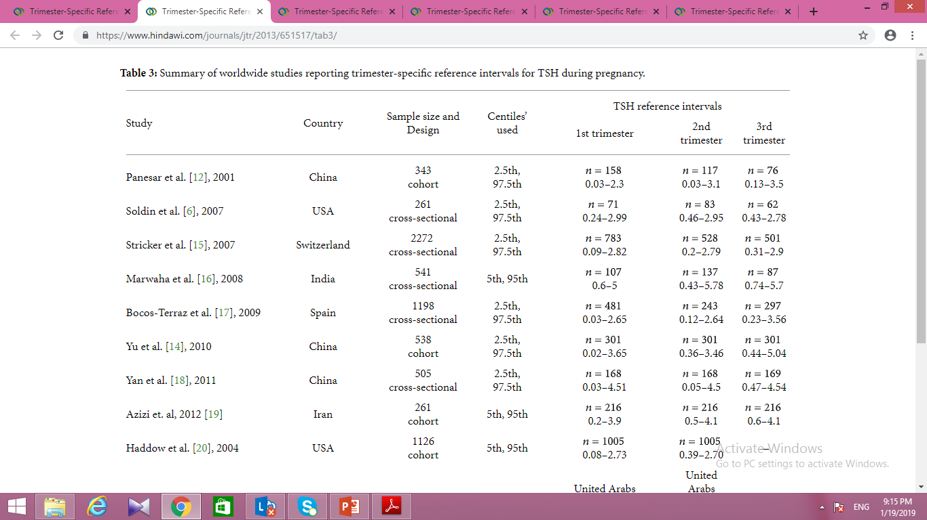
The normal reference range for TSH concentrations in each trimester of pregnancy?

Slide 54
The definition of hypothyroidism in pregnancy?
RECOMMENDATION 25
In the setting of pregnancy, maternal hypothyroidism defined as a TSH, elevated beyond the upper limit of the pregnancy-specific reference range.
Reference ranges defined in healthy TPOAb-negative pregnant women with optimal iodine intake and without thyroid illness.
If pregnancy-specific TSH reference ranges is not available, an upper reference limit of 4.0 mU/L may be used.
This limit represents a reduction in the nonpregnant TSH upper reference limit of 0.5 mU/L.

Slide 55
The optimal method to assess serum T4 concentration during pregnancy?
The accuracy of serum Free-T4 measurement by the indirect analog immunoassays influenced by pregnancy.
Accurate estimation of the Free-T4 concentrations can be done :
by calculating a Free-T4 index,
Or Total-T4 measurement (with a pregnancy-adjusted reference range).

Slide 56
Adverse pregnancy outcomes with overt hypothyroidism during?
Increased risks of premature birth,
low birth weight,
pregnancy loss,
and lower offspring IQ.

Slide 57
Adverse pregnancy outcomes with subclinical hypothyroidism ?
An increasing risk of pregnancy loss and preterm delivery:
( this effect exacerbated in TPOAb-positive women when TSH exceeds 2.5 mU/L. However, in TPOAb-negative women similar adverse risk is not apparent until maternal TSH exceeds 5mU/L)
Adverse neurocognitive effect on the offspring ? Insufficient evidence.

Slide 58
Subclinical hypothyroidism treatment in pregnancy?
Pregnant women with TSH > 2.5 mU/L should be evaluated for TPOAb status.
LT4 therapy :
recommended for TPOAb-positive women with a TSH greater than the pregnancy-specific reference range (Strong recommendation).
may be considered for TPOAb-positive women with TSH >2.5 mU/L and below the upper limit of the pregnancy-specific reference range (Weak recommendation).

Slide 59
Subclinical hypothyroidism treatment in pregnancy?
LT4 therapy :
recommended for TPOAb-negative women with a TSH>10.0. (Strong recommendation).
may be considered for TPOAb-negative women with TSH greater than the pregnancy specific reference range and below 10.0 mU/L. (Weak recommendation).
LT4 therapy:
not recommended for TPOAb - negative women with a TSH < 4.0 mU/L .(Strong recommendation).

Slide 60
Euthyroid women at risk for hypothyroidism during pregnancy?
TPOAb- or TgAb-positive,
post-hemithyroidectomy,
and post-radioactive iodine,
TSH measured approximately every 4 weeks until midgestation and at least once near 30 weeks gestation.

Slide 61
LT4 adjustment in treated Hypothyroid patients, who are planning pregnancy?
1) TSH should be evaluated preconception,
and LT4 dose adjusted to achieve a TSH between the lower reference limit and 2.5 mU/L.

Slide 62
The treatment goal for hypothyroidism in pregnant women ?
Target a TSH in the lower half of the trimester-specific reference range.
When this is not available, target is maternal TSH<2.5 mU/L.

Slide 63
LT4 adjustment in treated Hypothyroid patients , with a suspected or confirmed pregnancy?
should independently increase their dose of LT4 by 30% and urgently notify their caregiver for prompt testing .
This means to administer two additional tablets weekly of the patient’s current daily LT4 dosage.

Slide 64
How should LT4 be adjusted postpartum hypothyroid patients?
Following delivery,
LT4 dose reduced to the patient’s preconception dose, And TSH evaluated 6 weeks post partum.
women in whom LT4 initiated during pregnancy about 50 µg/d, are candidates for discontinuing LT4, and TSH evaluated, 6 weeks post partum.

Slide 65
In conclusion:
LT4 (25–50 µg) may be considered to euthyroid autoantibody positive pregnant woman :
with a history of recurrent pregnancy loss,
Infertility improvement and ART ?

Slide 66
Screening for thyroid dysfunction in
Pregnancy ?

Slide 67
Should women universally tested for thyroid function before or during pregnancy?
Insufficient evidence,
with the exception of women planning assisted reproduction or those known to have TPOAb positivity.
All pregnant women verbally screened at the initial prenatal visit for any history of thyroid dysfunction, and prior or current use of LT4 or antithyroid medications.

Slide 68
TSH testing recommended for all patients seeking pregnancy, or newly pregnant with:
1. A history of hypothyroidism/hyperthyroidism,
2. Known thyroid antibody positivity or presence of a goiter,
3. History of head or neck radiation or prior thyroid surgery,
4. Age >30 years,
5. Type 1 diabetes or other autoimmune disorders,
6. History of pregnancy loss, preterm delivery, or infertility,
7. Multiple prior pregnancies ≥2,
8. Family history of autoimmune thyroid disease ,
9. BMI ≥ 40 kg/m2,
10. Use of amiodarone, lithium, or recently used iodinated radiologic contrast,
11. Residing in an area of known moderate to severe iodine insufficiency.

Slide 69
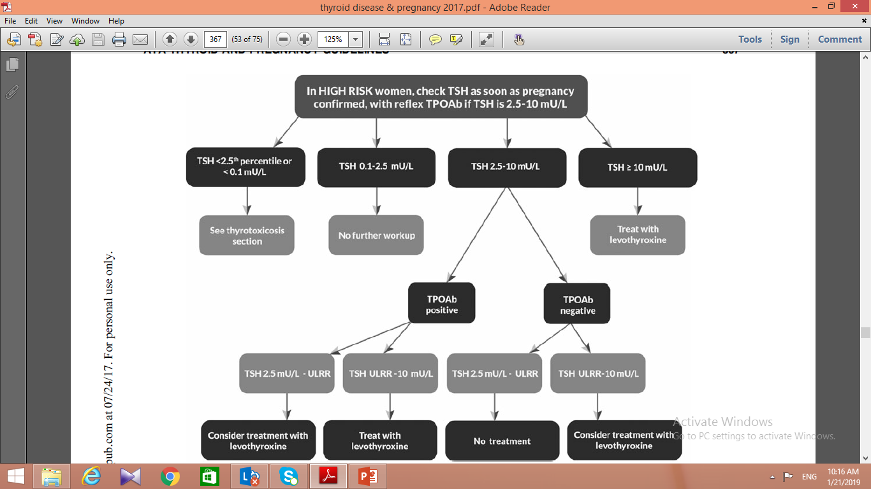

Slide 70


