Slide 1
Management of Hyperglycemia in Type 2 Diabetes, 2018. A Consensus Report by the American Diabetes Association (ADA) and the European Association for the Study of Diabetes (EASD) https://doi.org/10.2337/dci18-0033 & ADA guideline - 2019
«بسمه تعالی»
Present by :
Dr. A. R. Goharian , Endocrinologist

Slide 2
Diabetes Care Publish Ahead of Print, published online October 4, 2018

Slide 3
Diabetes Care Publish Ahead of Print, published online October 4, 2018

Slide 5
Summary of Revisions : Standards of Medical Care in Diabetes - 2019
Diabetes Care 2019;42(Suppl. 1) : S4–S6
https://doi.org/10.2337/dc19-srev 01

Slide 6
Section 2. Classification and Diagnosis of Diabetes
Based on new data, the criteria for the diagnosis of diabetes was changed to include two abnormal test results from the same sample (i.e., fasting plasma glucose and A1C from same sample).

Slide 7
DIAGNOSTIC TESTS FOR DIABETES
The concordance between the FPG and 2-h PG tests is imperfect, as is the concordance between A1C and either glucose-based test.
Compared with FPG and A1C cut points, the 2-h PG value diagnoses more people with prediabetes and diabetes (9).

Slide 10
When HbA1C is invalid ?
In conditions associated with an altered relationship between A1C and glycemia, such as :
1 - sickle cell disease, iron deficient anemia (31)
2 - pregnancy (second and third trimesters and the postpartum period),
3 - glucose-6-phosphate dehydrogenase deficiency,
4 - HIV,
5 - hemodialysis,
6 - recent blood loss or transfusion,
7 - or erythropoietin therapy,
only plasma blood glucose criteria should be used to diagnose diabetes. / B

Slide 11
POSTTRANSPLANTATION DIABETES MELLITUS
Patients should be screened after organ transplantation for hyperglycemia, with a formal diagnosis of posttransplantation diabetes mellitus being best made once a patient is stable on an immunosuppressive regimen and in the absence of an acute infection. E
The oral glucose tolerance test is the preferred test to make a diagnosis of posttransplantation diabetes mellitus. B

Slide 12
Section 3. Prevention or Delay of Type 2 Diabetes
The nutrition section was updated to highlight the importance of weight loss for those at high risk for developing type 2 diabetes who have overweight or obesity.
Because smoking may increase the risk of type 2 diabetes, a section on tobacco use and cessation was added.

Slide 13
Section 5. Lifestyle Management
Evidence continues to suggest that there is not an ideal percentage of calories from carbohydrate, protein, and fat for all people with diabetes.
Therefore, more discussion was added about the importance of macronutrient distribution based on an individualized assessment of current eating patterns, preferences, and metabolic goals.

Slide 14
MNT
The Mediterranean (55,56), Dietary Approaches to Stop Hypertension (DASH) (57–59), and plant-based (60,61) diets are all examples of healthful eating patterns that have shown positive results in research,
but individualized meal planning should focus on personal preferences, needs, and goals.

Slide 15
Section 5. Lifestyle Management
A recommendation was modified to encourage people with diabetes to decrease consumption of both sugar sweetened and nonnutritive-sweetened beverages and use other alternatives, with an emphasis on water intake.
The sodium consumption / Restriction
Physical Activity
E – cigarrete : was not more effective than “usual care.”

Slide 16
Section 7. Diabetes Technology (NEW)
This new section includes : new recommendations, the self-monitoring of blood glucose section and a discussion of insulin delivery devices (syringes, pens, and insulin pumps), blood glucosemeters , continuous glucose monitors (real-time and intermittently scanned [“flash”]) , and automated insulin delivery devices.

Slide 17
PHARMACOLOGIC THERAPY FOR TYPE 1 DIABETES
The U.S. Food and Drug Administration (FDA) has also approved the first hybrid closed-loop pump system.
The safety and efficacy of hybrid closed loop systems has been supported in the literature in adolescents and adults with type 1 diabetes (10,11).
Intensive diabetes management using CSII and continuous glucose monitoring should be considered in selected patients.

Slide 18
Insulin Injection Technique
Exogenous-delivered insulin should be injected into subcutaneous tissue, not intramuscularly. Recommended sites for insulin injection include the abdomen, thigh, buttock, and upper arm (21).
Because insulin absorption from IM sites differs according to the activity of the muscle, inadvertent IM injection can lead to unpredictable insulin absorption and variable effects on glucose, with IM injection being associated with frequent and unexplained hypoglycemia in several reports (21–23).
Risk for IM insulin delivery is increased in younger and lean patients when injecting into the limbs rather than truncal sites (abdomen and buttocks) and when using longer needles (24).

Slide 19
Noninsulin Treatments for Type 1 Diabetes
Pramlintide
The addition of metformin to adults with type 1 diabetes caused small reductions in body weight and lipid levels but did not improve A1C (31,32).
The addition of the glucagon-like peptide 1 (GLP-1) receptor agonists liraglutide and exenatide to insulin therapy caused small (0.2%) reductions in A1C compared with insulin alone in people with type 1 diabetes and also reduced body weight by #3 kg (33).

Slide 20
Noninsulin Treatments for Type 1 Diabetes
Similarly, the addition of a sodium–glucose cotransporter 2 (SGLT2) inhibitor to insulin therapy has been associated with improvements in A1C and body weight when compared with insulin alone (34–36); however, SGLT2 inhibitor use is also associated with more adverse events including ketoacidosis.

Slide 21
Sotagliflozin
The dual SGLT1/2 inhibitor sotagliflozin is currently under consideration by the FDA and, if approved, would be the first adjunctive oral therapy in type 1 diabetes.

Slide 23
Section 9. Pharmacologic Approaches to Glycemic Treatment in T2DM
The section on the pharmacologic treatment of type 2 diabetes was significantly changed to align, as per the living Standards update in October 2018, with the ADA-EASD consensus report on this topic, summarized in the new Figs. 9.1 and 9.2.

Slide 24
Section 9. Pharmacologic Approaches to Glycemic Treatment
A recommendation that, for most patients who need the greater efficacy of an injectable medication, a glucagon-like peptide 1 receptor agonist should be the first choice, ahead of insulin.

Slide 25
Insulin injection technique
A new section was added on insulin injection technique, emphasizing the importance of technique for appropriate insulin dosing and the avoidance of complications (lipodystrophy, etc.).

Slide 26
Section 11. Microvascular Complications and Foot Care
To align with the ADA-EASD consensus report, a recommendation was added for people with type 2 diabetes and chronic kidney disease to consider agents with proven benefit with regard to renal outcomes.

Slide 27
Gabapentin was added to the list of agents to be considered for the treatment of neuropathic pain in people with diabetes based on data on efficacy and the potential for cost savings.
The gastroparesis section includes a discussion of a few additional treatment modalities.

Slide 28
The recommendation for patients with diabetes to have their feet inspected at every visit was modified to only include those at high risk for ulceration.
Annual examinations remain recommended for everyone.

Slide 29
Section 13. Children and Adolescents
A recommendation was added to emphasize the need for disordered eating screening in youth with type 1 diabetes beginning at 10–12 years of age.
Based on new evidence, a recommendation was added discouraging e-cigarette use in youth.

Slide 30
Section 14. Management of Diabetes in Pregnancy
Greater emphasis has been placed on the use of insulin as the preferred medication for treating hyperglycemia in gestational diabetes mellitus as it does not cross the placenta to a measurable extent and how metformin and glyburide should not be used as first line agents as both cross the placenta to the fetus.

Slide 31
DSMES (Diabtes Self-Management Education and Support)
DSMES is a key intervention to enable people with diabetes to make informed decisions and to assume responsibility for day-to-day diabetes management.
DSMES programs usually involve face-to-face contact in group or individual sessions with trained educators,

Slide 32
DSMES
The best outcomes are achieved in those programs with a theory-based and structured curriculum and with contact time of over 10 h.

Slide 34
PHARMACOLOGIC THERAPY FOR T2DM
key patient factors:
1) important comorbidities such as atherosclerotic
cardiovascular disease (ASCVD), chronic kidney disease
(CKD), and heart failure (HF),
2) hypoglycemia risk,
3) effects on body weight,
4) side effects,
5) cost, and
6) patient preferences

Slide 35
PHARMACOLOGIC THERAPY FOR T2DM
Metformin is the preferred initial pharmacologic agent for the treatment of type 2 diabetes./ A
Once initiated, metformin should be continued as long as it is tolerated and not contraindicated ; other agents, including insulin, should be added to metformin. /A

Slide 36
Metformin
Long-term use of metformin may be associated with biochemical vitamin B12 deficiency, and periodic measurement of vitamin B12 levels should be considered in metformin-treated patients, especially in those with anemia or peripheral neuropathy. / B

Slide 37
Dual therapy in T2DM
Consider initiating dual therapy in patients with newly diagnosed type 2 diabetes who have A1C ≥ 1.5% , (12.5 mmol/ mol) above their glycemic target. / E
A comparative effectiveness meta-analysis suggests that each new class of noninsulin agents added to initial therapy generally lowers A1C approximately 0.7–1.0% (46).

Slide 38
Insulin therapy in T2DM
The early introduction of insulin should be considered if there is evidence of ongoing catabolism (weight loss), if symptoms of hyperglycemia are present, or when A1C levels ( >10% , [86 mmol/mol]) or blood glucose levels ( ≥300 mg/dL, [16.7 mmol/L]) are very high. / E

Slide 39
Combination Therapy
In trials comparing the addition of GLP-1 receptor agonists or insulin in patients needing further glucose lowering, the efficacy of the two treatments was similar (48–50).

Slide 40
Glucose – lowering Medications
Because of the new evidence for the benefit of specific medications to reduce mortality, heart failure (HF), and progression of renal disease in the setting of established CVD, their use was considered compelling in this patient group.
Thus, we recommend that providers consider a history of CVD very early in the process of treatment selection.

Slide 41
Glucose – lowering Medications
In addition to CVD, we recommend early consideration of weight, hypoglycemic risk, treatment cost, and other patient-related factors that may influence treatment selection.

Slide 42
Glucose – lowering Medications
Therefore, an important early step in this new approach (Fig. 3) is to consider the presence or absence of ASCVD, HF, and CKD, conditions in aggregate affecting 15–25% of the population with type 2 diabetes.

Slide 43
ASCVD Definition :
Established CVD : (e.g., myocardial infarction [MI], stroke, any revascularization procedure) , while variably including : related conditions compatible with clinically significant atherosclerosis:
(e.g., TIA , hospitalized unstable angina,amputation, CHF New York Heart Association [NYHA] class ii–iii , 50% stenosis of any artery, symptomatic or asymptomatic coronary artery disease documented by imaging,

Slide 44
Drugs in ASCVD
Among patients with type 2 diabetes who have established ASCVD , SGLT2 inhibitors or GLP-1 receptor agonists with proven cardiovascular benefit are recommended as part of glycemic management. (Figs. 2 and 3)

Slide 45
ASCVD
Taken together, it appears that among patients with established CVD, some GLP-1 receptor agonists may provide cardiovascular benefit, with the evidence of benefit strongest for liraglutide, favorable for semaglutide, and less certain for exenatide.
There is no evidence of cardiovascular benefit with lixisenatide .

Slide 46
ASCVD
For the SGLT2 inhibitors studied to date, it appears that among patients with established CVD, there is likely cardiovascular benefit, with the evidence of benefit modestly stronger for empagliflozin than canagliflozin .

Slide 47
While the evidence of an ASCVD outcomes benefit for GLP-1 receptor agonists and SGLT2 inhibitors has been demonstrated for people with established ASCVD, the evidence of benefit beyond glucose lowering has not been demonstrated in those without ASCVD.
Indeed, in subgroup analyses of these trials, lower-risk individuals have not been observed to have an ASCVD benefit.

Slide 48
PHARMACOLOGIC THERAPY FOR T2DM
Among patients with atherosclerotic cardiovascular disease at high risk of heart failure or in whom heart failure coexists, sodium–glucose cotransporter 2 inhibitors are preferred. / C
For patients with type 2 diabetes and chronic kidney disease, consider use of a sodium–glucose cotransporter 2 inhibitor or glucagon-like peptide 1 receptor agonist shown to reduce risk of chronic kidney disease progression, cardiovascular events, or both./ C

Slide 49
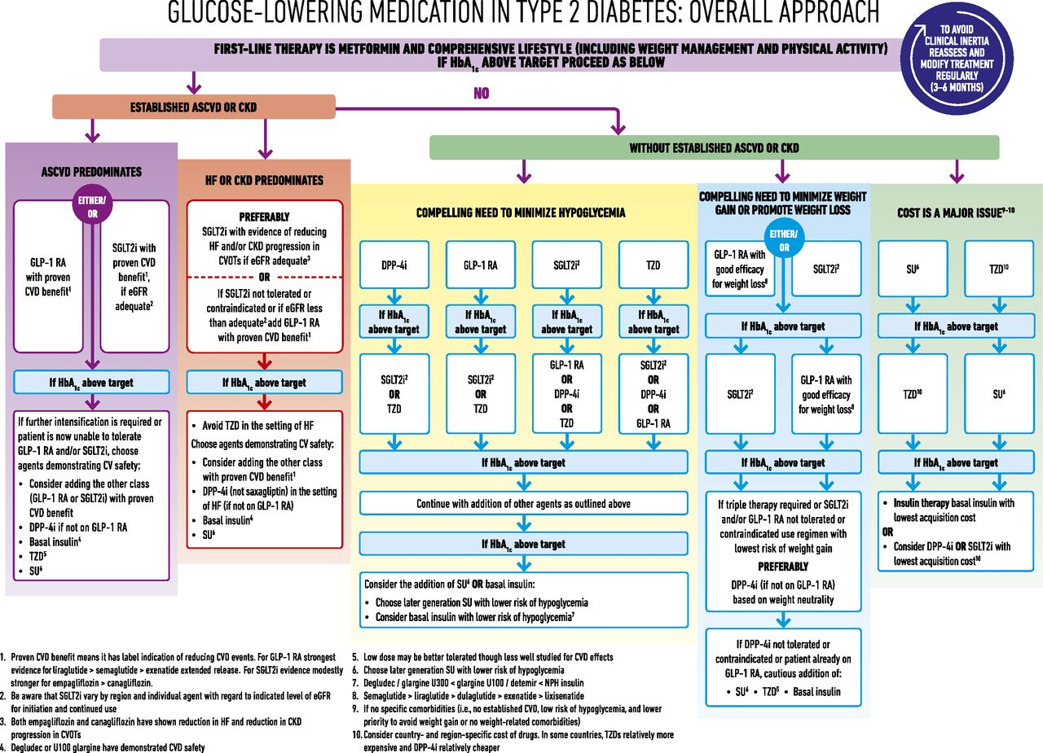
©2018 by American Diabetes Association
Melanie J. Davies et al. Dia Care 2018;41:2669-2701
Notes:
Glucose-lowering medication in type 2 diabetes: overall approach. CV, cardiovascular; DPP-4i, dipeptidyl peptidase 4 inhibitor; GLP-1 RA, glucagon-like peptide 1 receptor agonist; SGLT2i, SGLT2 inhibitor; SU, sulfonylurea.

Slide 51
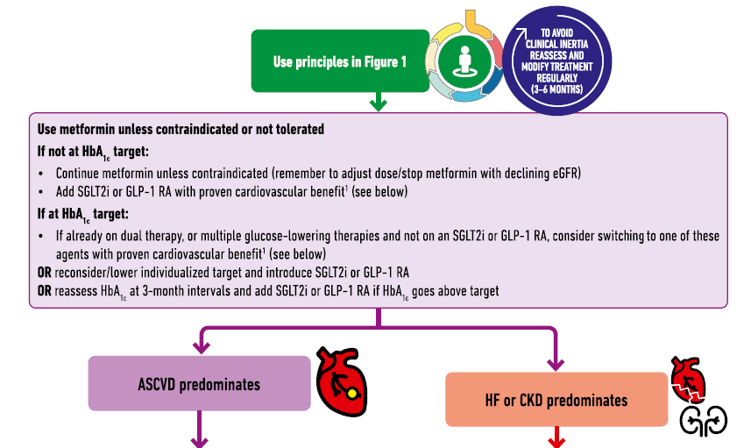

Slide 53
6. TZD

Slide 55
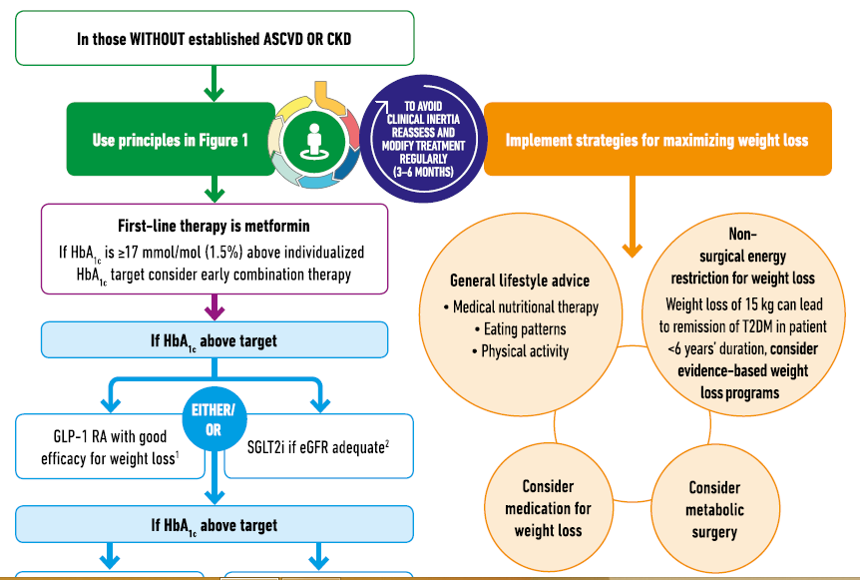

Slide 56
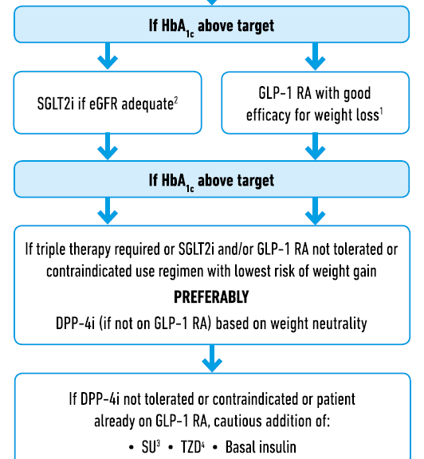

Slide 58
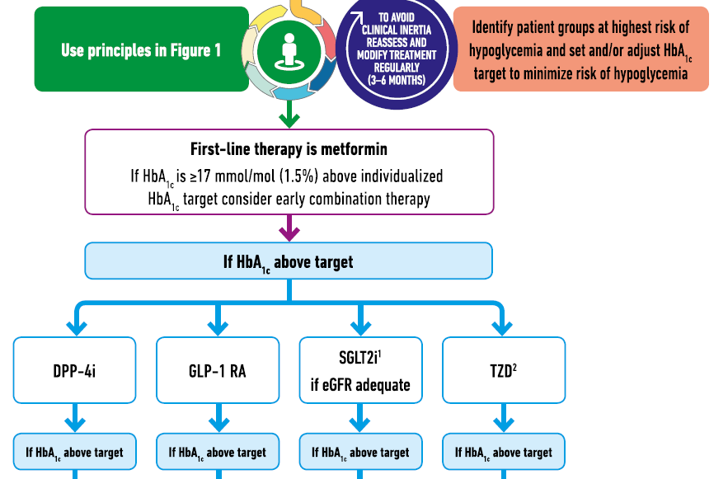

Slide 59
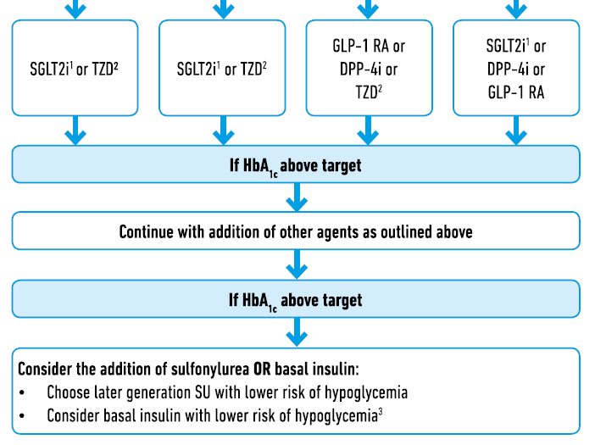
DPP-4 inh
GLP-1RA
SGLT2 inh
TZD

Slide 61
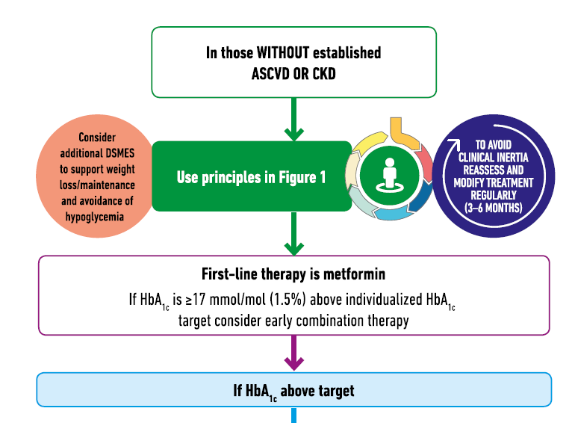

Slide 62
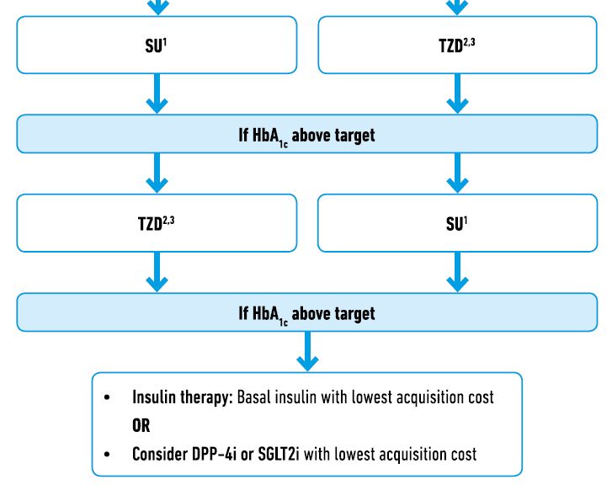

Slide 64
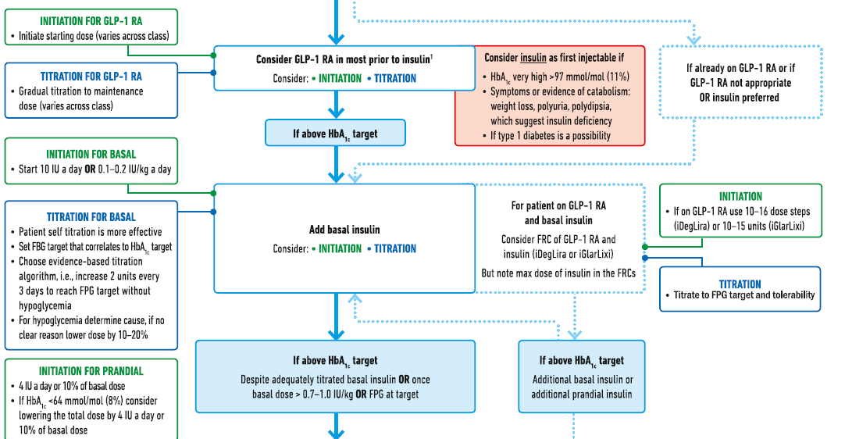

Slide 65
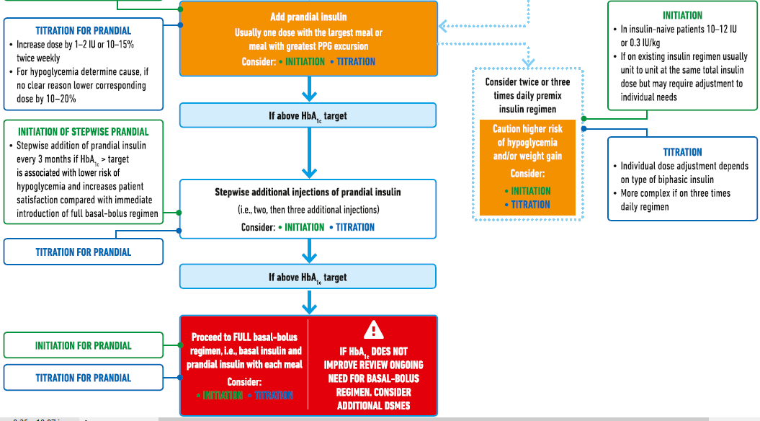

Slide 66
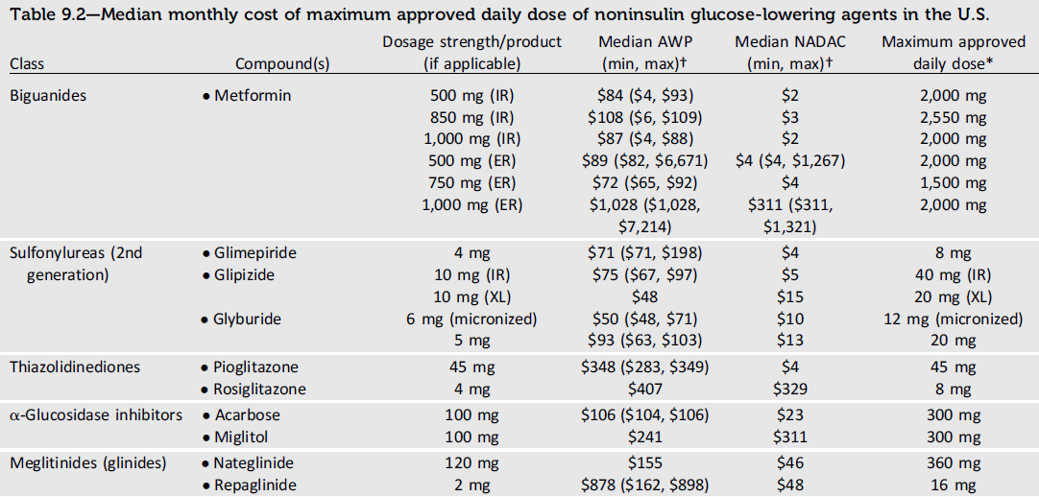

Slide 67
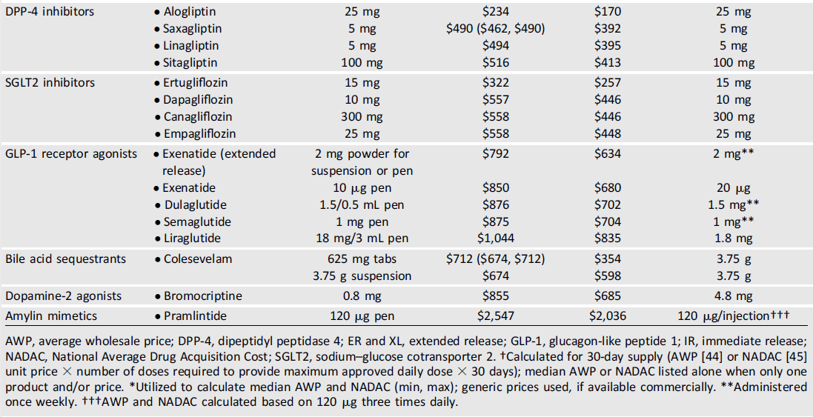

Slide 68
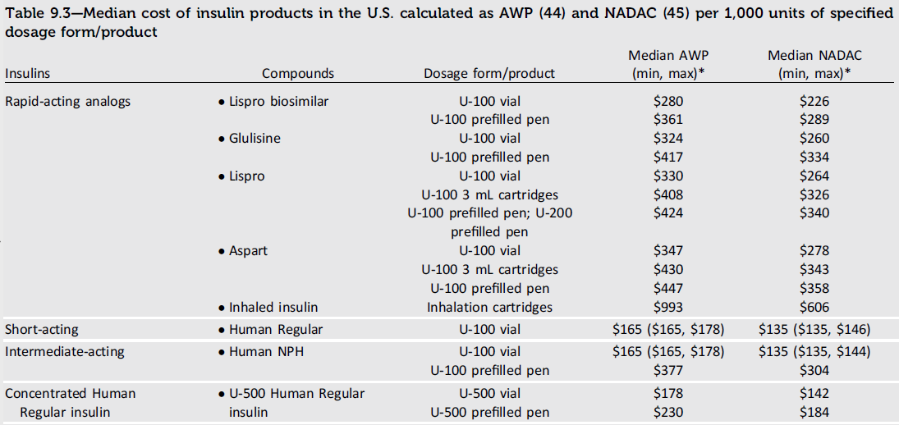

Slide 69
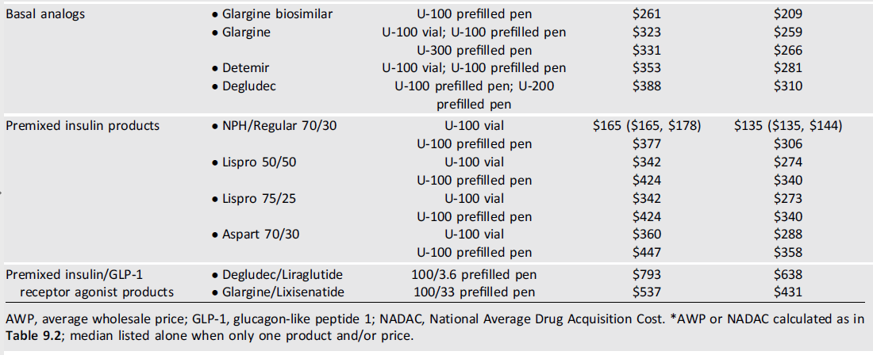

Slide 70
Basal Insulin
Direct patient costs ,contribute to treatment nonadherence (76).
For many patients with type 2 diabetes (e.g., individuals with relaxed A1C goals, low rates of hypoglycemia, and prominent insulin resistance, as well as those with cost concerns), human insulin (NPH and Regular) may be the appropriate choice of therapy, and clinicians should be familiar with its use (77).

Slide 71
Prandial Insulin
Meta-analyses of trials comparing rapid-acting insulin analogs with human regular insulin in patients with type 2 diabetes have not reported important differences in A1C or hypoglycemia (78,79).

Slide 72
Inhaled Insulin
Inhaled insulin is available for prandial use with a limited dosing range; studies in people with type 1 diabetes suggest rapid pharmacokinetics (20)
Inhaled insulin is contraindicated in patients with chronic lung disease, such as asthma and chronic obstructive pulmonary disease, and is not recommended in patients who smoke or who recently stopped smoking.
All patients require spirometry (FEV1) testing to identify potential lung disease prior to and after starting inhaled insulin therapy.

Slide 73
Concentrated Insulin Products
U-500 regular insulin is, by definition, five times more concentrated than U-100 regular insulin.
U-300 glargine and U-200 degludec are three and two times as concentrated, respectively, as their U-100 formulations and allow higher doses of basal insulin administration per volume used.
U-300 glargine has a longer duration of action than U-100 glargine

Slide 74
Concentrated Insulin Products
TheFDA has also approved a concentrated formulation of rapid-acting insulin lispro , U-200 (200 units/mL).
These concentrated preparations may be more convenient and comfortable for patients to inject and may improve adherence in those with insulin resistance who require large doses of insulin.

Slide 75
Combination Injectable Therapy
Two different once-daily fixed-dual combination products containing basal insulin plus a GLP-1 receptor agonist are available: ( FRC )
- insulin glargine plus lixisenatide and
- insulin degludec plus liraglutide.

Slide 76
Premixed Insulin
Alternatively, in a patient on basal insulin in whom additional prandial coverage is desired, the regimen can be converted to two or three doses of a premixed insulin.
Each approach has advantages and disadvantages.

Slide 77
Combination Injectable Therapy
When initiating combination injectable therapy, metformin therapy should be maintained while sulfonylureas and DPP-4 inhibitors are typically discontinued.
Adjunctive use of a thiazolidinedione or an SGLT2 inhibitor may help to improve control and reduce the amount of insulin needed, though potential side effects should be considered.

Slide 78
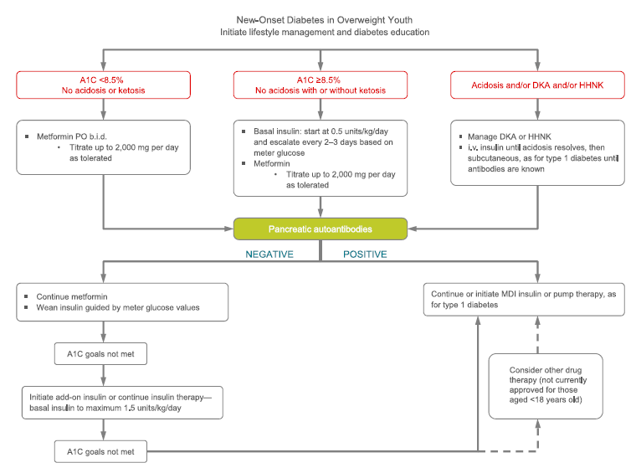

Slide 80
12. Older Adults : Standards of Medical Care in Diabetes – 2019 Deintensification (or simplification) of complex regimens
Diabetes Care 2019;42(Suppl. 1):S139–S147 | ttps:// doi.org/ 10.2337 /dc 19s012

Slide 81
Trend of Combination Therapy
As people with type 2 diabetes get older, it may become necessary to simplify complex insulin regimens because of a decline in self-management ability.

Slide 82
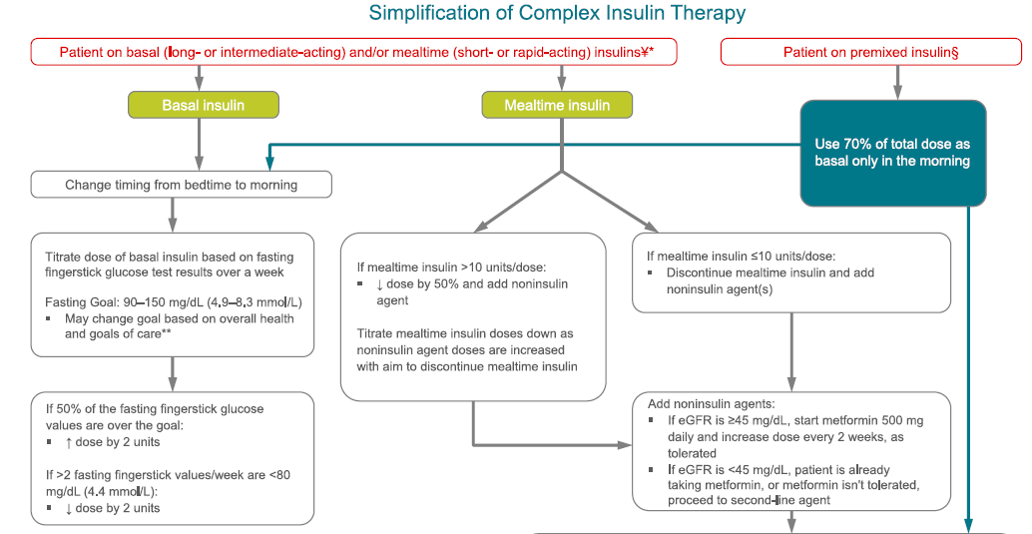

Slide 84
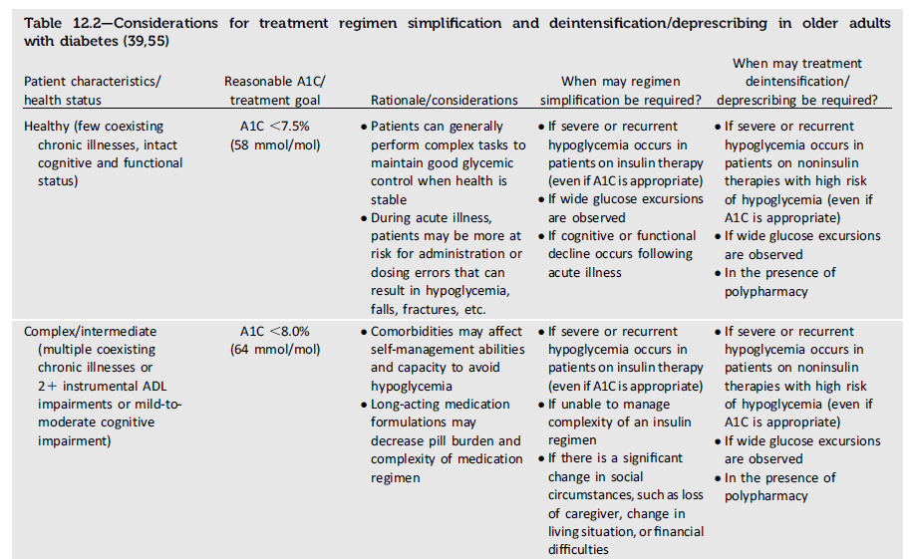

Slide 85
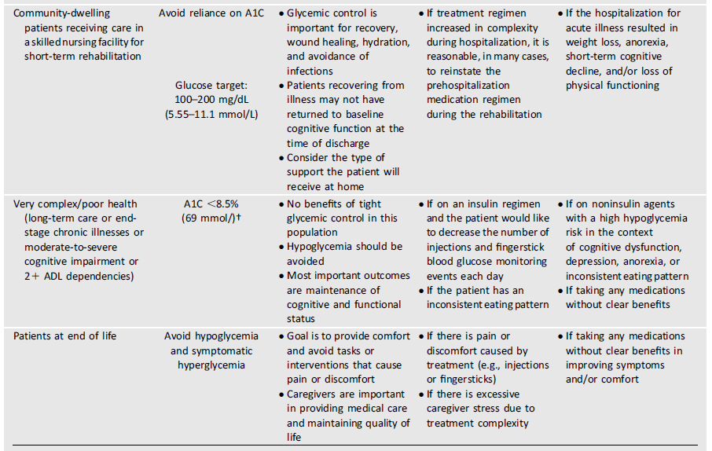

Slide 86
با سپاس ازتوجه شما

