Slide 1
OSTEOGENESIS IMPERFECTA
Bita Alimardani

Slide 2
INTRODUCTION
Osteogenesis imperfecta (OI) is an inherited connective tissue disorder with many phenotypic presentations.
It is often called "brittle bone disease."

Slide 3
Osteogenesis Imperfecta (OI) is primarily characterized by liability to fractures, often accompanied by low bone mineral density (BMD)
Secondary features that may be present are blue sclerae, dentinogenesis imperfecta , hearing loss, ligamentous laxity and short stature.
The birth prevalence of OI is estimated at 6–7 per 100,000

Slide 4
CLINICAL MANIFESTATIONS
The clinical manifestations vary substantially within families.
For milder types of OI, one member may be significantly affected clinically, whereas another member with the same mutation may have normal function.
Mild forms of OI may manifest with only premature osteoporosis or severe postmenopausal bone mineral loss.

Slide 5
CLINICAL MANIFESTATIONS
Excess or atypical fractures
Short stature
Scoliosis
Basilar skull deformities, which may cause nerve compression or other neurologic symptoms
Blue sclerae
Hearing loss (usually detected in later childhood to early adulthood)
Opalescent teeth that wear quickly (dentinogenesis imperfecta)
Increased laxity of the ligaments and skin
Wormian bones (small, irregular bones along the cranial sutures)
Easy bruisability

Slide 6
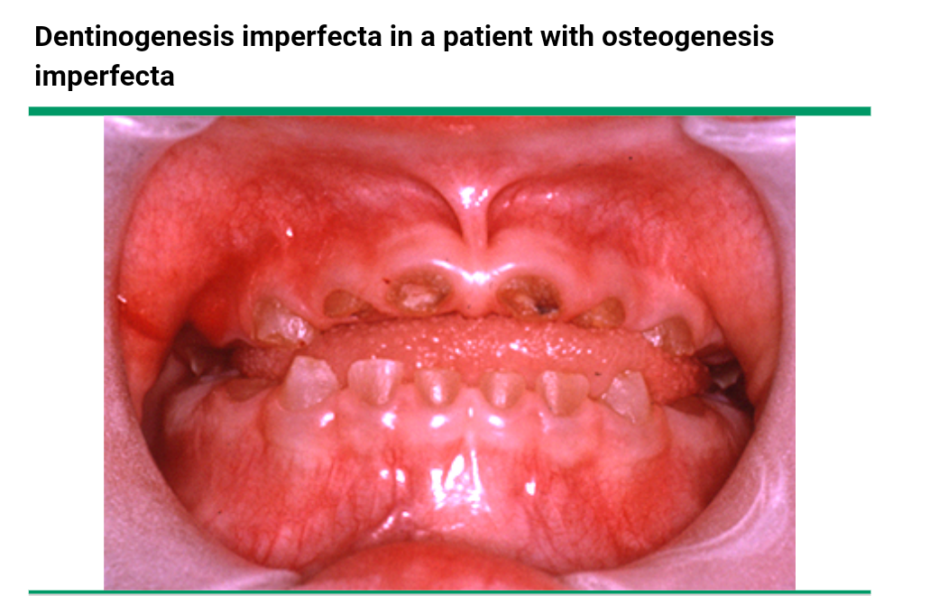

Slide 7
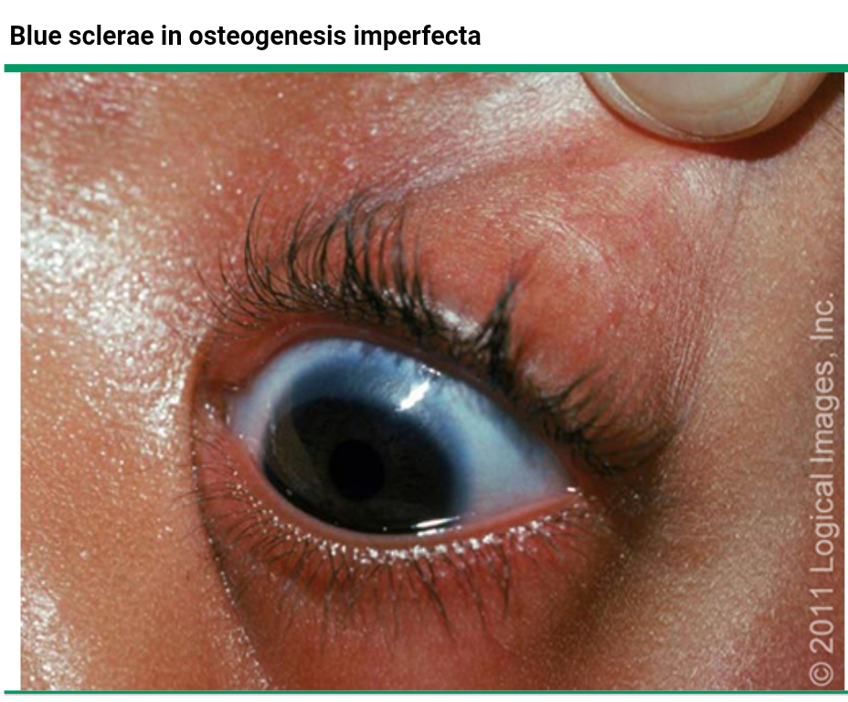

Slide 8
CLASSIFICATION
In OI patients there are significant differences in severity (amount of bone fractures, bone deformation) and the presence of secondary clinical features.
This clinical variability in OI has led to a classification in five types of OI (van Dijk and Sillence, 2014).

Slide 9
The original Sillence classification of four types of osteogenesis imperfecta has been expanded to include at least 10 additional numbered types of this disorder and the identification of additional mutant genes to which the illnesses can be attributed

Slide 10
The mildest, and most common type of OI is type I.
This type is associated with fractures, blue sclerae, and hearing impairment.
People with OI type 1 rarely have congenital fractures but when they start to walk and consequently fall, fractures occur.
These individuals often have multiple fractures in childhood, usually without bone deformation, but improve clinically after puberty and have a normal life expectancy

Slide 11
Osteogenesis imperfecta type I:
autosomal dominant (new mutation in 33% of patients) due modestly decreasing production of intact procollagen type I.
relatively benign
intensely blue sclerae that are present at birth and persist throughout adulthood,
modestly low bone mass,
infrequent fractures with little deformity
low normal adult stature,
hearing loss in 50%,
mitral valve prolapse in 18%,
rarely dentinogenesis imperfecta (osteogenesis imperfecta type IB).

Slide 12
OI type II is a perinatal lethal form with fractures showing as early as 14–16 weeks of gestation.
Affected fetuses and infants are usually stillborn, or die within a few days to weeks after birth due to multiple thoracic fractures causing respiratory complications, and possibly have an intrinsic pulmonary collagen pathology

Slide 13
Osteogenesis imperfecta type II :
lethal in the perinatal period or in early infancy.
usually the result of de novo heterozygous mutations in COL1A1 or COL1A2
in utero fractures,
long bone deformities,
very little calvarial mineralization,
death due to respiratory insufficiency

Slide 14
The most severe OI type compatible with surviving the neonatal period is type III.
In people with OI type III, bone fractures are visible around 18 weeks of pregnancy, and after birth fracture frequency is very high, leading to severe deformationss of the skeleton.
Individuals with OI type III may suffer hundreds of fractures, and often have a markedly short stature, progressive deformities, severe scoliosis, and a shortened life span.
DI is common and sclera has variable hue.

Slide 15
Osteogenesis imperfecta type III
autosomal dominant
recurrent fractures leading to progressive bone deformities that are often apparent at birth,
kyphoscoliosis,
extreme short stature,
blue sclerae that lighten with age,
abnormal dentition (in 80% of children younger than 10 years of age),
hearing loss.

Slide 16
OI type IV is a moderate form, with a phenotype spanning between types I and III in severity and clinical characteristics
Type IV can be progressive and deforming although typically not as deforming as in OI type III.

Slide 17
Osteogenesis imperfecta type IV
autosomal dominant
usually associated with point mutations or small deletions in COL1A2 and occasionally in COL1A1.
variable severity with prolonged survival,
mild to moderate bone deformities,
short stature,
normal sclerae,
Dentinogenesis imperfecta,
hearing loss.

Slide 18
Type V is a rare subtype and characterized clinically by inability of pronation and supination due to uni-or bilateral calcification of the interosseous membrane between bones of the forearm.
Furthermore, in type V increased callus formation is often observed.

Slide 19
osteogenesis imperfecta type V
autosomal dominant
phenotypically similar to osteogenesis imperfecta type IV
calcification of the interosseous membranes between radius and ulna
exuberant callous formation at fracture sites.
Moderate to severe bone fragility
moderate to mild growth retardation
dislocation of the radial head,
white sclerae,
normal dental development.

Slide 20
Osteogenesis imperfecta type VI:
phenotypically similar to type IV
autosomal recessive
severe bone fragility that first manifests after 6 months of age,
excess unmineralized osteoid,
and a “fish-scale” pattern of lamellation of bone matrix on microscopic examination consistent with a defect in bone mineralization
do not respond to treatment with bisphosphonates

Slide 21
DISEASE CLASSIFICATION
A more useful clinical classification, is based upon the typical problems that manifest in infants, children, and adults with mild, moderate to severe, and lethal disease.

Slide 22
Mild (type I)
Bone fragility is the least severe in type I OI .
The fracture rate is variable. Individuals with type I OI may have few or no fractures before puberty or numerous fractures throughout their lives.
Deformity is minimal, and stature is usually normal.

Slide 23
Adults with OI type I may present with premature or accelerated osteoporosis following menopause.
In addition, adults may present with premature hearing loss, predominantly mixed conductive and sensorineural that begin in the second to fourth decade of life and is generally progressive.

Slide 24
Moderate to severe (types III to IX)
Bone fragility is moderate to severe in patients with OI types III, IV, V, VI, VII VIII, and IX.
Those with OI type III are most severely affected. However, children with OI type VII and VIII may also develop a severe, lethal type of OI resembling OI type II.

Slide 25
Children with OI of these types have an increased number and frequency of fractures, mild to moderate bone deformities, kyphoscoliosis, and variable short stature.
Some children are immobile and require motorized wheelchairs. In addition, children may develop ossicular dislocation, stapes fixation, or fracture of the ossicles, resulting in conductive hearing loss

Slide 26
Adults with moderate OI develop hearing loss and osteoporosis, similar to adults with mild OI. However, the onset may be earlier and the expression more intense.
Mothers are prone to accelerated bone loss following pregnancy and breastfeeding. Aging and physical inactivity also accelerate OI-related osteoporosis.

Slide 27
Hypermobility of the joints of the hands, wrists, and feet can cause pain and decreased function requiring orthopedic intervention.
Cardiovascular abnormalities are more common in patients with OI, particularly type III, compared with the general population.
The practical aspect of identifying moderate to severe OI is that bisphosphonate therapy is helpful in these patients.

Slide 28
Lethal perinatal form (type II)
Patients usually die in utero or in early infancy.
Severe fractures and pulmonary failure are typical problems that accelerate death in this group.
Treatment of OI type II is supportive.

Slide 29
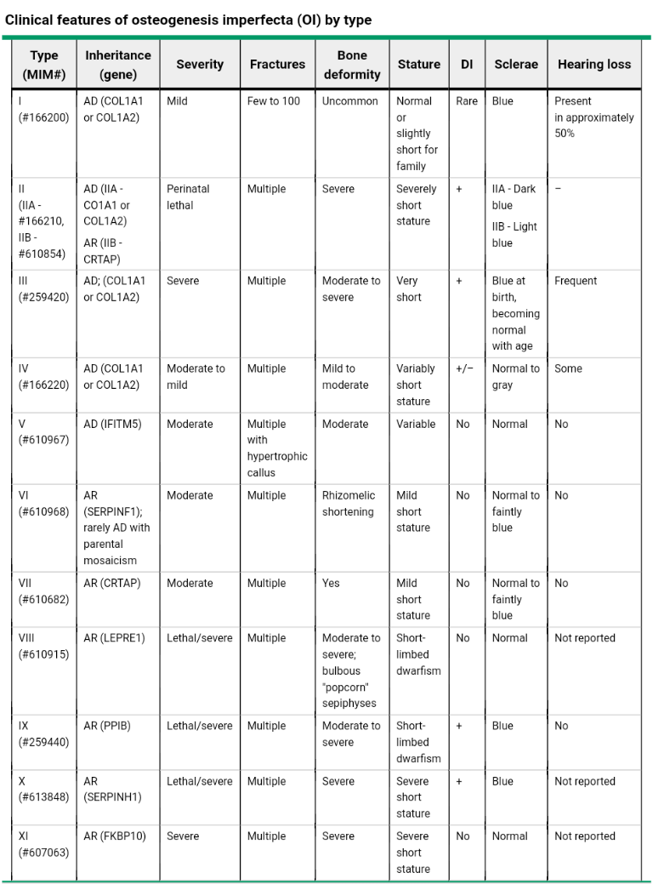

Slide 30
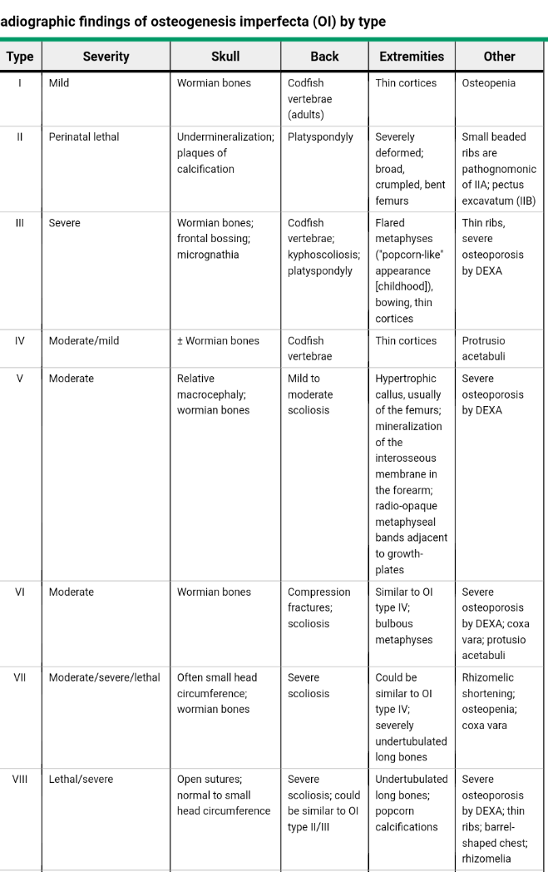

Slide 31
PATHOGENESIS
OI is most commonly caused by mutations in genes encoding the alpha-1 and alpha-2 chains of type I collagen or proteins involved in posttranslational modification of type I collagen.
Most patients with OI have an autosomal dominant mutation in COL1A1 (located at 17q21.31-q22) or COL1A2(located at 7q22.1) that affects the structure of one of the two alpha chains of type I collagen.

Slide 32
Type I collagen fibers are polymers of tropocollagen molecules, each of which is a triple helix that contains portions of one alpha 2 and two alpha 1 polypeptide chains.
Type I collagen is an important structural protein for bone, tendon, ligament, skin, and sclerae.
Defective bone quality explains many clinical aspects of OI.

Slide 33
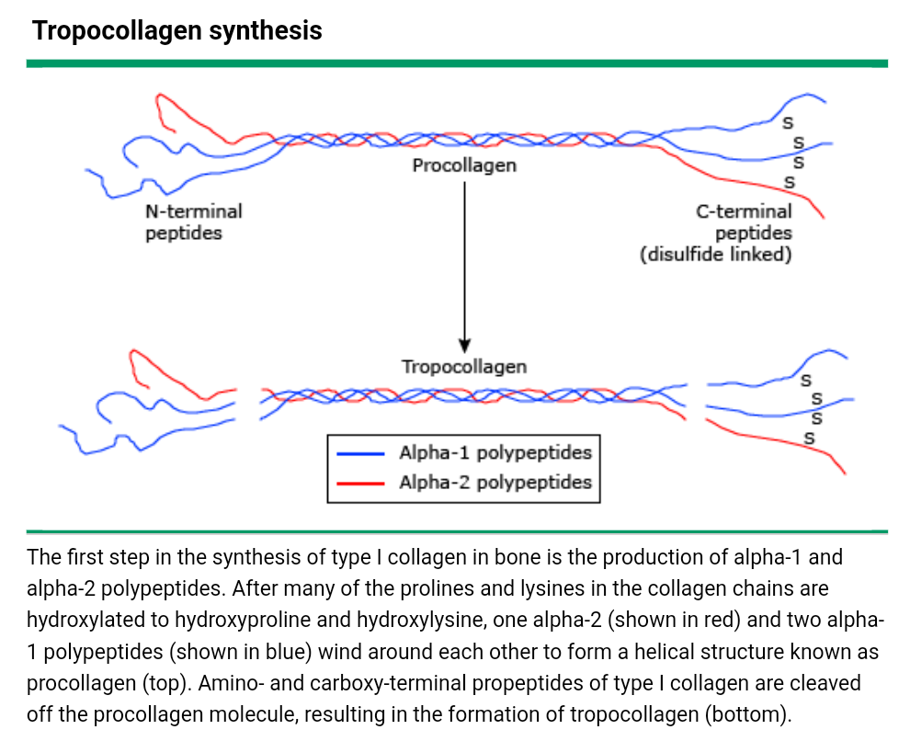

Slide 34
The severity of the clinical presentation depends upon the effect of the mutation.
Mutations in COL1A1 or COL1A2 that lead to decreased amounts of normal collagen cause the mild phenotype seen in type I OI.
Mutations that disrupt the formation of the normal type I collagen triple helix cause the lethal phenotype seen in type IIA OI.
Other COL1A1 and COL1A2 mutations that result in structural protein defects cause moderate (type IV) and severe, but not lethal (type III), forms of OI.

Slide 35
COL1A1 and COL1A2 genes are normal in approximately 10 percent of cases.
Many of these patients have autosomal recessive genetic defects.

Slide 37
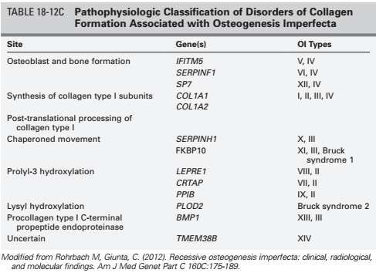

Slide 38
LABORATORY FINDINGS
Biochemical parameters of bone and mineral metabolism are usually normal in OI,
But some abnormalities may be noted, including:
Elevated levels of serum alkaline phosphatasereported in type VI OI, reflecting impaired bone mineralization.
Hypercalciuria is common in OI children, and its magnitude appears to reflect the severity of the skeletal disease.
The children with hypercalciuria were of shorter stature and had a greater lifelong fracture rate compared with OI children with normal urinary calcium excretion.
Renal function was not compromised.

Slide 39
Markers of bone formation (C-terminal propeptide of type I procollagen) may be lower, and markers of bone resorption (C-telopeptide of type I collagen) can be higher in OI, particularly in severely affected subjects

Slide 40
RADIOLOGIC FINDINGS
diffusely low bone mass,
thin cortices,
metaphyseal flaring,
fractures and bone deformities
wormian skull bones (frequent but not pathognomonic of osteogenesis imperfecta),
platybasia that may compress overlying hindbrain,
vertebral compression
triradiate pelvis

Slide 41
Bone densitometry reveals decreased mineralization, the extent of which correlates to a degree with clinical manifestations.

Slide 42
PATHOLOGY
Bone histology may show disorganized (woven) bone, especially in more severely affected children.
A bone biopsy study in 70 children with types I, III, and IV OI demonstrated normal mineralization with significant reductions in cortical width, cancellous bone volume, trabecular number, and trabecular width. This study also found significantly increased bone remodeling (turnover) in all types of OI studied

Slide 43
The latter observation provides a rationale for the use of bisphosphonates in children with OI.
Bone remodeling, however, is normal in type VI OI, which is characterized by defective mineralization, and, thus, bisphosphonates should not be prescribed to these children.

Slide 44
DIAGNOSIS
The clinical diagnosis of OI is based on the signs and symptoms.
The diagnosis is usually straightforward in individuals with bone fragility and a positive family history or several extraskeletal manifestations.

Slide 45
However, in the absence of these features, diagnosis may be difficult.
Extraskeletal manifestations can be
  subclinical (eg, hearing loss),
  nonspecific (eg, dark or bluish sclerae are commonly present in infants, limiting the usefulness of this sign in this age group),
  or more obvious at certain ages (eg, dentinogenesis imperfecta may be more noticeable in the primary than the permanent dentition).

Slide 46
Sequence analysis of DNA for mutations in COL1A1 and COL1A2 can detect 90 percent or more of all collagen type I mutations.
Negative studies do not exclude the diagnosis, because of the OI types that are not associated with type I collagen mutations (types II B and types V through IX) and the false negative rate of approximately 10 percent.

Slide 47
DIFFERENTIAL DIAGNOSIS
child abuse,
various forms of rickets including hypophosphatasia,
McCune-Albright syndrome of fibrous dysplasia,
juvenile Paget disease,
juvenile osteoporosis.

Slide 48
Child abuse
multiple fractures in various stages of healing, similar to children with moderate to severe types of OI.
metaphyseal, rib, and skull fractures.
OI is a well-recognized cause of fractures that occur with minimal or no witnessed trauma, but it is a rare disorder and consequently is seldom the cause of such fractures.

Slide 49
Rickets
Rickets can cause slow growth, bone deformities, elevation of alkaline phosphatase, defective bone mineralization, and in some forms, abnormal tooth formation.
Scleral abnormalities and hearing loss do not occur.
Radiographic findings are characteristic: an increased width of the epiphyseal plate, irregular hazy margins of the distal metaphysis, and marginal metaphyseal overgrowth that results in a ball-in-cup-like appearance.
Vitamin D-resistant rickets in children, or osteomalacia in adults, may be associated with hypophosphatemia.

Slide 50
Osteomalacia
Osteomalacia in adults can cause bone pain, insufficiency fractures, and alkaline phosphatase elevation,
but neither hearing loss nor blue sclerae.
The most common radiologic finding in osteomalacia is: reduced bone density;
other abnormalities include Looser's zones or pseudofractures, and the loss of distinctiveness of trabeculae in vertebral bodies.

Slide 51
Other skeletal syndromes
Other skeletal syndromes with moderate to severe bone fragility and/or deformity include:
Bruck syndrome: previously called OI with congenital joint contractures,
an autosomal recessive disorder.
Congenital contractures of the knees, ankles, and feet; webbing of the elbow and knee; and clubfoot.

Slide 52
Other skeletal syndromes
Osteoporosis-pseudoglioma syndrome:
an autosomal recessive disorder that was previously called the ocular form of OI.
caused by deletion of the gene for low-density-lipoprotein (LDL) receptor-related protein 5 (LRP-5).
Other characteristic findings : microcephaly; pseudoglioma (inflammatory changes of the vitreous body, secondary to iridochoroiditis, that mimic retinal glioma); blindness (with onset in infancy); vitreoretinal abnormalities; cataract; absent anterior chamber; iris atrophy; intraocular calcification; and hypotonia

Slide 53
Other skeletal syndromes
Panostotic fibrous dysplasia:
The extreme form of polyostotic fibrous dysplasia (McCune-Albright syndrome),
Caused by a somatic mutation in the guanine nucleotide stimulatory protein (GNAS1) gene.
Characterized by cystic or ground glass lesions in all bones.

Slide 54
Other skeletal syndromes
Juvenile Paget disease:
Also known as idiopathic hyperphosphatasia
An autosomal recessive disorder
Increased serum alkaline phosphatase, which distinguishes it from OI, in which alkaline phosphatase is usually normal.
However, elevated levels of serum alkaline phosphatase have been reported in some patients with type VI OI.

Slide 55
Other skeletal syndromes
Mild forms of OI may manifest with only premature osteoporosis or severe postmenopausal bone mineral loss.

Slide 56
MANAGEMENT
The goals of therapy for patients with OI are to reduce fracture rates, prevent long-bone deformities and scoliosis, minimize chronic pain, and maximize mobility and other functional capabilities.
Treatment requires a coordinated multidisciplinary team approach and consists of physical therapy (PT), surgical interventions, medications, and, in some cases, experimental therapies.
Patients with OI need monitoring for potential complications.

Slide 57
No cure for OI exists. Supportive management consists of orthopedic treatment, physical therapy, dental treatment and/or treatment for hearing loss.
Calcium and vitamin-D supplements are considered useful supportive agents as they are vital in bone physiology, and are often prescribed as they are well tolerated and inexpensive.
Pharmacological treatment is also available for patients with OI, namely oral or intravenous bisphosphonates (BP).
These medications inhibit bone turnover by decreasing osteoclast activity, therefore increasing overall bone mass, and providing greater skeletal strength.

Slide 58
The main limitation of bisphosphonate therapy is that BP are not aimed at the primary defect in OI: abnormal and/or decreased collagen type I production by osteoblasts.
Other pharmacological therapies that are currently being investigated as treatment for OI include Denosumab (a RANKL inhibitor) and anabolic agents such as Teriparatide (recombinant form of parathyroid hormone), Cathepsin K inhibition, Growth hormone, Sclerostin-inhibitory antibodies and TGFβ inhibition

Slide 59
BISPHOSPHONATE THERAPY
Bisphosphonates are stable analogs of pyrophosphate and are potent inhibitors of bone resorption and bone turnover.
They are used widely in the treatment of osteoporosis in adults and have reduced the risk of fractures in women with postmenopausal osteoporosis, men with osteoporosis, and patients with glucocorticoid-induced osteoporosis.

Slide 60
Bisphosphonates are the mainstay of pharmacologic fracture-prevention therapy for most forms of OI (except for type VI , in which bone mineralization is defective), although none are approved specifically for use in either children or adults with OI.

Slide 61
Bisphosphonates for the management of infants, children and adolescents with osteogenesis imperfecta types I, III, and IV has been of substantial benefit.
Patients often responded symptomatically (decreased musculoskeletal pain, increased mobility) and bone mass has increased, but the effect of bisphosphonates on the fracture rate is uncertain

Slide 62
Treatment with intravenous pamidronate is suggested for patients with all forms of OI, except type VI, in whom clinical benefits are likely to outweigh potential long-term risks:
those with long-bone deformities,
vertebral compression fractures,
and ≥3 fractures per year

Slide 63
Reports of bisphosphonates for children with OI are encouraging, with a reduced fracture frequency of up to 100 percent in observational studies.
The long-term effects on structural outcomes such as scoliosis and basilar invagination are unclear.
The optimal dose range, dosing interval, duration of treatment, and the long-term efficacy and safety profile of these drugs in the treatment OI have yet to be established.

Slide 64
Intravenous pamidronate
The majority of information about the use of bisphosphonates in OI comes from uncontrolled studies of cyclical infusions of pamidronate in various regimens in children with OI.
These reports have noted increased bone mineral density (BMD), decreased fracture rate, and improved functional abilities, mobility, ambulation, and pain, without negative effects on fracture healing or growth rate in most studies, even when used in young children.

Slide 65
Pamidronate is administered intravenously in cycles of three consecutive days at two- to four-month intervals with doses ranging from 0.5 to 1 mg/kg/day, depending upon age, with a corresponding annual dose of 9 mg/kg.
The smallest effective dose should be used, with careful monitoring of vertebral geometry, long-bone fractures, and BMD before imitating a new cycle of treatment.

Slide 66
The short-term endocrine and metabolic effects of intravenous pamidronate therapy observe d in 165 children (age two weeks to 17.9 years) who received cyclic infusions included:
Short-lived lowering of serum calcium concentrations following three sequential daily infusions (none requiring supplemental intravenous calcium)
Increased parathyroid hormone (PTH) levels
Increased 1,25-dihydroxyvitamin D levels
Decreased urinary excretion of type I collagen degradation products (N-telopeptide of type I collagen, also called amino-terminal collagen crosslinks or NTX), a marker of bone turnover

Slide 67
There do not appear to be any adverse short-term effects on bone quality or fracture healing despite the significant reduction in the rate of bone turnover with bisphosphonate treatment.
Iliac bone biopsy results in 45 patients treated with pamidronate for a mean of 2.4 years revealed that bone formation and bone mineralization were not impaired.
Chronic suppression of bone turnover in children with OI does not appear to be associated with any detrimental effects on linear growth rate.

Slide 68
However, it appears that most of the benefit of pamidronate therapy occurs during the first two to four years of therapy.
Nonetheless, it is prudent to reserve its use for patients in whom clinical benefits are likely to outweigh the long-term risks since the long-term effects of pamidronate therapy are unknown

Slide 69
It has been recommended that bisphosphonates be employed in infants with osteogenesis imperfecta with congenital and recurrent fractures, deformities of the long bones, and decreased bone mass.
Infants as young as 2 months of age have safely tolerated 4-hour intravenous infusions of pamidronate (0.5 mg/kg/day for 3 consecutive days every 6 to 8 weeks) realizing clinical improvement such as decline in bone pain (perhaps a placebo effect), an increase in lumbar vertebral BMD, and a decrease in fracture rate after 1 year of therapy.

Slide 70
Bisphosphonate administration is also recommended for children with OI and recurrent fractures of the extremities or vertebral collapse that is symptomatic in concert with demonstrated decreased bone mineralization
During 2 to 4 years of intravenous pamidronate administration, increase in vertebral (trabecular) bone mass and size are accompanied by a decline in the extent of vertebral compression and fewer compressed vertebrae than in untreated patients.

Slide 71
In older children and adolescents with osteogenesis imperfecta, bisphosphonates are employed if the patient has more than two fractures in 1 year and bone mass is low.

Slide 72
Near maximal benefits of bisphosphonates on lumbar vertebral aBMD (DEXA) and on mean cortical width are achieved within the first 2 to 4 years of treatment with little further change with more prolonged therapy
Because of the accumulation and persistence of bisphosphonates in bone and their long-term effects, it is recommended that these agents be administered to patients with osteogenesis imperfecta for no more than 2 to 4 years.

Slide 73
In addition to pamidronate, children with osteogenesis imperfecta have been treated with intravenous infusions of zolendronate every 4 to 6 months or with oral residronate or alendronate.

Slide 74
Intravenous zoledronic acid
Treatment with intravenous zoledronic acid requires infusion every six months.
The safety and efficacy of zoledronic therapy were evaluated in a study of 17 patients with mild (type I) OI aged 1.5 to 16.8 years who were treated for one to three years.
Bone density increased after two years of treatment. Two patients developed symptomatic hypocalcemia.
It is difficult to determine from the reported results whether the fracture rate decreased because of a short duration of follow-up and small number of fractures.

Slide 75
Oral risedronate
The safety and efficacy of oral risedronate have been evaluated in two randomized trials.
In the first, 53 children were randomly assigned to receive one of three doses (0.2, 1, or 2 mg/kg per week) of risedronate for two years.
BMD increased and long-bone bowing deformities decreased with increasing risedronate dose.
The fracture rate decreased significantly in all three groups during the treatment period compared with the previous two years, but there was no difference among the groups.

Slide 76
In the second trial, 147 children with mostly mild phenotype were randomly assigned to receive oral risedronate (2.5 mg if weight was 10 to 30 kg or 5 mg if weight was >30 kg) or placebo for one year, followed by open-label treatment in all subjects for two additional years.
There were significant differences between the risedronate and placebo groups in mean lumbar spine areal BMD and clinical nonvertebral fractures.
Adverse events were similar in the two groups.
There were no significant differences between the two groups with regard to BMD or fractures during the open-label phase.

Slide 77
Oral alendronate
The effect of daily oral alendronate (5 or 10 mg based on body weight: below or above 40 kg, respectively) was studied in 139 children, aged 4 to 18 years, with severe OI in a randomized trial.
After two years of treatment, alendronate produced a significant increase in lumbar spine BMD compared with placebo.
There were no significant differences between groups with regard to growth velocity, incidence of long-bone fractures, bone pain, or pediatric disability score.
The safety and tolerability of alendronate were favorable and comparable with that of placebo. Longer-term data will be required to fully assess the bone safety and efficacy of alendronate in OI children.

Slide 78
Pretreatment evaluation and monitoring
Pretreatment evaluation and monitoring of bisphosphonate treatment in children with OI is similar to that in adults with osteoporosis.
Calcium and vitamin D intake: based upon RDAs for a child's age (700 to 1300 mg/day for calcium and 400 to 600 int. units for vitamin D). The child should be supplemented before bisphosphonate treatment is initiated if dietary intake is inadequate.
Indices of calcium homeostasis (eg, calcium, phosphorous, PTH) and renal function should be assessed before initiation of treatment and followed every 6 to 12 months.
Calcium levels should also be assessed before each intravenous bisphosphonate infusion to assure that the child is not hypocalcemic.

Slide 79
Intravenous versus oral therapy
In one small, randomized trial comparing oral alendronate with intravenous pamidronate for children with OI, BMD increased similarly in both groups.
Nonetheless, many clinicians believe that intravenous pamidronate is more effective in treating bone pain and possibly has a greater effect on fracture risk reduction than oral therapy.

Slide 80
ADULTS
Adults with OI may have a higher fracture risk than healthy peers because they are unlikely to reach an equivalent peak BMD.
In addition, the structural defects of collagen may contribute to decreased bone strength, independently of BMD, thereby increasing the risk of fractures.

Slide 81
Postmenopausal bone loss beginning from a lower than normal peak may increase fracture risk in untreated women with OI compared with postmenopausal women in general.
Thus, treatment with selective estrogen receptor modulators (SERMs) or bisphosphonates should be considered immediately after menopause to prevent accelerated bone loss and osteoporotic fractures in women with the superimposed problems of postmenopausal osteoporosis and OI (self-history or family history).

Slide 82
In an observational study, 90 adults with OI (types I, III, and IV) were treated with intravenous pamidronate (n = 28), oral alendronate (n = 10), oral risedronate (n = 17), or not treated (n = 35) for an average of 52 months.
A significantly increasing rate of BMD per year of treatment was seen in all types of OI treated with pamidronate but only in patients with type I OI treated with oral bisphosphonates.
Fracture rate decreased significantly only in the type III/IV patients treated with pamidronate.

Slide 83
Off-label bisphosphonate treatment of adults with OI must be considered on a case-by-case basis and in general should be based upon the assessment of fracture risk using BMD and clinical risk factors, such as history of nontraumatic fracture, family history of osteoporosis, weight, smoking, and alcohol consumption in addition to the risk associated with OI.

Slide 84
The relative contribution of OI, besides low BMD, to the fracture risk in adults as a result of defective bone quality is unknown.
Nevertheless, it is suggested that the therapeutic threshold should be lower for adults with OI with the same level of fracture risk as compared with those without OI.

Slide 85
Adverse effects
Adverse effects of pamidronate therapy include:
An influenza-like syndrome (fever, myalgias, malaise, rash, vomiting) following the first infusion. It is seen after the first dose and is unlikely to occur with subsequent doses
Unexplained rapid weight gain that may interfere with rehabilitation
Uveitis: This adverse effect resolves with discontinuation of the drug
Respiratory distress in infants younger than two years

Slide 86
transient hypocalcemia
increased levels of PTH and calcitriol,
decreased levels of markers of bone turnover.

Slide 87
Adverse musculoskeletal events in adults:
Osteonecrosis of the jaw (ONJ) primarily associated with intravenous bisphosphonate use in cancer patients who may have jawbone vulnerability resulting from radiation therapy to the head and neck or from cancer chemotherapy.
ONJ also been reported in some patients on oral bisphosphonates for osteoporosis.
It is important to document good dental health before commencing bisphosphonate therapy.

Slide 88
Atypical long-bone fractures: particularly in the subtrochanteric area of the femur, after long-term use of bisphosphonates.
Both ONJ and the atypical long-bone fractures may be related to significant suppression of bone turnover that interferes with normal bone repair and renewal processes.

Slide 89
Musculoskeletal syndrome: bone, joint, and muscle pains have been reported with bisphosphonate therapy.
In some patients, the musculoskeletal syndrome is seen early in therapy, is tolerated, and goes away with time.
In other patients, the musculoskeletal syndrome may lead to discontinuation of bisphosphonate therapy.

Slide 90
Neither ONJ nor atypical fractures have been reported in OI children treated with bisphosphonates

Slide 91
ORTHOPEDIC AND OTHER SURGERY
Experienced orthopedic surgeons with an interest in OI are ideal to helping OI patients reach the highest functional level possible
Typical orthopedic services:
management of fractures (with quick mobilization to prevent bone loss due to inactivity)
placement of intramedullary rods to prevent or correct long-bone deformities.
Telescoping rods may be appropriate for patients older than two years who are actively growing.
Severe scoliosis: may benefit from surgery in carefully selected cases.

Slide 92
Neurosurgical correction: for basilar skull deformity that causes nerve compression or other neurologic symptoms
Hearing loss: Stapedotomy may be appropriate for some patients with predominantly conductive hearing loss

Slide 93
The management of fractures in OI is similar to patients without OI.
Early mobilization is particularly important to prevent bone loss secondary to inactivity.

Slide 94
Anesthesia
Cardiopulmonary compromise: kyphoscoliosis, restrictive lung disease, valvular heart disease, aortic root dilatation may require invasive monitoring and/or modification of the choice of anesthetic induction agents.
Airway management: short neck, megalocephaly, limited range of motion of cervical spine may cause difficulty with airway management

Slide 95
Risk of facial bone fractures, cervical spine injury, and dental damage during endotracheal intubation, placement of supraglottic airways, or even mask ventilation.
Every effort should be made to minimize cervical spine motion during airway management.

Slide 96
Bone fragility and joint laxity: risk of positioning-related fracture and joint dislocation.
Fractures can theoretically occur from fasciculations that occur with administration of succinylcholine.
Fracture or bruising may also occur with excessive inflation of the blood pressure cuff. The use of a manual blood pressure cuff or an intra-arterial catheter for blood pressure monitoring may avoid such injuries.

Slide 97
Coagulopathy: capillary fragility and platelet function abnormalities can result in significant hemorrhage during surgery or slow oozing after the procedure.
Large-bore intravenous access should be obtained before major surgical
Nonsteroidal anti-inflammatory drugs should be avoided
Bleeding time and coagulations tests should be obtained prior to surgical procedure.
If there is a history suggestive of abnormal bleeding, hematology consultation is advised

Slide 98
Hyperthermia: may occur for unclear reasons, but these patients are not at increased risk of malignant hyperthermia.
Forced-air blankets or water-circulating mattress covers are usually adequate to maintain normothermia

Slide 99
Regional anesthesia: Regional anesthesia techniques (ie, neuraxial anesthesia or peripheral nerve blocks) may be options for some procedures and would avoid the need to manage the airway.
Spinal deformity may make it technically challenging and unpredictable.
A careful bleeding history should be taken, and normal coagulation should be documented prior to neuraxial anesthesia, though platelet dysfunction will not be detected by standard coagulation testing.

Slide 100
PHYSICAL AND OCCUPATIONAL THERAPY
Results of PT and OT interventions are not always dramatic, but the children and their parents appreciate even small advances that can be quite meaningful to them in the long term.
Physical therapists for designing a physical activity program that minimizes fracture risk while ensuring mobilization to prevent contractures and bone loss from immobility.
Occupational therapists can address the impairments in activities of daily living secondary to upper or lower limb deformity.

Slide 101
PRIMARY CARE CONSIDERATIONS
Routine care and immunizations
Growth and head circumference.
Hearing (formal audiology initially at nine months of age and then at regular intervals).
Vision screening every two to three years

Slide 102
PRIMARY CARE CONSIDERATIONS
Developmental monitoring: referral to early intervention services for those younger than three years, and referral to physical therapy (PT) and occupational therapy (OT) for those older than three years
Pneumococcal and influenza vaccination
Dental referral for dentinogenesis imperfecta.
Educational program: Chronic illness and physical disability may affect school performance. Children with OI should receive an educational program to address these issues

Slide 103
MONITORING FOR COMPLICATIONS
Regular surveillance for potential complications (eg, hearing loss, worsening of osteoporosis) so that appropriate intervention is initiated as soon as possible.
A hearing test to evaluate for conductive and sensorineural hearing loss, dual-energy absorptiometry (DXA) to assess bone mineral density (BMD), and spirometry to monitor for restrictive defects secondary to rib and vertebral fractures every two years (or sooner if clinically indicated), particularly in patients with moderate to severe OI.

Slide 104
Spirometry: yearly for patients with type III deforming OI or other moderate to severe types of OI (to evaluate for restrictive lung disease due to kyphoscoliosis and chest deformities)
Electrocardiogram and Echocardiogram: every two years (to detect aortic root dilation and valvular dysfunction).

Slide 105
Basilar skull deformity could lead to basilar invagination
Neurologic examination and cranial assessment as indicated by symptoms or behavioral changes, particularly in patients with type III OI and other forms with a similar phenotype (types VII to IX)

Slide 106
Skeletal radiographs: At the time of diagnosis and then every one to two years (or sooner if clinically indicated) and coordinated with orthopedic advice
Yearly (or more frequently as clinically indicated) assessment of BMD and radiologic assessment of long bones and spine for children receiving bisphosphonate treatment to determine the effect of treatment

Slide 107
EXPERIMENTAL THERAPIES
Growth hormone:
Still an experimental therapy. The theoretical basis for using GH is to stimulate bone formation and also to increase stature. No studies have extended beyond two years.
Cell replacement therapies:
Although transplantation of mesenchymal stem cells or bone marrow stromal cells have a good theoretical basis for correcting genetic defects of bone and cartilage, more clinical research is needed.
Gene therapy :specific gene replacement and mutation silencing strategies.

Slide 108
RANK ligand inhibition:
Denosumab is a biologic agent that inhibits receptor activator of nuclear factor kappa-B (RANK) ligand, leading to decreased osteoclast formation with a consequent increase in bone mass.
It has been approved for treatment of osteoporosis in adults and for other indications.

Slide 109
Limited pediatric data.
Bone turnover returns to baseline within 12 months of discontinuing denosumab.
Rebound in bone turnover could result in hypocalcemia.
One strategy under exploration is to follow denosumab treatment with a follow on bisphosphonate treatment of finite duration so as to consolidate the bone mass gains.

Slide 110
PROGNOSIS
Depends upon the type of OI .
Mild OI (type I) typically have a few childhood fractures, no long-bone deformity, and a normal life expectancy.
Moderate to severe (types III to IX) have an increased risk of premature death in both childhood and adult life compared with the general population.
Shortened lifespan may be related to immobility and thoracic deformities in a subset of patients with moderately severe disease.
These problems create an increased risk of severe pulmonary infections and subsequent loss of lung function.

Slide 111
THANKS

