Slide 1
IN THE NAME OF GOD

Slide 3
Conventional & New Treatments of Hypoparathyroidism

Slide 4
Etiology

Slide 7
Acute and chronic manifestations of hypocalcemia and hypoparathyroidism

Slide 8
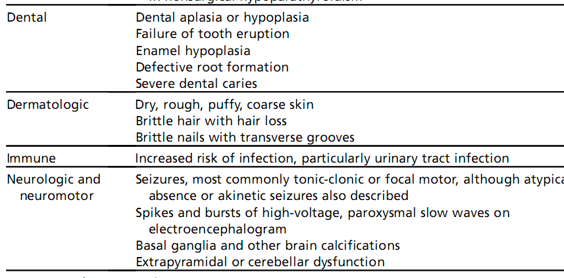

Slide 9
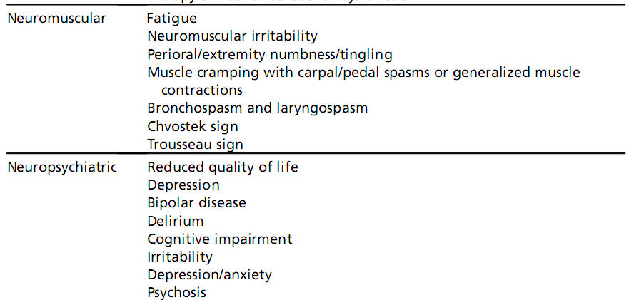

Slide 11
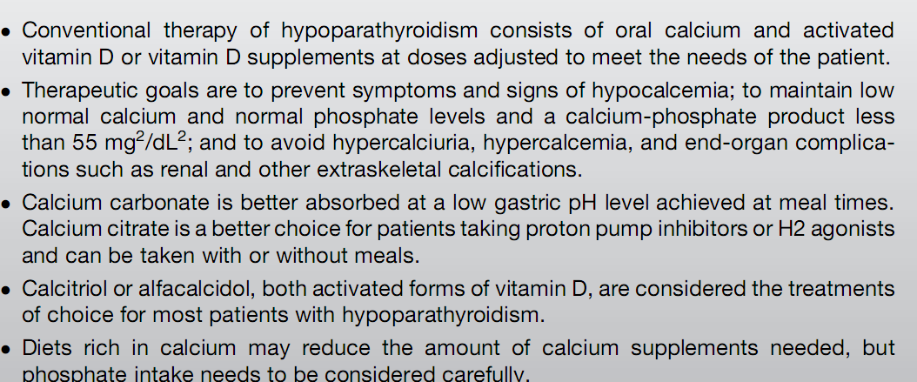

Slide 12
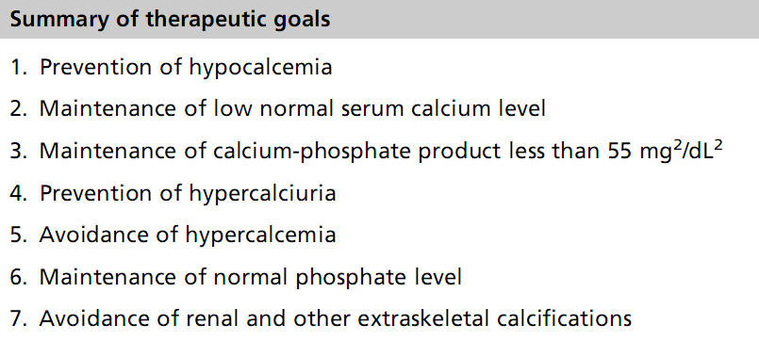

Slide 13
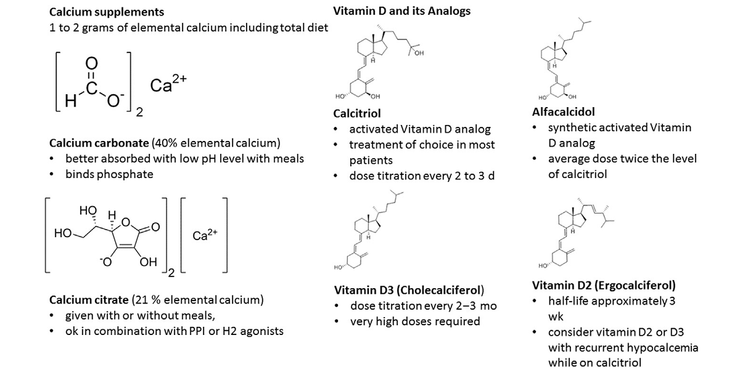

Slide 14
ACUTE MANIFESTATIONS OF HYPOPARATHYROIDISM
The maintenance of a normal extracellular ionized calcium concentration is critical for multiple tissues and organ systems, including the brain, heart, and skeletal muscles. Acute or severe hypocalcemia can cause well-recognized manifestations, some life threatening, and potentially leading to respiratory or cardiac arrest.The rate of development and severity of hypocalcemia may affect the presentation.

Slide 15
Patients with acute post-parathyroidectomy reductions in parathyroid hormone (PTH) concentrations may complain of severe tetany despite a serum calcium concentration that is close to the normal range. The symptoms are
due primarily to the rapid reduction in the serum calcium and not the actual level per se. In contrast, patients with autoimmune hypoparathyroidism that develops over a long period may be asymptomatic despite severe biochemical disturbances and evidence for ectopic soft tissue calcifications.

Slide 16
The Chvostek sign is neither a sensitive nor specific test for hypocalcemia. Approximately 10% to 25% of healthy individuals will have a positive Chvostek sign,6 and it can be negative in approximately 30% of hypocalcemic patients.7 By contrast, the Trousseau sign has a sensitivity approaching 94% to 99% and is present in only 1% of normocalcemic individuals.7,8 To elicit the Trousseau sign, a blood pressure cuff is placed on the upper arm and inflated above the systolic blood pressure for 3 minutes, occluding the brachial artery and vasa nervosum.

Slide 17
The cardiovascular manifestations of acute hypocalcemia can include
hypotension, bradycardia, impaired cardiac contractility, and arrhythmias. In the setting of an acute drop in serum calcium, there can be diminished vascular smooth muscle tone. This generalized state of vasodilatation can be refractory to fluid repletion and pressors until calcium is correcte. A more rapid drop in serum calcium is associated with additional prolongation of the QT interval. Torsades de pointes is a specific form of polymorphic ventricular tachycardia associated with a long QT interval. Although hypocalcemia can cause torsades de pointes, this unusual cardiac condition is more often reported in the presence of hypokalemia and hypopmagnesemia. Hypocalcemia can also cause ST, QS, and T-wave changes suggestive of myocardial infarction.

Slide 18
Seizures
Generalized tonic-clonic and focal motor seizures have been reported among the presenting symptoms of hypocalcemia, even in the absence of frank tetany. Atypical absence or akinetic seizures also have been reported, although much less frequently. Patients with hypocalcemic seizures have both spikes and bursts of high-voltage, paroxysmal slow waves on electroencephalogram (EEG). There is no correlation linking a specific serum calcium level to the seizure threshold or to EEG changes in hypocalcemia.

Slide 19
Papilledema
Papilledema can be a finding in severe hypocalcemia from any etiology. The pathophysiological mechanism remains poorly understood. Papilledema may be accompanied
by elevated cerebrospinal fluid pressure (eg, benign intracranial hypertension),but pressure is normal in many cases, and the term “pseudopapilledema” has also been used. It has been postulated that hypocalcemia decreases axonal transport, leading to swelling of the axons and optic disc. Papilledema, if present, improves with
resolution of hypocalcemia.

Slide 20
Psychiatric Symptoms
Delirium and cognitive impairment have been the most frequently reported psychiatric symptoms associated with acute hypocalcemia; also, irritability, depression, and anxiety. Psychosis is an uncommon presentation of acute hypocalcemia.

Slide 21
CHRONIC MANIFESTATIONS OF HYPOPARATHYROIDISM
The chronic complications of hypoparathyroidism can affect multiple organ systems, including the renal, neurologic, neuropsychiatric, skeletal, and immune systems. These manifestations of hypoparathyroidism may be due to the disease itself or to complications of therapy. Low PTH concentrations, chronic hypocalcemia, relative hypercalcemia, hyperphosphatemia, an elevated calcium phosphate product, and hypercalciuria have all been postulated to cause the chronic manifestations.

Slide 22
Renal
Due to the very elevated risk of renal disease in patients with hypoparathyroidism,the European Society of Endocrinology guidelines recommend measurement of 24-hour urine calcium and creatinine at least annually and renal imaging if serum creatinine rises or if there are symptoms of nephrolithiasis.

Slide 23
Basal ganglia calcification was first noted in association with hypoparathyroidism in 1939. The etiology for ectopic calcifications in hypoparathyroidism is thought to be due to an elevated calcium phosphate product. Another mechanism for basal ganglia calcification specifically may be through the actions of elevated serum phosphorus to activate the inorganic phosphate transporter pit1 (SLC20A1) resulting in the expression of osteogenic molecules in the caudate nucleus and gray matter. Basal ganglia calcification occurs in various infections and other diseases without metabolic disturbances, however, and the exact pathogenic mechanisms require further study.

Slide 24
Neuromotor abnormalities have been described in hypoparathyroidism, in particular symptoms of parkinsonism, including bradykinesia, shuffling gait, and resting tremor. Other extrapyramidal symptoms (chorea, hemiballismus) and cerebellar findings (truncal ataxia, disordered coordination) have also been described.

Slide 25
The association between hypoparathyroidism and cataract, primarily of the posterior subcapsular type in patients with nonsurgical hypoparathyroidism, was first described in 1880. Pohjola found a 58% prevalence of cataract in 69 patients with nonsurgical hypoparathyroidism. Goswami and colleagues36 found a 51% prevalence of cataract in nonsurgical disease, correlated to duration of disease and presence of basal ganglia calcification, as noted previously.

Slide 26
Chronic hypocalcemia can also cause cardiomyopathy and congestive heart failure that is reversible with treatment of hypocalcemia.

Slide 27
Quality of Life
Studies using well-defined metrics have demonstrated that quality of life in patients with hypoparathyroidism is reduced. Quality of life is reduced even when patients are taking sufficient calcium and active vitamin D therapy to maintain serum calcium levels at goal. Patients with hypoparathyroidism have reduced quality of life in both physical and mental health domains.

Slide 28
Skeletal Manifestations
Bone remodeling is markedly reduced in patients with hypoparathyroidism, and bone mineral density values are typically greater than healthy, age-matched controls.

Slide 29
Infection
In the studies from Underbjerg and colleagues, the risk of hospitalization due to infection was increased in postsurgical (HR 1.42, 95% CI 1.20–1.67) and nonsurgical disease (HR 1.94, 95% CI 1.55–2.44), particularly urinary tract infections in patients with nonsurgical disease. The excess risk of hospitalization for infection remained significant
even after exclusion of urinary tract infections.

Slide 30
Dermatologic
Chronic hypocalcemia is associated with dermatologic manifestations, including dry, rough, puffy, coarse skin; coarse and brittle hair with hair loss; and brittle nails with transverse grooves. The etiology for the nail disorders and dermatologic findings is believed to be angiospasm. These findings are not specific to hypoparathyroidism and can be reversed with treatment of hypocalcemia.

Slide 31
Dental
Enamel hypoplasia is the most common dental abnormality in patients with hypocalcemia. In the setting of hypocalcemia during early development before the teeth have entirely formed, dental aplasia or hypoplasia, failure of tooth eruption, defective root formation, and severe dental caries can occur. These dental abnormalities are obviously much more common among those with autoimmune forms of hypoparathyroidism.

Slide 32
Conventional therapy of hypoparathyroidism consists of oral calcium and activated vitamin D or vitamin D supplementation at varying doses. Calcium levels are usually restored to the low
normal range with conventional treatment, but several effects of PTH in bone and kidney and possibly in the central nervous system are likely not adequately addressed with conventional management.

Slide 33
First, hypocalcemia should be avoided to prevent complications such as tetany, seizures,painful muscle cramps, paresthesias, and other neuromuscular manifestationsand to minimize chronic fatigue, poor concentration, reduced memory, and cognitive function, which are often connected to the impaired quality of life that patients with hypoparathyroidism report. Clinical symptoms and signs of hypocalcemia by history,physical examination, and laboratory tests should be monitored every 6 months, once stable therapeutic dosing of calcium supplements and vitamin D analogues has been
achieved.

Slide 34
Second, serum calcium levels should be maintained slightly below the normal range (ie, no more than 0.5 mg/dL below normal) or in the low normal range. While adjusting treatment with calcium and activated vitamin D or vitamin D, clinical and laboratoryassessment (serum calcium, albumin, and phosphate levels) should be done frequently, up to a few times per week, weekly, or monthly, depending on the clinical circumstances and the treatment being adjusted.

Slide 35
Third, the calcium-phosphate product should be kept at less than 55 mg2/dL2 in an effort to prevent ectopic calcifications in the brain, kidneys, vascular system, and other soft tissues. If a patient is very stable, laboratory tests (serum calcium, phosphate, creatinine levels) may be obtained every 6 or 12 months. The same parameters should be reassessed with any changes of medications.

Slide 36
Fourth, hypercalciuria should be prevented or minimized to avoid kidney stone formation, nephrocalcinosis, renal dysfunction, and end-stage renal disease. Twenty-four–hour urinary calcium excretion and serum creatinine level and estimated glomerular filtration rate should be measured at least once yearly and after adjustments in medication doses. If a patient with hypoparathyroidism is taking thiazide diuretic, serum sodium, potassium, magnesium, and urea nitrogen levels should be added to the abovementioned measurements.

Slide 37
Fifth, hypercalcemia can lead to symptoms (eg, weakness, altered mental status, nausea, constipation, dehydration, and abdominal pain), increased risk of renal and soft tissue calcification, and renal dysfunction. Laboratory tests including serum calcium, phosphate, urea nitrogen, creatinine, and electrolyte levels should be obtained twice a year or yearly if very stable. During active management and medication titration, clinical assessment and serum biochemical determinations should occur more frequently.

Slide 38
Sixth, serum phosphate should be maintained within the normal range or at levels only slightly greater than that to prevent extraskeletal calcifications. Serum phosphate levels should be obtained every 6 months or more often during dose adjustments. Following a low-phosphate diet is recommended if this target is not reached, and oral phosphate binders may even be used, if serum phosphate levels are very high and do not respond to dietary measures alone.

Slide 39
Seventh, the risk of renal and other extraskeletal calcifications should be addressed to prevent renal dysfunction and ultimately the progression to chronic kidney disease; central nervous system calcifications with possible dysfunction contributing to seizures, altered mental status, and movement disorder; and visual loss due to cataracts. Renal imaging (ultrasonography or computed tomography) should be obtained at baseline and considered every 5 years or more frequently as the clinical circumstances demand, which would be the presence of renal stones or development of impaired renal function or any other renal complication. Monitoring for the development and progression of cataracts is to be considered.

Slide 41
TREATMENT WITH CALCIUM AND VITAMIN D AND ITS ANALOGUES
Twenty-four–hour urinary calcium should remain within sex-specific reference ranges (men, <300 mg/d or 7.49 mmol/d; women, <250 mg/d or 6.24 mmol/d) to avoid the complications of renal stone formation, calcification, and dysfunction. A variety of regimens have been used, tailoring the treatment to the individual patient’s circumstances. In some situations, a lower dose of calciumsalt (providing 800–1200 mg elemental calcium per day in divided doses) is given witha relatively higher dose of activated vitamin D (calcitriol or alfacalcidol). Alternatively, a high dose of calcium (2–3 g of elemental calcium per day in divided doses) is combined with a relatively low dose of activated vitamin D and proves successful for a given patient.

Slide 42
MANAGEMENT OF ACUTE HYPOCALCEMIA
If moderate to severe symptoms and signs of acute hypocalcemia are present, such as tetany, seizures, laryngospasm, or bronchospasm, intravenous infusion of calcium should be promptly administered in a two-step approach to address the clinically urgent situation. First, 1 or 2 ampules of a 10% calcium gluconate solution in 50 mL of 5% dextrose can be given intravenously slowly over 10 to 20 min with continuous electrocardiographic monitoring. Second, a slower intravenous infusion of calcium gluconate at the rate of 0.5 to 1.5 mg calcium per kilogram body weight per hour over an 8- to 10-hour period (or longer) can be prescribed.

Slide 43
THERAPEUTIC APPROACH TO TRANSIENT HYPERCALCEMIA
Episodes of hypercalcemia may sometimes occur unpredictably, without changes in calcium supplementation or vitamin D analogue dosing, in patients with hypoparathyroidism. Most often hypercalcemia is due to vitamin D intoxication. Serum calcium levels are usually mildly elevated with no or only mild symptoms of hypercalcemia. The dose of calcium supplements and active vitamin D can be reduced by 25% to 50% in mild hypercalcemia while encouraging a high oral fluid intake. If renal impairment is present and hypercalcemia moderate to severe, calcium supplements and activated vitamin D should be discontinued temporarily, and the patient should receive intravenous isotonic saline infusion (3–4 L/d) for rehydration and to promote calcium excretion.

Slide 44
Loop diuretic administration is not strongly supported by clinical evidence, even though renal calcium excretion can be increased by these agents. Forced diuresis is reserved for managing patients with fluid overload, given the risk of precipitating calcium-phosphate crystals in the kidneys and causing hypokalemia and
hypomagnesemia.

Slide 45
If serum calcium needs to be rapidly reduced, salmon calcitonin (4 IU/kg) injections can be considered and administered intramuscularly or subcutaneously every 12 hours. Calcitonin inhibits osteoclastic bone resorption and increases renalcalcium excretion. Calcitonin doses can be increased up to 8 IU/kg every 6 to 8 hours as needed. Hypocalcemic effect of calcitonin diminishes as early as after 24 to 48 hours likely because of receptor downregulation. In addition, glucocorticoids have been prescribed to treat hypercalcemia associated with vitamin D intoxication. It may take 2 to 3 days before the hypocalcemic effect is fully apparent. Glucocorticoids partly work to antagonize actions of vitamin D by decreasing intestinal calcium absorption and increasing renal calcium excretion.

Slide 46
It is critical to treat low serum magnesium levels while treating hypocalcemia. Magnesium is needed for PTH secretion and for signal transduction by PTH receptors. In hypomagnesemia, PTH actions in kidney and bone are inadequate for defending the serum calcium level, and hypocalcemia can result. This phenomenon is known as “functional hypoparathyroidism.” Patients with hypomagnesemia and hypoparathyroidism often demonstrate symptoms similar to hypocalcemia and do not respond as well to conventional treatment with calcium supplements and vitamin D.

Slide 47
Patients on established regimens may sometimes abruptly exhibit an altered set of serum calcium values (either hyper- or hypocalcemia) due to different actions and potency of their vitamin D or activated vitamin D therapy, sometimes without clear explanation. Importantly, conventional treatment does not make up for the lack of PTH effects in bone, the kidneys, and central nervous system. Reduced quality of life in patients with hypoparathyroidism is likely related
to it.

Slide 48
The use of recombinant human (rh)PTH (1–84) is indicated in patient with hypoparathyroidism who cannot be well controlled on conventional treatment inadequate control of serum calcium; increased doses of either supplemental calcium (>2.5 g) and/or activated vitamin D (>1.5 mg calcitriol or >3 mg alfacalcidol); evidence of renal involvement; hyperphosphatemia or calcium-phosphate product of greater than 55 mg2 per dL2 (or >4.4 mmol2 per L2).

Slide 49
Not surprisingly, Fuller Albright was the first person, in 1929, to use PTH as replacement therapy for hypoparathyroidism. In a young hypoparathyroid patient, he showed the effect of a bovine extract of PTH to increase serum calcium and decrease serum phosphorous levels.1 This prescient report was not followed-up in earnest until 1967. At that time, Melick and associates demonstrated the development of anti-PTH antibodies after short-term replacement therapy with bovine parathyroid extract.This postponed further significant progress for another 30 years, by which time pure forms of hPTH became available. In the early 2000s, rhPTH(1–84) became a focus of therapeutic interest in hypoparathyroidism, culminating in the approval by the Food and Drug Administration (FDA) in 2015 of this full-length peptide as a replacement therapy for hypoparathyroidism.

Slide 50
rhPTH(1–84) could be considered in any patient with well-established chronic hypoparathyroidism of any cause, except for ADH, who met any one of the following criteria: (1) variable and inconstant control of the serum calcium with frequent episodes of hypo- and hypercalcemia; (2) nephrolithiasis, nephrocalcinosis , or reduced creatinine clearance or estimated glomerular filtration rate to less than 60 mL/min; (3) hypercalciuria and/or other biochemical indices of renal stone risk;(4) Persistently elevated serum phosphorus and/or calcium-phosphate product (>55 mg2/dL2 or 4.4 mmol2/L2); (5) excessive amounts of oral medications required to control symptoms such as greater than 2.5 g of calcium or greater than 1.5 mg of calcitriol (or >3.0 ug of the 1-alpha analogue), or both, and a gastrointestinal tract disorder that might lead to variable calcium and vitamin D absorption; or (6) reduced QoL.

Slide 52
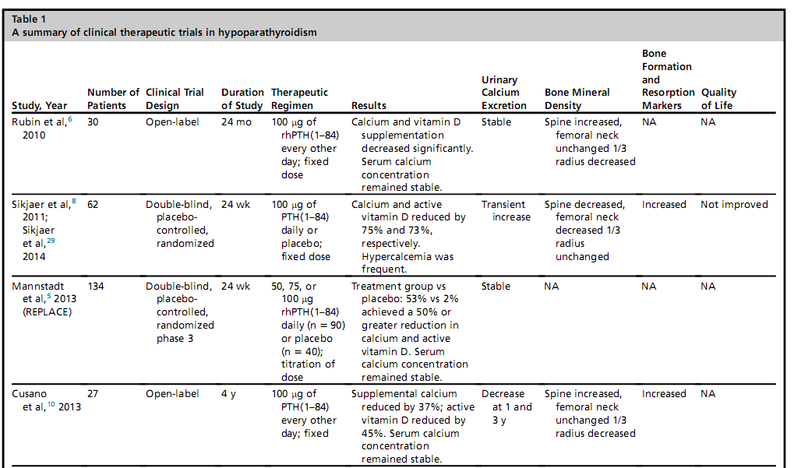

Slide 53
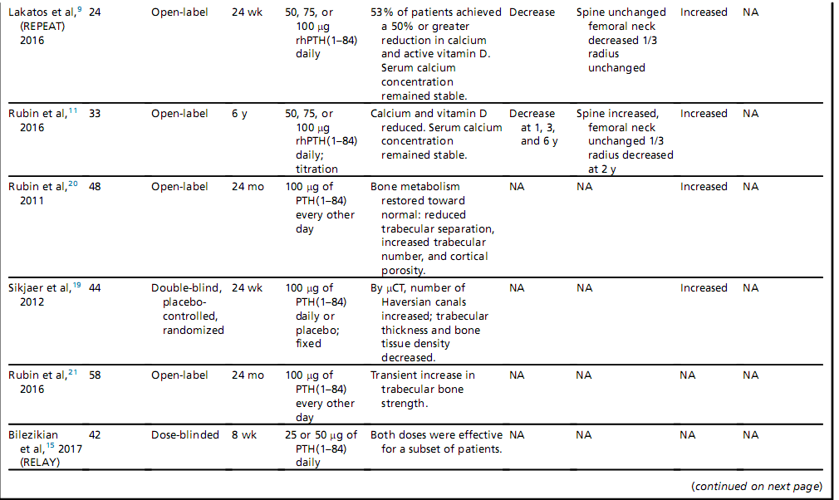

Slide 54
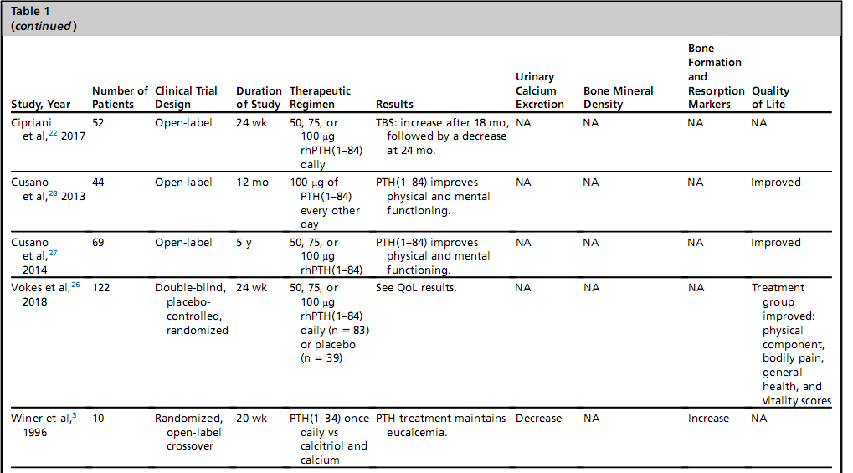

Slide 55
Markers of bone formation and bone resorption are typically reduced along with higher bone density due to increased trabecular and cortical bone volume, in individuals with hypoparathyroidism. After treatment, bone turnover markers increase quickly and markedly with the administration of rhPTH(1–84). Both bone formation and bone resorption markers reach a peak approximately 3-fold above baseline values within approximately 1 year and then decline to levels that represent a new baseline that is higher than pretreatment baseline values.

Slide 56
Histomorphometric changes were investigated by Sikjaer and colleagues19 after 24 weeks of treatment and by Rubin and colleagues20 after 24 months of rhPTH(1– 84) treatment. Twenty-four weeks of rhPTH(1–84) treatment led to an increase in the number of Haversian canals per unit area in cortical bone and reduced trabecular thickness and trabecular bone tissue density. Structural changes were seen as early as 1 year after rhPTH(1–84) treatment, with reduced trabecular separation and increased trabecular number and cortical porosity. These structural changes are consistent with an increase in bone-remodeling rate in both the trabecular and cortical compartments and with a restoration of bone metabolism toward normal euparathyroid levels.

Slide 57
The most common adverse events related to the use of rhPTH(1–84) in hypoparathyroidism are muscle spasm, hypocalcemia, paresthesia, headache, and nausea.

Slide 58
FUTURE DIRECTIONS
1.Administration of PTH by infusion pump.. 2.Pegylated PTH.
3.Long-Acting Analogues of PTH.

