Slide 1
IN THE NAME OF GOD

Slide 2
CONGENITAL ADRENAL HYPERPLASIA
Dr Mozhgan Karimifar
Assistant Prof. of Endocrinology
Isfahan University Of Medical Sciences

Slide 3
CONGENITAL ADRENAL HYPERPLASIA
CAH comprises a group of autosomal recessive disorders caused by deficient adrenal corticosteroid biosynthesis.
It results from defects in one of the steroidogenic enzymes involved in cortisol biosynthesis or in the electron providing factor, POR.

Slide 4
CONGENITAL ADRENAL HYPERPLASIA
↓cortisol production →↑(ACTH)
↑ ACTH → adrenal hyperplasia and ↑accumulation of cortisol precursors and/or overproduction of ACTH-dependent adrenal steroids along other pathways

Slide 5
Clinical manifestations of CAH
The clinical manifestations of the different disorders are due to diminished production of cortisol and, depending upon the site of block, decreased or increased production of mineralocorticoids and/or androgens.

Slide 6
Congenital lipoid adrenal hyperplasia
Caused by StAR deficiency affecting mitochondrial cholesterol uptake, is a subform of this disease complex with the unique feature of lipid accumulation leading to cell destruction.
W533

Slide 7
Aldosterone synthase deficiency
Aldosterone synthase deficiency does not affect glucocorticoid biosynthesis and does not lead to adrenal hyperplasia, but it has been historically grouped into this disease complex.
W533

Slide 9
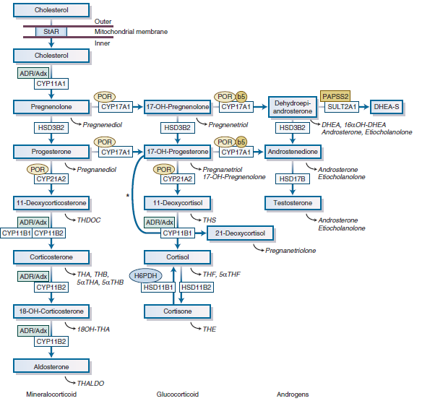

Slide 10
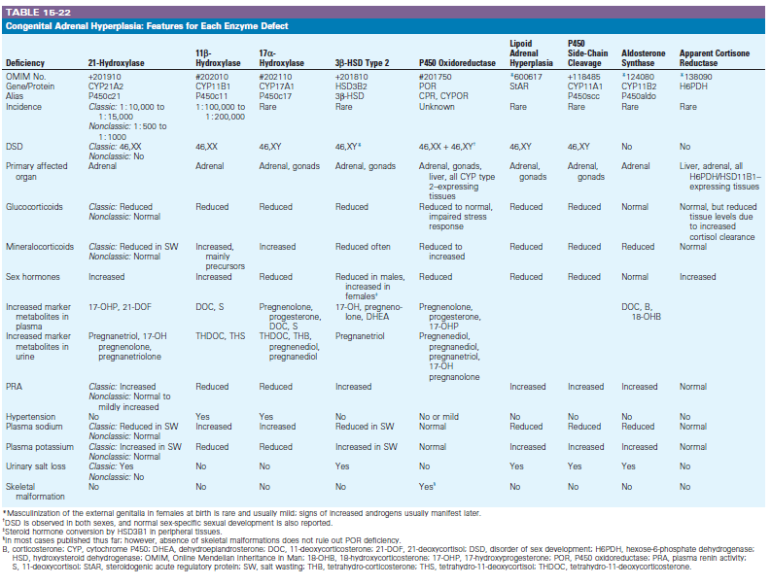

Slide 11
21-Hydroxylase Deficiency
Between 90% and 95% of cases of CAH are caused by 21-hydroxylase deficiency.
In Western societies, the incidence varies
from 1 in 10,000 to 1 in 15,000 live births
but in isolated communities the incidence may be much
higher (e.g., 1 : 300 in Alaskan Inuit populations).
Nonclassic CAH is more common, with an incidence of about 1 in 500 to 1 in 1000 live births.
W533

Slide 12
21-Hydroxylase Deficiency
The condition arises because of defective conversion of 17α-OHP to 11-deoxycortisol.
↓cortisol →↓negative feedback drive → ↑ACTH ,↑adrenal androgens
↓mineralocorticoid (75%)because of failure to convert sufficient progesterone to DOC in the ZG.
W533

Slide 14
21-Hydroxylase Deficiency
Clinically, several distinct variants of 21-hydroxylase deficiencyhave been recognized
W533

Slide 15
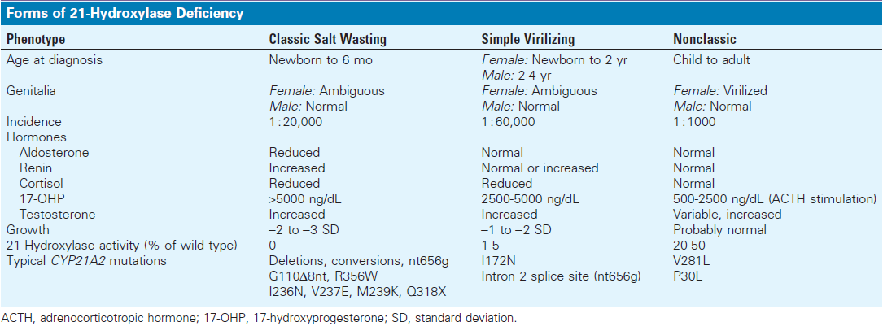

Slide 16
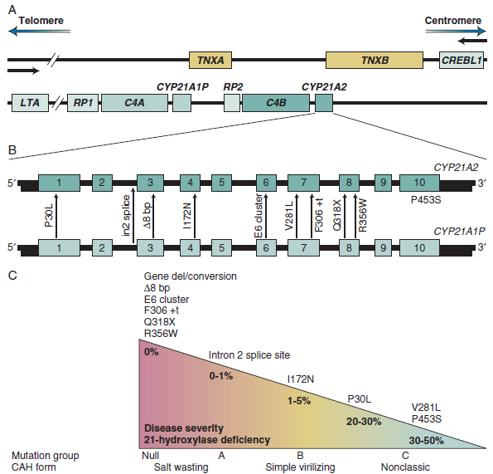

Slide 17
Simple Virilizing Form
↑ ACTH → adrenal androgen secretion in utero → virilization
Affected female fetus
Depending on the severity:
Clitoral enlargement
Labial fusion
Development of a urogenital sinus
Sexual ambiguity at birth and even inappropriate sex assignment
W535

Slide 18
Simple Virilizing Form
Males are:
phenotypically normal at birth and are
at risk of not being diagnosed; this explains
the skewed female-to-male ratio of simple virilizing CAH diagnosed in the preneonatal screening era.
W535

Slide 19
Simple Virilizing Form
Males patients may present in
precocious pseudopuberty
pubic hair development
Growth acceleration due to premature androgen excess
If left untreated, this stimulates premature epiphyseal closure, and final adult height is invariably diminished
W535

Slide 20
Salt-Wasting form of 21-Hydroxylase Deficiency
In addition to the described features, neonates commonly present after the first 2 weeks of life with a salt-wasting crisis and hypotension.
W535

Slide 21
The clinical signs and symptoms of salt wasting
Include :
Poor feeding
Vomiting
Failure to thrive
Lethargy
Sepsis-like symptoms
Delayed diagnosis of male baby (significant neonatal mortality rate)
W536

Slide 22
Nonclassic or Late-Onset 21-Hydroxylase Deficiency
Present in childhood or early adulthood with premature pubarche or with a phenotype that may masquerade as polycystic ovary syndrome (PCOS).
More common than the classic variant
W536

Slide 23
Nonclassic or Late-Onset 21-Hydroxylase Deficiency
At least 30% of adult patients have an impaired cortisol response to ACTH(1-24) and may be prone to stress-induced adrenal insufficiency.
Routine assessment of adrenal glucocorticoid reserve is indicated.
W536

Slide 24
Nonclassic or Late-Onset 21-Hydroxylase Deficiency
In some series from tertiary referral centers, nonclassic 21-hydroxylase deficiency accounts for up to 12% of all PCOS patients, but more realistic prevalence rates are probably 1% to 3%.
W536

Slide 25
Nonclassic or Late-Onset 21-Hydroxylase Deficiency
Females present with:
Hirsutism
Primary or secondary amenorrhea
Anovulatory infertility
Androgenic alopecia
Acne
W536

Slide 26
Mutations in the human 21-hydroxylase gene
Salt wasting, simple virilizing, and late-onset 21-hydroxylase deficiency are all caused by homozygous or compound heterozygote mutations in the human 21-hydroxylase gene (CYP21A2).
W536

Slide 27
Heterozygote 21-Hydroxylase Deficiency
In the carrier or heterozygote state, only one allele is mutated.
The clinical significance of the heterozygote state is uncertain; it does not appear to disadvantage reproductive capability but may cause signs of hyperandrogenism in adult women.
W536

Slide 28
Molecular Genetics of CAH
21-Hydroxylase deficiency is inherited as an autosomal recessive trait, and the higher incidence of the condition consanguinity.
The CYP21A2 gene and its highly homologous pseudogene (CYP21A1P) are located on the short arm of chromosome 6 (6p21.3).
Approximately 65% to 75% of CAH patients are compound heterozygous for the disease-causing mutations.

Slide 29
Diagnostic Criteria of 21-hydroxylase Deficiency
in any newborn infant with genital ambiguity and salt wasting, hypotension, or hypoglycemia
Hyponatremia and hyperkalemia with raised plasma renin activity are found in salt-wasters.
In later life, adrenal androgen excess (DHEAS, androstenedione) is found in patients presenting with sexual precocity or a PCOS-like phenotype.
w536

Slide 30
Diagnostic Criteria
Classic 21-hydroxylase deficiency→↑↑↑ 17-OHP (randomly timed )
17-OHP (salt-wasting CAH )>non–salt-losing
w536

Slide 31
Stimulation tests
17-OHP is measured basally and then 60 minutes after administration of 250 μg Synacthen. Stimulated values are invariably grossly elevated (>35 nmol/L [>11 μg/L = ng/ml ]) in patients with classic and nonclassic forms of the disorder.
There is some overlap between values seen in heterozygotes and in normal subjects.

Slide 32
Diagnostic Criteria
Heterozygote patients usually have stimulated values between 10 and 30 nmol/L (330 and 1000 ng/dL).
w536

Slide 33
Diagnostic Criteria
Basal 17-OHP <5 nmol/L (<150 ng/dL) in the follicular phase of the menstrual cycle effectively excludes late-onset 21-hydroxylase deficiency
w536

Slide 35
When do you suggest genotyping in individuals with CAH?
Results of the adrenocortical profile after a cosyntropin stimulation test are equivocal
Cosyntropin stimulation cannot be accurately performed (i.e., patient receiving GC)
Purposes of genetic counseling
Technical remark: Genotyping at least one parent aids in the interpretation of genetic test results because of the complexity of the CYP21A2 locus.*
Congenital Adrenal Hyperplasia Due to Steroid 21-Hydroxylase Deficiency: An Endocrine Society* Clinical Practice Guideline
J Clin Endocrinol Metab, November 2018, 103(11):1–46

Slide 36
Prenatal Diagnosis of 21-Hydroxylase D
has been advocated, because treatment of an affected female may prevent masculinization in utero
17-OHP can be assayed in amniotic fluid, but the most robust approach is the rapid genotyping of fetal cells obtained by chorionic villous sampling in early gestation.
w538

Slide 37
when a fetus is known to be at risk?
An affected sibling
Both partners are known to be heterozygous for one of the severe mutations
uptodate

Slide 38
Prenatal Diagnosis of 21-Hydroxylase D
In patients with known 21-hydroxylase deficiency (male or female) seeking fertility, determination of 17-OHP levels across an SST in the partner before conception will uncover nonclassic or heterozygote cases and provide the endocrinologist/geneticist with some assignment of risk before pregnancy.
W538

Slide 39
Prenatal diagnosis of 21-hydroxylase deficiency
provide parents with information
prenatal therapy is contemplated
However, because adverse effects of prenatal therapy (on the fetus and mother) have been described and long-term risks are unknown, the decision to treat should only be considered in consultation with a highly experienced team in a research setting and after a detailed discussion with the pregnant couple.
uptodate

Slide 40
Chance of having CAH
The fetus will have a 1:4 chance of having CAH and a 1:2 chance of being female; thus, there is a 1:8 chance that the fetus will be female and have CAH. Because the period during which fetal genitalia may become virilized begins ;6 weeks after conception, treatment must be started by 6 to 7 weeks.
Congenital Adrenal Hyperplasia Due to Steroid 21-Hydroxylase Deficiency: An Endocrine Society* Clinical Practice Guideline
J Clin Endocrinol Metab, November 2018, 103(11):1–46

Slide 41
All pregnancies at risk for CAH would need to be treated
Because genetic diagnosis by chorionic villous biopsy cannot be performed until 10 to 12 weeks, all pregnancies at risk for CAH would need to be treated, although the treatment is directed at only one in eight fetuses.
Congenital Adrenal Hyperplasia Due to Steroid 21-Hydroxylase Deficiency: An Endocrine Society* Clinical Practice Guideline
J Clin Endocrinol Metab, November 2018, 103(11):1–46

Slide 42
2.3 We advise that research protocols for prenatal therapy include genetic screening for Y-chromosomal DNA in maternal blood to exclude male fetuses from potential treatment groups. (Ungraded Good Practice Statement)
Congenital Adrenal Hyperplasia Due to Steroid 21-Hydroxylase Deficiency: An Endocrine Society* Clinical Practice Guideline
J Clin Endocrinol Metab, November 2018, 103(11):1–46

Slide 43
Newborn screening for 21-hydroxylase deficiency
We recommend that all newborn screening programs incorporate screening for CAH due to 21-hydroxylase deficiency (21OHD). (1|+++-)
Congenital Adrenal Hyperplasia Due to Steroid 21-Hydroxylase Deficiency: An Endocrine Society* Clinical Practice Guideline
J Clin Endocrinol Metab, November 2018, 103(11):1–46

Slide 44
17α-Hydroxylase Deficiency

Slide 45
17α-Hydroxylase Deficiency
A single enzyme is expressed in the adrenal and the gonads and possesses both 17α- hydroxylation and 17,20-lyase activities, but rare patients with isolated deficiency in the hydroxylation of 17-OHP or
17,20-lyase deficiency have been reported.
W539

Slide 46
17α-Hydroxylase Deficiency
Mutations within the CYP17A1 gene result in failure to synthesize cortisol (17α-hydroxylase activity), adrenal androgens (17,20-lyase activity), and gonadal steroids
but not in the placenta or in ovarian granulosa cells
Therefore, in contrast to 21- and 11β-hydroxylase deficiencies, 17α-hydroxylase deficiency results in adrenal and gonadal insufficiency and causes 46,XY DSD.
ILD, in contrast, does not significantly lead to adrenal hyperplasia and is more a form of gonadal insufficiency.*
W539, 926
*UPTODATE
Isolated 17,20-lyase deficiency (ILD), DSD, disorder of sex development

Slide 47
Prevalence of 17α-Hydroxylase Deficiency
~ 1 case per 50,000
individuals is reported in some areas, but in general the prevalence is lower than this
150 cases (17α-Hydroxylase Deficiency)
Brazil*(highest)
Isolated 17,20-lyase defciency (ILD) is extremely rare , with only approximately six cases described.*
W539
*uptodate

Slide 48
17OHD
The hallmarks of 17OHD, first described in 1966 , include
hypertension and hypokalemia due to the accumulation of cortisol precursors with mineralocorticoid activity upstream of the block,
plus sexual infantilism due to inability to synthesize androgens and estrogens.
*UPTPDATE

Slide 49
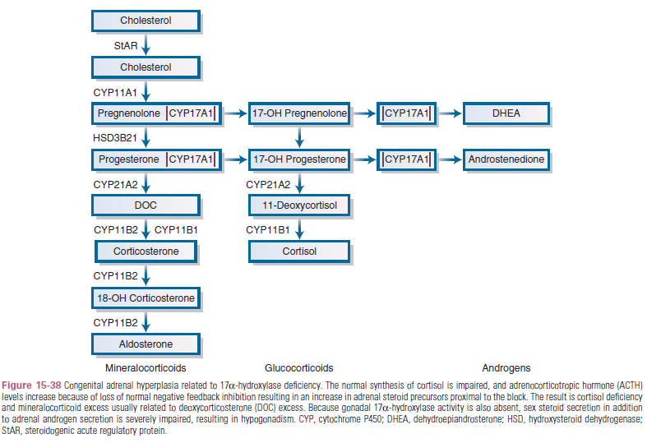

Slide 50
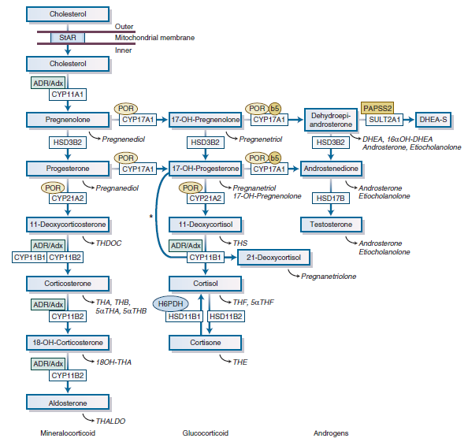

Slide 51
Figure 15-4 Adrenal steroidogenesis. After the steroidogenic acute regulatory (StAR) protein-mediated uptake of cholesterol into mitochondria within adrenocortical cells, aldosterone, cortisol, and adrenal androgens are synthesized through the coordinated action of a series of steroidogenic enzymes in a zone-specific fashion. The mitochondrial cytochrome P450 (CYP) type I enzymes (CYP11A1, CYP11B1, CYP11B2) requiring electron transfer via adrenodoxin reductase (ADR) and adrenodoxin (Adx) are marked with a box labeled ADR/Adx.
The microsomal CYP type II enzymes (CYP17A1, CYP21A2) receive electrons from P450 oxidoreductase (circle labeled POR). The 17,20-lyase reaction catalyzed by CYP17A1 requires, in addition to POR, cytochrome b5, indicated by a circle labeled b5. Urinary steroid hormone metabolites are given in italics below the plasma hormones.
The asterisk (*) indicates 11-hydroxylation of 17-OH-progesterone to 21-deoxycortisol in cases of 21-hydroxylase deficiency. The adrenal conversion of androstenedione to
testosterone is catalyzed by the aldo-keto reductase AKR1C3 (HSD17B5). CYP11A1, P450 side-chain cleavage enzyme; CYP11B1, 11β-hydroxylase; CYP11B2, aldosterone synthase;
CYP17A1, 17α-hydroxylase; CYP21A2, 21-hydroxylase; DHEA, dehydroepiandrosterone; DHEA-S, dehydroepiandrosterone sulfate; H6PDH, hexose-6-phosphate dehydrogenase;
HSD11B1, 11β-hydroxysteroid dehydrogenase 1; HSD11B2, 11β-hydroxysteroid dehydrogenase 2; HSD17B, 17β-hydroxysteroid dehydrogenase; HSD3B2, 3β-hydroxysteroid
dehydrogenase type 2; 17-OH-progesterone, 17α-hydroxyprogesterone; PAPSS2, 3′-phosphoadenosine, 5′-phosphosulfate synthase 2; SULT2A1, sulfotransferase 2A1;
THA, tetrahydro-11-dehydrocorticosterone; THB, tetrahydro-corticosterone; THALDO, tetrahydro-aldosterone; THDOC, tetrahydro-11-deoxycorticosterone; THF, tetrahydro-cortisol;
THS, tetrahydro-11-deoxycortisol.

Slide 52
DOC binds with high affinity to the mineralocorticoid receptor and is not a substrate for 11-beta-hydroxysteroid dehydrogenase type 2.
DOC excess causes volume expansion, hypertension, and kaluresis despite suppressed renin and aldosterone production.
uptodate

Slide 53
17α-Hydroxylase Deficiency
Corticosterone has weaker glucocorticoid activity than cortisol, but corticosterone excess generally prevents adrenal crises.
W539

Slide 54
17α-Hydroxylase Deficiency
↑↑ corticosterone and DOC → severe hypokalemic hypertension
Loss of 17,20-lyase activity → 46,XY DSD →
undervirilization in male newborns
primary amenorrhea in 46,XX
There is lack of pubertal development due to hypergonadotropic hypogonadism in both sexes.

Slide 55
The CYP17A1 gene
The CYP17A1 gene consists of eight exons and is located on chromosome 10q24.3.
w539

Slide 56
Mutations underlying isolated 17,20-lyase deficiency
Mutations underlying isolated 17,20-lyase deficiency are located within the area of the CYP17A1 molecule that is thought to interact with the cofactor cytochrome b5, thereby disrupting the electron transfer from POR to CYP17A1, specifically for the conversion of 17-hydroxypregnenolone to DHEA.
W541

Slide 57
The diagnosis of 17α-Hydroxylase Deficiency
At the time of puberty (usually)
present with
hypertension(Excess DOC secretion )
hypokalemic alkalosis
suppression of the renin-angiotensin system
hypergonadotropic hypogonadism
((lack of CYP17A1 expression within the gonad and impaired gonadal steroidogenesis.
↑LH and FSH ))
W=541

Slide 58
Female patients (XX) with 17α-Hydroxylase Deficiency
primary amenorrhea with absent sexual characteristics
normal female internal and external genital tracts
but the ovaries cannot secrete estrogens at puberty, resulting in absent breast development and hypogonadism with elevated plasma FSH and LH levels.
The lack of adrenal and ovarian androgens can result in little or no growth of pubic and axillary hair.
the ovaries have a high proportion of atretic follicles, and some ovaries contain an increased number of enlarged follicular cysts.
W541& 926

Slide 59
Male patients (XY) with complete combined 17α-hydroxylase/17,20-lyase deficiency
Female external genitalia but absent uterus and fallopian tubes
Intra-abdominal testes, in the inguinal canal(common ), or in the labioscrotal folds (should be removed)
Usually reared as females
Blind vaginal pouch
Wolffian derivatives are hypoplastic.
Bone age is frequently delayed, and prolonged linear growth can lead to tall stature
Pubic and axillary hair is absent or sparse
Hypergonadotropic hypogonadism (failure to develop secondary sexual) characteristics at puberty.
W541

Slide 60
Partial forms of combined 17α-hydroxylase/17,20-lyase deficiency
This condition most frequently manifests in a 46,XY infant with
Ambiguous genitalia or
Severe hypospadias
HTN may or may not be present in partial forms
Aldosterone secretion may be normal or even elevated
Corticosterone levels, which are usually 50- to 100-fold higher than normal, (prevent symptoms of cortisol deficiency)
Incomplete male secondary sexual characteristics at puberty
Gynecomastia is often seen
This rare condition has been associated with a phenylalanine deletion at codon 53 or 54 and several missense changes.

Slide 61
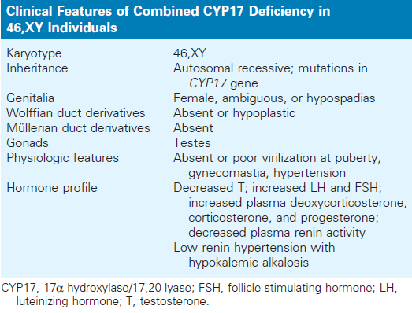

Slide 62
Isolated 17,20-lyase activity(46,XY individuals)
In a small number of patients
Normal secretion of glucocorticoids and mineralocorticoids
No hypertension and hypokalemia
Marked reduction in sex steroid synthesis
Affected girls develop only sparse pubic hair and can have dysmenorrhea
Genital ambiguity (male)
Gynecomastia
W

Slide 63
Breast development
Since estrogens derive from androgens, estrogen synthesis is secondarily impaired, but since estradiol is an extremely potent inducer of breast development, particularly when androgens are low, some breast development may be seen.
uptodate

Slide 64
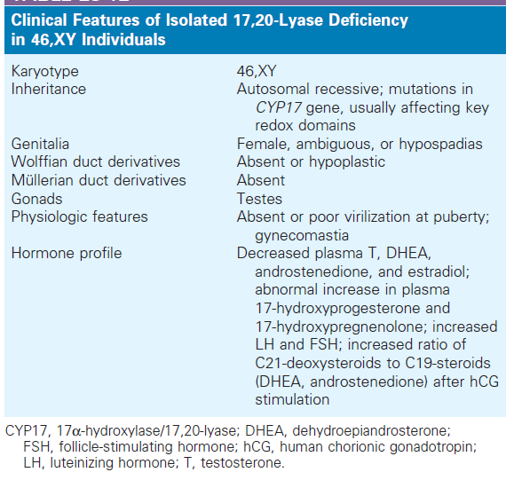

Slide 65
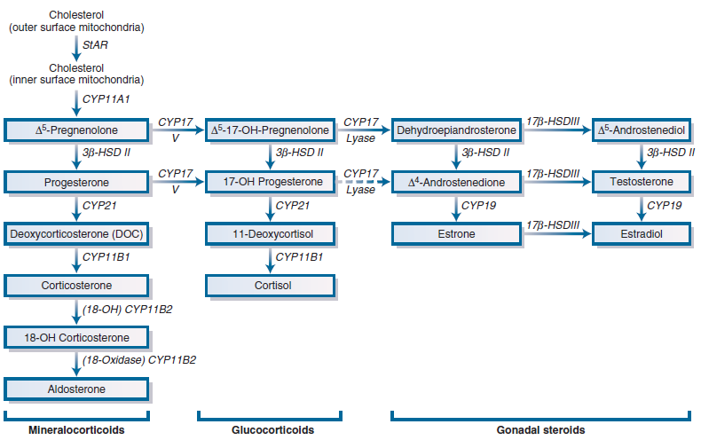

Slide 66
A defect in 17α-hydroxylation in the adrenal cortex and gonads results in:
Impaired synthesis of:
17-OHP and
17-hydroxypregnenolone
Cortisol
androgens
Estrogens
Increased :
ACTH
17-deoxysteroids by the adrenal cortex, including the mineralocorticoids
11-deoxycorticosterone (DOC)
Corticosterone (weak glucocorticoid)
18-hydroxycorticosterone
Diminished aldosterone synthesis and secretion are sometimes reported.

Slide 67
diagnosis of 17α-hydroxylase deficiency
The diagnosis of 17α-hydroxylase deficiency should be suspected in all cases of
46,XY DSD, and it is strongly supported by the discovery of hyporeninemic hypertension and hypokalemic alkalosis (detected in early adulthood) and by a lack of secondary sex characteristics at puberty.
W

Slide 68
diagnosis of 17α-hydroxylase deficiency
↑ ACTH
↑ DOC (>100 ng/dL[>3 nmol/L])
↑ Corticosterone (>4000 ng/dL [>116 nmol/L])
↑ progesterone
↓ 17α-OHP
↓ cortisol(<5 mcg/dL [<138 nmol/L])
↓ gonadal steroids
aldosterone and renin are suppressed

Slide 69
The characteristic feature of ILD
is the elevated 17- hydroxyprogesterone (17OHP)/androstenedione ratio (>50) , with all downstream (19-carbon) steroids reduced and 17-hydroxysteroids at or near normal.
uptodate

Slide 70
The goals of treatment in classic 17OHD
mitigate the effects of mineralocorticoid excess
prevent glucocorticoid deffciency, and
restore desired secondary sexual characteristics with attendant
benefits such as improved bone mineral density (BMD).
This is achieved by
mineralocorticoid blockade and
physiologic replacement of cortisol and sex steroids, rather than by supraphysiologic suppressive doses of glucocorticoid.

Slide 71
Treatment of 17α-Hydroxylase Deficiency
Glucocorticoid replacement reverses the DOC-induced suppression of the renin-angiotensin system and lowers blood pressure.
For patients reared as female, spironolactone is the drug of choice to block the mineralocorticoid receptor. Medications are titrated based on monitoring blood pressure, DOC, and electrolytes; renin suppression can persist for years, despite adequate therapy, in some cases.
Puberty is induced with low-dose estrogen at the expected time of pubarche. Cyclical withdrawal bleeding is only required for 46,XX females with an intact uterus. Androgen replacement has not been studied in this disorder.
uptodate
W

Slide 72
Fertility
A few cases of in vitro fertilization and a live birth in a 46,XX patient with incomplete 17OHD have been described.
The approach included ovulation induction with gonadotropin stimulation, egg retrieval, and freezing of embryos. During the ovarian stimulation, adrenal and ovarian progesterone secretion were suppressed with dexamethasone and gonadotropin-releasing hormone (GnRH) agonist administration.
Estradiol valerate was then given to prepare the endometrium and the frozen-thawed embryo transfer was performed.
uptodate

Slide 73
Treatment for 46,XY patients
Treatment for 46,XY patients with a disorder of sex development (DSD) due to ILD and partial 17OHD is much more complex and incorporates attention to genital surgery for hypospadias or clitoral reduction for those being reared as females.
Testosterone replacement may be given to stimulate penile growth in childhood and then resumed in adolescence and adulthood.
uptodate

Slide 74
Treatment of 17α-Hydroxylase Deficiency
Replacement therapy with physiologic doses of glucocorticoids
suppresses DOC and corticosterone secretion
and normalizes serum potassium levels, blood pressure,
and plasma renin and aldosterone levels.

Slide 75
The hypokalemia can be associated with life-threatening cardiac arrhythmia, so careful monitoring and treatment in the acute phase are needed.
Gonadectomy is usually performed in 46,XY patients who have a female gender assignment once this is established.
Appropriate gonadal steroid replacement therapy is indicated at puberty.
W

Slide 76
Cytochrome b5 Deficiency
A splice site mutation in the 17,20- lyase redox partner cytochrome b5 was first reported in a 46,XY child with ambiguous genitalia and methemoglobinemia,
although extensive hormone data were not reported.
However, homozygous nonsense and missense mutations in this gene (CYB5A) have now been described in 46,XY children with severe hypospadias and a biochemic profile consistent with isolated 17,20-lyase deficiency and in a family with multiple affected members and a range of genital phenotypes.
Methemoglobin was elevated above the normal range in all these cases, but it did not result in clinical signs.
W

