Slide 1



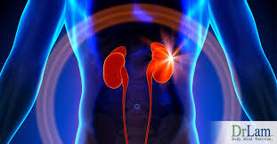
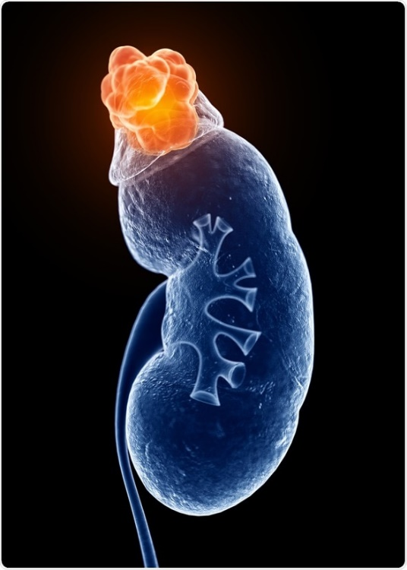
Adrenocortical Carcinoma
Maryam Heidarpour,MD
Endocrinologist

Slide 2
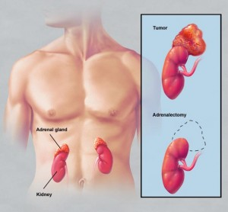



Agenda
Epidemiology And Pathogenesis Of ACC
Clinical Characteristics
Diagnostic procedures
Treatment

Slide 3
Adrenal tumors are very common, affecting 3% to 10% of the human population, and the majority are small benign nonfunctional adrenocortical adenomas.
Tobias Else: Adrenocortical Carcinoma . Endocrine Reviews, April 2014, 35(2):282–326

Slide 4
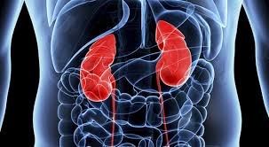
Epidemiology and pathogenesis of ACC
ACC, in contrast, is a very rare disease.
The estimated incidence of adult adrenocortical carcinoma (ACC) is between 0.7 – 2.0 per million per year.
ACC can occur at any age with a peak incidence between 40 and 60 years.
women being more often affected (55-60%).
Guidelines on the Management of Adrenocortical Carcinoma in Adults, July 2018

Slide 5
A bimodal distribution
A second peak of increased incidence during childhood can be detected seems to be dependent on the prevalence of regional predisposing factors.
The fact that 1.3% of all childhood cancers are ACCs as opposed to 0.02% to 0.2% of adult cancers confirms a higher relative incidence early in life.
In the adult as well as in the pediatric population, there is a predilection
for the female gender.
Tobias Else: Adrenocortical Carcinoma . Endocrine Reviews, April 2014, 35(2):282–326

Slide 6

In roughly 2% to 10% of ACC patients, a contralateral tumor is present, in some cases probably presenting a synchronous and in other cases a metachronous ACC.
It is of course difficult to determine whether the contralateral tumor is an independent primary tumor vs a metastasis to the contralateral gland.

Slide 7

In adults, the vast majority of ACCs are sporadic.
According to the American Cancer Society, about
15 percent of adrenal cancers are caused by a genetic disorder.
Tobias Else: Adrenocortical Carcinoma . Endocrine Reviews, April 2014, 35(2):282–326

Slide 8
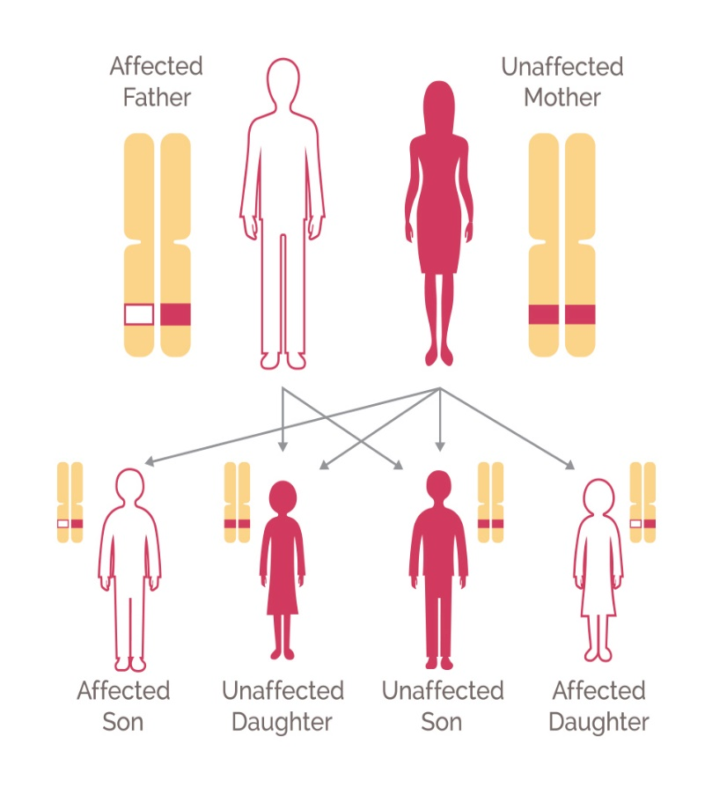
Occasionally, they occur as part of hereditary syndromes such as:
Li-Fraumeni syndrome
Lynch syndrome
Multiple endocrine neoplasia (MEN) 1
Familial adenomatous polyposis
Carney Complex/Syndrome
Guidelines on the Management of AdrenocorticalCarcinoma in Adults, July 2018

Slide 9


For adults with ACC, we recommend at least a basic clinical genetic evaluation, exploring personal and family history for evidence of a hereditary predisposition syndrome.
Recommendation
All children with a diagnosis of ACC should undergo a systematic search of germline TP53 pathogenic variants, because 50-90% of ACC in children are related to germline pathogenic TP53 variants.
Guidelines on the Management of AdrenocorticalCarcinoma in Adults, July 2018

Slide 10

Up to 5% of adult ACC arise in patients with germline TP53 mutations
and About 3% of all ACC patients have an underlying diagnosis of Lynch syndrome.
Special attention should be given to these two hereditary syndromes, because for them there are well-established screening guidelines available.
It is important to keep in mind that at least 20% of germline TP53 pathogenic variants occur as
de novo mutations in the absence of any family history.
Up to 13% of all adrenal lesions in patients with MEN1 represent adrenal cancer.
Germline genetic testing for ACC patients should primarily be considered for the genes related to Li-Fraumeni syndrome and Lynch syndrome.
Guidelines on the Management of Adrenocortical Carcinoma in Adults, July 2018

Slide 11

PREDISPOSING FACTORS
Aside from genetic predisposition,no risk factors have
been firmly established.
However, research has shown that people with certain risk factors are more likely than others to develop adrenal cancer.
Tobias Else: Adrenocortical Carcinoma . Endocrine Reviews, April 2014, 35(2):282–326

Slide 13
A review of data from the 1986 National Mortality Followback Survey identified smoking in men and contraceptive use in women, especially before age 25 as risk factors.
A role of estrogens has also been suggested by the observation of a probable relative increase of diagnosis of ACC during pregnancy.
Interestingly, recent in vitro studies confirm growth-promoting effects of estrogen on the ACC cell line NCI-H295.
Tobias Else: Adrenocortical Carcinoma . Endocrine Reviews, April 2014, 35(2):282–326

Slide 14


Our findings suggest that cigarette smoking and use of OCs may increase the risk of adrenal cancer, but additional studies are needed with more detailed information on risk factors and histologic type of adrenal cancer.
Ann W. HSINGRISK FACTORS FOR ADRENAL CANCER, Int. J. Cancer

Slide 15

Clinical Characteristics

Slide 16
Clinical Characteristics
There are 3 main clinical scenarios in which ACC patients Present
For 50% to 60% of patients, the major presenting complaints are symptoms and signs of
hormone excess.
1
Tobias Else: Adrenocortical Carcinoma . Endocrine Reviews, April 2014, 35(2):282–326

Slide 17
Hypercortisolism (Cushing’s syndrome)(50-70%):
Causing classic symptoms
Frequently, very high cortisol levels in ACC saturate the renal HSD11B2 system
Glucocorticoid-mediated mineralocorticoid receptor activation
Hypokalemia and hypertension are commonly observed in ACC patients
with hypercortisolism.
Together with pronounced muscle weakness, these symptoms of rapidly progressive Cushing’s syndrome are generally indicative of a malignant adrenal tumor.
1

Slide 18
The second most commonly produced hormones in patients with ACC are adrenal androgens(20-30%).
Concurrent androgen and cortisol production is evident in roughly half of all ACC patients with hormone excess.
The peripheral conversion of androgens to estrogens and/or the co-secretion of estrogen from the ACC induces significant symptoms.
Estrogen production occurs in 1% to 3% of male ACC patients, causing gynecomastia and testicular atrophy (through suppression of the gonadal axis).
regardless of size,
androgen or estrogen production should always raise the suspicion of a malignant tumor

Slide 19
Hormone excess
1
Autonomous aldosterone secretion (which classically leads to hypertension and hypokalemia) is rare in ACC.
More commonly, mineralocorticoid effects are mediated by high cortisol levels or possibly steroid precursors with mineralocorticoid activity, such as 11-deoxycorticosterone

Slide 20
Concomitant secretion of different steroids is a
hallmark of ACC.
Soraya Puglisi, Adrenocortical Carcinoma with Hypercortisolism Endocrinol Metab Clin N Am 47(2018)

Slide 21
Clinical Characteristics
2
Another third present with nonspecific symptoms due to local tumor growth, such as abdominal or flank pain, abdominal fullness, or early satiety. (30-40%)
An increasing number of cases are diagnosed within the group of incidentally discovered adrenal masses (incidentalomas) (≈ 10-15%).
However, the likelihood of an adrenal incidentaloma being an ACC is low (2-5%).
Guidelines on the Management of Adrenocortical Carcinoma in Adults, July 2018

Slide 22
Clinical Characteristics
3
Paraneoplastic syndromes : are Rare
Hyperreninemic hyperaldosteronism
Erythropoietin-associated polycythemia
Leukocytosis
Tumor associated hypoglycemia, which may be attributed to
IGF-2–mediated hypoglycemia
Classical tumor symptoms:
such as cachexia or night sweats rarely present.

Slide 24

Professor of Surgery
Division of General Surgery
Chief, Section of Endocrine Surgery
UCSF

Slide 25
New guidelines for adrenal incidentalomas
Adrenal incidentalomas are identified in 1–4% of abdominal imaging studies globally.
The new guidelines recommend that after the initial evaluation, no further follow-up, either hormonal evaluation or repeat scanning, is necessary for patients with homogeneous-appearing non-secreting incidentalomas <4 cm in diameter on non-contrast CT ≤10 HU.
This recommendation will have an enormous impact on clinical practice.
Quan-Yang Duh , European Society of Endocrinology Clinical Practice Guideline in collaboration with the European Network for the Study of Adrenal Tumors, Eur. J. Endocrinol.

Slide 26

Surgical indication for non-secreting adrenal incidentalomas has, therefore, changed from focusing on size (>4–6 cm in diameter) to appearance (>10 HU with indeterminate imaging features);
For instance, a 3 cm non-secreting incidentaloma of 15 HU now has a stronger surgical indication then a 6 cm tumour of 5 HU.
Quan-Yang Duh , European Society of Endocrinology Clinical Practice Guideline in collaboration with the European Network for the Study of Adrenal Tumors, Eur. J. Endocrinol.

Slide 27
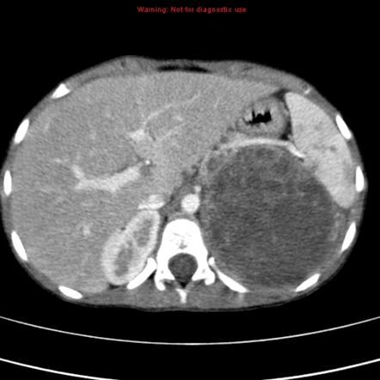
At the time of presentation, ACCs are generally large tumors, measuring on average 10 to 13 cm.
Only a minority of tumors are< 6 cm (9%–14%), with only 3% presenting as lesions <4 cm.

Slide 28

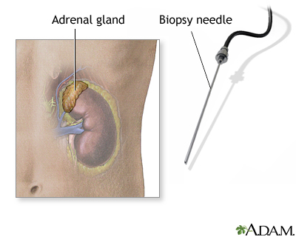
Against the use of an adrenal biopsy in the diagnostic work-up of patients with suspected ACC unless there is evidence of metastatic disease that precludes surgery and histopathologic proof is required to inform oncological management (without an hormone excess ).
Recommendation

Slide 29



Diagnostic procedures in suspected ACC

Slide 30

The diagnosis of ACC is not always obvious.
We recommend establishing as soon as possible whether an adrenal mass is malignant, using all required tools in a timely fashion.
Recommendation
1
Clinical aspects (e.g. rapidly developed features of adrenocortical hormone excess)
Results from hormonal work-up
Indeterminate or suspicious imaging
2
3

Slide 31
Every patient with (suspected) ACC should undergo careful assessment including case history, clinical examination for symptoms and signs of adrenal hormone excess.
1
Recommendation

Slide 32
All patients with suspected ACC undergo a detailed hormonal work-up to identify potential autonomous excess of:
Glucocorticoids
Sex-hormones
Mineralocorticoids
Adrenocortical steroid hormone precursors
In addition, a pheochromocytoma must be excluded.
2
Recommendation

Slide 33

Endocrine work-up is helpful for various reasons:
Establish the adrenocortical origin of the tumor.
The steroid pattern may indicate whether an adrenal lesion is an ACC.
For example, autonomous co-secretion of androgens and cortisol in any patient and secretion of steroid precursors or estradiol in males are highly
suspicious for ACC .
prognostic value as cortisol-secreting tumors generally have a worse prognosis .
If undiagnosed, autonomous cortisol secretion may be followed by life-threatening adrenal insufficiency after complete resection of the primary tumor.

Slide 34

Endocrine work-up is helpful for various reasons:
Tumor markers during follow-up.
Conventional imaging can not discriminate an ACC from a pheochromocytoma.
Pheochromocytoma has to be ruled out in any case of an adrenal tumor.
It is important to note, however, that slightly elevated metanephrines levels (< 2-fold), particularly when inconsistent with a large tumor size, might be non-specific and can be observed in ACC.

Slide 35

The best test to diagnose autonomous cortisol secretion is the 1-mg overnight dexamethasone suppression test.
If hypercortisolism is presen
It is crucial to prove ACTH-independency, because an adrenal
metastasis of an ectopic ACTH-secreting tumor(e.g. lung cancer) can mimic an ACC.
The resultant ACTH-independent Cushing’s syndrome is accompanied by a
low ACTH level (10 pg/mL).

Slide 36
DHEAS and total or bioavailable testosterone should be measured in every patient.
Whether the measurement of other steroid metabolites, such as:
17-OH-progesterone
Androstenedione
Estrogen
should be generally recommended is a matter of debate. However, elevated levels can certainly be useful as tumor.

Slide 37
We recommend adrenal-focused imaging in all patients with suspected ACC.
3
Recommendation

Slide 38

3 main imaging techniques available for the differentiation of malignant and benign adrenal tumors:
CT
MRI
PET with 18FDG
(mostly combined with CT; FDG-PET/CT).

Slide 39
However, the panel still considers that of
the available imaging modalities,
only non-contrast CT is sufficiently reliable to rule-out an ACC when the adrenal lesion is homogenous and has low CT density ≤ 10 HU.
In contrast, ACCs are usually large and of inhomogeneous appearance, and characterized by low fat content (and hence higher HU density).

Slide 40
Tobias Else: Adrenocortical Carcinoma . Endocrine Reviews, April 2014, 35(2):282–326

Slide 41
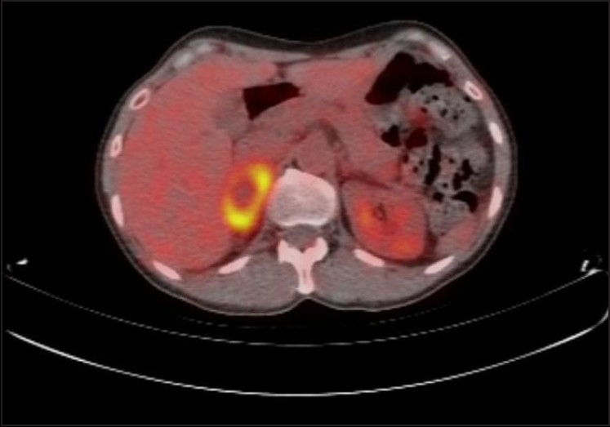
Recently, FDG-PET has been proposed as possibly the best second-line test to assess indeterminate masses by unenhanced CT.
However, the experience shows that sensitivity and negative predictive value are much better than specificity or positive predictive value.
Therefore, no consensus could be reached for a general recommendation on FDG-PET in all patients.
Additional reasons in favor of systematic FDG-PET are: whole body imaging (beyond thorax and abdomen, particularly for distant bone metastasis)
Evidence against FDG-PET includes cost, additional radiation exposure, false-positive findings, and difficult access in some countries.
Guidelines 2018

Slide 42
18FDG PET/CT imaging
ACC typically presents as a large, heterogeneous mass with intense FDG uptake greater than liver background.
Tobias Else: Adrenocortical Carcinoma . Endocrine Reviews, April 2014

Slide 43
18FDG PET/CT imaging
Can not distinguish ACC from metastases, lymphoma, or pheochromocytoma, which also exhibit high metabolic activity.
A useful modality for staging ACC and evaluating local recurrence.
low sensitivity for characterization of smaller lesions, particularly for those lesions less than 10 mm in diameter.
Not a tumor-specific tracer, and increased uptake may be seen in benign conditions including post operative changes.
Tobias Else: Adrenocortical Carcinoma . Endocrine Reviews, April 2014

Slide 44
The risk for malignant adrenal tumors increases with tumor size:
Masses 1 to 4 cm in diameter without definite benign imaging features, such as a homogenous, low-density (10 Hounsfield units [HU]) mass with smooth margins, need to be further assessed with a dedicated adrenal imaging protocol.
Tobias Else: Adrenocortical Carcinoma . Endocrine Reviews, April 2014, 35(2):282–326

Slide 45
If absolute percent washout is less than 60%, relative percent washout is less than 40%, or the mass has suspicious imaging features, further
evaluation is warranted.
Tobias Else: Adrenocortical Carcinoma . Endocrine Reviews, April 2014

Slide 46
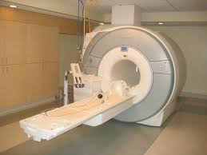
In any case where there is high suspicion for ACC performing a chest CT, in addition to an abdominal-pelvic cross-sectional imaging (CT or MRI), because the results might influence therapeutic decision-making.
Recommendation
Imaging should include contrast-enhanced imaging.

Slide 47
Performing additional imaging
(e.g. bone and brain imaging) only in case of clinical suspicion of metastatic lesions.
Suggestion
Bone and brain metastases are rare events (especially in patients without other metastatic lesions).
Therefore, additional imaging focusing on these sites is only warranted when there is increased clinical suspicion or other imaging is suggestive for bone metastases.

Slide 48
Prognostic Factors

Slide 49
Despite the generally unfavorable prognosis of ACC, there is a marked individual variation in disease progression, recurrence, and overall survival.
Increased age decreased the overall survival .
Tumor characteristics of malignancy and velocity of tumor growth.
Tumor extent (eg, stage), specifically the presence of distant metastasis and number of organs involved in metastatic disease, confers a worse prognosis.
Cortisol production as an adverse prognostic factor
Completeness of surgical excision
Higher Ki67 and mitotic indices
(20 mitoses per HPF)
ClaudiaScollo, Prognostic Factors for Adrenocortical Carcinoma Outcomes,frontiers in endocrinology,2016

Slide 50
Implications of cortisol excess on adrenocortical carcinoma prognosis
First,
Hypercortisolism is associated with increased morbidity and mortality, complicating the management of ACC patients.
Second,
the immunosuppressive effects of overt cortisol excess before surgery may favor the development of ACC micrometastases and recurrences.

Slide 51

Surgery for suspected localized ACC

Slide 52
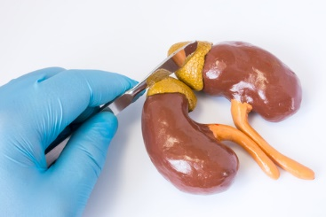
Adrenal surgery for suspected/confirmed ACC should be performed only by surgeons experienced in adrenal and oncological surgery.
Recommendation

Slide 53
ACC surgery requires expertise in both adrenal and oncological surgery due to the specific Anatomy, the malignant character of the disease and the potential need for multi-organ enbloc resection to optimize the probability of a R0 resection and minimize the risk of complications.

Slide 54
surgeons with different expertise
A minimal annual workload of 6 adrenalectomies/year seems to be required to ensure sufficient experience in adrenal surgery, but > 20 adrenalectomies/year are desirable for those involved in surgery for ACC.
Furthermore, due to the complexity of some operations, it is essential to involve surgeons with different expertise (e.g. vascular, liver, and cardiac surgeons) for pre-surgical planning and during these complex operations.

Slide 55
If adjacent organs are suspected to be invaded, we recommend en bloc resection.
However, we suggest against the routine resection of the ipsilateral kidney in the absence of direct renal invasion.
Recommendation

Slide 56
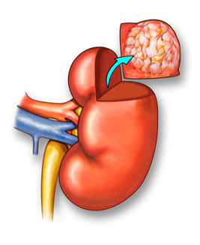
Combined nephrectomy, however, offers a lower risk of capsular rupture and can include complete lymphadenectomy of the renal hilum, but impairs kidney function and this may limit further access to chemotherapy.
Thus, in case of possible invasion in the kidney, partial nephrectomy should be considered on an individual basis.

Slide 57
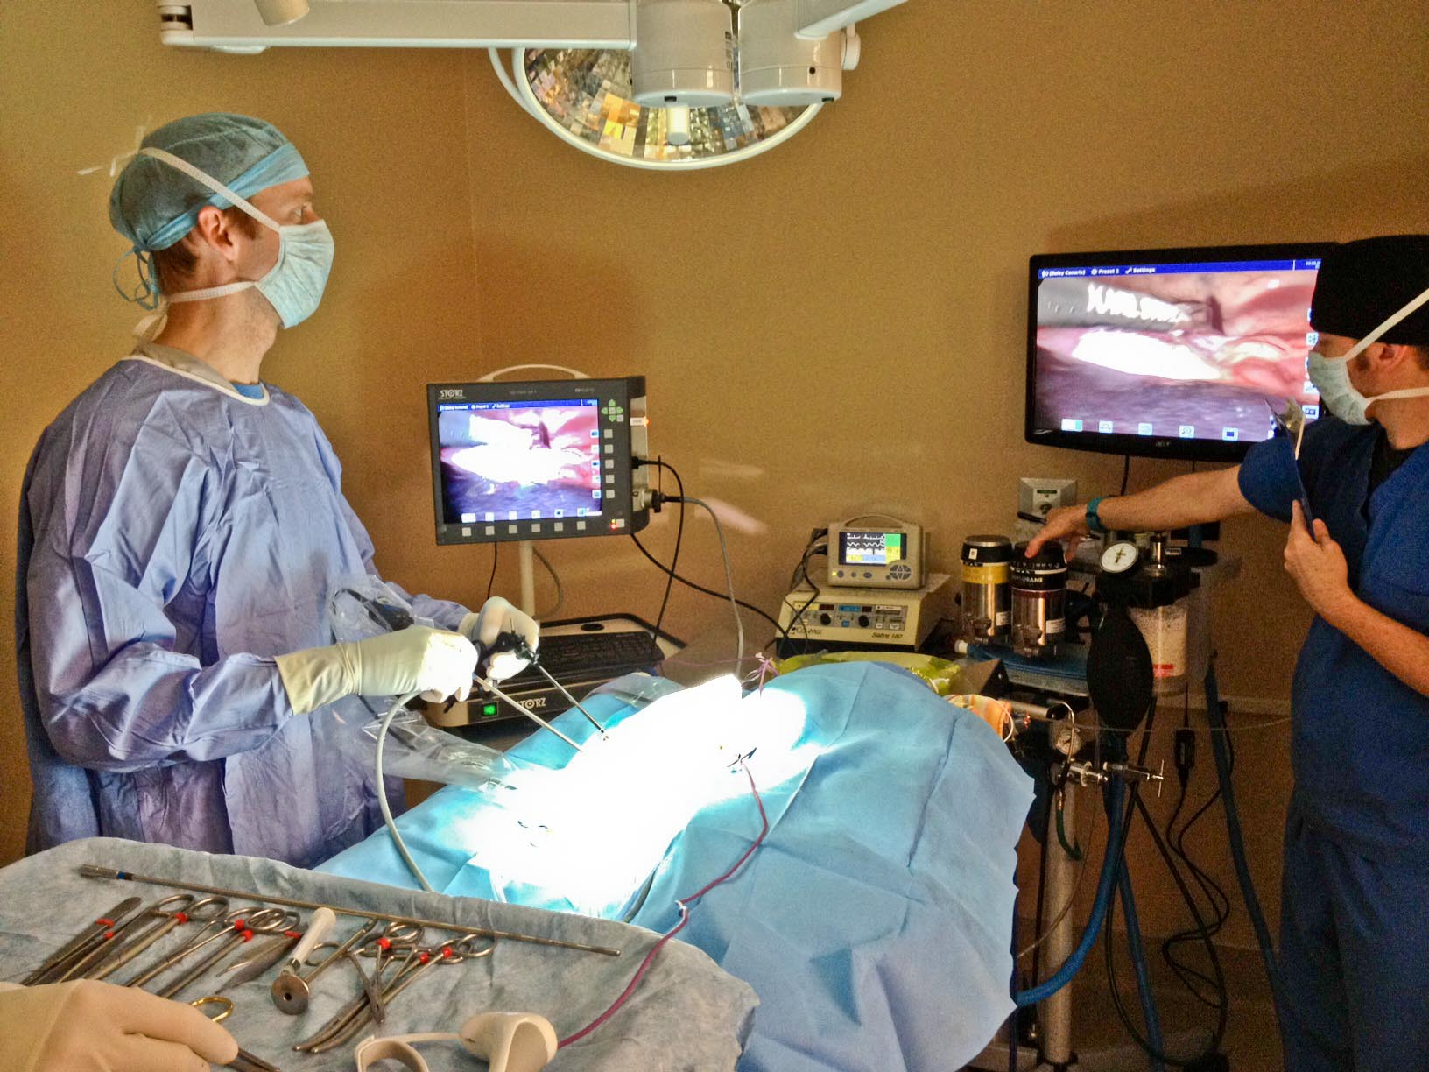
Open surgery is the standard surgical approach for confirmed or highly suspected ACC.
However, for tumors < 6 cm without any evidence of local invasion, laparoscopic adrenalectomy (respecting the principles of oncological surgery) is reasonable if the surgeon has sufficient experience in these types of surgery.
Recommendation

Slide 58
Recommendation
We recommend perioperative hydrocortisone replacement in all patients with hypercortisolism that undergo surgery for ACC.

Slide 59

Pathological work-up

Slide 60

Pathological work-up
Recommendation
We recommend that the diagnosis of ACC should be confirmed by histopathology.
Histopathology is the gold-standard of diagnosing ACC and should in principle be obtained in
all patients.

Slide 61
Recommendation
The use of immunohistochemistry for steroidogenic factor-1 (SF1) for the distinction of primary adrenocortical tumors and non-adrenocortical Tumors.

Slide 62

Generally, the distinction between adrenocortical and non-adrenocortical tumors is clear and can be made on the basis of hematoxylin and eosin-stained slides.
In case of doubt, immunohistochemistry with SF1 is the most sensitive and specific marker currently available to establish if the tumor in question is of adrenocortical origin, with a sensitivity of 98% and a specificity of 100%.
If this marker is not available, we advise a combination of markers, which should include:
inhibin-alpha
melan-A
calretinin

Slide 63
Use the Weiss system, based on a combination of 9 histological criteria that can be applied on hematoxylin and eosin-stained slides, for the distinction of benign and malignant adrenocortical tumors.
Recommendation
Using the Weiss system, a score of 3 or higher indicates ACC .
A score of 2 and 3 may be considered as borderline between benign and malignant tumors. (Tumors of uncertain malignant potential)

Slide 65

Use of Ki67 immunohistochemistry for every resection specimen of an adrenocortical tumor.
Recommendation
Ki67 immunohistochemistry has been proposed for prognostic purposes.
Higher Ki67 levels are consistently associated with poor prognosis.
Threshold levels of 10% and 20% have been considered for discriminating
low from high Ki67 labeling index.

Slide 66
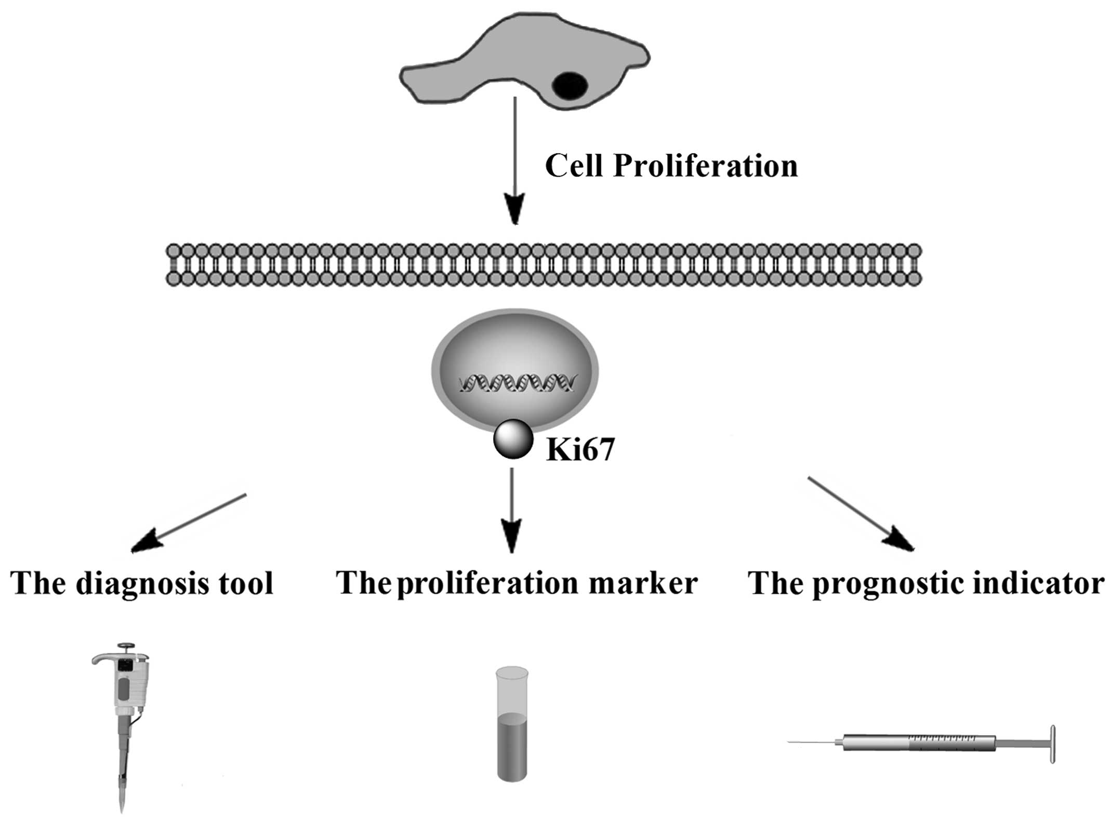
If Ki67 immunohistochemistry is not available, mitotic count may help in prognostic stratification of ACC.
Mitotic count has been proposed for grading of ACC, using >20 mitoses per 50 high-power field to define high-grade tumors.

Slide 67
Pathology report of a suspected ACC should at least contain the following information:
Weiss score (including the exact mitotic count)
Exact Ki67 index
Resection status
Pathological tumor stage
(indicating invasion or not of the capsule and/or surrounding tissue and organs)
Nodal status
Recommendation

Slide 68
Staging Classification

Slide 69
At initial diagnosis, we recommend using the ENSAT staging classification
Recommendation
Tumor staging is the most important prognostic factor.
.

Slide 71
Recommendation
We recommend following patients with regular cross-sectional imaging of the abdomen, pelvis and chest for disease recurrence or progression.

Slide 72
After complete resection, we suggest radiological imaging:
Every 3 months for 2 years
Then every 3-6 months for a further
3 years.
Recommendation
The majority of the panel suggests continuation of follow-up imaging beyond 5 years, but surveillance should then be adapted.

Slide 73
Panel preferred for instance an annual imaging for another 5 years.
After stopping regular imaging,
patients and primary care physicians should remain vigilant in terms of potential symptoms or signs of late recurrences.

Slide 74
In advanced ACC depends on the ongoing treatment and the overall
prognosis, usually be in 2-3 monthly intervals.
For patients opting for entirely palliative management, without any anti-neoplastic therapy no systematic imaging is advised.

Slide 75
In all patients, we recommend regular screening for hormone secretion.
Recommendation
Biochemical evaluation should focus on steroid hormones or metabolites that were present at the time of diagnosis of the initial tumor.
However, some panelists favored a more complete hormonal evaluation,
because:
Some tumors might change their steroid secretion pattern over time.

Slide 76

Adjuvant Therapy

Slide 77

For adrenal tumors with uncertain malignant potential, we recommend against adjuvant therapy.
Recommendation
Since all adjuvant therapies are associated with potential toxicity,
only patients with a definitive diagnosis of ACC should be considered for adjuvant treatment .

Slide 78
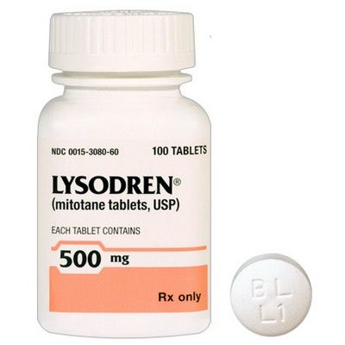
We suggest adjuvant mitotane treatment in those patients without macroscopic residual tumor after surgery but who have a perceived high risk of recurrence.
(stage III, or R1 resection, or Ki67 >10%).
However, we can not suggest for or against adjuvant therapy for patients at low/moderate risk of recurrence:
(stage I-II, R0 resection and Ki67 ≤ 10%)
Adjuvant therapy options should be discussed on an individual basis.
Recommendation

Slide 79
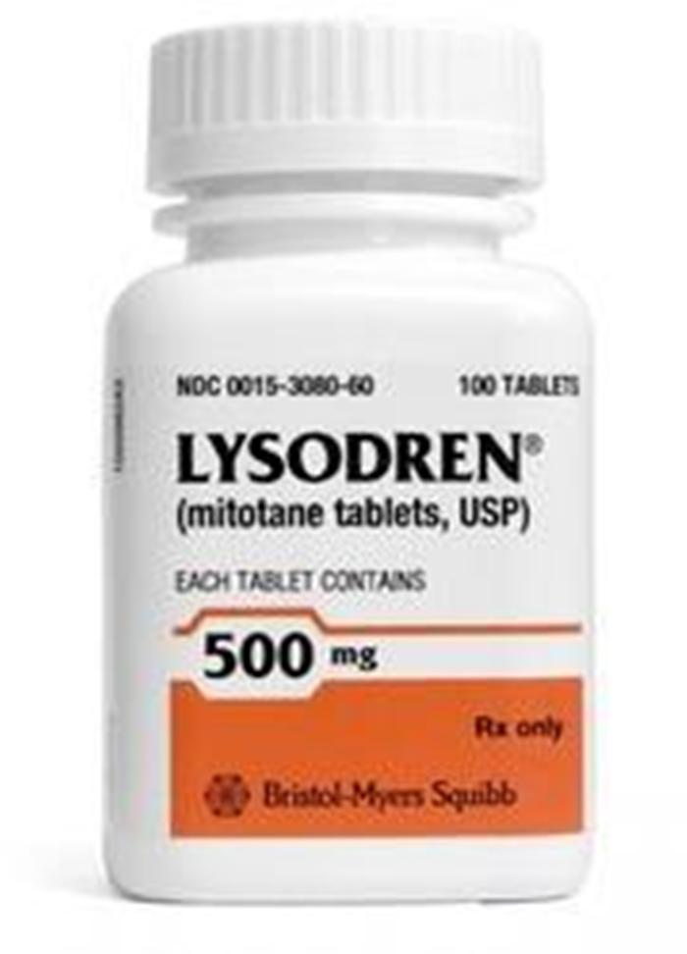
Mitotane is an inhibitor of the adrenal cortex.
It acts as an inhibitor of cholesterol side-chain cleavage enzyme P450scc and also of CYP11B1), aldosterone synthase, and 3β-HSD.
In addition, mitotane has direct and selective cytotoxic effects on the adrenal cortex, via an unknown mechanism, and thereby induces adrenal atrophy.
C.R. Kannan (6 December 2012). The adrenal gland . Springer Science & Business Media. pp. 160

Slide 80

Recommendation
Once the decision for mitotane treatment is established, we recommend starting mitotane as soon as clinically possible after surgery.
Starting mitotane within six weeks is ideal, and would not initiate the treatment later than 3 months.
This reasoning is sound with:
Latency of mitotane to reach effective levels and anti-tumor activity.

Slide 81
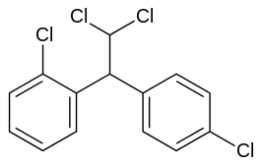
In patients without recurrence who tolerate mitotane in an acceptable manner,
we suggest to administer adjuvant mitotane for at least 2 years, but not longer than 5 years.
Recommendation

Slide 82
Factors that influence duration of treatment:
Prognostic factors at diagnosis
Patient compliance with treatment
Plasma mitotane levels reached during treatment .
However, the rate of recurrence 5 years after surgery is potentially too low to advise continuation of therapy treatment beyond this time point.
1,1-(dichlorodiphenyl)-
2,2-dichloroethane
(o,p'-DDD)

Slide 83

The panel did not come to a definitive consensus on adjuvant radiation therapy.
However, we suggest against the routine use of radiation therapy in patients
with stage I-II and R0 resection.
Recommendation
The panel suggests considering radiation in addition to mitotane therapy on an individualized basis therapy in patients with R1 or Rx resection or in stage III.

Slide 84

We suggest against the routine use of cytotoxic drugs in the adjuvant setting.
However, the panel suggests considering adjuvant chemotherapy in selected patients with very high risk for recurrence.
Recommendation

Slide 85

Despite the lack of published data, some members of the panel are currently using cisplatin, with or without etoposide, in patients at perceived very high risk of recurrence (e.g: Ki67 >30%, large tumor thrombus in the vena cava, stage IV, or R1 resection).

Slide 86

We suggest against the routine use of adrenal surgery in case of widespread metastatic disease at the time of first diagnosis.
Recommendation
In selected cases (e.g. patients with severe hormone excess) debulking surgery might be an option, although anti-hormonal drugs.should be considered here. In these cases, surgery might be especially reasonable if > 80% of the tumor
burden can be removed safely.

Slide 87

In patients with advanced ACC at the time of diagnosis not qualifying for local
treatment, we recommend either mitotane monotherapy or mitotane + EDP (etoposide, doxorubicin, and cisplatin) depending on prognostic parameters.
Recommendation

Slide 88
Recommendation
In patients who progress under mitotane monotherapy, we recommend to add EDP.

Slide 89
Special considerations on mitotane

Slide 90
We recommend starting therapy with mitotane in an escalating regimen depending on the performance status of the patient as well as the tolerability in the first weeks.
Recommendation

Slide 91
In patients with good performance status some panelists use a high starting dose approach:
Mitotane is administered at a starting dose of 1.5 g/day and if well-tolerated from a gastrointestinal perspective.
The dose is increased on day two to 3 g/day
On day three to 4.5 g/day, and on day four to 6 g/day This dosage will be administered until first mitotane blood level is assessed.
In this high dose regimen, it is strongly recommended to measure mitotane blood levels 2-3 weeks after initiation of therapy.

Slide 92

The high-dose starting regimen led to slightly higher mitotane plasma levels within 12 weeks of treatment, and more patients reached the target level of 14 mg/L.
Mitotane is a lipophilic drug and is supposed to be better absorbed from the gut with a high fat content of the diet, e.g. with milk or chocolate.
In case of limited gastrointestinal tolerance, symptomatic treatments of nausea and or diarrhea may be proposed.

Slide 93
We recommend monitoring of blood concentration of mitotane. The general aim is to reach a mitotane blood level above 14 mg/L.
Recommendation

Slide 94
As long as mitotane plasma levels are increasing and have not yet reached a plateau at >14mg/L, mitotane plasma levels will be assessed every 3-4 weeks.
When mitotane plasma levels have reached a plateau, it is usually sufficient to measure blood levels every 6-12 weeks.
Mitotane plasma level determination is best done as morning trough sampling, at least 12 hours after the last dose, preventing false high levels.

Slide 95
Several studies have shown that CNS-related adverse events in particular occur more frequently when the plasma mitotane is > 20 mg/L.
Therefore, many experts recommend aiming to keep plasma concentrations below 20 mg/L.

Slide 96
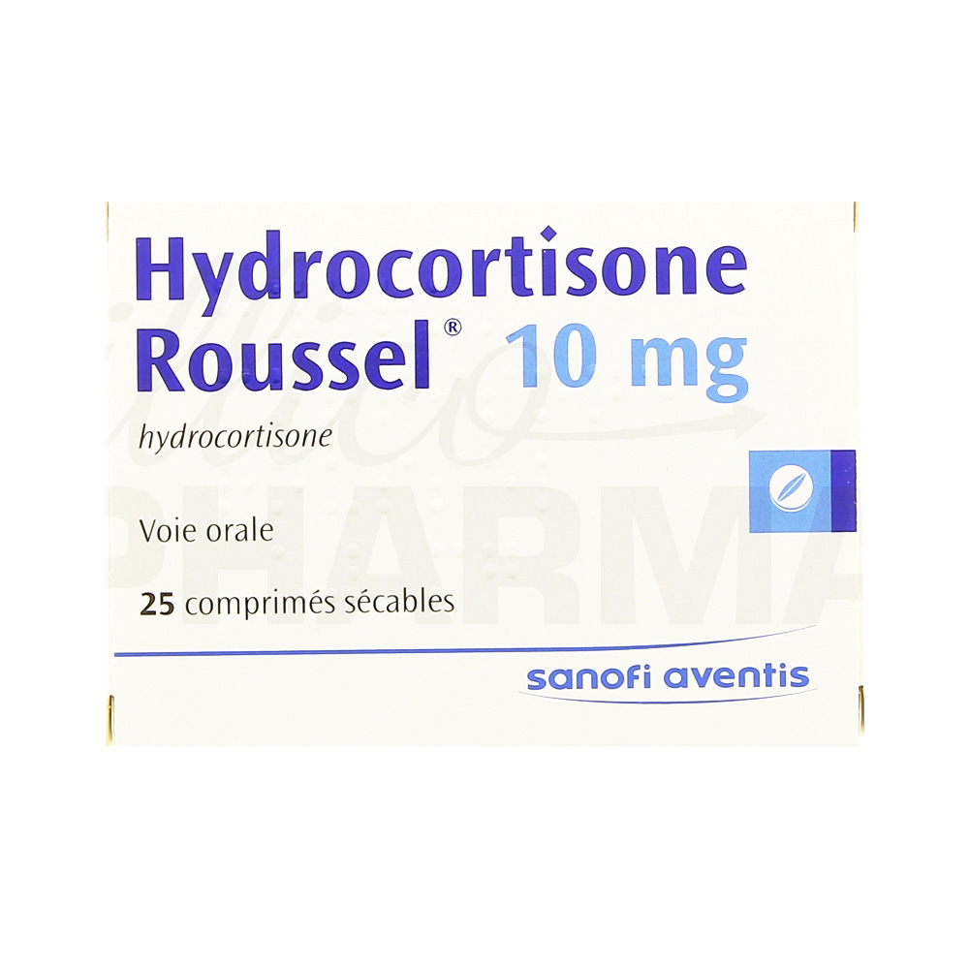
We recommend glucocorticoid replacement in all patients treated with mitotane (except those with ongoing cortisol excess).
We suggest to using hydrocortisone/cortisone acetate for
this purpose.
Due to increased steroid clearance and increase CBG at least twice the standard replacement dose is usually required.
Recommendation
The total hydrocortisone replacement dose will usually increased to a typical total daily dose of 50 mg in two or three divided doses.
(However, some patients require daily dosages up to 100 mg)

Slide 97
A possible strategy is to start concomitant treatment on day one of mitotane treatment with hydrocortisone 20 mg/d.
Patients can be instructed to start hydrocortisone later (e.g. after 2-3 weeks or in case they experience adrenal insufficiency), because impairment of glucocorticoid effectiveness is rarely observed within the first few weeks.

Slide 98
Optimal dosage of hydrocortisone
There is no reliable laboratory marker to guide the optimal dosage of hydrocortisone, which has to be based on Clinical judgment similar to the management of patients with adrenal insufficiency.
serum cortisol measurement:
Mitotane-induced increase in CBG may confound interpretation of serum cortisol measurement.
The measurement of free cortisol :
May offer additional information, but more studies are required to clarify the value of this method

Slide 99
ACTH levels more than 2-fold of the upper limit of normal as evidence for insufficient glucocorticoid replacement.
Other centers prefer a combined measurement of plasma ACTH and 24-hour urine free cortisol levels to assess adequacy of and optimize glucocorticoid replacement for patients receiving mitotane.
when urinary cortisol is measured by immunoassays, interference by cortisol metabolites induced by mitotane might occur

Slide 100
In case of acute adverse events and/or hospital admission, patients should be treated intravenously with high-dose hydrocortisone (e.g. 100 mg TID) until resolution of symptoms.
Some patients experience symptoms and signs of insufficient mineralocorticoid activity (hyperkalemia, hyponatremia, hypotension, decreased wellbeing) despite full-dose substitution with hydrocortisone.
In these patients, addition of fludrocortisone should be considered.
Clinical judgment, electrolytes, and plasma renin concentration can be used for decision making whether to start fludrocortisone.

Slide 101
We recommend regular monitoring of mitotane-induced adverse effects and to treat them appropriately .
To increase tolerability of mitotane, we suggest starting supportive therapy ideally before severe toxicity occurs.
Recommendation
(e.g. in the first 6 months every 3-4 weeks, thereafter every 6-12 weeks).

Slide 105
Assessment of thyroid hormone status (TSH, FT4, every 3 months) is advised as mitotane may induce a clinical picture similar to central hypothyroidism, possibly through a direct effect on the pituitary gland or induction of thyroid hormone metabolism.
Replacement therapy with levothyroxine can be considered for these patients.
Ovarian steroid synthesis is less affected but women in child bearing age treated with mitotane may develop multiple, and sometimes huge, ovarian cysts that may be painful and sometimes require treatment.

Slide 106
Cholesterol levels very frequently increase during mitotane.
Treatment Hypercholesterolemia can be treated with statin therapy using agents not metabolized by CYP3A4 (e.g. rosuvastatine or pravastatine).
However, HDL cholesterol is usually also elevated significantly and this should be taken in consideration. Thus, statin therapy might only be beneficial in selected patients (e.g. with good prognosis in an adjuvant setting, high LDL cholesterol and additional high cardiovascular risk factors).
Therefore, an individual decision making regarding the benefits of any lipid lowering therapy is necessary.

Slide 107
We recommend being aware of significant drug interactions of mitotane (e.g. due to strong induction of CYP3A4).
All concomitant medication should be checked for CYP3A4 interactions and substituted for an alternative if necessary and available.
Other care-providers should be advised not to initiate other drug therapies without consultation.
Recommendation

Slide 108

Supportive Therapies

Slide 109

We recommend therapy with anti-resorptive treatment in patients with bone metastasis.
Recommendation
The administration of denosumab or bisphosphonates in 'oncological doses' in association with calcium intake and vitamin D supplementation are therefore advisable in ACC patients with metastatic bone disease, with the aim to prevent adverse skeletal-related events and improve control of bone pain.

Slide 110
We suggest counseling for fertility protection in female patients in reproductive age.
Fertility counseling should not only be restricted to patients undergoing cytotoxic chemotherapy, but also given to patients who plan to embark on mitotane therapy.
Recommendation
Several drugs used to treat ACC harbor significant risk for impairment of fertility or the exact risks are unknown (e.g. mitotane).we just advise to discuss this topic with every patient.

Slide 111

Pregnancy and ACC

Slide 112
Recommendation
When an adrenal mass suspected to be an ACC is diagnosed during pregnancy, we recommend prompt surgical resection regardless of pregnancy trimester.

Slide 113
Recommendation
Patients should be informed on pregnancy-related concerns specific to the current or past diagnosis of ACC.
No evidence is available regarding how long patients should wait after the treatment of an ACC before they can safely consider pregnancy.

Slide 114
Importantly, the main concern is the poor prognosis of the malignant tumor and the potential, that pregnancy could be a negative prognostic factor, possibly increasing the risk of recurrence.
There is limited evidence that ACC occurring during pregnancy or in the postpartum period is associated with a worse prognosis than in non-pregnant women.
The hypothesis that pregnancy could favor the development of a more aggressive variant
of ACC was raised.

Slide 115
Since ACC may express estrogen receptors and there are preclinical data showing that estrogen may facilitate tumor development and progression through cross-talk with the IGF pathway, contraceptive measures other than estrogen-containing preparations are preferred.

Slide 116
We recommend avoiding pregnancy while being on mitotane treatment.
The main concern with mitotane therapy is the potential of teratogenic effects, due to the suspicion that the drug may cross the placenta and cause adrenolytic activity on the human fetus.
Recommendation
Woman treated with mitotane should be informed about these risks, and ensure effective contraception to avoid pregnancy.
Moreover, when mitotane treatment is discontinued, it seems wise to ensure undetectable mitotane plasma levels before considering pregnancy ,which might take 3-12 months.

Slide 117

In case a patient becomes pregnant while on mitotane therapy, the uncertainty regarding risks of mitotane for the fetus should be discussed.
In case the patient wishes to continue pregnancy mitotane therapy should be withheld.

Slide 118

THANKS FOR YOUR ATTENTION

