Slide 2
Gestational Diabetes Underpinning
Principles, Surveillance, and Management
Jeffrey M. Denney, MD, MS, Kristen H. Quinn, MD, MS
Obstet Gynecol Clin N Am 45 (2018)

Slide 3
GDM as glycemic intolerance diagnosed at or beyond the
achievement of 20 completed weeks of gestation.
GDM affects 3% to 25% of pregnancies.
Increased prevalence of GDM: African American
Pacific Islander
Hispanic
Native American

Slide 4
↑global prevalence of GDM:
1-increase of maternal obesity
2- delayed child bearing
3- sedative lifestyles

Slide 5
The authors discuss the emphasis on:
-Diet and activity/exercise as means of controlling blood sugars
-The usual schedule of glucose monitoring
-Indications for medical treatment
-Fetal surveillance
-Timing of delivery, neonatal care
-Postpartum care

Slide 7
These risks highlight the need for accurate diagnosis
and proper management of GDM.
In normal pregnancy, a myriad of physiologic alterations
occur to promote the growth and development of the
conceptus.

Slide 8
A euglycemic state is maintained despite the fetus’ energy
demands via a compensatory and proliferative response
within the maternal pancreas, namely the beta islet cells.
In women who ultimately develop GDM, pancreatic
beta-cell compensation fails to meet the metabolic demands,
creating a hyperglycemic state.

Slide 9
Two approaches to identifying GDM exist:
-The most commonly used is the 2-step approach using an
initial 1-hour screening 50-g glucose challenge test.
If negative, no further testing is required.
Screen positive individuals must undergo a formal diagnostic
evaluation with a 100-g 3-hour oral glucose tolerance
test(GTT).

Slide 10
-The other approach uses a singular 75-g, 2-hour GTT.
Either approach is reasonable, and the choice may be made
by the provider, depending on their ability to consistently
implement an approach for their patient population with
available resources.

Slide 11
Given that 90% of pregnant women in the United States
present with at least one risk factor for GDM and 20% of
those with no risk factors develop GDM, universal screening
appears most appropriate.

Slide 12
The US Preventative Services Task Force (USPSTF)
performed a systematic review on screening and deemed
sufficient evidence to support universal screening but only
after the achievement of 24 completed weeks’ gestation.

Slide 13
Accordingly, conventional timing for screening per ACOG
guidelines remains between 24 and 28 weeks, provided
there is no reason to suspect underlying pregestational DM.
For those suspected to be at increased risk for underlying
DM, screening should not be delayed and may be performed
as early as the first prenatal visit.

Slide 17
The 50-g oral glucose challenge can be taken regardless of
fasting or postprandial state with assessment of plasma
glucose 1 hour after consumption.
Positive screens
1- 130 mg/dL (7.2 mmol/L) 88% to 99% sensitivity and 66% to 77%
specificity
2- 135 mg/dL
3- 140 mg/dL (7.8 mmol/L) 70% to 88% sensitivity and 69% to 89%
specificity.

Slide 19
The Eunice Kennedy Shriver National Institute of Child
Health and Human Development Consensus
Development Conference on Diagnosing Gestational
Diabetes recommended the continued use of
the 2-step approach to screen for and diagnose GDM.

Slide 20
This recommendation was based on the lack of evidence
for improved clinical maternal or neonatal outcomes with
the 1-step approach (75-g 2hour GTT) and the increase
in health care costs that would result.
Based on this recommendation and a Cochrane Review
that reported no specific screening strategy has shown
to be optimal, ACOG supports the 2-step approach.

Slide 21
Carpenter and Coustan report greater than 95% probability
of GDM with 1 hour plasma glucose of greater than
182 mg/dL following the 50-g challenge.
Other studies report PPV of 200 mg/dL to range from
69% to 80%. The authors use 200 mg/dL as a threshold for
GDM diagnosis and not requiring exposure to the 100-g
GTT.

Slide 22
GDM as diagnosed on GTT by a list of criteria either by
the 1-step or by the 2-step approaches.
The authors’ group uses a 2-step approach with the
Carpenter-Coustan cut points.
They have adopted a threshold of BS »135 mg/dL for
the 50-g oral glucose challenge test.

Slide 24
Management (Diet Control)
Dietary changes are the mainstay of initial attempts in
glycemic control following the diagnosis of GDM.
Data demonstrate a clear association of postprandial
hyperglycemia and diet high (>55%) in carbohydrate
content.

Slide 25
Because carbohydrates are the sole macronutrient to
significantly raise postprandial blood glucose, dietary
modification predominantly consists of carbohydrate
restriction and distribution evenly throughout the 3
main meals of the day.

Slide 26
Glycemic control is improved by avoiding processed/red
meat, high-fat dairy, refined grains while favoring
vegetables, fruit, whole grains, and fish.

Slide 28
Recently, investigators have evaluated the impact of
a diet with low glycemic index(GI) for improvement of
outcomes in GDM.
GI is the number associated with the carbohydrates in a
particular type of food, indicating the individual’s
response (assessed by blood sugar level) relative to the
reference food—pure glucose.

Slide 30
GLYCEMIC LOAD (GL)

Slide 38
Gestational Weight Gain and Gestational Diabetes Mellitus
Because obesity and insulin resistance parallel one another
in terms of comorbidity, the 2 conditions are somewhat
inseparable in terms of clinical considerations.
Both, if not well controlled, lead to increased risk of indicated
preterm delivery, gestational hypertension, preeclampsia,
delivery by cesarean, and fetal growth abnormalities.

Slide 39
Excessive gestational weight gain correlates well with
onset of GDM.
Accordingly, 2009 IOM Guidelines Institute of
Medicine(IOM) weight gain guidelines in pregnancy for
weight gain in pregnancy provide direction for target
weight gain as based on intake body mass index (BMI).

Slide 40
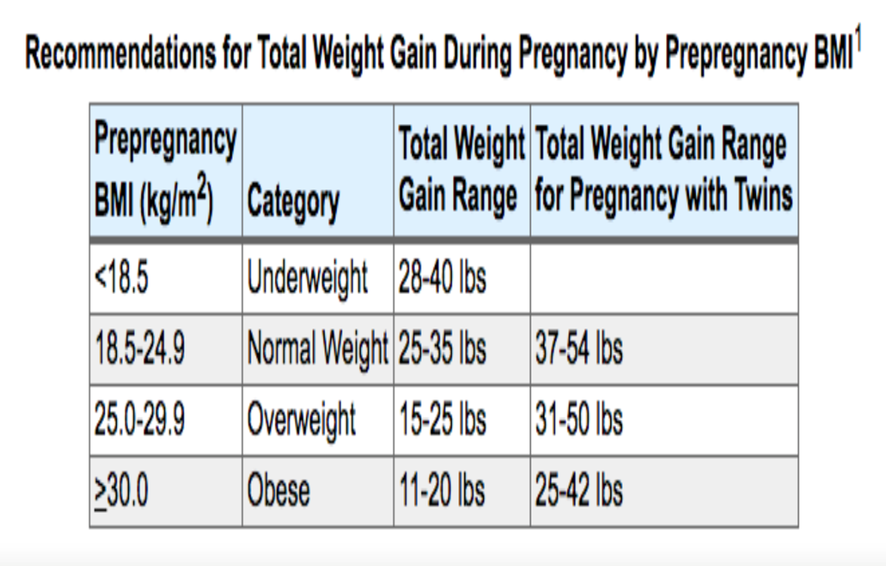

Slide 42
Online calculators based on IOM guidelines to
individualize the approach are available.
Regardless of BMI, a typical goal for a patient’s calorie
intake would be 30 to 35 calories per kilogram ideal
body weight.

Slide 43
Calorie intake : 30-35 kcal/kg (Ideal body weight)
500 cal (125g) : protein
remained calories : ½ fat and ½ carbohydrates
Breakfast: 24% calories
lunch: 30%
Dinner: 33%
Bed time snacks: 13%

Slide 44
For patients achieving target measures for glucose
control with GDM diet, the diagnosis remains
diet-controlled GDM or GDMA1.
Some patients will consistently demonstrate fasting
blood glucose greater than 100 mg/dL along with a
persistent pattern of postprandial glucose measures
greater than 120 mg/dL despite the GDM diet,
these patients require medical therapy and have GDMA2.

Slide 45
Some of these patients may have occult diabetes
simply diagnosed during pregnancy and may also
fail to achieve euglycemia with institution of the
GDM diet.

Slide 46
Management (Pharmacologic Control:
Oral Hypoglycemic Agents and Insulin)
Insulin therapy has been the most well-studied and used
treatment of both GDMA2 and DM and continues to be
endorsed by the ADA and ACOG as an accepted therapy.
Insulin does not cross the placenta and is the only regimen
approved by the FDA for treatment of GDM.

Slide 49
A commonly used protocol uses maternal weight and
gestational age to calculate starting daily insulin
requirements
Total Daily Dose: 2/3 long acting insulin
1/3 short acting insulin
Short acting insulin: divided into 3 dose with meals

Slide 50
In addition, close surveillance of glucose values is also
indicated in patients with GDM who are receiving a course
of antenatal corticosteroids for fetal lung maturity.
Corticosteroids are known to increase the risk of transient
hyperglycemia, thus more frequent assessments of maternal
glucose in this setting (eg, every 4 hours depending on initial
starting glucose level) are appropriate.

Slide 51
In the setting of post–corticosteroid hyperglycemia,
patients often require insulin coverage even if they were
previously well controlled with diet.

Slide 52
Oral Hypoglycemic Agents
Commonly used oral hypoglycemic agents include both
glyburide and metformin.
Glyburide is a second-generation sulfonylurea.
Initial studies demonstrated no significant transfer of
glyburide in both therapeutic and supratherapeutic dosing
concentrations.

Slide 53
The subsequent landmark randomized controlled trial
compared the insulin therapy to glyburide in the
management of GDM.
Not only was there no detectable glyburide in cord
blood but also maternal and neonatal outcomes were
similar with respect to glycemic control and adverse events.
Notably, subsequent data conflict the initial Langer
randomized controlled trial reporting glyburide being
actively transported from the fetus to the mother.

Slide 54
Although the range of fetal exposure varied widely,
9% to 70% maternal glyburide concentration, these data
create pause for consideration of possible fetal risks.
A 2015 meta-analysis showed therapeutic glyburide use
resulted in a 2-fold increase in neonatal hypoglycemia,
a 2-fold increase in macrosomia, and a 100-g increase in
mean birth weight compared with traditional insulin
therapy.

Slide 55
In addition, 4% to 16% of women who took glyburide as
initial therapy eventually required the addition of insulin.
Metformin is a biguanide used to improve both fertility and
glycemic control by way of increasing insulin sensitivity.
Insulin sensitivity is heightened by metformin via an
inhibitory effect on hepatic glucose production and
intestinal glucose absorption.

Slide 56
Pharmacologic studies demonstrate that metformin freely
crosses the placenta, rendering a circulating fetal concentration
roughly 50% that found in maternal circulation.
Accordingly, a landmark trial published by Rowan and
Colleagues called the Metformin in Gestational Diabetes (MIG)
trial compared the outcomes of 751 women and fetuses
allocated to either traditional insulin therapy or metformin for
the treatment of GDM.

Slide 57
Although there were no differences in congenital
malformations, serious maternal events, or serious
neonatal events; significant variance in outcome was
shown with use of metformin.
Namely, metformin use resulted in significantly less
neonatal hypoglycemia (3.3% vs 8.1%; P<.008) and an
unexpected higher rate of preterm delivery
(12.1% vs 7.6%; P 5 = .04).

Slide 58
A 2-year follow-up report on the MIG trial babies showed
those in the metformin arm had more subcutaneous fat in
upper arm and shoulder compared with those in the
insulin arm.
In addition, 26% to 46% of patients who took metformin
alone eventually required insulin.

Slide 59
Although insulin therapy remains the standard therapy
recommended by most, oral antihyperglycemic agents are a
reasonable alternative in patients who refuse to take or are
unable to comply with insulin therapy. Providers should have
a thorough discussion of the published outcome data and
unknown long-term effects of transplacental passage of oral
agents.

Slide 60
Fetal Surveillance
Given the effect of hyperglycemia on fetal growth and
well-being, women diagnosed with GDM are typically
followed with serial biometry and amniotic fluid volume
assessment. Frequency of such assessments is typically
performed every 4 to 6 weeks from time of diagnosis of
GDM to delivery.

Slide 61
Indications for antepartum fetal testing include insulin
or oral hypoglycemic requirement, polyhydramnios,
onset of gestational hypertension, or, less commonly in
the setting of GDM, growth restriction.

Slide 62
Either weekly biophysical profile or twice weekly nonstress
tests with weekly amniotic fluid indices after 32 weeks are
acceptable and equivalent for ensuring fetal well-being
when indicated.
There is currently no consensus regarding antepartum fetal
testing for women with GDMA1 because studies have not
demonstrated an increased risk of stillbirth in these patients
before 40 weeks.

Slide 63
Intrapartum Management and Delivery Timing
Provided glucose measures demonstrate good control with
diet alone and serial ultrasound demonstrates normal
growth and amniotic fluid volume, the patient essentially has
uncomplicated GDMA1 and does not require timed delivery
before 41 weeks 0 days.

Slide 64
Notably, ACOG does allow for the role of elective delivery
in term patients with good dating following the
achievement of 39 weeks’ gestational age.
Hence, timing for delivery in those who are term albeit less
than 41 weeks can be individualized with patient and the
obstetric provider.

Slide 65
On the contrary, patients with GDMA2 are likely best
served by delivery at 39 0/7 to 39 6/7 weeks of
gestation given increased risk of stillbirth in patients
who require insulin or oral hypoglycemic medication
for glucose control.

Slide 66
Moreover, recent data indicate inducing labor actually
does not increase risk for cesarean delivery and that
induction at 39 weeks yields lower failure rate
(as defined by cesarean) than induction at 40 or 41 weeks.

Slide 67
In women with poor glycemic control despite medical
intervention, delivery before 39 weeks may be warranted.
Recommendations for delivery timing should incorporate
consideration for risks of prematurity and ongoing risk of
stillbirth.

Slide 68
Delivery Mode
Simply stated, GDM is not an indication for cesarean delivery.
That being said, GDM places a fetus at greater risk for
macrosomia as defined by an estimated fetal weight (EFW)
in excess of 4500 g for pregnancies affected by GDM/DM per
the most recent ACOG Practice Bulletin.

Slide 69
In addition, fetuses often show an accelerated growth
pattern with abnormally low head circumference/abdominal
circumference ratio even in the absence of macrosomia.
These growth patterns are important risk factors for
complications, such as shoulder dystocia, Erb palsy, and
third/fourth degree lacerations.

Slide 70
Insulin Glucose Tolerance Test Protocol and Glycemic
Monitoring Protocol Intrapartum
Given that labor increases glucose utilization, hyperglycemia
in women not requiring medical control of GDM is rare.
Hence, practitioners may periodically monitor glucose
every 4 hours intrapartum for GDMA1.

Slide 71
On the contrary, gestational diabetics requiring either oral
hypoglycemic medications or insulin (GDMA2) respond
similarly to DM in labor and are best served by every
1- to 2-hour glucose assessments in the intrapartum period.
Although ketoacidosis is rare in GDMA2, intrapartum
maternal hyperglycemia may cause an acute increase in fetal
insulin, placing the fetus at heightened risk for neonatal
hypoglycemia.

Slide 72
The authors’ group initiates an insulin drip upon maternal
blood glucose at or greater than 120 mg/dL, with the
addition of D5 (dextrose 5%) ½ NS (normal saline) at
125 cc/h provided glucose levels are less than 200 mg/dL.
Similarly, in a survey of academic medical centers,
60% aimed to maintain maternal glucose less than
110mg/dL, whereas 30% targeted a value between
110 and 150 mg/dL.

Slide 73
Postpartum Screening
Many women with GDM are pregestational diabetics that
were first detected in pregnancy, and women with true GDM
are at risk for the development of DM later in life.
70% of women with GDM will develop DM at some point in
their life, and 40% to 50% of those women will develop DM
within 10 years.

Slide 74
Hence, all women should receive screening for DM with
a 75-g GTT at 6 to 12 weeks postpartum. If negative, they
should continue to be rescreened every 3 years with their
primary care provider.
Women with a positive 2-hour GTT are diagnosed with DM
and should be managed or referred for long-term
management accordingly.

Slide 75
Unfortunately, women seeing a primary care physician
after delivery often fail to disclose the fact their recent
pregnancy was complicated by GDM.

